Slide 1

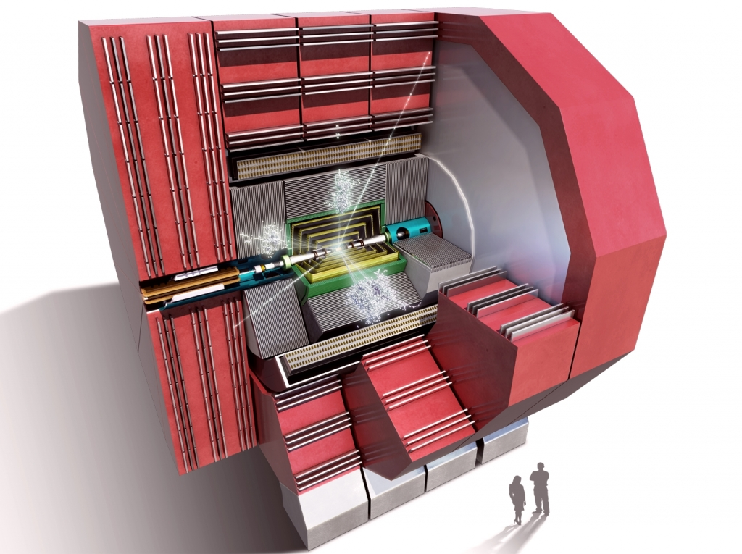
CLICdp achievements in 2014 and goals for 2015
Lucie Linssen, CERN
on behalf of the CLICdp collaboration
CLIC workshop, January 30th 2015

Slide 2

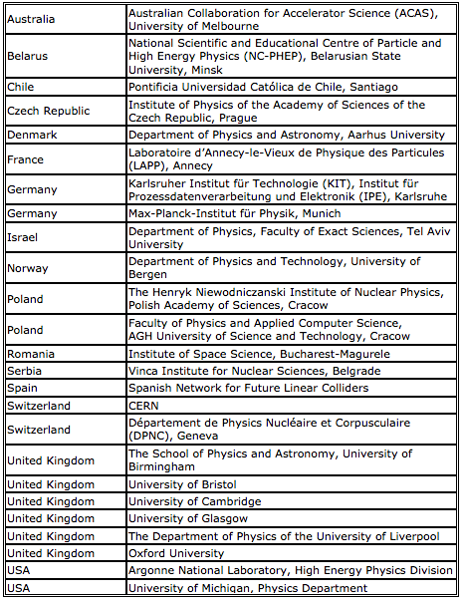
CLIC detector and physics (CLICdp)
http://clicdp.web.cern.ch/
Now 25 institutes (5 new in 2014)
In 2014:
3 CLICdp working groups:
WG analysis (incl. software)
WG vertex detector technology
WG detector optimisation
+
Collaboration with:
ILC detector concepts
CALICE + FCAL

Slide 3
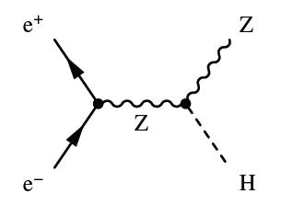
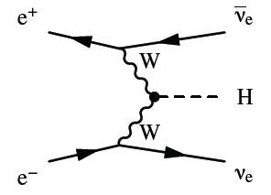
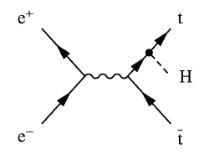
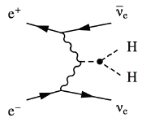
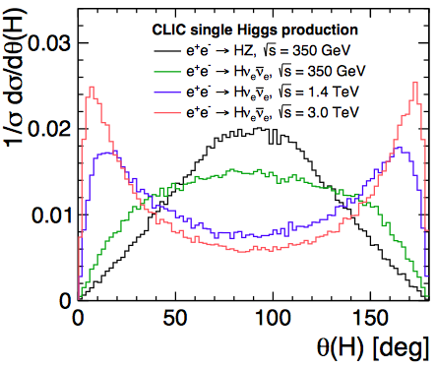
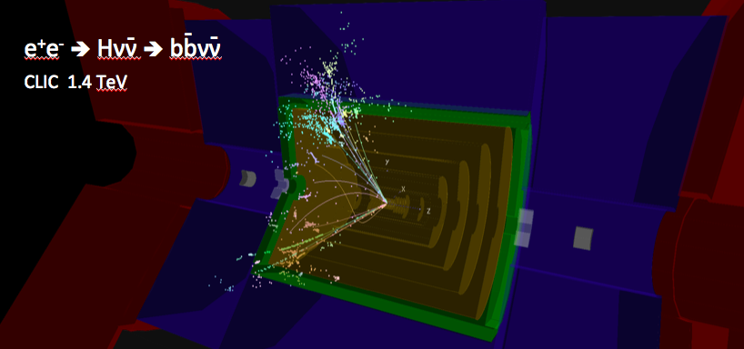
2014 => Higgs benchmark analyses
Wealth of production and decay modes addressed
at all three CLIC energy stages
A collaboration-wide effort !
=> good overview of CLIC Higgs capabilities
Draft publication is under collaboration review

Slide 4
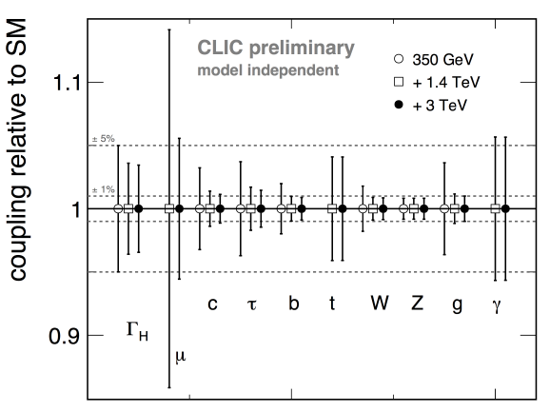
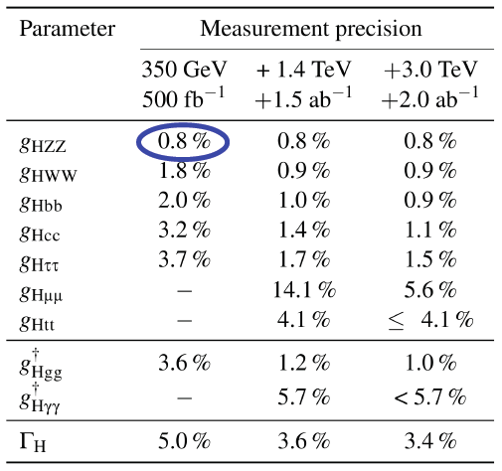
2014 => Higgs benchmark analyses
Model-independent global fits
model independent
much more accurate than HL-LHC
~1 % precision on many couplings
  limited by g_{HZZ} precision
similar accuracy as HL-LHC
Note: contrary to (HL-)LHC, CLIC results are model-independent
-80% electron polarisation assumed above 1 TeV

Slide 5
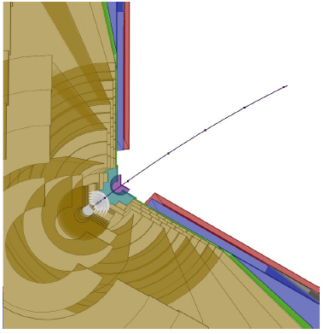
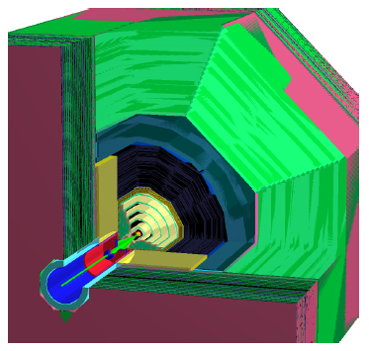
2014 => software development
Major improvements of simulation and reconstruction software
Most important new elements:
New geometry description (DD4hep)
  For simulation, reconstruction, event display, alignment….
  Generic, developed under AIDA EU project, also for other projects (FCC)
New/optimised track reconstruction for all-silicon tracker
Excellent progress in 2014 towards the new software framework
New CLIC detector model implemented in DD4hep
First reconstructed tracks using the selected and adapted reconstruction software

Slide 6
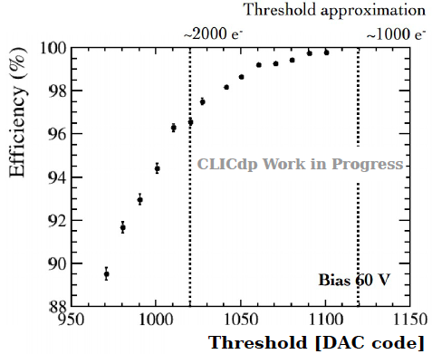
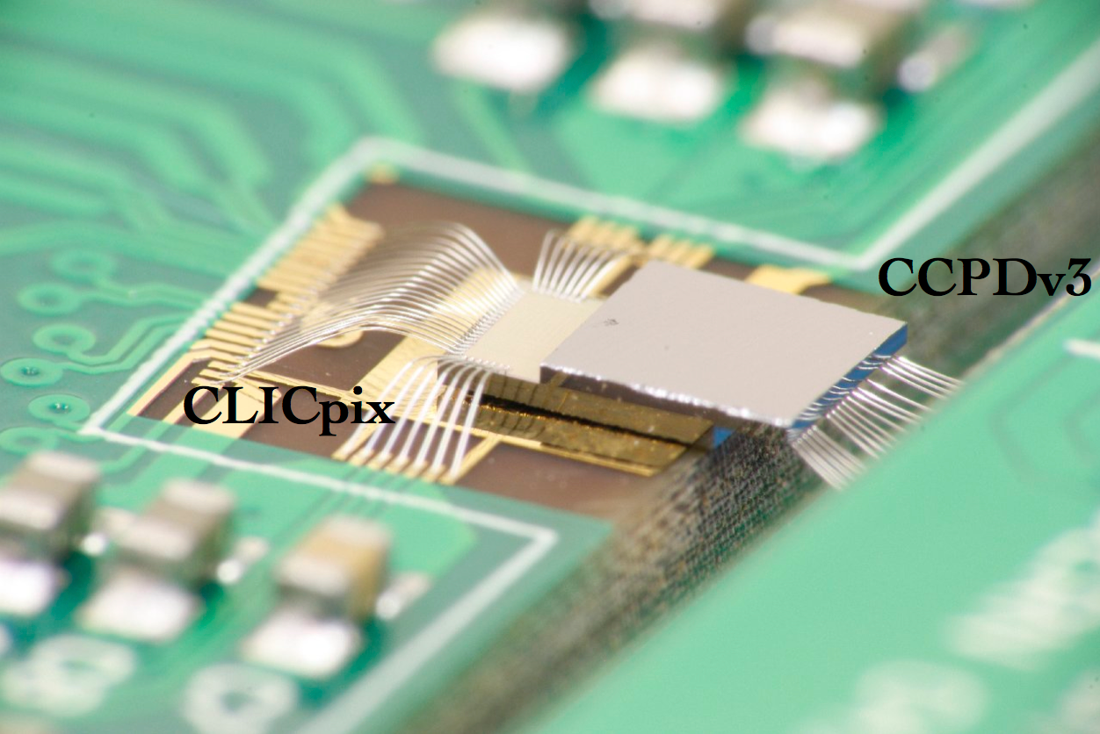
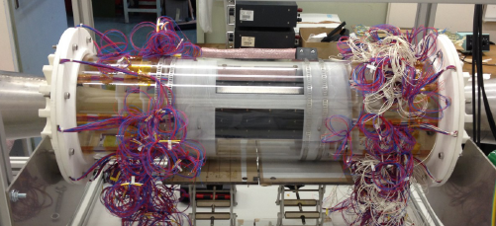
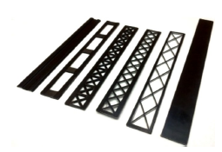
2014 => WG vertex detector technology
Successful 2014 beam tests with novel HV-CMOS technology
Active HV-CMOS sensor
AC-coupled (glue) to complex CLICpix readout chip
Fast signal !
Small pixels
High efficiency achieved at test beam
HV-CMOS + CLICpix, AC coupled
Engineering studies on support structures and air cooling
Full-scale thermo-mechanical mock-up of the vertex detector
Ultra-light supports tested for vibration stability in air flow

Slide 7
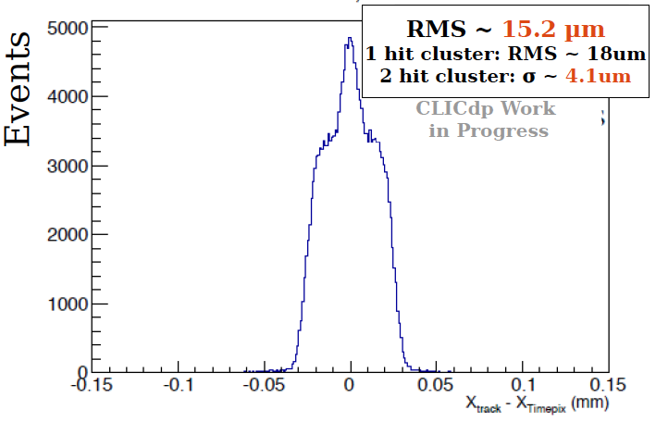
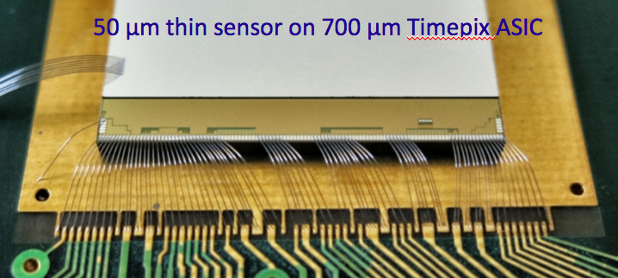
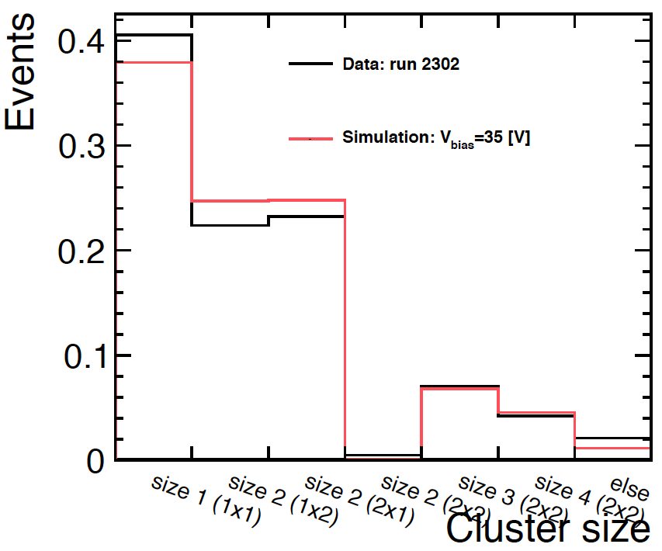
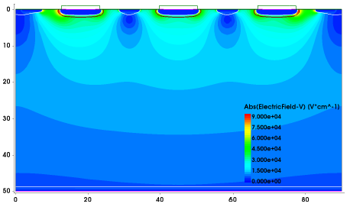
2014 => WG vertex detector technology
Analysis of 2013 test beam data
50 μm thin sensor
Required position resolution (~3 μm) can be achieved with charge sharing between neighbouring pixels.
But, how to get charge sharing for all hits ?
Better understanding through detailed simulations
Prediction of hit cluster sizes in a pixel detector
E-field in a HV-CMOS sensor for a given integrated irradiation

Slide 8
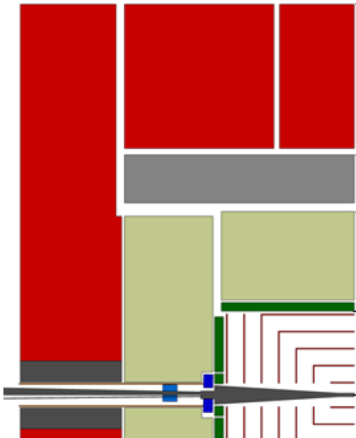
2014 =>
WG detector optimisation
towards one CLIC detector model
include lessons learnt so far
include experience from hardware R&D
2014 achievements
Already agreed working hypotheses:
Vertex: 0.2%X₀/layer
Vertex: double layer geometry
Vertex: spiraling disks
Tracker: all silicon
Tracker: radius 1.5 m, half-length 2.3 m
ECAL: 25 layers, 5×5 mm² cell sizes
HCAL: steel absorbers
Solenoid field: 4 Tesla
Ongoing assessments:
Tracker layout and technology options
HCAL: cells sizes
Enhancement of forward calo coverage
QD0 in detector or in tunnel
Luminosity for a long L*
……..

Slide 9
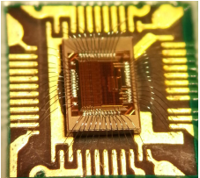
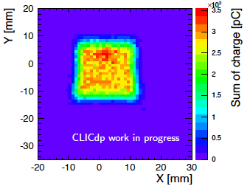
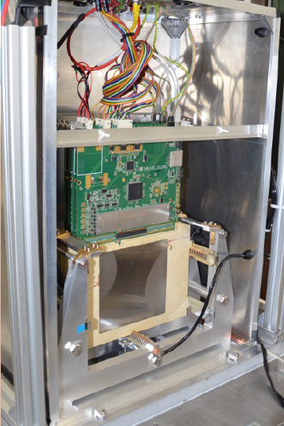
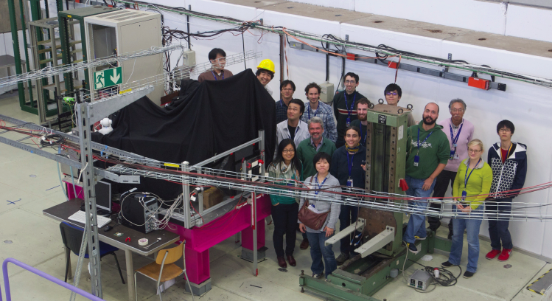
2014 R&D calorimetry CALICE / FCAL
Progress in many areas in parallel
Hardware development
Laboratory tests
Beam tests @ CERN PS
Data analysis
FCAL front-end development
CALICE scintillator lab test
CALICE scintillator (+ silicon) calorimeter beam test
FCAL multi-layer test beam module

Slide 10
2015, some of the main objectives
New CLIC detector concept
Continued studies, …. => new track reconstruction will be important
Increase forward acceptance
  Re-enforced MDI involvement !
  Assess Luminosity performance for long L*
Consolidation of new software tools
ambitious
mid 2015
goal
CLIC physics benchmark studies
Shift focus from Higgs to Beyond Standard Model (BSM)physics and top physics
Precision top physics as tool for New Physics (first CLIC stage + higher energies)
Precision Electroweak physics as tool for New Physics
BSM searches (dark matter, SUSY, compositeness, etc....)
R&D activities:
CLIC vertex detector technology
Fine-grained calorimetry (CALICE, FCAL)
New silicon tracking hardware activity

Slide 11
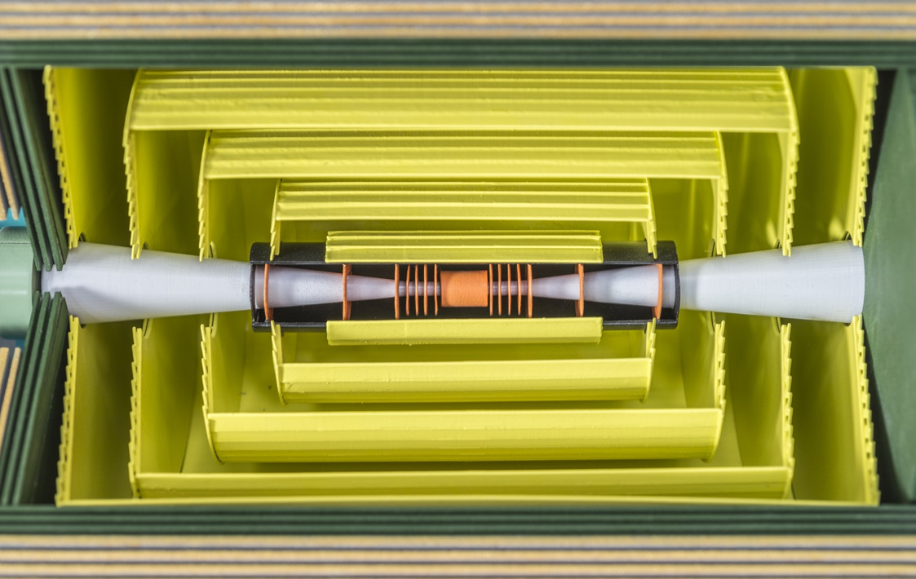
Main silicon tracker technology
Tracker requirements
7 μm single point accuracy
time-stamping 10 ns
~5-6 tracking layers
Radius ~1.5 m, half-length ~2.3 m
High occupancies in certain regions:
Calls for large pixels and/or short-strips
Very light => ~1%X₀ per layer
  Requires very thin materials/sensors
  => is this compatible with charge sharing and 7μm accuracy?
  Can we use power pulsing ?
  Air cooling probably not possible….
=> new CLIC tracker technology working group

Slide 12
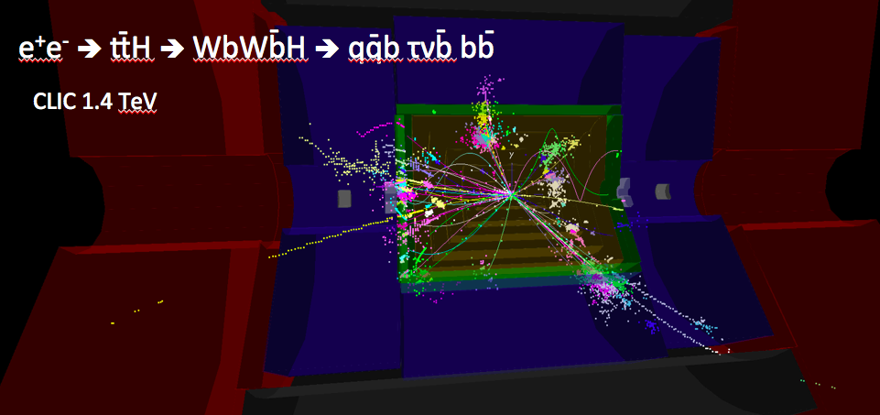
Summary
Good technical progress in 2014, in many domains:
Higgs benchmarking studies !
Detector optimisation towards a new CLIC detector concept
Development towards improved software tools
Vertex technology R&D
Fine-grained calorimeter R&D (CALICE, FCAL)
Possible thanks to many contributors !
Objectives for 2015 will focus on:
A new CLIC detector concept !
Consolidation of the new software tools
Physics => focus more on Beyond Standard Model capabilities
Continuation of vertex technology R&D
Continuation of fine-grained calorimeter R&D (CALICE, FCAL
Start of main silicon tracker R&D

