Slide 1







CLIC BPM R&D
MB Cavity BPM and DB Stripline BPM
J. Towler, A. Benot-Morell, S. Boogert,
F. Cullinan, A. Faus-Golfe, T. Lefevre, A. Lyapin,
J. Nappa, S. Smith, L. Søby, S. Vilalte, M. Wendt
CLIC Workshop, January 27th , 2015

Slide 2
Contents
Main Beam Cavity BPM
  Main beam requirements
  Cavity BPM basics
  Stainless steel prototype
  Copper prototype
  Conclusions and future work
Drive Beam Stripline BPM
  Drive beam requirements
  Stripline BPM basics
  Compact prototype
  Terminated prototype for CLIC TBM
  Conclusions and future work

Slide 3
CLIC MB BPM Requirements
MB parameters and BPM Requirements
Machine | CLIC | CALIFES
Bunch Spacing | 0.5 ns | 0.667 ns
Bunch Length | 44 μm | 225 μm
Train Length | 156 ns | 1 – 150 ns
BPM Spatial Resolution | <50 nm | <50 nm
BPM Time Resolution | <50 ns | <50 ns
BPM Accuracy | <100 μm | <100 μm
BPM Dynamic Range | ±100 μm | ± 100 μm
BPM Resonant Frequency | 14 GHz | 15 GHz
50 nm spatial and 50 ns time and resolution.
  Multiple measurements
  in a 156 ns long bunch train
  Dynamic range of ±100μm
  >4000 BPMs
14 GHz for CLIC
  Design is scalable
15 GHz resonant frequency for CTF prototype.
  Q factor tailored to match the required time resolution
  Prototype design based on stainless steel cavity,
  new design uses copper.

Slide 4
Cavity BPM Basics
Centered beam excites monopole mode (TM₀₁₀).
  Amplitude dependent on charge
Away from the center, other modes are excited.
  First order dipole mode (TM₁₁₀) depends linearly on beam offset and charge.
TM₁₁₀ splits in 2 orthogonal modes.
Beam excites other unwanted higher order modes.
  Requires suppression of unwanted modes.

Slide 5
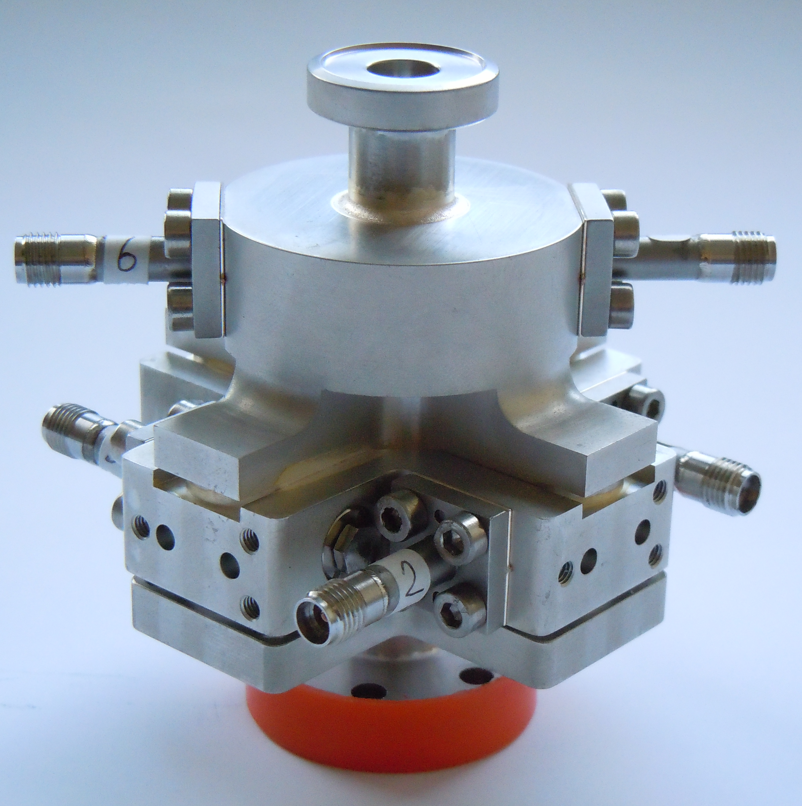
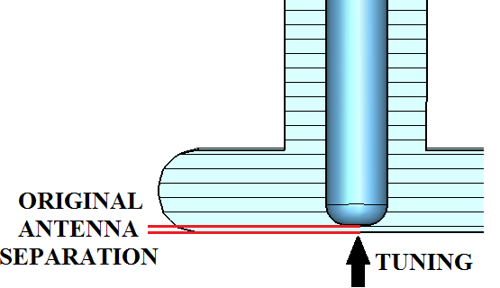
Stainless Steel Prototype BPM
Two cavities:
  Position cavity: pillbox
  Reference cavity:
  re-entrant pillbox
Stainless steel used to lower Q factor: ~ 250
  Results in unnecessary high temporal resolution
  Matched low Q in reference cavity
Waveguide/coax Couplers need tuners
  Very sensitive to antenna/wall separation
  Mechanical tolerances

Slide 6
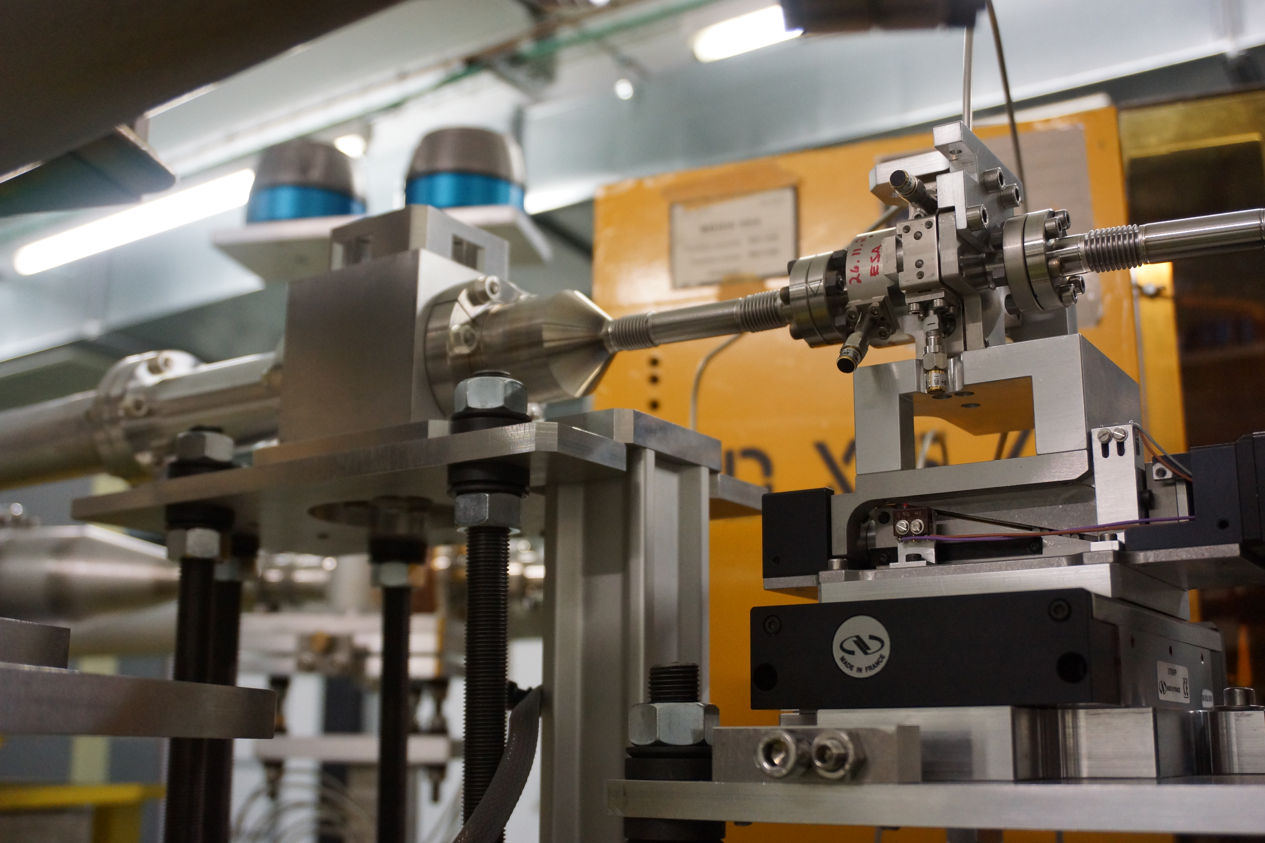
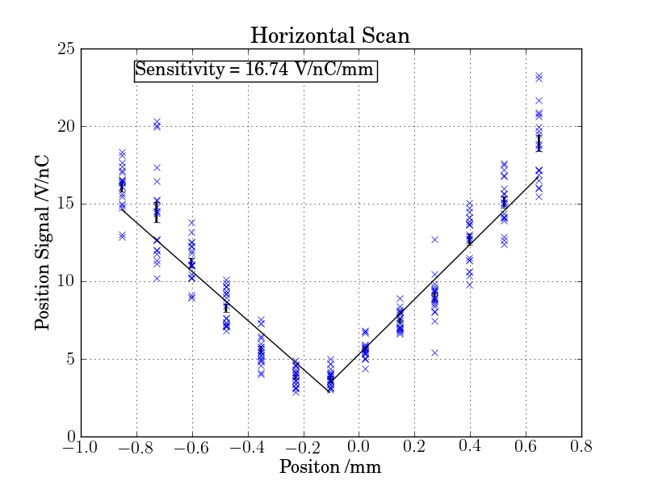
Stainless Steel BPM Testing
Installation at end of probe beam line.
Charge sensitivity measurements
Current monitor reading
  Fine charge scan not achieved
Position sensitivity
  Use hor./vert. translation stages
Sensitivity Measurement | Measured | Estimate
X Position (V/nC/mm) | 16.6 ± 0.2 | 17.1
Y Position (V/nC/mm) | 15.9 ± 0.4 | 17.1
Charge (single bunch) (V/mm) | 128.8 ± 2 | 117
Charge (multi bunch) | 608 ± 2 | -

Slide 7
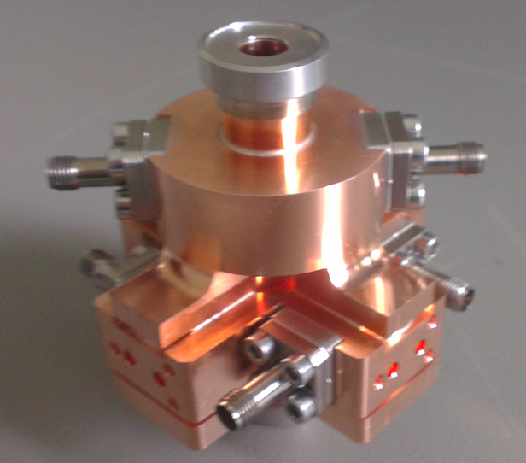
Copper Cavity BPM Prototype
Modified cavity BPM design
  Main geometry unchanged.
  Copper to raise Q to 500
  New feedthrough design.
Prototype manufactured for RF testing
  Poor dimensions, particularly the reference cavity
Measurements compared with simulations
  Before and after brazing
  Frequencies and Q factors
  External Q’s high – feedthroughs
  Excellent low cross coupling
Cavity | Q_{L} | f₀ /GHz
Reference | 938 | 14.772
Predicted | 500 | 15.0
Position | ~830 | 14.996
Predicted | 524 | 15.0

Slide 8
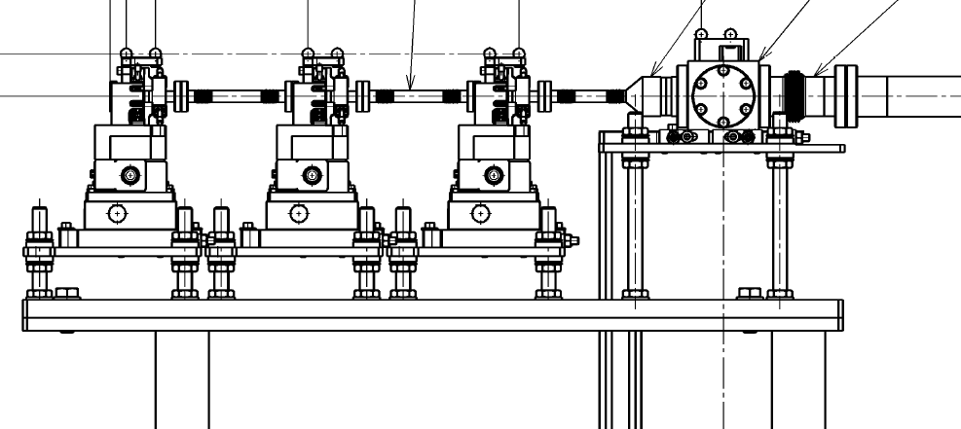
Conclusion and Future Work
Stainless steel prototype evaluated during 2013/2014
  Promising performance, improvements possible
Improved copper prototype designed
  Awaiting delivery of mechanical parts, RF measurement and brazing
  Q higher than expected, time resolution
  Feedthroughs – variation in Q_{ext}
3 copper BPMs to be installed in CTF3
  Remove beam jitter
  Determine spatial resolution
  Simultaneous spatial and temporal resolution?
  New electronics system

Slide 9
CLIC DB BPM Requirements
Close proximity to PETS
  130 MW of RF power at 12 GHz propagating along the Drive Beam pipe (fc_{TE11} = 7.64 GHz).
  Need to measure mW beam signals in close proximity of MW RF pulses.
  Suppression of 12 GHz PETS interference needed.
Simple and economic design imposed by number of units and available installation space (<150 mm).
Tight resolution and accuracy requirements.
BPM Requirements
N° BPMs | 41580
Beam current | 100 A
Bunch frequency | 12 GHz
Bunch length | 10 ps
Train length | 242 ns
Aperture | 23 mm
Spatial resolution | 2 μm
Time resolution | 10 ns
Accuracy | 20 μm

Slide 10
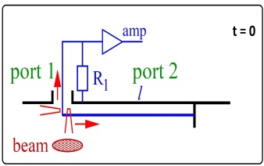
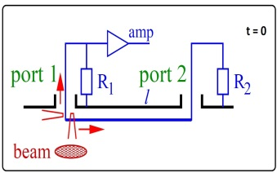
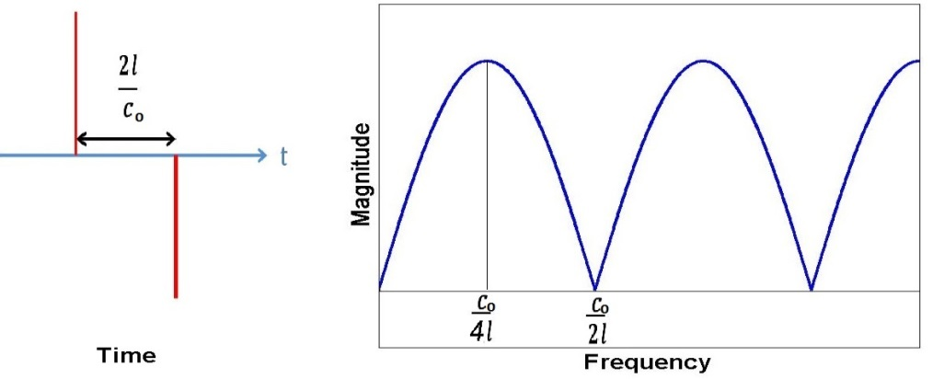
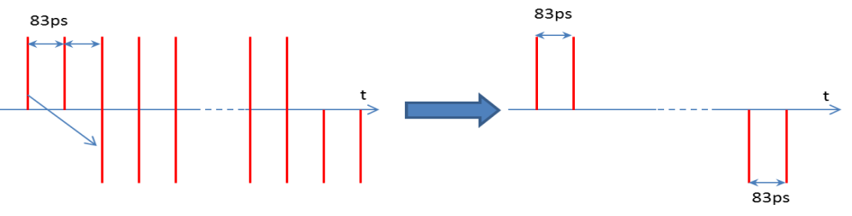
Stripline BPM Basics
130 MW PETS RF interference at 12 GHz needs to be suppressed.
  BPM technology with a suitable frequency response.
Two possible versions of stripline BPM:
  Compact, short-circuited: downstream short-circuited
  electrodes, simple, low cost.
  Terminated: 8-ports, improved notch-filter effect,
  loop-through calibration possible.
If → Bunch cancellation
(N^{th} notch tuned to f_{bunch} )

Slide 11
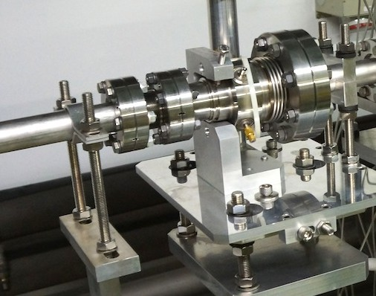


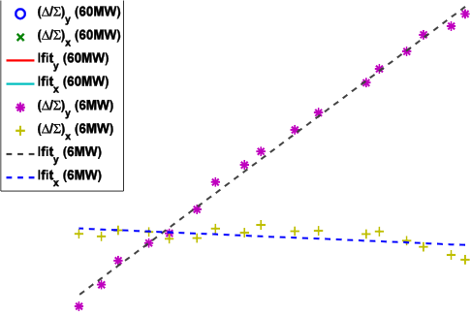



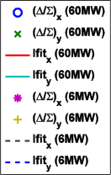
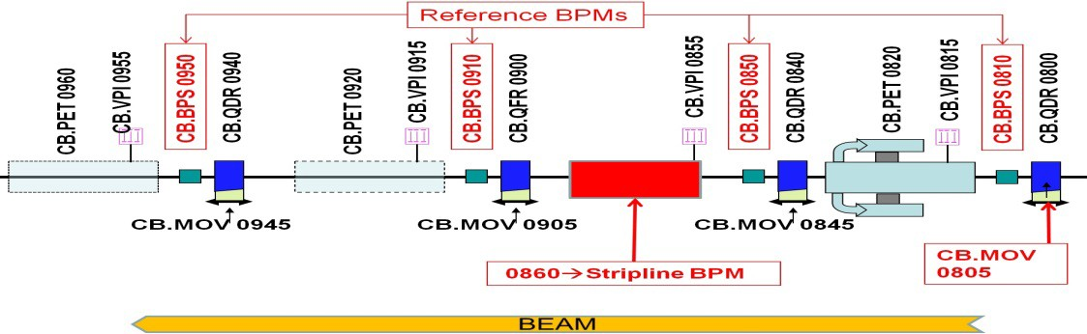
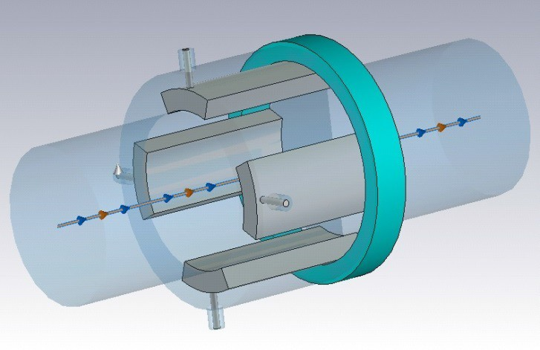

STRIPLINE BPM DEVELOPMENT FOR THE CLIC DRIVE BEAM
• Stripline prototype with short circuited electrodes installed in TBL at CTF3 and successfully tested with beam.
• FESA c lass de v e lope d for synchronous data acquisition with the rest of TBL BPMs
• Preliminary resolution tests performed using MIA/SVD analysis: 15 µm (H and V planes) for a 3A beam current.

Slide 12
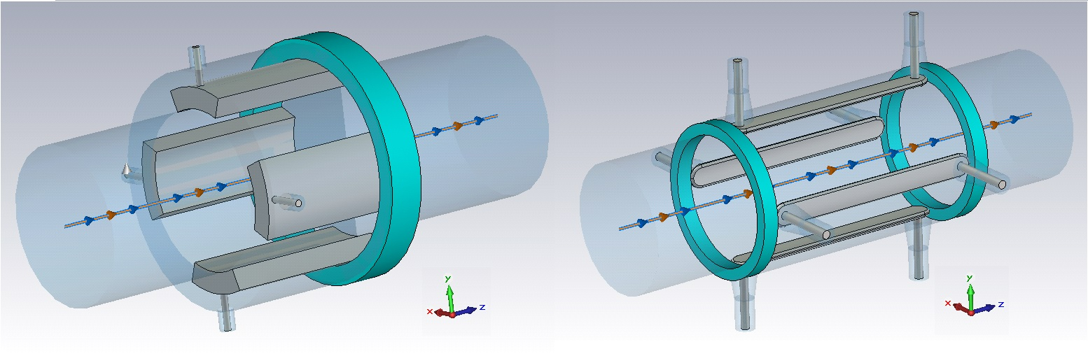
Terminated Stripline BPM for CLIC TBM
First prototype provides insufficient suppression of the 12 GHz CLIC RF power signal.
Longitudinal dimensions are very close to transverse ones (25 mm vs 23 mm) → non-ideal transfer response (non TEM fields).
New design intends to tune the third notch of the frequency response to 12 GHz → electrode length l = 37.5 mm.
Option for a loop-thru calibration via the downstream ports.

Slide 13
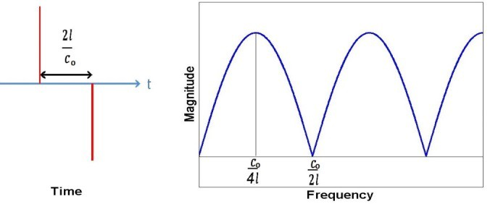
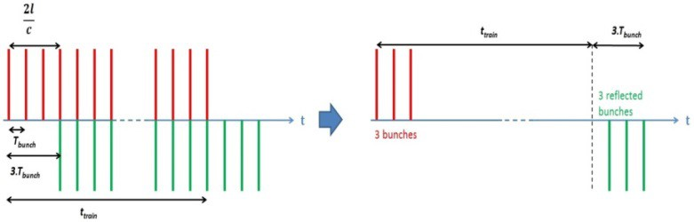
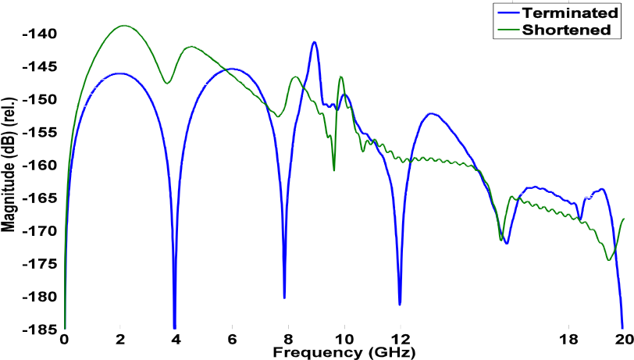
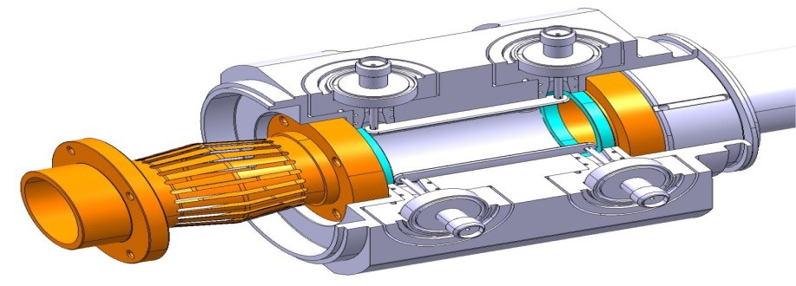
Terminated Stripline BPM for CLIC TBM
STRIPLINE BPM DEVELOPMENT FOR THE CLIC DRIVE BEAM
• 2 Stripline prototypes with 50Ω­‐-terminated electrodes developed for CLIC Module and installed in summer/autumn 2014.
• 8 port design for better notch filter effect
and loopthrough calibration.
• Enhanced PETS interference suppression at 12 GHz (*).
(*)
resonance due
to TM₁₀ in the
vacuum chamber
Parameter | Shorted BPM | Terminated BPM
Stripline length | 25 mm | 37.5 mm
Angular coverage | 12.5% (45°) | 5.55% (20°)
Electrode thickness | 3.1 mm | 1 mm
Outer radius | 17 mm | 13.54 mm
Ch. Impedance | 37 Ω | 50 Ω
Duct aperture | 23 mm | 23 mm
Resolution | 2 μm | 2 μm
Accuracy | 20 μm | 20 μm
Time Resolu4on | 10 ns | 10 ns
D. Gudkov BE-RF

Slide 14
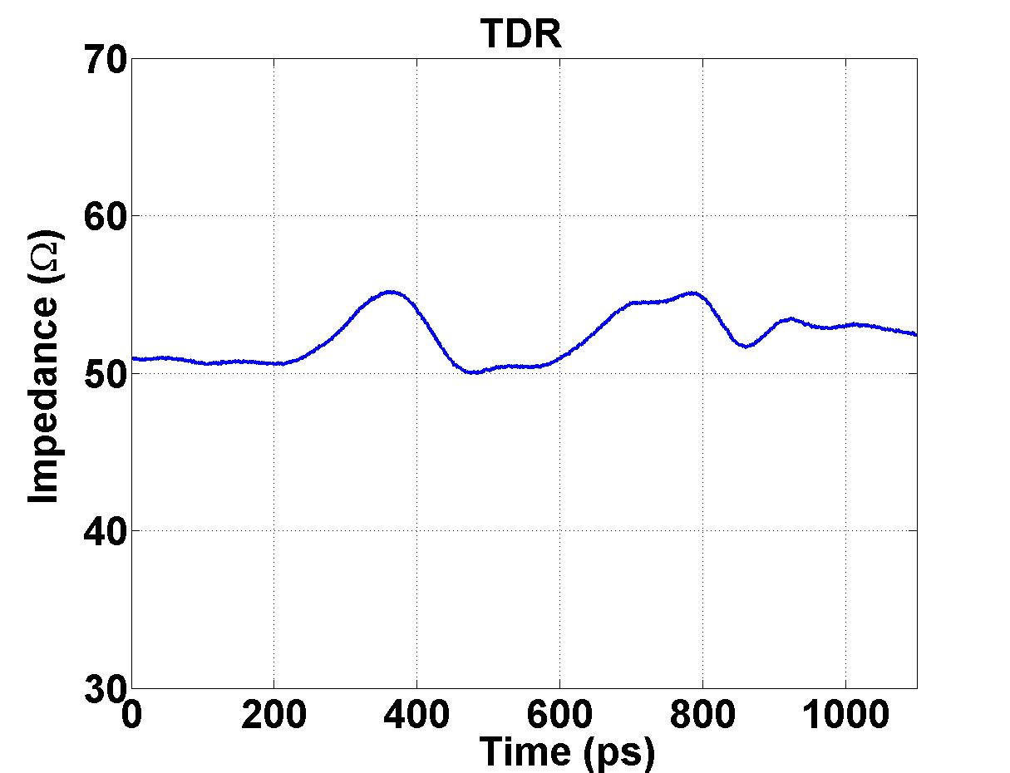
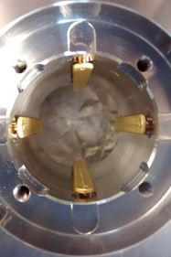
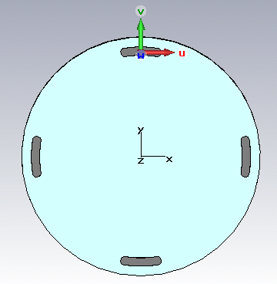
Terminated Stripline BPM for CLIC TBM
Mechanical realization
Stripline
Z₀ very sensitive to electrode and feedthrough pin fabrication tolerances (ΔZ₀ = ±3.5 Ω / 0.1 mm).
Target range: Z₀ = 50 ± 1 Ω

Slide 15
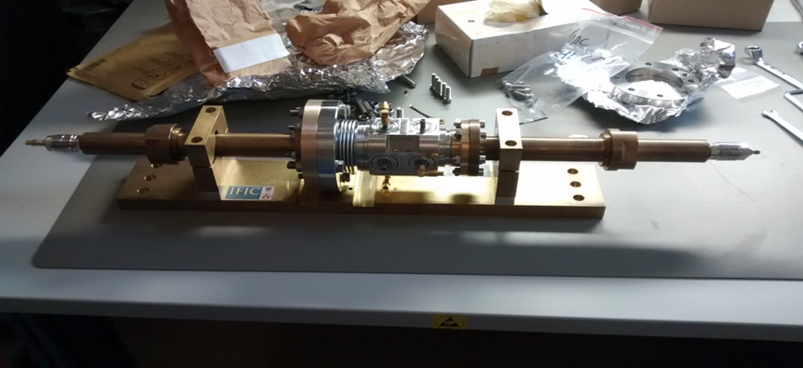
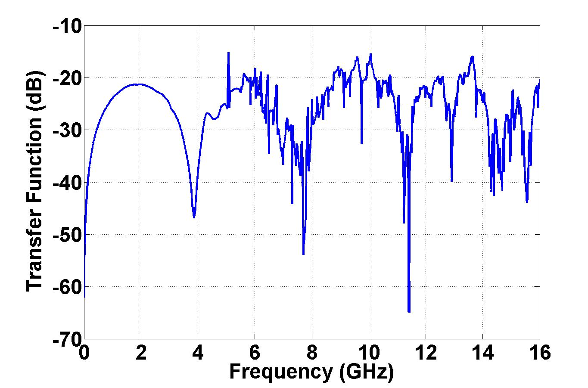
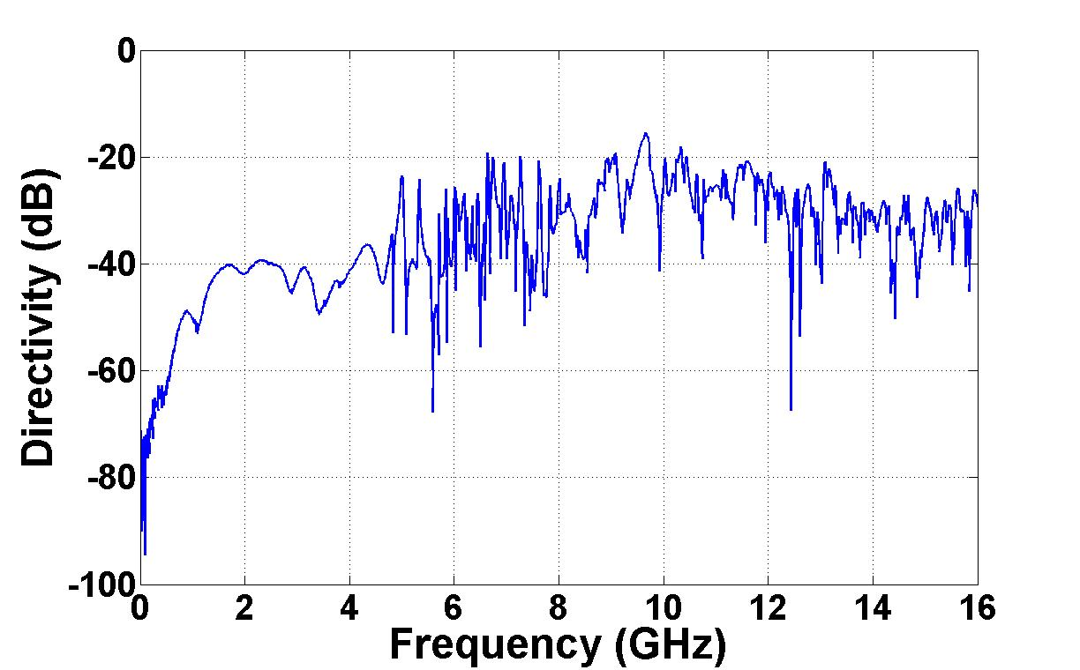
Frequency Response Measurement
Terminated Stripline BPM for CLIC TBM
STRIPLINE BPM DEVELOPMENT FOR THE CLIC DRIVE BEAM
STRIPLINE BPM DEVELOPMENT FOR THE CLIC DRIVE BEAM
Directivity: ~40dB up to 4 GHz→ LHC (25-30 dB)
45 dB-deep 3rd notch, moves between 11.4-12 GHz → Limited RF measurement because of poor flange connection.
45 dB

Slide 16
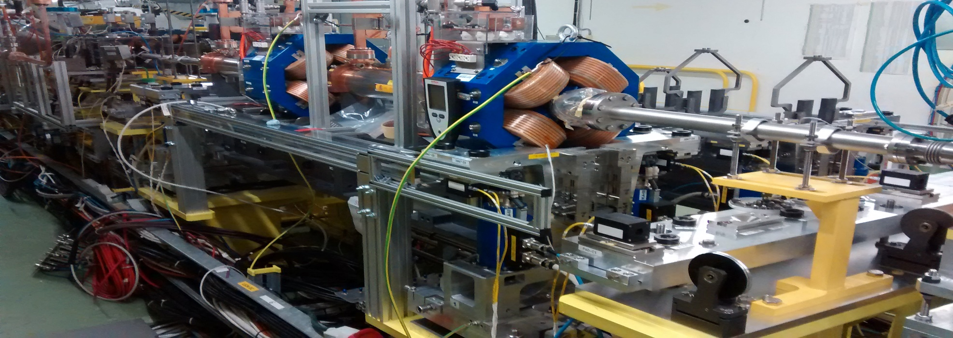
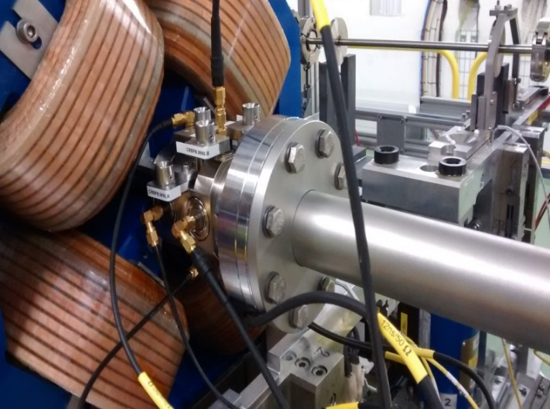
Installation in CLEX
Terminated Stripline BPM for CLIC TBM
STRIPLINE BPM DEVELOPMENT FOR THE CLIC DRIVE BEAM
STRIPLINE BPM DEVELOPMENT FOR THE CLIC DRIVE BEAM
BEAM
STRIPLINE BPMs
Two installed units:
  CM.BPL0645
  CM.BPL0685
Beam tests planned for spring 2015

Slide 17
Conclusions and Future Work
Compact prototype
  Insufficient suppression of 12 GHz PETS interference.
  Good linearity/sensitivity results with beam.
Terminated prototype
  Improved suppression of 12 GHz PETS interference.
  Excellent directivity also interesting for HL-LHC.
  Practical assembly aspects and cost to be optimized.
Plans for 2015
  Beam test at CTF3 (CLIC Module) of terminated prototype (2 units)
  Study of alternative technologies, e.g. buttons.

Slide 18
Thank you

Slide 19

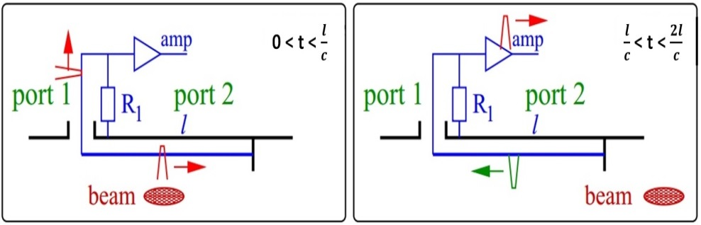

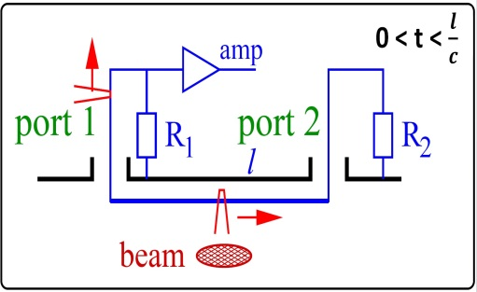
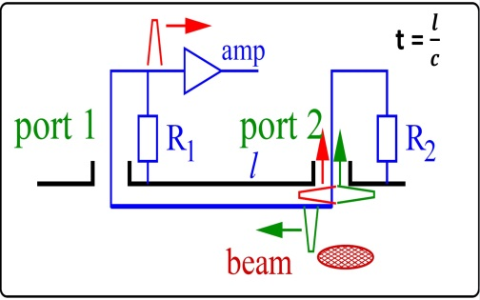
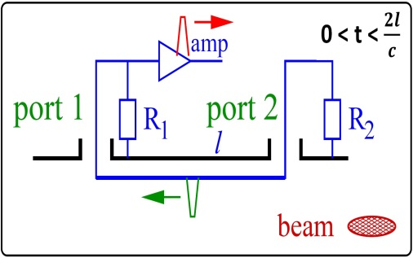

2 - Stripline BPM Basics
Compact version
(shorted electrodes)
If → Bunch cancellation
(N^{th} notch tuned to f_{bunch} )
Terminated version (8 ports)
CLIC Workshop 2015

Slide 20
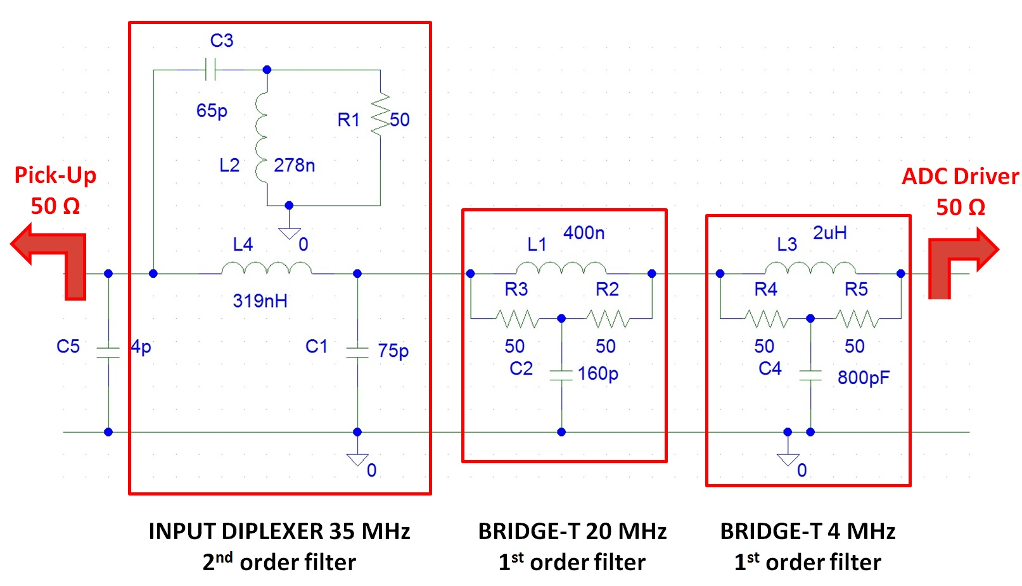
Passive filters for DB Stripline BPM
CLIC Workshop 2015

Slide 21
Geometrical Issues in Compact Prototype
Lobe distortion grows with electrode width.
TF sensitive to resonance at f_{TM_01}=9.99 GHz if aperture and electrode length become comparable.
CLIC Workshop 2015

Slide 22
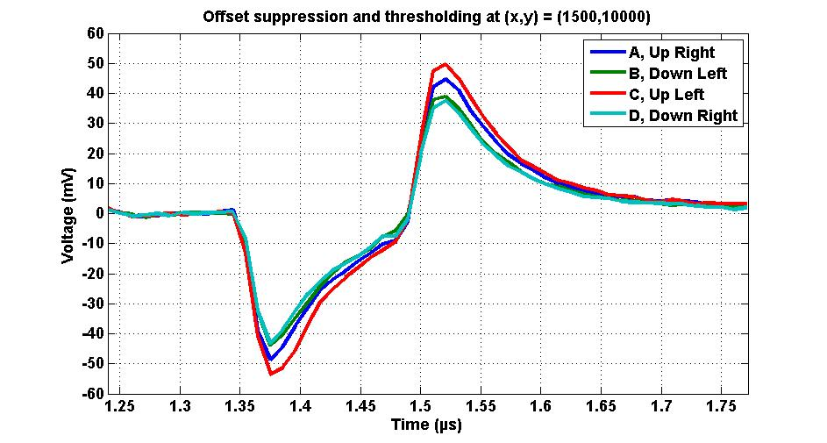
Beam Tests at CTF3
0.95Vp
CLIC Workshop 2015

