Slide 1
Thomson Scattering X-ray Source at Tsinghua University
HG Application, CLIC workshop 2015
Jiaru Shi
2015.01.29
for TTX team

Slide 2
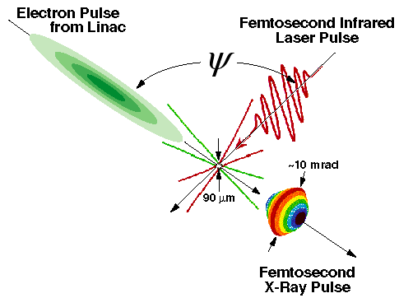
Thomson scattering x-ray
Small source size(~30 um)
Adjustable for energy of X-ray
Quasi-Monochromatic spectrum
Radiation in a small angle（～1/γ)
Ultra-short X-ray Pulse
Good synchronization for pump-probe
High Peak Brightness
Polarization
compact and affordable
…
Energy of electron
Scattering angle
Frenquency of laser

Slide 3
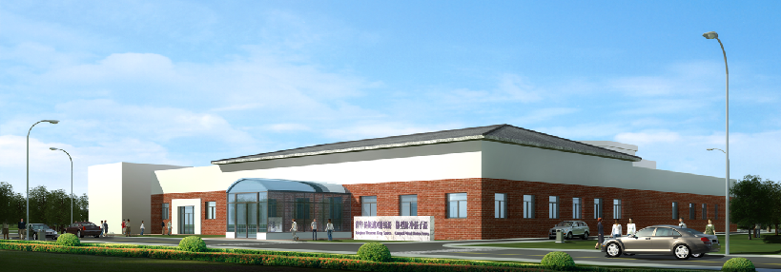
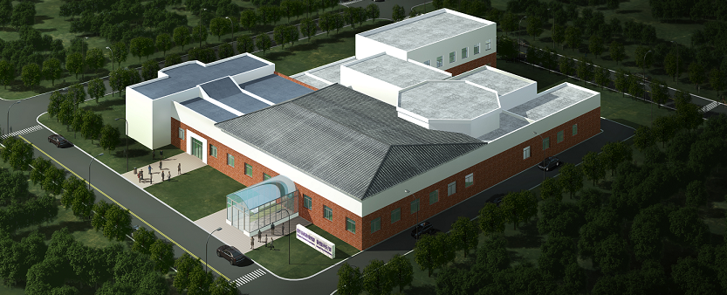
Tsinghua University-
Scientific Facility for Advanced Quantum Probes (TTX&CPHS)

Slide 4
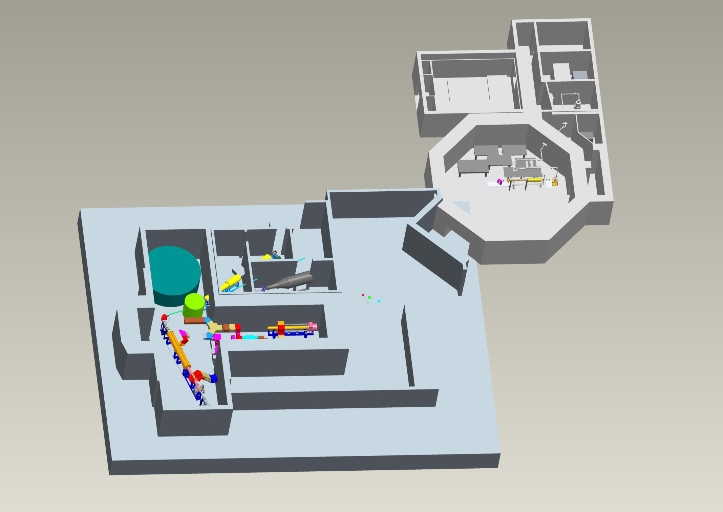
TTX: lasers, electrons & x-rays
CPHS-neutrons: Short-Pulse options: Diffraction, QENS, …
CPHS-neutrons: Long-Pulse – SANS, Imaging, …
CPHS-proton applications
CPHS Complex – approved boundary
CPHS-proton accelerator R&D

Slide 5
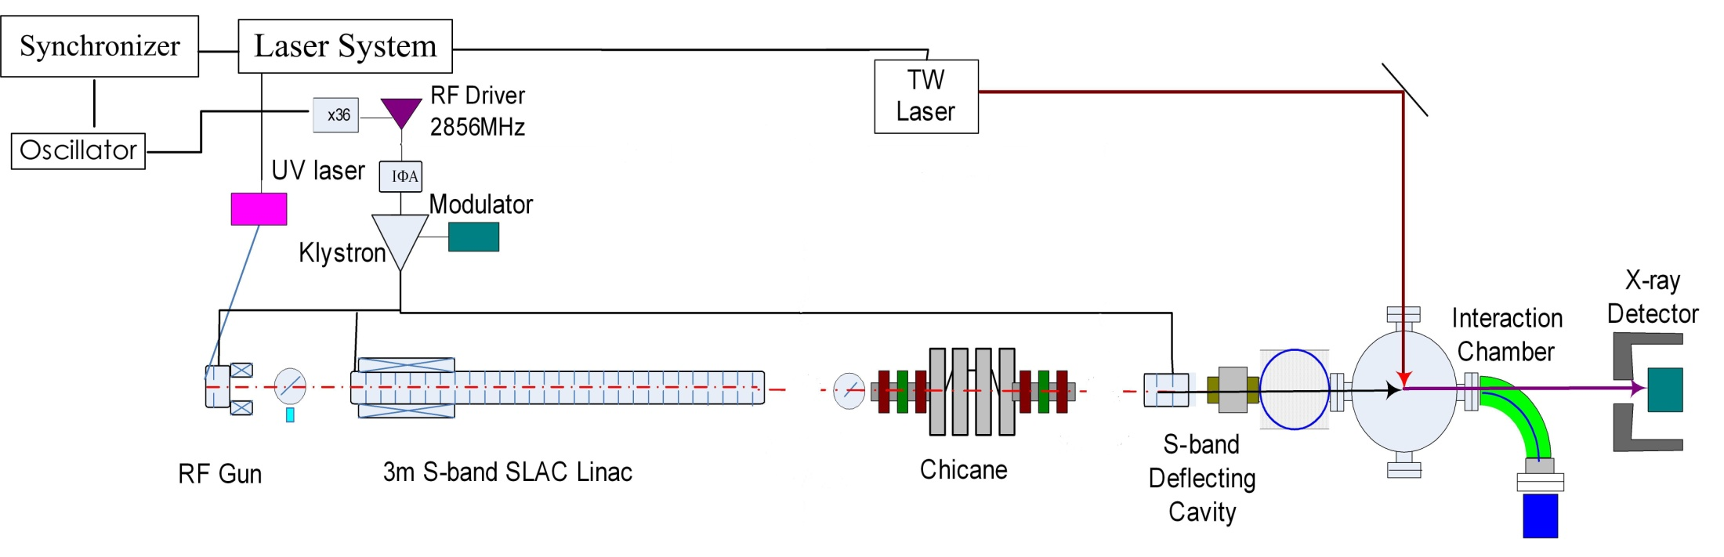
Tsinghua Thomson scattering X-ray source (TTX)
Parameters of Scattering X-ray
Photon energy | 24(90deg)~48(180deg)kev
Pulse duration | 0.16(90deg)~3(180deg)ps
Number photons | 8.4X10⁶(90deg)~5.5X10⁷(180deg)
Electron beam |  | Laser beam
Energy | 45MeV | Wavelength | 800nm
Bunch length | 1~4ps | Pulse duration | ~30fs
Charge | ~0.7nC | Pulse energy | ~500mJ
Beam size | 30(H)x25(V)um | Beam size | ~30um

Slide 6
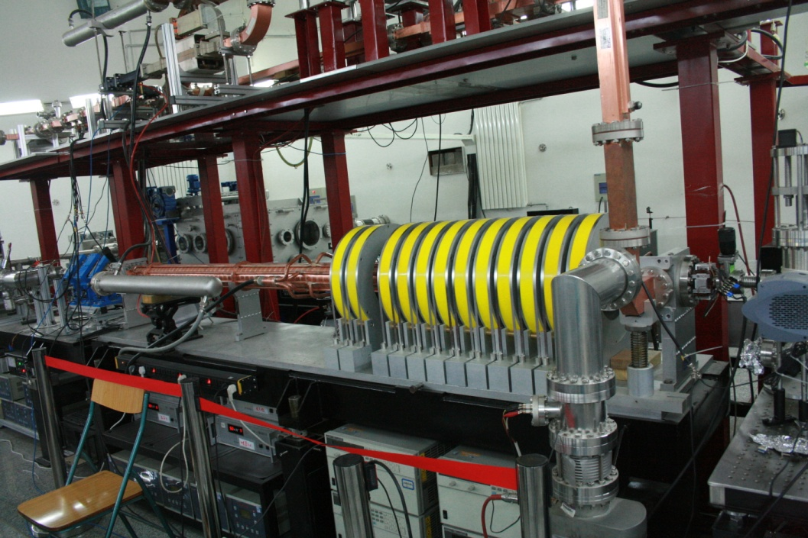
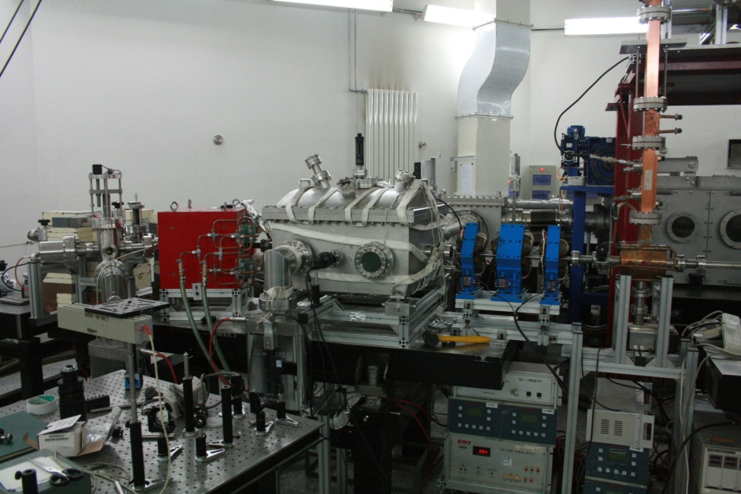
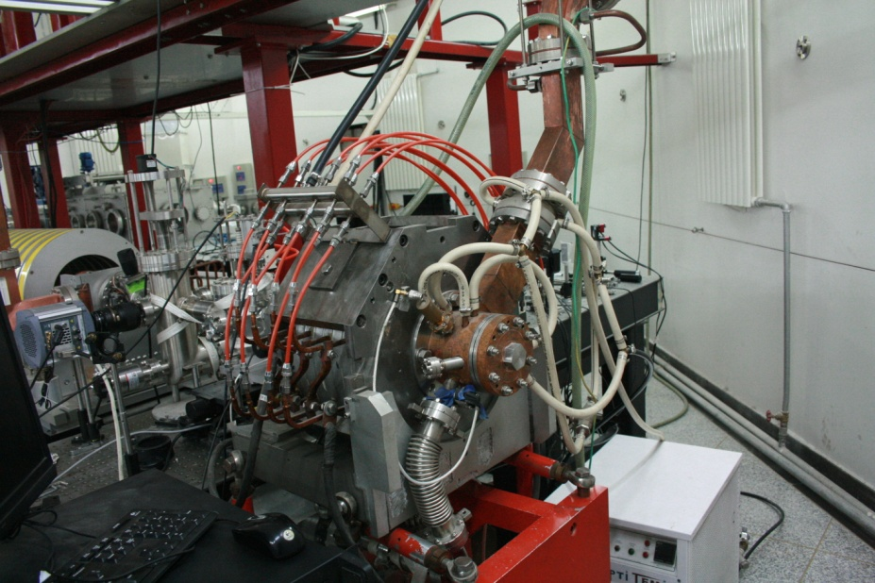
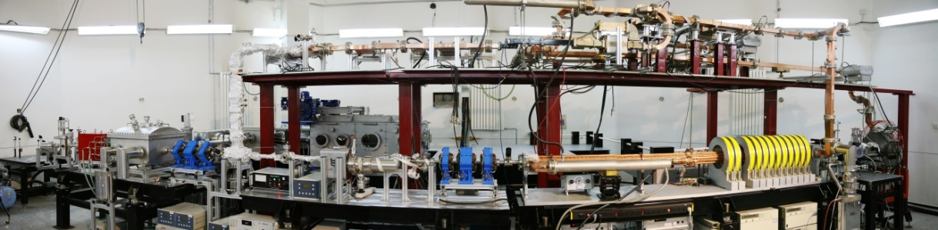
Electron beam line

Slide 7
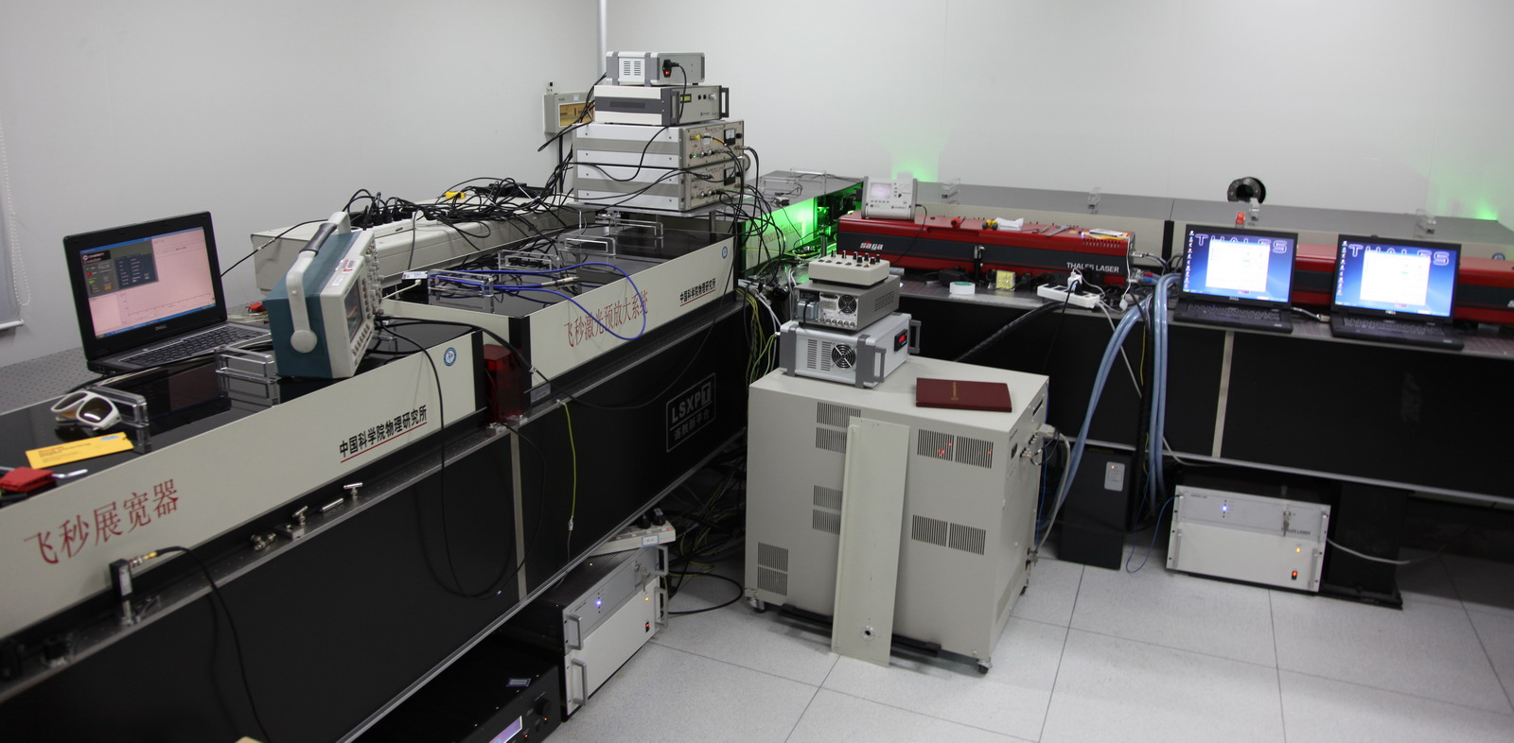
Laser System
RF Gun
TS IP
800nm, ~20TW, ~30fs
266nm, 1mJ, 30fs~10ps

Slide 8
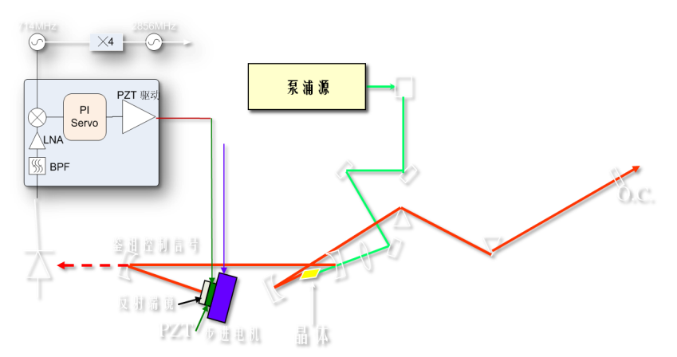
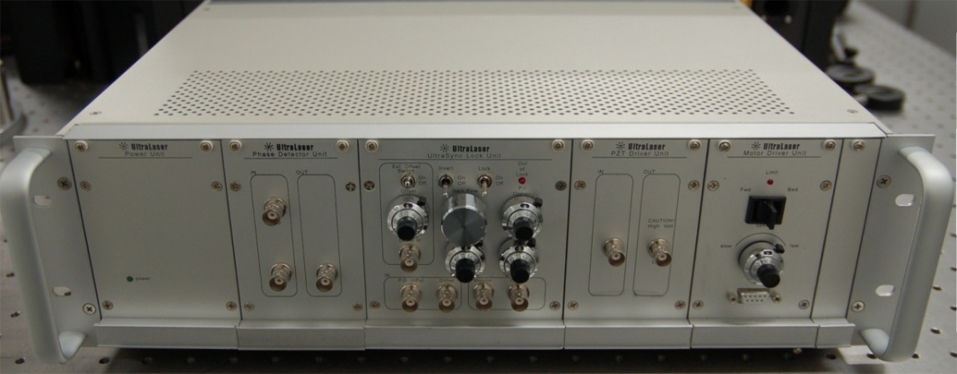
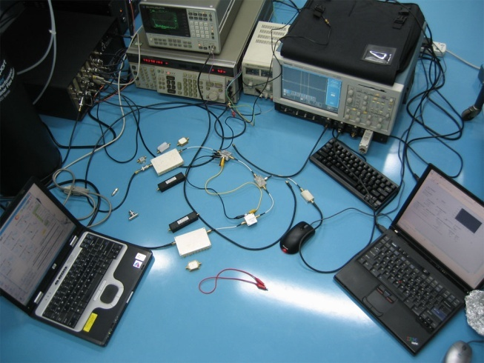
Time jitter control and measurement
Synchronization system between microwave and laser
phase locking feedback loop based on harmonic phase noise measurement
Timing jitter of this system <100fs
Notes:
高次谐波鉴相
相噪探测灵敏度∝谐波阶次²；
有利于消除激光幅度噪声对鉴相带来的误差；
全模拟系统
低噪声：<10μV/Hz ^{½}
高带宽：控制器>10MHz， PZT带载共振频率>100kHz；
灵活、稳定的控制
可调锁定相位、可调增益、可调PI拐点；
保证控制相位裕度>50°，锁定时间>8小时；
8

Slide 9
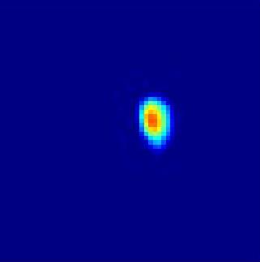
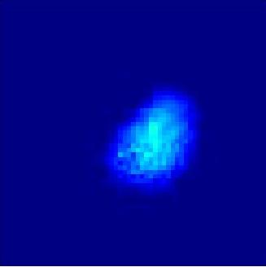
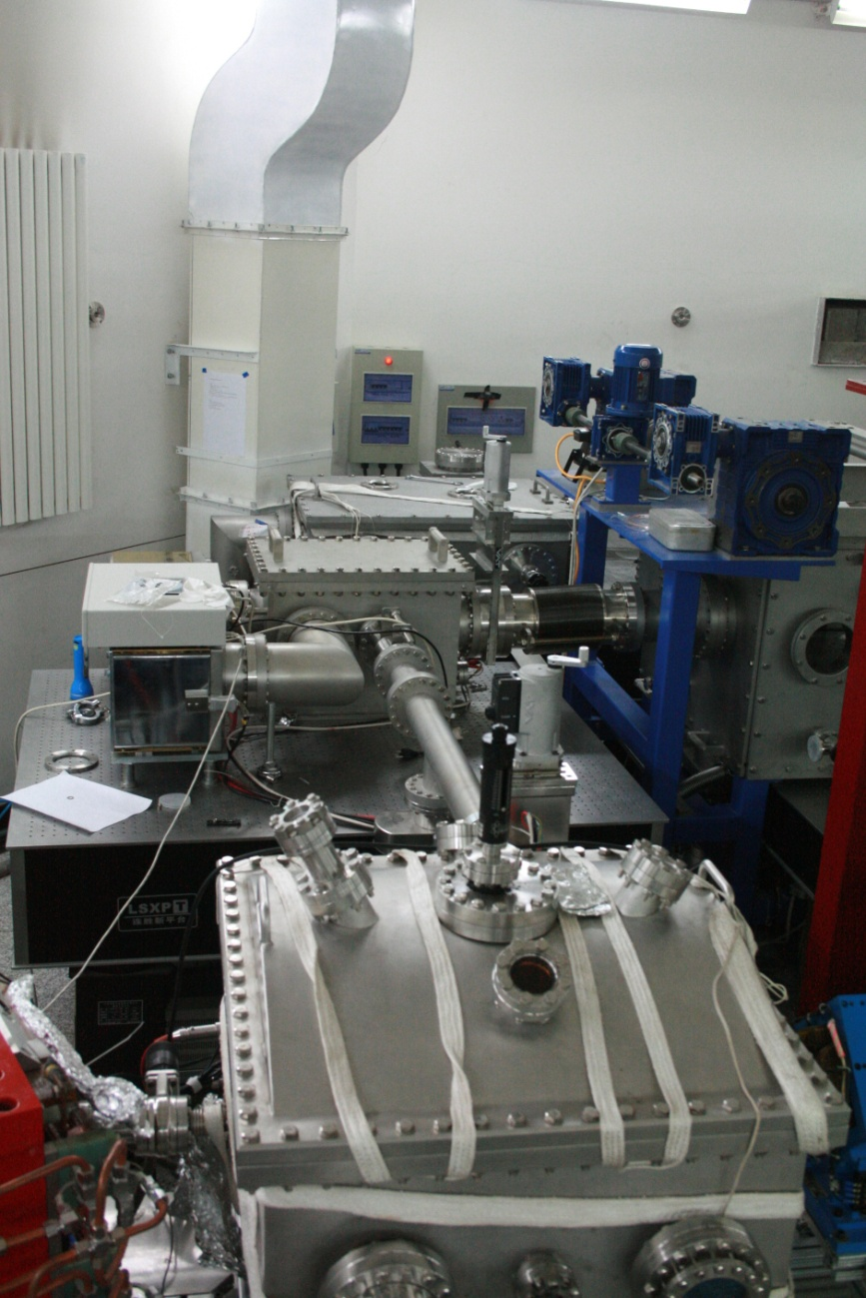
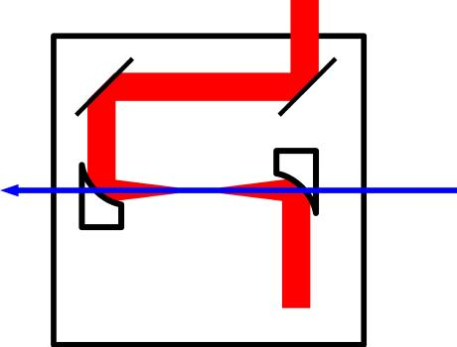
Thomson Scattering Experiment
Laser compressor
electron
laser
Delay stage
Ground glass screen for beam profile measurement
Triplet
Dipole
Interaction chamber
The laser is focused by a parabolic mirror with 4mm hole in center.

Slide 10
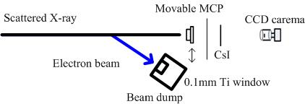
Thomson Scattering Experiment
X-ray detector
F4655-11 MCP from Hamamatsu

Slide 11
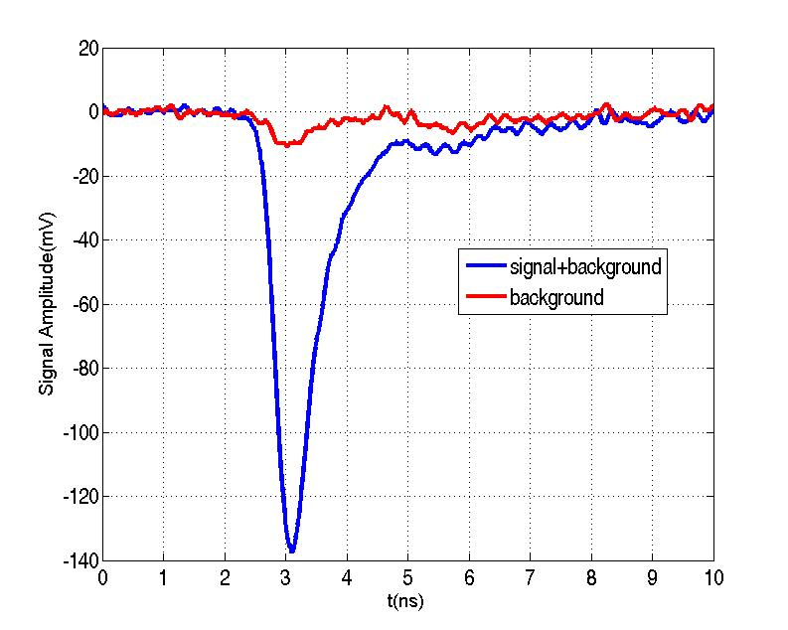
Thomson Scattering Experiment
Typical background and X-ray signal
Background x-ray from beam dump
The background from the beam is suppressed successfully.
Background x-ray from beam lost in the hole
Estimated number of X-rays: ~1.2X10^5;
Reasons:
misalignment in transverse and longitudinal?
detector efficiency or gain incorrect ?
Expected number of X-rays
laser electron
Energy 800nm(1.55eV) 47MeV
Intensity 150mJ(4.8X10^17) 0.1nC (6.25x10^8)
Beam size ~100um ~40um
Pulse width ~50fs ~2ps
Expected number of X-rays: ~3.5X10^5;

Slide 12
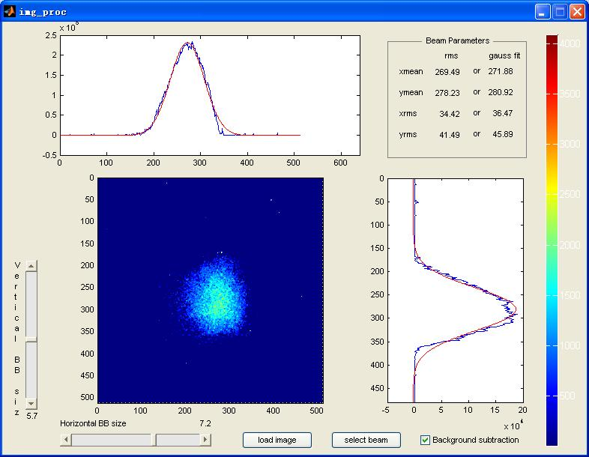
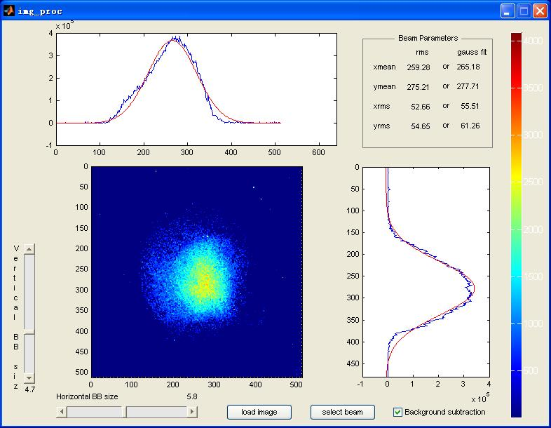
Thomson Scattering Experiment
X-ray profile measured by CsI screen and EMCCD
30 mm Ti window

Slide 13
the TTX Status
Some applications are being considered: X-ray imaging, and x-ray polarization detector calibration for astronomy…
Chicane has be installed recently;

Slide 14
TTX Next
Replace the 3-m linac with higher gradient structures
  Boundary of the experiment hall. Limited to 12 meters
  Space for beam physics study and beam manipulation, as well as other experiments
S-band klystron available now.
1.5m x30MV/m looks reasonable.

Slide 15
New Compact γ-ray source
Demand for photons above 2MeV with narrow energy spread.
To meet the requirement:
  Energy of e-beam: 200MeV
  Wavelength of laser: 400nm
Compact within 10m
  Limited length of the experiment hall
  Tabletop facility

Slide 16
200MeV linac layout
(Preliminary design)
50MW
7MWx2
PC 1:4
50MW
photo-cathode
RF Gun
S-band @ 30MV/m
X-band @ 70MV/m
1m x1
0.6m x4

Slide 17
TTX linac upgrade
1 year
1.5m x30MV/m
~3 year
1.5m x30MV/m + 0.6m x70MV/m
New beam line

Slide 18
X-band structure design, Preliminary
Will be refined with the info of RF power source available.
parameters
frequency | 11.424 | GHz
Phase adv | 120 | degree
# cells | 72
length | 630 | mm
Filling time | 88 | ns
a | 4, 3 | mm
vg/c | 3.76, 1.38
R/Q | 14.2, 16.3 | (kOhm/m)
Q | 6900, 7100
P Input | 50 | MW
Eacc | 75 | MV/m
S21 | -4.3 | dB
Eacc MV/m
@ 50MW
# of cells

Slide 19
Summary
TTX with 50MeV e⁻
200MeV linac under design:
  X-band structure aiming 70MV/m
Near future
  S-band @30MV/m replacement
  X-band unit demonstration: add one accelerating structure to existing beam line; build the RF power supply
Inputs are welcomed!

Slide 20
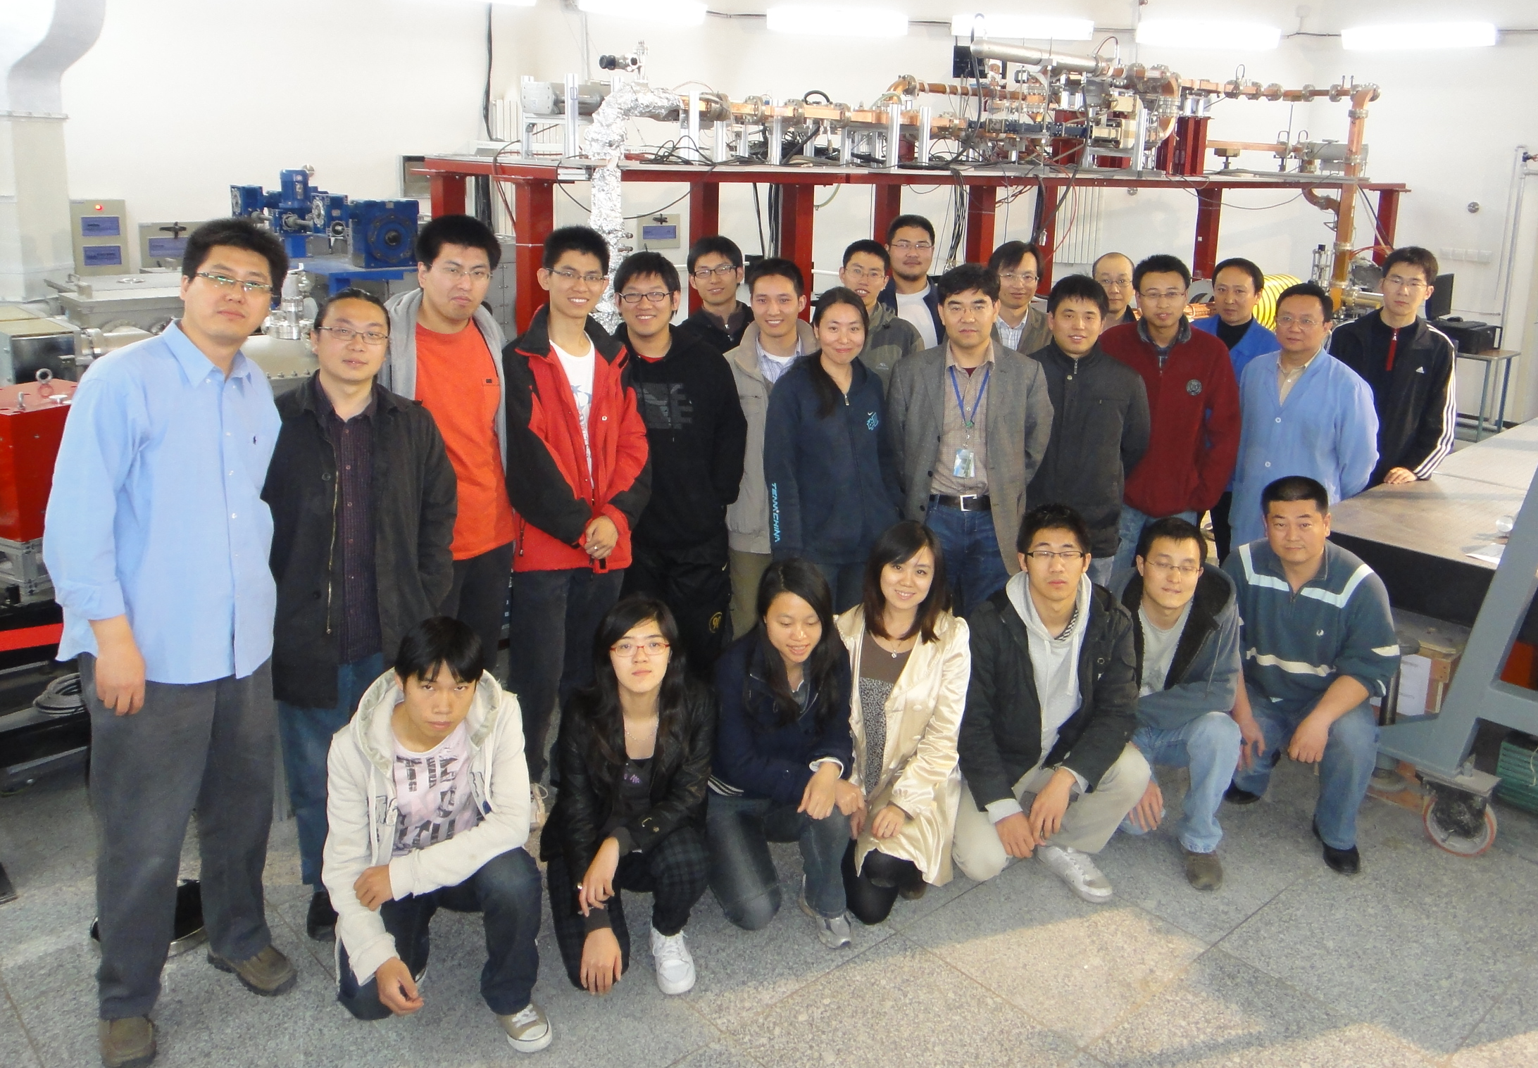
TTX Group

Slide 21

HG2015
HG structures
  Design
  Producing
  Testing
Klystrons/Test Stands
Basic breakdown theory
Industry Exhibition

