Slide 1

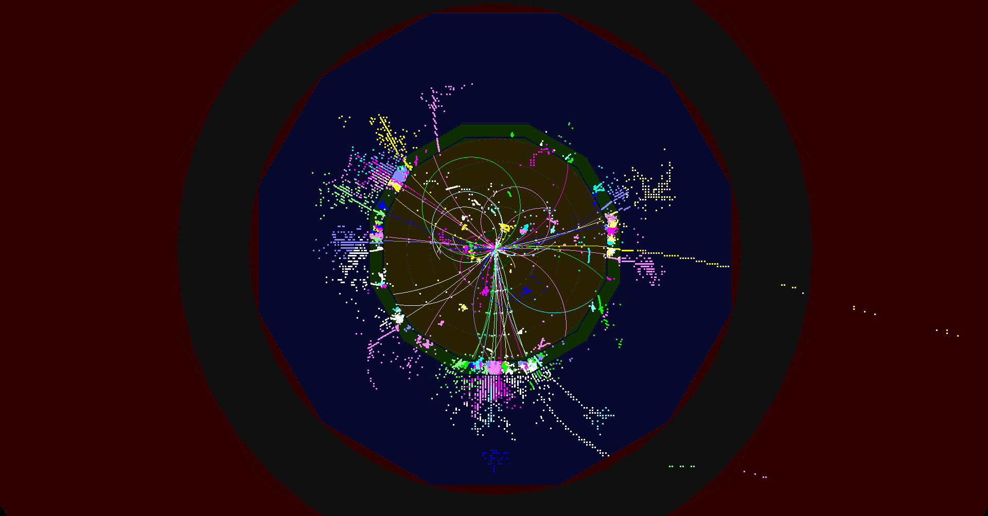
CLICdp, introduction and general news
e⁺e⁻ ➔ ttH ➔ WbWbH ➔ qqb τνb bb @ 1.4 TeV
Lucie Linssen, CERN
CLIC workshop, January 27th 2015

Slide 2

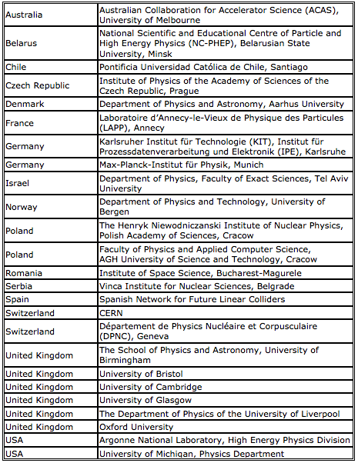
CLIC detector and physics (CLICdp)
http://clicdp.web.cern.ch/
Now 25 institutes
5 institutes joined in 2014:
Univ. of Michigan
Univ. of Liverpool
Univ. of Bristol
KIT-IPE Karlsruhe
DPNC of the Univ. of Geneva

Slide 3
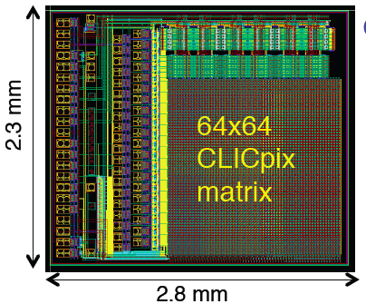
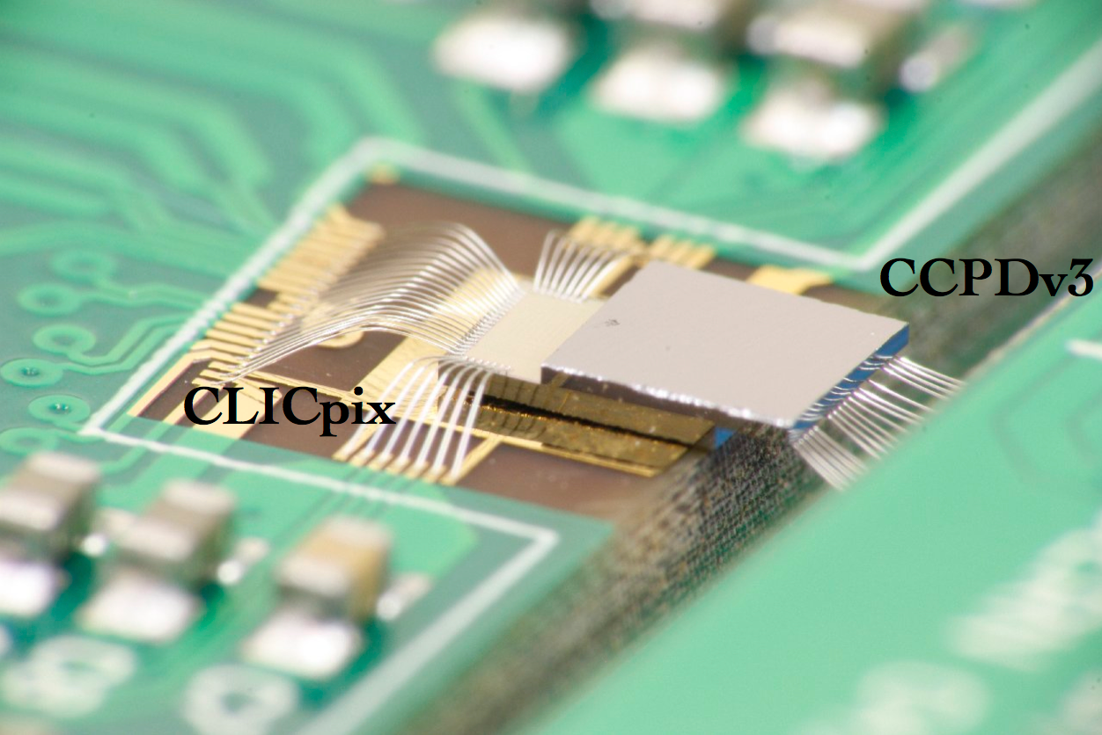
KIT-IPE and DPNC joined recently
Two institutes joined CLICdp at the end of 2014:
Karlsruhe Institute of Technology (KIT), Institut für Prozessdatenverarbeitung und Elektronik (IPE)
http://www.kit.edu/english/
http://www.ipe.kit.edu/
Contact: Ivan Peric
Département de Physique Nucléaire et Corpusculaire (DPNC), Univ. of Geneva
http://dpnc.unige.ch/
Contact: Giuseppe Iacobucci
HV-CMOS + CLICpix, AC coupled
Main interest for both institutes: vertex detector R&D, in particular R&D on HV-CMOS
Synergies with other projects, in particular ATLAS pixel R&D.

Slide 4
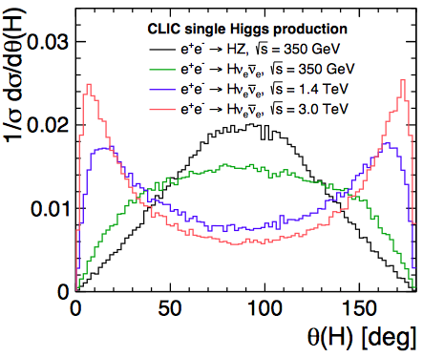
Higgs studies at CLIC
“Higgs Physics at the CLIC Electron-Positron Linear Collider”
Editors team: C. Grefe, S. Lukic P. Roloff, F. Simon, M. Thomson
Nightly build of the draft paper is available here:
http://proloff.web.cern.ch/proloff/clichiggspaper/
A collaboration-wide publication !
Please join the discussion
today at 18:15 hrs (main auditorium)

Slide 5
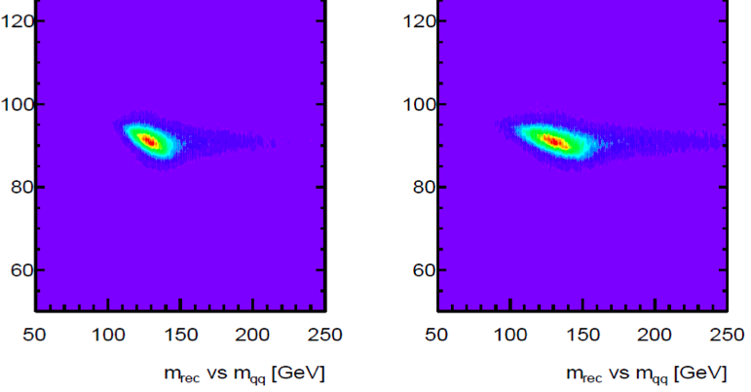
News from CLIC re-baselining
Further CLIC optimisation promised in the CDR:
Accelerator optimisation for a staged approach
Reduce cost, reduce power consumption
Update on physics input
Dedicated summary presentations on Friday 30/1
Z mass versus recoil mass
350 GeV
420 GeV
At the time of LCWS14:
Accelerator waiting for physics input for first stage
Trade-off between top physics and Higgs physics
  A^{FB}_{t} and top couplings to Z and photon may require ~420 GeV or more
  Higgs physics: HZ => Hqq to be checked in the 350-420 GeV range
Meanwhile:
  HZ => Hqq seems to have significantly degraded accuracy at 420 GeV
  So, preferred lower energy stage is likely ~360 GeV (for top threshold scan)
  Detailed top + Higgs presentations at this week’s analysis session

Slide 6
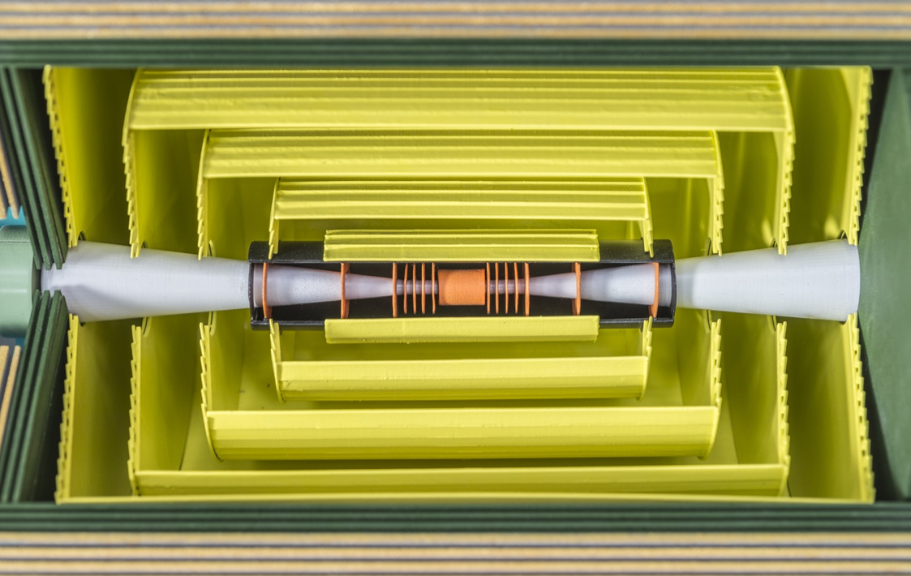
Main silicon tracker technology
Tracker requirements
7 μm single point accuracy
time-stamping 10 ns
~5-6 tracking layers
Radius ~1.5 m, half-length ~2.3 m
High occupancies in certain regions:
Calls for large pixels and/or short-strips
Very light => ~1%X₀ per layer
  Requires very thin materials/sensors
  => is this compatible with charge sharing and 7μm accuracy?
  Can we use power pulsing ?
  Is air cooling feasible in a large tracker volume ?
  Radiation level 10⁴ lower than LHC
new CLIC tracker technology working group
for discussion in this week’s IB meeting

Slide 7
CLICdp at CLIC 2015 workshop
day | Time | Room | session
Tue 27/1 | 13:30 - 15:00 | CERN auditorium | Plenary CLICdp
Tue 27/1 | 15:20 - 18:00 | CERN auditorium | Calorimetry (FCAL+CALICE)
Tue 27/1 | 18:15 - 19:00 | CERN auditorium | Discussion on Higgs paper
Wed 28/1 | 09:00 - 12:45 | 40-S2-B01 | Detector Optimisation
Wed 28/1 | 14:00 - 18:00 | CERN auditorium | Open Plenary Session
Thu 29/1 | 08:30 - 12:30 | CERN auditorium | Physics and Analysis
Thu 29/1 | 12:30 - 14:00 | 4-S-030 | CLICdp Institute Board
Thu 29/1 | 14:00 - 17:00 | CERN auditorium | Vertex and Tracking
Thu 29/1 | 17:00 - 18:00 | CERN auditorium | CLICdp wrap-up
Fri 30/1 | 08:30 - 12:30 | CERN auditorium | Plenary session CLIC+CLICdp
Workshop photo: Coffee break on Wednesday afternoon (main building)
Workshop dinner: Wednesday 19hrs in CERN restaurant #1

Slide 8
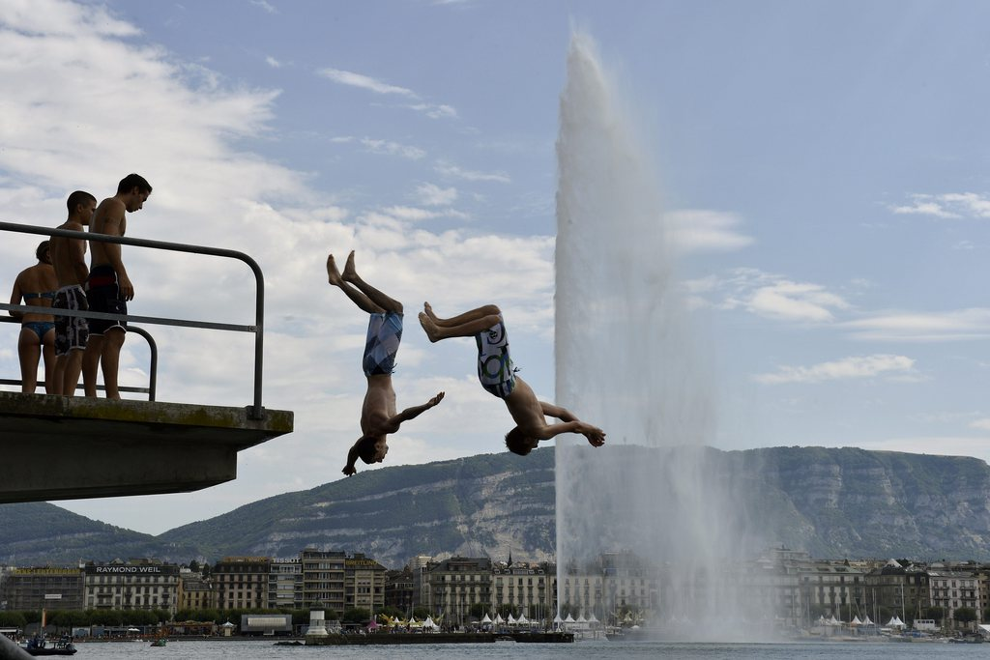
CLICdp dinner on Thursday
Detector/Physics fondue dinner
Thursday 29/1, 19:30 hrs
Bains des Pâquis, Geneva
http://www.bains-des-paquis.ch/
25 CHF/person, drinks included
Everyone welcome !
Please fill the doodle:
http://doodle.com/kfhgrsrcxszwb79i
Doodle will be closed at 11 am tomorrow 28/1

Slide 9
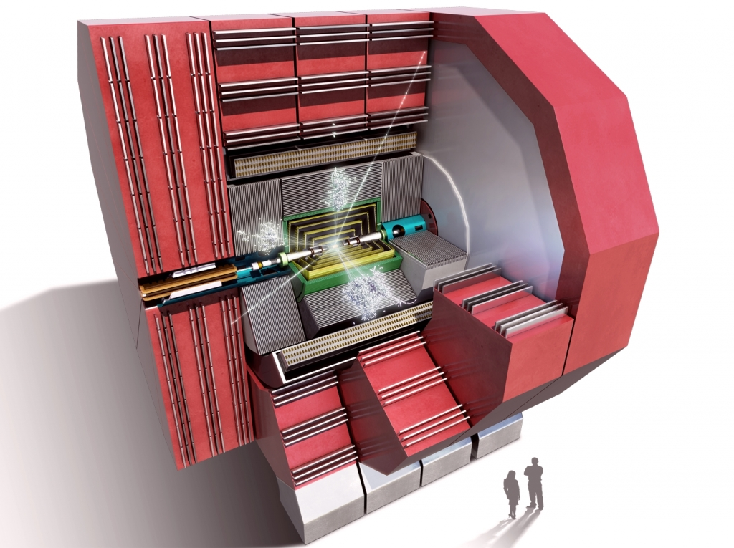
Enjoy the workshop !

Slide 10
SPARE
SLIDES

Slide 11
CLICdp session conveners
Topical session conveners:
Physics and analysis:
Tomas Lastovicka tomas.lastovicka@gmail.com
Philipp Roloff philipp.roloff@cern.ch
Detector optimisation:
Wolfgang Klempt wolfgang.klempt@cern.ch
Frank Simon fsimon@mpp.mpg.de
Vertex and tracking:
Dominik Dannheim dominik.dannheim@cern.ch
Joel Goldstein joel.goldstein@bristol.ac.uk
Calorimetry:
Aharon Levy aharon.levy@cern.ch
Eva Sicking eva.sicking@cern.ch

