Slide 1


Thermionic & RF Gun Simulations for the CLIC DB Injector
Mohsen Dayyani Kelisani
Institute For Research in Fundamental Science (IPM), Tehran, Iran
CERN, Geneva, Switzerland

Slide 2
Contents
Introduction
  1.1. CLIC DB Injector Layout
  1.1. Basic Beam Dynamics Studies (Emittance Growth)
DB Injector Thermionic gun
  2.1. Thermionic Gun Design
  2.2. Thermionic Gun Simulations
DB injector RF gun
  3.1. RF Gun Design
  3.2. RF Gun Simulations
  3.3. Comparison

Slide 3

1. Introduction 1
1.1. CLIC DB Injector Layout (2 Options)
DC Gun
Bunching System
$13$TW Accelerating Structures
RF Gun
12 TW Accelerating Structures

Slide 4
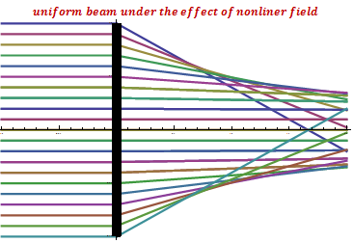
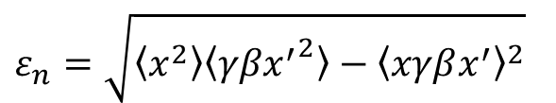


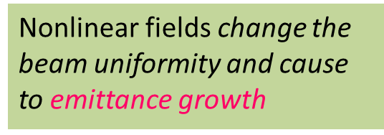

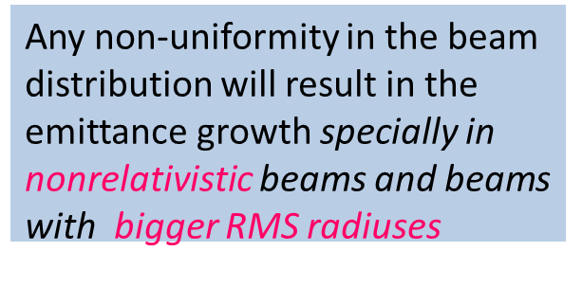
1. Introduction 2
1.2. Beam Dynamics Studies (Emittance Growth)
$$RMS beam radius$$
Wangler’s formula: $\frac{d{ε_{n}}^{2}}{dz}=−\frac{ecR^{2}}{2Imc^{2}\sqrt{γ^{2}−1}}\frac{d}{dz}∆U$
Any non-uniformity in the beam distribution will result in the emittance growth specially in nonrelativistic beams and beams with bigger RMS radiuses
Potential Energy difference
Between the beam and its equivalent uniform beam
$$Gamma Energy$$
$$ε_{n}=\sqrt{〈x^{2}〉〈{γβx^{′}}^{2}〉−{〈xγβx^{′}〉}^{2}}$$
Nonlinear fields change the beam uniformity and cause to emittance growth

Slide 5
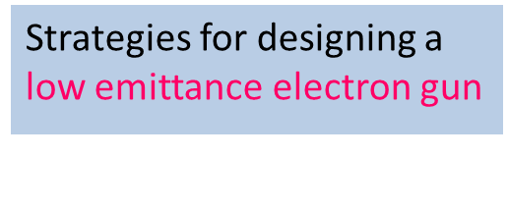

1. Introduction 3
1.2. Beam Dynamics Studies (Designing Strategies)
Wangler’s formula: $\frac{d{ε_{n}}^{2}}{dz}=−\frac{πε_{0}ecR^{2}}{2Imc^{2}\sqrt{γ^{2}−1}}\frac{d}{dz}∆U$
Strategies for designing a low emittance electron gun
Design the gun with as much as possible linear electromagnetic fields
Minimize the action of remaining nonlinearities with faster acceleration and smaller beam size

Slide 6
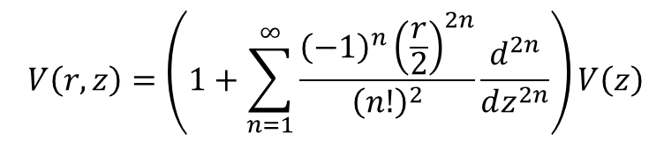
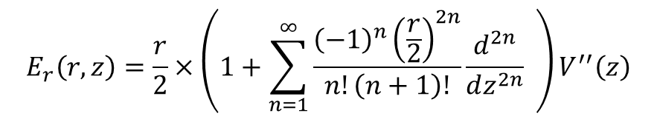
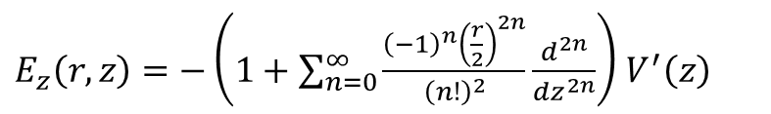
2. DB Injector Thermionic Gun 4
2.1. Thermionic Gun Design (Potential Expansion)
$$V\left(r,z\right)=\left(1+\sum_{n=1}^{∞}{\frac{{\left(−1\right)}^{n}{\left(\frac{r}{2}\right)}^{2n}}{{\left(n!\right)}^{2}}\frac{d^{2n}}{dz^{2n}}}\right)V\left(z\right)$$
According to the Maxwell equations for axisymmetric electrostatic fields we can write:
$E_{z}\left(r,z\right)=−\left(1+\sum_{n=0}^{∞}{\frac{{\left(−1\right)}^{n}{\left(\frac{r}{2}\right)}^{2n}}{{\left(n!\right)}^{2}}\frac{d^{2n}}{dz^{2n}}}\right)$ $V^{′}\left(z\right)$
$$E_{r}\left(r,z\right)=\frac{r}{2}×\left(1+\sum_{n=1}^{∞}{\frac{{\left(−1\right)}^{n}{\left(\frac{r}{2}\right)}^{2n}}{n!\left(n+1\right)!}\frac{d^{2n}}{dz^{2n}}} \right)V^{′′}\left(z\right)$$
If we can somehow find the potential function on symmetric axis z then we can easily find the electrostatic potential every where and so the electrode shapes
If we want to have a linear electrostatic field we should have a parabola shape for potential function on symmetric axis

Slide 7
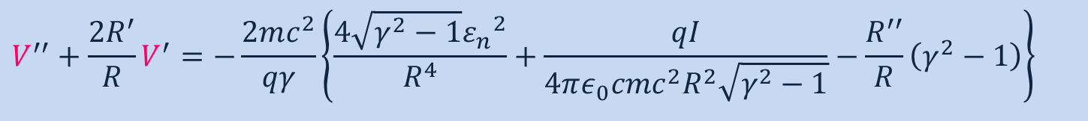

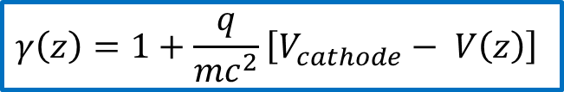
2. DB Injector Thermionic Gun 5
2.1. Thermionic Gun Design (Envelope Equation)
Envelope equation:
$$R^{′′}+\left(\frac{γ×γ^{′}}{γ^{2}−1}\right)×R^{′}+\left(\frac{γ×γ^{′′}}{2\left(γ^{2}−1\right)}\right)×R=\frac{qI}{4πε_{0}cmc^{2}{\left(γ^{2}−1\right)}^{3/2}R}+\frac{4{ε_{n}}^{2}}{R^{3}\left(γ^{2}−1\right)}$$
$$+$$
$$γ\left(z\right)=1+\frac{q}{mc^{2}}\left[V_{cathode}− V\left(z\right)\right]$$
$$V^{′′}+\frac{2R^{′}}{R}V^{′}=−\frac{2mc^{2}}{qγ}\left\{\frac{4\sqrt{γ^{2}−1}{ε_{n}}^{2}}{R^{4}}+\frac{qI}{4πε_{0}cmc^{2}R^{2}\sqrt{γ^{2}−1}}−\frac{R^{′′}}{R}\left(γ^{2}−1\right)\right\}$$

Slide 8

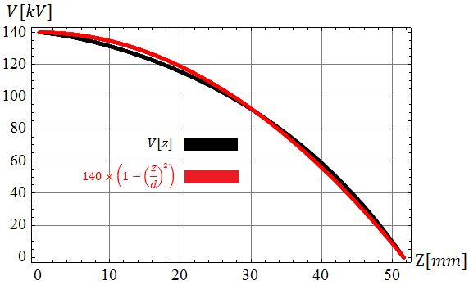


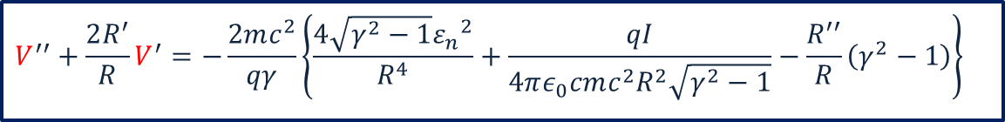
2. DB Injector Thermionic Gun 6
2.1. Thermionic Gun Design (Potential Equation)
$$V^{′′}+\frac{2R^{′}}{R}V^{′}=−\frac{2mc^{2}}{qγ}\left\{\frac{4\sqrt{γ^{2}−1}{ε_{n}}^{2}}{R^{4}}+\frac{qI}{4πε_{0}cmc^{2}R^{2}\sqrt{γ^{2}−1}}−\frac{R^{′′}}{R}\left(γ^{2}−1\right)\right\}$$
$$V_{c}=140 kV$$
Very close to a parabola and so linear fields
$$d=51.6mm$$

Slide 9
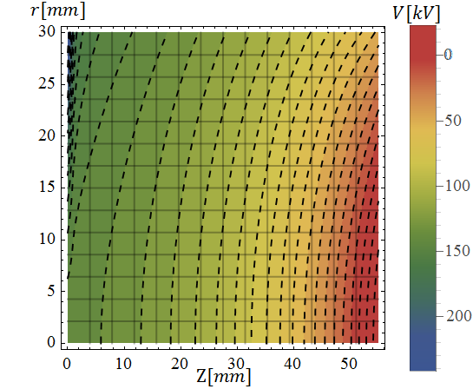
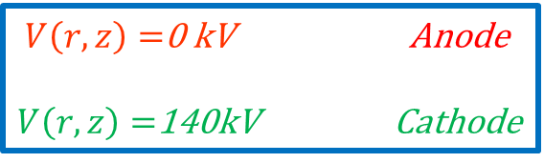
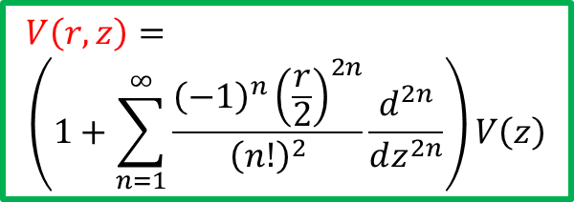
2. DB Injector Thermionic Gun 7
2.1. Thermionic Gun Design (Equipotential Surfaces)
$$V\left(r,z\right)=$$
$$\left(1+\sum_{n=1}^{∞}{\frac{{\left(−1\right)}^{n}{\left(\frac{r}{2}\right)}^{2n}}{{\left(n!\right)}^{2}}\frac{d^{2n}}{dz^{2n}}}\right)V\left(z\right)$$
$V\left(r,z\right)=$0 kV Anode
$V\left(r,z\right)=$140kV Cathode

Slide 10
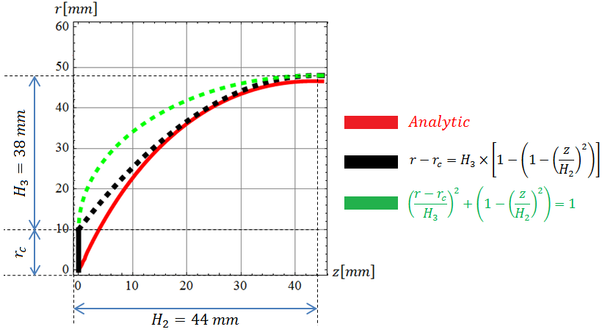
2. DB Injector Thermionic Gun 8
2.1. Thermionic Gun Design (Cathode Shape)
A parabola could be a good approximation for the cathode shape

Slide 11
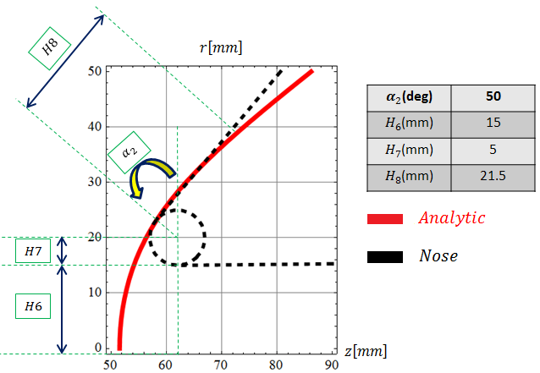
2. DB Injector Thermionic Gun 9
2.1. Thermionic Gun Design (Anode Shape)
A nose could be a good approximation for the anode shape

Slide 12
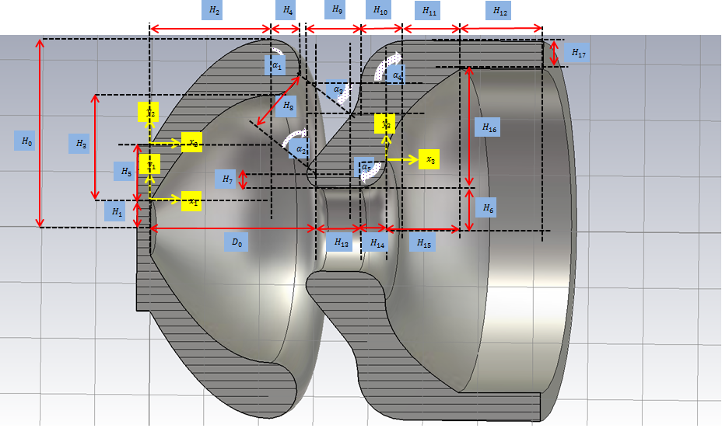

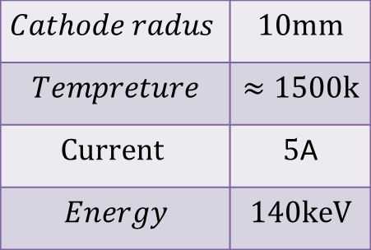

2. DB Injector Thermionic Gun 10
2.1. Thermionic Gun Design (DC Gun Geometry)
$$Cathode radus$$ | $$10mm$$
$$Tempreture$$ | $$≈1500k$$
$$Current$$ | $5$A
$$Energy$$ | $$140keV$$
$$V=−140kV$$
$$V=0kV$$

Slide 13

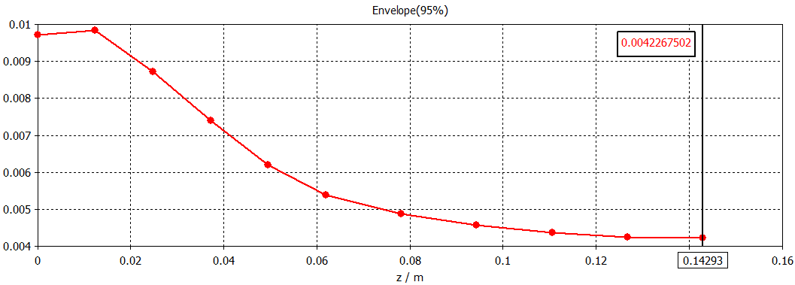



2. DB Injector Thermionic Gun 11
  2.2. Thermionic Gun Simulations (Beam Envelope)
$$Cathode$$
$$Nose center$$
$$R_{RMS}=3.6mm$$

Slide 14
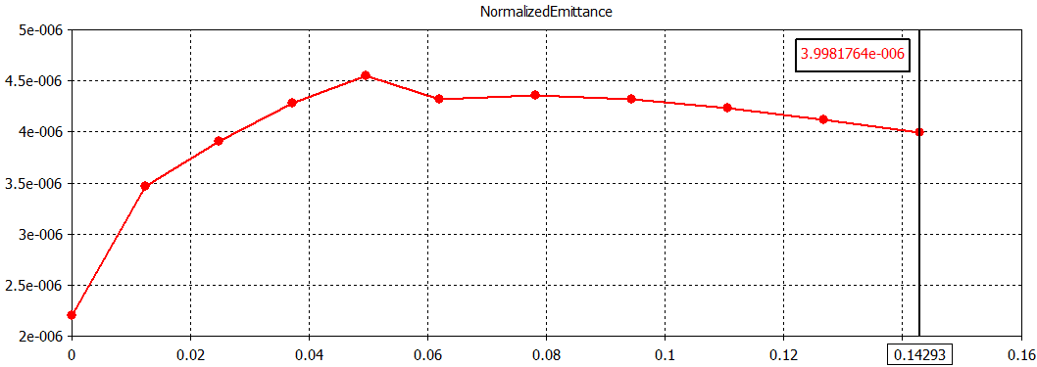


2. DB Injector Thermionic Gun 12
  2.2. Thermionic Gun Simulations (Normalized Emittance)
$$Cathode$$
$$Nose center$$

Slide 15
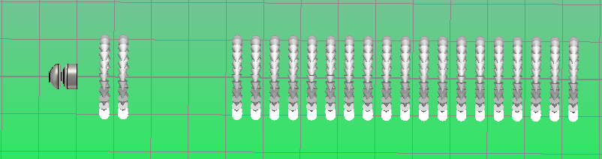
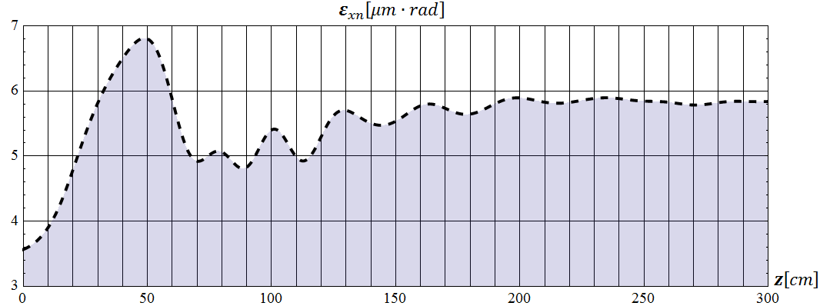



2. DB Injector Thermionic Gun 13
  2.2. Thermionic Gun Simulations (Solenoid Channel)
$$B=774 G$$
$$ε_{n}=5.8 mm∙mrad$$

Slide 16
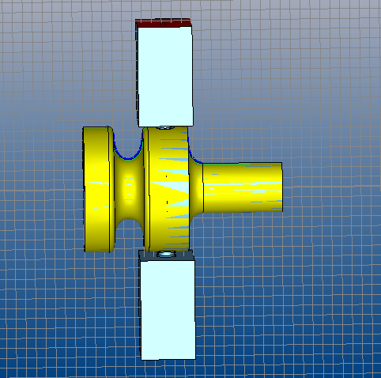
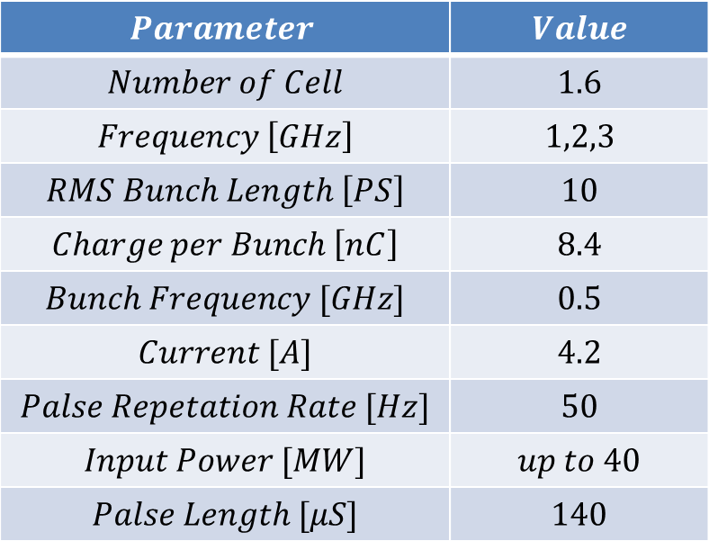
2. DB Injector RF Gun 14
2.1. RF Gun Design (Specifications)
$$Parameter$$ | $$Value$$
$$Number of Cell$$ | $$1.6$$
$$Frequency \left[GHz\right]$$ | $$1,2,3$$
$$RMS Bunch Length \left[PS\right]$$ | $$10$$
$Charge per Bunch \left[nC\right]$ | $$8.4$$
$$Bunch Frequency [GHz]$$ | $$0.5$$
$$Current [A]$$ | $$4.2$$
$$Palse Repetation Rate [Hz]$$ | $$50$$
$$Input Power [MW]$$ | $$up to 40$$
$$Palse Length [μS]$$ | $$140$$

Slide 17


2. DB Injector RF Gun 15
2.1. RF Gun Designing (Designing &Optimization Algorithm)
Selection of a Working Phase for the cavity
Optimum Structure
Beam Loading calculations and find the optimum coupling factor and detuning with the goal of having minimum input power
Change the working phase of the cavity
Matching the beam to the solenoid channel and simulate the beam in acc structures
Designing the cavity with this coupling factor and calculate its electromagnetic fields with CST
Beam dynamics simulations in cavity fields with Parmela and calculate the beam parameters at the end of cavity

Slide 18
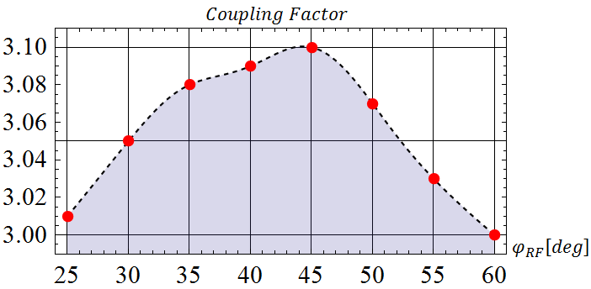
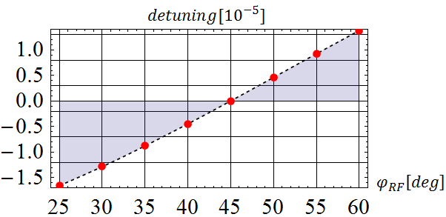
2. DB Injector RF Gun 16
2.1. RF Gun Design (Beam Loading Optimization)

Slide 19
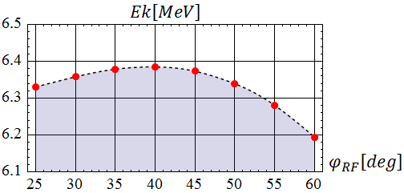
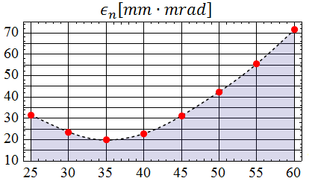
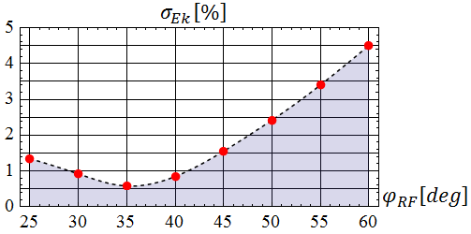
2. DB Injector RF Gun 17
2.1. RF Gun Design (RF Phase Optimization)

Slide 20
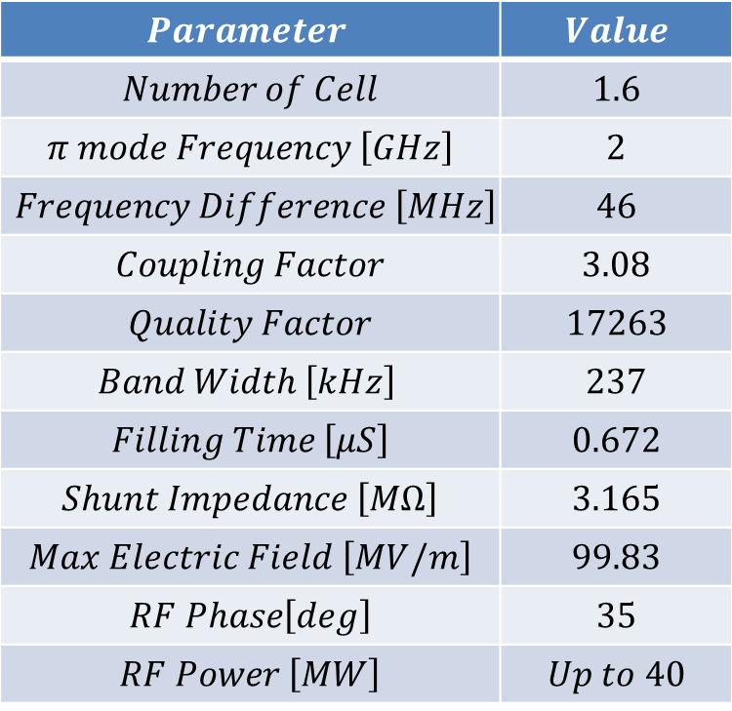
2. DB Injector RF Gun 18
2.1. RF Gun Design (Specifications of Optimum Structure)
$$Parameter$$ | $$Value$$
$$Number of Cell$$ | $$1.6$$
$$π mode Frequency \left[GHz\right]$$ | $$2$$
$$Frequency Difference \left[MHz\right]$$ | $$46$$
$$Coupling Factor$$ | $$3.08$$
$$Quality Factor$$ | $$17263$$
$$Band Width \left[kHz\right]$$ | $$237$$
$$Filling Time \left[μS\right]$$ | $$0.672$$
$$Shunt Impedance \left[MΩ\right]$$ | $$3.165$$
$$Max Electric Field \left[MV/m\right]$$ | $$99.83$$
$RF Phase\left[deg\right]$ | $$35$$
$$RF Power \left[MW\right]$$ | $$Up to 40$$

Slide 21
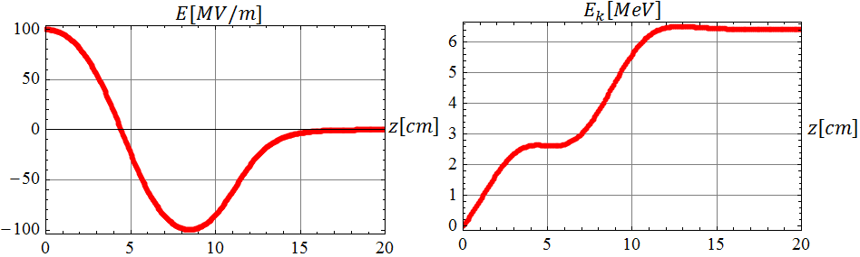
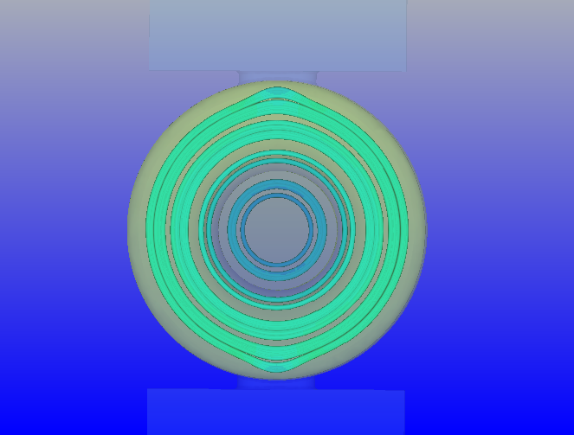
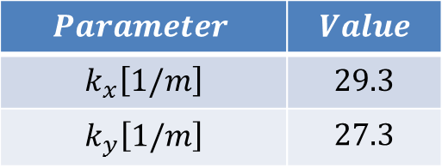
2. DB Injector RF Gun 19
2.1. RF Gun Design (Cavity Fields)
$$Parameter$$ | $$Value$$
$$k_{x}\left[1/m\right]$$ | $$29.3$$
$$k_{y}\left[1/m\right]$$ | $$27.3$$

Slide 22
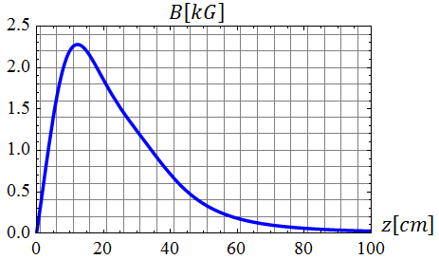
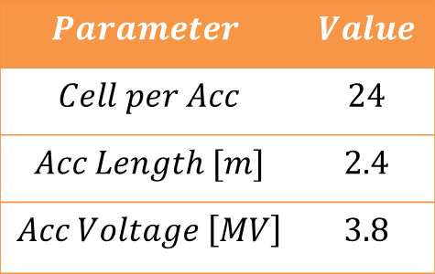
2. DB Injector RF Gun 20
2.1. RF Gun Design (Focusing Channel)
12 Accelerating Structures
$$Parameter$$ | $$Value$$
$$Cell per Acc$$ | $$24$$
$$Acc Length [m]$$ | $$2.4$$
$$Acc Voltage \left[MV\right]$$ | $$3.8$$
Envelope Equation

Slide 23

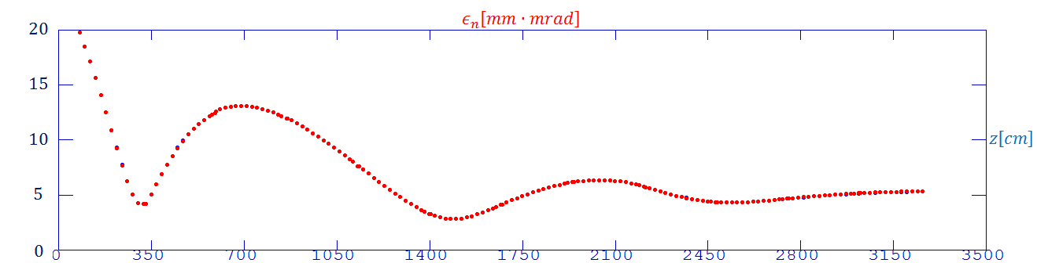
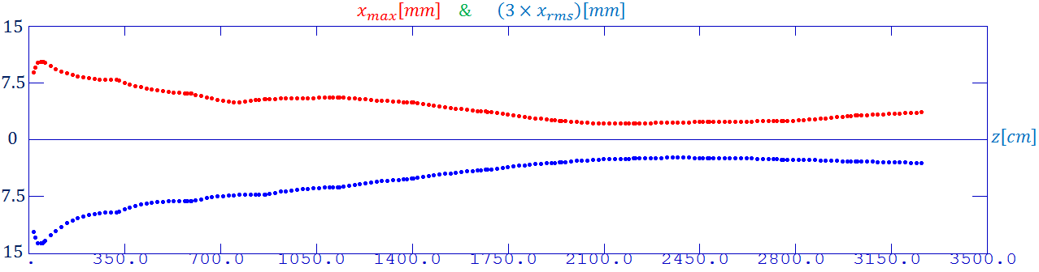


2. DB Injector RF Gun 21
2.2. RF Gun Simulations (Emittance & Envelope)
$$ε_{n}=5.26$$
$$x_{rms}=1.02$$

Slide 24
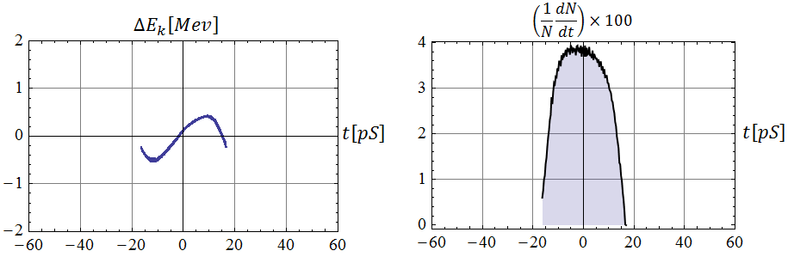
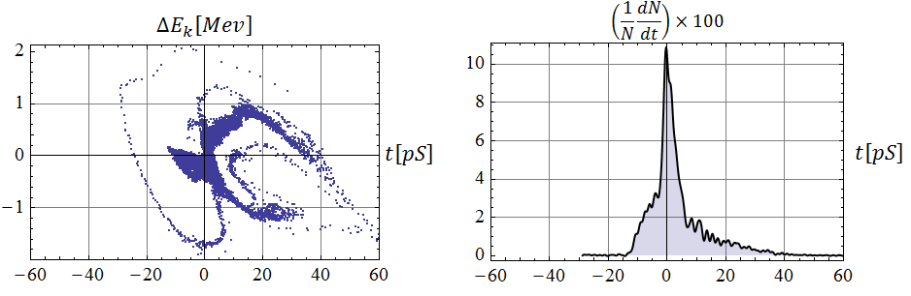
2. DB Injector RF Gun 22
2.3. RF Gun Simulations (Longitudinal Parameters )
RF
DC

Slide 25
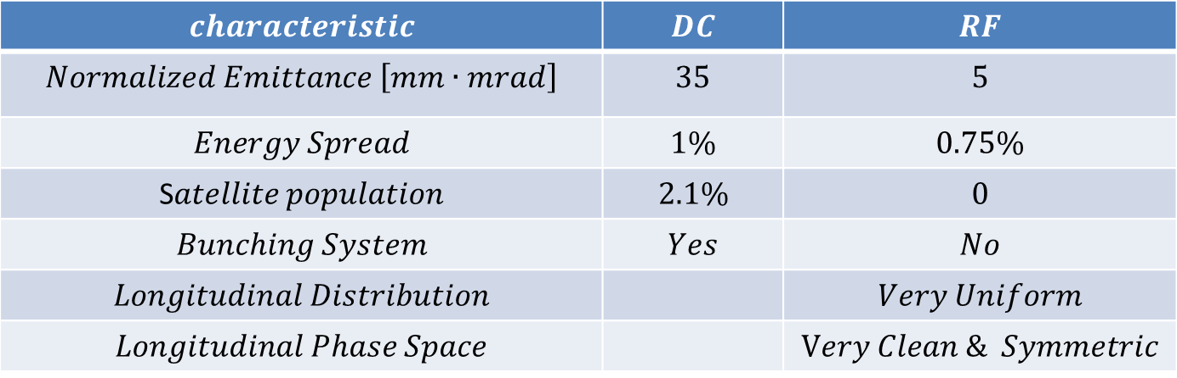
2. DB Injector RF Gun 23
2.3. Comparison
$$characteristic$$ | $$DC$$ | $$RF$$
$$Normalized Emittance \left[mm∙mrad\right]$$ | $$35$$ | $$5$$
$$Energy Spread$$ | $$1\%$$ | $$0.75\%$$
S$atellite population$ | $$2.1\%$$ | $$0$$
$$Bunching System$$ | $$Yes$$ | $$No$$
$$Longitudinal Distribution$$ |  | $$Very Uniform$$
$$Longitudinal Phase Space$$ |  | $$Very Clean \& Symmetric$$

Slide 26

Work in Progress
Thanks for Attention

