Slide 1


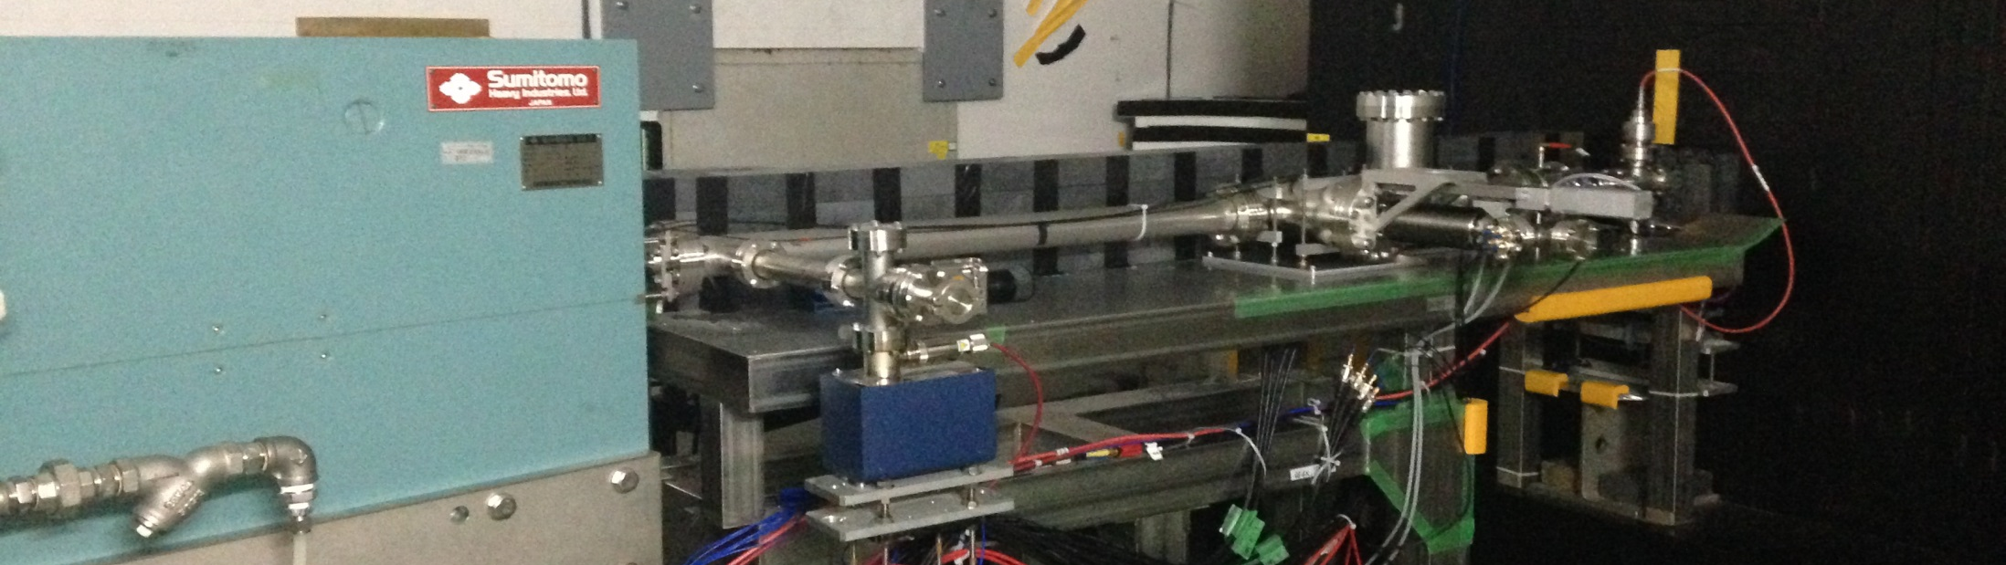











Beam Halo Measurement using Diamond Sensor at ATF2
S. Liu, P. Bambade, F. Bogard, P. Cornebise, V. Kubytskyi, C. Sylvia, A. Faus-Golfe, N. Fuster-Martínez, T. Tauchi, N. Terunuma

Slide 2
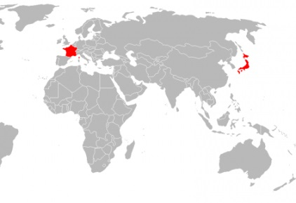
Motivations
Issues of beam halo @ATF2
Outlines
Main Goals for 2014 Run @ ATF2
Characterization of Diamond Sensor
Beam Halo Measurements
Conclusions and Prospects

Slide 3
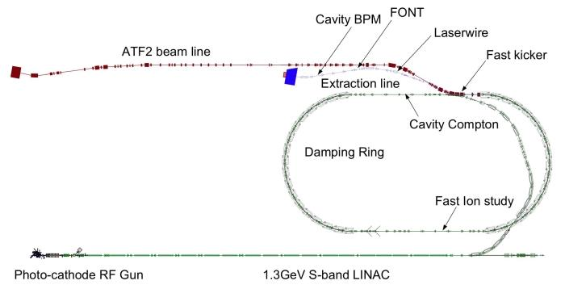
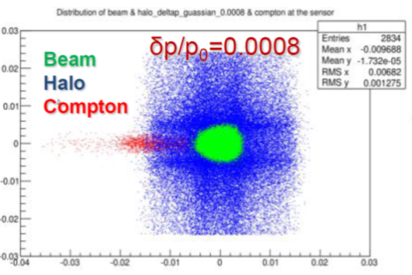
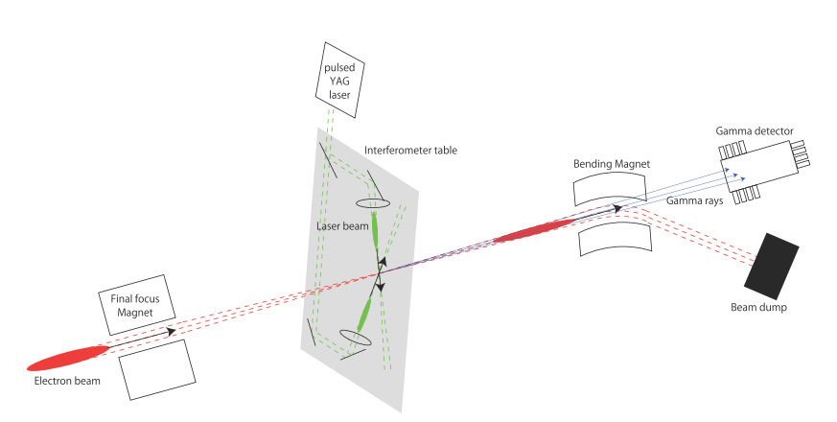
Motivations
Diamond sensor
IP
Old
Damping Ring
Shintake Monitor
Compton
Diamond Sensor
Beam halo transverse distribution unknown → investigate halo model
Probe Compton recoil electron (prepare future investigations of higher order contribution to Compton process)

Slide 4
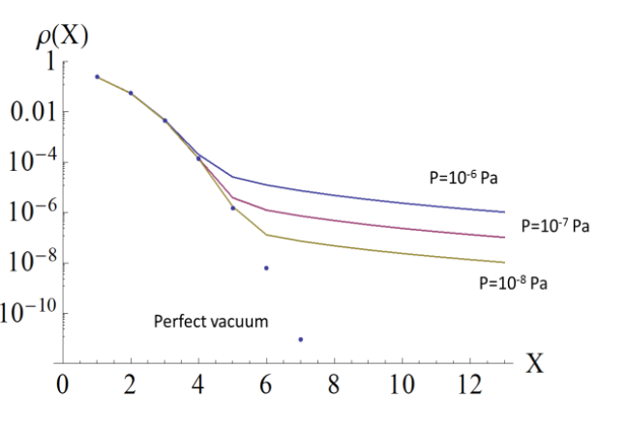
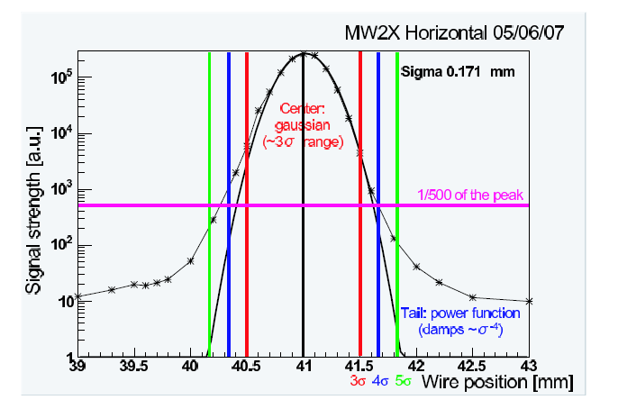
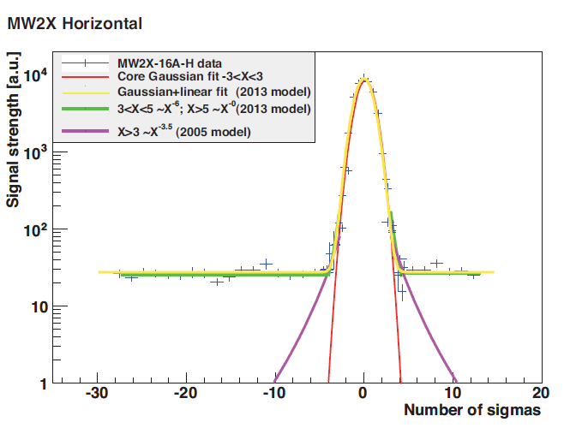
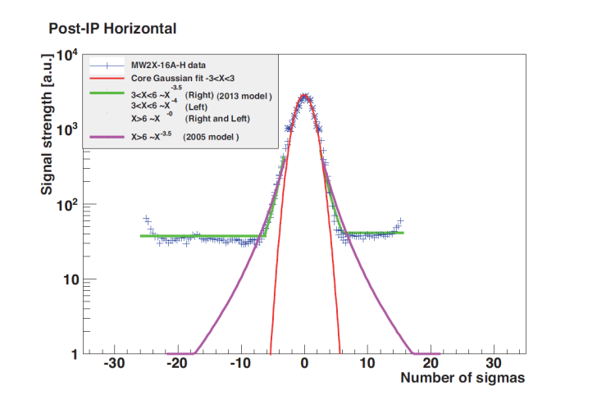
Issues of Beam Halo @ATF2
MW2X
New EXT Line
Diamond sensor
26m
Old
Post-IP WS
5m
Cherenkov detector
Damping Ring
Analytical estimation of horizontal beam halo distribution with different vacuum pressure (effect of beam gas scattering) ^{[1]}
Old EXT Line
^{[2]}
New EXT Line
Post-IP WS
16-April-2013
[1] D. Wang et al., arXiv:1311.1267v2(2014)
[2] T. Suehara et al., arXiv:0810.5467v1(2008)
[3] S. Liu, N. Fuster et al., ATF-14-01 report
4
Notes:
Measurement of beam halo distribution using wire scanner is quit limited by the background photons generated by the beam halo hitting the vacuum chamber and the apertures.

Slide 5
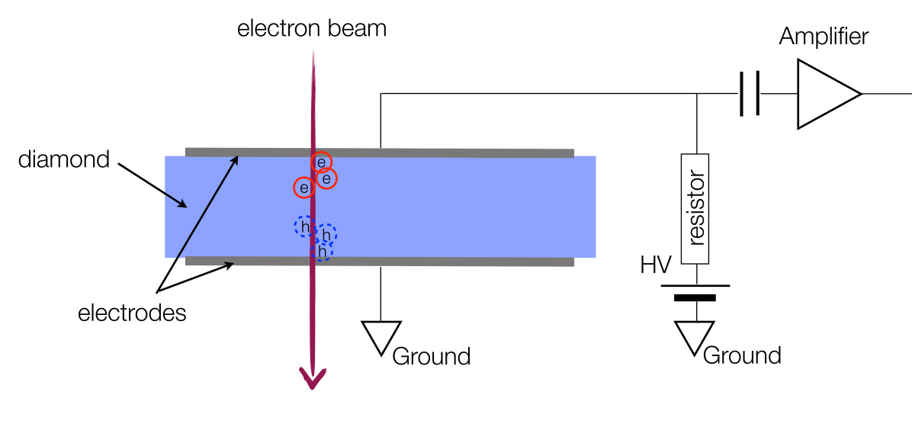
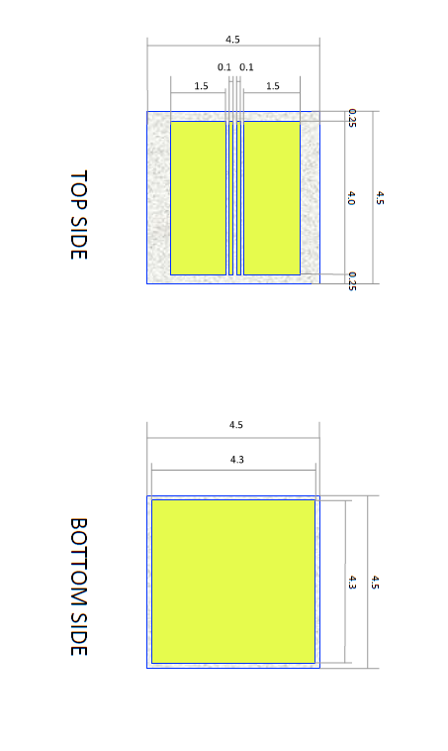
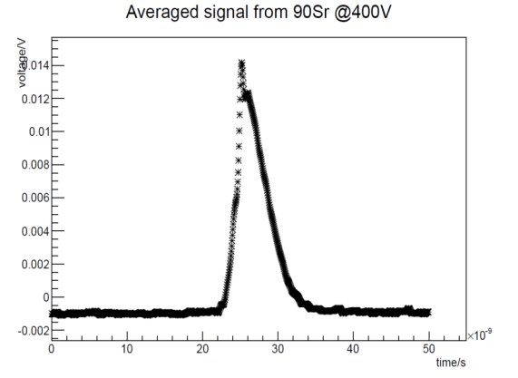
Diamond Sensor (DS) Characteristics
ADVANTAGES
electron beam
Readout
• Large band-gap⇒ low leakage current
• High breakdown field
• High mobility⇒ Fast pulse (several ns)
• Large thermal conductivity
• High binding energy⇒ Radiation hardness
HV
Charge generated by 1 MIP for 500 µm diamond (with 100% CCE): 2.88 fC
4.5mm X 4.5mm X 500µm
Dynamic range: 1 ->10⁸ e⁻
1 MIP With 40dB amplifier
 | Total N | Min.～Max. N/mm² @ DS | Charge signal/mm²
Beam | 10¹⁰ | 6.16×10⁸ | 1.6887μC
Halo | 10⁷ | 1.14×10⁴～2.24×10⁴ | 31.236pC～61.376pC
Compton | 28340 | 30～520 | 82.2fC～1.4284pC
FWHM ≈4ns
5

Slide 6
Wire Scanner
Diamond Sensor
Signal: Ionized e- hole pairs
Dynamic range:
⇒ 1～ >10⁸ e⁻ (adding amplifier or attenuator)
Possible background:
Beam halo hitting B-Dump bending magnet
⇒ can be collimated by collimators upstream
-> N.Fuster’s talk
Back-scattered neutrons from dump
⇒ slow neutrons can be separated in time
Bremsstrahlung photons
⇒ can be neglected?
Data Taking :
Different channel for beam core and halo
⇒ possible to do overall scan
Signal: Bremsstrahlung photons
Dynamic range limited by:
Background level
14 bit ADC counts
PMT high voltage
Background sources:
Beam halo hitting the beam pipe
Beam halo hitting another wire
Data Taking :
Difficult to combine data
Difficult to avoid beam position jitter

Slide 7
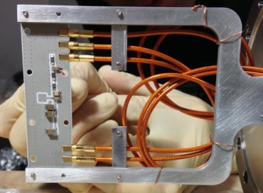
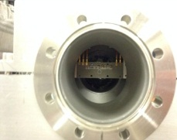
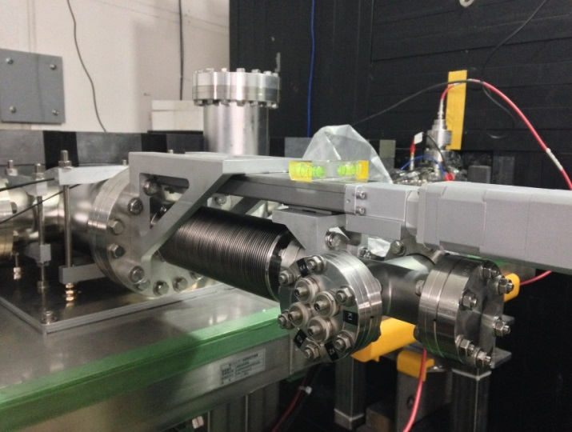
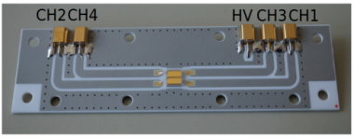
In Vacuum Diamond Sensor @ATF2
@CIVIDEC
The first Diamond Sensor is installed horizontally at ATF2 in Nov. 2014
A second unit will be installed vertically in 2015 for vertical halo measurements

Slide 8
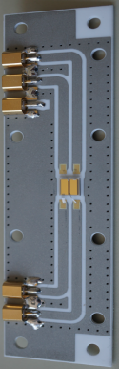
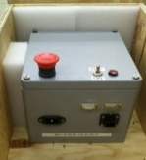

Data Acquisition System
@ Post-IP
Power supply
@ IP laser room
Diamond Sensor
Agilent 6104 Oscilloscope
4Gs/sec, 1GHz bandwidth
HV
Ethernet 1
feedthrough
5
50Ω
RG58 coax cable
2.5 m
Heliax 1/4 inch coax cable 21 m
Coax cable
0.6 m
Vacuum cable
0.64 m
CH1 CH2 CH3 CH4
Ext. Trigger
Motor control
Vacuum chamber
Ethernet 2
@ Control room
PC
Tests of the system were done with beam at PHIL (photoinjector beamline at LAL) in Oct. 2014 before installation at ATF2
Data acquisition
using Matlab
Ethernet 3

Slide 9
Main Goal for 2014 Run
Commission and characterize DS
Initial measurement of horizontal beam halo distribution
November Run (5 shifts)
December Run (6 shifts)
Pick-up study
Study of correlation between DS, ICT and BPM data
Beam core and halo scan with different HV
Background study (background signal from cables observed)
Vertical alignment (VA) applied
Tests of auto vertical range setting
Charge Collection Efficiency (CCE) study with attenuators(with different HV)
Beam halo scan for different beam intensity (1.1*10⁹,2.5*10⁹,4.9*10⁹)
Beam halo scan for different beam optics
Study the background from cables
Study the cut of beam halo by upstream apertures
First try to measure Compton recoil electrons

Slide 10
Characterization of Diamond Sensor (DS)
Lower limit of DS : pick-up study
Higher limit of DS : linearity study

Slide 11
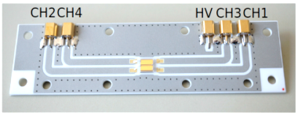
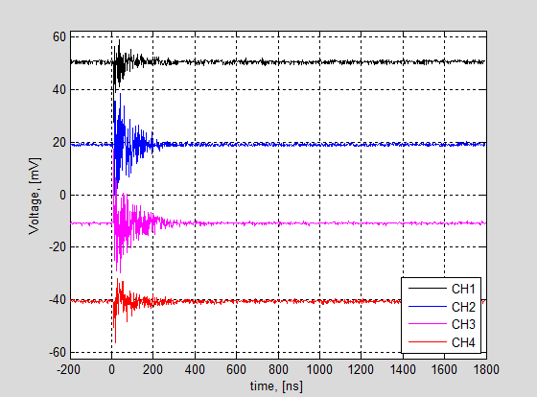
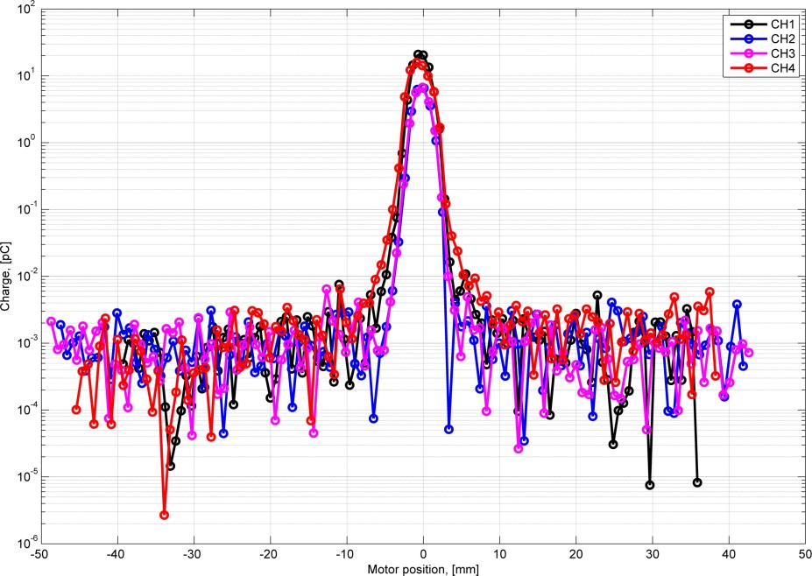
Signal Pick-up Study
Signal pick-up by the strip lines on the PCB was observed as the PCB is not shielded
Pick-up scan w/o applying HV on DS
Residual signal?
Charge, [nC]
Background from Pick-up ≈ 500 e⁻

Slide 12
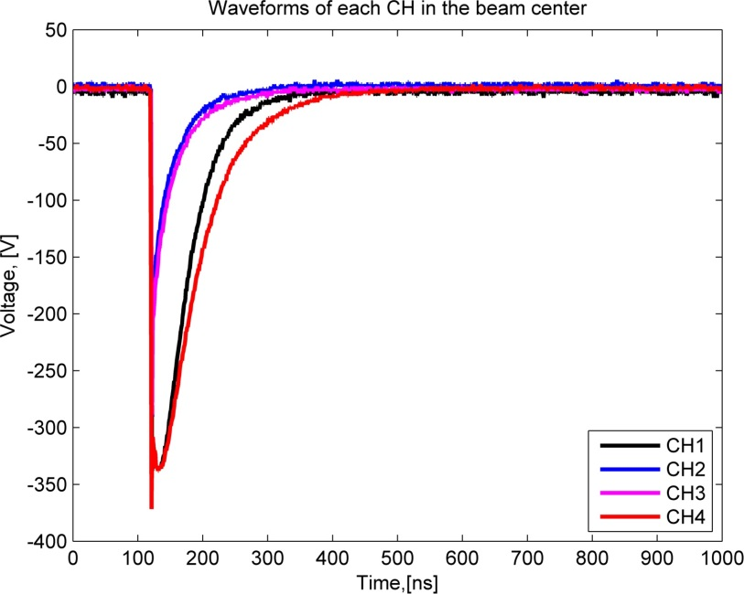
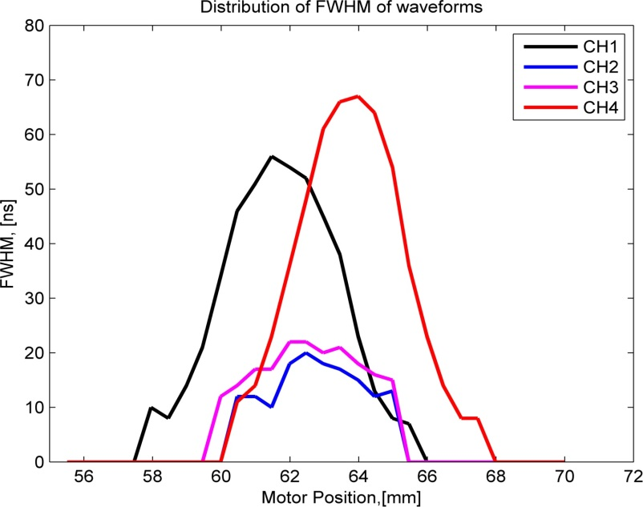
Charge Collection Efficiency
Charge collection efficiency (CCE) depends on the “effective” bias voltage (EBS) on DS
EBS = applied HV – voltage drop on the 50Ω
electron beam
Readout
Oscilloscope
50Ω
HV
HV= 400V
Typical life time of e⁻h pairs:
τ_{e,h} ≈40 ns
HV= 400V

Slide 13
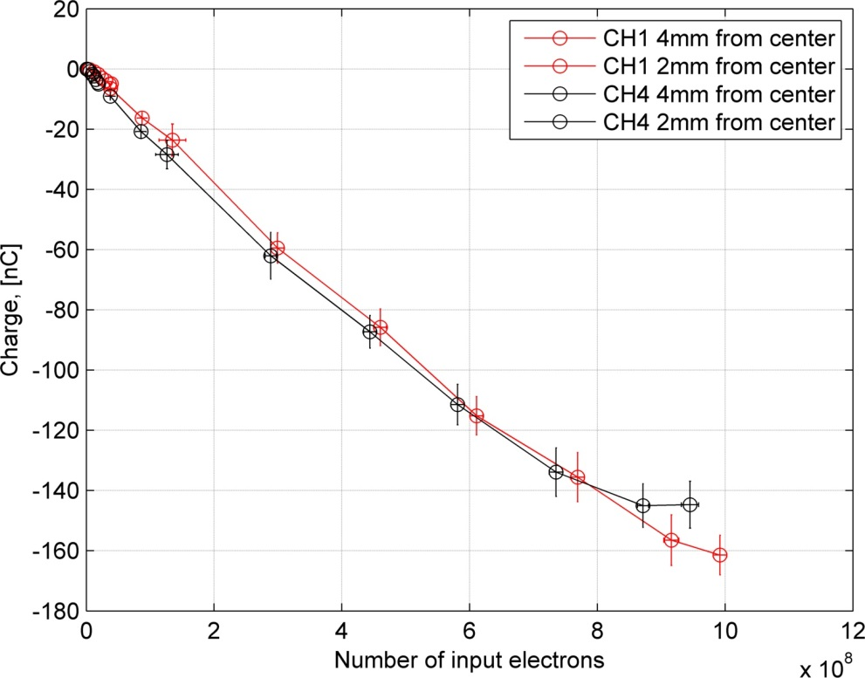
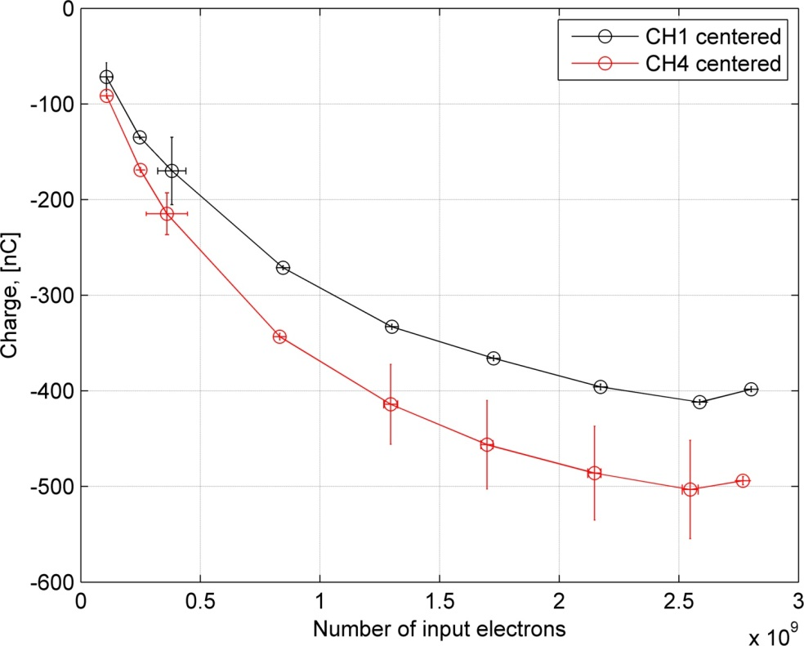
Linearity of DS Response
Preliminary
Preliminary
Response is linear when the voltage drop is not significant
In the beam core we observed an obvious non-linear response due to large voltage drop

Slide 14
Beam Halo Measurements
Beam core scan and beam core distributions
Beam size verification
Beam halo scan and beam halo distributions

Slide 15
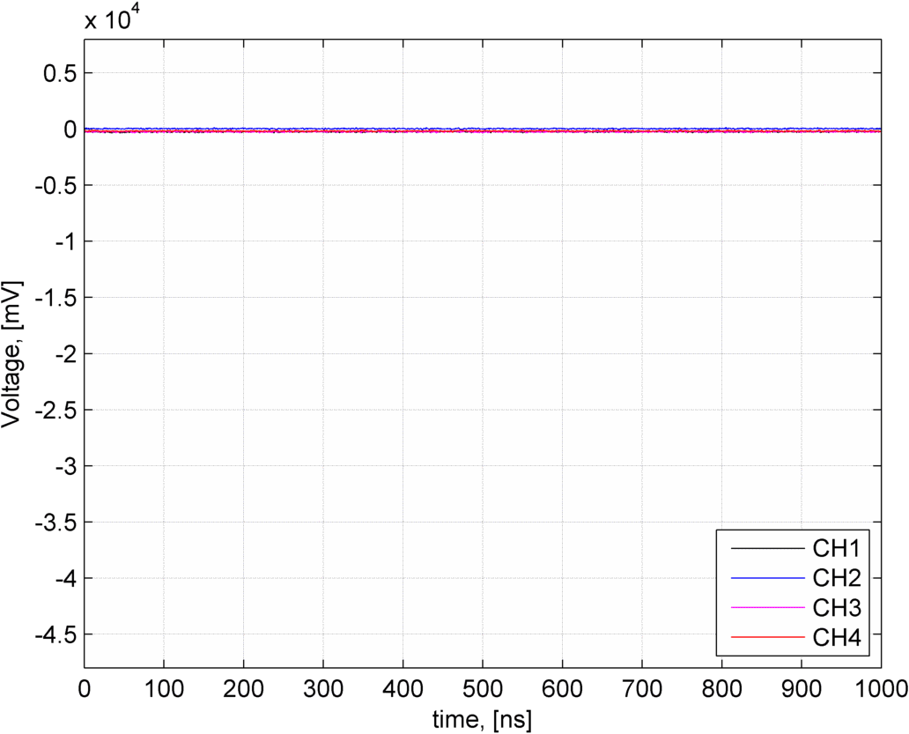
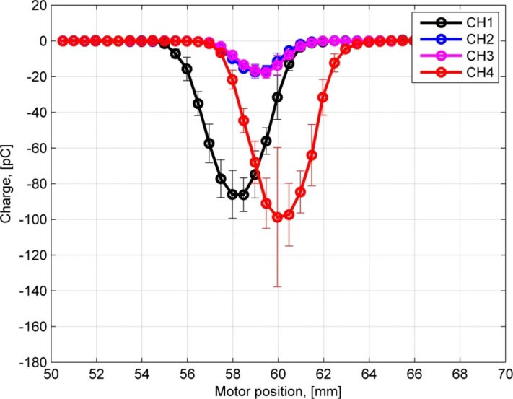
Waveforms and Integrated Charge during Scan
Charge, [nC]
Total Beam intensity: 1.2*10⁹
Voltage on DS: -40V
Collected charge during beam scan
The beam core is scanned by DS by applying low voltage
The charge of waveform at each position is integrated to get the distribution

Slide 16
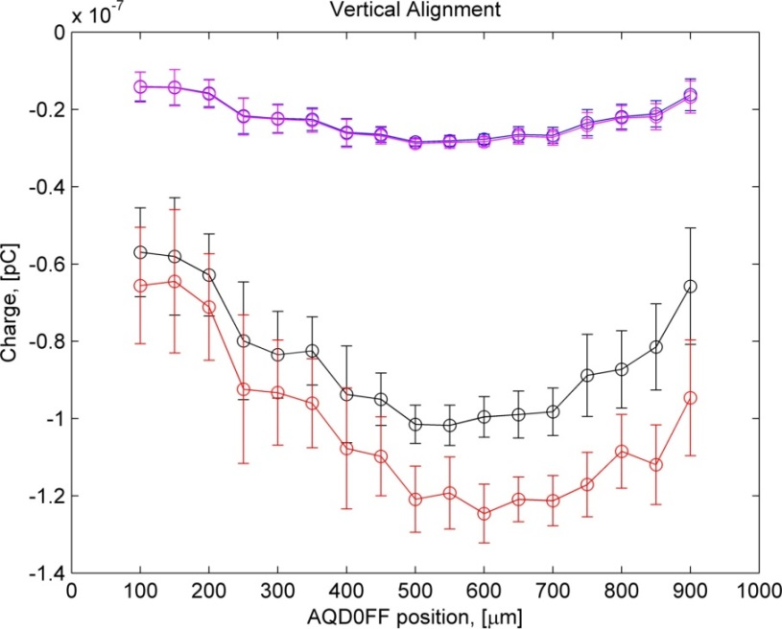
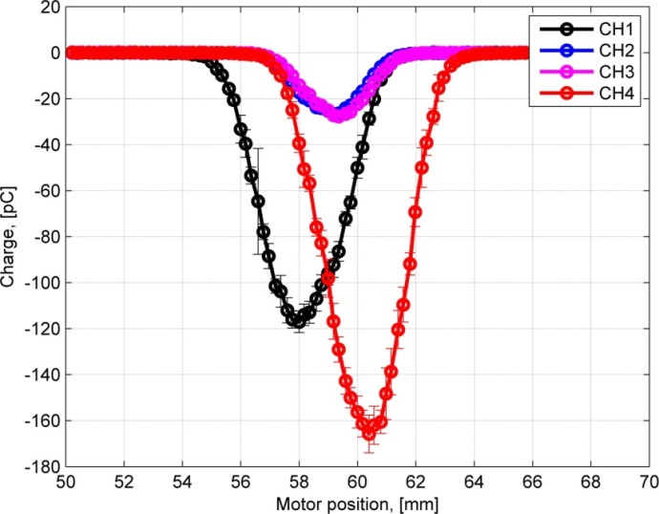
Beam Core Scan
Vertical Alignment
Before Alignment
Charge, [nC]
Charge, [C]
After Alignment
Charge, [nC]
We move the AQD0FF magnet mover vertically to find the max. charge collected on DS

Slide 17
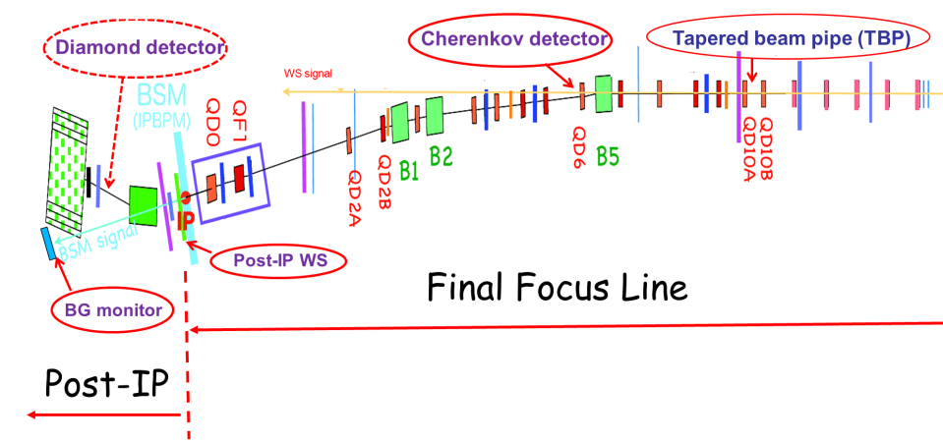
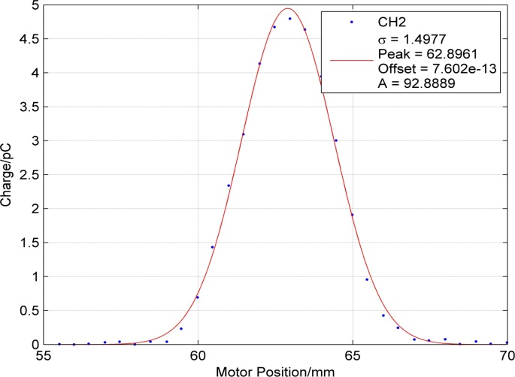
Beam Size Verification
12-12-14 data
 | BX10BY0.5 (12-12-14)
 | σ_{x} (m) | σ_{y} (m)
Post-IP WS calculated | 1.564e-04 | 2.892e-04
Post-IP WS measured | 2.174e-04 | 5.57e-04
DS calculated | 1.394e-03 | 1.787e-03
DS expected | 1.938e-03 | 3.442e-03
DS measured (CH2) | 1.498e-03 | Non
Vertical beam size is extrapolated from the Post-IP WS measured beam size

Slide 18
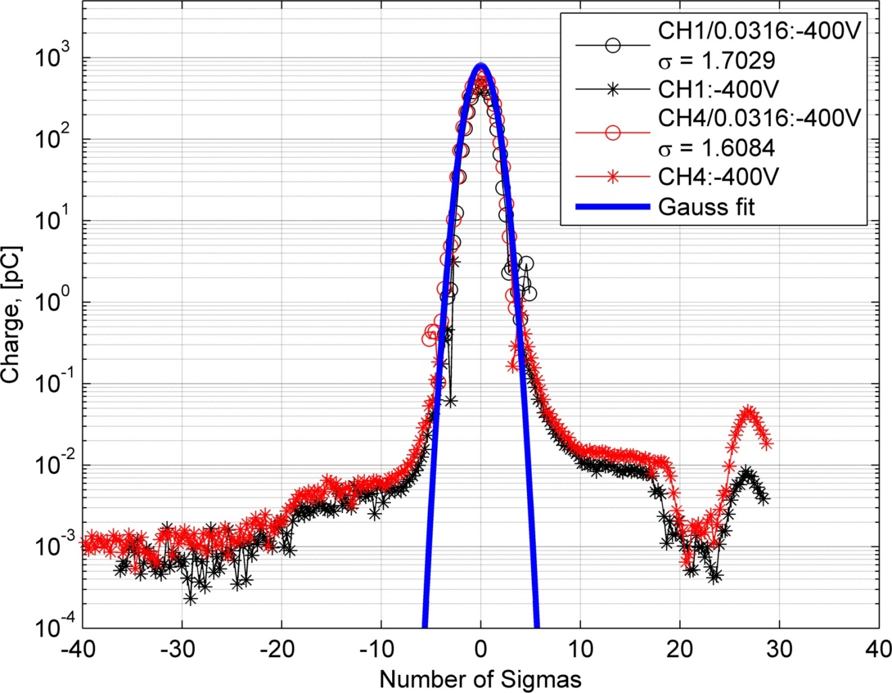
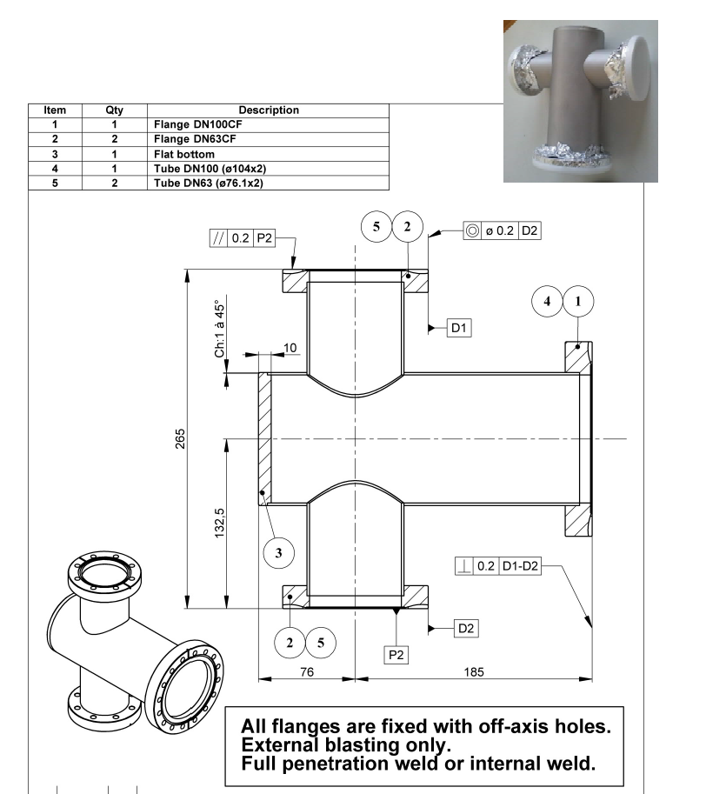
2014/12/18 - Day Shift
Beam Halo Scan
Present Dynamic
Range: 10⁶
Preliminary
Charge, [nC]
Low Energy (LE)
High Energy (HE)
HE
LE
76mm
65mm

Slide 19
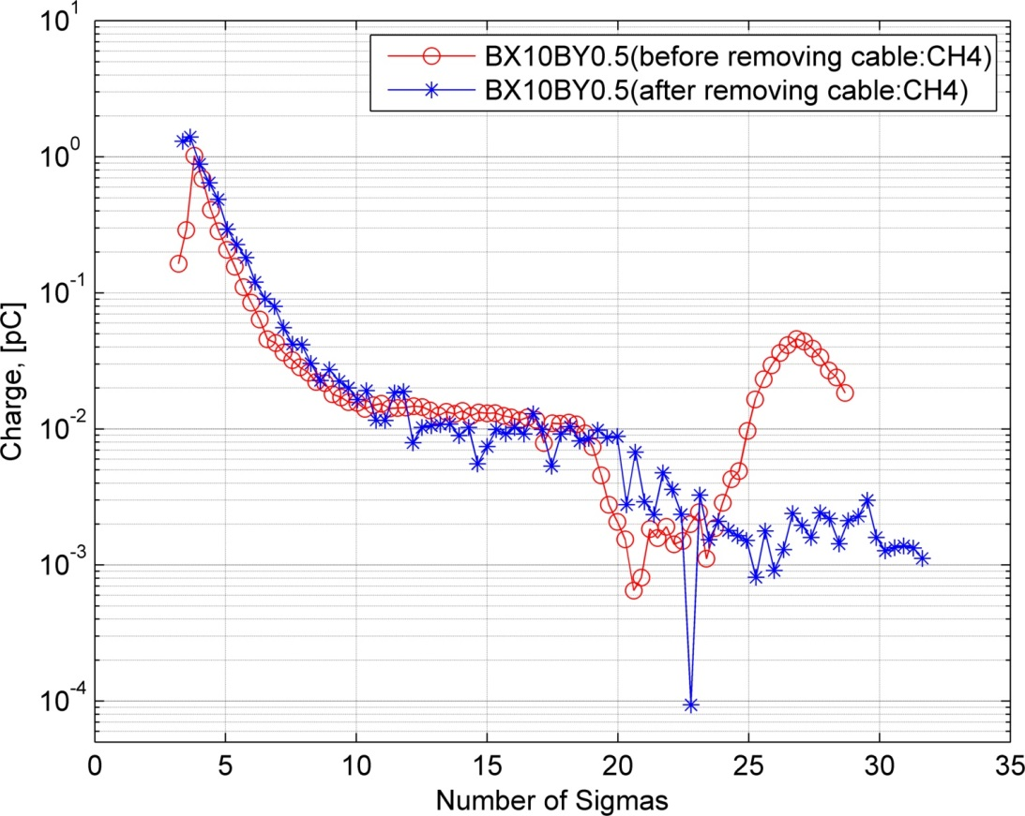
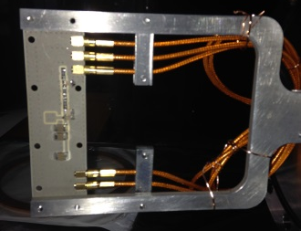
Issue with cables
Before
Before fixing
After
After fixing

Slide 20
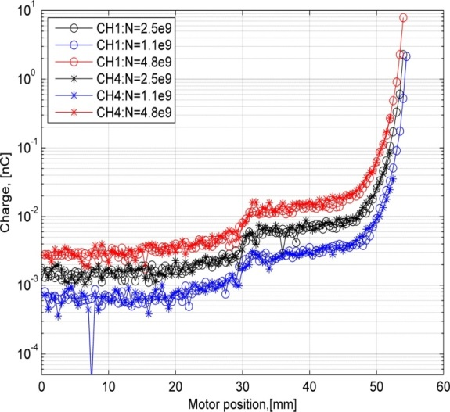
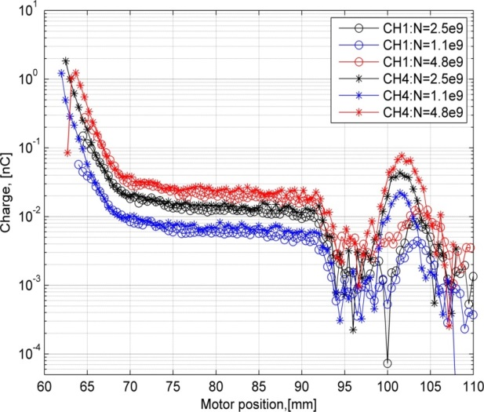
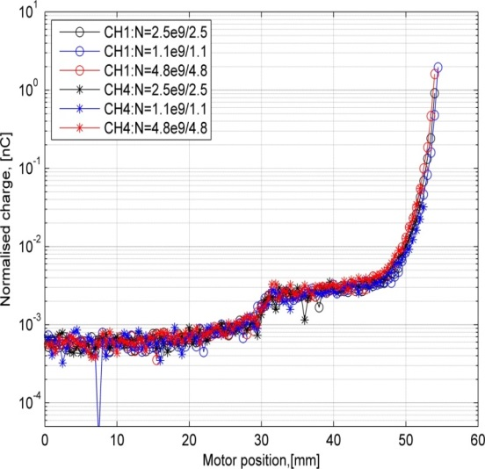
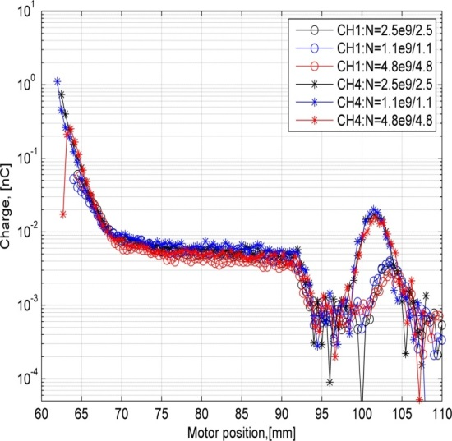
Beam Halo Distribution for Different Beam Intensity
Before Normalization
Measurements were done for BX10BY0.5 optics with
N= 1.1*10⁹,2.5*10⁹,4.9*10⁹
After Normalization
No change in horizontal beam halo distribution was observed
-> We expect to see the changes on the vertical beam halo distribution

Slide 21
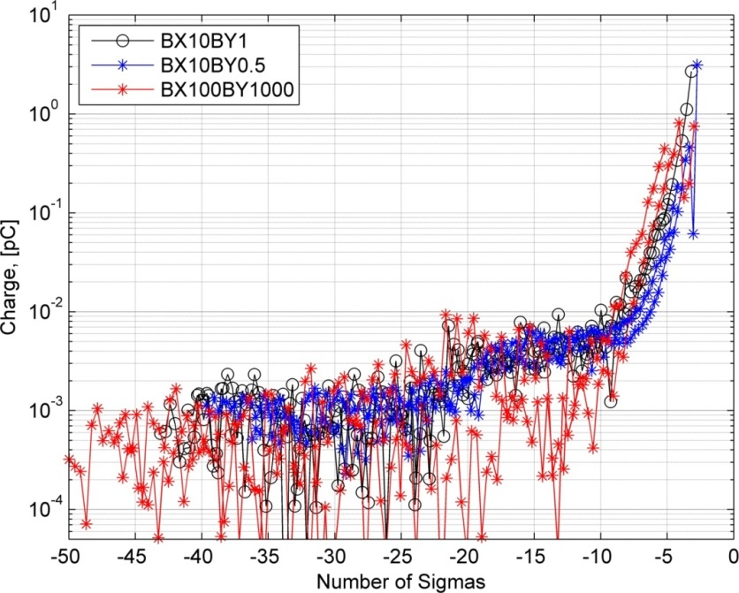
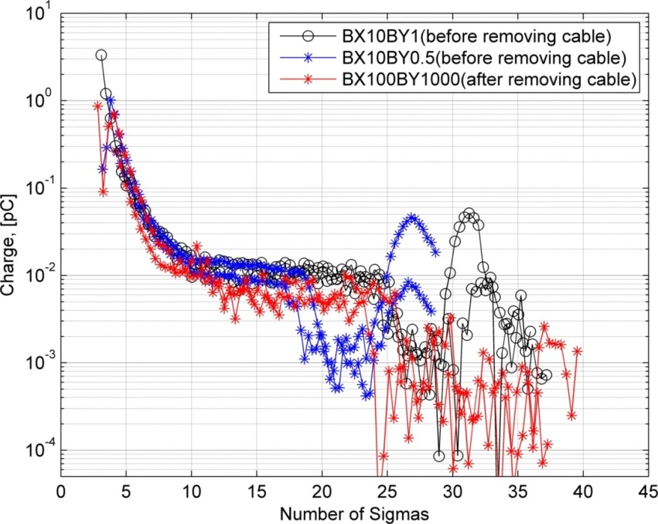
Beam Halo Distribution for Different Optics
Preliminary
No obvious change observed in the horizontal beam halo distribution between BX10BY1 and BX10BY0.5 optics
For BX100BY1000 optics, beam halo seems less than other optics -> binning is needed

Slide 22
Conclusions and Prospects
In Nov. and Dec. Run at ATF2 we performed:
Studies to characterize the in vacuum DS performance
Initial measurements of horizontal beam halo distribution
We can use DS to scan both the beam core and beam halo with a dynamic range of 10⁶ (from 5*10² to 5*10⁸ e⁻) with a 30dB attenuator -> saturation of charge collection will be studied in detail-> improvements on the PCB (shielding etc.) will further improve the dynamic range
Horizontal beam halo distribution was measured -> will be compared with the measurements done in 2013 using the Post-IP WS -> will be useful to see effects from collimators soon to be installed
Asymmetry of horizontal beam halo distribution was observed -> origin of this asymmetry will be studied
Dependence on beam intensity and beam optics will be checked for the vertical beam halo distribution using the 2nd unit of DS -> will be installed in April 2015
Further study to check the possibility of measuring Compton recoil electrons is ongoing

Slide 23
Thank you!

Slide 24
Back up …

Slide 25
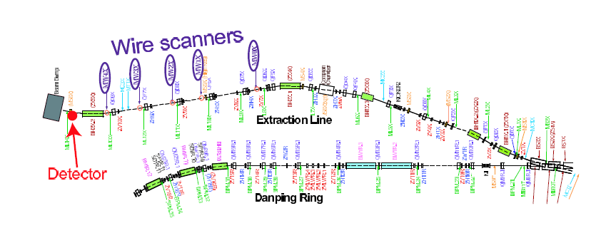
High Energy (HE) side
Asymmetry of Horizontal distribution
Old ATF2 line in 2007
Low Energy (LE) side
HE
LE
We can see the asymmetry of horizontal beam halo distribution from the data taken in 2007

Slide 26
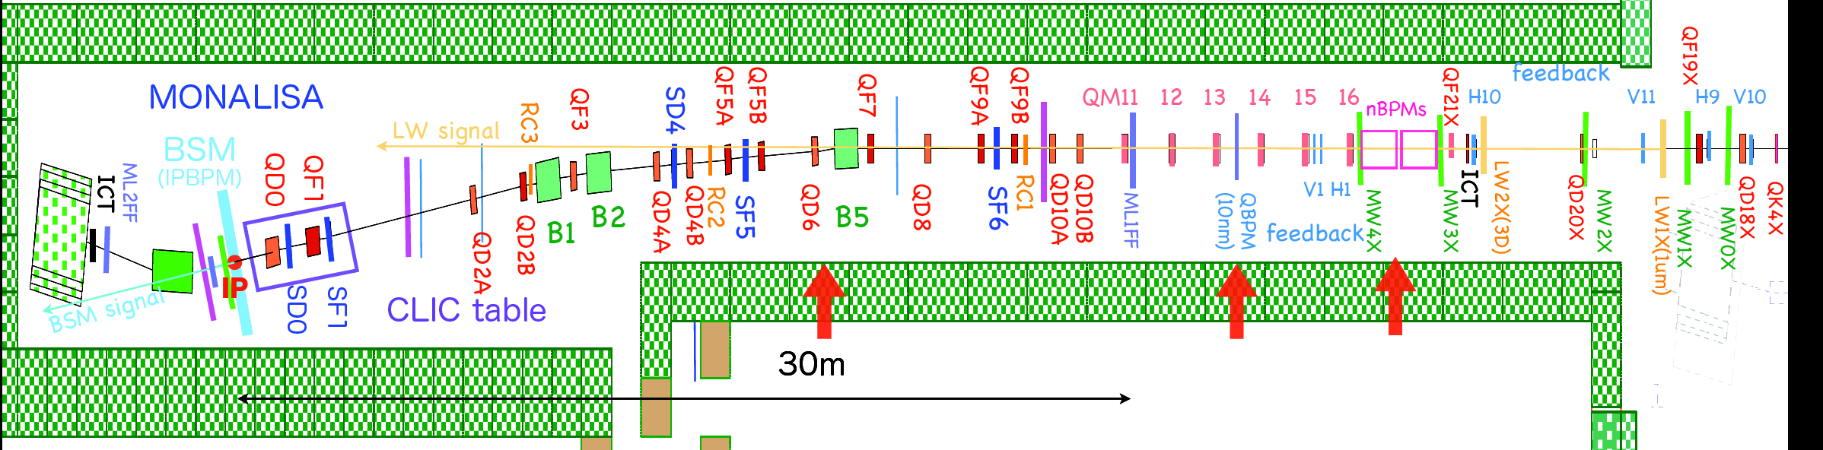
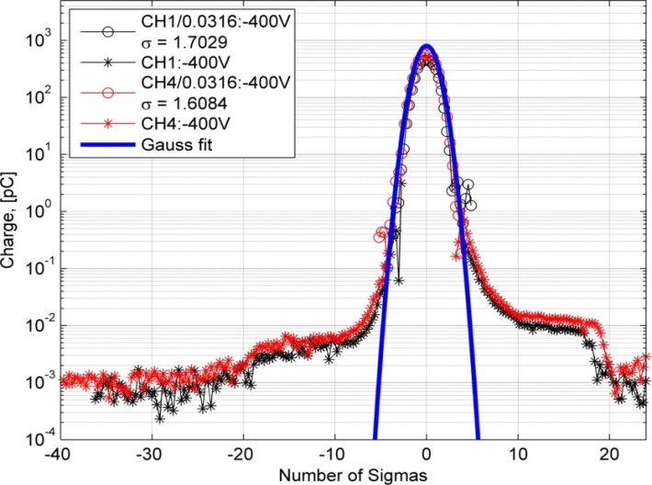
Asymmetry of Horizontal distribution
LE side
HE side
Cherenkov detector
Tapered beam pipe (TBP)
Diamond Sensor
WS signal
Post-IP WS
HE side
LE side
Post-IP WS 16-April-2013
Diamond sensor 18-Dec-2014
This asymmetry was observed also in the data taken in 2013 using Post-IP WS and in 2014 using DS
HE
LE
Charge, [nC]
LE
HE

Slide 27
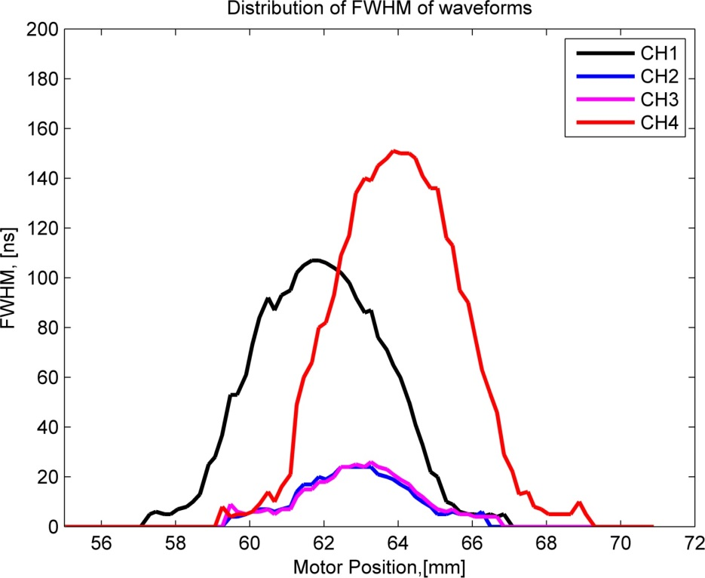
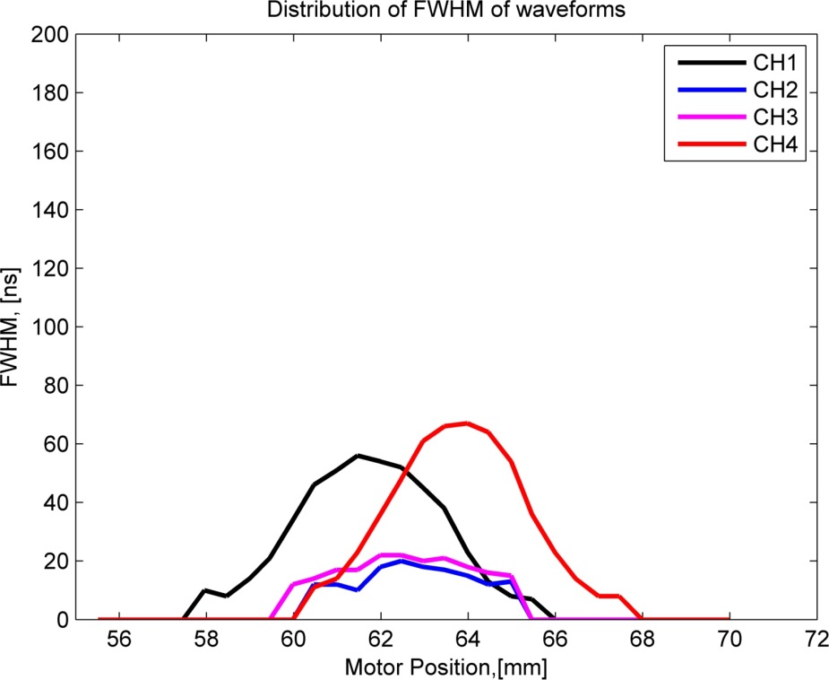
Signal FWHM distribution
Typical life time of e⁻h pairs^{[1]} : τ_{e,h}≈40 ns
HV= 40V
HV= 400V
τ_{e,h}
Hecht formula: ${CCE}^{[2]}=\frac{τ_{e,h}}{t_{tr}}(1−e^{−\frac{t_{tr}}{τ_{e,h}}})$ =($μτ_{e,h}V/d^{2})[1−e^{−d^{2}/μτ_{e,h}V}$]
[1] H. Pernegger et al., J.Appl.Phys. 97, 073704(2005) [2] M. Pomorski et al., phys. Stat. sol. (a) 203, No. 12 (2006)

Slide 28
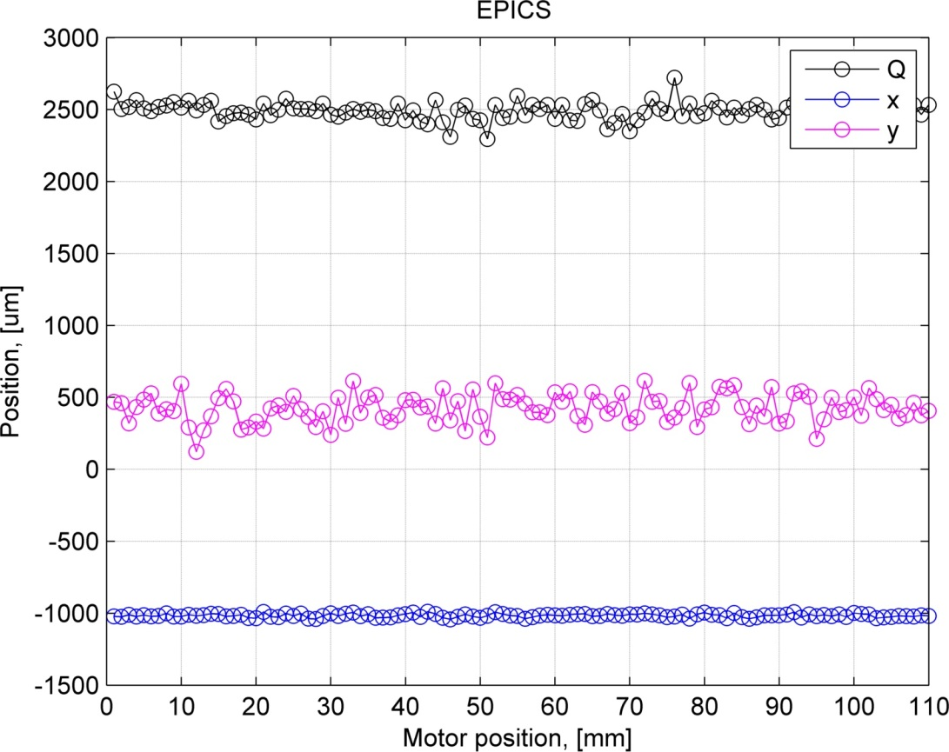
Information from ICT and BPMs
ICT correction and beam position jitter (4-6 µm) can be taken into account in data analysis
We read the data from Epics via SSH, but it is possible to use Labca to get data directly from Matlab
In the future we can also input data from DS to the Epics system
ICT after IP, [10⁶ ]
BPM after IP on X
BPM after IP on Y

Slide 29
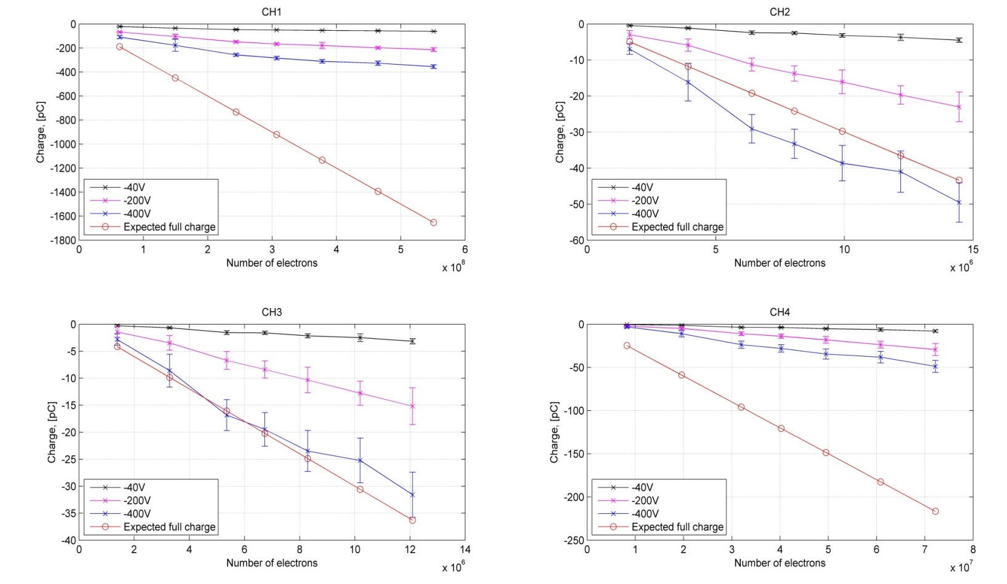
Charge Collection Efficiency

Slide 30
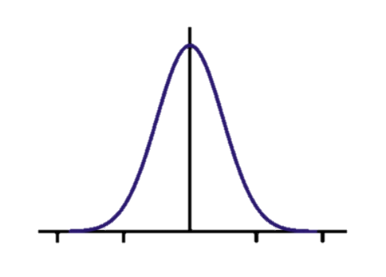
Beam Core Scan
Scan direction
Signal at each channel is a convolution of beam (Gaussian) with strip (rectangular shape)
Fit function: F(d1,a1,b1,s1) = d1+a1*(erf(((x+0.75-b1)/(sqrt(2)*s1)))-erf(((x-0.75-b1)/(sqrt(2)*s1))))

Slide 31
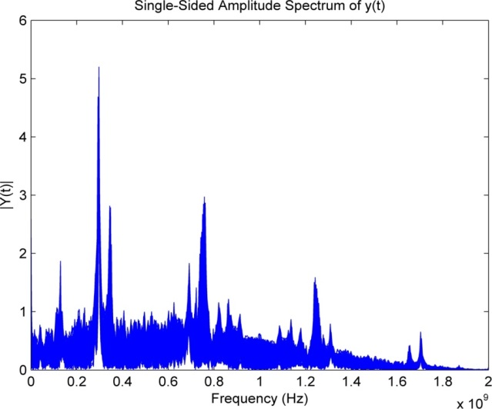




FFT of Pick-up
1-20mm
20-50mm
Asymmetry in frequency domain observed
70-90mm
90-110mm
50-70mm
(center)

Slide 32




Background from cables
Cable 1
2
3
Move the beam step by step
Cable 2
Cable 3
Cable 1

Slide 33

Expected signal (400V)
 | CH1 | CH2 | CH3 | CH4
Measured σ_{x} | 1.70 mm | 1.49 mm | 1.53 mm | 1.61 mm
Ratio of collected e- | 13.34% | 1.04% | 1.02% | 14.07%
Expected full charge (3fC/MIP) | 1.88µC | 147.21nC | 143.68nC | 1.98µC
Max. charge collected | 442.72nC | 151.79nC | 158.11nC | 600.8nC
Corresponding CCE | 23.55% | 101% | 101% | 30.35%
Scan_Run60_12-12-2014_143616_core_400V
Data taken with 30dB attenuator
Total e- number: 4.8*10⁹

Slide 34


Compton recoil electrons study
2014/12/20 - OWL Shift
2014/12/18 - DAY Shift
Charge, [nC]
Charge, [nC]
Perform simulations in CAIN and Mad-X for different optics
Compare the estimated signal level with the background/pick-up signal level

Slide 35



