Slide 1
ATF2 Progress Report
For CLIC Workshop 2015.01.28.
Kiyoshi KUBO

Slide 2
Goals of ATF2 +α
Achievement of 37 nm beam size (Goal 1)
  Demonstration of a compact final focus system based on local chromaticity correction
Control of beam position (Goal 2)
  Demonstration of beam orbit stabilization with nano-meter precision at the IP
    Establishment of beam jitter controlling techniques at the nano-meter level with an ILC-like beam
Understand (and solve, if possible) beam size intensity dependence
  Goal 3 or Goal 1.5(?):
Other studies:
Lower betay* (mainly for CLIC)
Ground motion – orbit feedforward
Development of instrumentations (beam monitors)
etc.

Slide 3
Status for Goal 1
Reported in IPAC14 and ICHEP14
No significant improvement in Oct.-Dec. RUN (Mainly dedicated to IPBPM commissioning, intensity dependence studies, etc.)
44 nm (or smaller) beam size confirmed (design: 37 nm) at low intensity (June 2014).
  Average of 10 consecutive measurement, with 3 nm standard deviation. (Showing the level of the stability.)
Small beam can be achieved repeatedly and quickly, even after machine shutdown.
Local Chromaticity correction was demonstrated.
  (Without chromatic correction, beam size is ~450 nm.)
Strong intensity dependence was observed. (It had not been expected.) → Goal 3 or 1.5

Slide 4
Presented in IPAC14
History of measured minimum beam size
Still being improved.

Slide 5
Presented in IPAC14
Beam Size Tuning
after 3 weeks shutdown
Small beam (~60 nm) observed
~32 hours from operation start
~10 hours of IP beam size tuning
Beam Size Tuning
after 3 days shutdown
Small beam (~60 nm) observed
~16 hours from operation start
~8 hours of IP beam size tuning
σ_{y} (nm)
Time (hours) from Operation Start after 3 Weeks Shutdown
Week 2014 April 7
Week 2014 April 14

Slide 6
Data of Last Week before summer 2014
Presented in IPAC14
IPBSM Modulation
(174 degree Crossing angle)
Beam Size Evaluated from Modulation
(no systematic error assumed)
Mean: 0.58
Standard dev.: 0.05
Mean: 44 nm
Standard dev.: 3 nm
Bunch charge ~ 0.16 nC

Slide 7
Smallest observed size was 44 nm. Why not 37 nm?
Beam was jittering?
  Upstream measurement indicate orbit jitter 15~30% of nominal beam size. (37 → ~39 nm, if 30% rms jitter)
  Oscillation of Final Doublet quads caused beam position jitter at IP. (37 → 39.8 nm till summer 2014, 37 → 38.3 nm now)
  Effect of wakefeild even at low intensity (37 → ~39 nm)
Beam size monitor was not accurate enough?
  Stability of interference fringe phase, intensity, etc.? (next talk)
Problem of optics?
  Quality, or stability of magnetic fields of magnets?
  etc. ?

Slide 8
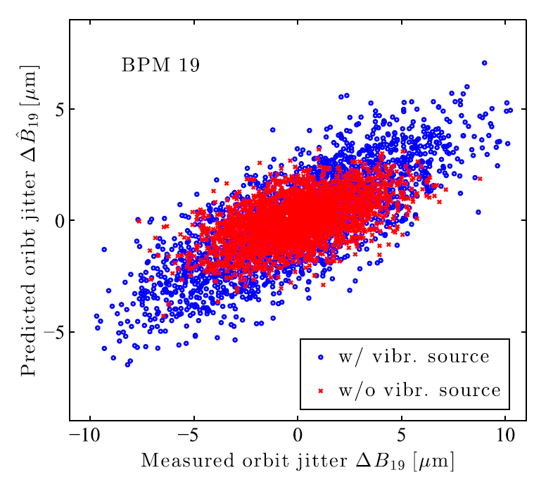
QF1X, QD2X magnets vibration reduced
Large vibration of the first two quad magnets in Extraction Line was induced by a cooling water pipe.
Vibration reduced and beam orbit jitter significantly reduced. (amplitude factor ~0.7)
Effect to IP position jitter ?
Will be Reported in following
talk(s) on Ground Motion Study.
Orbit jitter before and after
J. Pfingstner, et.al.,
Phys. Rev. ST Accel. Beams 17, 122801

Slide 9
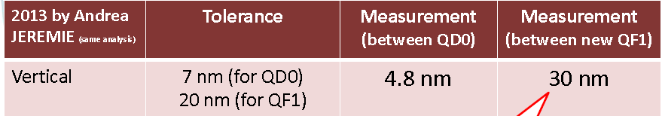
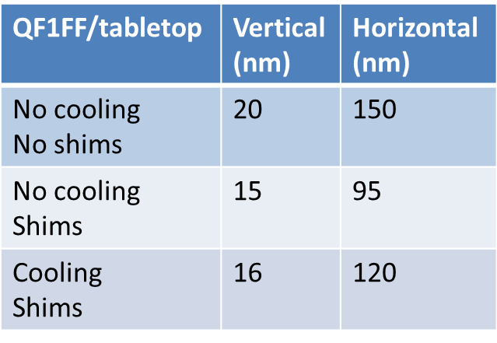
QF1FF magnet vibration reduced
2013: New QF1 vibration was large
A.Jeremie 2013.8.30
ATF2 meeting
2014 summer: Shims inserted for more stable (rigid) support
Improvemenr in summer 2014
 | QD0 | QF1 | FD Total
Vibration | 4.8 | 30 | ---
Effect to beam at IP | 7.3 | 12.6 | 14.6
Vibration | 4.8 | 16 | ---
Effect to beam at IP | 7.3 | 6.7 | 9.9
A.Jeremie 2014.12.2
Third JCL (Journées Collisionneur Linéaire)

Slide 10
Intensity Dependence – Wakefield?
Before summer 2014
Beam size at IP strongly depend on bunch intensity
Various efforts to reduce wakefield (bellows shield, removal of unused structures, moves of structures from high beta to low beta region): No clear improvement.
Theoretical and Experimental estimation of wakefield strength of some structures (cavBPM, Bellows): experiments showed factor ~2 stronger wake than calculations.
Found wake field of OTR monitor chamber affected beam size and orbit.

Slide 11
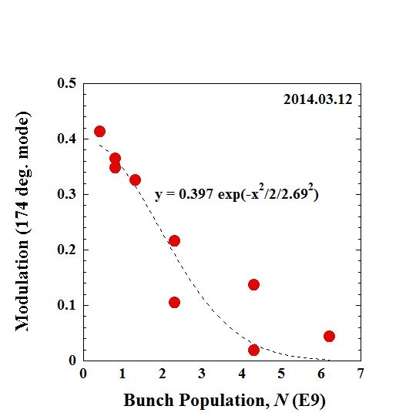
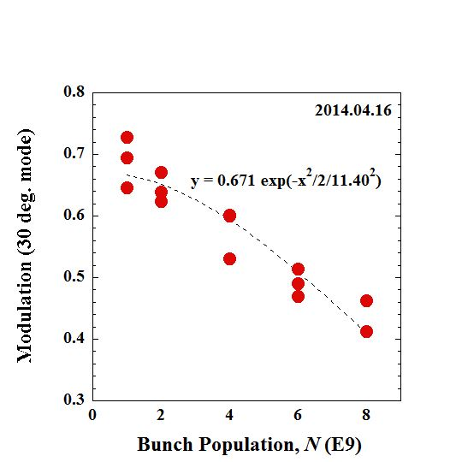
Presented in IPAC14
Beam Size Depends on Bunch Intensity
IPBSM modulation as function of bunch population. Measured with crossing angle 174 degrees (left) and 30 degrees (right).

Slide 12
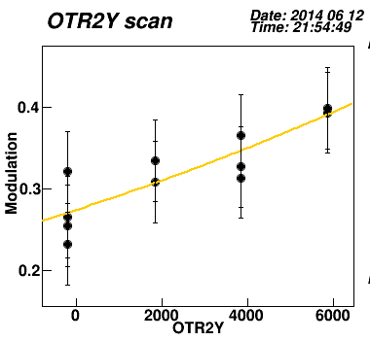
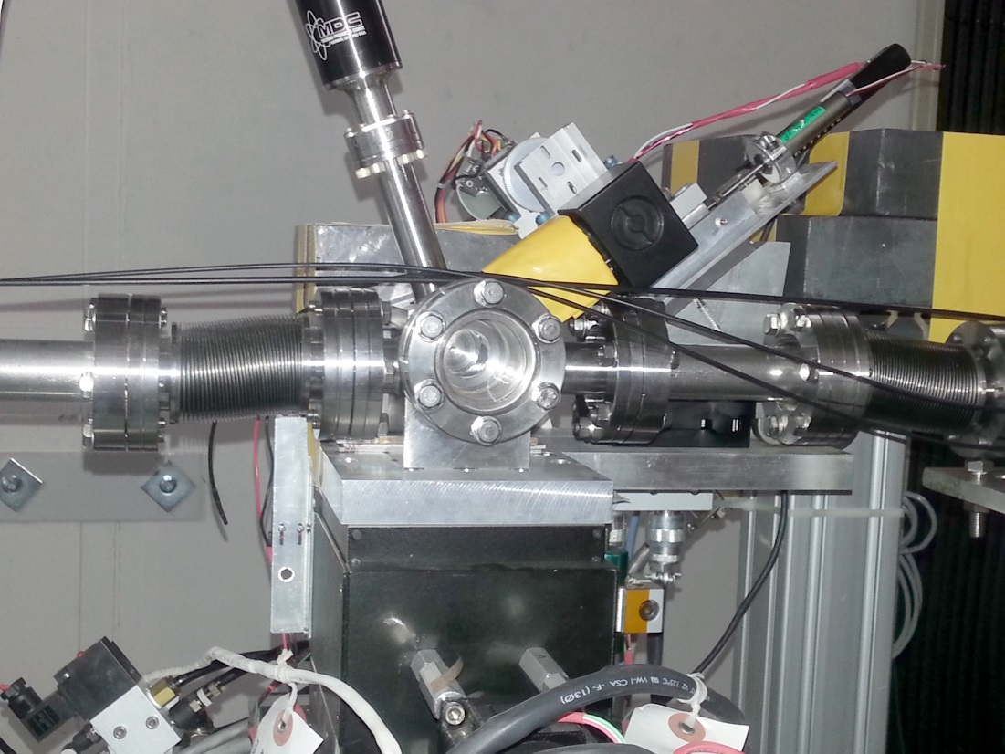
Effect of OTR monitor chamber (beam size monitor in EXT line) to IP vertical beam size was found (June 2014)
IPBSM 174 degrees
N~3E10

Slide 13
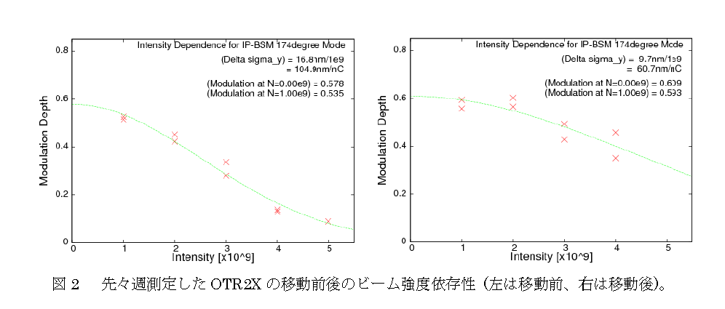
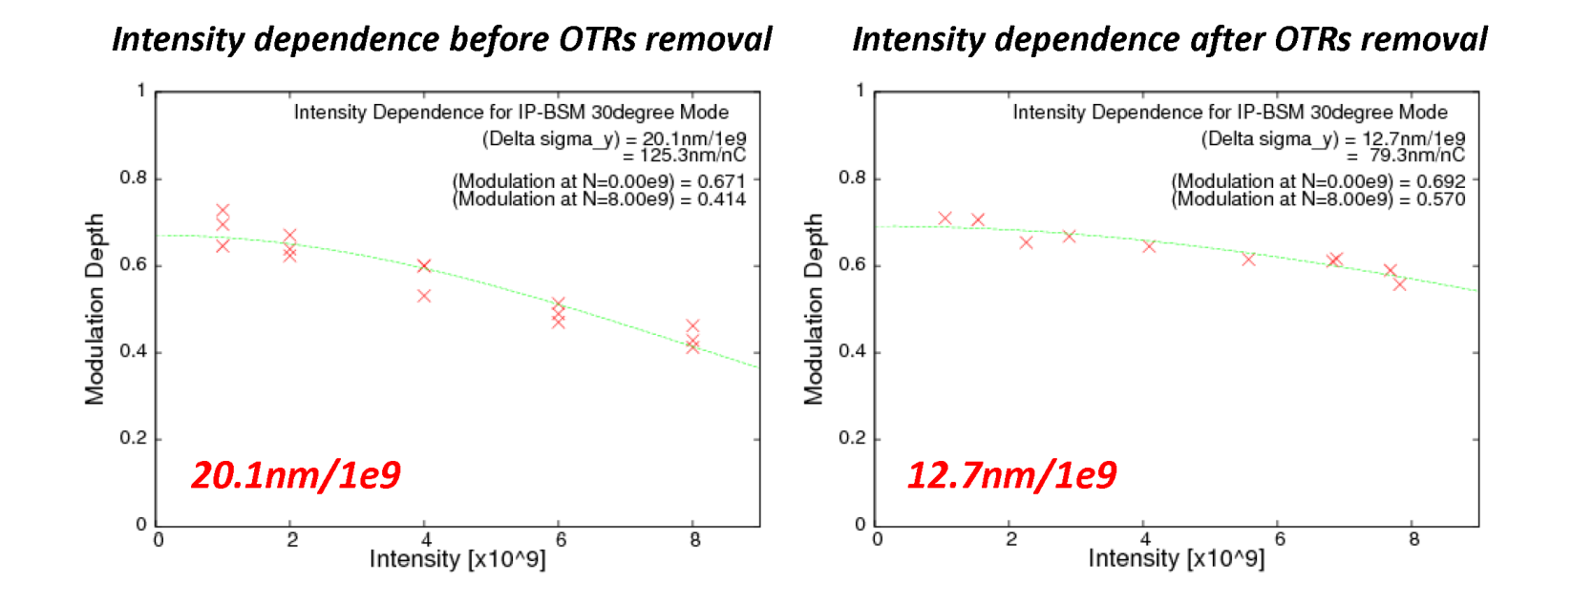
Before OTR2X position optimization After optimization (174 deg mode)
By Okugi, 2014.6.23
16.8 nm/1e9 → 9.7 nm/1e9
Removal of all OTRs
(30 deg mode)
Okugi, 2014.6.26 ATF Op. meeting
20.1 nm/1e9 → 12.7 nm/1e9
30 deg mode tend to give stronger dependence than 174 deg mode.
Slide by K.Kubo in ATF operation meeting Nov 7, 2014

Slide 14
Intensity Dependence – Wakefield
Oct-Dec, 2014
Improved symmetry of OTR monitor chamber
  Operation with better chamber position
Orbit – Intensity correlation data
Wakefield Free Steering test (later talk)

Slide 15
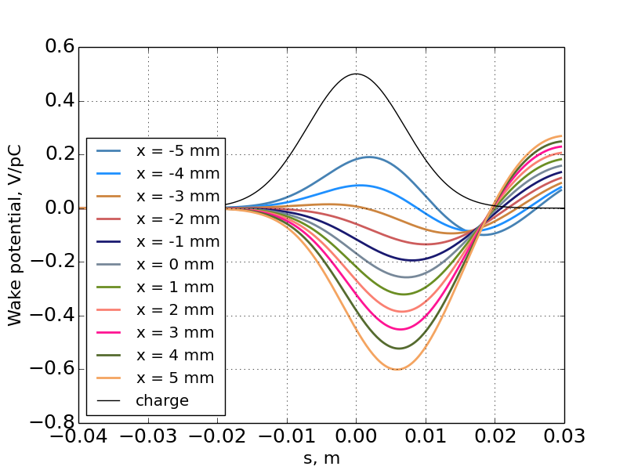
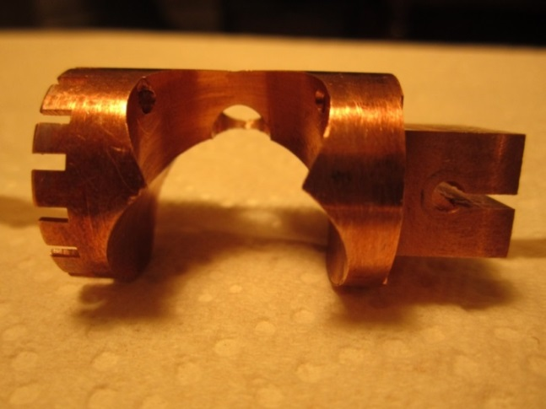
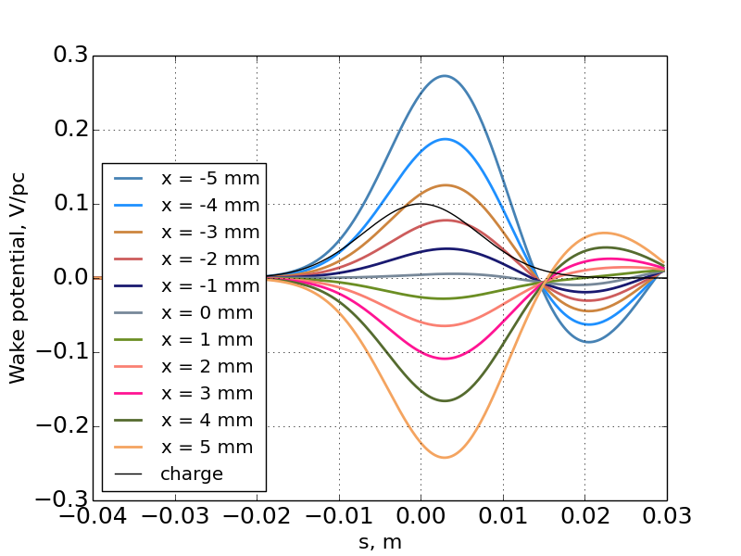
OTR monitor View Port Shield
No shield
by A. Lyapin
Photo by D. McCormick
With shield
Remove vertical asymmetry
Reduce position dependent wake
(factor 0.6)
by A. Lyapin

Slide 16
OTR Chamber wake
Significant effect of OTR chamber position was found (June 2014)
  Removal of all four OTRs and optimization of the chamber positions showed similar intensity dependence of the IP beam size
    Before optimization: ~ 17-20nm/1E9
    Removal or position optimization : 10-13 nm/1E9
All OTR chamber view ports shielded
  Vertical symmetry became better (optimum position is closer to chamber center)
Response of orbit downstream and beam size at IP to vertical move of each OTR chamber.
  Observed responses suggested the strength of wake much larger than calculations.
  Calculations should include other moving parts?
This apparent discrepancy does not explain strong intensity dependence of IP beam size after optimization of chamber positions.

Slide 17
Intensity Dependence – Wakefield
Near future
Need more theoretical and experimental studies
Theoretical
  Wakefield sources not included in present calculations?
  Transverse kick with large offset (near beam pipe radius?)?
  Effect of orbit jitter?
  Other effect? E.g. Small band width + energy spread increase? ?
Experimental
  Orbit data: Intensity dependent orbit change, WFS, etc..
  More structures on movers?
  ??

Slide 18
For Goal 2
Main Program in Oct-Dec 2014
New IPBPM installed and commissioned
Resolution estimation
Intra-pulse feedback at IP
Details will be presented in following talks.
IPBPM for Gola 1 and 3
Position jitter at IP: Significant compare with beam size?
IPBPM as bunch tilt monitor. Sensitive enough?

Slide 19
Other important studies
Beam tuning with low betay* optics
  Betay* 0.05 mm (design x 1/2) (betax* 40 mm, design x 10)
Ground motion – orbit feedforward study
Beam halo measurement
  Diamond sensor installed and data taking
Will be reported in following talks.

Slide 20
Near Future plans of ATF operation
No more beam operation in 2014 fiscal year (till March 31)
Next fiscal year (April 2015 – March 2016): Expect improved total operation period more than 2014. (will be fixed in early March)
We should have effective beam time.
ATF2 Project meeting Feb. 24-26
Goal 2 and Goal 3 (or 1.5. Need discussions to decide) will be our priorities.
Solving remaining Goal 1 issues depends on these studies.
Continue studies on; Low betay*, Ground motion, Monitors

