Slide 1
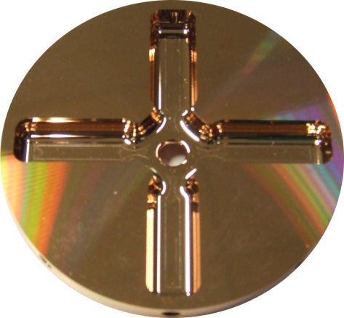
Xband accelerating structures review 24-25.11.2014
N. Catalan Lasheras

Slide 2
Goals of the review
Describe/put together existing manufacturing steps
  Conditions, procedures, tests, etc.
Verify and agree on the procedures
Bring short term modifications
  To be implemented already in 2015
Propose longer term modifications, studies or R&D efforts
  There was not be time for discussing all in detail but we eleborated a list of potential directions to explore
  Work to be done in coordination with other CLIC-RF work packages

Slide 3
Participants
31 participants including outside laboratories
D. Schulte, CERN/ABP
PH. Lebrun, S. Stapnes, CERN/DG
S. Atieh, A. Cherif, G. Favre, M. Garlache, A. Perez Fontenla, CERN/MME
M. Aicheler, O. Brunner, N. Catalan Lasheras, M. Filippova, A. Grudjev, D. Gudkov, S. Lebet, A. Olyudnin, C. Rossi, A. Solodko, I. Syratchev, J. Vainola, A. Xydou, B. Woolley, W. Wuensch, CERN/RF
M. Taborelli, M. Thiebert, CERN/VSC
F. Toral, L. Sanchez. Ciemat, Spain
T. Higo, T. Abe, KEK, Japan
M. Franzi, J. Weng, SLAC, USA
23 talks plus discussions
2 long days

Slide 4
Program of the review
Introduction to the review. N. Catalan Lasheras
Manufacturing workflow and status of the procedures. A. Solodko
…..
Tolerances coming from alignment. D. Schulte
Tolerances coming from RF. A. Grudjev
Manufacturing for High-Gradient. W. Wuensch
Ultra precision machining and built to cost disk optimization. S. Atieh
How do we measure/accept the disks, shape. Roughness. A. Cherif
…..
Review of SLAC and KEK etching procedures. J. Wang
Current cleaning and etching procedures followed at CERN. M. Taborelli
Heat treatment study results, burrs and roughness. A. Perez Fontenla
Role of oxidation in bonding . M. Taborelli
…..
Assembly and alignment procedure. M. Aicheler
Cell to cell alignment on GLC structures. T. Higo
Brazing/bonding sequence. S. Lebet, A. Solodko
Bonding dependence from weight and roughness. A. Xydou
H2 diffusion bonding against vacuum brazing. T. Higo
…..
TD26CC plans from CIEMAT. L. Sanchez
MTF. M. Filippova
RF measurements and tuning. R. Wolf, B. Wooley
Baking requirements. M. Taborelli
Systematic analysis done on existing samples. A. Perez Fontenla
…..
Manifolds assembly. D. Gudkov
SiC to copper brazing. A. Solodko

Slide 5
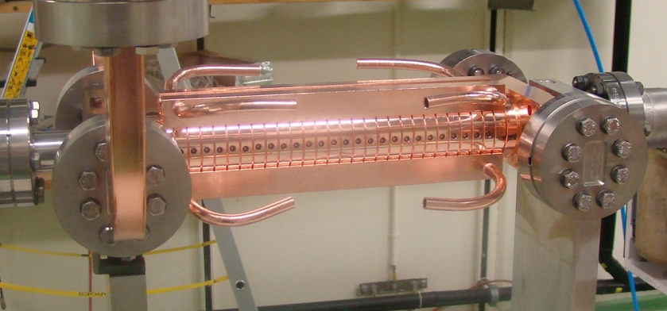
Baseline manufacturing flow
RF DESIGN
ENGINEERING DESIGN (3D models, 2D drawings)
QUALITY CONTROL AT FACTORY
RF DESIGN
ENGINEERING DESIGN (3D models, 2D drawings)
ULTRA PRECISION MACHINING
QUALITY CONTROL AT FACTORY
Add a final dimensional control
CONFORM
NOT CONFORM
CONFORM
NOT CONFORM
PRELIMINARY RF CHECK
QUALITY CONTROL AT CERN
PRELIMINARY RF CHECK
ASSEMBLY OF COUPLERS (brazing, machining)
CLEANING
(LIGHT ETCHING)
QUALITY CONTROL AT CERN
DIFFUSION BONDING OF DISC STACK
BRAZING OF COUPLERS, TUNING STUDS, COOLING CIRCUITS
LEAK TIGHTNESS TEST
RF CHECK AND TUNING
LEAK TIGHTNESS TEST
RF CHECK AND TUNING
INSTALLATION
INSTALLATION
BAKING
(vacuum 650 °C,
10 days)
PACKAGING AND SHIPPING
PACKAGING AND SHIPPING

Slide 6
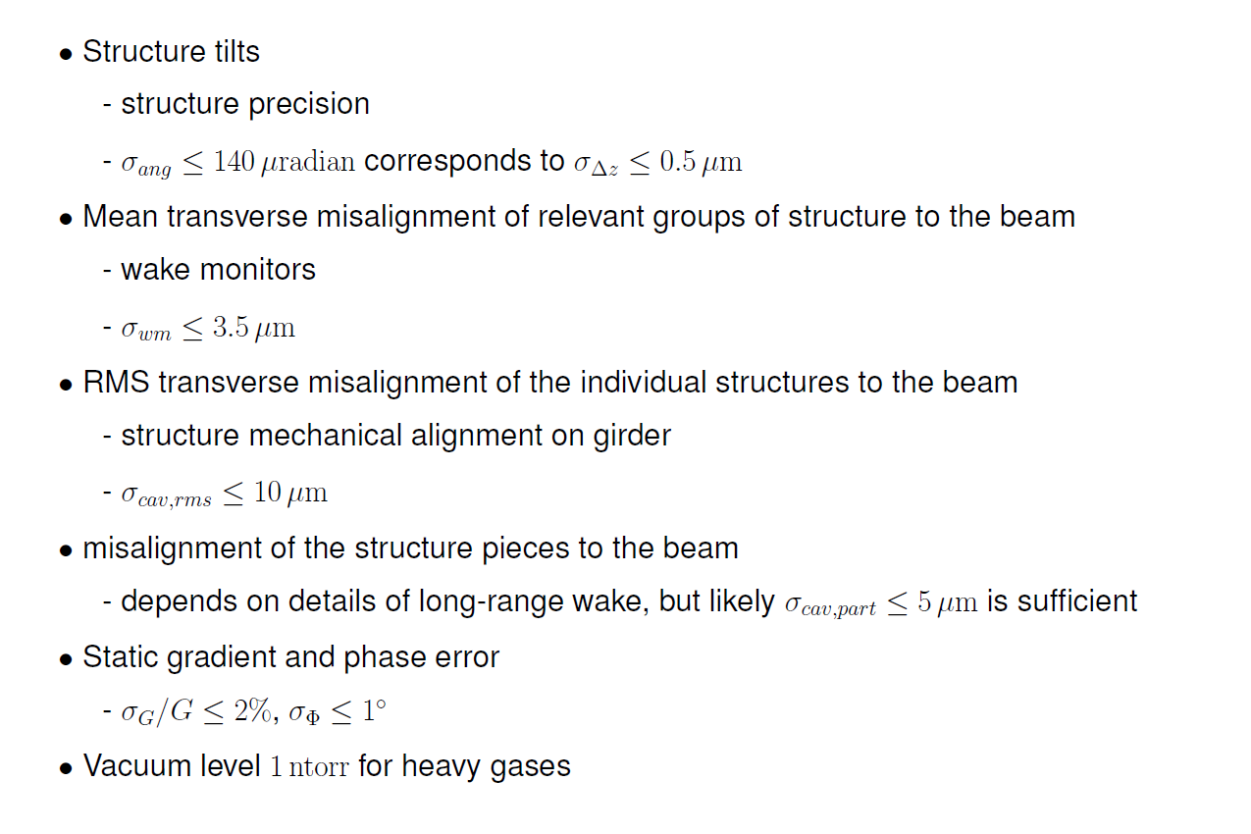
Requirements from luminosity. D. Schulte
See. N. Galindo Munoz talk
See A. Solodko talk

Slide 7
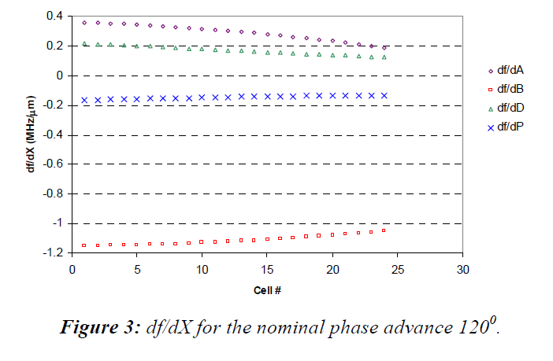
Tolerances coming from RF. A. Grudjev
Sensitivity study for undamped cell.
Riccardo Zennaro, “Study of the machining and assembly tolerances for the CLIC accelerating structures”, EUROTeV-Report-2008-081, (2008)
Jiaru Shi, Alexej Grudiev, Walter Wuensch, “Tuning of X-band traveling-wave accelerating structures”, NIMA 704 (2013)
r
l
e=ae/be
b
ae
d
s
be
a
Sub micron precision is required if no tuning is applied and no temperature correction is allowed
Only systematic errors considered. Random errors being studied

Slide 8
Conclusions from RF tolerances
Sensitivity studies hints to sub-micron accuracy
  Only systematic errors
  Damping waveguides to be considered
2B is the parameter most critical for input couplers
Tuning could correct 10 MHz but is not the baseline of CLIC.
  Prototypes need to be produced according to the baseline aiming at no tuning.
  Tuning will be used as a measure of accumulated errors and assembly quality
  eventual feedback to RF design and beam dynamics if not achievable.
We should try to correlate tuning to disk geometry. Action?
  Not all data available for all disks
  One attempt was done in the past without success. (EDMS1291907)
Study random manufacturing errors.
Systematic deformations?
Stay at submicron tolerance in the shape

Slide 9
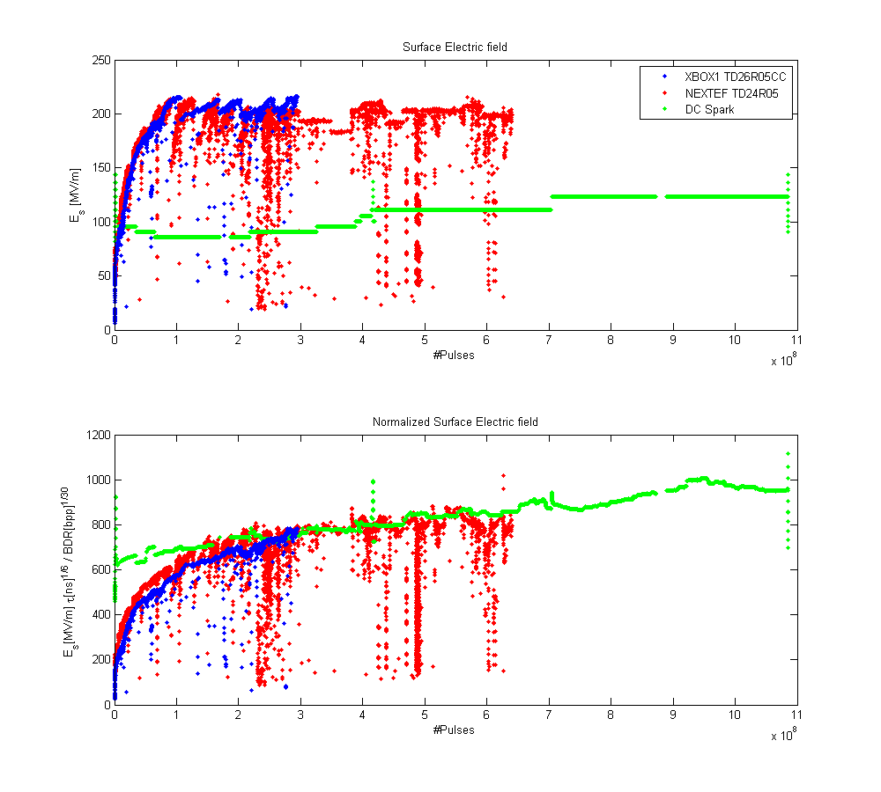
Taking shortcuts. W. Wuensch
High power breakdown behaviour of a pair of electrodes seems to be similar to that of an accelerating structure once the “appropriate” scaling laws are applied… work in progress
We could “judge” changes or improvements in the current procedure using sample electrodes.
surface treatment, cleaning, etching, degassing, etc

Slide 10
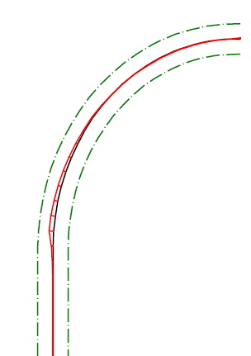
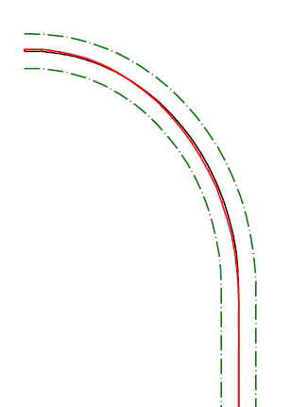
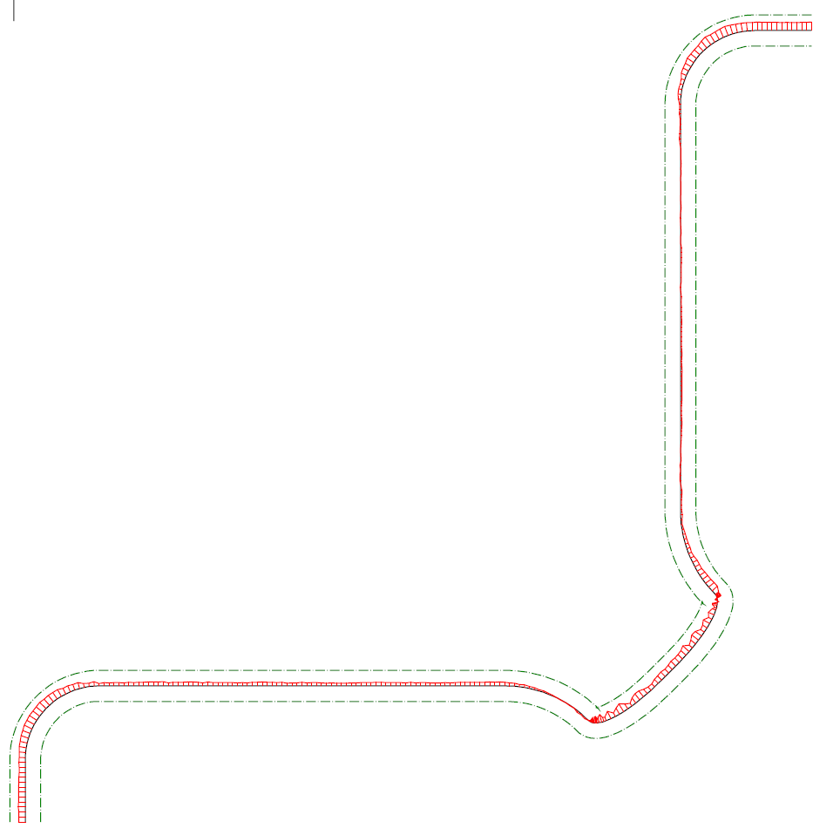
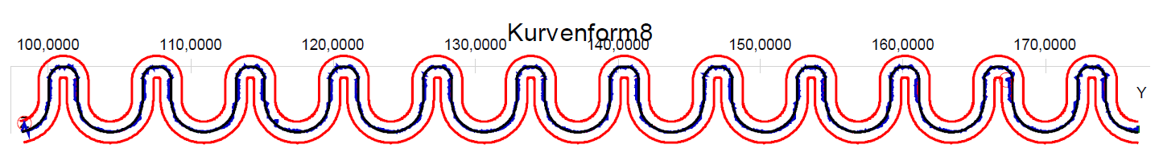
Shape accuracy. S. Atieh
Not a problem. Well within reach in critical areas!

Slide 11
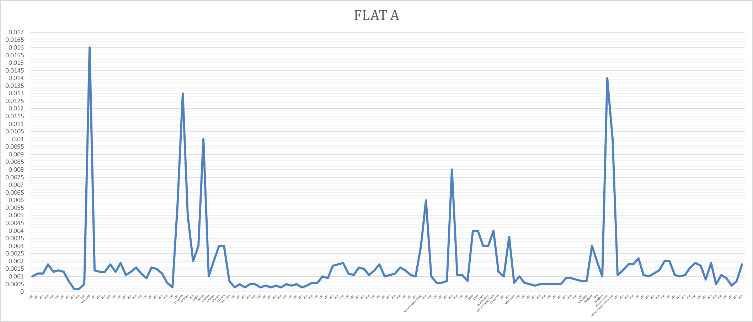
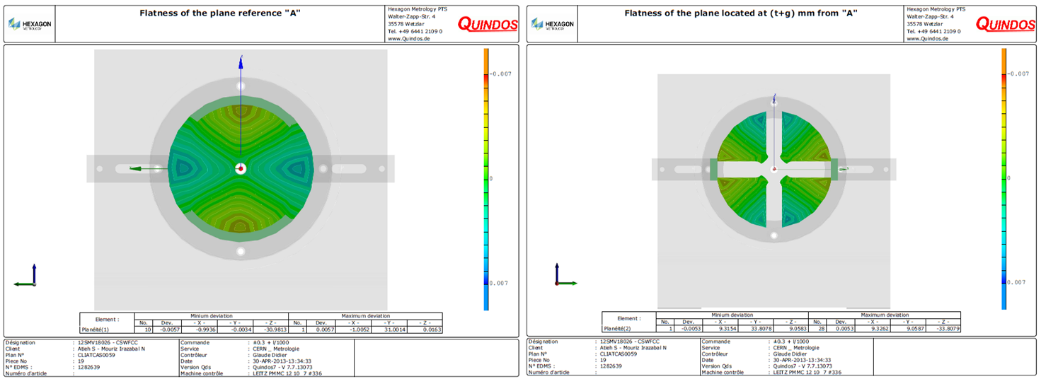
Achieved Flatness. S. Atieh
2008
2009
2010
2011-2012
  Seems to be ok for closed waveguide but not for open waveguide.
  Disks are saddle-shaped for open waveguides

Slide 12
Achieved Flatness II
  Outliers are measured in free state for damping waveguides
    Could come from the free-state requirement
Need to compare between free state and vacuum chuck and change specifications if necessary

Slide 13
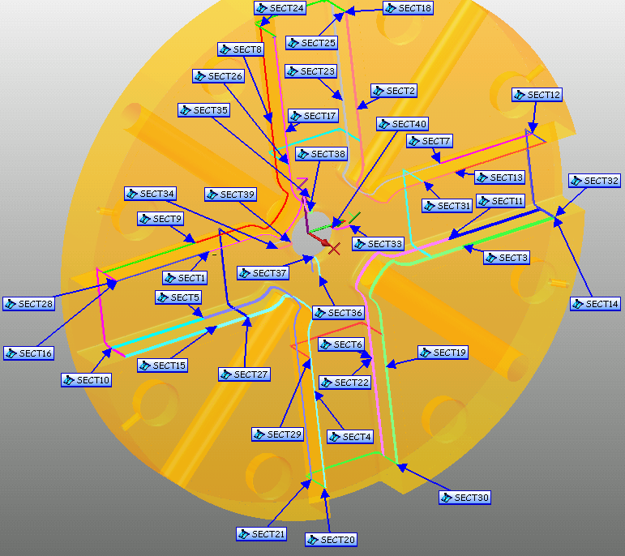
How do we measure/accept the disks? A. Cherif
Metrology and SEM analysis done only on spare disks
Parts arrival
Cleaning by TE/VSC
Temperature stabilization inside the laboratory
Program construction
Measuring setup
Tool calibration
Measurements
      Characteristics on the drawing
      Iris
      Cavity
      Flatness
      Concentricity
Roughness
      Mitutoyo
      Veeco
Results on EDMS

Slide 14
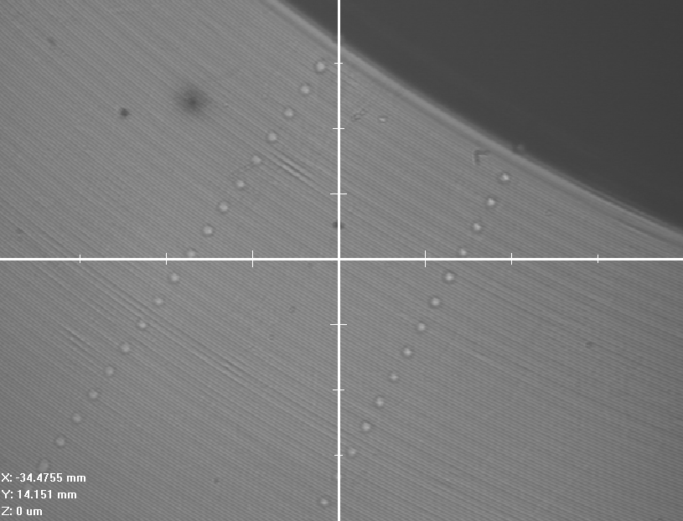
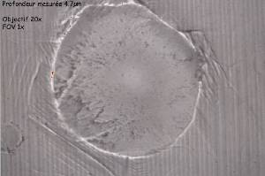
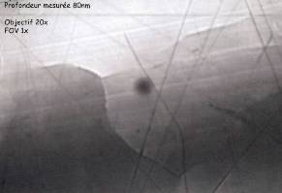
How do we measure/accept the disks? A. Cherif
Lost of effort on reducing dimples by CMM
  Probe marks
From 4.7 to 0.08 um!

Slide 15
Discussion on machining and acceptance
Some metrology needs to be done for all pieces including reference outside surface and shape.
Sharp edge. Machining sequence to be stated in the technical specs to chose the orientation of burrs. Action: Said.
Can we accept a larger roughness in the cell wall? Action: Alexej
Burrs, scratches, contamination and indents. How small can we visually detected 10-100um? Action: Andrej.
Flatness should be not relaxed but measurements checked.
  Measurements with the vacuum chuck to be compared with the “free state” Action Ahmed
Changing R05 to 1.0 or 2.5 to be studied Action: Alexej
Shall we tight the tolerance for OD to +/1um? And the shape?
Review disks conditioning

Slide 16
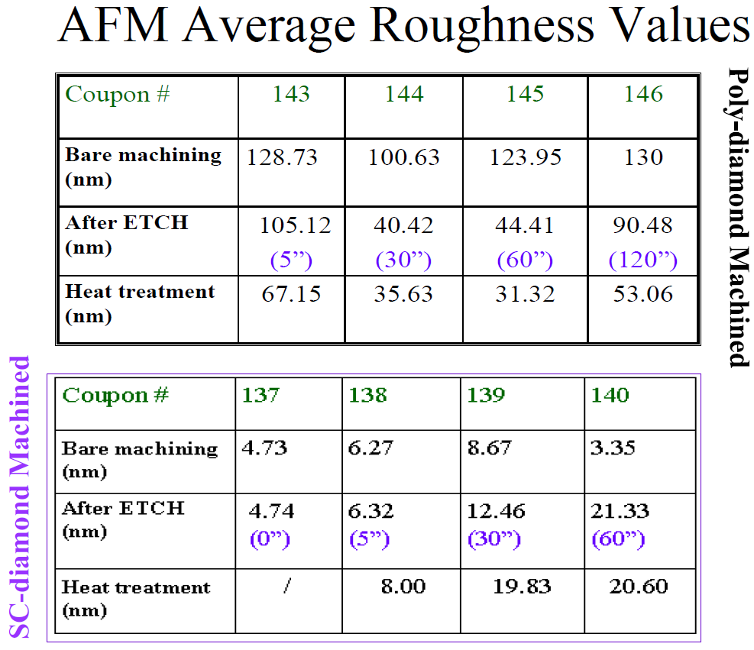
Surface issues for RF structures in SLAC. J. Wang
Surface roughness after etching
Etching for removing slight contamination and fluids
Not justified for diamond-turned pieces

Slide 17
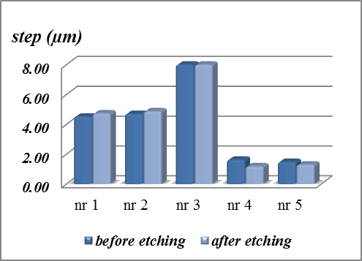
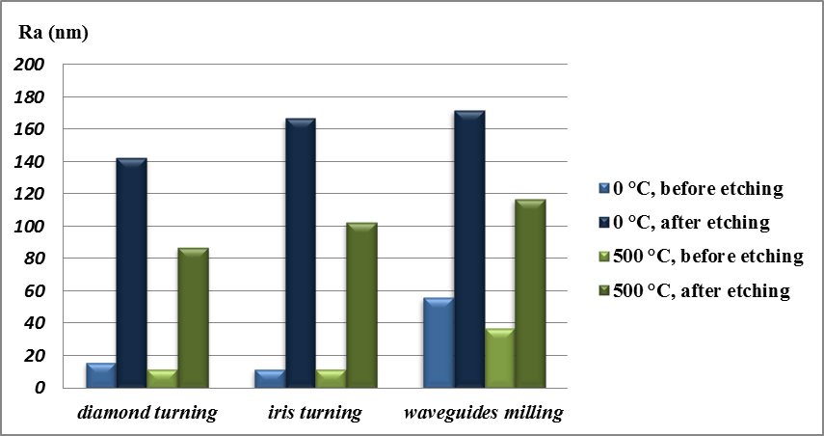
Study of heat and chemical treatments effects on the surface of ultra-precision machined discs for CLIC. A. Perez Fontenla
  The presence of steps (µm) was confirmed in all discs, before and after etching; The discontinuity before etching is smaller on discs annealed for a longer time or higher T (nr 4 & 5);
Etching increases drastically roughness and is worse in low temperature samples
Burrs are removed by etching.

Slide 18
Role of oxidation on bonding. M. Taborelli
Surface diffusion more important than bulk diffusion. H2 may speed up the process.
Oxidation reduces adhesion force.
Oxidation appears in less than an hour.
Unlike vacuum, heating in H2 will reduce oxidation
Beware of carbon contamination which will not be removed
1040 degrees will eliminate oxide in open surfaces. What about bonding surfaces?

Slide 19
Discussion on surface treatment
No etching should be done on disks anymore.
  Only solvent cleaning.
  Thus no dimples should be allowed in the RF part larger than? Ra?
  Burrs and machining steps need to be under control
Test on oxide to be prepared. XPS measurements of oxide layer growth.
  Bonding cycle on oxidised samples to assess the bonding quality and the “deoxidising” capacity of the heating cycle. Action: Mauro, Serge.
Handling from the reception of the disks needs to be reviewed. Action Nuria
  Beware of Carbon contamination
Stress relieve temperature much lower than in SLAC, KEK and CIEMAT. Is this a concern? Action Said

Slide 20
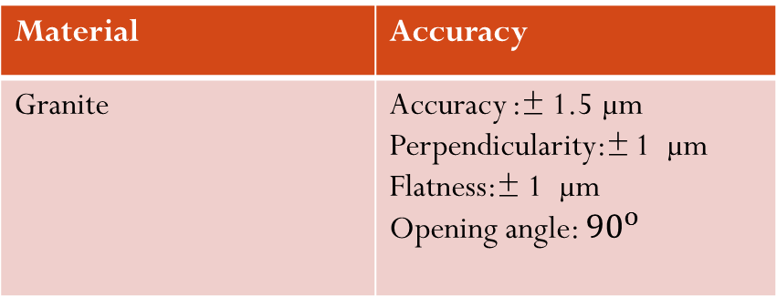
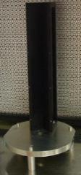
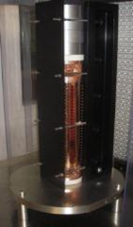
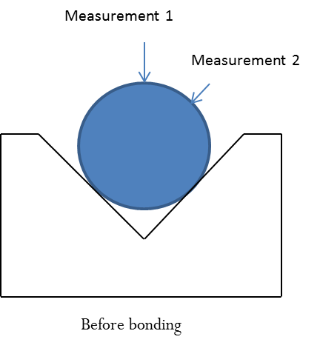
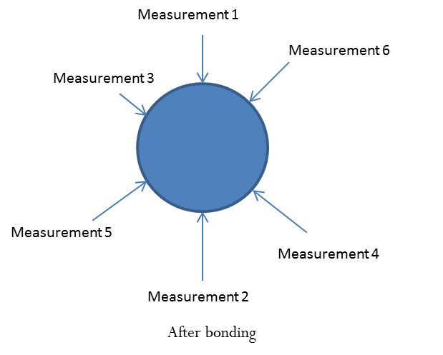
Assembly and alignment procedure. M. Aicheler
Manual stacking made against a UP machined V-block using tuning holes or machined line
Manual stacking against automatic stacking
Measured before and after bonding

Slide 21
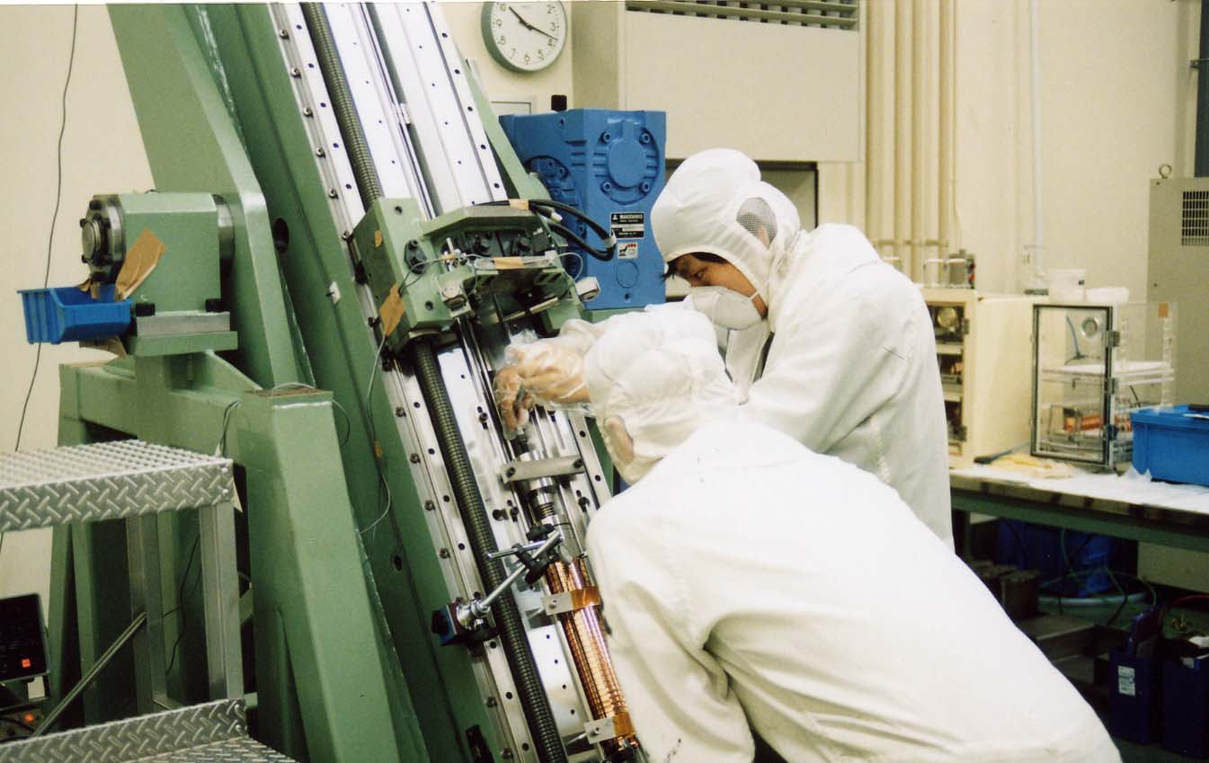
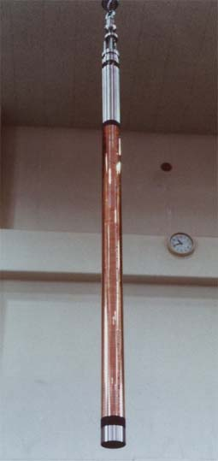
Cell to cell alignment on GLC structures. T. Higo
OD is the key for measurements need to be fully measured.
Stacked manually against a V-block.
Hold during transport to the oven.
Later used pre-bonding at low temperature ~150 degrees before releasing fixture

Slide 22
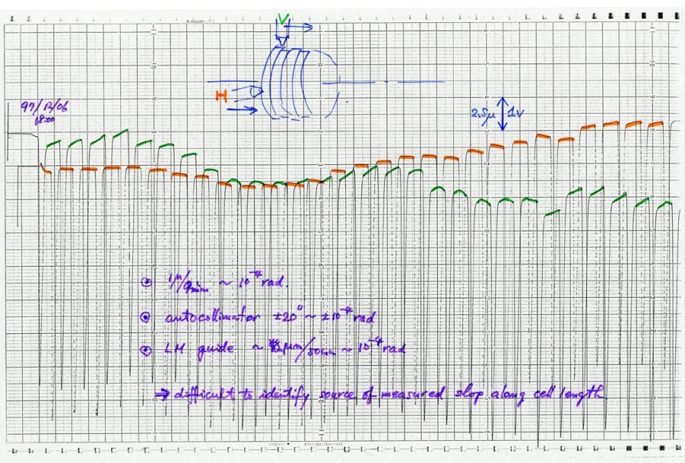
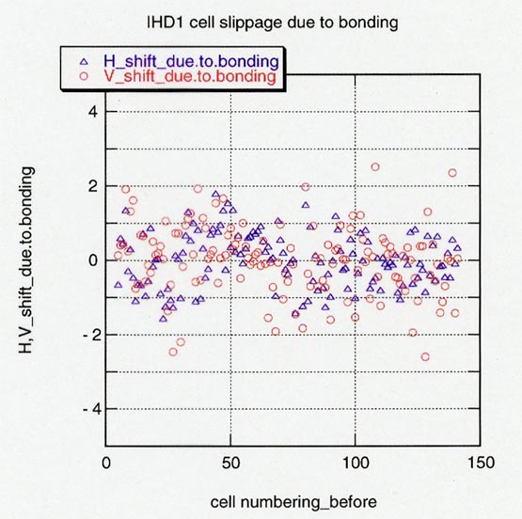
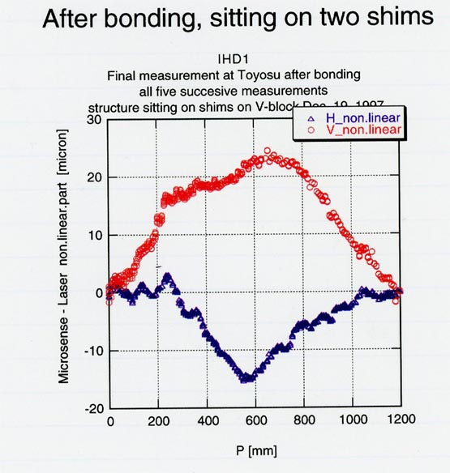
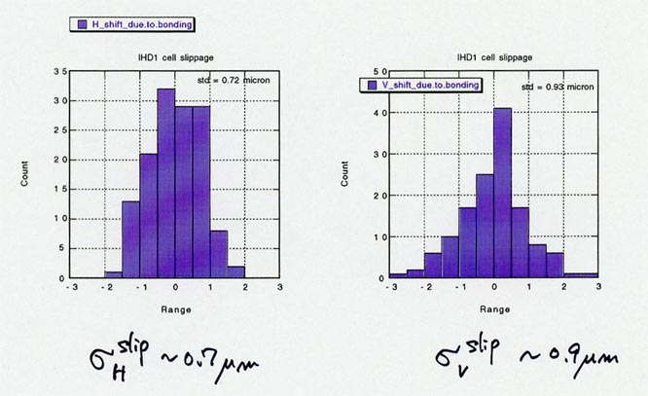
Some (really) typical results
Bonding slippage < 1um
Cell to cell alignment < 1um
Smooth shape. Large bow
Very good cell to cell alignment.
Lots of measurement points
Bow can be easily corrected

Slide 23
Discussion on bonding/brazing
Clear and detailed procedures for bonding/brazing
Bonding dependence on weight studies
  See A. Xydou presentation
Vacuum brazing used at lower frequency. Single cell study In KEK. Waiting for the results
No big changes in the procedure in the short term
  Could be worth to study different atmosphere in electrodes?
New smaller tooling to avoid leaving the cleanroom. Action Serge

Slide 24
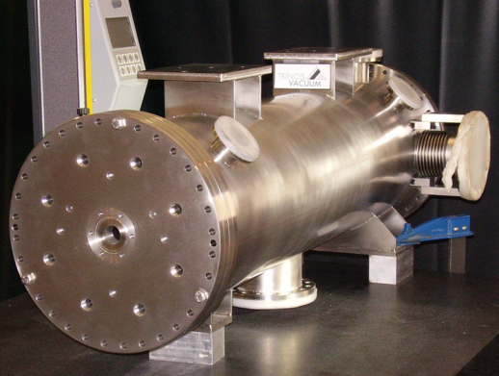
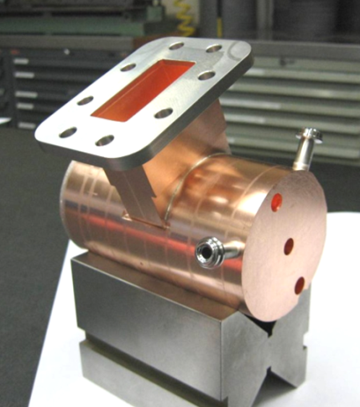
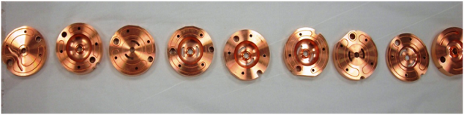
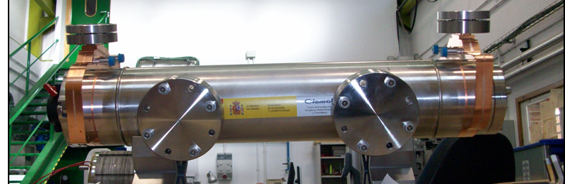
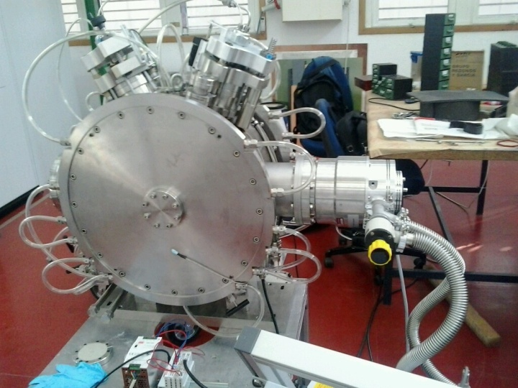
RF X-band previous projects @ CIEMAT
Microtron
TBL PETS
Buncher
Precision machining
Precision joining
Vacuum brazing
Precision assembly
Low power RF tests
Bead pull and tuning

Slide 25
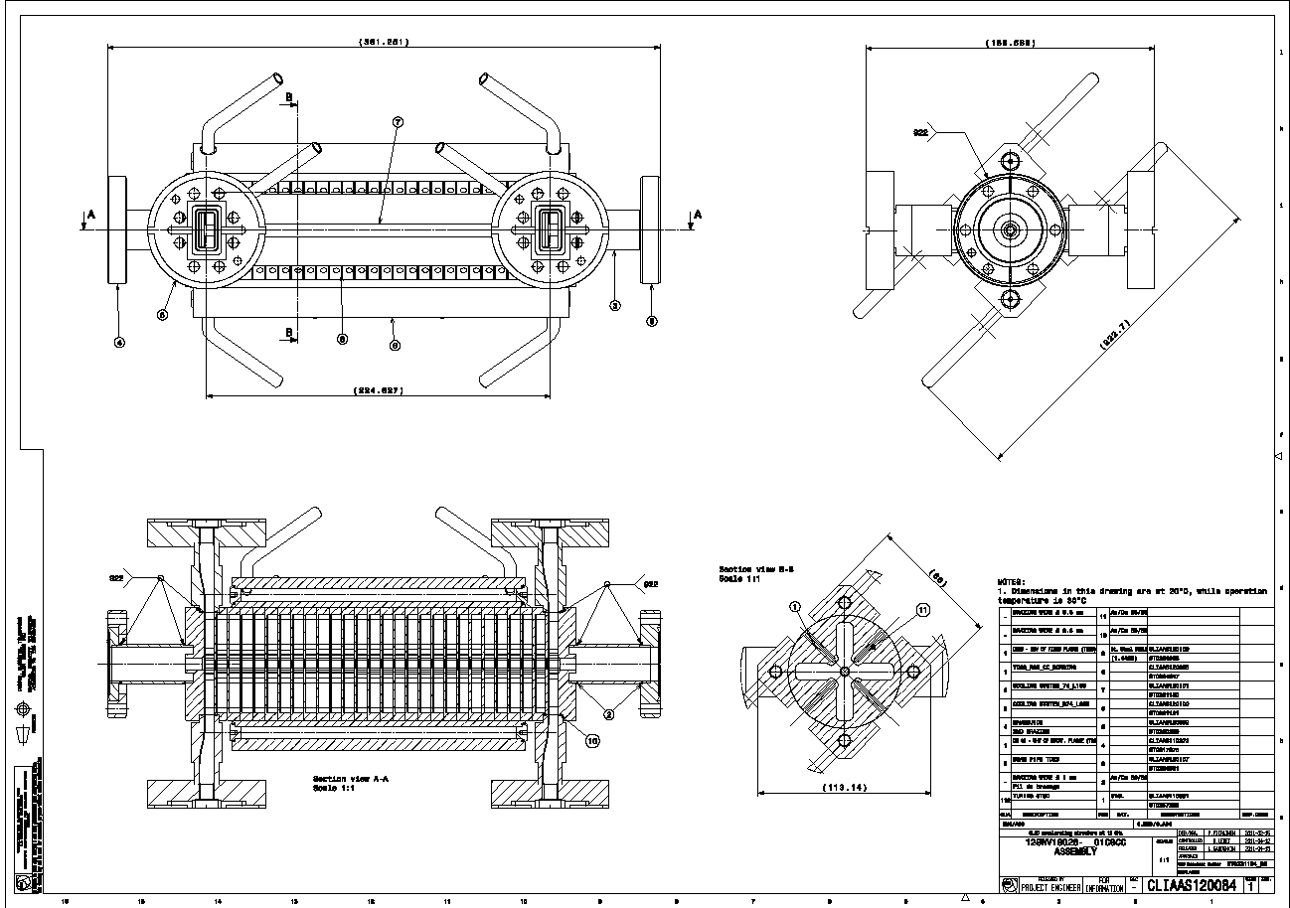
Plans for CLIC structures: TD26CC
Scope of the collaboration
CIEMAT will manufacture a TD26CC structure according CERN procedures
Disc machining
Bonding
Parts machining
Brazing
Assembly
Leak testing
Tuning at CERN

Slide 26
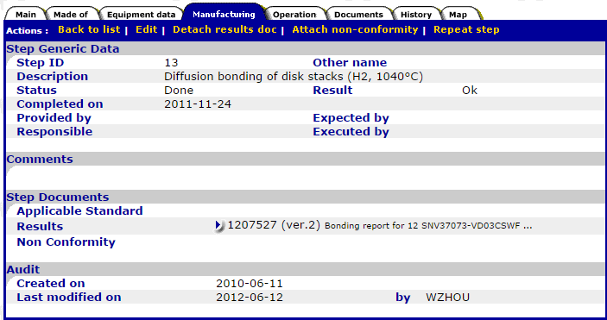
New workflow steps. M. Filippova
Dimensional control
Manufacturing Step Main Catalogue Data:
Applicable Standard →EDMS document № where the corresponding step procedure is attached
Results → EDMS document № of the corresponding result report
Some step data fields to be implemented individually for some steps according to table 3, column “Manufacturing step catalogue data”.
MTF. Maria Filippova

Slide 27
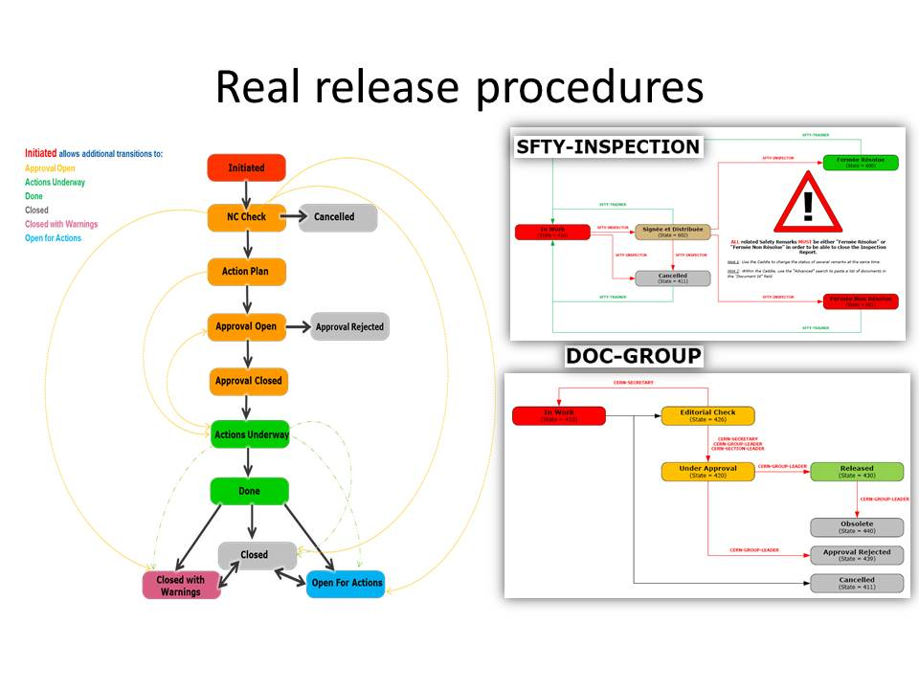
Responsibilities
Define manufacturing sequence
Approve procedures
Coordinate between steps
Discuss and decide on NC actions
Write procedure
After each manufacturing step:
Close the MTF step
Attach result file
Open Non conformity in not ok

Slide 28
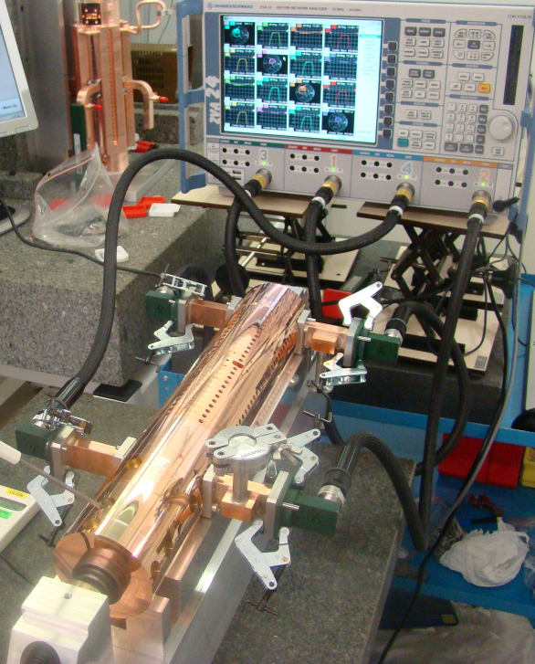
RF measurements. B. Woolley, R.Wegner
4 Port VNA
high-quality measurement cables
TWS input ports
discs clamped together
TWS output ports
RF Measurements and Tunning. A. Olyunin, R. Wegner, B. Woolley
contact thermometer
clamping device
V-block

Slide 29
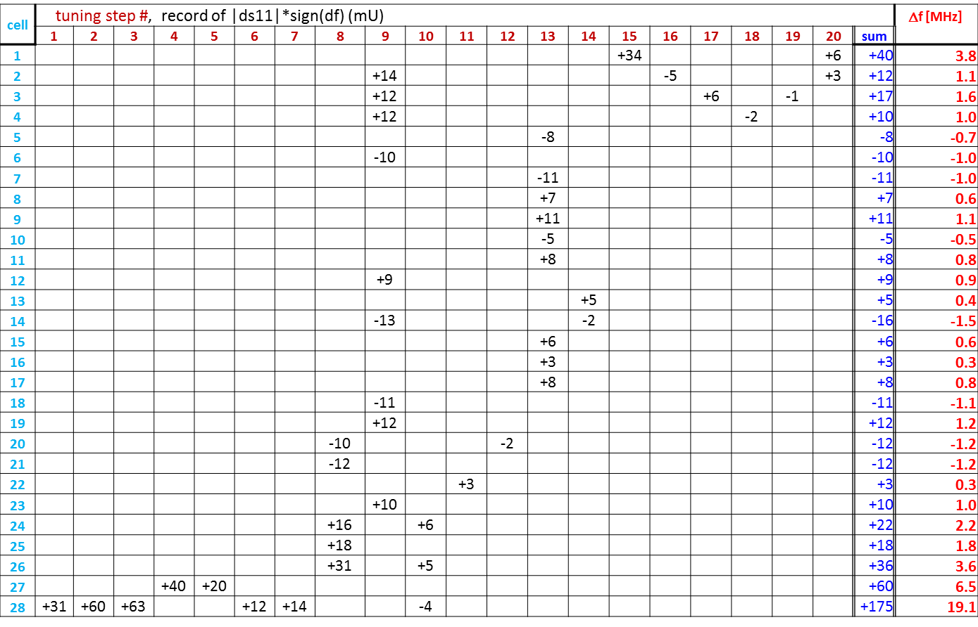
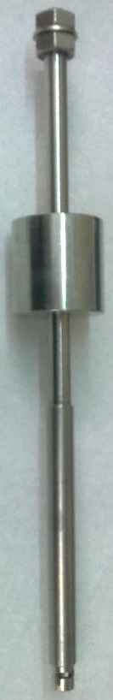
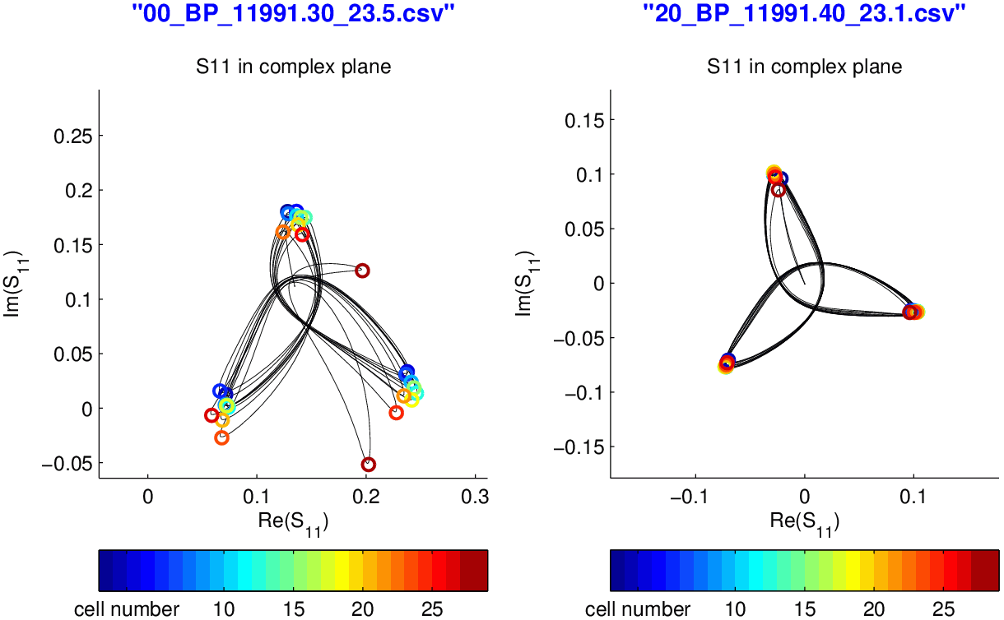
Tuned structure and tuning record
RF Measurements and Tunning. A. Olyunin, R. Wegner, B. Woolley

Slide 30
Discusion and Conclusions
Use the same pins for all structures.
Verify that tuning is preserved during manufacture
Need statistical study of tuning for all structures up to know
  To validate the CLIC baseline (no tuning)
  To evaluate the assembly quality,
No correlation found between tuning records and disks/cells geometry errors.
  Possibly most errors are produced by assembly
  TBC. Only one structure has been done.
  See A. DeGiovanni talk
RF Measurements and Tunning. A. Olyunin, R. Wegner, B. Woolley

Slide 31
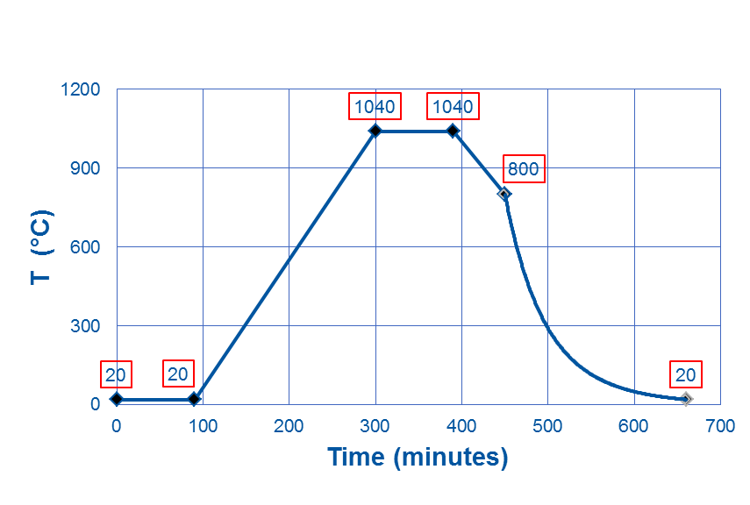
Baking requirements
H₂
H₂
Changes after 8h are only in 1e-10 of concentration!

Slide 32
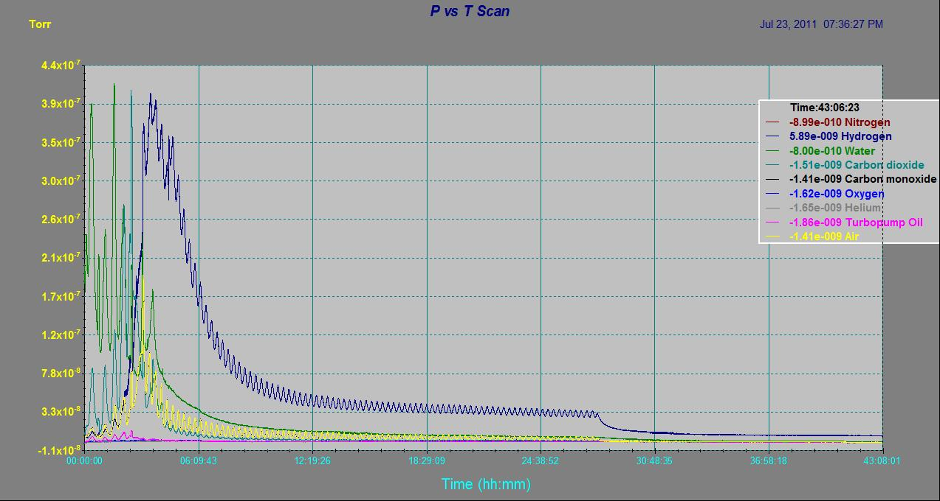
Degassing data from PSI structure

Slide 33
Discussion on baking
According to simulations work 10 hours would be sufficient to eliminate H2 in the copper bulk.
  Sample is thin (1cm) and may not be representative?
Data from PSI structure seems to indicate that degassing is not that fast.
  Significant reduction after 12 hours
Refurbished degassing oven in building 101 has been equipped with gas analyser. Action Ivo
  Data to be taken on the next cycles. TD26CC on January
  With and without structure

Slide 34
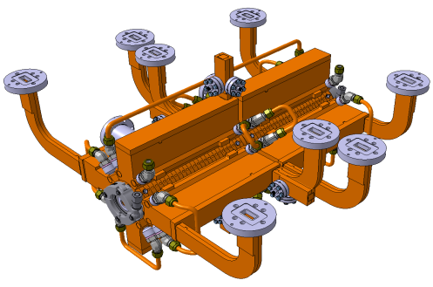
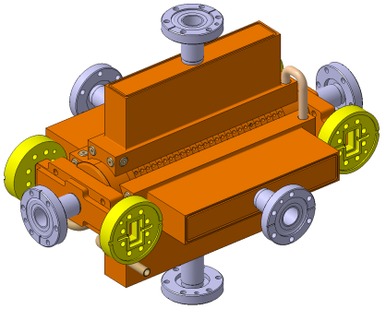
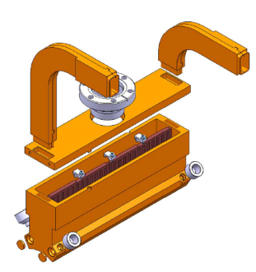
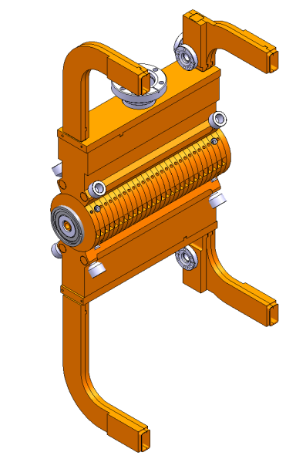
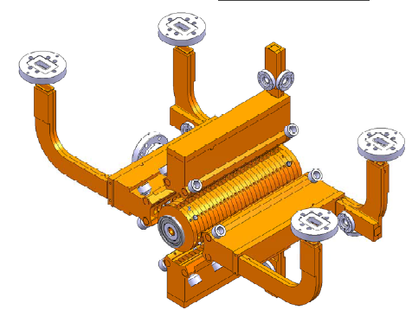
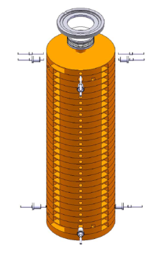
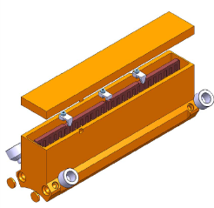
Manifolds assembly. D. Gudkov
+
Serge Lebet, Vadim Soldatov

Slide 35


Alternatives to manifolds. Discussion
First of this kind in CLEX now.
TD24_SiC being manufactured slightly differently
Putting manifolds and SiC in vacuum tank could also be a possibility
Integrated disks
  Very accurate shape of the external reference is a bigger problem for these disks.
  First samples arrived
Waiting for TD24_SiC experience
Study is under way

Slide 36






Needs for SiC to Cu joining
RF GATE VALVE
Undergoing study by Igor and Anastasiya
Crack
AS with damping material

Slide 37
Conclusions
Procedures are now fully known and justified. Ongoing with the authors.
Industry-ready specs need to include a clear QA
Some conslusions and follow-ups
  Immediate changes, to be implemented from next year
  Follow-up items to be defined during the following months
  Long term studies
We make prototypes to prove CLIC baseline
  No compromises
  Conditioning is as important as hig gradient
Faster feedbak
  Changes that may impact bonding quality will be tested in simple disks in the oven.
  Changes that may impact high gradient will be first tested on electrodes
Larger and faster interaction with other work packages

Slide 38
Thanks!

