Slide 1
High-Gradient and X-band:
Applications and Industry

Slide 2
Overview of relationships among different aspects of the CLIC study – introduction to this morning’s session
A few particularly relevant X-band and high-gradient working group highlights

Slide 3
Electron linacs:
XFELs, Compton sources, neutron production, security, medical etc.
Industrial suppliers:
precision machining, high-efficiency and power sources, etc.
commercial base
accelerator systems
High-gradient science and technology
CLIC project
goal
Beam dynamics and instrumentation
Other high-energy
physics projects:
LHC, ILC, FCC, etc.
Areas of crucial expertise
Precision alignment and stabilization
Vacuum, magnets, controls etc.
Radio-frequency

Slide 4
Electron linacs:
XFELs, Compton sources, neutron production, security, medical etc.
Industrial suppliers:
precision machining, high-efficiency and power sources, etc.
commercial base
accelerator systems
High-gradient science and technology
CLIC project
The goal of this morning’s session is show some examples of these collaborations.

Slide 5
Presentations this morning
Accelerator applications which use X-band technology | Non-accelerator applications which use high gradients | Industries involved in X-band technology
Security Linacs Graeme Burt, Lancaster University | Vacuum Interrupters and breakdown issues Zhenxing Wang, Xi’an Jiaotong University | Introduction to the Fraunhofer Institute, industrialization of CLIC and X-band structures Dirk Oberschmidt, Fraunhofer Insititute
X-band XFEL proposals tbd | Time-resolved electron diffraction Hirofumi Yanagisawa, ETH Zurich | Experience machining precision accelerator components: VDL Mathieu Breukers, VDL
Thomson scattering source at Tsinghua University Jiaru Shi, Tsinghua University |  | Experience supplying precision accelerator components: Radiabeam Salime Boucher, Radiabeam

Slide 6
Electron linacs:
XFELs, Compton sources, neutron production, security, medical etc.
Industrial suppliers:
precision machining, high-efficiency and power sources, etc.
commercial base
accelerator systems
High-gradient science and technology
CLIC project
Now a few particularly relevant X-band and high-gradient working group highlights

Slide 7
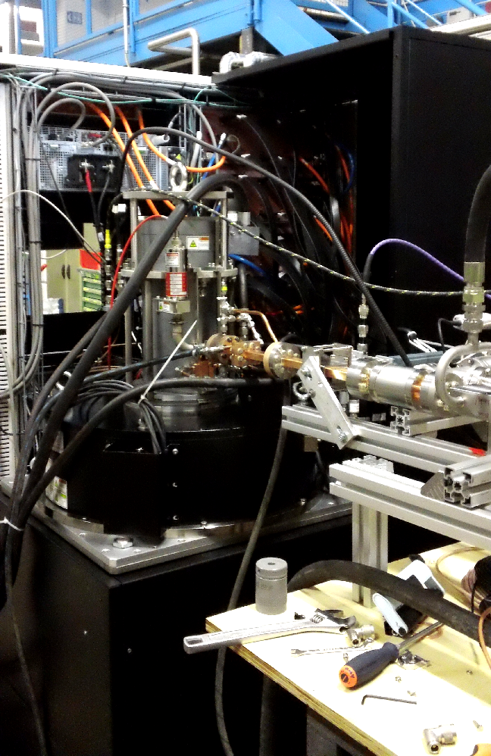
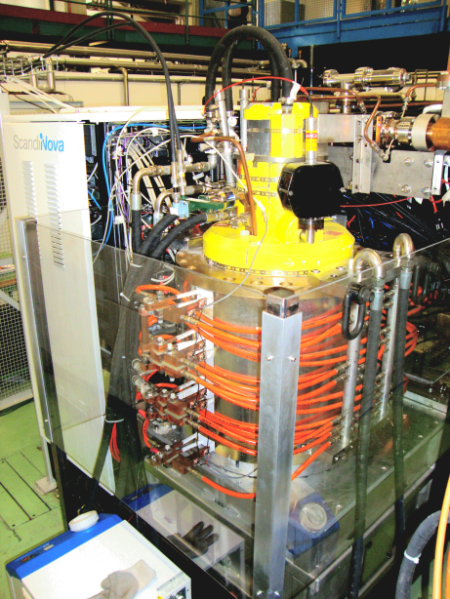
rf power sources
We now have two types of commercial X-band power sources running at CERN.
Toshiba 6 MW, 5 μs, 400 Hz
CPI 50 MW, 1.5 μs, 50 Hz

Slide 8
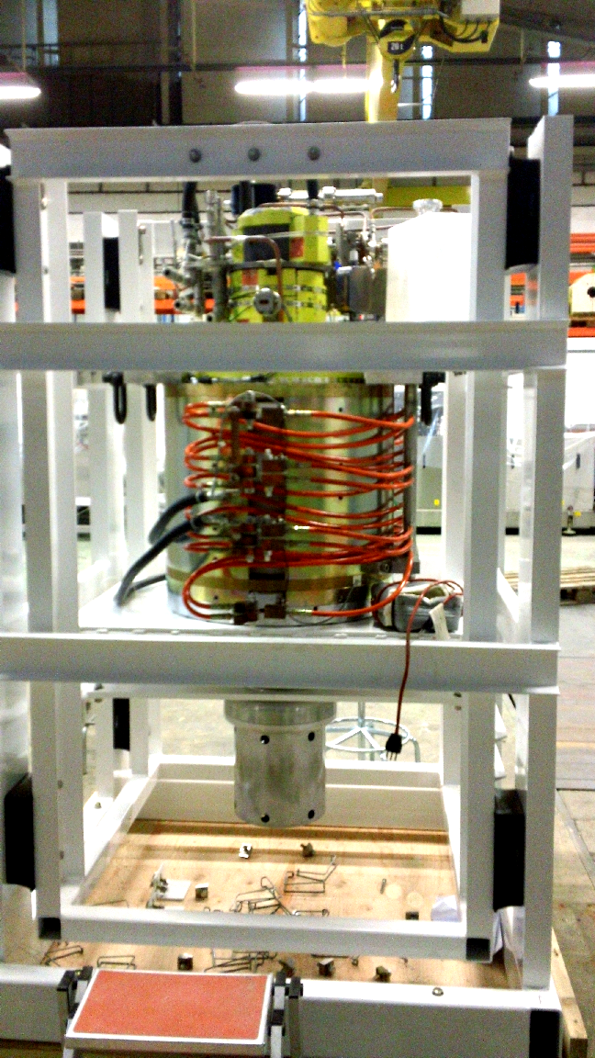
Thank you SLAC XL5!
Have a good rest while you are waiting for repair.

Slide 9
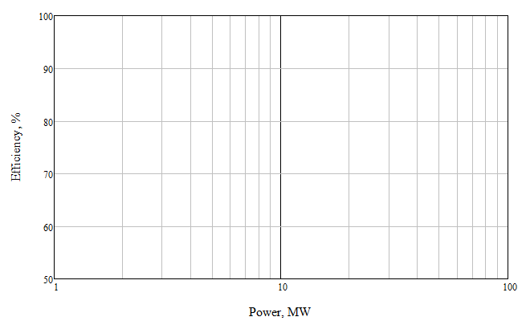
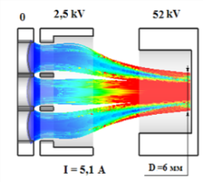
Roadmap for high-efficiency high RF power klystron development
L-band, CW/long pulse
FCC, ESS
<20 beams; <50 kV
Optionally – gun with controlled electrode (2.5 kV)
3 years
3 years
L-band. CLIC.
40 beams; 60 kV
1.0 year
X-band
Kladistron
S-band Demonstrator
40 beams; <60 kV
L-band
CLIC
6-10 beams; ~160 kV
L-band
ILC
6 beams; 116 kV
1.0 year
Exists
2
6
20
40

Slide 10
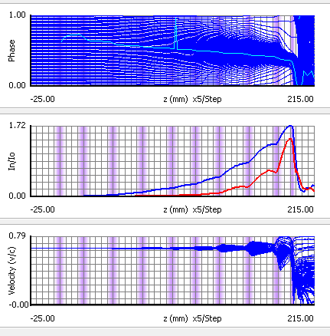
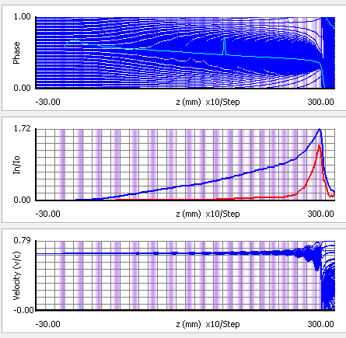
Comparison 10 cavities/20 cavities
10 cavities
Efficiency 67.2 %
Length 197 mm
20 cavities Efficiency 78 %
Length 285 mm
The idea is also to maintain a classical perveance value of 1.4 µA/V^{1.5} (170 kV – 100 A) : high current leads to shorter plasma wavelengths (and so shorter structures)
In the design proposed, the cavities are weakly coupled to the beam (low R/Q) and largely detuned to avoid strong bunching

Slide 11
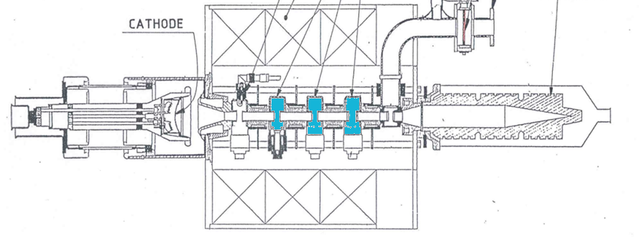
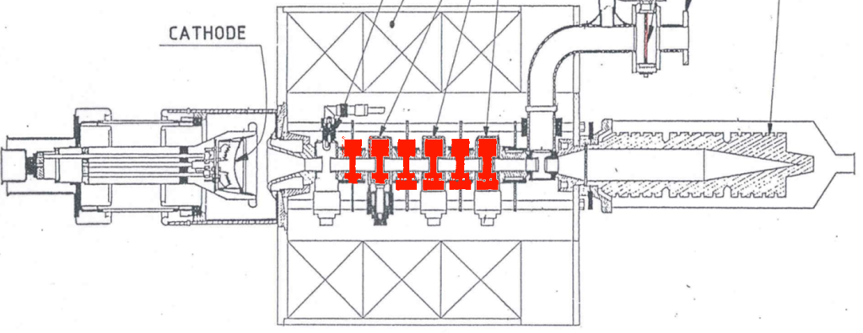
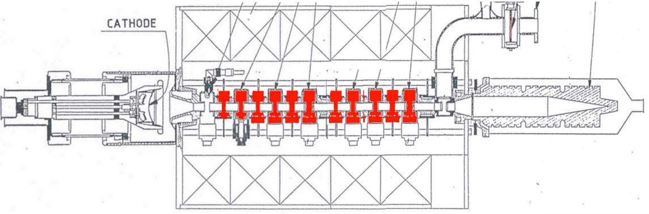
Changing the length?
The efficiency of the TH2166 is ≈ 50%
If we can get a higher efficiency without changing the klystron length = advantage
General philosophy : Verify the increase in efficiency without optimization
Quickly go to a test even if the gain in efficiency is modest (50% ⇨ 60%)
Check that oscillation due to higher gain are not an issue

Slide 12
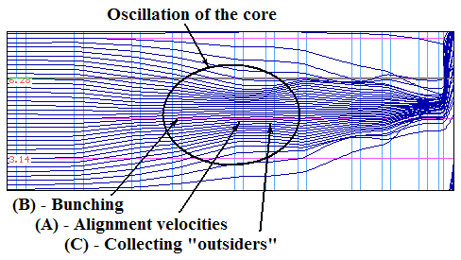
Methods to get high efficiency
2. BAC method by I. Guzilov
Space Charge De-bunching method
Electrons of the core in the BAC method also make oscillatory movements to get high efficiency. To accelerate the process of oscillations of the core de-bunching cavity (A – for Alignment velocity spread of electrons) add. Resonant frequency of this cavity A is lower than the working frequency.
Using of BAC method allows to reduce the length of the interaction space twice in comparison with Space Charge De-bunching method, while maintaining high efficiency.
CLIC workshop, Geneva, CERN, 23-26 January 2015, p.6
Notes:
12
ё

Slide 13
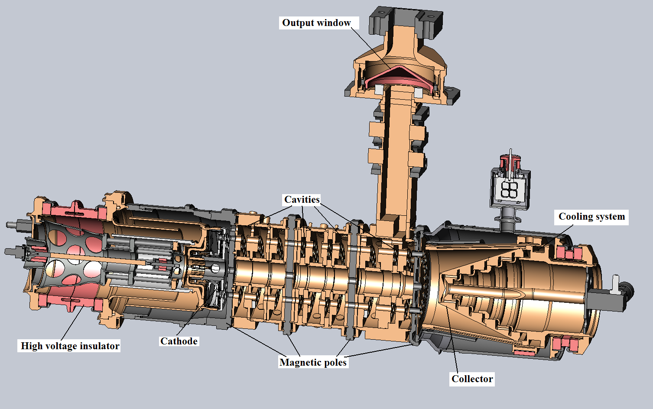
Appearance of klystron
Space Charge De-bunching method
CLIC workshop, Geneva, CERN, 23-26 January 2015, p.25
Notes:
13
ё

Slide 14
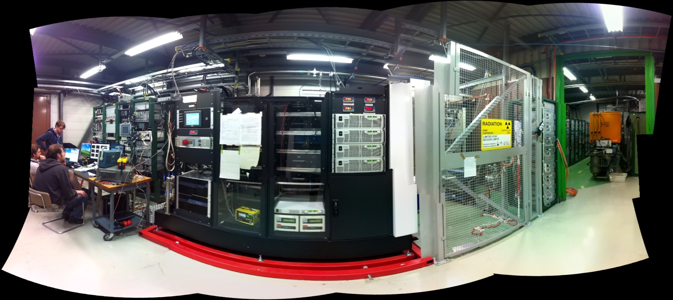
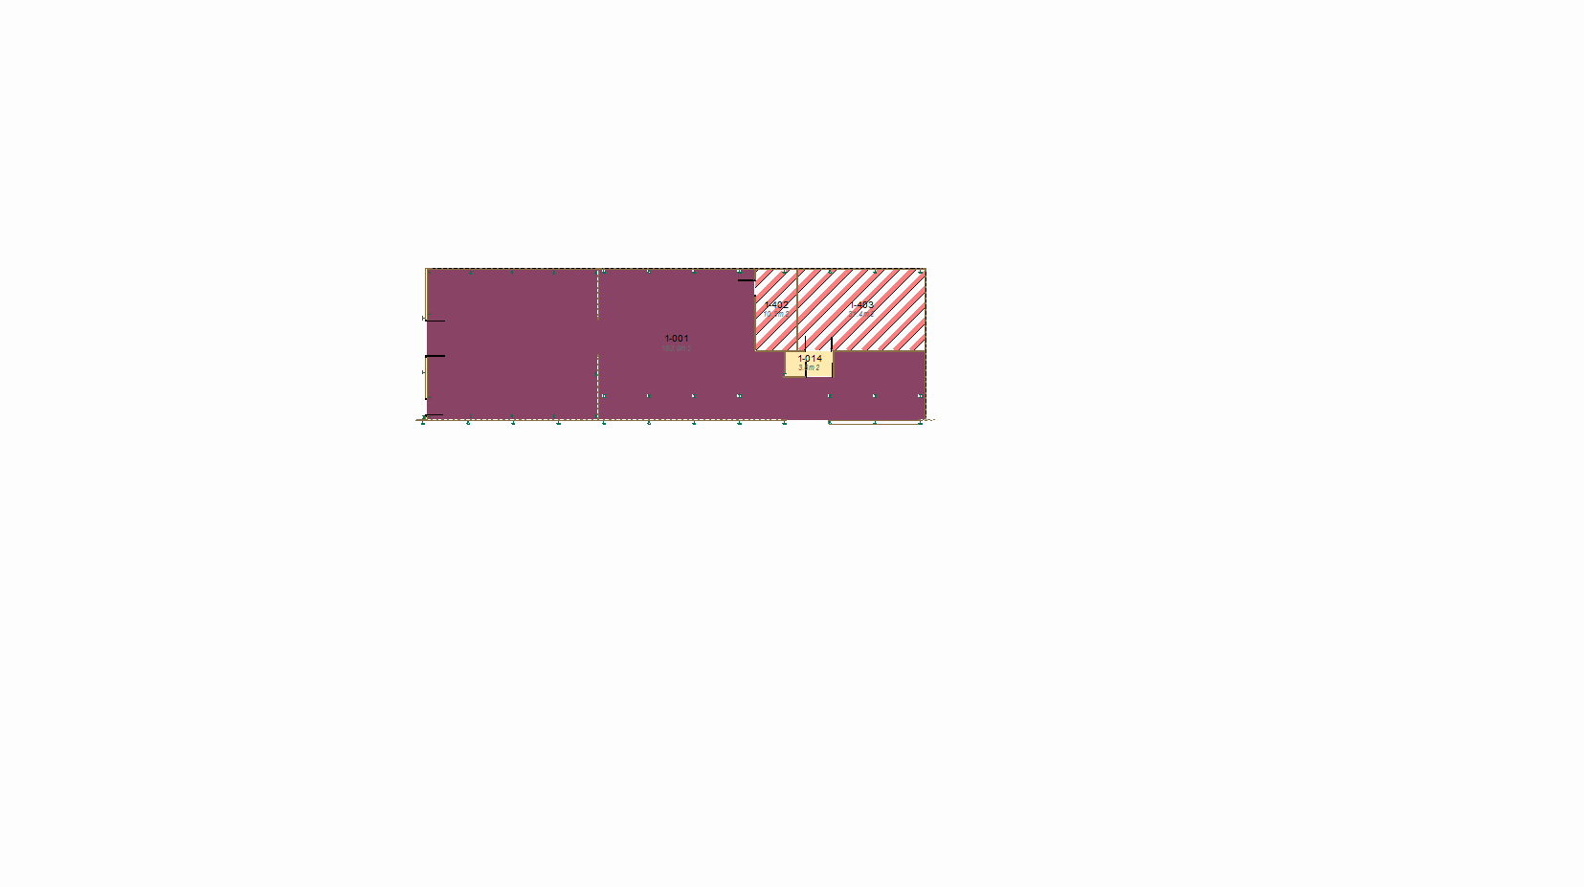
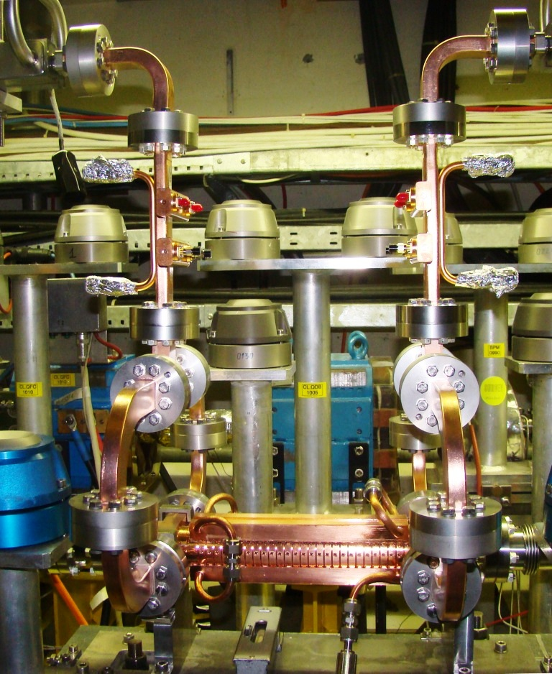
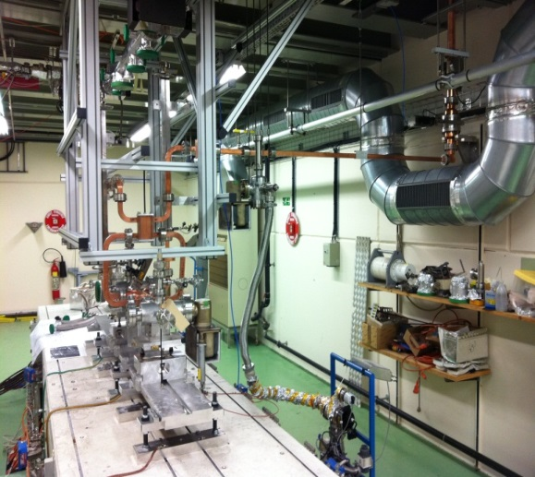
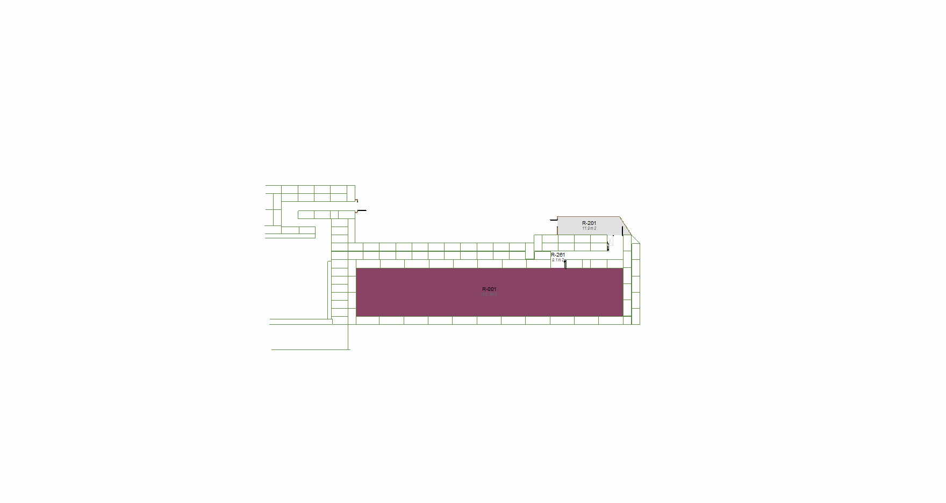
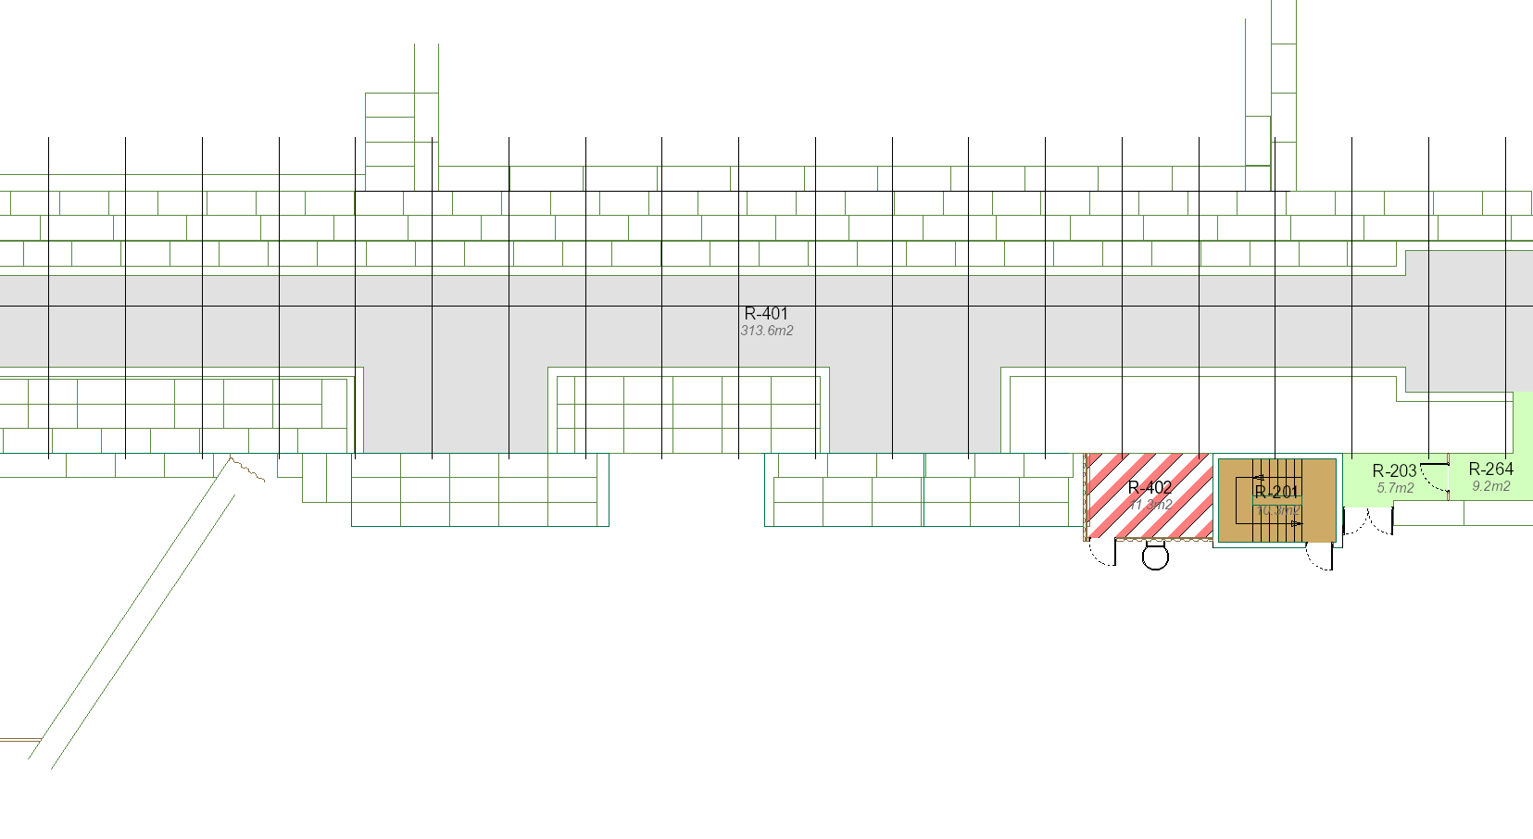
Xbox1 in b. 2013
CTF3 klystron gallery
CTF2
Dog-Leg in 2001

Slide 15
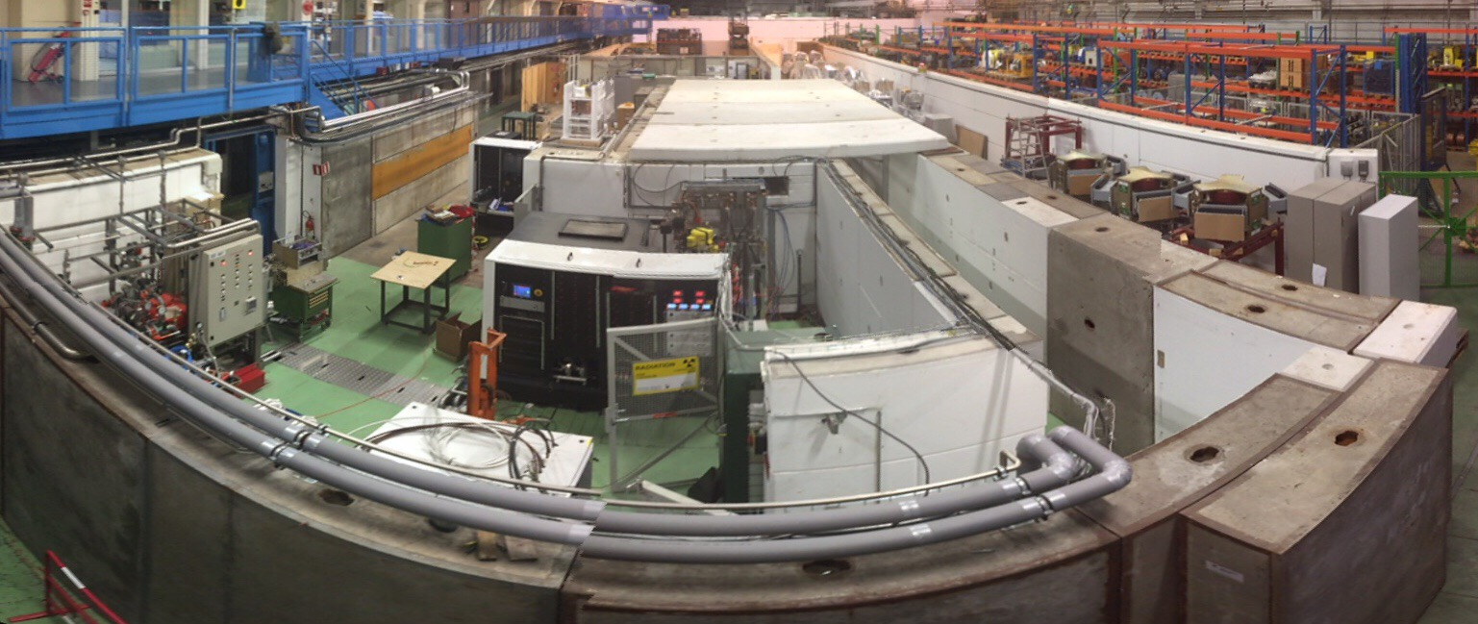
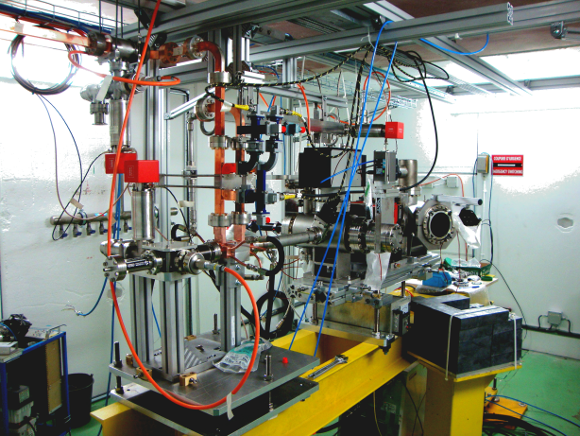
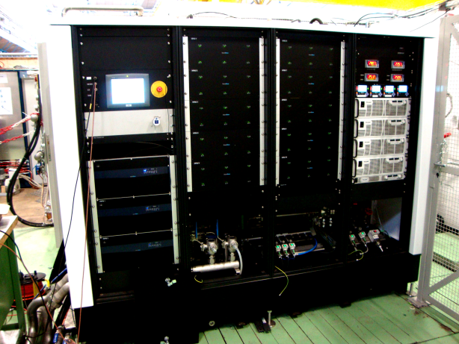
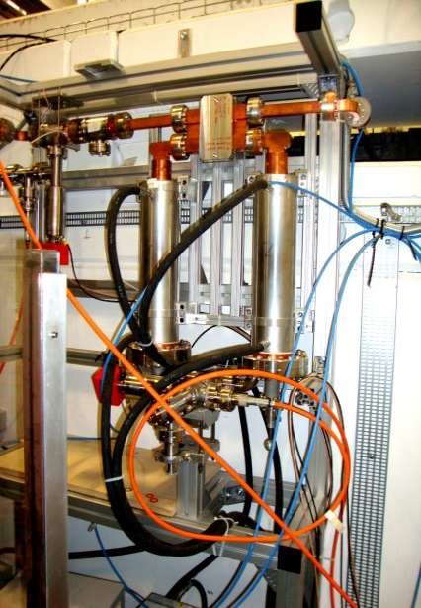
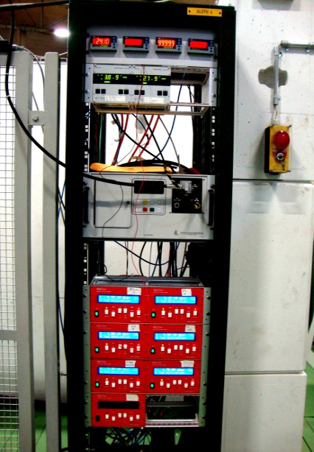
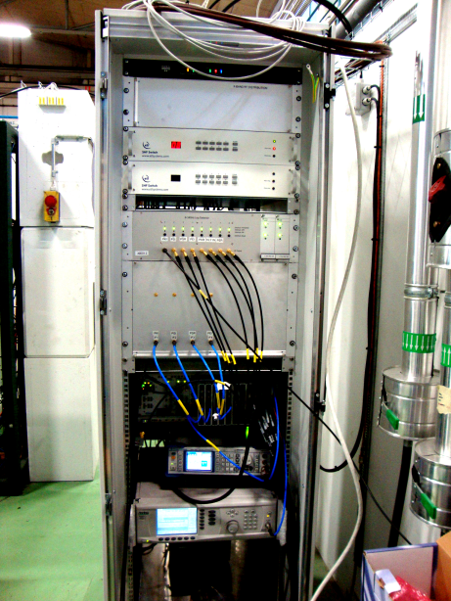
Xbox2 in b. 150
Crab cavity
Spectrometer
50 MW Klystron
Vacuum controllers
RF Pulse compressor
430 kV modulator
LLRF

Slide 16
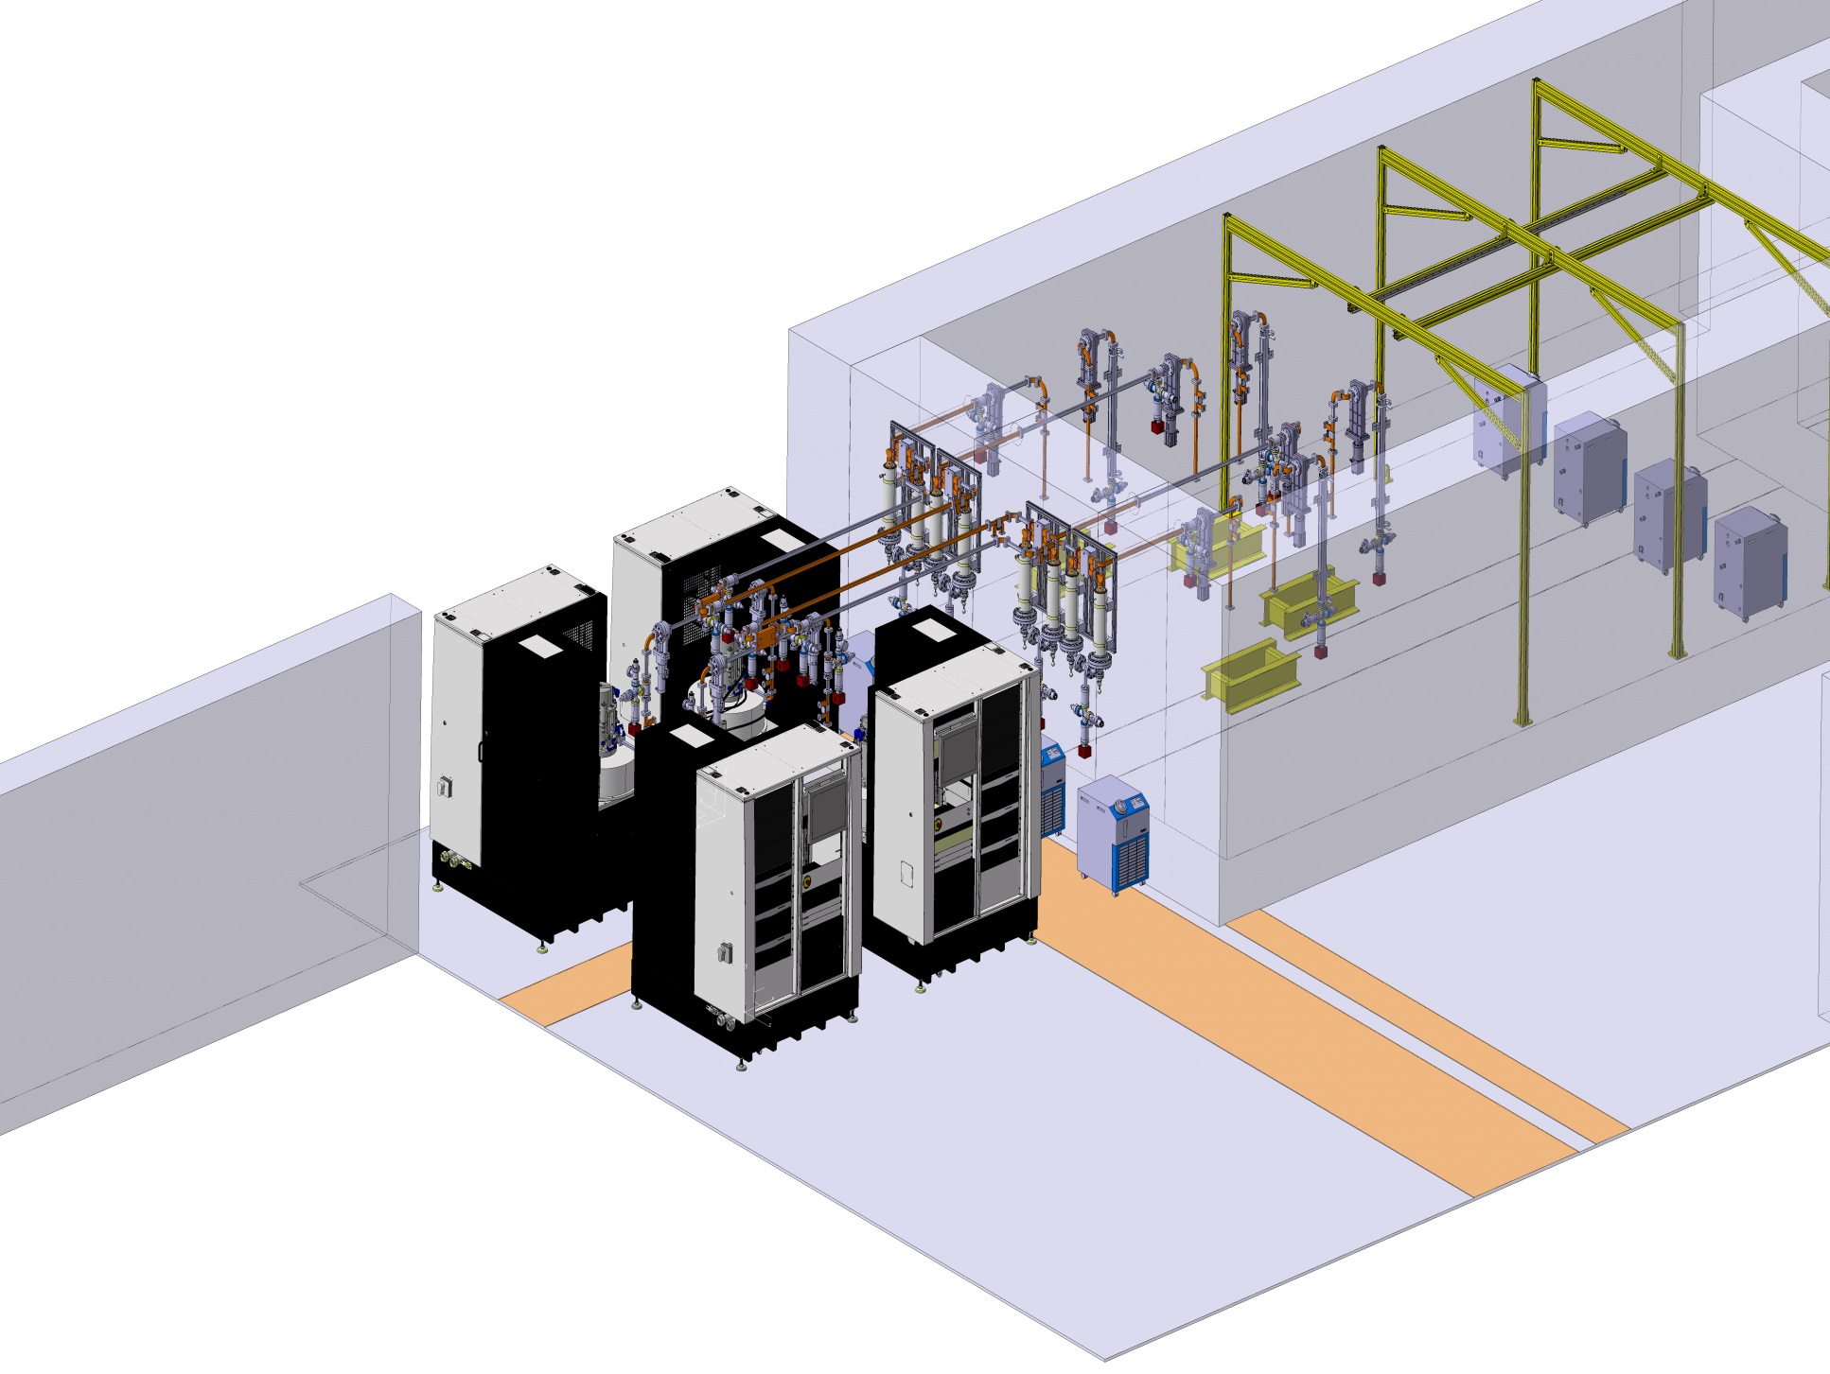
Xbox3 in b. 150

Slide 17
Test schedule for next two years

Slide 18
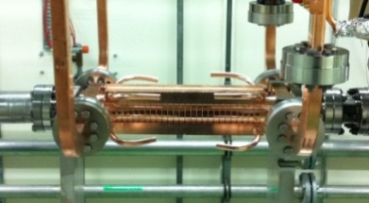
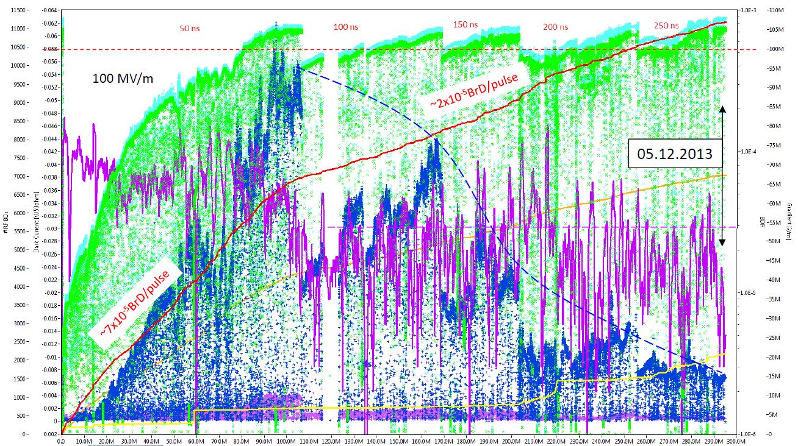
Xbox-1: TD26CC#1 conditioning history
Automatic operation by a conditioning algorithm
[see J.Tagg presentation]
11168 BDs
B. Woolley - CLIC WS2014

Slide 19
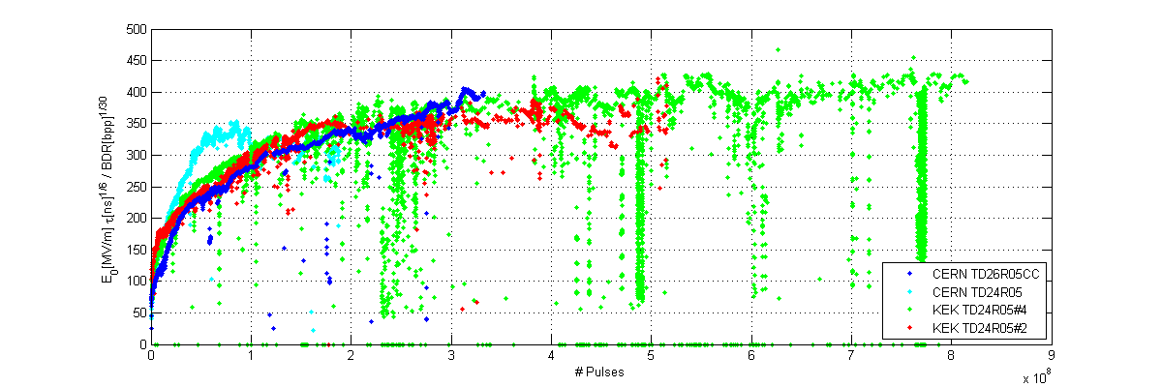
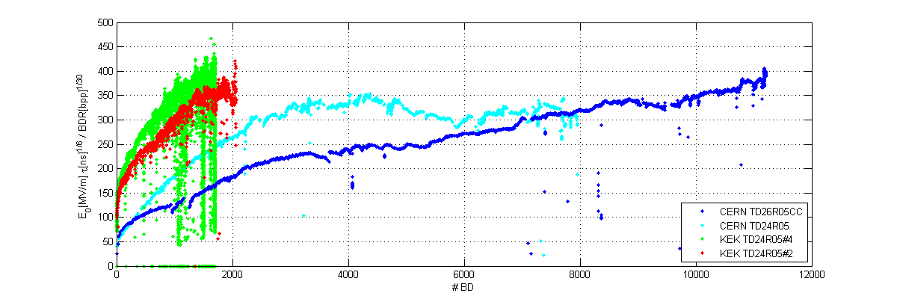


Comparison of conditioning evolution
Scaled gradient vs cumulative number of PULSES
$$E_{0}^{∗}$$
#Pulses
Conditioning to high-gradient is given by the pulses not the breakdowns!
Scaled gradient vs cumulative number of BREAKDOWNS
$$E_{0}^{∗}$$
#BDs

Slide 20
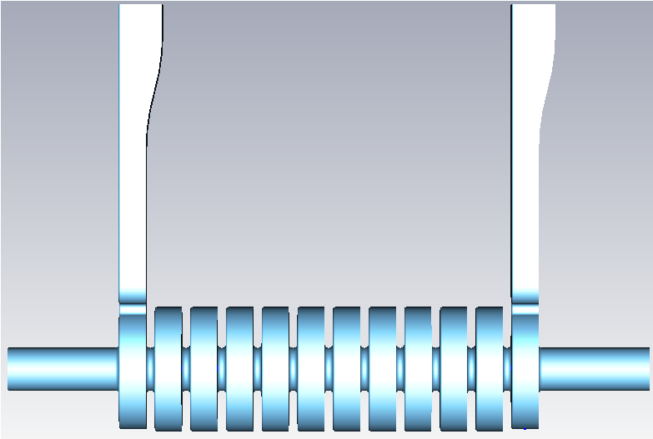
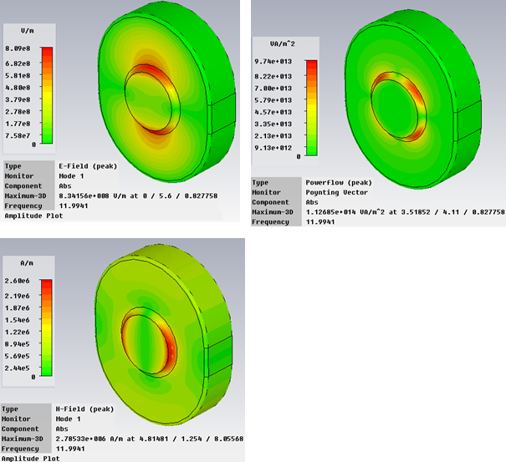
RF Design
E_{surf}
Peak electric and magnetic fields of the dipole mode are located 90 degrees from each other on the iris
Surface Poynting flux S_{surf} is however at 45 deg to both E and H
Location of the breakdown on the iris provides critical information about the role of magnetic field in breakdown.
The cavity has a large Sc but relatively low E and H fields at the surface so this also provides an independent verification of new theories.
H_{surf}
Property | Crab cavity | CLIC_G
Mode | 120° , 11.9942 GHz | 120° , 11.9942 GHz
Q | 6247 | 6100-6265
V_{group} | -2.9 %c | 1.66-0.83 %c
Kick | 2.55 MV | NA MV
Gradient | 26 MV/m | 100 MV/m
Power | 13.35 MW | 42 MW
E_{surf} | 103 MV/m | 190 MV/m
H_{surf} | 348 kA/m | 410 kA/m
ΔT (200ns) | 26 K | 21 K
Sc | 3.32 W/mm² | 3.8 W/mm²
S_{surf}=(ExH)_{surf}

Slide 21
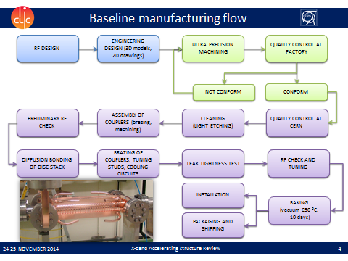
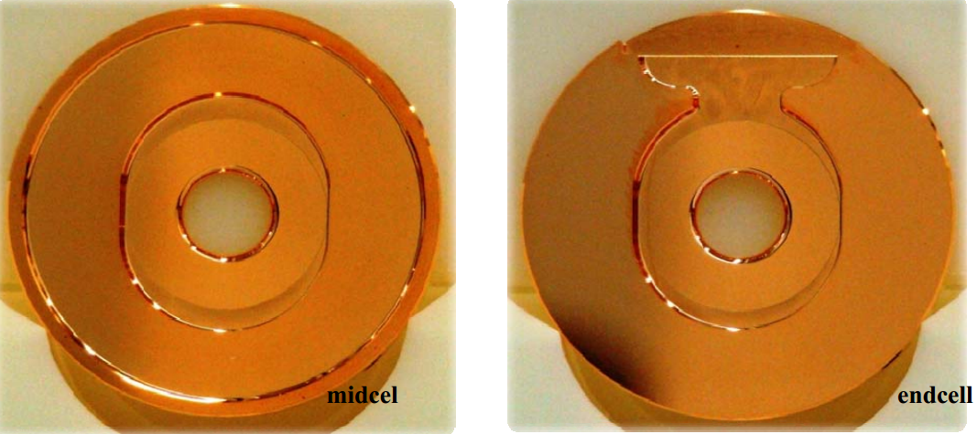
Fabrication
Manufactured with normal CERN techniques:
Discs ultra-precision machined at VDL
Stacking and alignment performed at CERN or Bodycote.
Coupler brazing and bake out at Bodycote.

Slide 22
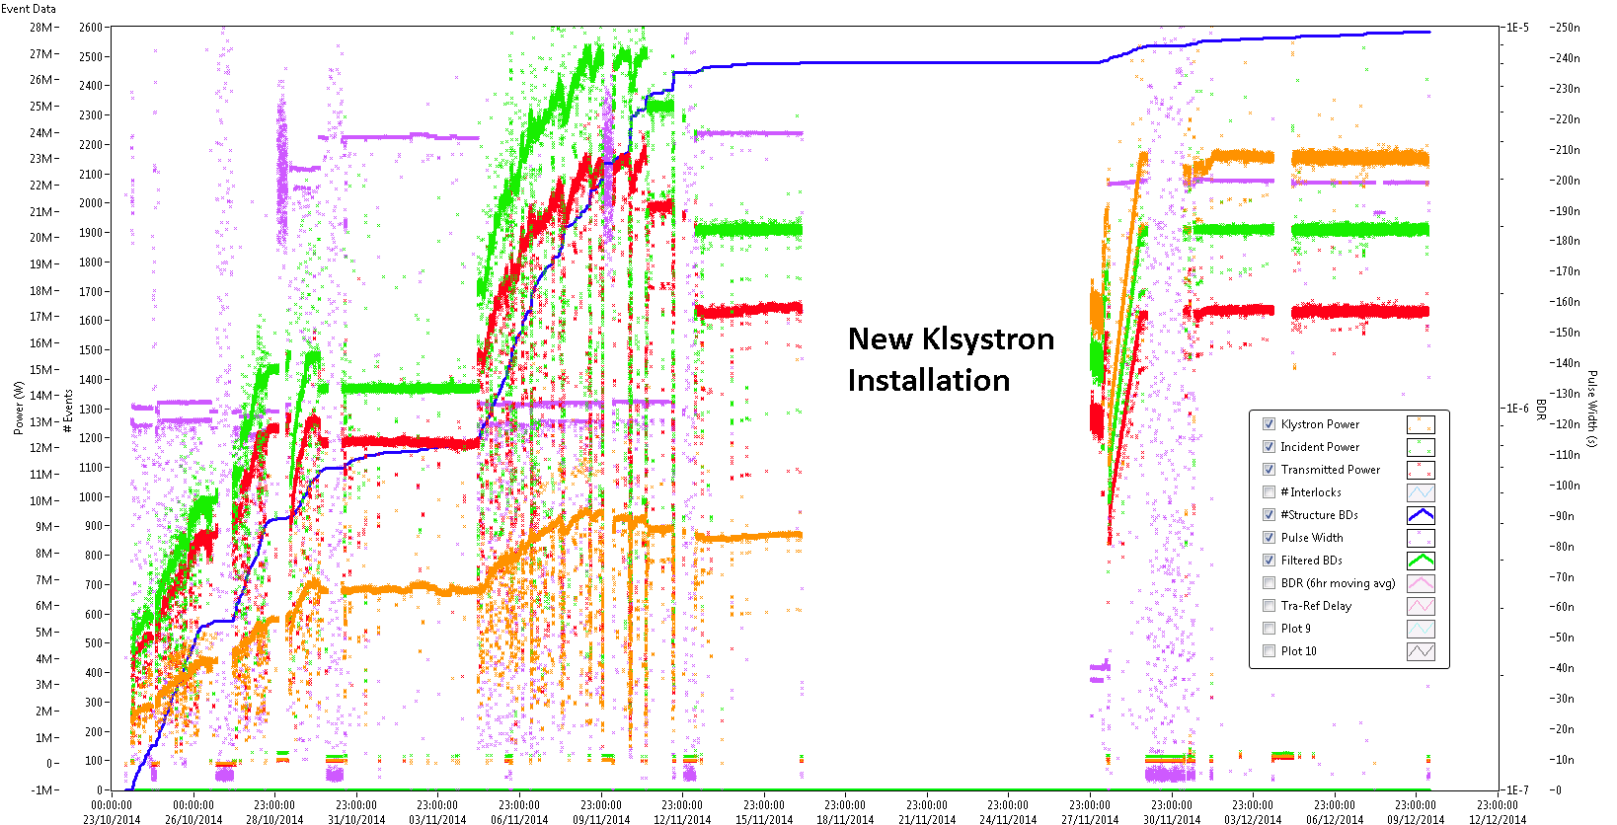
Results
23rd October – 10th December
Almost 2600 recorded breakdowns
New klystron allowed the pulse compressor to be turned off

Slide 23
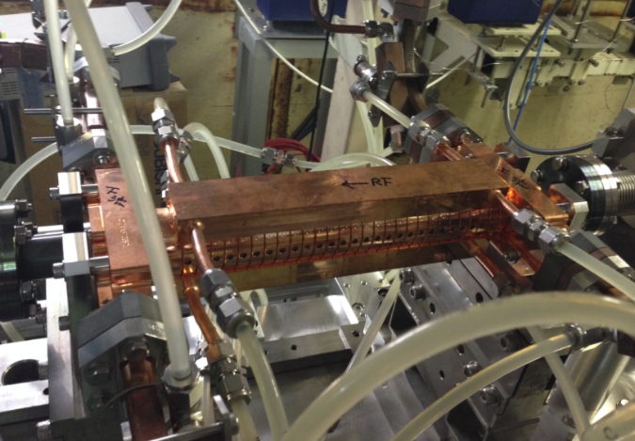
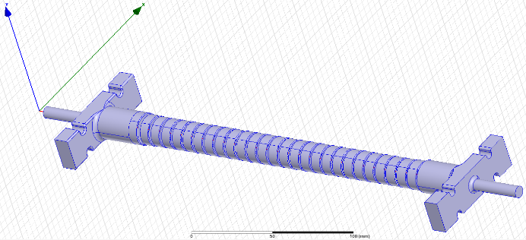
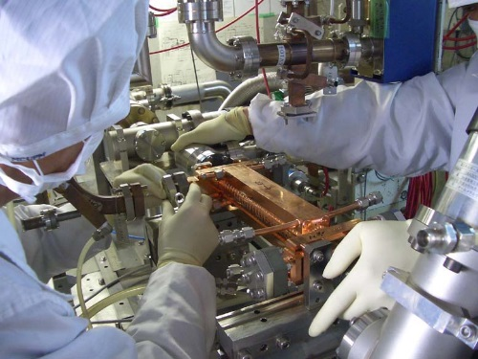
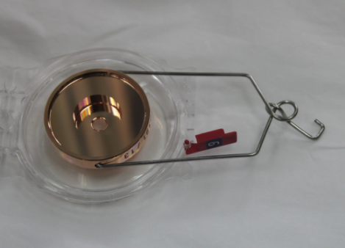
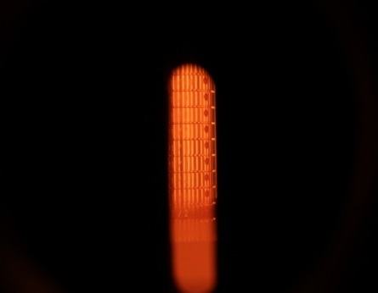
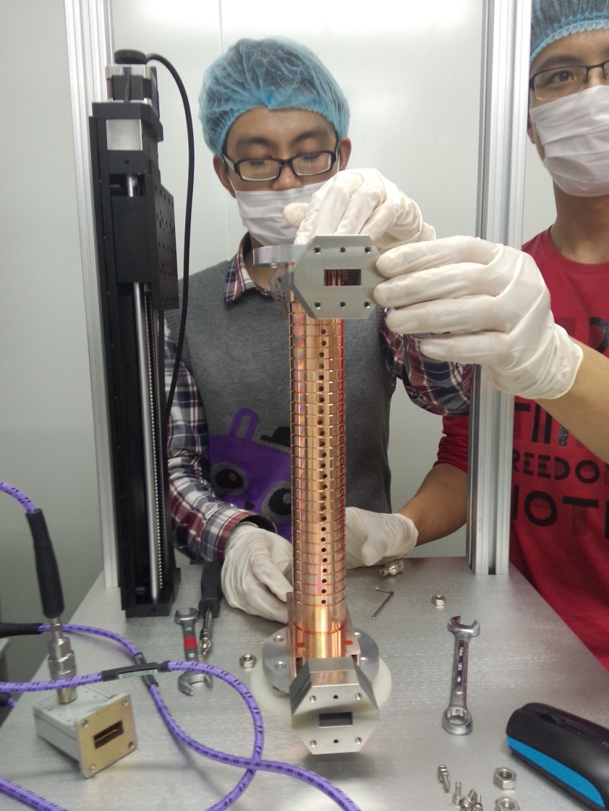
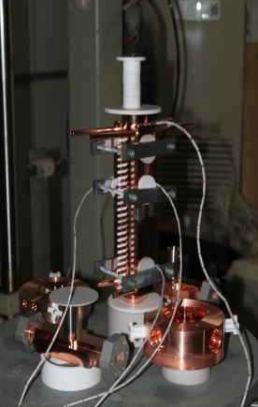
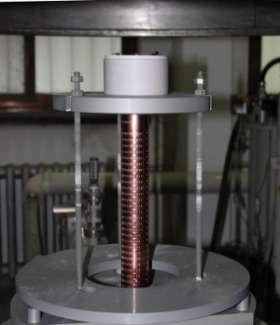
T24_THU_#1 fab/test flow
Fabrication of parts (VDL)
Design for CLIC (CERN)
High power test (Nextef-KEK)
Cleaning
Etching
(Tsinghua Univ.)
Bench test (Tsinghua Univ.)
Vac bake (Tsinghua Univ.)
Bonding Brazing
(Tsinghua Univ.)
Tuning(Tsinghua Univ.)

Slide 24
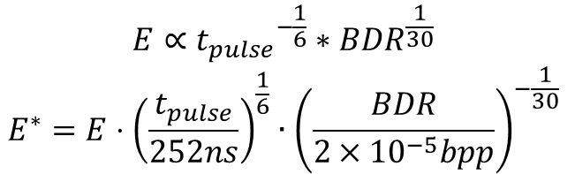
Normalized Gradient plot
Normalize to 252ns, 2e-5 bpp
$$E∝{t_{pulse}}^{−\frac{1}{6}}∗{BDR}^{\frac{1}{30}}$$
$$E^{∗}=E⋅{\left(\frac{t_{pulse}}{252ns}\right)}^{\frac{1}{6}}∙{\left(\frac{BDR}{2×{10}^{−5}bpp}\right)}^{−\frac{1}{30}}$$

Slide 25
Compare with other T24 testing results (2)
T24_THU_#1 costs more time to reach 100 MV/m at 51ns pulse width but having a smaller BDR compared with T24_Dogleg
T24_#3 shows an excellent performance with higher ramping speed and less breakdowns
Full conditioning
BDR~6.35e-5bpp
BDR~1.97e-5bpp
Full conditioning
Only 50ns conditioning
BDR~0.79e-5bpp

Slide 26
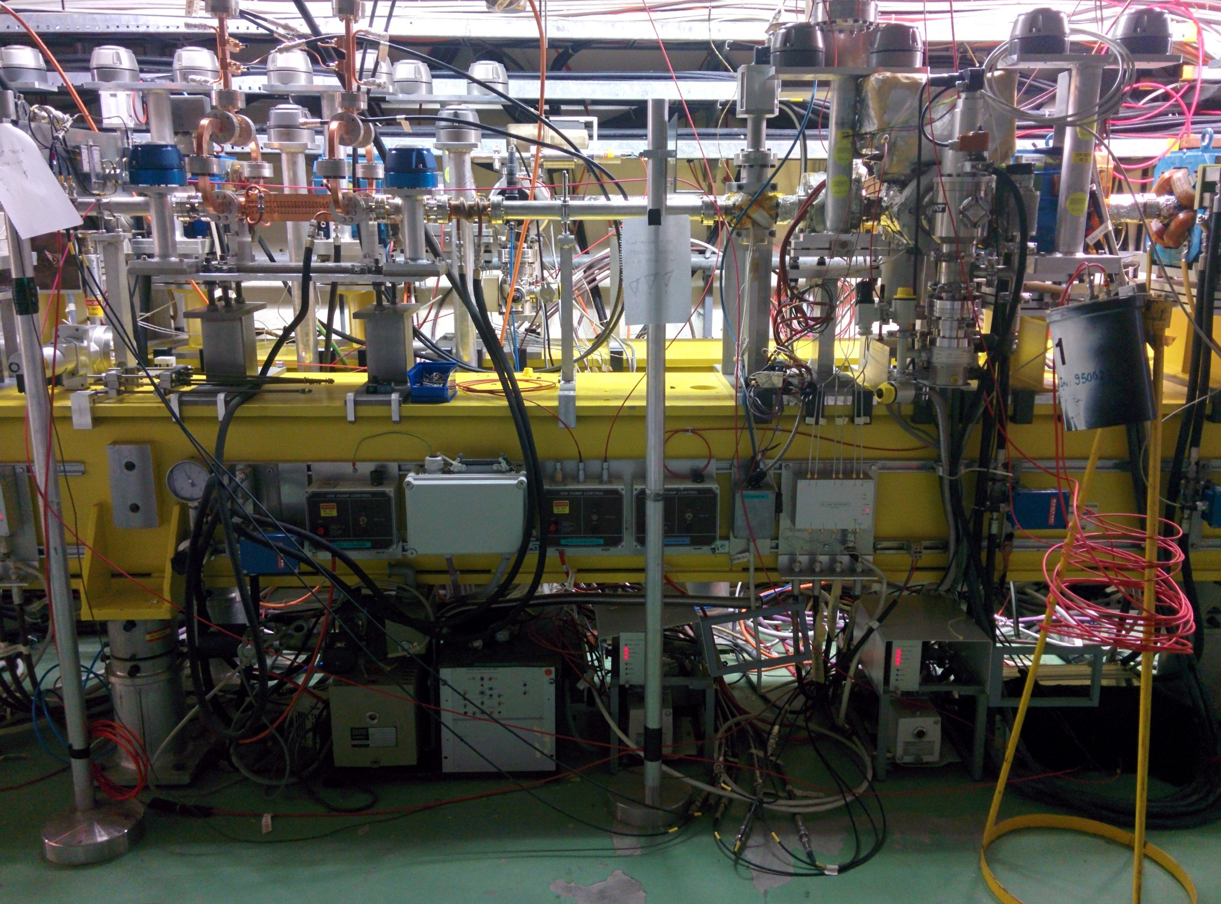
Diagnostic, control and protection
12 GHz RF output
12 GHz RF input
Vacuum pumps and gauges
Beam
6 mm collimator
BPM upstream
12 GHz
ACS
Fibre and diamond BLMs
12 GHz accelerating structure surrounded by a complete set of instrumentation:
2 inductive BPMs (1 upstream and 1 downstream)
6 mm collimator to protect the structure
Fibre optic and diamond beam loss monitors
Vacuum pumps and gauges in beam chamber and RF waveguides
BPM
downstream
BPMs
BLMs
Collimator
Vacuum readings
Interlock system
Notes:
It is surrounded by a full set of equipement
An upstream and a downstream BPM allows to measure beam transmition through the structure.
A 6mm collimator prevents damages to the structure in case of uncontrolled beam losses
Fibre optic and diamond detectors allow to check beam loses and detects breakdowns.
Directional RF couplers allow measurements of input, output and reflected power from the structure.

Slide 27
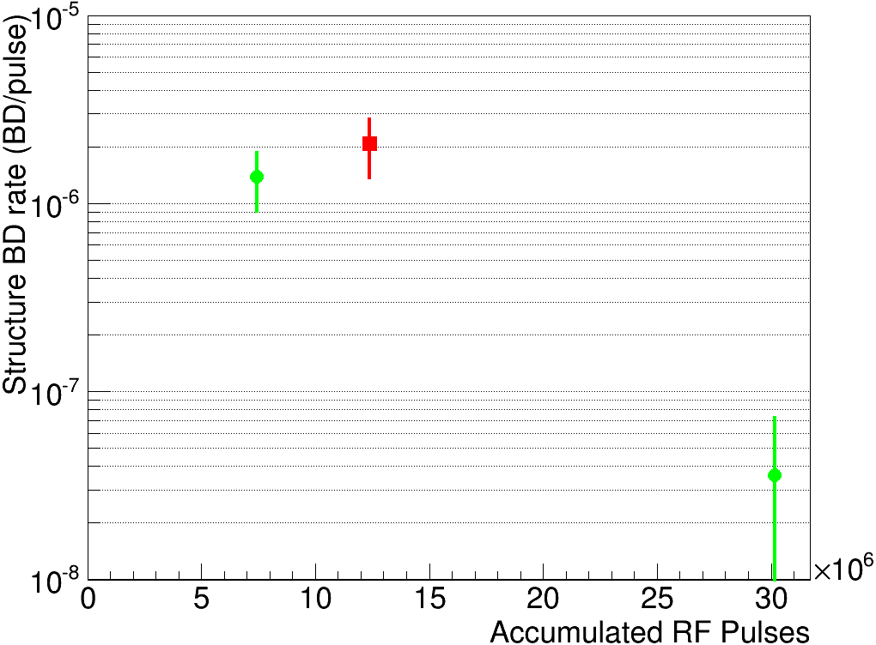
First Results: BDr
Compatible with previous result at 29 MW input power
Gradient, MV/m
Length, m

Slide 28
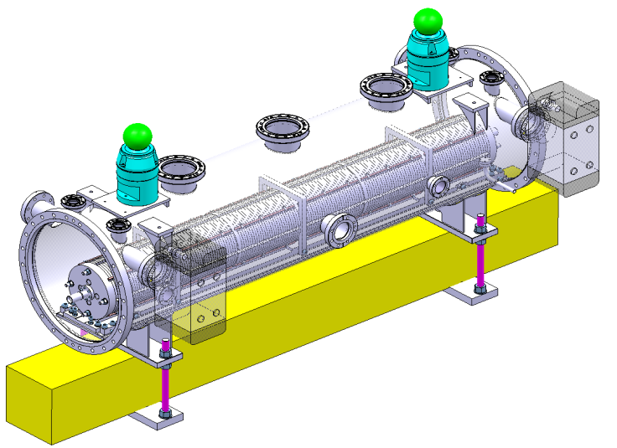
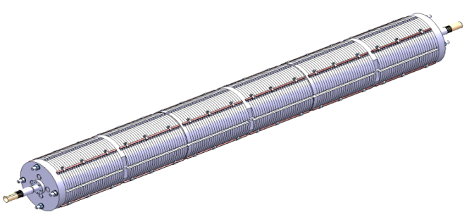
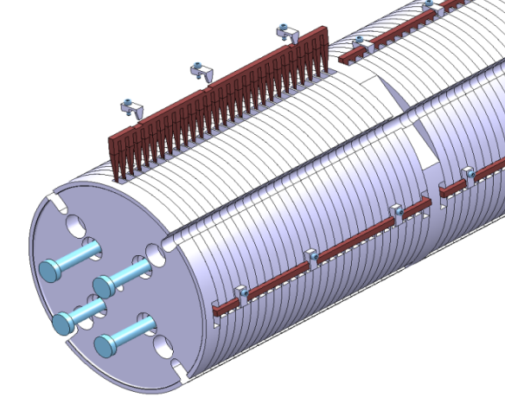
Direct wakefield measurement in FACET
Prototype structure are made of aluminium disks and SiC loads (clamped together by bolts).
6 full structures, active length = 1.38m
FACET provides 3nC, 1.19GeV electron and positron.
RMS bunch length is near 0.7mm.
Maximum orbit deflection of e- due to peak transverse wake kick (1mm e+ offset): 5mm, BPM resolution: 50um
AS
AS
AS
AS
AS
Aluminium disk
AS
Damping
material (SiC)
e-, NRTL
e+, Driven bunch
Dump
e-, Witness bunch
Dipole
Dipole
e+
Kick
Downstream BPMs
e-
CLIC-G TD26cc
Transverse offset
deflected orbit
e+, SRTL

Slide 29
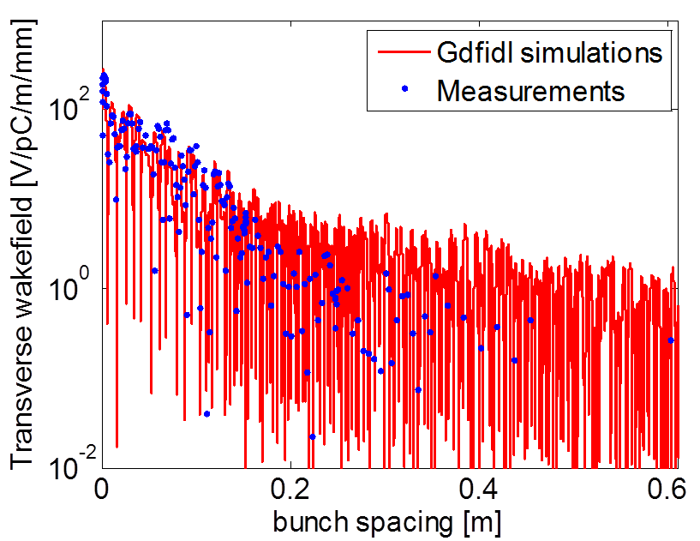
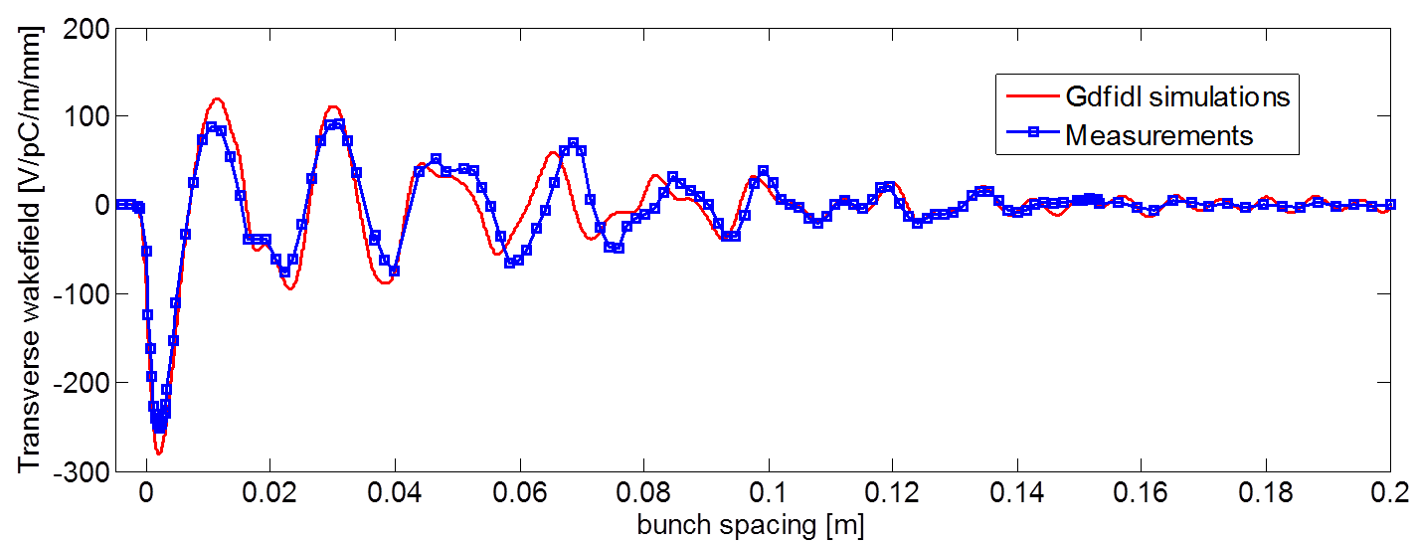
Final results
We measure the absolutely wakefield value, peak value 10% lower than simulations.
Wake potential at second bunch seperation = 4.5V/pC/m/mm.
Decay faster than simulation.

Slide 30

The TULIP Project
70 MeV
new 3 GHz bwTW structure
11m 5-6 m
230 MeV
5 MeV
Low β structure
750 MHz RFQ
CERN
Notes:
But first, let me start wit an introduction on the TULIP project.
Single room proton therapy facility which foreseen a linac mounted on a rotating structure, which we call a “gantry”
It’s of course of great interest to have the linac as compact as possible. So few years ago there was this idea of collaborating with the CLIC group in order to transfer the knowledge, in terms of high gradient structure, to a medical accelerating structure.
The result of this collaboration is this 3 GHz bwTW structure that I will talk about.

Slide 31




RF design
The Sc/Ea² constraint has been widely respected
A reflection lower than -50 dB at the resonant frequency of 2.9985 GHz has been reached
Even electric field profile along the structure
Phase advance of 5π/6 at the operating frequency chosen
Notes:
So, I will not dedicate much time to the RF design. This work was partially presented at the CLIC workshop of last year. But to summarize:
We managed to obtain an even distribution of Modified pointing vector along the structure, and below the constraint we wanted to respect
The structure has been well matched, we should have a reflection lower than 50 dB
The phase advance is 150° at the resonant frequency chosen
And we have a nice flat profile of the electric field, so the couplers do not influence the accelerating gradient profile.
If you are interested in learning more about the work done, you can also refer to the proceeding of Linac14, where we have presented this work.

Slide 32



Mechanical design
How did we come to this?
Tolerances specification
Creep analysis and test
Tuning analysis and test
Thermal and stress analysis
Cell drawings released
for tender in Fall 2014
Notes:
Now, the mechanical design
This is how the structure will look like when we’ll finish to braze everything together.
So we have 4 cooling plates, then we have 4 dimple tuners per cell, then the two couplers with the wg adptation and standard S-band flanges, and here the flanges for the beam pipe.
The drawnings have been released for tender a couple of months ago, and now we received the first test pieces of the structure, I’ll show a picture later.
But first, I will present you a bit the work done from the mechanical point of view, which can be summarized with tolerances specification, creep, tuning, and thermal/stress
I will not present anything on tolerances specification, it was just to mention that there was a lot of back and forth between RF side and mechanical side to find the best compromise in this regard…

Slide 33

Xband accelerating structures review 24-25.11.2014
N. Catalan Lasheras

Slide 34
Participants
31 participants including outside laboratories
D. Schulte, CERN/ABP
PH. Lebrun, S. Stapnes, CERN/DG
S. Atieh, A. Cherif, G. Favre, M. Garlache, A. Perez Fontenla, CERN/MME
M. Aicheler, O. Brunner, N. Catalan Lasheras, M. Filippova, A. Grudjev, D. Gudkov, S. Lebet, A. Olyudnin, C. Rossi, A. Solodko, I. Syratchev, J. Vainola, A. Xydou, B. Woolley, W. Wuensch, CERN/RF
M. Taborelli, M. Thiebert, CERN/VSC
F. Toral, L. Sanchez. Ciemat, Spain
T. Higo, T. Abe, KEK, Japan
M. Franzi, J. Weng, SLAC, USA
23 talks plus discussions
2 long days

Slide 35

Baseline manufacturing flow
RF DESIGN
ENGINEERING DESIGN (3D models, 2D drawings)
QUALITY CONTROL AT FACTORY
RF DESIGN
ENGINEERING DESIGN (3D models, 2D drawings)
ULTRA PRECISION MACHINING
QUALITY CONTROL AT FACTORY
Add a final dimensional control
CONFORM
NOT CONFORM
CONFORM
NOT CONFORM
PRELIMINARY RF CHECK
QUALITY CONTROL AT CERN
PRELIMINARY RF CHECK
ASSEMBLY OF COUPLERS (brazing, machining)
CLEANING
(LIGHT ETCHING)
QUALITY CONTROL AT CERN
DIFFUSION BONDING OF DISC STACK
BRAZING OF COUPLERS, TUNING STUDS, COOLING CIRCUITS
LEAK TIGHTNESS TEST
RF CHECK AND TUNING
LEAK TIGHTNESS TEST
RF CHECK AND TUNING
INSTALLATION
INSTALLATION
BAKING
(vacuum 650 °C,
10 days)
PACKAGING AND SHIPPING
PACKAGING AND SHIPPING

Slide 36
Discussion on surface treatment
No etching should be done on disks anymore.
  Only solvent cleaning.
  Thus no dimples should be allowed in the RF part larger than? Ra?
  Burrs and machining steps need to be under control
Test on oxide to be prepared. XPS measurements of oxide layer growth.
  Bonding cycle on oxidised samples to assess the bonding quality and the “deoxidising” capacity of the heating cycle. Action: Mauro, Serge.
Handling from the reception of the disks needs to be reviewed. Action Nuria
  Beware of Carbon contamination
Stress relieve temperature much lower than in SLAC, KEK and CIEMAT. Is this a concern? Action Said

Slide 37


Building a community

