Slide 1


Linacs for Cargo Screening
Dr Graeme Burt
Lancaster University, Cockcroft Institute
CERN High gradient Day 2015

Slide 2
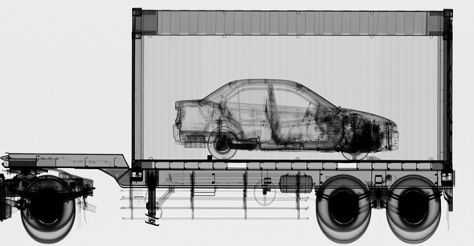
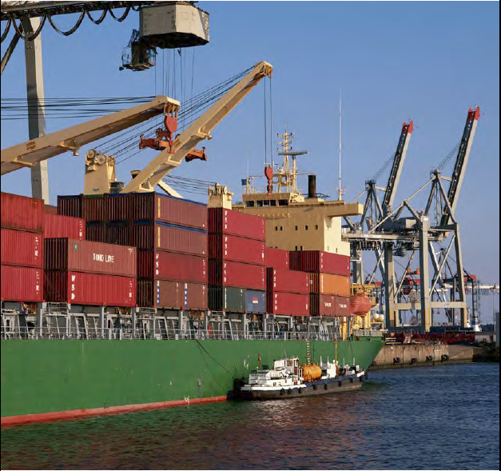
Cargo screening
A major use is in cargo screening to ensure that what is in a shipping container is what is in the manifest and not cash, drugs, gold, uranium, cigarettes or cars.

Slide 3
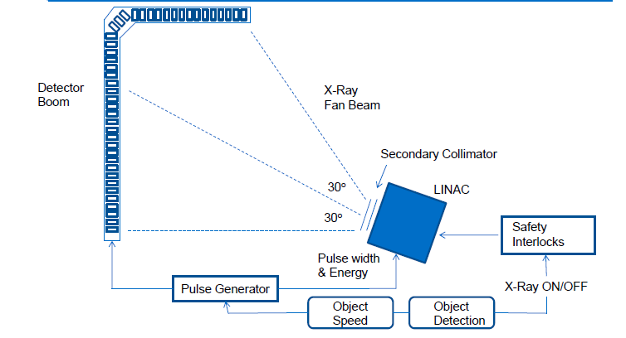
Linac and Array set-up

Slide 4
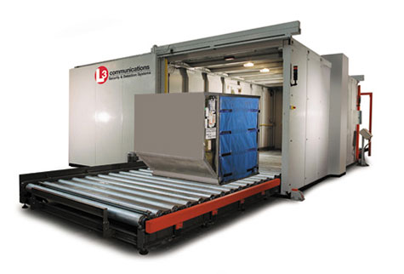
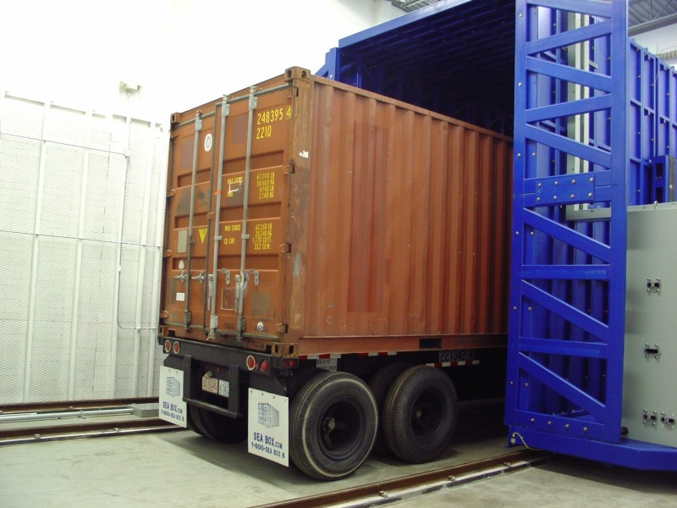
Horizontal Resolution
The horizontal resolution is created by moving the object or the linac in time.
For trucks they go through the scanner at a few mph
For air cargo they go on a conveyor
For shipping containers the gantry moves

Slide 5
Linac Specifications
Penetration
Energy | 1.25 MeV | 2 MeV | 3 MeV | 4 MeV | 6 MeV | 9 MeV
Steel | 133 mm | 205 mm | 297 mm | 352 mm | 406 mm | 430 mm
Water | 880 mm | 1370 mm | 2050 mm | 2530 mm | 3160 mm | 3640 mm
Below 2 MeV X-rays do not penetrate heavy cargo, and above 9 MeV requires shielding from neutrons produced. Typically systems operate 3-6 MeV.
For aviation cargo which are typically much smaller 1-3 MeV is used.
Linacs are typically pulse at 50-500 Hz with 4 μs pulses, and peak currents of 100 mA.
Normally magnetron driven for size and cost but some high energy Klystron systems are available

Slide 6
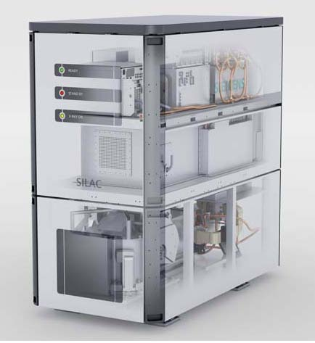
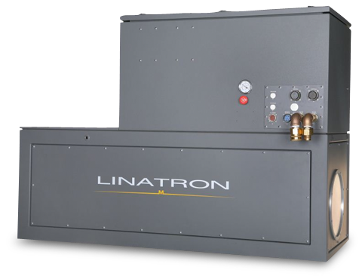
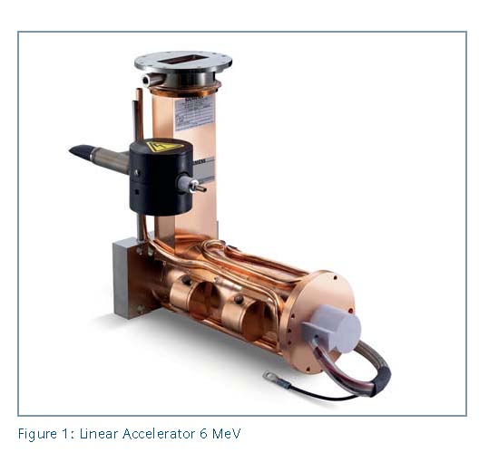
Typical Systems
Unlike medical linacs most security linacs are side-coupled standing wave linacs.
To improve reliability the gradient is only 10-20 MV/m
Silac
Linatron M9
As well as the RF structure the unit also contains a magnetron (RF source), vacuum pumps, modulator (for the magnetron), HVDC power supply, an electron gun, a target and water cooling.

Slide 7
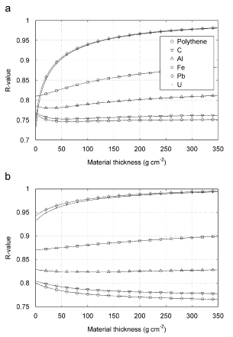
Material Separation
Different materials have slightly different attenuation coefficients.
If we do a measurement at a single energy we get the product of the attenuation coefficient and the path travelled, two unknowns.
Hence we need two different measurements to resolve both, this is normally done by using two different X-ray energies.
R is the ratio of mass attenuation coefficients, μ, given by
Where I is the intesity with the cargo in place and I0 is the intensity with no cargo for energy 1 and 2.
R for 5 and 9 MeV
R for 5 and 9 MeV filtered with lead

Slide 8
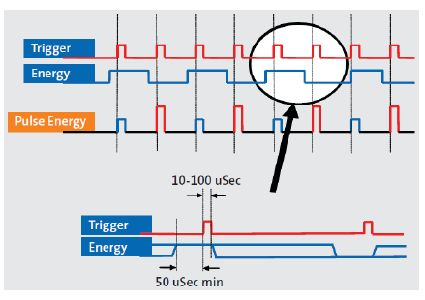
Dual Energy
Typically the linac will produce two interleaved energies.
The energy is varied by varying the power supplied from the magnetron.
This means the current from the modulator needs to vary, this takes time to switch so the pulses have to be at least 50 μs apart.

Slide 9
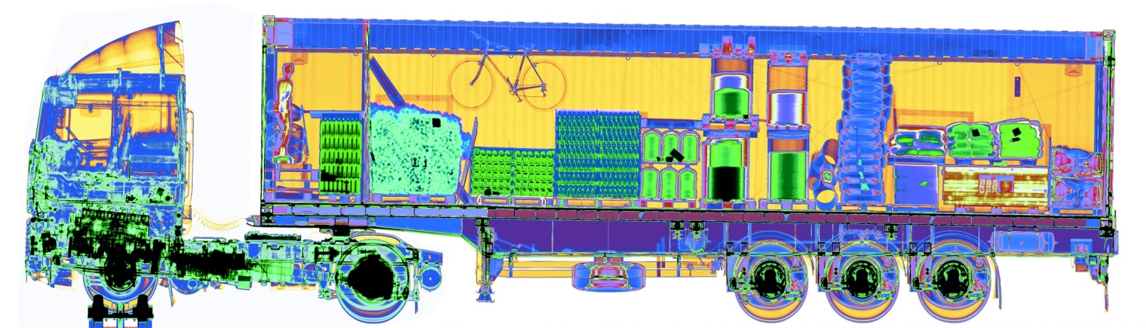
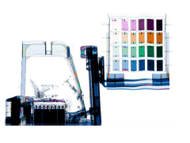
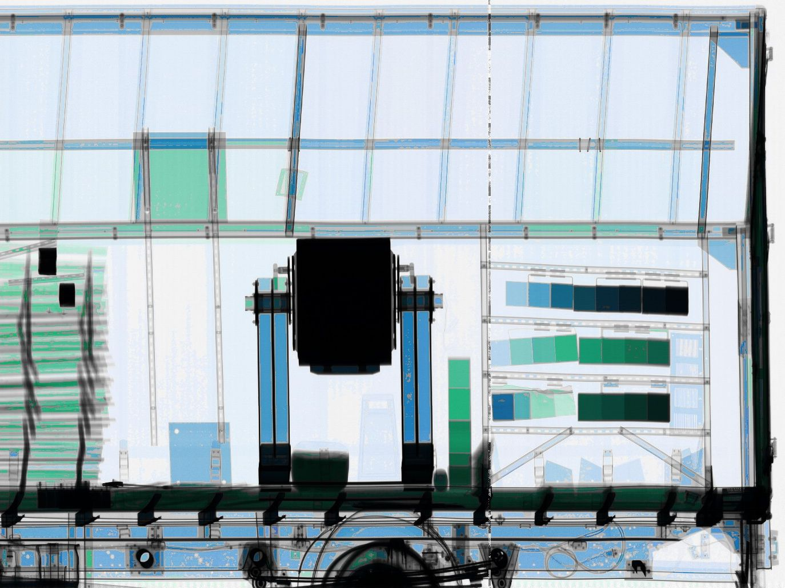
Dual Energy Images
The R value is dependant on Z so we can designate colour with Z on the images. High Z materials are red low Z is blue.

Slide 10
Current/Future developments
Time of flight Compton Backscatter
  Alloys 3D images to be created with access to only one side. Handling distortion cased by intensity dropping with distance is a challenge. Improved resolution can be achieved with smaller pulse lengths with higher current. Needs a higher current due to low backscattered dose.
CW linacs
  Lower peak dose, and easier for detector to deal with temporally.
Phase contrast
  Offers better contrast for low Z materials (a weakness in X-ray scanners).

Slide 11
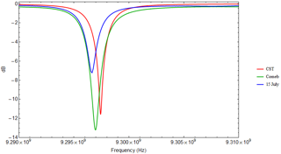
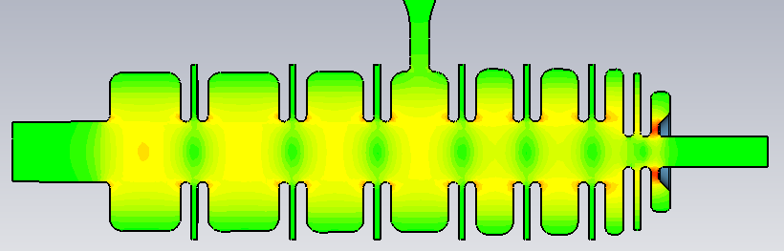
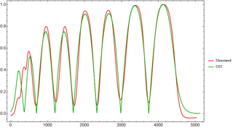
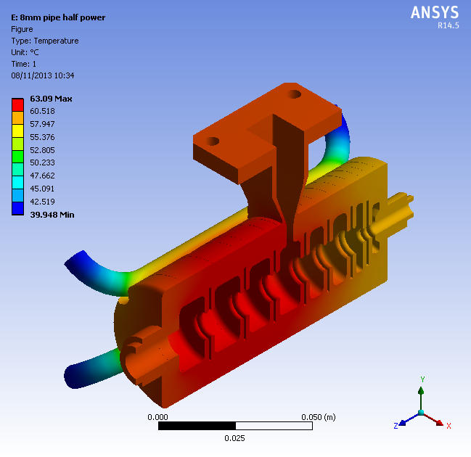
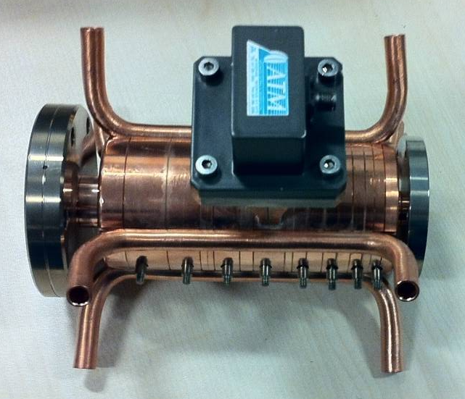

Lancaster/STFC X-band structure
We have developed a new X-band structure with much greater cell-to-cell coupling to increase tolerances.
Simple structure design with no slots to help tolerances (low fields and low voltage make this acceptable)
Built by Comeb, Italy

Slide 12
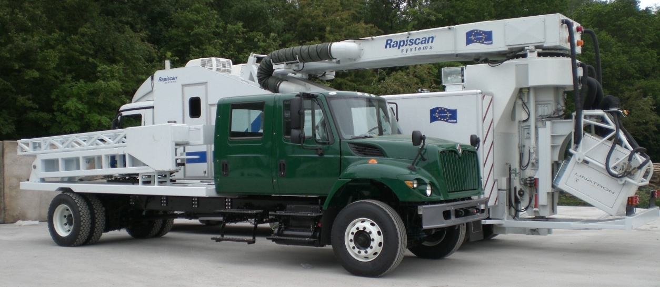
Why X-band?
For a mobile linac mounted on a robotic arm the weight of the linac is critical.
While the linac isn’t very big or heavy the shielding is.
X-band means that the shielding diameter is much less.
Area of shielding is given by
(2r_{cav}t_{shield} + t_{shield}²)π
Availability of 9.3 GHz magnetrons

Slide 13
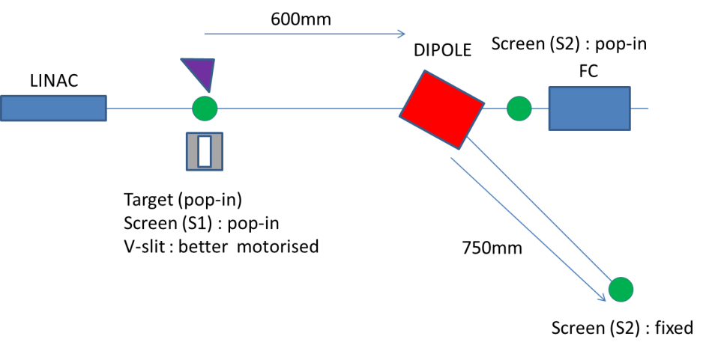
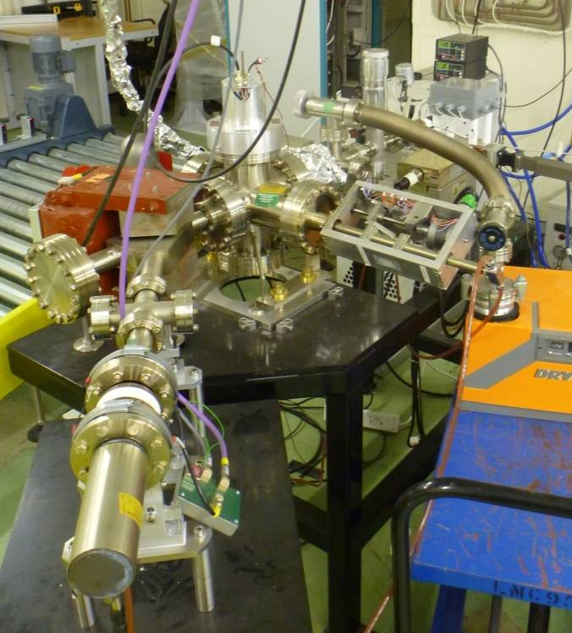
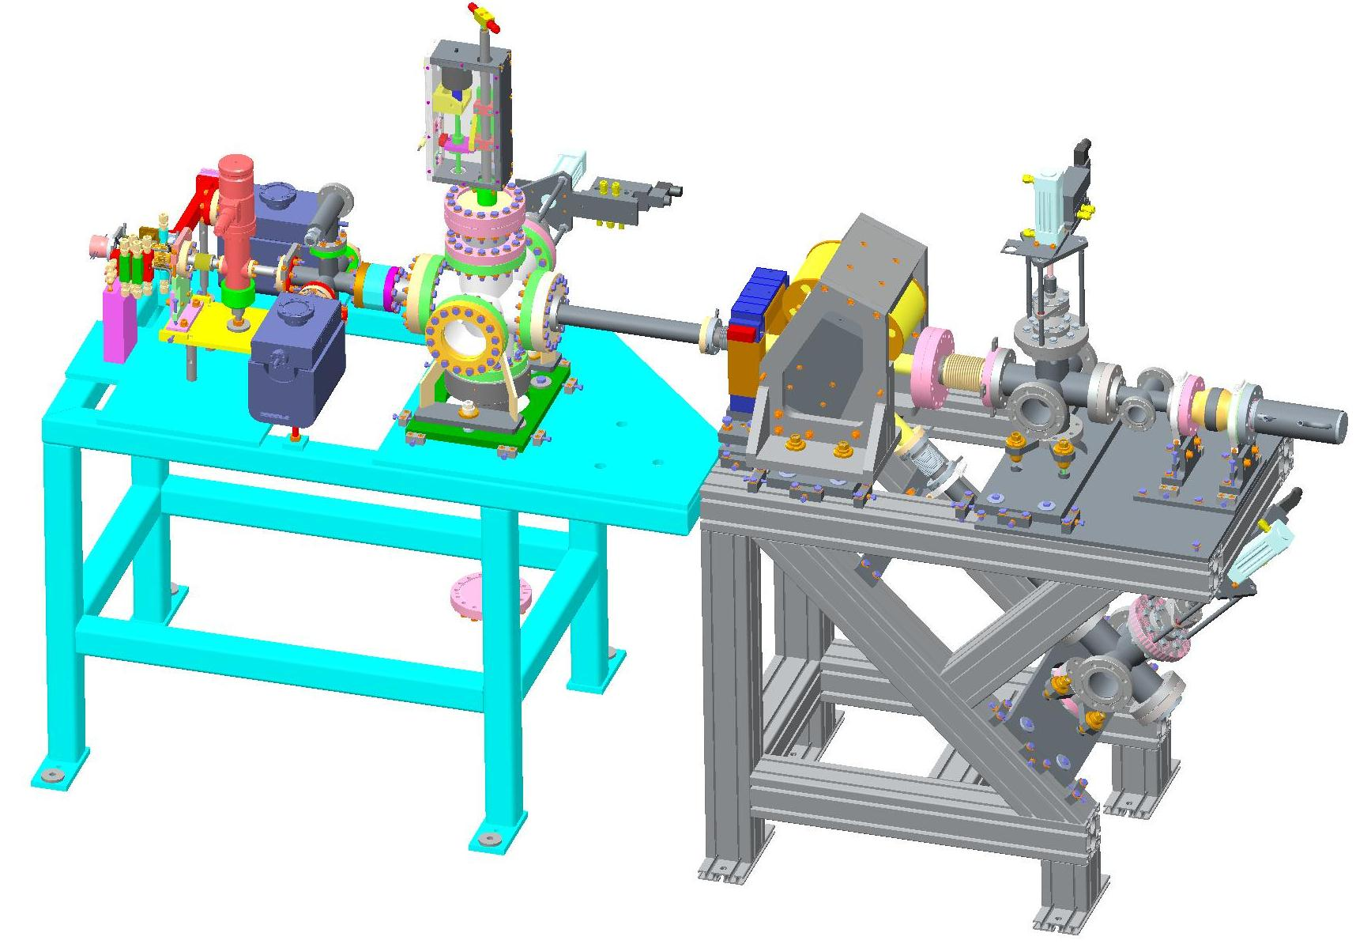
Diagnostics Line
In order to fully diagnose the beam from the linac we have a diagnostics line fitted to the output.
We have a motorised section which can either provide a slit, a screen, a tungsten target or vacuum.

Slide 14
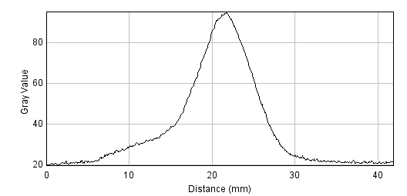
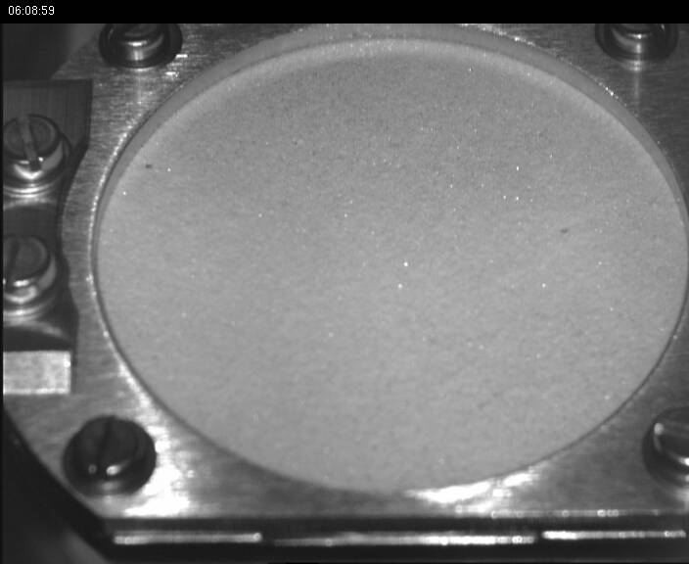
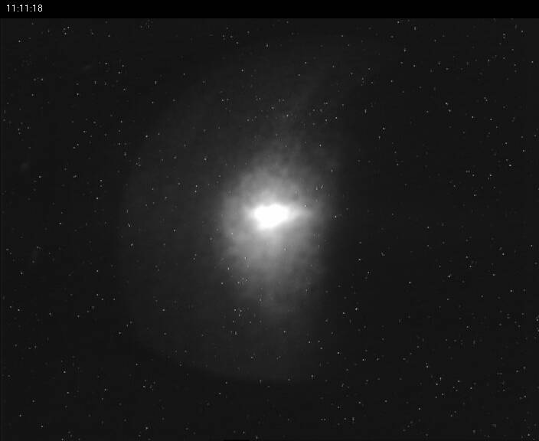
Spot Size
Spot size measured on phosphor screen at 3 mm.
This is a few cm away from the linac so we still need to work out the size at the linac exit.
We capture around 30-40% of the current emitted from the gun.

Slide 15
Energy spectrum
An energy up to 1.5 MeV has been produced.
The energy spread is strongly correlated with bunch charge.

Slide 16
Conclusion
Linacs are routinely used for cargo screening
New linacs are required for the next generation of scanning systems
X-band reduces the shielding weight and transverse size which is critical for mobile systems
This also means a bi-periodic on-axis coupled structure is prefered
Lancaster and STFC have developed a 1 MeV system for aviation cargo (and possibly NDT) and are currently developing a 1-3 MeV system.

