Slide 1
PHIN Results
Christoph Hessler, Eric Chevallay, Steffen Doebert, Valentin Fedosseev, Irene Martini, Mikhail Martyanov
CLIC Workshop 2015, CERN
27.01.2015

Slide 2
Motivation for a CLIC Drive-Beam Photoinjector
A conventional system (thermionic gun, sub-harmonic buncher, RF power sources) is not necessarily more reliable than a photoinjector. At CTF3 e.g. the availability of the CALIFES photoinjector is high.
With a photoinjector in general a better beam quality can be achieved than with a conventional system.
Conventional system (thermionic gun, sub-harmonic buncher) generates parasitic satellite pulses, which produce beam losses.
  Reduced system power efficiency
  Radiation issues
These problems can be avoided using a photoinjector, where only the needed electron bunches are produced with the needed time structure.
→ Has been demonstrated for the phase-coding in 2011.
M.Csatari Divall et al., “Fast phase switching within the bunch train of the PHIN photo-injector at CERN using
fiber-optic modulators on the drive laser”, Nucl. Instr. And Meth. A 659 (2011) p. 1.

Slide 3
Challenges for a CLIC Drive-Beam Photoinjector
Achieve long cathode lifetimes (>150 h) together with high bunch charge (8.4 nC) and high average current (30 mA)
Produce ultra-violet (UV) laser beam with high power and long train lengths (140 µs)
  UV beam degradation in long trains
  Thermal lensing and heat load effects?
High charge stability (<0,1%)
→ Vacuum improvement, new photoemissive materials,
new cathode substrate surface treatment
→ Usage of Cs₃Sb cathodes sensitive to green light
→ New UV conversion schemes with multiple crystals
→ Study the dynamics of laser system with full CLIC specs
→ Feedback stabilisation, new laser front end
Photocathode R&D
Photoinjector optimization and beam studies
Laser R&D

Slide 4
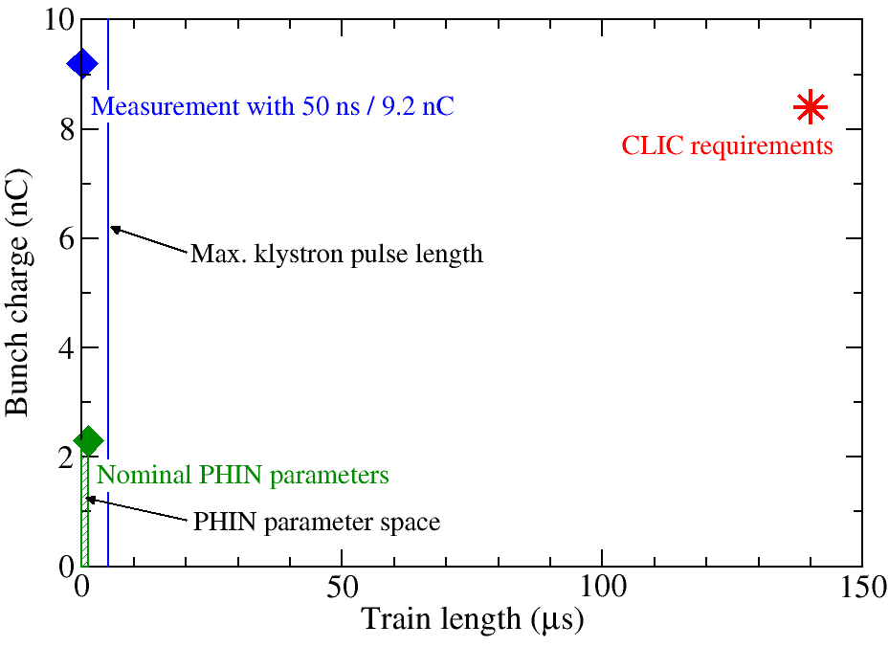
Challenge to Verify Feasibility of Drive-Beam Photoinjector
CLIC requirements far beyond PHIN specs:
One PHIN run per year with 3 cathodes to test.
→ No statistics possible under these conditions!
Photocathode lifetime measurements require long measurement periods, which are in general not available to the extend as needed.
Different macro-pulse repetition rates:
0.8 – 5 Hz (PHIN)
50 Hz (CLIC)

Slide 5
Recent R&D Activities at PHIN
Since a strong negative impact on vacuum level is expected for CLIC parameters, the vacuum level in PHIN has been improved and its impact on photocathode performance studied:
  Lifetime studies with Cs₂Te cathode under improved vacuum conditions.
  Lifetime studies with Cs₃Sb cathodes and green laser light under improved vacuum conditions.
Focus on Cs₃Sb cathodes sensitive to green light:
  Lifetime measurements.
  RF lifetime measurements.
  Dark current studies.
Long-term measurement with Cs₂Te under nominal operating conditions (2.3 nC, 1.2 µs)
Studies for AWAKE project:
  Emittance measurement with low intensity beam to investigate PHIN’s suitability for AWAKE.
  QE measurement of copper cathode for defining QE requirements for AWAKE.

Slide 6
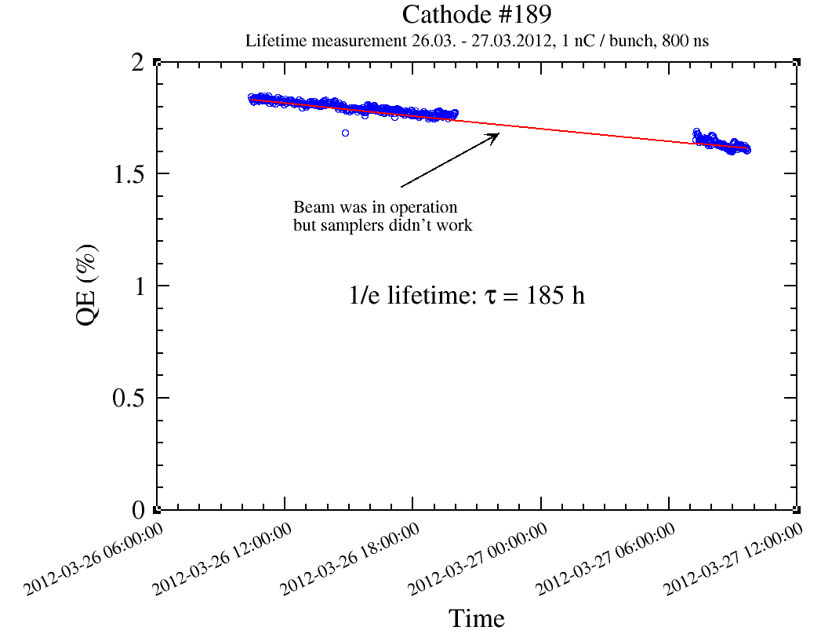
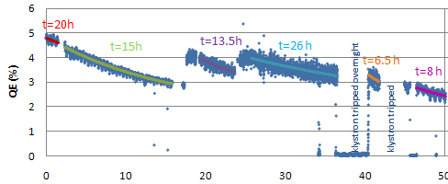
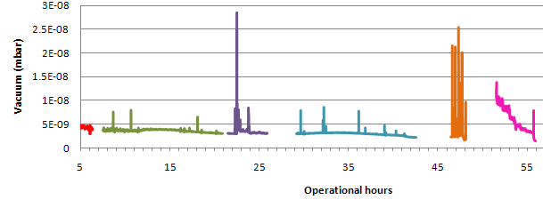
Improvement of Vacuum in PHIN
March 2011
March 2012
July 2013
Dynamic vacuum level:
4e-9 mbar
Static vacuum level:
2.2e-10 mbar
Activation of NEG chamber around gun
Installation of additional NEG pump
7e-10 mbar
1.3e-10 mbar
<2e-10 mbar
2.4e-11 mbar
1/e lifetime 26 h
1/e lifetime 185 h
1/e lifetime ?
1 nC, 800 ns, λ=262 nm, Cs₃Sb
1 nC, 800 ns, λ=524 nm, Cs₃Sb

Slide 7
Photocathodes Used during PHIN Run 2014
Number | Material | Age | QE in DC gun | QE in PHIN
#198 | Cs₂Te | New cathode, produced 05.03.2014 | 14.8% after production | ~10%
#199 | Cs₃Sb | New cathode, produced 27.5.2014 | 5.2% after production | 4.9%
#200 | Cs₃Sb | New cathode, produced 7.8.2014 | 5.5% after production | 3.9%
6A56 | Cu | Copper plug (Diamond powder polished) used for RF conditioning | 2e-4 after PHIN run | 3e-4
Test for
AWAKE
In 2014 the initial QE of Cs₂Te and Cs₃Sb cathodes in PHIN was in reasonable agreement with the measurements in the DC gun.
QE of Cu cathode was too high compared with best literature values (1.4e-4) . Maybe contaminated with Cs.

Slide 8
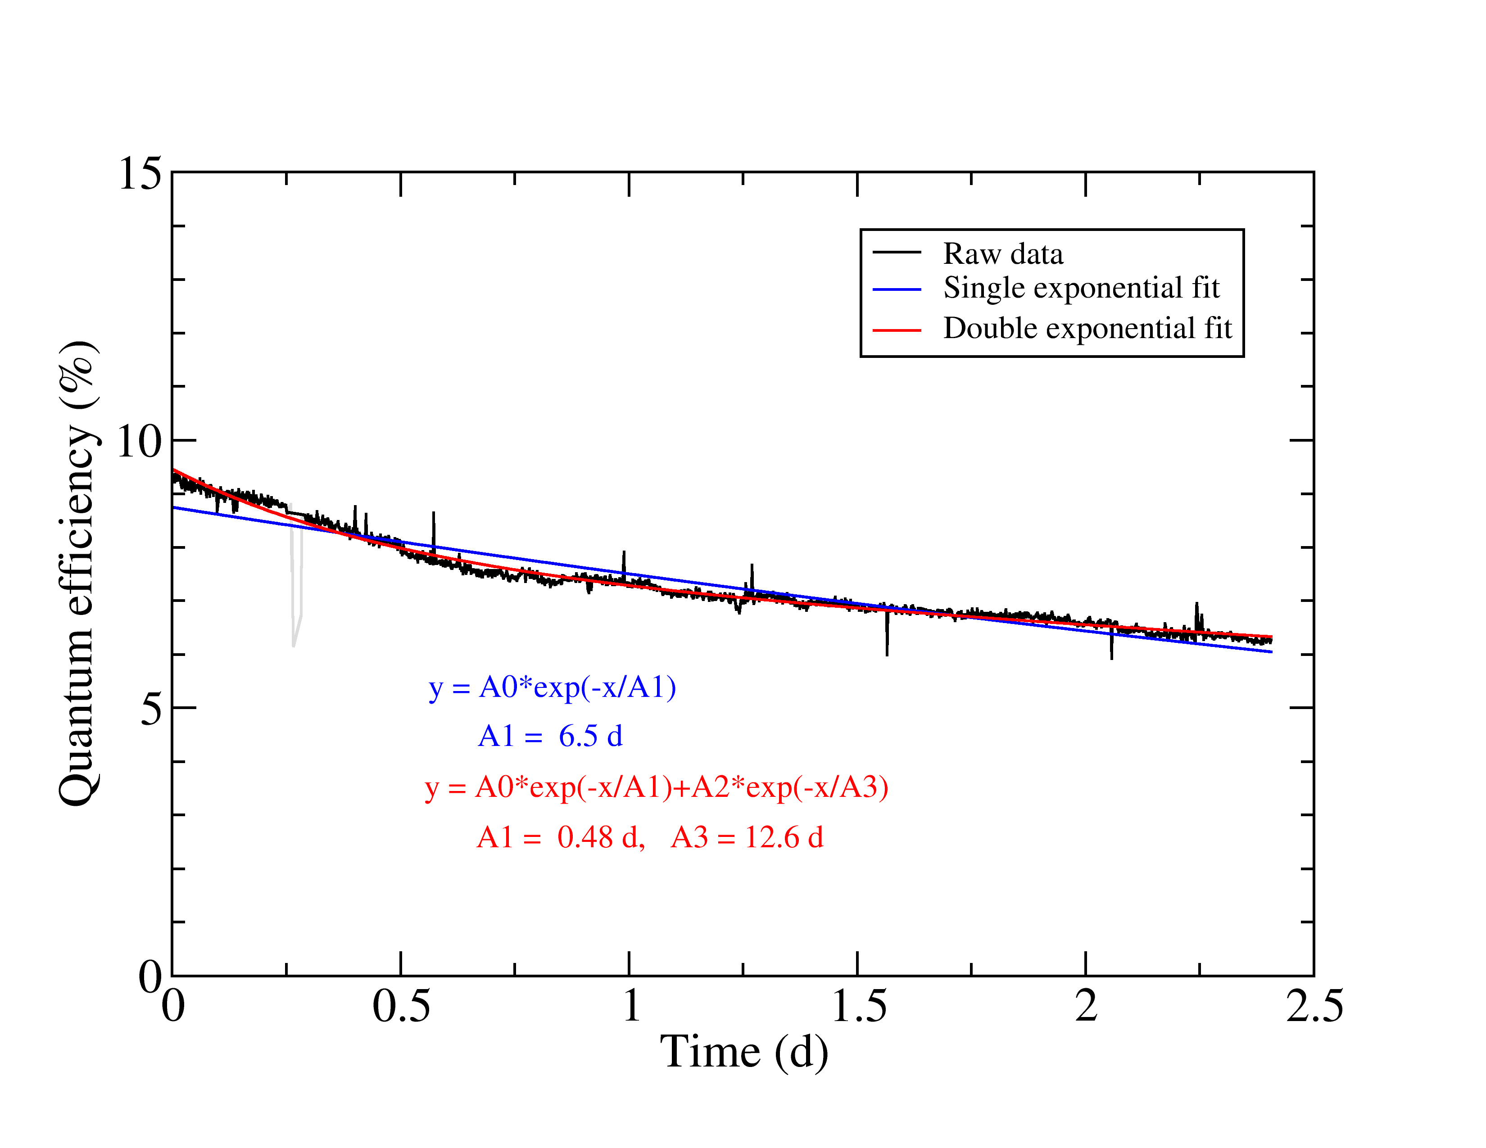
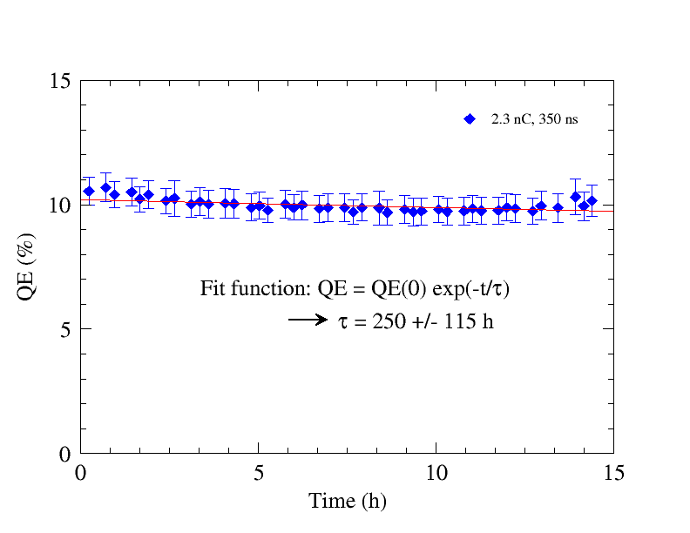
Lifetime Measurement with Cs₂Te Cathode
Under improved vacuum conditions:
Double exponential fit represents well the data
Lifetime similar to previous measurement.
Cs₂Te is not ultra-sensitive against non-optimal vacuum conditions
Dynamic pressure: 3e-10 mbar 1.5e-9 mbar
2014
2011
τ₂ = 300 h
2.3 nC, 350 ns, Cs₂Te #198
2.3 nC, 350 ns, Cs₂Te #185

Slide 9
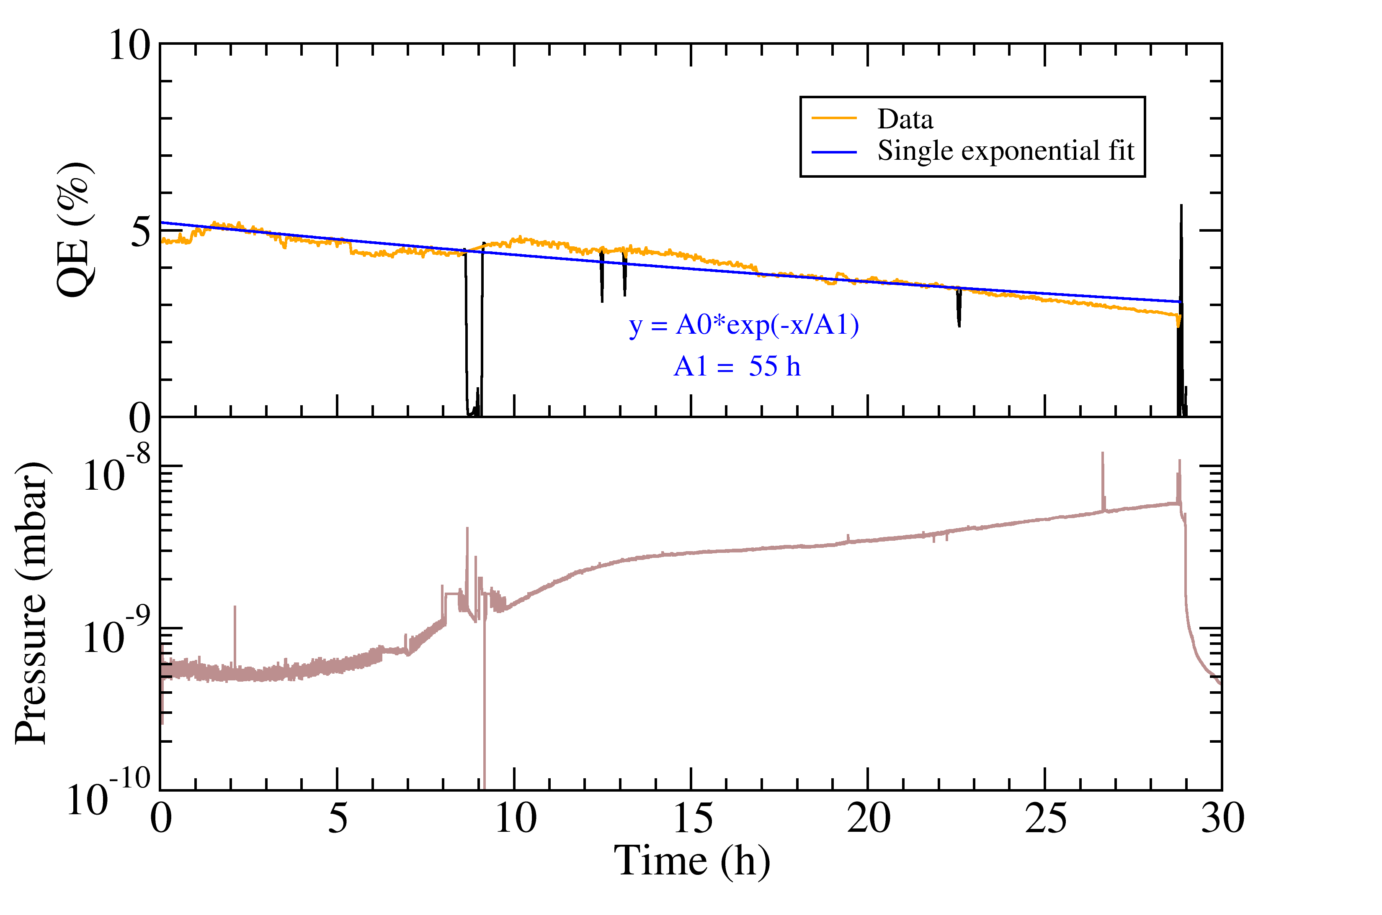
Lifetime Measurement with Cs₂Te Cathode
Under nominal operation conditions (2.3 nC, 1.2 µs)
Strong pressure increase. Heating of (uncooled) Faraday cup?
1/e lifetime still 55 h
2.3 nC, 1.2 µs, Cs₂Te #198

Slide 10
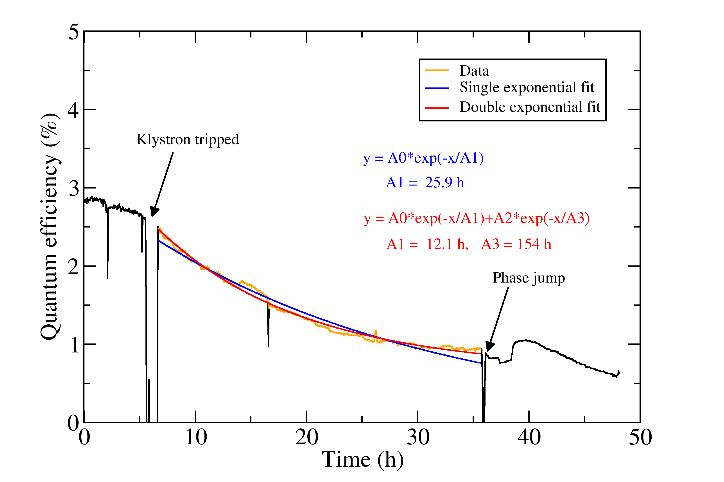
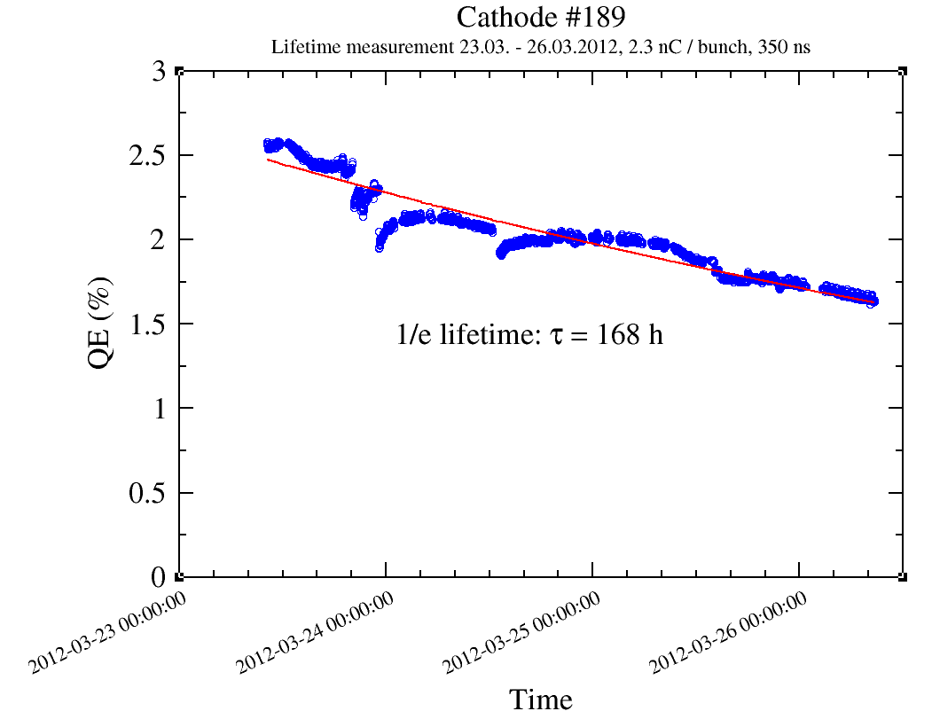
Lifetime Measurement with Cs₃Sb Cathodes
Under improved vacuum conditions
Data can be partially fitted with a double exponential curve, with similar lifetime as 2012, however, measurement time is too short for reliable fit.
Klystron trip and phase jump changed slope drastically.
Dynamic pressure: 2.5 - 5e-10 mbar ~9e-10 mbar
2014
2012
1/e lifetime 168 h
τ₂ = 154 h
2.3 nC, 350 ns, Cs₃Sb #199
2.3 nC, 350 ns, Cs₃Sb #189

Slide 11
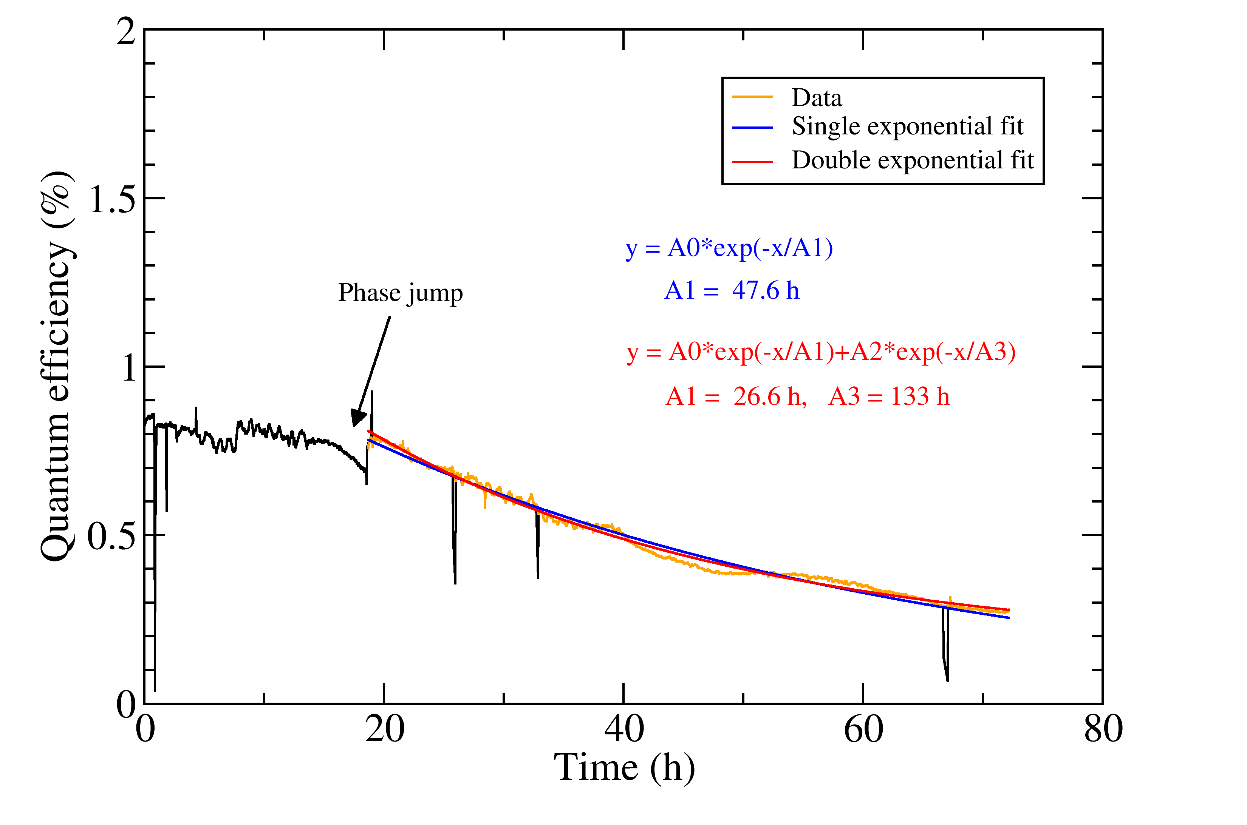
Lifetime Measurement with Cs₃Sb Cathodes
Under improved vacuum conditions:
Despite better vacuum level the lifetime is significantly shorter.
Strong QE decrease started after a phase jump.
Dynamic pressure: 2.3e-10 mbar
7e-10 mbar
2014
2012
τ = 47.6 h
1/e lifetime 185 h
1 nC, 800 ns, Cs₃Sb #200
1 nC, 800 ns, Cs₃Sb #189

Slide 12
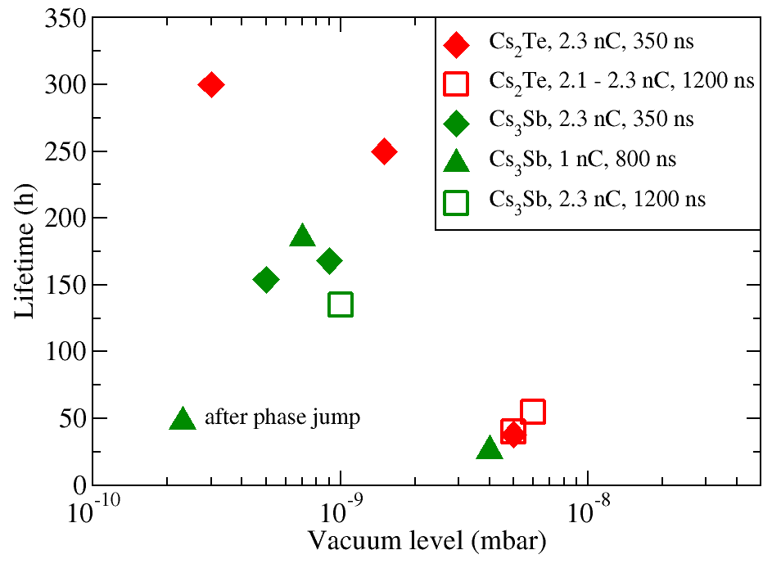
Lifetime Dependence on Vacuum
Cs₂Te yields better than Cs₃Sb, but not drastically better.
Measurements with different beam parameters but similar vacuum conditions yielded similar lifetimes.
→ It seems that lifetime is mainly determined by vacuum level. But the
vacuum level is also a function of beam parameters.

Slide 13
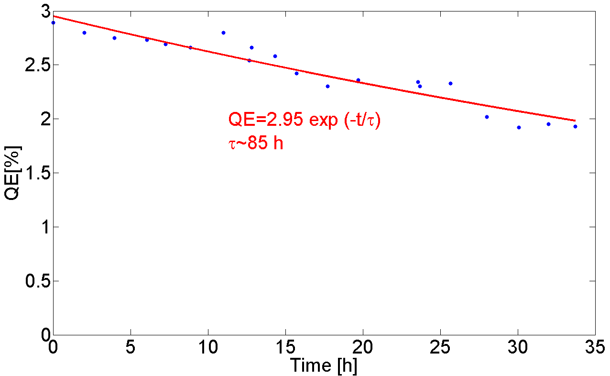
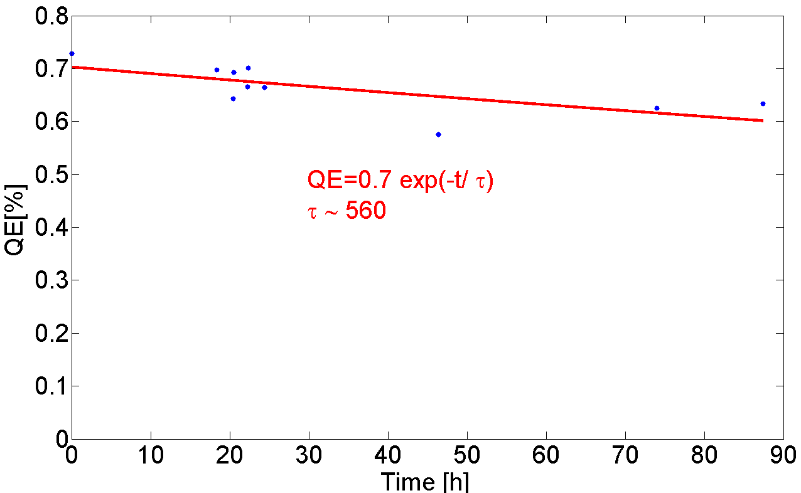
RF Lifetime of Cs₃Sb Cathodes
Dynamic vacuum level: 3e-10 mbar
Dynamic vacuum level: 2.5e-10 mbar
Fresh cathode
Cathode #200 (Cs₃Sb)
Used cathode
Cathode #199 (Cs₃Sb)
Fast and slow decay visible as during beam operation.
In both cases longer lifetimes as during beam operation.
Lower vacuum level than during beam operation.

Slide 14
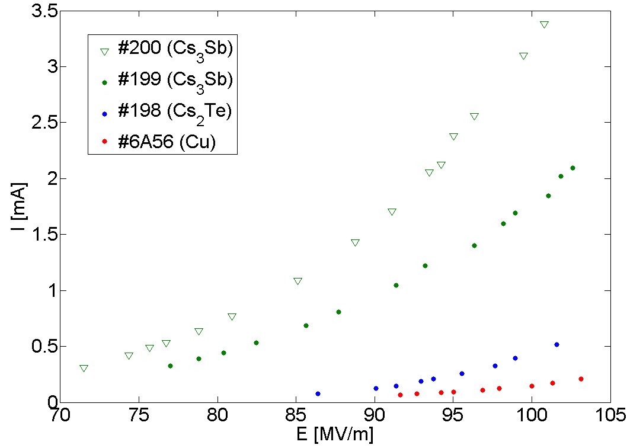
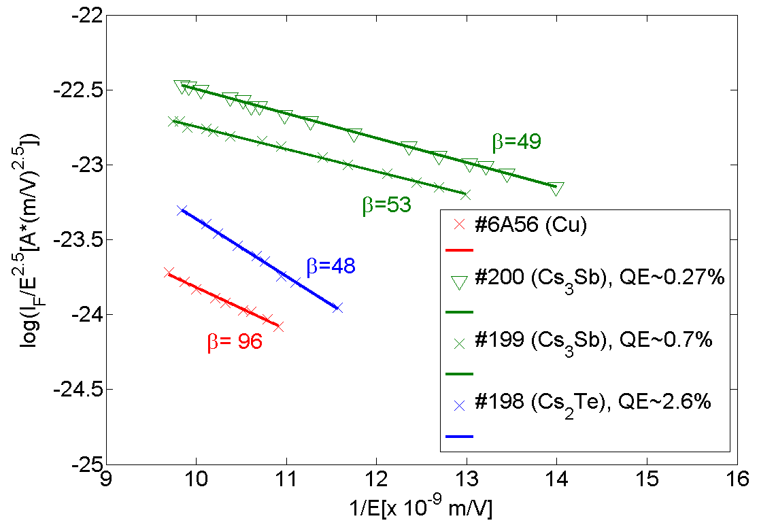
Dark Current Measurements
Field emission contribution from gun cavity (Cu) and cathode.
Cs₃Sb cathodes (Φ~2 eV) produce higher dark current than Cs₂Te (Φ~3.5 eV) and copper (Φ~4.5 eV).
→ Higher vacuum level for Cs₃Sb than Cs₂Te under same beam conditions.
The low dark current measured with copper confirms that the major contribution is coming from the cathode.

Slide 15
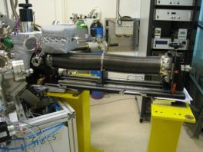
Cathode Surface Studies
Surface analysis of photocathode materials with XPS and their impact on the cathode performance in collaboration with TE/VSC has started.
  New UHV carrier vessel was commissioned to transfer cathode from production laboratory to the XPS set-up:
  XPS measurement allows material characterization of the surface. Together with qualitative elemental composition also chemical and quantitative information can be obtained (not straightforward):
  Easy case: Cu (slightly oxidized)
  Complex case: Cs₃Sb
Peaks overlap!
Courtesy Irene Martini

Slide 16
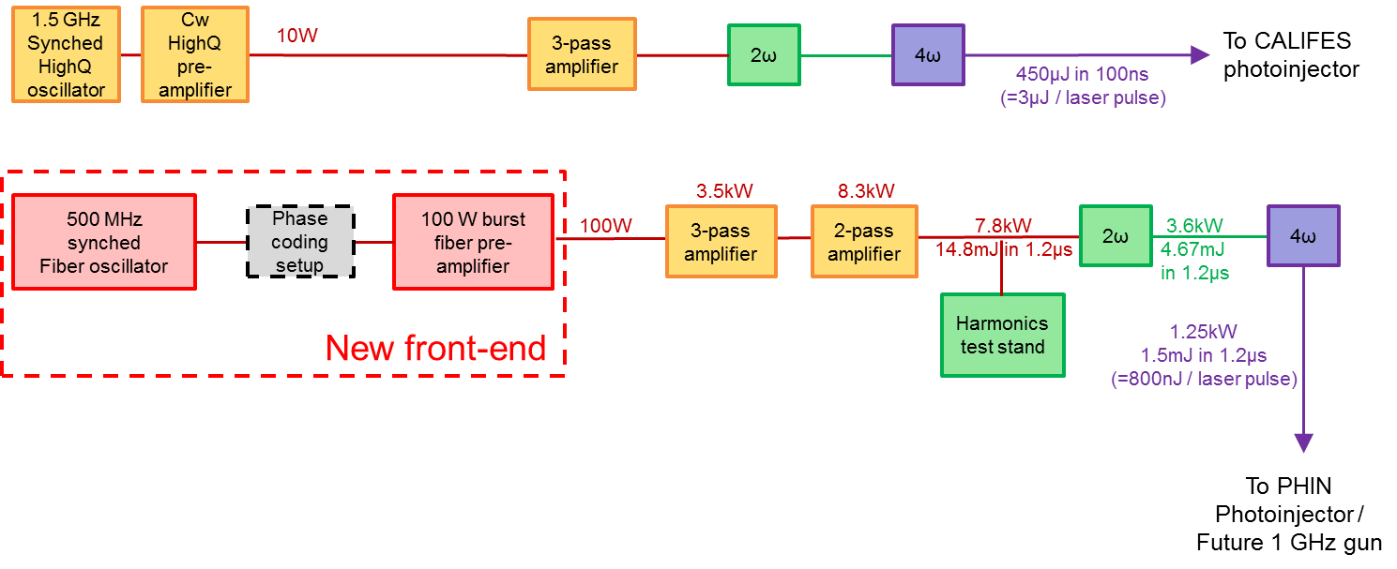
Upgrade of Laser System
Installation of new 500 MHz fiber front end with CLIC specs for PHIN. Decoupling PHIN and CALIFES laser systems, but keeping the possibility to switch back to the old front end for PHIN.
Delivery of new front end delayed,
but expected in the coming weeks.
Preparation work (re-arrangement of current laser system) has started.
Planned studies:
  Stability studies with new front end with improved stability.
  Studies of heat-load effects and thermal lensing in laser rods at 50 Hz rep rate.
  In parallel further studies on new harmonics generation schemes with multiple crystals to solve problem with UV generation for 140 µs long trains.

Slide 17
Outlook: Plans and Ideas for PHIN
Cathode lifetime studies with 2.5 µs long pulse trains (double of nominal PHIN train length) and tentatively 5 Hz repetition rate:
→ “old” 1.5 GHz time structure needed for obtaining conclusive results.
→ Vacuum window needed.
→ Long and probably painful RF conditioning required.
→ Using Cs₂Te cathodes.
Measurement of RF lifetime of Cs₂Te cathode
Study of impact of the longer bunch spacing with new laser front end on the photocathode lifetime.
→ Measurements with 1.05 µs (=3*350 ns) and 2.3 nC with Cs₂Te
Study of charge stability with the new laser system.
Study the effect of surface roughness on cathode lifetime (Electro-polished cathode plugs).
Study the performance of three components cathodes in PHIN (e.g. K₂CsSb).
Re-measure QE of uncontaminated copper cathode for AWAKE.
⇒ Many interesting ideas for a further PHIN run in 2015!

Slide 18
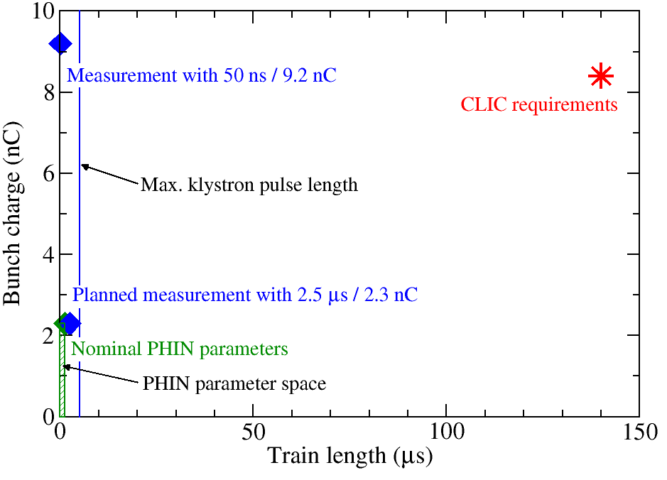
Ideas for Future CLIC Photoinjector Developments
The main concern about a CLIC drive beam photoinjector is:
Will the high bunch charge and average current create conditions (e.g. vacuum level), which are deadly for the photocathode?
It is clear that this question cannot be answered alone by extrapolating from PHIN experiments.
To verify feasibility of photocathodes for CLIC specifications, at some point a RF gun with full CLIC specs must be built.
If the environment will be not suitable for standard photocathodes, are there any fundamentally new ideas which could potentially solve the problem?

Slide 19
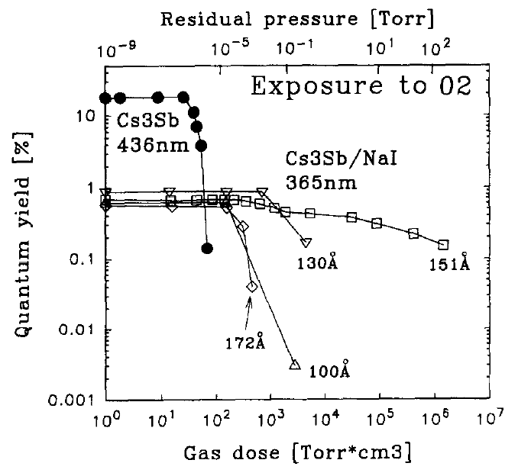
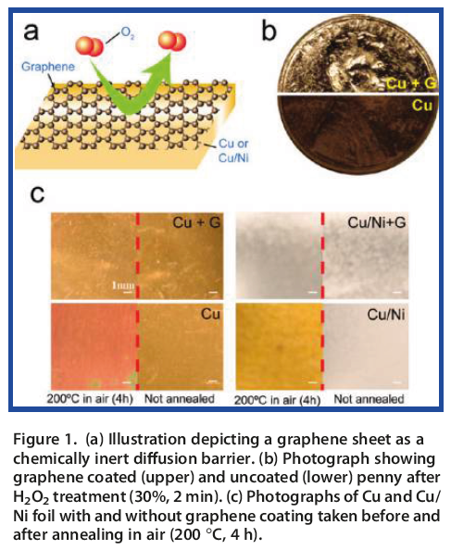
Protective Layers for Photocathodes
Protective layer of alkali-halides (NaI, CsI, CsBr) can increase resistivity against oxidation:
Graphene (2D material, monolayer) as a chemically inert diffusion barrier to prevent oxidation:
Works for metals. Is it also suitable for photocathodes?
Buzulutskov et al., Nucl. Instr. and Meth.
A 387 (1997) 176
S. Chen et al., ACS Nano 5 (2011) 1321

Slide 20
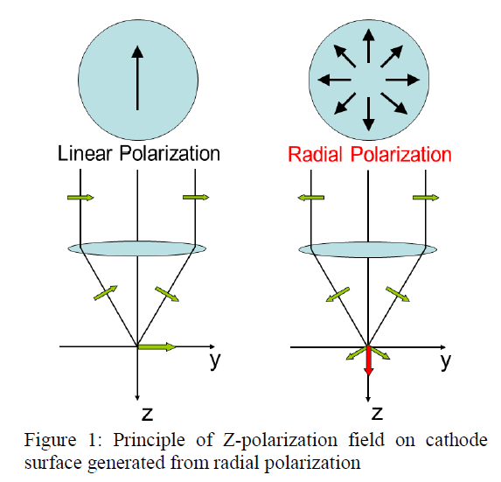
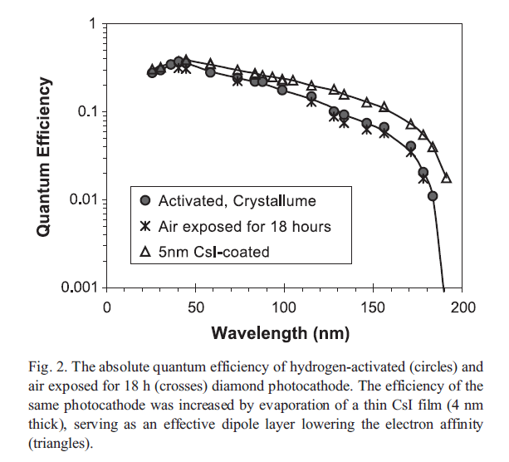
Diamond Photocathodes
Chemical stable photocathode
Survives air-exposure
High QE, however in the deep UV (<190 nm), not achievable with conventional laser sources.
Potential solution (first proposed by H. Tomizawa et al (JASRI/SPring-8)): Z-polarized laser beam:
High Z-field (few GV/m) reduces work function due to Schottky effect.
Excitation with longer wavelength could be possible.
H. Tomizawa et al., Proc. LINAC2012, 996
A.S. Tremsin, O.H.W. Siegmund,
Diamond & Related Materials 14 (2005) 48–53

Slide 21
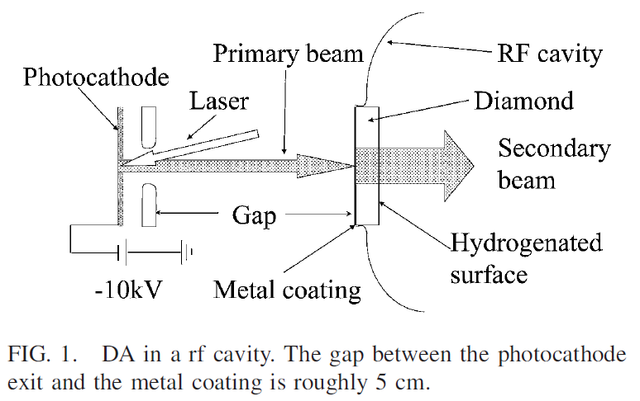
Diamond-Amplified Photocathodes
Concept developed at BNL:
Diamond as a secondary electron emitter.
Due to robustness of diamond long lifetimes with high current seems to be reachable.
In test setup at BNL a 35% probability of electron emission from the hydrogenated diamond surface was measured with an emission gain of 40 [1].
However, slow charging of the diamond due to thermal ionization of surface states cancels the applied field within it.
→ Generation of long pulses
might be problematic.
Complicated setup (DC and RF acceleration)
[1] X. Chang et al., PRL 105, 164801 (2010)

Slide 22
Acknowledgement
Controls: Mark Butcher, Mathieu Donze, Alessandro Masi, Christophe Mitifiot
Beam instrumentation: Thibaut Lefevre, Stephane Burger
Vacuum: Berthold Jenninger, Esa Paju
RF: Stephane Curt, Luca Timeo
Wilfrid Farabolini
CTF3 operators
XPS studies: Holger Neupert, Valentin Nistor, Mauro Taborelli, Elise Usureau
Collaborators at LAL and IAP-RAS
… and many others
… and thank you for your attention!

Slide 23
Backup Slides

Slide 24
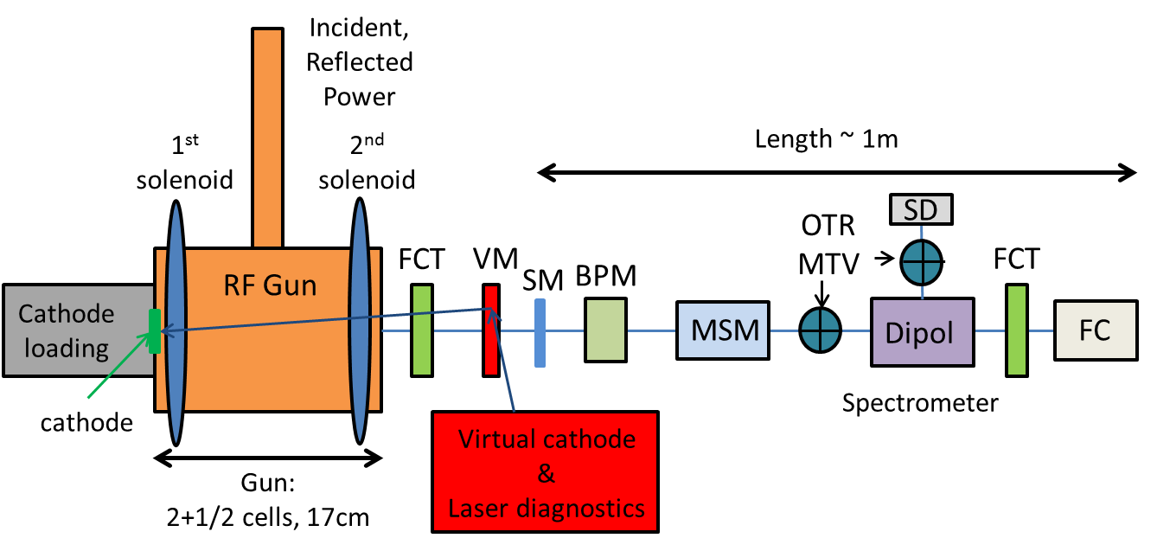
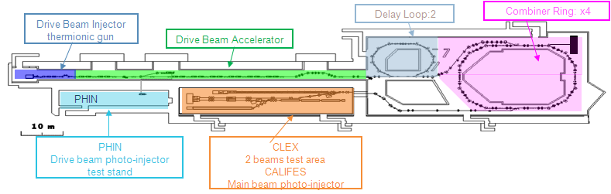
Layout of PHIN
FCT: Fast current transformer
VM: Vacuum mirror
SM: Steering magnet
BPM: Beam position monitor
MSM: Multi-slit Mask
OTR: Optical transition radiation screen
MTV: Gated cameras
SD: Segmented dump
FC: Faraday cup

Slide 25
PHIN and CLIC Parameters
Parameter | PHIN | CLIC
Charge / bunch (nC) | 2.3 | 8.4
Macro pulse length (μs) | 1.2 | 140
Bunch spacing (ns) | 0.66 | 2.0
Bunch rep. rate (GHz) | 1.5 | 0.5
Number of bunches / macro pulse | 1800 | 70000
Macro pulse rep. rate (Hz) | 5 | 50
Charge / macro pulse (μC) | 4.1 | 590
Beam current / macro pulse (A) | 3.4 | 4.2
Bunch length (ps) | 10 | 10
Charge stability | <0.25% | <0.1%
Cathode lifetime (h) at QE > 3% (Cs₂Te) | >50 | >150
Norm. emittance (μm) | <25 | <100

Slide 26
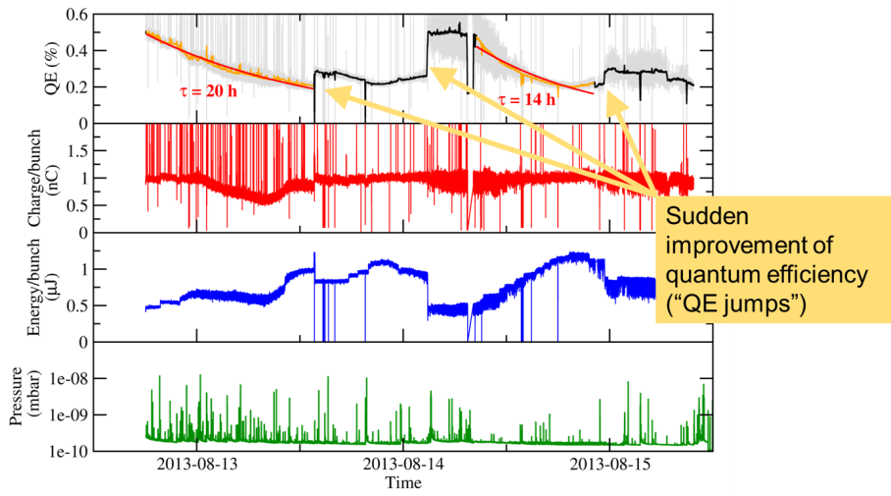
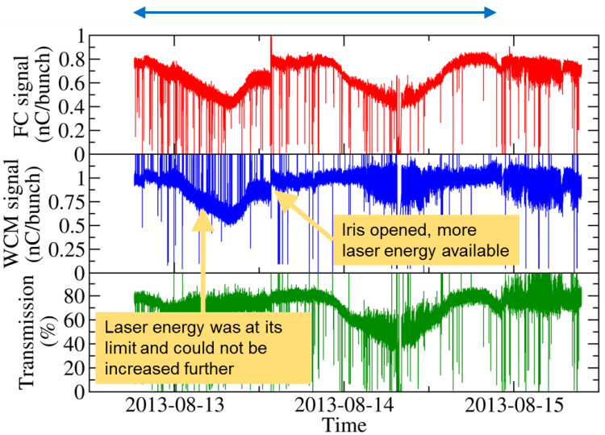
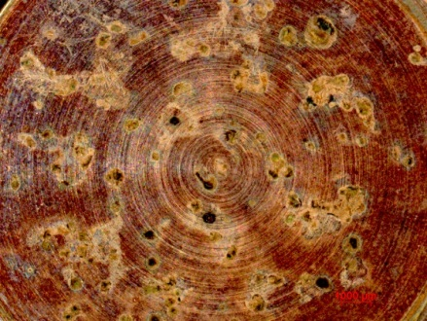
Photocathode Lifetime Studies 2013
Lifetime studies under improved vacuum conditions were already planned for 2013, however due to many problems no comparable lifetime measurement could be performed at that time.
Problems in 2013 among others: “unknown” beam instrumentation, low initial QE, fast QE decrease, QE jumps, 24h drifts.
Problems with photocathodes could be
potentially traced back to a wrong surface
finishing of the cathode substrates and
have been solved in 2014.
Photocathode surface after usage

Slide 27
Emittance Measurements for AWAKE
Laser beam size: ~ 1 mm sigma, charge 0.2, 0.7, 1.0 nC, energy 5.5 – 6 MeV
Normalized emittance for 0.2 nC:
3.2 mm mrad
( big errors !)
E_{n}(0.2 nC): 3.2 mm mrad
E_{n}(0.7 nC): 4.6 mm mrad
E_{n}(1 nC): 5.5 mm mrad
Charge dependence is roughly sqrt as it should be

Slide 28
QE Measurement for AWAKE
Copper plug 6A56:
  QE(DC-gun) = 2e-4
  QE(PHIN) = 3e-4
QE of Cu cathode was too high compared with best literature values (1.4e-4).
Possible explanation: Contamination with Cs. The plug was located in photocathode preparation chamber during a bake-out.
Copper plug 6A46 has not been in preparation chamber during bake-out and has a QE (DC gun) = 3e-5.
It is planned to test 6A46 also in PHIN.

