Slide 1



Electro-Optic development for short bunch length monitoring
David Walsh, ASTeC
Steven Jamison, Edward Snedden,
Allan Gillespie, Thibaut Lefevre

Slide 2
Outline of Talk
Requirement/Aims
EO Techniques
Our new technique: EO Transposition
System Design and Testing
  Predicting EOT signal level
  Status of EOT monitor construction
  EOT + FROG results!
Resolution (Materials)

Slide 3
Requirement and Aims
CLIC project targets
Non-invasive
Single shot
Diagnostic target resolution ~20fs rms (Bunches ~150fs rms)
EO diagnostics: (encoding of Coulomb field into a laser field)
Advantages
Scales well with high beam energy
  Particle methods get impractical (size, beam dumps)
Non-destructive
  Bunches can still be used
  Live feedback
Challenges
Unreliability, maintenance and cost of suitable ultrashort pulse laser systems
Temporal resolution
We aim to improve on the resolution and the robustness of EO diagnostics

Slide 4
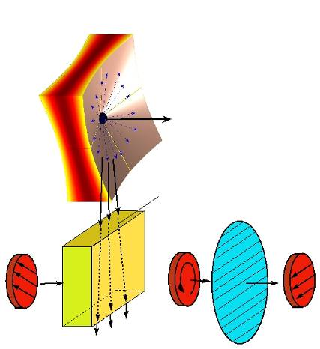
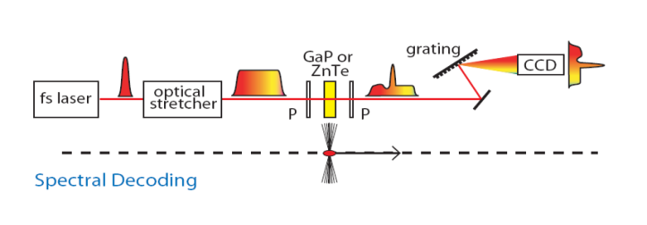
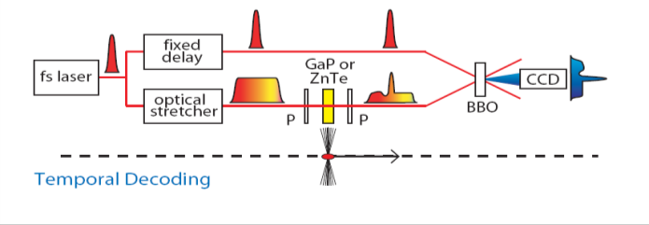
Current EO Techniques
Standard Description
Coulomb field flattens transversely, and defines charge distribution
Pockels effect induces polarization ellipticity
Technique borrowed from THz electro-optic sampling where (t_{probe} << t_{THz})
Coulomb field of
relativistic bunch
probe laser
non-linear crystal
~1ps
Spectral Decoding
Chirped optical input
Spectral readout
Uses time-wavelength relationship
Temporal Decoding
~150fs
Long pulse + ultrashort pulse as gate
Spatial readout (cross-correlator crystal)
Uses time-space relationship

Slide 5
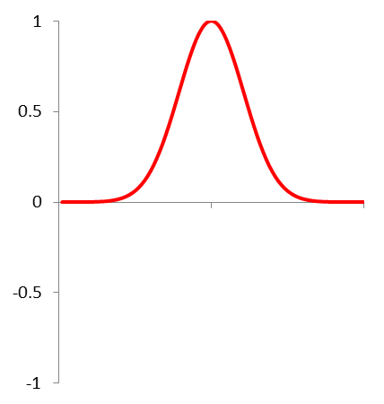
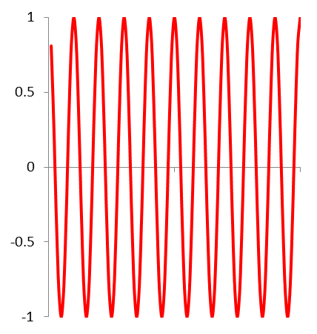
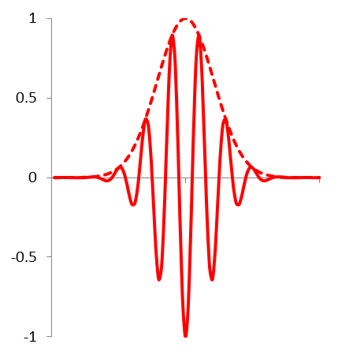
Physics of EO Transposition
More Rigorous Description – nonlinear frequency mixing
S.P. Jamison Opt. Lett. v31 no.11 p1753
Coulomb field
Optical field
EOT spectrum
Frequency Domain
few mm
~820nm
Intensity
Intensity
Intensity
circa 20nm
tens μm
ν
ν
820nm
ν
Coulomb field
Optical field in
EOT pulse
Time Domain
E
~50fs
E
E
t
t
t

Slide 6
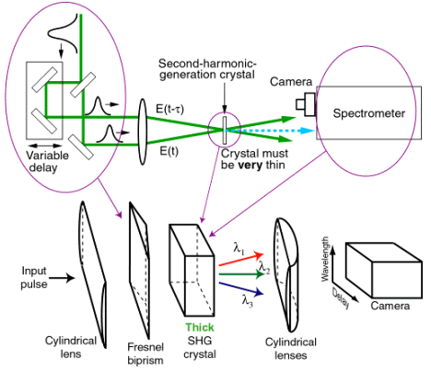
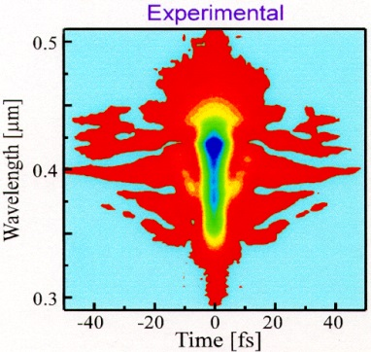
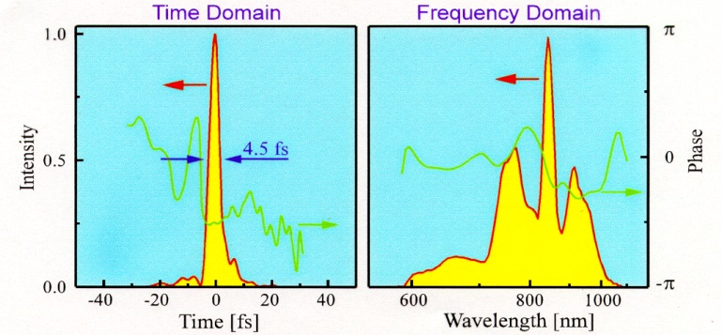


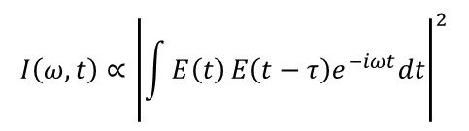
Characterisation of Transposed Pulse
Considerations: * needs to be single shot
* autocorrelation not unambiguous – no shorter reference pulse available
* low pulse energy
Solution: Grenouille (frequency resolved optical gating), a standard and robust optical diagnostic.
Retrieves spectral intensity and phase from spectrally resolved autocorrelation.
What we want to know
$$E\left(t\right)=Re\left(\sqrt{I\left(t\right)}e^{i\left(ω_{o}t−φ\left(t\right)\right)}\right)$$
<-Fourier->
$\tilde{E}\left(ω\right)$=$\sqrt{S\left(ω\right)}e^{−iφ\left(ω\right)}$
“Carrier” frequency
Can’t measure
Spectrum
Spectral Phase
Can be retrieved!
$$I\left(ω,t\right)∝{\left|\int{E\left(t\right)}E\left(t−τ\right)e^{−iωt}dt\right|}^{2}$$
4.5 fs
pulse
The most sensitive “auto gating” measurement
Self-gating avoids timing issues (no need for a fs laser)
Requires minimum pulse energy of ~1 μJ
Baltuska, Pshenichnikov, and Weirsma, J. Quant. Electron., 35, 459 (1999).

Slide 7
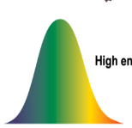

EO Transposition System
Generation
Coulomb field
~800nm
10ns
1mJ
GaP
1000x Amplification
(NCOPCPA)
Measurement
532nm
10mJ
10ns
¼λ plate
& polariser
Nanosecond
Laser System
Stretcher
BBO
Beam
dump
Comp-
ressor
DIY
GRENOUILLE
Beam
dump
nanosecond probe
recompressed
Pulse Evolution
“transposed pulse”
stretched
amplified
amplitude
time
Nanosecond laser derived single frequency probe brings reliability
“Electro-Optic Transposition” of probe encodes temporal profile
Non-collinear optical parametric chirped pulse amplification (NCOPCPA) amplifies signal
Full spectral amplitude and phase measured via FROG
Coulomb field, and hence bunch profile, calculated via time-reversed propagation of pulse

Slide 8
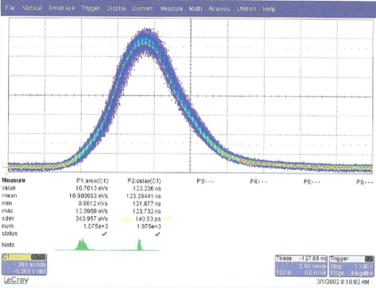
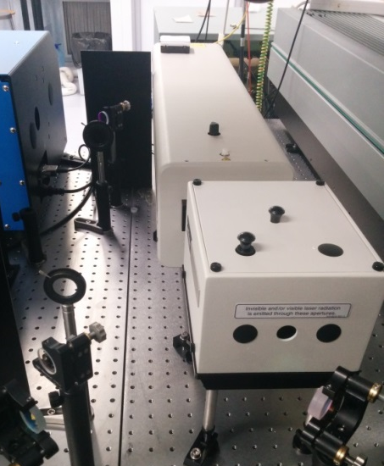
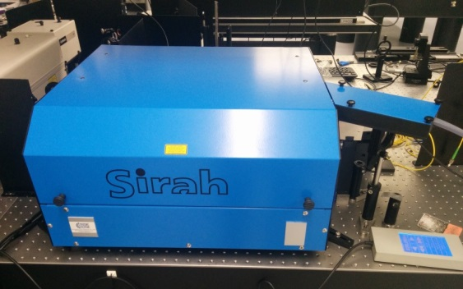
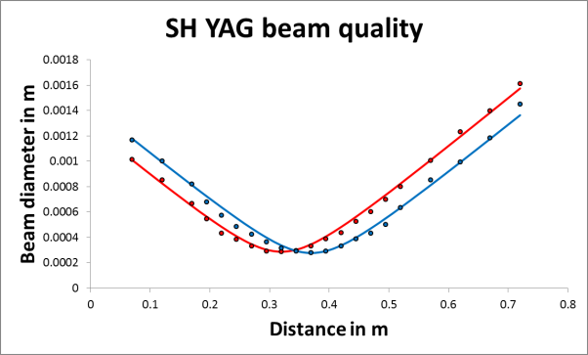
EOT System Build Status
Primary laser systems finally delivered end of Nov 2014– Characterisation largely complete
All other components ready (except camera for FROG) and can now be integrated, characterised, and made robust
Dye laser not proposed for the final design – possibility of building a seeded OPO
Continuum Surelite YAG
~ 4.5 ns, 150 mJ, seeded
Sirah Cobra Dye laser
6 ns, 3 mJ, linewidth < 2 GHz
Jitter < 0.3 ns r.m.s.
M² = 1.6

Slide 9
Characterisation of EO Transposition
Femtosecond laser-based test bed
Auston switch THz source mimics Coulomb field.
Well-characterised spectral and temporal profile.
Δν ~44GHz
Δ t ~10ps FWHM
Femtosecond laser pulse spectrally filtered to produce narrow bandwidth probe
Switchable diagnostics – Balanced sampling, Crossed Sampling, and Autocorrelation (spectrally resolved!)

Slide 10
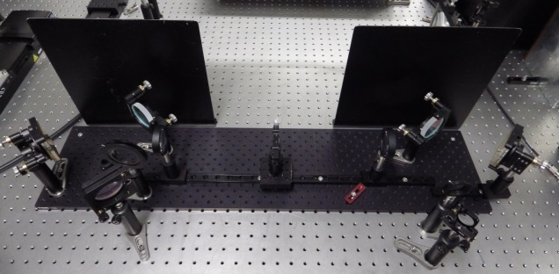
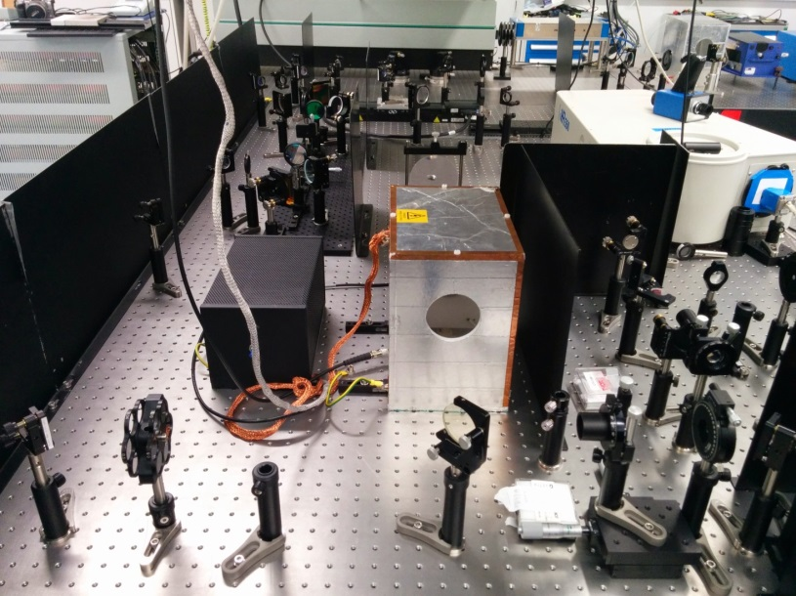
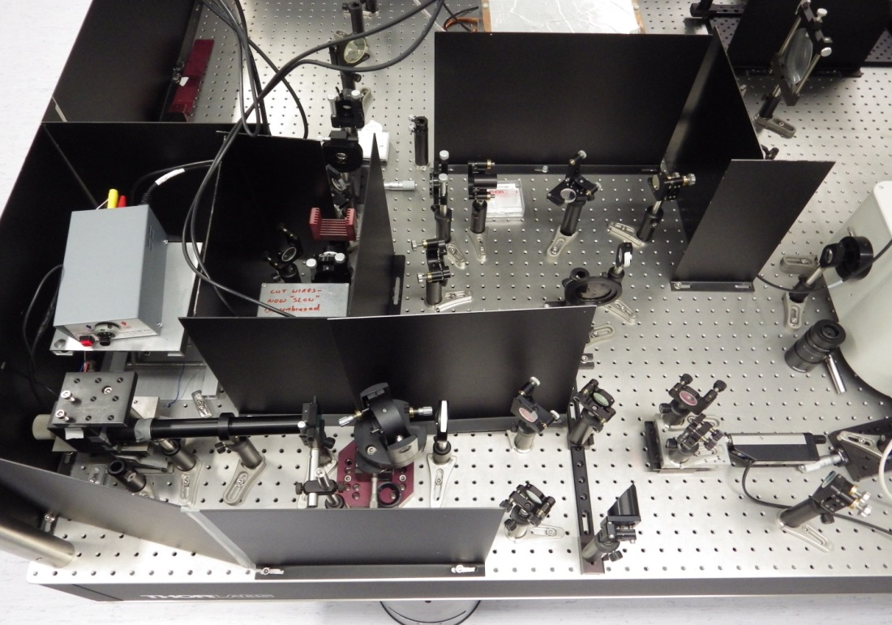
Experimental System
4-f filter
Balanced
detectors
THz Source and interaction point
Crossed
Polariser
And
Spectrometer
Pmt &
Lock-in
Autocorrelator

Slide 11
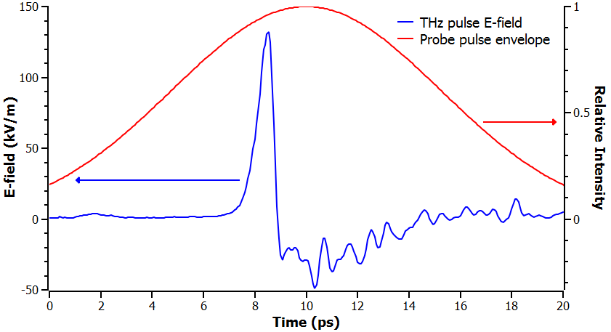
Transposed Pulse Measurements
Input pulses
Optical probe length Δt ~ 10 ps
Optical probe energy S ~ 28 nJ
THz field strength E ~ 132 kV/m
Leaking probe
Spectral Measurement
Autocorrelation
| |²
(<0.5 nJ)

Slide 12


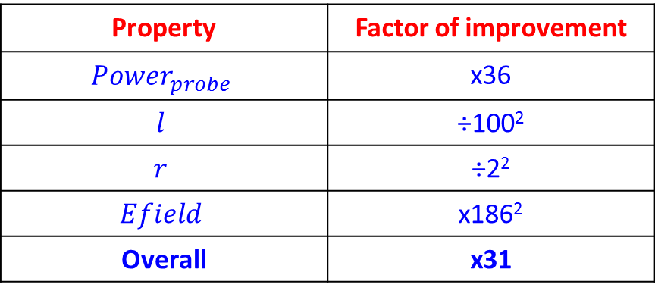
Extrapolation to bunch parameters
Scaling factors
$${Energy}_{upconv}∝{Power}_{probe}×{\left(Efield×l×r\right)}^{2}$$
$l$ is the EO crystal length, $r$ is the nonlinear coefficient
CLIC Example:
Total energy in EOT Pulse ~470pJ
“Typical” nanosecond pulse
laser as probe
Pulse energy 1mJ
Pulse duration 10ns
${Power}_{probe}\sim$ 100 kW
Coulomb field for target CLIC
bunch parameters (CDR)
Bunch length 44μm
Bunch charge 0.6pC
$Efield\sim =$24.5 MV/m
Property | Factor of improvement
$${Power}_{probe}$$ | x36
$$l$$ | ÷100²
$$r$$ | ÷2²
$$Efield$$ | x186²
Overall | x31
Pulse energy of ~15nJ is predicted.
1μJ required for the commercial single-shot FROG, “Grenouille”.
Method can be used to estimate applicability to other beams
– left as an exercise for the listener!

Slide 13

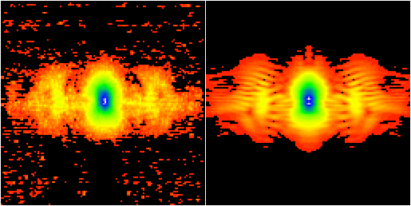
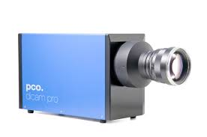
FROG Measurement
Experimental Spectrogram
Recovered Spectrogram
Frequency
Delay
PCO dicam pro
ICCD camera
256x frame integration
30x software averaging
0.55 ps pulse measured with a 10 ps, transform limited, probe!

Slide 14
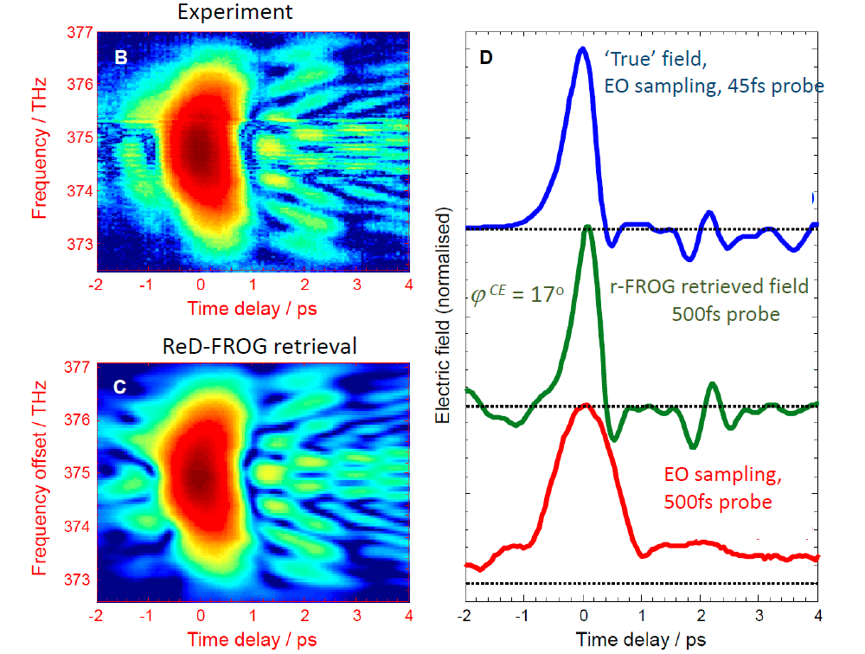
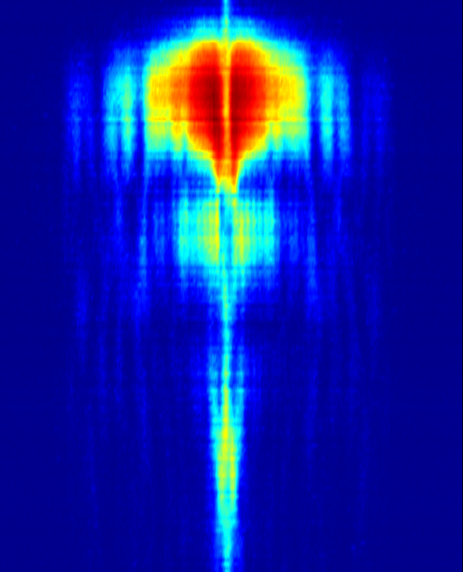
New THz Measurement Scheme
(an absolute phase FROG!)
This is a FROG where both SFG and DFG mechanisms are present and spectrally overlap, a FROG algorithm was modified to account for this.
Essentially, the interference pattern between SFG and DFG in the trace reveals the absolute phase.
Delay (60 ps window)
This looks like a spectrogram!
Theory extended to optical pulses
and is being published (on Arxiv now)
arXiv:1501.04864 [physics.optics]

Slide 15
Temporal Resolution
EO transposition scheme is now limited by materials:
Phase matching and absorption bands in ZnTe/GaP.
Other materials are of interest, such as DAST or poled polymers, but there are questions over the lifetime in accelerator environments.
Collaborative effort with MAPS group at the University of Dundee on development of novel EO materials
Potential to produce an enhancement of nonlinear processes through metallic nanoparticles.
THz field induced second harmonic TFISH enhancement being investigated.
Surface nonlinear effects…
A key property of the EO Transposition scheme may be exploited
FROG (Grenouille) retrieves the spectral amplitude and phase
At frequencies away from absorptions etc. the spectrum should still be faithfully retrieved
Potential to run two, “tried and tested”, crystals with complementary response functions side by side to record FULL spectral information!

Slide 16
Spectral Compositing of Multiple Crystals
Phasematching not the whole story
  Dips caused by absorption near phonons
  Phase distortion near absorptions become very large
  Distortions in χ⁽²⁾ near absorptions
Discard data around the absorption lines
Fill in the blanks with different crystals
(10 μm thicknesses)
Basic numerical study is promising.
Not yet demonstrated for THz…
(insufficient bandwidth)

Slide 17
Thank you for your attention

Slide 18
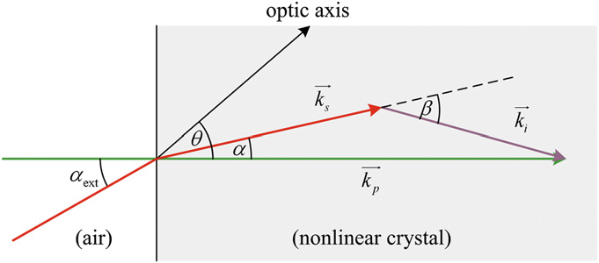
Chirped Pulse Optical Parametric Amplification
Very small Phase and Amplitude distortions can be calculated (and so can be removed)
Bandwidth very broad >50THz
Tested using stand-ins for pump and signal – picosecond laser system and Ti:Sapphire laser
Pulse spectrum maintained
Pump derived from 50ps pulse laser
532nm, ~300MW/cm²
Photodiode or
Spectrometer
α
Heavily attenuated
800nm, 50fs pulse
θ
optic axis
20mm BBO
θ = 23.81
α = 2.25
Gain of >1000x verified

Slide 19
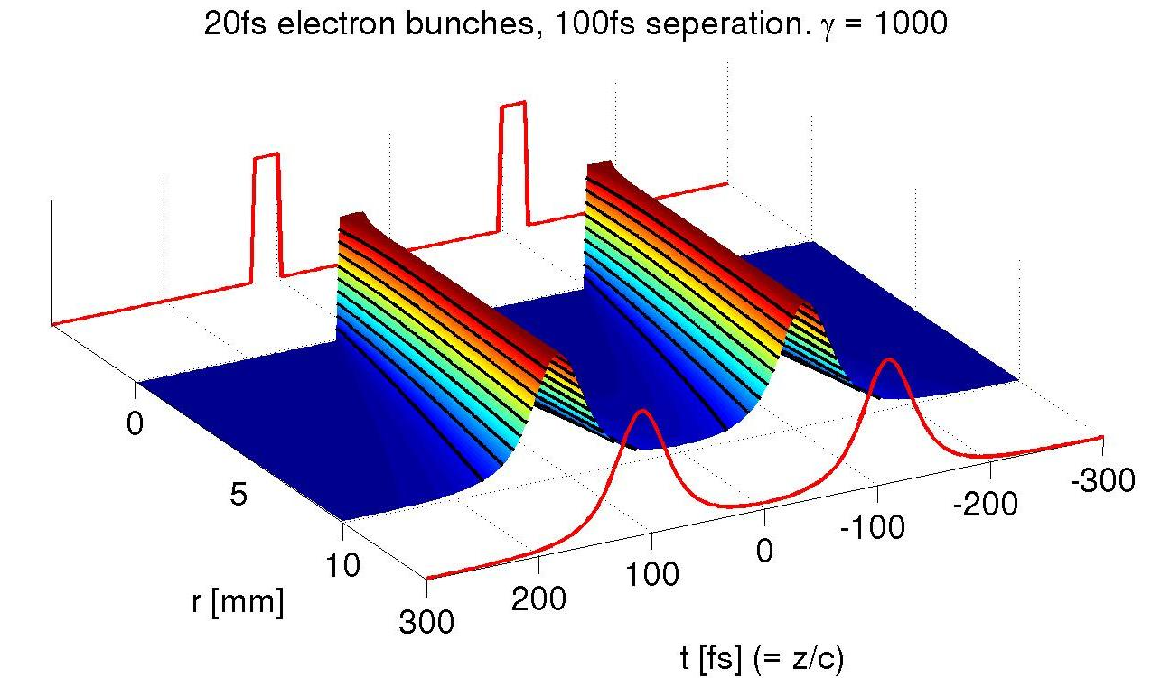
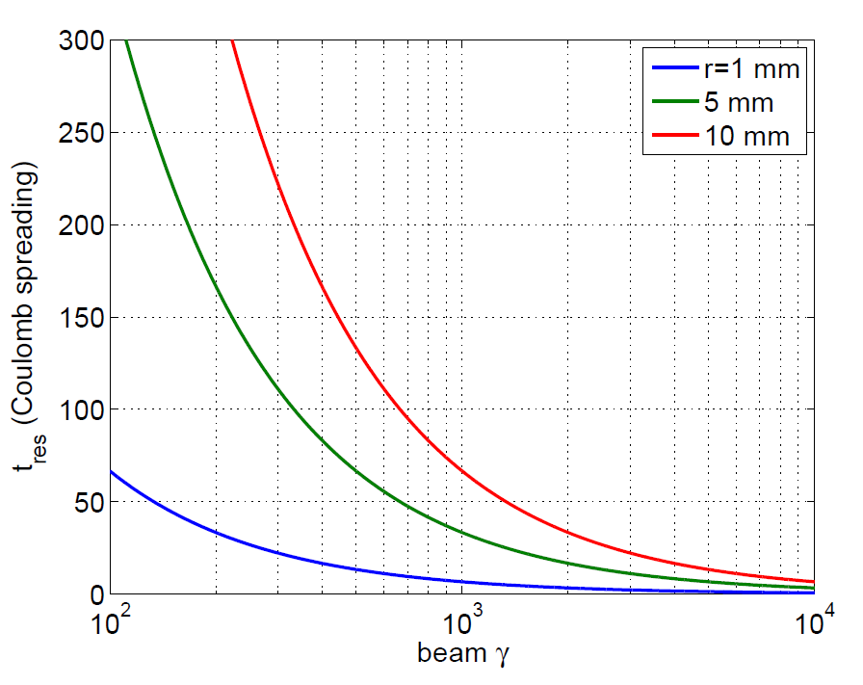




Common Problem - Field at Source
Field radiated or probed is related to Coulomb field near electron bunch
$$ρ$$
$$E$$
$$?$$
20fs electron bunches, 200fs separation, γ =1000
$$z,t$$
20 fs
20fs resolution
only obtainable
For >1GeV beams
High γ is an advantage!
Time response & spectrum of field dependent on spatial position, R:
δt ~ 2R/cγ
⇒ ultrafast time resolution needs close proximity to bunch
(N.B. equally true of CTR, CDR, Smith-Purcell, Electro-Optic, etc.)

Slide 20
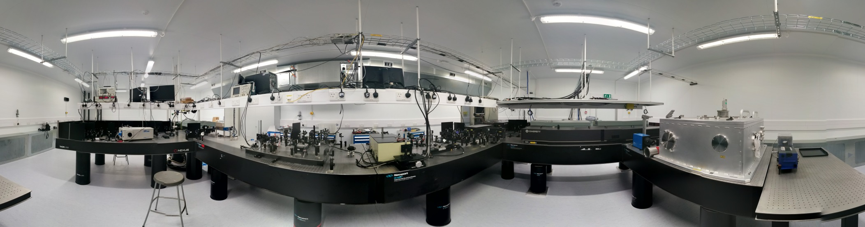
LATTE Lab
The Laboratory for
Laser, Terahertz and Terawatt Experiments
in accelerator applications
Lab overview
Longitudinal Profile Monitor CLIC-UK project
UV diagnostics and novel EO materials
TW laser system: to be commissioned. Output available in lab
High power, adjustable temporal profile and polarisation state THz sources >1 MV/m
Core laser sources (lockable to RF):
Ti:Sapphire - 81 MHz, <50 fs, 400 mW or 1 kHz, <50 fs, >1 mJ
OPA - 1 kHz, 570 nm to 12 µm, 1 µJ to 270µJ (λ dependent)

Slide 21
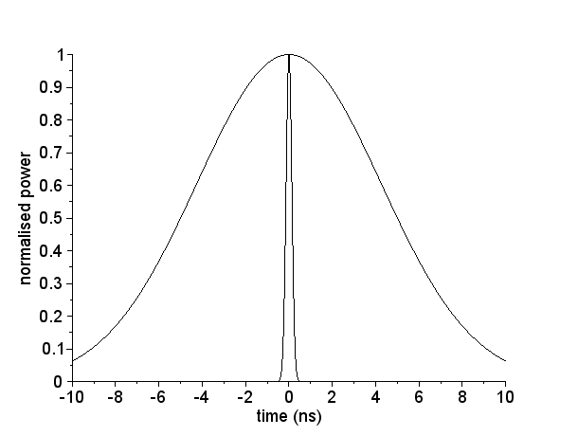
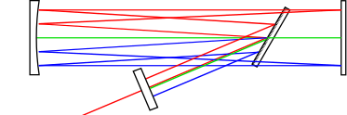
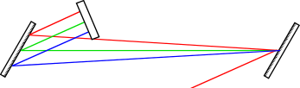
Stretcher and Compressor Design
Pulse | Properties | Peak Power
532nm Pump | 10mJ, 10ns Gaussian temporal profile | 1x10⁶ W
800nm EO Transpostion Signal | Amplified signal energy > 1 μJ, ~50 fs | 20x10⁶ W
As above but stretched GVD = 5.6x10⁶ fs² | > 1 μJ, ~310 ps | 3.2x10³ W
>Pump! Not possible
OK, will not distort
Conjugate Stretcher and Compressor designs
1m
0.5m
GVD = 5.6x10⁶ fs²
All gratings
G=1200 lines/mm
Θ_{deviation}~15°
1m
Calculations indicate nanosecond
level jitter has negligible effect

