Slide 1
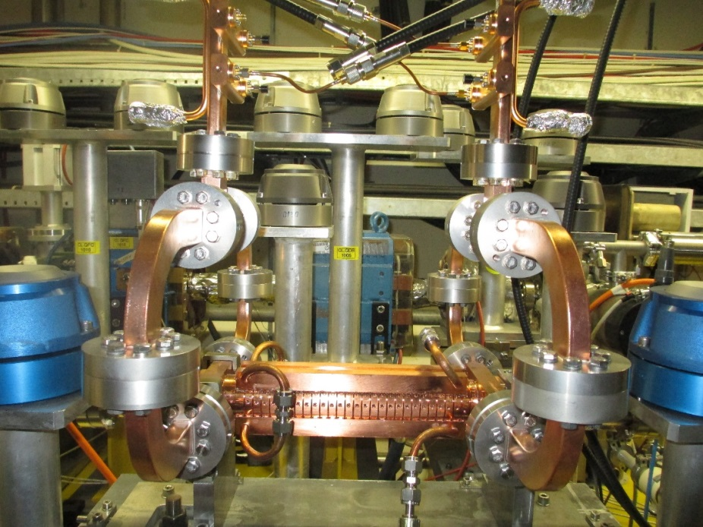


Dogleg Results
J.L. Navarro (CERN),
for the CLIC/CTF3 collaboration

Slide 2
Outline
The breakdown problem
The Dogleg experiment layout
First Results
Next steps
Conclusions

Slide 3
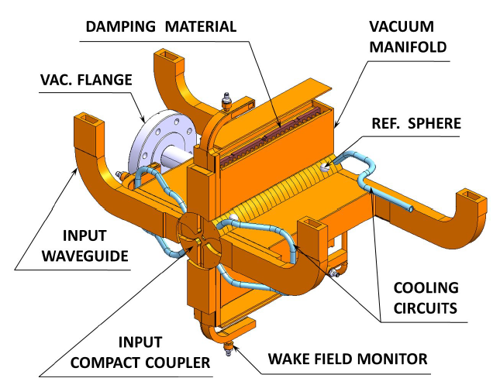
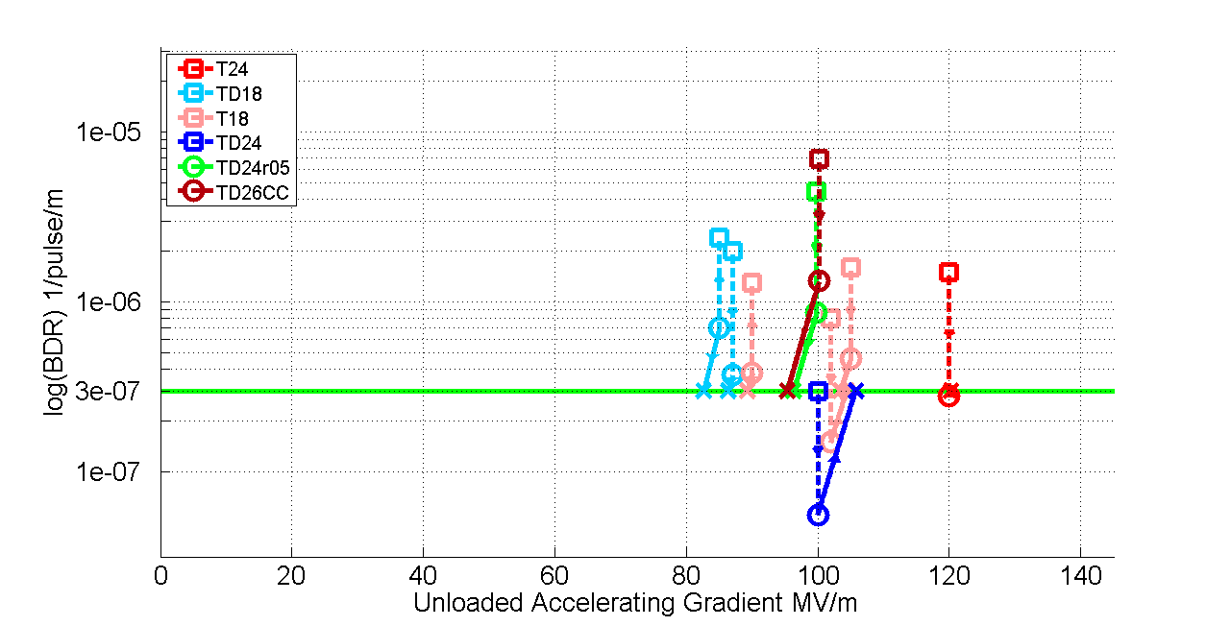
The breakdown problem
Strong Accelerating fields (~100 MV/m)
Problem of Break Downs (BD): Very fast (10 ns – 100 ns) and localized dissipation of stored energy in the structure.
BD Undesired effects:
Loss of acceleration
Kick in the beam
Damage in the structure
…
Luminosity Reduction:
Max DB rate allow for CLIC specifications:
3 10⁻⁷ BD pulse⁻¹ m⁻¹
Log(BDR) 1/pulse/m
Unloaded Accelerating Gradient MV/m
Notes:
This study is focused on the high gradient accelerating structures of the main linac of CLIC, althoug the results are of general interest for the high gradient community.
The limiting factor to achieve those strong accelerating gradients are breakdowns.
A break down is nothing else that a very fast and localized dissipation of energy.
This energy dissipation has collateral effects with a direct impact in luminosity.
We need to keep this effect under control to meet the CLIC luminosity specifications.
So far, some structures have been already tested only with RF power demonstrating that the CLIC specifications are indeed achievable.

Slide 4
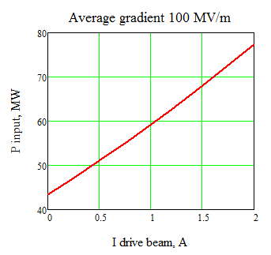
Beam loading effect
Beam Loading modifies the gradient distribution along the structure
Gradient, MV/m
I = 0 A
P ~ 43 MW
CLIC nominal
Length, m
Gradient profile along the structure without beam loading
Unloaded
Notes:
When we speak about an accelerating gradient of 100MV/m we are speaking about the longitudinal profile along the structure of the upper figure.

Slide 5
Beam loading effect
Beam Loading modifies the gradient distribution along the structure
Gradient, MV/m
I = 0.35 A
P ~ 43 MW
CLIC nominal
Length, m
The beam loading modifies the gradient profile
Notes:
When we start loading the structure, the profile is modified due to the beam loading effect.

Slide 6
Beam loading effect
Beam Loading modifies the gradient distribution along the structure
Gradient, MV/m
I = 0.6 A
P ~ 43 MW
CLIC nominal
Length, m
The beam loading modifies the gradient profile
Notes:
The higher the current, the higher the beam loading effect

Slide 7
Beam loading effect
Beam Loading modifies the gradient distribution along the structure
Gradient, MV/m
I = 0.95 A
P ~ 43 MW
CLIC nominal
Length, m
The beam loading modifies the gradient profile

Slide 8
Beam loading effect
Beam Loading modifies the gradient distribution along the structure
Gradient, MV/m
I = 1.2 A
P ~ 43 MW
CLIC nominal
Length, m
We do not have anymore 100 MV/m in average.
Notes:
And for CLIC nominal current, the average accelerating gradient is not anymore 100MV/m for the same input power

Slide 9
Beam loading effect
Beam Loading modifies the gradient distribution along the structure
Gradient, MV/m
I = 1.2 A
P ~ 53 MW
CLIC nominal
Length, m
We compensate increasing the RF input power
Notes:
We compensate the effect increasing the input power

Slide 10
Beam loading effect
Beam Loading modifies the gradient distribution along the structure
Gradient, MV/m
I = 1.2 A
P ~ 63 MW
CLIC nominal
Length, m
What is the effect on BD rate?
Notes:
And in this conditions the breakdown rate is unpredicted.

Slide 11
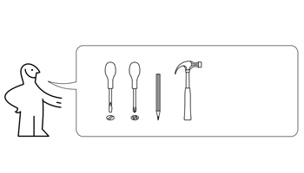
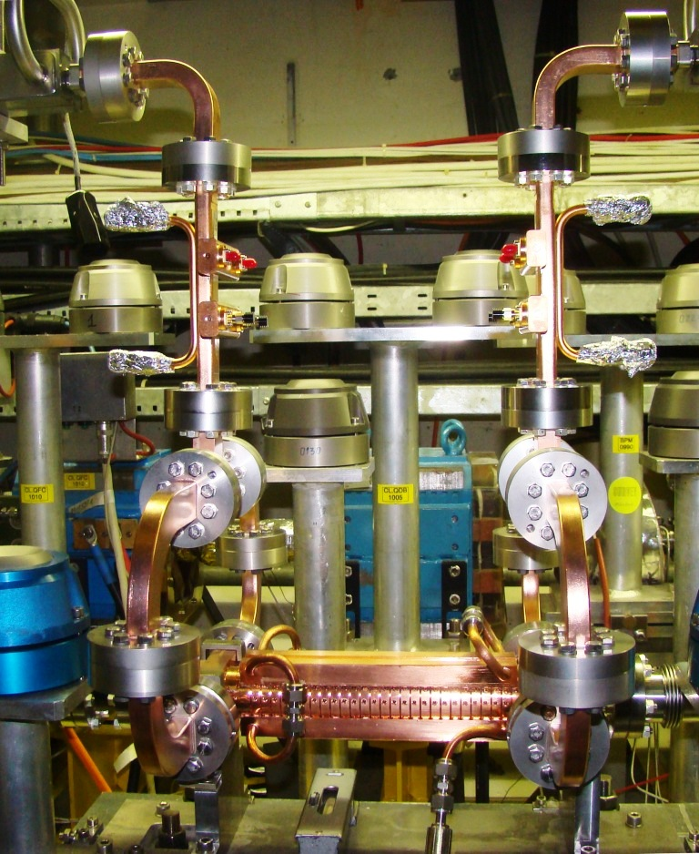
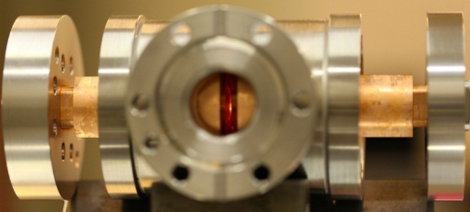
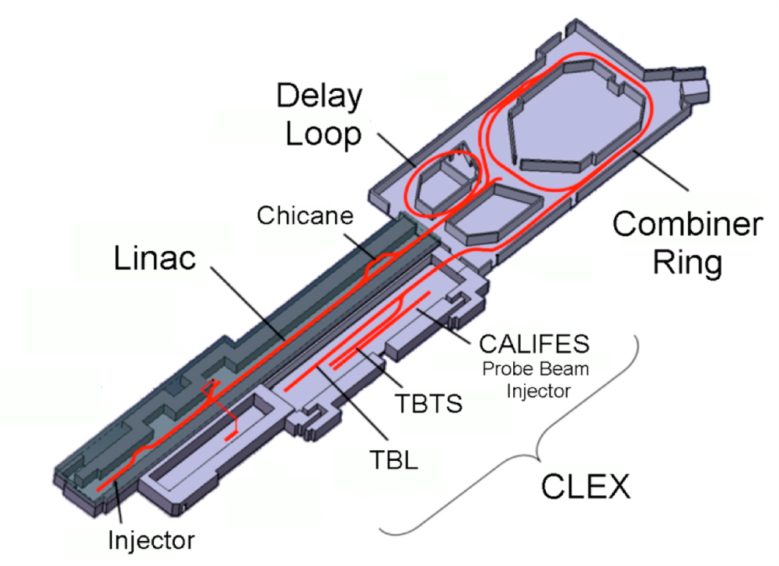

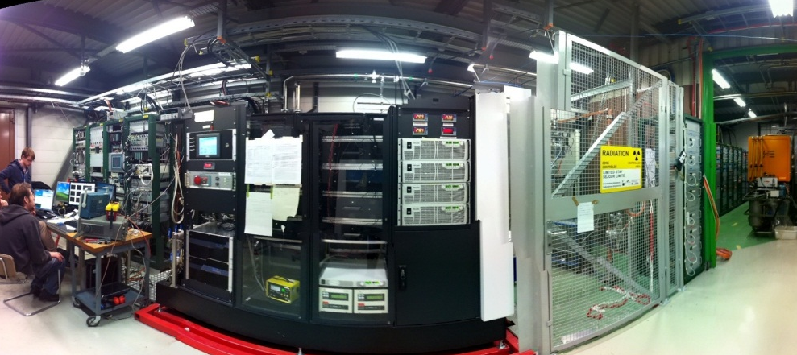

Experiment Mounting Instructions
1x
?x
1x
Dogleg
XBox1
RF team
1x
?x

Slide 12

Experiment layout
Dogleg
12 GHz RF:
90 MW RF power
Up to 50 Hz rep. rate
XBOX1
12 GHz RF
XBox1
CTF3 Injector
35 m low loss waveguide
Beam:
CTF3 Drive Beam modified
3GHz beam at ~1.2 A
Pulse length up to 250 ns
Energy ~125 MeV at structure
Up to 25 Hz pulse rep. rate
Structure (T24):
24 cells
Tapered linearly
No HOM Damping
MKS02
3 GHz RF
MKS03
MKS05
MKS06
MKS07
Gun
Notes:
The drive beam linac is flexible enough to mimic the CLIC main beam characteristics, so we use this injector to provide 1.2 A 250 ns beam to load the accelerating structure which is installed in a dogleg linac branching off the linac. The structure is fed with 12GHz RF provided by the XBOX system through 35 m off low loss RF network.

Slide 13
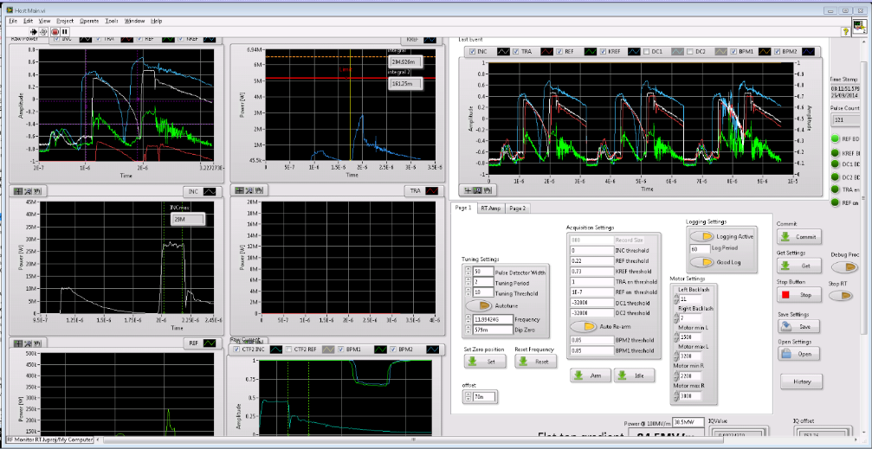
Control and DAQ system
PXI NI unit:
Real time interlocking
Data taking and storage
12 GHz RF control
User interfaced with Labview

Slide 14
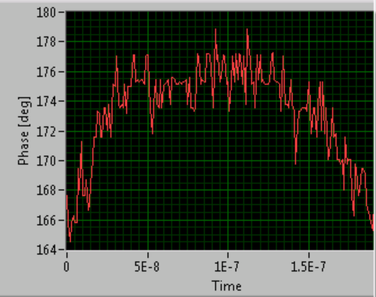
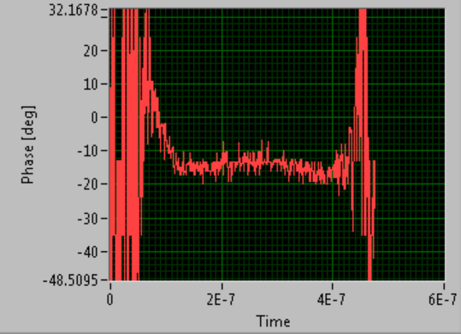
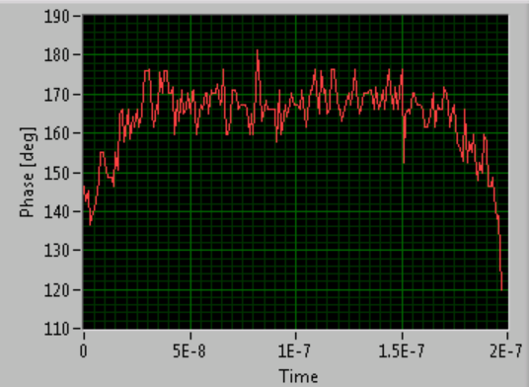
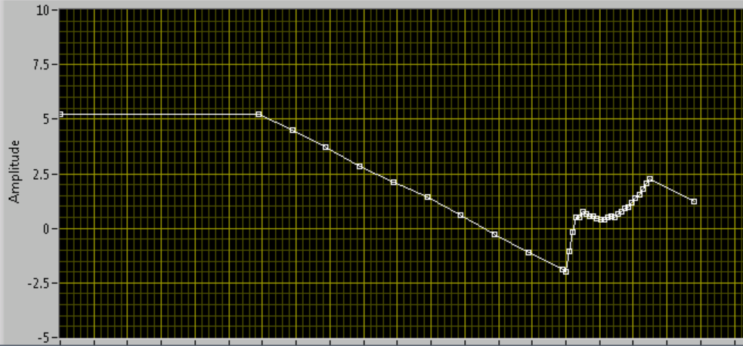
RF – Beam Phase adjustment
RF Phase
Beam Phase
Phase variation along the pulse is around 10 degrees
Beam + RF Phase
with correct slope
Phase function programed
200 ns

Slide 15
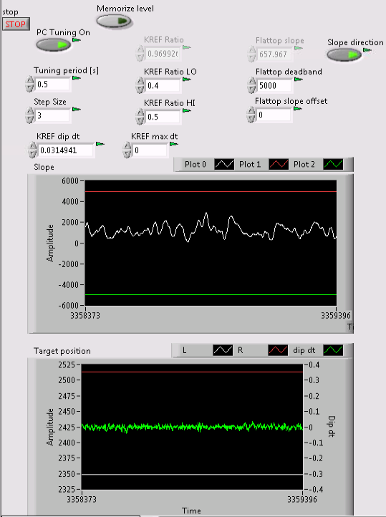
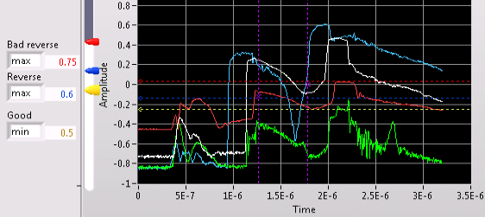
Big improvements in hardware/software
Big effort was done improving acquisition and control system:
Implementation of beam control
Modifications of tuning algorithm (pulse compressor)
Debugging control and data logging
Running efficiency over period ~75%
Thanks to A. Degiovanni, D. Gamba, J. Giner, J. Tagg, F. Tecker and B. Woolley for the efforts debugging and improving the software.
We are successfully running the first facility to test heavy beam-loaded high-gradient structures.

Slide 16
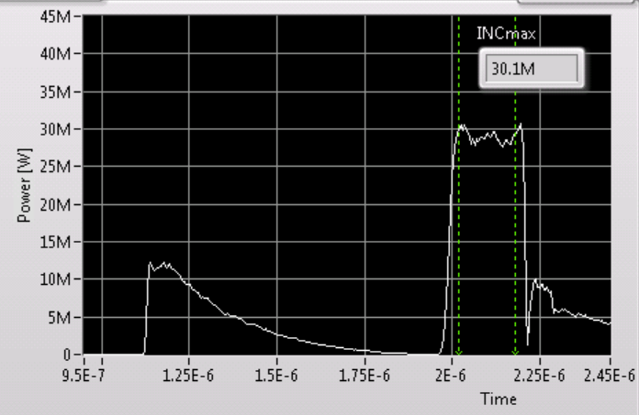
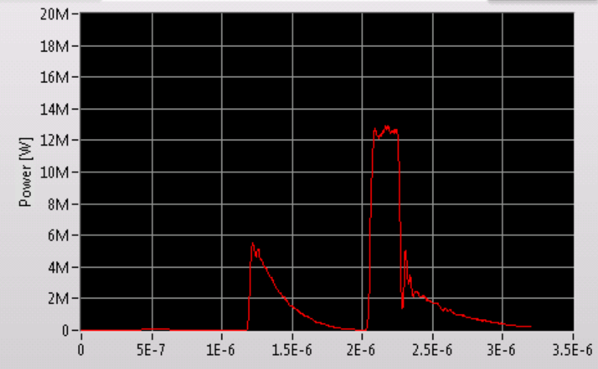
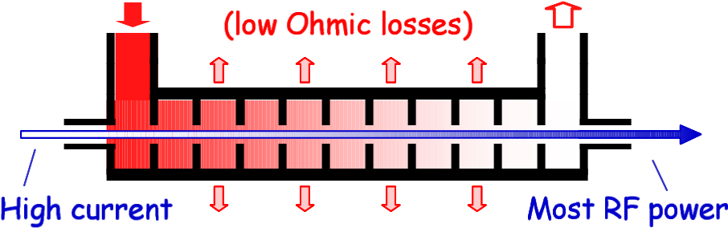
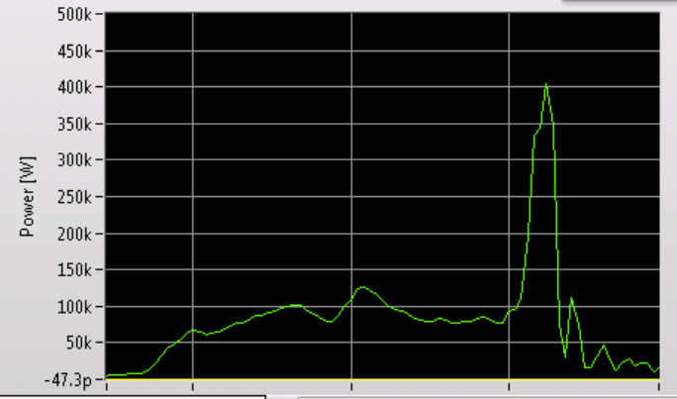
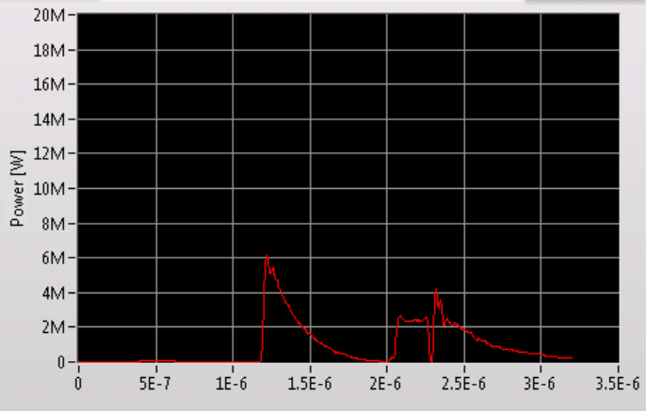
How the signals looks like?
Unloaded output signal
(No beam presence)
Incident Signal
Beam
Loaded output signal
(beam presence)
Reflected Signal

Slide 17
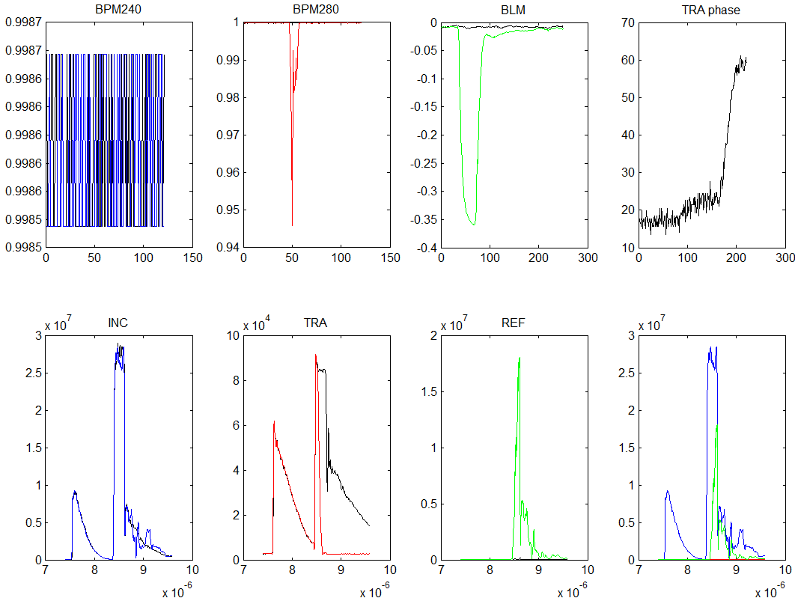
How do we detect breakdowns?
Typical Unloaded Real Breakdown

Slide 18
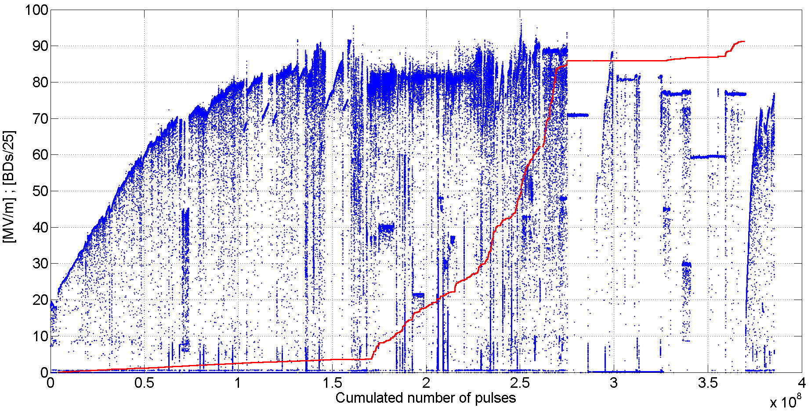

Overview of running history
Gradient normalized only to pulse width (not to number of BDs)
Number of BDs divided by 25.
$$E^{∗}=E⋅{\left(\frac{t_{pulse}}{252ns}\right)}^{\frac{1}{6}}∙{\left(\frac{BDR}{2×{10}^{−5}bpp}\right)}^{−\frac{1}{30}}$$
Data provided by A. Degiovanni

Slide 19
The loading effect for the T24 structure
Unloaded
Loaded
Gradient dependency with power for the T24 structure for unloaded and nominal CLIC loaded conditions.
Plot by A. Degiovanni

Slide 20
Measure at constant input power
Unloaded
Loaded
Gradient, MV/m
Length, m

Slide 21
Measure at constant gradient
Unloaded
Loaded
Gradient, MV/m
Length, m

Slide 22
Experiments performed
Unloaded
Loaded
c
29MW (68MV/m)
26MW (63MV/m)
34MW (75MV/m)

Slide 23
First Results: BDr at 29MW input power
Unloaded
Loaded
29MW (68MV/m)
26MW (63MV/m)
34MW (75MV/m)

Slide 24
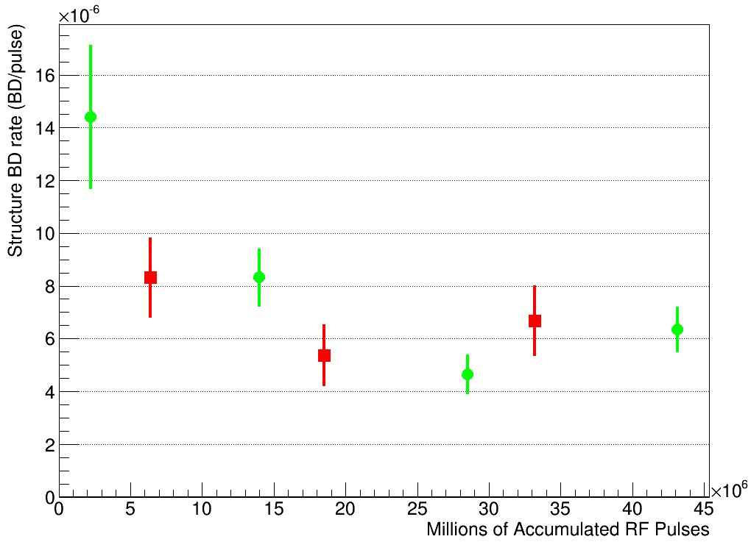
First Results: BDr
Very preliminary results!!!!!!
Gradient, MV/m
Unloaded
Loaded
Structure BD rate
Beam transmission not perfect
(but better than 90%)
Length, m
4.6 M pulses
31 BD
7.6 M pulses
63 BD
4.1 M pulses
34 BD
10 M pulses
63 BD
4.5 M pulses
24 BD
10 M pulses
46 BD
Accumulated Pulses
Central value and errors computed using 1σ Feldman-Cousins confident intervals.

Slide 25
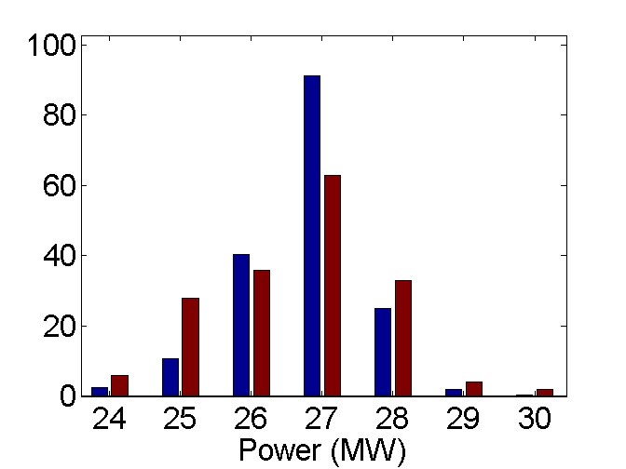
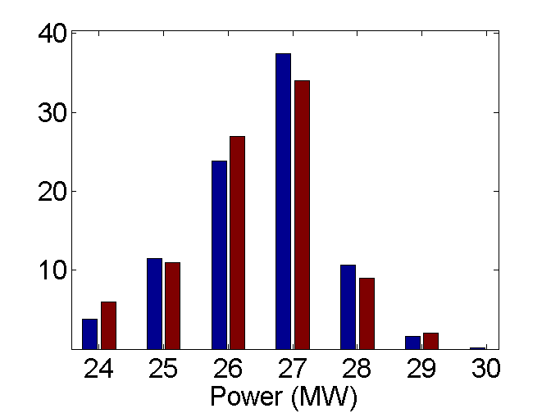
First Results: BDr at constant input Power
Unloaded
Loaded
Normal Pulses
BDs
<P> = 26.8 MW
<P> = 26.6 MW
Normal Pulses
BDs
<P> = 26.5 MW
<P> = 26.3 MW
Combined Results at 29 MW RF input power:
Unloaded BDr: (6.9 ± 0.5) 10⁻⁶
Loaded BDr: (6.7 ± 0.7) 10⁻⁶
Preliminary Conclusion
Beam does not increase BDr at constant input power

Slide 26
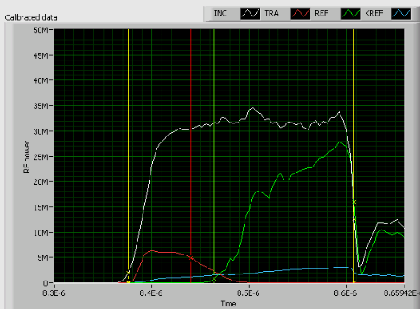
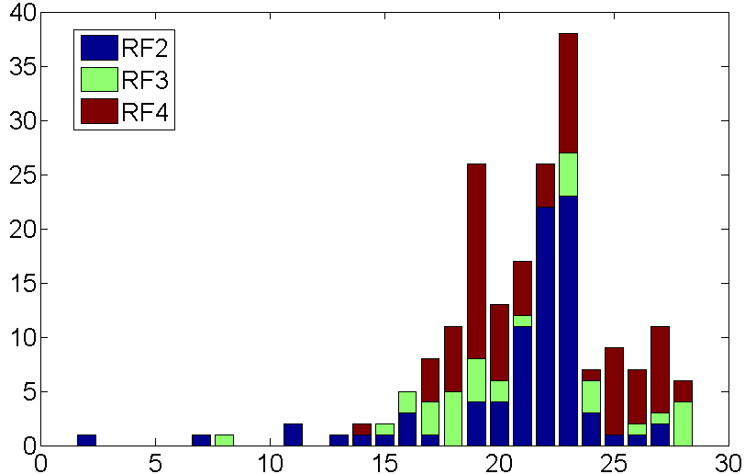
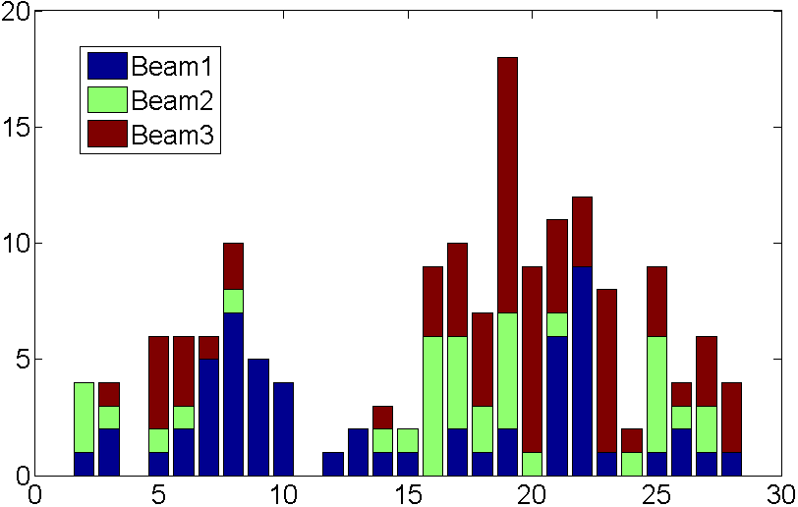
First Results: BDr at constant input Power
Breakdown cell distribution for unloaded data.
WARNING: Cell distribution still under analysis.
Very preliminary results!!!!!!
Acknowledgement: A. Degiovanni
Loaded
Unloaded

Slide 27
First Results: BDr
Unloaded
Loaded
c
29MW (68MV/m)
26MW (63MV/m)
34MW (75MV/m)

Slide 28
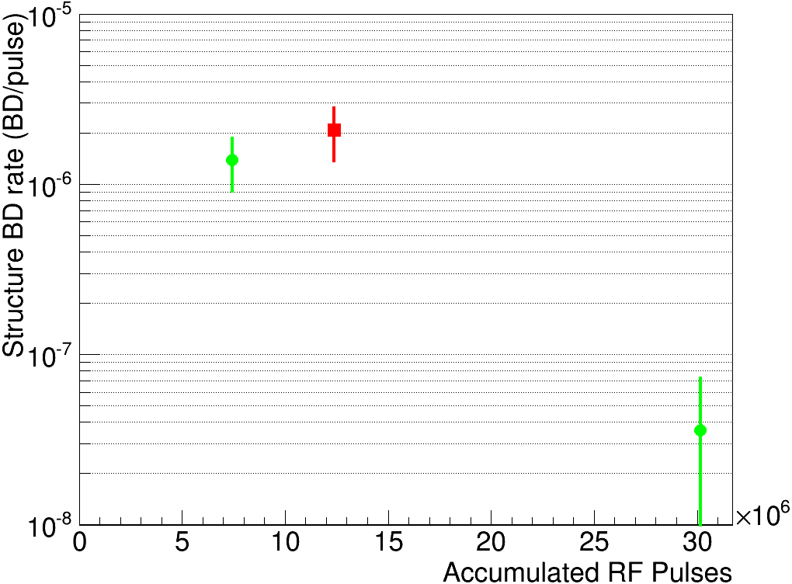
First Results: BDr
Compatible with previous result at 29 MW input power
Gradient, MV/m
Length, m

Slide 29
First Results: BDr
Unloaded
Loaded
c
29MW (68MV/m)
26MW (63MV/m)
34MW (75MV/m)

Slide 30
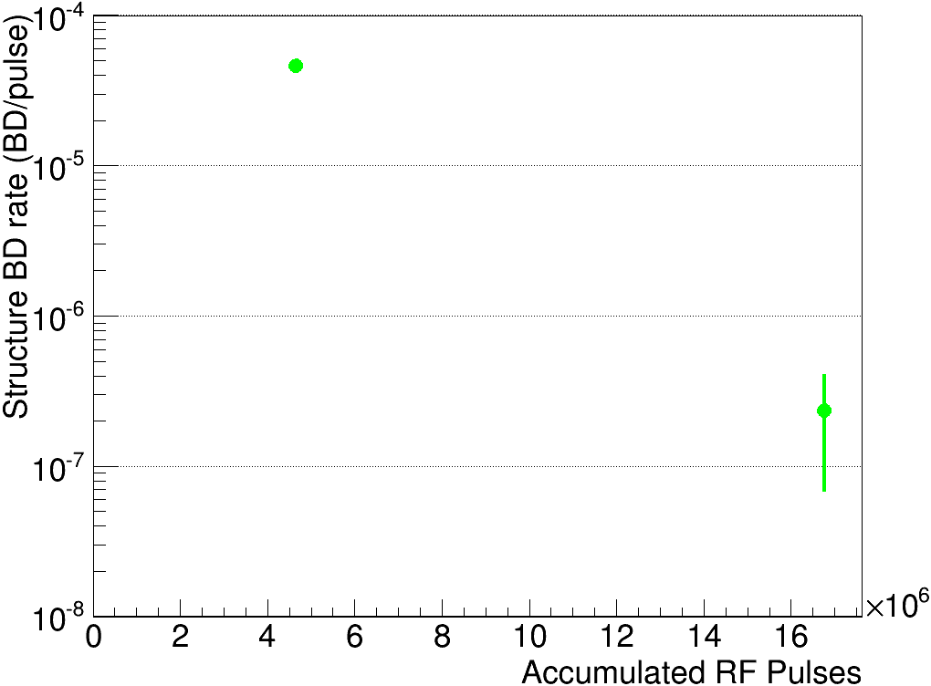
First attempt at constant average gradient
Gradient, MV/m
Length, m

Slide 31
First Results: BDr
Unloaded
Loaded
29MW (68MV/m)
26MW (63MV/m)
34MW (75MV/m)
Notes:
Lest put all the information together.

Slide 32
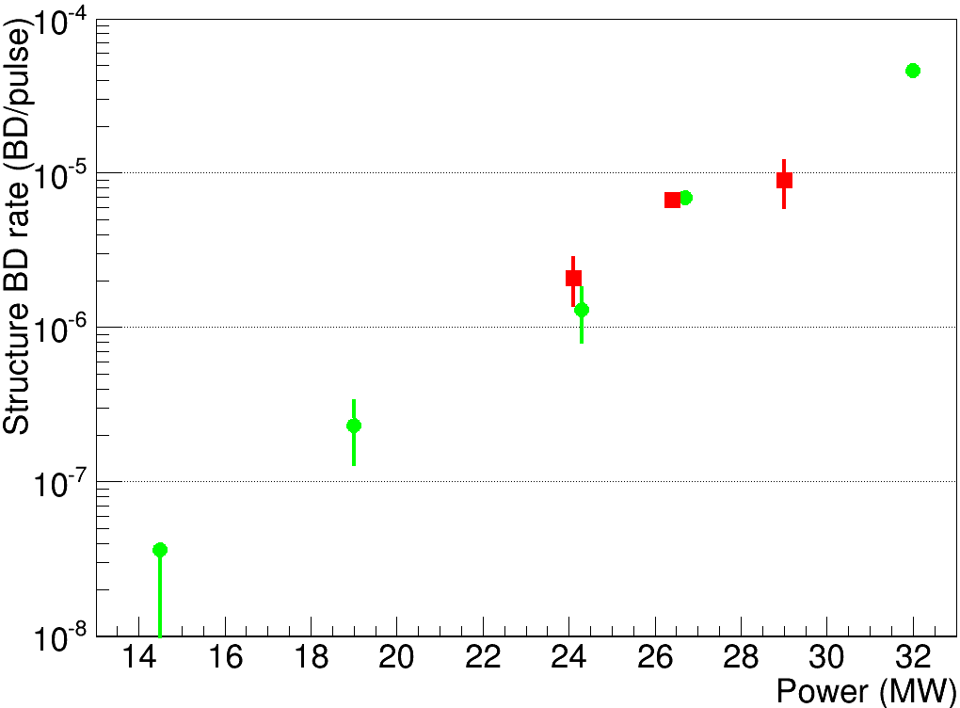
BDr dependency with input power
Unloaded
Loaded
Gradient, (au)
Length, m
Preliminary results!!!!!!
Note: X axis ~ Peak gradient

Slide 33
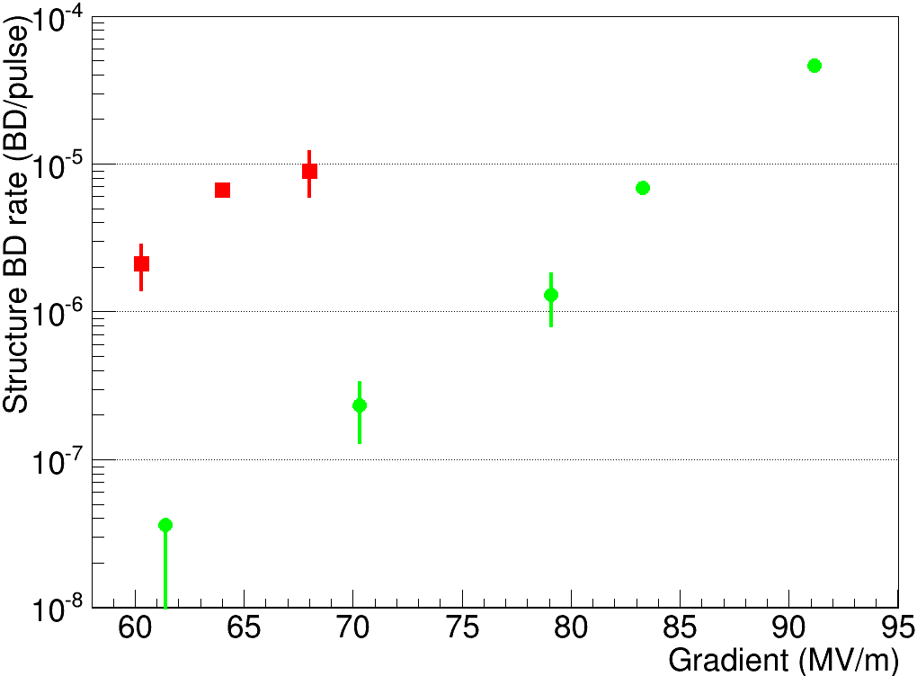
BDr dependency with gradient
Preliminary results!!!!!!
Unloaded
Loaded
Gradient, (au)
Length, m
Results need to be revalidated this year but:
The BDr seems to be dominated by the peak gradient rather than the average gradient
It suggest to taper differently the structures
Tests loading with anti-phase will be done next run
Average

Slide 34
Prospects
During the first run the experiment has been tested, solving all ‘challenges’ and improving stability
A second run starting mid-February 2015 will allow to revalidate the first results and further explore the breakdown phenomena under heavy beam-loading conditions
  Beam-RF phase dependency
  Beam current
  Beam size
  …
Technical stop on May to change pulse compressor will improve stability and pulse quality.
E Field
V
t
Cell

Slide 35
Summary
Breakdown rate measurements in heavy loaded high gradient structures was a missing block in the high gradient program.
CTF3/CLIC collaboration has successfully set up an experiment to measure the effect of beam loading at nominal CLIC gradients.
The experiment has started collecting data from end of September.
Preliminary analysis shows that the beam presence does not have a harmful effect on the breakdown rate at constant input power.
The breakdown rate seems to be dominated by the peak gradient rather than the average gradient along the structure.
More detailed analysis will be done to draw further conclusions.
More measurements will be done to validate the results.
A long-term program of tests under beam loading conditions of new structures with a different tapering should be considered.
We are ready for a more exciting 2015 running!!!

Slide 36
Acknowledgements
RF/PM
CTF3
XBOX
BI
M. Filippova
A. Grudiev
D. Gudkov
P. Guyard
A. Olyunin
A. Samochkine
A. Solodko
P. De Souza
R. Corsini
S. Doebert
D. Gamba
J.L. Navarro
T. Persson
P. Skowronski
F. Tecker
N. Catalan
S. Curt
A. Degiovanni
J. Giner
G. McMonagle
S. Rey
I. Syratchev
J. Tagg
L. Timeo
B. Woolley
W. Wuensch
M. Kastriotou
E. Nebot
Notes:
This experiment is the result of the collaboration of many people from different sections, thanks to all of them.

Slide 37



J.L. Navarro for the CLIC/CTF3 Collaboration

Slide 38
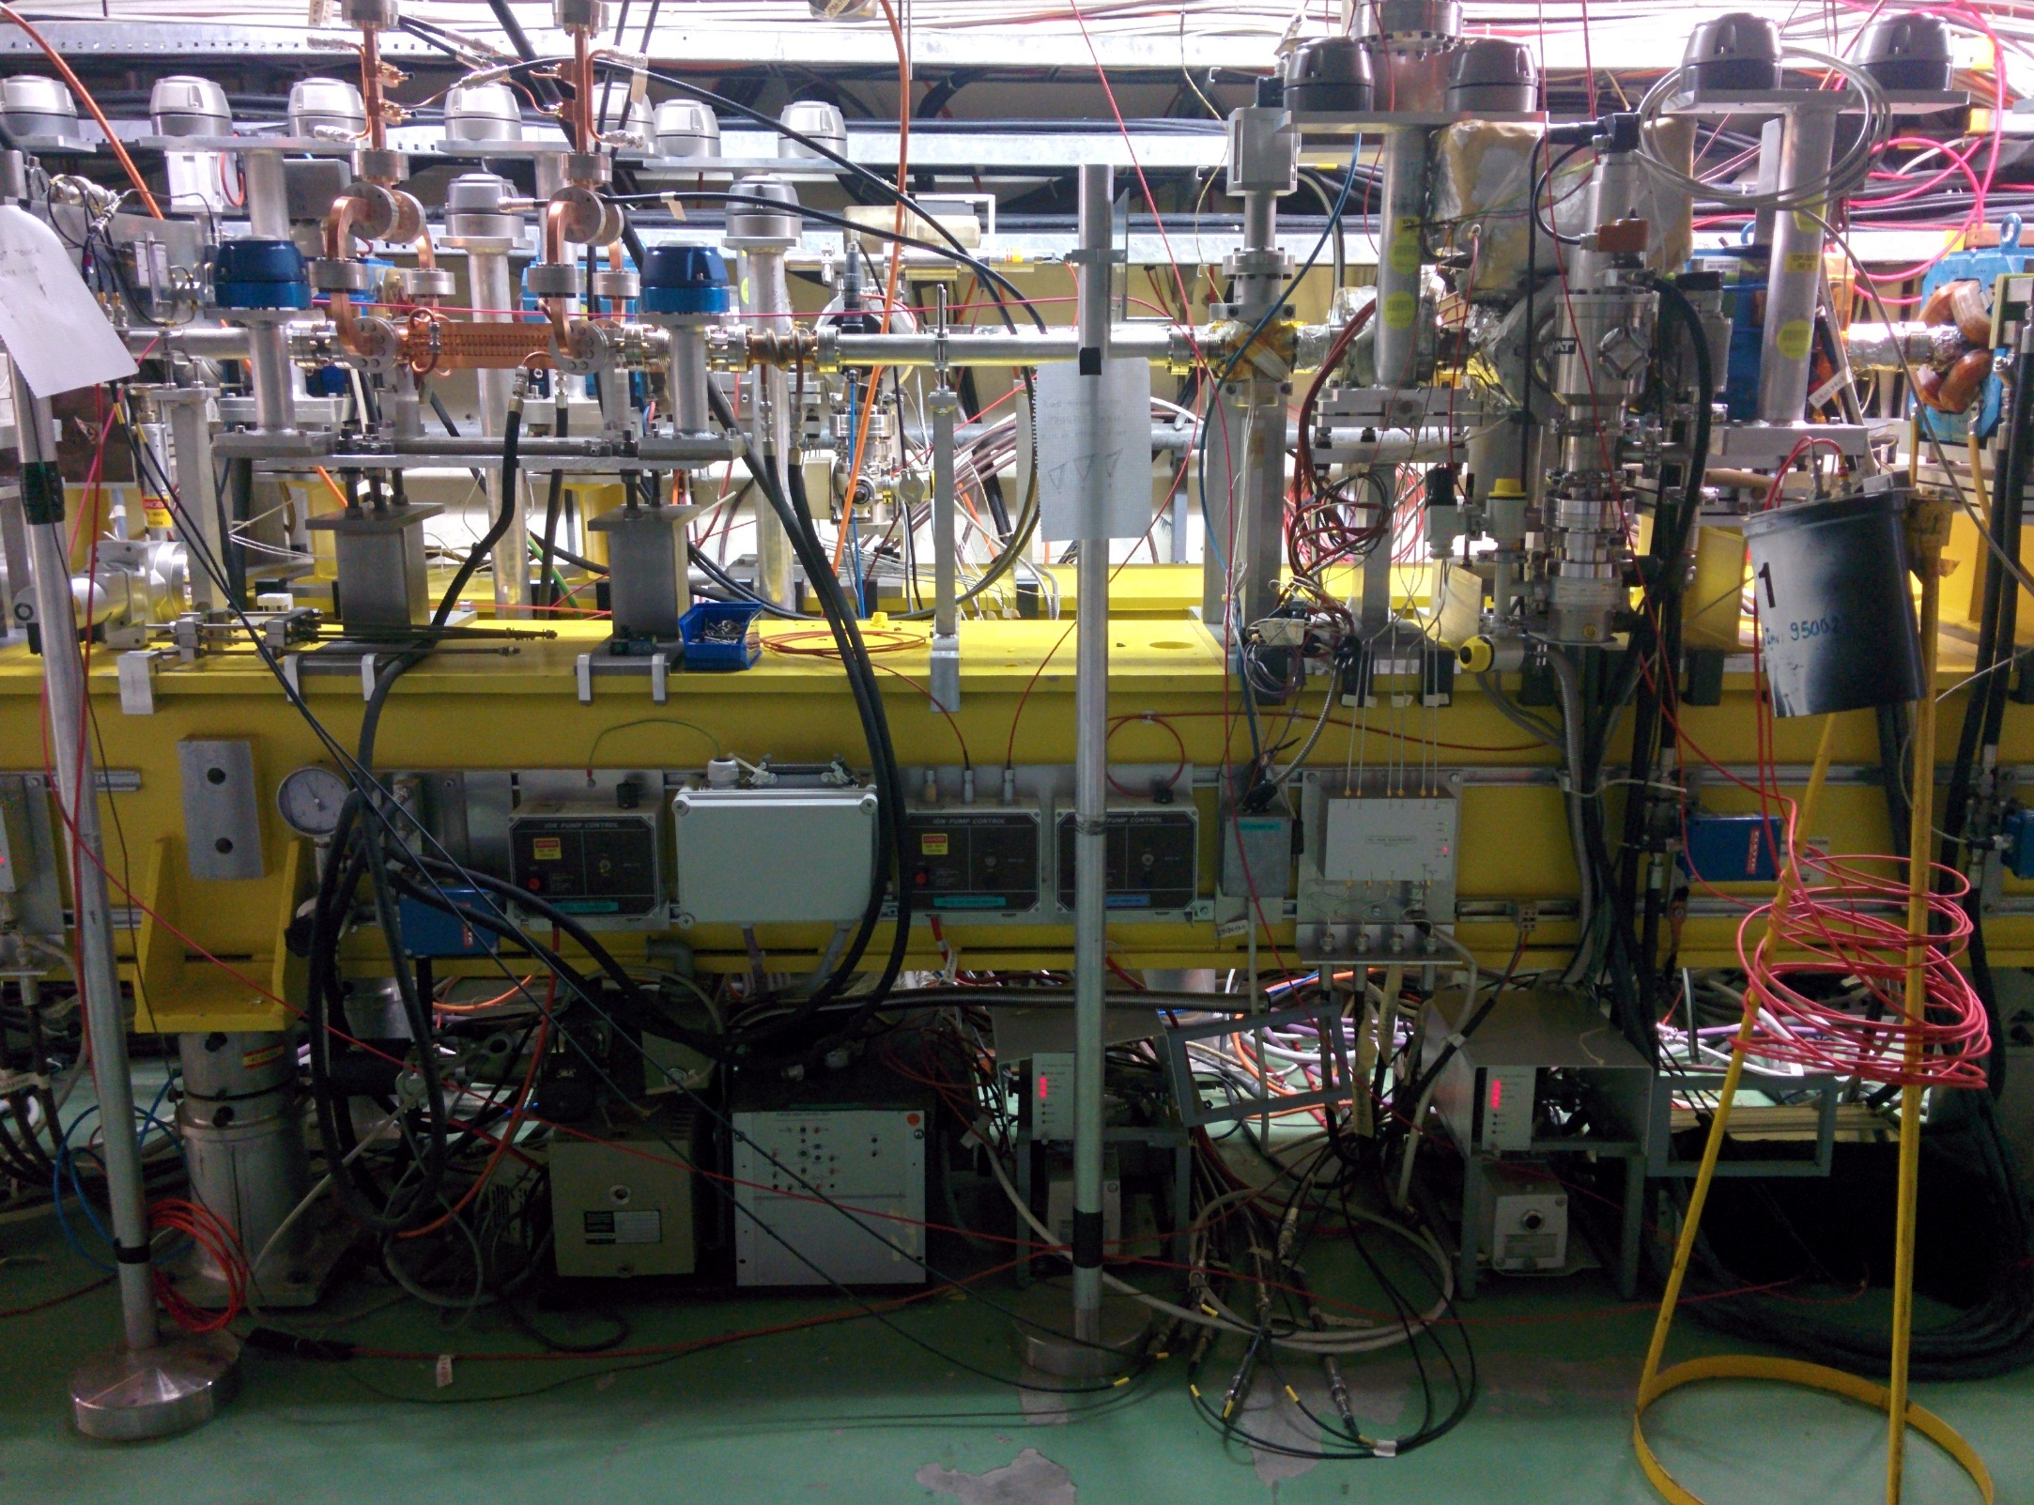
Diagnostic, control and protection
12 GHz RF output
12 GHz RF input
Vacuum pumps and gauges
Beam
6 mm collimator
BPM upstream
12 GHz
ACS
Fibre and diamond BLMs
12 GHz accelerating structure surrounded by a complete set of instrumentation:
2 inductive BPMs (1 upstream and 1 downstream)
6 mm collimator to protect the structure
Fibre optic and diamond beam loss monitors
Vacuum pumps and gauges in beam chamber and RF waveguides
BPM
downstream
BPMs
BLMs
Collimator
Vacuum readings
Interlock system
Notes:
It is surrounded by a full set of equipement
An upstream and a downstream BPM allows to measure beam transmition through the structure.
A 6mm collimator prevents damages to the structure in case of uncontrolled beam losses
Fibre optic and diamond detectors allow to check beam loses and detects breakdowns.
Directional RF couplers allow measurements of input, output and reflected power from the structure.

Slide 39
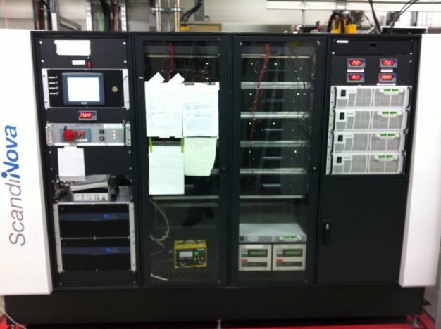
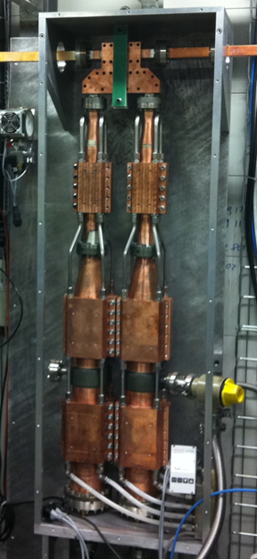
The 12GHz RF source
ScandiNova Modulator:
Designed for 400kV, 300A, 3.25us HV pulse width FWHM, 1.5us RF pulse width at 50Hz repetition rate
CPI VKX-8311A klystron:
50MW, 1.5us rf pulses
50Hz repetition rate at 400kV, 300A, 5kW avg. power
Working frequency 11.994GHz
SLED I type pulse compressor:
Power gain of 2.82
Q_{loaded} = 2.375x10⁴,
Beta = 4.27,
Q₀ = 1.31x10⁵
5% power loss
Enough power to reach 100 MV/m loaded gradient
(~43 MW)
Notes:
The RF is provided

Slide 40
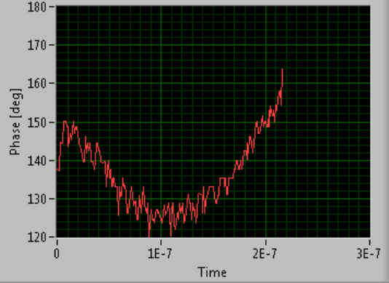
RF – Beam Phase adjustment
RF Phase sag
Beam Phase sag
A lot of effort was done matching RF and beam phases
Beam + RF Phase sag
with wrong slope
Phase function programed
200 ns

Slide 41
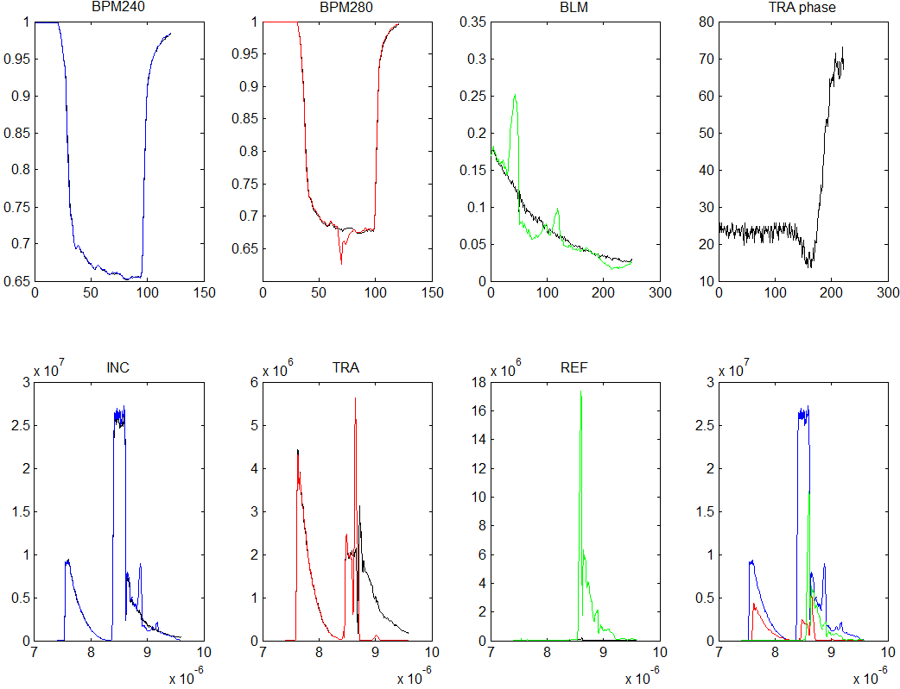
Closer view to some signals
Typical loaded Breakdown

Slide 42
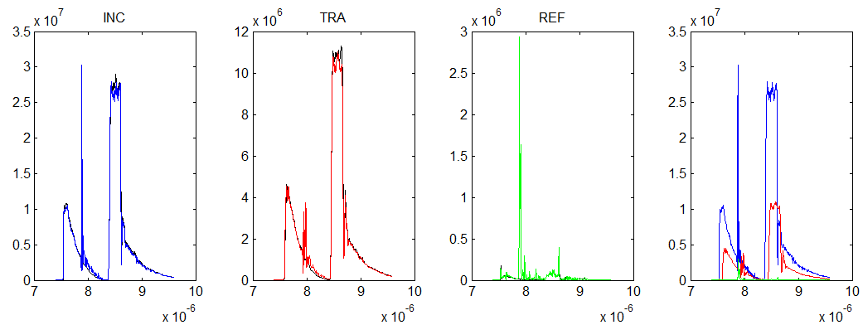
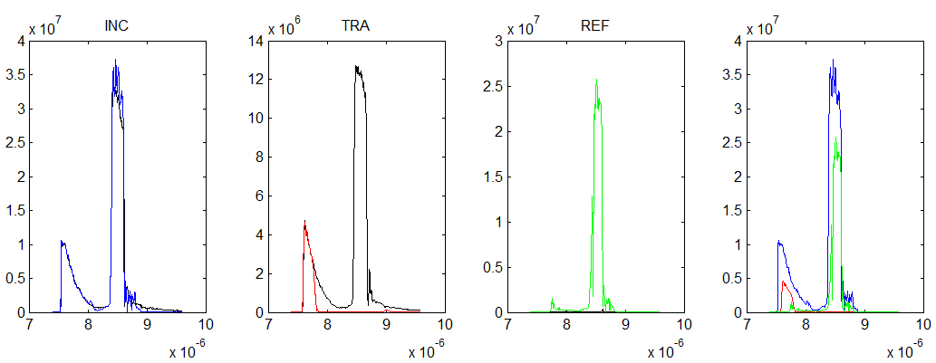
Closer view to some signals
2 discarded Breakdowns

Slide 43
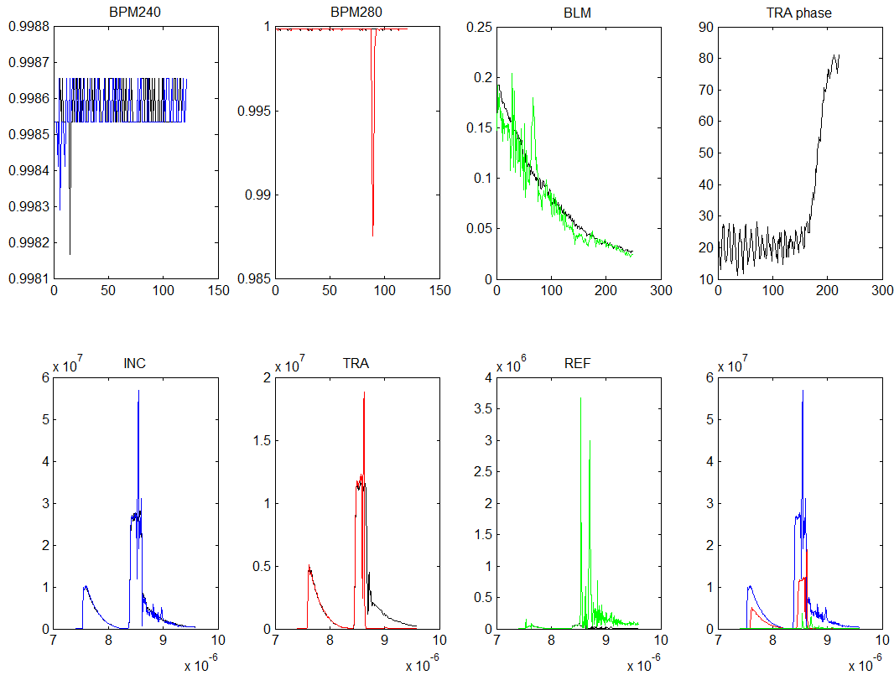
Closer view to some signals
Event selected in this analysis

Slide 44
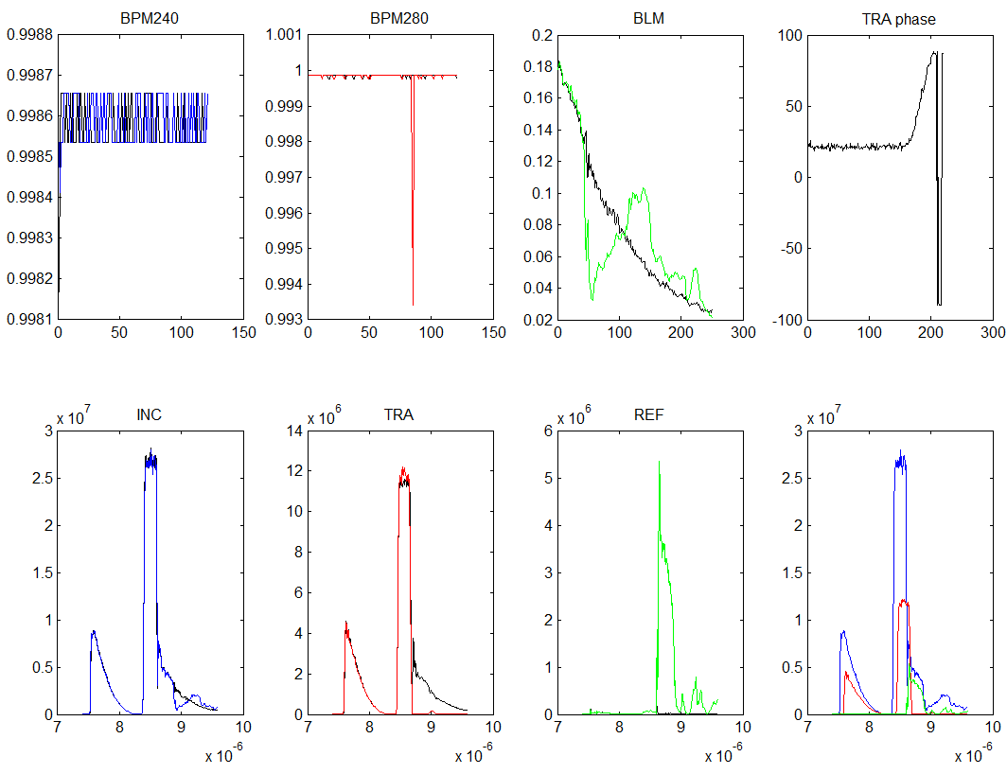
Closer view to some signals
Selected in this analysis but in the limit

Slide 45
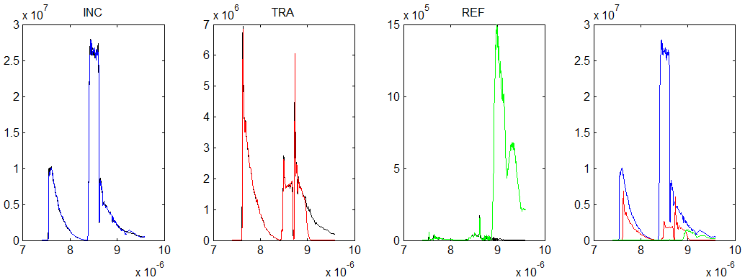
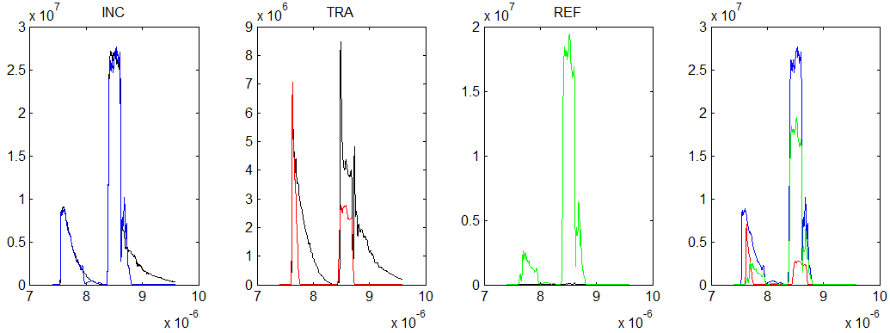
Closer view to some signals
Two not selected breakdowns in loaded condition

Slide 46
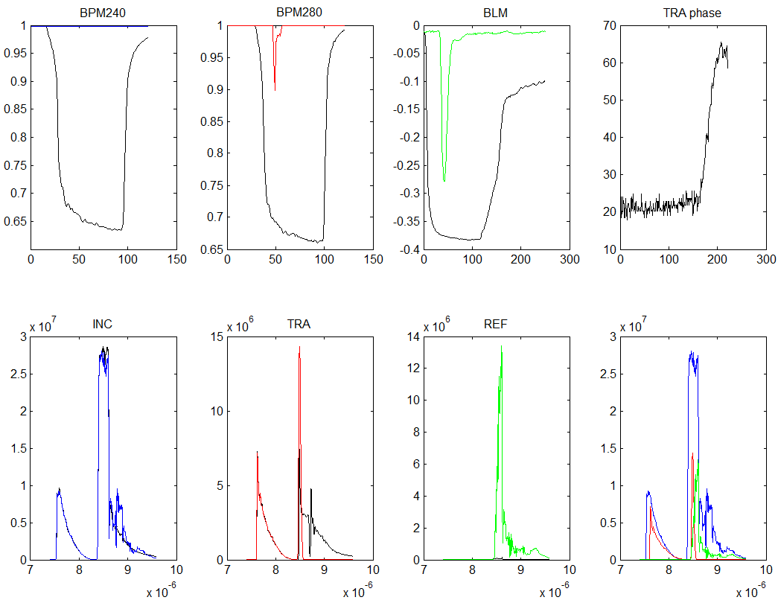
Closer view to some signals
Breakdown in a missed beam pulse. Not selected.

Slide 47
First Results: BDr
Very preliminary results!!!!!!
Data from 23/09/2014 to 08/10/2014
Point 1 (no beam):
BD rate: (1.4 ± 0.3) 10⁻⁵
Point 2 (beam):
BD rate: (8.3 ± 3) 10⁻⁶
Point 3 (no beam):
BD rate: (8.3 ± 1) 10⁻⁶
Point 4 (beam):
BD rate: (5.3 ± 2) 10⁻⁶
Point 5 (no beam):
BD rate: (4.6 ± 0.7) 10⁻⁶
Point 6 (beam):
BD rate: (6.7 ± 1) 10⁻⁶
Point 7 (no beam):
BD rate: (6.3 ± 0.8) 10⁻⁶
Gradient, MV/m
Points 1, 3, 5 and 7
Points 2, 4 and 6
Length, m
Preliminary Conclusion:
Need increased statistic to reduce errors

Slide 48
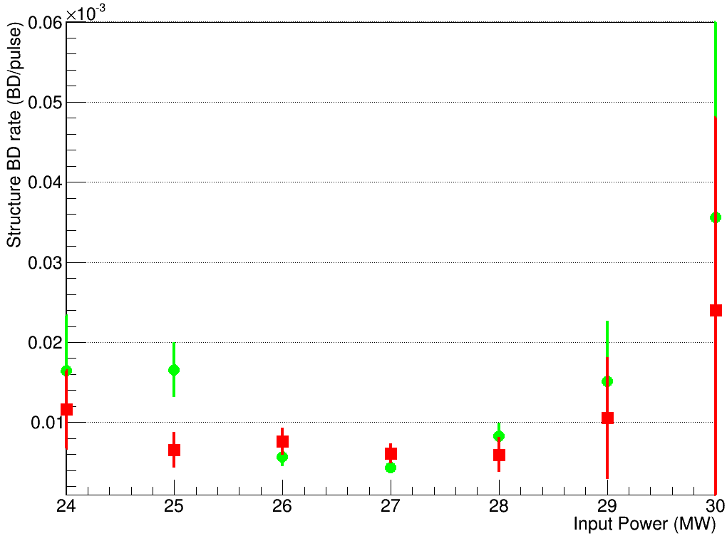
First Results: BDr at constant input Power
Unloaded
Loaded

Slide 49
First attempt at constant average gradient
Main goal: Measure loaded and unloaded breakdown rate at same gradient
215 BDs/ 4.6 M pulses
BDr: (4.6 ± 0.3) 10⁻⁵
Gradient, MV/m
2 BDs/10.7 M pulses
BDr: (2.3 ± 1.6) 10⁻⁷
12 BD/1.4M pulses
BDr: (9 ± 3) 10⁻⁶
Warning!!
Not clean conditions
Length, m
Notes:
The main goal is to measure and compare the DB rate in loaded and unloaded structure. The structure for the test is in our argot a T24: linearly tapered structure, with 24 cells without damping coupling. This experiment has been organized in two phases. We already have finished the first one that is basically all the optics design, and hardware and beam commissioning and we expect to begin with the second one by middle of this year.

Slide 50
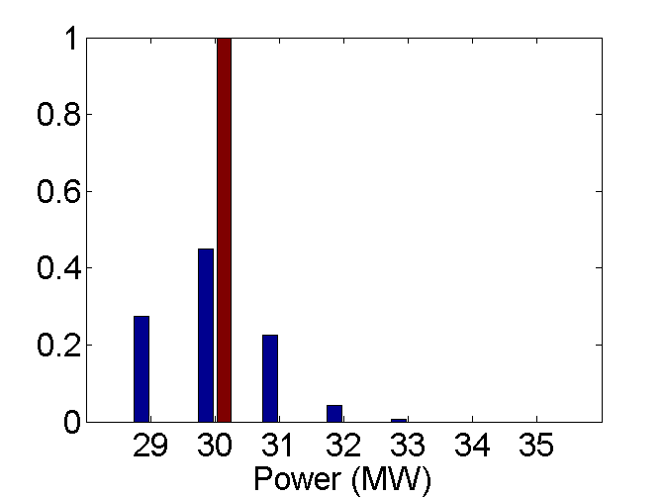
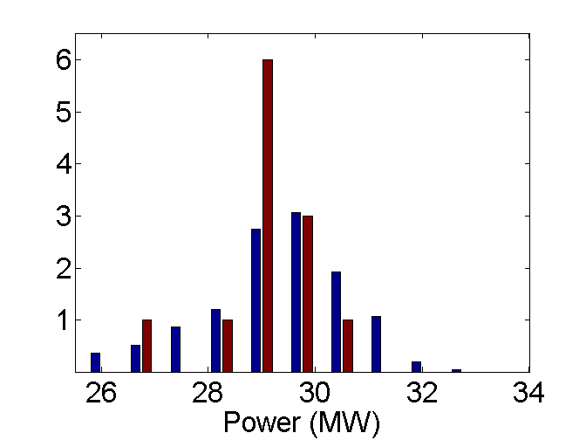
First attempt at constant average gradient
Normal Pulses
BDs
Normal Pulses
BDs
1 BD; <P> = 30MW
1M pulses; <P> = 30MW
BDr: (1.6 ± 1.2) 10⁻⁶
12 BD; <P> = 29 MW
1.4M pulses; <P> = 29.3 MW
BDr: (9 ± 3) 10⁻⁶
Loaded measurement with different cuts in power
Notes:
The main goal is to measure and compare the DB rate in loaded and unloaded structure. The structure for the test is in our argot a T24: linearly tapered structure, with 24 cells without damping coupling. This experiment has been organized in two phases. We already have finished the first one that is basically all the optics design, and hardware and beam commissioning and we expect to begin with the second one by middle of this year.

Slide 51
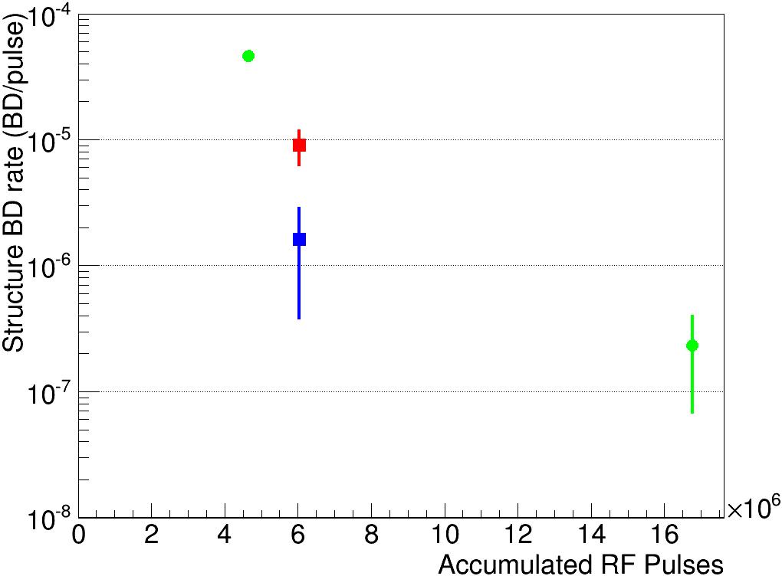
First attempt at constant average gradient
215 BDs/ 4.6 M pulses
BDr: (4.6 ± 0.3) 10⁻⁵
<P> = 32 MW; 92 MV/m
12 BD/1.4M pulses
BDr: (9 ± 3) 10⁻⁶
<P> = 29 MW; 68 MV/m
1 BD/1M pulses
BDr: (1.6 ± 1.2) 10⁻⁶
<P> = 30 MW; 70 MV/m
2 BDs/10.7 M pulses
BDr: (2.3 ± 1.6) 10⁻⁷
<P> = 19 MW; 70 MV/m
Warning!!
Not clean conditions
Period dominated by RF net activity
Good period
Notes:
The main goal is to measure and compare the DB rate in loaded and unloaded structure. The structure for the test is in our argot a T24: linearly tapered structure, with 24 cells without damping coupling. This experiment has been organized in two phases. We already have finished the first one that is basically all the optics design, and hardware and beam commissioning and we expect to begin with the second one by middle of this year.

Slide 52
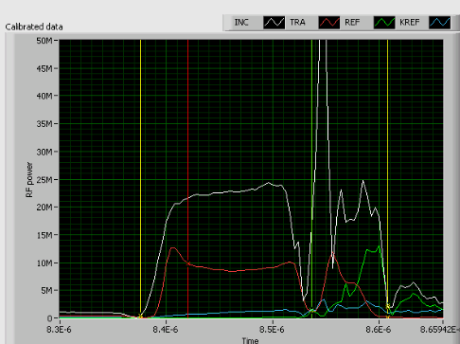

First Results: BDr at constant input Power
Break down cell distribution for unloaded data.
Cell distribution for loaded periods still under analysis.
Acknowledgement: A. Degiovanni

Slide 53


Current limitation
Pulse is chopped after the circular waveguide
Signals collected by A. Degiovanni
2 - CTF2 after RF valve and circular WG
1 - After Pulse compressor
3 – Input to the ACS
High activity in the RF network near a RF valve above 31 MW (at the structure)
High power is real!
Courtesy of A. Olyunin and I. Syratchev

Slide 54

RF pulses
Input power (MW)

Slide 55

RF BDs
Input power (MW)

Slide 56

Backup: CLIC Nominal parameters

Slide 57

Optics design
Objective: Transport the beam trough the Linac up to the structure requiring…
- Full transmission efficiency
- Minimum beam size on average inside the structure
Structure
Maximize relative distances between aperture and beam size (M. Dayyani). MAD model by F. Tecker.
Beam envelope
Structure
Re-matched optics for last running
Linac+dogleg
Notes:
We need a careful design of the optics to perform this experiment. We need to design the optics in order to have the minimum beam side possible and no dispersion inside the structure to ensure no beam looses inside the structure. The left plot shows the designed optics to keep the minimum beam size in average inside the structure and the right one the measured optics during the last running.

Slide 58

Phase I Results: Running of May 2013
Measured power scaled down by 3dB.
Shape reproduced…
…but error in calibration
Notes:
On the other hand we compared the measured pulse shape with the expected one. Black line shows the current profile crossing the structure and Red line shows the expected produced power when the current cross the structure. The blue line is the measured power scaled down by 3dB. It suggest that we had and error in the calibration that was confirmed with a calibration during the summer shutdown.

Slide 59

Backup
Accelerating gradients achieved in tests.
Status: 4-9-2012
loaded

Slide 60




Backup (I. Syrachev. CLIC Workshop 2013)
Structure under test:
CERN’s T24 (12WNDSvg1.8 KEK N1)
No damping

Slide 61





Calibration (I. Syrachev. CLIC Workshop 2013)
-49.32
-52.04
Insertion losses of the input/output waveguide network (splitter and bends) is -0.15 dB (η=0.967)

Slide 62





Dog-leg waveguide line installation status.
All the components are installed.
Connected to accelerated structure and closed for vacuum.
Vacuum leaks checked (tight).
Ready to be connected to XBOX1.

Slide 63





RF power transmission measurements
S11 data
Transmission (simulated)
S21 Reconstructed
(Xiaowei Wu)
Short circuit(+offset)
Reflection
Matched load
The measured RF power transmission efficiency is 80%.
Reflection is below -27dB.
The group delay time is 75 ns (~23.5 m).

Slide 64

Overall power transmission efficiency
0.87
0.8
Xbox1
CTF2
wall
CTF3
The overall measured RF power transmission efficiency is 67%.
The round group delay time is 230 ns (~35 m).
To provide nominal CLIC RF pulse, XBOX1 klystrons needs to deliver 36 MW x 1.5μs

Slide 65

Backup

Slide 66


Backup

Slide 67

Phase I Results: Running of Dec 2013
And from the RF side:
Theoretical model fits within experimental uncertainties
Data from May 2013
P[MW]=2.62 I²
P[MW]=3.17 I²
P[MW]=1.91 I²
Data from Dec 2013
(after DAQ recalibration)

