Slide 1
CTF3 as a plasma wakefield acceleration test facility?
First thoughts
Erik Adli
Department of Physics, University of Oslo, Norway
Input from: Steffen Doebert, Wilfried Farabolini, Patric Muggli, Chris Clayton
CLIC Workshop 2015
January 26, 2015

Slide 2
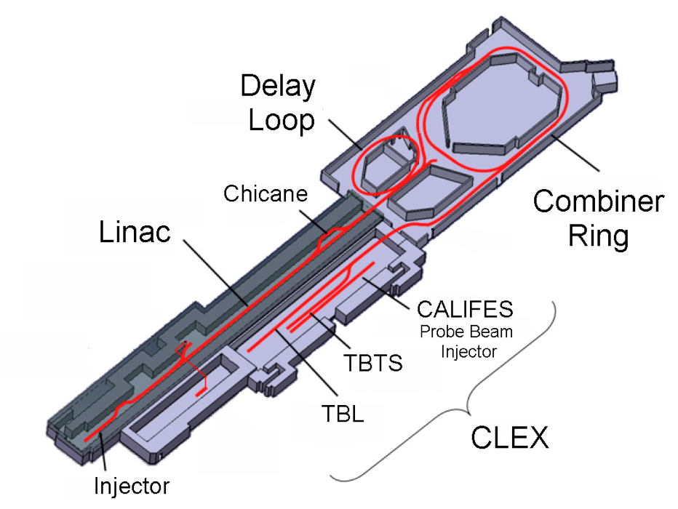
CLIC Test Facility 3
Shut down planned at the end 2016
Accelerators +rich infrastructure of diagnostics and control “up for grabs”
Recent years : increased interest in plasma wakefield acceleration (PWFA)
Can CTF3 be converted to a
plasma wakefield acceleration test facility?

Slide 3
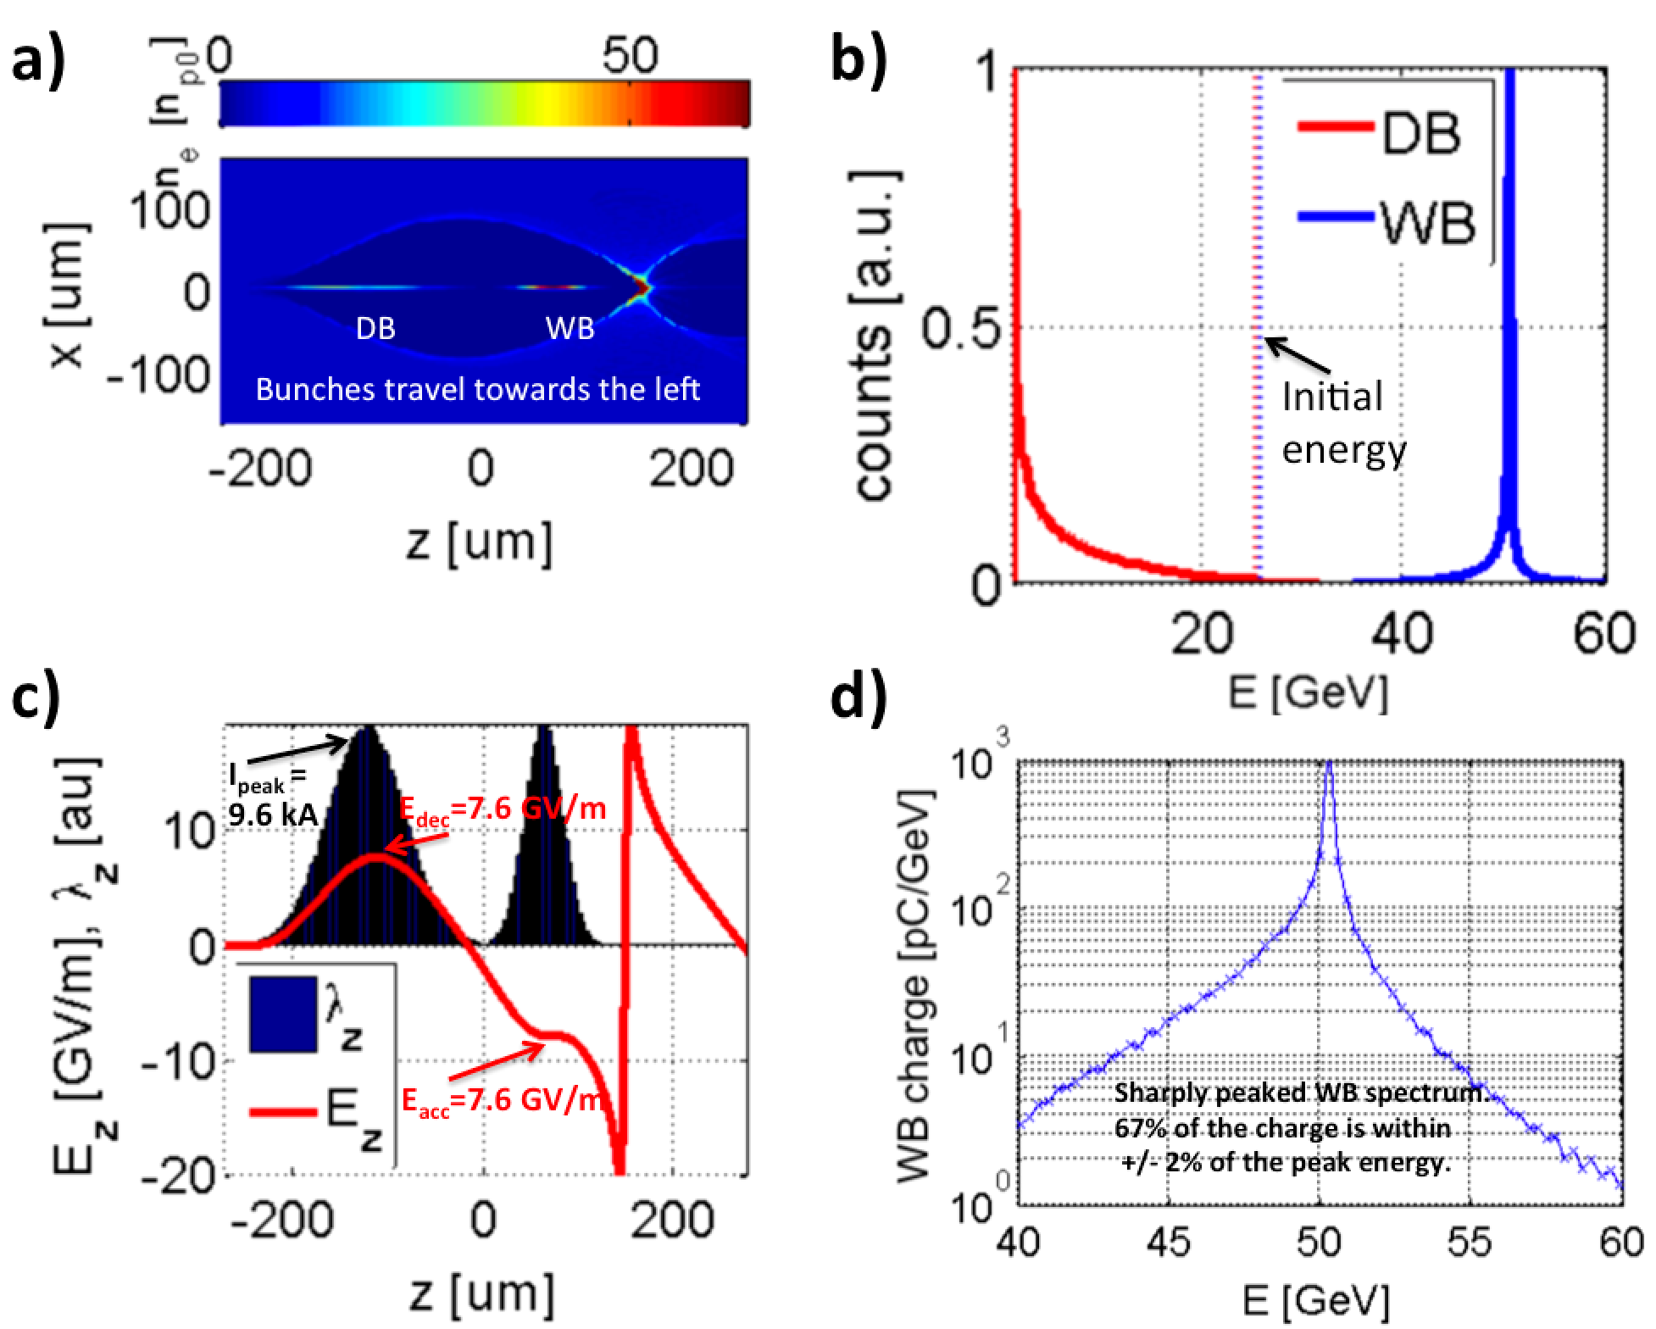
Beam driven PWFA
Beam driven PWFA:
Two-bunch acceleration. A drive bunch drives a plasma wake, being decelerated. A witness bunch extract the wake energy, being accelerated.
PWFA has potential for:
High gradient (>10 GV/m)
High efficiency (>50%)
Low energy spread (<1%)
High charge (~nC)
Emittance preservation
Above: PIC simulation based on example parameters from the PWFA-LC design study.
Not discussed here: laser driven plasma wakefield acceleration.
PIC simulations performed with the code QuickPIC (W. An, W. Mori, UCLA)

Slide 4
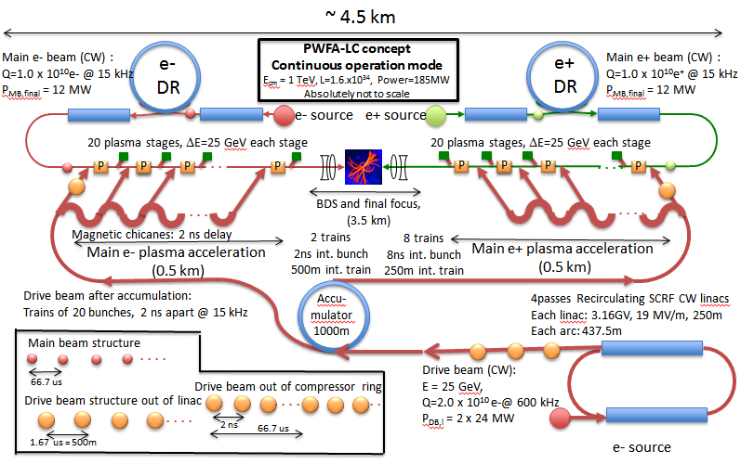
Possible application - PWFA-LC?
Concept for PWFA-LC layout for 1TeV. Based on earlier work from 2009 by Raubenheimer et al.
J.P. Delahaye, E. Adli et al., “A beam driven Plasma Wake-Field Linear Collider”, CSS2013 and arXiv:1308.1145

Slide 5
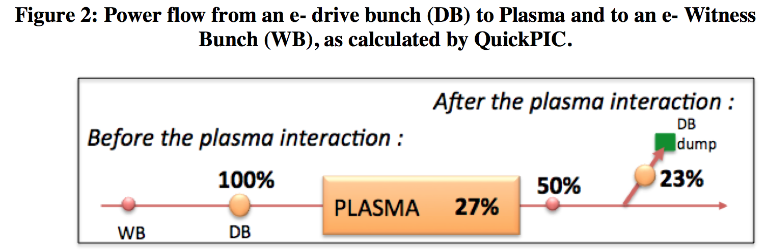
Energy efficiency in a PWFA-LC
Shaping of the WB may increase this number.
Shaping of the DB may reduce this number.
The total beam to beam efficiency of 50% is, together with the gradient, what makes the PWFA-LC a potentially very interesting option for a future linear collider.

Slide 6
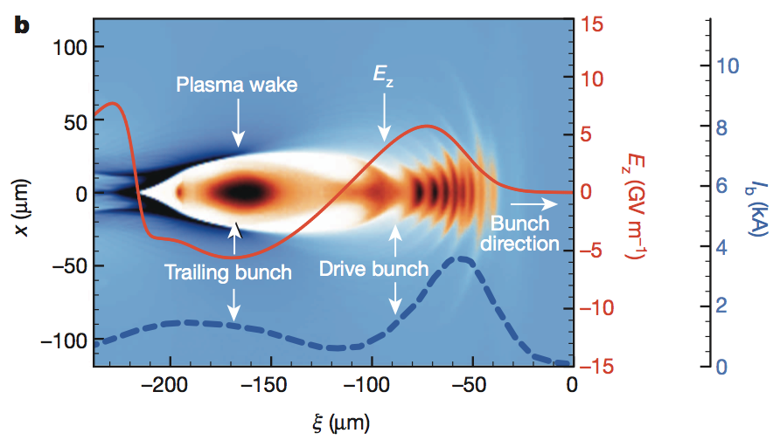
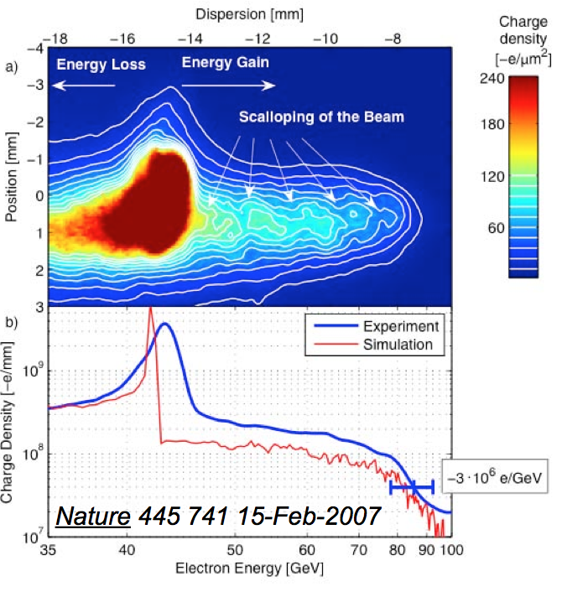
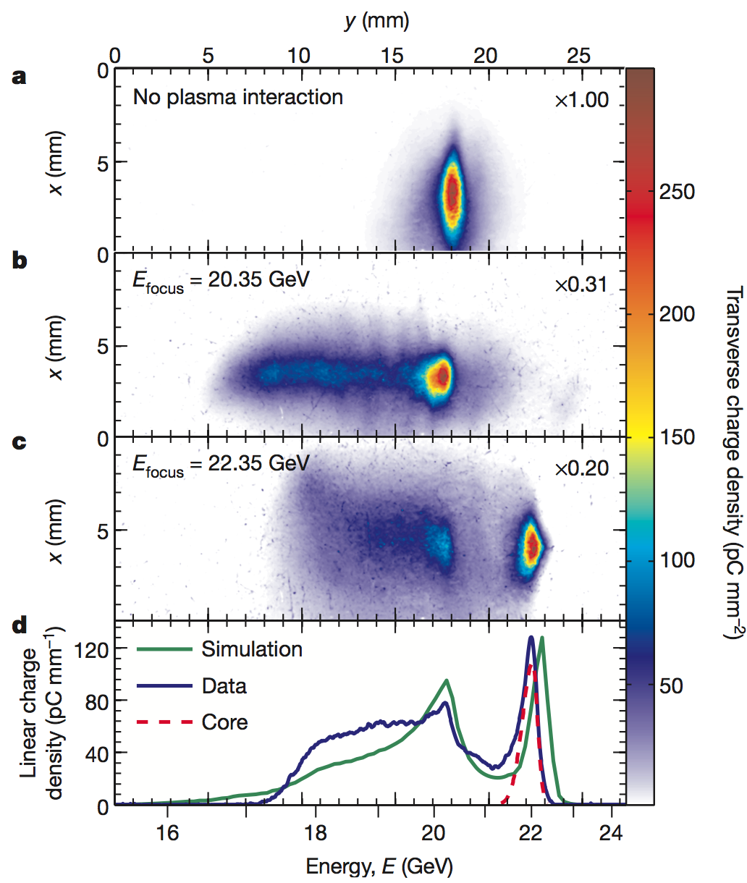
Experimental progress in PWFA
High gradient (~50 GV/m) demonstrated several years ago; SLAC linac energy doubling of beam tail.
Blumenfeld, I. et al. Nature 445, 741 (2007).
M. Litos et al., Nature 515, 92 (2014)
Acceleration of a witness beam, with high efficiency (>30% wake to beam), high gradient (5 GV/m) and low energy spread (~1%) recently demonstrated at SLAC/FACET.
See CERN A&T seminar with C. Joshi, Dec 18.

Slide 7
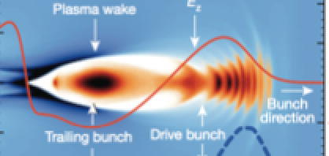
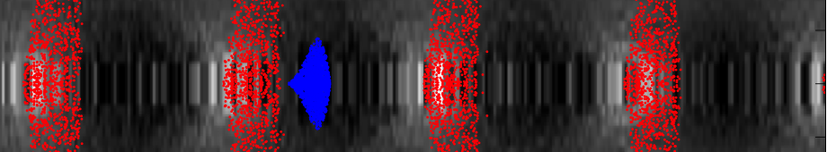
PWFA experimental R&D
Much experimental work is required to fully demonstrate PWFA for applications, and especially for a LC, including studies of :
sub-um emittance preservation
beam loading and energy efficiency
phase stability at fs level, and shot-to-shot reproducibility
injection, extraction and matching
plasma cell staging
drive bunch depletion
multi-bunch plasma heating/relaxation
Beam driven PWFA test facilities :
ATF2 @ Brookhaven: one e-bunch split
FLASH-FORWARD @ DESY: one e-bunch + laser plasma injector
Possibly other experiments in LAOLA
FACET-I: e-, e+ single bunch cut in two for two-bunch acceleration.
FACET-II (not yet funded): separate e- witness bunch photo-injector
AWAKE: proton driver, using the SPS bunch of 19 kJ. e- witness bunch probles self-modulated wake. Target: investigate wakes from high energy proton drivers.
A based PWFA-LC test facility should offer two separately lepton controlled beams. Only FACET-II (> 2017) may offer this capability.
AWAKE: studies alternative way towards a PWFA-LC (single stage driven by LHC proton bunch); complementary study.

Slide 8
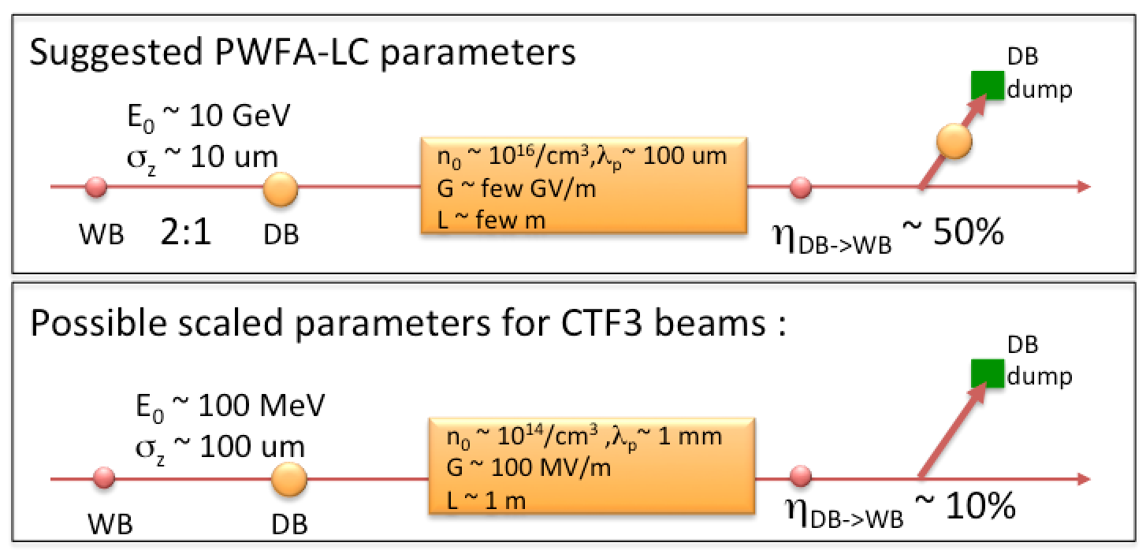
Potential for CTF3 as a PWFA-LC
CTF3 has two independent electron beam lines.
CTF3 is equipped with extensive beam diagnostics. Precise knowledge of beam parameters is important (a challenge at FACET).
The CTF3 parameters are far from suggested PWFA-LC parameters
Physics scale with plasma density, n_{0.} Most physics remains the same.
  Electric fields and gradient: E₀ ~ √n0
  Length scale : λ_{p} ~ 1/√n0
Not available in CTF3
plasma cell
Potentially available in CTF3
Not a very high-gradient facility (compared to other PWFA), however, a new test facility does not need to demonstrate high gradients in a plasma as this has already been demonstrated numerous times.

Slide 9
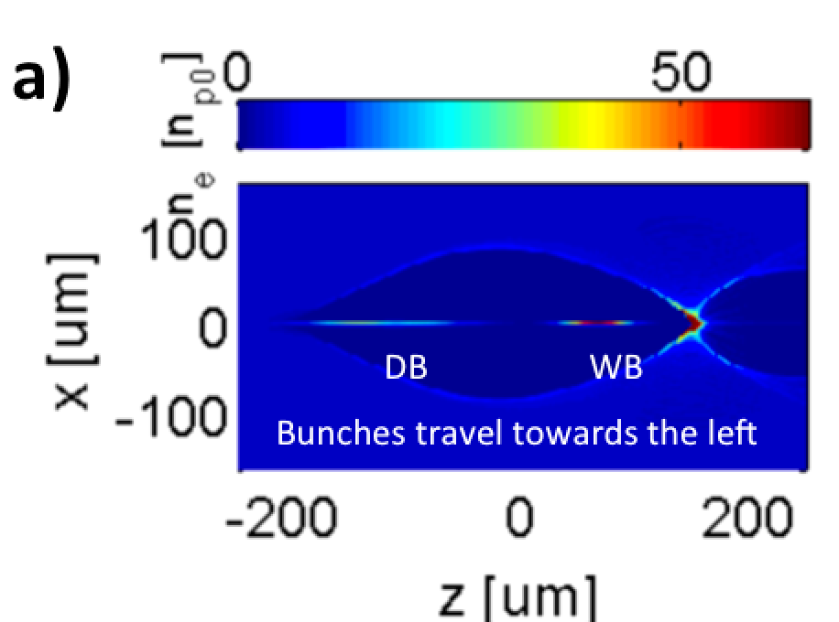
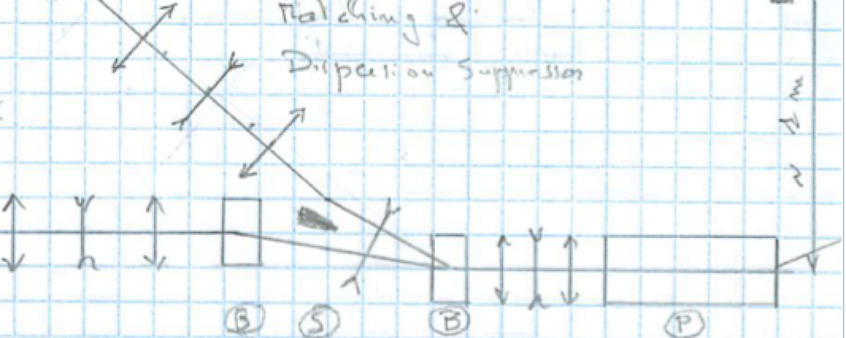
Requirements for a test facility
Need to inject the DB and the WB co-linearily, ideally matched to the plasma focusing. Injection can be based on energy separation. Typical matched betas for low energy and low plasma density are ~ 1 cm.
Plasma source : easier requirements than sources for FACET, AWAKE.
The PWFA-LC is based on acceleration in the “blow-out regime”; DB blows out all the plasma electrons; linear focusing and uniform E_{z}. This requires bunch density, n_{b}, higher than the plasma density, n₀
-> high bunch density required.
Fields scales as √I_{peak}
-> high peak current required.
DB
DB injection based on energy separation
MB from CALIFES
plasma
cell
A “TBTS”in CLEX with the two beams brought co-linear
PWFA in the blow-out regime

Slide 10
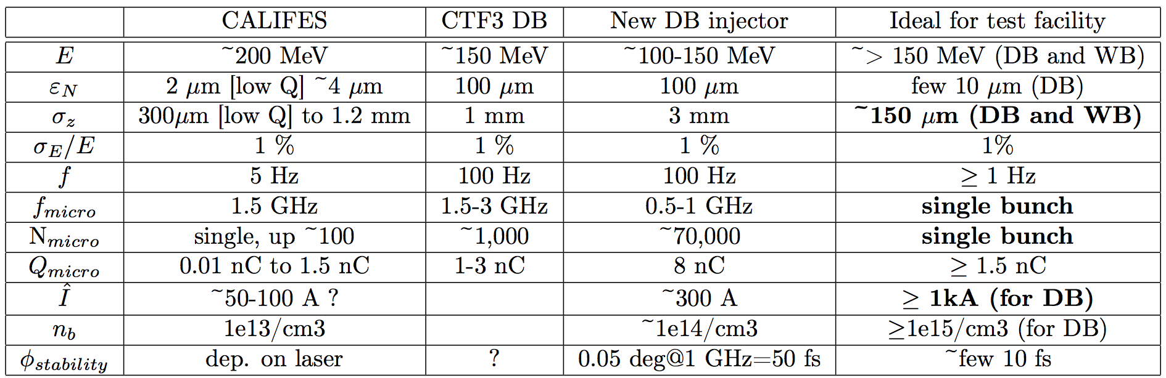
CTF3 parameters
Even at n₀ ~ 10¹⁴ /cm³ the DB and WB bunches must be shorter than what is currently available in CTF3.
On the next slides I will show a few PIC simulations where I use parameters based on the new DB injector as plasma DB, and CALIFES as plasma WB. Bunches is shortened as much as needed. Bunch shortening in CTF3 can be performed by new bunch compressors.

Slide 11
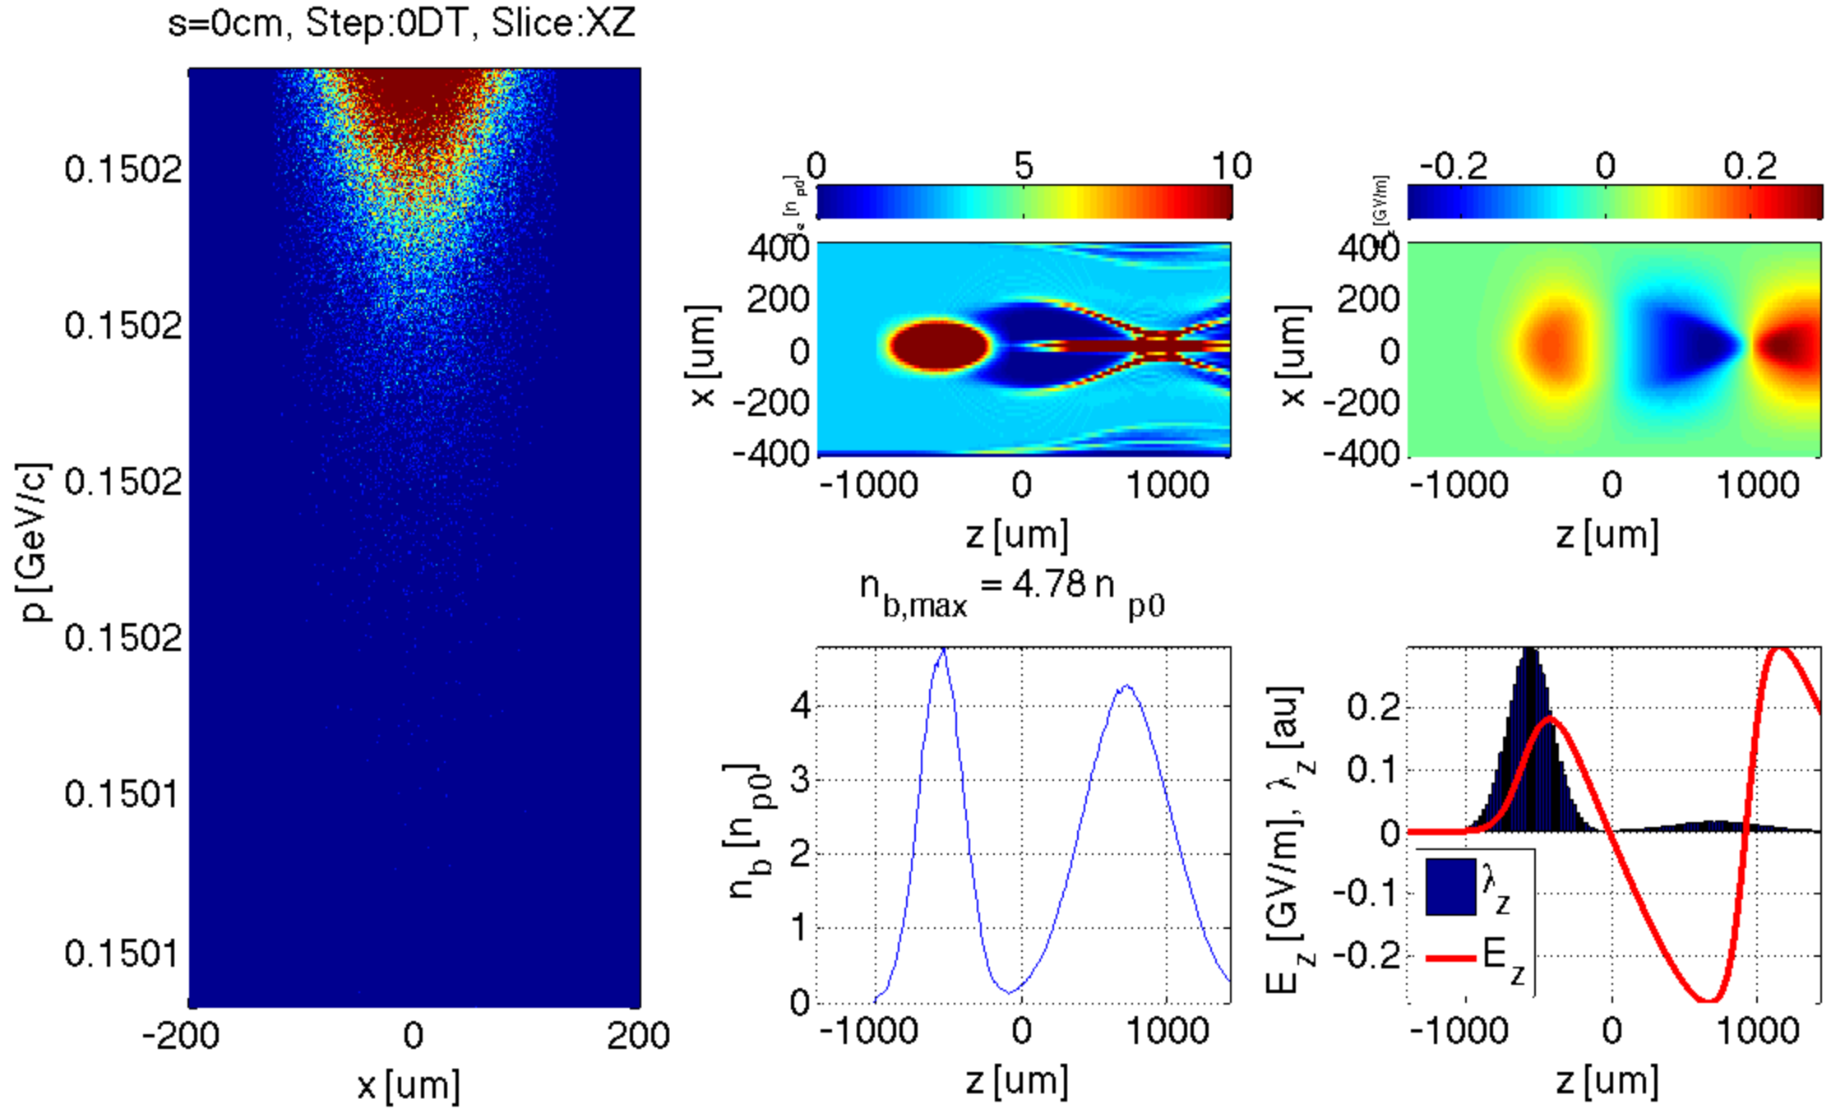
DB should drive a clean blow-out
Σ_{z {DB,WB}} = {150, 300} um
n₀ = 3.1 x 10¹⁴/cm3
ε_{zN,DB} = 100 um
Initial time step.
E₀ = 150 MeV
The blow-out “bubble” will have length of size ~ λ_{p} ~ 1 mm
Electron density
Longitudinal field
PIC simulations performed with the code QuickPIC (W. An, W. Mori, UCLA)

Slide 12
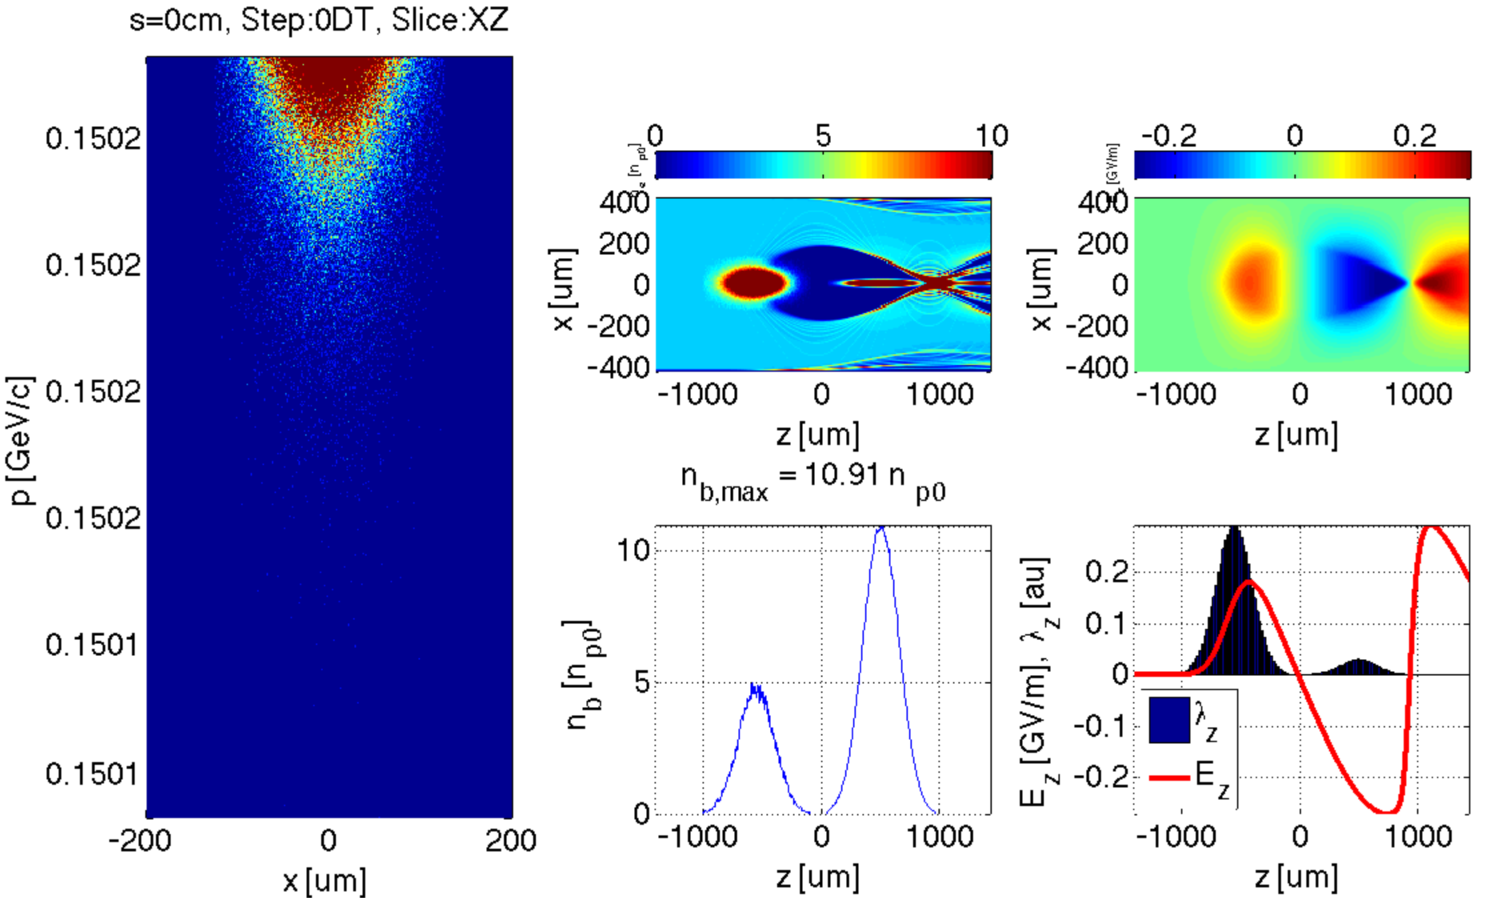
WB should fit in accelerating phase
σ_{z} = {150, 150} um
n₀ = 3.1 x 10¹⁴/cm3
Initial time step.

Slide 13
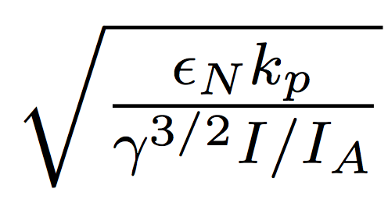
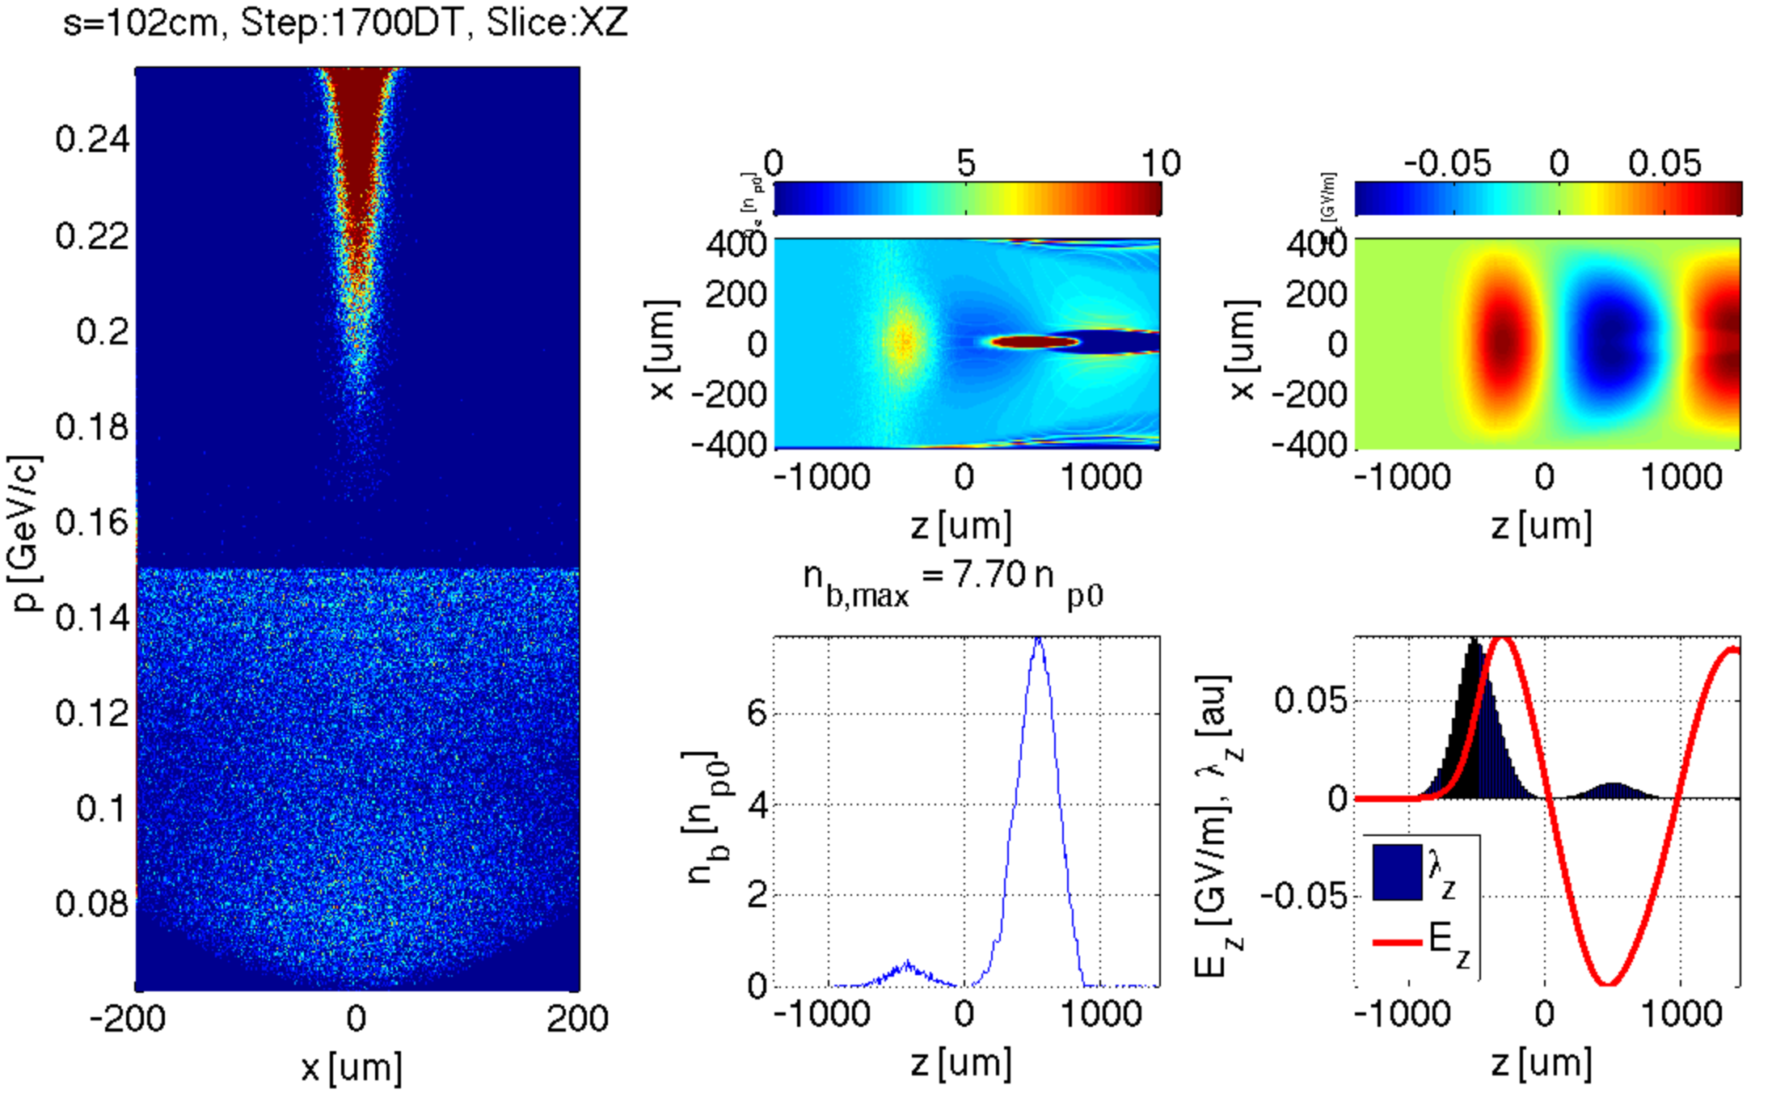
DB erosion sets limits on emittance
σ_{z} = {150, 150} um
n₀ = 3.1 x 10¹⁴/cm3
s = 1.0 m
Head erosion of propagating drive bunch scales as :

Slide 14
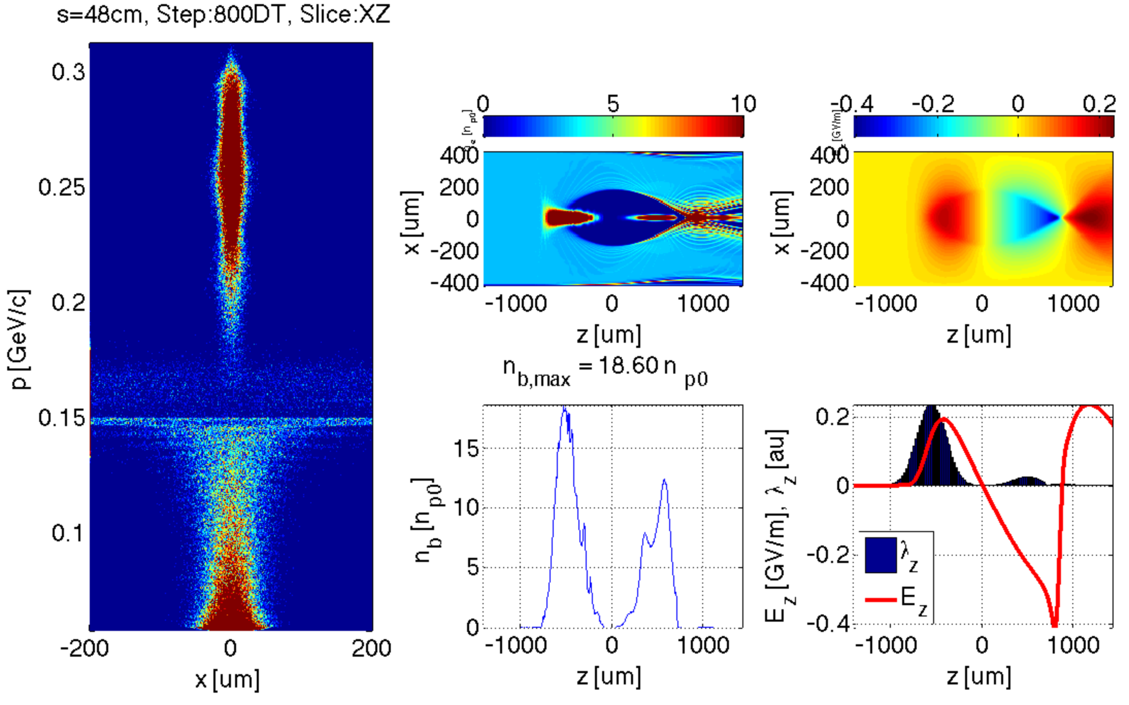
DB emittance from 100 um to 10 um
In this scenario, the blow-out is clean until the full drive beam depletion. Excellent emittance preservation of the WB is predicted by the simulations.
σ_{z} = {150, 150} um
n₀ = 3.1 x 10¹⁴/cm3
ε_{zN,DB} = 10 um
s = 0.5 m
DB and WB must be shortened to about 150 um
DB emittance must be reduced to about 10 um

Slide 15
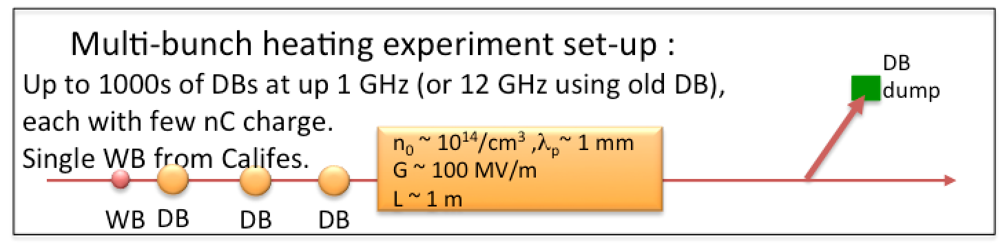
Multi-bunch plasma heating
Multi-bunch plasma heating from high frequency drive bunch trains is not well studied. What is the time scale of the plasma relaxation and heat dissipation? Simple estimates lead to ~< 1 ns. To my knowledge, this has not been shown rigorously in simulations or experiments
CTF3 offers drive bunch trains at 0.5-1 GHz (ideal: use of old DB@12 GHz), combined with arbitrary timed witness bunch injection
In comparison; suggested PWFA-LC rep. rate is a few 10 kHz.
Study of multi-bunch heating is an interesting and relevant experiment in itself :
The expectation is that at 0.5 GHz there should be negligible DB cross-talk in the plasma. Possibility for single drive bunches is strongly desired as reference and fall-back for the two-bunch experiments.

Slide 16
Summary of requirements for PWFA@CTF3
Two independent co-linear electron beams: ~adjustable relative timing with accuracy of ~10 fs
Required upgrades to CALIFES :
  <~ 150 um bunch length
  as large single bunch charge as possible (ideal is >~ 1 nC, but this is not a hard requirement)
Required upgrades to the DB
  <~ 150 um bunch length
  >~ 100 MeV beam energy
  <~ 10 um normalized emittances (linked to other parameters, like peak current; to be further studied)
  possibility to extract single shot (to be studied further)
Required upgrades to CTF3 complex
  Installation of plasma cell and diagnostics
  Co-linear injection/extraction (energy based)

Slide 17
Conclusions
In order to demonstrate the feasibility of plasma for accelerator applications, there is need for additional test facilities.
CTF3 has potential to perform plasma experiments; relevant to a PWFA-LC. Complementary to AWAKE. Some overlap with FACET-II, FF. The more precise we can control and diagnose bunches, the more attractive CTF3 is.
Unique possibility to do multi-bunch plasma heating experiments possible (up to 1 GHz)
Bunches would need to be compressed by a significant factor
Single bunch capabilities for the DB strongly desired
We are interested in further developing this proposal with CLIC/CTF3

Slide 18
Extra

Slide 19
Plasma sources
Requirement: plasmas source of 1-2 m, with relatively uniform plasma density of n₀ = 10¹⁴/cm³ – 10¹⁵/cm³.
Requirements on the source are less stringent than the sources for FACET and AWAKE.
Sources based on gas discharge, not requiring expensive ionization laser, can be considered.
The source would in this case not be a significant cost driver.

Slide 20
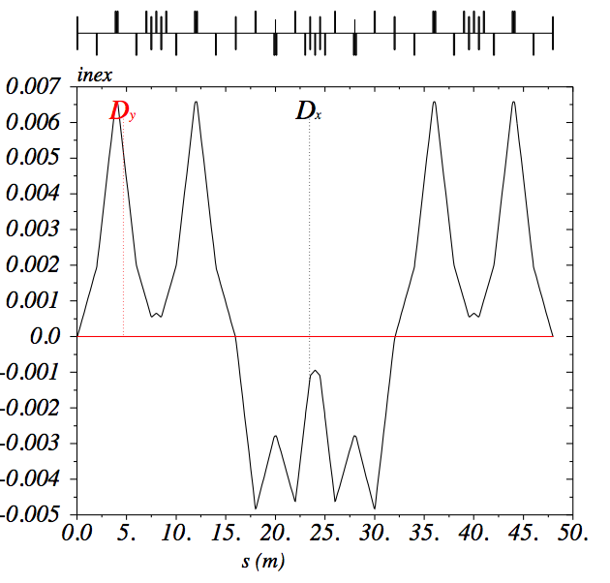
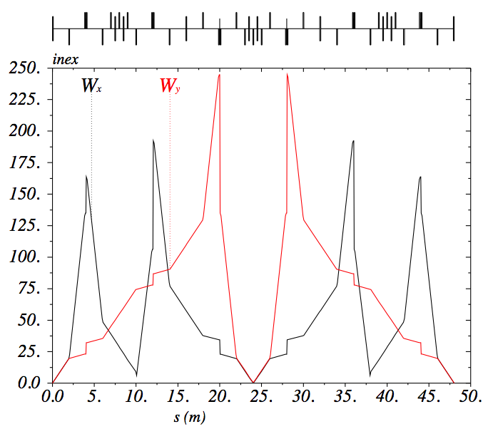
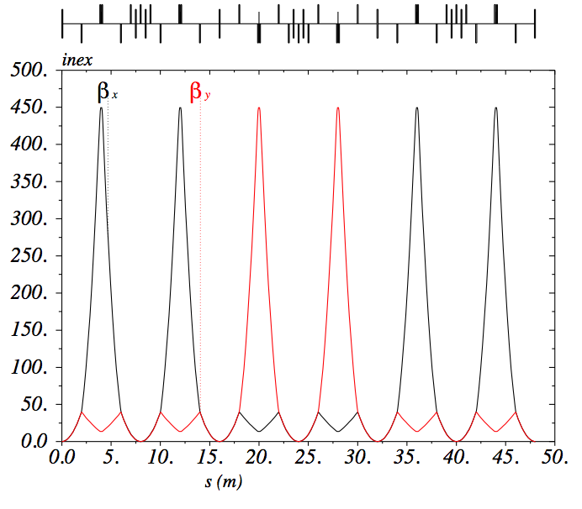
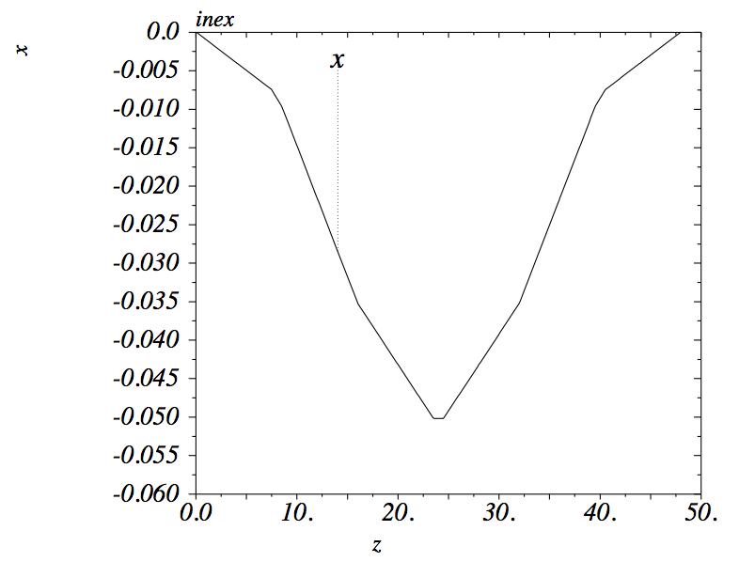
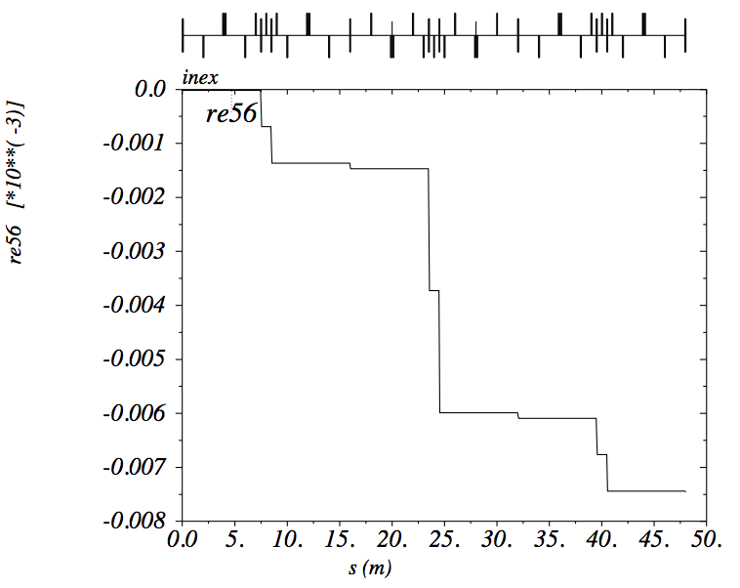
Progress in PWFA-LC design
Plasma interstage design (preliminary) :must match beta, be achromatic, control W-functions, R56 and footprint.
Carl A. Lindstrøm and E. Adli (Univ. of Oslo)
Candidate: symmetric design with 6 sextupoles and three “–I” transforms.
Total interstage length depends on energy; ~25 m up to ~100 GeV, then L~√E.
Negligible emittance growth for β* >~ 5 mm

