Slide 1

Radiation Testing with CALIFES
M. Brugger, R. Corsini, T. Lefevre

Slide 2
Overview
Report from a meeting held with ESA last December
(ESA/R2E collaboration meeting: CERN December 8th)
http://indico.cern.ch/event/357271/
One point we addressed linked to CLIC/CTF3:
Why is radiation testing with electrons interesting for ESA
  The JUICE mission
  (JUpiter ICy moon Explorer)
  Radiation Environment (electrons)
  Challenges at higher electron energies
Beam and test requirements
Main interest/options and timeline

Slide 3
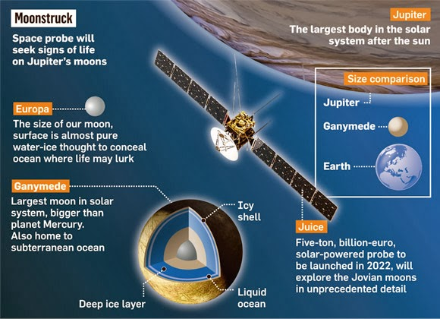
The JUICE Mission
Characterise Ganymede, Europa and Callisto as planetary objects and potential habitats
Explore the Jupiter system as an archetype for gas giants
© ESA 2013

Slide 4
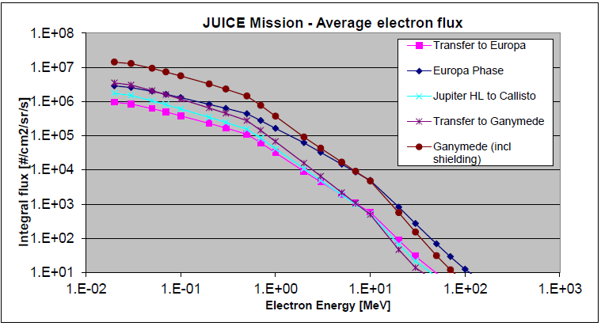
Radiation Environment: electrons
Predicted average trapped electron flux per phase of the JUICE mission.
© ESA Mission TEC-EES Specification

Slide 5
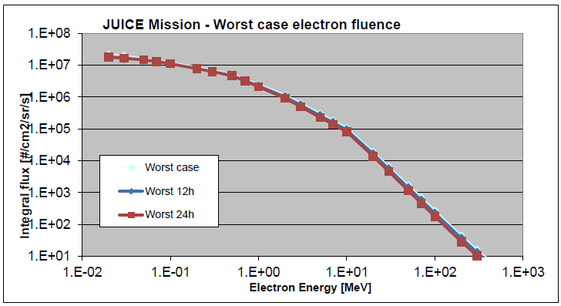
Radiation Environment: electrons
Worst case electron fluences for the JUICE mission.
© ESA Mission TEC-EES Specification

Slide 6
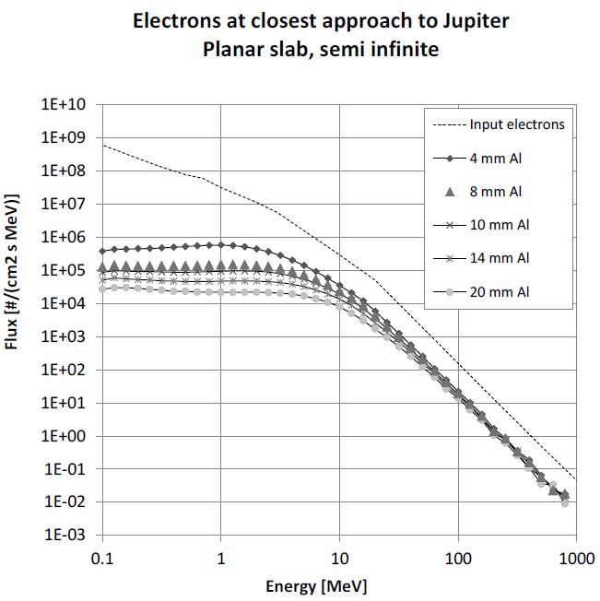
Radiation Environment: electrons
© ESA Mission TEC-EES Specification

Slide 7
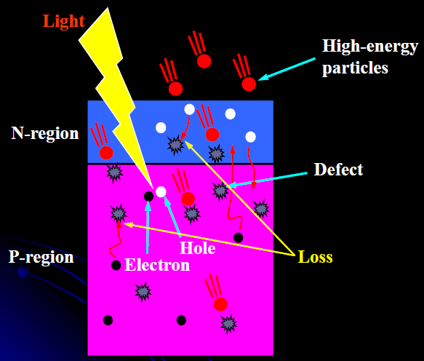
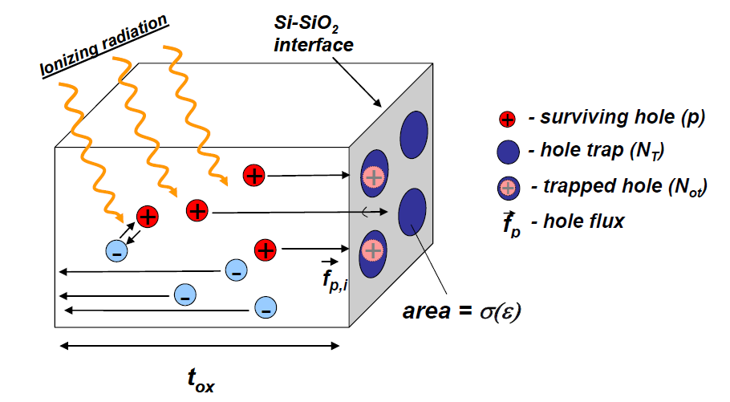
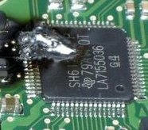
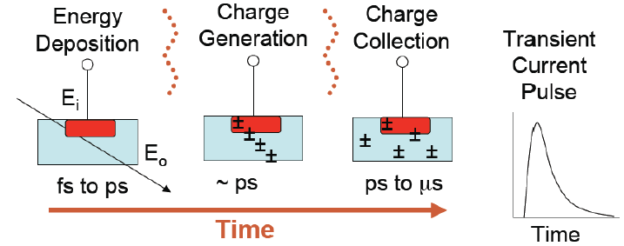

Electronics : Radiation Effects
TID. Total Ionizing Dose
DD. Displacement damage
SEE. Single event effect
EFFECTS
SEE
DD
TID
Stochastic
Immediate effects
Single Events
Cumulative
Effects with time
Critical for injection lines

Slide 8
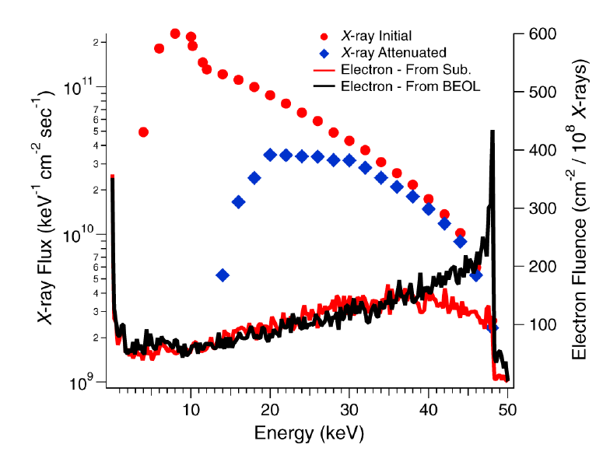
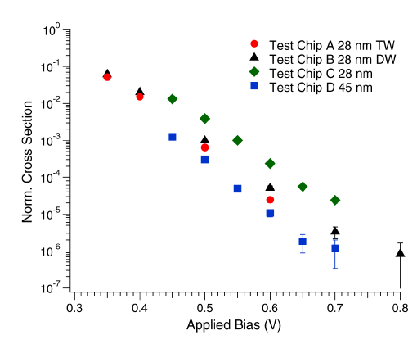
Electron-induced SEU in literature
Fist experimental evidence of single event upset in 28 nm and 45 nm CMOS SRAMs produced by single energetic electrons
Electrons generated through X-ray beam with maximum energy of 50 keV
Critical charge of 0.19 fC to 0.38 fC, corresponding to 4.3 to 8.6 keV
King, M.P. et al., "Electron-Induced Single-Event Upsets in Static Random Access Memory," Nuclear Science, IEEE Transactions on , vol.60, no.6, pp.4122,4129, Dec. 2013

Slide 9
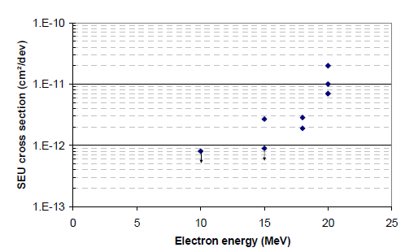
Electron-induced SEU in literature (II)
Test at higher energies (up to 20 MeV) using electron linac
Component under test is 45 nm internal embedded SRAM in commercial FPGA
Further characterizations with higher electron energy are conceivable if an appropriate electron facility is found
Geant4 modeling: charge deposition is generated through ionization of (i) primary and secondary electrons (main contribution) and (ii) recoils from electron-nucleus collisions
The worst-case SEU rate calculation for the JUICE mission is ~20 SEUs per day and device
Samaras, A. et al., "Experimental Characterization and Simulation of Electron-Induced SEU in 45-nm CMOS Technology," Nuclear Science, IEEE Transactions on , vol.61, no.6, pp.3055,3060, Dec. 2014

Slide 10
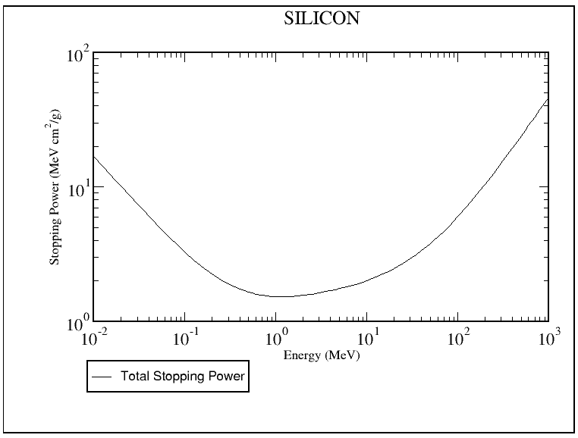
Electron LET in silicon
200 MeV
20 MeV
From estar online tool, http://physics.nist.gov/PhysRefData/Star/Text/ESTAR.html

Slide 11
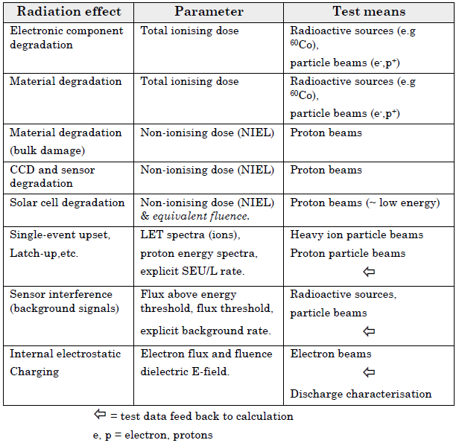
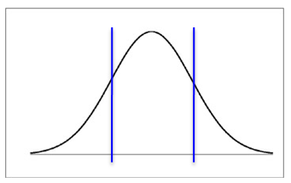
The ESA Juice Mission
ESA
JUICE
Environmental Specification
TEC-EES & SRE-PAP
2013
high-E e⁻?
Beam Parameters:
size: few centimetres (90%)
energy: >20MeV
dose rates (flux)
  low: <1Gy/min
  (~10⁷e/cm²/s)
  higher for xChecks

Slide 12
ESA Interest
Two (Three) main activities
  Coupled effects: TID + DD (with electrons)
  SEEs at higher energies
  Monitor calibration (requires very low energies)
TID tests (electrons as compared to gammas)
  <20MeV dominated -> less interesting for CERN
  For CERN beams, focus clearly on coupled effects
SEEs in advanced electronics
  (50)100-200 MeV range of interest
    e.g, KINTEX-7 FPGA where first results exist
    SEE effects in imagers
    Safety margins and modelling parameters

Slide 13
Time-Line & Next
TimeLine
  ESA research time-line:
    TID/DD (coupled effects): 2015/2016
    SEE: mid-2015 - until 2017
  ESA beyond: depends on results
Next
  First focus on SEE tests at high-energies
    new Cypress or new Xilinx FPGA
    ST: 28nm process
  TID/DD test for cross-check/calibration
    ESA: components to be defined
    CERN: Floating Gate test
  2015 planning:
    1 or 2 experiments for a few days?
    installation time seems more critical

