Slide 1
Potential of using CALIFES or CTF3 electron beam for LHC complex impedance studies
Elias Métral, Benoit Salvant, Carlo Zannini
for the impedance team
Acknowledgments :
Fritz Caspers, Roberto Corsini, Giovanni di Michele, Alexej Grudiev, Andrea Latina, Thibaut Lefevre, Helmut Schmickler, Rogelio Tomás Garcia, Christine Vollinger,
Manfred Wendt.
CLIC workshop 2015
January 27th 2014

Slide 2
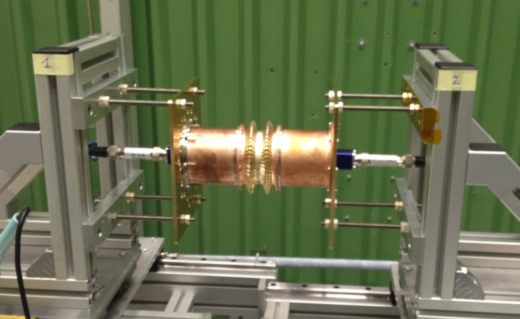
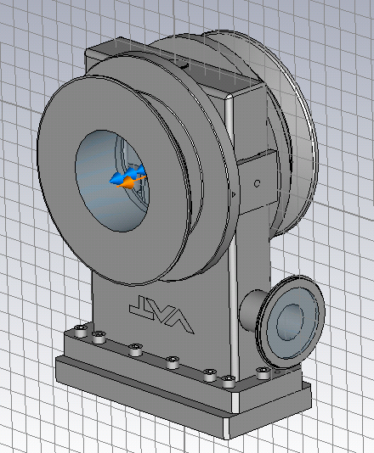
Context
Impedance team involved in design and approval of new and modified equipment in all CERN circular machines (in particular PSB, PS, SPS and LHC, but also AD, ELENA and CLIC damping rings).
Tools at our disposal:
  Bench measurements with wires and probes
  → problem: not direct measurement of
  impedance or wake, and possibly strong
  perturbation of the EM fields
  Numerical simulations
  → problem: difficulty to reproduce reality with
  a model (e.g. design errors, small features,
  coatings, matching errors) , simulated exciting
  bunch is not a delta function.
→ Measurement with electron bunches could be an interesting complement to these existing tools

Slide 3
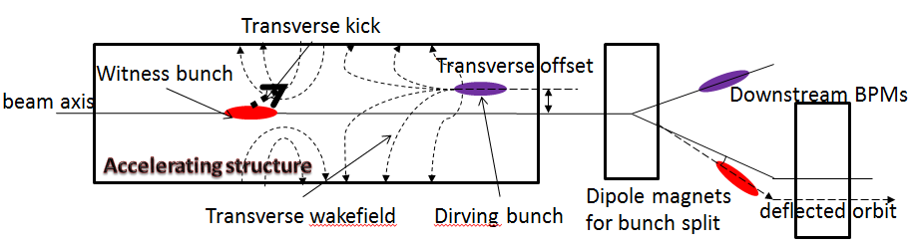
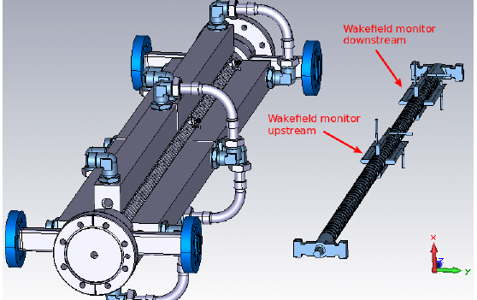
Recent use electron beams to measure wakefields of accelerator structures
Measurements of A. Latina and H. Zha at FACET (presentation at this workshop)
See the following presentation by Steven Jamison
Measurements of G. di Michele at PSI and Trieste: using embedded wakefield monitors into a CLIC accelerating structure.
Use of positrons
and electrons
Direct measurement
Very short range wake
Use of electrons
Indirect measurement
Very short range wake
Use of electrons
Indirect measurement
Very short range wake
→ What could we do with CALIFES?
Use of electrons only
Direct or indirect measurement
Long range wake
Assumptions
for LHC complex:
Courtesy PhD thesis G. di Michele

Slide 4
What would we be interested to measure?
With a realistic exciting source:
Direct measurement of generated electromagnetic fields
Direct measurement of “wake function”
Direct measurement of coherent effects between bunches
Direct measurement of heating
Difficult to
implement
at CALIFES
→ This is what we would like, but the feasibility is yet to be proven

Slide 5
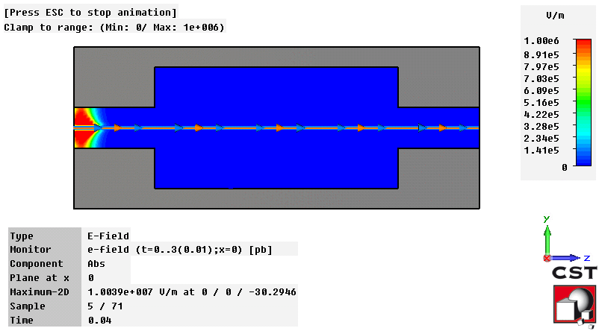
Direct measurement of generated electromagnetic fields
Source bunch
Possibility to measure EM fields from available
antennas, buttons, striplines, wires, all mode couplers
already in the device (or installed just for that reason).
→ See also proposal of electro optical
pickup in the following talk.
Indirect measurement in principle, but possibility of direct benchmark of CST Particle Studio simulations with fields monitors and check their validity
→ probe measurements only validate the Qs from eigenmode simulations
→ wire measurements can perturb significantly the modes.
→ real interest in using an electron source
For the case of the wirescanners for instance, possibility to directly measure the signals that we need
→ current induced by the beam → beam induced heating
→ would be very important, and the only direct way of measuring the heat load to the wire (besides installing it in the SPS or the LHC).
For other devices, it would be an indirect measurement that could validate the model, meshing and simulation.
RF pickup
Simple measurement, would not need any additional hardware
Requires pre installation of a probe in the device (if there is not already one).
Switch from ferrite damping to coupler damping is proposed to avoid beam induced heating

Slide 6
What would we be interested to measure?
With a realistic exciting source:
Direct measurement of generated electromagnetic fields
Direct measurement of “wake function”
Direct measurement of coherent effects between bunches
Direct measurement of heating
→ This is what we would like, but the feasibility is yet to be proven

Slide 7
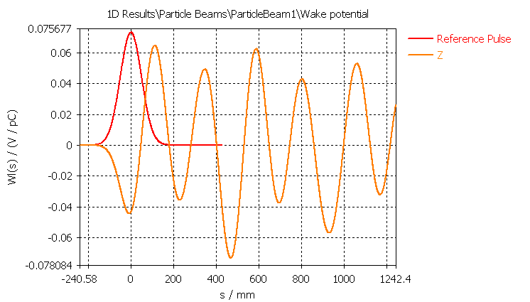
Direct measurement of “wake function”
Measurement of energy loss as a function of source/test bunch spacing → longitudinal wake
Measurement of kick as a function of source/test bunch spacing → transverse wake
In simulations, difficult to reach source bunch below 1 mm for standard devices due to mesh size.
Very small bunch length achievable with electron beams (2 to 3 ps in CALIFES)
→ “wake function” could be measured provided the sampling is sufficient. Feasible?
Source bunch
Test bunch
Test bunch
Source bunch
Bunch spacing

Slide 8
Direct measurement of “wake function”
Important to disentangle the “dipolar” impedance contribution from the “quadrupolar” contribution to assess the impact on collective effects
Driving impedance contribution
Detuning impedance contribution
Test bunch
Source bunch
Test bunch
Source bunch
x_{test}=0
x_{source}=d
x_{test}=d
x_{source}=0
Bunch spacing
Bunch spacing
All particles in the test bunch receive the same kick
Coherent effect
Drives instabilities
All particles in the test bunch receive a kick proportional to their position
Incoherent effect
Impact on instability depends on the type of instability
→ Can the orbits of the source and test bunches be controlled separately?

Slide 9
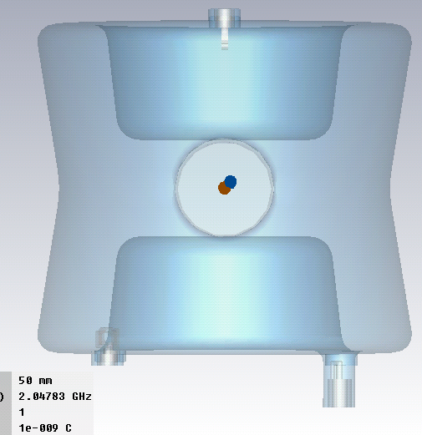
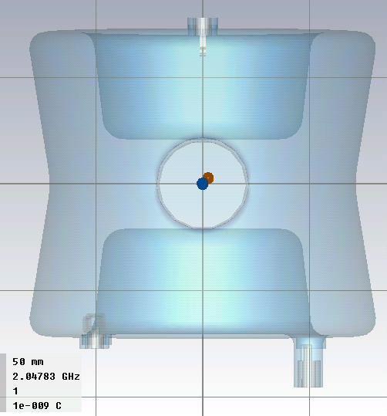
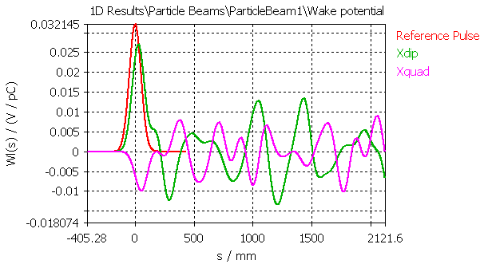
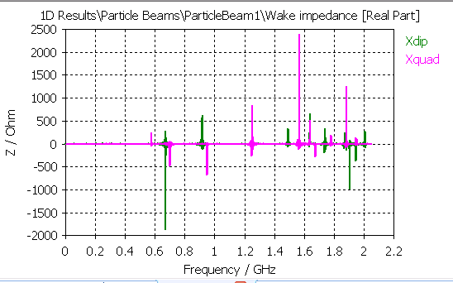
Example: LHC crab cavities
Driving impedance
(also called
dipolar impedance)
Detuning impedance
(also called
quadrupolar
impedance)
Wake potential
Impedance
Very different features between driving and detuning impedance and very different effects.
Detuning impedance generally small for cylindrically symmetric structures
Detuning impedance is very significant for SPS kickers (for instance) and tricky to obtain from wire measurements
Need to control separately source and test bunches

Slide 10
Potential limitations
Minimum kick strength observable with the BPM resolution
    Many components are in the 1 to 10 kOhm/m range for the transverse impedance, in the mOhm range for the longitudinal impedance
    Previous studies show that the kick is of the order of 10 microns after 1 m for 10 kOhm/m
    Roberto Corsini proposed possibilities to amplify this kick using lever arms
    This could require 3 BPMs before the device and 3 BPMs after the device (H. Schmickler)
    Reducing the energy of the test bunch would help!
Need to disentangle between the test and source bunch
    Can we resolve 0.1 ns between two bunches? Challenging together with resolution requirements
    Would need special BPM development
    Could a high bandwidth kicker be used (prototype installed in SPS to work in GHz range)?
Accurate control of the orbit and spacing of test vs source
→ difficult to do with one electron source, contrary to FACET
→ ideas to delay the bunch, delay the laser pulse to control the spacing
→ ideas to move the laser pulse transverse position to control independently the transverse position
→ this could be the main limitation for the setup
Control of intensity of both bunches (highest on source and low on test)
Available length (for both device installation and for observation)
→ some critical elements are very long (SPS septa, LHC TDI and kickers).
Need for large flexibility in length and radius of input device
→ the facility may become a tapering factory.
Contribution from the BPMs and tapers should not dominate (from 40 mm/20 mm radius to the aperture of the element)

Slide 11
Potential limitations
Minimum kick strength observable with the BPM resolution
Need to disentangle between the test and source bunch
Accurate control of the orbit and spacing of test vs source
Control of intensity of both bunches
Available length (for both device installation and for observation)
Need for large flexibility in length and radius of input device
Contribution from the BPMs and tapers should not dominate

Slide 12
ASSUMPTIONS / CONDITIONS
SOME IMPEDANCE COMPUTATIONS WITH CALIFES
Elias Métral
Conditions
  1 bunch of e-
  E = 200 MeV
  σ_{t} = 1 ps
  ε = 20 μm (rms. norm.)
  Initial beam transverse offset x₀ = 1 mm
Case 1: Resistive-wall impedance from a copper collimator
  Length L = 1 m
  Resistivity = 17 nΩm (Copper)
  Half gap b = 4 mm
Case 2: Equipment with constant imaginary impedance
  Z_{t} = K j

Slide 13
CASE 1
Case 1: Resistive-wall impedance from a copper collimator
  Length L = 1 m
  Resistivity = 17 nΩm (Copper)
  Half gap b = 4 mm
→ Challenging resolution

Slide 14
CASE 2
Case 2: Equipment with constant imaginary impedance
  Z_{t} = K j
Q = 0.6 nC
→ Challenging resolution

Slide 15
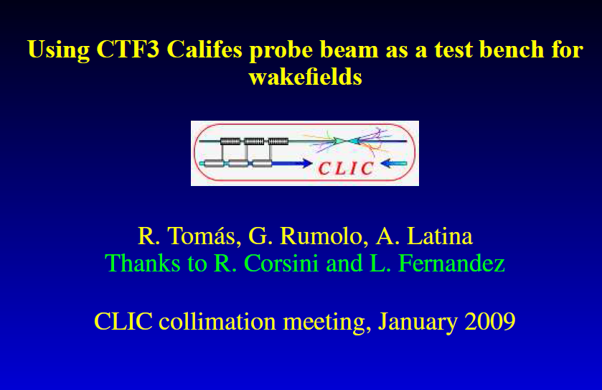
Transverse displacement from previous work:

Slide 16
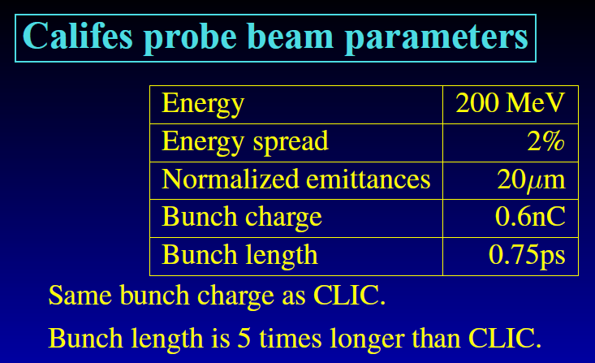
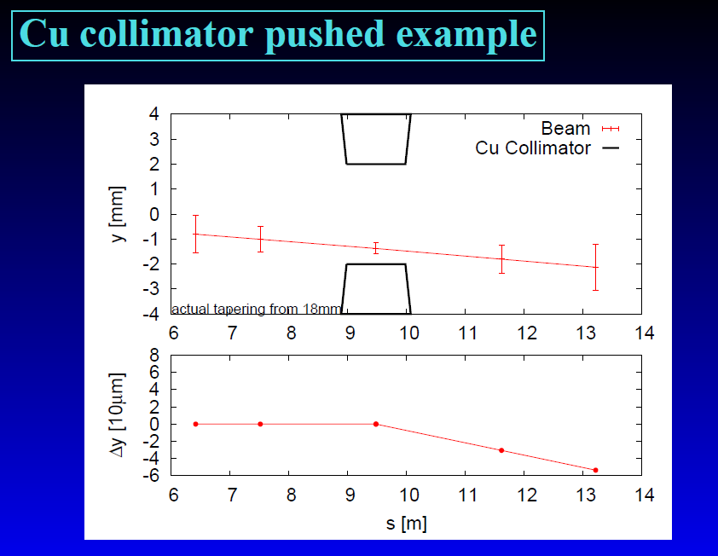
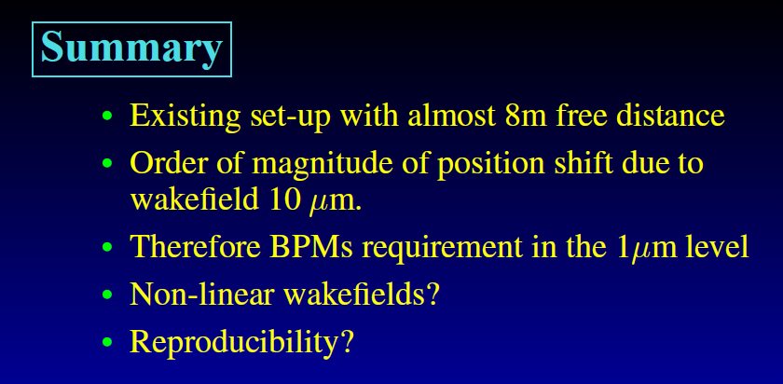

Slide 17
Potential limitations
Minimum kick strength observable with the BPM resolution
Need to disentangle between the test and source bunch
Accurate control of the orbit and spacing of test vs source
Control of intensity of both bunches
Available length (for both device installation and for observation)
Need for large flexibility in length and radius of input device
Contribution from the BPMs and tapers should not dominate

Slide 18
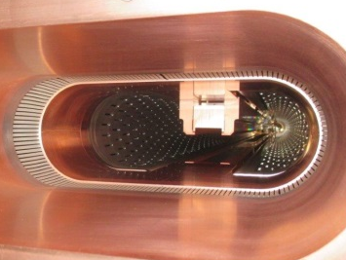

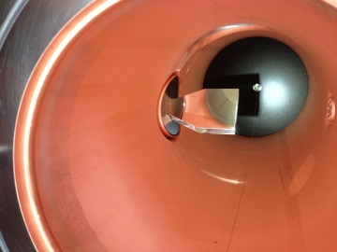
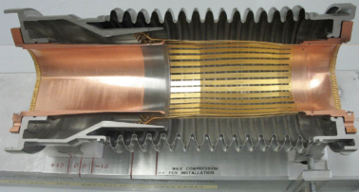
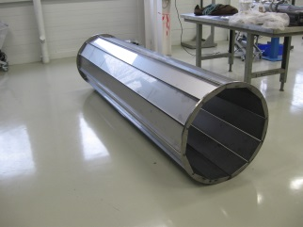
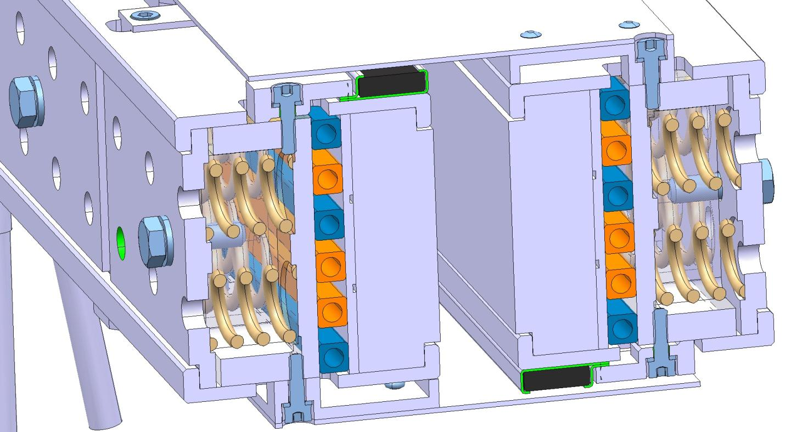
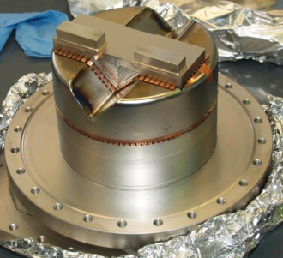
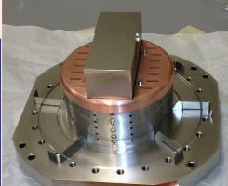
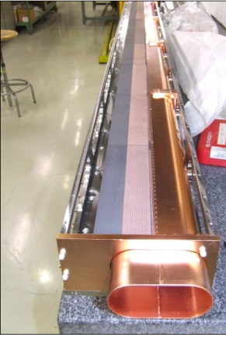
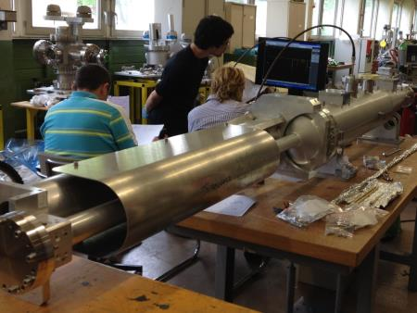
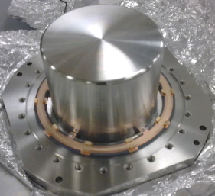
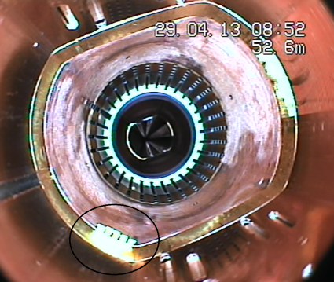
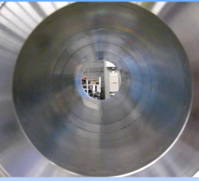
Example of LHC hardware to be measured
Consolidation:
  TDI beam screen consolidation
  TCP replacement with spare
  BSRT mirror design change
  RF fingers consolidation, carroussel
Upgrade:
  Tertiary collimators with BPMs (TCTP and TCSP)
  ATLAS-ALFA
  “TOTEM consolidation” of existing Roman pots
  MKI screen conductor upgrade
  New experimental beam pipe in CMS and ATLAS
  Schottky
New equipment:
  New TCL4 and TCL6
  3rd TCDQ module
  BGV on B2
  New “TOTEM upgrade” pots
  New UA9 goniometer
Non conformities:
  Contacts in triplets
→ A whole zoo of devices with all kinds of aperture and lengths.

Slide 19
Potential limitations
Minimum kick strength observable with the BPM resolution
Need to disentangle between the test and source bunch
Accurate control of the orbit and spacing of test vs source
Control of intensity of both bunches
Available length (for both device installation and for observation)
Need for large flexibility in length and radius of input device
Contribution from the BPMs and tapers should not dominate

Slide 20
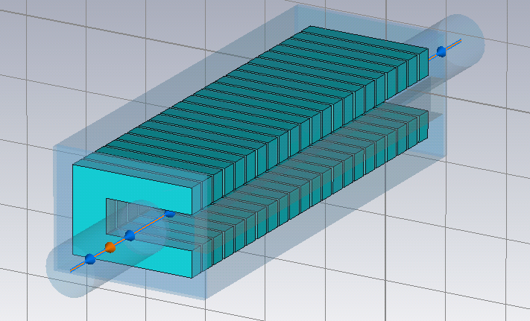
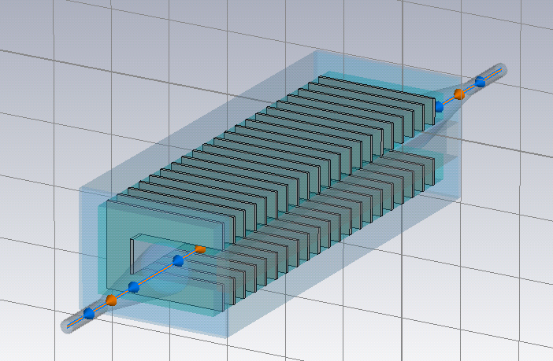
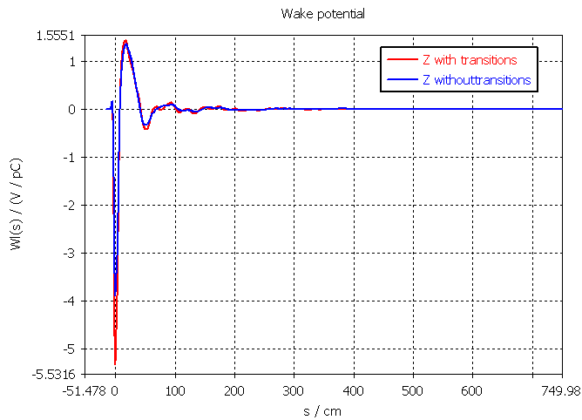
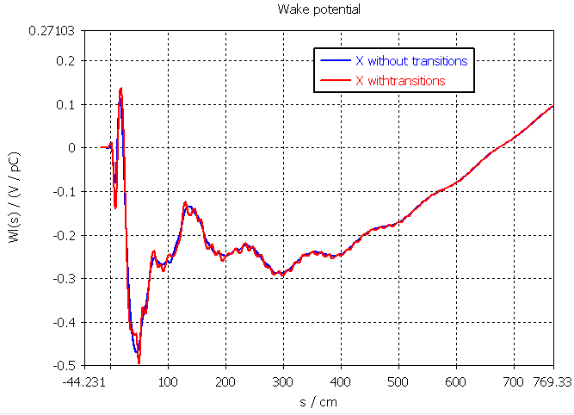
Example for the effect of transitions
Typical SPS kicker in the SPS
Transitions needed for installation in CALIFES
Transverse wake potential
Longitudinal wake potential
→ For this case of SPS kickers the transitions would not be critical

Slide 21
Table of “ideal” requirements (draft, for discussion)
 | Direct measurement | Wake function reconstruction
Intensity of the source bunch | ~1 nC | ~1 nC
Intensity of the test bunch | - | Not critical
Number of bunches | - | At least 2 bunches
Minimum bunch spacing | - | 0.1 ns – 0.3 ns
Maximum bunch spacing | - | 25 ns – 1 ms
Sampling in bunch spacing | - | 0.1 ns within the first 5 ns, 0.3 ns after the first 5 ns
BPM resolution (time) | - | 0.1 ns - 0.3 ns
BPM resolution (position) |  | 1 micron
Source bunch energy | - | 200 MeV
Test bunch energy | - | Would help if lower than 200 MeV
Available installation length | 1.5 m for devices + 1 m for taper = at least 2.5 m | At least 2.5 m

Slide 22
Preliminary Conclusions from the discussions so far
Using CALIFES or CTF3 beam to measure impedance may not work in many cases due to constraints:
  need to tune the spacing/orbit between the source and the test bunches
  Lower limit of detectable impedance kick/energy loss (due to available intensity, resolution of BPM and other impedance contributions that need to be added)
  Available space and flexibility
  BPM time resolution
However, some reachable features can not be obtained with other means so far and we think it would be interesting to investigate further the feasibility of such measurements
  “Wake function” with very short bunches (longitudinal/dipolar/quadrupolar)
  In case it does not work, single bunch measurement could provide average kick (last resort if one cannot distinguish between two bunches, as in ESTB at SLAC)
  Direct measurement of EM fields

Slide 24
Previous attempt: Argonne test facility
H. Figueroa et al., "Direct Measurement of Beam-Induced Fields in accelerating Structures", Physical Review Letters, Vol.60, N. 21, p.2144, (1988).
Beams
Two bunched beams of different energy and intensity with adjustable delay
Energy change and transverse offset induced on the trailing bunch
The change of energy of the trailing bunch (low intensity and energy) is mainly due to the effect of the wake fields because its own losses are negligible.

Slide 25
Direct measurement of coherent effects between bunches
In case of high Q resonances, wake fields do not decay fast and another bunch comes when the fields have not yet decayed → coherent effects could therefore be checked.
Need to generate several source bunches and one test bunch and to be able to adjust the spacing between the bunches.
Very interesting to study the coherent heat deposition:P_{loss}α M²Nb²
And the impact of coherence on transverse kicks
Test bunch
Source bunch N
Source bunch 2
Source bunch 1
x_{test}=0
Bunch spacing

Slide 26
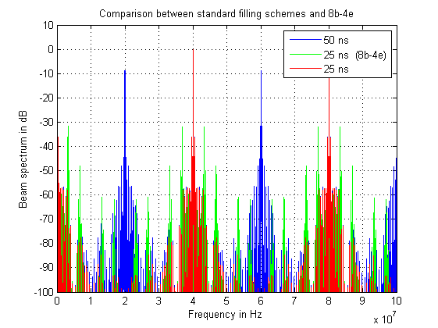
Direct measurement of beam induced temperature increase
Monitor temperature of the device with many bunches
Questions:
  is the available intensity enough to generate enough power loss?
  Need to be able to adjust the beam spectrum lines (therefore adjust the spacing to e.g. 25 ns)

