Slide 1
Xbox-3 LLRF
Ben Woolley
Stephane Rey & Heiko Damerau

Slide 2
Outline
Xbox-3 original layout.
Xbox-3 new plan.
RF channels to be acquired.
LLRF systems needed.
Components and pricing.
Experimental verification and results.

Slide 3
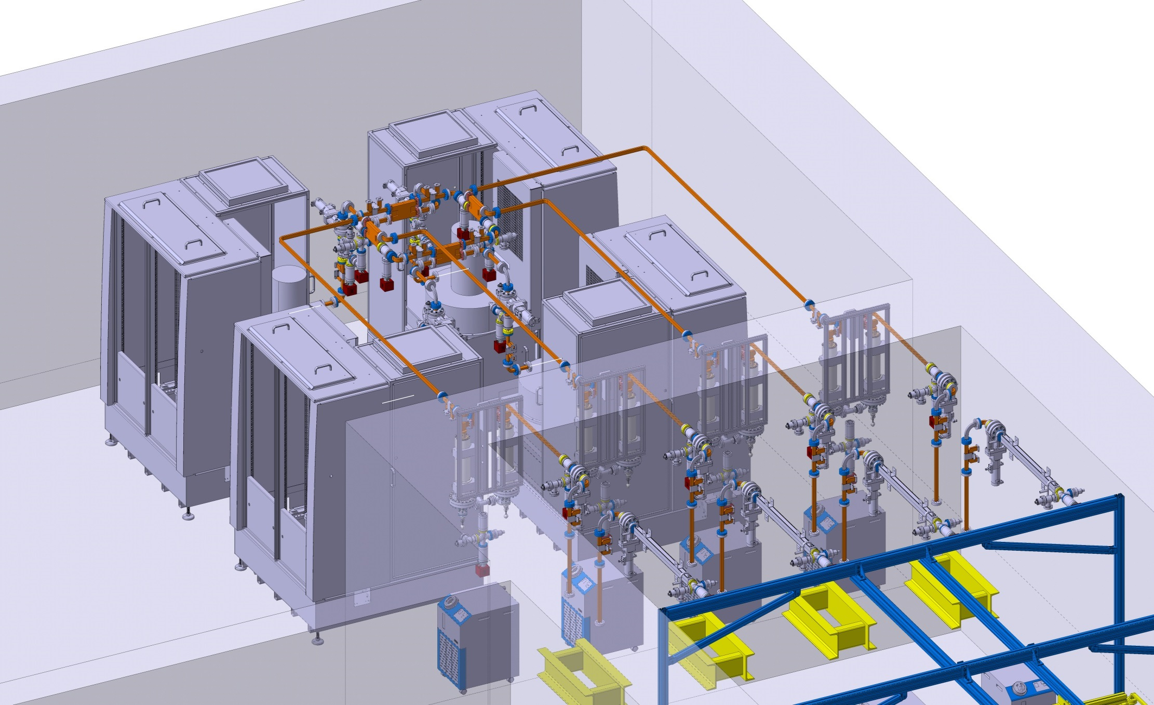
XBOX3 is a ‘clever’ way to convert the high rep. rate into the bigger number of testing slots with high peak power.
3D layout/integration of XBOX3

Slide 4
High Power RF network
Klystron/modulator
Directional coupler
RF/vacuum pumping port
RF pulse compressor
RF load
RF /vacuum gate valve
WR90 waveguide network
3 dB hybrid
24 MW x 4µs x 100 Hz
80 MW x 300 ns x 100 Hz
6 MW x 4µs x 400 Hz
Igor Syratchev

Slide 5
High Power RF network
Klystron/modulator
Directional coupler
RF/vacuum pumping port
RF pulse compressor
RF load
RF /vacuum gate valve
WR90 waveguide network
3 dB hybrid
14MW x 4µs x 200 Hz
56 MW x 250 ns x 100 Hz
7 MW x 4µs x 400 Hz
Igor Syratchev

Slide 6
High Power RF network Signals
Klystron/modulator
Directional coupler
RF pulse compressor
RF load
14 MW x 4µs x 200 Hz
6 7 MW x 4µs x 400 Hz
RF /vacuum gate valve?
3 dB hybrid
56MW x 250 ns x 200 Hz
TS = TEST SLOT
- Phase & amplitude 400MHz. @1.6GSPS → Structure RF Signals INC, REF, TRA. (3 /TS) (or 1.5/TS with switch)
- Phase & amplitude @400MHz @ 250MSPS → Phase but not speed is key KLYin, KLYout, PCin (3/TS)
- Slow Amplitude only. Log det. @250MSPS → Reflected signals/machine protection (3/TS)
-Faraday Cup Signals → (2/TS)

Slide 7
High Power RF network NEW PLAN
Klystron/modulator
Directional coupler
RF pulse compressor
RF load
14 MW x 4µs x 200 Hz
6 7 MW x 4µs x 400 Hz
RF /vacuum gate valve?
3 dB hybrid
56MW x 250 ns x 200 Hz
x8:4 could be switched…
x12 not switched
x12 400-MHz not switched
x12:6 400-MHz switched

Slide 8
Up-mixing Stages XBOX-3
2.4 GHz input From PXI IQ modulator
To TWT
0 dBm
12 GHz BPF
Amp
9.6 GHz input
13 dBm
splitter
12 GHz BPF
To
Reference input
0 dBm
2.4 GHz input
Distribution of 2.4GHz and 9.6 GHz from PLL crate

Slide 9
Down-mixing Mixing Stages XBOX-3
RF Input 1
400 MHz LPF
Amp
IF output 1
RF Input 2
splitter
Amp
400 MHz LPF
IF output 2
RF Input 3
Amp
400 MHz LPF
IF output 3
RF Input 4
10 dBm
Amp
400 MHz LPF
IF output 4
17 dBm
21 dBm
splitter
5V TTL in
11.6 GHz input
RF Input 5A
400 MHz LPF
Amp
2:1 Mux
RF Input 5B
IF output 5
splitter
Amp
400 MHz LPF
RF Input 6A
Amp
400 MHz LPF
RF Input 6B
2:1 Mux
IF output 6
Amp
400 MHz LPF
Top shelf in mixing crate
5V TTL in

Slide 10
PLL Crate XBOX-3
15 dBm (need 11-14dbm)
We allow up to 3dB loss in the cables
MC ZVA-183+
23 dBm
splitter
Amp
9.6 GHz BPF
x4 9.6 GHz
9.6 GHz BPF
Marki Microwave
FB-0955
splitter
x4 2.4 GHz for mix-up
X4 freq.
MC ZX60-272LN+
18.5 dBm
16.5 dBm
4 dBm (need 0 dbm)
5.5 dBm
splitter
Amp
2.4 GHz BPF
splitter
We allow up to 3-4dB loss in the cables
2.4 GHz PLL
MC ZFBP-2400+
5.5 dBm
4 dBm (need 0 dbm)
x4 2.4 GHz
For PXI IQ mod
splitter
Marki Microwave
FB-1215
24 dBm
23 dBm (need 21dbm)
2.9 GHz PLL
32 dBm
We allow up to 2dB loss in the cables
Amp
11.6 GHz BPF
splitter
X4 freq.
11.6 GHz BPF
Marki Microwave
AQA-1933
MC
ZVE-3W-183+
x4 11.6 GHz
For mix-down
X4 freq.

Slide 11
Dark Current (DC) signals MUX crate
5V TTL in
DC upstream A
2:1 Mux
DC upstream A/B
DC upstream B
DC downstream A
2:1 Mux
DC downstream A/B
DC downstream B
5V TTL in
DC upstream C
2:1 Mux
DC upstream C/D
DC upstream D
DC downstream C
2:1 Mux
DC downstream C/D
DC downstream D
5V TTL in

Slide 12
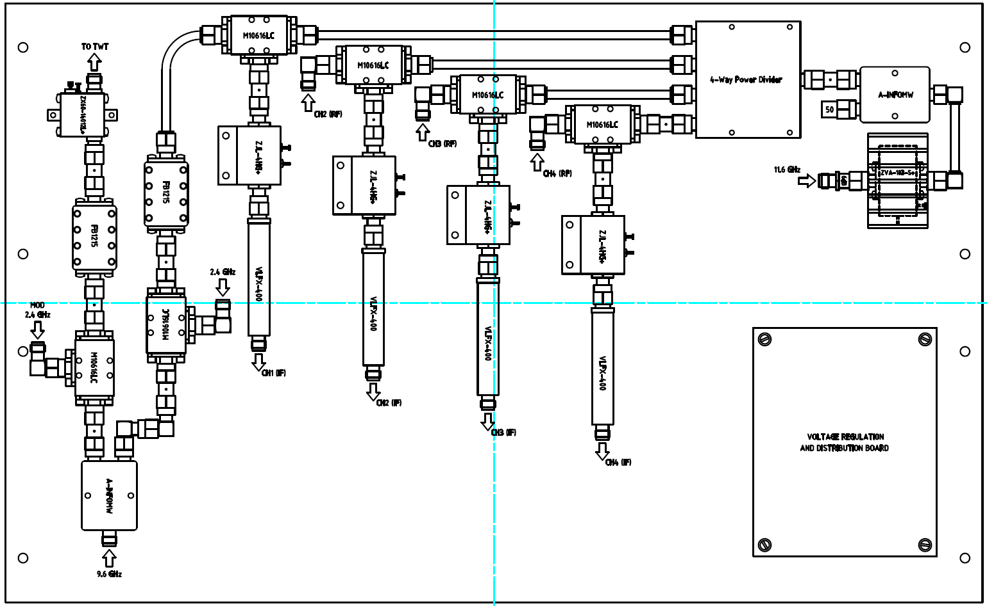
Initial Drawing: mix-down
Component dimensions are in AutoCAD and drawings for the other crates are being prepared.

Slide 13
Parts list + Pricing: LLRF Components
Device | Description | Quantity | Cost/item | Total
ML10616LC | Mixer | 40 (10/crate) | $209 | $8360
AQA-1933K | X4 multiplier | 2 (PLL) | $356 | $712
FB1215 | 12GHz BPF | 10 (2/crate+2PLL) | $200 | $2000
FB0955 | 9.55GHZ BPF | 2 (PLL) | $240 | $480
ZJL-4HG+ | IF Amp | 32 (8/crate) | $140 | $4480
VLFX-400 | 400MHz LPF | 32 (8/crate) | $42 | $1344
GF-T2-6000-18000 | 2-way 6-18GHZ splitter | 8 (2/crate) | 202EUR | 1616EUR
JXPD4-6G-18A EDH doc 5575052 | 4-way 9.6-11.6GHz splitter | 10 (2/crate +2PLLcrate) | 150EUR | 1500EUR
ZASWA2-50DR-FT+ | 2:1 MUX | 12(2/crate)+(4DC crate) | $94 | $1128
ZAPD-4-S+ | 2way 2.4GHz split | 2 (PLL) | $64 | $128
? | Isolator 2.4GHz | 8(PLL) | ? | ?
? | Isolator 9.6-11.6GHz | 8(PLL) | ? | ?
ZA4PD-4-S(+) | 4-way 2.4GHz splitter | 2 (PLL) | $90 | $180
ZVE-3W-183+ | Big amp 11.6GHz | 1 (PLL) | $1300 | $1300
ZVA-183+ | 9.6GHz amp | 1(PLL) | $895 | $895
ZX60-272LN+ | 2.4GHz amp | 1(PLL) | $40 | $40
VBF-2435+ | 2.4GHz LPF | 1(PLL)+ | $35 | $35

Slide 14
Parts list + Pricing: PXI Crate
CARD | Function | Quantity | Price/item | Price Total
5793+FPGA | RF Gen | 2 | 16 518 | 29 071
5772AC+FPGA | Fast Acq | 4 | 11 732 | 41 296
5761+FPGA | Slow Acq | 4 (2xAC 2xDC) | 10 290 | 36220
5160 4ch | Acq FC | 1 | 13 389 | 11 782
6583+FPGA | Trig+Interlock | 1 | 7 215 | 6 349
8432/8 | RS232 | 1 | 646 | 568
8433/4 | RS485 | 1 | 702 | 618
6363 | Vac + more | 1 | 1 727 | 1 520
 |  |  | Total | 127 424
Components displayed for 2 testing slots (i.e. half of the total)

Slide 15
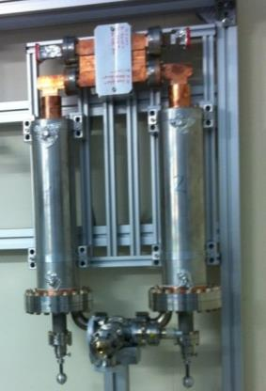
Two RF sources + Pulse Compressor
10 mW amplifier
12 GHz FAST Signals (x5)
RF pulse compressor
LLRF CRATE
400 MHz IF (x5)
Down mixing Stage (Aq.)
PCREF1
PCIN1
TRA1
12 GHz
KREF1
KLYOUT1
LO PLL 2.9 GHz
LO PLL 2.4 GHz
Up mixing Stage1 (Gen.)
WG network
RF loads
Up mixing Stage2 (Gen.)
2.4 GHz
12 GHz
Co-ax Hybrid
2.4 GHz
KREF2
KLYOUT2
TRA2
PXI CRATE
RFSG 1 (IQ gen. & VM)
RFSG 2 (IQ gen. & VM)
12 GHz SLOW Signals (x3)
1.6 GSPS ADC x5
Diode/Log detector CRATE
250 MSPS ADC x1 (4ch.)
DC coupled 50 MHz (x3)
Diode/log detectors x4/x8
PXI and LLRF crates are locked by 10 MHz reference

Slide 16
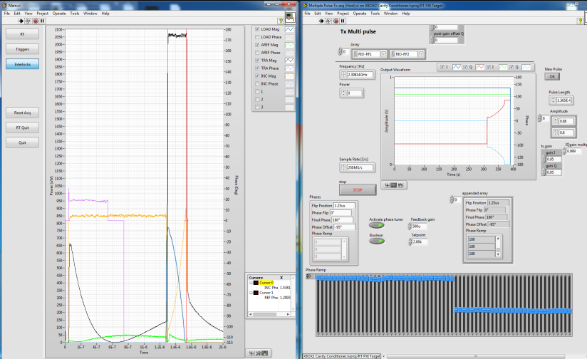

2 RF source Results
Concept of phase switching proved in 2013 with modified version of the Xbox-2 LLRF system.
Low power hybrid and the Xbox-2 pulse compressor were used.

Slide 17
Thank you!

