Slide 1
Proposed US Activities for Future Circular Colliders
W. Barletta, G. Sabbi
Exploring the Physics Frontier with Circular Colliders
January 26 - February 1st, 2015

Slide 2
Outline
P5 Recommendations relevant to Future Circular Colliders
Accelerator R&D priorities and proposals under consideration
  Accelerator studies for a 100 TeV proton collider
    Vacuum and synchrotron radiation
    Machine protection, radiation, beam physics
  Magnet development for a 100 TeV pp collider
    Main drivers and opportunities for cost reduction
    Results from ongoing US programs (GARD and LARP)
    Proposals for future activities
  Potential contributions to FCC-ee, CEPC and SppC
Summary

Slide 3
P5 Guidance on Future Circular Colliders
From the Particle Physics Project Prioritization Panel (P5) May 2014 Report
“Strategic Plan for U.S. Particle Physics in the Global Context”
Recommendation #24: Participate in global conceptual design studies and critical path R&D for future very high-energy proton-proton colliders. Continue to play a leadership role in superconducting magnet technology focused on the dual goals of increasing performance and decreasing costs.
Recommendation 26: Pursue accelerator R&D with high priority at levels consistent with budget constraints. Align the present R&D program with the P5 priorities and long-term vision, with an appropriate balance among general R&D, directed R&D, and accelerator test facilities and among short-, medium-, and long-term efforts. Focus on outcomes and capabilities that will dramatically improve cost effectiveness for mid-term and far-term accelerators.
A HEPAP subcommittee on accelerator R&D will provide detailed guidance on the implementation of accelerator R&D aligned with P5 priorities.

Slide 4
Accelerator R&D Sub-Panel
Charge (June): provide input on
Appropriate goals for medium- and long-term R&D
Scope of the current effort and its alignment with goals
Requirements/impediments related to resources, management, expertise and infrastructure
Assess if training of accelerator scientists and engineers is adequately addressed
How to maintain an appropriate balance for the program in different budget scenarios
Members:
Bill Barletta (MIT)
Ilan Ben-Zvi (BNL, Stonybrook)
Marty Breidenbach (SLAC)
Oliver Bruning (CERN)
Bruce Carlsten (Los Alamos)
Roger Dixon (Fermilab)
Steve Gourlay (LBNL)
Don Hartill, Chair (Cornell)
Georg Hoffstaetter (Cornell)
Zhirong Huang (SLAC)
Tadashi Koseki (KEK/J-PARC)
Geoff Krafft (JLAB)
Andy Lankford (UC Irvine)
Lia Merminga (Triumf)
Jamie Rosenzweig (UCLA)
Mike Syphers (MSU)
Bob Tschirhart (Fermilab)
Rik Yoshida (Argonne)
Young-Kee Kim (Univ. Chicago)
Community input (August-September):
Meetings at BNL (energy frontier), FNAL, SLAC/LBNL
Public submissions through the website: http://www.usparticlephysics.org/p5/ards
Next phase: discussions and deliberations:
Sub-panel meetings and teleconferences
Reporting

Slide 5
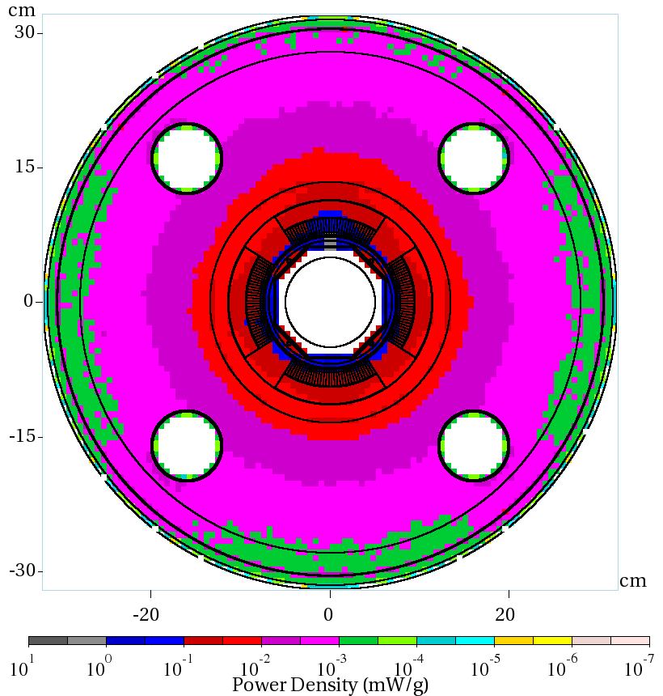
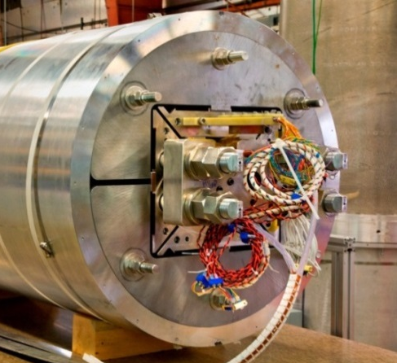

Program elements under discussion
Accelerator design and performance optimization
  Strong US expertise in critical areas
  Building on previous US studies (e.g. VLHC)
  Guidance/support to magnet R&D (LARP example)
  Presentations on specific studies on Saturday:
    FCC-pp: Mike Syphers
    FCC-ee: Uli Wienands
  CEPC/SppC: Weiren Chou
Accelerator technology
Superconducting magnets: most critical component for the high energy pp colliders
High priority to cost reduction, consistent with P5
Exploit synergies with other accelerator R&D thrusts (e.g. SCRF)
Energy deposition studies for HL-LHC (MARS)
HD2: highest bore field in accelerator dipole (13.8 T)

Slide 6
Considerations on High Energy pp Colliders
Community input - using excerpts from V. Shiltsev’s presentation at the BNL meeting, but similar considerations were made in other ARD sub-panel presentations and submissions
Overarching R&D goals: address feasibility of acceptable cost, better understand the performance reach, explore cost/performance trade-offs
R&D goal #1: Superconducting Magnets
  Most suitable for the US: world-leading expertise in SC magnets R&D and construction, synergy with LARP & HL-LHC
  Program should be focused on the substantial reduction of the magnet cost and performance optimization:
  In close coordination with the accelerator design teams (to understand the specs) as well as with magnet design and development partners (to avoid duplications)
R&D Goal #2: Performance and Design
  Launch limited scope long-term research on selected topics of importance for optimization of the most cost-effective machine design
  In coordination with (much bigger) global design studies in Europe and Asia
  Assure the best benefits from synergies with LARP, activities in Accelerator Science and Modeling thrust and R&D Toward Multi-MW Beams

Slide 7
FCC-pp Collider Design Activities
Criteria: address key technical challenges; synergy with past/ongoing projects (VLHC, LARP), and with other ARD thrust areas; relevance to magnet R&D
Potential areas for US contributions | Motivation
Coping with SR power: 28 W/m/aperture (x100 LHC) & 4.8 MW total (330 x LHC) Collider design optimization, vacuum system technology. | Key challenge; US Lab expertise (FNAL, SLAC) and facilities for SR tests (Cornell). VLHC studies and absorber R&D; coupled to magnet aperture, layout.
Coping with ~100kW of radiation load at each IP (~45 x LHC, 8 x HL-LHC) | Extension of LARP IR optics studies; IR Quad R&D; heat deposition calculations
Instabilities at injection energy, impedance and feedback systems | Extension of LARP AP & feedback system; coupled to magnet aperture, field quality
Beam stored energy and machine protection | Critical issue potentially limiting beam current and luminosity; collimator design
Electron cloud effects | Critical issue; US expertise and synergy with other ARD thrusts and projects
FCC-pp machine physics topics discussed in M. Syphers’s presentation, Saturday PM

Slide 8
Improving Magnet Performance vs. Cost
Superconductor development
  Improvements in fundamental properties (current density, stress limits)
  Fabrication and processing (production scale-up, cabling, insulation, reaction)
Magnet design specifications
  Aperture: coil volume approximately scales linearly in the range of interest
  Field: rapid increase of coil volume as we approach the conductor limit
    - Still appropriate to push field in R&D in order to shift the cost optimum
Magnet design optimization
  Coil layout, compactness, grading, protection (minimum copper fraction)
Magnet performance optimization
  Design/operating margin: nominal field vs. conductor limit
  Minimum quenches to nominal field and robust operation (cycling, radiation)
Magnet fabrication
  Cost of structural materials and components; streamlined/automated processes
Cryogenic system:
  Operating temperature vs. design field
  Handling of synchrotron radiation: coil layout, beam screen/absorber design
Cost reduction target: need to establish an appropriate reference as a first step

Slide 9
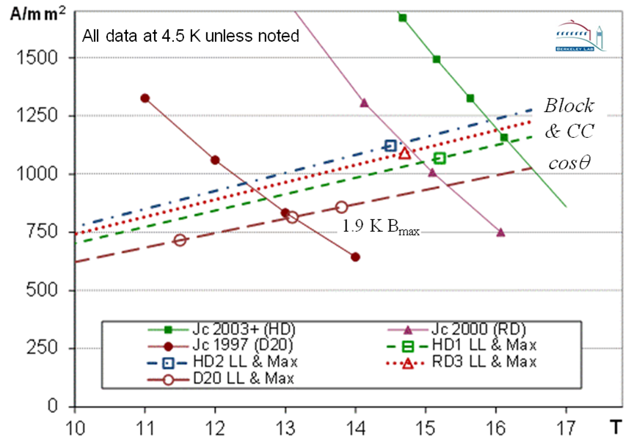
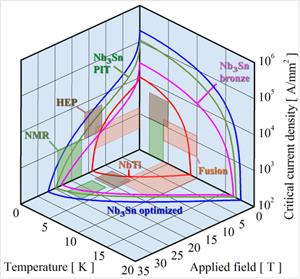
Past improvement of Nb₃Sn J_{c}
Bore field to peak field ratios:
  D20 : 0.98
  HD2: 0.95
  HD1: 1.06
  RD3: 0.99
HEP conductor development program resulted in +3T field potential (4.5K)
Achieved performance consistent with improvements in conductor properties
Optimal design choices driven by accelerator requirements and production cost

Slide 10


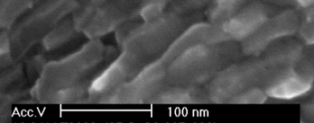
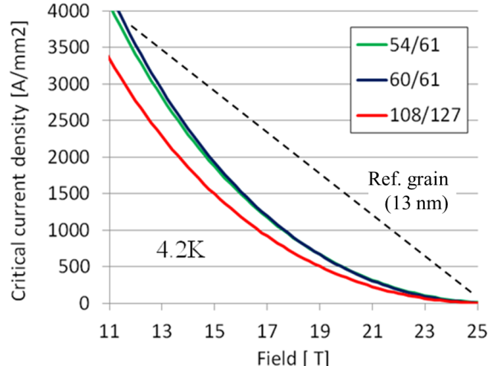
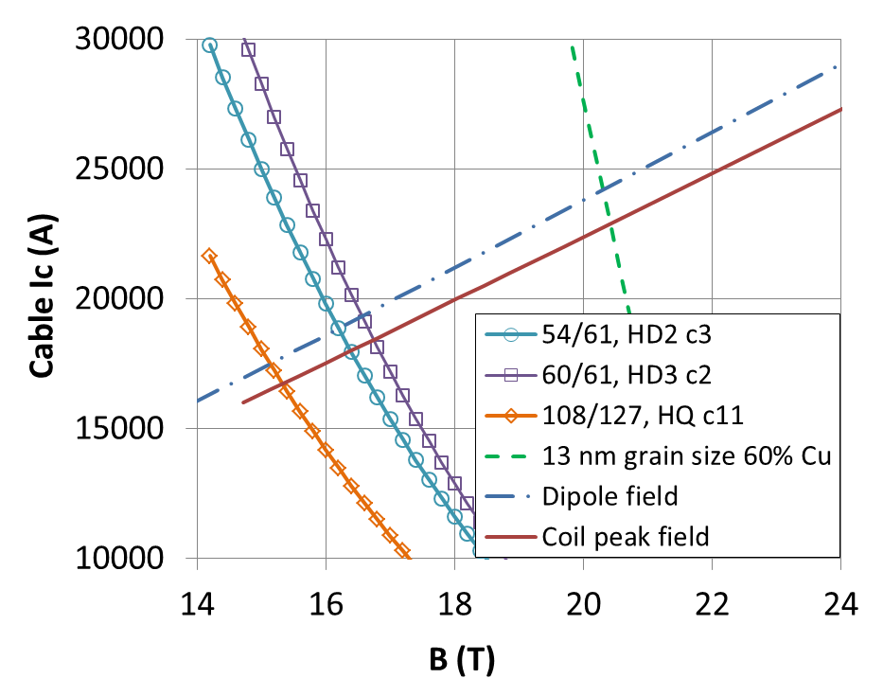
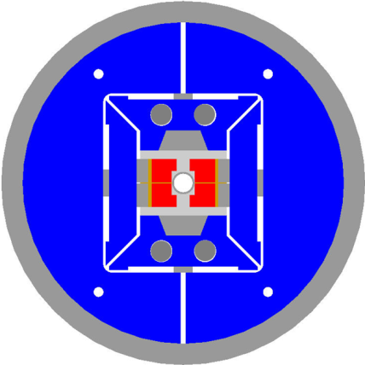
Potential for further improvements
Principle: increase of Nb₃Sn pinning force at high field through grain refinement
Exciting recent results in wires (X. Xu et al, Appl. Phys. Lett. 104 082602 & ASC14):
J_{c}(12 T, 4.2K): from
3.5 kA/mm² @ 100+ nm (e.g. best HD2 wire) to
9.6 kA/mm² @ ~35 nm
Extrapolation to HD2 & 13 nm grain size (G. Sabbi et al., IEEE-TAS 25 (3) 4001407):
B₀>19T
@ 4.5K
HD2 cross-section

Slide 11
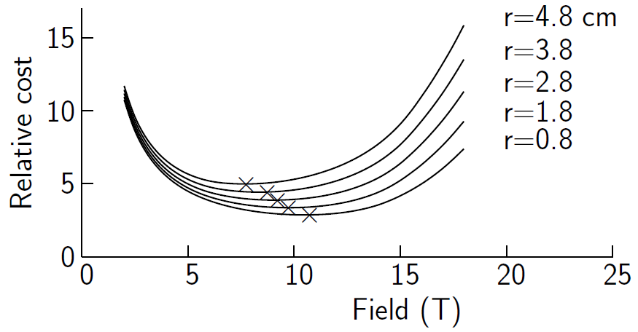
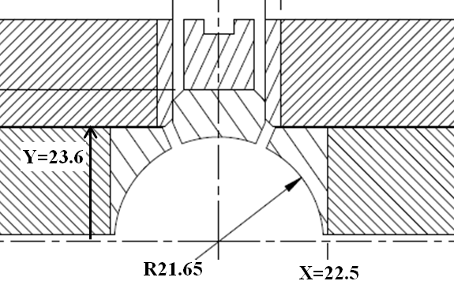

Aperture Considerations
Conductor and structure requirements depend on the magnet aperture
Scaling is approximately linear in the parameter range of interest
  Consistent findings by parametric models and realistic magnet designs
  +25% aperture (40 to 50 mm) would have a significant impact on cost
For same reason, optimization of internal bore components is essential
  Integrate magnet design with vacuum, cooling etc.
Parametric model (B. Palmer)
HD2 bore design
Ref: B. Palmer, presentation to ARD panel, BNL
Ref: G. Sabbi et al., IEEE-TAS 25 (3) 4001407

Slide 12
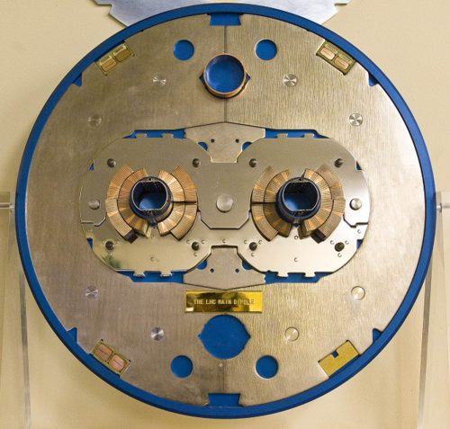

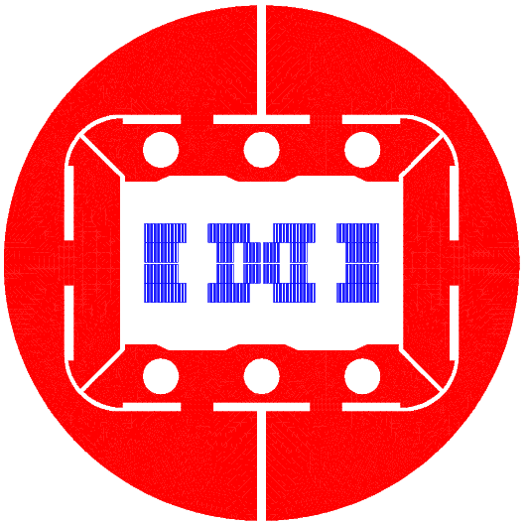
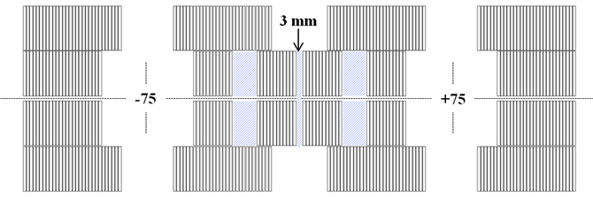

Minimizing the cold mass size
Compact arrangement has significant cost benefits
Beam separation may be lowered to 150 mm
Smaller beam separation allows smaller yoke OD
60 cm yoke OD to be compared with 55 cm LHC
Short sample performance | I_{ss} |  | B₁^{ss}
Temperature | 4.5K | 1.9K | 4.5K | 1.9K
Single aperture (HD2) | 18.0 | 20.1 | 15.52 | 17.15
Double aperture (2HD) | 17.8 | 19.7 | 15.49 | 17.12
Asymmetric coil design for minimal spacing between apertures
G. Sabbi et al., IEEE-TAS 25 (3) 4001407 (2015)

Slide 13
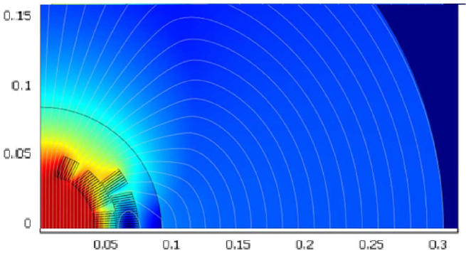
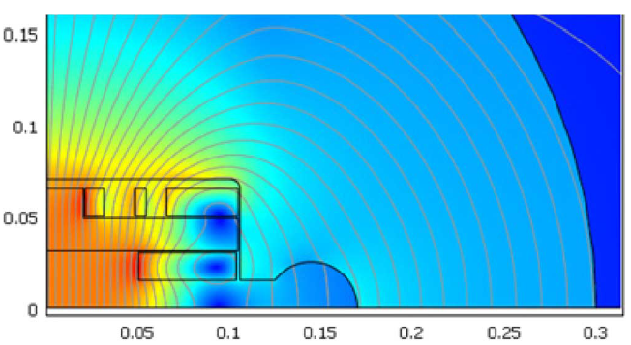
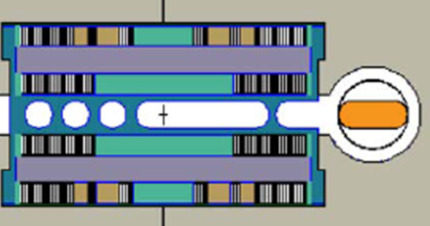
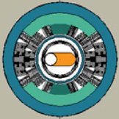
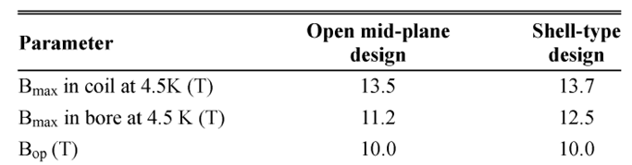
Open Mid-plane Dipole Design Studies
Goal: provide a channel for synchrotron radiation to be absorbed away from the bore
Ref: I. Novitski, et al, Conceptual design of Dipole Magnet for Muon Collider Storage Ring, IEEE-TAS 21 (3) June 2011 (several other studies performed at BNL, LBNL etc)
Mechanical support assumptions have critical impact: need experimental verification

Slide 14

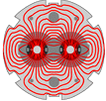
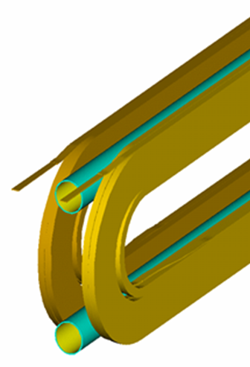
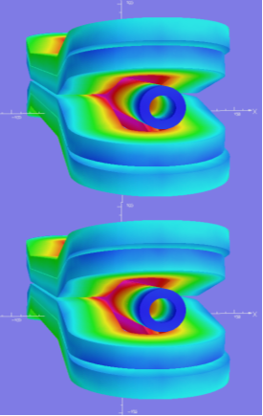
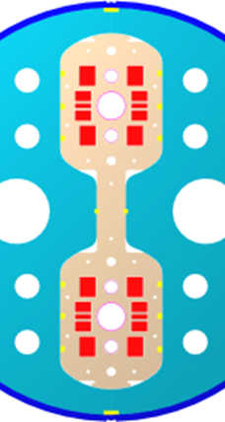
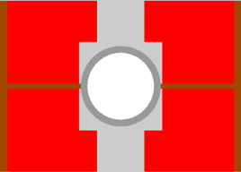
2-in-1: Horizontal vs. Vertical Layout
Horizontal layout is favored by magnetic and mechanical efficiency:
Magnetic flux from one aperture is returned through the other
Horizontal forces between apertures may be reacted against each other
Open mid-plane design favors a vertical layout:
Loss of magnetic efficiency is not large if peak fields are balanced
Mechanical structure needs to contain 2x force from single apertire
Potential issue for common coil design: coil ends cross the mid-plane
Open mid-plane
w/SR channel
Horizontal 2-in-1 layout
Vertical 2-in-1 layout
Block (or cosθ)
Common coil (VLHC)
Flux return:
Horizontal forces

Slide 15
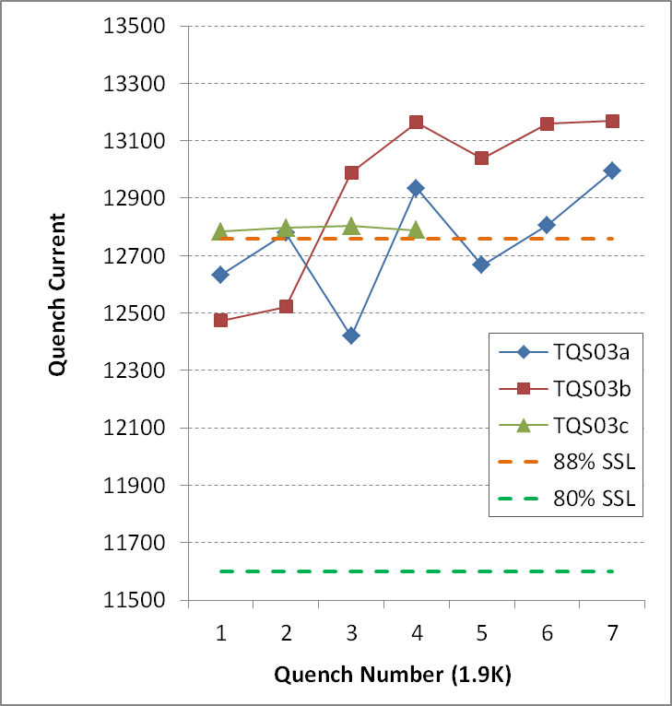
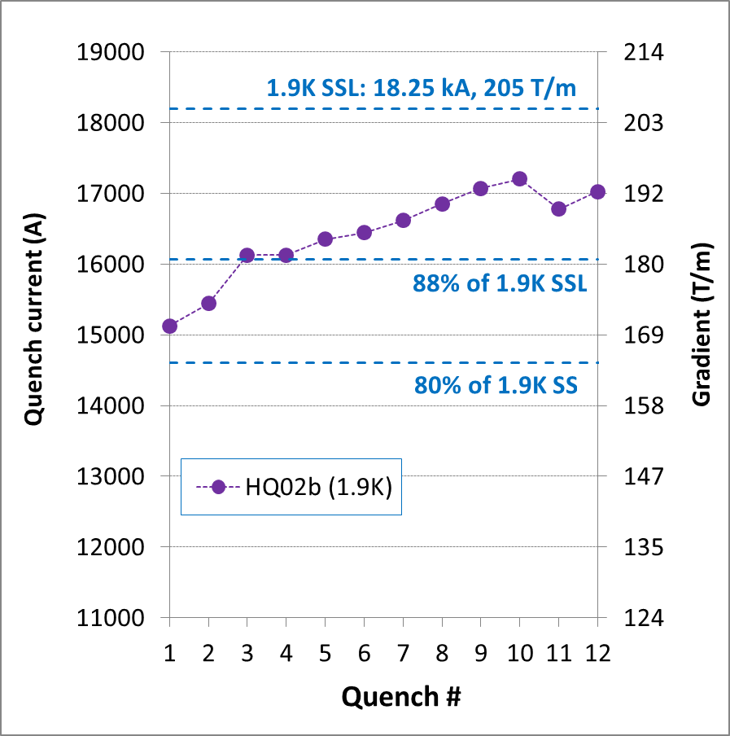

Target Operating Field vs. SSL
Critical cost driver, in particular for high field designs and large production
Optimized Nb₃Sn models reach ~95% of the conductor limit with fast training
Support target operating field level at 85% of the conductor limit, or even higher
Ref: G. Sabbi, “IR Quadrupole R&D Program as a basis for MQXF”, MQXF Design Review, December 2014 (http://indico.cern.ch/event/355818/contribution/3/material/slides/5.pdf)

Slide 16
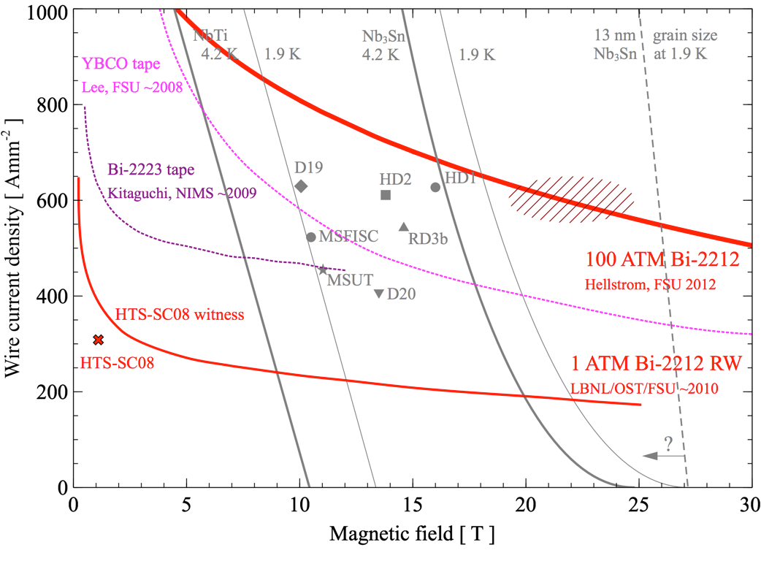
Field Reach vs. Technology Readiness
Technology foundation:
Conductor properties
Fabrication methods
Design concepts, tools
Bi-2212
YBCO
Performance demonstration in simple configurations
From: A. Godeke, WAM-HTS (5/14)
http://indico.cern.ch/event/308828/
Full qualification in
accelerator configurations
In-depth analysis & optimization
  Conductor properties
  Fabrication technology
  Material characterization
  Modeling and diagnostics
Nb₃Sn
NbTi
System integration

Slide 17
High Field Magnet R&D Proposal
White paper submitted to HEPAP ARD subpanel: G. Apollinari et al., “National Program on High Field Accelerator Magnet R&D” Fermilab-FN-0993-TD
Calls for creation of a US Lab Program (BNL, FNAL, NHMFL, LBNL) coordinated with international efforts to support P5 priorities
Main objectives:
Develop accelerator magnets at the limit of Nb₃Sn capabilities.
Explore LTS accelerator magnets with HTS inserts for fields beyond Nb₃Sn capabilities.
Drive high-field conductor development, both Nb₃Sn and HTS materials, for accelerator magnets.
Address fundamental aspects of magnet design, technology and performance that could lead to substantial reduction of magnet cost.
These common goals are implemented focusing on different coil geometries

Slide 18
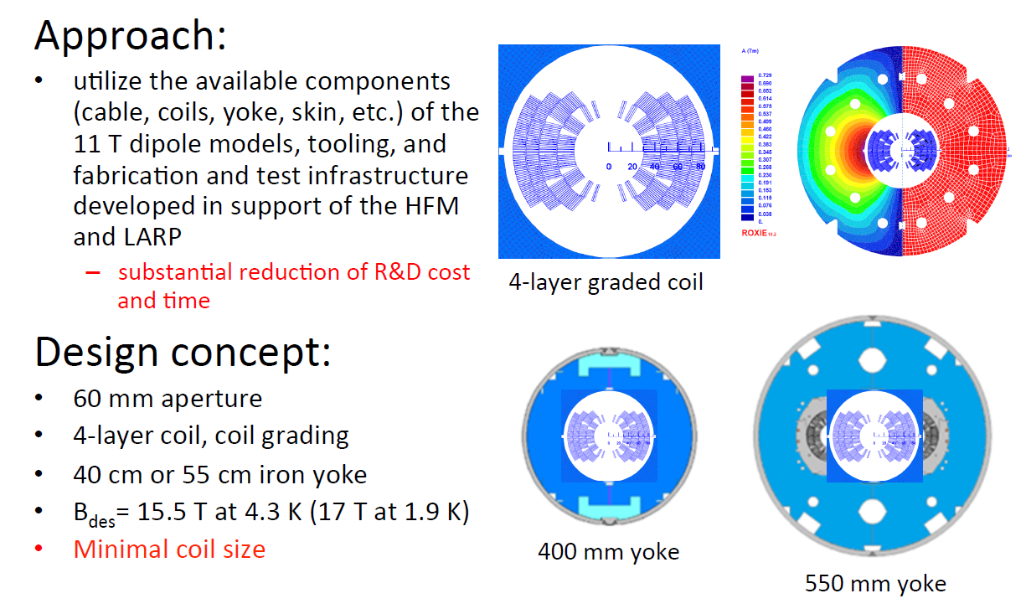
FNAL: Cosθ 16 T Nb₃Sn Dipole
A. Zlobin, ASC-FCC Meeting Presentation, August 2014

Slide 19

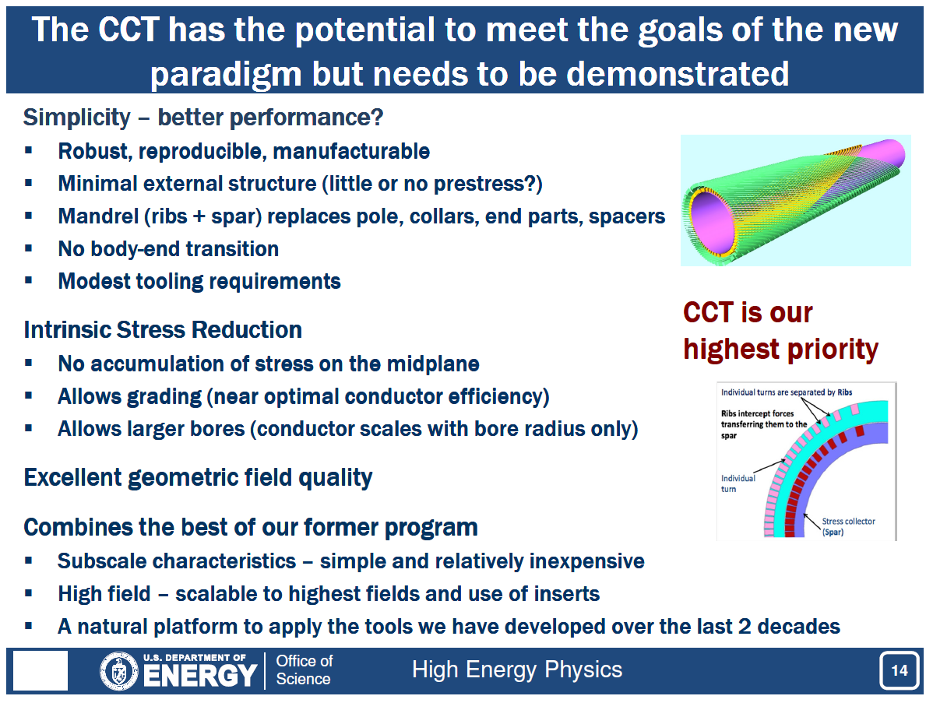
LBNL: Canted Cosine Theta Concept
S. Gourlay, ASC-FCC Meeting Presentation, August 2014

Slide 20
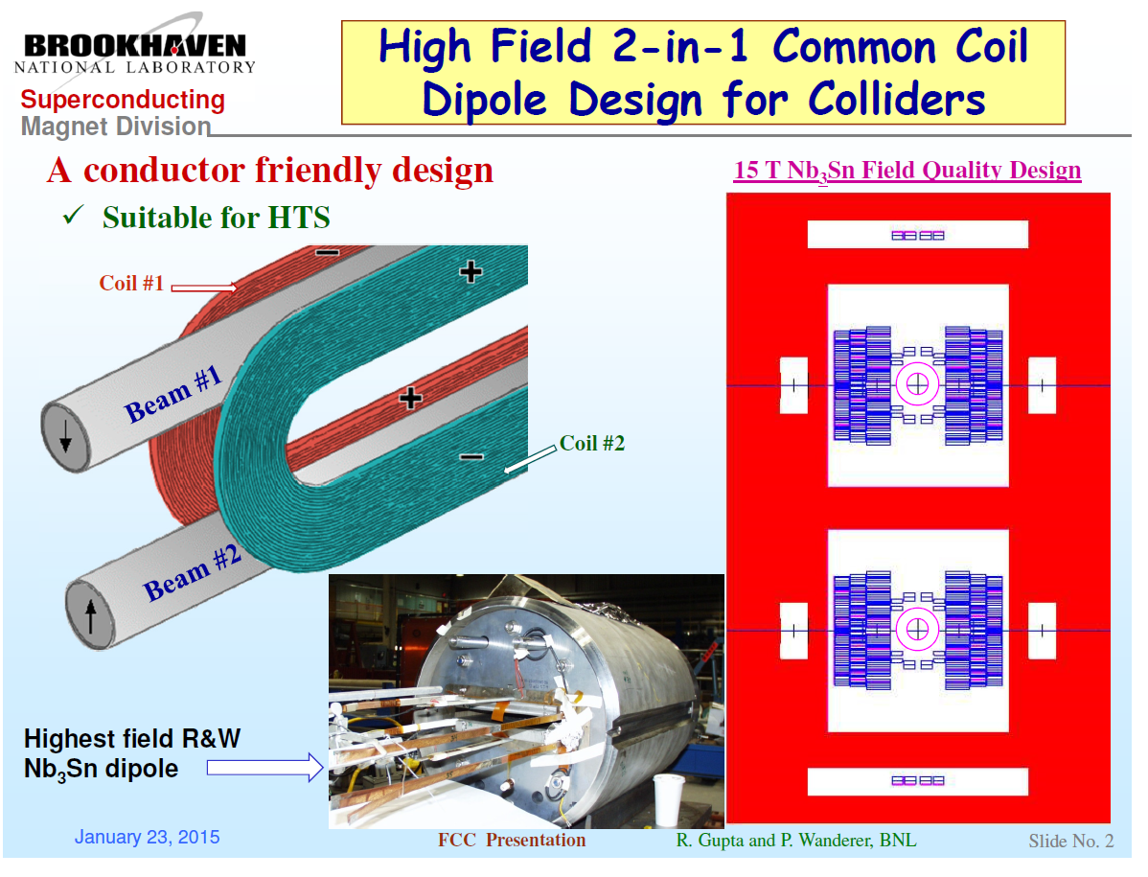
BNL: Common Coil Dipoles
R. Gupta, P. Wanderer, ASC-FCC Meeting presentation (updated)

Slide 21
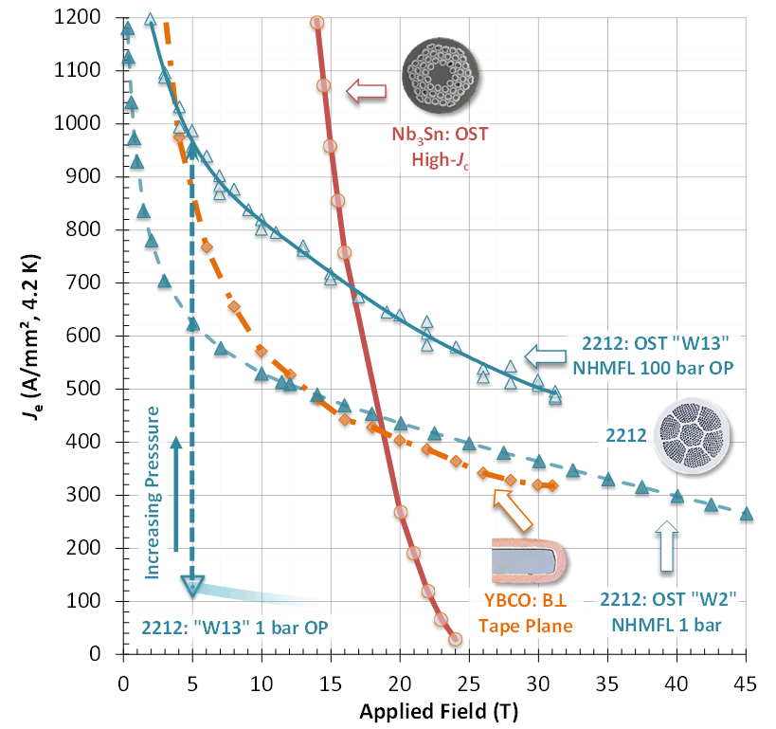

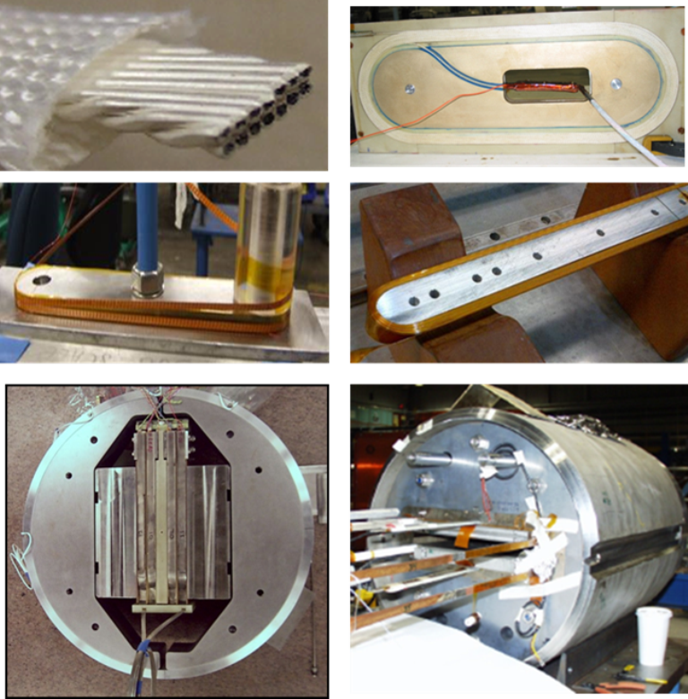


HTS Conductor & Technology Development
Bi-2212: significant Jc improvement by reaction under high pressure (~100 bar)
Challenge: application to large systems
Development of HTS cable and coils for eventual use as inserts in Nb₃Sn dipoles (BNL, FNAL, NHMFL, LBNL)
D. Larbalestier, ASC-FCC Meeting, August 2014

Slide 22
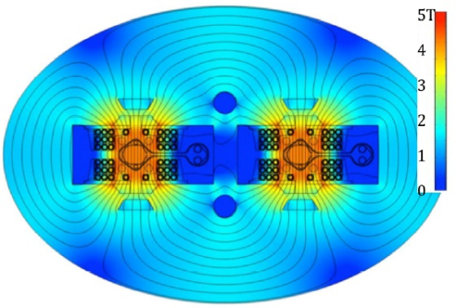
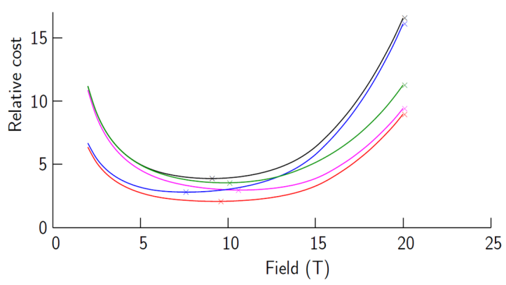


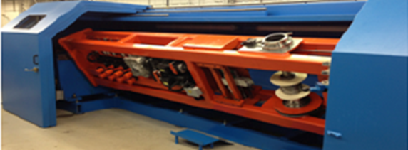
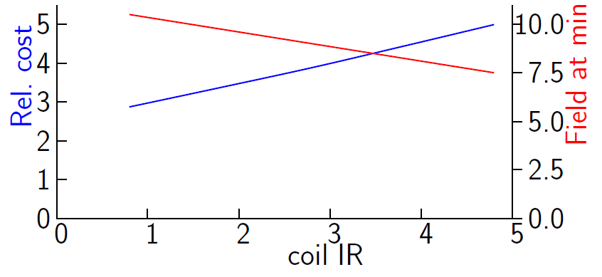
Studies of pp Colliders at Lower Field
Motivated by cost models (from VLHC study) and open mid-plane design
Longer circumference (or lower energy) not consistent with FCC/SppC goals
Can provide valuable insights and new design concepts for global optimization
B. Palmer et al., “Accelerator Optimization issues of a 100 TeV collider”, ARD panel meeting, BNL
P. McIntyre et al., “4.5T, cable-in-conduit SC dipole for future hadron colliders”, ASC 2014
Updating/refining VLHC models
Dipole design:
cable in conduit
warm iron
open mid-plane
SR anti-chamber
Sensitivity to different
assumptions
Dependence on aperture
Automation techniques from electrical industry

Slide 23
FCC-ee Collider Design Activities
Criteria: address key technical challenges; areas of special US expertise; synergies with past/ongoing projects, with other ARD thrust areas and between pp/ee studies
Potential areas for US contributions | Motivation
Vacuum system design and technology | US Lab expertise (FNAL, SLAC) and facilities for SR tests (Cornell). Relevant to both hadron and electron positron machines.
Machine design and optics, beam dynamics, impedance and stability thresholds; IR design and machine-detector interface | US expertise with electron-positron colliders (e.g. PEP-II at SLAC); synergy with FCC-hh studies.
Diagnostics and feedback systems counteracting beam instabilities | US-Lab expertise and collaboration on fast feedback (e.g. LBNL-SLAC on Hi-Lumi LHC, PEP-II); luminosity monitoring etc.
RF cavity and system design | US Lab expertise in SCRF (FNAL, Jlab, Cornell); synergy with other R&D thrusts
FCC-ee design machine physics topics discussed in U. Wienands talk, Saturday AM

Slide 24
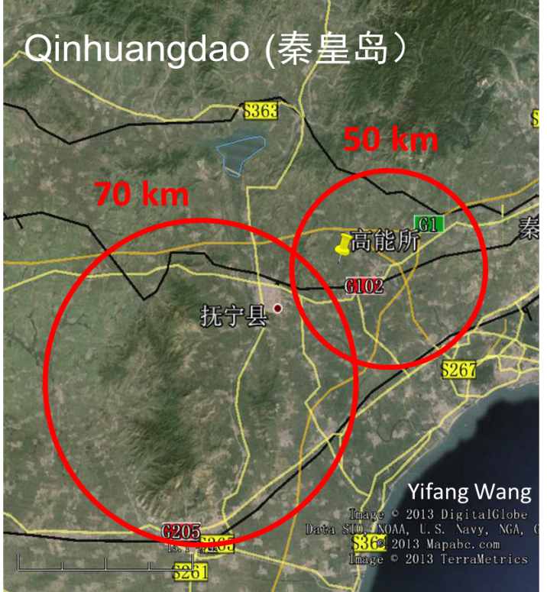
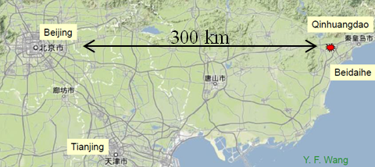
CEPC/Sppc Activities
Collaboration activities were discussed at US-China HEP annual meeting in October 2014 in Beijing:
Strong interest in joint studies on the science of future colliders
Six US laboratories (Fermilab, BNL, LBNL, ANL, Jlab and SLAC) plan to work together with IHEP and other Chinese institutions to identify specific R&D topics and to arrange mutual exchange and workshops:
  Extended visits by US scientists (theory, experiment and accelerator) to IHEP
  Contributions to the CEPC-SPPC Preliminary Conceptual Design Report (10 US co-authors)
  Joint organization and participation of an ICFA mini-workshop on SC magnets in June 2015 in Shanghai, China.
Details on CEPC/SppC machine design in Weiren Chou’s presentation, Saturday AM

Slide 25
Summary
HEPAP P5 report strongly supports studies and R&D toward future very high energy colliders:
  Exploration of the energy frontier is one of the key science drivers
  US expertise in critical aspects of machine design and technologies
  Synergies with other previous/ongoing programs and P5 R&D thrusts
  R&D focus: improving performance and reducing cost
Discussions on details of US involvement are underway as part of the ARD sub-panel activities
  Community input: strong interest from all HEP Labs, and proposals consistent with P5 recommendations
  Key areas of machine studies and technology R&D have been identified
  High field superconducting magnets viewed as a primary US contribution
Acknowledgement: input from discussions, presentations and papers by:
W. Chou, A. Godeke, S. Gourlay, R. Gupta, D. Larbalestier, P. McIntyre, B. Palmer, V. Shiltsev, M. Syphers, P. Wanderer, U. Wienands, X. Xu, A. Zlobin

Slide 26

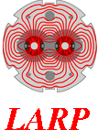
BACKUP SLIDES

Slide 27
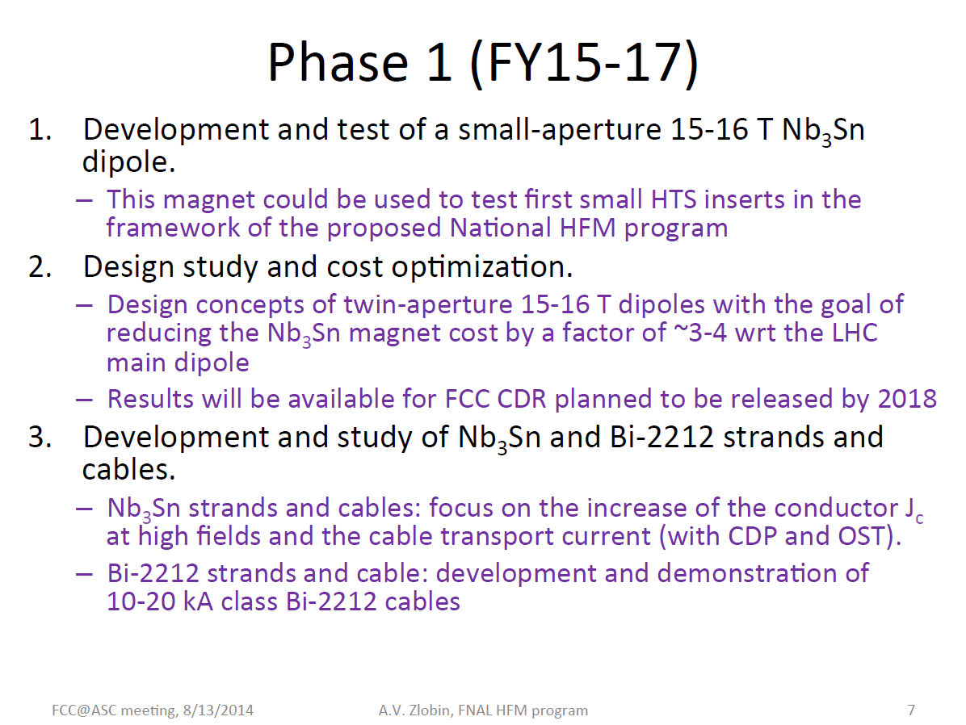
FNAL Magnet R&D Proposal

Slide 28
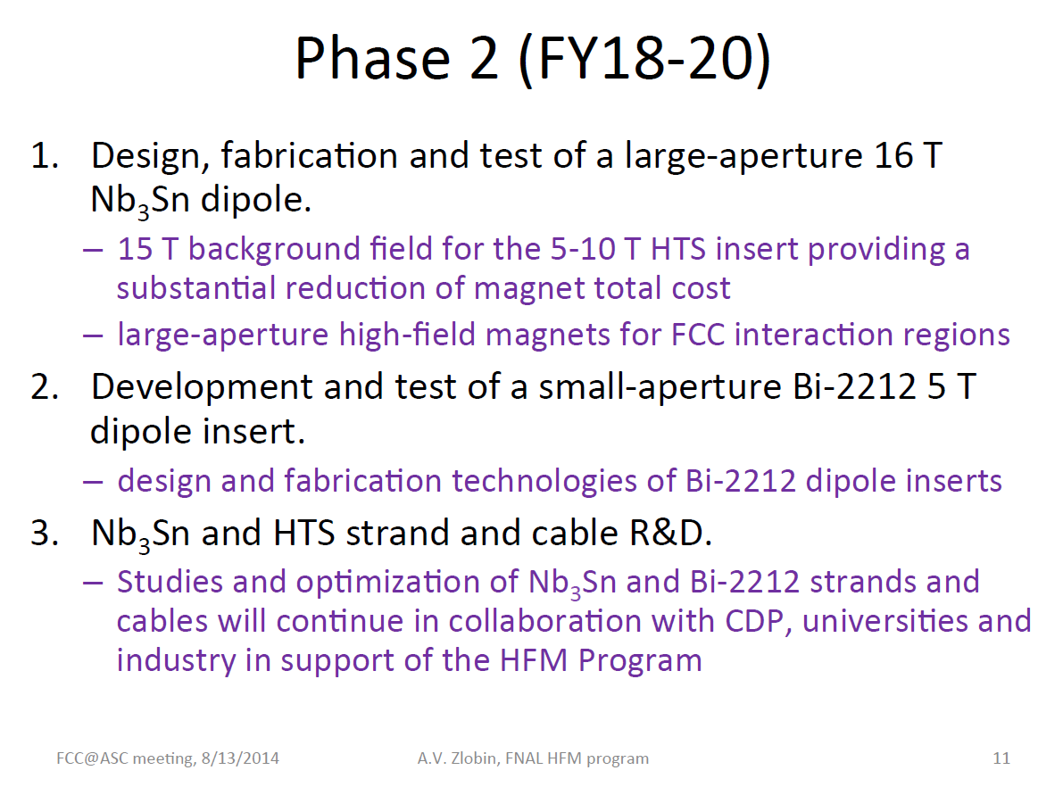
FNAL Magnet R&D Proposal

Slide 29
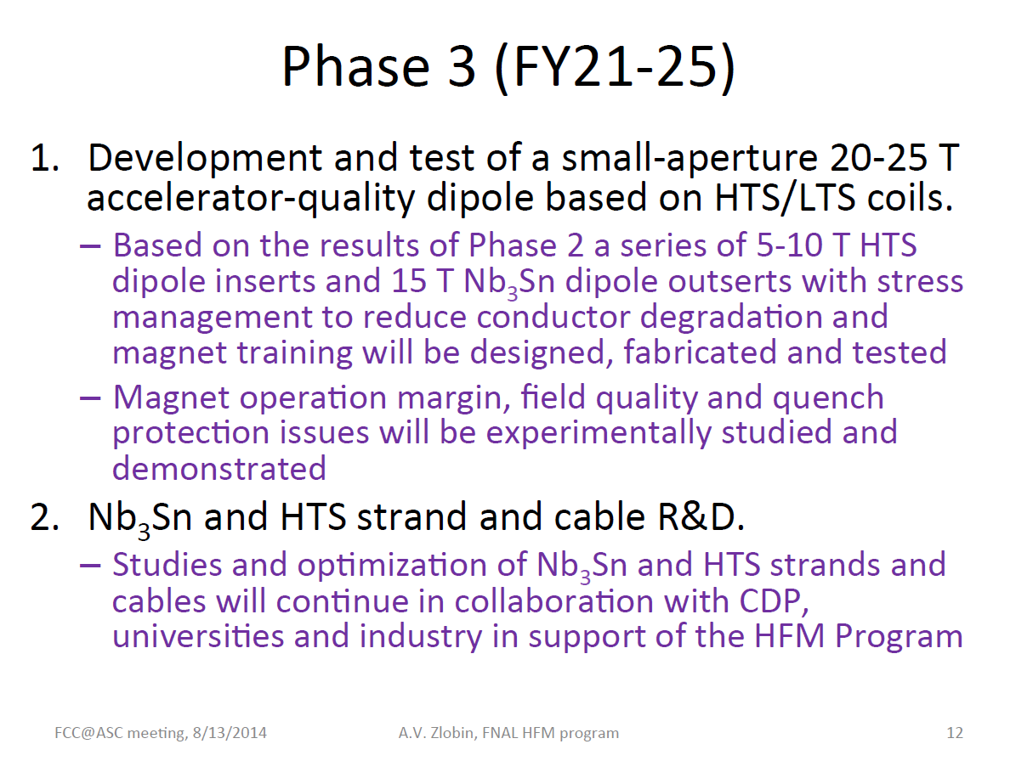
FNAL Magnet R&D Proposal

Slide 30
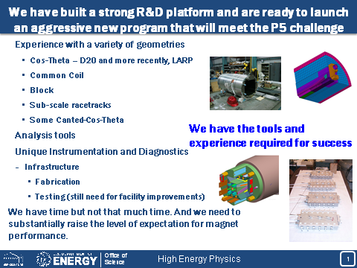
LBNL Magnet R&D Proposal

Slide 31
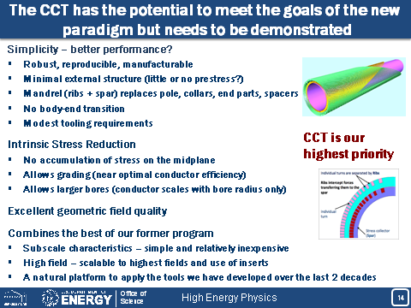
LBNL Magnet R&D Proposal

Slide 32
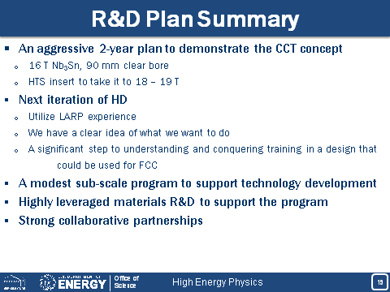
LBNL Magnet R&D Proposal

Slide 33
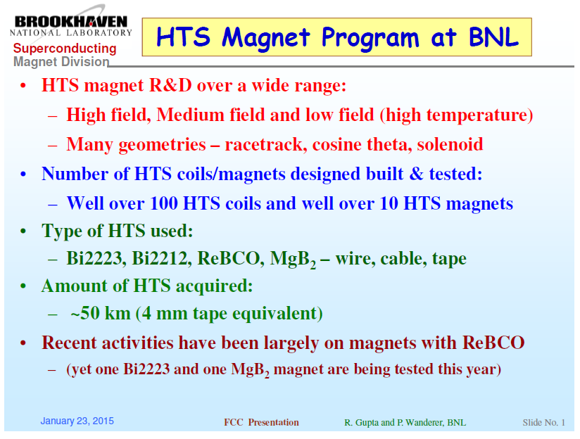
BNL Magnet R&D Proposal

Slide 34
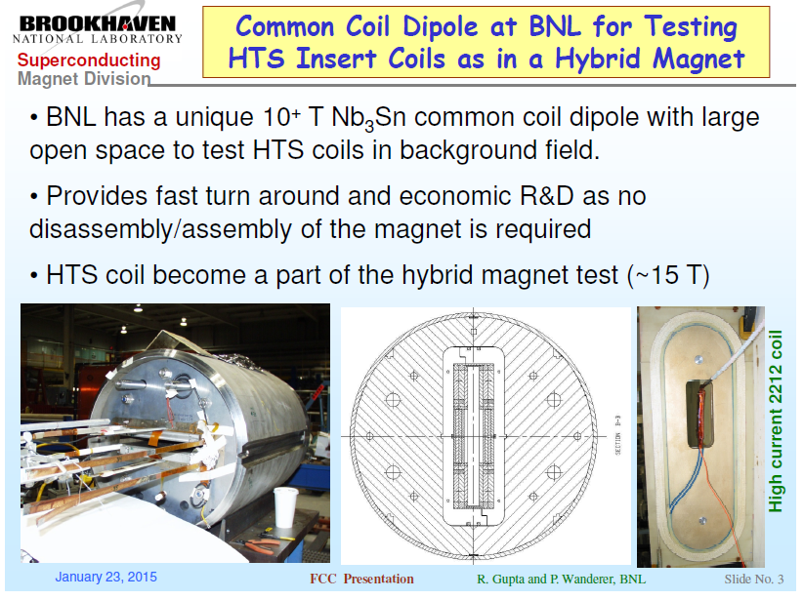
BNL Magnet R&D Proposal

Slide 35
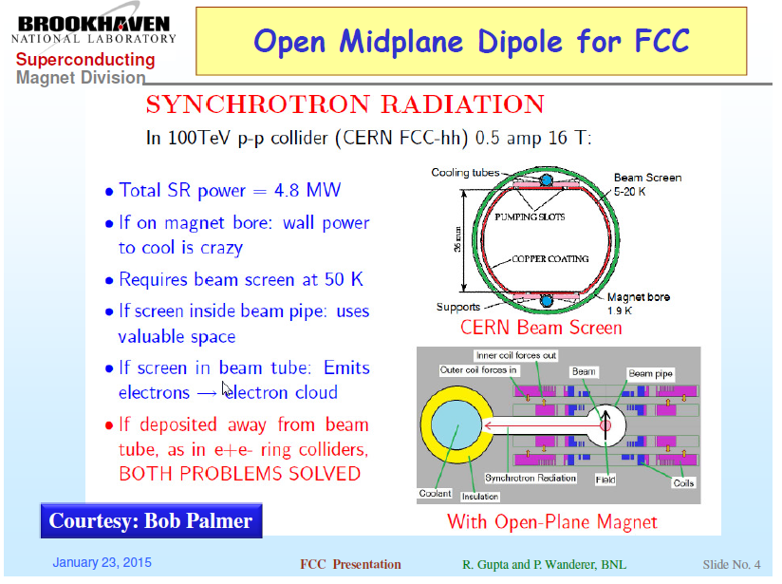
BNL Magnet R&D Proposal

