Slide 1


Welcome
Workshop on Cloud Services for File Synchronization and Sharing
to Accelerating Science and Innovation
Notes:
1

Slide 2
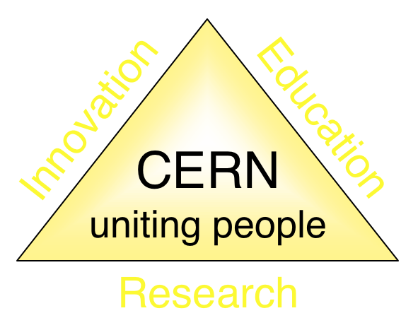
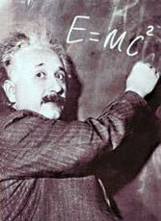

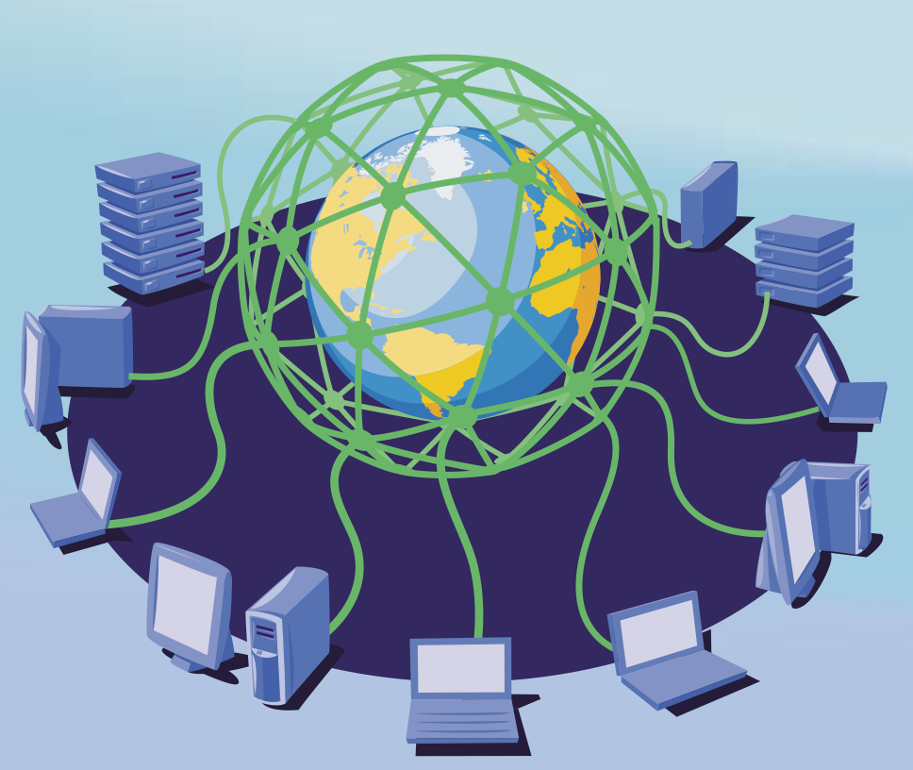

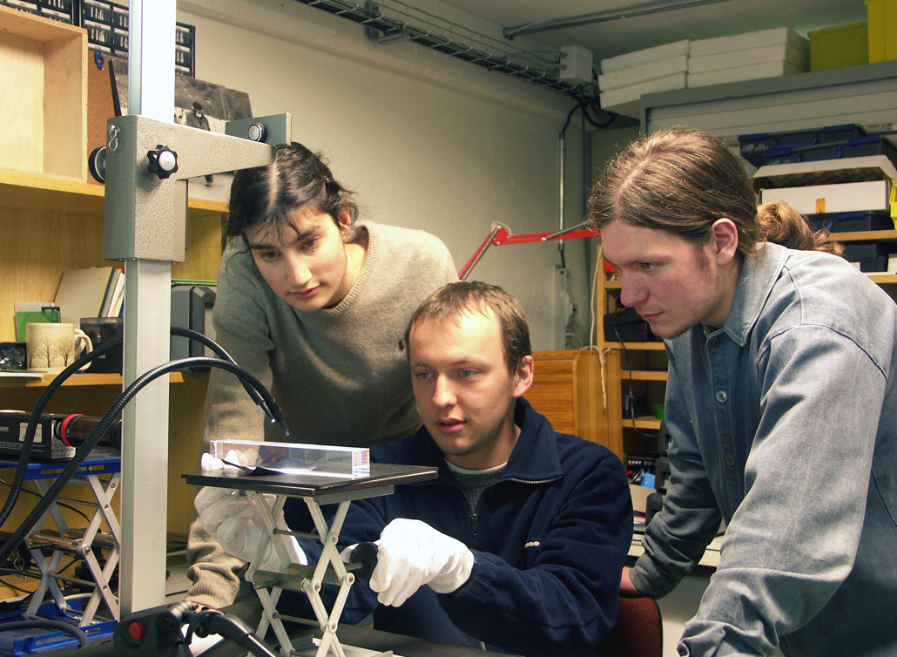
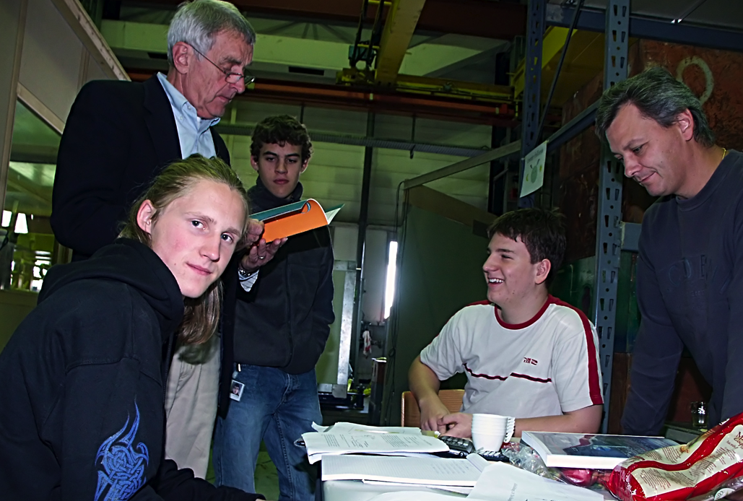
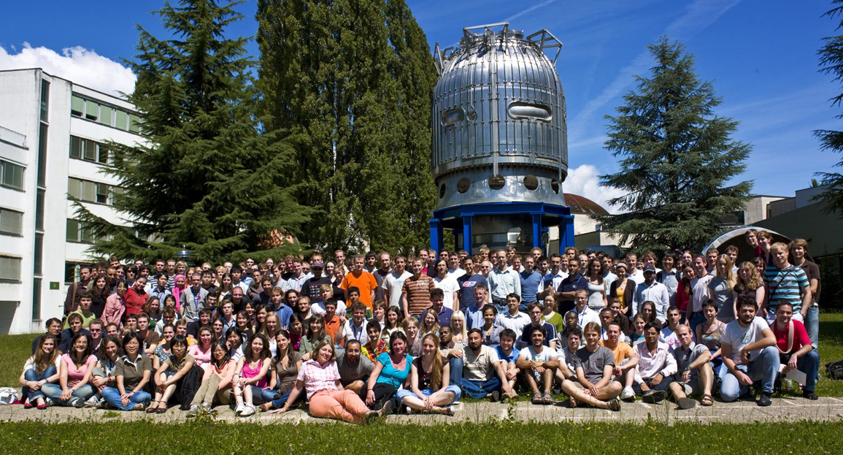
The Mission of CERN
Push back the frontiers of knowledge
E.g. the secrets of the Big Bang …what was the matter like within the first moments of the Universe’s existence?
Develop new technologies for accelerators and detectors
Information technology - the Web and the GRID
Medicine - diagnosis and therapy
Train scientists and engineers of tomorrow
Unite people from different countries and cultures
Notes:
2

Slide 3
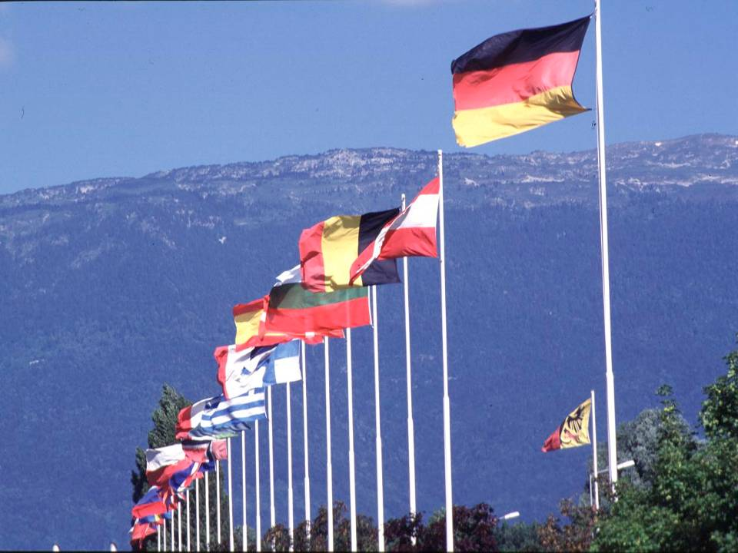

CERN was founded 1954: 12 European States
“Science for Peace”
Today: 21 Member States
~ 2300 staff
~ 1600 other paid personnel
~ 10500 users
Budget (2014) ~1000 MCHF
Member States: Austria, Belgium, Bulgaria, the Czech Republic, Denmark, Finland, France, Germany, Greece, Hungary, Israel, Italy, the Netherlands, Norway, Poland, Portugal, Slovakia, Spain, Sweden, Switzerland and
the United Kingdom
Candidate for Accession: Romania
Associate Member in Pre-Stage to Membership: Serbia
Applicant States for Membership or Associate Membership:
Brazil, Cyprus, Pakistan, Russia, Slovenia, Turkey, Ukraine
Observers to Council: India, Japan, Russia, Turkey, United States of America; European Commission and UNESCO
3
Notes:
3
----- Meeting Notes (09/01/2013 14:16) -----
nnn

Slide 4
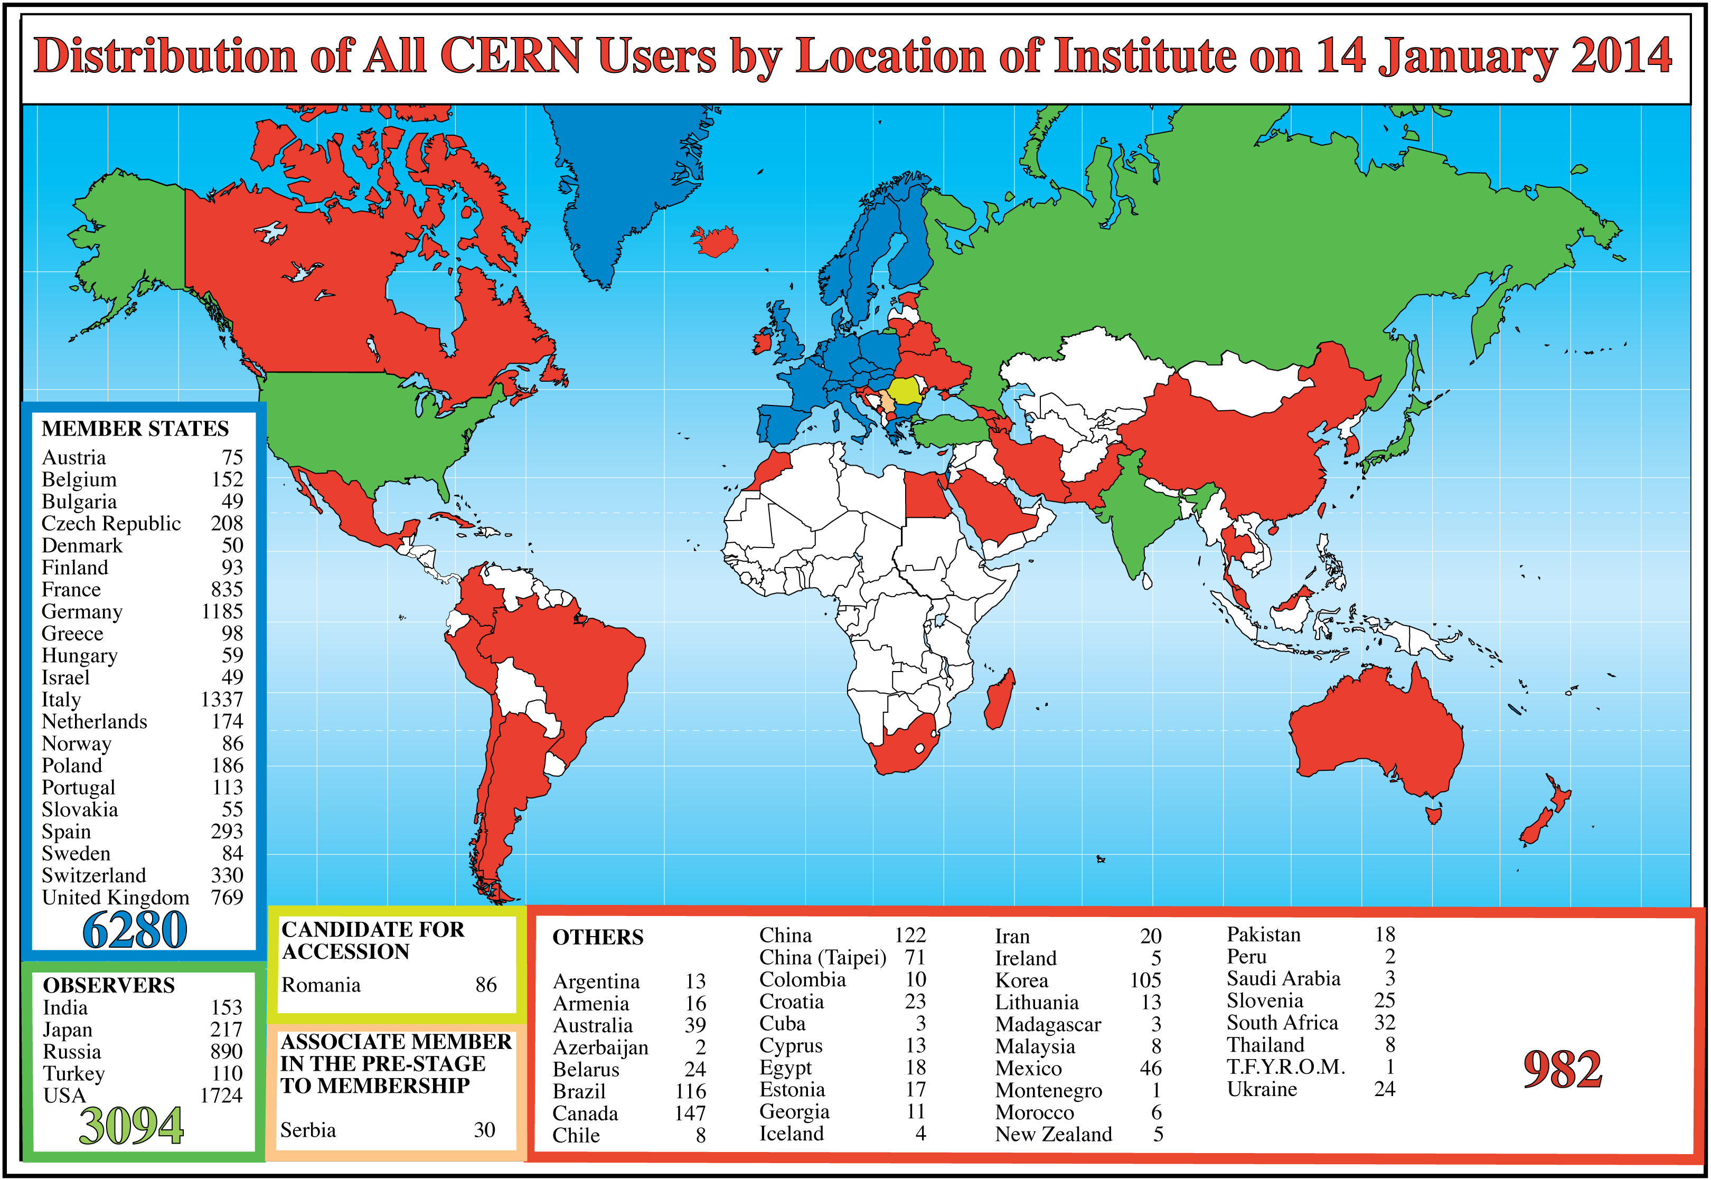
Science is getting more and more global
Notes:
4
4

Slide 5
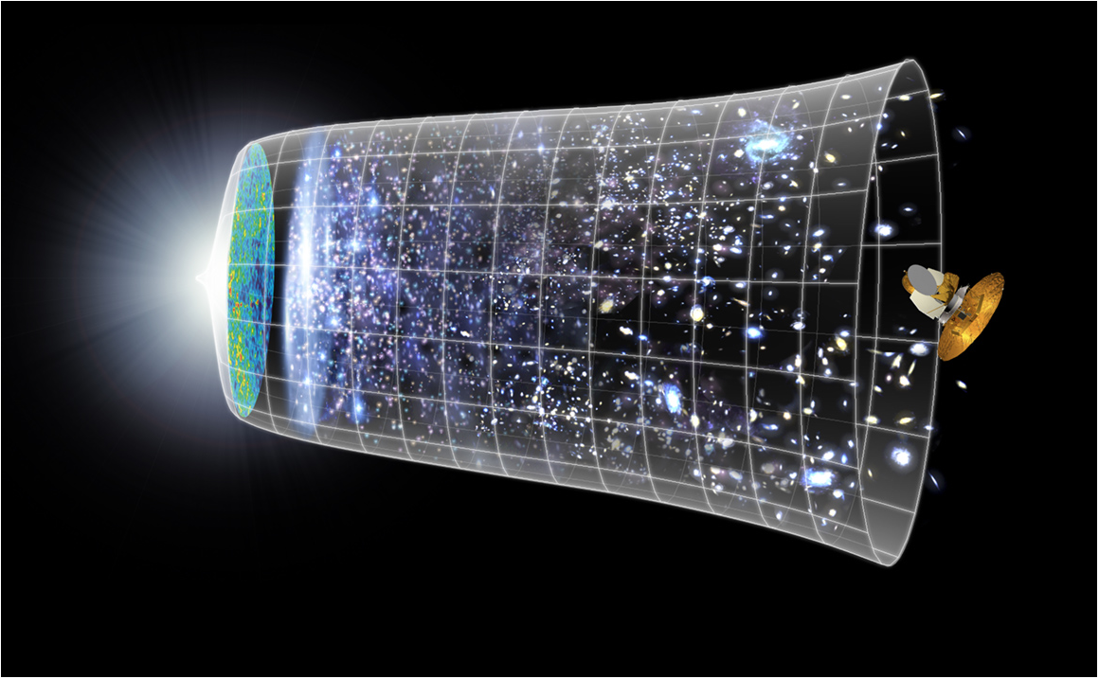
Next Scientific Challenge:
to understand the very first moments of our Universe after the Big Bang
Big Bang
WMAP
13.8 Billion Years
Today
10²⁸ cm

Slide 6
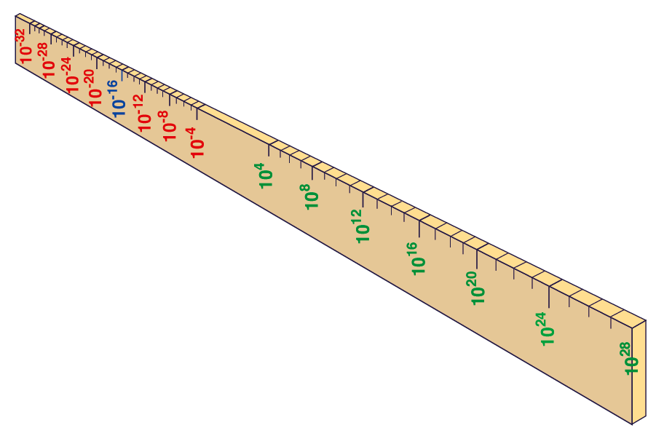
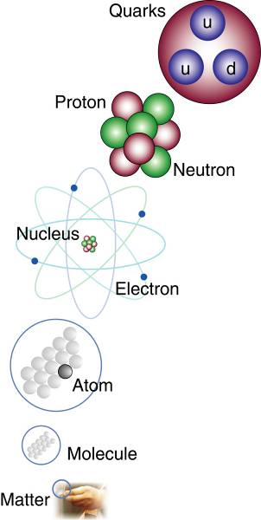
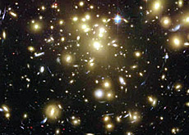
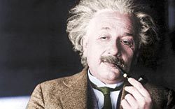

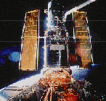
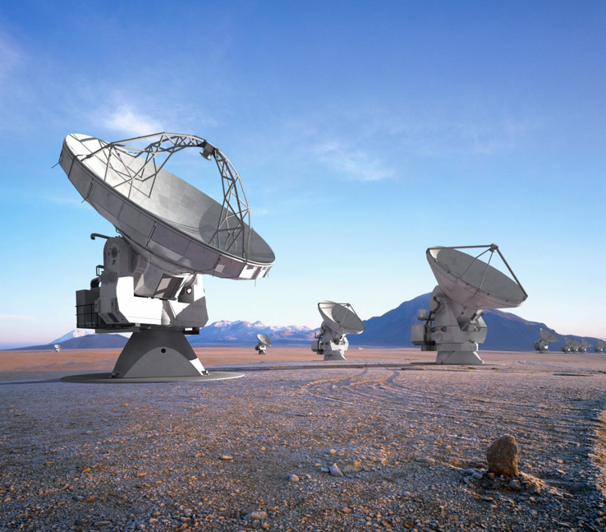

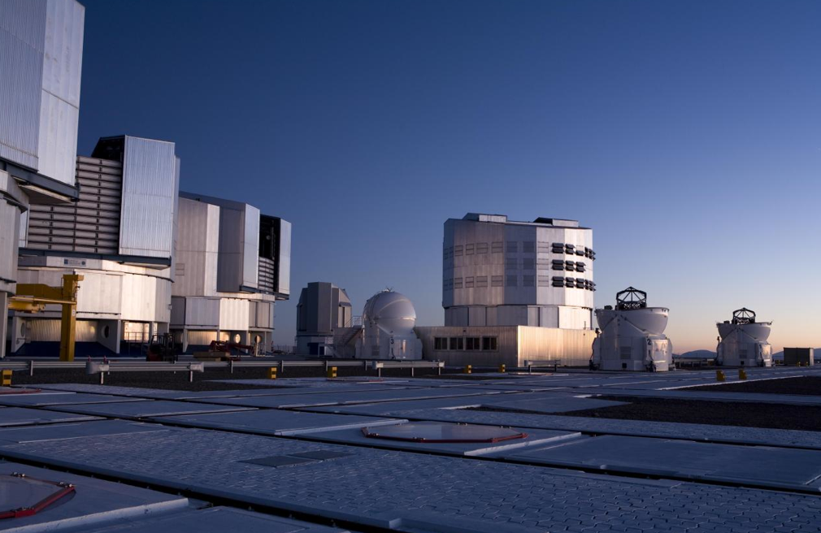
Big Bang
Proton
Atom
Radius of Earth
Earth to Sun
Radius of Galaxies
Universe
LHC
Super-Microscope
Hubble
ALMA
cm
Study physics laws of first moments after Big Bang
increasing Symbiosis between Particle Physics,
Astrophysics and Cosmology
AMS
VLT
Notes:
6

Slide 7
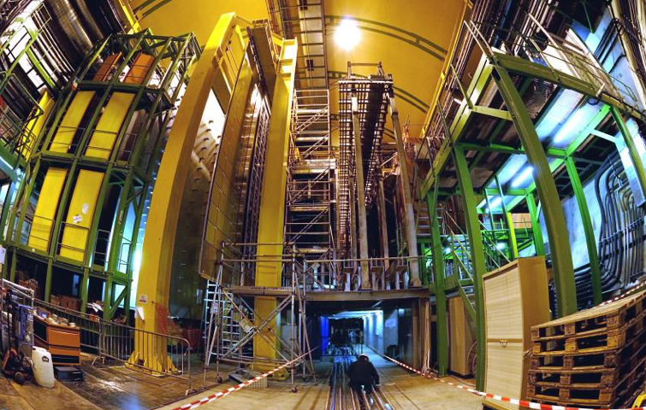


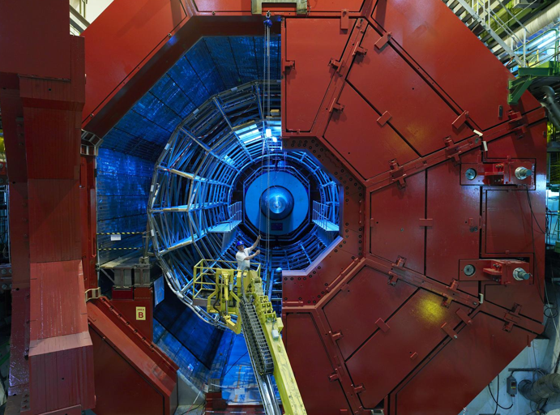

2010: a New Era in Fundamental Science
LHCb
CMS
ATLAS
Exploration of a new energy frontier
in p-p and Pb-Pb collisions
ALICE
LHC ring:
27 km circumference
Notes:
7

Slide 8
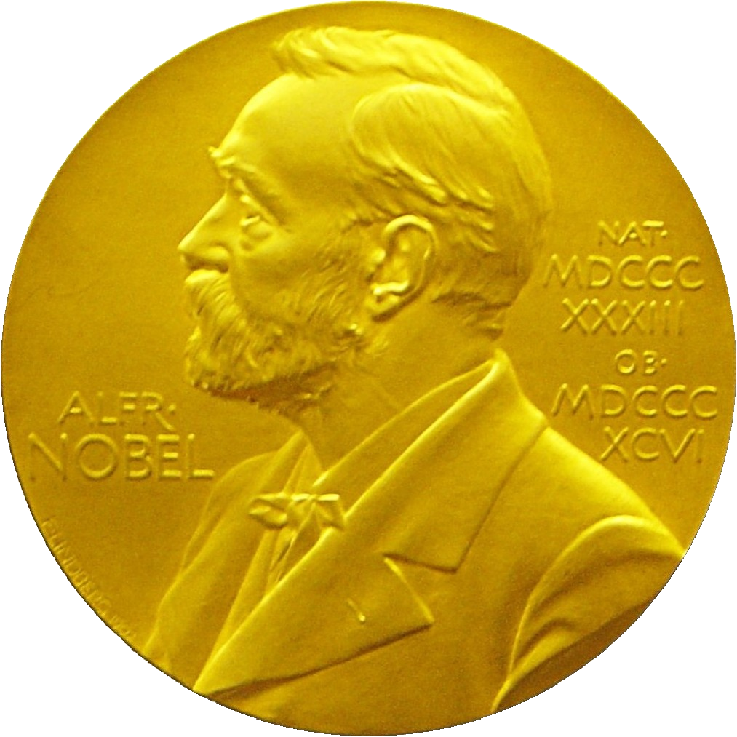
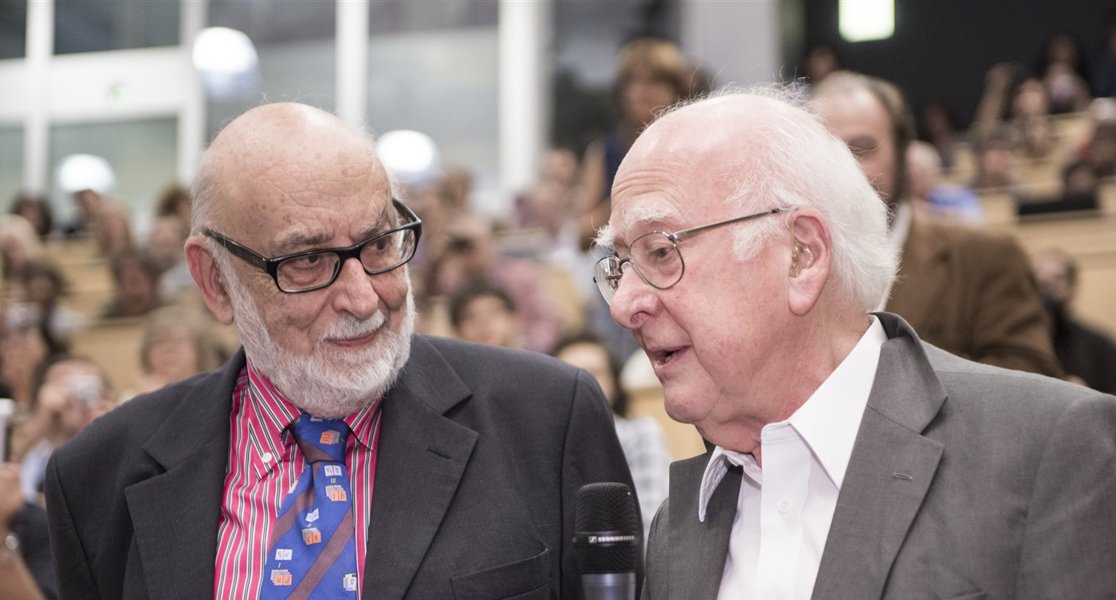
Nobel Prize in Physics 2013
The Nobel Prize in Physics 2013 was awarded jointly to François Englert and Peter W. Higgs "for the theoretical discovery of a mechanism that contributes to our understanding of the origin of mass of subatomic particles, and which recently was confirmed through the discovery of the predicted fundamental particle, by the ATLAS and CMS experiments at CERN's Large Hadron Collider”.

Slide 9
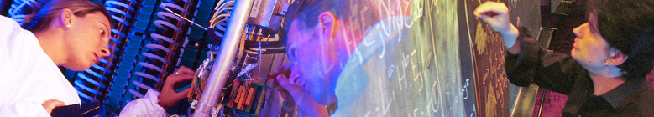

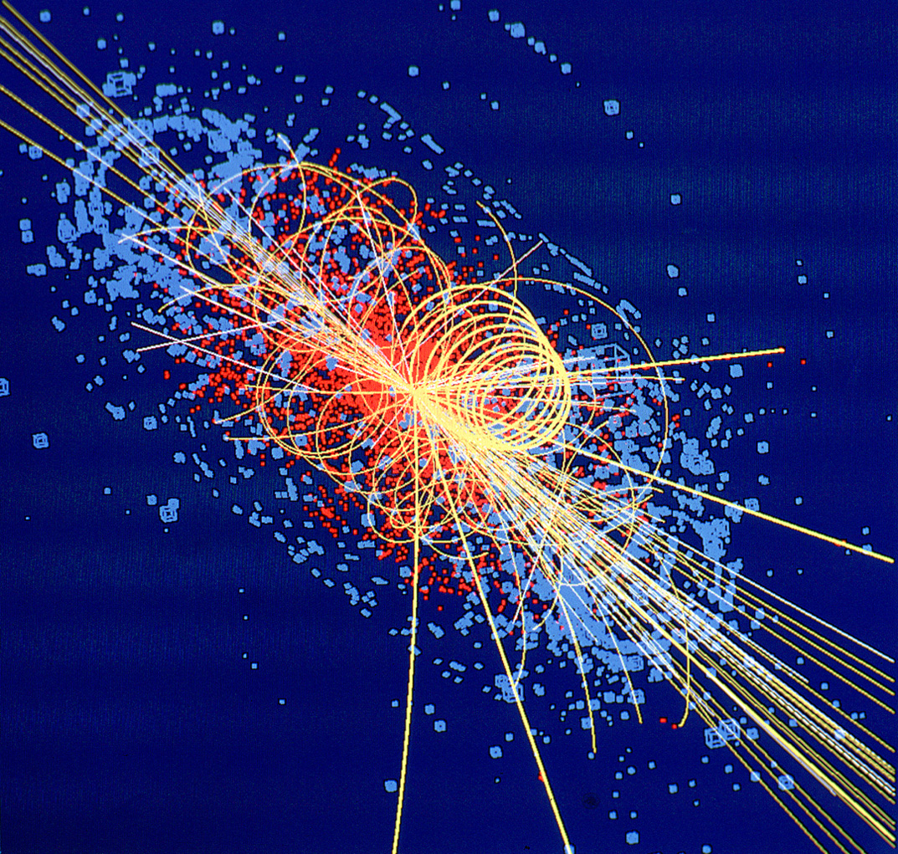
CERN: Particle Physics and Innovation
Interfacing between fundamental science and key technological developments
CERN Technologies and Innovation
Accelerating particle beams
Detecting particles
Large-scale computing (Grid)
Notes:
9

Slide 10
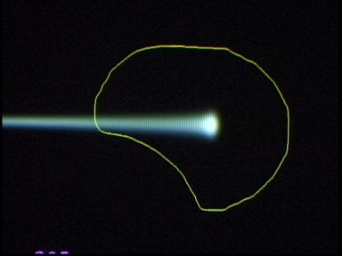
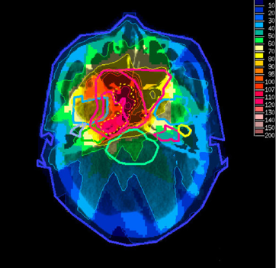
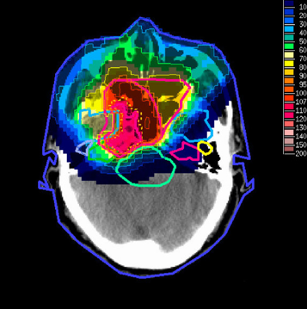
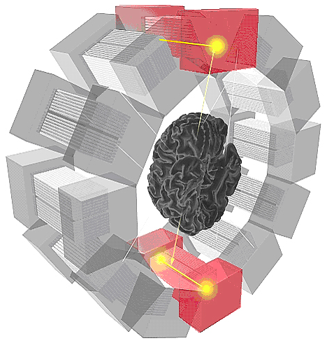
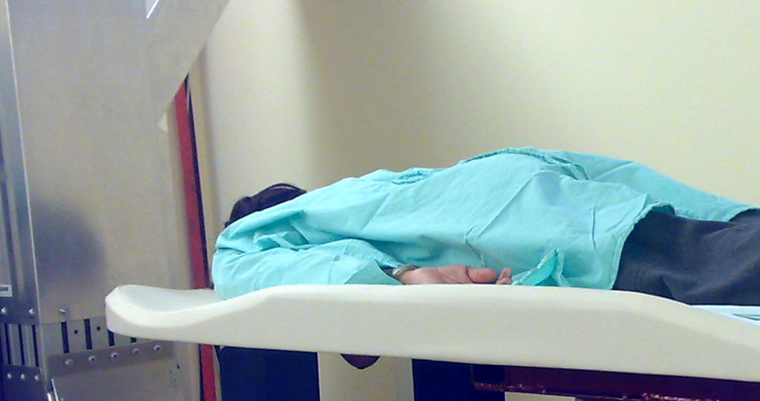
Medical Application as an Example of Particle Physics Spin-off
Combining Physics, ICT, Biology and Medicine to fight cancer
Hadron Therapy
Tumour Target
Leadership in Ion Beam Therapy now in Europe and Japan
Protons
light ions
Accelerating particle beams
~30’000 accelerators worldwide
~17’000 used for medicine
X-ray
protons
>100’000 patients treated worldwide (45 facilities)
>50’000 patients treated in Europe (14 facilities)
Imaging
PET Scanner
Clinical trial in Portugal, France and Italy for new breast imaging system (ClearPEM)
Detecting particles
Notes:
10

Slide 11
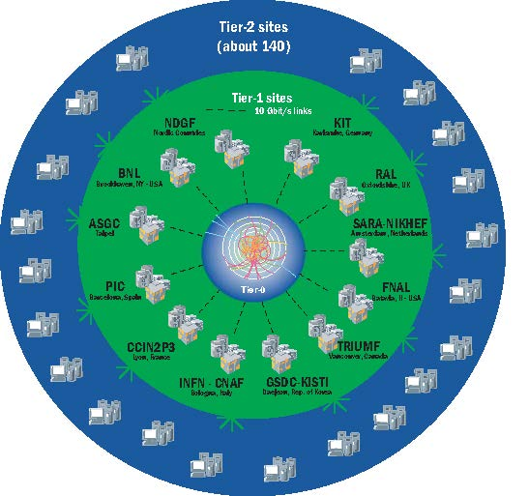
The Worldwide LHC Computing Grid
A distributed computing infrastructure to provide the production and analysis environments for the LHC experiments
Managed and operated by a worldwide collaboration between the experiments and the participating computer centres
The resources are distributed – for funding and sociological reasons
Our task was to make use of the resources available to us – no matter where they are located
Tier-0 (CERN):
  Data recording
  Initial data reconstruction
  Data distribution
Tier-1 (12 centres + Russia):
Permanent storage
Re-processing
Analysis
Tier-2 (~140 centres):
Simulation
End-user analysis
~ 160 sites, 35 countries
300000 cores
200 PB of storage
2 Million jobs/day
10+ Gbps links
Notes:
The Tier 0 centre at CERN stores the primary copy of all the data. A second copy is distributed between the 11 so-called Tier 1 centres. These are large computer centres in different geographical regions of the world, that also have a responsibility for long term guardianship of the data. The data is sent from CERN to the Tier 1s in real time over dedicated network connections.
In order to keep up with the data coming from the experiments this transfer must be capable of running at around 1.3 GB/s continuously. This is equivalent to a full DVD every 3 seconds.
The Tier 1 sites also provide the second level of data processing and produce data sets which can be used to perform the physics analysis. These data sets are sent from the Tier 1 sites to the around 130 Tier 2 sites.
A Tier 2 is typically a university department or physics laboratories and are located all over the world in most of the countries that participate in the LHC experiments. Often, Tier 2s are associated to a Tier 1 site in their region. It is at the Tier 2s that the real physics analysis is performed.

Slide 12
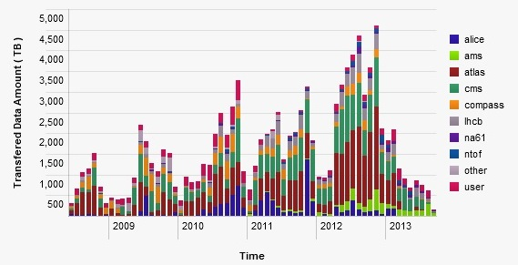
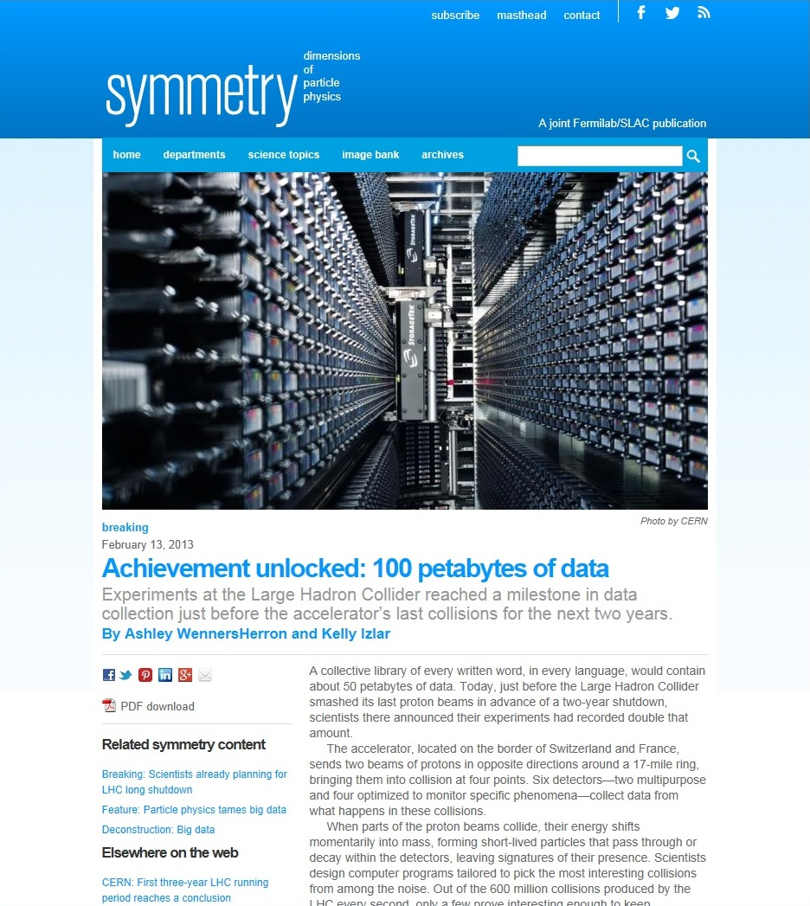
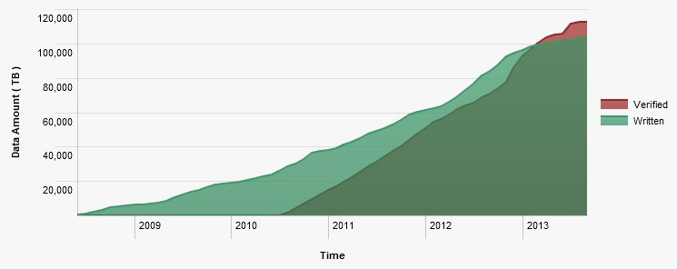
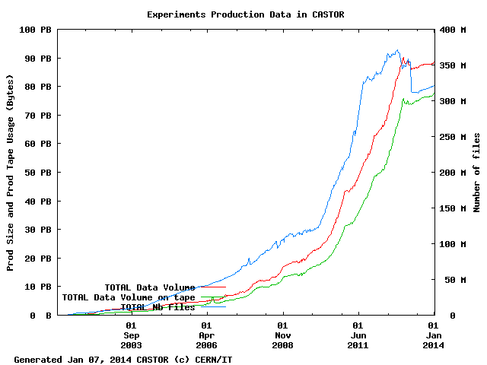
LHC Data Volumes @ CERN

Slide 13
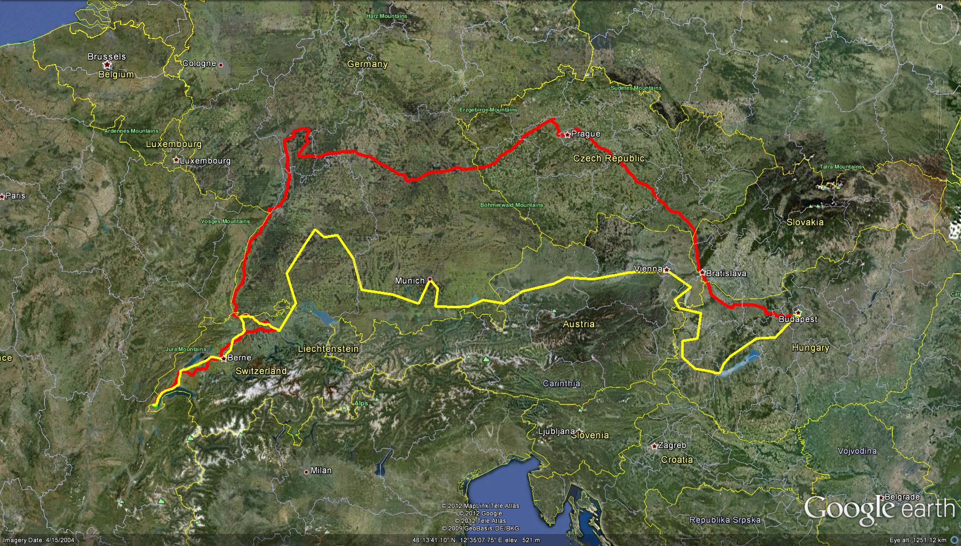
Connectivity (100 Gbps)
Dante/Géant
T-Systems

Slide 14
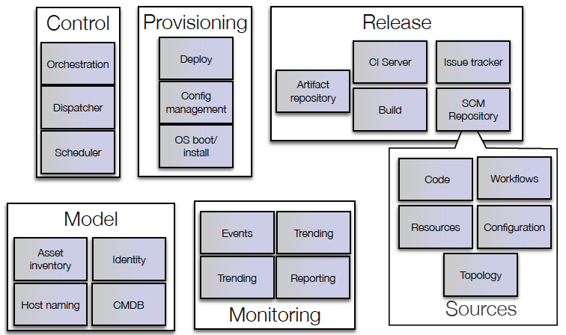
mcollective, yum
Bamboo
Puppet
AIMS/PXE
Foreman
JIRA
OpenStack
Nova
git
Koji, Mock
Active Directory /
LDAP
Yum repo
Pulp
Hardware database
Lemon /
Hadoop /
LogStash /
Kibana
Puppet-DB
Notes:
We adopted a Google toolchain approach. The majority of home written software was replaced by open source projects. Commercial tools which were already working well such as JIRA and Active Directory were maintained. The approach was to select a tool, prototype, fail early and then refine requirements (following the we are not special approach)
Key technologies were Puppet for configuration management and OpenStack for the private cloud.

Slide 15









Our Tool Chain

Slide 16
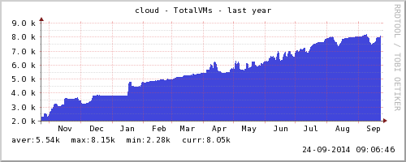
Evolution of the CERN private cloud service

Slide 17
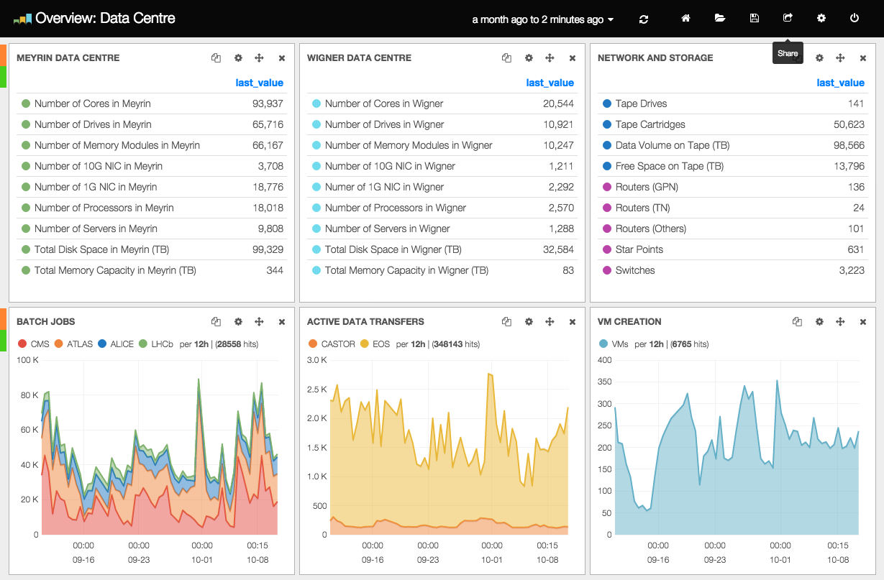
Tier 0
Current tender – 2015 capacity
  50 PB disk, 750 kHS06 (36 k cores)
    2/3 in Wigner, 1/3 in Meyrin

Slide 18
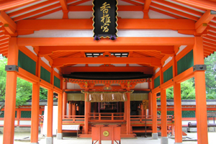
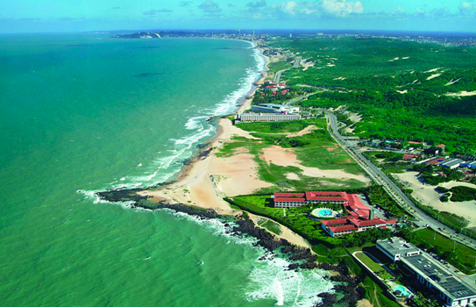
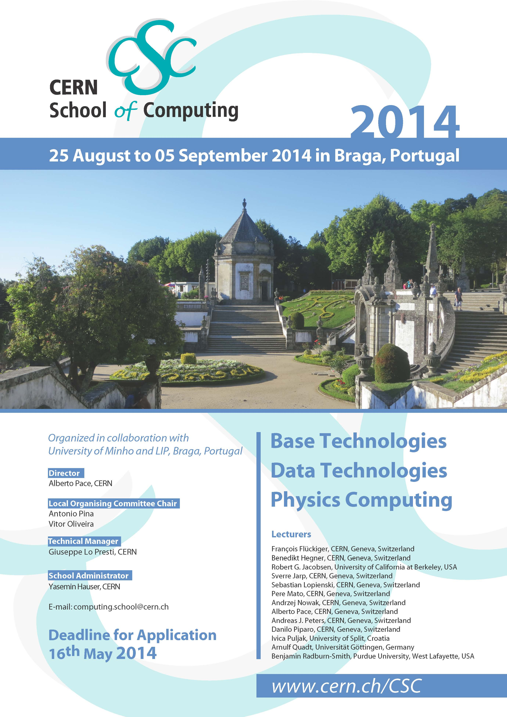
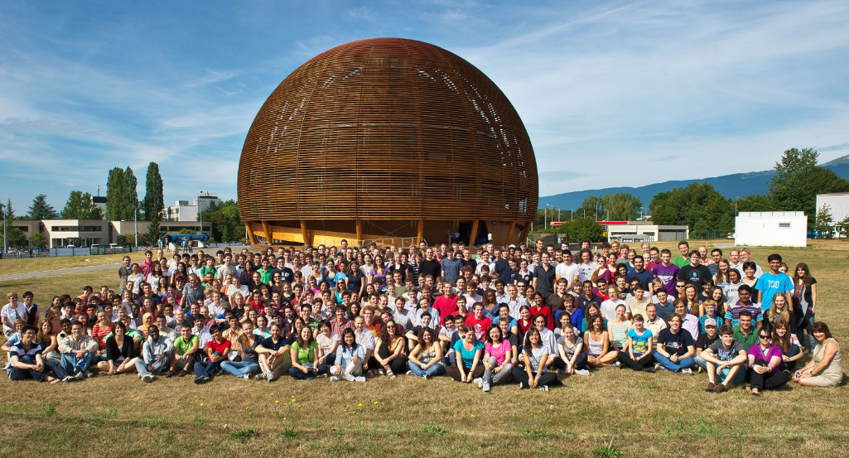
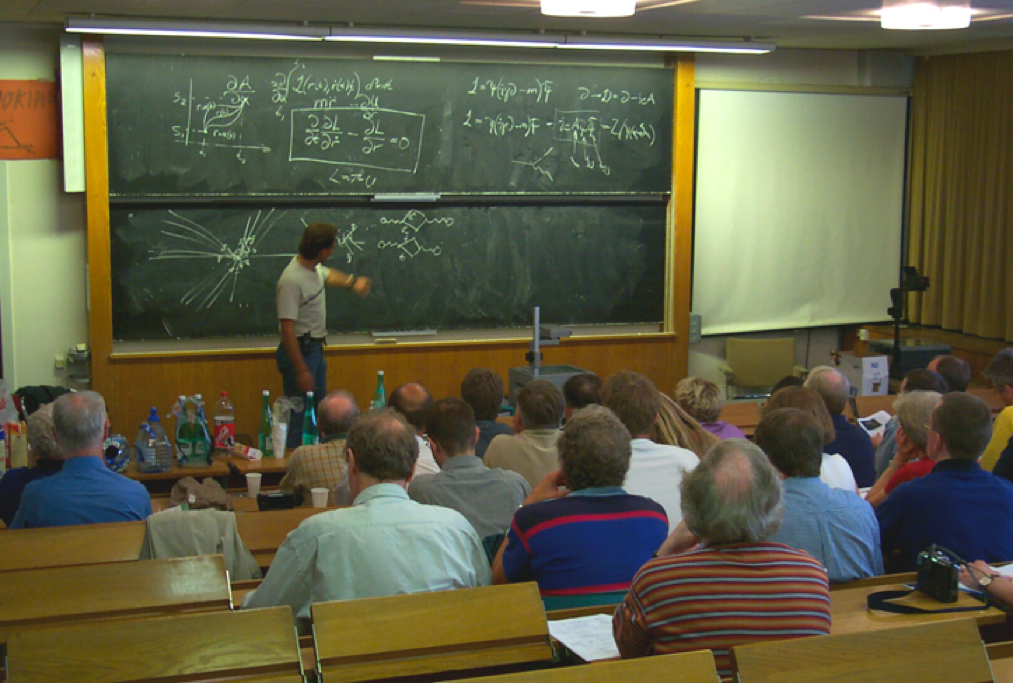
CERN Education Activities
Latin American School
Natal, Brazil, 2011
Arequipa, Peru, 2013
NEW:
Asia-Europe-Pacific School of High-Energy Physics
Fukuoka, Oct 2012
India, 2014
Scientists at CERN
Academic Training Programme
Young Researchers
CERN School of High Energy Physics
CERN School of Computing
CERN Accelerator School
CERN School of Computing
Portugal, August 2014
Physics Students
Summer Students
Programme
CERN Teacher Schools
International and National Programmes

Slide 19
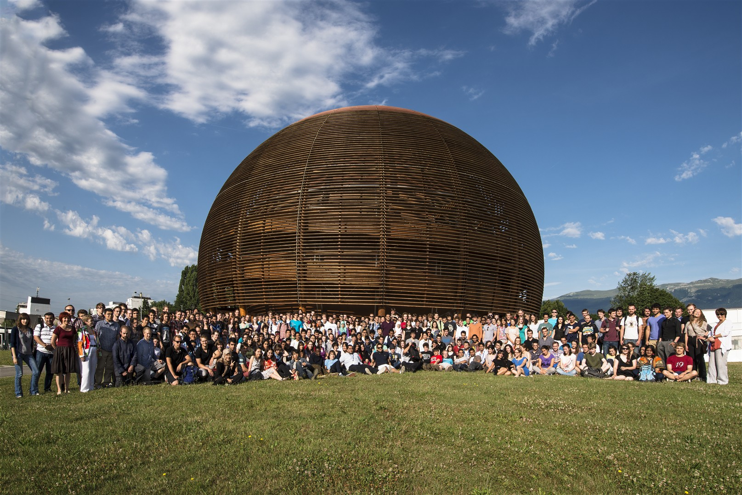
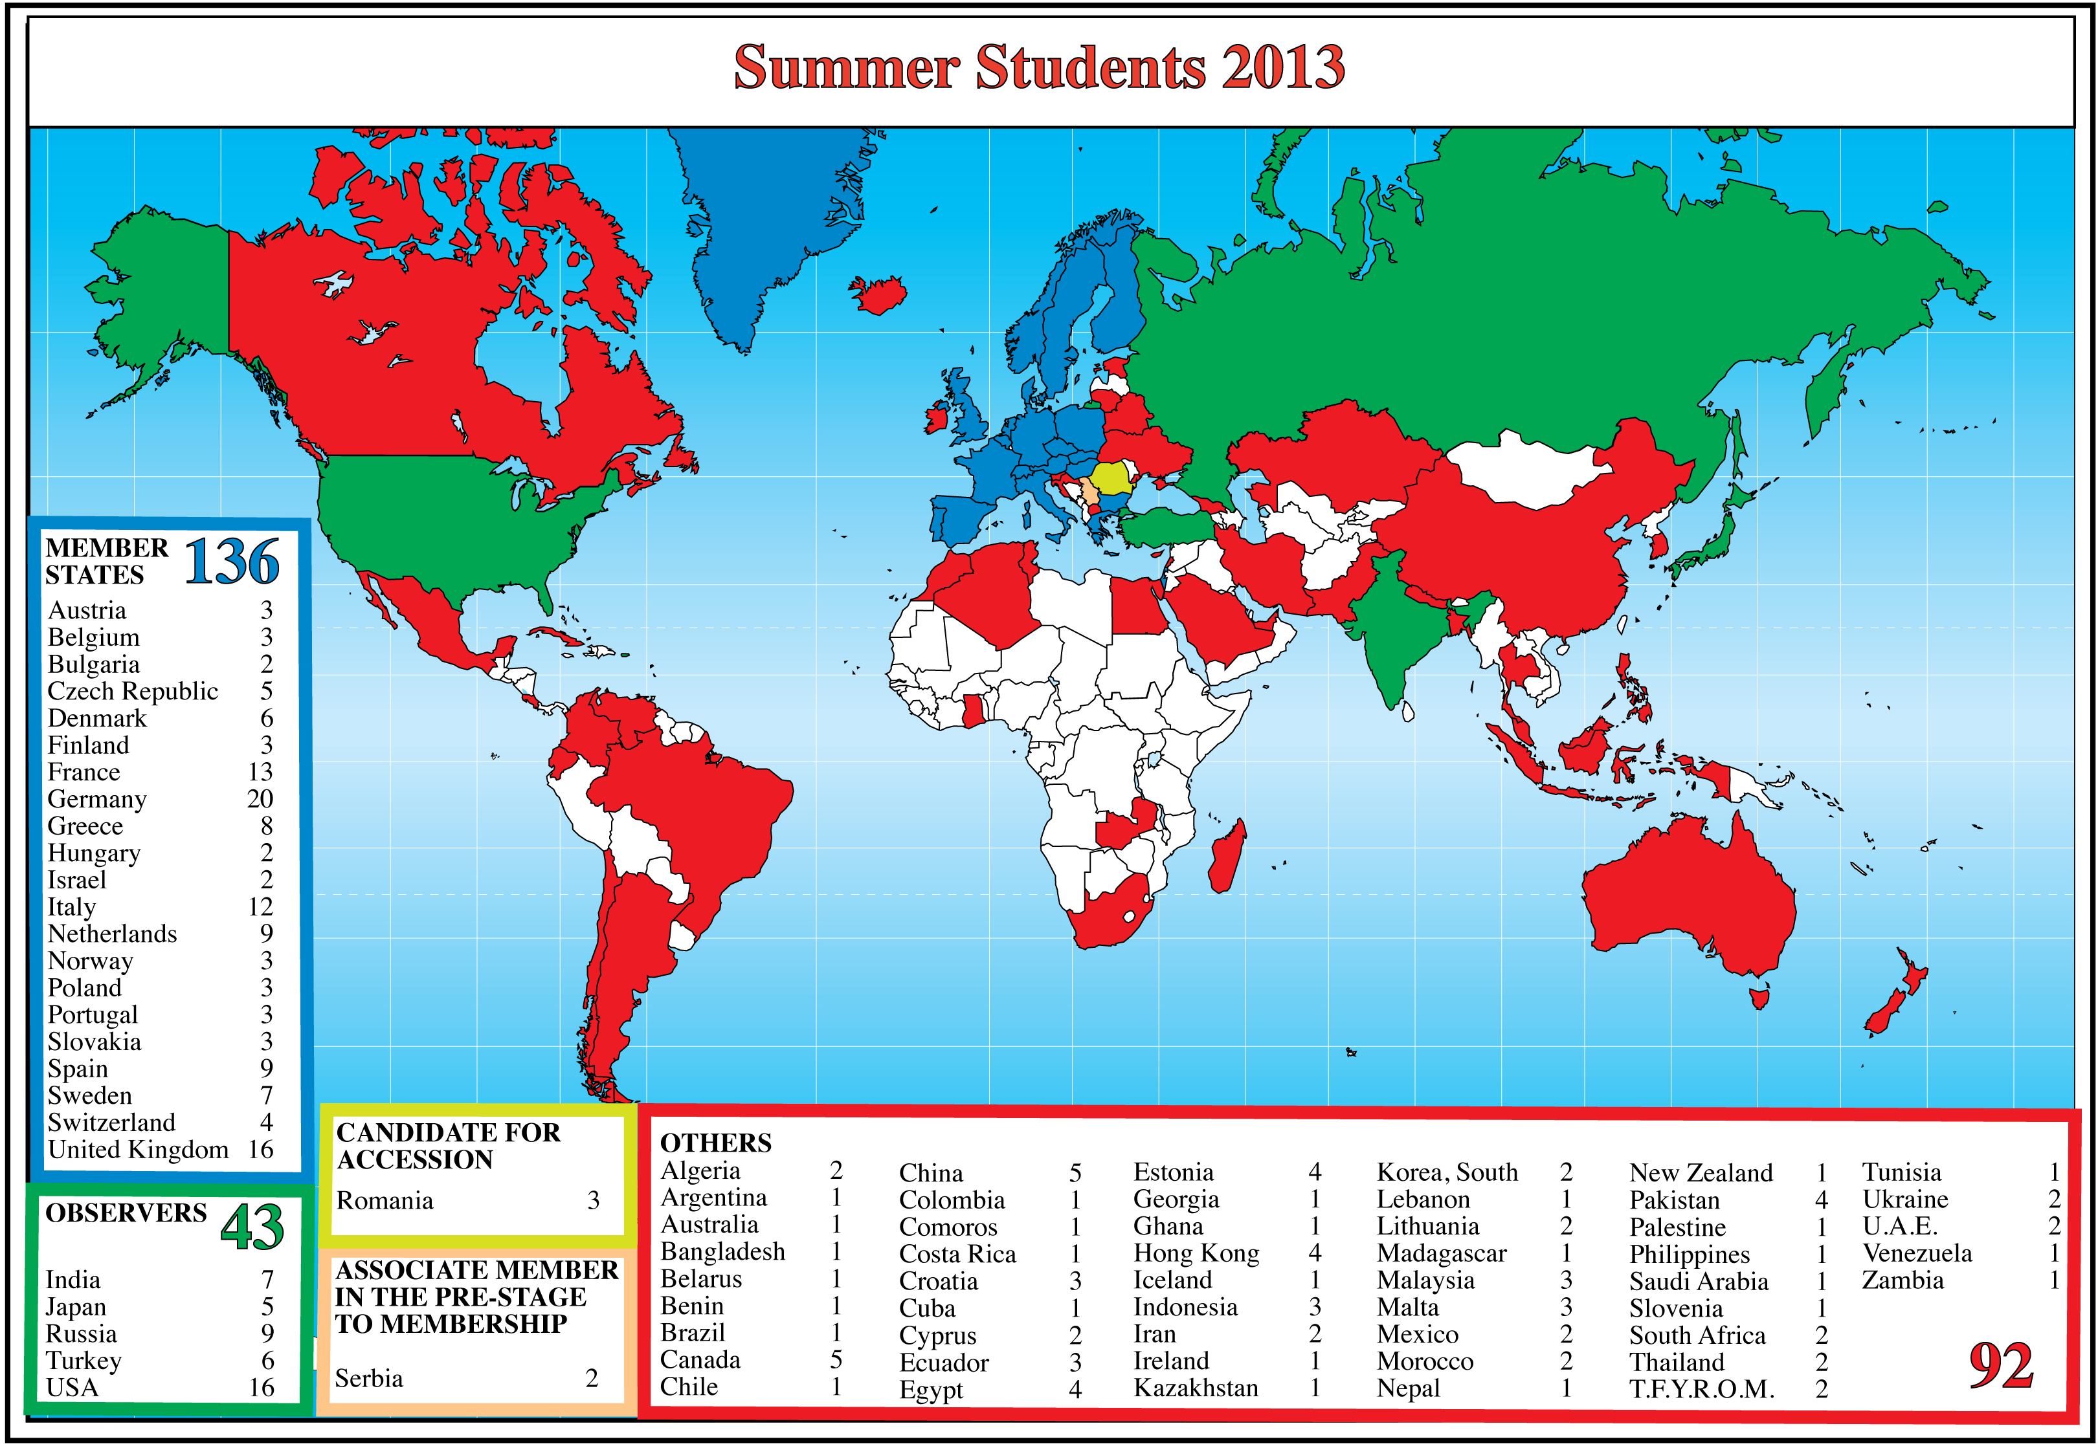
Summer Students 2013

Slide 20
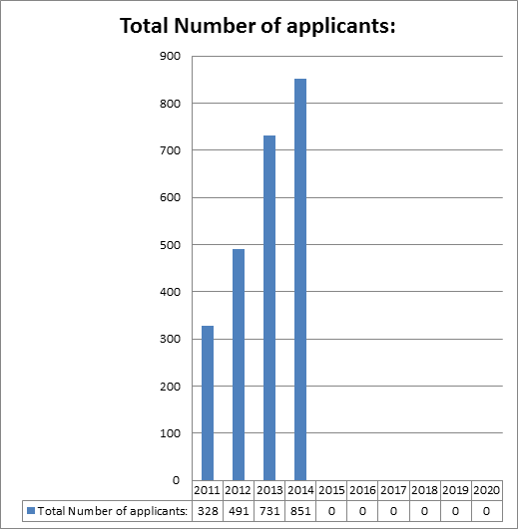
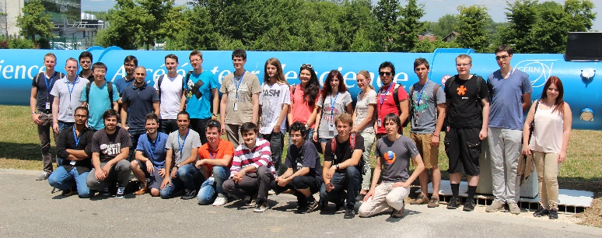
Openlab Summer Student Program
Summer student program 2013
  720+ applicants
  22 selected candidates
  13 lectures (including new lectures from external labs)
  A new lightning talks session
  22 technical reports
Summer student program 2014
  850+ applicants
  23 selected candidates
  Lectures and visits program being designed, will include contributions from external labs and companies

Slide 21
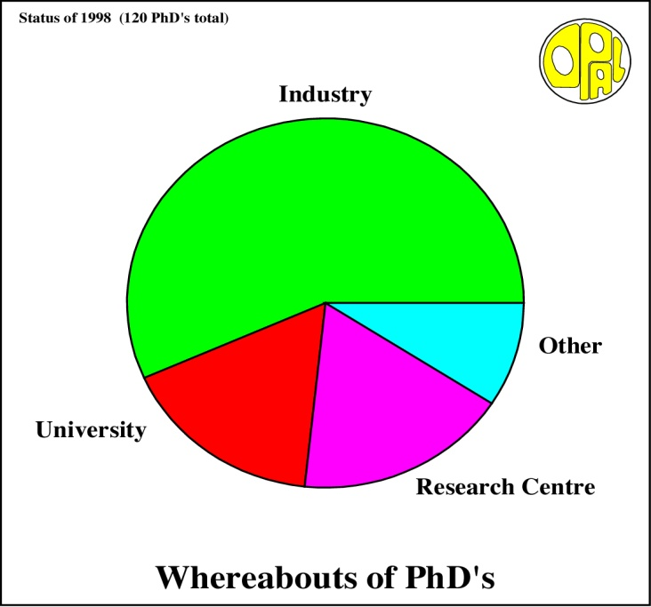
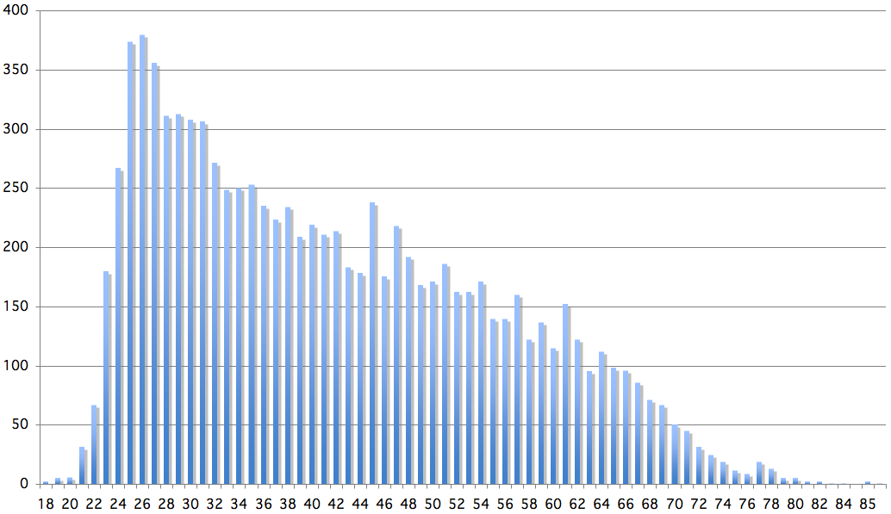
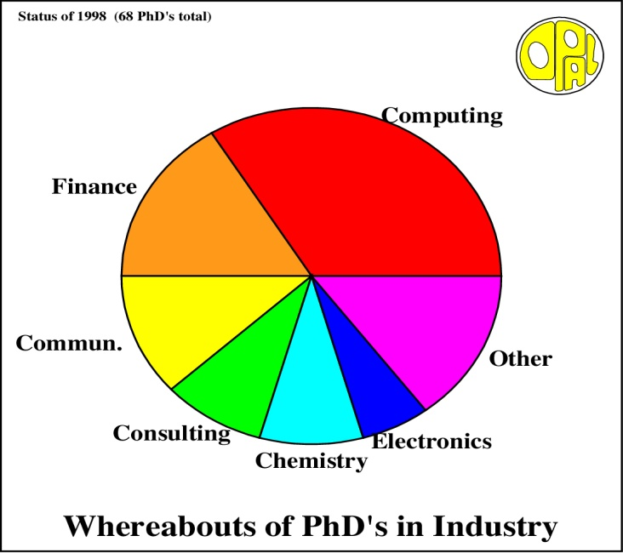
Age Distribution of Scientists
- and where they go afterwards
Survey in March 2009
26
Today:
∼2500 PhD students
in LHC experiments
65
They do not all stay: where do they go?

Slide 22
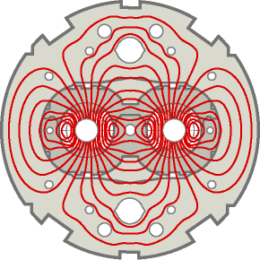
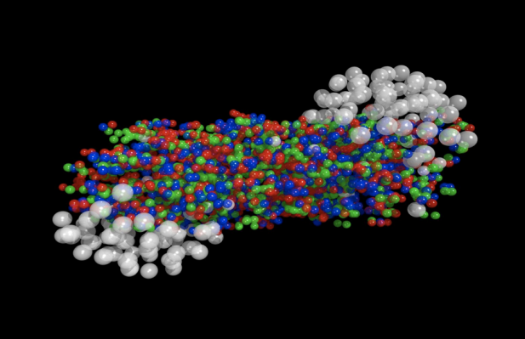



The study of LHC data will allow us to answer some of the big questions ...
Will we understand the primordial state of matter after the Big Bang before protons and neutrons formed?
Have we found “THE” Higgs particle that is responsible
for giving mass to all elementary particles?
Will we find the reason why antimatter and matter did not completely destroy each other?
Will we find the particle(s) that make up the mysterious ‘dark matter’ in our Universe?

Slide 23
Preparations for LHC Run 2

Slide 24

Opening:100%
100 % done
100 % done
99 % done
100 % done
97 % done
Closure: 80%
3000
3
90 % done
70 % done
Done
Done
100 % done
96 % done

Slide 25
LS 1 from 16th Feb. 2013 to Dec. 2014
16th Feb.
17th November
2013
2014
2015
F
M
A
M
J
J
A
S
O
N
D
J
F
M
A
M
J
J
A
S
O
N
D
J
F
M
A
LHC
SPS
PS
PS Booster
beam to beam
available for works
Physics
Beam commissioning
Shutdown
Powering tests

Slide 26

LS 1: LHC status
Schedule: version 3.1

Slide 27


Further Reading…
Future IT Challenges in Scientific Research
Compute Management & Provisioning
Data analysis facility
  Preserve applications
  Secure remote researcher access
Secure data federation
  Federated identity
  Role based data access
Remote management of analysis facility
  Secure remote access for administration
  Isolation of roles
Research clouds at scale
  Elastic access to large compute resources
  Project based authentication, provisioning and resources
To be released soon
Update of the Computing Models of the WLCG and the LHC Experiments
E-Infrastructure for the 21st century
http://cds.cern.ch/record/1695401
http://zenodo.org/record/7592

Slide 28
Thank You!
Accelerating Science and Innovation
Notes:
28

