Slide 1
Welcome!

Slide 2
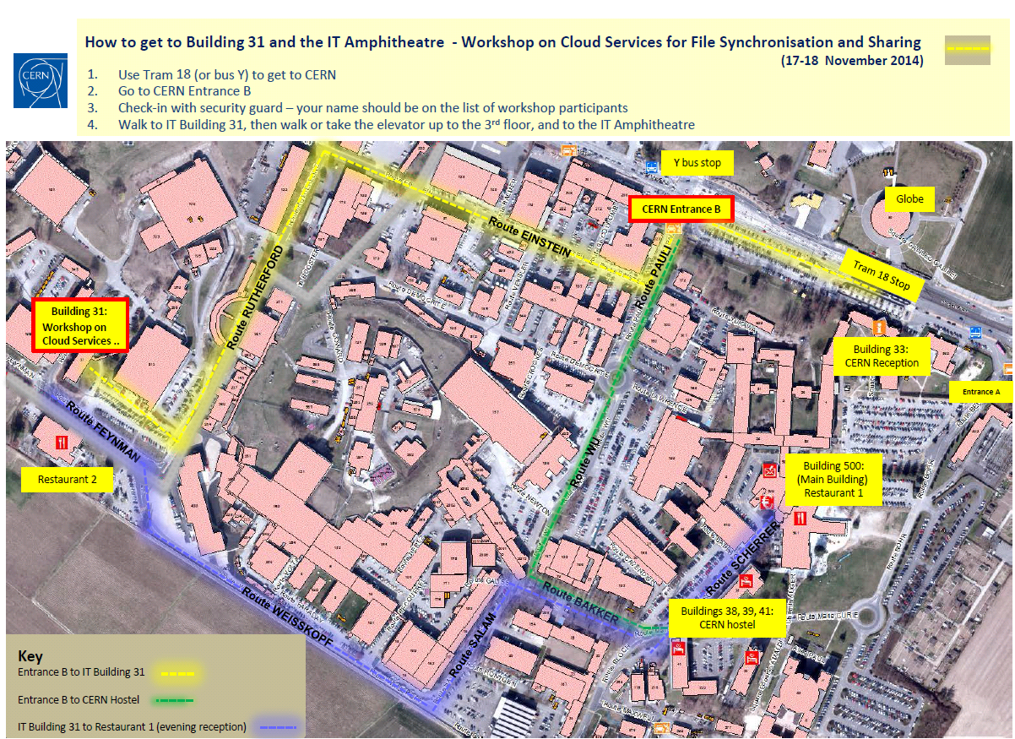

Slide 3

Lunch and reception
For those with lunch tickets
  Restaurant #2
    Cross the street
  Use the ticket to pay
    Upper floor: canteen
    Ground floor: sandwiches, refreshments and coffee machines
  You will get a token for the coffee machines
Reception:
  Restaurant #1
    Next to the Hostel area
  19:30

Slide 4
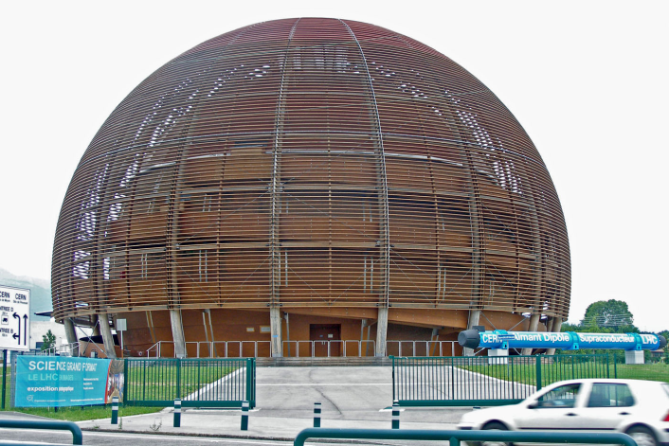
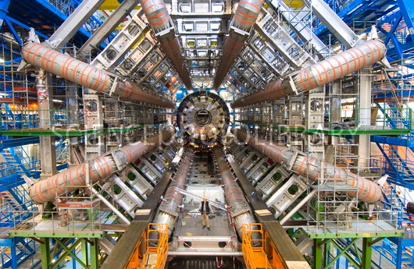
ATLAS visit
You will be “guided” by one of us
  Walking down next to CERN Globe (meeting point)
  Please note: >16yrs; no pregnant ladies; no pacemakers holders; flat closed shoes
You will not have the time for a “regular” lunch
  You can use your lunch ticket to buy a sandwich and a drink

Slide 5
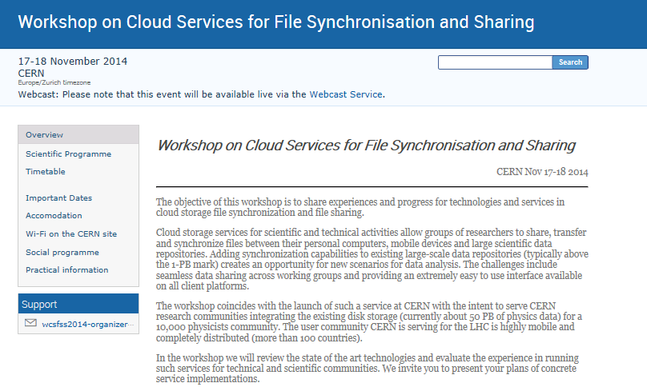
Speakers
Please upload your
talk on the conference
site before your
session starts…
  Really tight schedule!
Most of the talks
will be:
  Webcast in real time
  Recorded for offline access
One-stop site for all info, presentations:
  https://indico.cern.ch/event/336753/

Slide 6
Everyone
Wi-Fi
  https://indico.cern.ch/event/336753/page/2
  EduRoam:
    http://information-technology.web.cern.ch/book/eduroam-visitors-cern
  Alternatively register your MAC address in advance:
    https://network.cern.ch/sc/fcgi/sc.fcgi?Action=VisitorRegistration
Receipts:
  Contact Massimo
Otherwise…
  Do not hesitate to ask us…

