Slide 1
ATLAS RPC Electronics
Adrian Sanchez

Slide 2
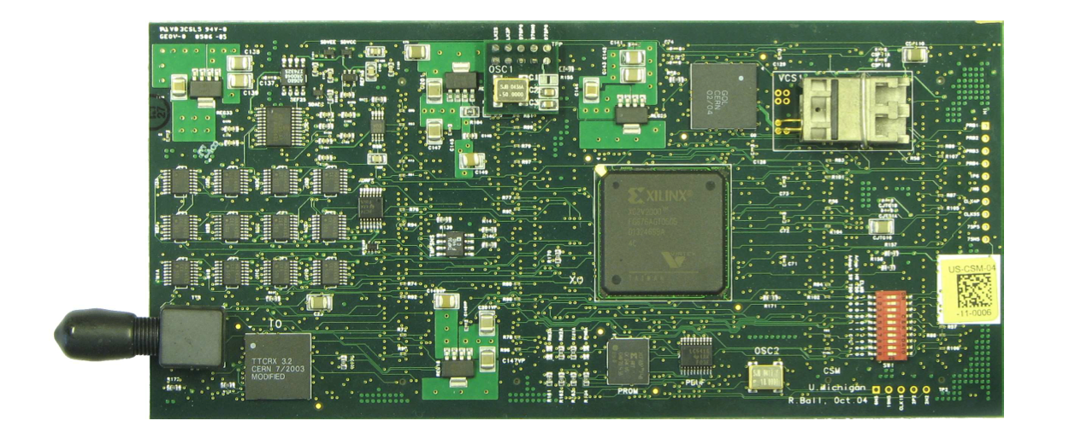
CSM Firmware
Switch from 2010012209 (old) to new CSM firmware
Parity errors were encountered with new firmware
Ran many tests to find if the parity errors were derived from hardware or firmware
CSM

Slide 3
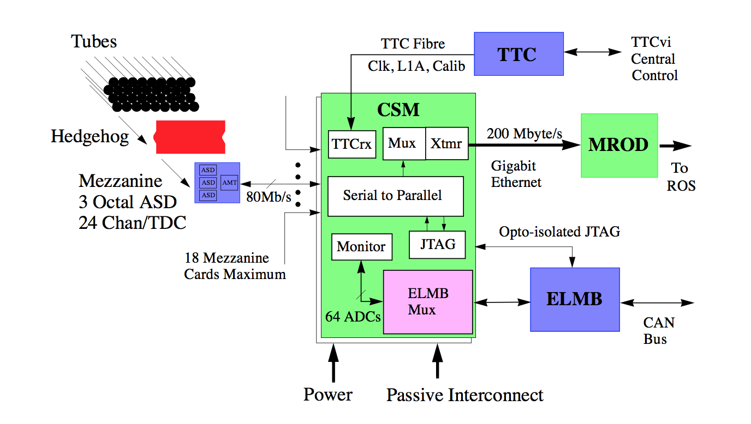
Hardware

Slide 4
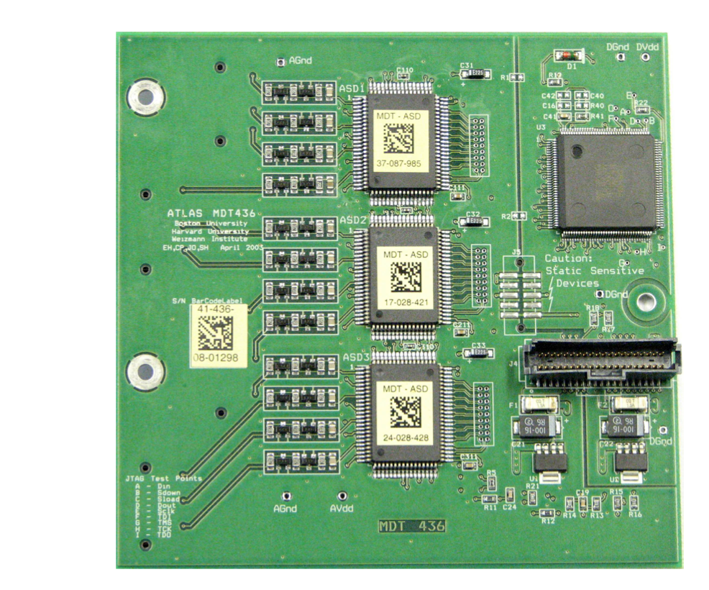
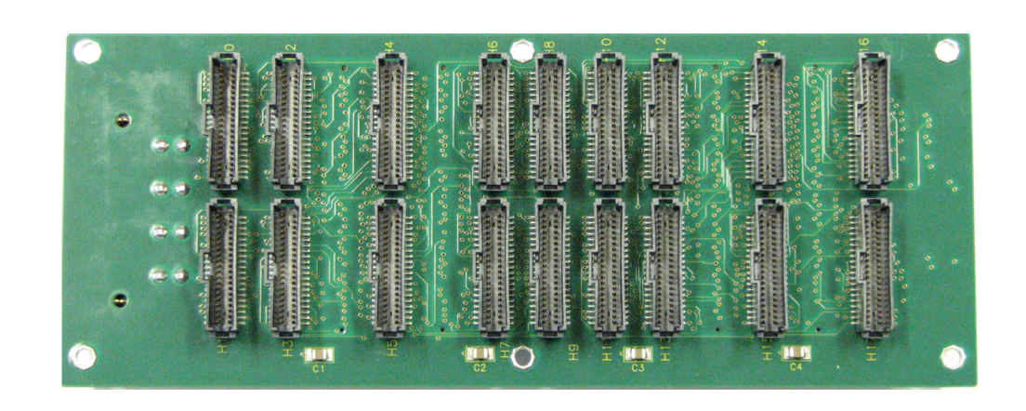
Hardware
Mezzanine
CSM
Cable
Direct Connection
18 Mezzanines to 1 CSM Motherboard
CSM Motherboard

Slide 5
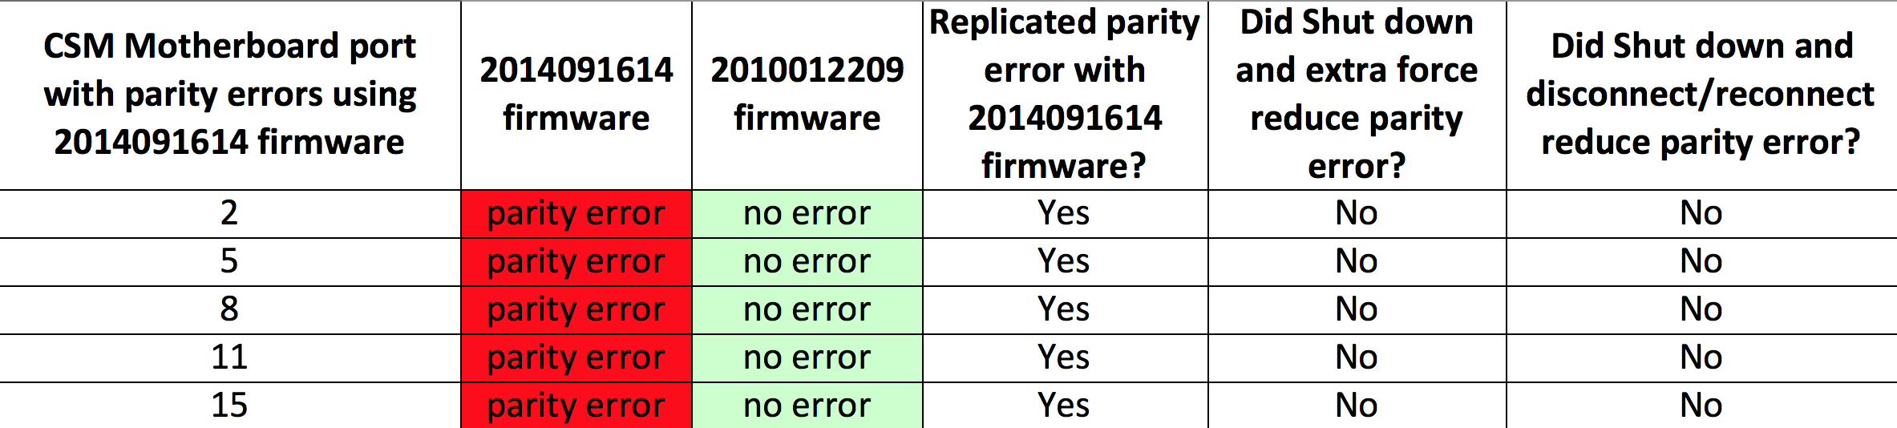
CSM Firmware Results
Problem is in the new firmware

Slide 6
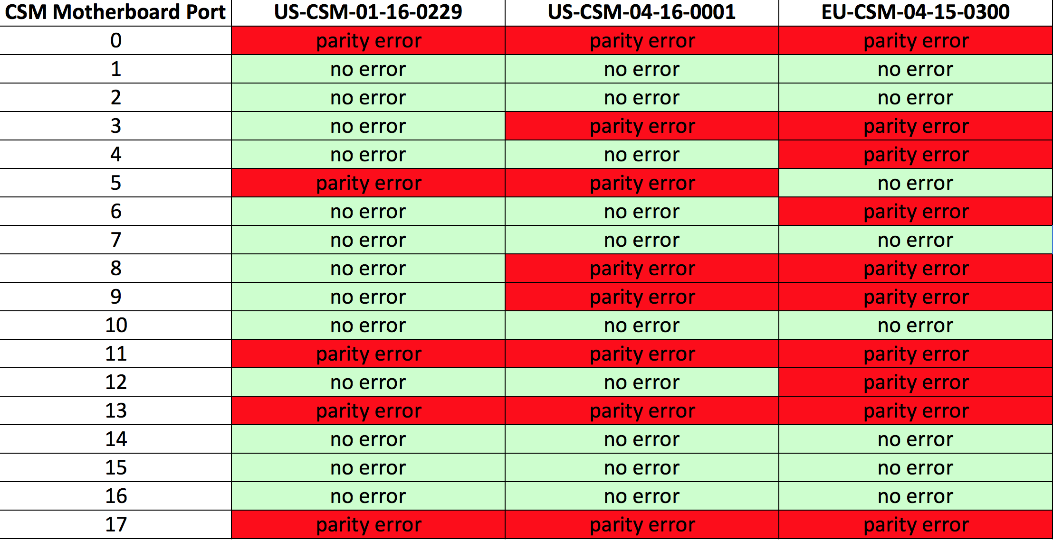
CSM Firmware Results
The parity errors vary across differing CSMs

Slide 7
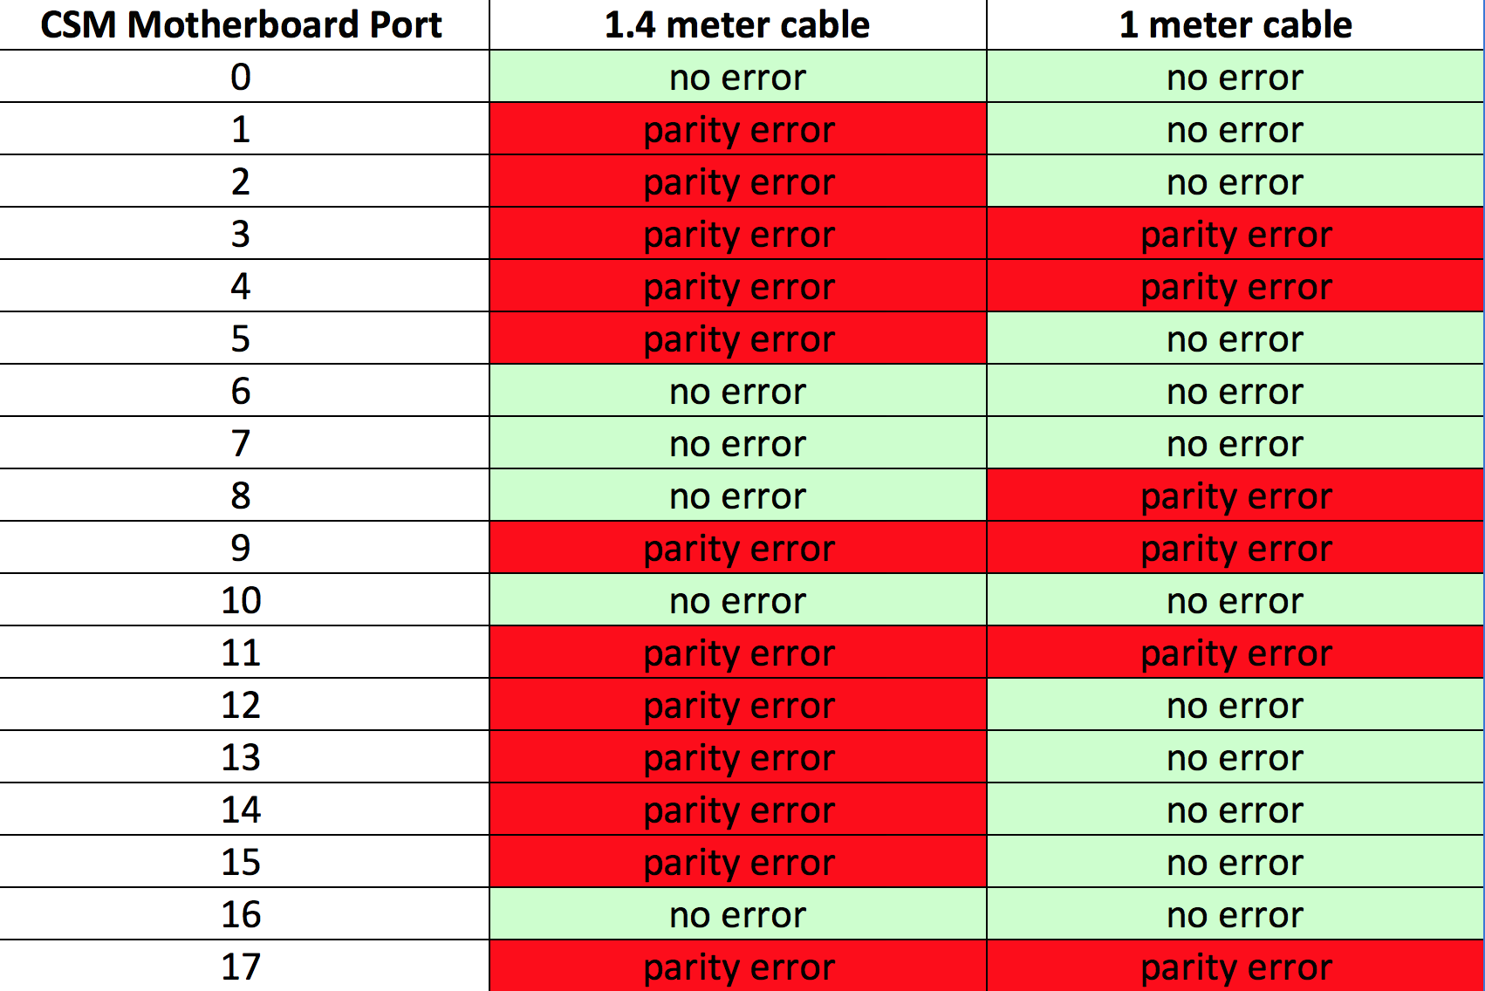
CSM Firmware Results
Parity error depends on length of cable between mezzanine and motherboard

Slide 8
CSM Firmware Summary
It is believed problem lies in the firmware
  This is why when we switch to the old firmware, the errors are no longer produced
  Manipulating hardware did not help
Reason parity error varies across CSMs is because the hardware is not absolutely identical
Signal is being measured near its edges and producing parity errors
    This is why when we switch the cable length, parity error behavior changes.

Slide 9
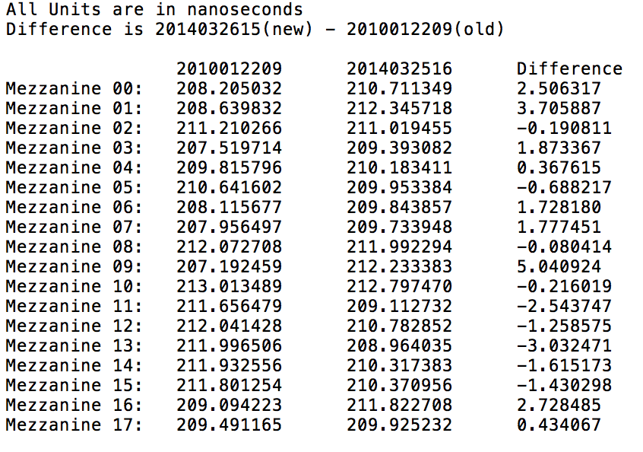
TDC Shift
Found TDC Shift between old firmware and new firmware

Slide 10
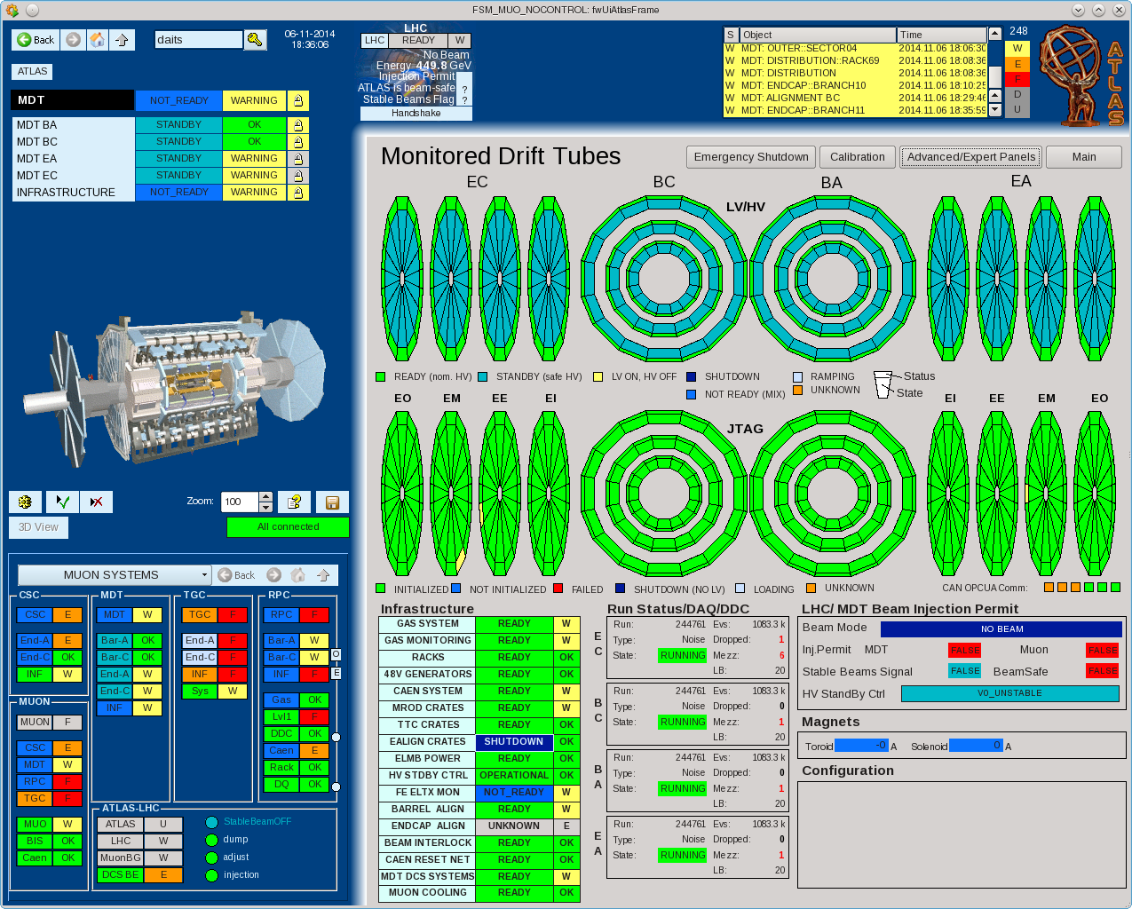
Learning About ATLAS DCS

Slide 11
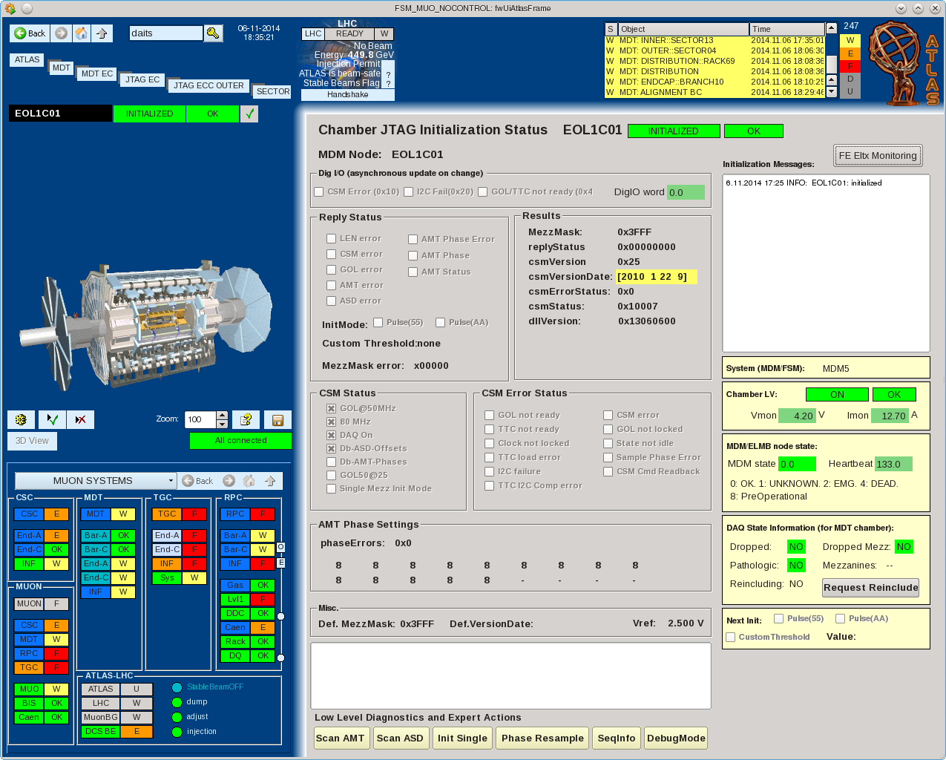
Learning About ATLAS DCS

Slide 12
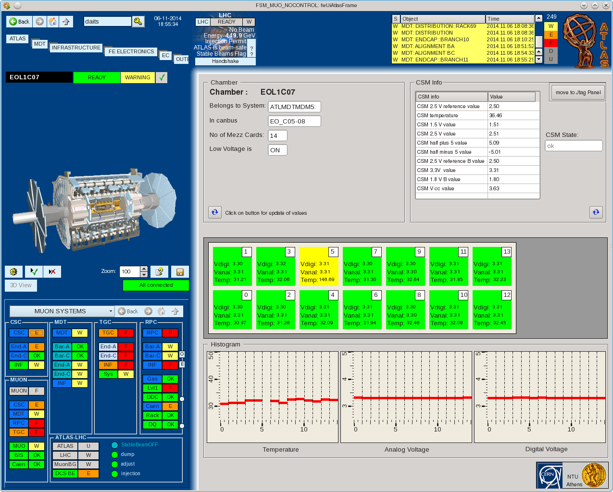
Learning About ATLAS DCS

Slide 13
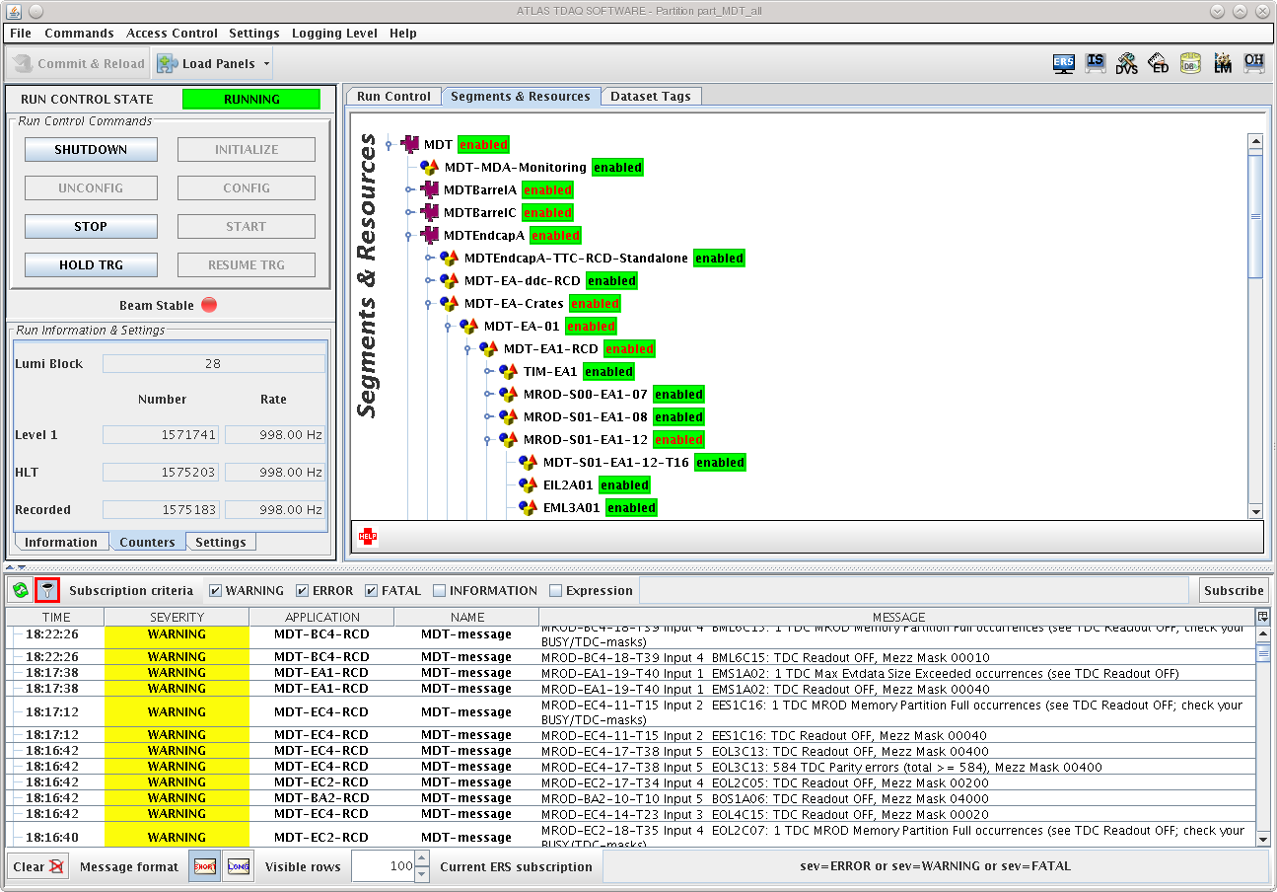
Learning About TDAQ

