Slide 1
Spectrum
CERN – ATLAS Research Semester: Fall ‘14
Joe Gibson, Computer Engineering
Grand Valley State University

Slide 2
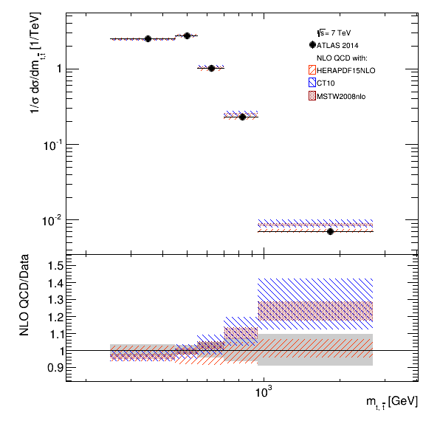

Slide 3
Experimental Data
Data formats
  Spectrum T1S
  Spectrum T1A
  Spectrum T2S
  Spectrum T2A
  Spectrum T3S
  Spectrum T3A
  HERAFitter
Systematic Errors
  Symmetric or Asymmetric (S/A)
  Total or Total + Individual (T1/T2)
  Individual Systematic Errors (T3)
  Explicit (HERAFitter)

Slide 4
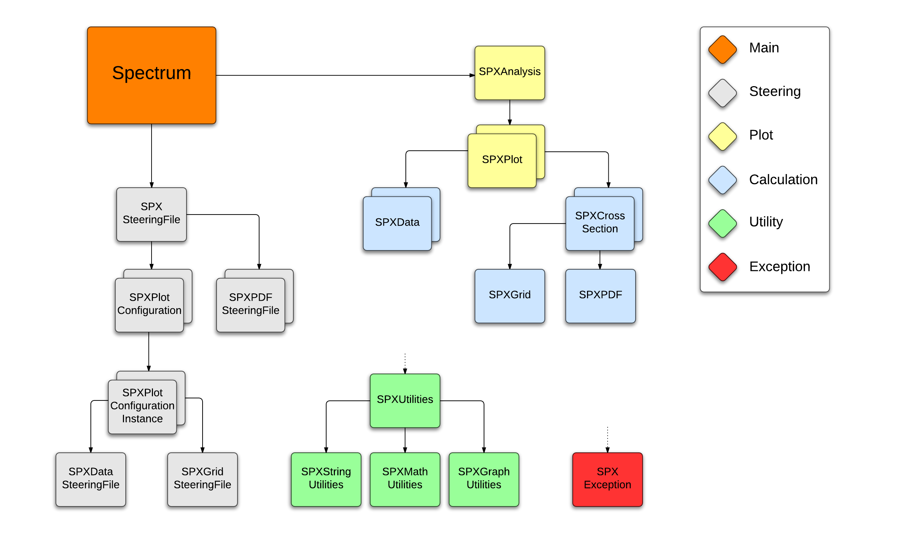

Slide 5
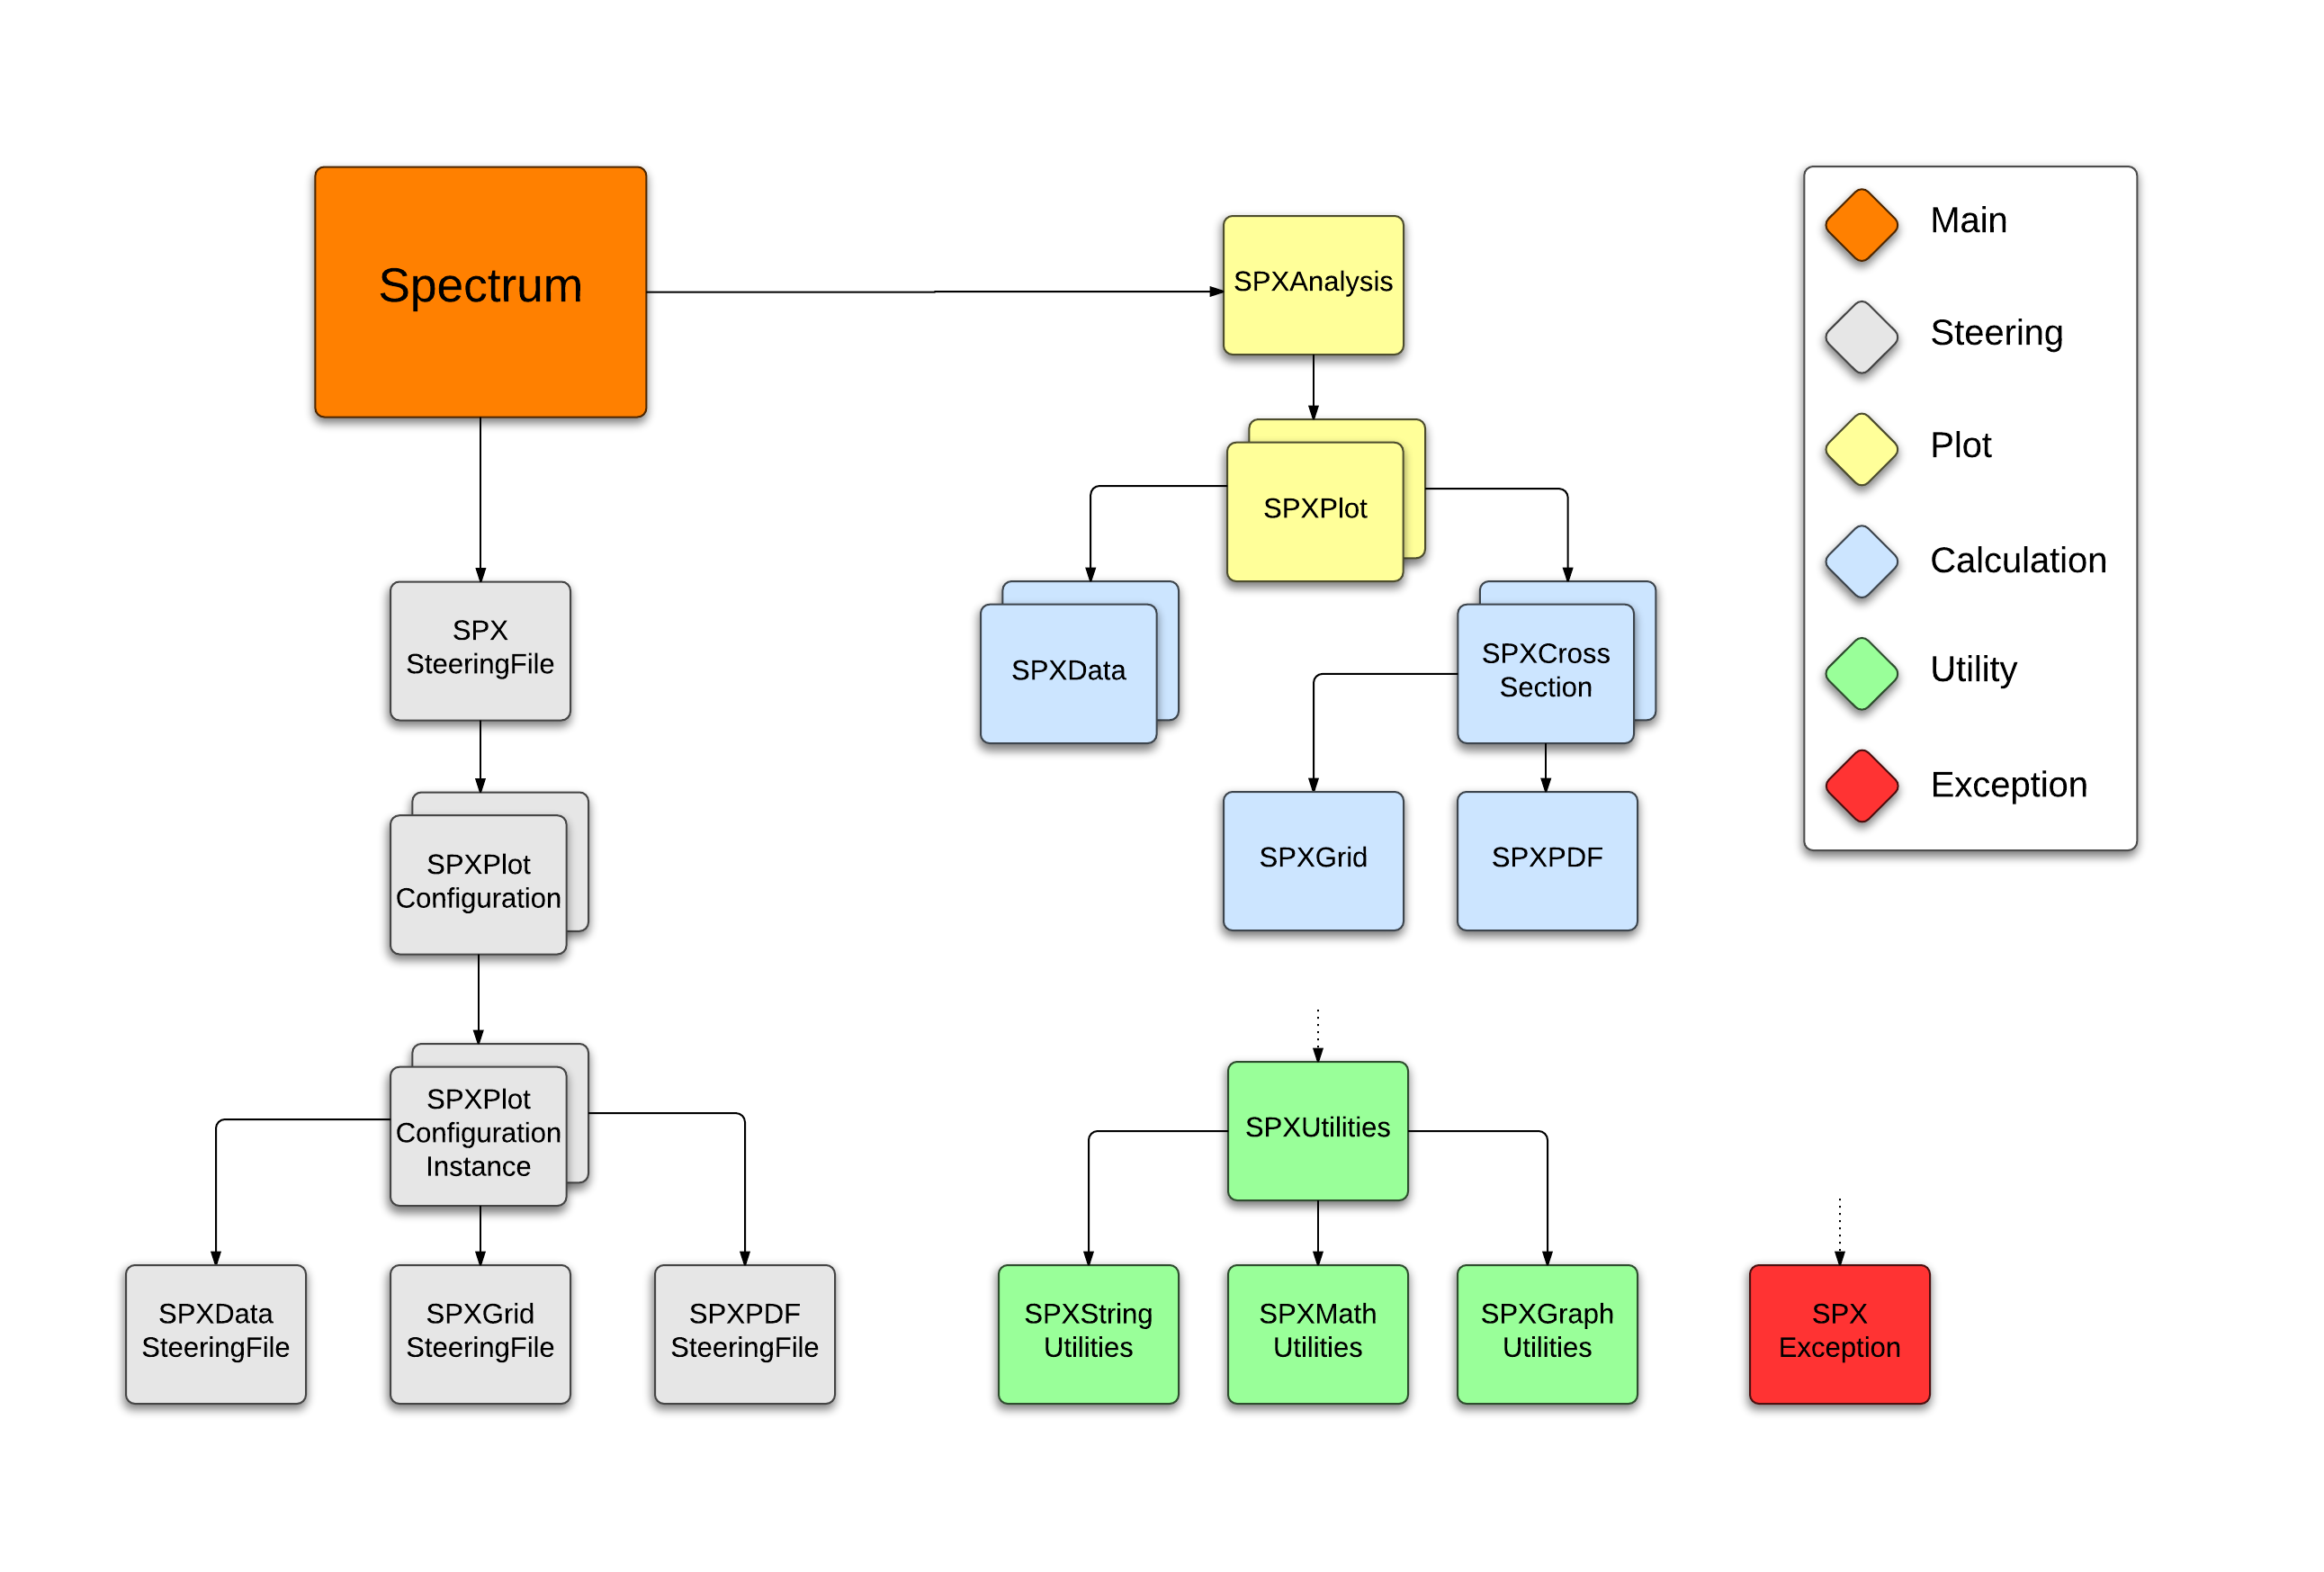

Slide 6
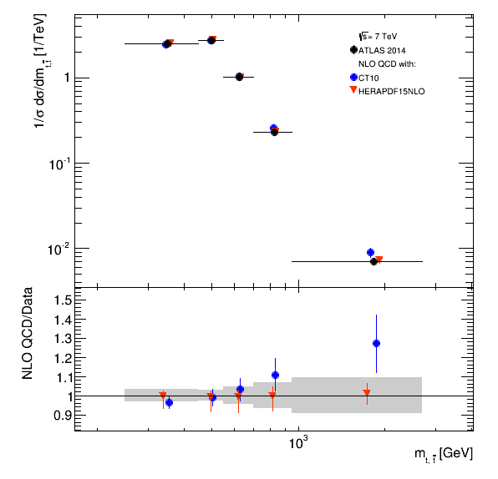
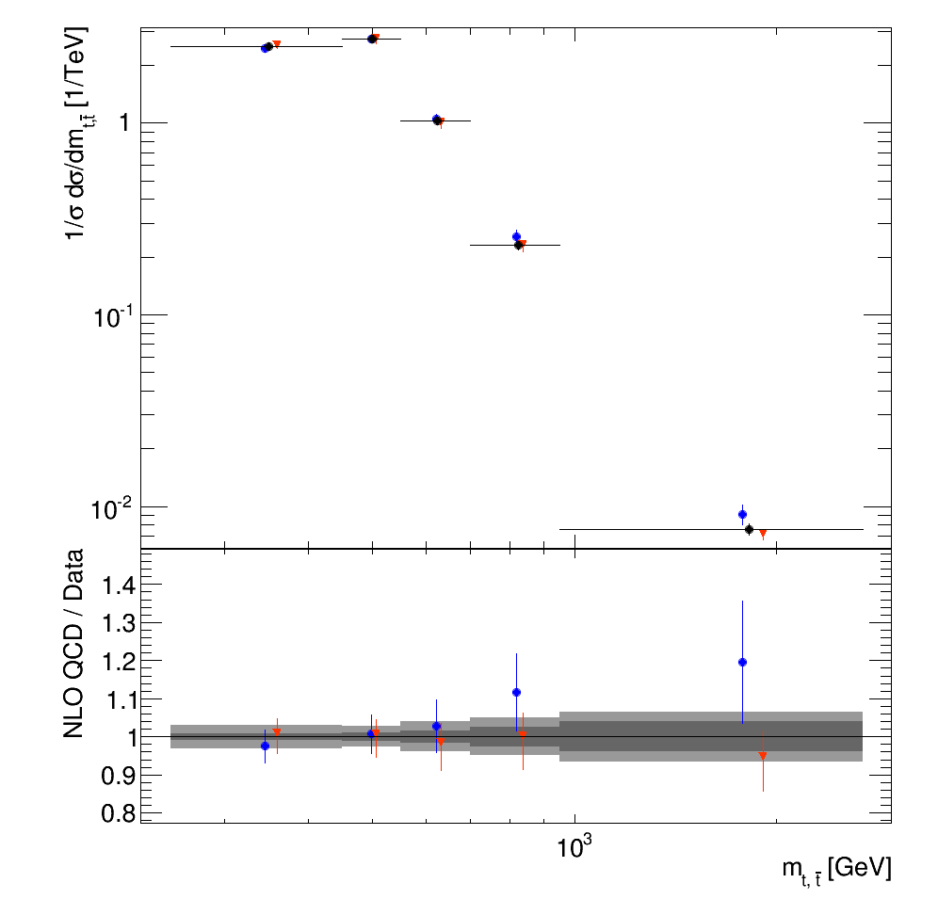
Spectrum Plots

Slide 7
Total Systematic + Statistical

Slide 8
Test Website (Plot)
http://hep-project-applgrid.web.cern.ch/hep-project-applgrid/spectrum/spectrum.php

Slide 9
Test Website (UI)
http://spectrum.web.cern.ch/spectrum/

Slide 10
Spectrum Technologies
C++
Python
JavaScript
HTML
CSS
PHP
CGI
AJAX
CherryPy
jQuery
REST
Pure
Bootstrap
Node.js

Slide 11
HTML Forms
HTML Forms
  <form action=“cgi-bin/script.py” method=“POST”>
HTTP Requests (invented here at CERN…)
HTTP Post Request
CGI Script
(Python)
Parse Request
JavaScript AJAX Handler
Python Script
CherryPy Framework

Slide 12
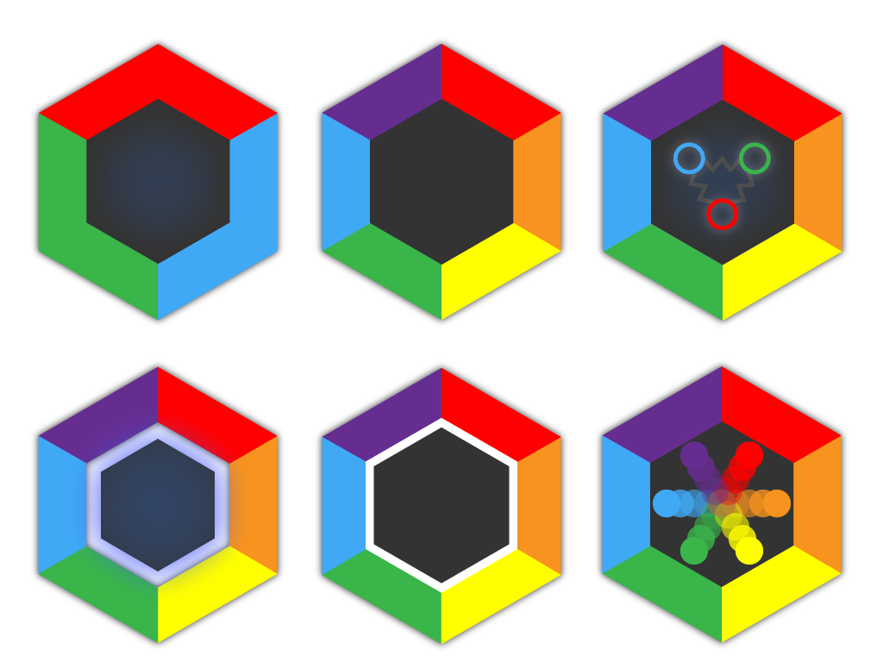

Slide 13


Slide 14


