Slide 1

Heater Control and Plasma Optimization
Matthew Bohman
ALPHA Collaboration
University of Michigan
Semester at CERN

Slide 2
Bakeout and Heater Control

Slide 3
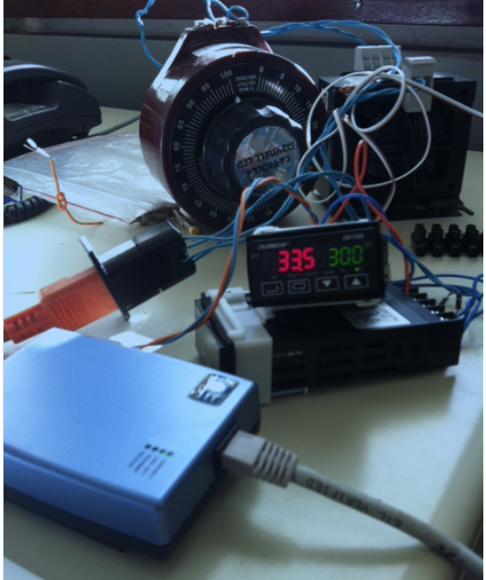
Heater Control Schematic
PC
TCP Server
Ethernet to Serial Adapter
Heater Controller
Heater

Slide 4
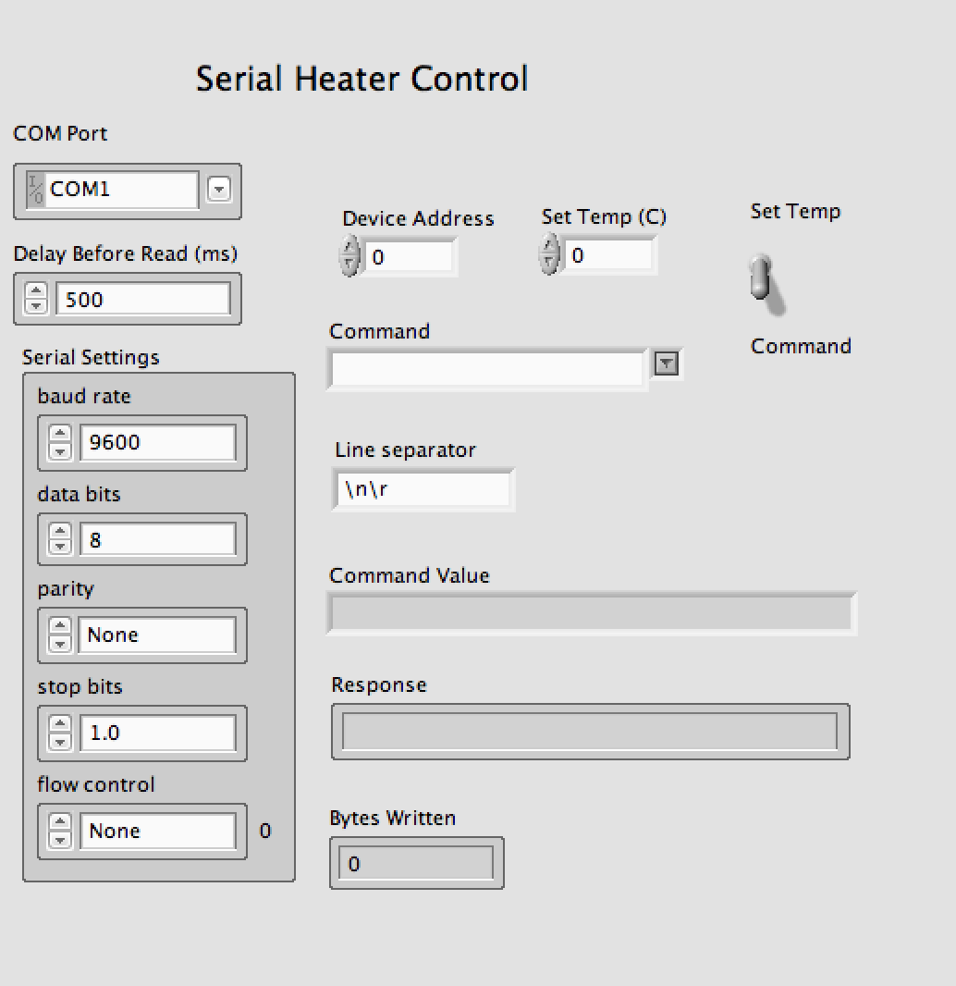
New System
PC
Serial Data
Heater Controller
Current
Heater

Slide 5
Plasma Optimization

Slide 6
Anti-Hydrogen Formation
Radiative Recombination
Three Body Recombination
Small, dense, and cold plasmas will maximize anti-hydrogen formation rates
Notes:
4e-2, here n is the energy level of the positron and epsilon_0 is the binding energy of the ground state

Slide 7
Formation Rates
Notes:
Sigma = total

Slide 8
Rotating Wall
Notes:
e is the charge, n is the density, e0 is vacuum permutivity, must spin faster than plasma

Slide 9
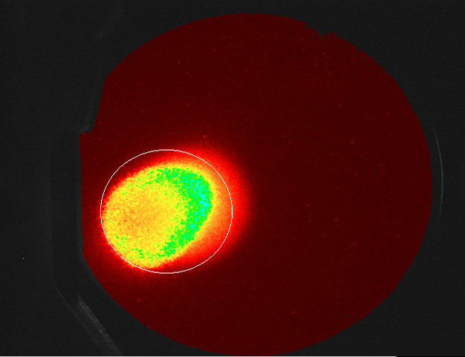
Uncompressed Plasmas
Notes:
Discuss misshapenness, field lines, larmor radius

Slide 10
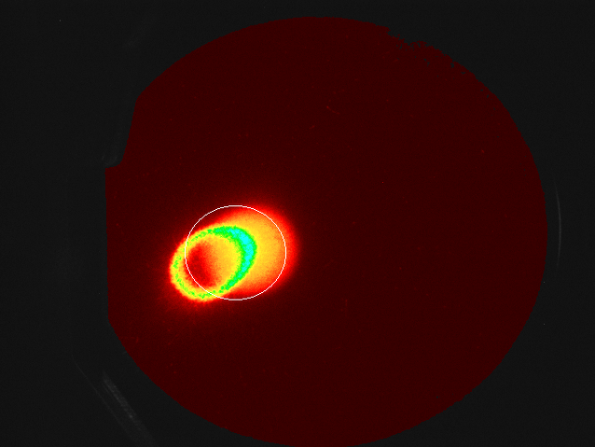
Partially Compressed, Centrifugally Separated

Slide 11
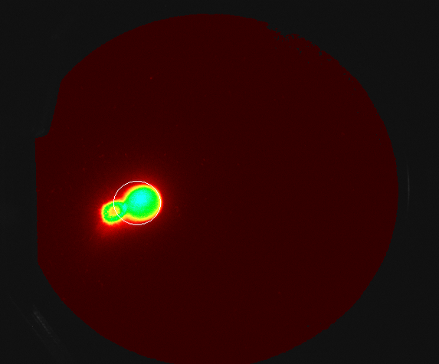
Fully Compressed Plasmas

Slide 12
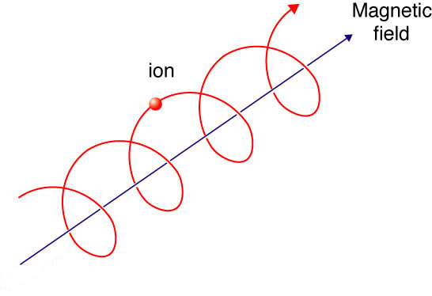
Cooling
Notes:
Sigma_t is the thompson cross section, (light matter), u0 is the permeability of free space NOTE: sigma term when expanded is 1/m^4

Slide 13
Evaporative and Sympathetic Cooling
Notes:
Cool sympathetically, by cyclotron radiation

Slide 14
Evaporative Cooling

Slide 15
Sources:
Slide 6, 7, 8, 13: images and equations from
E. Butler, Antihydrogen formation, dynamics and trapping, Ph. D. thesis, Swansea University (2011).
Slide 12: image from EUROfusion

