Slide 1
BLM INTEGRATION IN
PSB H- INJECTION SYSTEM
EDMS 1410831
PSB H- INJECTION - 04.09.2014
M.Garlaschè, B.Riffaud, L.Zuccalli (EN-MME)

Slide 2
Outline
Components
Requested positions
Integration solution
Optimized positions

Slide 3
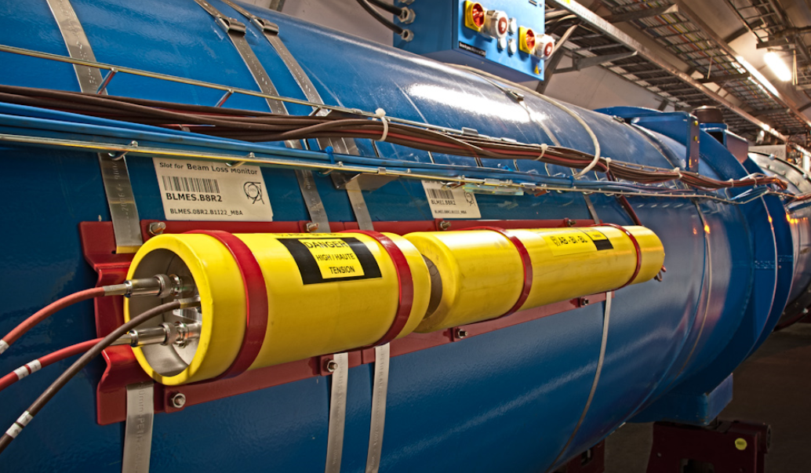
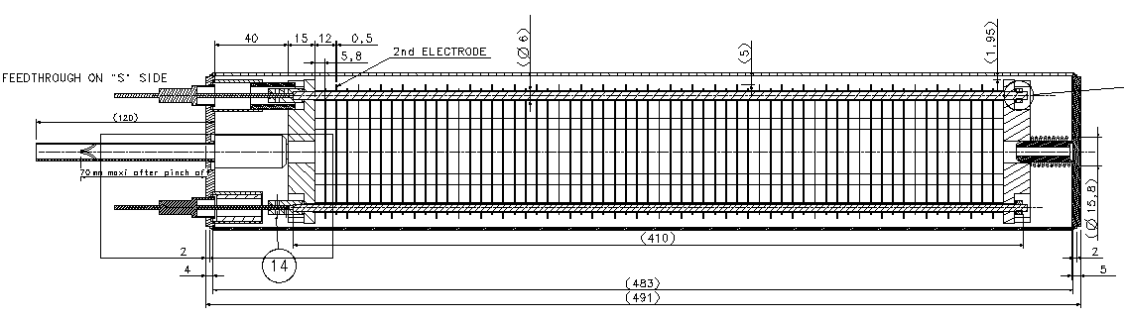
Multiple Electrode BLM
Courtesy of
Christos Zamantzas

Slide 4
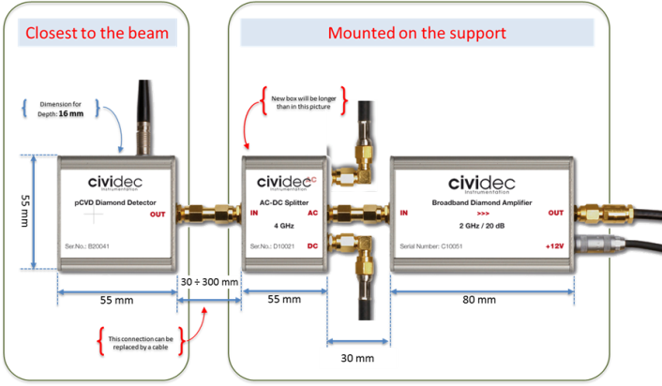
Diamond detector
Courtesy of
Christos Zamantzas

Slide 5
Requested positions
H0/H- Dump
Stripping Foil
BSW4
BSW3
BSW2
BSW1
1 Multiple Electrode BLM
+
1 Diamond Detector
1 Multiple Electrode BLM
+
1 Diamond Detector
1 Multiple Electrode BLM

Slide 6
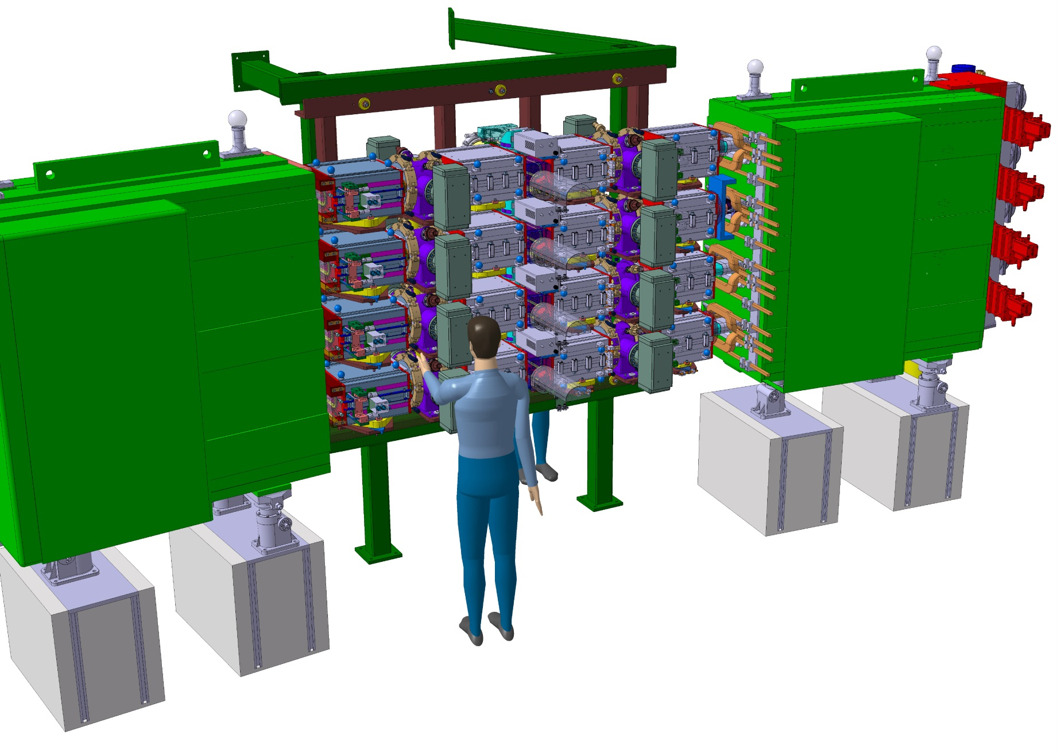
H- injection system assembly
Inner Ring

Slide 7
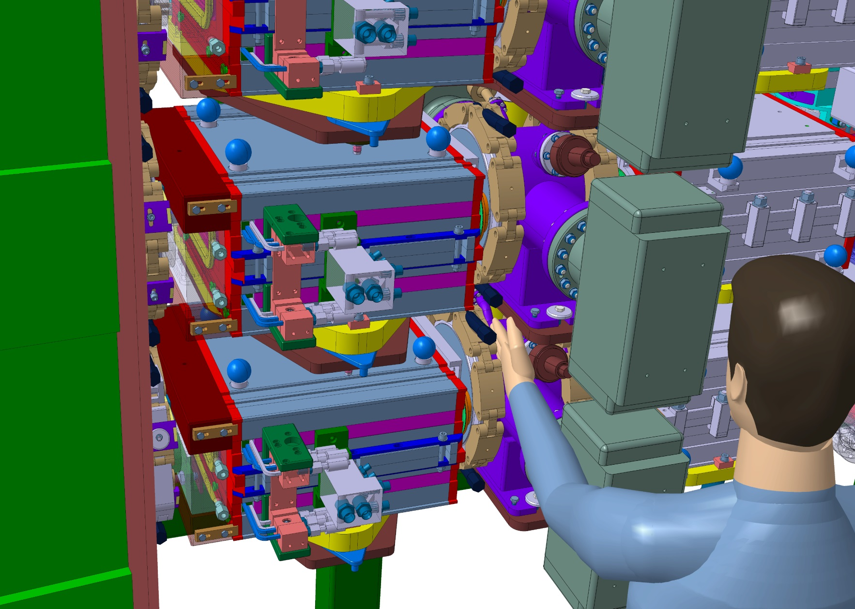
Space available for installation and maintenance
Inner Ring

Slide 8
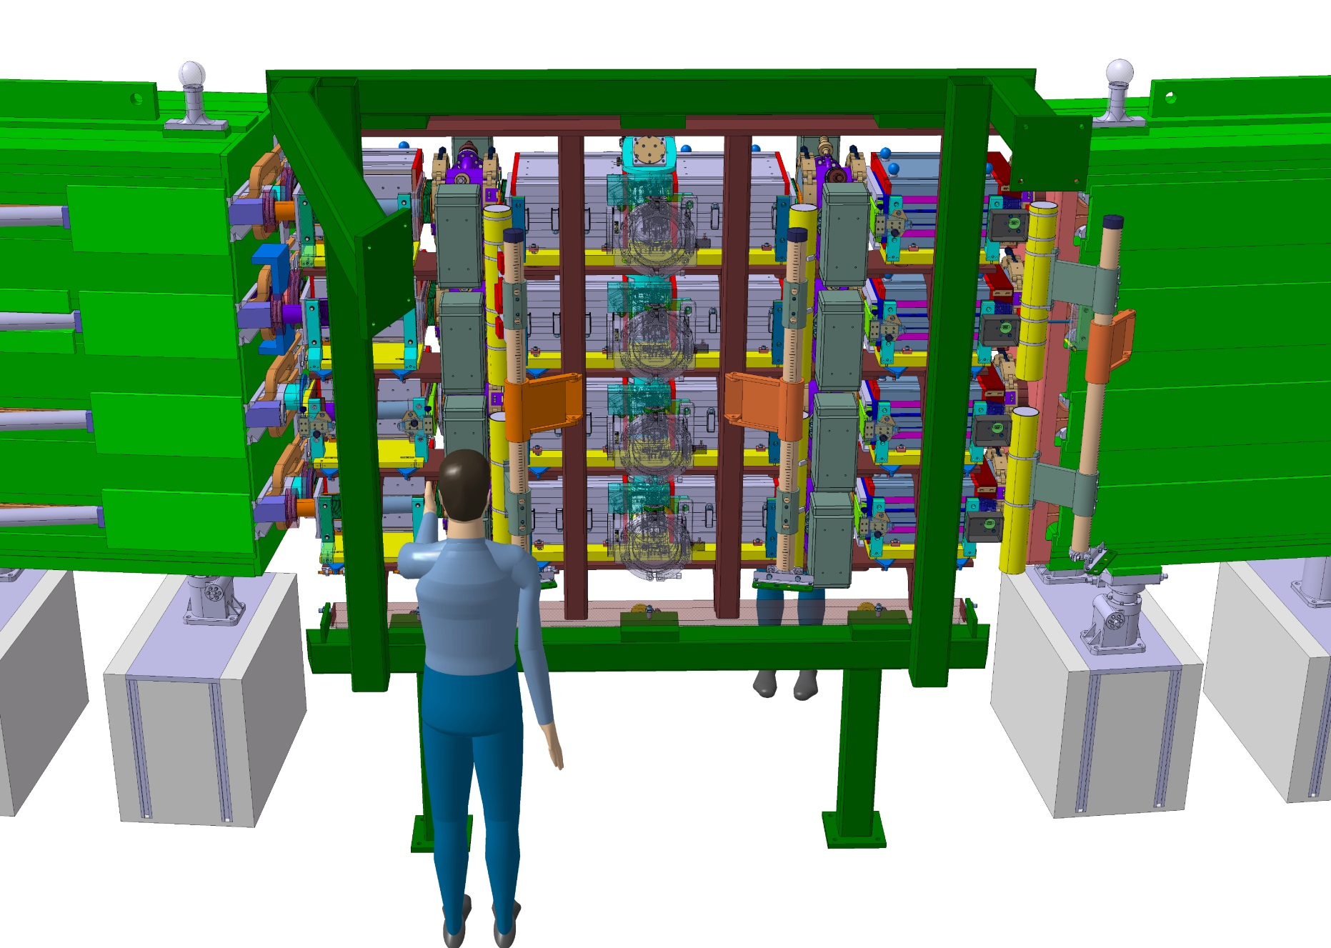
Proposal for BLM integration
Outer Ring
Movable supports

Slide 9
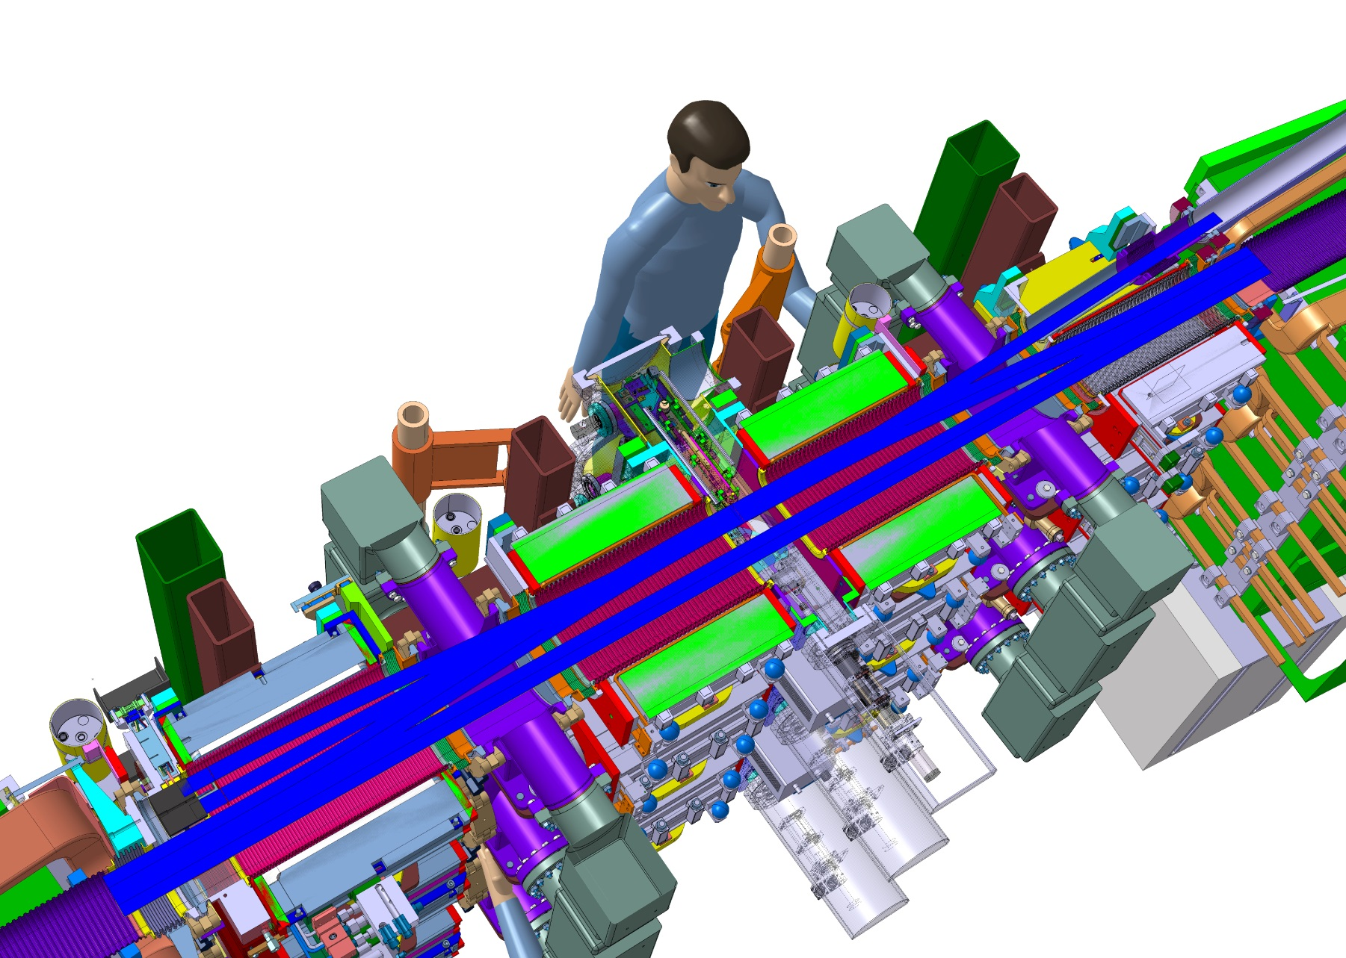
Proposal for BLM integration
Multiple
Electrode
BLM
Diamond
Detector
Multiple
Electrode
BLM
Diamond
Detector
Multiple
Electrode
BLM

Slide 10
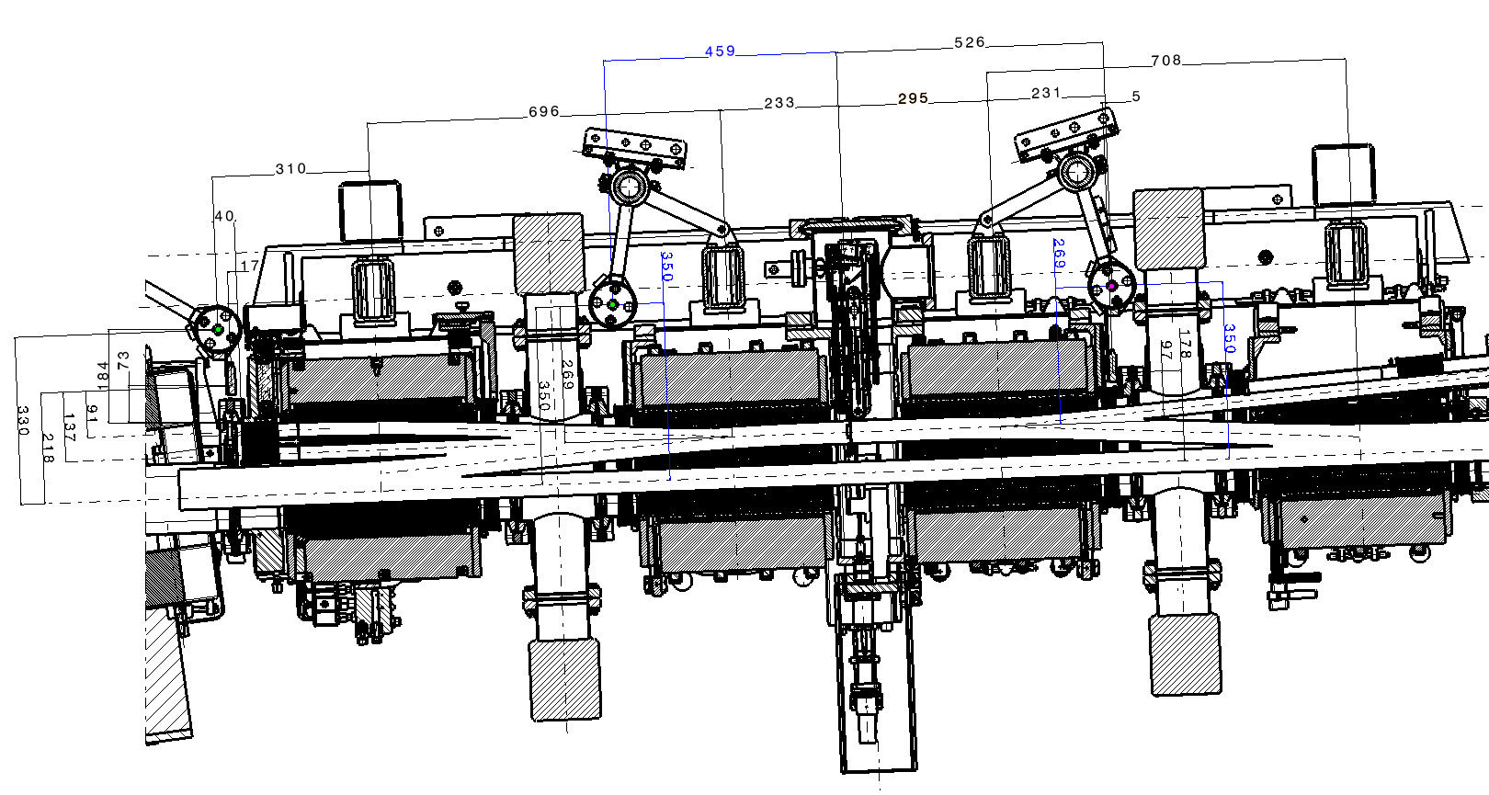
Optimized positions

Slide 11
Conclusion
BLMs to be positioned outside of the ring to make transport and maintenance access easier from the inside of the ring.
Optimized position of Multiple Electrode BLMs: 350mm far from circulating beam (maximum value).
Optimized position of Diamond Detectors: 350mm far from circulating beam (maximum value).
Optimized position of Multiple Electrode BLM for H0/H- dump: 184mm far from external surface.
Optimized position of Diamond Detector for H0/H- dump: 73mm far from external surface.
Next step : validation of solution and detailed drawings.

