Slide 1
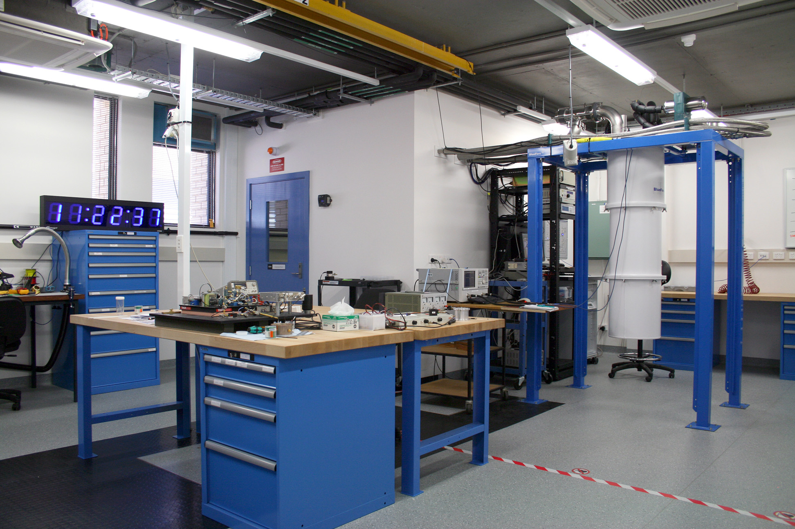
AXIONS & WISPS
Faculty of science
Stephen parker
2nd Joint CoEPP-CAASTRO Workshop
September 28 – 30, 2014
Great Western, Victoria

Slide 2
Talk Outline
Frequency & Quantum Metrology Group at UWA
Basic background / theory for axions and hidden sector photons
Photon-based experimental searches + bounds
Focus on resonant cavity “Haloscope” experiments for CDM axions
Work at UWA: Past, Present, Future
A Few Useful Review Articles:
J.E. Kim & G. Carosi, Axions and the strong CP problem, Rev. Mod. Phys., 82(1), 557 – 601, 2010.
M. Kuster et al. (Eds.), Axions: Theory, Cosmology, and Experimental Searches, Lect. Notes Phys. 741 (Springer), 2008.
P. Arias et al., WISPy Cold Dark Matter, arXiv:1201.5902, 2012.
Stephen.Parker@uwa.edu.au

Slide 3

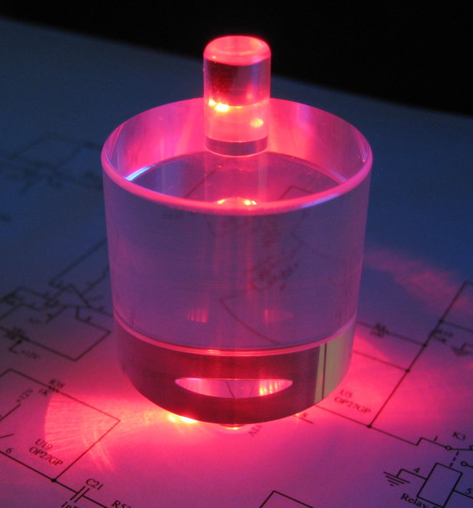
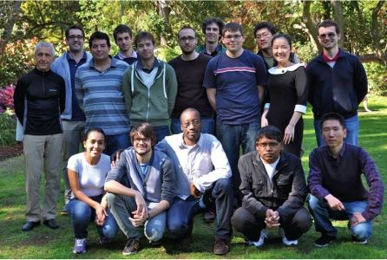
Frequency & Quantum Metrology Research Group
~ 3 staff, 6 postdocs, 8 students
Hosts node of ARC CoE EQuS
Many areas of research from fundamental to applied:
Cryogenic Sapphire Oscillator
Tests of Lorentz Symmetry & fundamental constants
Ytterbium Lattice Clock for ACES mission
Material characterization
Frequency sources, synthesis, measurement
Low noise microwaves + millimetrewaves
…and lab based searches for WISPs!
Core WISP team: Stephen Parker, Ben McAllister,
Eugene Ivanov, Mike Tobar
Stephen.Parker@uwa.edu.au

Slide 4
Axions, ALPs and WISPs
Weakly Interacting Slim Particles Axion Like Particles
Slim = sub-eV
Origins in particle physics (see: strong CP problem, extensions to Standard Model) but become pretty handy elsewhere
Can be formulated as:
Dark Matter (i.e. Axions, hidden photons)
Dark Energy (i.e. Chameleons)
Low energy scale dictates experimental approach
WISP searches are complementary to WIMP searches
WISPs
ALPs
Axions
Stephen.Parker@uwa.edu.au

Slide 5



The Axion – Origins in Particle Physics
CP violating term in QCD Lagrangian implies
neutron electric dipole moment:
But measurements place constraint:
Why is the neutron electric dipole moment (and thus θ) so small?
This is the Strong CP Problem.
“Best” solution: Introduce the U(1)_{PQ} symmetry. This symmetry breaks at some energy scale (f_{a}); the associated (pseudo) Goldstone boson is the axion, which acts as a dynamical CP-conserving field.
Coupling to quarks and gluons gives the axion mass:
Coupling with QCD / SM / ED particles/fields also suppressed by f_{a}
Weakly interacting, small mass particle: WISP Dark Matter Candidate.
Stephen.Parker@uwa.edu.au

Slide 6


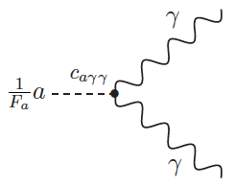
Axion / Photon Coupling
Axion-2 photon coupling provides very important experimental and observational access (with minimal model dependence).
g_{γ} ~ O(1)
B field can act as 2nd virtual photon
to induce axion-photon conversion
Axion mass dictates photon frequency
Want to test / bound g_{aγγ}
What values of f_{a} make sense for axion dark matter?
Stephen.Parker@uwa.edu.au

Slide 7
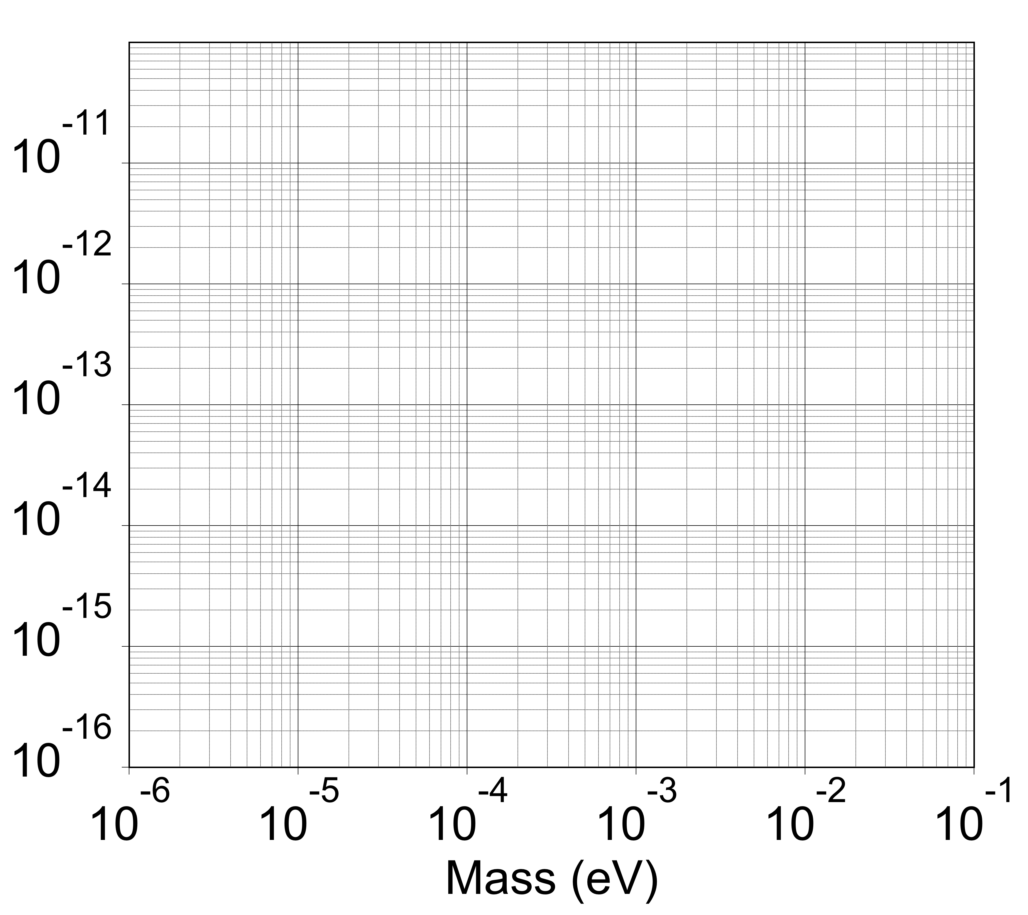
Axion Mass / Photon Coupling
Photon Frequency
240 MHz
24 GHz
24 THz
Microwaves
& mm-waves
Cold Dark Matter
AXIONS!
g_{aγγ} (GeV⁻¹)
Axion decay
Energy loss
(e.g. SN1987A)
Overclosure
f_{a} ~ 6x10¹² GeV
f_{a} ~ 6x10⁷ GeV
Stephen.Parker@uwa.edu.au

Slide 8
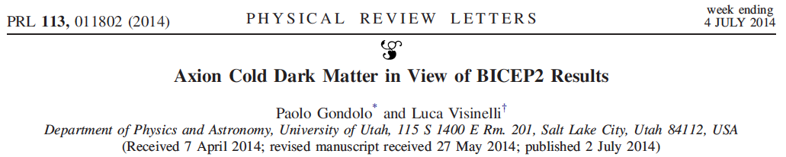

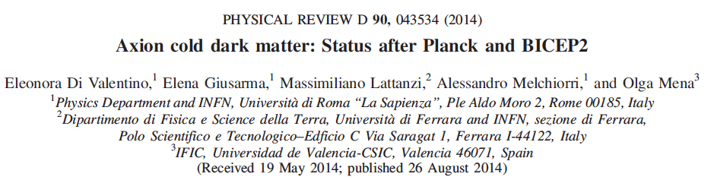

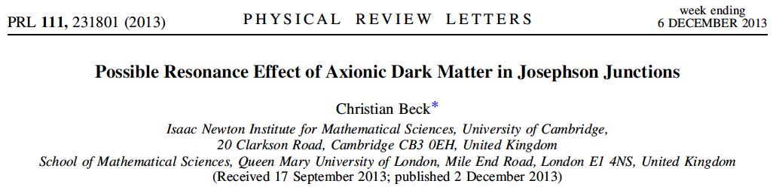

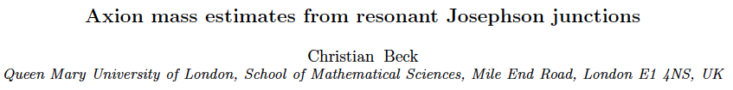
BICEP2 and Others Hints…
There’s some (dubious) smoke, but will we find a fire?
Stephen.Parker@uwa.edu.au

Slide 9

Just Briefly: Hidden Sector Photons
Different SM extensions introduce “hidden sectors” of particles due to addition of extra symmetries.
Addition of extra U(1) symmetry interacts very weakly via kinetic mixing of the gauge bosons.
Consequence: Photon – Hidden Sector Photon oscillations
Broad range of allowable mass and coupling strength.
Can be formulated as WISP Dark Matter
Experimentalist’s approach: It’s like an axion but without the need for a magnetic field.
Stephen.Parker@uwa.edu.au

Slide 10
Some Types of Experiments Using Photons
Light Shining Through a Wall (LSW)
optical
B
LASER
Detector
B
microwave
FFT
Helioscope
Haloscope
FFT
B
B
Stephen.Parker@uwa.edu.au

Slide 11
Types of Experiments
Lab Generation / Detection
Light Shining Through a Wall
Solar Generation / Detection
Helioscope
Dark Matter Detection
Haloscope
Optical
OSQAR (CERN)
ALPS/ALPS-II (DESY)
GammeV/REAPR (Fermilab)
Microwave
ADMX (UW)
CROWS (CERN)
UWA
Yale
CAST (CERN)
TSHIPS (DESY)
Sumico (Tokyo)
IAXO
WISPDMX (DESY)
ADMX (UW)
ADMX-HF (Yale)
CAPP (IBS/KAIST)
UWA… (Acronym TBA)
Stephen.Parker@uwa.edu.au

Slide 12
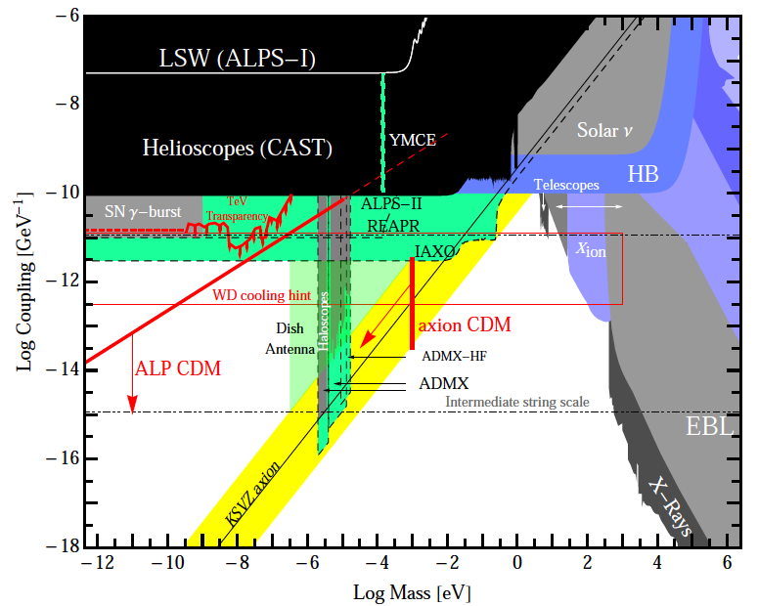
Axion / ALP Exclusion Plot
G. Carosi et al., Probing the axion-photon coupling: phenomenological and experimental perspectives. A snowmass white paper, arXiv: 1309.7035, 2013.
Stephen.Parker@uwa.edu.au

Slide 13
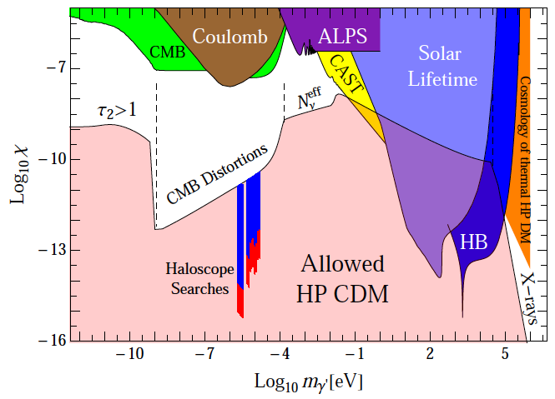
Hidden Sector Photon Exclusion Plot
Jump in sensitivity due to difference between LSW and Haloscopes
i.e. convert once vs convert twice
P. Arias et al., WISPy Cold Dark Matter, arXiv:1201.5902v2, 2012.

Slide 14
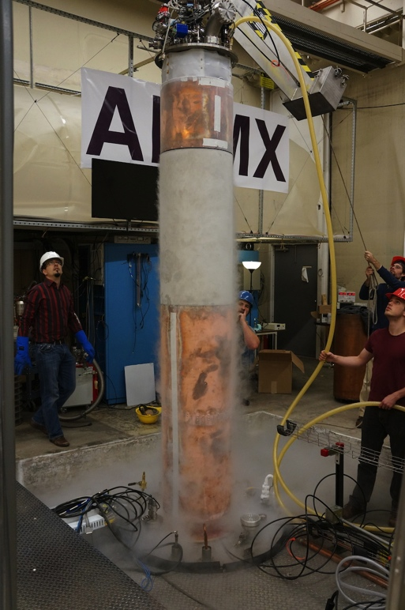
The Axion Haloscope
Precision microwave – millimetre wave measurements to constrain axion-photon coupling
Advantages:
Excellent sensitivity (real discovery potential)
Can reveal some astrophysics
Relatively cheap
Disadvantages:
Not broadband (narrow search range)
Major technological challenges for higher masses…
…challenges we can overcome!
ADMX @ University of Washington
http://www.phys.washington.edu/groups/admx/home.html

Slide 15
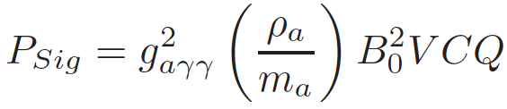
The Axion Haloscope
Cavity enables resonant enhancement of converted photon signal
FFT
B
Expected signal (power in Watts)
ρ_{a} – Axion density (~0.3 GeV/cm³)
m_{a} – Axion mass
B₀ – Magnetic field strength
V – Cavity volume
C – Form factor (E.B overlap)
Q – Cavity quality factor (or axion Q)
Measure power to constrain axion-photon coupling.
Stephen.Parker@uwa.edu.au

Slide 16

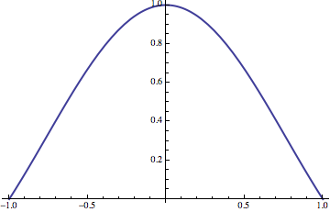
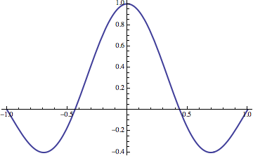
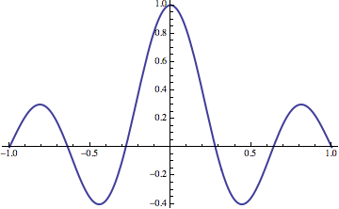
C – the form factor
Recall - Dot product of E and B
for axion-2 photon conversion:
C, the form factor, provides value between 0 and 1 describing how much of E and B overlap in the cavity
Good choice is the TM_{0x0} mode family:
Frequency scales with 1/r
E_{z}
TM₀₁₀
TM₀₂₀
TM₀₃₀
r
C ~ 0.69
C ~ 0.13
C ~ 0.05
Stephen.Parker@uwa.edu.au

Slide 17
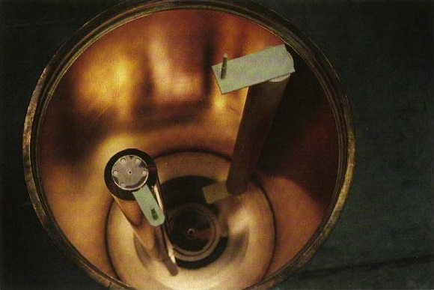
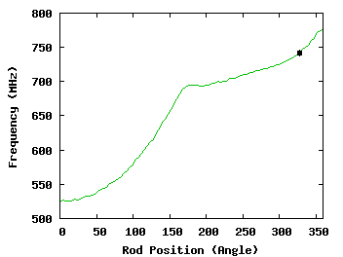
Cavity Frequency Tuning
Want to scan over a large region of parameter space
Hard to adjust radius of the cavity on-the-fly…
One approach: perturb the field structure.
ADMX Cavity
Stephen.Parker@uwa.edu.au

Slide 18
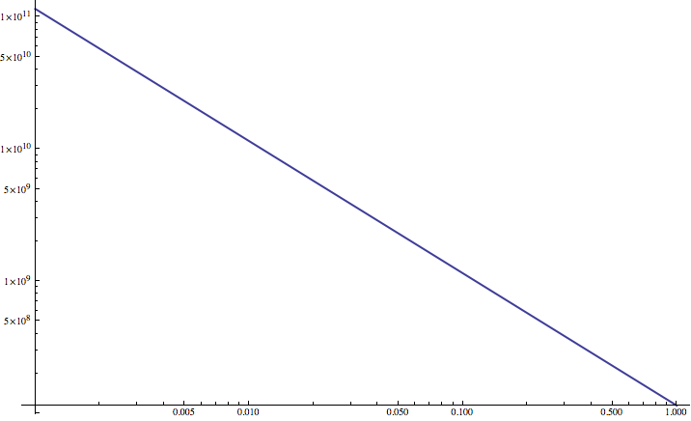
V – cavity volume
TM₀₁₀ Frequency
100 GHz
(0.4 meV)
10 GHz
(40 μeV)
1 GHz
(4 μeV)
Cavity radius
1 mm
1 cm
10 cm
1 m
Stephen.Parker@uwa.edu.au

Slide 19


Q – Quality factor
Q is actually minimum of cavity Q or “axion Q”
Amplitude
Implies “axion Q” ~ 10⁶
Frequency (Hz)
Other assumptions do allow for lower dispersion (higher Q) axions.
Also need to consider Doppler shifting / daily modulation
Stephen.Parker@uwa.edu.au

Slide 20
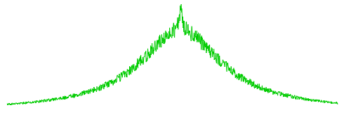
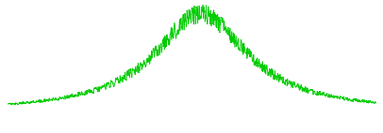
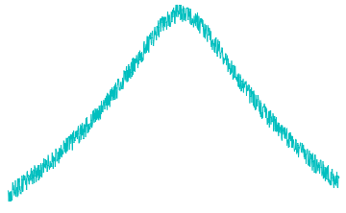
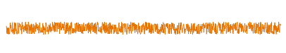



Noise
Cavity thermal noise
+
Amplifier noise
= measurement system noise
PSD
+
=
Frequency
t = integration time
b = bandwidth
Sit and wait until you reach desired SNR
Stephen.Parker@uwa.edu.au

Slide 21
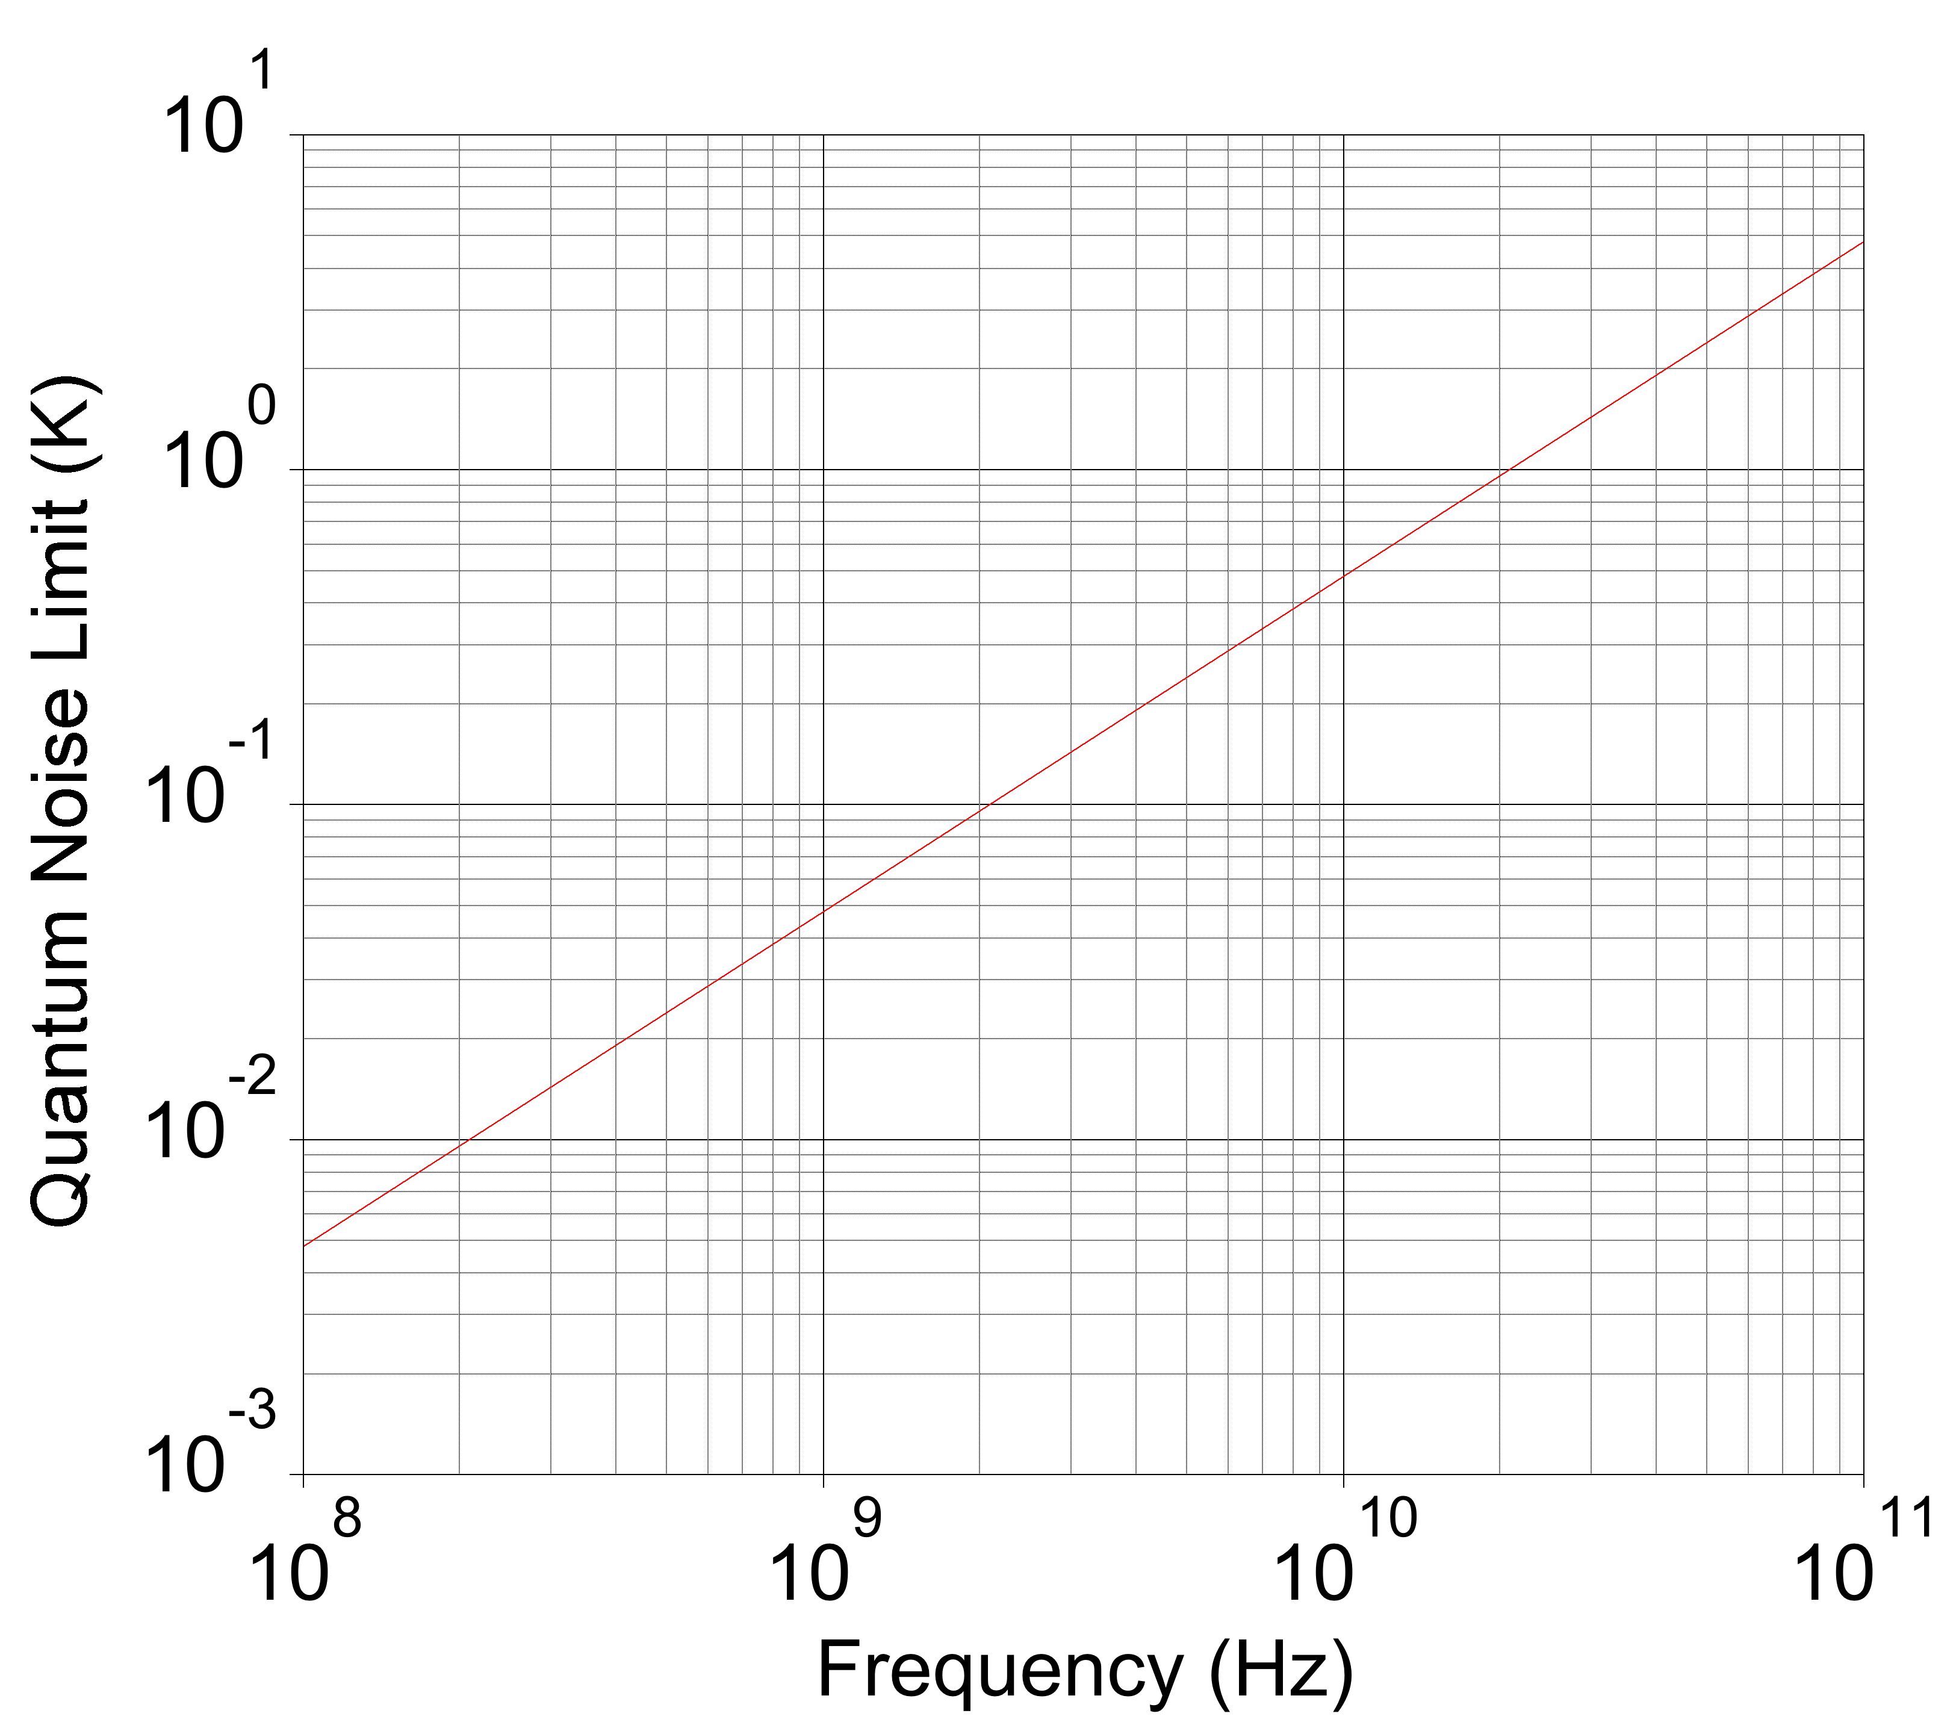
Dealing With Noise
Cavity thermal noise
Amplifier noise
Physical cooling:
Liquid helium ~ 4.2 K
Dilution fridge < 100 mK
Physical cooling
Amplifier technologies
HEMT ~ O(1-10) K
SQUID ~ near quantum
JPA ~ near quantum
Also: new measurement schemes to improve SNR (current research at UWA)
Stephen.Parker@uwa.edu.au

Slide 22
Probing higher axion masses with haloscopes
Many things conspire against us:
Smaller volume
Lower Q
Higher system noise
~ 100 GHz (axion from hell)
~ 1 GHz (achievable)
~ 10 GHz (difficult)
Areas of research being pursued:
Stronger magnetic field (very expensive)
Hybrid superconducting cavities
Different cavity structures and designs
Different amplifier technologies
Stephen.Parker@uwa.edu.au

Slide 23
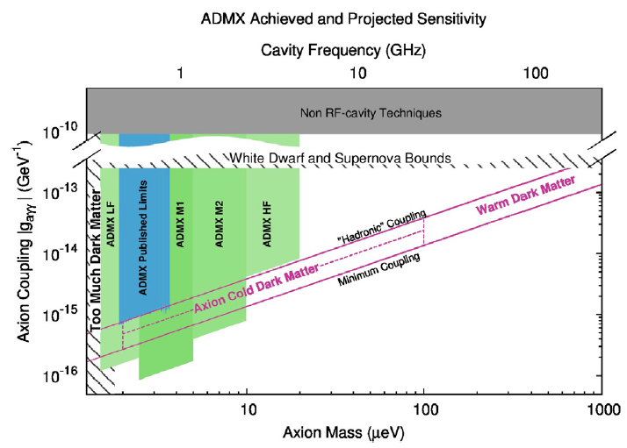
Prospects for CDM-Axion Haloscope Searches
We (UWA) are well positioned to immediately search in the 15 – 40 GHz region
Stephen.Parker@uwa.edu.au

Slide 24
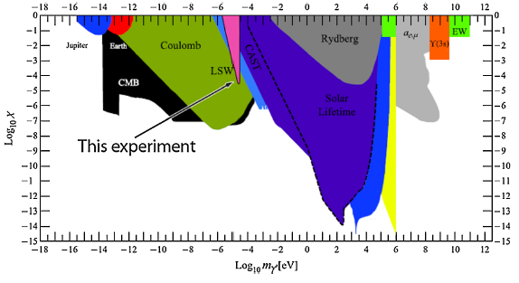
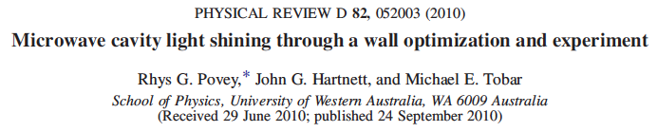
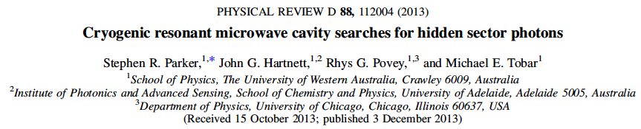
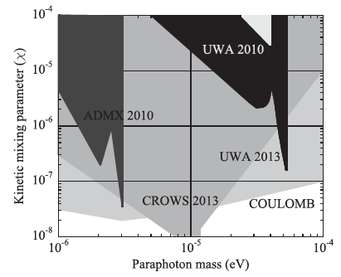
UWA – Past Work (Hidden Sector Photons LSW Experiments)
FFT
Stephen.Parker@uwa.edu.au

Slide 25
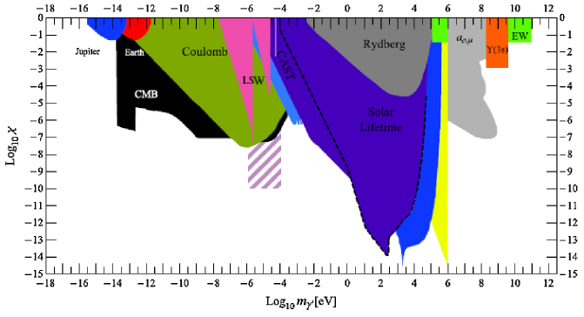
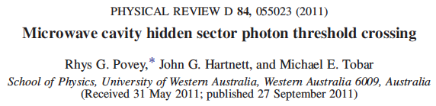
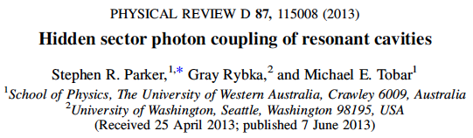
UWA – Past Work (HSPs)
Exchange of HSPs between cavities leads to coupling, hence they will resonate at normal mode.
Frequency shift proportional to HSP-Photon kinetic mixing parameter.
Classical analogy: two spring-mass systems coupled via third weak spring
Stephen.Parker@uwa.edu.au

Slide 26
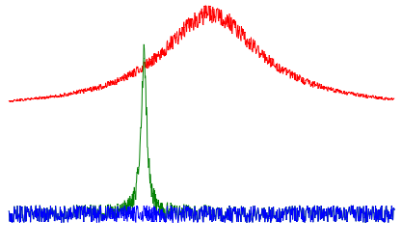
UWA – Present Work
New measurement scheme to improve SNR of Haloscope experiments
Novel application of precision microwave measurement techniques
Conversely: Increases scanning speed to reach desired SNR
Effectively increases the mass range that standard Haloscope can practically cover
Experimental work finished, manuscript under preparation.
Other ideas for new experimental schemes being explored…
Stephen.Parker@uwa.edu.au

Slide 27
UWA – Future Work
Axion search in the 10 – 40 GHz region*, enabled by new measurement scheme
26 GHz (0.11 meV) prototype experiment first up
Improved LSW Hidden Sector Photon searches
Further development of new schemes and ideas…
*pending funding (as always).
Stephen.Parker@uwa.edu.au

Slide 28
Summary
Axions (and WISPs) are compelling dark matter candidates
Haloscope experiments currently probing viable parameter space
More groups are joining the search with good prospects of covering all
CDM QCD axion possibilities.
A Few Useful Review Articles:
J.E. Kim & G. Carosi, Axions and the strong CP problem, Rev. Mod. Phys., 82(1), 557 – 601, 2010.
M. Kuster et al. (Eds.), Axions: Theory, Cosmology, and Experimental Searches, Lect. Notes Phys. 741 (Springer), 2008.
P. Arias et al., WISPy Cold Dark Matter, arXiv:1201.5902v2, 2012.
Stephen.Parker@uwa.edu.au

