Slide 1
MQXF Goals & Plans
G. Ambrosio
MQXF Conductor Review
November 5-6, 2014
CERN

Slide 2
Outline
Scope
MQXF Main Requirements & Lengths
MQXF Main Design Features
Schedule
Strand overview
Cable overview
Past Experience
Agenda

Slide 3
Scope
MQXF: new quads for ATLAS and CMS IRs
  Critical component for the High Luminosity LHC

Slide 4
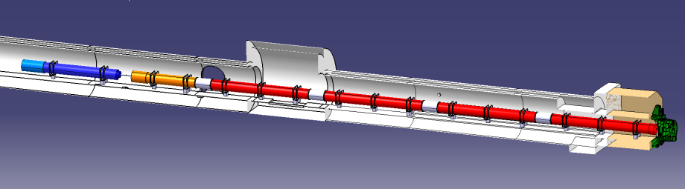





MQXF Main Requirements
140 T/m in 150 mm coil aperture
Q1/Q3 length: 8 m
Q2 length: 6.8 m
Max outer diameter: 630 mm
1.9 K operating temperature
Radiation strength: > 25 MGy (no problem for conductor)
Field quality: see next presentation
ATLAS
CMS

Slide 5
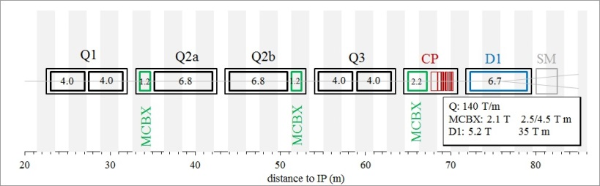
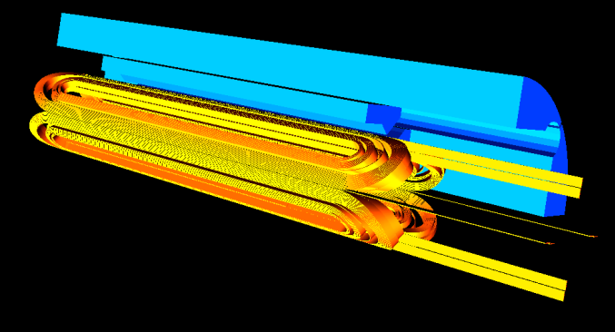
MQXF Lengths
 | Short model | Q1/Q3 (half unit) | Q2
Magnetic length [m] | 1.2 | 4.0 | 6.8
“Good” field quality [m] | 0.5 | 3.3 | 6.1
Cable unit length per coil [m] | 150 | 450 | 710
Strand per coil [km] | 6.5 | 18.9 | 30

Slide 6
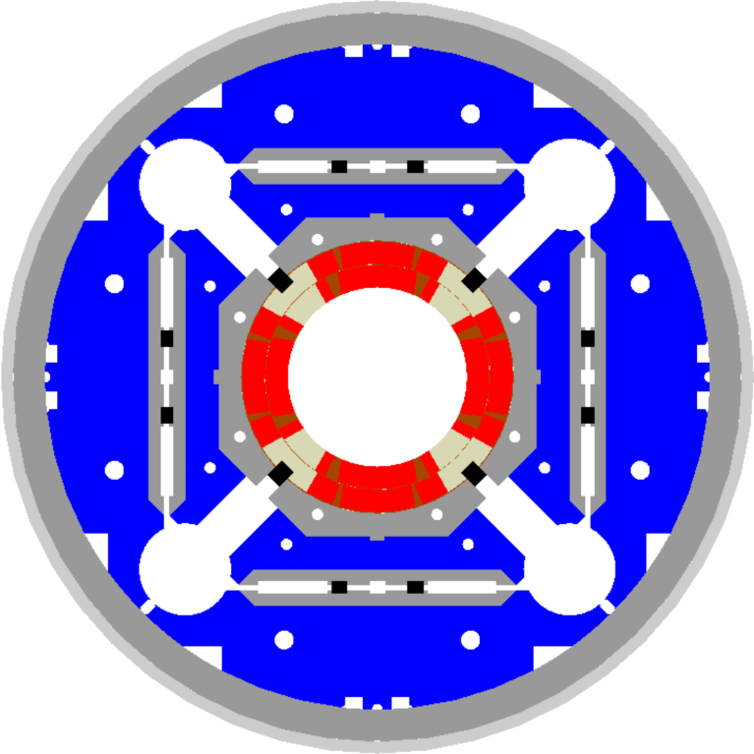
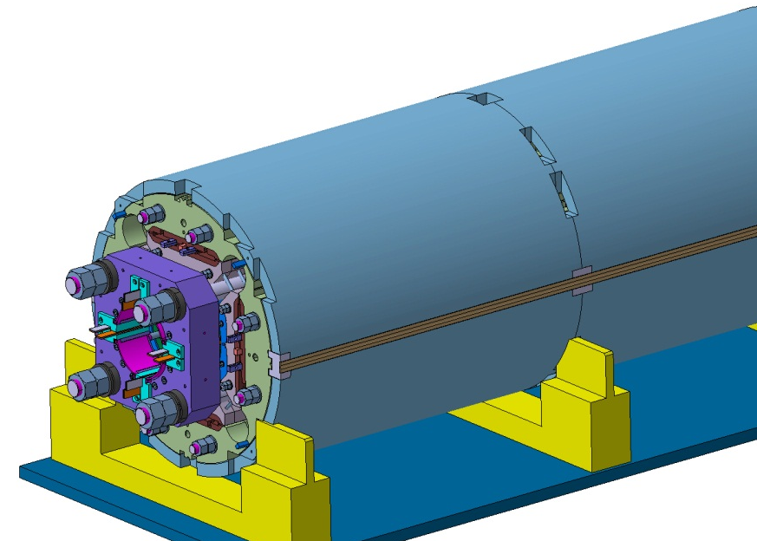
MQXF Main Design Features
Same design for Q1/Q3 and Q2s:
Two-layer coils
  Without internal splice
  With one wedge per layer
Al shell structure preloaded by bladders and keys
  Segmented Al shell
Axial preload by tie-rods
Quench protection by active heaters
  and possibly CLIQ

Slide 7
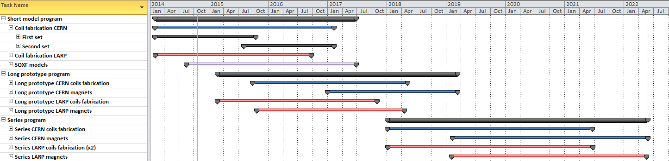
MQXF Schedule
Short model program: 5 CERN-LARP models, 2014-2016
  Coil fabrication started in 02-03/2014
  First magnet test (MQXFS1) in 07/2015 (3 LARP coils, 1 CERN coil)
Long prototype program: 2 (CERN) + 3 (LARP) models, 2015-2018
  Coil fabrication starts in 2015: 02 (LARP), 10 (CERN)
  First magnet test in 08/2016 (LARP) and 07/2017 (CERN)
Series production: 10 (CERN) + 10 (LARP) cold masses, 2018-2021
  Coil fabrication starts in 01/2018; First magnet test in 10/2019
  US-HiLumi contribution contingent on proven baseline by Jan/Mar 2016

Slide 8
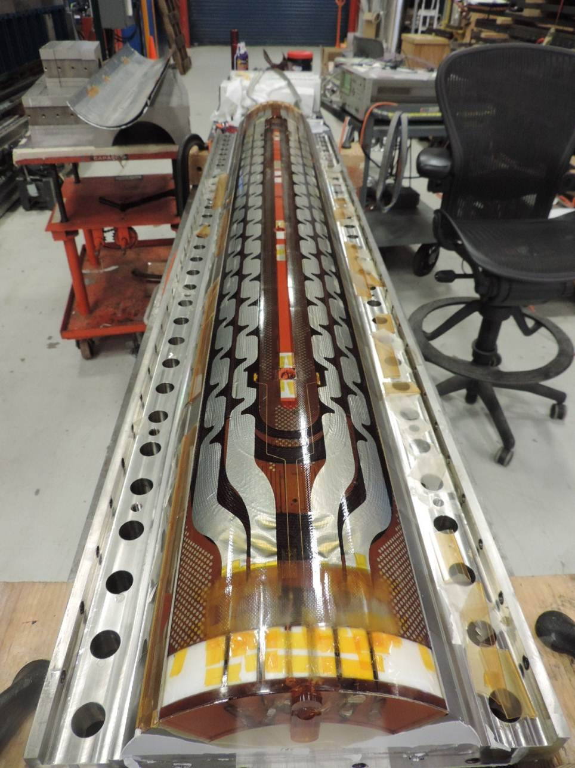
MQXFS Coils
MQXFS1 coils are in progress both by LARP and CERN:
MQXFS coil #2 by LARP
to be tested in mirror structure

Slide 9
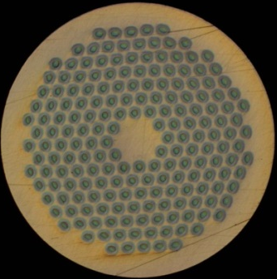
MQXF Strand - Overview
(from CERN technical specification document)
0.85 mm strand
Filament size <50 μm
  OST 132/169: 48-50 μm
  Bruker PIT 192: 42 μm
Cu/Sc: 1.2 ± 0.1 → 55% Cu
Critical current at 4.2 K and 15 T
  361 A at 15 T (632 A at 12 T)
OST RRP strand, 132/169
CERN baseline: 50% RRP and 50% PIT
More details in Amalia’s talk
Bruker PIT strand, 192
US baseline: RRP 132/169
Based on ~20 yr. experience by CDP, LARP, Base Programs
The PIT conductor is back-up / alternative option
More details in Arup’s talk

Slide 10
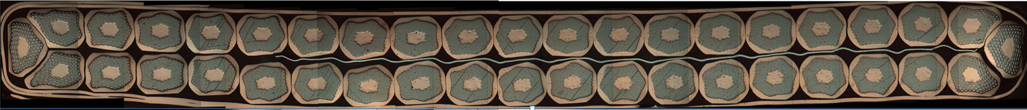
MQXF Cable - Overview
Same baseline for Q1/Q3 and Q2s:
Coils with these cable parameters are being fabricated by CERN & LARP for the 1st short model (MQXFS1)
to be tested in Summer 2015
40-strand cable
Mid thickness
  1.525 mm
  tolerance: +/- 0.010 mm
Width
  18.150 mm
  tolerance: +/- 0.050 mm
Keystone angle
  0.55 deg.
  tolerance: +/- 0.1 deg.
Pitch length
  109 mm
SS core 12 mm wide and 25 μm thick
RRP cable

Slide 11
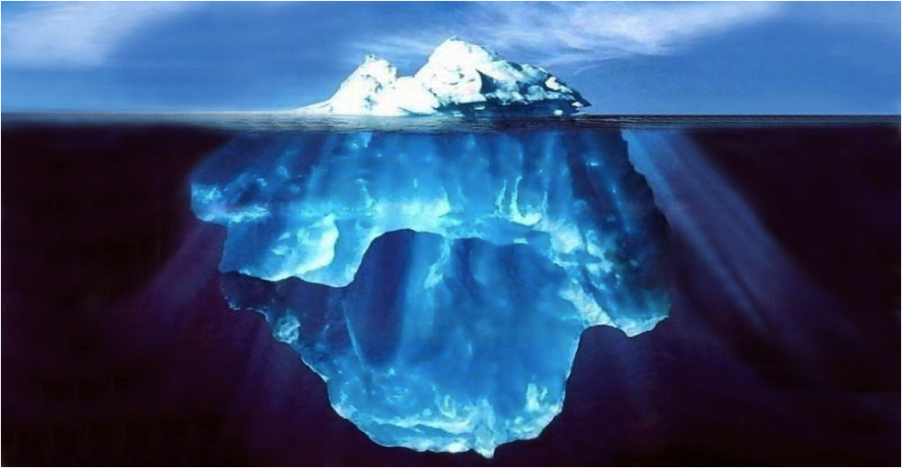
Past Experience - Risk Reduction
Conductor and magnet parameters have been selected taking into account many years of conductor development and magnet R&D in the US and at CERN

Slide 12
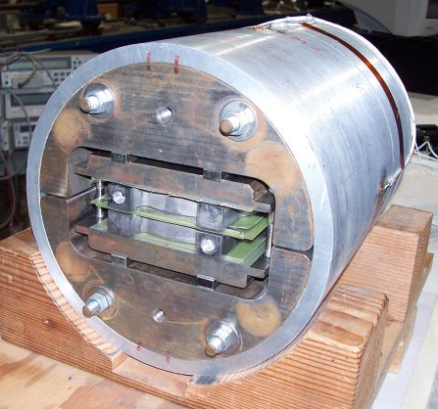
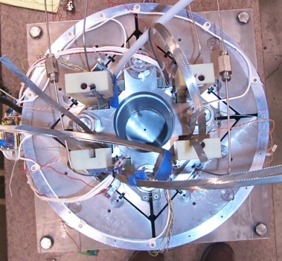
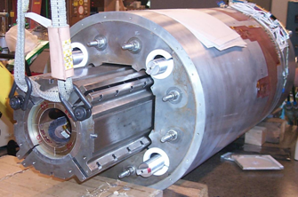
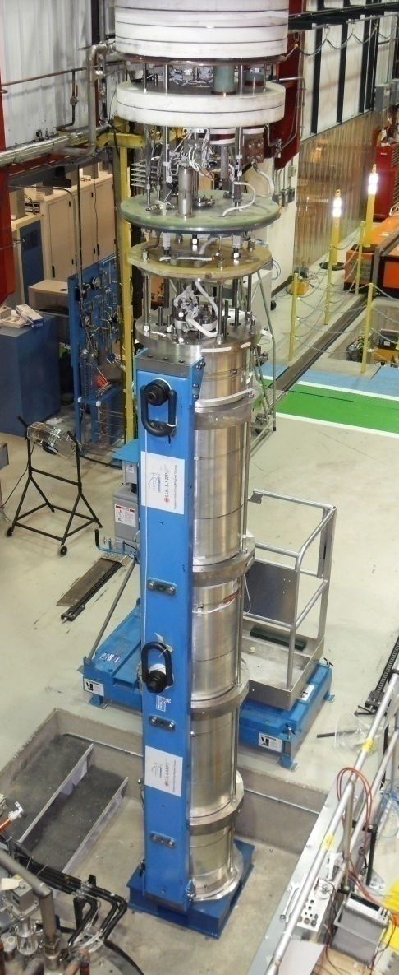
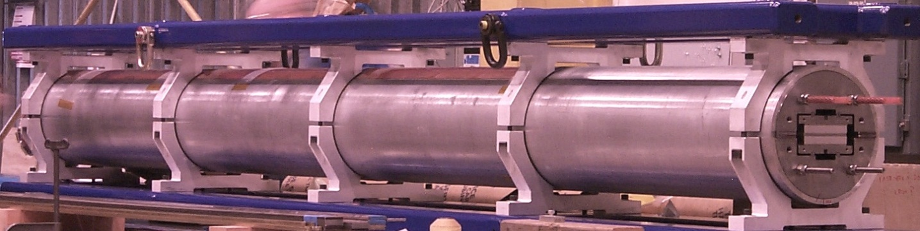
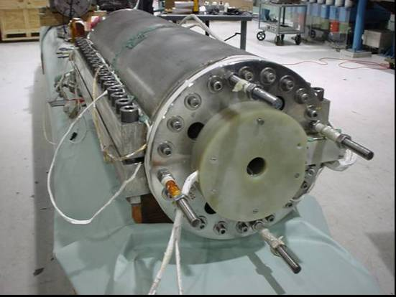
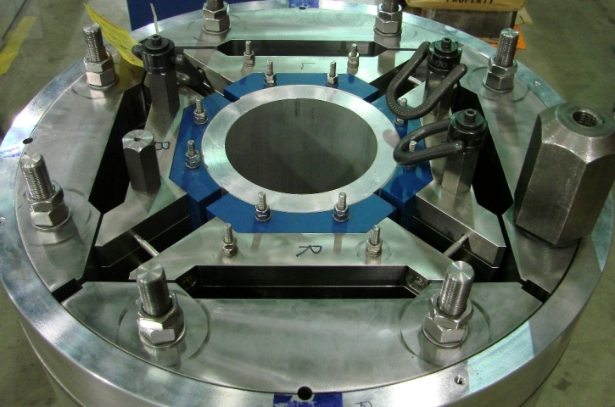
Overview of LARP Magnets
SM
SQ
TQS
LQS
LR
TQC
HQ

Slide 13


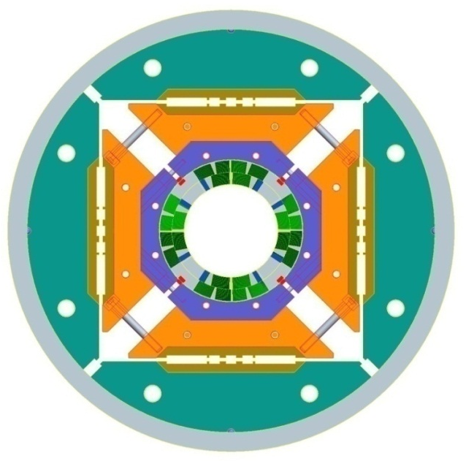
High Field Quadrupole (HQ)
Goal: demonstrate all performance requirements for Nb₃Sn IR Quads in the range of interest for HL-LHC (magnetic, mechanical, quench protection etc.)
Main design parameters and features in the latest models tested (HQ02a/b):
Conductor and cable
Strand diam. (mm) | 0.778
Cu/Sc | 1.2
No. strands | 35
Cable width (mm) | 14.8
Cable thickness (mm) | 1.375
Keystone angle (deg.) | 0.75
Al shell
Iron yoke
Coil
Al
collar
Short Sample Performance
Param. | 4.5K | 1.9K
I_{ss} [kA] | 16.4 | 18.2
B_{pk} [T] | 12.9 | 14.2
G_{ss} [T/m] | 186 | 205
Bladder
locations
Alignment key

Slide 14
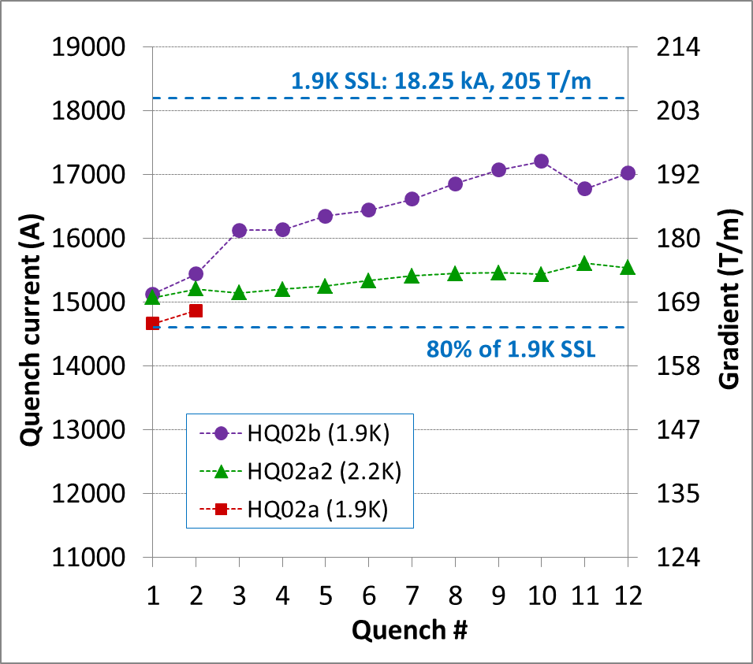
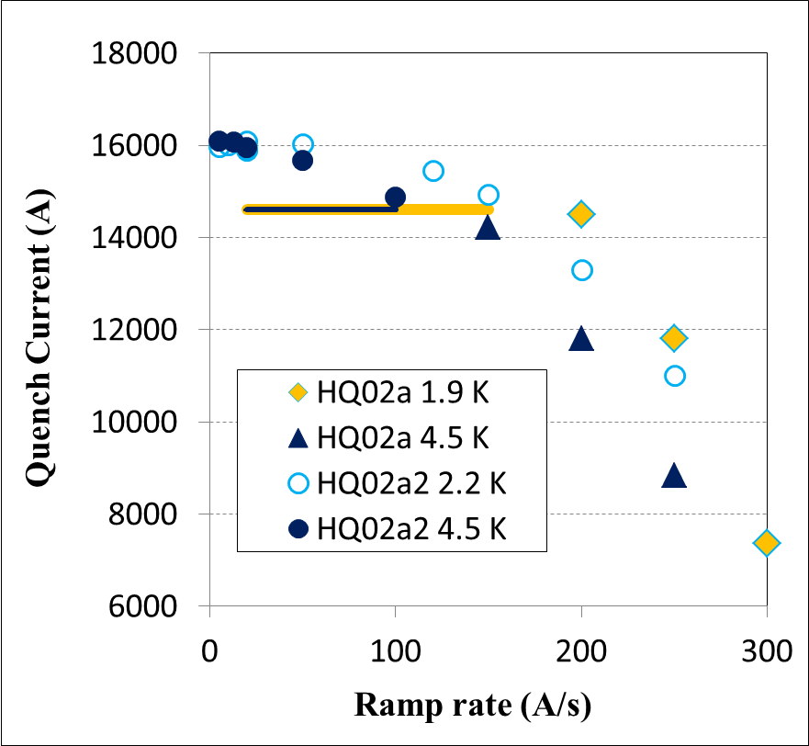
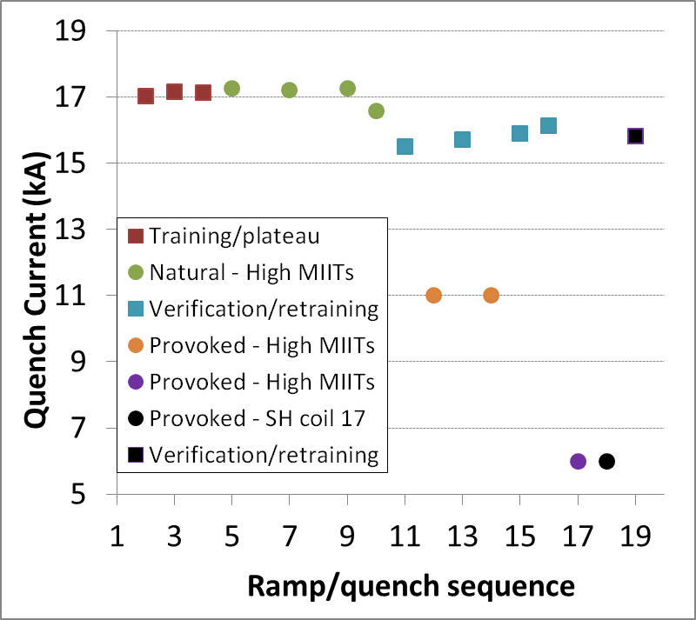
HQ02 Results
Quench performance
HQ02a: operational gradient (80% SSL) with no training
HQ02b: fast training to 95% level with 200 MPa pre-load
Accelerator Quality
Order of magnitude reduction of dynamic effects (ramp rate, field quality) with cable core
Quench protection
380K quench temperature without degradation
Successful first test of the CLIQ system in Nb₃Sn
250K
320K
380K

Slide 15
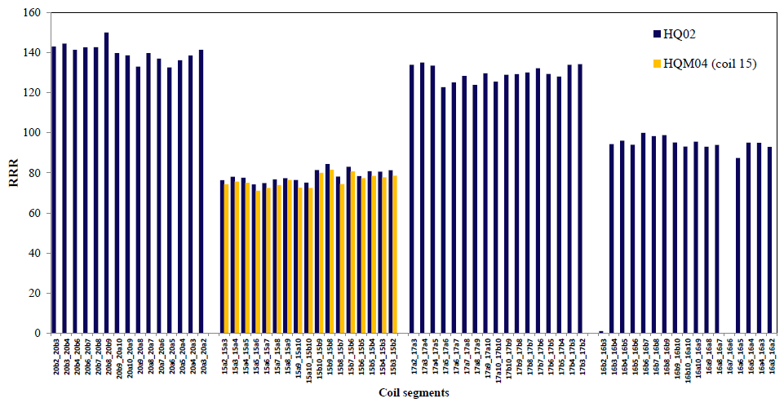
HQ02 RRR
Coil #20
Coil #17
Coil #15
Coil #16
Note: Coil #15 extracted strands showed RRR as low as 50

Slide 16
Agenda
Start Time | Duration |  | Speaker(s)
9:00 | 0:20 | Welcome and review charge | Lucio/Apollinari
9:20 | 0:30 | MQXF goals and plans | Giorgio
9:50 | 0:30 | MQXF Design and Conductor Requirements | Paolo
10:20 | 0:30 | Mechanical stability and QXF coil winding | Paolo/Giorgio
10:50 | 0:20 | Coffee break
11:10 | 0:45 | Conductor Technical Specifications | Amalia/Arup
11:55 | 0:25 | MQXF RRP-Strand for Q1/Q3 | Arup
12:20 | 0:25 | MQXF RRP-Strand for Q2 | Bernardo
12:45 | 1:30
14:15 | 0:30 | MQXF Cable for Q1/Q3 | Dan
14:45 | 0:30 | MQXF Cable for Q2 | Luc
15:15 | 0:25 | PIT Strand & Cable for Q2 | Amalia
15:40 | 0:30 | Lessons Learnt from CERN experience | Luc
16:10 | 0:20 | Coffee break
16:30 | 0:30 | Lessons Learnt from LARP experience | Arup/Dan
17:00 | 0:25 | US-HiLumi Conductor Procurement | Arup
17:25 | 0:25 | HiLumi Conductor Procurement | Amalia
17:50 | 1:00 | Closed Session
18:50

Slide 17
Agenda II
Start Time | Duration |  | Speaker(s)
9:00 | 0:20 | QA/QC plans for Q2 Strand | Bernardo
9:20 | 0:20 | QA/QC plans for Q2 Cable | Christian
9:40 | 0:40 | QA/QC plans for Q1/Q3 Conductor | Ian
10:20 | 0:15 | Coffee break
10:35 | 0:20 | Summary | Paolo/Giorgio
10:55 | 0:45 | Questions from Committee
11:40 | 1:00 | Closed session
12:40 | 1:30
14:10 | 3:00 | Closed session
17:10 | 1:00 | Close-out
18:10 |  | ADJOURN

Slide 18
Nomenclature
MQXF production magnet for HiLumi
MQXFS short model (a.k.a. SQXF)
MQXFL long prototype (a.k.a. LQXF)
TQ 90 mm short (1m) quadrupole
LQ 90 mm long (3m) quadrupole
HQ 120 mm short (1m) quadrupole

Slide 19
Back up Slides

Slide 20
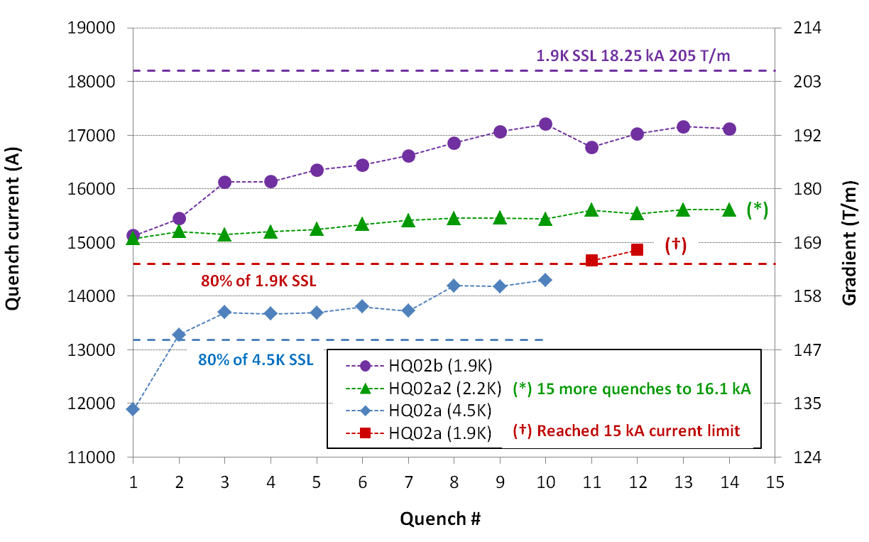
HQ02b Quench Performance
Significant improvement of training rate above 15 kA, reaching 95% of 1.9K SSL
~230 A/quench
~30 A/quench
H. Bajas, G. Chlachidze, M. Martchevsky,
F.Borgnolutti, D. Cheng, H. Felice, et al.

