Slide 1
MQXF RRP® Strand for Q1/Q3
A. K. Ghosh
MQXF Conductor Review
November 5-6, 2014
CERN

Slide 2
Outline
Introduction
RRP® Strand
RRP® 108/127 Strand for MQXFS1
  Design change for RRR Control
RRP® 132/169 MQXF strand
Present status of wire performance
  Comparison of vendor and LARP data on Ic
  Ic and RRR optimization
Strand Magnetization
Cable and Insulation
RRR of Extracted strand
Summary

Slide 3

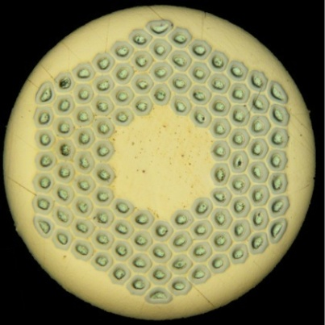
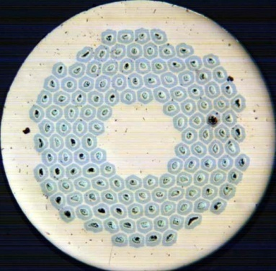
Introduction
For the MQXF Q1/Q3 Magnets we will most likely use RRP® wire from Oxford Superconducting Technology
Strand diameter 0.85 mm
  Ti-Ternary Nb₃Sn
Cable is a 40- strand Rutherford Cable with stainless steel core
The 1st Short model MQXFS1 magnet is using coils made with 108/127 strand.
Subsequent Short model and Long prototype MQXF magnets will use 132/169 design wire (smaller filament diameter)

Slide 4
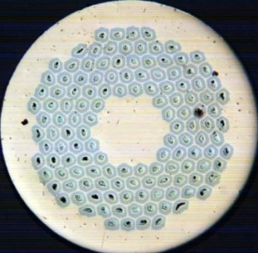
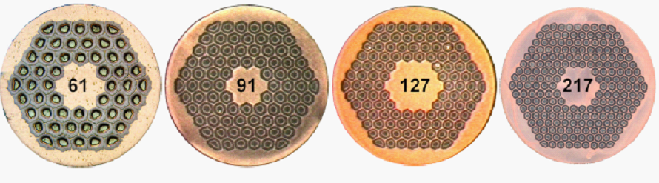
RRP® strands with smaller filaments
  Smaller sub-elements can minimize flux jumps and improve stability.
  Filament Magnetization decreases
Smaller Filament Size
169
Courtesy of Jeff Parrell (OST)

Slide 5
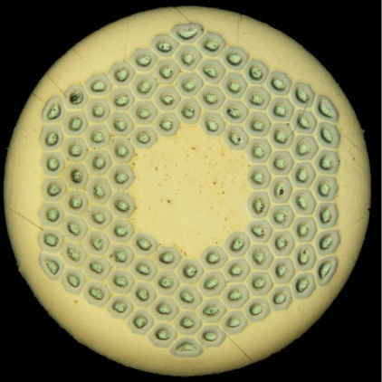
Sub-element (Filament) diameter D_{s}
R=Cu/Non-Cu=1.2 , 45.5% SC, 54.5 % Cu
Cu/Non-Cu=1.2 , 45.5% SC
Table of Sub-element diameter in μm
0.85 mm strand with132 filaments has the same sub-element size as the 0.778 mm wire with 108 filaments that is used in HQ

Slide 6
Ti-Ternary 108/127 Strand Production
From prior experience we found that RRR is not well controlled in the “standard” RRP-wire. (details in a later presentation by A. Ghosh and D. Dietderich)
For the LARP order of 410 Kg which used 12 billets, OST introduced a small design change in the sub-element
  This production was used to resolve RRR control
  6 billets use standard Tin content (Nb/Sn ratio=3.4)
  6 billets use 5%-Reduced Tin content (Nb/Sn ratio=3.6)
Reduced Tin has significant impact on the RRR of the copper.
    Side-effect: Marginal decrease in J_{c}.
Piece lengths have been very good; some billets drew down in a single piece.

Slide 7
MQXF Strand Specification
Process | RRP® or PIT Nb3Sn
Strand Diameter, mm | 0.850 ± .003
Ic(15 T) at 4.2 K, A | > 361
n-value | > 30
Ic(12 T) at 4.2 K, A (Reference Only) | (> 632 )
Ds, µm (sub-element diameter) | < 50
Cu : Non-Cu volume Ratio | 1.2 ± 0.1
RRR (after full reaction) | ≥ 150
Twist Pitch, mm | 19 ± 2
Twist Direction | Right-hand screw
Strand Spring Back, deg. | < 720
Magnetization Width at 3 T, 4.2 K, mT | < 300
Minimum Piece length, m | TBD for Q1/Q2/Q3

Slide 8
Specification for MQXF Strand
LARP-M-8007 Rev.0
Process | Ti-Ternary RRP® Nb₃Sn
Strand Diameter, mm | 0.850 ± .003
Ic(15 T) at 4.2 K, A | > 361
n-value | > 30
Ds, µm (sub-element diameter) | < 50
Cu : Non-Cu volume Ratio | 1.2 ± 0.1
RRR (after full reaction) | ≥ 150
Twist Pitch, mm | 19 ± 2
Twist Direction | Right-hand screw
Strand Spring Back, deg. | < 720
Magnetization Width at 3 T, 4.2 K, mT | < 300
Minimum Piece length, m | 550
High temperature HT duration, h | ≥ 48
J_{c}(15 T) > 1400 A/mm²
132/169
Nb/Sn ratio > 3.4 to meet RRR

Slide 9
RRP 132/169 strand for MQXF short model magnets
LARP had an existing PO of 255 Kg (~55 km) for 108/127 under specification LARP-M-8004-Rev. B
Contract was revised to change design to 132/169
Process | Ti-Ternary RRP® Nb₃Sn
Strand Diameter, mm | 0.85 ± .003
Ic(15 T) at 4.2 K, A | > 361
Ic(12 T) at 4.2 K, A | > 684
n-value | > 30
Ds, µm (sub-element diameter) | < 60
Cu : Non-Cu volume Ratio | > 1.1
RRR (after full reaction) | ≥ 150
Twist Pitch, mm | 14 ± 2
Twist Direction | Right-hand screw
Minimum Piece length, m | 750
High temperature HT duration, h | ≥ 48
Exception:I_{c}(15 T) > 350 A

Slide 10
RRP 132/169 strand for MQXF model magnets
LARP had an existing PO of 255 Kg (~55 km) for 108/127 under specification LARP-M-8004-Rev. B
  This was converted to 132/169- strand with “reduced-Sn”, using Nb Type-1.
  Exception to I_{c} (15 T) specification: 350 A (compared to 361 A)
  Strand qualified using HT schedule: 210C/48h + 400C/48h + 665C/50h
  9 billets were made
  I_{c}, RRR and Cu/non-Cu measurements made at OST for samples taken from the front-end and back-end of each billet.
  I_{c} and RRR measurements made at BNL using samples reacted with the same nominal HT schedule

Slide 11
MQXF strand 132/169, “reduced-Sn”, OST data
210C/48h + 400C/48h + 665C/50h
UCL-Upper Control Limit
LCL – Lower control limit
LSL – Lower specification limit
AVG – Average
σ – Std. Dev
Exception to LSL
Ic-AVG needs to be increased in production to meet LSL of 361 A

Slide 12
RRR of the billets with the same HT
Average RRR | 315
± σ | 32
    RRR is well above specification minimum of 150

Slide 13
Cu/Non-Cu ratio
Average Cu/Non-Cu | 1.21
± σ | 0.035

Slide 14
Comparison of BNL and OST data
Samples were reacted and measured at each facility
 | I_{c}(15T) BNL | I_{c}(15T) OST | I_{c}(12T) BNL | I_{c}(12T) OST | I_{c}(15T)_OST/ I_{c}(15T)_BNL | I_{c}(12T)_OST/ I_{c}(12T)_BNL | RRR BNL | RRR OST
Average | 374 | 370 | 692 | 687 | 99.0% | 99.3% | 288 | 315
σ | 15 | 15 | 19 | 20 | 1.0% | 1.0% | 38 | 32
OST and LARP measurements are very consistent
H, T | Ic_OST | Ic_BNL | n_OST | n_BNL
11.0 |  | 819 |  | 52
12.0 | 681 | 678 | 50 | 46
13.0 | 557 | 558 | 48 | 46
14.0 | 447 | 450 | 46 | 41
15.0 | 352 | 355 | 44 | 35
16.0 | 269 |  | 34
Round Robin Test of samples reacted at BNL

Slide 15
Optimizing 132/169 for MQXF
    There is headroom in RRR to increase I_{c} by using longer times at 665 ºC or slightly higher temperature 670 ºC
    Or by adjusting the Nb/Sn ratio
Specification Limits

Slide 16
Longer times at 665 ºC
665 C | 50 h | 100 h
Average, A | 374 | 388
σ, A | 17 | 17
3.7 % Increase in I_{c}

Slide 17
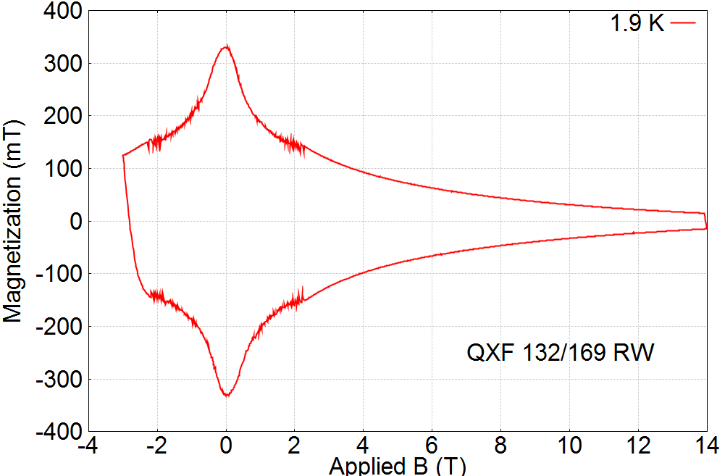

Magnetization of MQXF 132/169
ΔM
X. Wang
Measurements performed at OSU
By M. Sumption and X. Xu
ΔM = 238 mT at 3 T, 1.9 K
ΔM expected to be ~ 200 mT at 3 T, 4.5 K

Slide 18
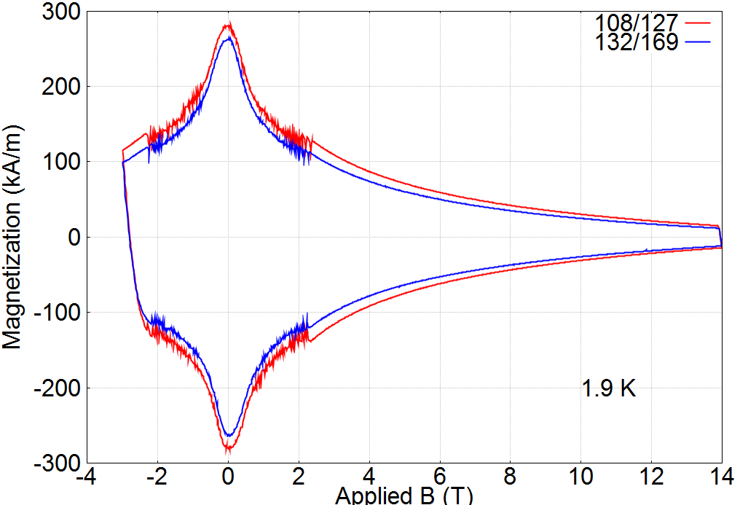
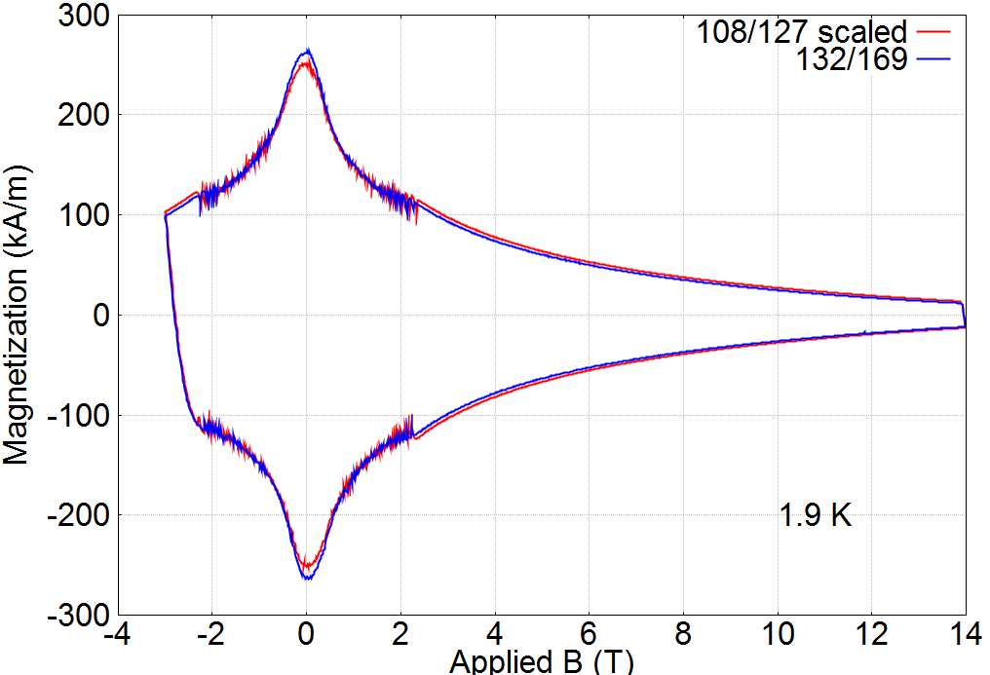
Magnetization of 0.85 mm,108/127 and 132/169 at 1.9 K
Strands have same J_{c} and Cu/Non-Cu ratio
108/127 Scaled by 89%
Magnetization scales with filament diameter
X. Wang
Measurements performed at OSU
By M. Sumption and X. Xu

Slide 19
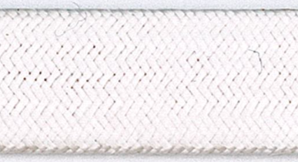
Cable Insulation at LARP
Insulation is braided directly on cable
  New England Wire Technology (NEWT)
Using S-2® glass (from AGY) with 933 Silane sizing
  48 carriers
  2 ply yarn, twist pitch 75 mm
Several lengths of QXF cable has been insulated
  Using braiding parameters to yield target specification of 0.145 ± 0.005 mm thickness
  10-stack measurements at 5 MPa are used to determine insulation thickness
  Thickness can be readily adjusted to meet any change to present specification.
Each Cable length ~ 170 m | Measurement at 5 MPa
~170 m | mm
Cable ID | Ist Cycle | 2nd Cycle | 3rd Cycle
1050Z | 0.142 | 0.140 | 0.140
1051Z | 0.143 | 0.140 | 0.138
1053Z | 0.154 | 0.149 | 0.147
1055Z | 0.148 | 0.145 | 0.143
1057Z-A | 0.149 | 0.146 | 0.145
1057Z-B | 0.149 | 0.146 | 0.145

Slide 20
Summary
The “reduced-Sn” design change increases RRR manufacturing margin with minimal loss of J_{c}.
  Implemented for all billets in process and future procurements.
RRP® 132/169 wire can meet strand specs
  Manufacturing margin in I_{c} needs to be increased by good control of the Nb/Sn ratio, and by reaction optimization
LARP plan implements 132/169-strand in MQXFS2 magnet and all MQXFL prototypes.
Strand procurement has been planned to meet cable manufacture and coil winding schedule. (Later Presentation)
Specification and Production QA plan and documents is being finalized this fiscal year for pre-production lots and preparing for issuing call for RFP(Request For Proposal) for the production.

Slide 21
End of Presentation

