Slide 1



MQXF Cable Specification
A. K. Ghosh
MQXF Conductor Review
November 5-6, 2014
CERN

Slide 2
Outline
Introduction
  Cable development at LARP and CERN
Specification of “Baseline” MQXF Cable
  Engineering Drawings
Cable parameters
  CMM measurements
  I_{c} Measurements
  Example of RRR measurement at cable edge
Mechanical stability
Cable Insulation
Summary

Slide 3
MQXF Cable Development at LBNL/LARP
D. Dietderich
Using RRP 108/127 Ti-Ternary 0.85 mm Strand
Preliminary Parameters
40 Strands
0.85 mm diameter
w = 18.27 mm
t = 1.50 mm
KS angle = 0.65 deg.
Expand dimensional range
w = 17.75 - 18.27 mm
t = 1.48 - 1.53 mm
KS angle = 0.50 - 0.65 deg.
With/without SS Core
Core widths of 8,12.7 and 15.8 mm
Cables evaluated for
  Mechanical stability, cable x-section to assess sub-element damage, Ic and RRR measurements using extracted strands – cabling degradation
3

Slide 4
Cabling the MQXF conductor at CERN
L. Oberli, B. Bordini, A. Ballarino
Using RRP-132/169 and PIT-192
Several Cables with different parameters were fabricated at CERN
In order to assess the critical current degradation due to cabling, extracted wires were systematically measured
Generally the degradation was limited to less than 5 % despite the strand looking significantly deformed at the thin edge
The wire is extremely robust in term of I_{c} degradation, and the cabling program is focusing on :
  Maintaining the local RRR above 100
  Manufacturing a mechanical stable cable

Slide 5
Cabling Trade-offs
Minimize the amount of strand damage
  Less compaction can lead to
  Mechanically unstable cable for coil winding “popped” strands
Increase mechanical stability of cable by increasing compaction
  Leads to increase in sub-element deformation at the cable edges
  Consequences - Reduced critical current and RRR (Sub-element shear leading to barrier thinning and barrier breakage causing Sn leak into copper and reducing RRR)
    Microscopy of cable x-sections is used to evaluate damage to sub-elements at the minor and major edges of the cable.
    Main impact is on “local RRR”

Slide 6
I_{c} decrease due to cabling
“Cabling Degradation”
Results from the Cable Development Phase
Target < 5%
Nominal Cable parameters

Slide 7
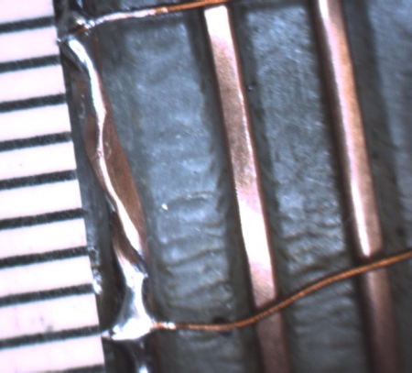
An Example of sub-element shearing and barrier rupture in a non-ideal cable (high compaction)
These damage lead to mostly RRR degradation of the copper stabilizer at the edges of the cable. Low RRR can lead to conductor instability due to “magnetization” and “self-field” effects. Target is to maintain RRR > 100 at the cable edges.
Width = 17.94 mm
Thickness = 1.49 mm
PL = 109 mm
V-tap configuration to measure RRR at edges

Slide 8
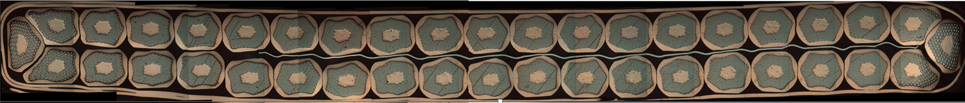
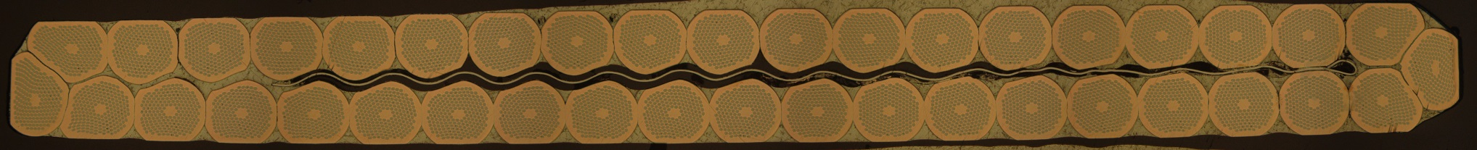
MQXF Cable Specification
Baseline design
Number of strands 40
Mid-thickness 1.525 mm +/- 0.010 mm
Width 18.15 mm +/- 0.050 mm
K.S. angle 0.55 deg. +/- 0.10 deg.
Pitch Length 109 mm +/- 3 mm
Core Material Annealed 316L SS
Core Width 12 mm
Core thickness 0.025 μm
  tolerance: +/- 0.05 deg.
Pitch length
  109 mm
Core Location
  Biased towards major Edge
I_{c} decrease due to Cabling
  < 5%
  Based on extracted strand test
RRR Extracted Strand
  > 100 at the edges
RRP cable
PIT cable

Slide 9
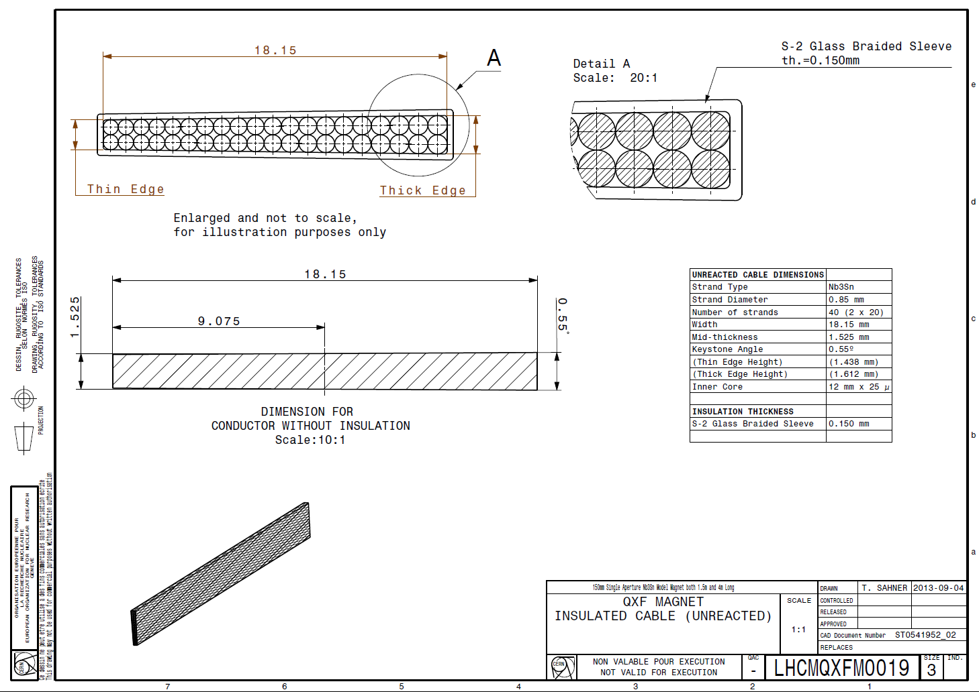
Insulated Cable Drawings (CERN)

Slide 10
Insulated Cable Drawing (LARP)

Slide 11
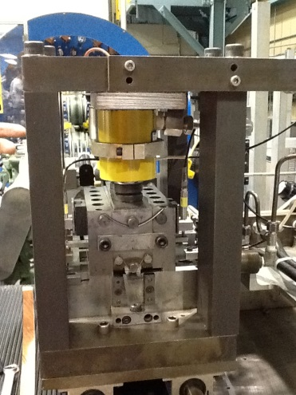
Cable Dimension
Mid-Thickness: 1.525 ±.010 mm
Primary tool is the in-line CMM device

Slide 12
Cable Dimension
Mid-Thickness: 1.525 ±.010 mm
Example of CMM data for 370 m MQXF cable

Slide 13
Width
18.15 ± 0.05 mm

Slide 14
Keystone Angle
0.55 ± 0.10 Deg

Slide 15
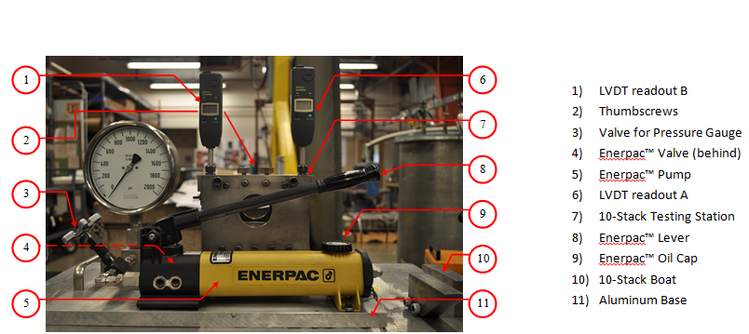
Cable Mid-thickness
Off-Line Measurements
10-stack Measurement taken at the Start and End of cable run.
Also used for Insulation Thickness measurement

Slide 16
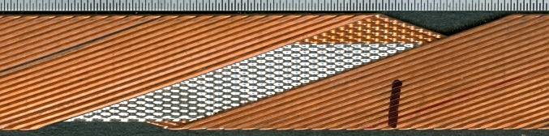
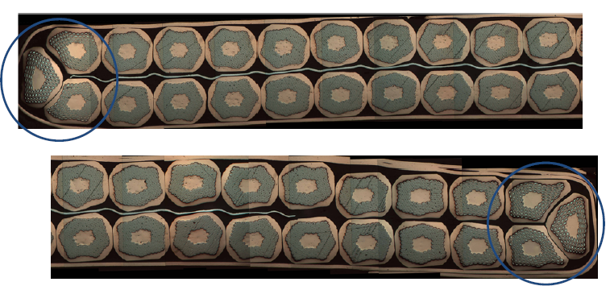
MQXF cable uses a central SS-Core for eddy current control
316 L SS Core to reduce Eddy Current losses
Thick
edge
Biased towards the Major Edge
Thin
Edge

Slide 17
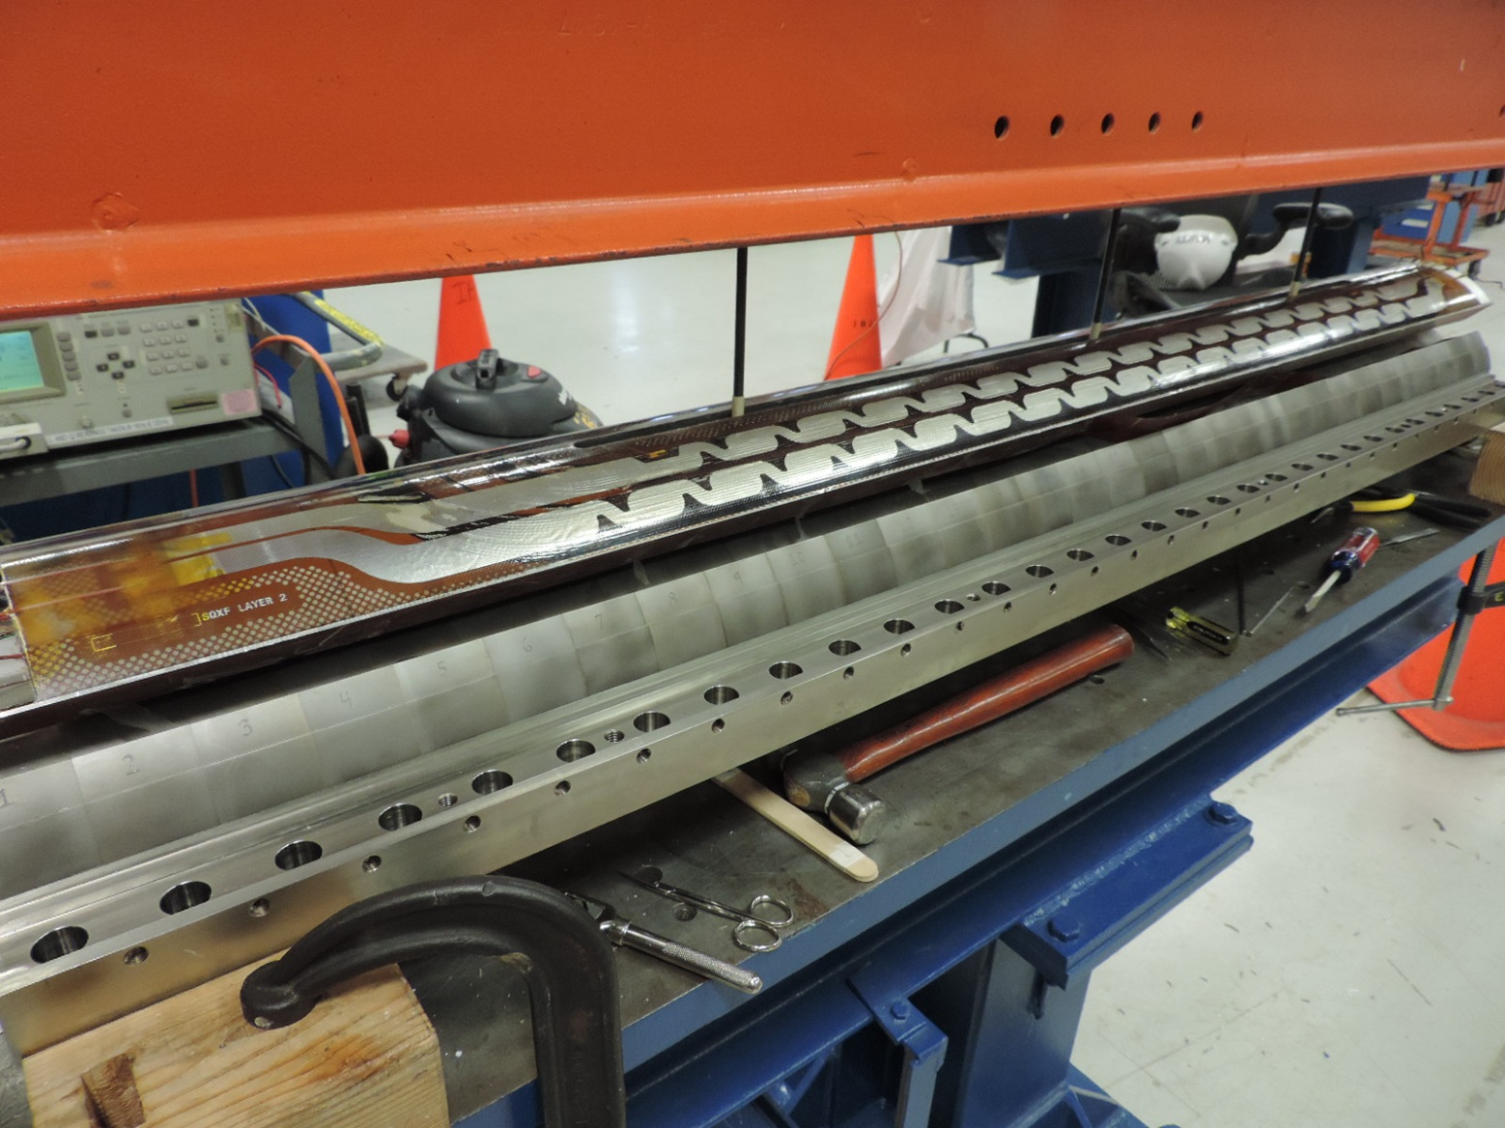
Mechanical stability
Cables, made with RRP strands, using nominal baseline parameters are not fully mechanically stable during coil winding
  Occasional “popped strands”
At this time cables are being managed during coil winding by using a winding block and ceramic binder on the fiberglass insulation.
So far 5 MQXFS coils have been successfully wound at LARP (3) and CERN (2).

Slide 18
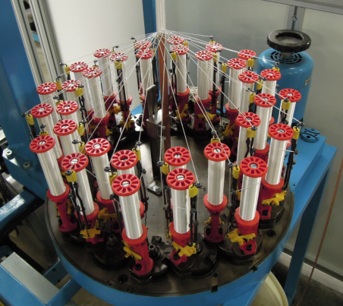
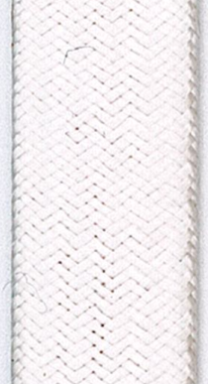
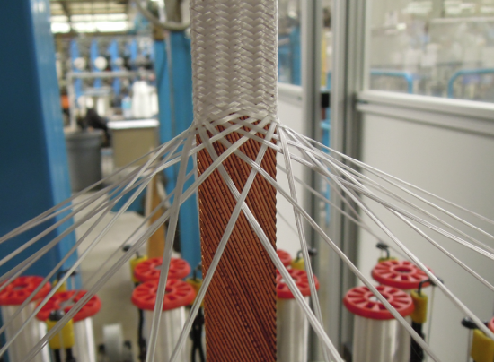
Cable Insulation
Insulation is braided directly on cable
Using S-2® glass (from AGY) with 933 Silane sizing
Several lengths of MQXF cable has been insulated
  Using braiding parameters to yield target specification of 0.145 ± 0.005 μm thickness
  10-stack measurements at 5 MPa are used to determine insulation thickness
  Thickness can be readily adjusted to meet any change to present specification.

Slide 19
Summary
MQXF cable with the “baseline” parameters have been successfully fabricated using RRP 108/127 and RRP 132/169.
Cable “as fabricated” is not fully mechanically stable. Winding aids have been used to successfully wind and react coils using insulated cables
Extracted Strand Measurements show that
  Cabling Degradation is typically < 5 %
  Average RRR is > 100, however “local” RRR which reflects local sub-element shearing (as observed in optical microscopy) at the cable edges is being investigated and analyzed at CERN and at LARP. In some cases, this “local” RRR for extracted strands of “baseline” cable has been observed to be < 100.
CERN and LARP continue fabricating and conducting qualification tests of MQXF cable using RRP 132/169 wire to ensure that cable design chosen is robust enough for MQXF magnets. Final specifications will be adopted within the next 6 months.
Amalia Ballarino will discuss CERN’s MQXF cable using PIT conductor

Slide 20
Details of cable development and present status of LARP and CERN Cable Development presented by:
D. Dietderich (for Q1/Q3) and B. Bordini (for Q2)
End of Presentation

Slide 21
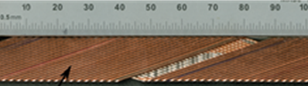
Field Quality – HQ Experience
Large dynamic effects observed in LARP quadrupoles (TQ/LQ, HQ01)
A thin (25 μm) stainless steel core with partial coverage (8mm, 60%) and biased toward the thick edge was included in HQ02 cables
Increased the effective R_{c} from 0.1-0.4 μΩ (HQ01) to 2-4 μΩ (HQ02) with a corresponding decrease of the observed errors
Parameter | Unit | HQ01e | HQ02a
Core material | - | - | SS316L
Strand diameter | mm | 0.80 | 0.778
Cable width | mm | 15.15 | 14.77
Cable mid thickness | mm | 1.437 | 1.376
GianLuca Sabbi, X. Wang
LARP/HL-LHC Collaboration Meeting – CM22

Slide 22
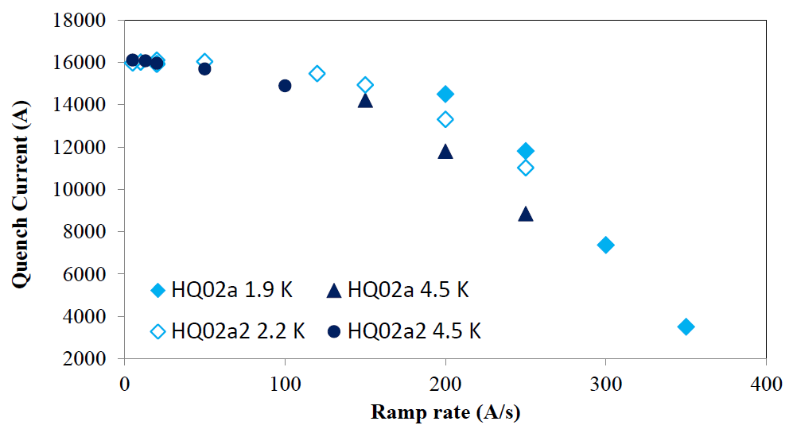
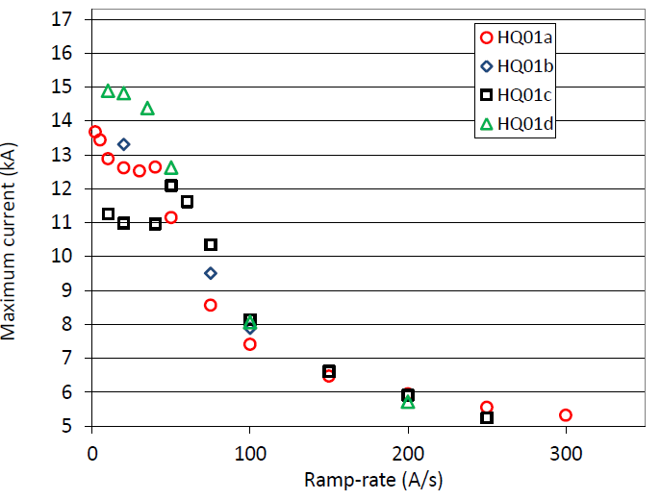
Ramp Rate – HQ Experience
HQ02: 15kA @ 150 A/s
HQ01: 6.5 kA @150 A/s
150 A/s
150 A/s
GianLuca Sabbi, X. Wang
LARP/HL-LHC Collaboration Meeting – CM22

