Slide 1
MQXF Cable for Q1/Q3
D.R. Dietderich
MQXF Conductor Review
November 5-6, 2014
CERN

Slide 2
Outline
MQXF parameters in draft specification (LARP-MAG-M-8007)
  Cable made with these parameters and RRP 132/169 wire
MQXF-S cable fabrication experience in LARP
  A sub-set of the R&D to support the parameter selection
  Cable parameters from the LARP MQXF-S cable runs
Strand deformation and quality of strands with the MQXF cable parameters
  Metallographic observations – Quality score
  Effect on RRR and I_{c}
Observation on cables made from annealed vs. un-annealed wire
Summary

Slide 3
MQXF Cable Parameters
Mid-thickness = 1.525 mm +/- 0.010 mm
Width = 18.15 mm +/- 0.050 mm
K.S. angle = 0.55 deg. +/- 0.10 deg.
Pitch Length = 109 mm +/- 3 mm
S.S. core = 12.0 mm wide
  0.025 mm thick
  bias towards thick edge
Anneal wire at 170C for 15 hrs.
Before reviewing some of the R&D that lead to the above specification I will evaluate a cable made with RRP132/169

Slide 4
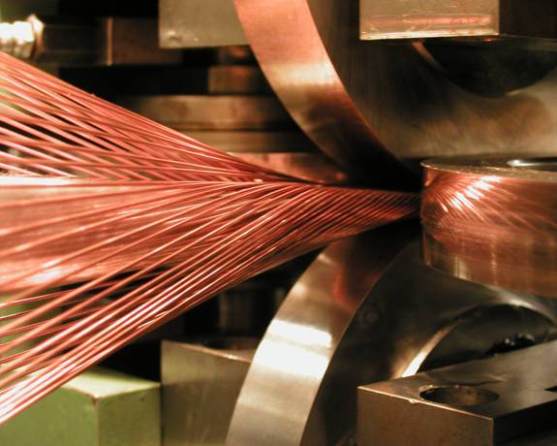
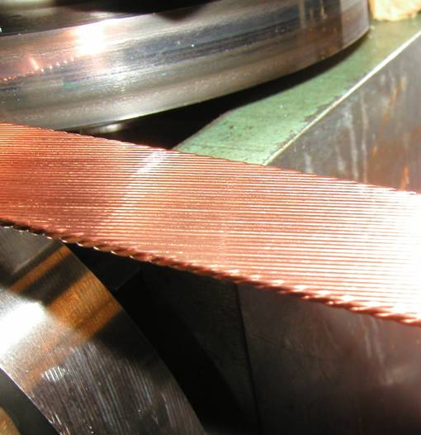
Cable Machine Hardware at LBNL
Strands wrapping around mandrel
Side roll
Mandrel
Cable exiting
from rolls
Top and bottom rolls

Slide 5
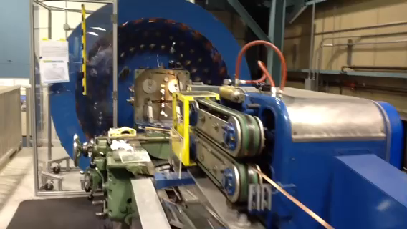
Fabricating Cable at LBNL

Slide 6
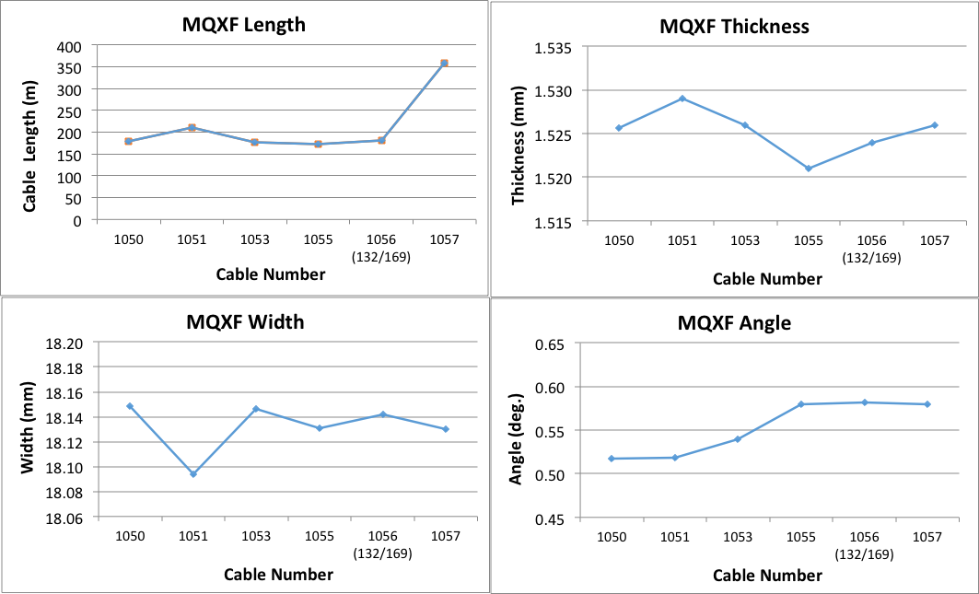
MQXF Production Cable Parameters
Spec
Tolerance
Tolerance
Spec
Tolerance
Spec
12 mm wide core biased to thick edge
10 mm wide core centered

Slide 7
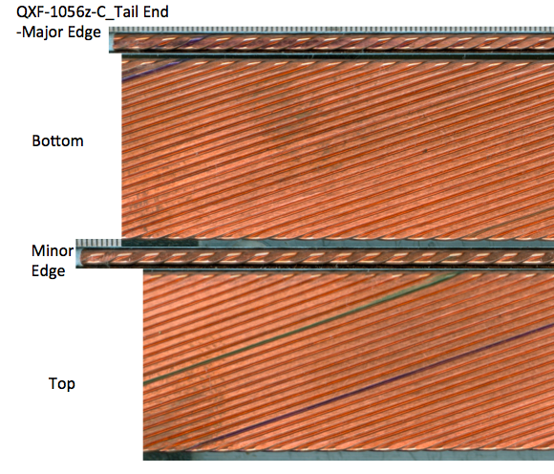
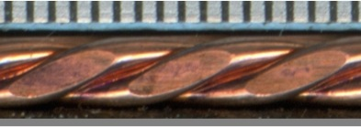
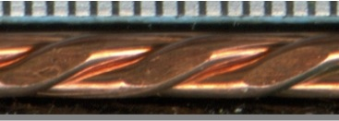
MQXF Cable 1056Z with 132/169
Facet are uniform and not too large
All surfaces show uniform wire spacing

Slide 8
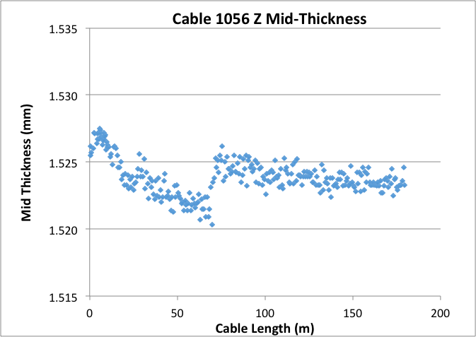
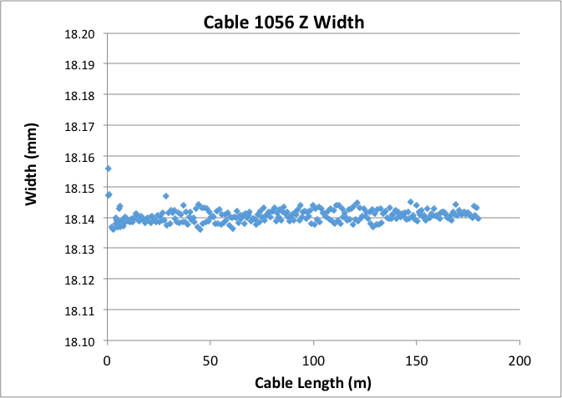
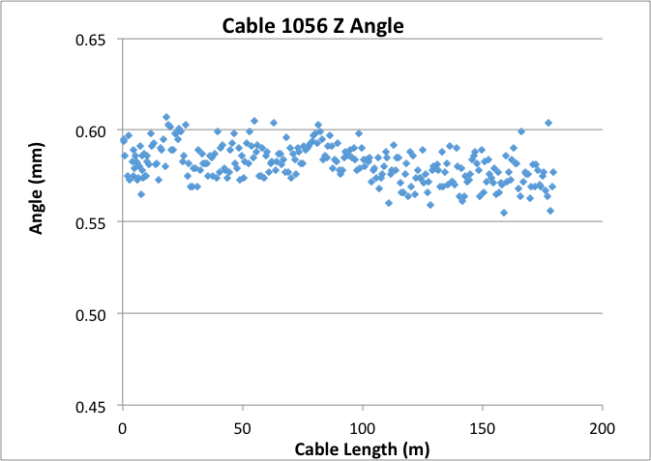
MQXF Cable with RRP 132/169 Wire and Draft Parameters
Tolerance
Tolerance
Spec
Spec
Spec
Tolerance

Slide 9
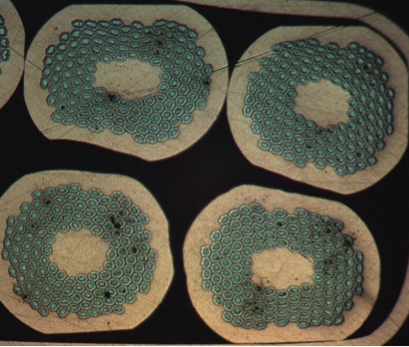
1056Z – Rectangular Configuration
Orientation when polishing started

Slide 10
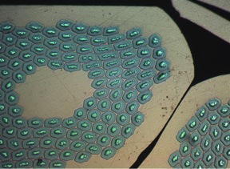
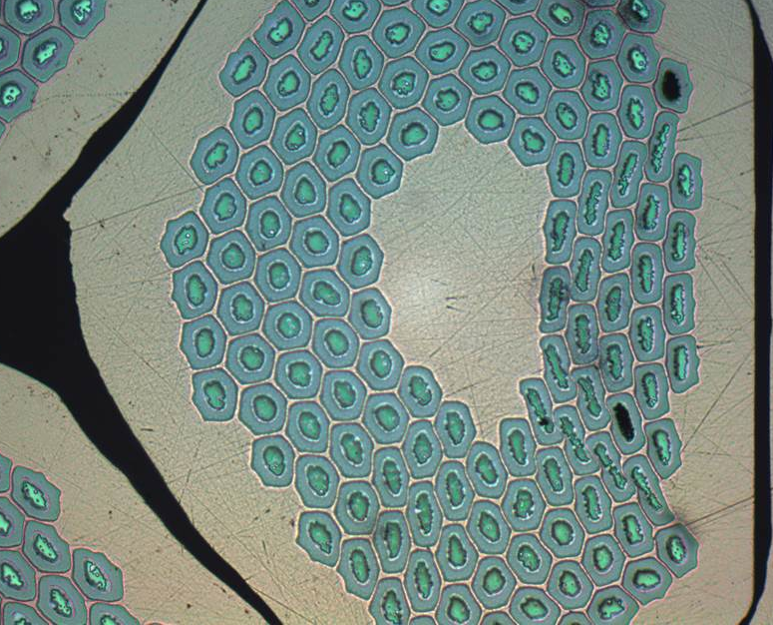
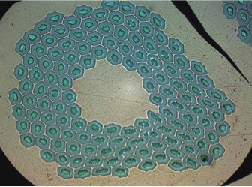
1056Z – Triplett Configuration at
Top
Apex
Worse case for 8 cables sections:
One strand has 6-8 broken sub-elements
Typical:
0-3 broken sub-elements
Bottom

Slide 11
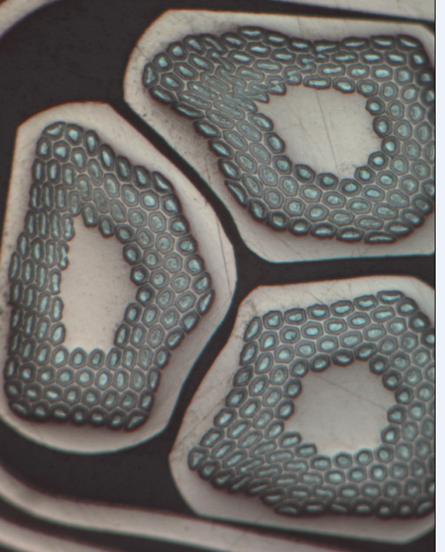
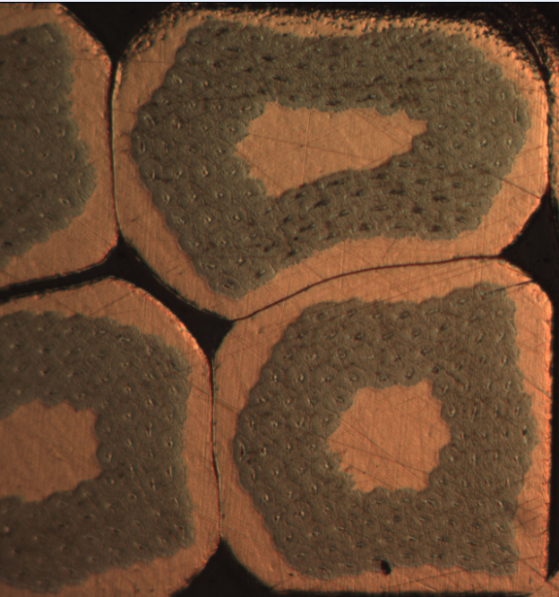
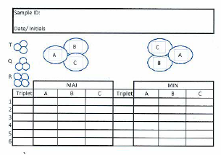
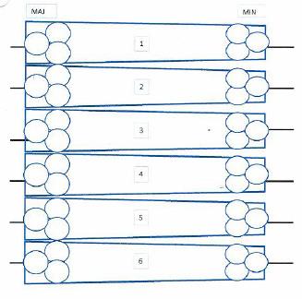
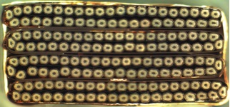
Strand Quality Score

Slide 12
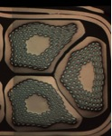
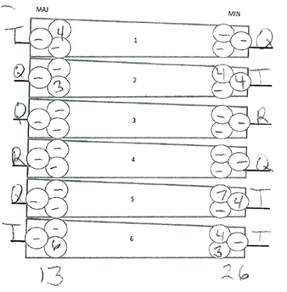
Quality Score Method for Cable
1048Z (Un-annealed)
How is the “Quality Score” determined?
The number of sheared sub-elements in the wires at the each edge of the each cable is determined.
One method is to average the number of sheared sub-elements at each edge of the cable.
The other assumes that the stability performance of the cable in a magnet is going to be limited by the highest score (i.e. lower local RRR) not the average at each edge.
A “Quality Score” is determined by one of these methods.
  Highest value in any one wire , i.e. 7 for the minor edge and 6 for the major edge
  However the average method would give a values of (0+2.66+0+0+3.66+2.33)/6 cables = 2.88

Slide 13
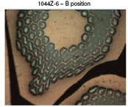
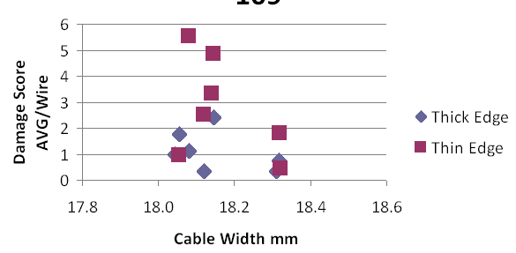
Trade-off Between Cable
Mechanical Stability vs. Strand Quality
RRP 108/127, ~1.50 mm thick
Better Mech. Stability
Better Stand Quality
1042Z-13
Quality Score
18.47 mm calc. width for 109 mm P.L.
Need 17.95 mm width for
Cable Winding score of zero
Cable Width
Width Ratio =
Calculated Width

Slide 14
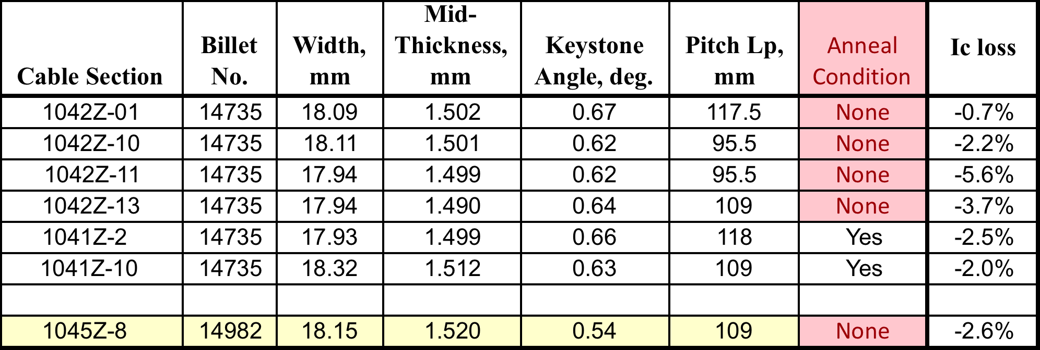
Cable Parameters from R&D Effort with
Reduced Sn
1045Z-8 was made to specifications but with un-annealed wire

Slide 15
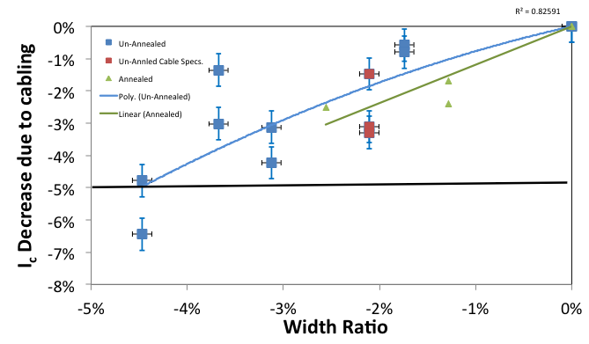
I_{c}(11T, 4.2K) Decrease due to Cabling
Annealed wire
To spec but un-annealed
Un-Annealed wire
Spec < 5% loss

Slide 16
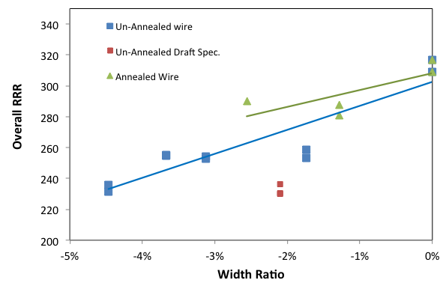
RRR of Extracted Strands for Annealed and Un-Annealed Wire
Annealed wire
1042Z-13
1045Z
Billet 1498

Slide 17
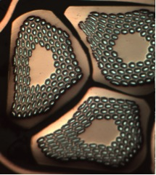
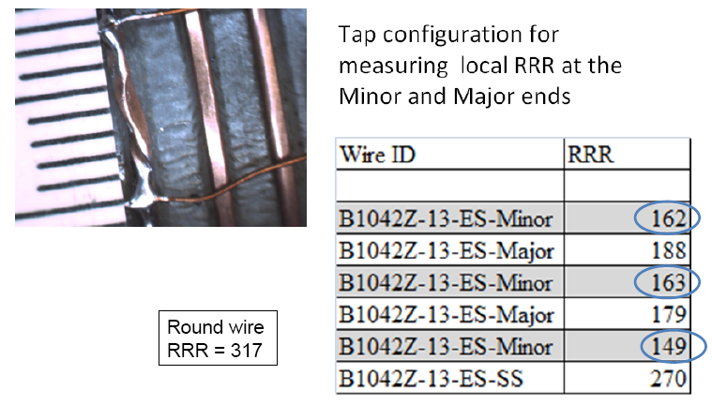
RRR of Edges of MQXF Strands
Extracted from Cable
For heat treatment of 650C for 48 hr.
Round strand has RRR of 317
RRR of kink (edge of cable) is 150-160 for Voltage Tap spacing ~7 mm
Cable width 17.94 mm, R&D cable
Wire RRR specification is >150.
1042Z -13
RRP 14735

Slide 18
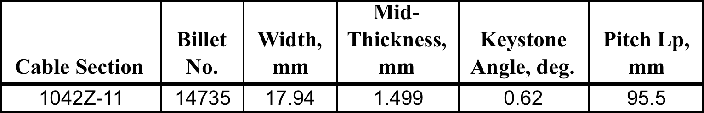
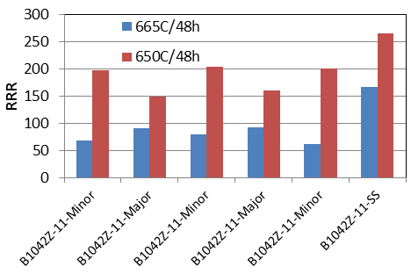
Control of RRR with Heat Treatment
R&D cable is narrower and thinner than spec
  Plus shorter pitch length and larger keystone angle
RRP 108/127 with reduced Sn
7 mm voltage tap spacing

Slide 19
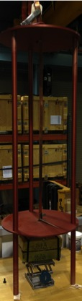
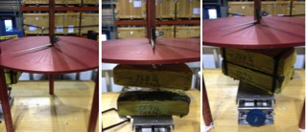
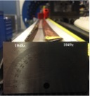
Cable Residual Twist
Residual Twist Measurements In Deg./m
Three loads were used 0, 12.2 & 24 kg
-Deg. cable loosens when straightened “unfavorable”
+Deg. (CW) cable tightens when straightened “favorable”
VERTICAL Rotation (deg.) Horizontal
Load (Kg) 0 kg 12.2 kg 24 kg 0 .
1048z (Un-annealed) +40º +60º +80º +50º (CW to 0º)
1049z (Annealed) -10 5º +25º 0º
Both seem to be acceptable for coil winding

Slide 20
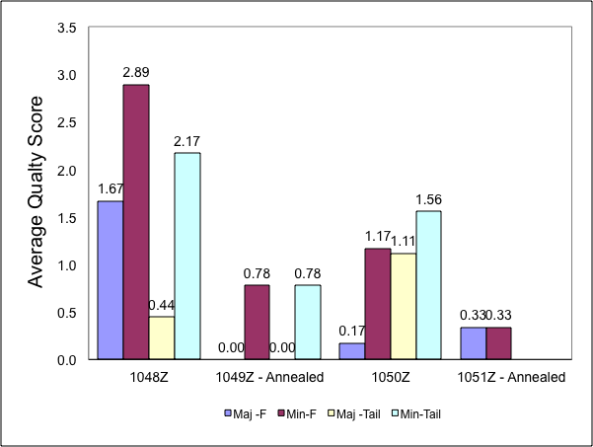
Reasons to Anneal Wire
LARP has prior experience with annealing cable and wire
Cables with annealed wire appears to have less strand damage during cabling
  Lower Quality Score (i.e. fewer sheared sub-elements)
May provide a higher RRR at the edges of a cable
  This has yet to be confirmed
Cable is flatter
Has less residual twist
Could reduce dimensional changes of coil during heat treatment (HT)
Permits smaller gaps in coil pole pieces prior to HT

Slide 21
Summary
For LARP no changes to cabling parameters are expected
  Mid-thickness = 1.525 mm +/- 0.010 mm
  Width = 18.15 mm +/- 0.050 mm
  K.S. angle = 0.55 deg. +/- 0.10 deg.
  Pitch Length = 109 mm +/- 3 mm
  S.S. core = 12.0 mm nominal width
    0.025 mm thick
    bias towards thick edge
  Anneal wire at 170C for 15 hrs.
Baseline cabling process uses annealed wire
Extracted strands have good “quality” with the cable parameters listed above
For RRP® 108/127 strand the RRR and I_{c} reduction measured in extracted strands is acceptable with these cable parameters
LARP is still investigating the local RRR of extracted strands of RRP 132/169

Slide 22
The End

Slide 23
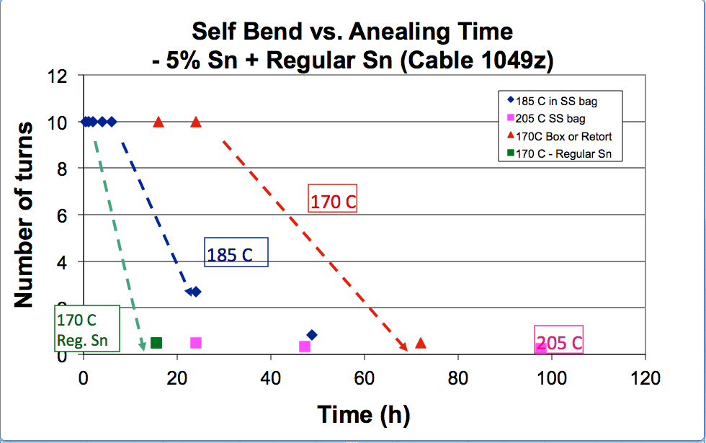
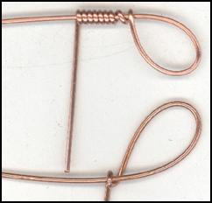
Risk of annealing wire
Risk of annealing wire – It may become brittle
  If temperature is too high or too long
Strain in self bend test is 4 times greater than during cabling
5% reduced Sn
RRP 108/127

