Slide 1



Lessons learnt from CERN experience
Luc Oberli
MQXF Cable Review
Nov. 5, 2014

Slide 2
Outline
Comparison between LHC cable production and Nb₃Sn cable production for HiLumi
Experience with Nb₃Sn cable fabrication done at CERN
CERN experience and lessons from LHC cable production
organisation to follow the LHC cable production
organisation of the quality assurance system
lessons from LHC for the MQXF cable fabrication
Summary

Slide 3
Comparison between LHC cable production
and Nb₃Sn cable production for HiLumi
LHC cable production done in a very different context compare to what is foreseen for the MQXF cable production. Nevertheless, it is interesting to draw a parallel.
1. The MQXF cable quantity to be fabricated is much lower than the LHC cable production
32 km of cable for Q2 7500 km of cable for LHC
40 km of cable for Q1 and Q3
2. Two wire producers for the MQXF cable and six wire producers for the LHC cable
MQXF Cable fabrication for Q2 foreseen at CERN while for LHC cable fabrication done in industry
The QA/QC system implemented for LHC cable production can be applied to the MQXF cable production, but more constraints with Nb₃Sn wire on the QC system as the Nb₃Sn wire must be reacted for the Ic and RRR measurements.

Slide 4
Experience with Nb₃Sn cable fabrication done at CERN
Experience with the 11 T cable fabrication
CERN’s experience based on 31 different cabling runs dedicated to the 11T cable fabrication,
which represents in total 3700 m of cable.
Fabrication of 10 cable unit length of ~ 230 meters either with RRP 108/127 or RRP 132/169
Fabrication of 1 cable unit length of ~ 230 m with PIT 114 wire
Fabrication of 2 cable unit lengths of ~ 230 meters with WST wire
Experience with the MQXF cable fabrication
CERN’s experience based on 16 different cabling runs dedicated to the MQXF cable fabrication
Fabrication of 14 RRP cables and 10 PIT cables with different parameters during the R&D program before to arrive to the “first iteration” parameters for the cable (10 cabling runs and in total 250 m of cable).
Fabrication of 4 cables with the “first iteration” dimensions with RRP 132/169 wire for the model program (4 cabling runs and in total 650 m of cable).

Slide 5
QA/QC system Organisation to follow the LHC cable production
To guarantee the performance of the wires and cables, systematic tests were implemented by CERN on wire verification samples and on cables.
Team of Engineers
Each contract for LHC wire and cable fabrication was followed by an engineer in daily relation with the contractor.
A monitoring of the LHC billet production was implemented. Wire producers provide data on wire production and verification samples for qualification tests at CERN. (the supplier shall have the feeling that the billet production is under control).
Laboratory
for mechanical tests
Building 103
Laboratory for cryogenic measurements
Building 163
The quality assurance system was organised around a database which had to collect all the data on wire production and which enabled to follow the advancement of the production.
BNL
Ic Câble at 4.2 K

Slide 6
Organisation of the quality assurance system
Three holding points in the cable production
Billet Approval
Holding points introduced at three different levels of the cable production are very important to ensure that the LHC cables meet all the quality requirements.
The Contractor must get CERN’s approval to use the wires from a billet for cabling, to go ahead with the cable production
data
decision
Cable strand map Approval
  Billet approval based on the data coming from systematic tests performed during the wire production by the contractor to qualify the billet and on the counter-measurements performed by CERN on the verification samples.
Cable strand map approval: the contractor must submit to CERN a cable strand map for each cable unit length and must get CERN’s approval before to start cabling (only strands from approved billets can be used for cabling).
M a n u f a c t u r i n g
data
decision
Cable Approval
data
decision

Slide 7
First holding point Billet Approval
The strand piece lengths produced from a billet shall be approved by CERN before to be used for cabling.
A 10 m long verification sample cut from every wire piece length and adjacent to the sample used by the wire producer for the Ic test was delivered to CERN.
The verification samples were used to perform by sampling acceptance tests at CERN and to cross-check the measurements done by the wire producer.
A magnetization measurement was mandatory for the approval of every billet.
Billet Approval for LHC made in two steps:
Two decisions were taken independently: a decision based on wire producer’s data and separately a decision based on CERN tests data.
Final decision on the billet when the decisions was taken on wire producer’s data and CERN data. Decision on a billet was the responsibility of the contact follower.

Slide 8

The holding point at the level of billet approval must be implemented for HiLumi
Quite a lot of fabrication problems have been detected by the tests performed at CERN on verification samples and thanks to the holding point at the level of the billet approval, the wires were not incorporated in the LHC cables.
Magnetization measurements performed by CERN on one sample of every billet.
Width of the Magnetiza tion loop
Drift of the magnetization out of the control limits seen during the wire production and indicating fabrication problems.
Important deformation of the NbTi filaments without a significant effect on the Jc values.
5 billets refused due to excessive value of the magnetization.
M = 60 mT,
Jc = 1510 A/mm² 4.2K
Magnetization measurements shall also be mandatory for HiLumi

Slide 9
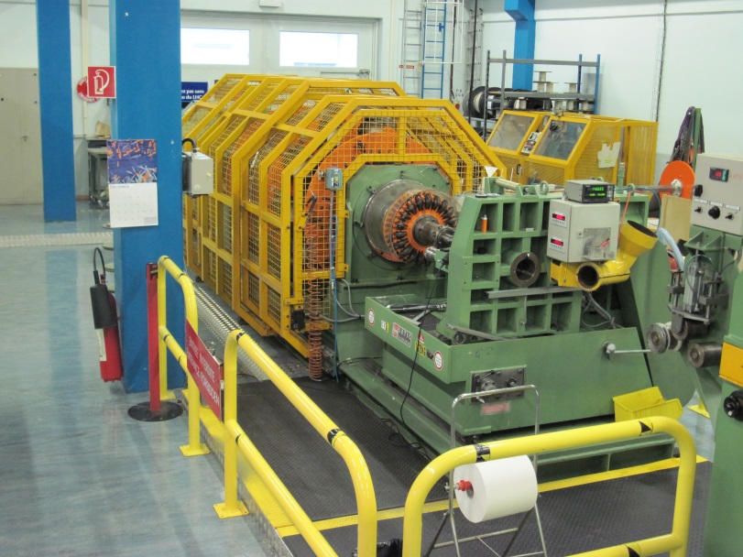
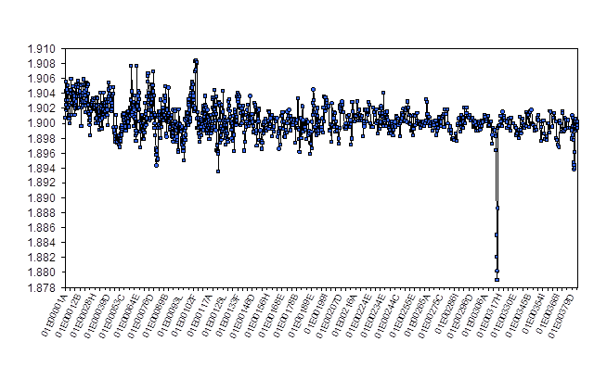
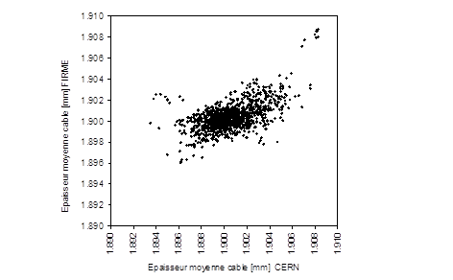
MQXF cable fabrication
CERN cabling machine already used in industry for LHC cable fabrication.
40 spools cabling machine.
Capacity of 8 cable unit lengths for a cabling run
During LHC, the calibration of the CMM done at the beginning of the run with a calibration gauge was cross-checked with a second gauge.
At the beginning of each cabling run, a 10 stack measurement was also performed to determine the absolute value of the cable mid-thickness.
Very good correlation between measurements done in industry and at CERN
A similar procedure shall be implemented for MQXF cable fabrication
A problem with the CMM head during cabling was responsible of the mid-thickness out of specification

Slide 10
MQXF cable fabrication
Cable strand map approval
The approval of the cable strand map must be implemented for the QXF cable fabrication.
All the cable strand maps must be approved around 2 weeks before to start the preparation of a cabling run.
Number of cabling run for Q2
45 cable unit lengths of 710 meters have to be fabricated for Q2
Distribution of wire piece lengths : 50 % in piece length < 1600 m
No possibility to make cold welds with Nb₃Sn wire
Implication : all the cabling runs will be done with a strand map for 1 or 2 cable unit lengths.
30 < Number of cabling runs < 45
Typically 6 months of fabrication

Slide 11
Some considerations on the planning of the MQXF cable fabrication
To manage the cable production
Enough wire piece lengths from approved billets shall be available to prepare the cable strand maps.
Approval of a cable strand map to be done at least 2 weeks before a cabling run.
For Q1, a cable unit length needs ~ 20 km of wire
For Q2, a cable unit length needs ~ 32 km of wire
A stock of wire for 2 months of cable production should be foreseen to have enough wire to prepare the cable strand map in order to mix the wires coming from different billets in the best way and also in case of delay in wire delivery.
Strategic stock of MQXF cables
During LHC cable fabrication, the main shaft of the cabling machine AC370 in Brugg broke and the reparation took 5 months.
Two possibilities to overcome such a problem:
1. Consider a strategic stock of MQXF cable
2. Transfer a part of the cable fabrication to another facility
For LHC, the strategic stock of cables corresponded to 5 months with the delivery rate requested for the coil manufacturing.
Notes:
Adequate preventive maintenance to be implemented for the cabling machine AC250.

Slide 12
Summary
Many lessons can be drawn from the LHC cable production.
The QA system put in place to follow the production of the LHC cable was fully tried and proven to be relevant. A similar QA system must be implement for MQXF cable production.
The quality assurance system has to be organised around a database which had to collect all the data on wire production and all the measurements done on the verification samples.
Billet approval and cable strand map approval must be implemented for HiLumi
Strategic stock of cable equivalent to few months of coil fabrication has to be put in place.

