Slide 1

Hi-Lumi Conductor Procurement
HL-LHC/LARP International Review of
Superconducting Cable for the
HL-LHC Inner Triplets Quadrupoles (MQXF)
Ballarino, TE-MSC-SCD
6th November 2014
Ballarino, B. Bordini, L. Oberli

Slide 2
Outline
Quantity of conductor procured
    Procurement of wire for series production
    Cable production plan

Slide 3
Conductor for MQXF quadrupole
Double sourcing
  Procurement of PIT and RRP® Nb₃Sn wire
  Needed: (520 + 230) km of RRP®
    (520 + 230) km of PIT
    1500 km (8.4 tons) in total
    Procured: 1000 km (4.54 tons) of RRP (+ option for 500 km)
    1000 km (4.54 tons) of PIT (+ option for 500 km)
    The option enables to act in case of problems from one supplier
Notes:
32 km of wire per cable

Slide 4
Procurement –Nb₃Sn Wire
Procurement strategy as presented at the Hi-Lumi/LARP Conductor Internal Review, CERN, October 2013
Planned
Planned
LP: 200+200 km
SMP: 20+20 km
Ordered
Procured
6+6 LMCs
5+5 SMCs (May 2015)
SMP: 35+35 km
Conductor
for series
Cabling trials: 5+5 km
6+6 SMCs
2012
2013
2014
2015
2016
2017
Long Prototypes
Short Model Program

Slide 5
Procurement – Nb₃Sn Wire
Internal Process Launched
IT Committee 7th Nov. 2014
FC March 2015
Planned
Ordered in
February 2014
Planned
LP: 200+200 km
Received
SMP: 20+20 km
Ordered
Procured
6+6 LMCs
5+5 SMCs (May 2015)
SMP: 35+35 km
Conductor
for series
Cabling trials: 5+5 km
6+6 SMCs
2012
2013
2014
2015
2016
2017
Long Prototypes
Short Model Program

Slide 6
Nb₃Sn Wire for MQXF Prototype Program
Short Models (UL = 400 m)
5 km (RRP 132/169) + 5 km (PIT 192) – Cabling trials
45 kg delivered from December 2012 to March 2013
35 km (RRP 132/169) + 35 km (PIT 192)
318 kg delivered from November 2013 to October 2014
20 km (RRP 132/169) + 20 km (PIT 192)
182 kg to be delivered in the first trimester 2015
545 kg of Nb₃Sn for MQXF ordered
Long Models (UL = 800 m)
200 km (RRP) + 200 km (PIT)
1.8 ton to be delivered in 2016 (18 months)
Tot = 2.35 tons of Nb₃Sn for MQXF Prototype Program

Slide 7
Procurement of Nb₃Sn
1000+500 km
1000+500 km
200+200 km
20+20 km
45 coils
35+35 km
6+6 LMCs
5+5 SMCs
5+5 km
6+6 SMCs
2012
2013
2014
2015
2016
2017
2018
2019
2020
Series
Long Prototypes
Short Model Program
Notes:
One coil=30 km of wire

Slide 8
Strand delivery and cable production
Coil winding
Jan 2018-Nov 2020
Cables ready for insulation
Oct 2017-Sept 2020
Delivery
200 km +200 km
Cabling activity
April 2017-December 2019
Wire delivery (series)
Preparation
(IT Committee,…)
Jan 2017-September 2019
FC March 2016
Adjudication of contracts
Options
2016
2017
2018
2019
2020
2021

Slide 9
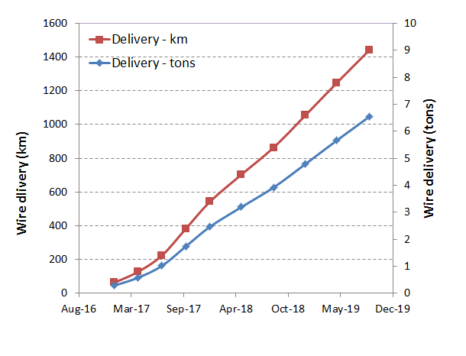
Wire delivery
(32+32) km in Jan 2017
(32+32) after 4 months
(43+43) km after 3 months
(80+80) km every 3 months
(96+96) km every 3 months
Maximum delivery rate ∼ 100 km (450 kg) every 3 months
Notes:
For the 400 km order: 30 km every 2 months
For the 1500 km order

Slide 10
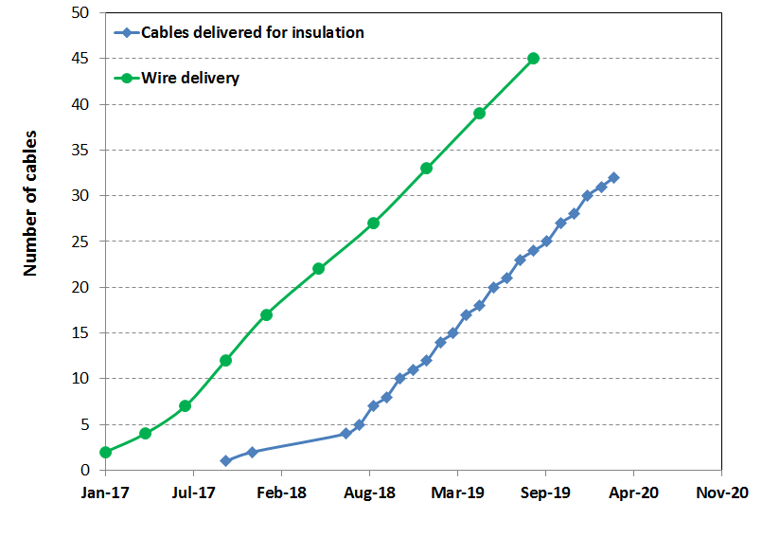
Wire delivery and cables production - Series
March 2020
Series (32 coils)
Dec 2017
Oct 2017
Delivered to magnet team: 2 months before coils assembly (for electrical insulation)
Available: availability of cables according to wire delivery schedule

Slide 11
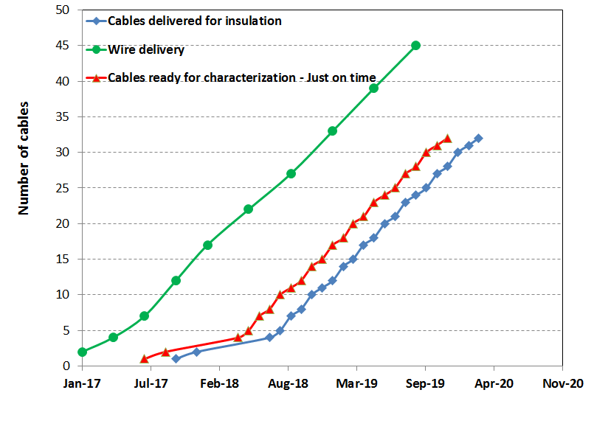
Wire delivery and cables production - Series
Dec 2019
July 2017
Delivered to magnet team: 2 months before coils assembly (for electrical insulation)
Cables ready for characterization : 3 months before delivery to magnet team
Available: availability of cables according to wire delivery schedule

Slide 12
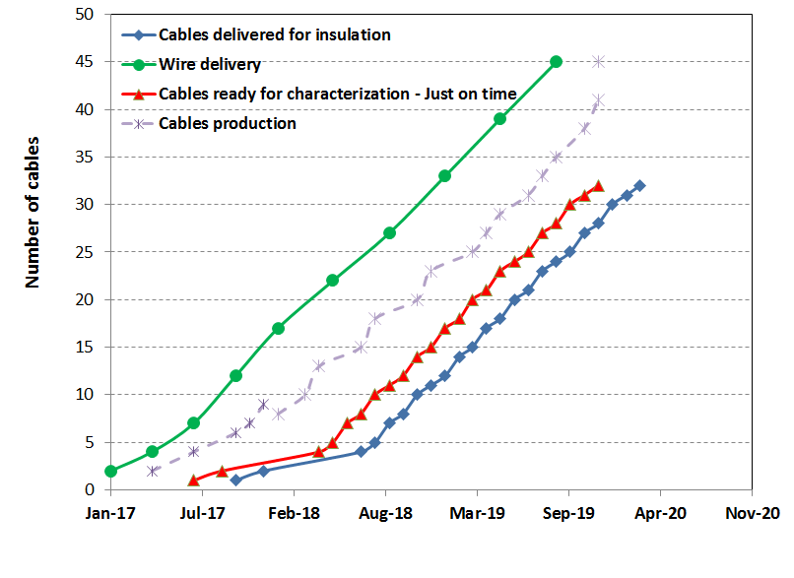
Cables production - Series
December 2019
December 2019
Series
August 2019
Series
March 2020
Series
Buffer of 4 cables
Max cable production rate:
2 cabling runs/month
Delivered to magnet team: 2 months before coils assembly (for electrical insulation)
Cables ready for characterization : 3 months before delivery to magnet team
Available: availability of cables according to wire delivery schedule

Slide 13
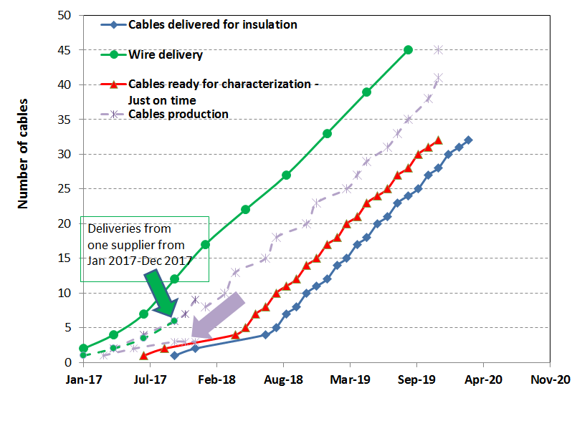
Cables production - Series

Slide 14
Cable production
Total quantity: 45 cables to be produced during 3 years – 32 for series production
From April 2017 till December 2017: production of cables for earlier deliveries plus buffer of 4 fully qualified cables – to compensate for unforeseen stop of production (cabling machine, QC equipment, delay in measurements…)
Cable production rate: one cable every two weeks. Three months have been taken into account for measurements before delivery of cables for coils winding

Slide 15
Conclusions
A wire procurement strategy has been established in accordance with requirements for cable production
A cable production plan has been established in accordance with requirements for coils assembly
Cabling activity will be performed at CERN. Production of unit lengths of cables will be launched sufficiently early to assure cables need for coils assembly – also in case of late delivery from one wire manufacturer - and availability of a buffer of cables

