Slide 1
MQXF Q1/Q3 Conductor Procurement
A. K. Ghosh
MQXF Conductor Review
November 5-6, 2014
CERN

Slide 2
Outline
Introduction
MQXFS and MQXFL Magnet Strand and Cable
  Strand procurement for the prototype magnet (qualification phase or pre-production phase)
MQXF Strand Production/Procurement Plan
    Phase I followed by Phase II production
    QA/QC plan at vendor and within the project
MQXF Cable
  Cabling,
  Insulation and Testing
  QA
Summary

Slide 3

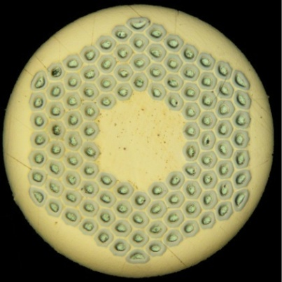
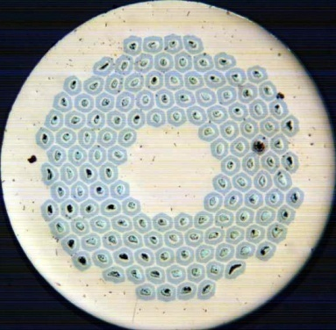
Introduction
For the MQXF Q1/Q3 Magnets we will likely use RRP® wire from Oxford Superconducting Technology
Strand diameter 0.85 mm
  Ti-Ternary Nb₃Sn
Cable is a 40- strand Rutherford Cable with stainless steel core
The 1st Short model MQXFS magnet is using coils made with 108/127 strand.
Subsequent Short and Long MQXF magnets will use 132/169 design wire (smaller filament diameter)
Final Specification Documents for the MQXF magnet strand will be released in June’2015.
  It will be a performance based specification as is currently being used for LARP strand procurements.

Slide 4
LARP-MAG-M-8004-Rev. B (Present spec.)
Process |  | Ti-Ternary RRP® Nb₃Sn
Strand Diameter, mm |  | 0.85 ± .003
I_{c}(12 T) at 4.2 K, A |  | ≥ 684
I_{c}(15 T) at 4.2 K, A |  | > 361
n-value |  | > 30
D_{s}, µm (sub-element diameter) |  | < 60
Cu-fraction, % |  | > 53
RRR (after full reaction) |  | ≥ 150
Twist Pitch, mm |  | 14 ± 2
Twist Direction |  | Right-hand screw
Minimum Piece length, m |  | 750
High temperature HT duration, h |  | ≥ 48
D_{s} sub-element diameter
I_{c} Critical Current
RRR residual resistivity ratio

Slide 5
MQXF Strand Specification
Process | RRP® or PIT Nb3Sn
Strand Diameter, mm | 0.850 ± .003
I_{c}(15 T) at 4.2 K, A | > 361
n-value | > 30
I_{c}(12 T) at 4.2 K, A (Reference Only) | (> 632 )
D_{s}, µm (sub-element diameter) | < 50
Cu : Non-Cu volume Ratio | 1.2 ± 0.1
RRR (after full reaction) | ≥ 150
Twist Pitch, mm | 19 ± 2
Twist Direction | Right-hand screw
Strand Spring Back, deg. | < 720
Magnetization Width at 3 T, 4.2 K, mT | < 300
Minimum Piece length, m | TBD

Slide 6
LARP-MAG-M-8007 Rev.0 (TBR)
Process | Ti-Ternary RRP® Nb₃Sn
Strand Diameter, mm |  | 0.85 ± .003
I_{c}(15 T) at 4.2 K, A |  | > 361
I_{c}(12 T) at 4.2 K, A (for reference) |  | (≥ 632)
n-value |  | > 30
D_{s}, µm (sub-element diameter) |  | < 50
Cu : Non-Cu volume Ratio |  | 1.2 ± 0.1
RRR (after full reaction) |  | ≥ 150
Twist Pitch, mm |  | 19 ± 2
Twist Direction |  | Right-hand screw
Strand Spring Back, deg. |  | < 720
Magnetization Width at 3 T, 4.2 K, mT |  | < 300
Minimum Piece length, m |  | 550
High temperature HT duration, h |  | ≥ 48
D_{s} sub-element diameter
I_{c} Critical Current
RRR residual resistivity ratio

Slide 7
Procurement Plan for MQXF RRP-132/169 strand leading up to the Prototype magnet
Require 6 coils for short MQXF; cable unit length 150 m
Require 16 coils for Long MQXF; cable unit length 450 m
Assuming 12% loss in strand from cable mapping
Total length of strand for MQXFS: ~ 50 km (250 Kg)
  55 km of strand is in inventory
Total length required for MQXFL: 350 km (~ 1750 Kg)
  12 km in inventory
  17 km awaiting delivery pending all tests
  A total of 320 km has to be procured in FY’15 & FY’16
Present specification LARP-MAG-M-8004 Rev. B
  Is being replaced by LARP-MAG-M-8007
Notes:
Cable in MQXFS coil is 126 m, need minimum 136 m. fabricated length 150 m
Cable in LQXFL coil is 407, need minimum 420 m, fabricated length 450 m
Cable mapping loss 12 % based on actual delivered lengths

Slide 8
Procurement Plan for MQXF Q1/Q3Magnets
Require 90 coils for Q1 and Q3
Unit length of cable : 450 m
Assuming 12% loss in strand from cable mapping
Total length of strand for UL of cable: 22.4 km
Total length required for project: 2016 km (~ 10,000 Kg)
  ~ 225-250 billets depending on yield
  Present billet size is 45 Kg
Coil production start: Jan’2018
Cable Production start: June 2017
  Final Strand Specification set June’2015
  RFP sent out Oct’2015
  Contract placed Apr’2016
  Phased Production
    Phase 1 : First delivery of 500 Kg May’2017
    Phase 2 : Production Phase July’2017 through Oct’2018
  Delivery complete Oct’2018

Slide 9
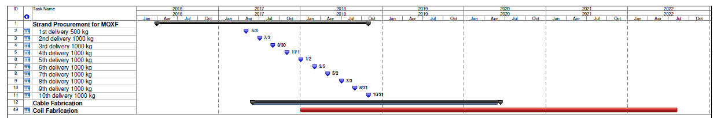
Strand Delivery Schedule
First delivery after 12 months of placing of contract
Cable mapping using first 500 Kg of wire
1 UL will use wire from at least 3 billets

Slide 10
Strand Delivery Schedule
OST (most likely vendor for RRP wire) has sufficient capacity to handle both CERN and US orders in the same time frame. Production rate ~ 1 metric ton/month. During ITER the production rate was ~ 2 tons/month.

Slide 11
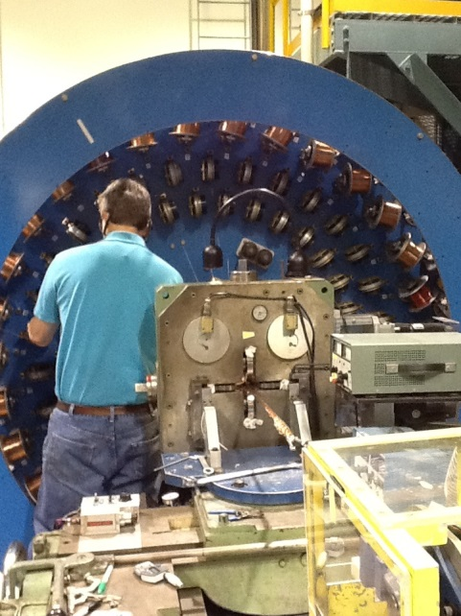
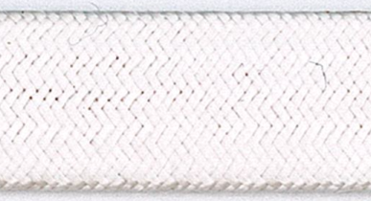
Cabling and Insulation Plan
Cabling at LBNL
Cabling to start 5-6 months in advance of start of coil winding.
Cabling Start June 2017
  Unit length is fabricated within 1 week.
Cabling throughput required 2 UL’s / month at start, ramping to 3 UL’s/month by July’2018
S2 glass Insulation braided directly onto cable
Vendor: New England Wire Technology (qualified)
  Sufficient capacity to keep up with cabling rate, 2 braiders available.
  Unit length insulated within 5 working days.

Slide 12
QA-Plan
Conductor Qualification - 1
Billets from OST
QC Tests at OST
Strand Delivered
Cable Mapping
Billet Qualification
Cable fabrication
Cable Qualification
Coil Winding & HT
= Hold point
HT Witness Sample Test
Cold Mass Fabrication

Slide 13
Conductor Qualification -2
Billet Qualification
  Primarily based on vendor QA/QC
  Apply SPC to track uniformity of strand production
  QC tests on a smaller subset of samples at a US lab
  Phase I will have more extensive checks than Phase 2
  OST data will be verified periodically with measurements at a US lab.
Cable Qualification
  This is important and needs to be completed prior to coil winding.
  Mechanical tests, metallographic test, insulation thickness
  I_{c} and local RRR electrical test: minimum 3 extracted strand and one round wire
    Heat Treatment schedule (HT) as specified for coil reaction

Slide 14
Strand QC Tests and Reports
QC Tests and Reports
  Cu/Non Cu
  Twist Pitch and Twist Direction
  Ic, n-Value, RRR
  Magnetization Width
  Wire Springback
  Surface Cleanliness Certification
    Eddy Current Certification
  Final Wire Diameter
  Piece Length
Material Certifications:
  Tin Rod
  Niobium Rod
  Niobium/Titanium Rod
  Niobium Sheet
  Copper Tube
Ian Pong will elaborate on the QA/QC plan

Slide 15
Cable QC Tests and Reports
QC Tests and reports
  Cable dimensions from CMM
  Cable 10-stack measurements
  Cable cross-section microscopy
  Cable Residual Twist
  RRR of Extracted strand
  Ic, n value of extracted strands
  Cabling Report
  Cable Piece Length
  Insulation thickness
Material Certifications:
  Insulation fiber
  Stainless Steel core

Slide 16
Summary
Strand procurement has been planned to meet coil winding schedule.
  Strand production will last for 30 months
  Phase I used to assess vendor QA/QC and set control limits on full production
Cabling start is planned for 5 months before coil winding
  Goal is to be well ahead of cable required for coil winding
Peak cabling rate of 3 unit lengths/ month during production can be handled at LBNL
  Cable throughput ramps up after one year of operation.
Final Specification documents and Strand and Cable production QA plan to be released in time for strand RFP (Request For Proposal) solicitation in Oct’2015.

Slide 17
End of Presentation

Slide 18
Cable Insulation
Insulation is braided directly on cable
  New England Wire Technology (NEWT)
Using S-2® glass (from AGY) with 933 Silane sizing
6 lengths of MQXF cable (170 m long) has been insulated
  Using braiding parameters to yield target specification of 0.145 ± 0.005 mm thickness
  10-stack measurements at 5 MPa are used to determine insulation thickness
  Thickness can be readily adjusted to meet any change to present specification.

