Slide 1
LARP Materials QA/QC
Ian Pong ipong@lbl.gov (Toohig Fellow)
Dan Dietderich drdietderich@lbl.gov (Cable Task Leader)
Arup Ghosh aghosh@bnl.gov (Materials Task Leader)
MQXF Conductor Review
November 5-6, 2014
CERN

Slide 2
Outline
What are QA/QC?
What we can learn from large Nb₃Sn projects – a comparison
  Procurement comparison
  Strand QA/QC comparison
  Cable (Conductor) QA/QC comparison
QA Overall and an example of Cable QA
QC for strand, cable, and HT
Database
Summary
Notes:
leverage ITER experience and at the same time take advantage of our simpler organizational structure

Slide 3
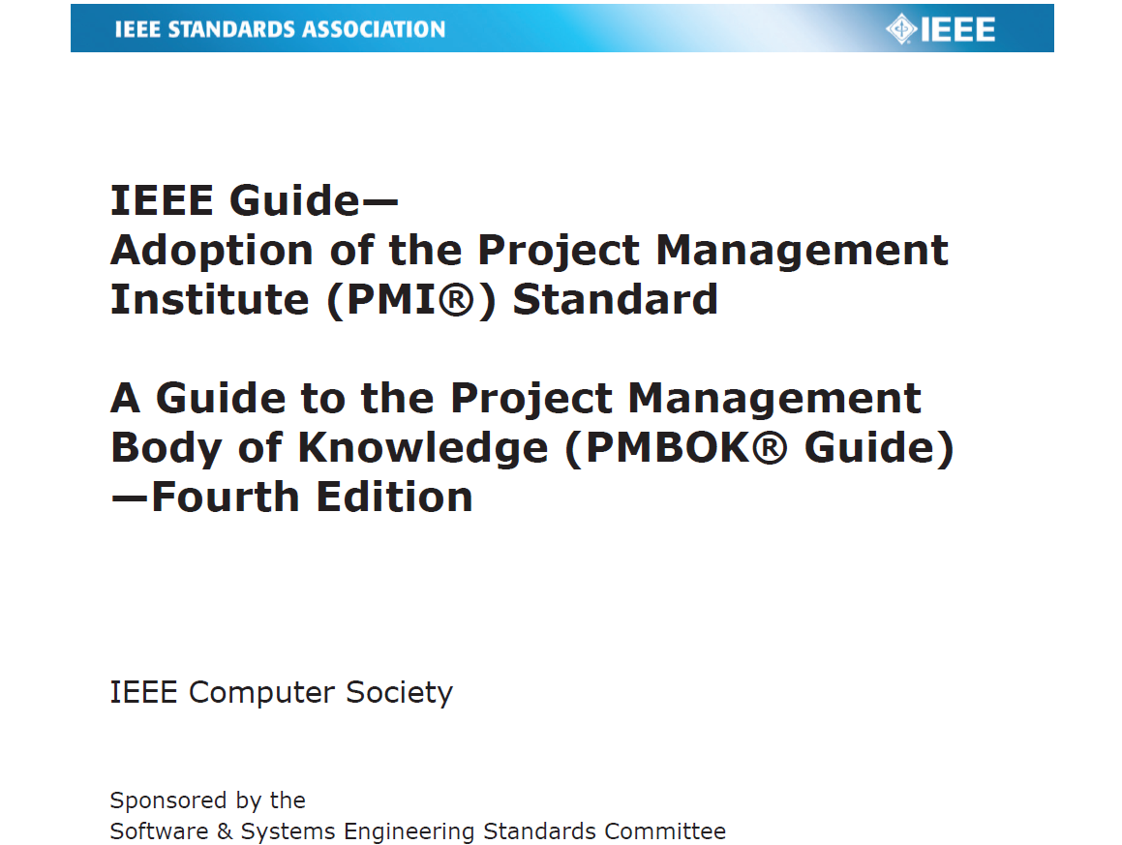
What are QA & QC
According to the IEEE Guide – Adoption of the Project Management Institute (PMI®) Standard, A Guide to the Project management Body of Knowledge (PMBOK® Guide) 4th Edition
  Quality Assurance is the process of auditing the quality requirements and the results from quality control measurements to ensure appropriate quality standards and operational definitions are used.
  Quality Control is the process of monitoring and recording results of executing the quality activities to assess performance and recommend necessary changes.
QA is an integral part of all tasks, to avoid risk transfer to subsequent stages.
We make planned and systematic actions to provide confidence that quality requirements will be fulfilled.
Quality is planned, designed, and built in – not inspected in
― PMI, PMBOK® Guide

Slide 4
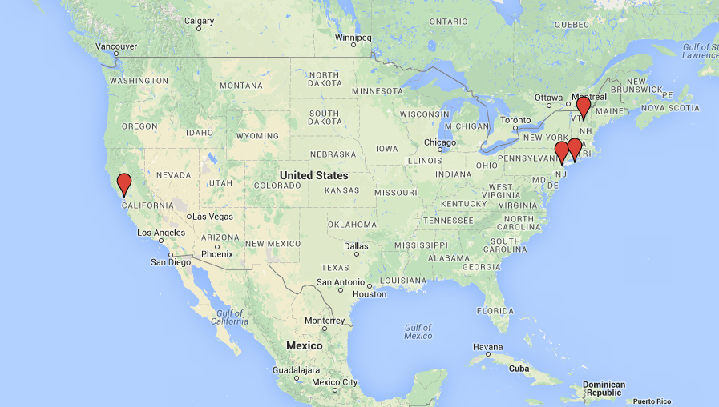
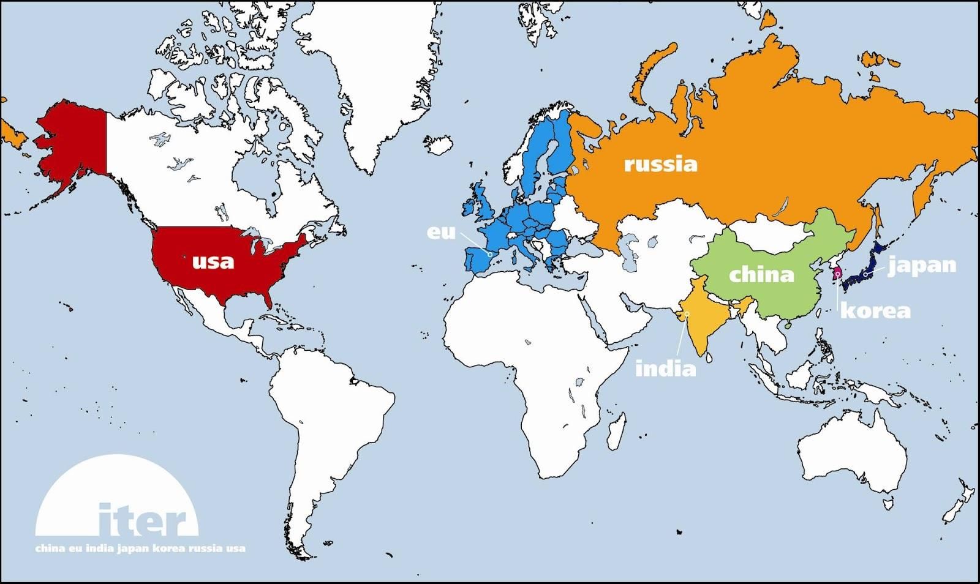
Procurement Comparison
LARP
ITER
TF Coils - A Worldwide Collaboration
Bare Cable
Moderate Nb₃Sn procurement (~10 t)
Single strand supplier
RRP (see Arup’s talk)
Strand, SS core, cable, insulation
1 cable, 1 SS core , 1 insulation supplier
LARP-Supplier contract
Small number of parties involved: flexibility, efficiency, responsiveness
Prototype → Construction; DOE critical decision related. Pre-production → Production.
Largest Nb₃Sn procurement (~600 t)
8 TF suppliers, 3 CS suppliers (6 DAs)
BR, IT; different designs
Strand, spiral, cable, jacket, wrap etc.
Multiple Cable & Jacket/ing Suppliers
IO-DA PA ‘in-kind’ contribution; DA-Supplier contract
Requirements highly uniform#
  e.g. Q_{hys} measurement frequency same for supplier
  ~50 mJ cm⁻³ & ~600 mJ cm⁻³
4 phases; readiness review
  # DR possible
Insulated
Cable
Wire
TF Coil
TF coil cases
Conductor
Russia
Japan
Japan
China
Europe
South Korea
United States
Japan
Europe
Smaller Amount, Simpler Procurement
Notes:
SQXF: 6 coils, UL 150 m = ~0.25 t (~50 km of strands)
LQXF: 16 coils, UL 450 m = ~1.8 t (~350 km of strands)
MQXF: 10 cold mass (16 + 2 spare Q1/Q3) or 90 coils, UL 450 m ? = ~ 10 t ? (~1600 km of strands?)
MQXF pre-project funding: FY16 USD ~2.5M, FY17 USD ~5M (DOE Review of LARP Q&A 2014 02 18 Apollinari slide 6)
OST ITER: EU (~37 t) + US ~70 t
LHC: call for tender; pre-production ~10 cables?; production
ITER TF: Phase II: ~0.45 t / supplier; Phase III: ~3.25 t / supplier
LARP: pre-production in FY15-16, ~1600 kg, ~35-40 billets. Production ~225 billets.
7 superconducting tokamaks: Russian T-15 (Nb3Sn); EAST (NbTi); Indian SST (NbTi); KSTAR (Nb3Sn); JT60-SA (Nb3Sn, ITER TF BR); ITER; W7X (NbTi);
JT60SA 4 CS modules: 216 Nb3Sn 0.82 mm strands, 20 kA at 8.9 T. ITER TF BR. (http://www.jt60sa.org/b/index_nav_3.htm?n3/magnets.htm)
KSTAR 16 TF + 10/14 PF (Nb3Sn). TF: 486 Nb3Sn, 35.2 kA at ; PF (8 CS aka PF1-4 + PF5): 0.78 mm; Jc>750 A/mm2 at 12 T, 4.2 K; RRR>100; Cu ratio=1.5; TP=13 mm. Mitsubishi, Outokumpu, KAT. 7.7 tons of PF, 15.7 tons of TF.
ITER TF: 3x3x5x5x6 + 12x6
ITER
Minimum 384 t of TF, ~ € 334 M*
Minimum 122 t of CS, ~ € 140 M*
Conductor cost ~ $30/kA-m at 4.2 K, 12 T
(Strand: BR ~ $12/kA-m, IT ~ $15-22/kA-m)
LARP
QXF Estimated ~10 t (LARP), ~ $ 15-20 M
RRP Strand: ~ $10-14/kA-m at 4.2 K, 12 T

Slide 5
Strand QA/QC Comparison
LARP MQXF
ITER TF
Periodic facility cross checks
Statistical Process Control planned, similar to ITER
Systematic RT & LT tests planned; frequency change according to production phase, similar to ITER
S/V measurements (V sampling)
No characterization required (cf. CDP)
Pedigree: monofilament, subelement; Data entry: billet, strand piece length
Test data reporting via DCD template to LBNL server DB
Worldwide benchmarking
SPC on critical parameters (± 3 σ)
  e.g. I_{c}: BR 5-10+%; IT ~15-20%
Systematic RT & LT tests on P/T of every billet plus statistical sampling of drawing breakages
S/V measurements (V sampling)
Extensive characterization for CPQS
Data entry: raw materials*, intermediate product, billet, strand piece length
Test data entry directly into online Conductor DB
Single supplier simplifies QA;
Reduced QC steps based on supplier and LARP experience
Notes:
expected strand verification rate during pre-production + phase I (50%) and production phases (25%)
expected extracted strand sampling rate during pre-production (100% cables, 3-4/40 strands) and production phases (100% cables, 3-4/40 strands)
expected 10-stack supplier sampling rate (100%) and LARP verification rate (100%) for insulation
LHC: 3 Ic per billet, down to 1 per billet
SPC: 01XX II & III 120703 sigma RRR = ~20%, TP = ~5%, Ic = ~6%, n = ~16%, Cu:non-Cu = ~6%
Cf. ITER NbTi Ic SPC (3 sigma) = ~7%; LHC NbTi S-PC (3 sigma) = ~4-6%
LHC NbTi RRR sigma = 5.8-17.3%
ITER PF+CC/Feeder = 224+21 t; LHC = 1300 t (6000 billets)
Cost: RRR ~USD 500@; Ic ~USD 1000@
ITER TF PA: The performance qualification test on a full-size CICC sample shall be accompanied by extensive characterizations of the component strands…
ITER strand: Process Qualification verification level: 100%; Pre-Production: 50%; Production: 25%
ITER Raw materials data entry for internal tracking or at the request of the DA regarding basic compositional, physical, electrical properties (not required by IO)
ITER Intermediate product data entry requires selection of raw component (Nb rods, Cu tubes, etc.), raw material lot number and component quantity.
ITER Billet data entry requires supplier internal QA ID, design type, number of breakages and intentional cuts, raw component, raw material lot number
ITER Strand piece length data entry requires production unit code, piece length number, length, internal ID, comment (reason for withholding a piece). Barcode.
ITER Test data: Before plating, After plating, RT&LT,
Workflow status: Supplier verified, Supplier rejected, DA approved, DA sent back, ATPP cleared, IO objected
Z reports

Slide 6
Cable QA/QC Comparison
LARP MQXF
ITER
Extracted strands from Rutherford Cable, no full size cable tests
High cable sampling rate, extracted strand sampling level will be billet-weighted
n/a
Insulation thickness by 10-stack, S/V
Strand-cable database on PTC® Windchill, will trace full history
Supplier internal approval → LARP acceptance/DW
Full size CICC test at SULTAN, none at cable level, no extracted strands
High sampling rate
Jacket tests
n/a
Dedicated online Conductor Database tracing full history
Supplier internal approval → NP/ATPP → DA approval/send back/NCR/DR → IO approval/rejection/objection
40 strands only,
well understood cable geometry
Notes:
Windchill: Project LifeCycle Management Platform
ITER SULTAN sampling rate: Phase II 100%; Phase III 100%; Phase IV 25%
ITER CSIO test at SULTAN ~250 kEur
LHC: 7500 km cable (1998-2006); LARP: ~9 km cable
LHC beam life time ~10 h
For Cable fabrication, dimension and cable damage assessment is the first PASS/FAIL decision. Extracted strand Ic may need to be qualified if only say one strand does not meet RRR of Ic.

Slide 7
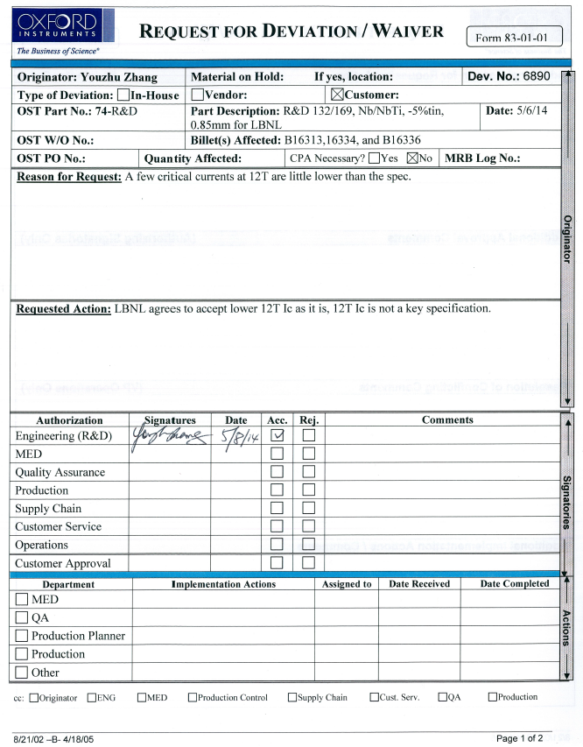
LARP QA
Specifications, Procedures, IEC, etc.
Deviation Request
Deviation Waiver / Non-Conformity Report
Notification Point, Authorization-To-Proceed Point (Cable)
Design control document/release note/acceptance documents
Shipment documentation
QA Documentation (online); Strand/cable data in DB (LBNL)
Use of barcode and ID scheme (CERN compatible)
LARP QA with Task Leaders, QC with responsible parties (At present, Strand: OST, Cable: LBNL, insulation: NEWT)
Notes:
IEC: International Electrotechnical Commission
ITER IO Conductor Database assists the DA’s in monitoring their industrial contracts
IO QA division, QC TRO, but
Overall QA: IO
QC: DA main, IO secondary

Slide 8
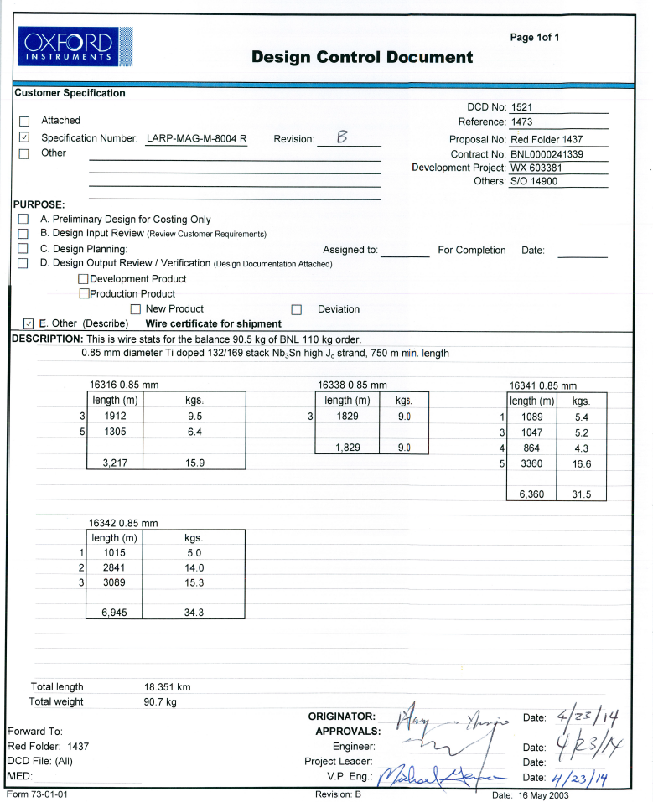

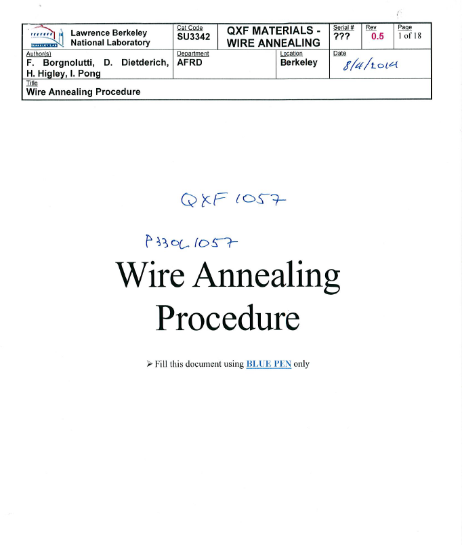
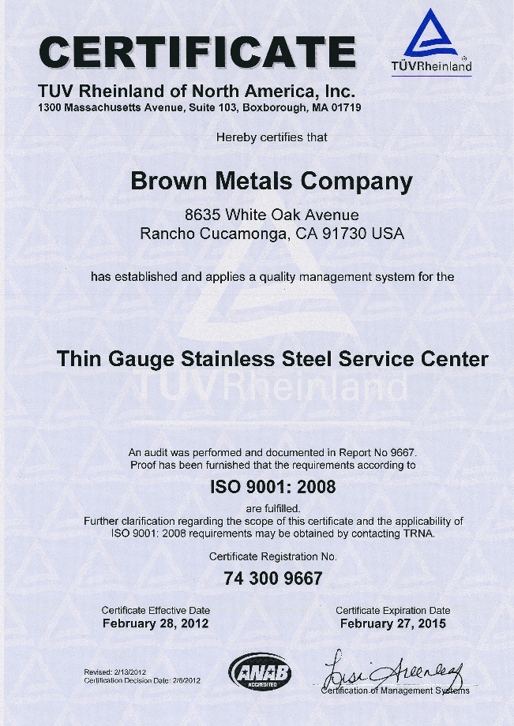
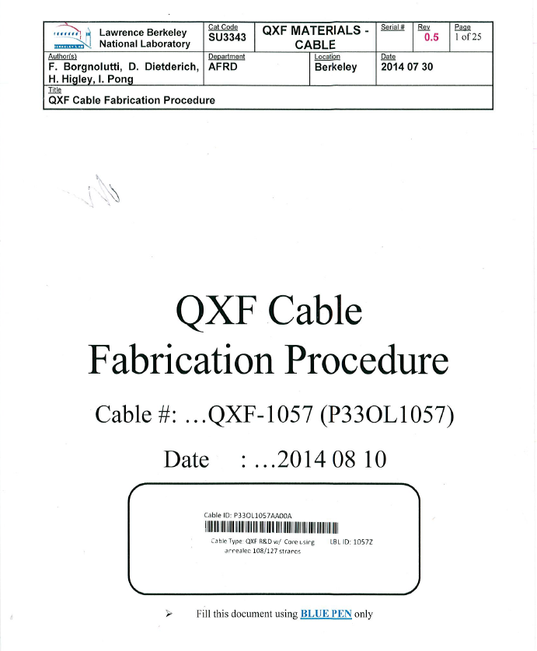
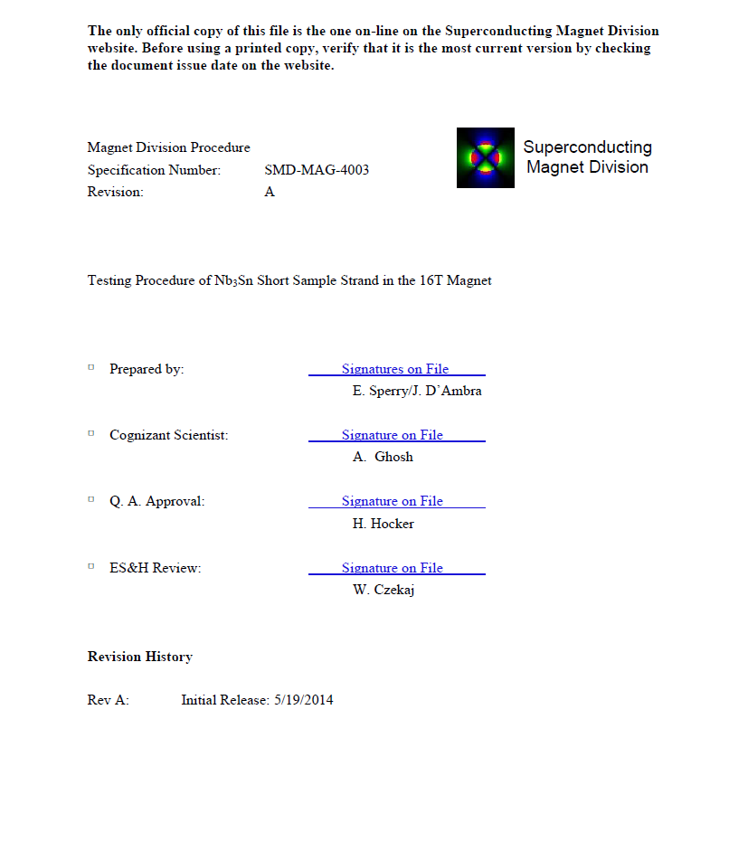
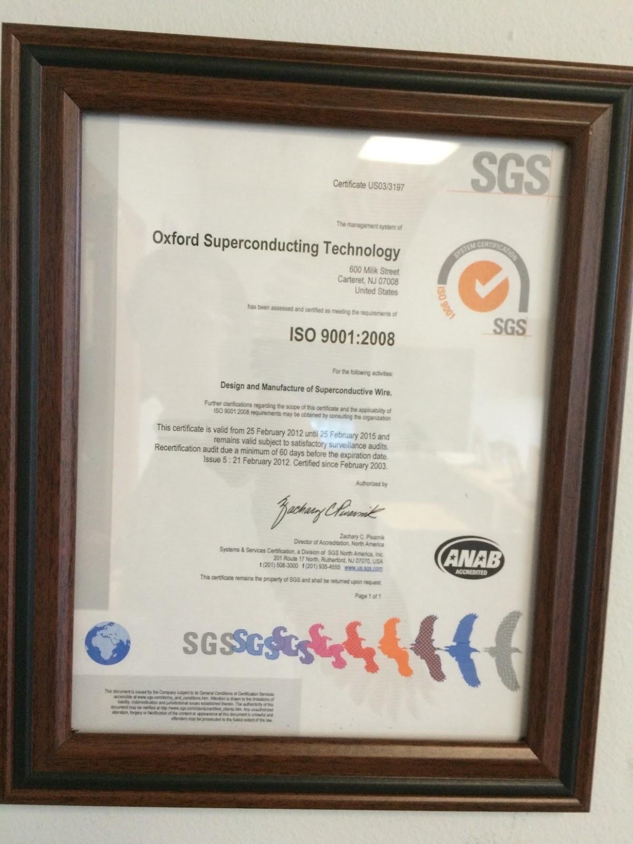
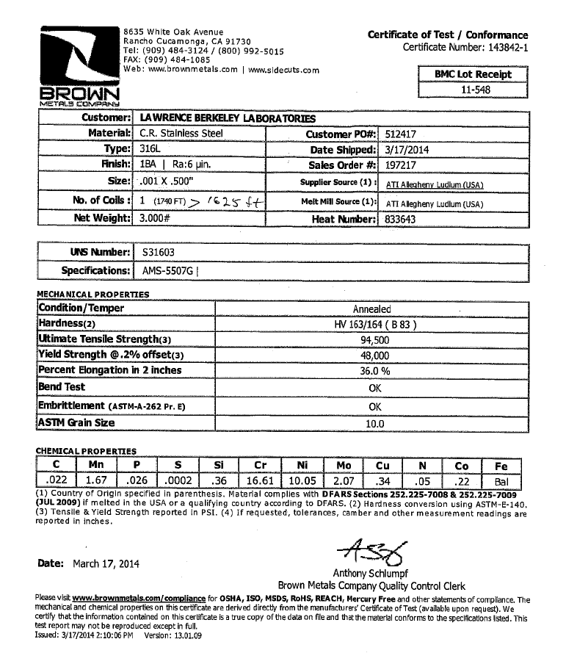
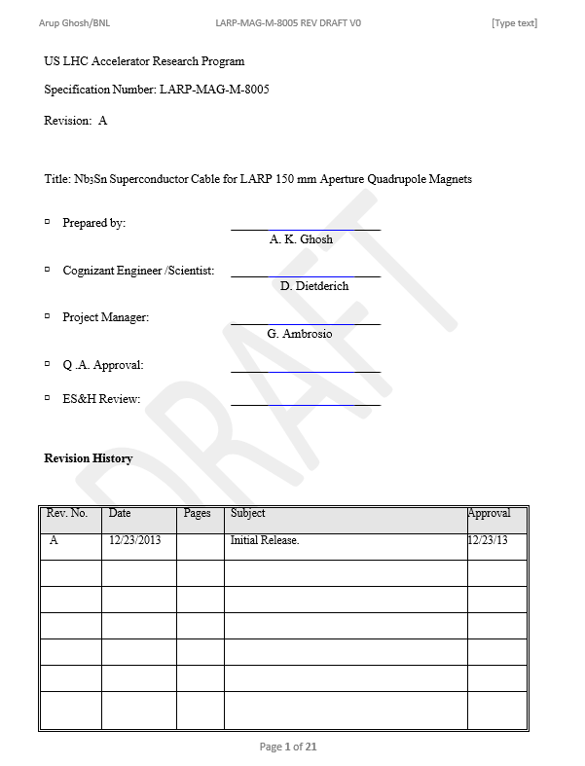
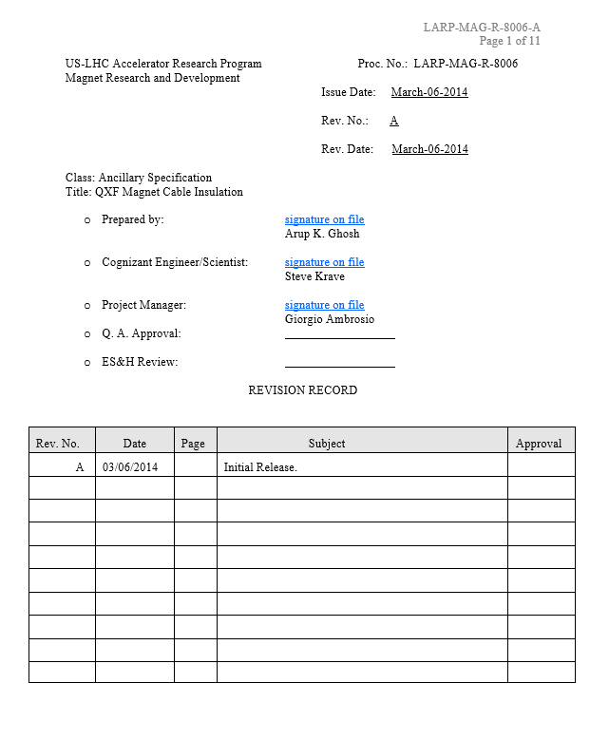
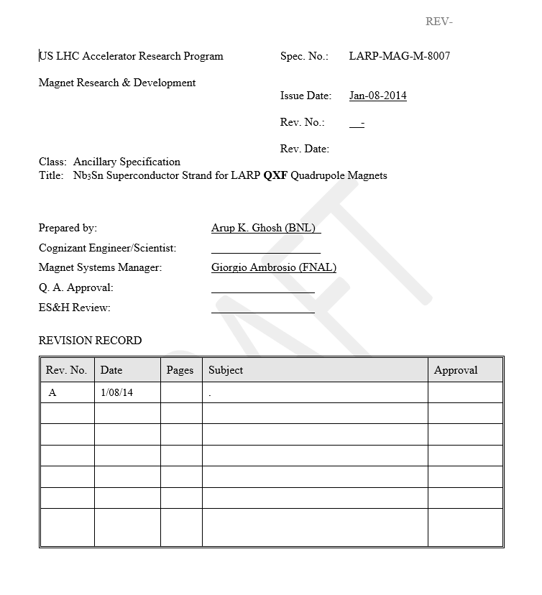
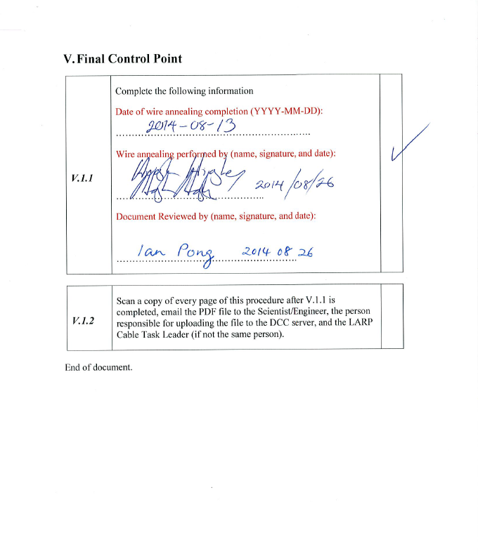
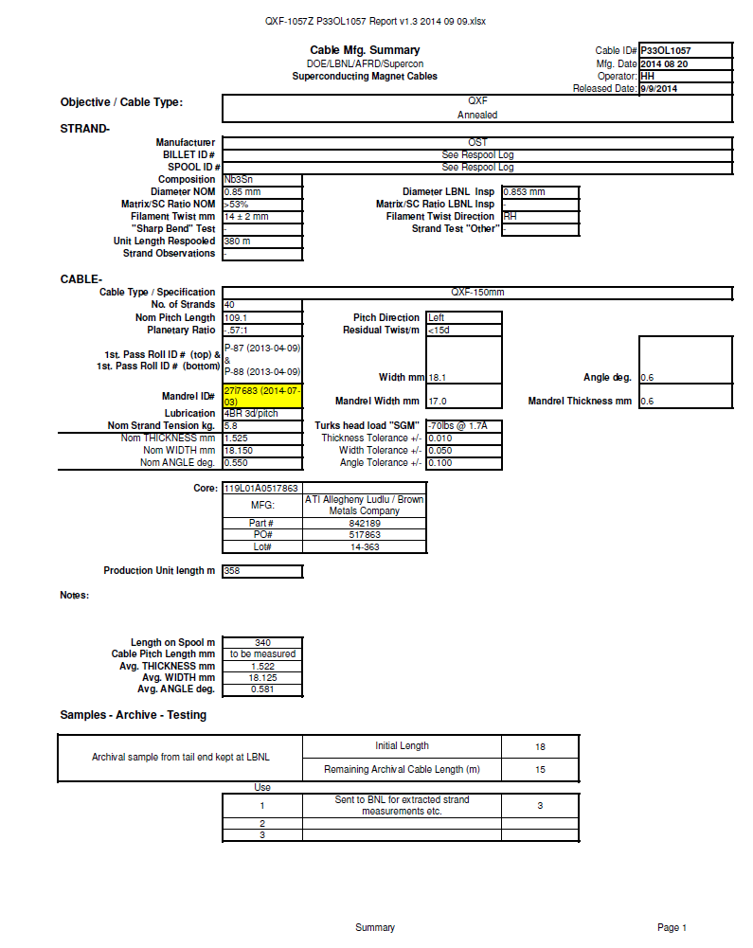
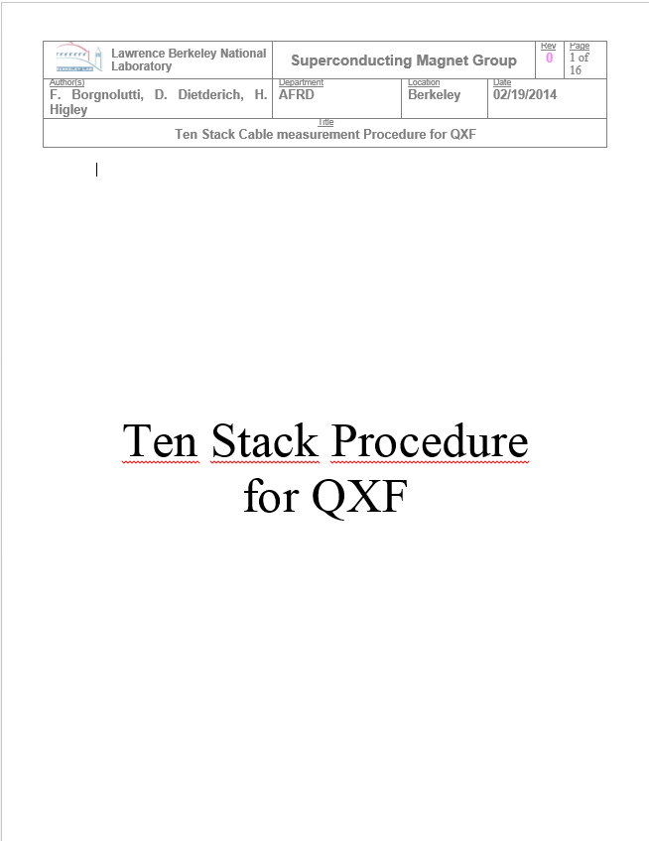
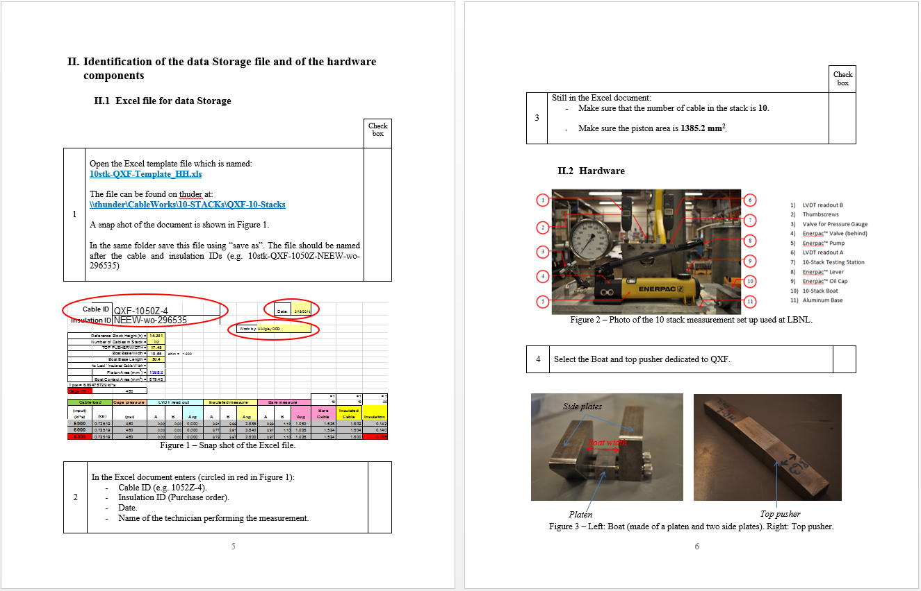
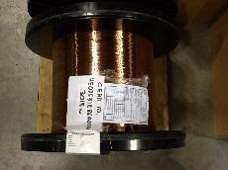
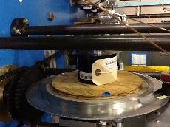
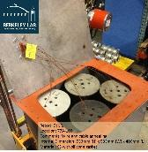
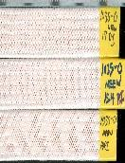
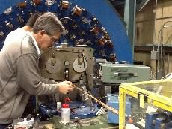
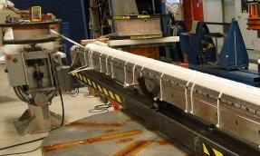
Present LARP Strand and Cable QA
Comparison: Procurement, Strand, Cable
QA: Overall, Cable, Strand
QC: Strand, Cable, HT
Database
Wire manufactured by OST
QC: OST Quality Plan;
ISO 9001:2008 certified
Spec: LARP-MAG-M-8007
ISO 9001:2008 certified
SS Core provided by Brown Metals
OST DCD; LARP Verify; acceptance
Certificate of Test/Conformance
Wire annealed at LBNL
QC: Wire Annealing Proc.; Spec: LARP-MAG-M-8005
ISO 9001:2008 certified;
Spec: LARP-MAG-R-8006
Annealing Control Point
Insulation performed at NEWT
Cable fabricated at LBNL
QC: Cable Fabrication Proc.; Spec: LARP-MAG-M-8005
Cable Release Note
Conductor ready for coil winding at FNAL/BNL
LARP Extracted Strand
10-Stack Measurement
Notes:
OST QP: 1. Description of raw materials selection and inspection; 2 vendor selection and monitoring; 3 project organization; 4 in-process testing and controls; 5 employee training; 6 final product testing

Slide 9
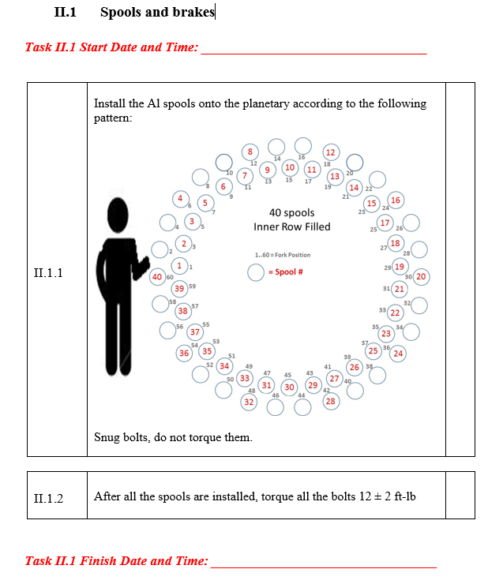
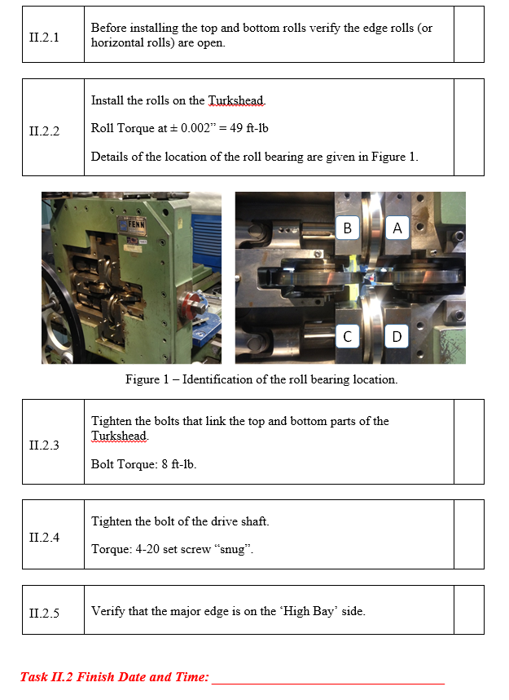
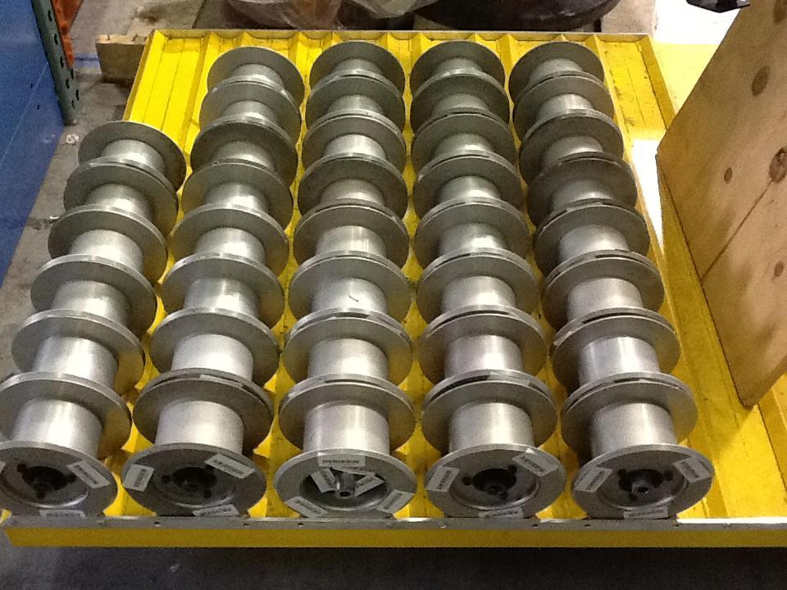
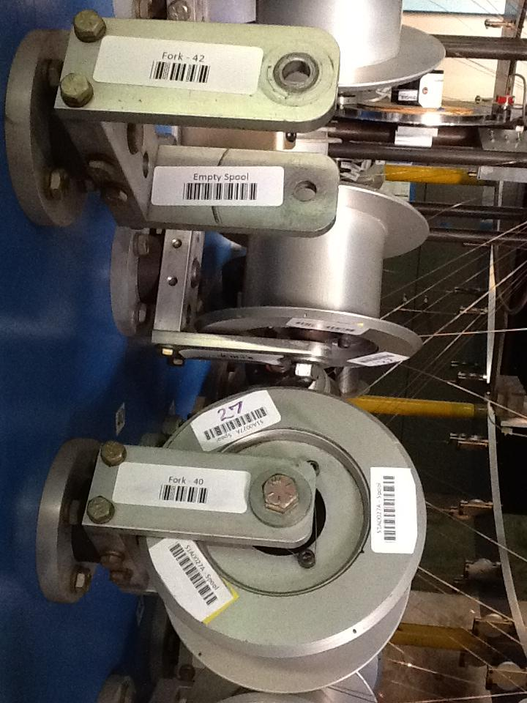
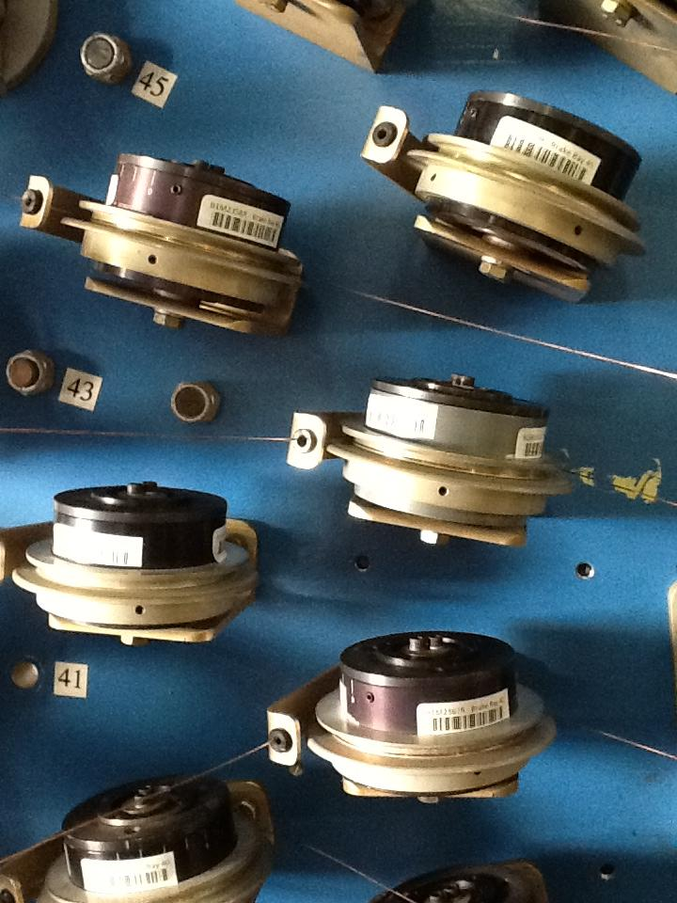
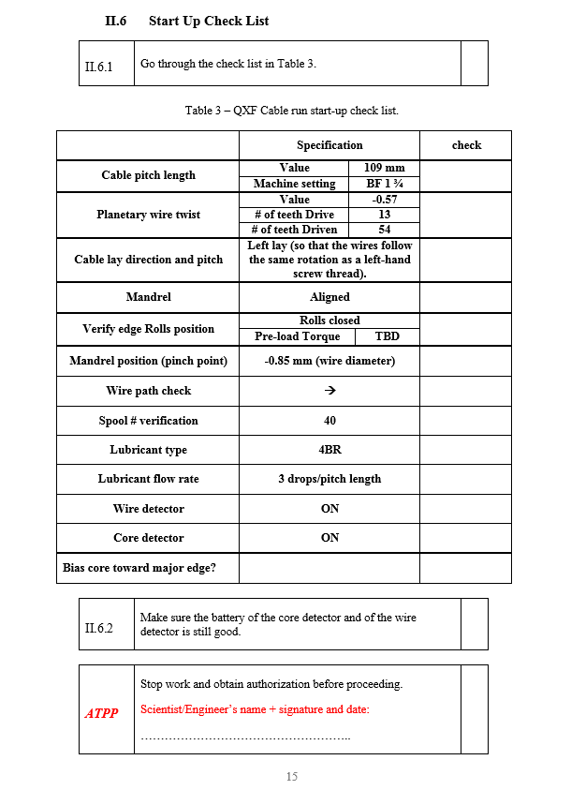
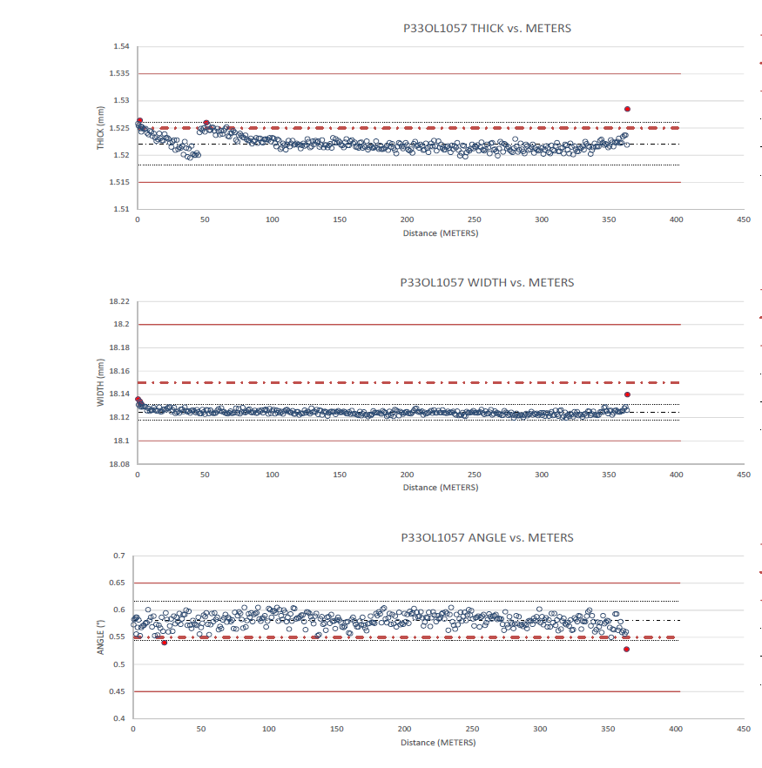
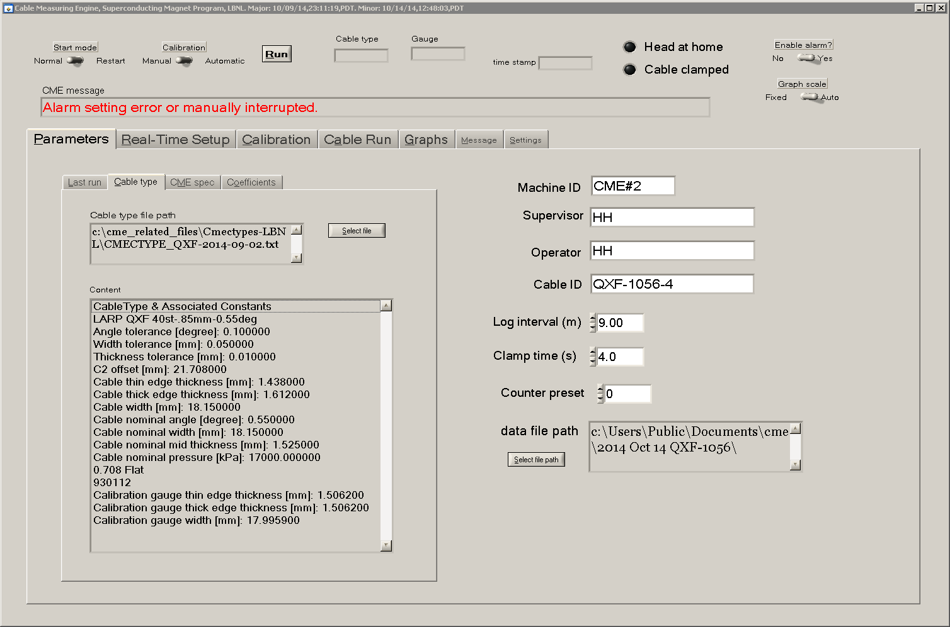
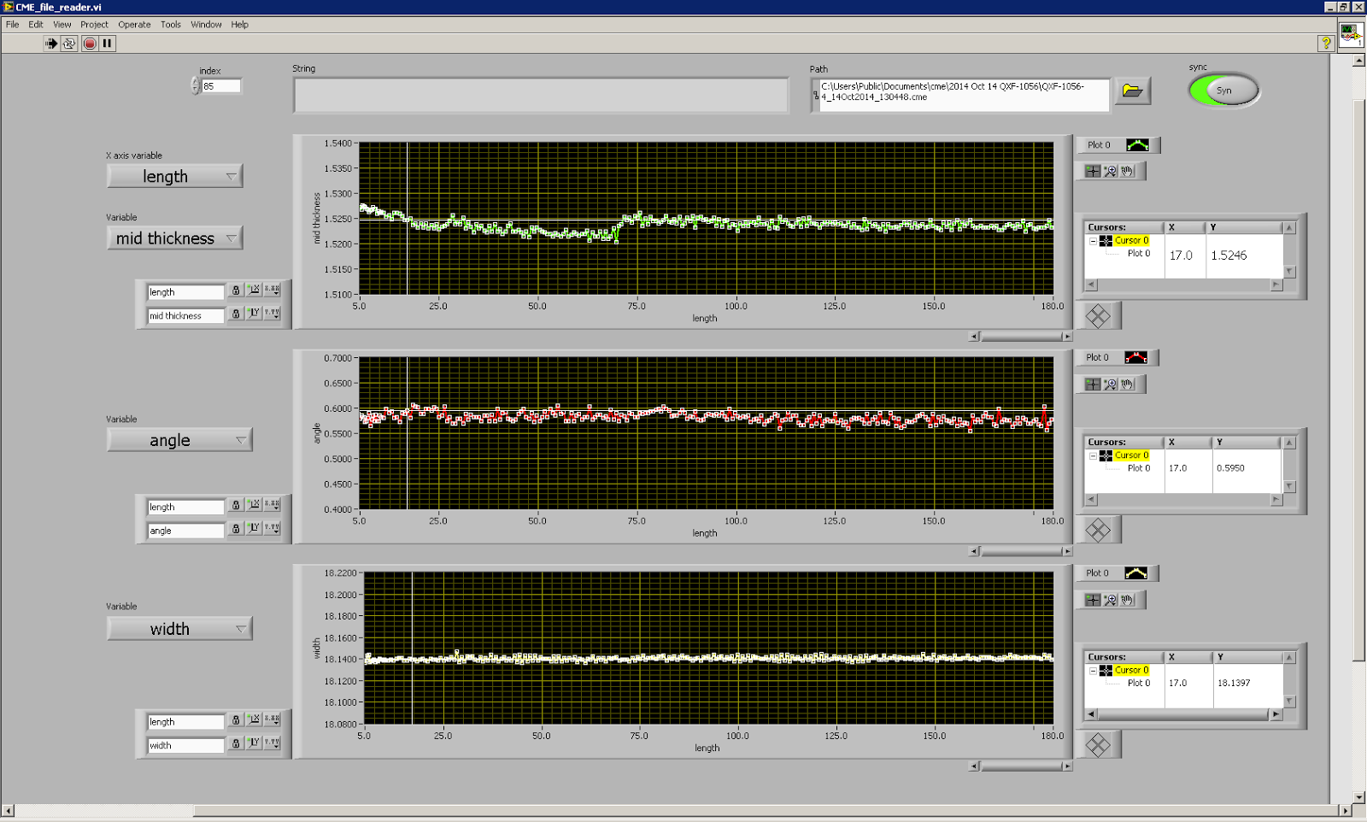
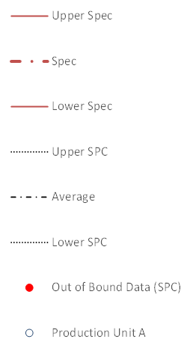
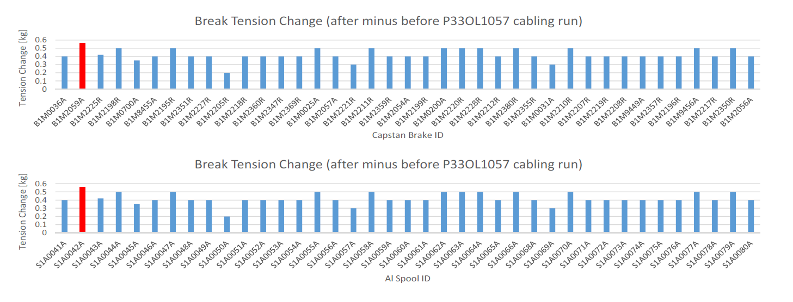
LARP Cable QA
Corrective Action
ATPP
Authorization To Proceed Point
NP
Notification Point

Slide 10
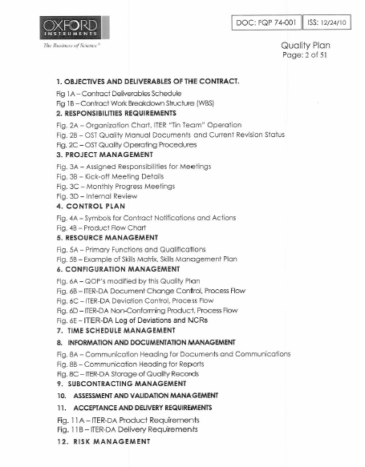
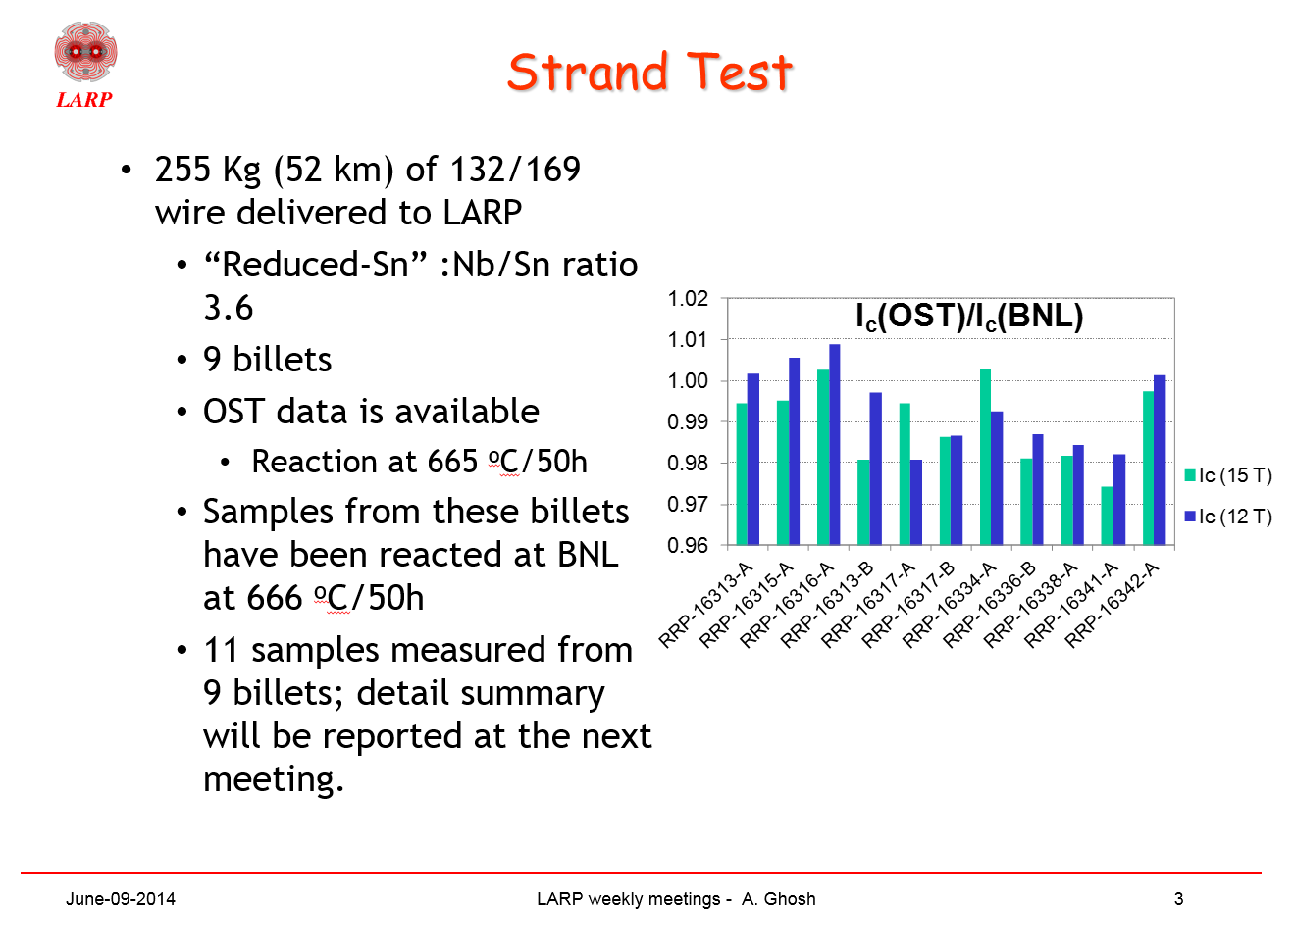
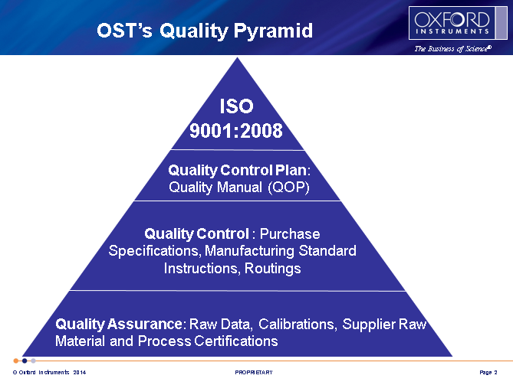
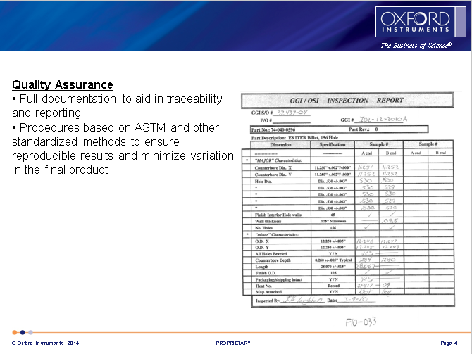
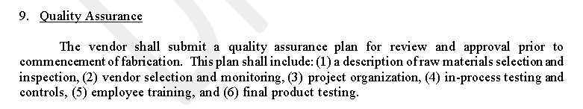
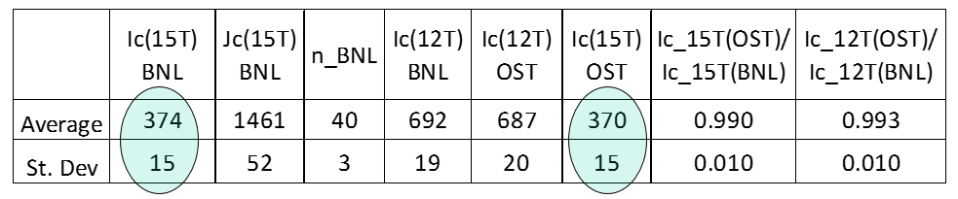
LARP Strand QA
https://plone.uslarp.org/MagnetRD/WeeklyUpdates/2014/20140609/
Supplier QA plan will be required per LARP-MAG-M-8007
LARP procurement in two phases:
  Pre-production in FY15-16, ~1.6 t, ~35-40 billets
  Followed by production, ~8-10 t, ~225 billets
SPC will be used to identify issues before falling out of spec
Verification level to fall with increasing data and confidence
Budgetary consideration to be decided by management which may impact the extent of LARP performing measurements
LARP Materials Task will present a balance of adequacy and cost
LARP-MAG-M-8007 Draft

Slide 11
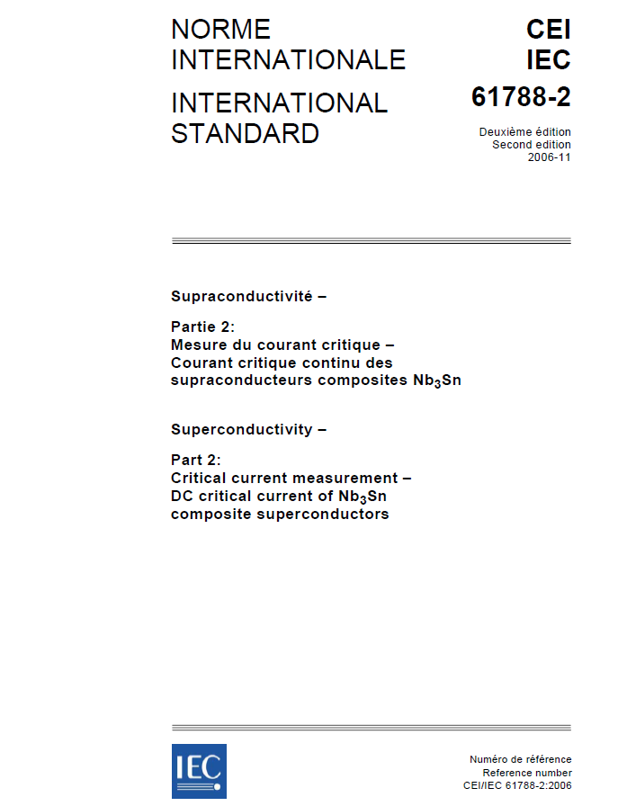
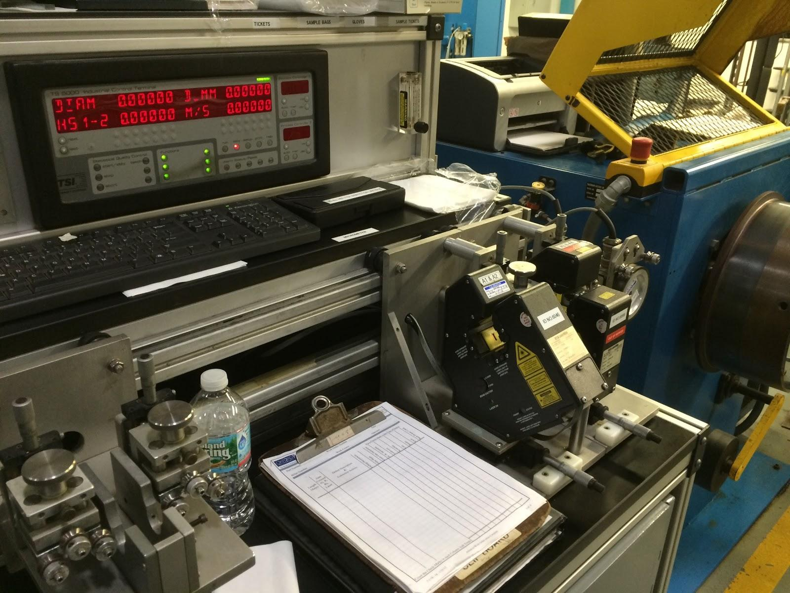
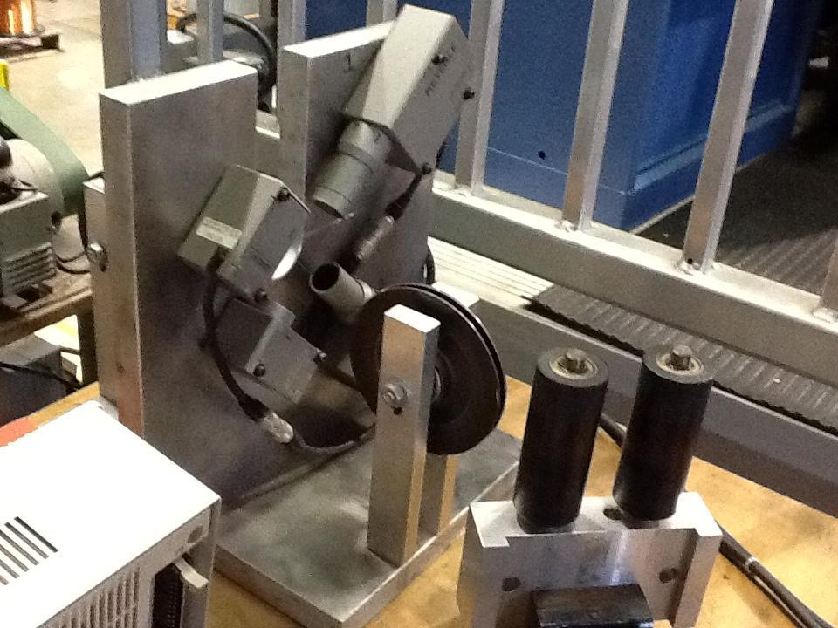
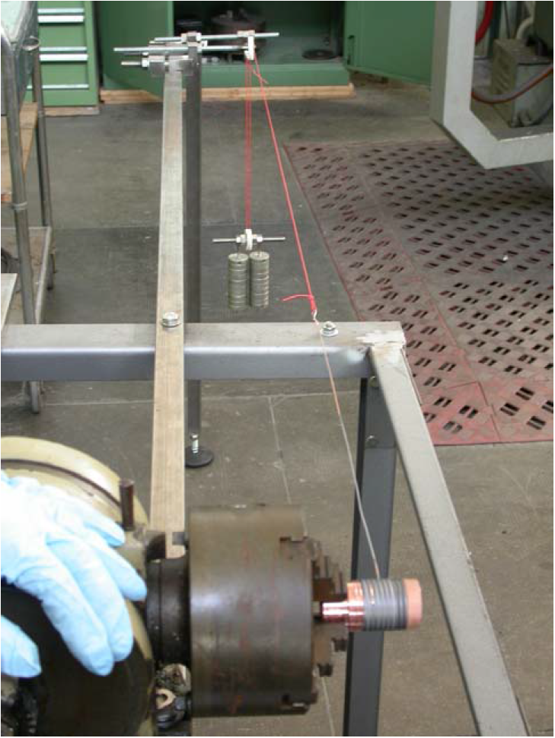
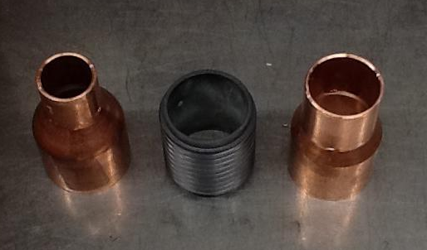
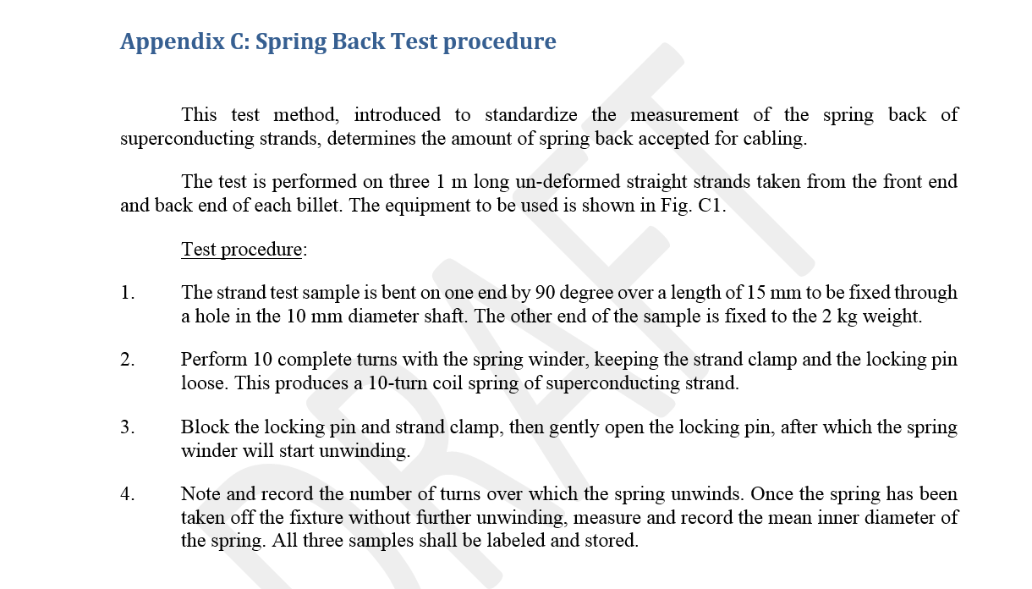
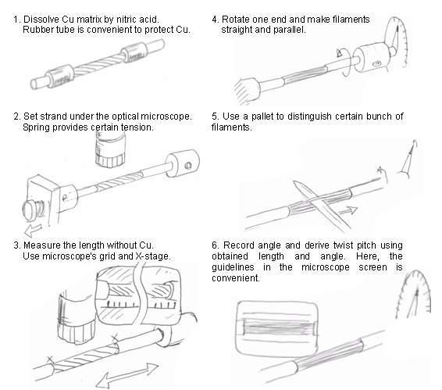
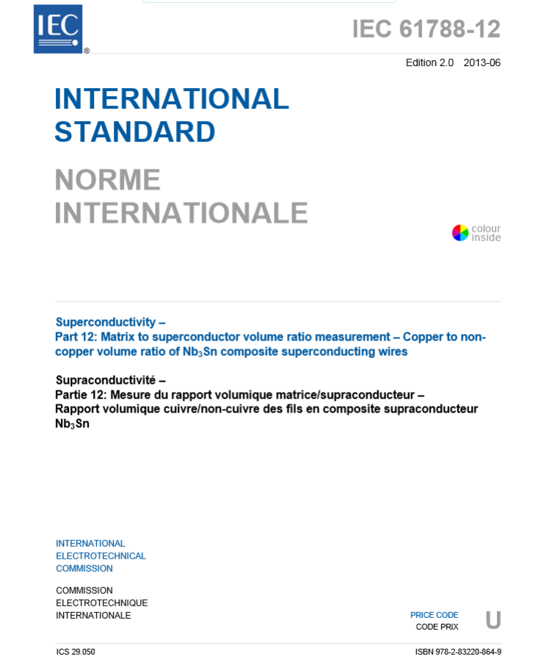
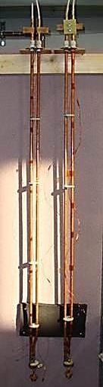













Strand QC Tests and Reports
Image by courtesy of Luigi Muzzi
Similar to techniques suggested by
IEC 61788-12
Image analysis of transverse cross-section
Weighing and copper etching
QC Tests and Reports
  Cu/Non Cu
  Twist Pitch and Twist Direction
  Ic, n-Value, RRR
  Magnetization Width
  Wire Springback
  Surface Cleanliness Certification
    Eddy Current Certification
  Final Wire Diameter
  Piece Length
Material Certifications:
  Tin Rod
  Niobium Rod
  Niobium/Titanium Rod
  Niobium Sheet
  Copper Tube
NI SCXI
𝒑
𝜶
𝝅𝑫
Oxford 15/17 T
𝒑 =(𝝅𝑫)tan𝜶·cos(90° - ϕ)
Generic defects and Eddy current test results
where ϕ = cos⁻¹(δ/R)
Simple
𝒑 =(𝝅𝑫)tan𝜶
model increasingly inaccurate away from strand centerline
p = twist pitch
δ = distance from central axis to striation trace
R = Strand radius
𝑫 = strand diameter
𝜶 = angle of striation trace with respect to strand edge
Drawing by courtesy of Peter Lee and Carlos Sanabria
I source
RHIC-MAG-M-4147
SSC-MAG-M-118
Spring-back Test Fixture
LHC
ITER
Spring-back Test Fixture
Magnet power
Image by courtesy of Jun Lu
Image Courtesy of Mike Field, OST
Image Courtesy of Mike Field, OST
Notes:
Currently, for QXF cables we do not have a consistent plan to qualify cables, except metallographic examination and edge RRR testing. Ic tests have been done for development cables.
In production, the plan is to qualify cables with off-line 10-stack meas., cable residual twist, RRR of extracted strands and Ic of at least 3 extracted strands and one virgin strand. If we specify a minimum Ic for the extracted strands then round wire measurements should be unnecessary.

Slide 12
LARP Strand QC
Automatic and online QC + dedicated facility sample tests
Tests are based on established techniques
Experience from RHIC, SSC, LHC, ITER
Candidate supplier has appropriate equipment already in use
Existing and accepted procedures
Notes:
we request average and standard deviation from OST online diameter measurement.

Slide 13















Cable QC Tests and Reports
After Etienne Rochepault
QC Tests and reports
  Cable dimensions from CMM
  Cable 10-stack measurements
  Cable cross-section microscopy
  Cable Residual Twist
  RRR of Extracted strand
  Ic, n value of extracted strands
  Cabling Report
  Cable Piece Length
  Insulation thickness
Material Certifications:
  Stainless Steel core
Note that all MQXF SS Cores are to be purchased in one single batch

Slide 14
LARP Cable QC
Cabling parameters are monitored online and verified before and after production
Techniques applied are established
Rutherford cable is well understood, LARP investigation showed extracted strand is consistent with and predictive of cable and magnet performance → relatively cheap and fast; test lab flexibility.
Well-defined, streamlined process based on 10+ years of LARP experience
Notes:
Extracted Strand Ic: 343 A, cf. virgin 361 A at 15 T, 4.2 K ➔ 5% degradation
Requirements set in LARP-MAG-M-8005 (draft)
Mechanical:
Mid-thickness (1.525 ± 0.010 mm), width (18.15 ± 0.05 mm), keystone angle (0.55 ± 0.1°); CMM data every 3 m
Cable lay direction (left) and pitch (109 ± 3 mm)
SS core width (12.0 ± 0.2 mm), SS core thickness (0.025 mm)
Residual twist (< +150°), bend test – every continuous length
Electrical:
Cable minimum I_{c} at 15 T, 4.2 K (13,720 A); minimum RRR (150)
Verified by extracted strand I_{c}, RRR
Additional
online defect detection system; spool-brake performance tracking
All QXF SS Core to be purchased in one single batch

Slide 15



LARP Annealing QC

Slide 16




LARP Reaction HT of Strands QC
Furnace ID: BA
Location: BNL
Manufacturer:
Model No.:
Serial No.:
Furnace ID: BB
Location: BNL
Manufacturer:
Model No.:
Serial No.:
Heat treatment process controlled and data documented

Slide 17
LARP Strand-Cable Database (LBNL)
Wire Production and QC Data (being developed)
  Monofilament ID, Subelement ID,
  Billet parameters
  Piece length parameters
  HT, RT & LT test data
Wire and Cable Inventory and Usage (operational)
  Wire, Cable, and Cabling Components (e.g. rollers, mandrels, SS core etc.)
  Sorting, Strand Mapping, Cable Map, Summary
  Respool Log (wire ↔ Al spool ↔ spool/Capstan brake relation, tension)
  Barcode generator
QA documentation (being identified)
Notes:
Program management is fully aware of the need for a QA tool, and that the conductor is among the very first items that will require such a tool. Possibilities are being explored. The QA management plan will be reviewed as part of the DOE CD process. CD1 in FY16.
ITER CDB: security, workflow, communication
Strand summary/sorting: billet design filter, piece length, usage, HT, into which cable; cable summary: cable parameters, usage, what strands,

Slide 18
Summary on LARP QA/QC
Credible and adequate
  Build on ITER QA/QC, with some LHC, RHIC, SSC experience.
  Scaled down due to lower volume and smaller number of suppliers.
Schedule
  Strand and Cable qualification and acceptance are decoupled.
  Strand acceptance: per billet similar, but lower volume.
  Cable acceptance: extracted strand from Rutherford cable is relatively cheap and fast; test lab flexibility.
  Online DB being implemented
  QA management plan is part of the DOE CD review process

Slide 19
EXTRA SLIDES

Slide 20


LARP Equipment and Capacity
Online defect imaging system

Slide 21
Input Template Structure

Slide 22





Slide 23

Input Template for Vendor
Notes:
Add RT and LT screen shot

Slide 24





Database - Strand

Slide 25





Database - Cable
Notes:
Cable parameters: twist pitch, mid-thickness, width, keystone angle, roll opening, mandrel pinch point
Etc.: strand tension, lubrication type and rate, windability tests, damage scoring etc.

