Slide 1



Quality assurance of the QXF-Q2 Nb₃Sn cable mass production
C. Scheuerlein, 6 November 2014
HL-LHC/LARP International Review of the Superconducting Cable for the HL-LHC Inner Triplets Quadrupoles (MQXF)

Slide 2
Outline
Scope and organisation of the QXF Q2 Nb₃Sn cable QA
Quantities and schedule
LHC Nb-Ti cable QA and holding points
QXF-Q2 Nb₃Sn cable QA and holding points
  QXF Q2 Nb₃Sn cable homogeneity verification
  QC tests of the produced cable extremities
Conclusion

Slide 3
Scope and organisation of the QXF-Q2 cable quality assurance (QA)
QA is put in place when the cable development has been completed, and when the tooling and all cabling parameters have been defined and are frozen.
The goal of the QA is to guarantee the uniformity of the entire QXF Q2 cable production, and to make sure that all cable unit lengths (ULs) that will be delivered to the magnet factory are conform with specifications.
The QA team is independent from the cable production team.

Slide 4
QXF-Q2 cable quantities and schedule
  10 UL for prototypes
  45 UL for Q2 series production (32+13 spare) over a period of about 3 years (see Amalia’s presentation).
  The QA/QC procedures need to be ready before the start of the production of the prototype Q2 cables (in about one years time).
  For the organisation of the QC tests we also need to take into account other Nb₃Sn cables to be produced and controlled, e.g. for the 11 T dipole cables.

Slide 5
QC tests and holding points during the production of the LHC Nb-Ti Rutherford cables
All 7000 km (more than 11’000 Uls) of cable were produced outside CERN (at Alstom, Brugg Kabelwerke (with two cabling machines), New England Electric Wire (NEEW) and Furukawa Electric Co., Ltd. (FEC)
A rigorous test protocol had been imposed on all companies.
  On-line cable dimensional measurements with CMM of all cables at production sites
  Re-measurement of dimensions of 5500 UL at CERN with three CMM lines
  Samples cut from cable extremities controlled at production sites and at CERN
  2600 cable I_{c} measurements at BNL and at CERN
  5500 interstrand contact resistance measurements at CERN
  More than 30’000 RRR measurement of extracted strand samples at CERN, in addition to the RRR tests by the companies.
  Systematic cross checks of company test results with CERN test results.
Material and data flow during the LHC conductor production at FEC and holding points.
From S. Meguro, IEEE Trans. Appl. Supercond. 14(2), (2004)
From D. Leroy, IEEE Trans. Appl. Supercond. 16(2), (2006)

Slide 6
Sequence of QXF-Q2 quality control steps and holding points
There will be two holding points in the Q2 cable production.
The first holding point is the cabling map approval, where the QA team verifies that all strands to be used have been approved, and that the approved tooling and production parameters will be used.
The second holding point is the UL approval. After verification that all online measurements and all QC tests are conform, the QA team approves the cable ULs for delivery to the magnet factory.

Slide 7
Some differences between the Q2 Nb₃Sn and the LHC
Nb-Ti Rutherford cable mass productions relevant for the QA
Importance of the diffusion barrier integrity after Nb₃Sn cabling.
Comparatively small mechanical stability of Nb₃Sn cables.
Important volume changes in Nb₃Sn after cabling.
Presence of a stainless steel core in the QXF cables (in the LHC cables the interstrand contact resistance was controlled by the oxidation of a Cu₃Sn surface layer).
Little experience with the QA of the mass production of Nb₃Sn Rutherford cables.
Comparatively small Q2 cable production rate. Q2 cable production is interrupted by the production of other cable types.
Q2 cables are made with two Nb₃Sn strand types (PIT and RRP) with different properties.

Slide 8
QA of a cabling run
The QA of the cabling process must assure the cable homogeneity over the entire cable length of 710 m, so that the samples cut from the cable extremities are representative for the entire UL.
For this purpose we will analyse:
  Production parameters
  Relative variations of the cable dimensions
  Cable edge deformation
After the cable run, at least ten meter-long cable samples are cut at each extremity of all ULs for further QC tests.
Long cabling runs consisting of several ULs are desirable for the cable homogeneity, as well as for the cabling efficiency.

Slide 9
Verifying the cable homogeneity
Relative changes of cable dimensions are monitored online with the so-called Cable Measuring Machine (CMM).
  We plan to monitor the cable edge deformation by edge facet analyses, as suggested by LBNL.
  If feasible, a procedure for the online analysis of the cable edge deformation will be developed, with the definition of a maximum acceptable edge facet size, and a maximum edge facet size variation on both sides of RRP and PIT Q2 cables.
Wherever possible cabling parameters shall be measured and recorded online and be used for statistical process control (SPC).
Facets on the strands at the thin edge of two LARP Nb₃Sn cables produced at LBNL.
From D.R. Dietderich, et al., IEEE Trans. Appl. Supercond. 17(2), (2007)

Slide 10
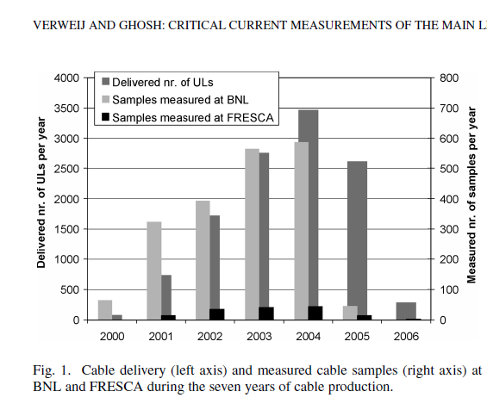
Tests of entire cables
  During LHC Nb-Ti cable production 2600 cable I_{c} measurements have been performed at BNL and at CERN.
The preparation of Nb₃Sn cable samples for I_{c} measurements is delicate, and availability of test facilities is limited.
The local RRR at the most deformed strand parts cannot be assessed by routine cable tests.
Therefore, cable I_{c} tests as a routine QC tool are not foreseen and the QC of the produced cables will be mainly based on tests of extracted strands.
Some cable measurements should be performed at the beginning of the production.
From A. P. Verweij, A. K. Ghosh, IEEE Trans. Appl. Supercond. 17(2), (2007)

Slide 11
Routine QC tests of the samples cut from the cable extremities
  The number of QC tests to be performed depends on the number of ULs that can be produced in one cabling run. Long cabling runs could reduce the number of some QC tests.
Cable dimensional measurements – at least one per UL → 55 ten-stack measurements
Extracted strand I_{c} measurements –3 to 5 strands per UL
→ about 165-275 I_{c} measurements
Extracted strand RRR measurements - 10 strands per UL
→ about 550 RRR measurements
Extracted strand local RRR measurements at the thin edge - 40 strands per UL
→ about 2200 local RRR measurements.
Interstrand contact resistance R_{c} measurements → to be defined (not foreseen as a routine QC test)
Cable surface cleanliness → to be defined (not foreseen as a routine QC test)
A mechanical cable stability QC test is not foreseen

Slide 12
Cross checks of cable QC test results
For the LHC Nb-Ti strand and cable QA the firm QC results had been cross checked with the CERN QC results.
Similarly, for the Nb₃Sn strands the firms QC results can be compared with the CERN QC results.
It should be helpful to exchange a limited number of cable samples with another laboratory, in order to have a cross check of our QC results:
  Dimensional measurements (ten stack and CMM)
  Edge facet measurements
  Local RRR at the thin edge of extracted strand

Slide 13
General and production procedures to be developed or finalised
We will use the CERN Engineering and Equipment Data Management (EDMS) service for the distribution, control and approval of all procedures.
General procedures include:
  Naming convention and data flow for the QXF-Q2 Nb₃Sn cable production
  Cutting, storage and shipment of the QXF-Q2 Nb₃Sn strands, cables and test samples
Production procedures include
  Nb₃Sn strand re-spooling for the QXF-Q2 cable production
  Alignment of the tooling for the QXF-Q2 Nb₃Sn cable production
  Online control of the QXF-Q2 Nb₃Sn cable production parameters

Slide 14
Cable QC procedures
QC test procedures with acceptance threshold values must allow us to distinguish unambiguously between conform cables that can be used in a magnet, and non-conform cables that must not be used.
The QC procedures that need to be developed or finalised include:
  Measurement of the QXF Q2 Nb₃Sn cable edge facets
  Measurement of the QXF Q2 Nb₃Sn cable dimensions with the Cabling Measurement Machine (CMM)
  The local RRR measurement at the thin edge of strands extracted from the QXF Q2 Nb₃Sn cables
  Critical current measurement using strands extracted from the QXF Q2 Nb₃Sn cables

Slide 15
Conclusion
The homogeneity and conformance with specifications of each of the 55 Q2 cable UL will be assured by the combination of:
  quality control tests using samples cut from the cable extremities
  analysis of the production parameters, online measurement of the cable dimensions, and if feasible the online measurement of the cable edge deformation
QC procedures and threshold values must allow the unambiguous distinction between non-conform cables, and conform ULs that can be used for the construction of the QXF-Q2 coils.
The QC of the produced cables is mainly based on tests of extracted strands. Cable I_{c} tests as a routine QC tool are not foreseen.
The local RRR measurement at the thin cable edge will be the most important QC test. For the QA of the QXF-Q2 cables about 2200 local RRR measurements at the thin edge of extracted wires will be performed.
In addition 550 integral RRR measurements and between 165-275 I_{c} measurements of extracted strands will be performed.
A good information flow and collaboration are essential.

Slide 16

< http://www.art-gallery-lurvink.ch/galerie/natur/images/eisberg.jpg >
Thank you for your attention

Slide 17
Back-up slides

Slide 18
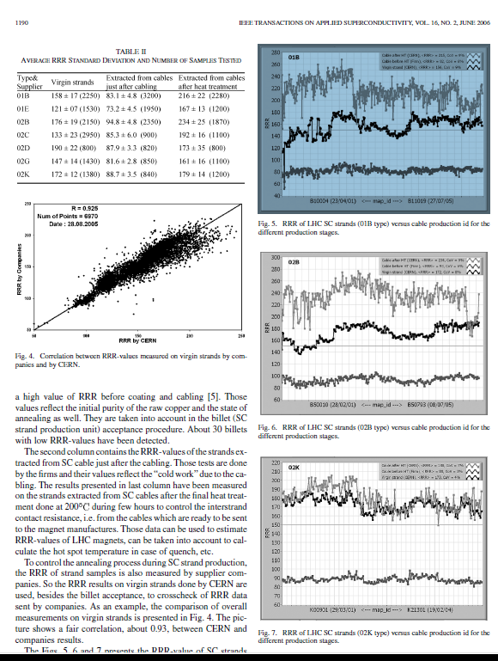
Cabling induced Cu resistance ratio changes
For the QC of the LHC Nb-Ti strands and cables more than 30’000 RRR measurements have been performed at CERN. Results have been cross checked with the companies RRR results.
More than 18’000 RRR measurements have been performed on strands extracted from cables. The cold work during cabling invariably degrades the Cu RRR.
In contrast to the LHC Nb-Ti cables, where the RRR degradation is completely recovered during the final cable heat treatment, the cabling tools and parameters can strongly influence the RRR of heat treated Nb₃Sn cables.
From Z. Charifoulline
IEEE Trans. Appl. Supercond. 16(2), (2006)

Slide 19
Comparison of the mechanical properties of different wires used for cabling
Nb₃Sn BR
Nb₃Sn-RRP
Nb₃Sn-PIT
Cu hard drawn
Nb-Ti LHC 02
Comparison of the stress-strain curves of different Nb₃Sn/Cu, Nb-Ti/Cu and Cu wires.
From: R. Bjoerstad et al. CERN internal note, EDMS No. 1421825, (2014)

