Slide 1
Физика на LHCb
Vanya Belyaev (ITEP/Moscow)
The material from the lectures
by Profs. T.Nakada and S.Stone is used

Slide 2
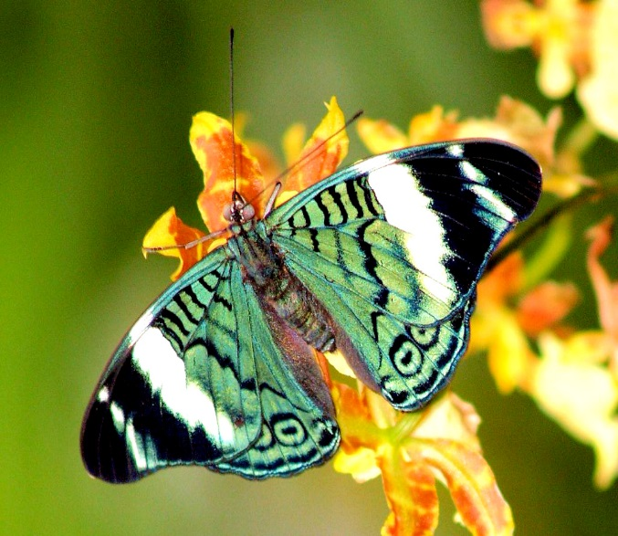

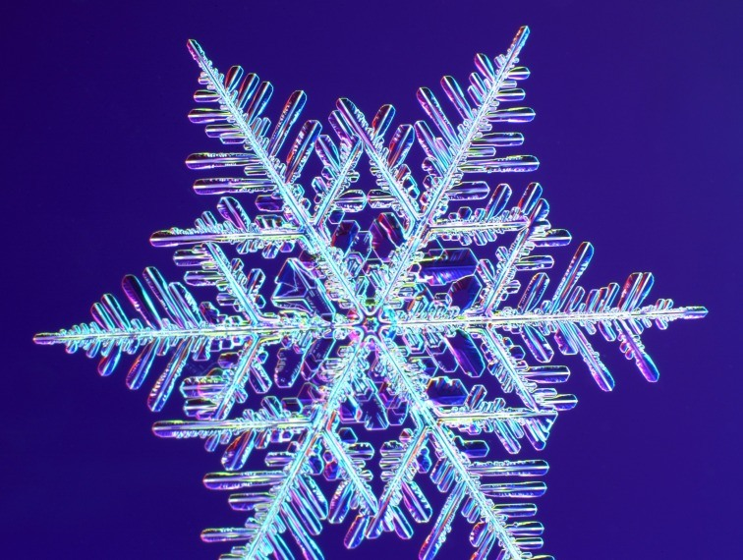
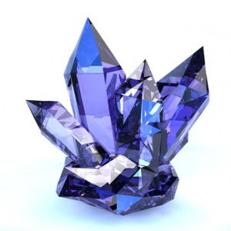
Beauty and symmetry

Slide 3
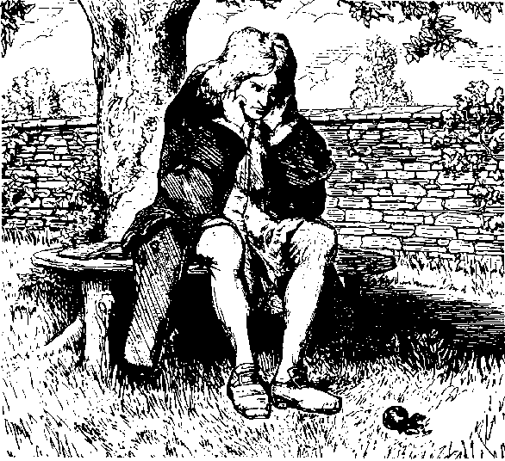
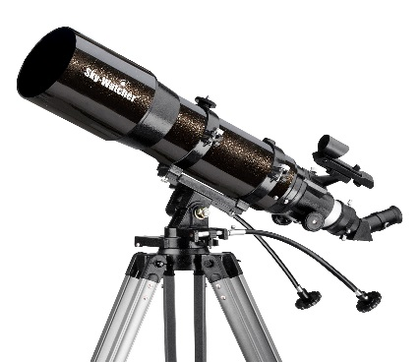
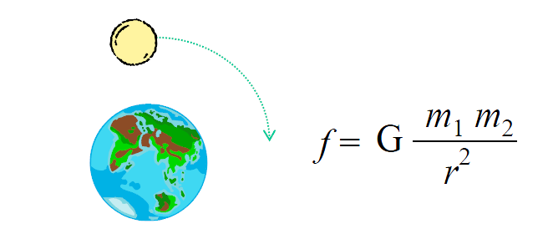
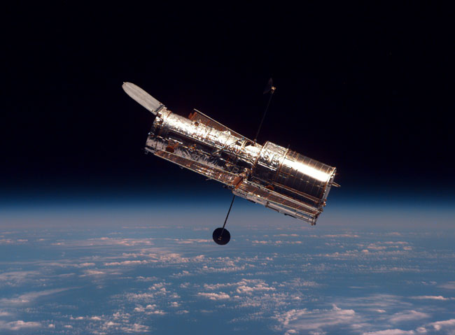
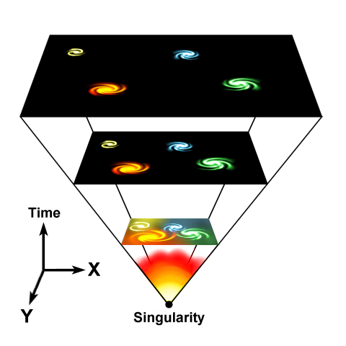
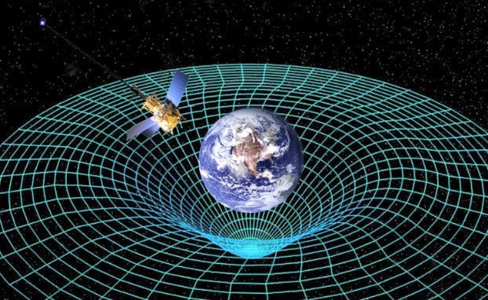
Science
Observation
Generalization: making physics laws
Make an experiment: observation
Make an experiment: observation
Extract more abstract concepts
Make predictions

Slide 4
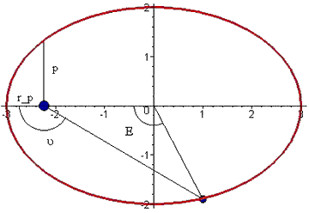
Symmetry
Symmetry is important input for generalization
  It usually point to some underlying laws
Symmetry of Kepler’s orbits
Bertran’s problem
F ~ 1/r²
F ~ r¹

Slide 5
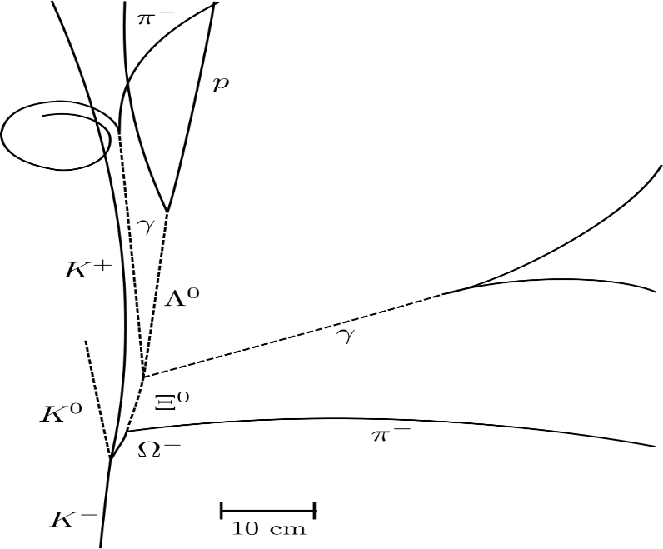
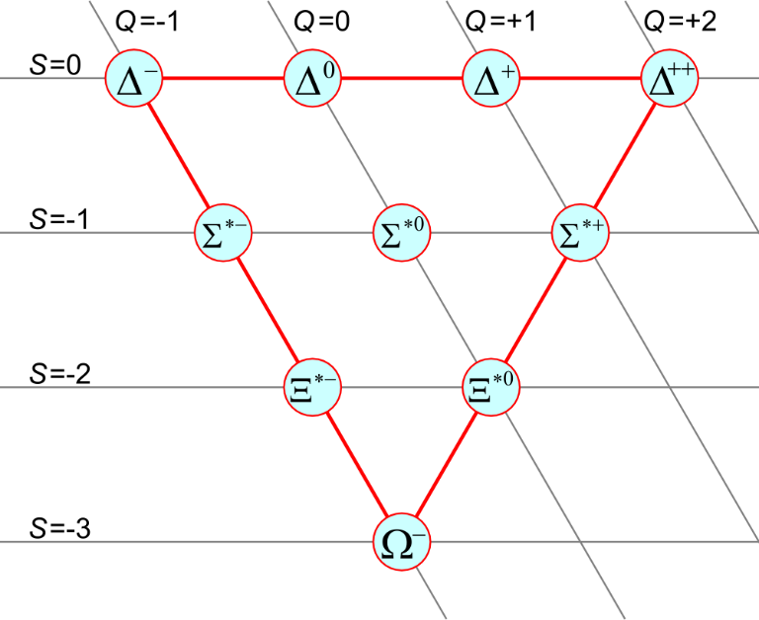
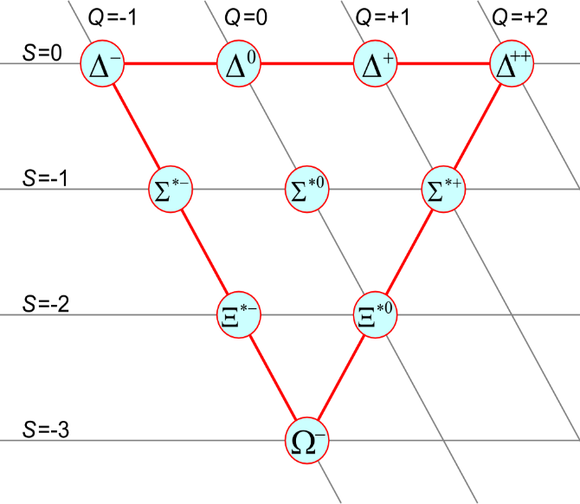
Symmetry: Ω⁻ baryon discovery
1962
1964
Quark model: u.d,s

Slide 6
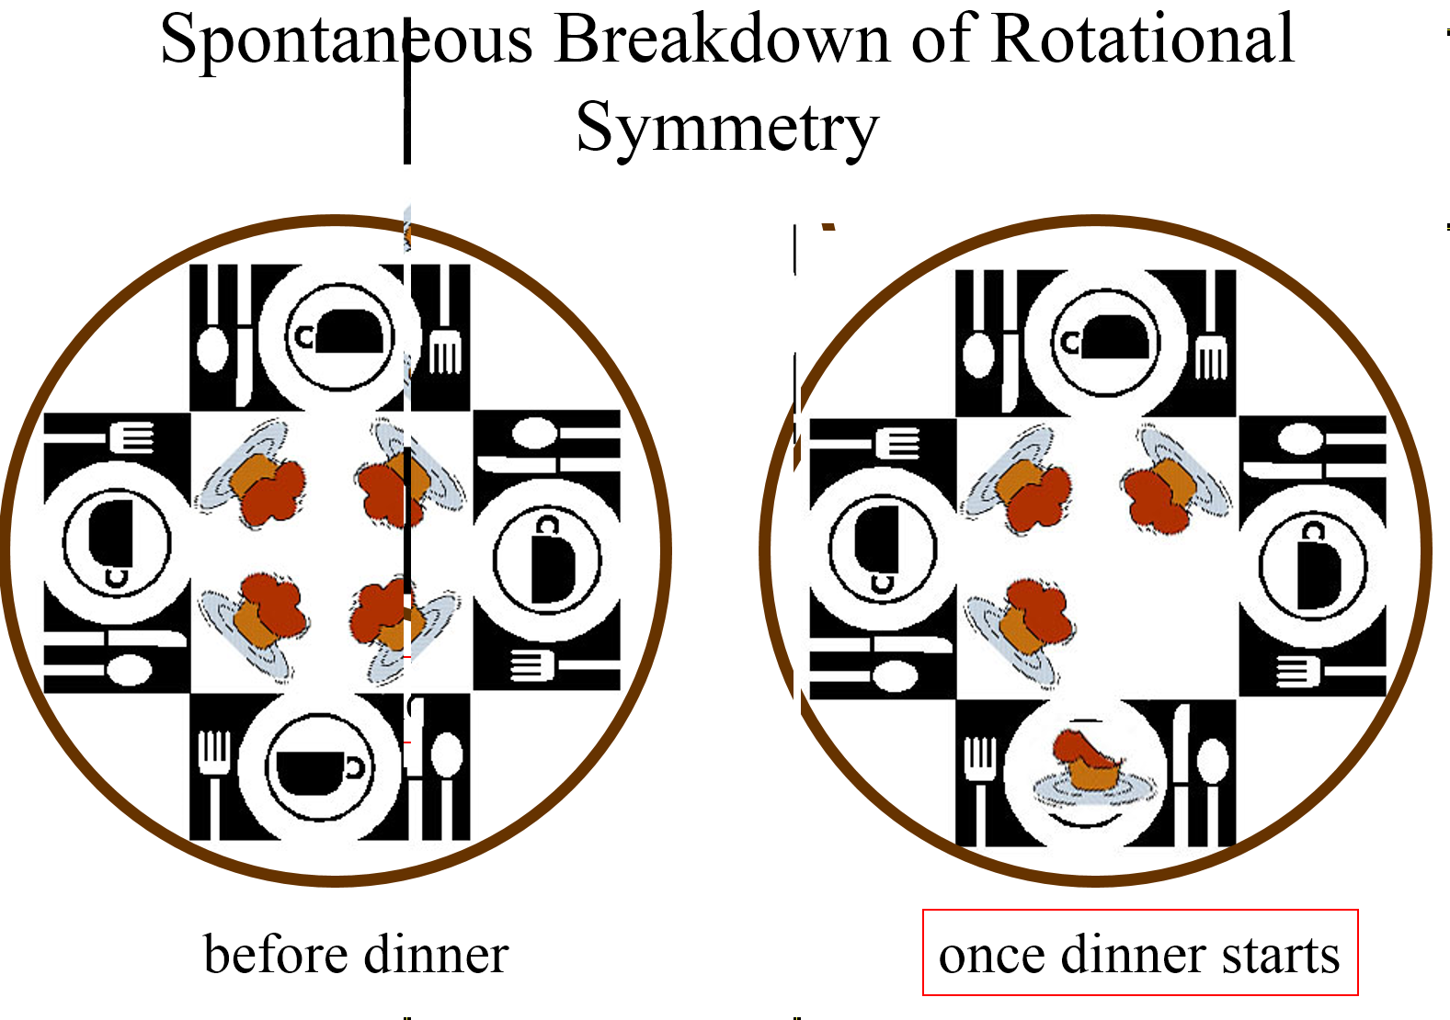
Not exact symmetry
Sometime symmetry is not exact, e.g. for Ω⁻ case
  But still the concept of approximate symmetry is very useful
Sometime symmetry is broken and not visible
But even remnants are useful

Slide 7
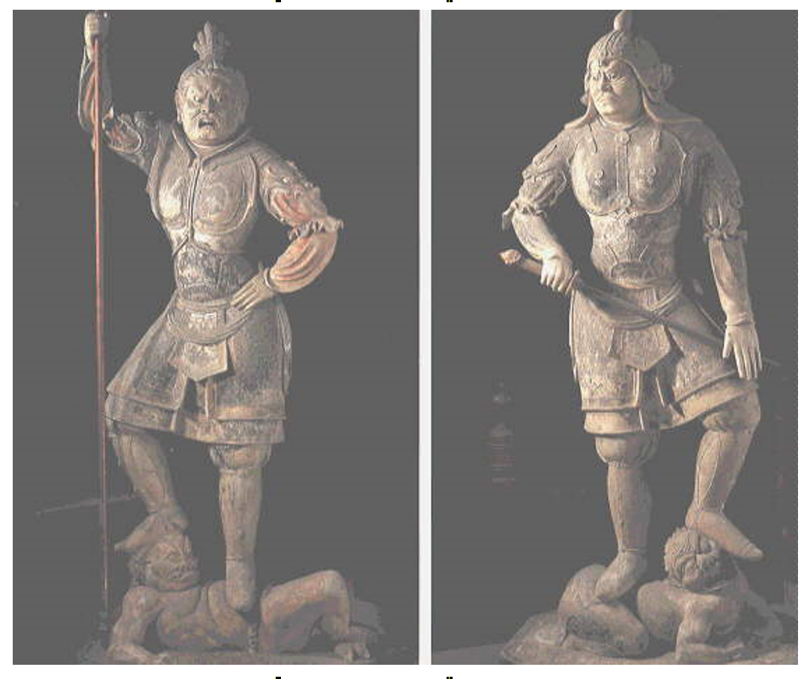
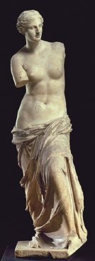
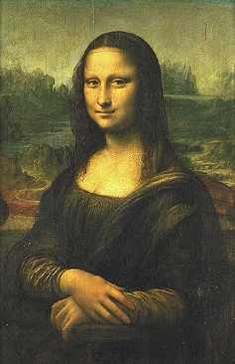
Broken and hidden symmetry

Slide 8
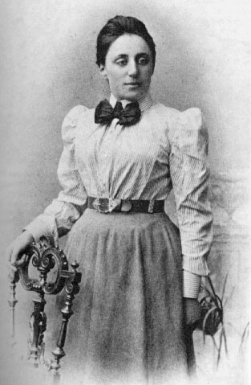
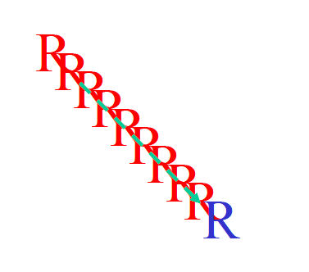
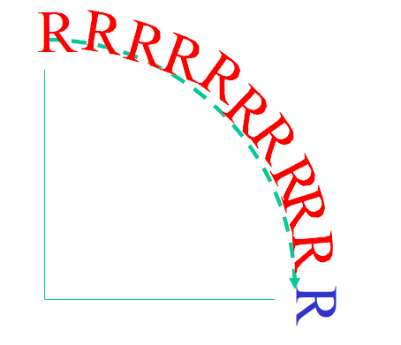
Conservation laws
Symmetries (often) related to conservation laws
  Noether’s theorem
Translation symmetry in space
  momentum conservation
Rotation symmetries
  Angular momentum conservation
Time translation
  Energy conservation

Slide 9
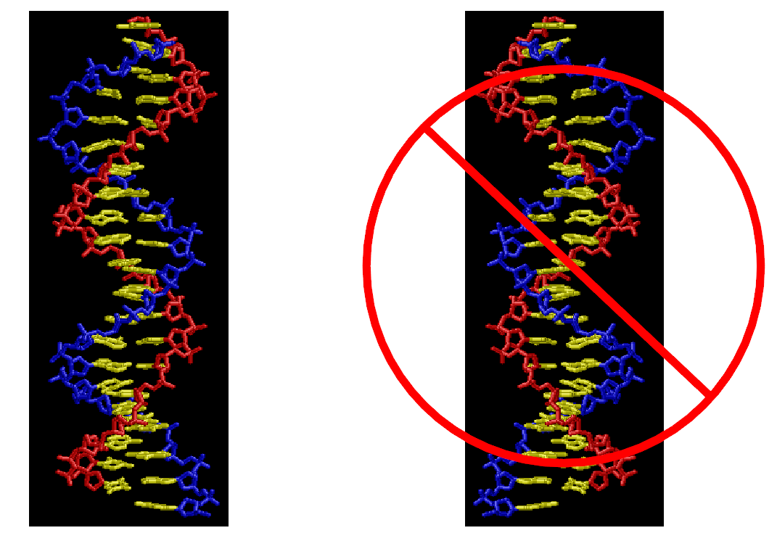
Mirror symmetry (parity) and time reversal
Laws of classical physics is symmetrical against the reflection in the mirror
  … but ~90% of us are right-handed
  DNA is only left-handed
  …
Laws of classical physics is symmetrical against the time reversal
  …. but the entropy is raising
  day-by-day we become older and not younger
Liouville’s lemma
Gas
Vacuum
Gas
Gas
Vacuum
when?

Slide 10
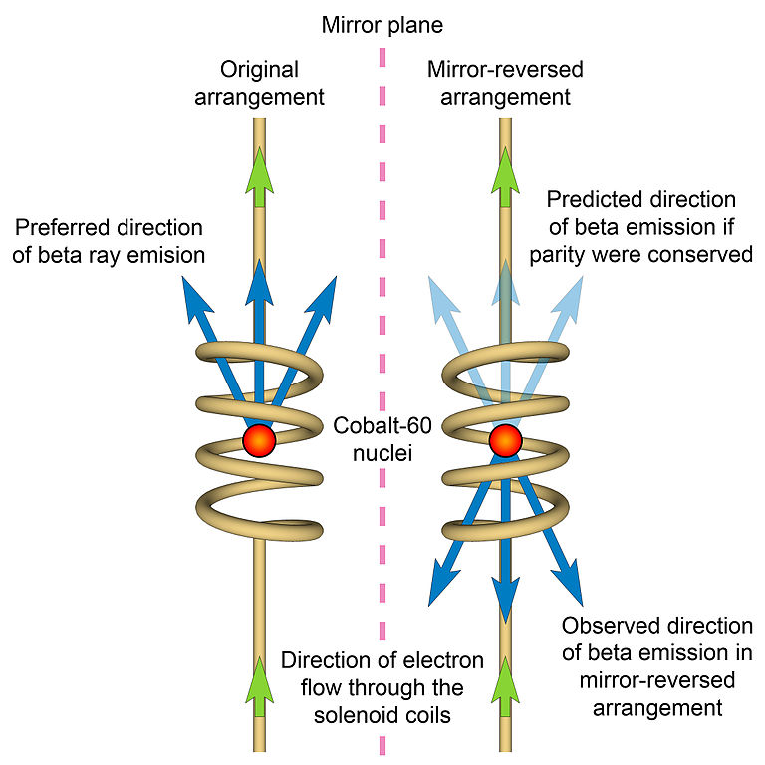
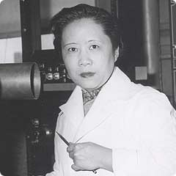
Mirror symmetry for particles
Laws of nature respect parity: disproved by Wu in 1956

Slide 11
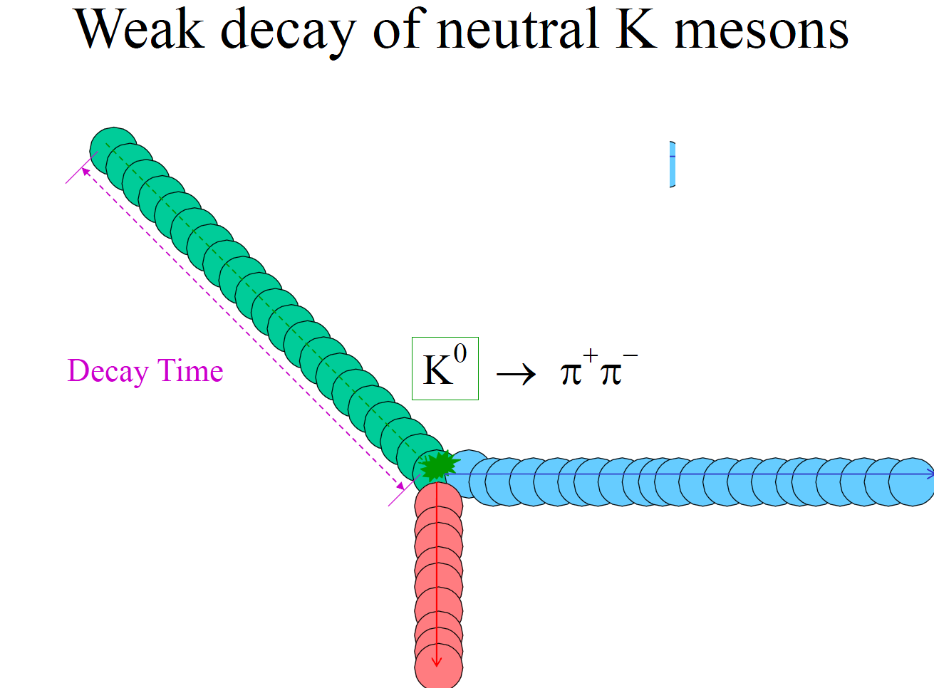
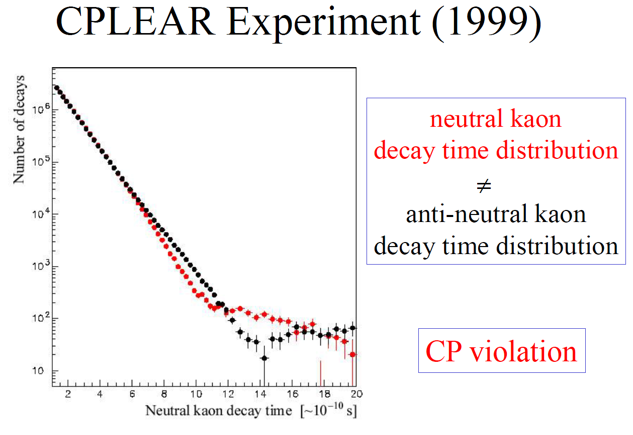
Combined (CP) symmetry
Both space and charge parity are maximally violated
  What about CP-parity?
But it is also violated. Violation is small, but very important for the fate of Universe

Slide 12
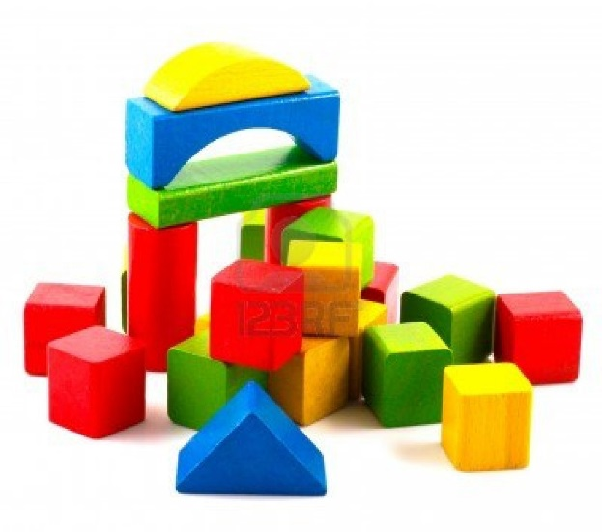
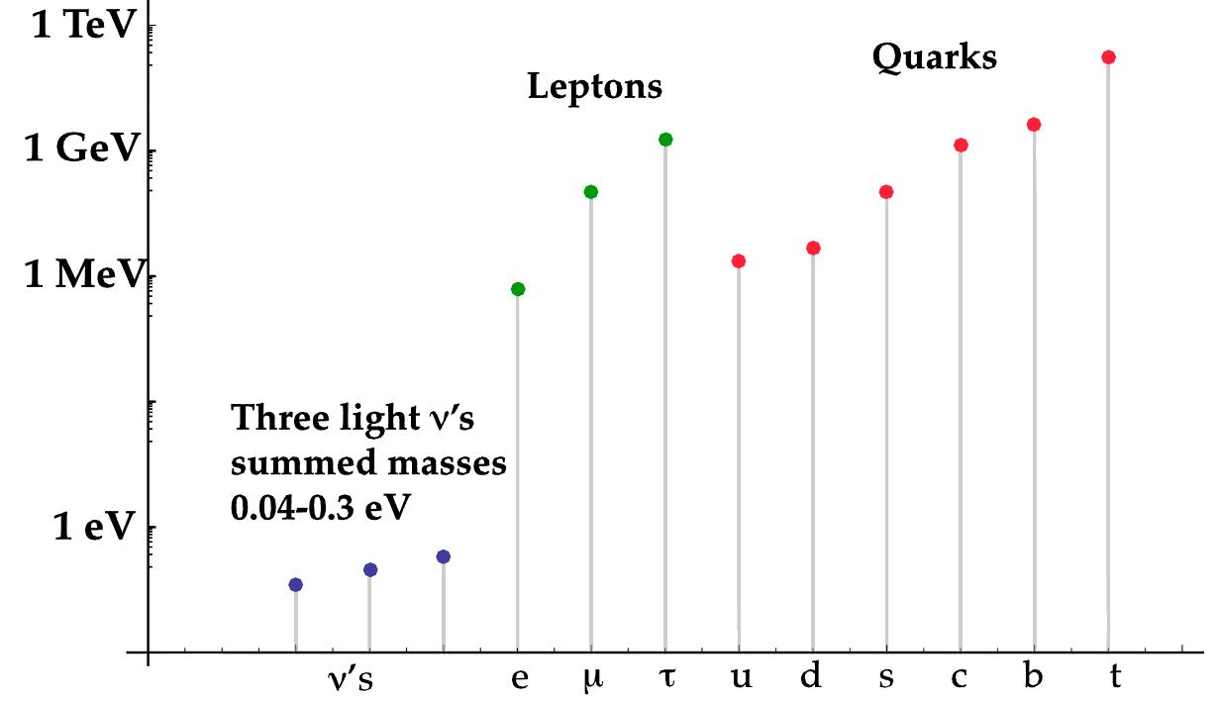
Building blocks
6 quarks
  of 3 colours
6 leptons
  3+3
3+1 forces
1 Higgs boson
Standard model
charm
strange
beauty

Slide 13
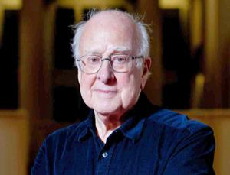

Standard Model
Great success!
  Discovery of Higgs boson
Intensive (direct) tests by many experiments for long time (since appearance in the end of 70s)
  No failures (up to now)
But is it right and complete?
  Likely not…. There are some deep problems and some of them related to symmetries and beauty

Slide 14
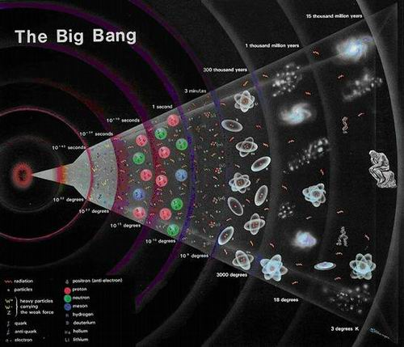
Problems (not all…)
No so beauty (too many free parameters)
If SM is right, we would never has this lecture
  Moreover the universe will be very different…
At Big Bang:
equal amount of matter (particles)
and antimatter (antiparticles)
Now: only matter..
There is no antimatter around us
Baryon asymmetry of Universe: 10⁻⁹
SM allows ~10⁻²⁰

Slide 15
Dark matter
There is “something else”
  E.g. new heavy particles

Slide 16
“New Physics”
In spite of the current triumph of Standard Model we know that “New Physics” exists
Likely “New Physics” comes with new particles, new interactions, …
  E.g. Supersymmetry: double amount of all particles
It should explain baryon asymmetry
  Is should have another sources of CP-violation

Slide 17
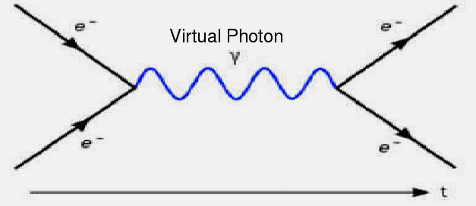
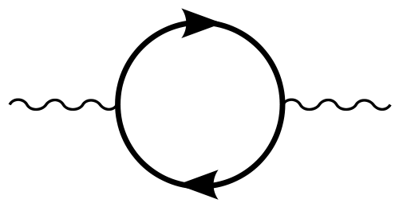
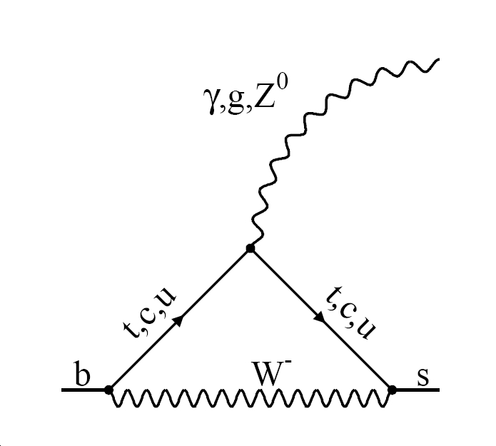
Where to look for NP ?
New heavy particles (if not too heavy) can be produces at LHC
  We are looking for them!
Otherwise exploit one the most intriguing features of quantum mechanics: virtual particles
Note apppearance of “beauty” again

Slide 18
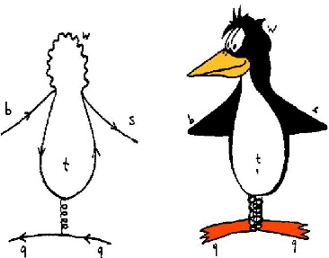
Virtual particles can be heavy
W⁻ 89 GeV
t-quark 170 GeV
NP ?
photon
Beauty quark
m~5GeV
strange quark
m~0.13GeV

Slide 19

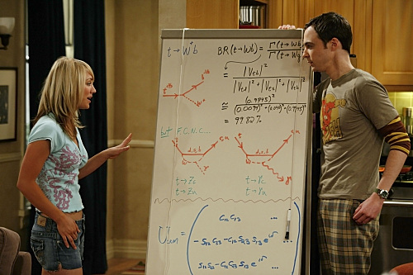
Few more diagrams with virtual particles

Slide 20
LHCb experiment
Look for new physics
  Mainly in decays of beauty particles
  Seek for appearance of virtual particles in loops
Beauty quarks are heavy enough (mass ~ ⁵Li)
  Many decay modes, many observables
  High precision of theory predictions
Beauty particles are light enough to be produced copiously at LHC
  ~A pair of beauty particles per each 250 proton-proton collisions

Slide 21
Beauty particles
Particles that have b-quark. If they have b-quark and corresponding anti-quark they called “hidden beauty particles”
Story started in 1977. Discovered in US
Their importance for theory have been recognized in start of 80s
From those time 4 dedicated
experiments: Germany, 2xUS, Japan.
LHCb is just once more?
  No! We want to be the best!

Slide 22
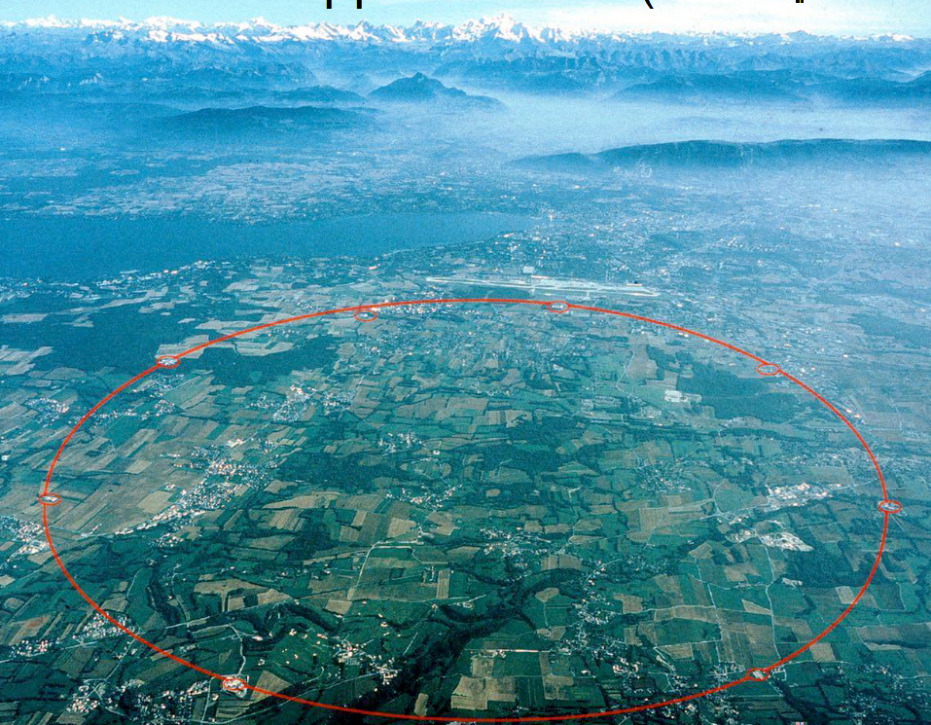
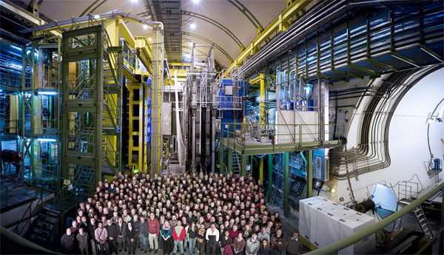
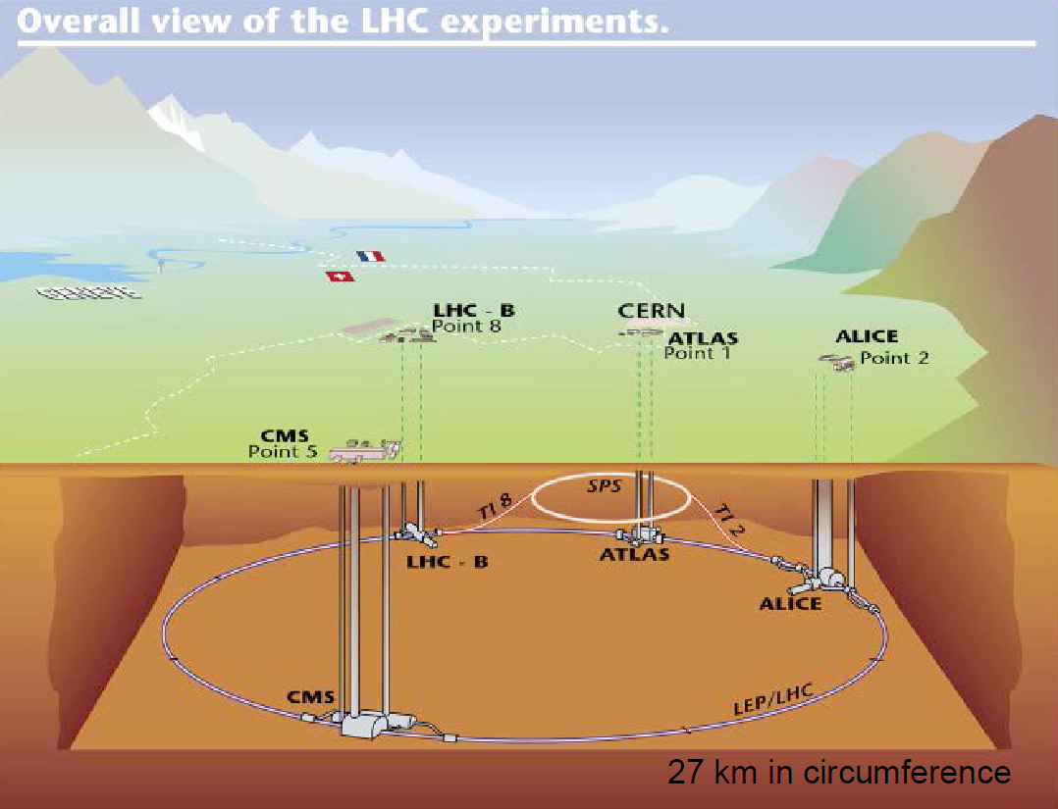
LHCb
14 countries
67 institutions
~800 scientists

Slide 23
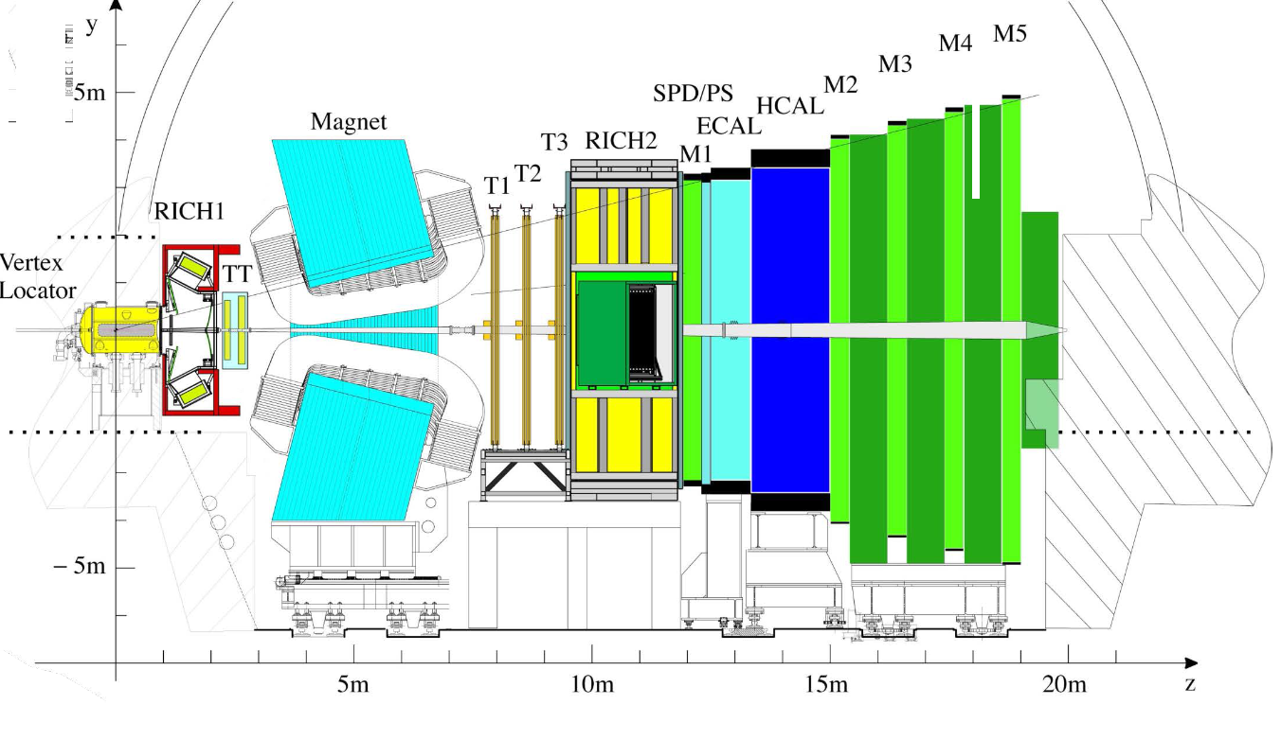
LHCb-detector

Slide 24
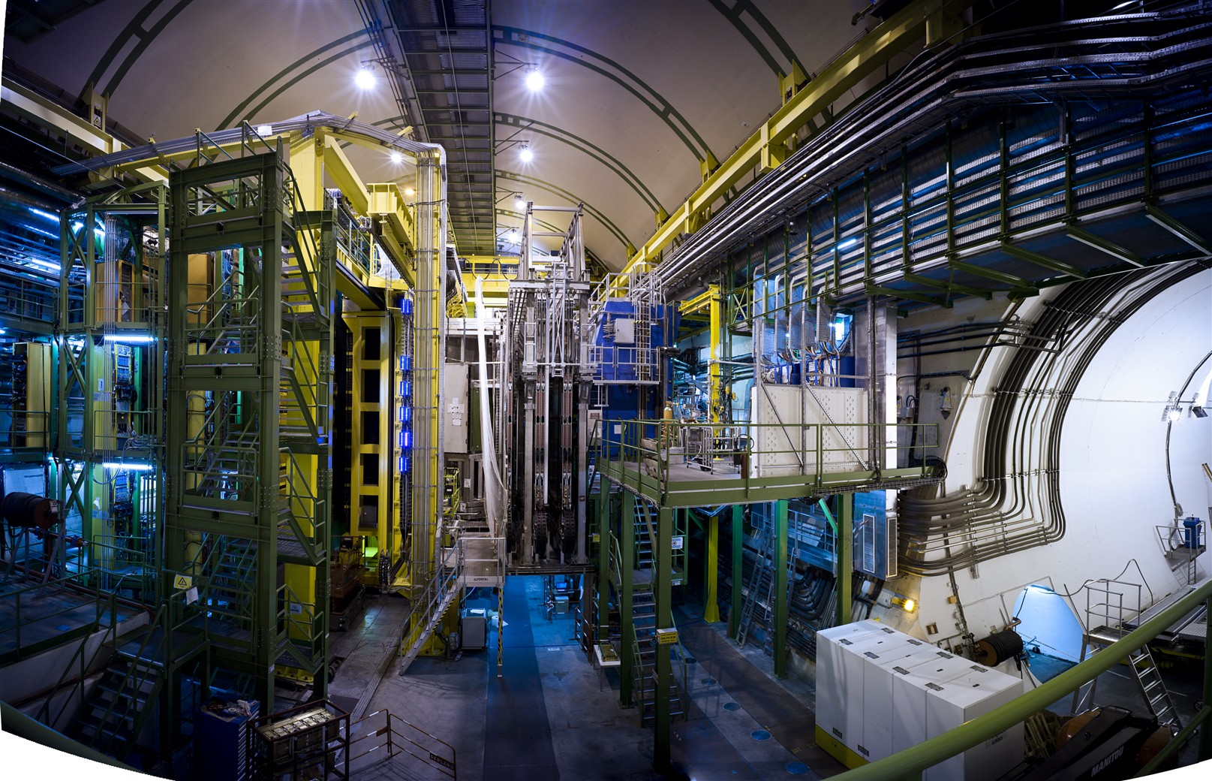
LHCb-detector

Slide 25
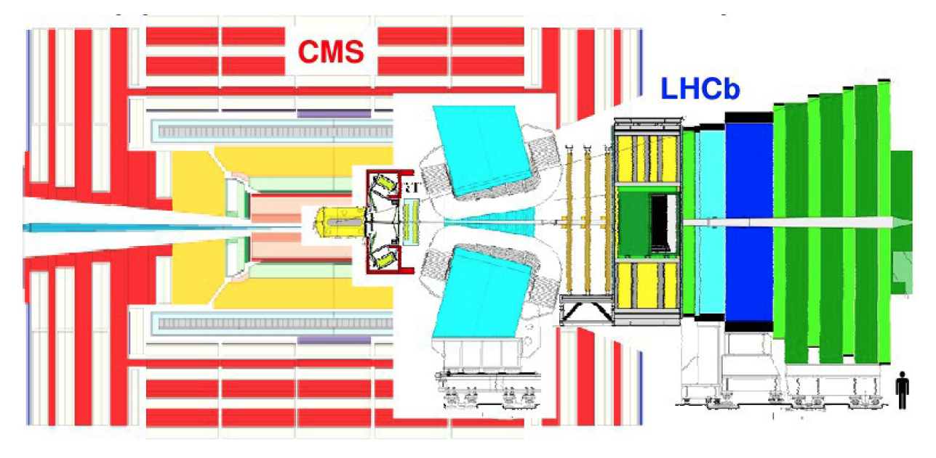
LHCb and other detectors

Slide 26
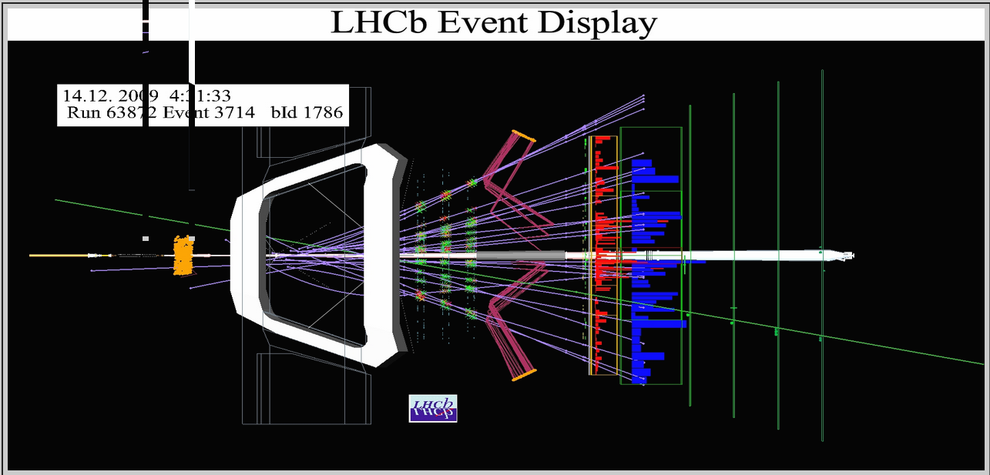
Proton-proton collisions

Slide 27
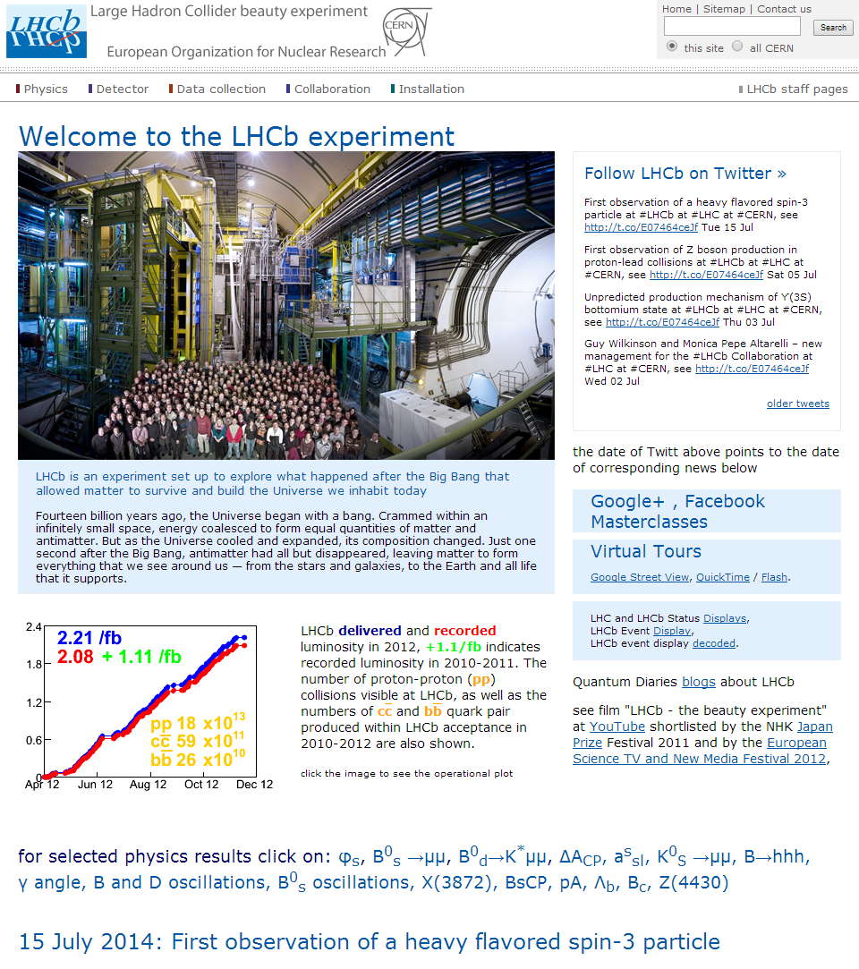
http://lhcb-public.web.cern.ch/lhcb-public
We have a lot of interesting and exciting results
Concentrate of study of symmetry violation in decays of beauty particles
  But not only! One of our the most popular papers devoted to charm particles!
No new physics is discovered (yet)
Many possible scenarios of new physics are already excluded

Slide 28

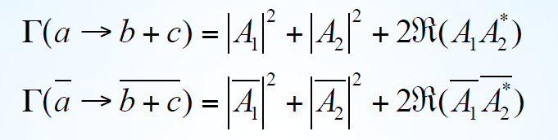
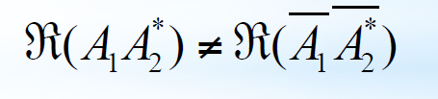
How to look for CP-violation?
Assume two (complex) amplitudes contributes
Necessary condition
If magnitudes are invariant, different phases are needed:
Some changes with CP (weak phases) and some invariant (strong)
Loop diagrams: many different amplitudes, rich pattern

Slide 29
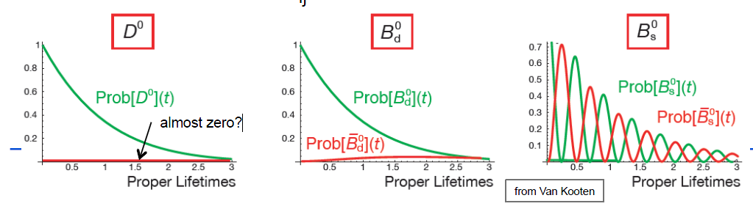
Loops and mixing

Slide 30
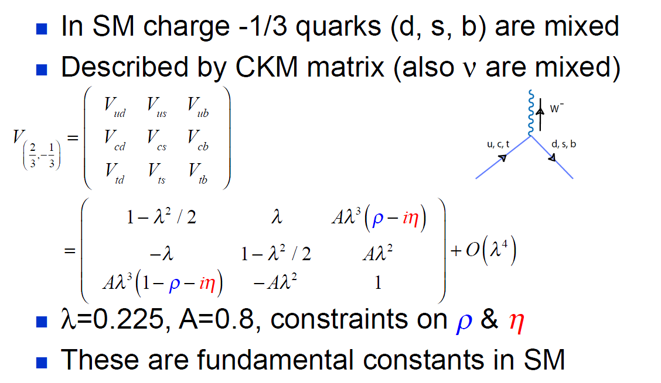
CKM-matrix

Slide 31
CKM-triangle
All measurements together

Slide 32
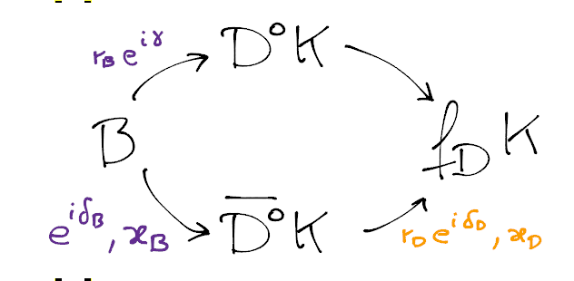
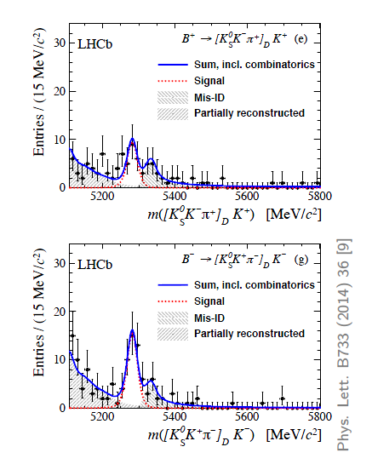
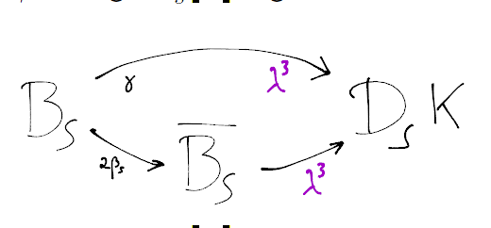
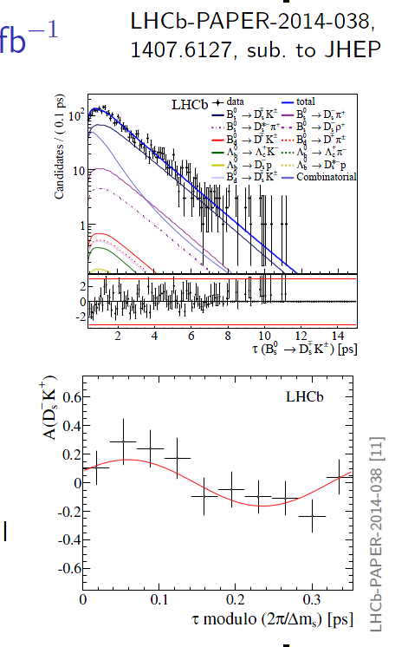

Angle γ

Slide 33
CKM-triangle
Only trees

Slide 34


Other example of loop decays

Slide 35


LHCb + CMS
LHCb and CMS together!

Slide 36

Before plots…

Slide 37


Slide 38

~30 years long story

Slide 39




Other examples: C and P parity violation
B⁺ →Κ⁺π⁺π⁻γ

Slide 40

What it means for us?
Attempt to translate scientific paper ☺

Slide 41


One more example

Slide 42


Hunting for New Physics
No new physics is discovered (yet)
Many possible scenarios of new physics are already excluded
Currently for our hunting we using fences instead of rifle: step-by-step we move our fence allowing less and less space for the New Physics.

Slide 43
Thank you for your attention!
Questions?

Slide 44

Too symmetric could be “unnatural”

Slide 45
Disclaimer
only ~45’, no time to go deep in details
keep as simple as possible
  oversimplification is unavoidable
    reality is more complicated and there are many corrections and exceptions
  hopefully oversimplification causes no confusion

