Slide 1
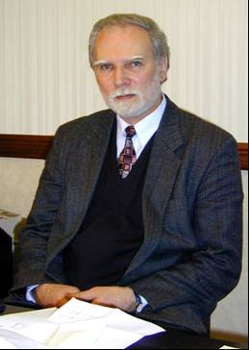
VLADIMIR GEORGIEVICH KADYSHEVSKY
(05.05.1937 – 24.09.2014)
On 24 September 2014, the outstanding Russian physicist-theoretician and science organizer, the Scientific Leader of the Joint Institute for Nuclear Research RAS Academician Vladimir Georgievich Kadyshevsky died suddenly.

