Slide 1

LHC : Big Data and Computing Challenges
CERN-CNIR-JINR
‘Introduction to Accelerators and Particle Physics’
course
Alexei Klimentov
Brookhaven National Laboratory

Slide 2
Main topics
Introduction
  CERN and Large Hadron Collider (LHC)
  LHC data processing challenges
  Evolution of LHC computing model
  Workload Management System core ideas.
Workload Management System - PanDA
LHC Computing needs for Run2+ (2015-2018)
Next Generation Workload Management System. BigPanDA project :
  Expanding PanDA beyond the Grid and High Energy Physics (HEP)
  PanDA at Oak Ridge Leadership Computing Facilities
Summary
Russian Federation Government Grants and “BigData Technologies for megaScience” project

Slide 3
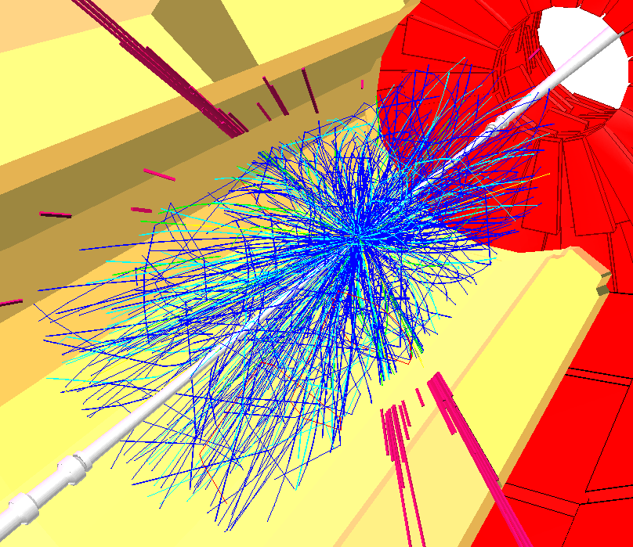

Our Task
Reality
We use experiments
to inquire about what
“reality” (nature) does
We intend to fill this gap
The goal is to understand
in the most general; that’s
usually also the simplest.
    - A. Eddington
Theory

Slide 4

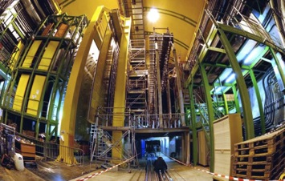
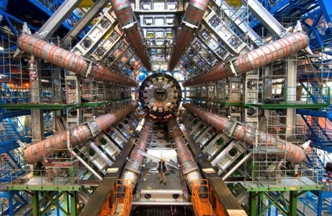
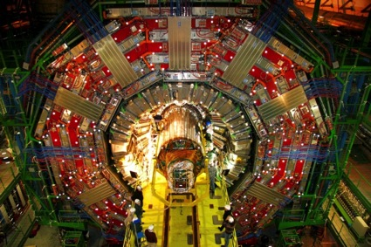
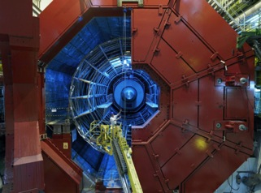
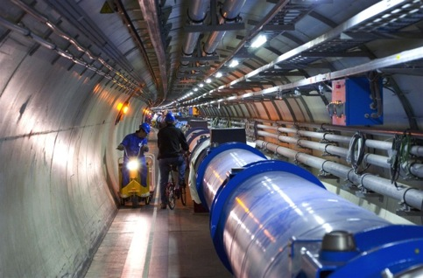

Tools: LHC and Detectors
pp, B-Physics, CP Violation
(matter-antimatter symmetry)
LHCb
CMS
ATLAS
General Purpose,
proton-proton, heavy ions
Discovery of new physics:
Higgs, SuperSymmetry
Exploration of a new energy frontier
in p-p and Pb-Pb collisions
ALICE
LHC ring:
27 km circumference
Heavy ions, pp
(state of matter of early universe)
Notes:
4

Slide 5
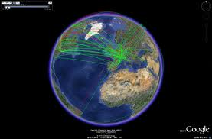
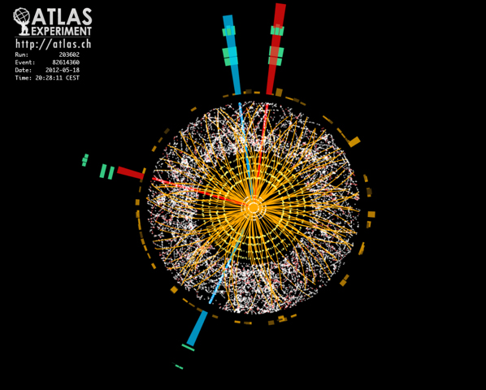
Proton-Proton Collisions at the LHC
LHC delivered billions of collision events to the experiments from proton-proton and proton-lead collisions in the Run1 period (2009-2013)
→ collisions every 50 ns
= 20 MHz crossing rate
1.6 x 10¹¹ protons per bunch
at L_{pk} ~ 0.8x10^{34/}cm²/s
≈ 35 pp interactions per crossing – pile-up
→ ≈ 10⁹ pp interactions per second !!!
in each collision
≈ 1600 charged particles produced
enormous challenge for the detectors and for
data collection/storage/analysis
Raw data rate from LHC detector : 1PB/s
This translates to Petabytes of data recorded world-wide (Grid)
Up to 6 GB/s to be stored and analysed after filtering
The challenge how to process and analyze the data and produce timely physics results was substantial, but at the end resulted in a great success
GRID
Candidate Higgs decay
to four electrons recorded
by ATLAS in 2012.

Slide 6
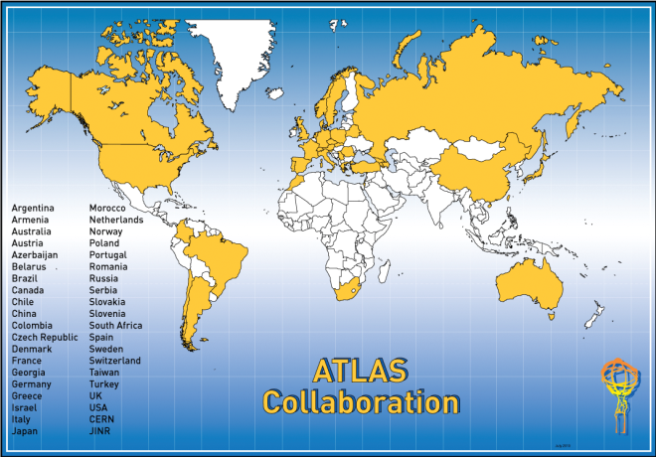
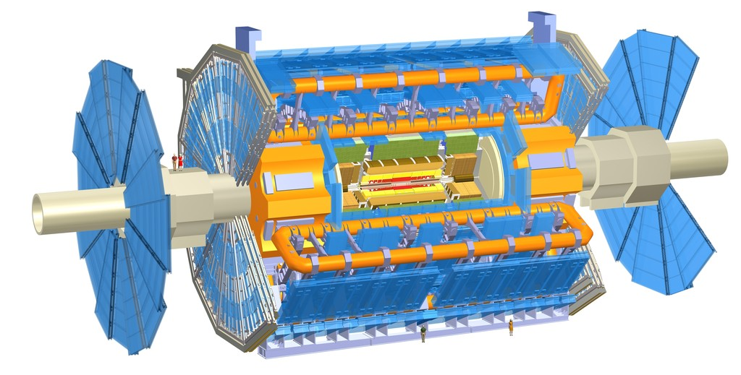
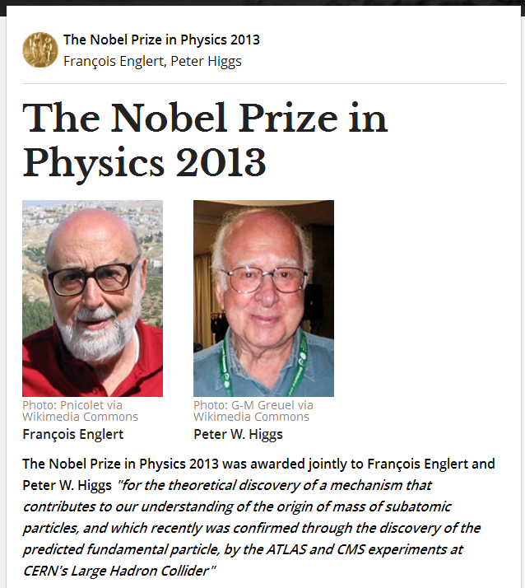

The ATLAS Experiment at the LHC
3000 scientists
174 Universities and Labs
From 38 countries
More than 1200 students
ATLAS has 44 meters long and 25 meters in diameter, weighs about 7,000 tons. It is about half as big as the Notre Dame Cathedral in Paris and weighs the same as the Eiffel Tower or a hundred 747 jets

Slide 7
Terminology
Data is collected online (real-time)
  Collision data recorded by the detectors
Physicists analyze this data offline
  Optimizing selection, estimating/modeling background, establishing limits, discovering New Physics, etc.
The LHC delivers a lot of data, which we need to first select online for future analysis
  Data filtering is done online and offline

Slide 8
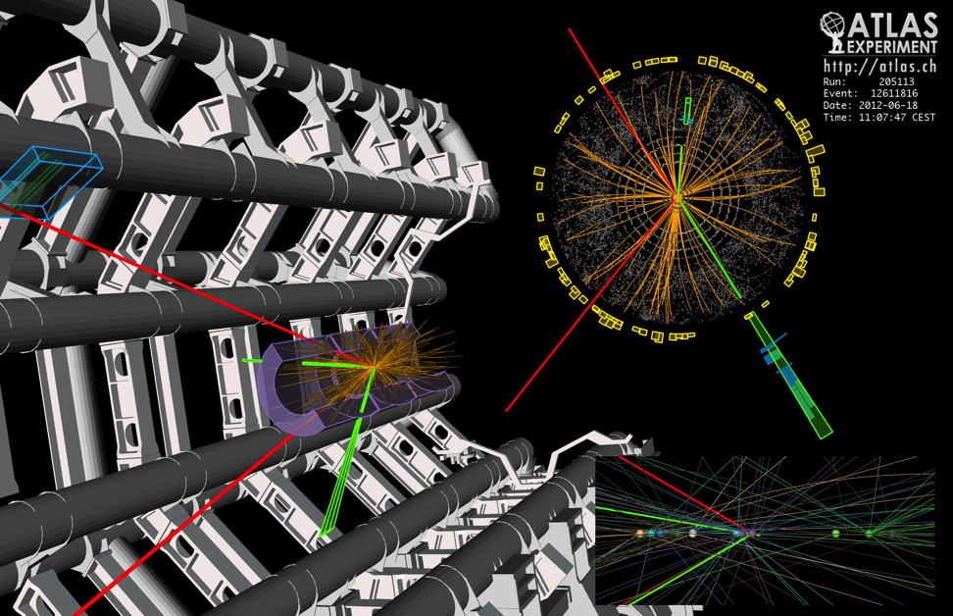
What is this data?
Raw data:
  Was a detector element hit?
  How much energy?
  What time?
Reconstructed data:
  Momentum of tracks (4-vectors)
  Origin
  Energy in clusters (jets)
  Particle type
  Calibration information
  …
150 Million sensors deliver data … ~ 40 Million times per second
Up to 6 GB/s to be stored and analysed after filtering

Slide 9
Experiment...
fraction of RAW event
“Address” :
which detector element took the reading
“Value(s)” :
what the electronics
wrote out

Slide 10
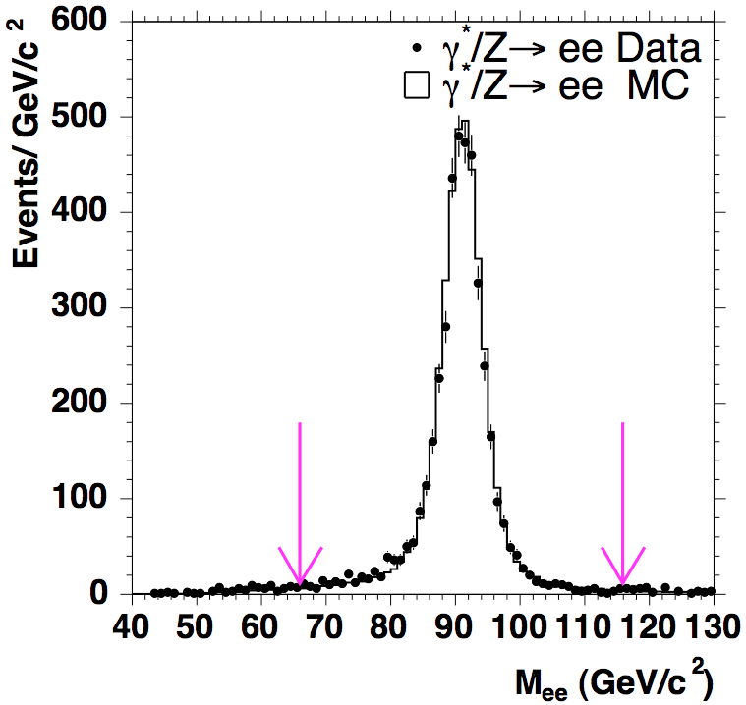

Data Analysis Chain
Have to collect data from many channels on many sub-detectors (millions)
Decide to read out everything or throw event away (Trigger)
Build the event (put info together)
Store the data
Analyze them
  reconstruction, user analysis algorithms,
  data volume reduction
do the same with a simulation
  correct data for detector effects
Compare data and theory

Slide 11
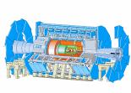

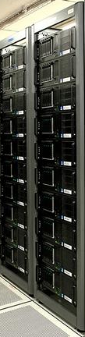

Data Handling and Computation for Physics Analysis
Online
Offline Reconstruction
Online trigger
and filtering
High Level Trigger
Selection &
Offline reconstruction
detector
Processed
Data (Active tapes)
Event
summary
data
Offline Analysis w/ROOT
Raw
data
10%
100%
Batch
physics
analysis
Event
reprocessing
1%
Offline Simulation
w/GEANT4
Event
simulation
Analysis objects
(extracted by physics topic)
Interactive
analysis

Slide 12
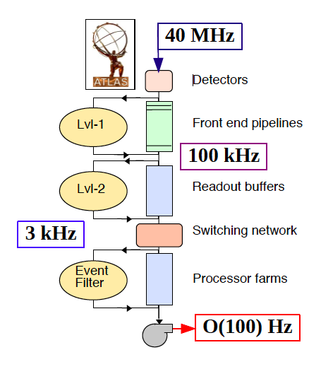
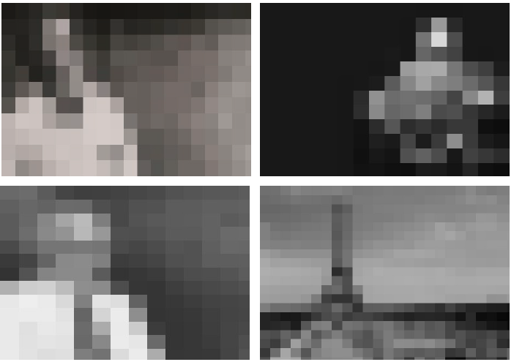
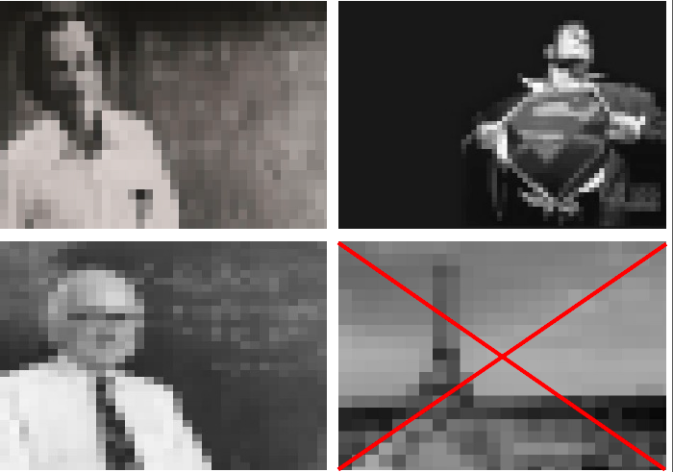
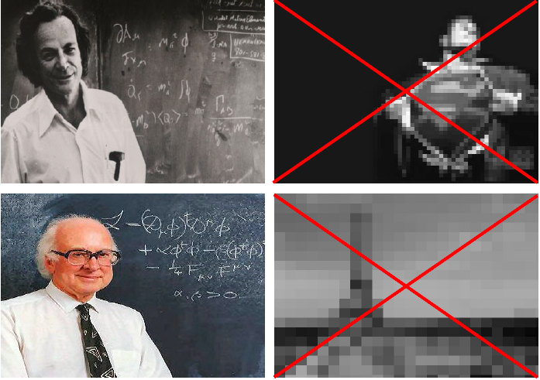
HEP Online. Reduce the data volume in stages.
Higgs Selection using the Trigger
20 MHz
Level 1:
Not all information
available, coarse
granularity
Level 2:
Reconstruct events
Improved ability to reject
events
Level 3:
High quality reconstruction
algorithms, using information
from all detectors
400 Hz
400 Hz. Run1 ATLAS RAW data rate to tape

Slide 13
HEP Offline. Data and Algorithms.
HEP data are organized as Events (particle collisions)
Simulation, Reconstruction and Analysis programs process “one event at a time”
  Events are fairly independent → Trivial parallel processing
Event processing programs are composed of a number of Algorithms selecting and transforming “raw” event data into “processed” (reconstructed) event data and statistics
~4 million lines of code (reconstruction and simulation)
  ~1000 software developers on ATLAS
RAW
Triggered events
recorded by DAQ
Detector digitisation
~2 MB/event
ESD/RECO
Reconstructed
information
Pseudo-physical information:
Clusters, track candidates
~100 kB/event
(D)AOD
Physical information:
Transverse momentum,
Association of particles, jets,
id of particles
Analysis
information
~10 kB/event
TAG
Classification
information
Relevant information
for fast event selection
~1 kB/event

Slide 14
Some history of the scale…
Date | HEP Collaboration sizes | Data volume, archive technology
Late 1950’s | 2-3 | Kilobits, notebooks
1960’s | 10-15 | kB, punchcards
1970’s | ~35 | MB, tape
1980’s | ~100 | GB, tape, disk
1990’s | 700-800 | TB, tape, disk : LEP
2010’s | ~3000 | PB, tape, disk : LHC
For comparison:
1990’s: Total LEP data set ~few TB
Would fit on 1 tape today
Today: 1 year of LHC data ~25 PB
LEP – Large Electron-Positron Collider. e+/e- collider at CERN in 1989-2000

Slide 15
The CERN Data Centre in Numbers
Data Centre Operations (Tier 0)
  24x7 operator support and System Administration services to support 24x7 operation of all IT services.
  Hardware installation & retirement
    ~7,000 hardware movements/year; ~1800 disk failures/year
  Management and Automation framework for large scale Linux clusters
Racks | 828
Servers | 8,750
Processors | 15,694
Cores | 68,443
HEPSpec06 | 482,507
Disks | 67,320
Raw disk capacity (TiB) | 97,096
Memory modules | 52,377
Memory capacity (TiB) | 205
RAID controllers | 3,749
Tape Drives | 160
Tape Cartridges | 45000
Tape slots | 56000
Data on Tape (PiB) | 65
High Speed Routers (640 Mbps → 10 Tbps) | 25
Ethernet Switches | 500
10 Gbps/100Gbps ports | 1200/50
Switching Capacity | 6 Tbps
1 Gbps ports | 16,041
10 Gbps ports | 1,884
IT Power Consumption | 2456 KW
Total Power Consumption | 3890 KW

Slide 16
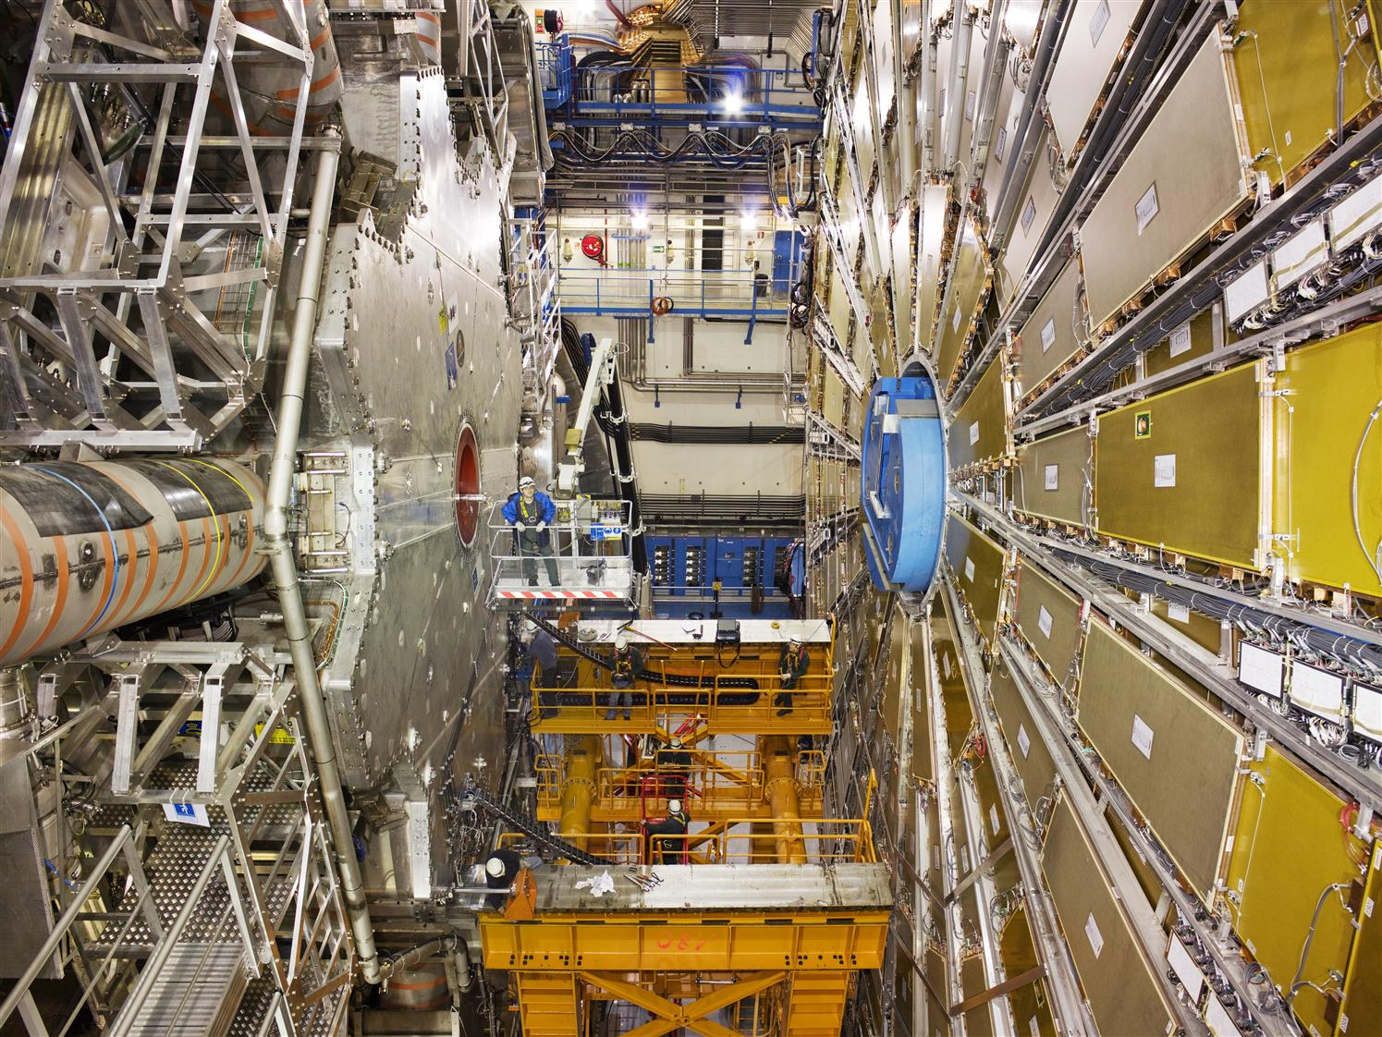
ATLAS . Big Data Experiment
150 million sensors deliver data …

Slide 17

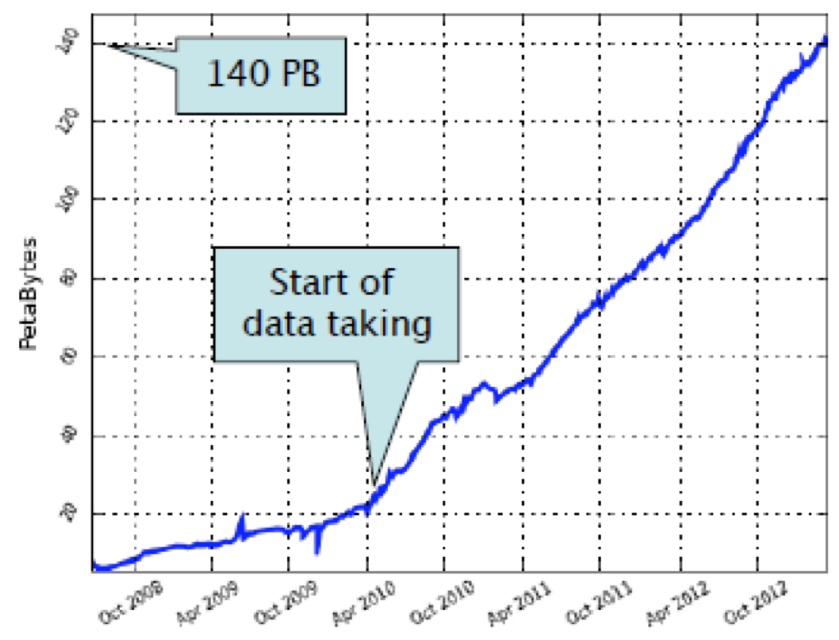
Big Data: often just a buzz word, but not when it comes to ATLAS…
Business emails sent
3000PB/year
(Not managed as
a coherent data set)
Lib of
Congress
ATLAS
data
Big Data in 2013
Climate
DB
Facebook uploads
180PB/year
Current ATLAS data set, all data products: 160 PB
1M files transferred per day
LHC data
25 PB/yr
Google search
100PB
Nasdaq
US
Census
YouTube
15PB/yr
Kaiser
Permanente
30PB
Wired 4/2013
http://www.wired.com/magazine/2013/04/bigdata/
Notes:
http://www.wired.com/magazine/2013/04/bigdata/

Slide 18

Higgs Boson Discovery

Slide 19
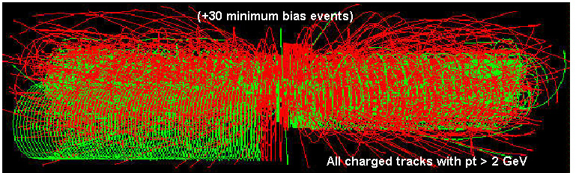
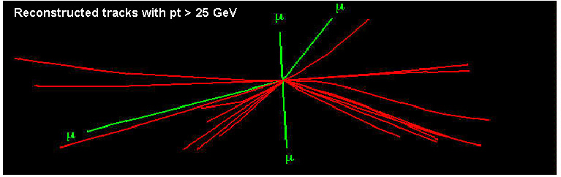
ATLAS Data Challenge
The ATLAS Data Challenge
800,000,000 proton-proton interactions per second
0.0002 Higgs per second
~150,000,000 electronic channels
Starting from this event…
We are looking for this “signature”
Selectivity: 1 in 10¹³
Like looking for 1 person in a thousand world populations
Or for a needle in 20 million haystacks!

Slide 20
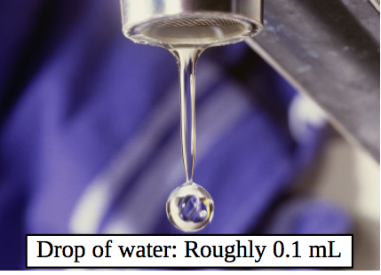
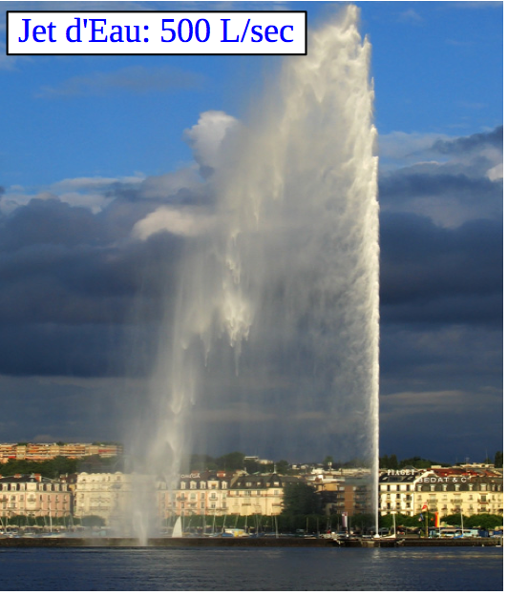
New physics rate ~ 0.00001 Hz
Event Selection :
1 in 10,000,000,000,000
Like looking for a single drop of water from the Geneve Jet d’Eau over 2+ days

Slide 21
Offline Computing in High Energy Physics
Offline computing in HEP
  Has changed and evolved dramatically over the past decades
  Especially for the biggest experiments – at the LHC
The situation ~15 years ago
  Data processing was performed in large computing centers using local batch systems with dedicated shares
  A few satellite centers did simulations, occasionally data reprocessing
  Users were mostly located near large computing centers, usually at the laboratory where the experiment was located, and used a combination of desktops and batch systems for analysis
  Final Data Summary Files versions were physically shipped for remote analysis

Slide 22



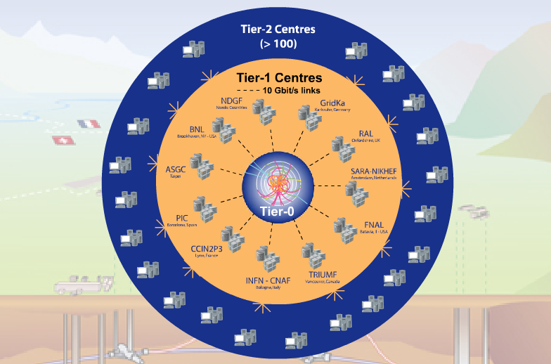


World-wide LHC Computing Grid
Tier-0 (CERN): (15%)
  Data recording
  Initial data reconstruction
  Data distribution
Tier-1 (11 centres; 2 in USA – BNL, FNAL): (40%)
Permanent storage
Re-processing
Analysis
Connected by direct Gb/s network links
Tier-2 (~140 centres): (45%)
Simulation
End-user analysis
15%
45%
40%
Notes:
The Tier 0 centre at CERN stores the primary copy of all the data. A second copy is distributed between the 11 so-called Tier 1 centres. These are large computer centres in different geographical regions of the world, that also have a responsibility for long term guardianship of the data. The data is sent from CERN to the Tier 1s in real time over dedicated network connections.
In order to keep up with the data coming from the experiments this transfer must be capable of running at around 1.3 GB/s continuously. This is equivalent to a full DVD every 3 seconds.
The Tier 1 sites also provide the second level of data processing and produce data sets which can be used to perform the physics analysis. These data sets are sent from the Tier 1 sites to the around 130 Tier 2 sites.
A Tier 2 is typically a university department or physics laboratories and are located all over the world in most of the countries that participate in the LHC experiments. Often, Tier 2s are associated to a Tier 1 site in their region. It is at the Tier 2s that the real physics analysis is performed.

Slide 23
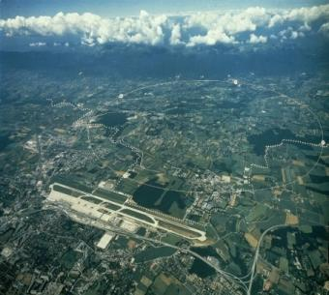
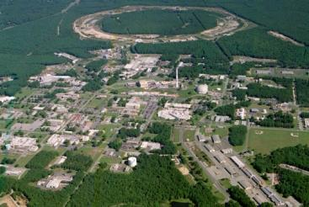
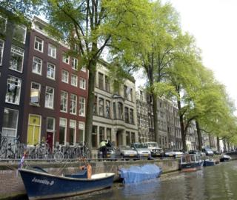
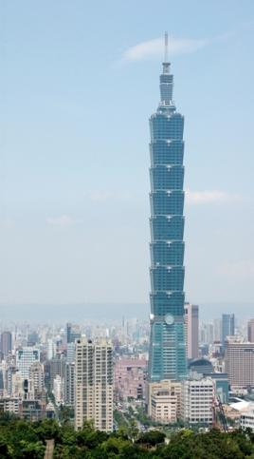
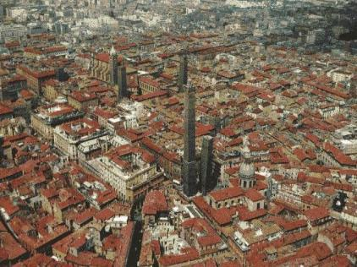
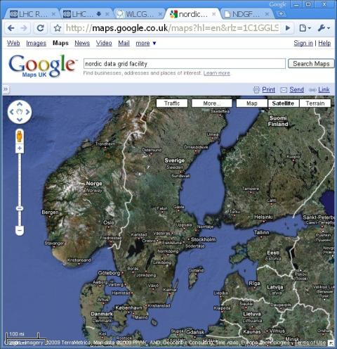
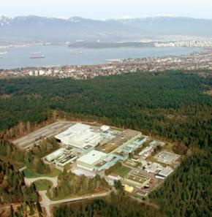
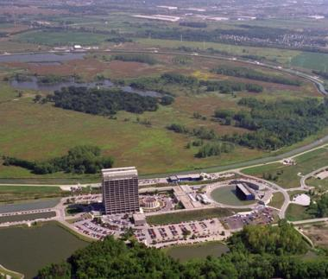
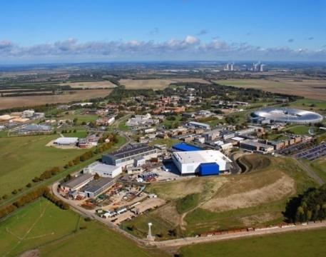
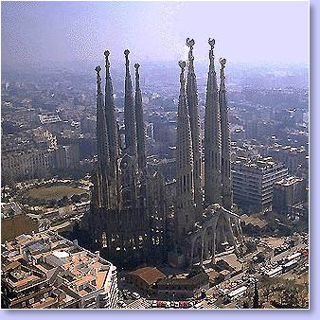
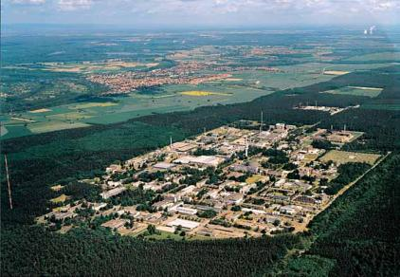
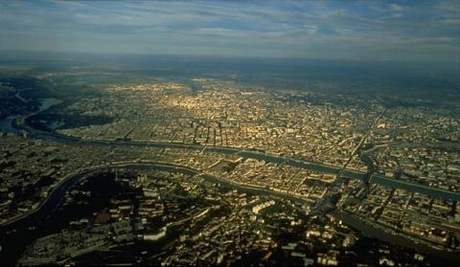
US-BNL
CERN
Amsterdam/NIKHEF-SARA
Bologna/CNAF
WLCG Collaboration Status
Tier 0; 11 Tier 1s; 68 Tier 2 federations (140 Tier 2 sites) + many T3 sites
Ca-
TRIUMF
Taipei/ASGC
Today we have 49 MoU signatories, representing 34 countries:
  Australia, Austria, Belgium, Brazil, Canada, China, Czech Rep, Denmark, Estonia, Finland, France, Germany, Hungary, Italy, India, Israel, Japan, Rep. Korea, Netherlands, Norway, Pakistan, Poland, Portugal, Romania, Russia, Slovenia, Spain, Sweden, Switzerland, Taipei, Turkey, UK, Ukraine, USA.
NDGF
US-FNAL
Barcelona/PIC
UK-RAL
De-FZK
Lyon/CCIN2P3

Slide 24
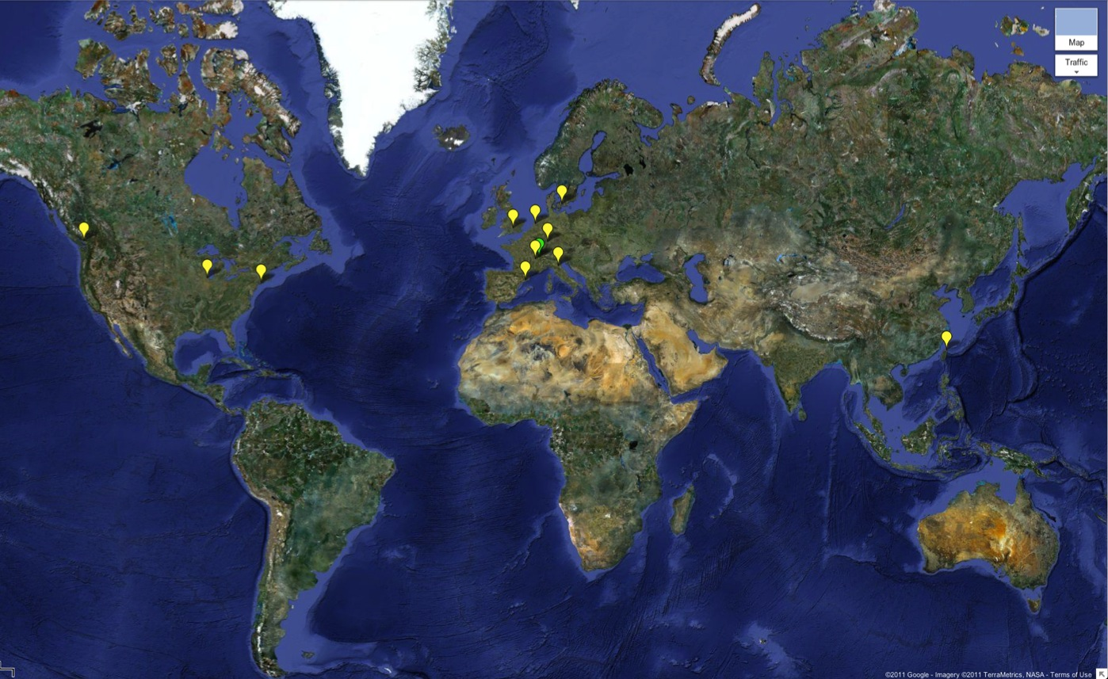

LHC Computing Grid: A global collaboration…
Tier-0 (CERN):
Data recording
Initial data reconstruction
Data distribution
Tier-1 (11 centres):
Permanent storage
Re-processing
Analysis
~150 sites
>250k CPU cores
>150 PB disk
Tier 0
Tier-2 (~140 centres):
Simulation
End-user analysis

Slide 25
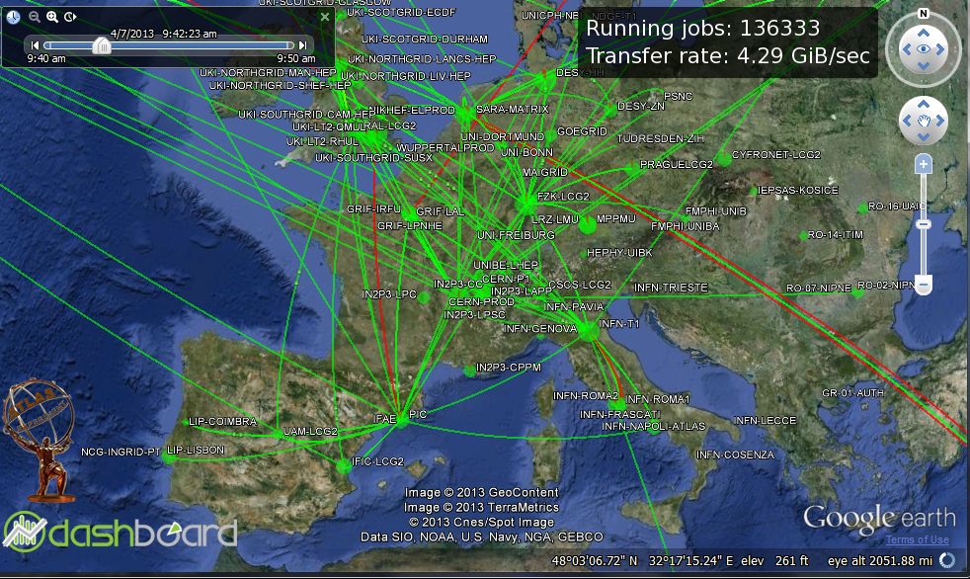
Data fans out all over Europe
More than 25 billions bits transferred every second

Slide 26
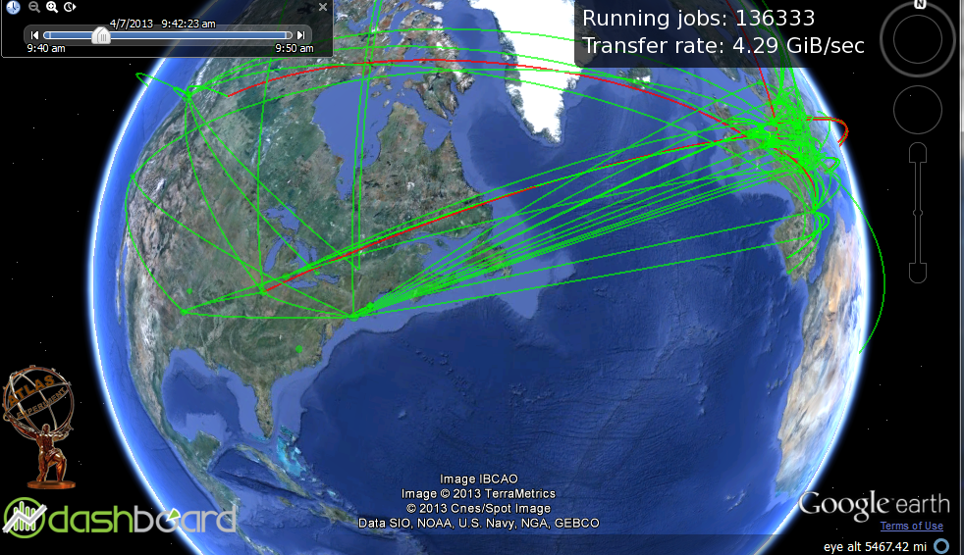
And across the Atlantic

Slide 27
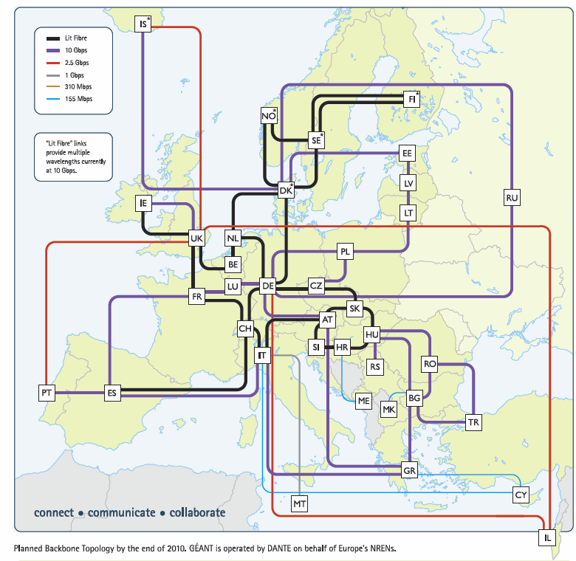
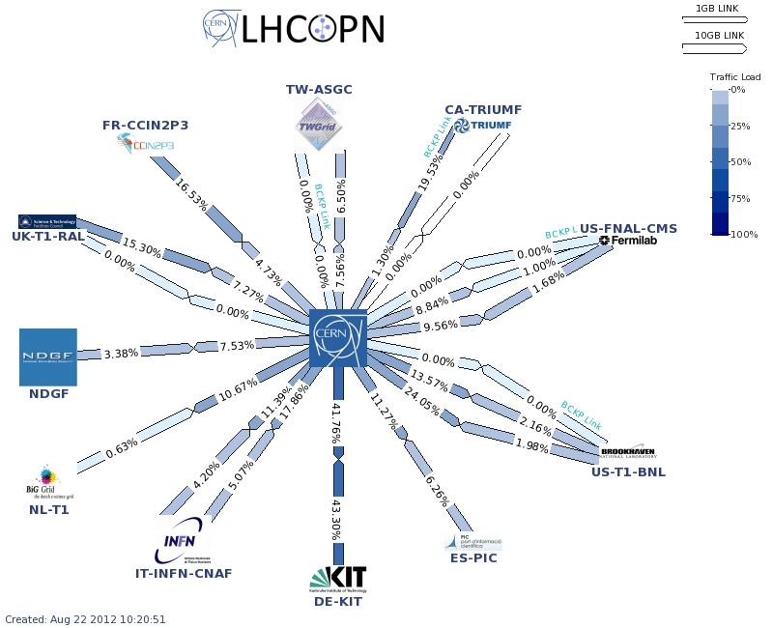
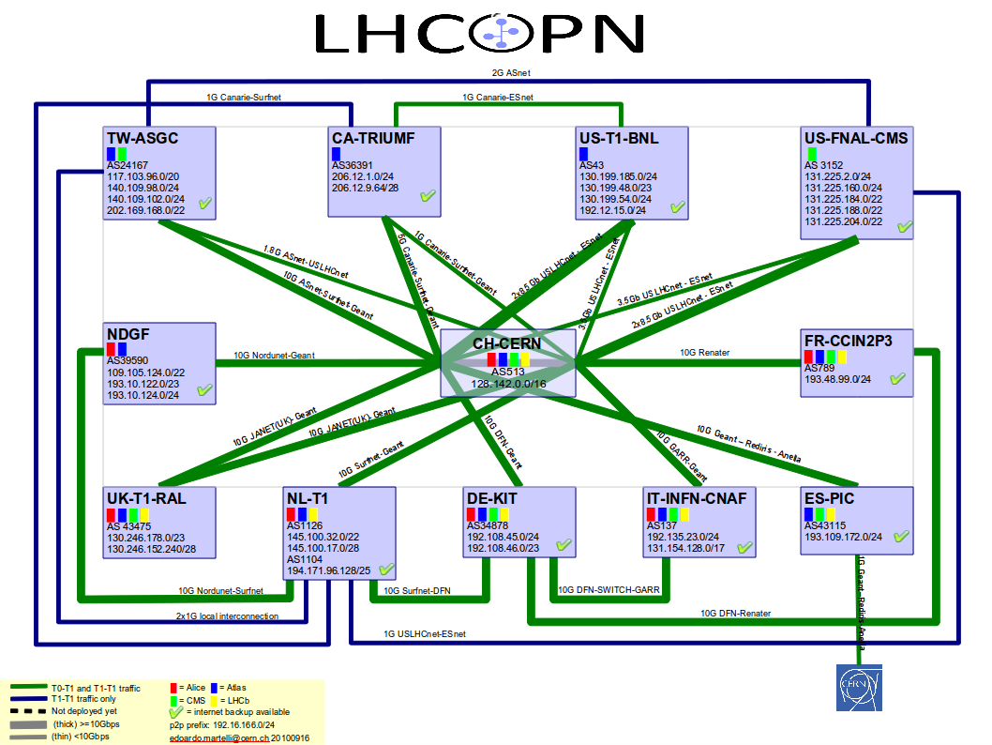
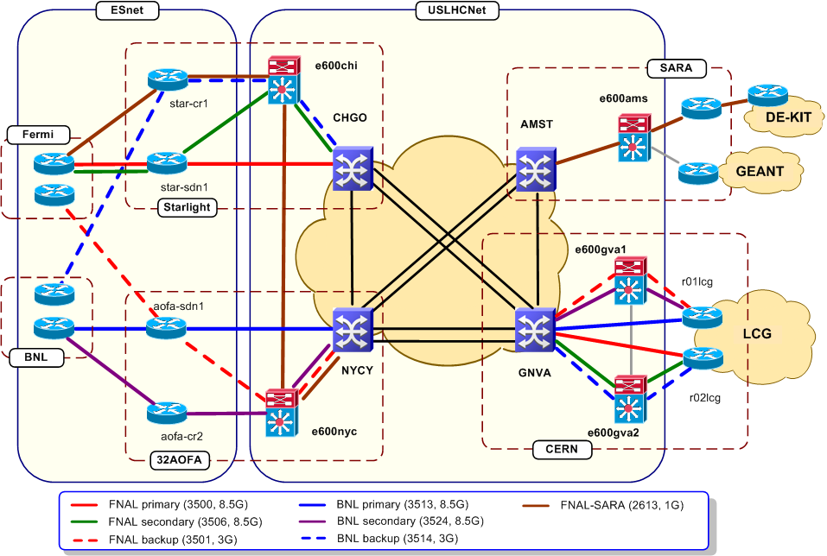
LHC Networking
Relies on
  OPN, GEANT, US-LHCNet
  NRENs & other national & international providers

Slide 28
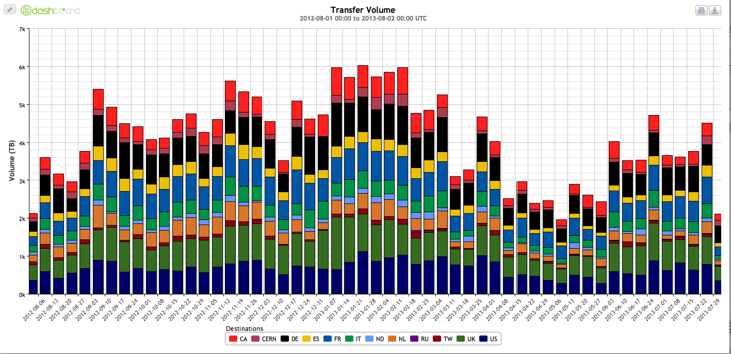
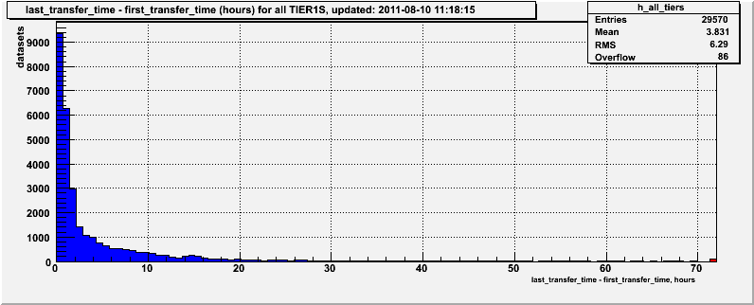
ATLAS Distributed Computing. Distributed Data Transfer
Data Transfer Volume in TB (weekly average). Aug 2012 - Aug 2013
TBytes
CERN to BNL data transfer
time . An average 3.7h
to export data from CERN
6 PBytes ->

Slide 29
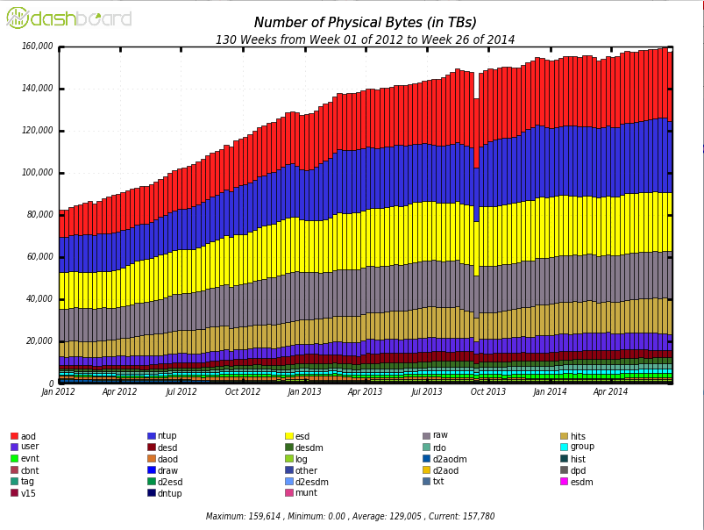
ATLAS Data Volume on the Grid Sites
TBytes
160 PBytes
Derived data
Raw data
Formats
RAW data volume ~3 PB/year,
Managed Data Volume on Grid sites 160 PB

Slide 30
Processing the Experiment Big Data
The simplest solution in processing LHC data is using data affinity for the jobs
  Data is staged to the site where the compute resources are located and data access by analysis code from local, site-resident storage
  However
    In distributed computing environment we don’t have enough disk space to host all our data at every Grid site
      Thus we distribute (pre-place) our data across our sites
    The popularity of data sets is difficult predict in advance
      Thus computing capacity at a site might not match the demand for certain data sets
  Different approaches are being implemented
    Dynamic or/and on demand data replication
      Dynamic : if certain data is popular over make additional copies on other Grid sites
      On-demand : User can request local or additional data copy
    Remote access : data can be accessed remotely
    Both approaches have the underlying scenario that puts the WAN between the data and the executing analysis code
Intelligent Workload Management System is needed to manage resources and to automate data processing, analysis and simulation

Slide 31
Workload Management System. Core Ideas
Make hundreds of distributed sites appear as local
  Provide central queue for users – similar to local batch systems
Reduce site related errors and latency
  Build a pilot job system – late transfer of user payloads
  Crucial for distributed infrastructure maintained by local experts
Hide middleware while supporting diversity and evolution
  WMS interacts with middleware – users see high level workflow
Hide variations in infrastructure
  WMS presents uniform ‘job’ slots to user
  Easy to integrate grid sites, clouds, recently HPC sites
Use the same system for Monte-Carlo simulation, data processing and users analysis

Slide 32

PanDA. Production and Data Analysis System
ATLAS computational resources are managed by PanDA Workload Management System (WMS)
PanDA project was started in fall of 2005 by BNL and University Texas at Arlington (UTA) groups
  An automated yet flexible workload management system which can optimally make distributed resources accessible to all users
  Standards based implementation
    REST framework – HTTP/S
    Oracle or MySQL backends
    About a dozen Python packages available from SVN and GitHub
    Command-line and GUI/Web interfaces
Through PanDA, physicists see a single computing facility that is used to run all data processing for the experiment, even though data centers are physically scattered all over the world.
Now successfully manages O(10²) sites, O(10⁵) cores, O(10⁸) jobs per year, O(10³) users
DOE ASCR and HEP funded BigPanDA project 2013 - 2016

Slide 33


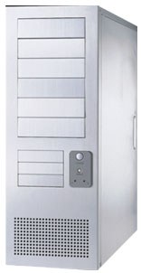

Workload Management System
Production
managers
Data Management
System
PanDA server
production
job
https
Local
Replica
Catalog
(LFC)
Local
Replica
Catalog
(LFC)
Local
Replica
Catalog
submitter
(bamboo/JEDI)
https
https
Logging
System
define
task/job
repository
(Production DB)
pull
https
https
https
NDGF
analysis
job
pilot
https
job
OSG
submit
pilot
arc
EGEE/EGI
ARC Interface
(aCT)
pilot
condor-g
End-user
pilot
scheduler
(autopyfactory)
Worker Nodes
NonPanDA components

Slide 34

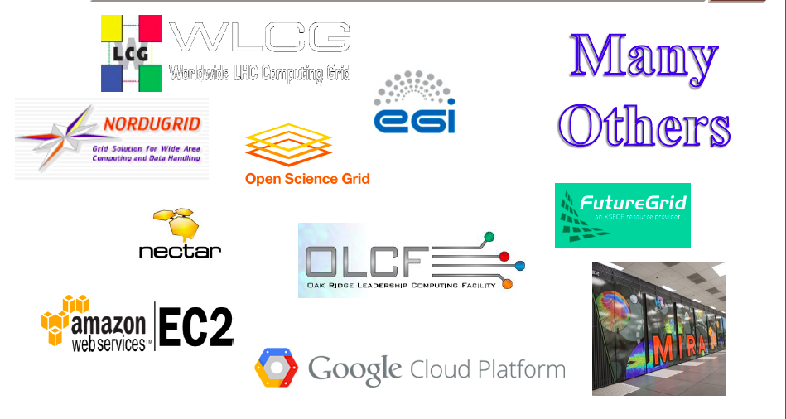

Resources Accessible via PanDA
OLCF

Slide 35

PanDA Performance
Up to 30M jobs completed every month
At more than 100 sites
Running at 130 000 cores worldwide
Consuming at peak ~0.2 petaflops
BNL in Green
PanDA is exascale now : 1.2 Exabytes of data processed by PanDA in 2013
All available resources are fully used

Slide 36
LHC Upgrade. Computing Needs
Run1 :
2009 - 2013
Run2 :
2015 - 2017
Run4
ATLAS
+
CMS
Run3
2019-2021
ALICE
+
LHCb
CPU needs per event
RAW data volume
in PetaBytes
CPU needs (per event) will grow with track multiplicity (pileup) and energy
Storage needs are proportional to accumulated luminosity
Grid resources are limited by funding and fully utilized

Slide 37


LHC Computing Model Evolution. Tiers Hierarchy
Evolution of computing models
Hierarchy
Mesh
Network capabilities and data access technologies have significantly improved our ability to use resources independent of location
Now we are relaxing hierarchical model : Flat instead of Tiered Grid model
Network capabilities and data access technologies have significantly improved our ability to use resources independent of location
Flat instead of Tiered Grid model

Slide 38


LHC Computing Model Evolution.
Global Data Federations… (Reducing Complexity)
CERN-IT : site or cloud is represented by
Virtual Storage Cloud Node
ATLAS : Global Data Federation - FAX
ALICE :
Virtually joining together the sites based on proximity (latency) and network capacity into Regional Data Clouds
  Each cloud/region provides reliable data management and sufficient processing capability
  Dealing with handful of clouds/regions instead of the individual sites

Slide 39




LHC, Amazon & Google Computing Centers
One Google Data Center is
estimated to cost ~$600M
  An order of magnitude more
  than the centre at CERN
Amazon : 9 large sites/zones
    up to ~2M CPU cores/site, ~4M total
    10 x more cores on 1/10 of the sites compared to our Grid
    500,000 users
LHC Computing (WLCG)
  150 sites
  350k CPU cores total
  ~5000 users
World LHC Computing Grid
Google
Amazon

Slide 40
ATLAS Scale of Needs
The ATLAS experiment uses a geographically distributed grid of approximately 130,000 cores continuously, to simulate, and analyse its data.
The need for simulation and analysis would overwhelm the expected capacity of LHC Grid computing facilities unless the range and precision of physics studies were to be curtailed.
  Physics requires to increase rate
    Run1 data-taking rate 400 Hz
    Run2 data-taking rate 1kHz
Leadership Computing Facilities contributions of the order of 10 Million or more core hours per year become important and valuable.
ATLAS computing can also be a close to ideal “crack-filling” application. PanDA WMS is being upgraded to make it aware of dynamically changing resources, and thus able to exploit groups of processors that become available for relatively short times.
Extending PanDA beyond the Grid will further expand the potential user community and the resources available to them.

Slide 41

HPC Scheduling
HEP applications (such as Geant or ROOT) can effectively use a single core
HPC is full, means that the system have allocated all the cycles it is able to deliver
  It is probably not all cycles it has
  Just as there is room for sand in the jar of rocks, there’s room for HEP jobs on even a “full” HPC

Slide 42

HPC Scheduling. Cont’d
This is not a typical workday view of HPC machine
At this moment machine is 85% full, the largest open partition has 1024 nodes
But the shortest job in the queue required 4096 nodes
The scheduler will be happy to run a short job in R12
24h backfill tests have been conducted on Titan together with OLCF team

Slide 43
The Top 500 Computers
Most of the computational power is concentrated in a small number of machines
  Half the total power is in the top dozen computers
Equivalent ATLAS Grid use is about the size of the sector (little green star)
Equivalent ATLAS Grid would be around #27 on this chart

Slide 44

High Performance Computing (Top 10, Nov 2013)
cores
Rmax
Rpeak
Power
Collaborations have members with access to these machines and to ARCHER, NERSC, …
Some HPCs are already successfully used as part of Nordu Grid (Abisko, Abel, Triolith, C2PAP, Hydra)

Slide 45
BigPanDA. Extending PanDA beyond the Grid
Proposal titled “Next Generation Workload Management and Analysis System for BigData” – BigPanDA is DOE Advanced Scientific Computing Research (ASCR) and HEP funded project.
  Generalization of PanDA as meta application, providing location transparency of processing and data management, for HEP and other data-intensive sciences, and a wider exascale community.
    BNL + UTA (Lead PI : A.Klimentov)
There are three dimensions to evolution of PanDA
  Making PanDA available beyond ATLAS and High Energy Physics
  Extending beyond Grid (Leadership Computing Facilities, Clouds, University clusters)
  Integration of network as a resource in workload management

Slide 46
Workload Management and Networking.
Why WMS should care about networking ?
    Distributed workload management systems need to transfer data (or use direct access) both for input and output
    Data transfer/access is done asynchronously : by DQ2/Rucio in ATLAS, PhEDEx in CMS, pandamover/FAX …
    Data transfer/access systems can be optimized for network performance – PanDA will use these enhancements
    But network information can also be used directly in workflow management in PanDA at a higher level – first step to try
Goal for PanDA
  Direct integration of networking with PanDA workflow – never attempted before for large scale automated WMS systems
Main PanDA use cases
  Use network information for cloud selection
  Use network information for job assignment
  Use network information for site selection

Slide 47
PanDA and Networking. Concept.
PanDA as workload manager
  PanDA automatically chooses job execution site
    Multi-level decision tree – task brokerage, job brokerage, dispatcher
    Also manages predictive future workflows – at task definition, PD2P (PanDA Dynamic Data Placement)
  Site selection is based on processing and storage requirements
    Can we use network information in this decision?
    Can we go even further – network provisioning?
  Further – network knowledge used for all phases of job cycle?
Network as resource
  Optimal site selection should take network capability into account
    We do this already – but indirectly using job completion metrics
  Network as a resource should be managed (i.e. provisioning)
    We also do this crudely – mostly through timeouts, self throttling

Slide 48
Intelligent Network Services and PanDA
In BigPanDA we will use information on how much bandwidth is available and can be reserved before data movement will be initiated
In Task Definition user will specify data volume to be transferred and deadline by which task should be completed. The calculations of (i) how much bandwidth to reserve, (ii) when to reserve, and (iii) along what path to reserve will be carried out by Virtual Network On Demand.
Site Status Board
Grid Information
System
SchedConfigDB
Raw data, historical data
Averaged network data for atlas sites
Averaged network data for panda sites
Brokerage
Site selection module
Measurement sources
Sonar
PerfSonar
XRootD
PanDA

Slide 49

Network Performance Measurements
SSB: http://dashb-atlas-ssb.cern.ch/dashboard/request.py/siteview#currentView=Sonar&highlight=false

Slide 50

BigPanDA. Extending the scope. Cloud Computing.
  Compute Engine (GCE) preview project : Google allocated additional resources for ATLAS for free :~5M CPU hours, 4000 cores for about 2 months
  Resources are organized as PanDA queues
  Output exported to BNL
  Transparent inclusion of cloud resources into ATLAS Distributed Computing
  The idea was to test long term stability while running a cloud cluster similar in size to Tier 2 center in US ATLAS
  Intended for CPU intensive Monte-Carlo simulation workloads, planned as a production type of run. Delivered to ATLAS as a resource and not as an R&D platform.

Slide 51

Running PanDA on Google Compute Engine
We ran for about 8 weeks (2 weeks were planned for scaling up)
Very stable running on the Cloud side. GCE was rock solid.
Most problems that we had were on the ATLAS side.
We ran computationally intensive jobs
  Physics event generators, Fast detector simulation, Full detector simulation
Completed 458,000 jobs, generated and processed about 214 M events
Invited BNL PAS talk at Google IO conference
Failed and Finished Jobs
reached throughput of 15K jobs per day
most of job failures occurred during start up and scale up phase

Slide 52
BigPanDA for Leadership Computing Facilities
Expanding PanDA from Grid to Leadership Class Facilities required significant changes in our system
  Each LCF is unique
    Unique architecture and hardware
    Specialized Operating System, “weak” worker nodes, limited memory per worker node
    Code cross-compilation is typically required
    Unique job submission systems
    Unique security environment
HEP applications (such as Geant or ROOT) can effectively use a single core
PanDA has potential to generate 300M hours per year
PanDA submission algorithm has been adopted to use backfill information and to submit jobs in backfill mode.
Final tests have been conducted in August together with OLCF team
  Were able to collect ~ 200,000 core hours
  Max number of nodes per job – 5835 (93360 cores)
    Close to 75% ATLAS Grid in size!
  Used ~2.3% of all Titan core hours or ~14.4% of free core hours

Slide 53



#2
27 PFlops (Peak)
18,688 compute nodes with GPUs
299,008 CPU cores
AMD Opteron 6200 @2.2 GHz (16 cores)
32 GB Ram per node
Nvidia TESLA K20x GPU per node
32 PB disk storage (Luster)
29 PB HPSS tape archive

Slide 54

Extending PanDA to Oak Ridge Leadership Computing Facilities
Grid Center
Data (GridFTP)
Data (PanDAmover)
Local
storage
Payload SW
CVMFS/rsync
ATLAS (BNL, UTA), OLCF, ALICE (CERN,LBNL,UTK) :
  adapt PanDA for OLCF (Titan)
  reuse existing PanDA components and workflow as much as possible.
  PanDA connection layer runs on front-end nodes in user space. There is a predefined host to communicate with CERN from OLCF, connections are initiated from the front-end nodes
  SAGA (a Simple API for Grid Applications) framework as a local batch interface.
  Pilot (payload submission) is running on HPC interactive node and communicating with local batch scheduler to manage jobs on Titan.
  Outputs are transferred to BNL T1 or to local storage
The same architecture has been tested on other super-computers

Slide 55

Interfacing PanDA with Titan. Cont’d
PanDA modular pilot augmented with HPC specific classes
SAGA (Simple API for Grid Applications) framework as pilot’s interface to HPC batch schedulers
  http://saga-project.github.io/saga-python/
  http://www.ogf.org/documents/GFD.90.pdf
MPI wrapper/overlay scripts that allow to run multiple single threaded workload instances in parallel
“Backfill” functionality in pilot
Pilot on HPC with MPI wrapper
MPI
“One to One”
MPI
“One to Many”

Slide 56

PanDA pilot tests on Titan
Average wait time 70 seconds !

Slide 57
Summary
2000s – The decade of the Grid
First years of LHC data – Distributed Computing has helped deliver physics rapidly
Entering a phase of computing evolution
Challenges for computing – scale & complexity – will continue to increase dramatically
The distributed computing model allows us to incorporate clouds and LCF/HPC centers and to use them efficiently for LHC Run 2 and beyond
Access to the LCF coupled with collaborative help in the transformation of HEP code would be a major scientific contribution to the physics discoveries of the next ten years
The work on extending PanDA to Leadership Computing Facilities has started. PanDA has been successfully ported on OLCF Titan and NERSC.

Slide 58
Summary. PanDA’s Success
PanDA was able to cope with increasing LHC luminosity and ATLAS data taking rate
Adopted to evolution in ATLAS computing model
Several leading HENP and astro-particle experiments (ALICE, AMS, LSST, COMPASS) has chosen PanDA as workload management system for data processing and analysis or evaluating it.
It is also used for Biomedical applications
Cost effectiveness. PanDA enables BigData processing at a fraction of the cost at Google/Amazon data centers
PanDA is exascale now : 1.2 Exabytes of data processed by PanDA in 2013
PanDA was cited in the document titled “Fact sheet: Big Data across the Federal Government” prepared by the Executive Office of the President of the United States as an example of successful technology already in place at the time of the “Big Data Research and Development Initiative” announcement

Slide 59
Russian Government Grant Program
The program was started in 2010 to attract leading scientists to Russian Universities and Research Institutes
  “…In order to strengthen governmental support for the development of science and innovations in tertiary education and to improve the quality of higher education, on April 9, 2010, the Government of the Russian Federation instituted monetary grants that are made available on a competitive basis to support of scientific research projects implemented by the world’s leading scientists at Russian institutions of higher learning…”
  Resolution No.220 of the Government of the Russian Federation of April 9, 2010

Slide 60
Grant Program Goals
To bring world-renowned scientists, including scientists from among Russian citizens residing abroad, to Russian institutions of higher learning;
To create scientific research laboratories capable of competing with the world’s leading laboratories;
To ensure achievement of world-class research results;
To create conditions required to improve the professional quality of the faculty and research specialists of Russian institutions of higher learning, as well as to create an effective and efficient system of motivation of scientific work;
To encourage young people to pursue professional development in the fields of science, education, and high technologies;
To help create sustainable links between Russian institutions of higher learning and the world’s leading universities and science schools;
To facilitate commercialization of the research results and new technologies developed in the course of the scientific research projects supported under the program.

Slide 61

Russian Government Grant Program

Slide 62





“BigData Technologies For megaScience Projects”
The project will be carried out at the National Research Center Kurchatov Institute in Moscow (NRC KI)
  NRC KI is the lead Russian Organization involved in research at the LHC, FAIR, XFEL, RHIC
  NRC KI will host Tier-1 center for three LHC experiments (ATLAS, ALICE, LHCb)
  Moscow Engineering Physics Institute (MEPhI), SINP and CNIR of Moscow State University, National University of Information Technologies, Mechanics and Optics (ITMO, St.Petersburg) are participating in the project
3 year project (2014-2016) with possible extension for 2 years, funding is started in June
“BigData Тechnologies” Laboratory is set up within Center of nano, bio and information technologies at NRC KI
Academician Kurchatov square
(Moscow)
Igor Kurchatov & Andrei Sakharov (1958)
NBICS center (NRC KI)

Slide 63
Key Considerations
ATLAS is a Big Data and megaScience Project
megaScience projects are international
Software technologies development (and software development in general) for such projects is difficult without international collaboration and cooperation
  Very positive discussions within ATLAS, NRC KI, with LHC and NP experiments, and WLCG
The new Laboratory scientific program should be tightly coupled with LHC experiments priorities and address challenges we will meet in 2-3 years
  And many “our” challenges are not ATLAS (HEP, LHC) specific
ATLAS has a proven use case when software developed for the experiment is expanded beyond HEP and expanded to other areas and disciplines
  PanDA project

Slide 64
First Steps
Very strong support from NRC KI directorate
  To build laboratory NOW
    Two senior researches are at CERN this week
Very strong support from IHEP Protvino, MEPhI and StPINP ATLAS groups to involve young researchers and computing specialists in the project
Very strong support from Moscow State University and CNIR
Scientists from JINR, Duke, UTA, ANL, BNL, IJS, Genova have expressed interest to collaborate
Ongoing discussion with other experiments and WLCG

Slide 65
The Growing PanDA Ecosystem
ATLAS PanDA
  US ATLAS, CERN, UK, DE, ND, CA, Dubna, Protvino, OSG …
ASCR BigPanDA
  DoE funded project at BNL, UTA – 3 years (2012-2015)
ANSE PanDA
  NSF funded network project - CalTech, Michigan, Vanderbilt, UTA
HPC and Cloud PanDA
Taiwan PanDA – not only astro-particle physics (AMS), but also biology, chemistry,…
  Dedicated meeting in March between ASGC, Rucio and PanDA teams
CMS PanDA – Common Analysis Framework
AliEn PanDA
MegaPanDA
  MegaPanDA – RF funded project

Slide 66
Thanks
This talk drew on presentations, discussions, comments, input from many
Thanks to all, including those I’ve missed
D.Benjamin, K.De, I.Bird, P.Buncic, D.Duellmann, R.Gardner, O.Keeble, T.LeCompte, D.Oleynik, S.Panitkin, A.Peters, A.Petrosyan, K.F.Read, M.Schulz, T.Wenaus…

