Slide 1
VASCO Study
For ALICE new LS2 layout

Slide 2
Summary
Reference
VASCO Parameters
Calculation
Some Results

Slide 3
Reference
1st TREX meeting: http://indico.cern.ch/event/325756/
2nd TREX meeting: http://indico.cern.ch/event/333087/
Work package EDMS:
ECR LHC-VAM-EC-0001 v.1.0 , EDMS 1238042
“Change of the Warm Module in ALICE at 9 m left of the IP”

Slide 4
VASCO Parameters
For ALICE new LS2 layout

Slide 5
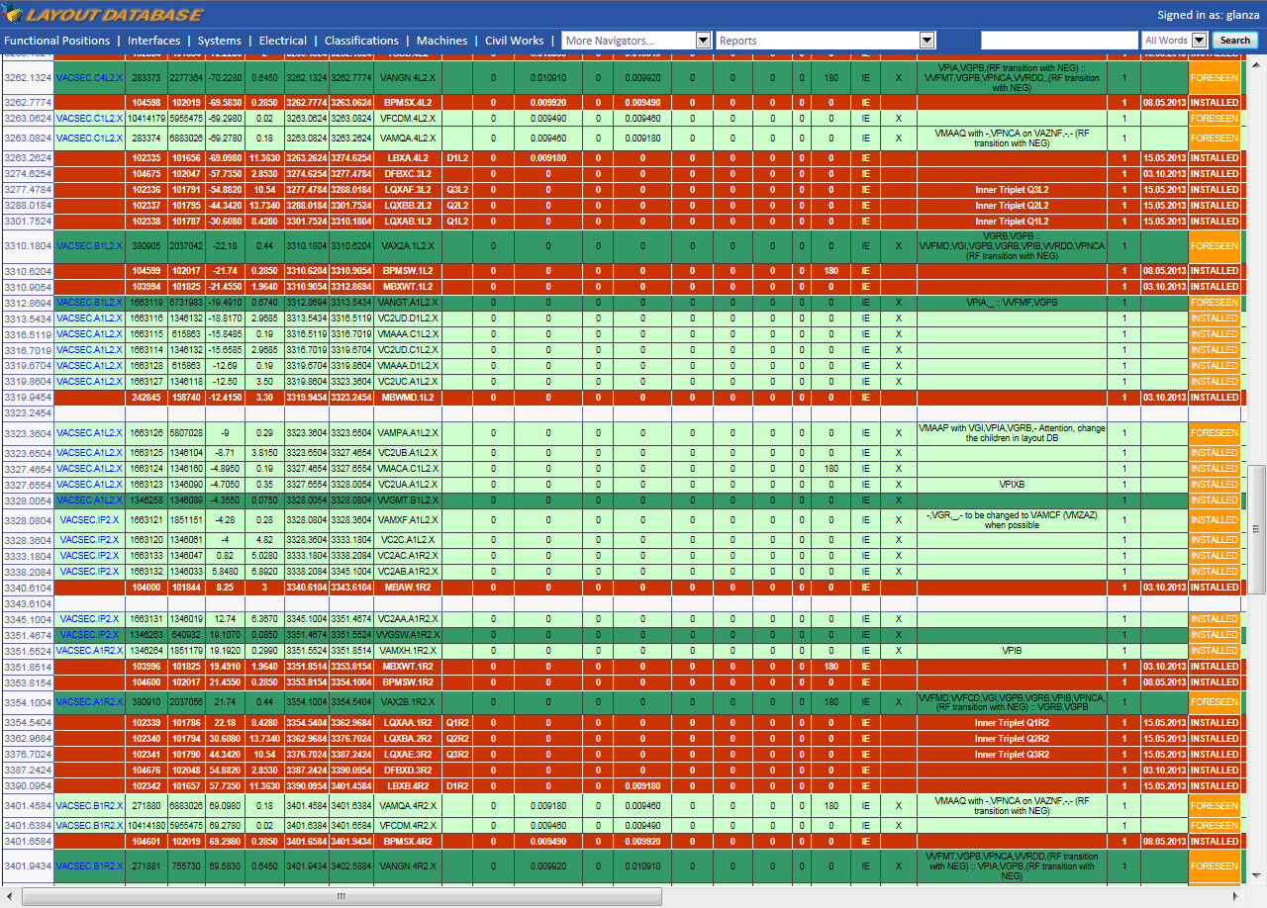
Layout database
(maybe not completely upgraded after LS1?)

Slide 6
Ion Pumps
VPIB.220.1L2.X
53 | 0 | 0 | 0
0 | 15 | 0 | 0
0 | 0 | 10 | 0
0 | 0 | 0 | 10
Zone 5x10⁻¹¹ mbar
VPIA.193.1L2.X
16 | 0 | 0 | 0
0 | 28 | 0 | 0
0 | 0 | 12 | 0
0 | 0 | 0 | 12
Zone 5x10⁻¹² mbar
VPIA.89.1L2.X
16 | 0 | 0 | 0
0 | 28 | 0 | 0
0 | 0 | 12 | 0
0 | 0 | 0 | 12
Zone 1x10⁻¹² mbar
VPIXB.45.1L2.X
10 | 0 | 0 | 0
0 | 5 | 0 | 0
0 | 0 | 10 | 0
0 | 0 | 0 | 10
Zone 5x10⁻¹² mbar
43 | 0 | 0 | 0
0 | 15 | 0 | 0
0 | 0 | 7 | 0
0 | 0 | 0 | 7
VPIB.193.1R2.X
Zone 5x10⁻¹² mbar
53 | 0 | 0 | 0
0 | 15 | 0 | 0
0 | 0 | 10 | 0
0 | 0 | 0 | 10
VPIB.220.1R2.X
Zone 5x10⁻¹¹ mbar

Slide 7
Ion Pumps + NEG cartridge after LS1
VPIB.220.1L2.X
200 | 0 | 0 | 0
0 | 15 | 0 | 0
0 | 0 | 50 | 0
0 | 0 | 0 | 50
Zone 5x10⁻¹¹ mbar
Values chosen (for the H2) to match the measured pressure
200 | 0 | 0 | 0
0 | 15 | 0 | 0
0 | 0 | 50 | 0
0 | 0 | 0 | 50
VPIB.220.1R2.X
Zone 5x10⁻¹¹ mbar

Slide 8
ISD-ESD-PSD
VASCO PARAMETERS
 | Parameters |  | NEG |  |  |  | Baked Copper |  |  |  | Cold |  |  |  | Cold
% |  |  | H2 | CH4 | CO | CO2 | H2 | CH4 | CO | CO2 | H2 | CH4 | CO | CO2 | H2 | CH4 | CO | CO2
in_Segment = [ |  |  | 1 | 0 | 0 | 0 | 3 | 0 | 0 | 0 | 2 | 0 | 0 | 0 | 4 | 0 | 0 | 0
in_d = [ | [mm] |  | 0 | 0 | 0 | 0 | 0 | 0 | 0 | 0 | 0 | 0 | 0 | 0 | 0 | 0 | 0 | 0
in_L = [ | [mm] |  | 0 | 0 | 0 | 0 | 0 | 0 | 0 | 0 | 0 | 0 | 0 | 0 | 0 | 0 | 0 | 0
in_dist_ref = [ | [mm] |  | 0 | 0 | 0 | 0 | 0 | 0 | 0 | 0 | 0 | 0 | 0 | 0 | 0 | 0 | 0 | 0
in_T = [ | [K] |  | 300 | 0 | 0 | 0 | 300 | 0 | 0 | 0 | 15 | 0 | 0 | 0 | 10 | 0 | 0 | 0
in_S = [ | Pumping Speed [L/s] of pump located at the left hand of the segment |  | 0 | 0 | 0 | 0 | 0 | 0 | 0 | 0 | 0 | 0 | 0 | 0 | 0 | 0 | 0 | 0
 |  |  | 0 | 0 | 0 | 0 | 0 | 0 | 0 | 0 | 0 | 0 | 0 | 0 | 0 | 0 | 0 | 0
 |  |  | 0 | 0 | 0 | 0 | 0 | 0 | 0 | 0 | 0 | 0 | 0 | 0 | 0 | 0 | 0 | 0
 |  |  | 0 | 0 | 0 | 0 | 0 | 0 | 0 | 0 | 0 | 0 | 0 | 0 | 0 | 0 | 0 | 0
in_g = [ | Local source of gas [torrl/s] |  | 0 | 0 | 0 | 0 | 0 | 0 | 0 | 0 | 0 | 0 | 0 | 0 | 0 | 0 | 0 | 0
in_sigma = [ | Ionization Cross Section |  | 4.45E-23 | 0 | 0 | 0 | 4.45E-23 | 0 | 0 | 0 | 4.45E-23 | 0 | 0 | 0 | 4.45E-23 | 0 | 0 | 0
 |  |  | 0 | 3.18E-22 | 0 | 0 | 0 | 3.18E-22 | 0 | 0 | 0 | 3.18E-22 | 0 | 0 | 0 | 3.18E-22 | 0 | 0
 |  |  | 0 | 0 | 2.75E-22 | 0 | 0 | 0 | 2.75E-22 | 0 | 0 | 0 | 2.75E-22 | 0 | 0 | 0 | 2.75E-22 | 0
 |  |  | 0 | 0 | 0 | 4.29E-22 | 0 | 0 | 0 | 4.29E-22 | 0 | 0 | 0 | 4.29E-22 | 0 | 0 | 0 | 4.29E-22
in_alpha = [ | Sticking coefficient for NEG |  | 5.00E-03 | 0 | 0 | 0 | 1.00E-12 | 0 | 0 | 0 | 1.00E-12 | 0 | 0 | 0 | 1.00E-12 | 0 | 0 | 0
 |  |  | 0 | 1.00E-12 | 0 | 0 | 0 | 1.00E-12 | 0 | 0 | 0 | 1.00E-12 | 0 | 0 | 0 | 1.00E-12 | 0 | 0
 |  |  | 0 | 0 | 0.50 | 0 | 0 | 0 | 1.00E-12 | 0 | 0 | 0 | 1.00E-12 | 0 | 0 | 0 | 1.00E-12 | 0
 |  |  | 0 | 0 | 0 | 0.50 | 0 | 0 | 0 | 1.00E-12 | 0 | 0 | 0 | 1.00E-12 | 0 | 0 | 0 | 1.00E-12
in_alpha_p = [ | Sticking coefficient for cryogenic surfaces |  | 1.00E-12 | 0 | 0 | 0 | 1.00E-12 | 0 | 0 | 0 | 1.00E-12 | 0 | 0 | 0 | 1.00E-12 | 0 | 0 | 0
 |  |  | 0 | 1.00E-12 | 0 | 0 | 0 | 1.00E-12 | 0 | 0 | 0 | 1.00E-12 | 0 | 0 | 0 | 1.00E-12 | 0 | 0
 |  |  | 0 | 0 | 1.00E-12 | 0 | 0 | 0 | 1.00E-12 | 0 | 0 | 0 | 1.00E-12 | 0 | 0 | 0 | 1.00E-12 | 0
 |  |  | 0 | 0 | 0 | 1.00E-12 | 0 | 0 | 0 | 1.00E-12 | 0 | 0 | 0 | 1.00E-12 | 0 | 0 | 0 | 1.00E-12
in_eta_i = [ | Ion induced desorption on room temperature surface | H2 | 5.40E-02 | 5.40E-02 | 5.40E-02 | 5.40E-02 | 0.54 | 0.54 | 0.54 | 0.54 | 0 | 0 | 0 | 0 | 0 | 0 | 0 | 0
 |  | CH4 | 4.00E-03 | 5.00E-03 | 7.00E-03 | 1.10E-02 | 0.04 | 0.05 | 0.07 | 0.11 | 0 | 0 | 0 | 0 | 0 | 0 | 0 | 0
 |  | CO | 2.50E-02 | 2.90E-02 | 2.90E-02 | 3.30E-02 | 0.25 | 0.29 | 0.29 | 0.33 | 0 | 0 | 0 | 0 | 0 | 0 | 0 | 0
 |  | CO2 | 1.40E-02 | 1.40E-02 | 1.40E-02 | 1.40E-02 | 0.14 | 0.14 | 0.14 | 0.14 | 0 | 0 | 0 | 0 | 0 | 0 | 0 | 0
in_eta_p_i = [ | Ion induced desorption on cryogenic surface | H2 | 0 | 0 | 0 | 0 | 0 | 0 | 0 | 0 | 0.33 | 0.33 | 0.33 | 0.33 | 0.33 | 0.33 | 0.33 | 0.33
 |  | CH4 | 0 | 0 | 0 | 0 | 0 | 0 | 0 | 0 | 0.02 | 0.03 | 0.04 | 0.07 | 0.02 | 0.03 | 0.04 | 0.07
 |  | CO | 0 | 0 | 0 | 0 | 0 | 0 | 0 | 0 | 0.15 | 0.17 | 0.17 | 0.20 | 0.15 | 0.17 | 0.17 | 0.20
 |  | CO2 | 0 | 0 | 0 | 0 | 0 | 0 | 0 | 0 | 0.09 | 0.09 | 0.09 | 0.09 | 0.09 | 0.09 | 0.09 | 0.09
in_eta_e = [ | e- induced desorption on room temperature |  | 3.30E-05 | 8.30E-07 | 1.70E-05 | 1.70E-05 | 1.80E-03 | 6.50E-05 | 4.50E-04 | 3.90E-04 | 0 | 0 | 0 | 0 | 0 | 0 | 0 | 0
in_eta_p_e = [ | e- induced desorption on cryogenic surface |  | 0 | 0 | 0 | 0 | 0 | 0 | 0 | 0 | 9.68E-03 | 8.72E-05 | 4.17E-04 | 9.68E-04 | 9.68E-03 | 8.72E-05 | 4.17E-04 | 9.68E-04
in_eta_ph = [ | photon induced desorption on room temperature |  | 2.50E-07 | 2.50E-09 | 1.20E-08 | 1.20E-08 | 1.50E-04 | 4.00E-06 | 1.50E-05 | 2.50E-05 | 0 | 0 | 0 | 0 | 0 | 0 | 0 | 0
in_eta_p_ph = [ | photon induced desorption on cryogenic surface |  | 0 | 0 | 0 | 0 | 0 | 0 | 0 | 0 | 1.98E-05 | 1.42E-06 | 5.67E-06 | 1.98E-05 | 1.98E-05 | 1.42E-06 | 5.67E-06 | 1.98E-05
in_Cbs = [ | Linear pumping speed for beam screen |  | 0 | 0 | 0 | 0 | 0 | 0 | 0 | 0 | 0 | 0 | 0 | 0 | 120 | 0 | 0 | 0
 |  |  | 0 | 0 | 0 | 0 | 0 | 0 | 0 | 0 | 0 | 42 | 0 | 0 | 0 | 42 | 0 | 0
 |  |  | 0 | 0 | 0 | 0 | 0 | 0 | 0 | 0 | 0 | 0 | 32 | 0 | 0 | 0 | 32 | 0
 |  |  | 0 | 0 | 0 | 0 | 0 | 0 | 0 | 0 | 0 | 0 | 0 | 26 | 0 | 0 | 0 | 26
in_Qth = [ | Thermal Degassing [mbar L/s cm2] |  | 5.00E-14 | 3.00E-17 | 1.00E-14 | 1.00E-14 |  |  |  |  | 0 | 0 | 0 | 0 | 0 | 0 | 0 | 0
in_n_e = [ | Vapour pressure cryogenic temperature |  | 0 | 0 | 0 | 0 | 0 | 0 | 0 | 0 | 0 | 0 | 0 | 0 | 0 | 0 | 0 | 0
in_N_e = [ | Electron Flux [e/m/s] |  | 0 | 0 | 0 | 0 | 0 | 0 | 0 | 0 | 0 | 0 | 0 | 0 | 0 | 0 | 0 | 0
in_Gamma_ph = [ | Photon Flux [ph/m/s] |  | 0 | 0 | 0 | 0 | 0 | 0 | 0 | 0 | 0 | 0 | 0 | 0 | 0 | 0 | 0 | 0
in_S_Nplus1 = [ | Pumping Speed [L/s] of pump located at the right hand side of LAST segment |  | 0 | 0 | 0 | 0 | 0 | 0 | 0 | 0 | 0 | 0 | 0 | 0 | 0 | 0 | 0 | 0
 |  |  | 0 | 0 | 0 | 0 | 0 | 0 | 0 | 0 | 0 | 0 | 0 | 0 | 0 | 0 | 0 | 0
 |  |  | 0 | 0 | 0 | 0 | 0 | 0 | 0 | 0 | 0 | 0 | 0 | 0 | 0 | 0 | 0 | 0
 |  |  | 0 | 0 | 0 | 0 | 0 | 0 | 0 | 0 | 0 | 0 | 0 | 0 | 0 | 0 | 0 | 0
in_g_Nplus1 = [ | Local source of gas of last segment [torrl/s] |  | 0 | 0 | 0 | 0 | 0 | 0 | 0 | 0 | 0 | 0 | 0 | 0 | 0 | 0 | 0 | 0

Slide 9
ISD-ESD-PSD
VASCO PARAMETERS
Stainless steel Vacuum fired
 | H2 | CH4 | CO | CO2
in_T = [ | 300 | 0 | 0 | 0
in_S = [ | 0 | 0 | 0 | 0
 | 0 | 0 | 0 | 0
 | 0 | 0 | 0 | 0
 | 0 | 0 | 0 | 0
in_g = [ | 0 | 0 | 0 | 0
in_sigma = [ | 4.45E-23 | 0 | 0 | 0
 | 0 | 3.18E-22 | 0 | 0
 | 0 | 0 | 2.75E-22 | 0
 | 0 | 0 | 0 | 4.29E-22
in_alpha = [ | 1.00E-12 | 0 | 0 | 0
 | 0 | 1.00E-12 | 0 | 0
 | 0 | 0 | 1.00E-12 | 0
 | 0 | 0 | 0 | 1.00E-12
in_alpha_p = [ | 1.00E-12 | 0 | 0 | 0
 | 0 | 1.00E-12 | 0 | 0
 | 0 | 0 | 1.00E-12 | 0
 | 0 | 0 | 0 | 1.00E-12
in_eta_i = [ | 5.42E-01 | 5.42E-01 | 5.42E-01 | 5.42E-01
 | 3.61E-02 | 5.42E-02 | 7.22E-02 | 1.08E-01
 | 2.53E-01 | 2.89E-01 | 2.89E-01 | 3.25E-01
 | 1.44E-01 | 1.44E-01 | 1.44E-01 | 1.44E-01
in_eta_p_i = [ | 0 | 0 | 0 | 0
 | 0 | 0 | 0 | 0
 | 0 | 0 | 0 | 0
 | 0 | 0 | 0 | 0
in_eta_e = [ | 1.80E-03 | 6.50E-05 | 4.50E-04 | 3.90E-04
in_eta_p_e = [ | 0 | 0 | 0 | 0
in_eta_ph = [ | 1.50E-04 | 4.00E-06 | 1.50E-05 | 2.50E-05
in_eta_p_ph = [ | 0 | 0 | 0 | 0
in_Cbs = [ | 0 | 0 | 0 | 0
 | 0 | 0 | 0 | 0
 | 0 | 0 | 0 | 0
 | 0 | 0 | 0 | 0
in_Qth = [ | 1.00E-12 | 5.00E-15 | 1.00E-14 | 5.00E-15
in_n_e = [ | 0 | 0 | 0 | 0
in_N_e = [ | 0.00E+00 | 0.00E+00 | 0.00E+00 | 0.00E+00
in_Gamma_ph = [ | 0 | 0 | 0 | 0
in_S_Nplus1 = [ | 0 | 0 | 0 | 0
 | 0 | 0 | 0 | 0
 | 0 | 0 | 0 | 0
 | 0 | 0 | 0 | 0
in_g_Nplus1 = [ | 0 | 0 | 0 | 0

Slide 10
Degassing
2009
 |  | VAX2A.1L2.X + VMABA.1L2.X
in_Qth = [ |  | 3.00E-11 | 1.00E-14 | 5.00E-14 | 5.00E-14
 |  | VAX2B.1R2.X
in_Qth = [ |  | 3.00E-11 | 1.00E-14 | 5.00E-14 | 5.00E-14
After 2 bakeout
2015 - after LS2
 |  | VAX2A.1L2.X + VMABA.1L2.X
in_Qth = [ |  | 5.00E-12 | 1.00E-14 | 5.00E-14 | 5.00E-14
 |  | VAX2B.1R2.X
in_Qth = [ |  | 5.00E-12 | 1.00E-14 | 5.00E-14 | 5.00E-14
Values chosen (for the H2) to match the measured pressure, combined with the NEG cartridge pumping speed

Slide 11
Calculation
ALICE RB26 layout for VASCO
Conical chamber VASCO dimensions scaled with surface

Slide 12
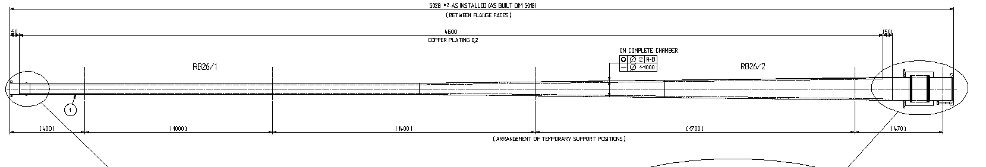
RB26/1-2
l=2228
l=2120
after LS1
(shorter due to longer IP chamber)
Real
d1 (mm) | d2 (mm) | l (mm) | S (mm2)
58.4 | 120 | 2228 | 1249182.344
VASCO
178.47 | X | 2228
Real
d (mm) | l (mm) | S (mm2)
58.4 | 2120 | 388954.30
VASCO

Slide 13
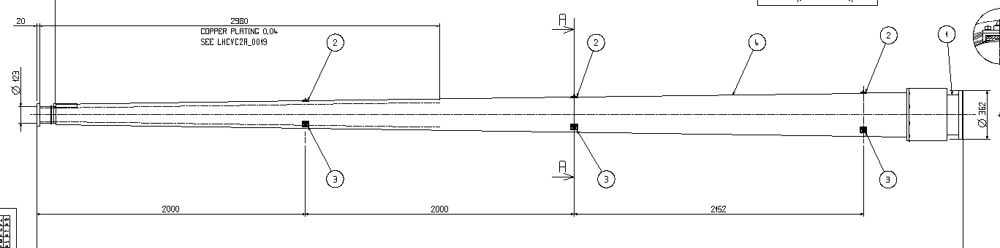
RB26/3
l=2000
l=2000
l=2892
Real
d1 (mm) | d2 (mm) | l (mm) | S (mm2)
120 | 170 | 2000 | 1822693.064
VASCO
290 | X | 2000
Real
d1 (mm) | d2 (mm) | l (mm) | S (mm2)
170 | 233 | 2000 | 2533379.617
403 | X | 2000
Real
d1 (mm) | d2 (mm) | l (mm) | S (mm2)
233 | 300 | 2892 | 4843863.41
VASCO
533 | X | 2892

Slide 14
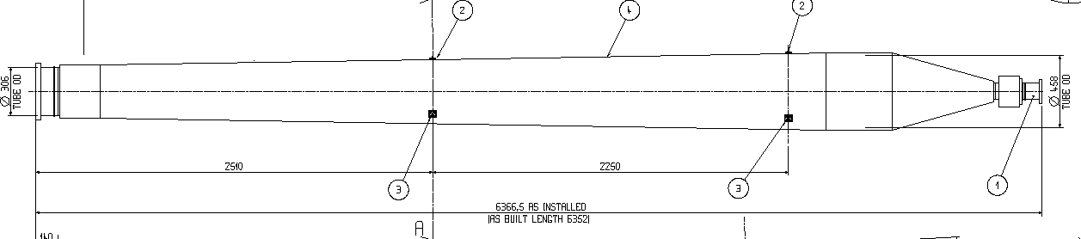
RB26/4
l=297
l=2906
l=2510
l=654
Real
d1 (mm) | d2 (mm) | l (mm) | S (mm2)
300 | 432 | 2510 | 5780087.38
VASCO
636.2 | X | 2510
Real
d1 (mm) | d2 (mm) | l (mm) | S (mm2)
432 | 450 | 2906 | 8052345.46
886.3 | X | 2906
Real
d1 (mm) | d2 (mm) | l (mm) | S (mm2)
450 | 100 | 654 | 1281678.71
VASCO
141 | X | 654

Slide 15
Some Results
Dynamic vacuum

Slide 16
Vacuum Stability
 | NEG Fully Activated and Ion Pumps as table below |  |  |  |  |  | NEG 90% saturated | NEG 90% saturated And all Ion Pumps off
Critical Current [A] | 45 | 45 | 45 | 45 | 45 | 20 | 45 | 20
 | Pumping speed (l/s)
Ion Pump | H2 | CH₄ | CO | CO₂ | Status
VPIB.220.1L2.X | 30 | 20 | 20 | 20 | OFF | ON | ON | ON | OFF
VPIA.193.1L2.X | 50 | 30 | 20 | 20 | ON | OFF | ON | ON | OFF
VPIA.89.1L2.X | 50 | 30 | 20 | 20 | ON | ON | OFF | ON | OFF
VPIXB.45.1L2.X | 10 | 5 | 10 | 5 | ON | ON | ON | OFF | OFF
VPIB.193.1R2.X | 30 | 30 | 20 | 20 | ON | OFF | ON | ON | OFF
VPIB.220.1R2.X | 30 | 20 | 20 | 20 | OFF | ON | ON | ON | OFF

Slide 17
Dynamic Vacuum: e⁻ flux on NEG

Slide 18
Dynamic Vacuum: NO e⁻ flux on NEG

Slide 19
Dynamic Vacuum: e⁻ flux on NEG

Slide 20
Dynamic Vacuum: NO e⁻ flux on NEG

Slide 21
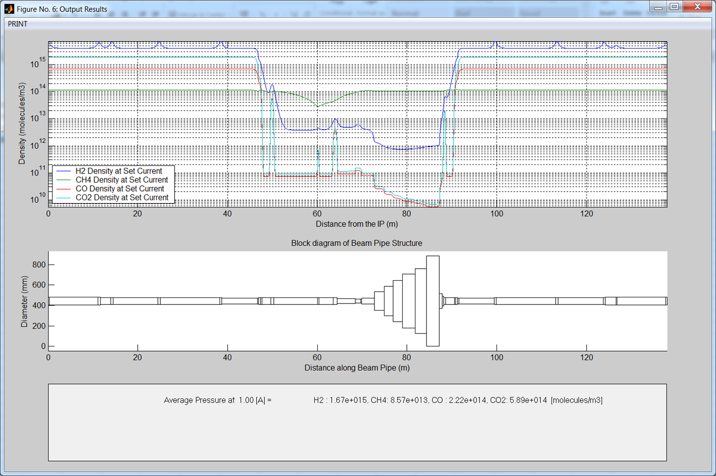
Dynamic Vacuum at IP: NO e⁻ flux on NEG electron cloud

