Slide 1

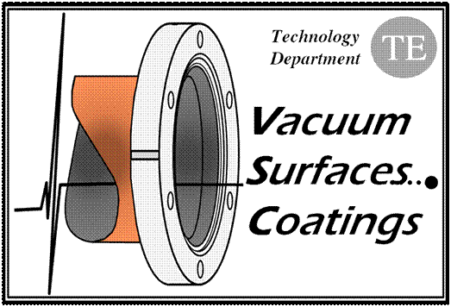
ALICE IP chamber aperture reduction
(VASCO simulations)
G. Lanza
TREX meeting
Vacuum LHC baseline
ALICE new central beampipe
Static vacuum profile
Static vacuum gas composition
Dynamic vacuum profile with electron cloud
Dynamic vacuum gas composition
Vacuum Stability: critical current in case of pumping speed reduction
Vacuum layout

Slide 2
Vacuum LHC baseline
To grant 100h beam lifetime:
      P< 1x10⁻⁸ mbar, H2 equivalent
Uncoated (no NEG) surfaces will suffer from e-cloud phenomena during machine startup
The LHC strategy for vacuum cleaning and beam pipe conditioning (reduction of the SEY) is scrubbing
  1 to 10 mC/mm² are required
  The achieved level of conditioning depends of the time spent above the multipacting threshold

Slide 3
ALICE new central beam pipe

Slide 4
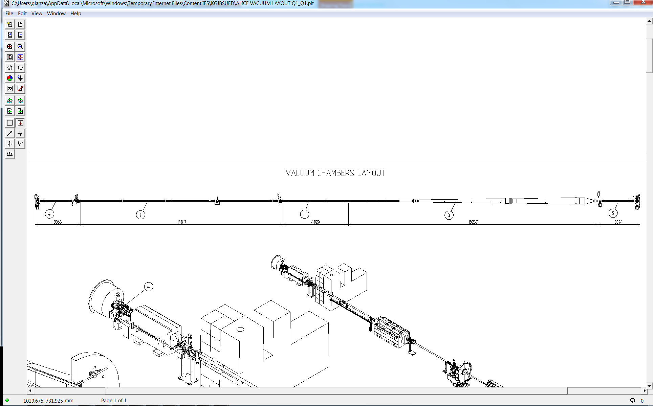
ALICE new central beam pipe
Since the beampipe is longer than the previous one, the vacuum layout changes
680mm
Moving the sector valve assembly towards the left side of RB24 will also distance the small pressure bump (see next chart) before the interaction point

Slide 5
Static Vacuum
This chart compare the static pressure at Start Up
(the parameters are different after years of LHC run)
After LS1, thanks to the installation of a new gauge, information about the pressure closer to the IP will be available

Slide 6
Static Vacuum
Gas composition
Pressure dominated by hydrogen and methane

Slide 7
Static Vacuum

Slide 8
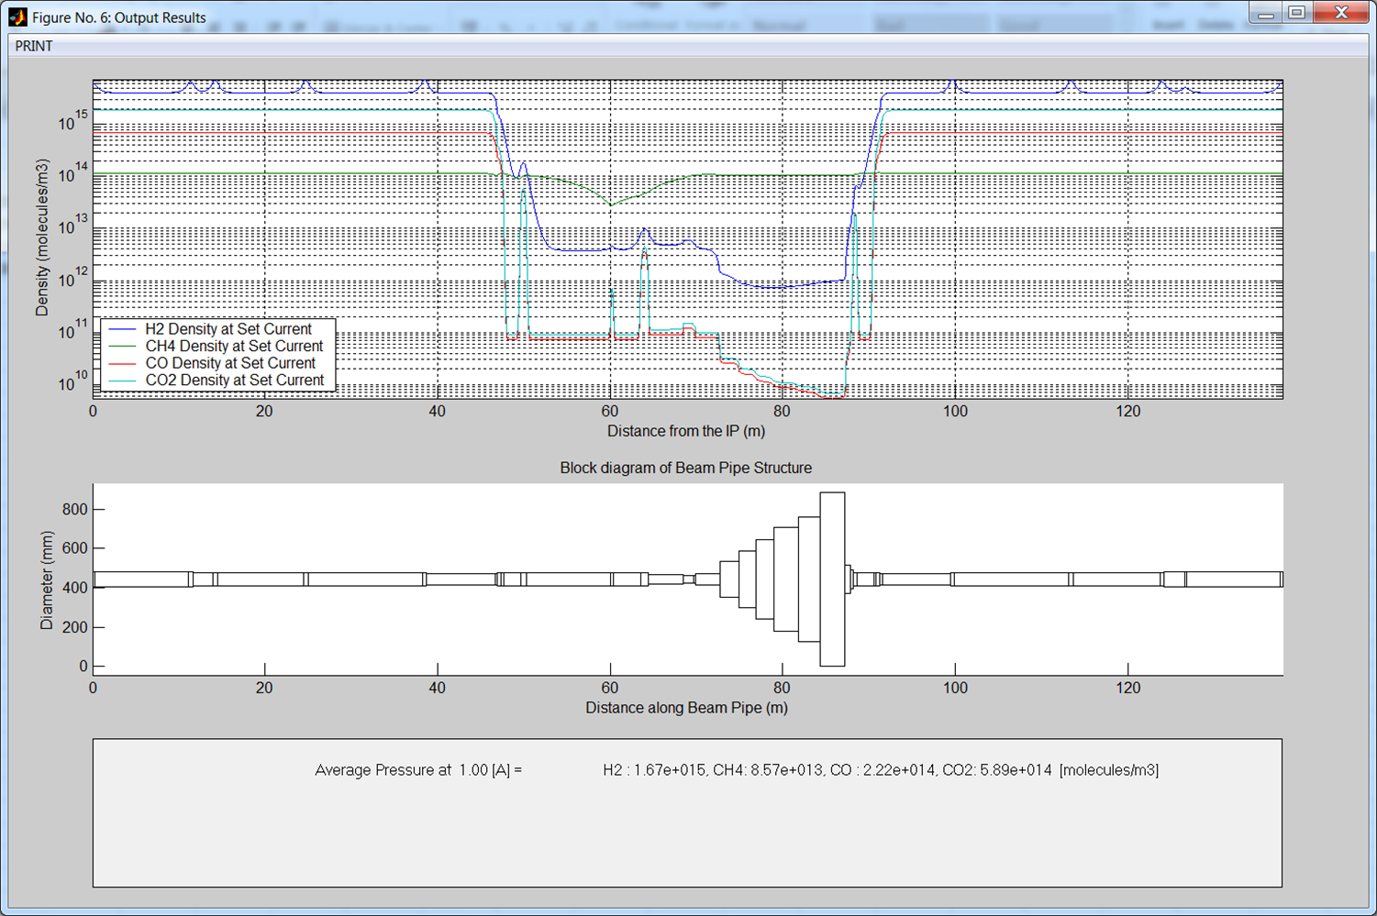
Dynamic Vacuum at IP electron cloud

Slide 9
Dynamic Vacuum

Slide 10
Dynamic Vacuum

Slide 11
Vacuum Stability
No evidence of vacuum stability runaway issue in case of
  NEG 90% saturated
  Ion pumps all out of order
  NEG 90% saturated and ion pumps all out of order
Checked for HL-LHC current parameters
The new central chamber is validated with this vacuum stability study.

Slide 12
Vacuum Layout
Installation of a penning gauge on the IP sector: probably integrated in the sector valve on the right
Move the sector valve further towards the left (and add a NEG chamber in the IP?!?) to distance the pressure bump from the interaction point.
The new layout will need a further vacuum acceptance study

