Slide 1
Cryogenics integration at IR4
1417843 0.1
——
HL-LHC
First volumes definitions for the installation of a new underground cold box at point 4 and surface impacts
C. Magnier EN-MEF-INT
JP.Corso EN-MEF
-
Serge Claudet, Bruno Feral, Paolo Fessia.

Slide 2
Project overview
PZ45
The goal
Separate the RF cryogenic supply from the rest of the LHC cryogenic distribution
The needs
A new cold box and a new cryogenic repartition
The consequences for integration
Underground
Find space for a new cold box
Find some ways to connect the new system with the existing one
Surface
Find space for a new compressor building
Find some ways to bring warm He to the new cold box
UX45 ”CRYO” side

Slide 3
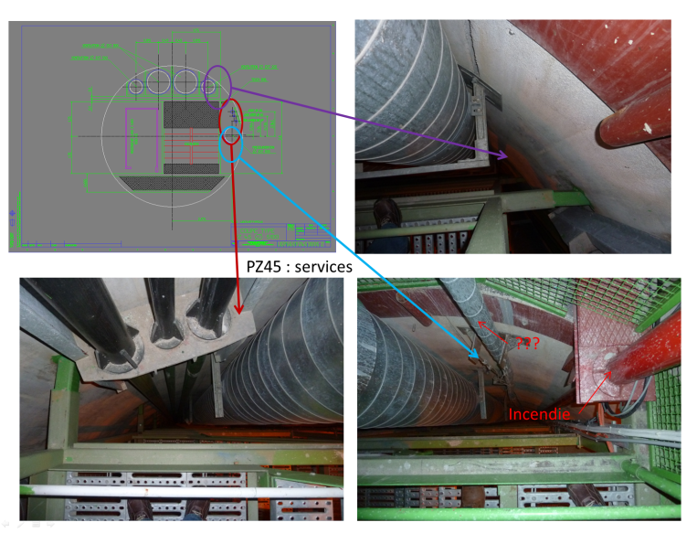

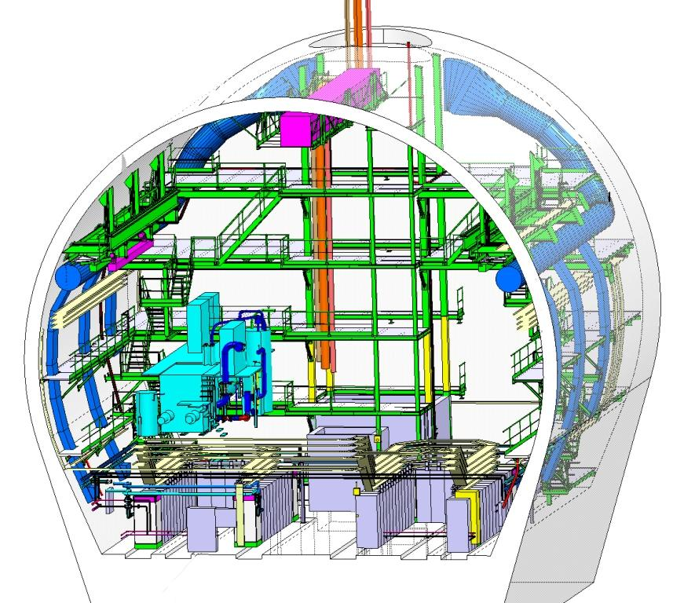
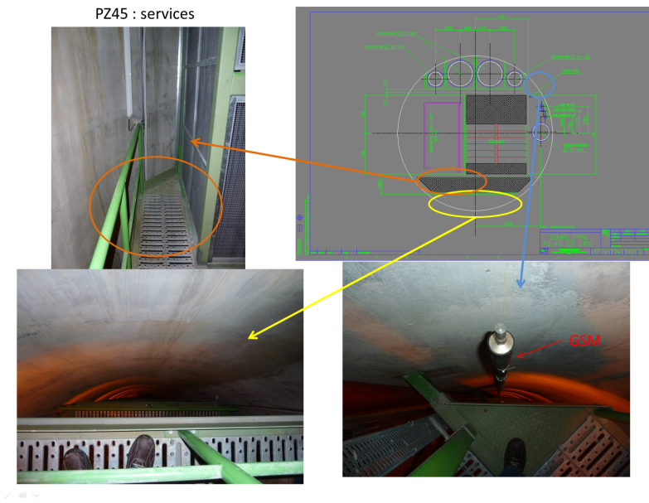
PZ45 Option (old base line)
PZ45
New refrigerator
cold box
It will be very difficult to put new pipes in this pit.
REMINDER
Direct access to level 0 is not possible, due to the lift.
UX45”RF” side
UX45 – “RF area”
In this case, Cryogeny and RF have to share their space. For Cryogeny, installation of the CB in this place means a large amount of pipe length.
According to these elements, we tried to find another free space for the cold box
UX45 ”CRYO” side

Slide 4
UNDERGROUND
PROPOSITION FOR THE NEW COLD BOX

Slide 5
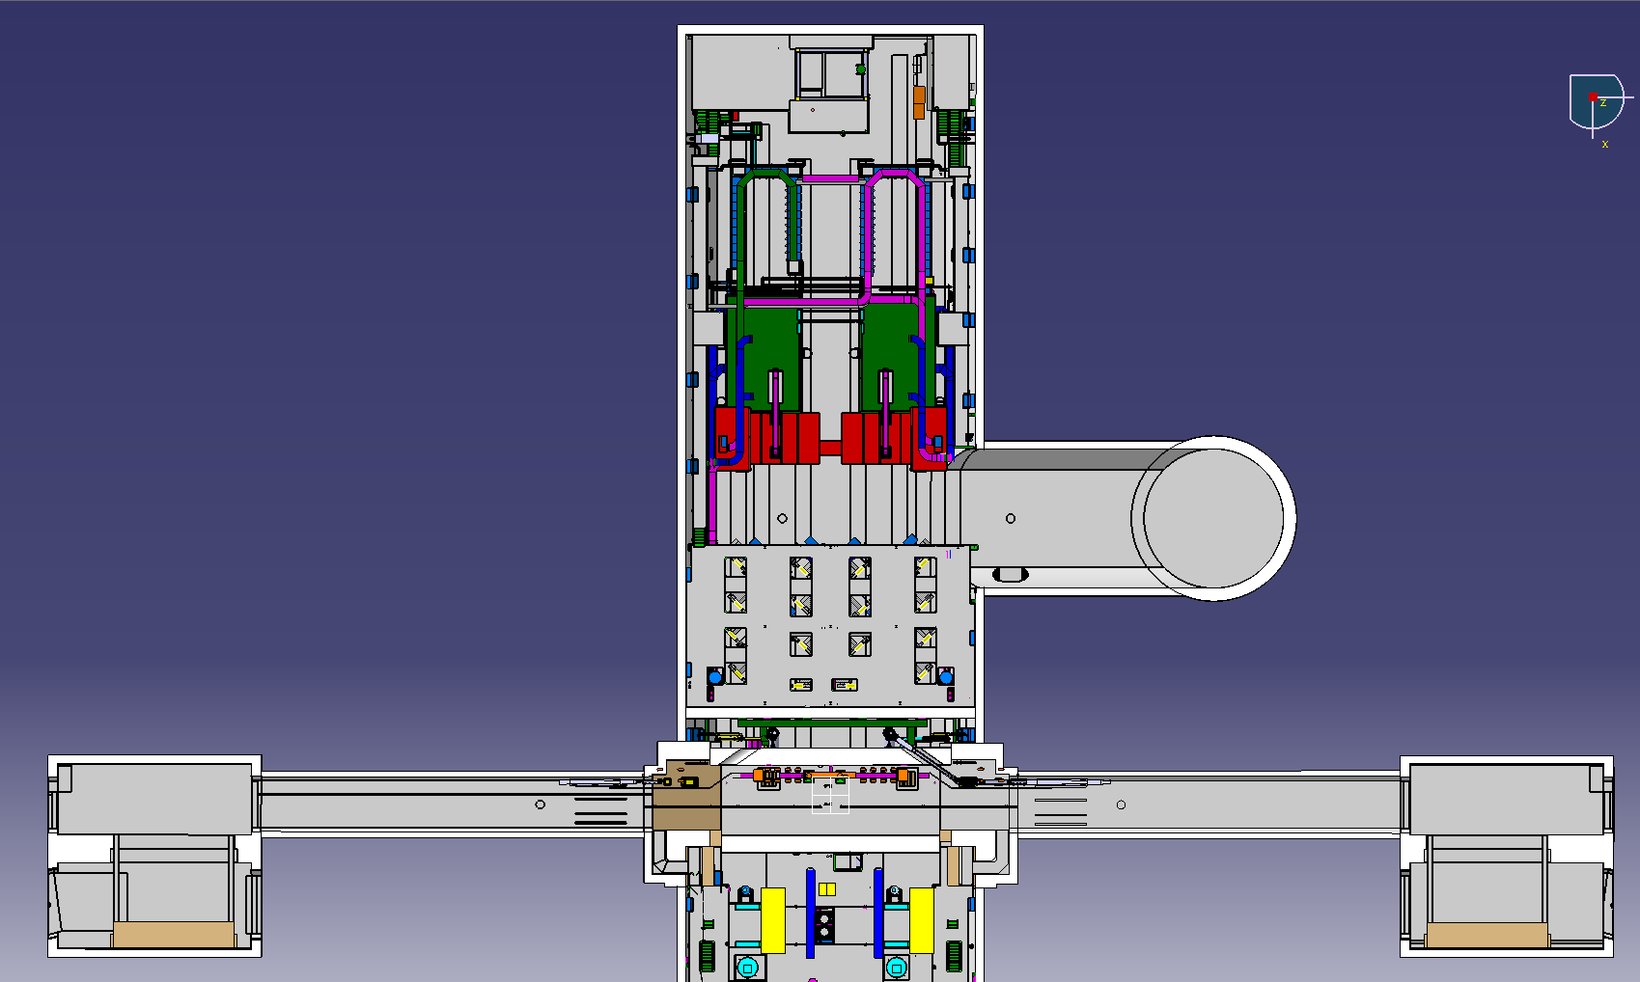
Installing the cold box in TX46
PZ45
- TX46 is an empty gallery
- We can use PX46 for the pipes
- TX46 is close to existing cryogenic
installation I the UX45
UX45”RF” side
TX46
PX46
UJ44
RB44
RB46
UJ46
UX45 ”CRYO” side

Slide 6
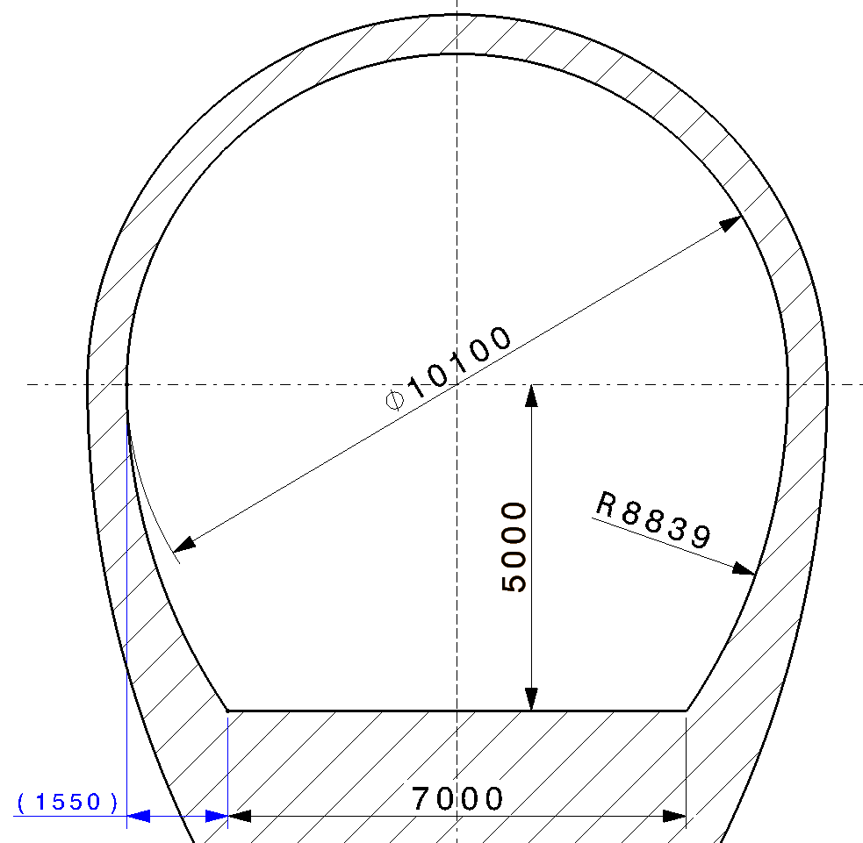
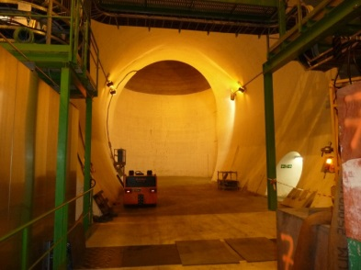
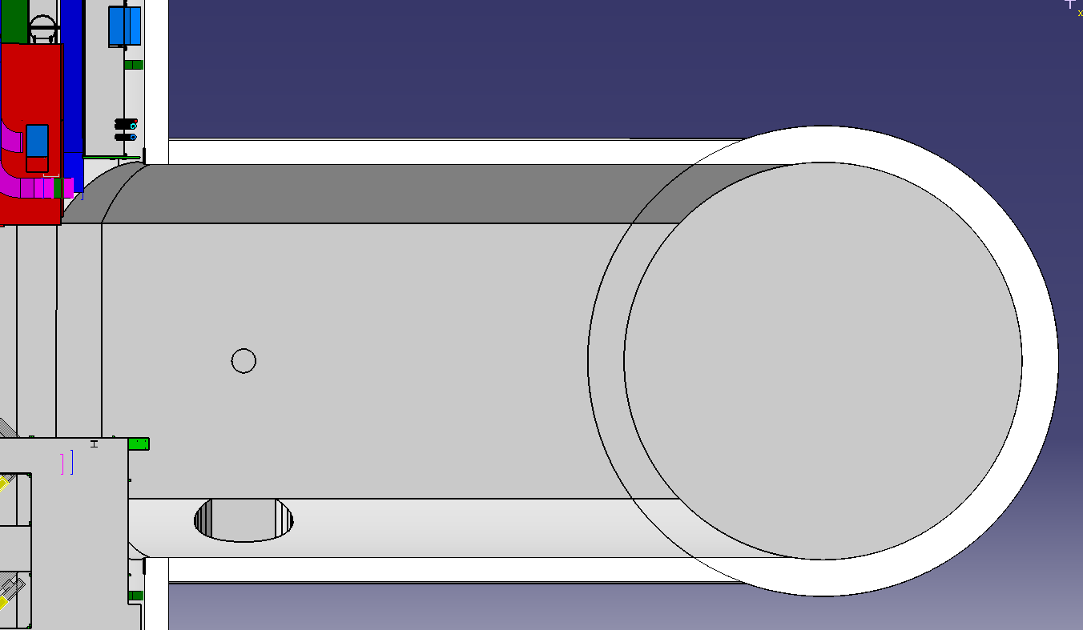
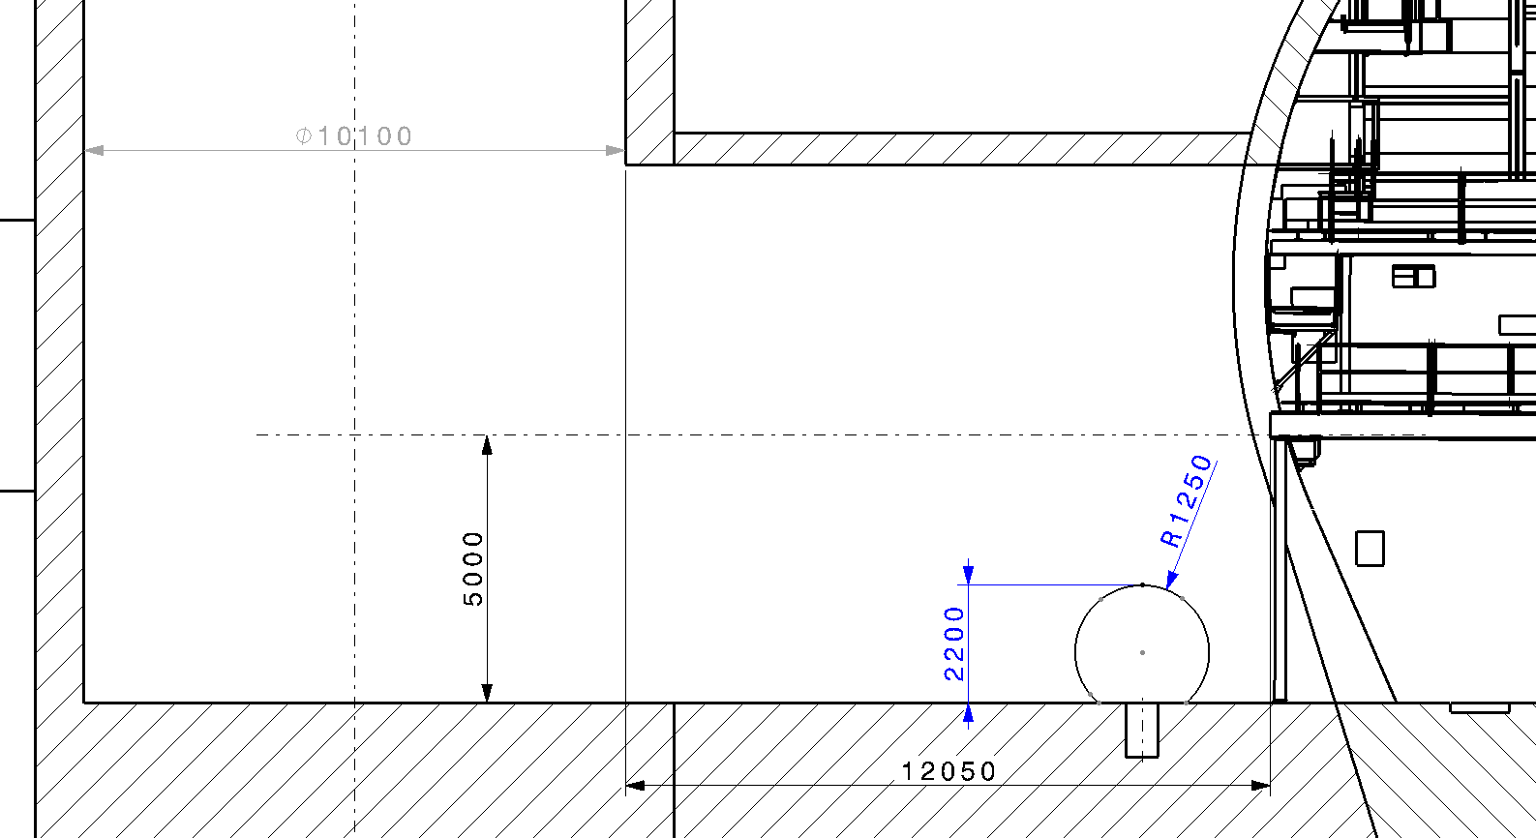
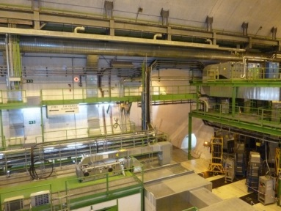
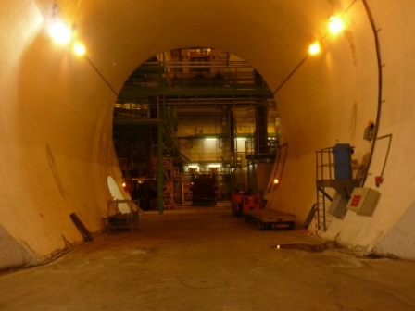
TX46 / PX46 : actual situation
Dia. 10,1m
12m
7m (pied de voute)
PX46
TX46
UX45
Existing structure
UP46

Slide 7
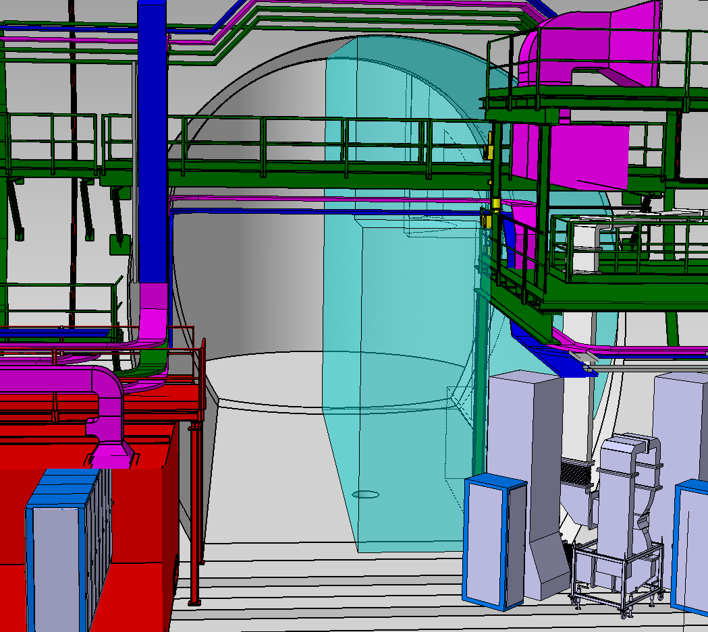
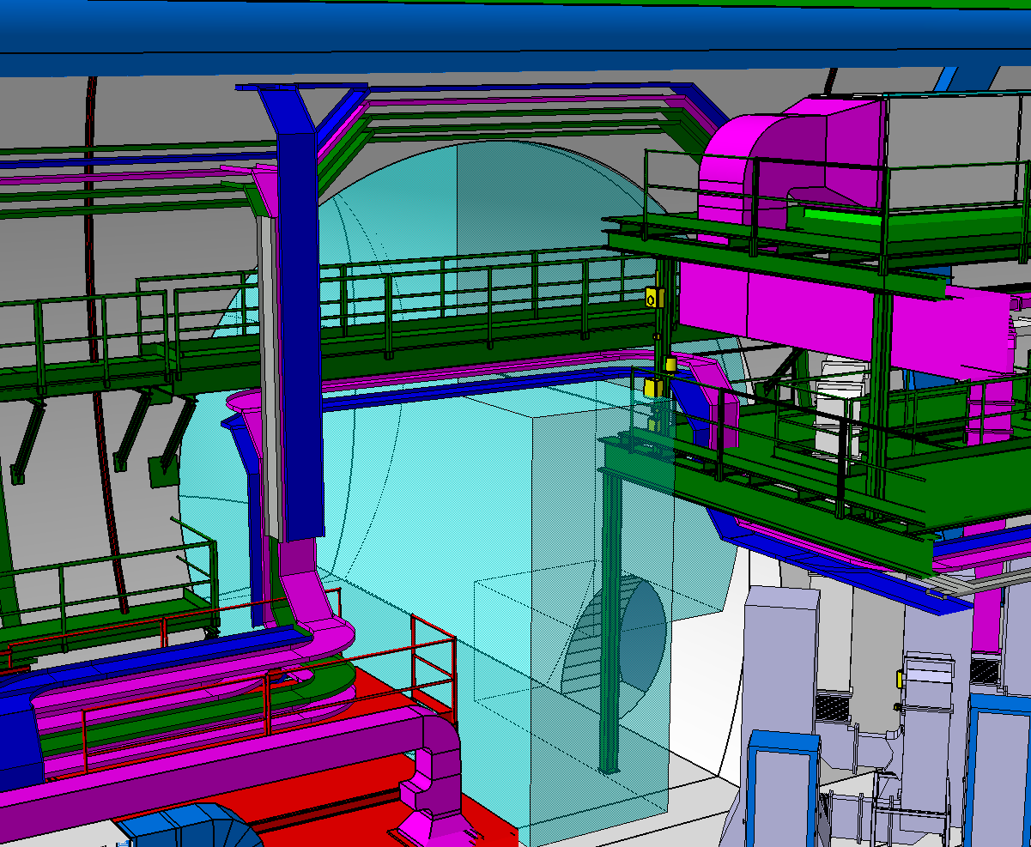
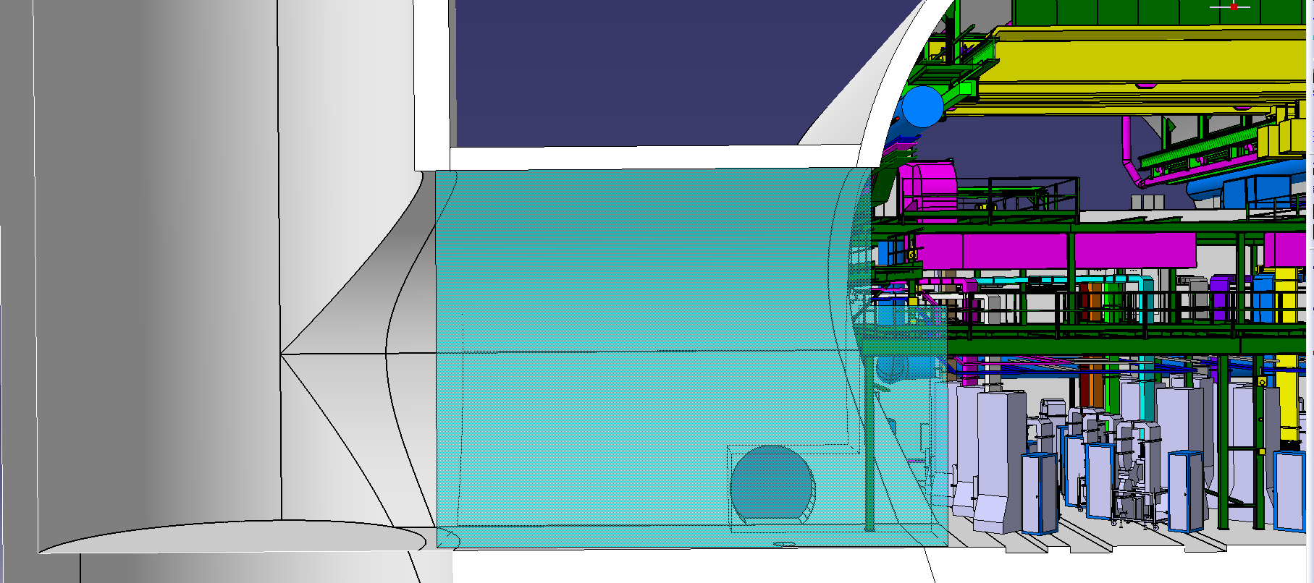
For Cryogeny, the best option is a vertical equipment assembly
Volume
representation
RF equipment
PX46
UX45
TX46

Slide 8
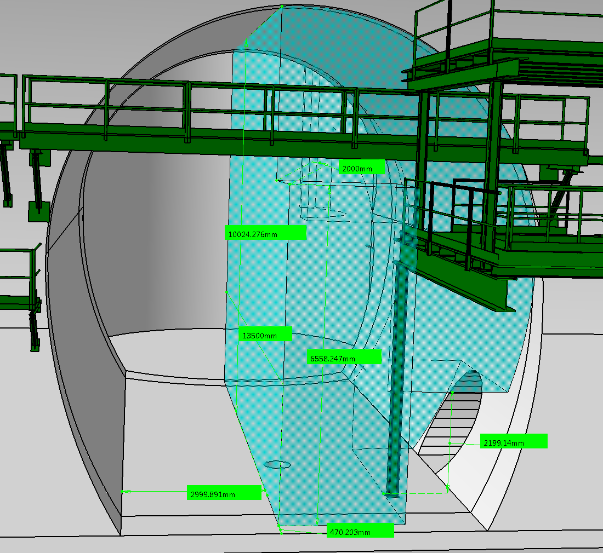
Vertical volume for cryo equipment (~ 550m3)

Slide 9
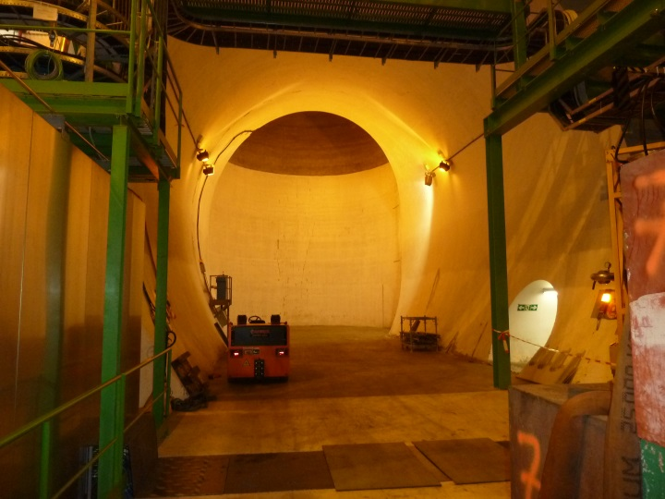
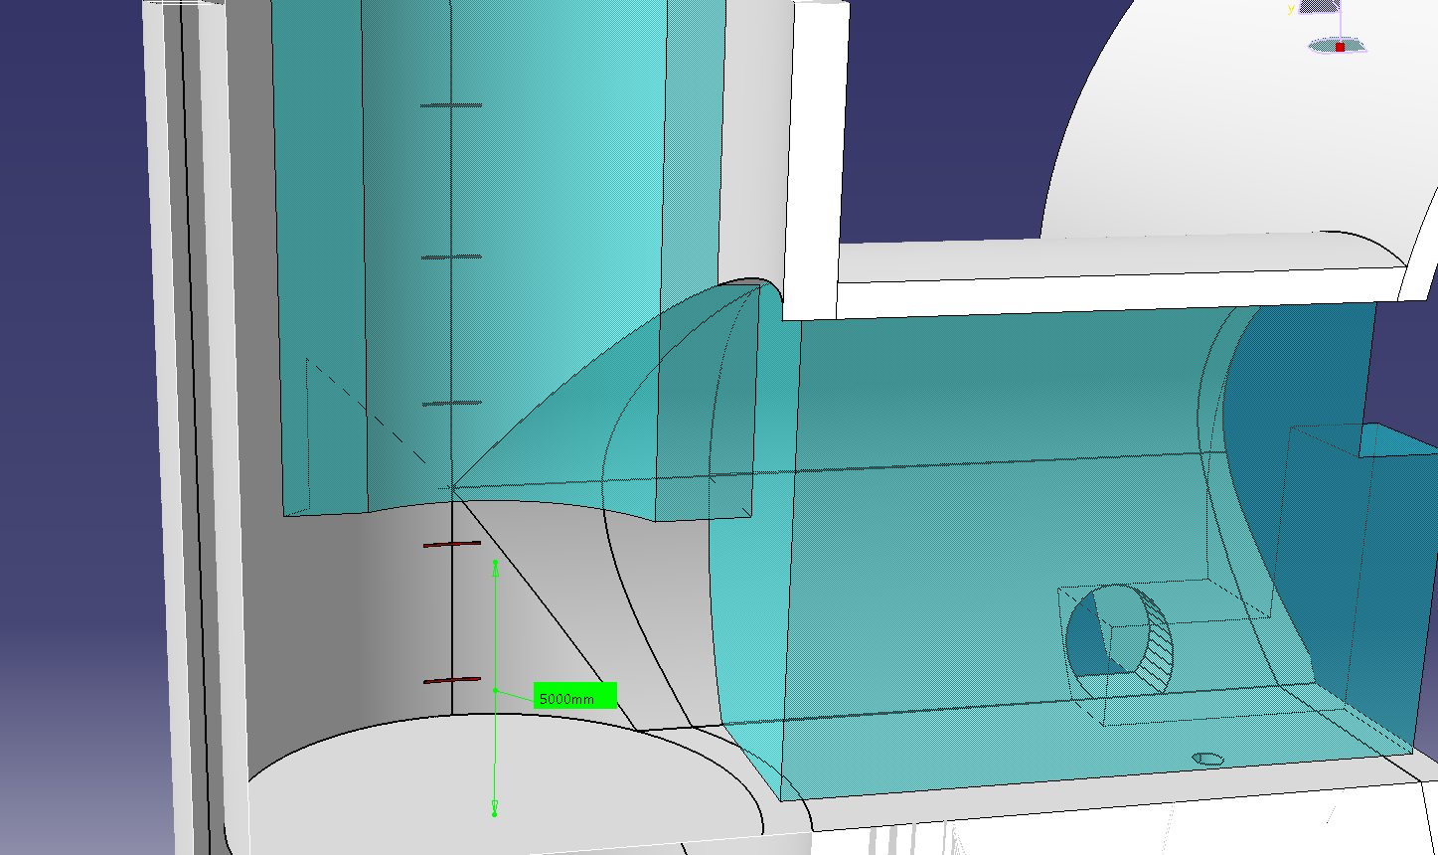
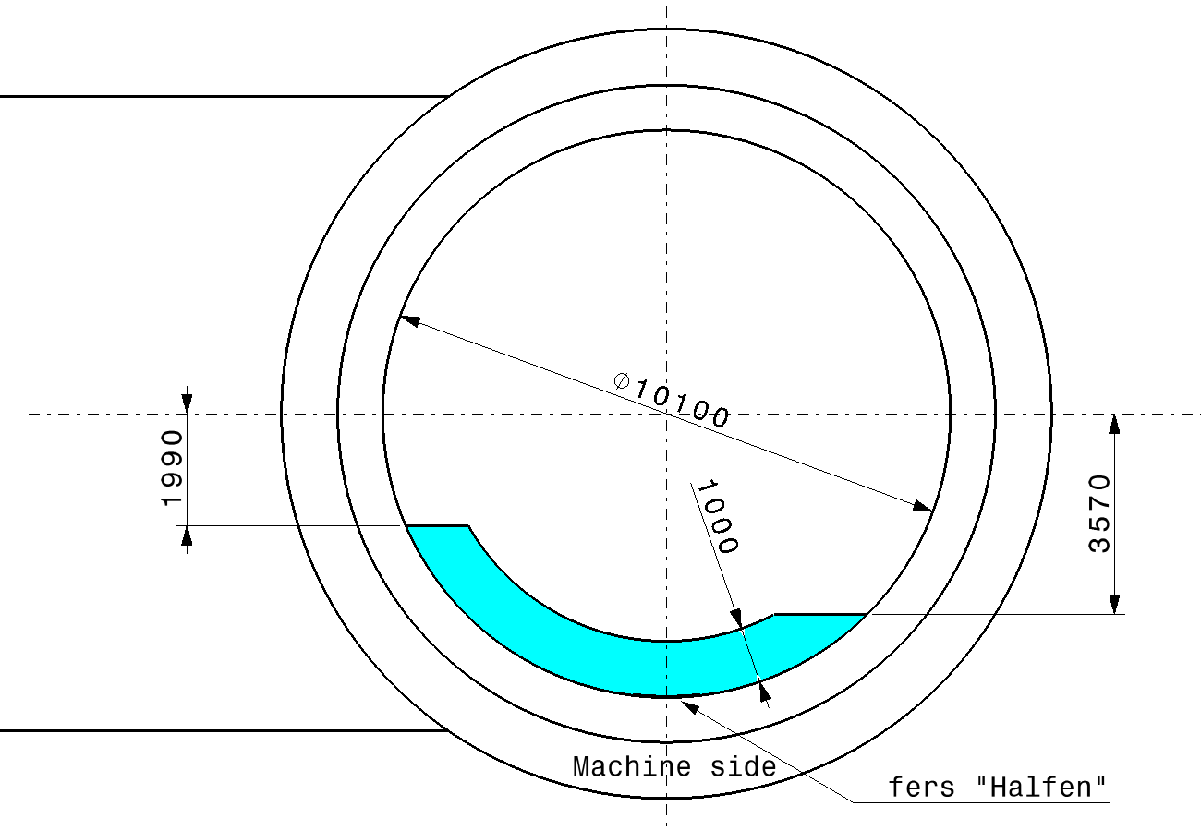
Space reservation in PX46 (for all services)
“fers Halfens”
TX46
PX46
PX46
TX46
Surface for services 8 m2

Slide 10
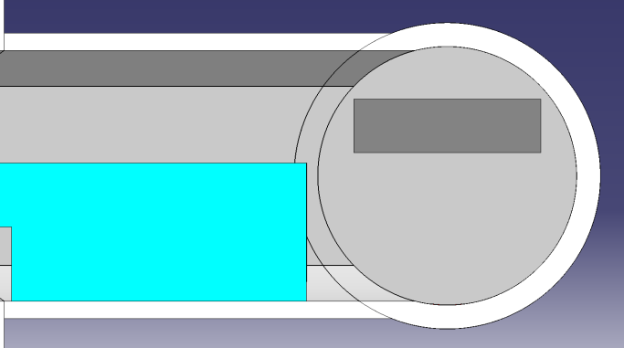
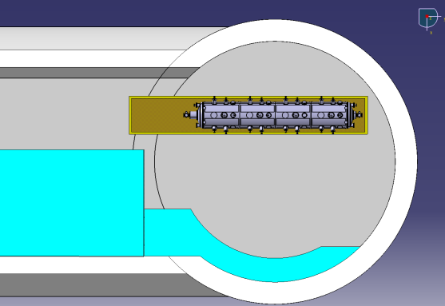
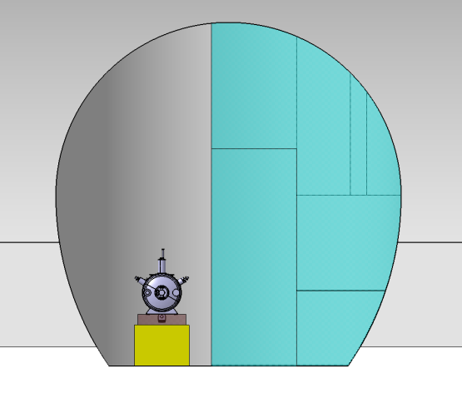
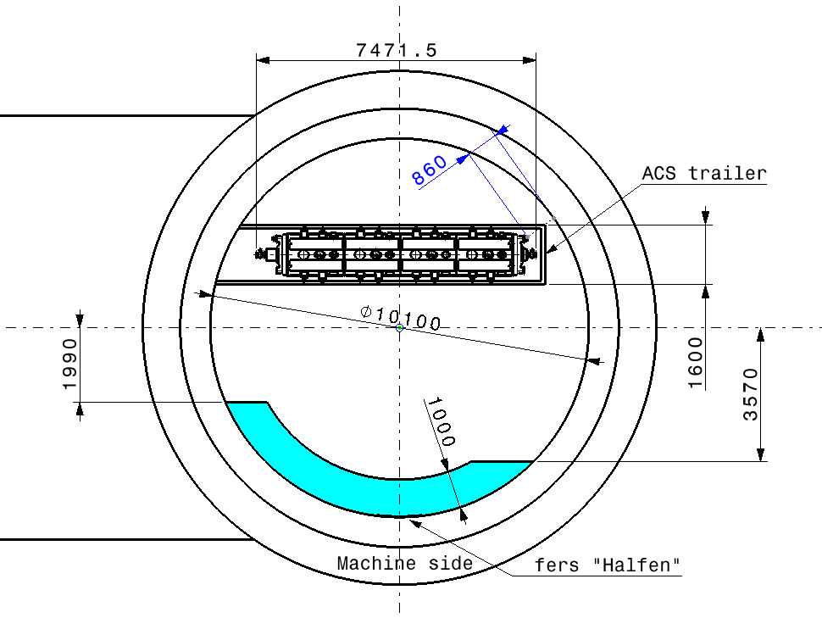
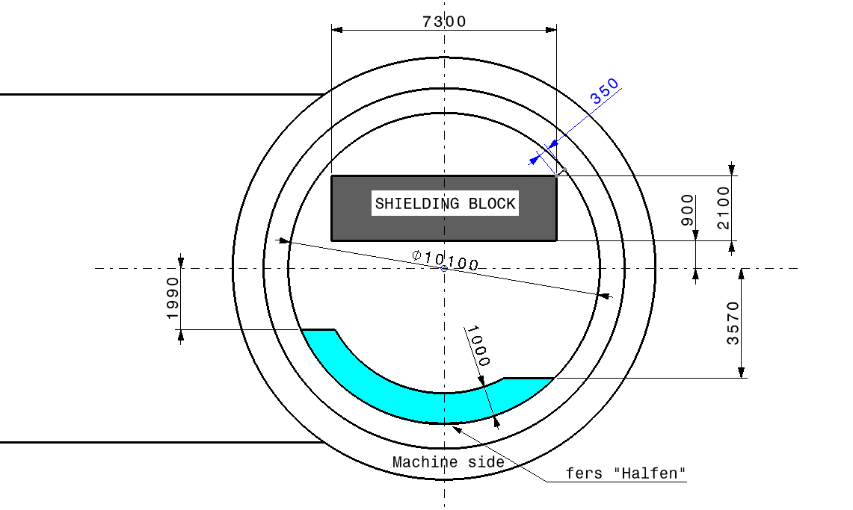
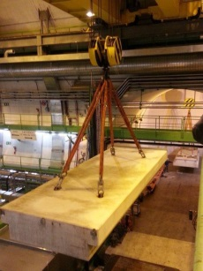
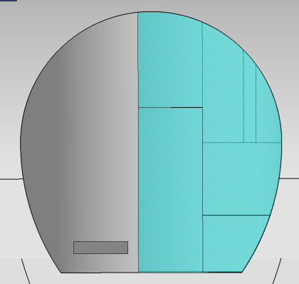
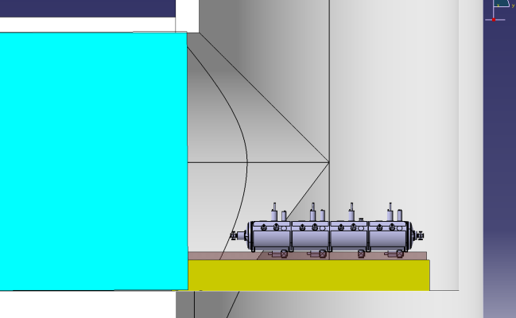
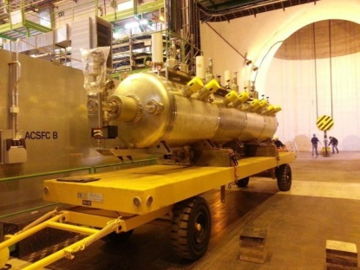
Handling in remaining place See also EDMS 1363932 v.1
RUX45 shielding
7300x2100x475h
ACSGA on trailer
400mm

Slide 11
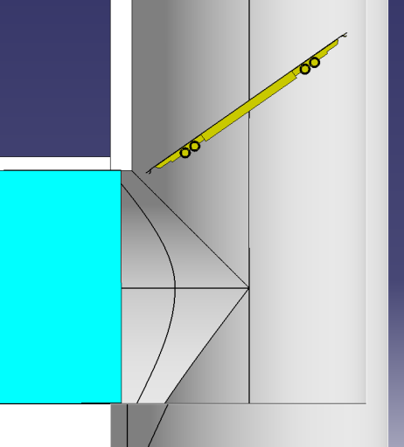
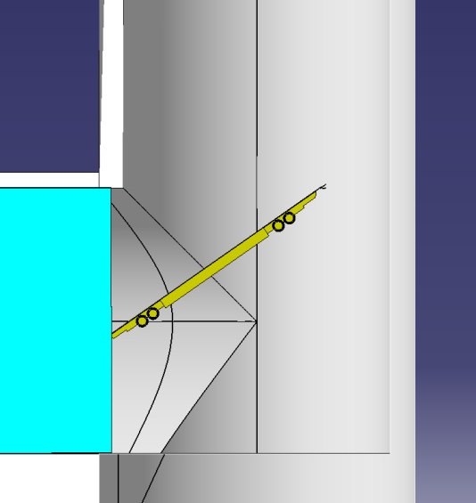
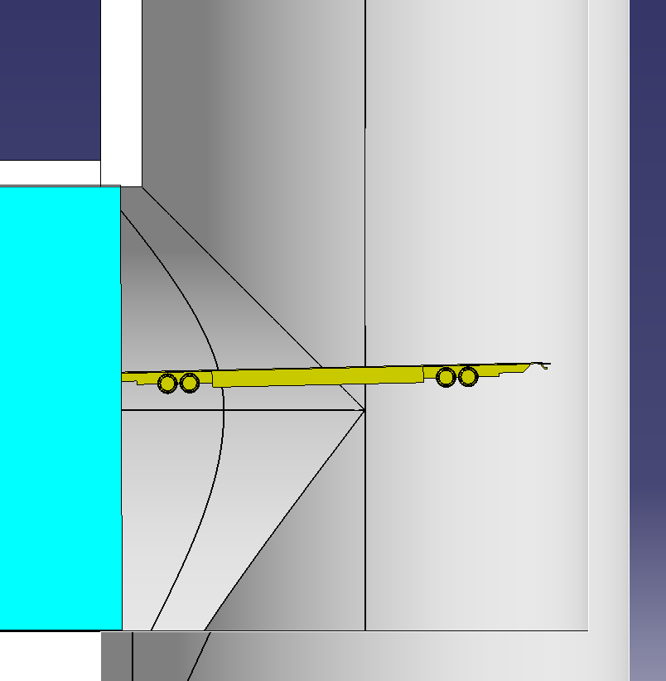
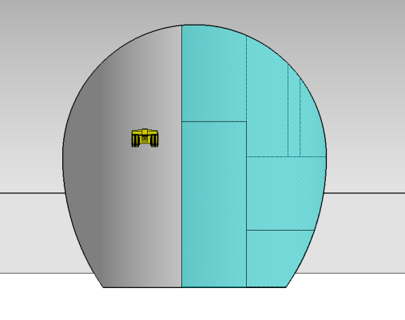
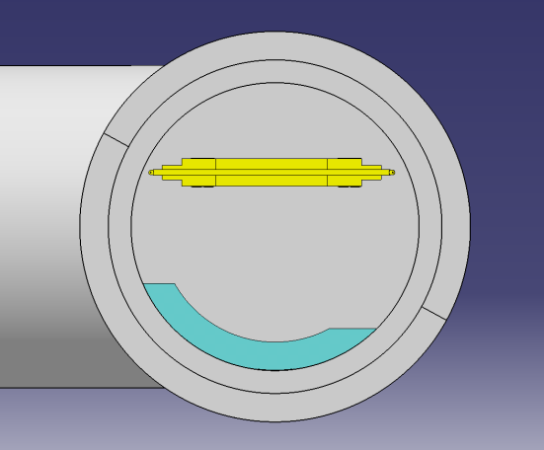
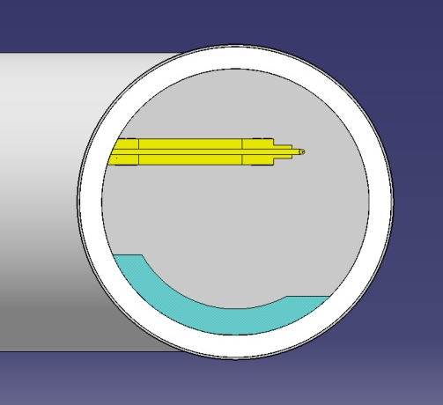
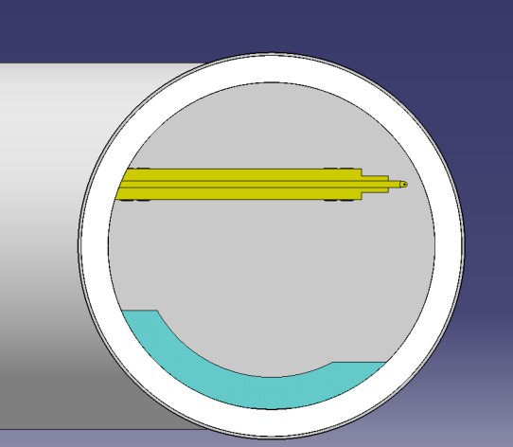
STU trailer handling
35 degrees/floor
350mm

Slide 12
PZ45
SURFACE
PROPOSITION FOR THE COMPRESSOR BUILDING
AND LINK TO THE LOW COLD BOX
UX45 ”CRYO” side

Slide 13
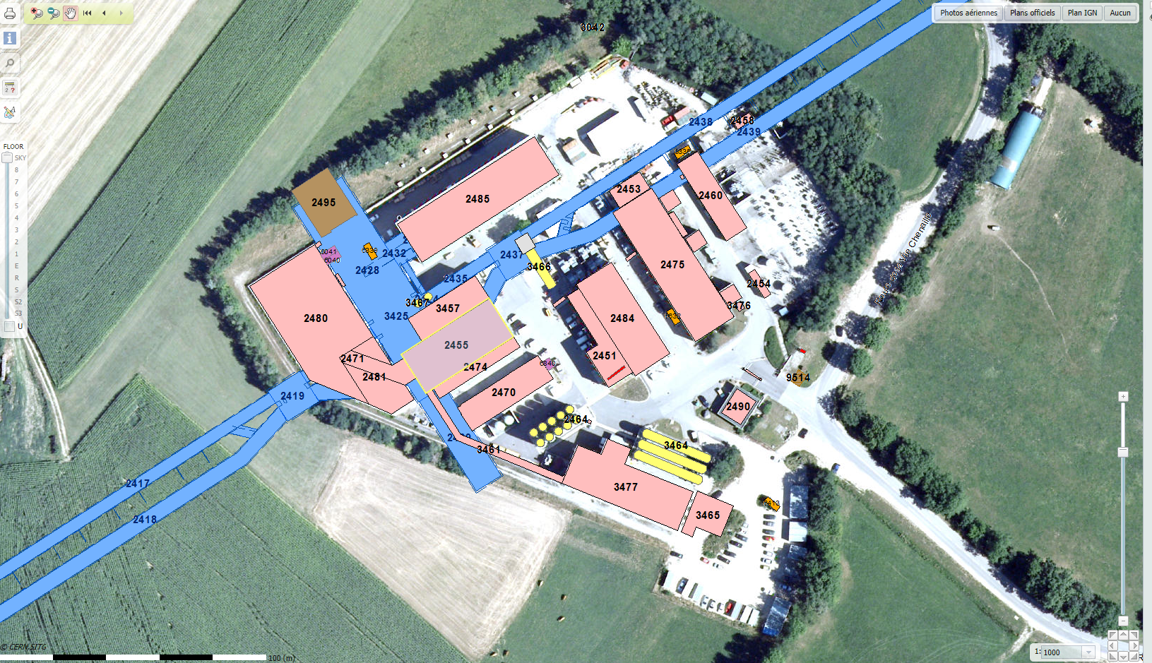
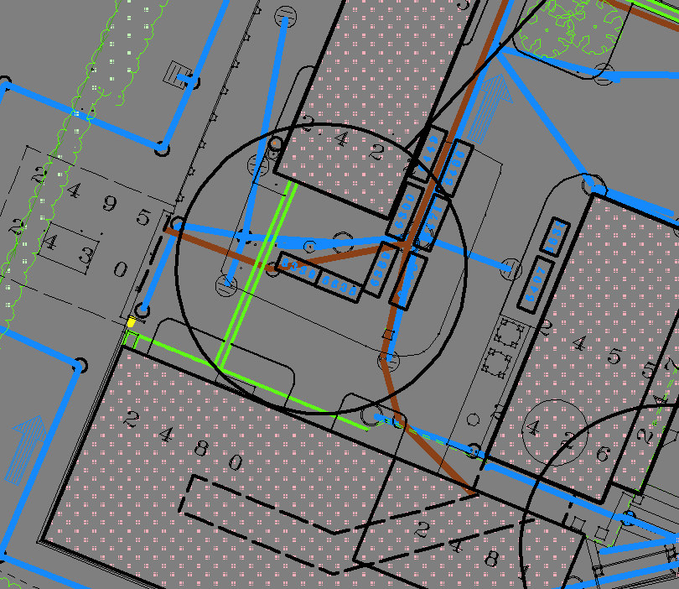
Point 4 : site overview
POINT 5
PZ45
SX4
UX45
SD4

Slide 14
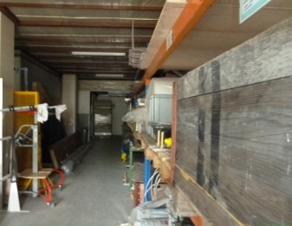
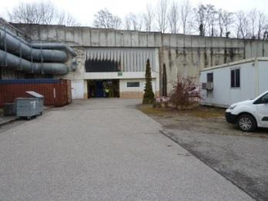
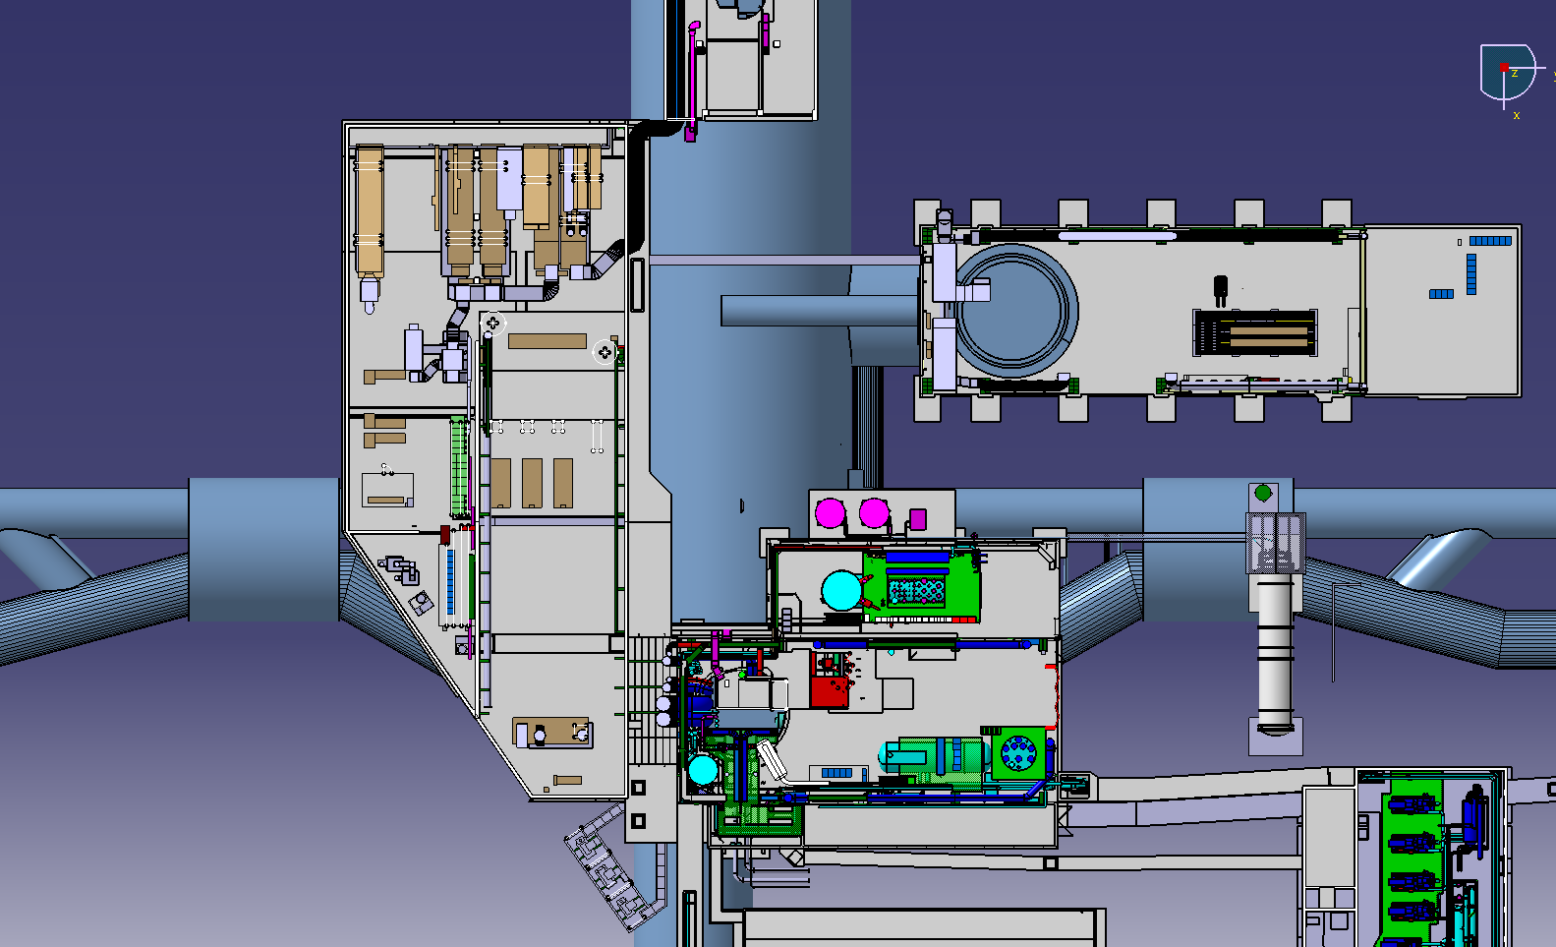
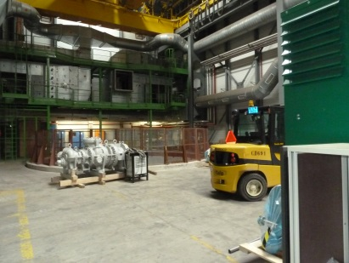
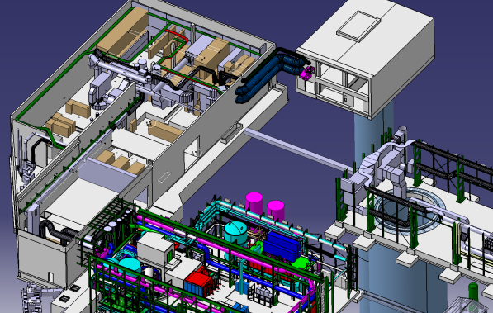
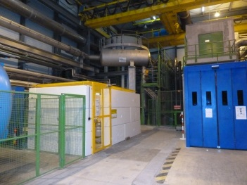
Pt4 surface : top view
SZ4
PX46
SX4
SU4
PM45
POINT 5
UJ44
UJ46
SUH4
SD4

Slide 15
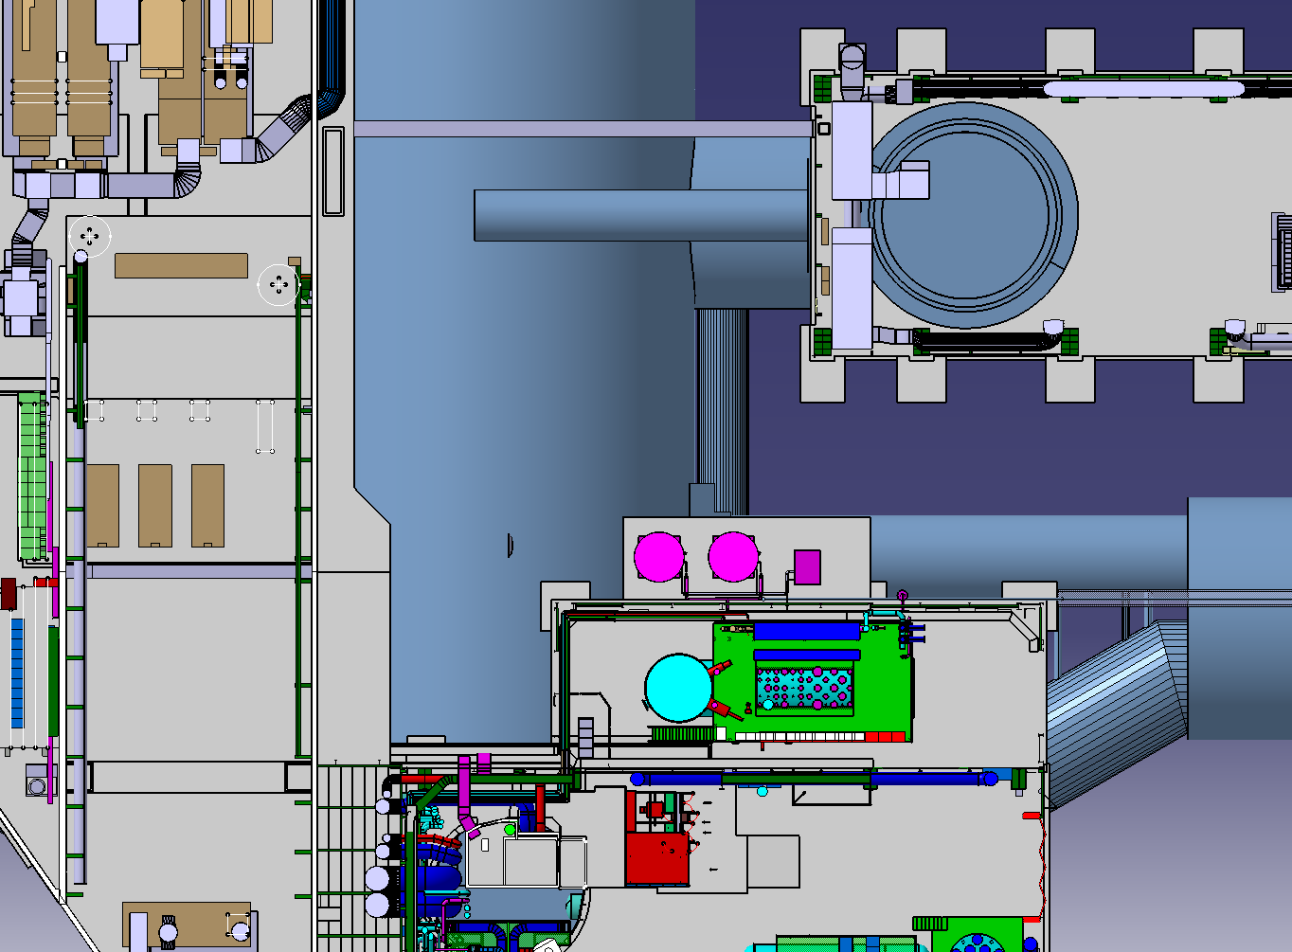
Cryogeny area
PX46
SX4
NEW TECHNICAL GALLERY
PLACE TO BE DEFINED (1.8mx2m)
Halfen supports
EXISTING TECHNICAL GALLERY
SUH4

Slide 16

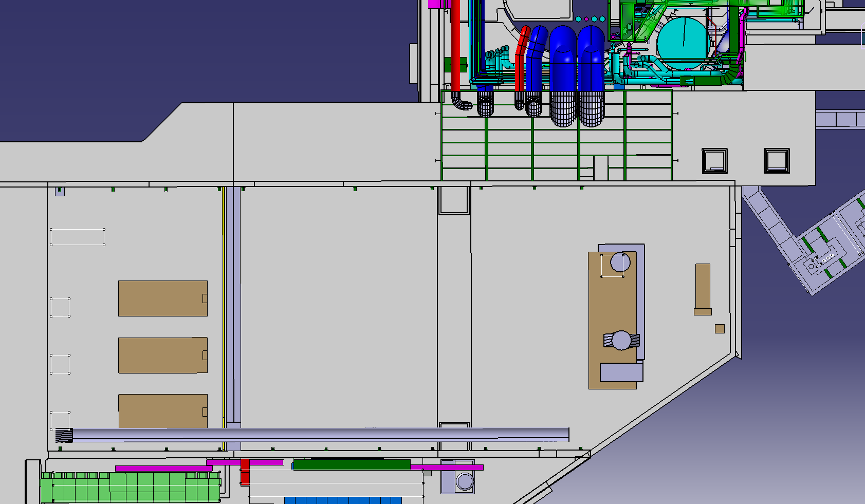
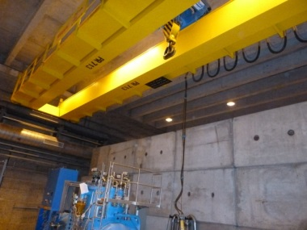
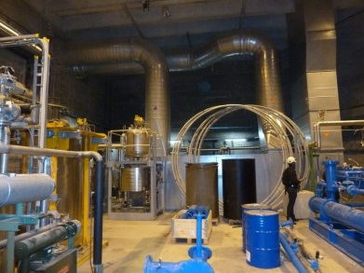
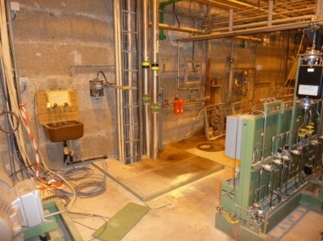
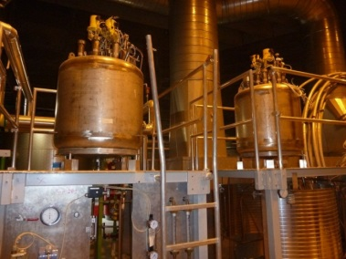
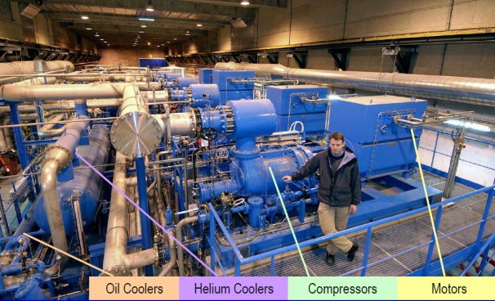
Cryo plant in SUH4
Noise-insulated existing building
Existing crane
Closed to PX 46
PM45
Technical gallery
Shielding-block
made wall
Cooling unit
SU4
Cryo-plant
Handling
area
Compressor station
To be indentified
To be removed
SUH4

Slide 17
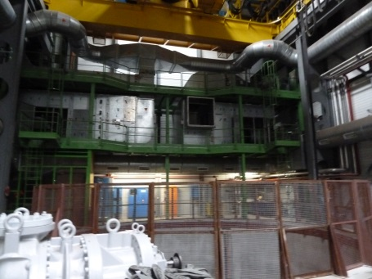
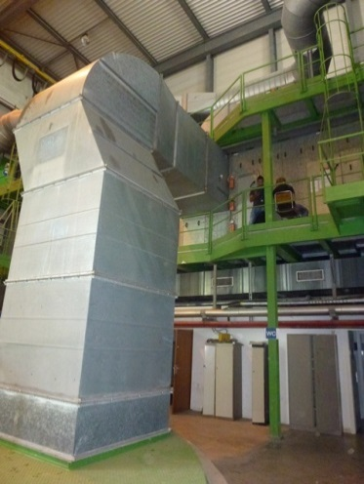







PX46
Pit cap and ventilation duct have to be in place during LHC operation
Existing gallery
(chilled water?)
Services reservation (8m2)
Halfen supports
Cryo pipes entry area (proposition)
(need a trench to reach the pit)

Slide 18











How to go out from SUH4?
FULL!
SD4
SUH4
Technical gallery
SU4
SUH4
SU4
SUH4
SUH4
Existing technical gallery
with holes toward SU4
SU4

Slide 19







How to join PX46
SX4
x
x
Bat 6339
SU4
SUH4
New technical gallery
(proposition)
SX4
PX46
SU4
SUH4

