Slide 1



Optical Diagnostics
State of the art and Future Trends
Prof. Carsten P. Welsch

Slide 2
Overview
Better resolution (time/space)
(Single) photon resolution
Improved radiation hardness
Least/non invasive
Able to cover variety of beams
Advantages of Optical Diagnostics:
  Fast response
  Parasitic use possible in some cases
Here:
  Examples – ‚appetizer‘ for the workshop

Slide 3
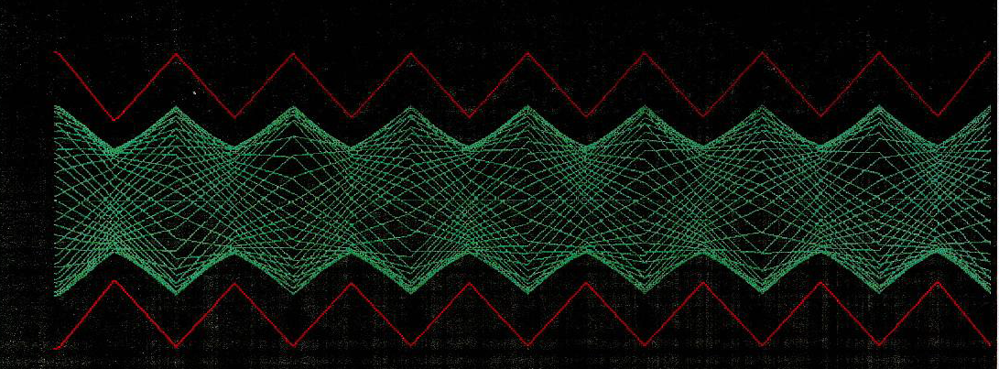
Emittance measurements
Beam size changes as a beam is focused and defocused.
Emittance describes ‘inherent’ size of the beam
It allows determining the beam size at any point.
More about emittance Ralph‘s talk.

Slide 4

Definition of the Emittance
Commonly used:
Misleading, as ΔE and x‘ can be very large, e.g. in plasma-accelerated beams.
Assuming a drift, where there is no correlation between energy and transverse position:
$${ε_{n}}_{}^{2}=\left\langle x^{2}\right\rangle \left\langle β^{2}γ^{2}{x′}^{2}\right\rangle −\left\langle xβγx′\right\rangle$$
$${ε_{n}}_{}^{2}A={\left\langle γ\right\rangle }^{2}{σ_{E}}_{}^{2}\left\langle x^{2}\right\rangle \left\langle {x′}^{2}\right\rangle +{\left\langle βγ\right\rangle }^{2}\left(\left\langle x^{2}\right\rangle \left\langle {x′}^{2}\right\rangle −{\left\langle xx′\right\rangle }^{2}\right)$$
Geometrical emittance
A. Cianchi, et al., Nucl. Instr. Meth. A 720 (2013)

Slide 5
Attention !!
$${ε_{n}}_{}^{2}A={\left\langle γ\right\rangle }^{2}{σ_{E}}_{}^{2}\left\langle x^{2}\right\rangle \left\langle {x′}^{2}\right\rangle +{\left\langle βγ\right\rangle }^{2}\left(\left\langle x^{2}\right\rangle \left\langle {x′}^{2}\right\rangle −{\left\langle xx′\right\rangle }^{2}\right)$$
is usually negligible
In plasma accelerators: large ΔE and x‘.
Normalized emittance depends on position of measurement !
Here: Focus on geometrical part.

Slide 6
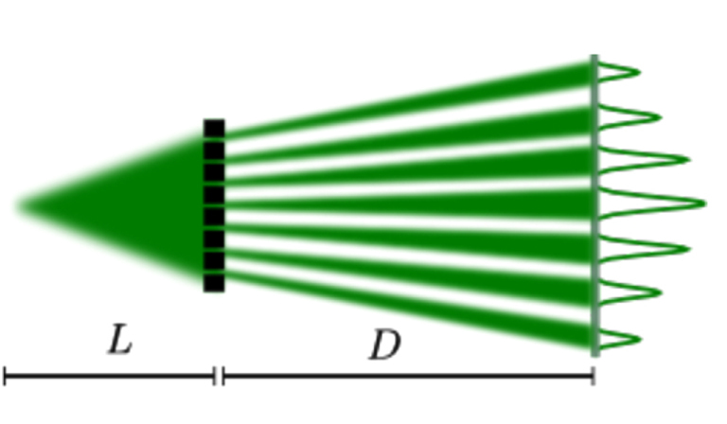
Emittance measurements
Measure angular spread of the beam and beam profile at the same time.
One option: ‘pepperpot’ and screen.
Block the beam apart from a few small holes.
Reduces space charge dominated beam to emittance-dominated beamlets that drift to screen.

Slide 7
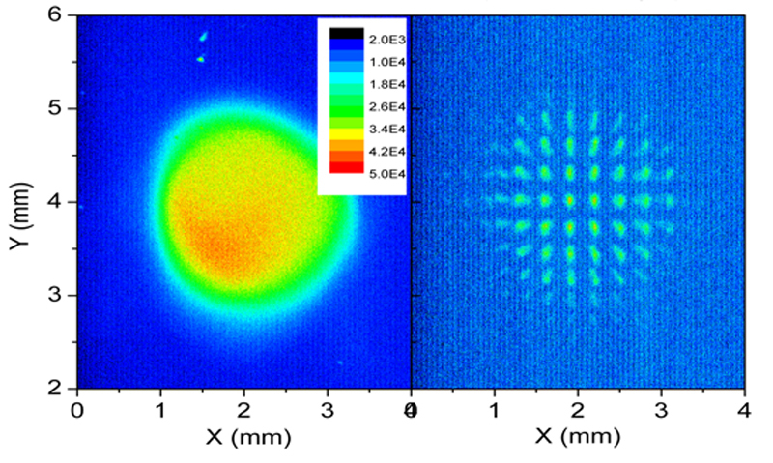
Emittance measurements
Use a ‘pepperpot’ mask and a screen.
Block the beam apart from a few small (well-defined) holes.

Slide 8
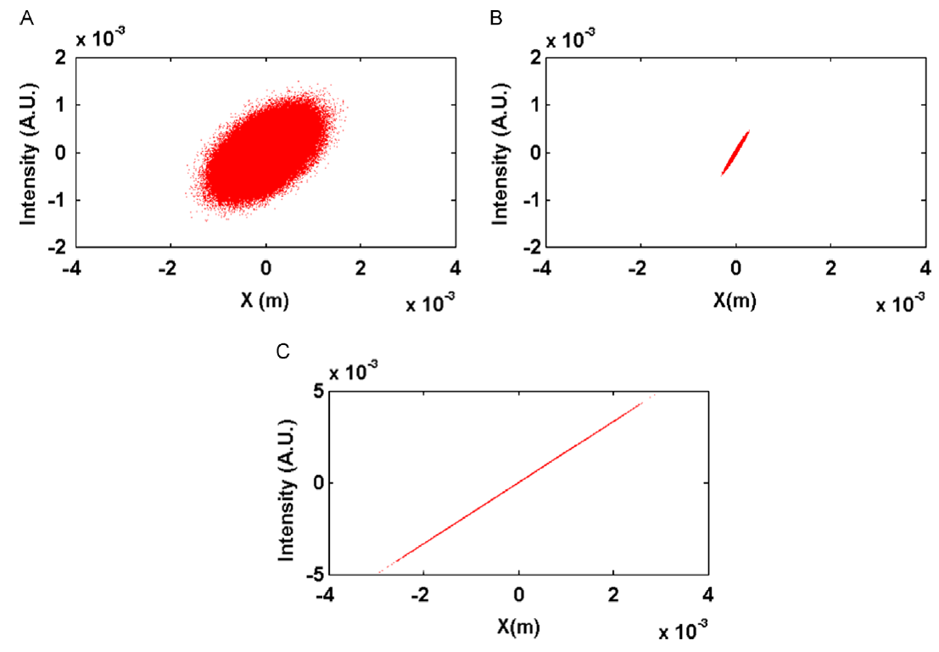
Pepperpot in Plasma Accelerators
5 MeV with size 1 mm; 500 MeV with 10 μm; 500 MeV with 1 μm

Slide 9
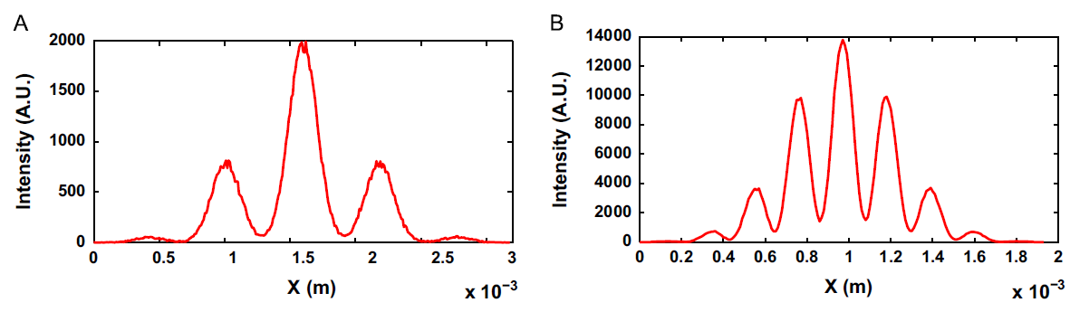
Pepperpot in Plasma Accelerators
Error estimation
around 1 % around 47 %
For case C – this would be 20x more:= 1000 % not suitable !

Slide 10
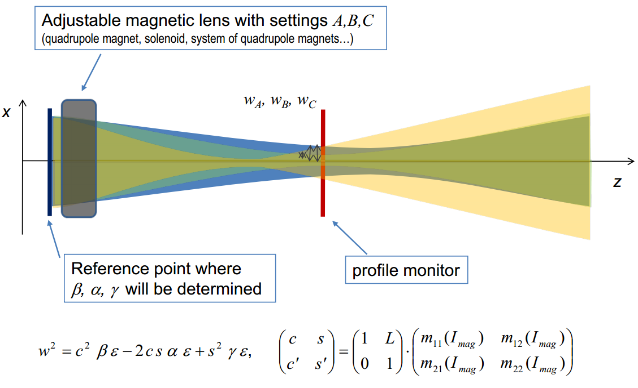
Quadrupole Scan

Slide 11
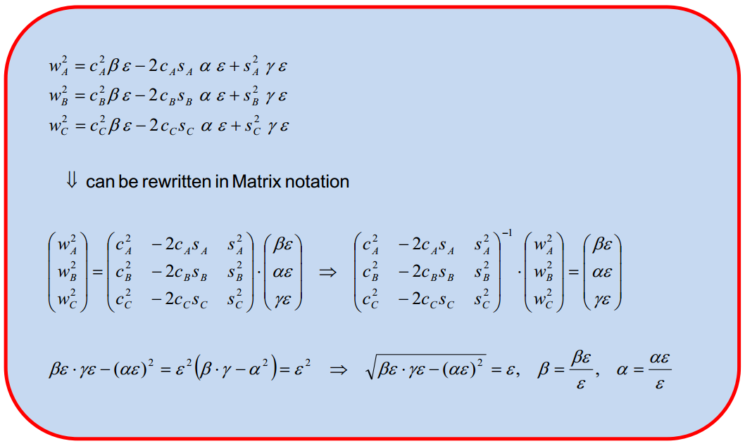
Change quad strength:

Slide 12
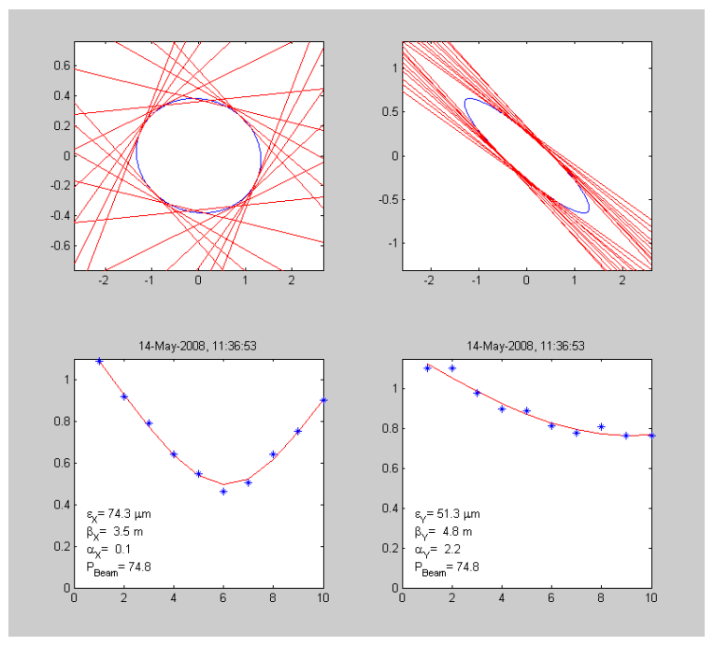
Quad scan @ CTF3

Slide 13
Quad scan: A candidate ?
Spot size dominated by large angular divergence;
Chromatic effects should not affect results
  Distance between quad – waist rather short.
Can be an issue in actual experimental setup.
However, good candidate.

Slide 14
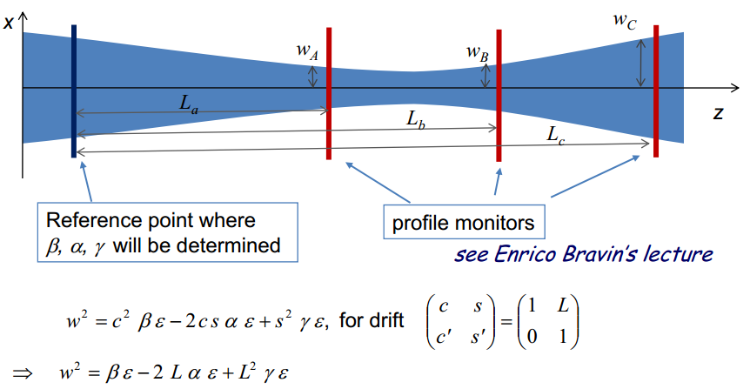
Three Screen Method
Determine α,β and γ together with ε.
H. Braun

Slide 15
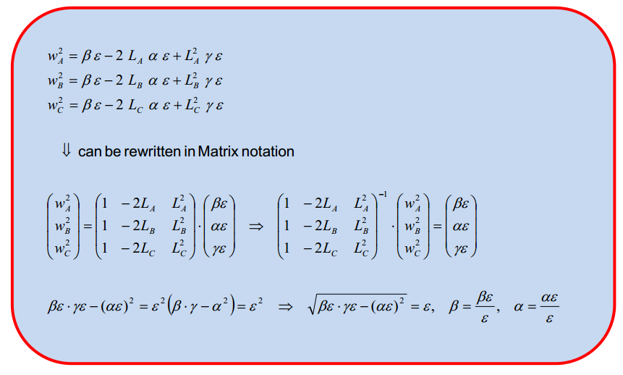
Derivation of TWISS parameters

Slide 16
Challenges
Access to single shot measurements
Requires thin foils
Multiple scattering in foils needs to be carefully assessed
Limitation
Probably only suitable if beam energy > 1 GeV.
Alternative: OTR interferometry...see Ralph‘s talk.

Slide 17
Ultra-short Bunches
Desirable: fs time resolution
Alternatives:
  EO Techniques (Rui and Andrii)
  RF measurements (Enrica)
  CTR measurements
  CDR measurements

Slide 18
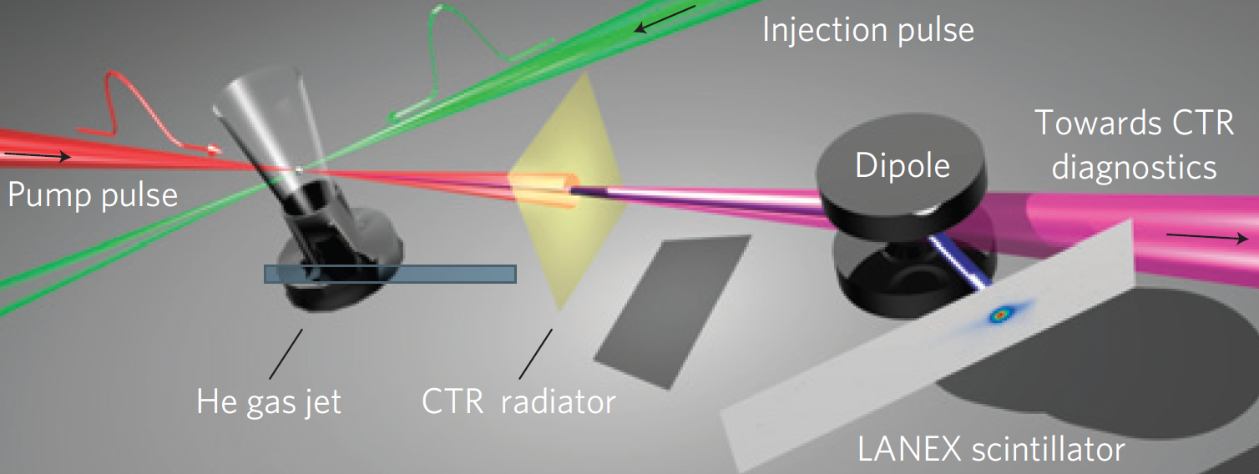
Bunch Length using CTR
30 fs (FWHM) pump pulse and injection pulse collide at 135°
3 mm He gas jet target, beam diameter @ foil: 90 μm
100 μm Al foil generates radiation after 15 mm
Peak charge: 15 pC and peak energy: 84 MeV
O. Lundh, et al., Nature Physics (2011).

Slide 19
Diagnostics details
1.6 T dipole magnet, l=25 mm
LANEX Phosphor screen
Doublet lens images screen on 16 bit CCD
Measure divergence with/without radiator
Determine energy spread

Slide 20
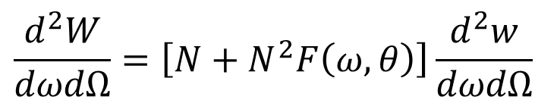
Transition Radiation
Spectral radiation field at frequency ω and observation angle θ is:
$$\frac{d^{2}W}{dωdΩ}=\left[N+N^{2}F\left(ω,θ\right)\right]\frac{d^{2}w}{dωdΩ}$$
Dominates ? coherent
Typically occurs if e⁻ bunch length < radiation wavelength λ.
Form Factor F contains information on bunch shape !
Check: Is radiation really coherent ?

Slide 21
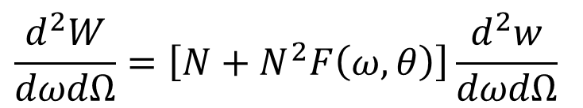
Coherent (?) Radiation
Image spatial distribution on CCD
Apply wavelength filter λ₀=546 nm, Δλ=10 nm.
17 mrad half-angle collection: 2.10⁷ photons
Integrating TR equation for 15 pC bunch charge yields: 5.10³ photons.
$$\frac{d^{2}W}{dωdΩ}=\left[N+N^{2}F\left(ω,θ\right)\right]\frac{d^{2}w}{dωdΩ}$$

Slide 22
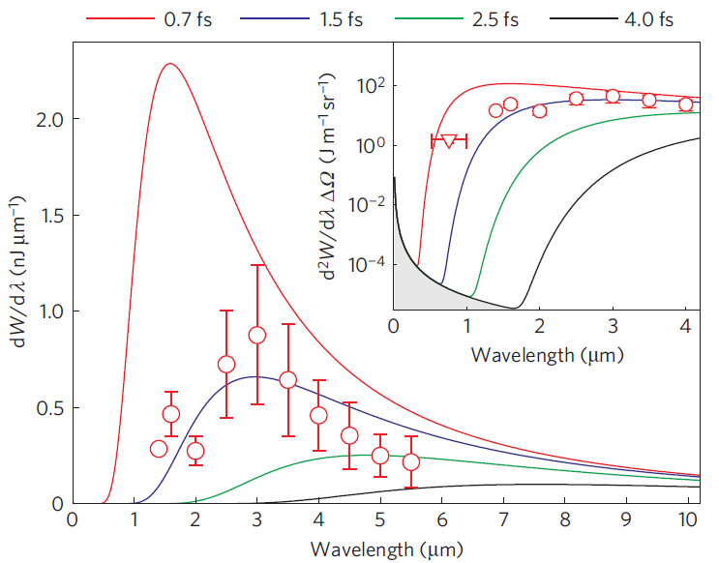
CTR Spectrum: Measurement
1) Scanning Monochromator [1.4 - 5.5 μm], collection angle: 2 mrad.
2) Imaging Spectrometer [0.55 – 1.0 μm], collection angle: 17 mrad.
Assumption:
Gaussian shape
Vary σ, find good fit
σ = 1.5 fs
Coherent part;
7 orders Δ in brightness !

Slide 23
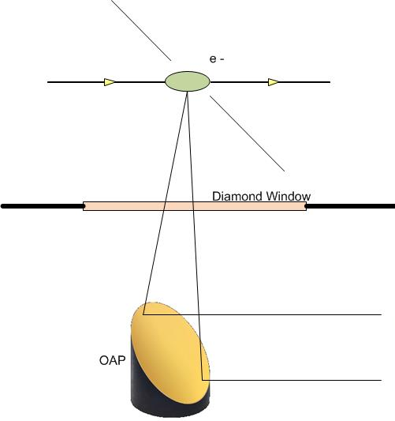
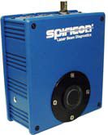

Experiment @ ALICE
Use simple slit at 45° and THz transmissive window
Use camera in the focal plane of focusing mirror to observe the far field angular distribution of the CDR.
Proof-of-principle measurments done at PSI
Need to be refined and compared against e.g. EO data
Camera
R. Fiorito, H. Zhang, C.P. Welsch

Slide 24

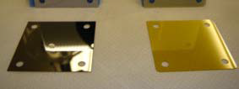
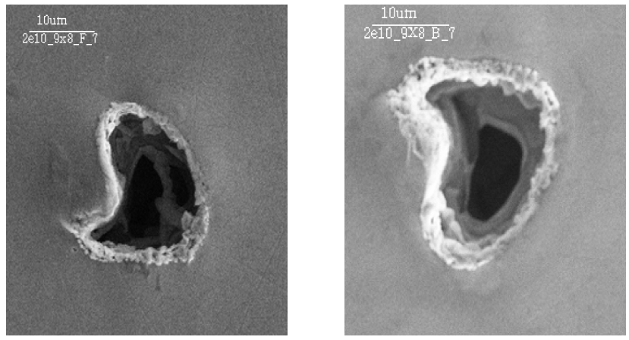
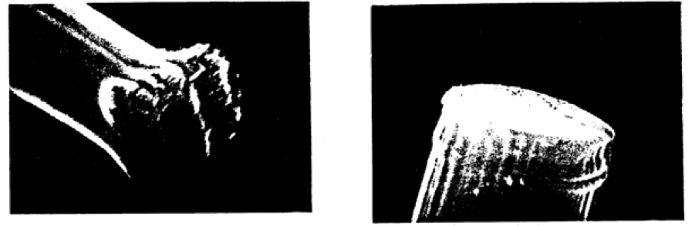
HL - LHC: Beam Profile ?
Damage caused by the beam
Ideally: Non-invasive.

Slide 25
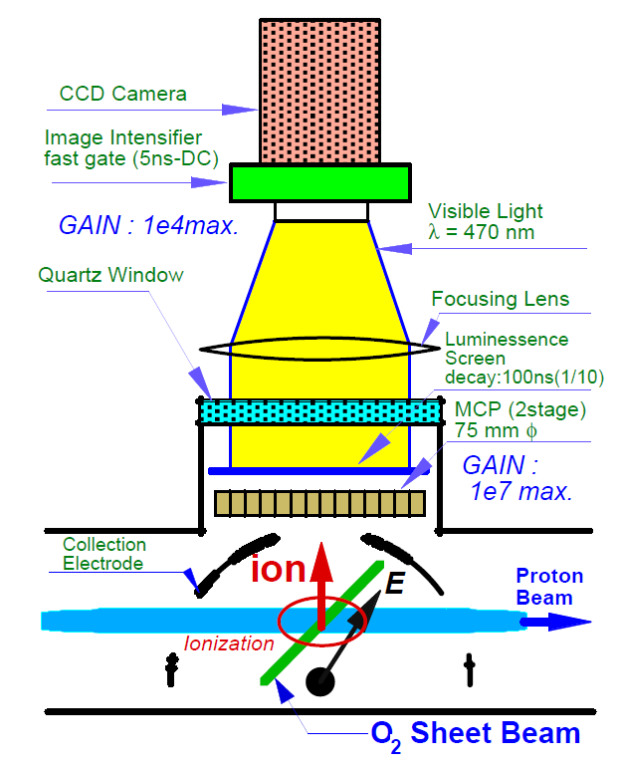
Gas Sheet Monitor
Generate thin atom gas curtain,
Ionize atoms with primary particle beam,
Extract ions via electric field,
Monitor on MCP, P screen.
Y. Hashimoto et al., Proc. Part. Acc. Conf., Chicago (2001)

Slide 26
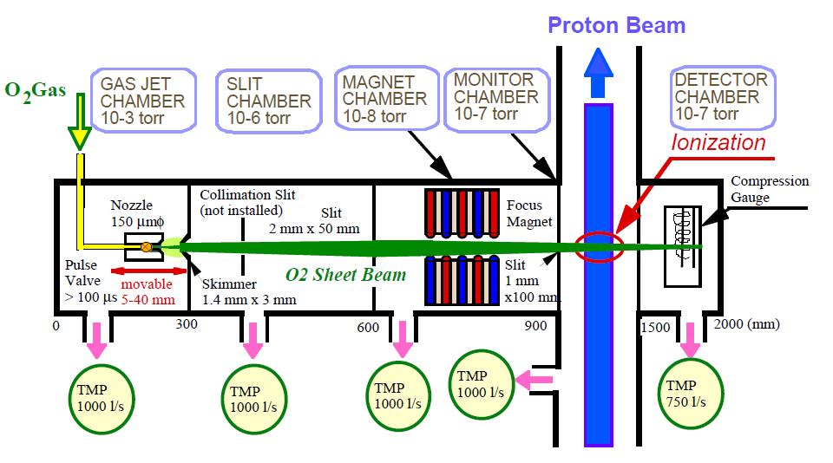
How to Generate the Jet ?
Y. Hashimoto et al., Proc. Part. Acc. Conf., Chicago (2001)

Slide 27
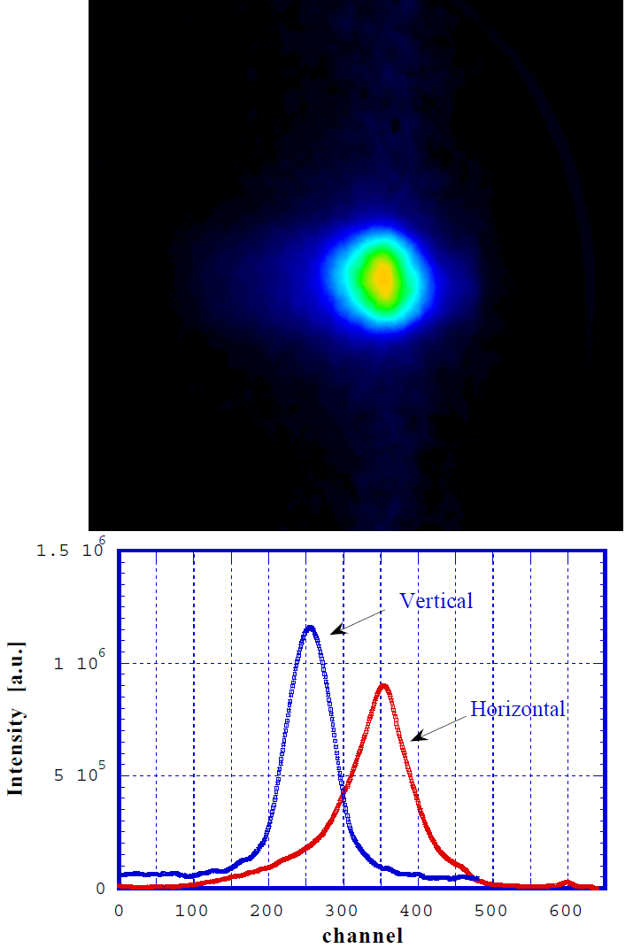
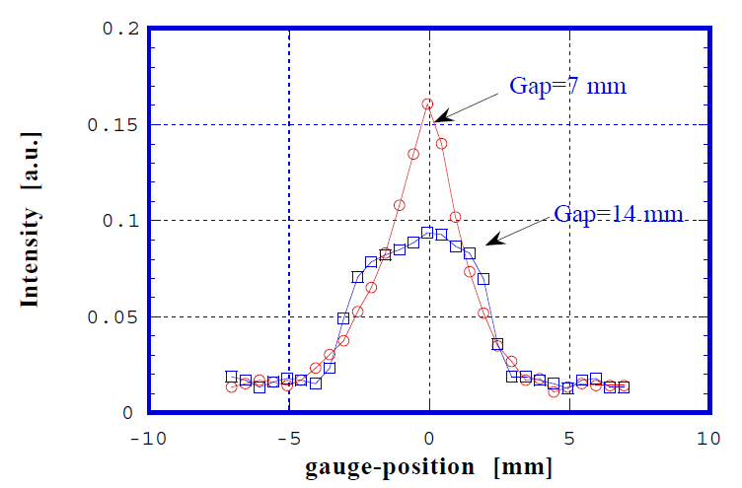
Experimental Data
Y. Hashimoto et al., Proc. Part. Acc. Conf., Chicago (2001)

Slide 28
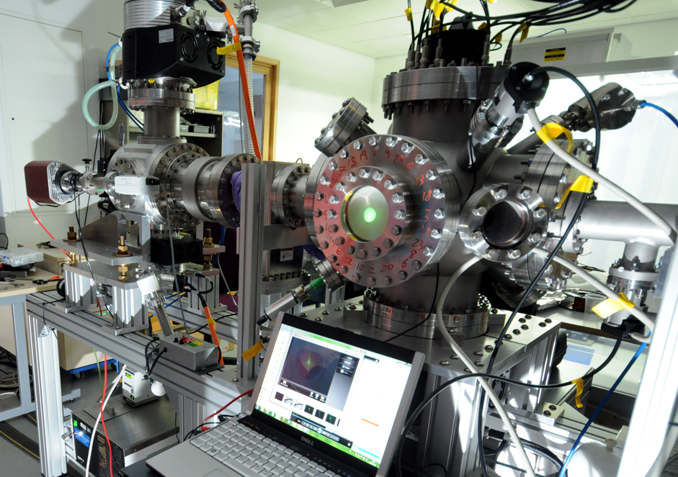
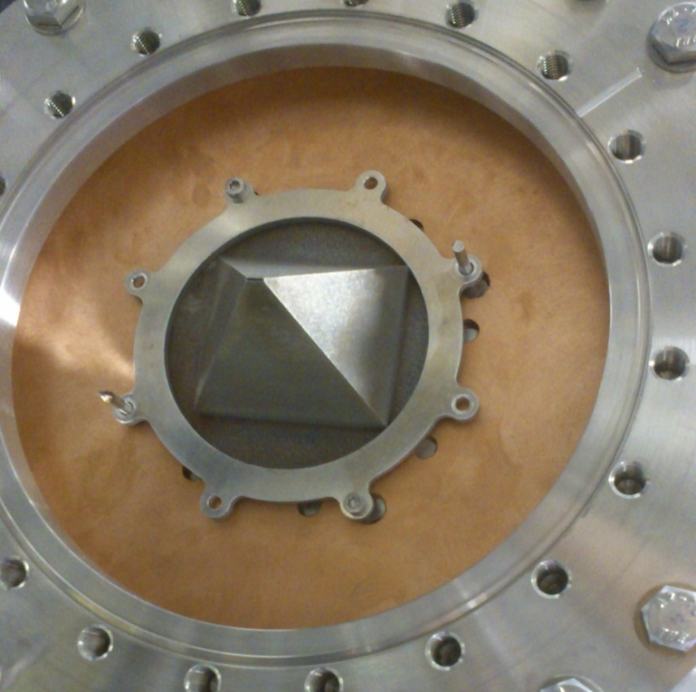
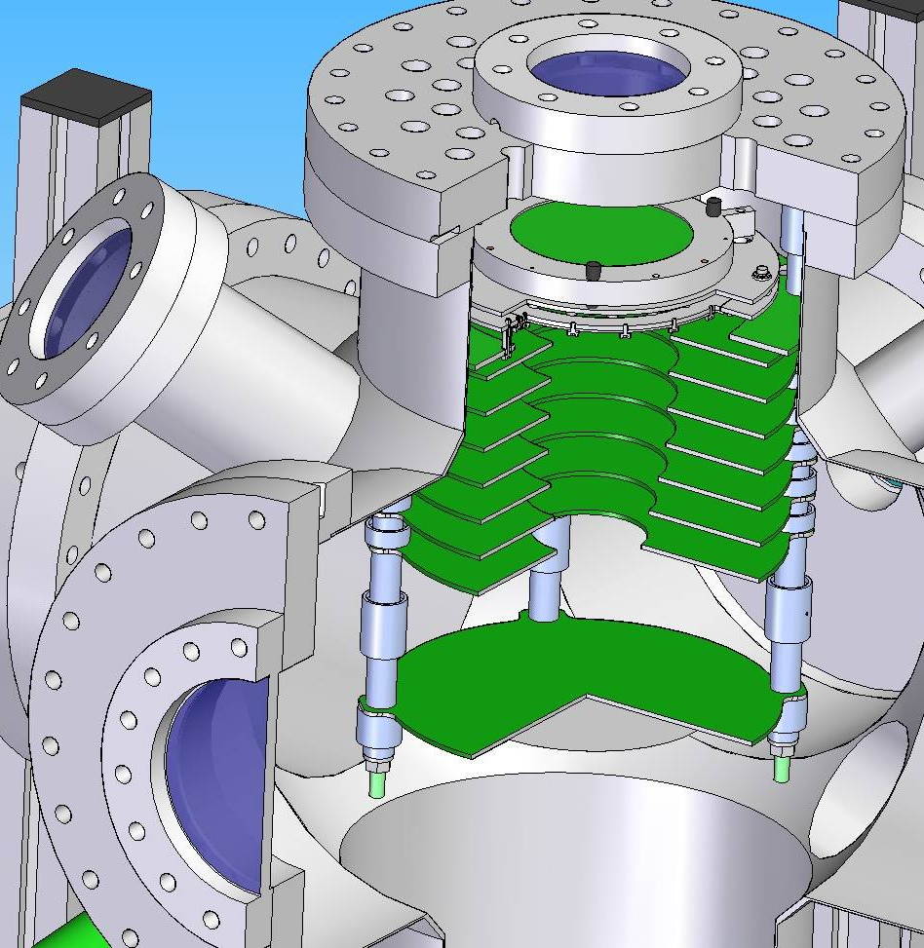
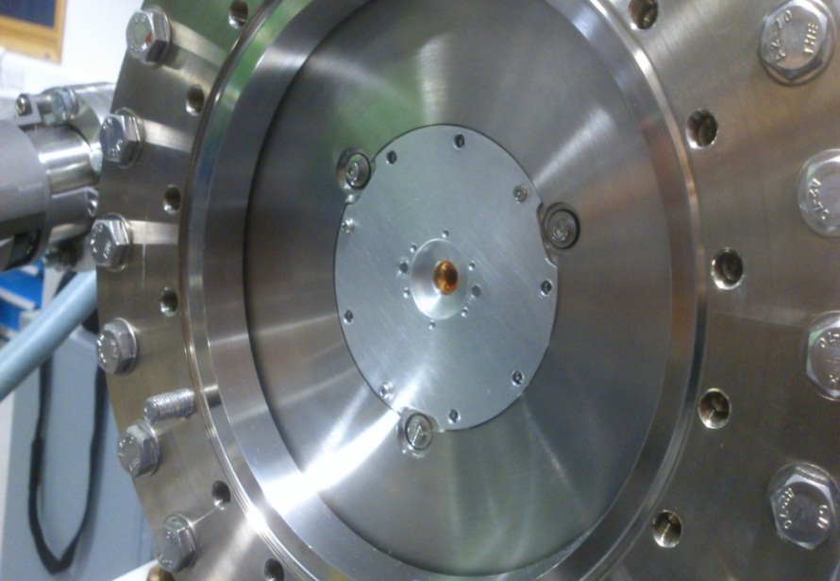
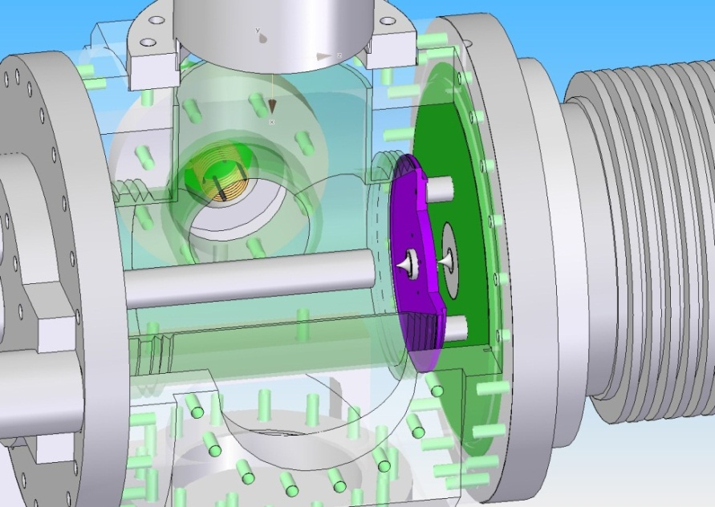
Setup @ Cockcroft Institute
^^

Slide 29
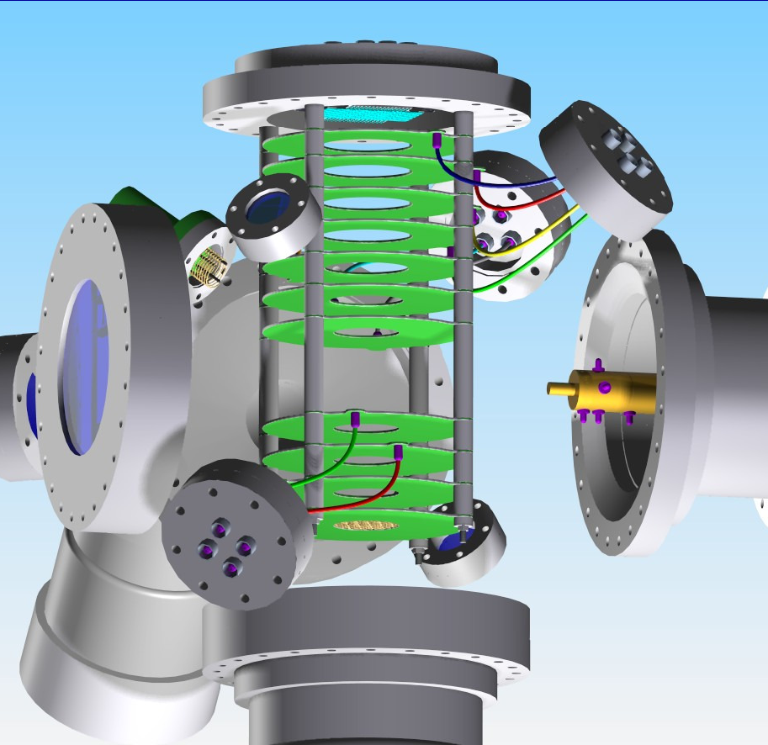
Zoom: Main chamber
MCP
Extraction
electrodes
Phosphor
coated
window
e⁻ gun

Slide 30
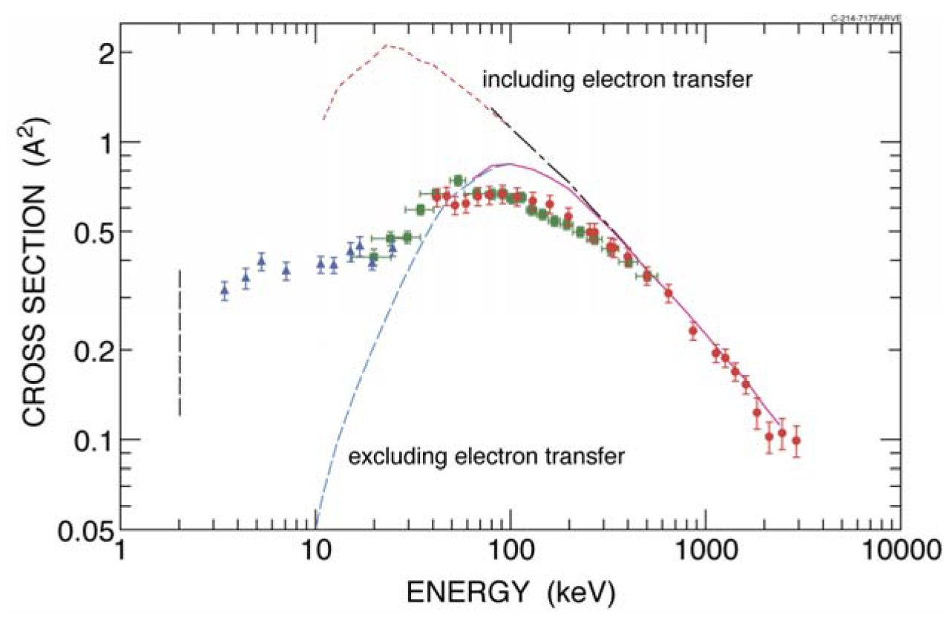
Ionization Cross Sections
Can be exotic, e.g. single ionization of helium by antiproton impact
H. Knudsen, Hyperﬁne Interactions 109 (1997) 133–143
H. Knudsen, Journal of Physics:Conf. Series 194 (2009) 012040

Slide 31
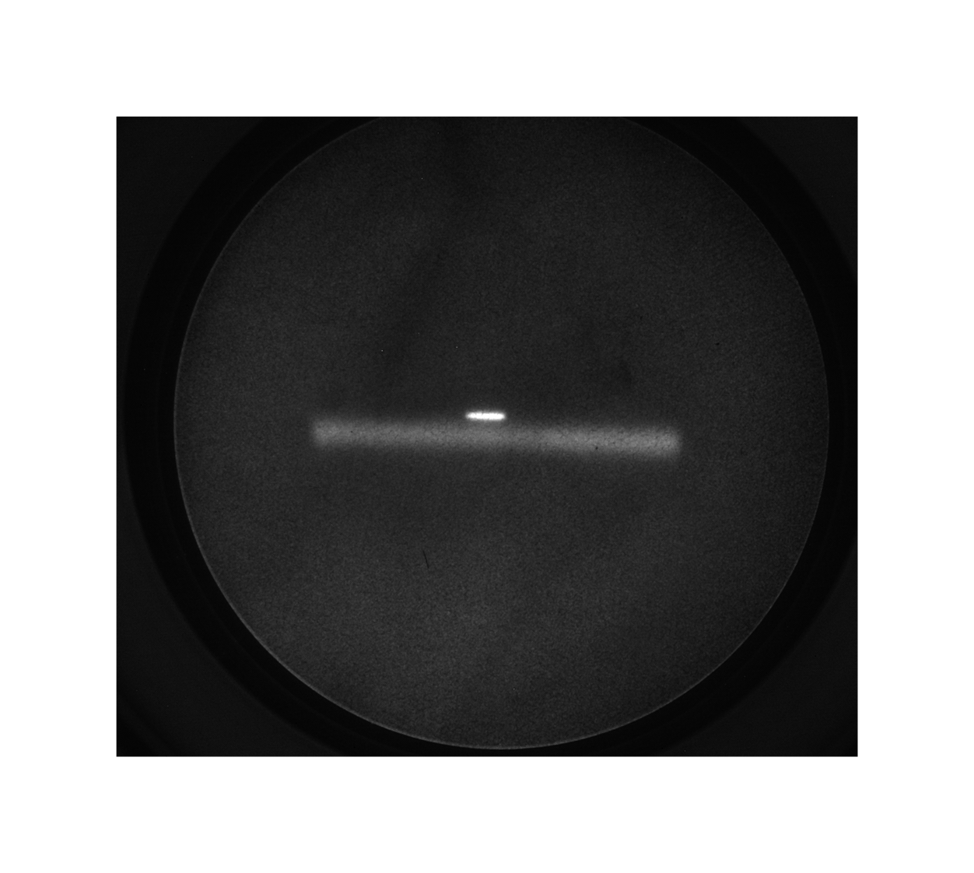
Initial Results
Residual
gas signal
e⁻ beam
Gas Jet
Jet signal
V. Tzoganis, et al.,
APL 104 204104 (2014)

Slide 32
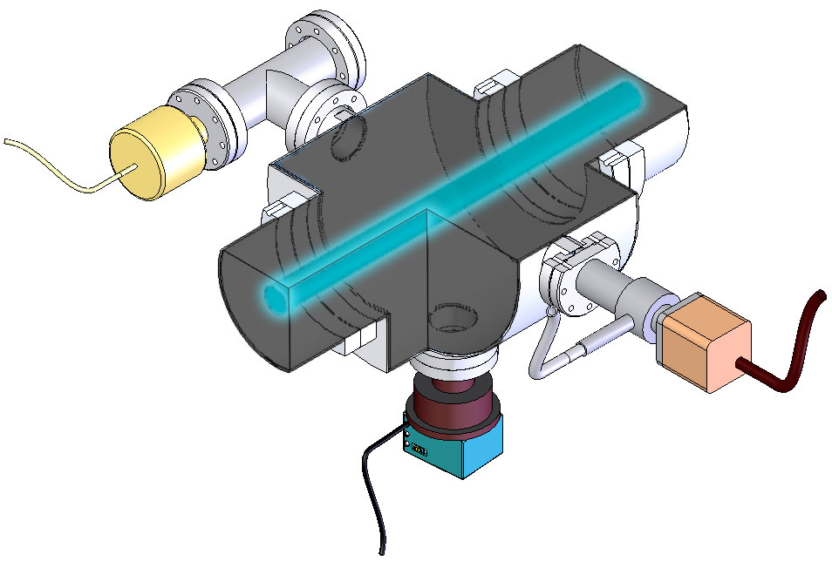
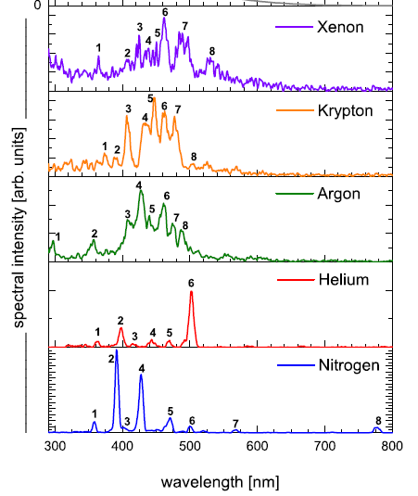
Fluorescence Monitor Principle
N₂-fluorescent gas
equally distributed
Vacuum gauge
Blackened walls
Valve
150mm flange
Ion beam
Viewport
Lens, Image-Intensifier
and CCD FireWire-Camera
P. Forck et al., Beam induced fluorescence profile monitor developments, Proc. HB2010
Gas molecules are excited by the beam and emit a photon when returning to the ground state.
Emission wavelength is determined by the gas species
The relaxation time is typically 10s or 100s of ns.

Slide 33
Benefit from both methods !
Generate electrons/ions or light in collisions between gas jet and beam to be measured
Detect electrons/ions or photons and measure profile
R&D challenges:
  Monitor integration (location, EM fields, cryostat,…)
  Optimum location, e.g. for dense electron beams: Do we have to measure inside a solenoid?
  Gas condensation, space charge issues,…
  Achievable resolution of optics and signal levels
  ...

Slide 34
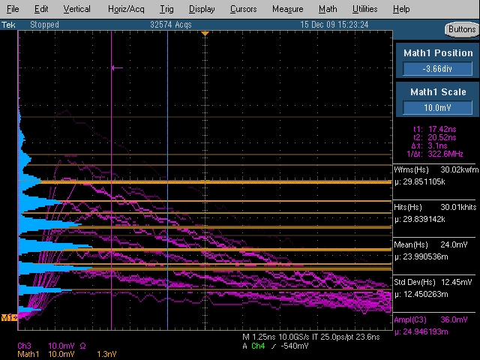
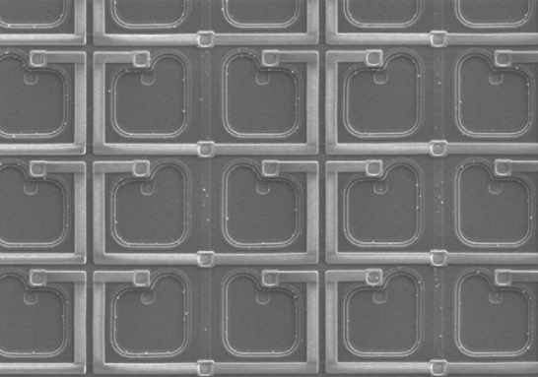
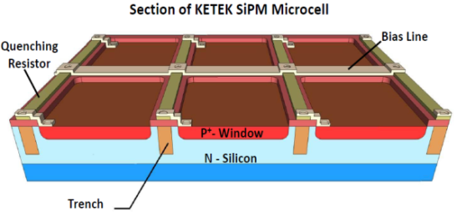

Wish list: Photon detection
Reaching the ideal single photon limit
See Sergey‘s talk

Slide 35
Conclusion
Only a few examples outlined here
There is much, much more:
  Beam halo monitors (DMD, coronograph,...)
  EO monitors for fs bunch length and position
  High power beam diagnostics (ESS)
  ...
Also needed: Simulation tools for detailed modeling
Much more to do...focus during the next 2 days.
  Enjoy the workshop !

