Slide 1
TOPLHCWG
6th open session
12-13th January 2015

Slide 2
Introduction and coordinates
Sixth open session of the TOPLHCWG
  Forum for public discussions (ATLAS+CMS+LHCb+TH) on combination and interpretation of top physics measurements at the LHC
  Open sessions (twice per year) organized in such a way to have ample time for discussion
Documentation and coordinates
  Integrated into the LPCC structure at CERN
  Agendas available at https://indico.cern.ch/categoryDisplay.py?categId=4463
  Twiki page available at http://lpcc.web.cern.ch/LPCC/index.php?page=top_wg
    Public notes produced so far also available from that page
  Please make sure you subscribe to the main open list lhc-toplhcwg@cern.ch
Welcome to the second late open session of 2014

Slide 3
Contacts: reminder
Main contacts
  M. Mangano (TH)
  M. Costa (ATLAS), R Chierici (CMS) (M. Mulders replacing Roberto after this WS)
Conveners
  A. Lister, M. Owen (ATLAS), A. Meyer, A. Giammanco (CMS)
Contacts for individual subgroups/combinations
  Top pair cross section: L. Shabalina (ATLAS), M. Aldaya (CMS)
  Single top cross section(s): J. Donini, R. Schwienhorst (ATLAS), L. Lista (CMS)
  Top mass: G. Cortiana (ATLAS), S. Wimpenny (CMS)
  W helicity: K. Kroeninger (ATLAS), M. Senghi Soarez (CMS)
  Charge asymmetry: F. Deliot (ATLAS), T. Chwalek (CMS)
  Top pair differential cross sections: F. Spano’ (ATLAS), M. Aldaya (CMS)

Slide 4
Recent (EXP) activities
Combination activities (see presentations today)
  Single top Wt channel at 8 TeV
  Top pair cross section at 8 TeV
Systematic contributions
  Treatment of JES in analyses
    Public notes on the agreed recommendations for standard JES splitting available
    JES/hadronisation double counting: internal discussions to get the different approaches in ATLAS and CMS consistent. Main points of discussion in the mass talks tomorrow
  Single top modelling systematics
    t-channel: agreement reached for the general strategy, details to be discussed today
    Wt: the combination exercise helped in spotting differences in the treatment of these systematics in the experiments. Internal discussions happened since, and residual questions will be presented today to hopefully reach an agreement.
Ongoing discussions
  Top mass World Average
    Cross collider discussions ongoing for establishing the (in)compatibility of the various measurements and think to further tests to be done before updating a WA.
  Extending the program of the WG
    Internal discussions for future combination activities, most awaiting for new results by the collaborations: spin correlations, tt+X (X=jets, W, Z, γ), |V|tb

Slide 5
Recent (TH) activities
NNLO
  Predictions for A_{FB} and A_{C}
  Further progress towards differential distributions
MC
  New models for colour reconnection in Pythia
  Matching to shower for NLO production+decay
Further contributions to this meeting
  First presentation at TOPLHCWG of TopDiff (=> parton-level differential distributions at NLO+NLL)
  Principle of maximum conformality for scale setting in top processes: predictions for asymmetries
  mtop from b-jet energy spectrum, update to NLO
In progress (for presentation at the next mtg):
  Further progress with single top at NNLO
  More on single top at NLO in aMC@NLO in the complex mass scheme

Slide 6
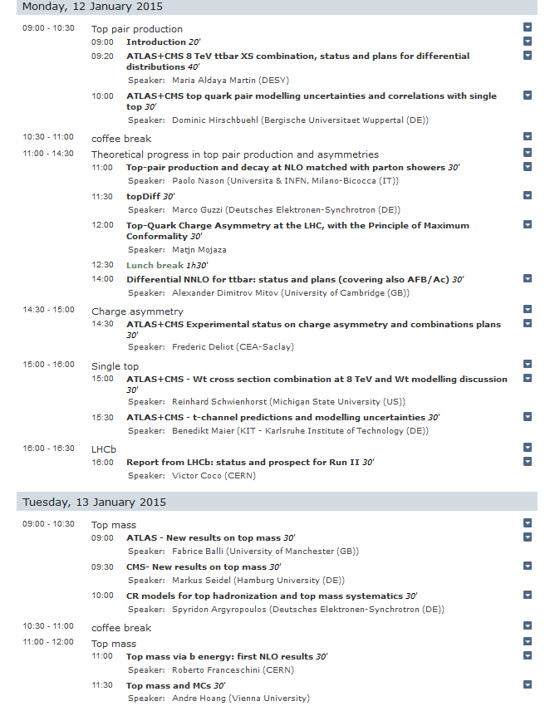
Agenda
Top pair production
Theoretical progress
in top pair production
and charge asymmetry
Single top
LHCb report
Top mass

