Slide 1
SRF Photo Injector for Electron-
Laser Interaction
Pengnan Lu
on behalf of
the ELBE and the Rossendorf SRF Gun Crew
LA³NET conference: Laser applications at accelerators, Mallorca, Spain, 25-27th March 2015

Slide 2
Outline
Motivation
Simulation design
Motiv.
Design
Results
Check
Simulation results
Check with first experiment results

Slide 3
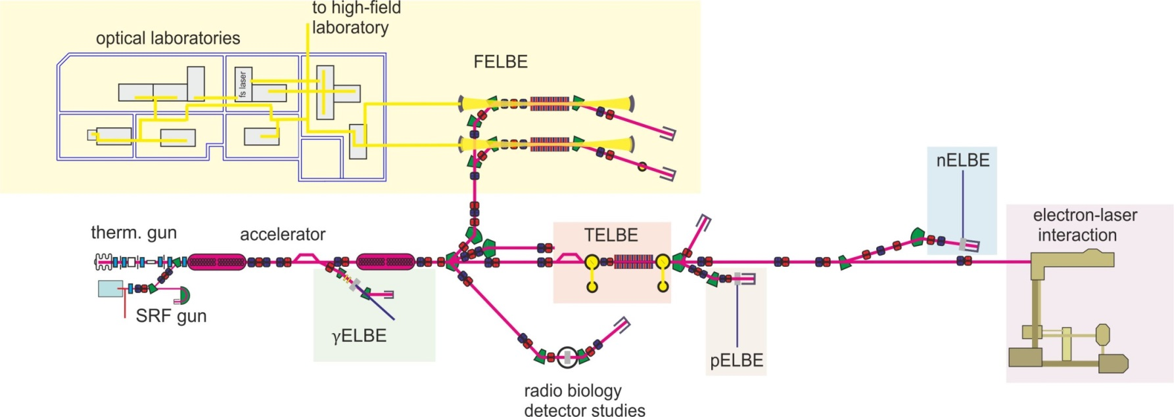
SRF Gun II @ ELBE
1 nC, 5 MeV electron bunch expected. (500 kHz)
Motiv.
Design
Results
Check
interest of high bunch charge

Slide 4
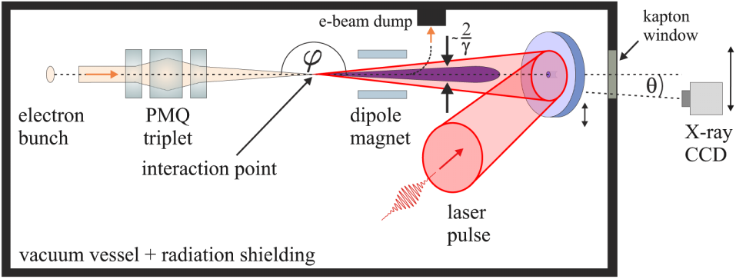
Compton Back Scattering (CBS) experiment
A. Jochmann, et. al., PRL 111, 114803 (2013)
Motiv.
Design
Results
Check
laser
e⁻
DRACO laser: 30 µm rms beam size
e⁻ must < 30 µm
Page 4

Slide 5
Longitudinal strategy
Longitudinal → transverse e. g. , Energy spread → emittance↗
Keep low energy spread
Longitudinal space charge “benefits” in drift distance
SRF
Gun
Motiv.
Design
Results
Check
Linac 1
Chicane 1
Linac 2
Chicane 2
Long drift
CBS
Page 5

Slide 6
Transverse strategy
SRF Gun: 5 free parameters scanning, tradeoff decision
80 m beamline: 35 free parameters, automatic simplex optimization
Motiv.
Design
Results
Check
beam
size
emittance
Page 6

Slide 7
Simulation scheme
SRF Gun (0 ~ 5 MeV)
UV + CS₂Te → initial phase space
gun cavity acceleration
space charge effect
ASTRA
ELBE beamline (5 ~ 22.5 MeV)
3rd order matrix
Coherent Synchrotron Radiation (CSR)
Longitudinal Space Charge (LSC)
Longitudinal wake effects
Labview
elegant
Motiv.
Design
Results
Check
Troubles
data file manipulation
result plotting
recode for optimization
user
Page 7

Slide 8
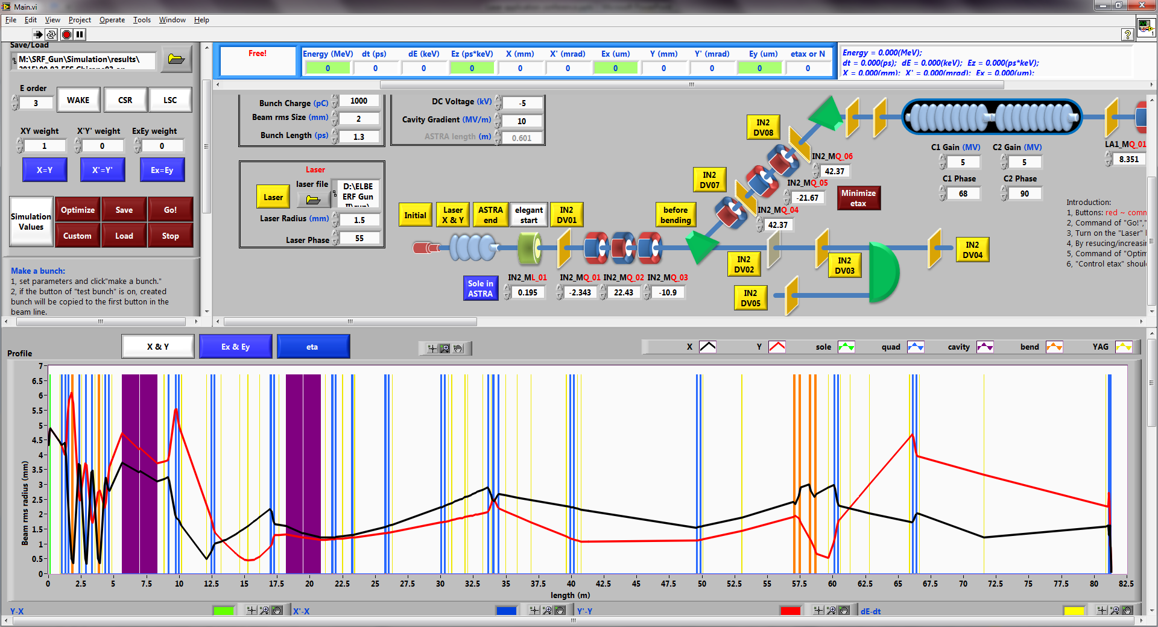
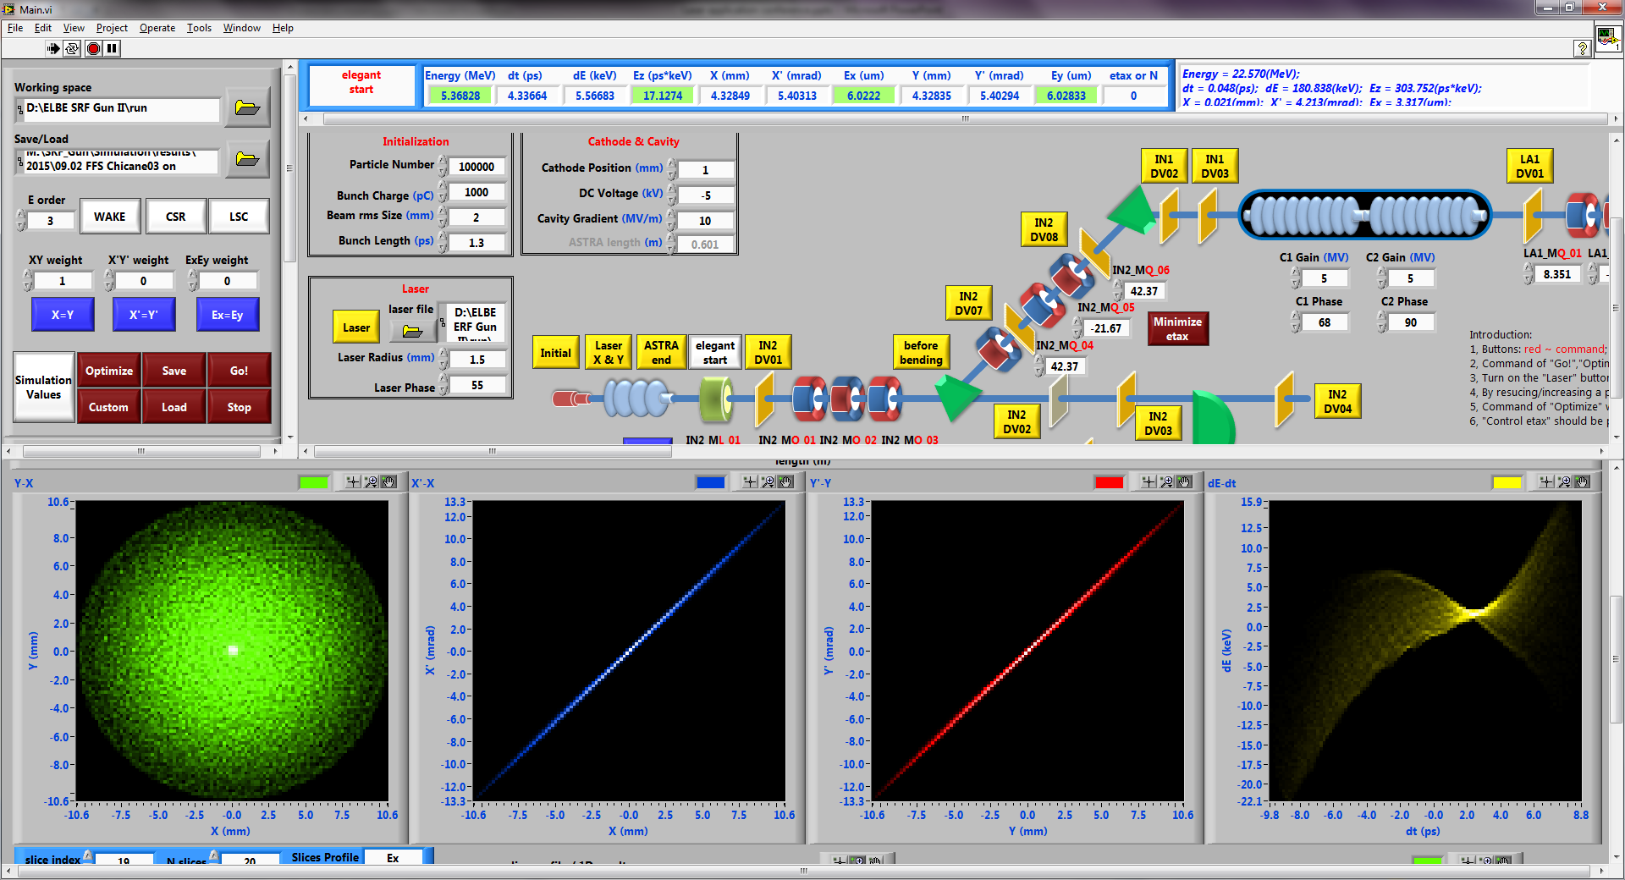
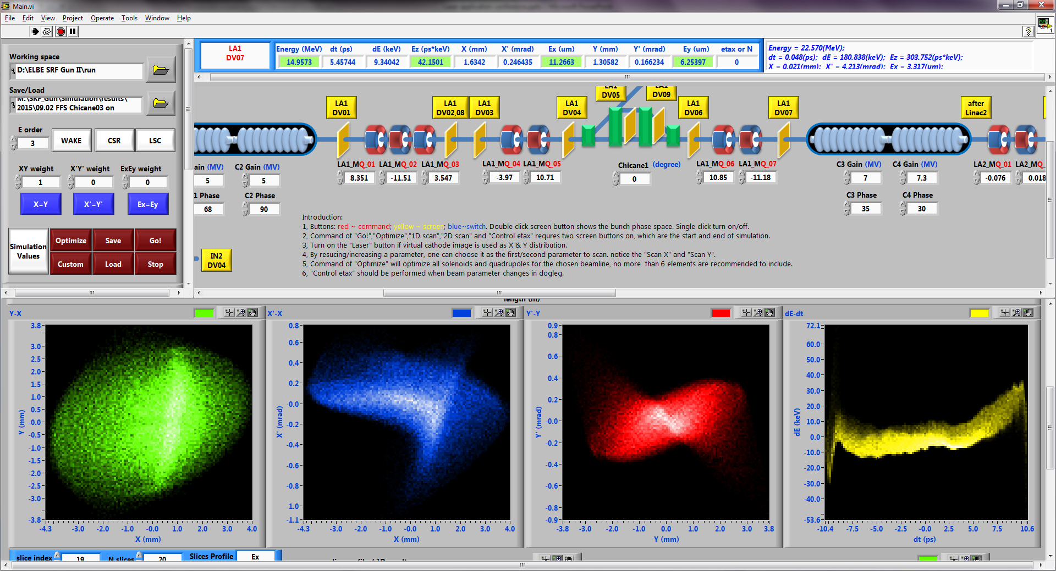
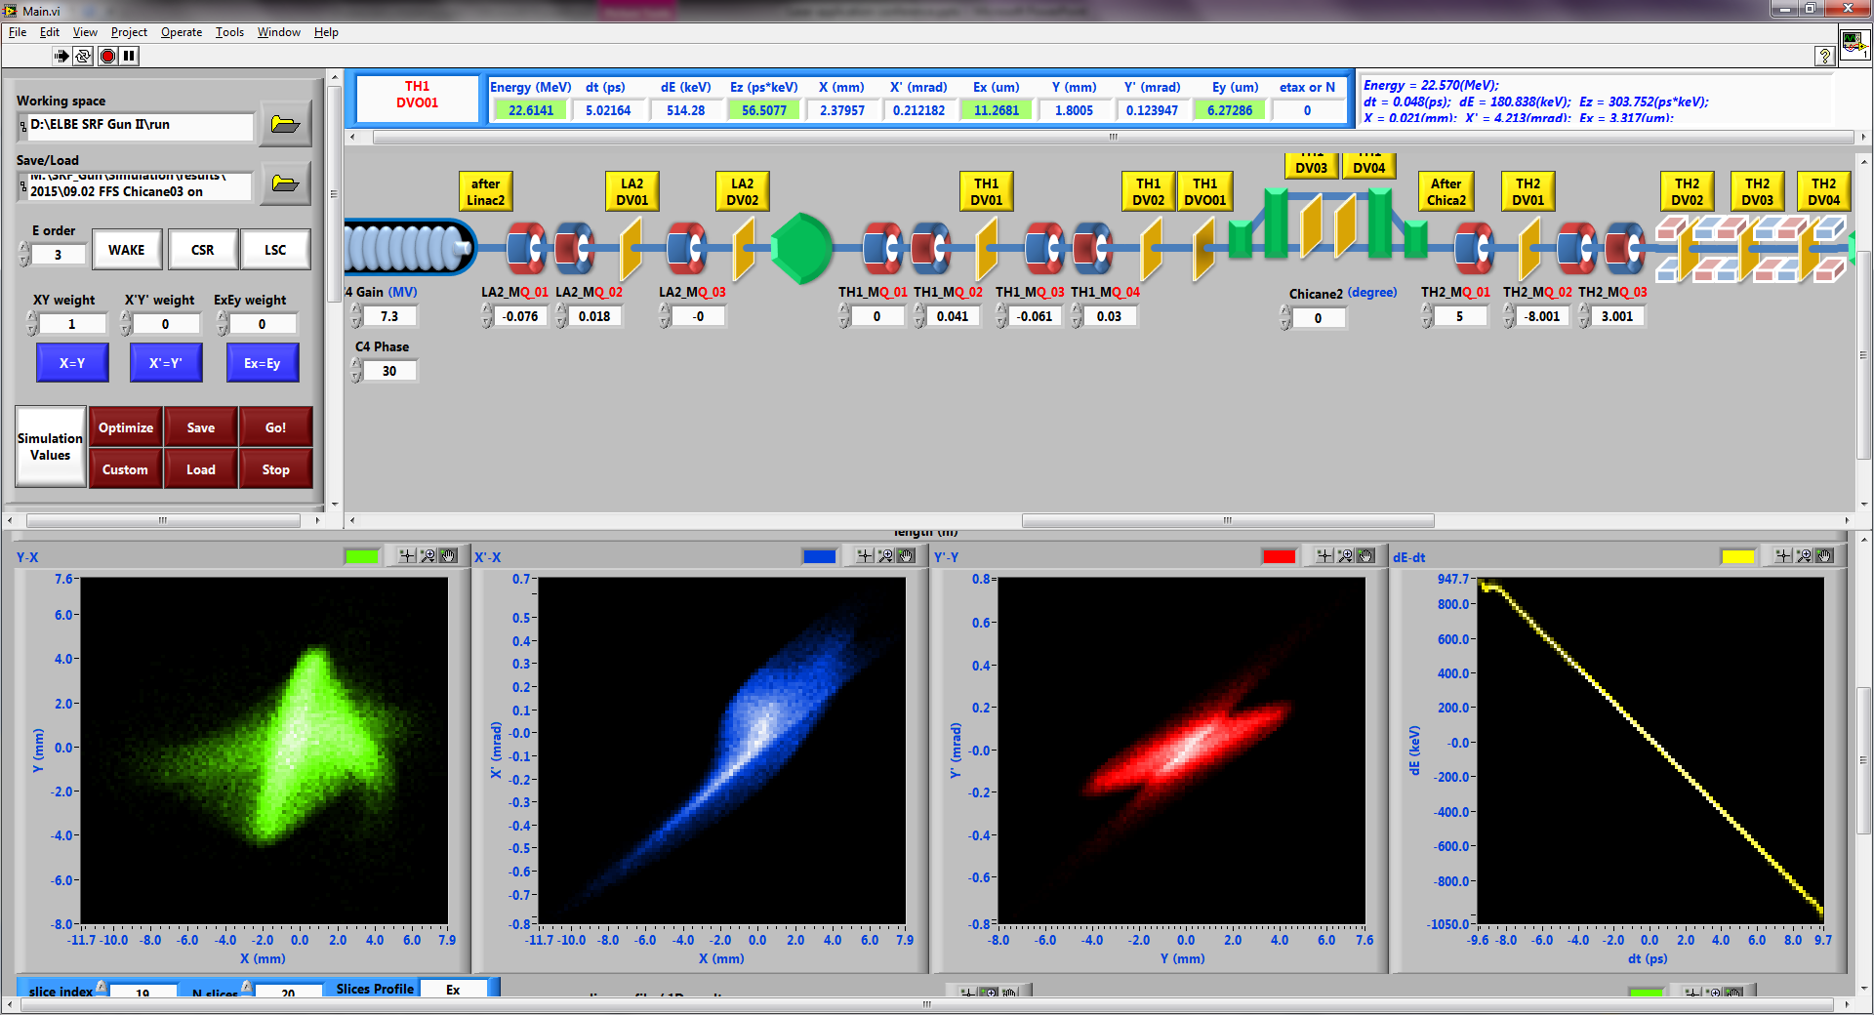
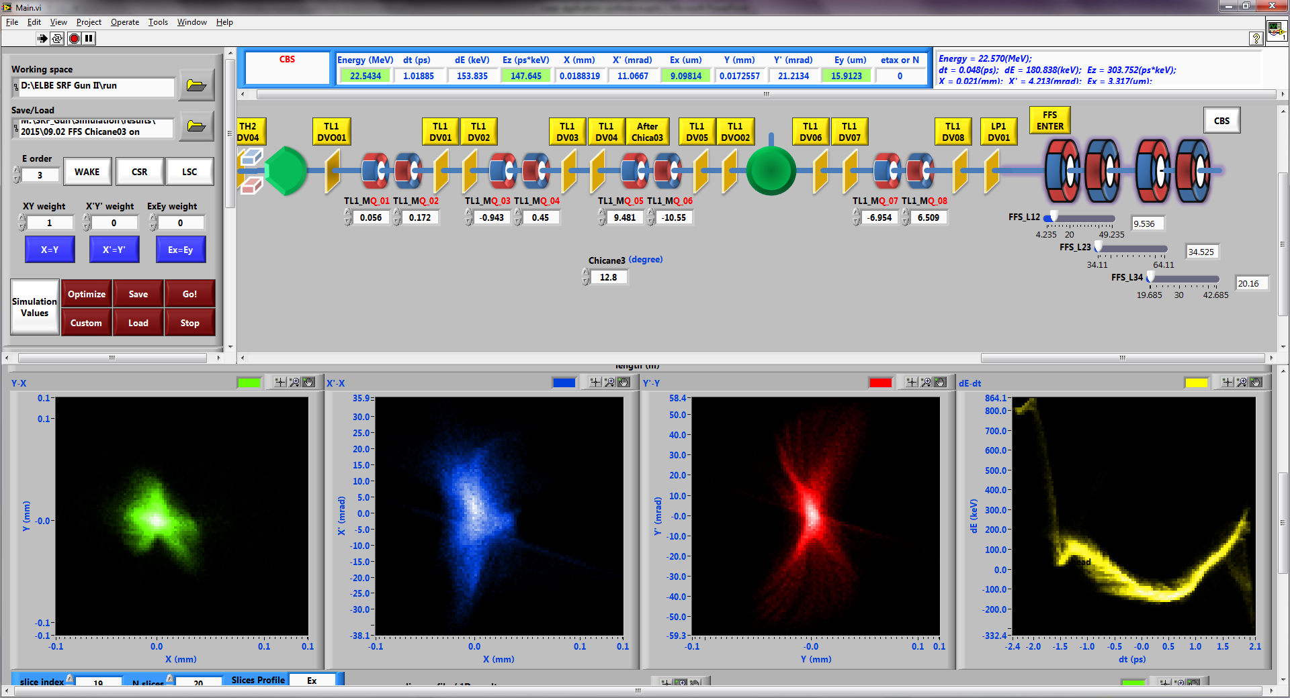
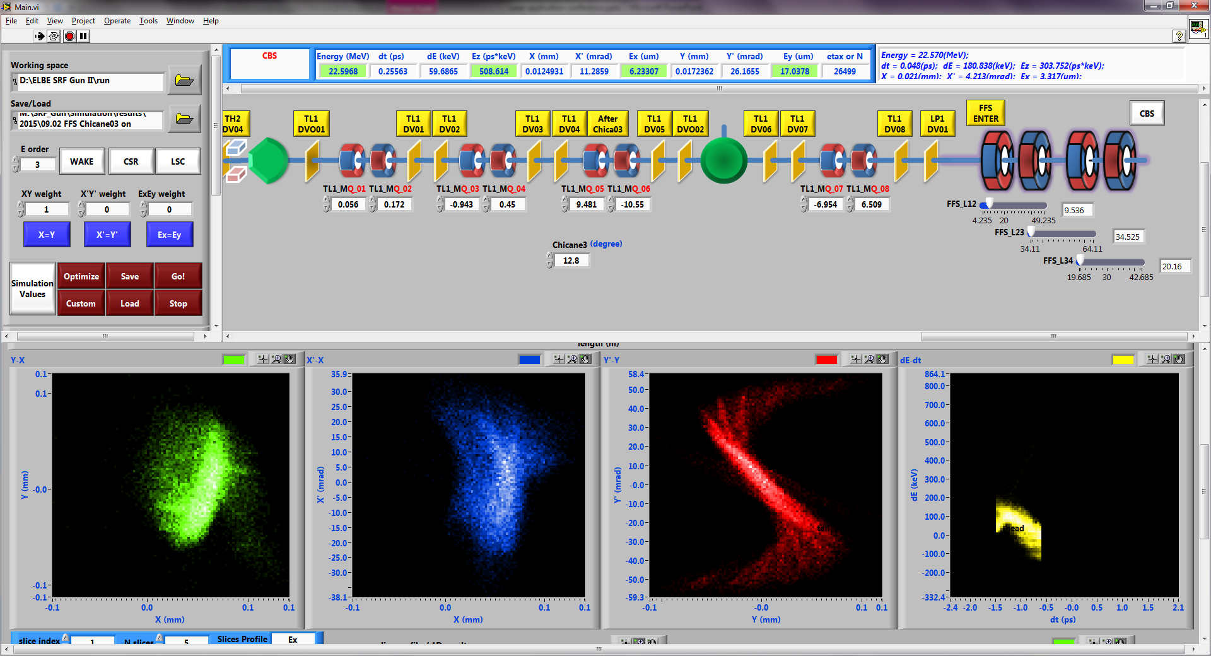
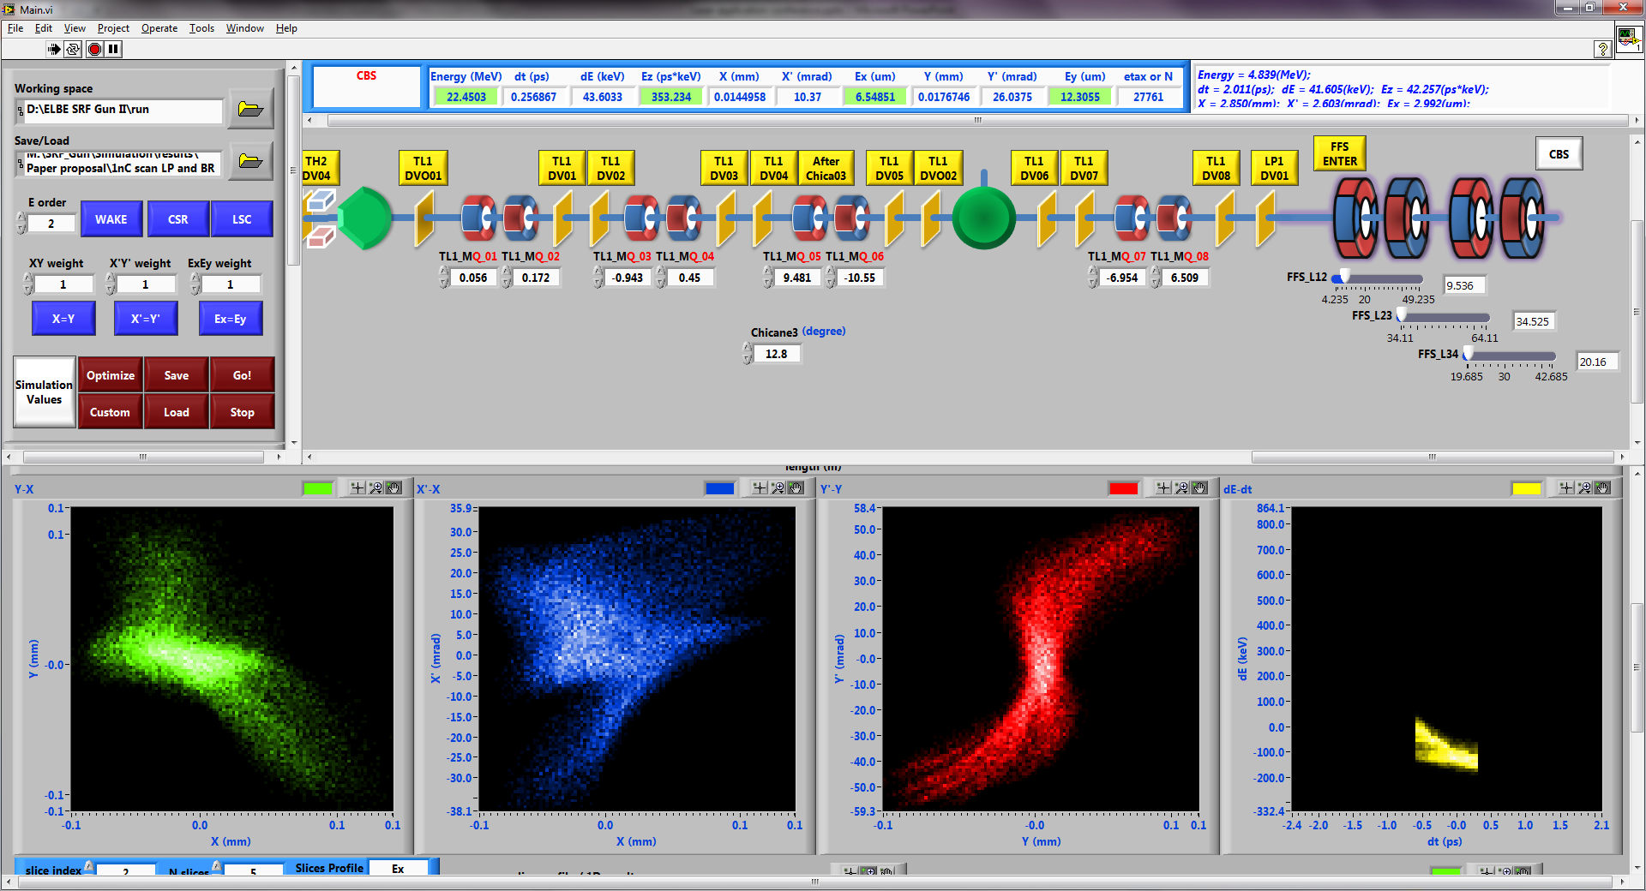
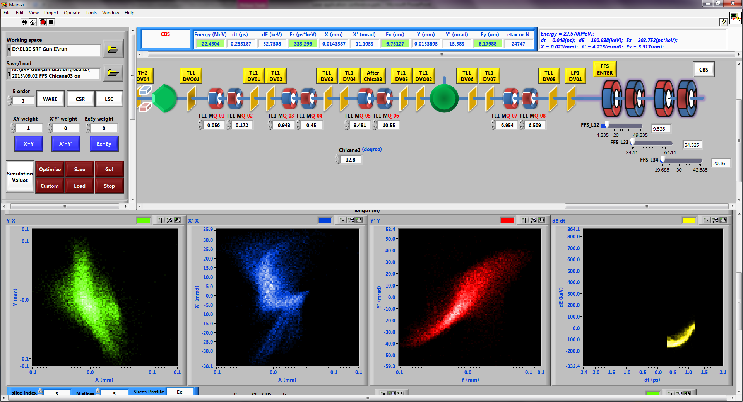
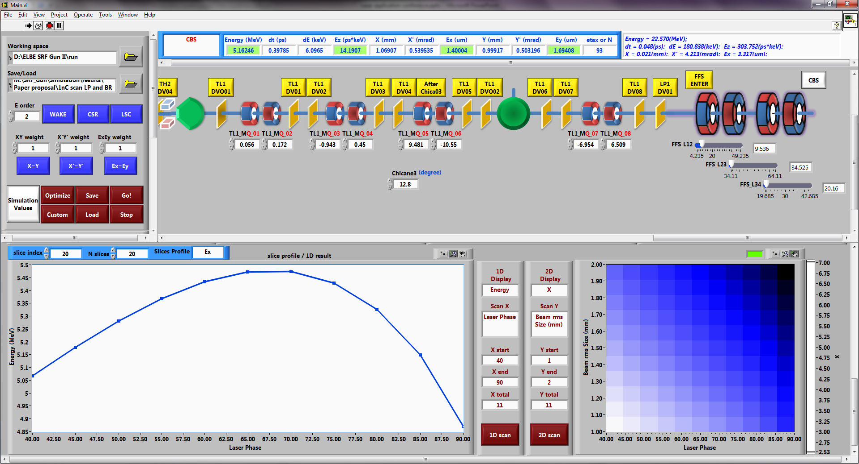
Simulation tool
Make something alive after Ph. D. …
Motiv.
Design
Results
Check
Page 8

Slide 9
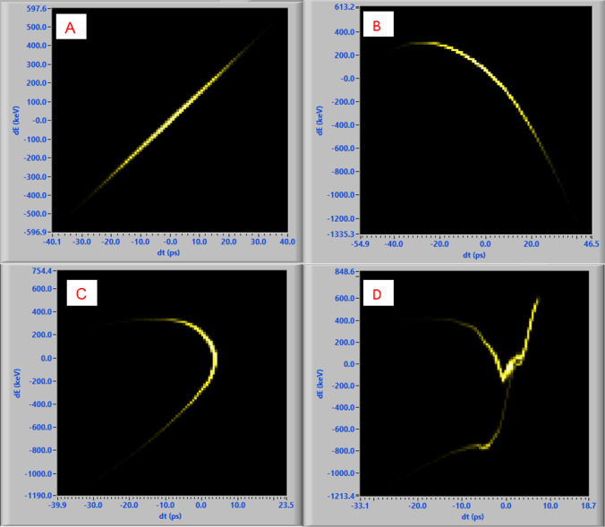
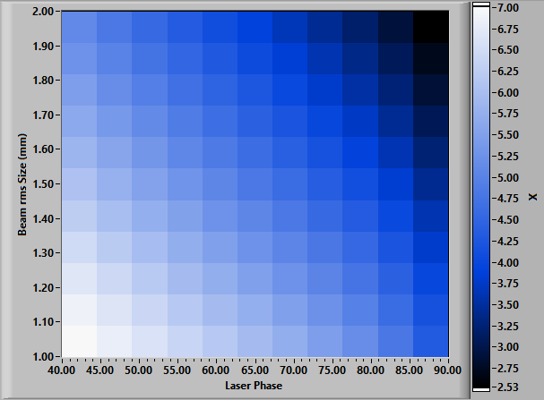
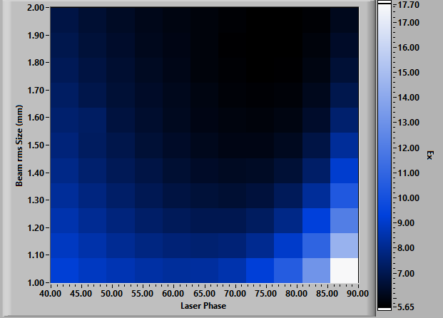
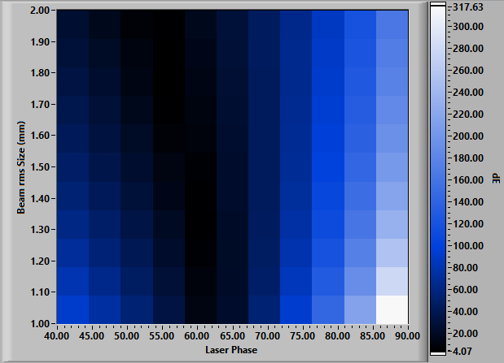
SRF Gun parameters determination
5ps: Longitudinal phase space
short UV laser: 1.3 ps, or else:
Initial beam size: the lager the better
gun
linac
laser phase for energy & energy spread
cathode position, DC voltage…
chicane
final
Motiv.
Design
Results
Check
X: laser phase
Y: initial bunch size
Color: final bunch size
X: laser phase
Y: initial bunch size
Color: transverse emittance
X: laser phase
Y: initial bunch size
Color: energy spread
Page 9

Slide 10
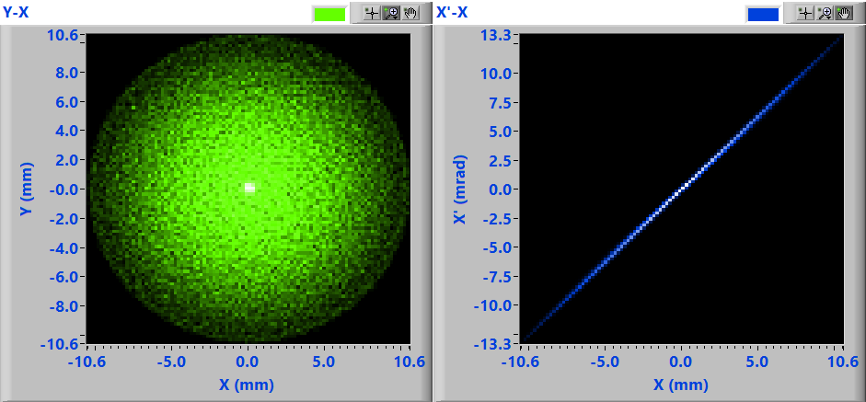
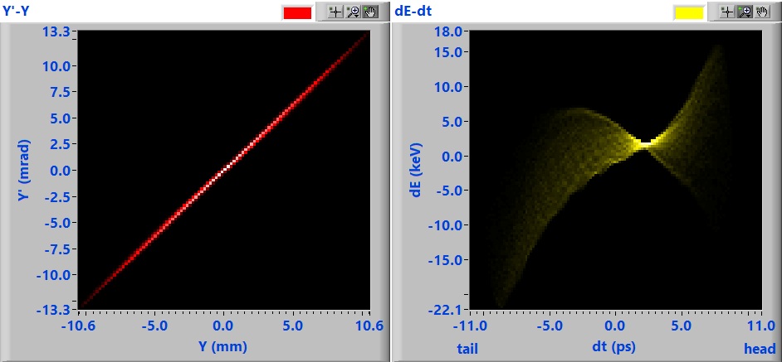
SRF Gun output phase space
Energy = 5.368(MeV);
dt = 4.337(ps);
dE = 5.567(keV);
Ez = 17.127(ps*keV);
X = 4.328(mm);
X' = 5.403(mrad);
Ex = 6.030(um);
Y = 4.328(mm);
Y' = 5.403(mrad);
Ey = 6.037(um);
Motiv.
Design
Results
Check
Page 10

Slide 11
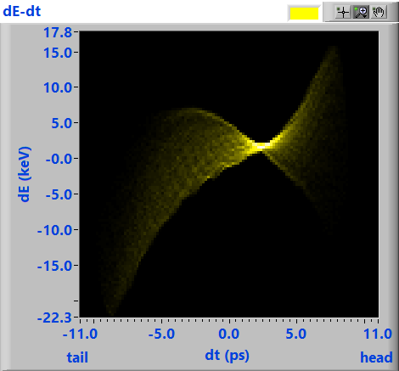
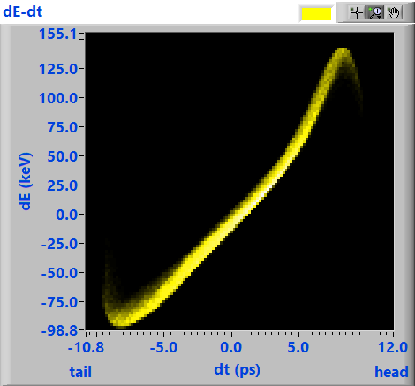
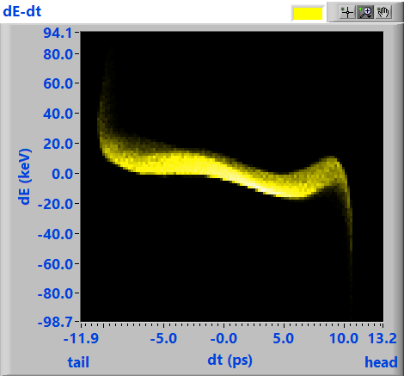
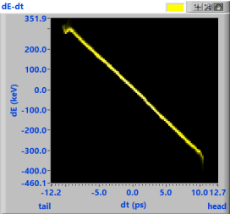
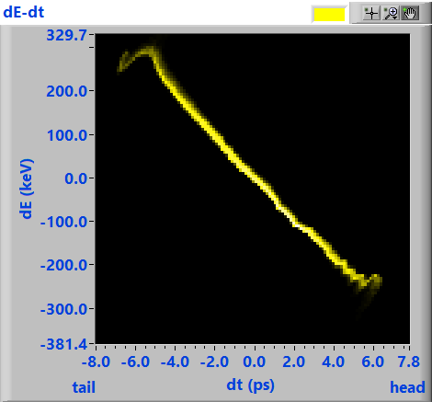
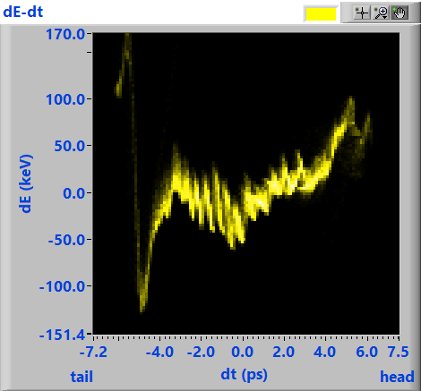
transport results — longitudinal
position | gun exit | before Linac 1 | after Linac 1 | after Linac 2 | after Chicane 2 | CBS point
energy (MeV) | 5.368 | 5.343 | 14.970 | 22.631 | 22.591 | 22.567
dt (ps) | 4.337 | 4.692 | 5.505 | 5.489 | 3.179 | 2.877
dE (keV) | 5.567 | 61.923 | 10.565 | 173.15 | 150.588 | 36.64
Ez (ps*keV) | 17.127 | 60.995 | 40.127 | 41.12 | 50.79 | 95.52
Motiv.
Design
Results
Check
Energy decrease: longitudinal wakes & coherent synchrotron radiation (CSR)
dt & dE changes in drift: longitudinal space charge (LSC)
Page 11

Slide 12
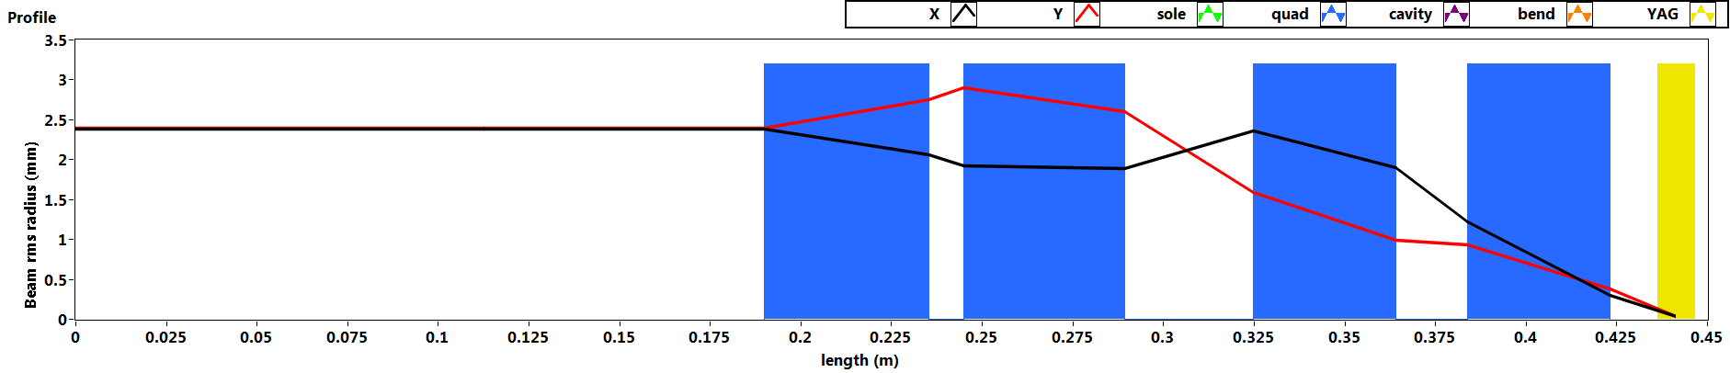
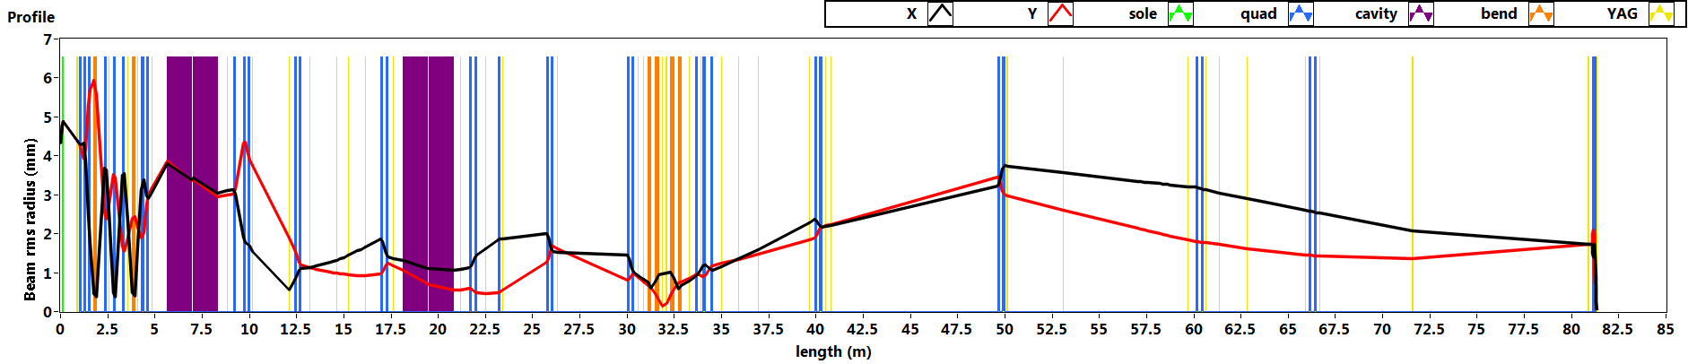
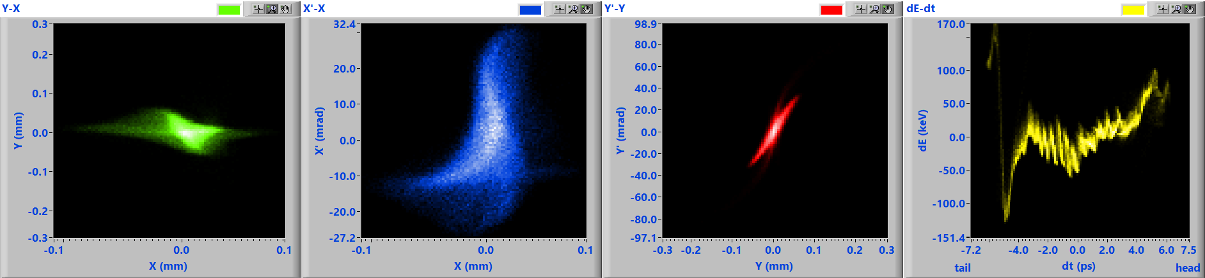
Transport results — transport
See Jakob’s report tomorrow
Beam parameters at the CBS point
Energy = 22.567(MeV);
dt = 2.877(ps); dE = 36.654(keV); Ez = 95.543(ps*keV);
X = 0.021(mm); X' = 12.091(mrad); Ex = 11.035(um);
Y = 0.021(mm); Y' = 15.762(mrad); Ey = 7.279(um);
Motiv.
Design
Results
Check
Page 12

Slide 13
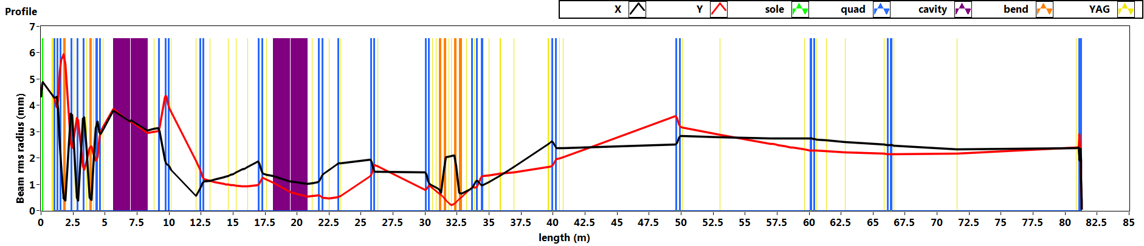
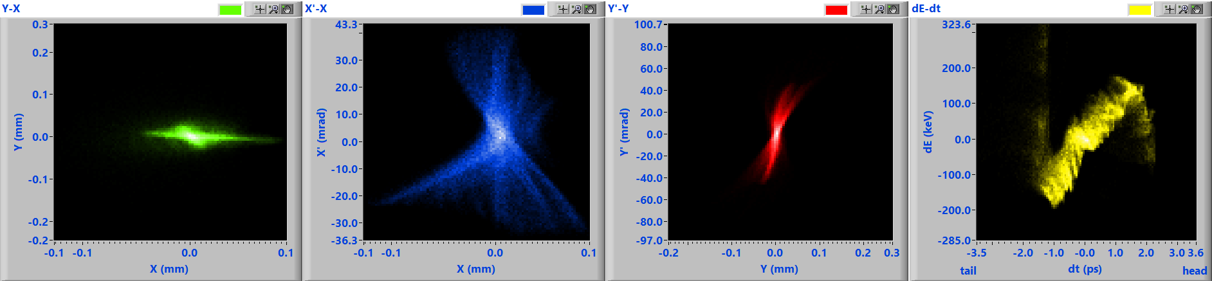
Compress the bunch to 1 pC
Beam parameters at the CBS point.
Energy = 22.523(MeV);
dt = 1.013(ps); dE = 93.29(keV); Ez = 79.106(ps*keV);
X = 0.029(mm); X' = 16.446(mrad); Ex = 20.293(um);
Y = 0.028(mm); Y' = 22.122(mrad); Ey = 15.348(um);
Motiv.
Design
Results
Check
Page 13

Slide 14
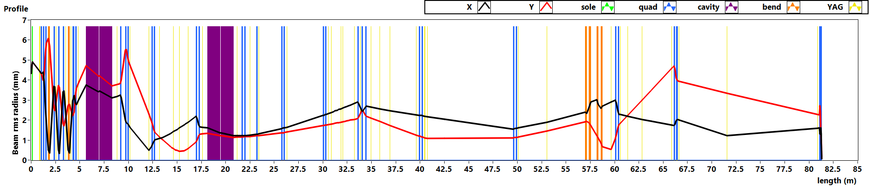
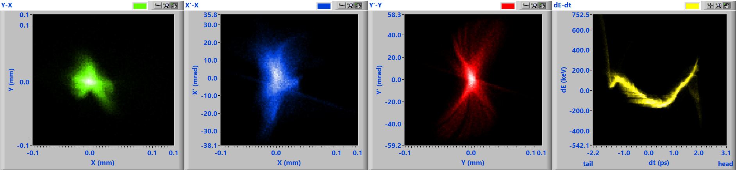
For better longitudinal phase space…
Beam parameters at the CBS point.
Energy = 22.543(MeV);
dt = 1.021(ps); dE = 155.495(keV); Ez = 148.965(ps*keV);
X = 0.019(mm); X' = 11.135(mrad); Ex = 9.232(um);
Y = 0.018(mm); Y' = 21.192(mrad); Ey = 16.193(um);
Motiv.
Design
Results
Check
Page 14

Slide 15
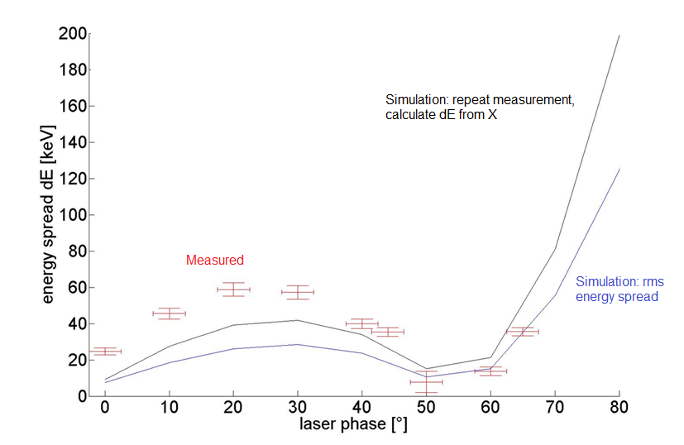
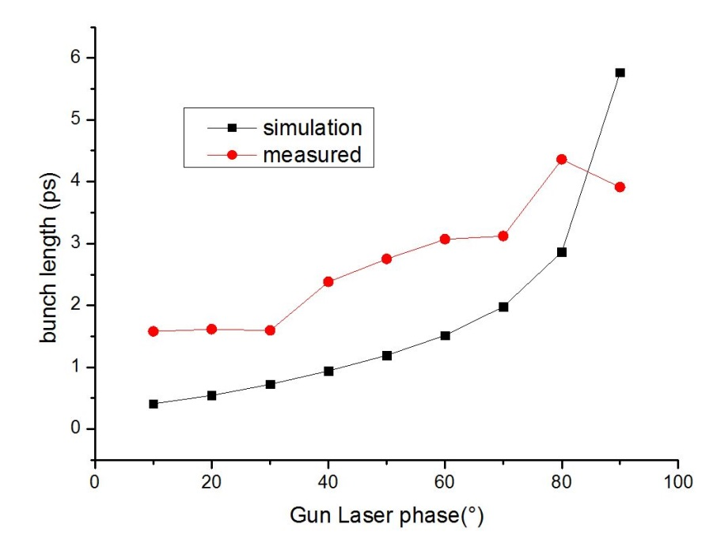
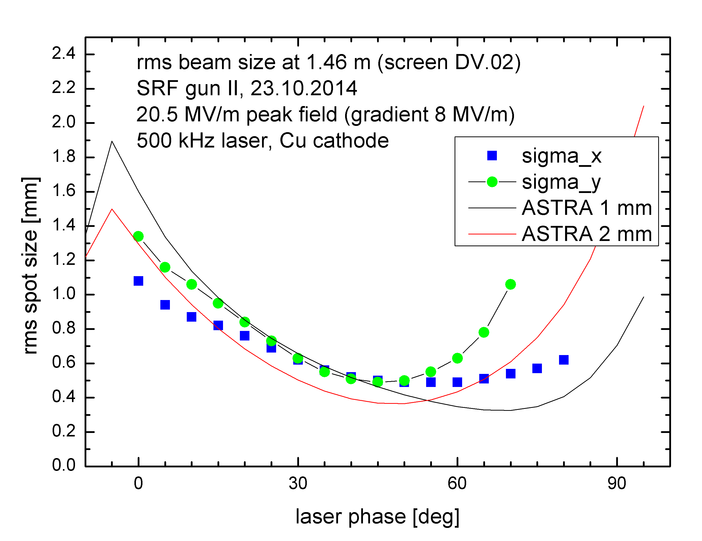
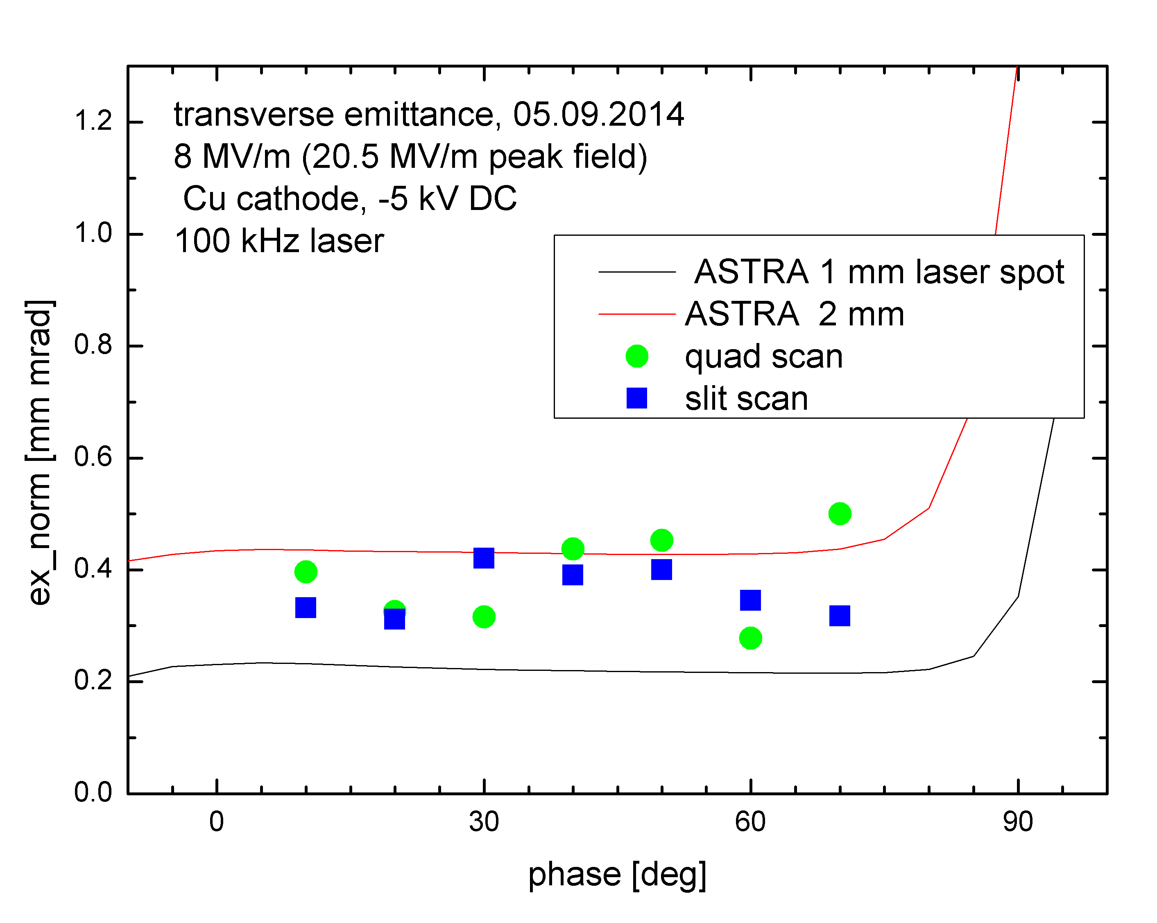
First measurements
Energy
Energy spread
Bunch length
Beam size
emittance
Motiv.
Design
Results
Check

Slide 16
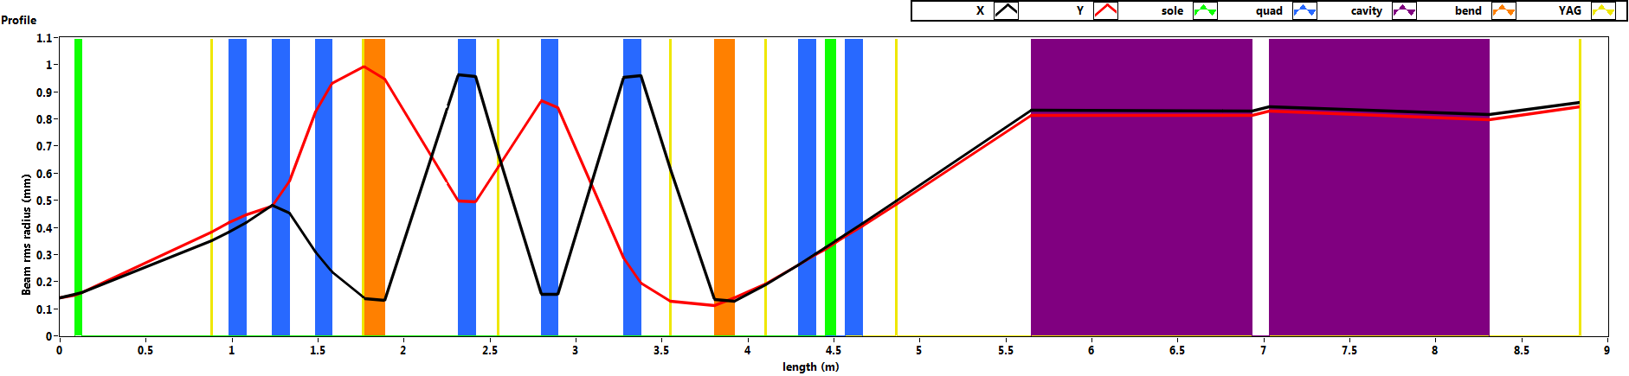
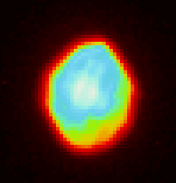
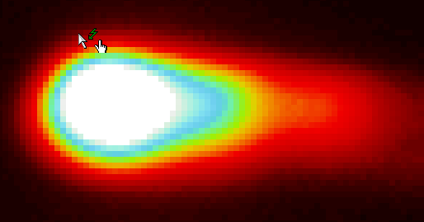
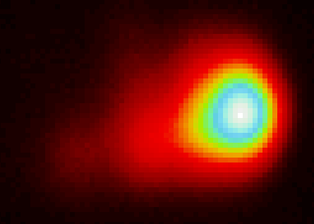
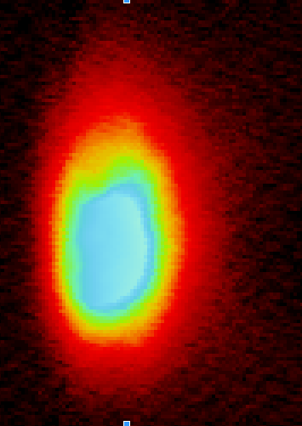
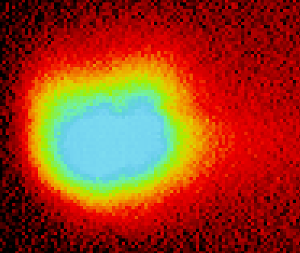
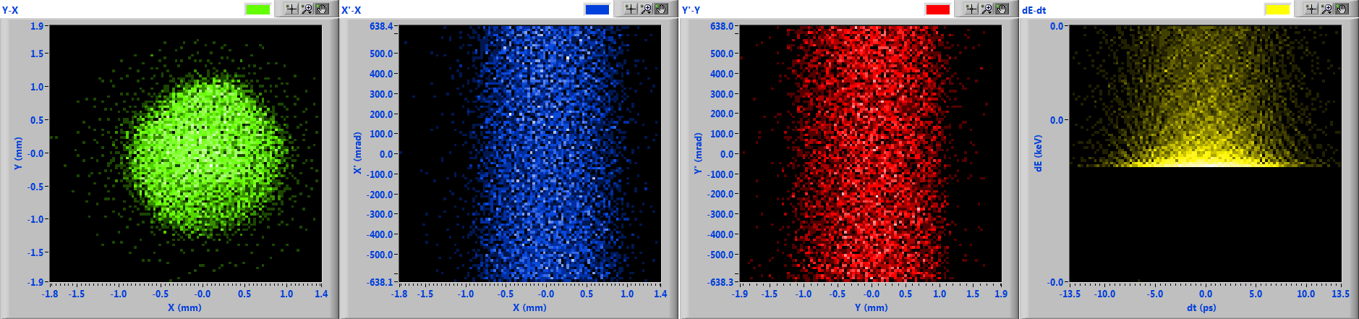
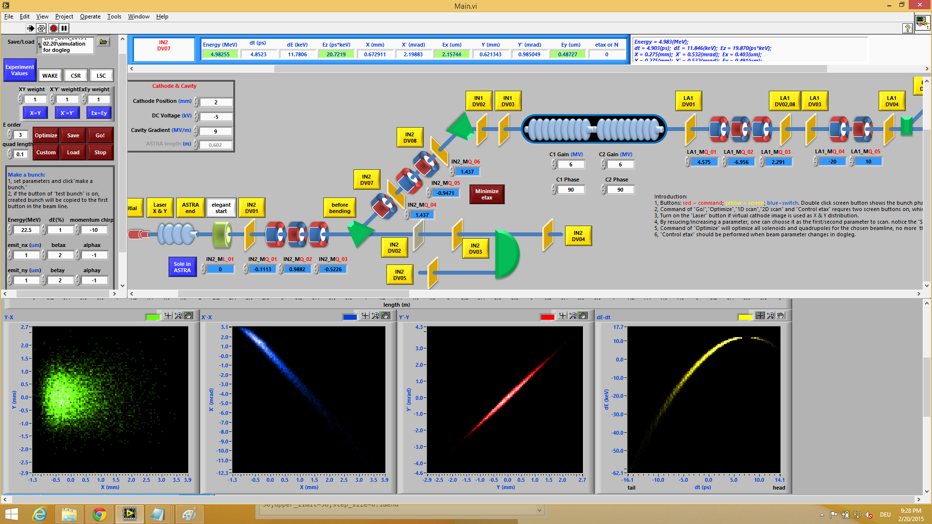
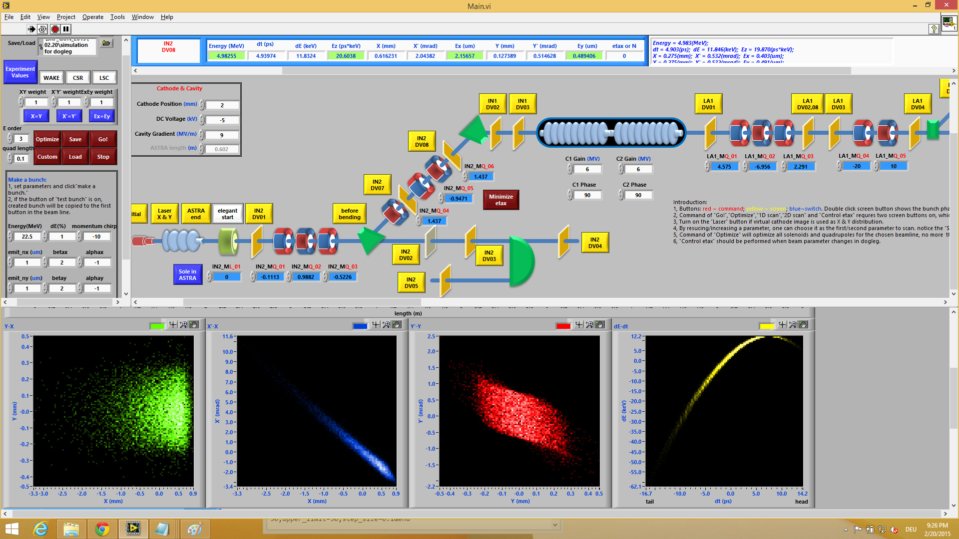
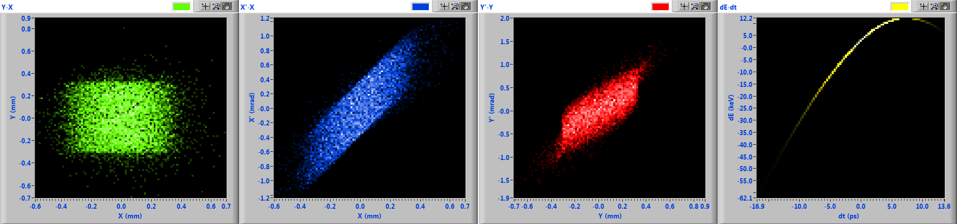
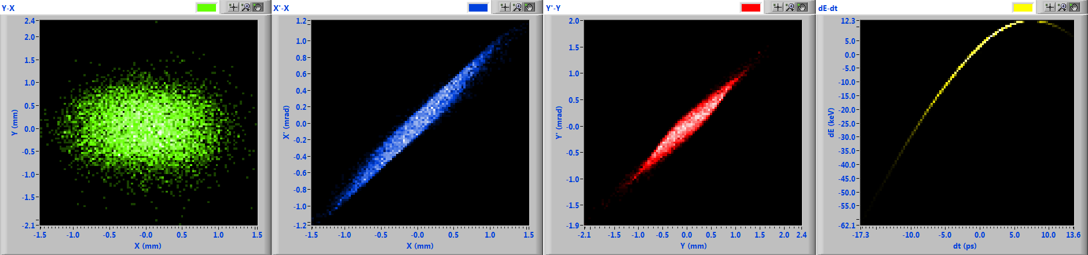
Comparison to experiments
4.5MeV, 1.8 pC, beam transport in dogleg
laser/initial
Motiv.
Design
Results
Check

Slide 17
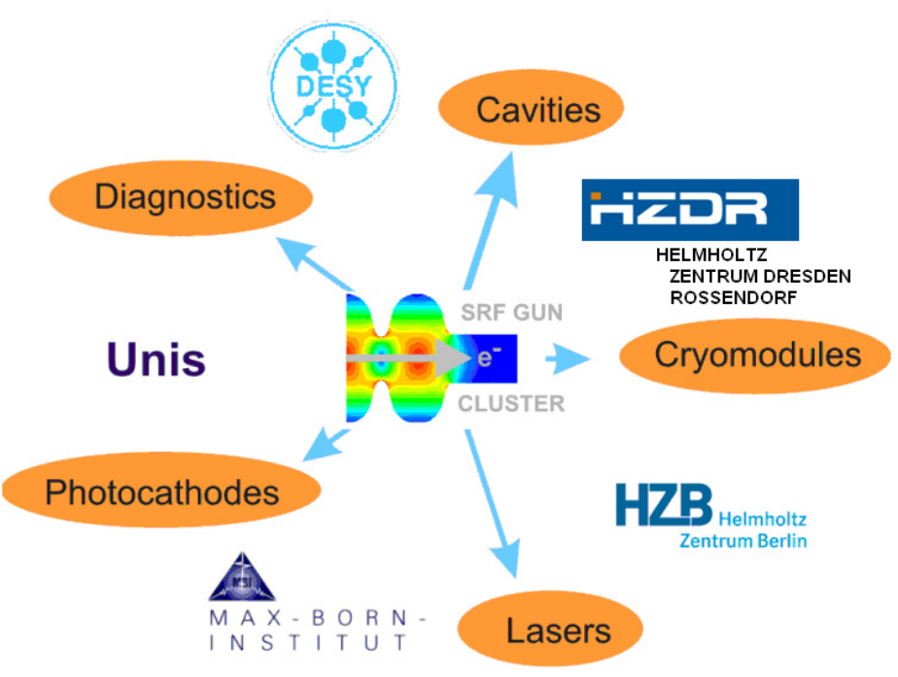
Thank you for your attention!

