Slide 1


Non-Destructive Laser-based
Emittance Measurement at LINAC4
Project Summary
T. Hofmann, E. Bravin, U. Raich, F. Roncarolo, F. Zocca (CERN)
G. Boorman, A. Bosco, S. Gibson, K. Kruchinin (RHUL)
B. Schmauss (FAU)
27.3.2015
Thomas Hofmann
CERN – Beam Instrumentation (BE/BI/PM)
thomas.hofmann@cern.ch

Slide 2
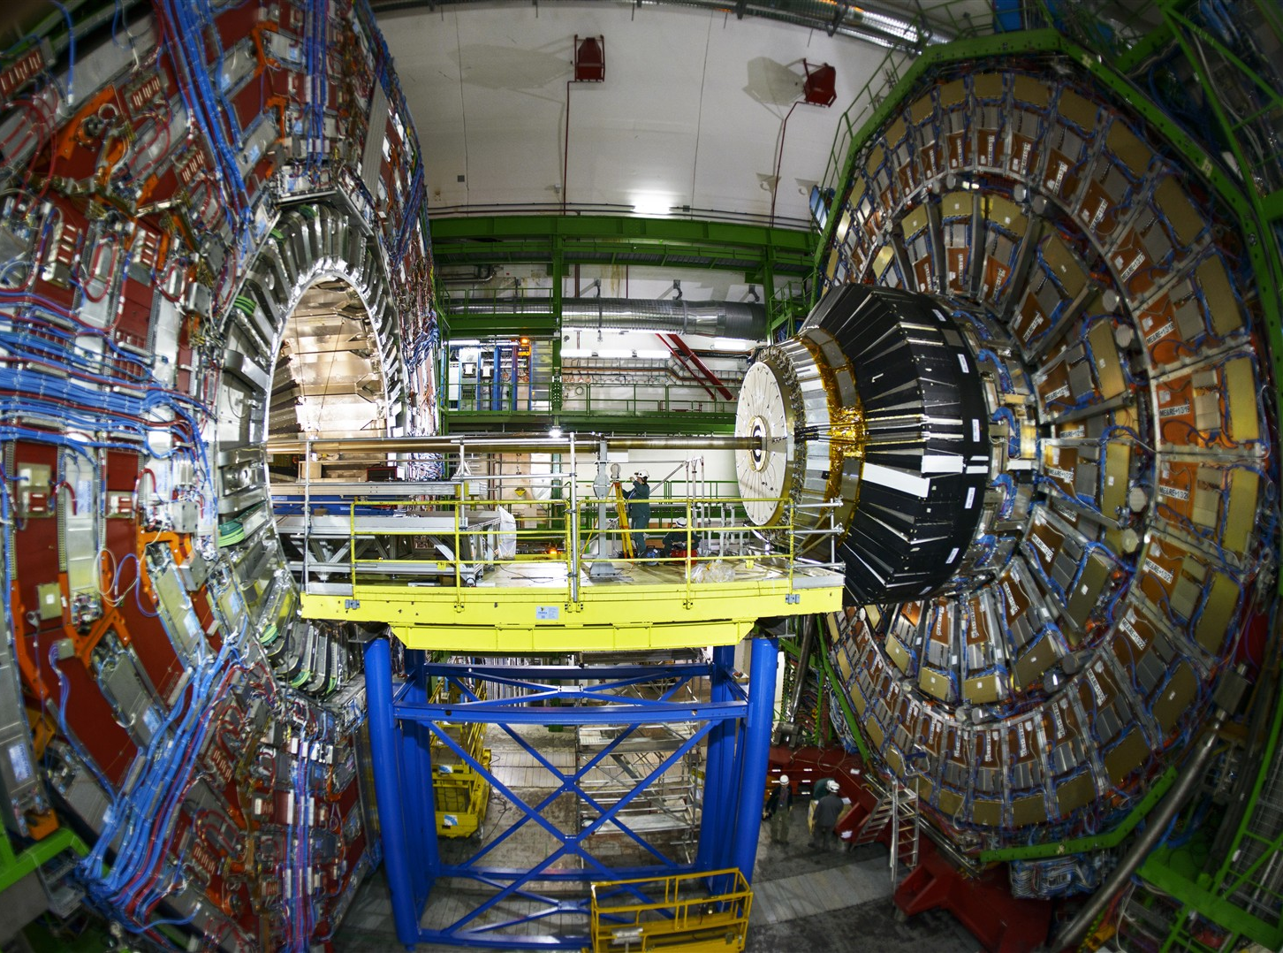
Contents
Motivation
Motivation
Concept
Emittance Measurements at 3 MeV and 12 MeV
Summary

Slide 3
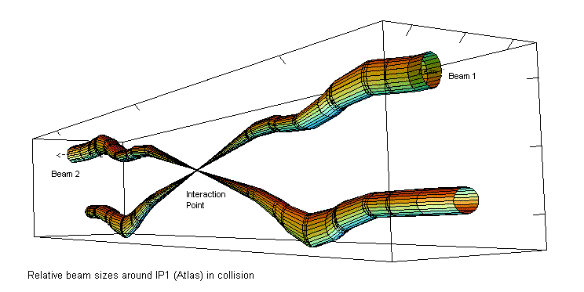
High Luminosity LHC Project
Luminosity: L = N² * f_{b}/(4π σ_{x} σ_{y})
How to maximize the integrated luminosity?
  High brightness beams
  Minimize downtimes ( -> Non-destructive and reliable instruments!)

Slide 4
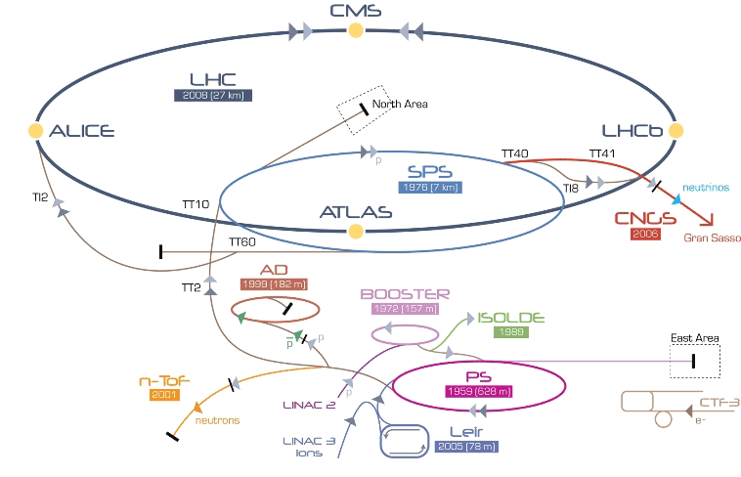
CERN Accelerator overview
LINAC 4

Slide 5
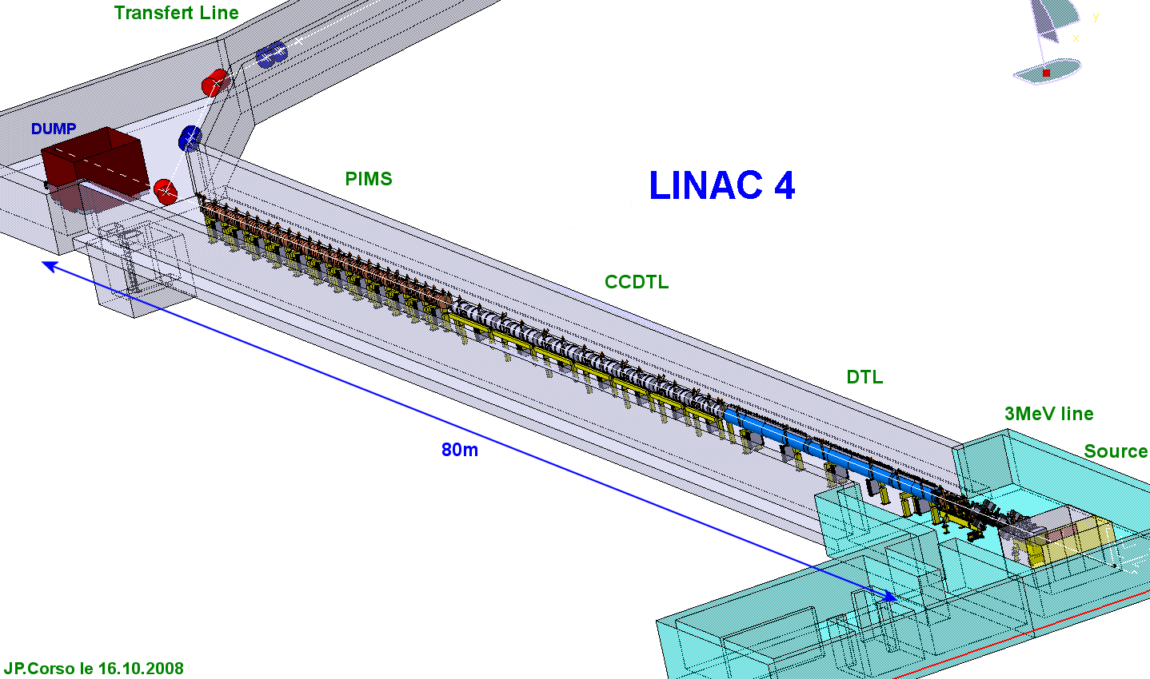
LINAC 4 overview
Particles: H⁻ ions
Top Energy: 160 MeV
Pulsed: 400µs / 40 mA
Length: 80 m
Transfer line to PSB
100 MeV / 50 MeV
160 MeV
100 MeV
Instrument tests at:
12 MeV / 3 MeV
Laser Emittance Meter
50 MeV

Slide 6
Transverse emittance
Transverse Phasespace
  Position (x,y)
  Angle (x‘,y‘)
  ε² = <x_{i}²> * <x_{i}‘²> - <x_{i}x_{i}‘>²
Conventional Techniques
  3 Profile method
  Quadrupol Scan
  Pepperpot
  Slit & Grid
Angle x`
Angle y`
Position x
Position y
Destructive / invasive

Slide 7
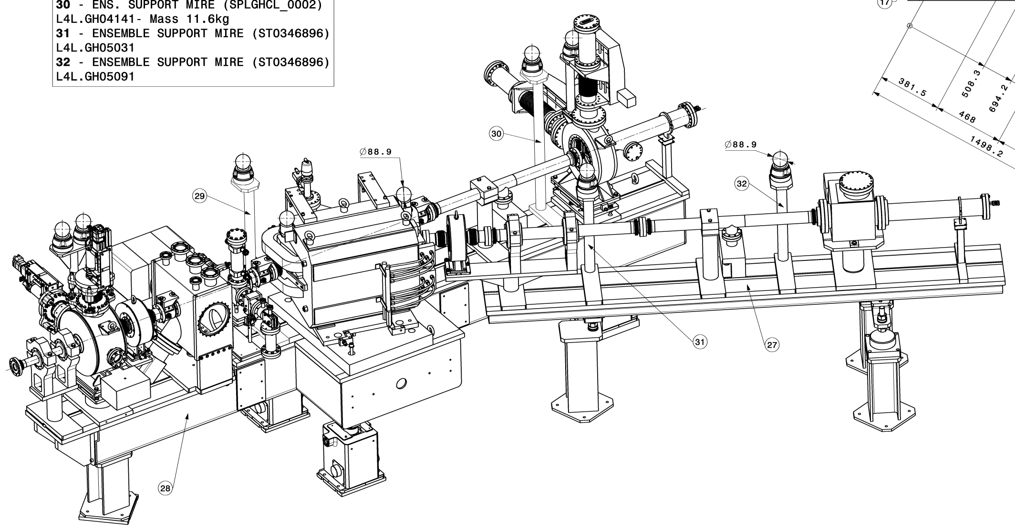
Contents
Concept
LINAC4 Background
Concept of Non-destructive Emittance Meter
Challenges
Emittance Measurements at 3 MeV and 12 MeV
Design for final location at 160 MeV
Summary
Image Concept: Animation shot

Slide 8
Concept of Non-destructive Emittance Meter
Laser
1064 nm
H⁻
Bending Magnet
H⁻ beam
Notes:
ICT: new LHC transformer to replace the FBCT in order to solve the beam position dependency issue

Slide 9
Concept of Non-destructive Emittance Meter
Laser
1064 nm
H⁻
Bending Magnet
H⁻ beam
Principle:
H⁻ + γ
H⁰ + e⁻
H⁻ beam
H⁰ beamlet
< 1 ppm
Notes:
ICT: new LHC transformer to replace the FBCT in order to solve the beam position dependency issue

Slide 10
Concept of Non-destructive Emittance Meter
H⁰ Detector
Laser
1064 nm
H⁰
H⁻
Bending Magnet
H⁻ beam
Principle:
H⁻ + γ
H⁰ + e⁻
H⁻ beam
H⁰ beamlet
< 1 ppm
beamlet
after drift
Notes:
ICT: new LHC transformer to replace the FBCT in order to solve the beam position dependency issue

Slide 11
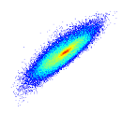
Concept of Non-destructive Emittance Meter
H⁰ Detector
Laser
1064 nm
H⁰
x-scan
H⁻
Bending Magnet
H⁻ beam
Principle:
H⁻ + γ
H⁰ + e⁻
x’
H⁻ beam
H⁰ beamlet
< 1 ppm
beamlet
after drift
x
Scan result:
Phasespace
Notes:
ICT: new LHC transformer to replace the FBCT in order to solve the beam position dependency issue

Slide 12
Concept of Non-destructive Emittance Meter
H⁰ Detector
Laser
1064 nm
H⁰
x-scan
H⁻
Bending Magnet
y’
y-scan
H⁻ beam
y
Principle:
H⁻ + γ
H⁰ + e⁻
x’
H⁻ beam
H⁰ beamlet
< 1 ppm
beamlet
after drift
x
Scan result:
Phasespace
Notes:
ICT: new LHC transformer to replace the FBCT in order to solve the beam position dependency issue

Slide 13

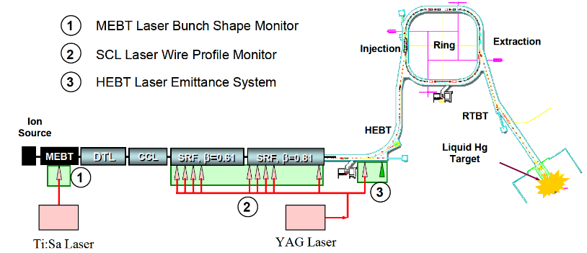
State of the Art
SNS: Operational Multi-Station Profile Measurement
Y. Liu et al., Proc. PAC 2011
  Challenge: Laser-Delivery!
  250 m complex free space delivery line due to radiation environment!

Slide 14
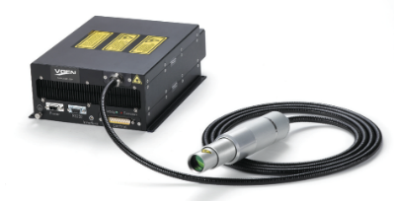
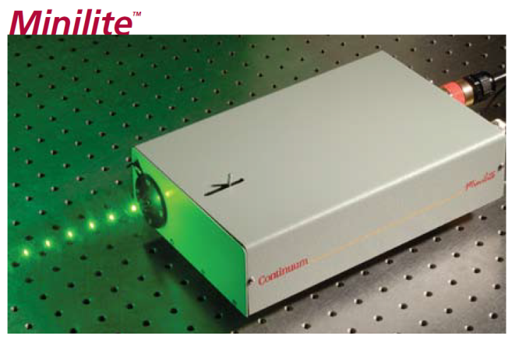
Challenge: Laser-Delivery
Comparison of Laser Systems
Laser | MOPA Fiberlaser (used at LINAC4) | Nd-YAG (used at SNS)
Energy per pulse | 0.1 mJ | 50 mJ
Diameter | ~ 150 µm | ~ 200 µm
P_{strip} @ 160 MeV for H⁻ crossing laser | 0.1 % | > 99 %
t_{pulse} | 3…300 ns | 5…10 ns
Repetition rate | 10...500 kHz | < 20 Hz
Beam transport | Fiber | Free Space

Slide 15
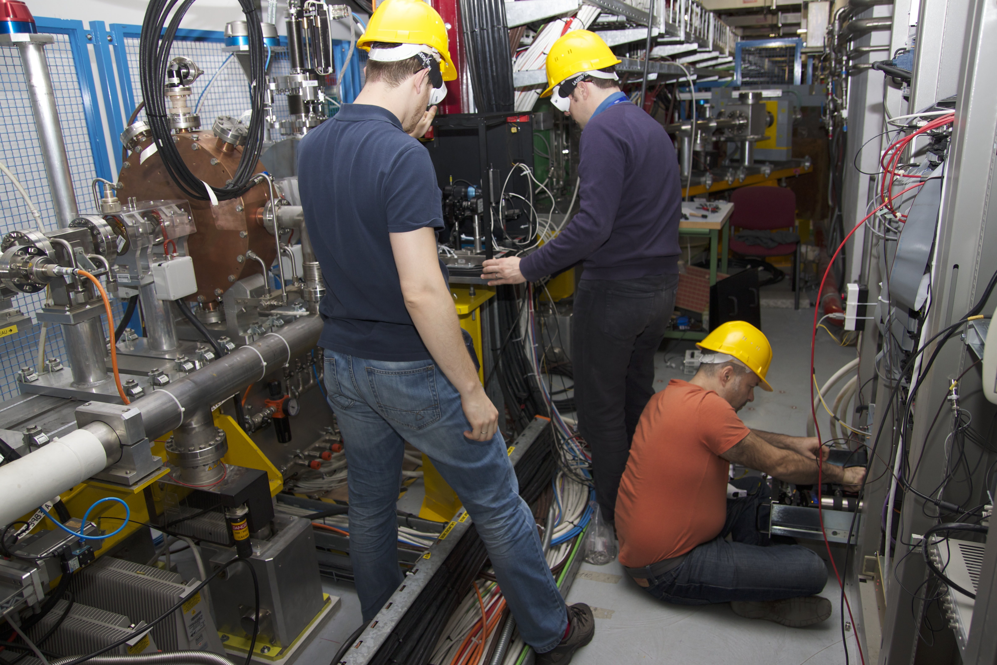
Prototype Design & Tests
Full screen: Measurements:
Me? measuring something

Slide 16
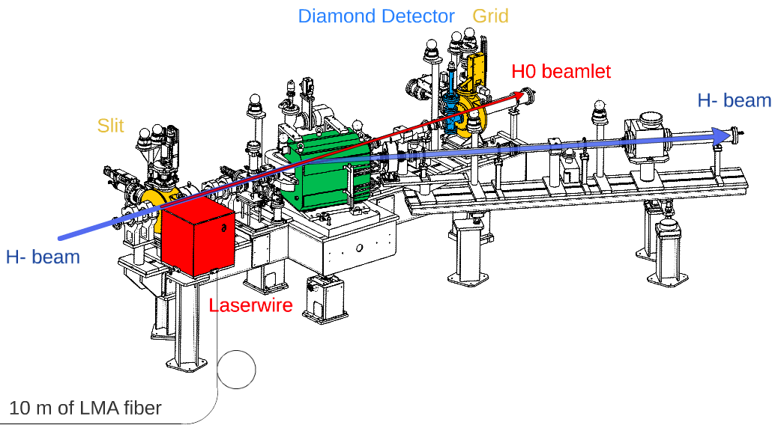
3 / 12 MeV Prototype Test Setup
T. Hofmann et al., Proc IBIC 2014

Slide 17
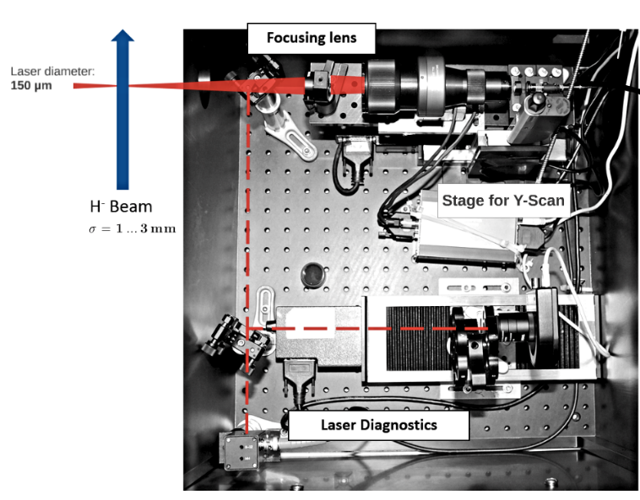
Laser Focus / Scan / Diagnostics - Setup
10m LMA fiber

Slide 18
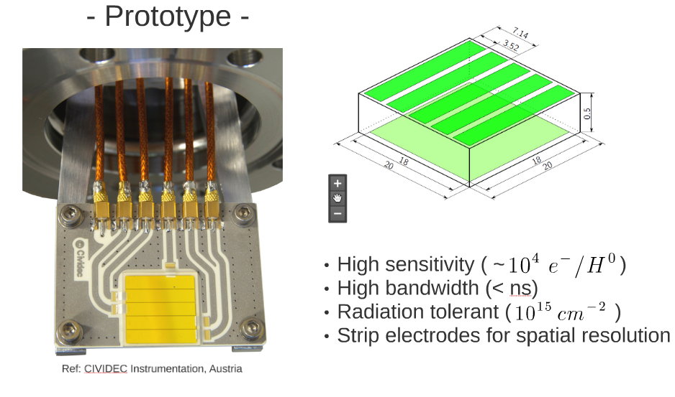
Diamond Strip Detector

Slide 19
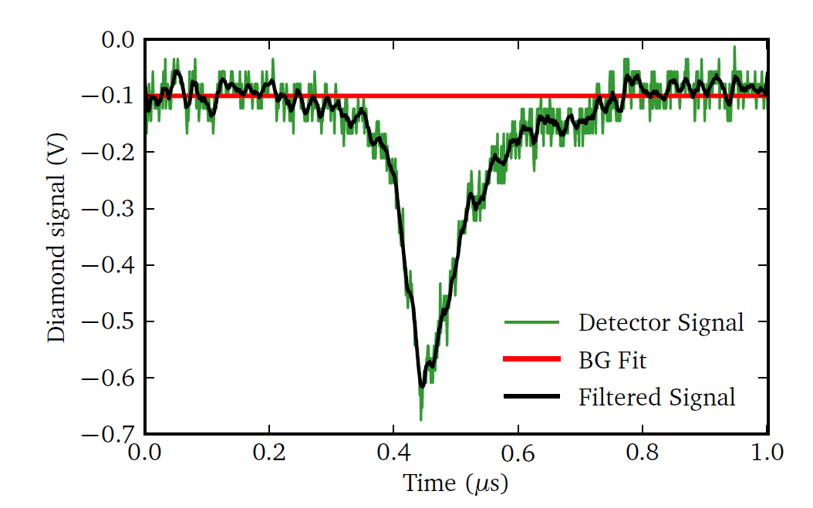
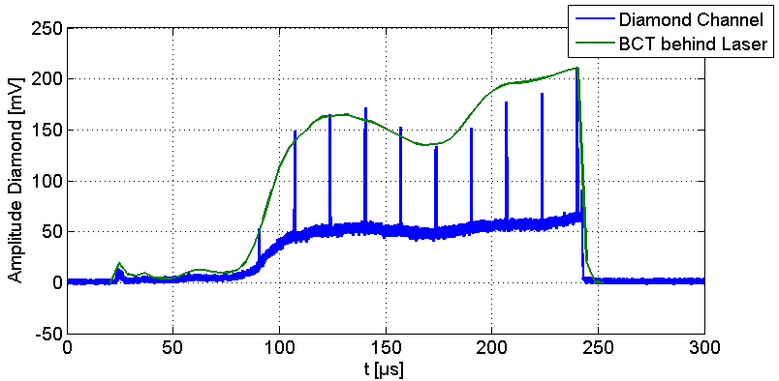
Diamond Raw Signal & Signal Analysis
LINAC4 H⁻ current
H⁰ particles originating from laserpulses
Background from H⁰, produced by residual gas collisions
-> Diamond capable to detect H⁰ beamlets with high linearity and sensitivity

Slide 20
3 / 12 MeV Prototype Test Setup
T. Hofmann et al., Proc IBIC 2014

Slide 21
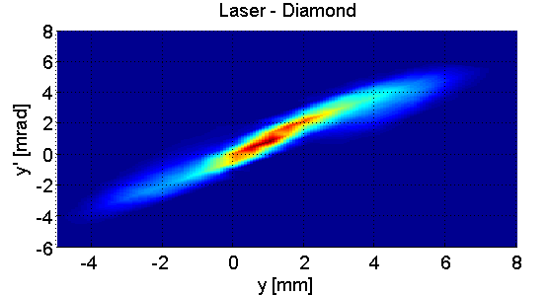
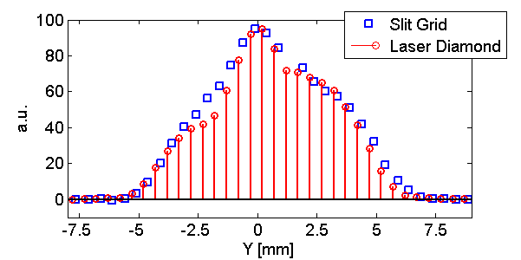
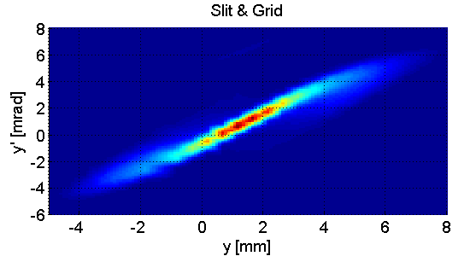
Results – Beam Profile and Phasespace
Comparison with Slit & Grid
  Beam Profile
  Phasespace

Slide 22
Summary – Non-destructive emittance meter
What did we achieve?
Prototype design
  Simple fiber-based laser delivery
  H⁰ Detection based on a diamond detector
Prototype test at 3 and 12 MeV H⁻ beam
  Comparison with Slit&Grid as reference shows excellent agreement
Proof of Principle for Non-Destructive Emittance Meter!
  CERN approved installation for operational use at LINAC4
What is to be done?
Design for final location at 160 MeV
  Longer Fiber delivery -> Non-linear effects?
  High resolution diamond detector -> Readout scheme!
Test of Non-destructive Profile Meter at 50 & 100 MeV beam

Slide 23
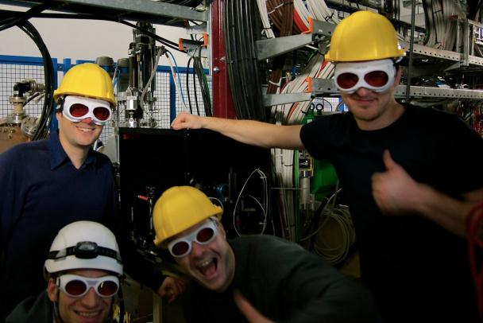


Thanks for your attention!
This project has received funding from the European Union’s Seventh Framework Programme for research, technological development and demonstration under grant agreement no 289191.

Slide 24
Spare Slides

Slide 25
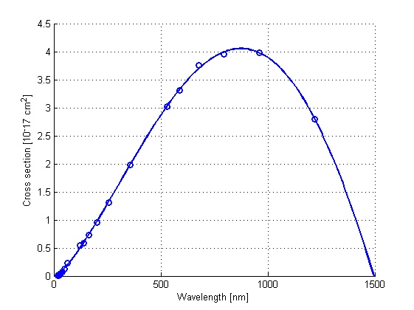

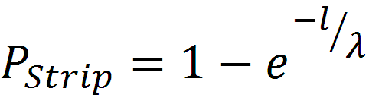
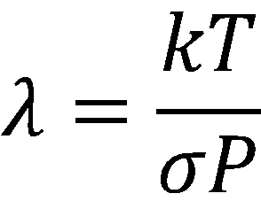
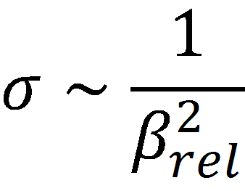
Photo Neutralisation
Binding Energy: 0.75 eV
Laser Stripping
Requirements for Laser:
  M² < 2 for diameter < 200 µm
  P_{Peak} > 1 kW
Residual Gas Stripping Background
  Stripping probability rises with gas pressure
  Stripping probability decreases with particle energy
Ref: J.T. Broad and W.P. Reinhardt, Phys. Rev. A14 (6) (1976) 2159
Beam pipe
    l = length;
;
H⁰
H⁻
H₂
e⁻

Slide 26
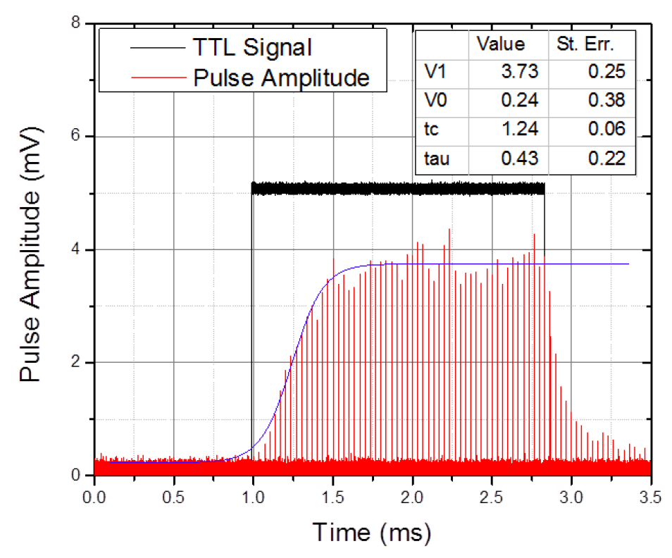
LINAC4 & Laser Timing
LINAC4
  1.2 s Period length
  400 µs Marcropulse
  352 MHz RF-System
MOPA Fiberlaser
  60 kHz Master Oszillator
  110 ns Pulsewidth
  Modulation via Power Amplifier
1.2 s
400 µs - Macropulse
110 ns
17 µs
Laser on
2.84 ns
24 Laserpulses per 400 µs Macropulse

Slide 27
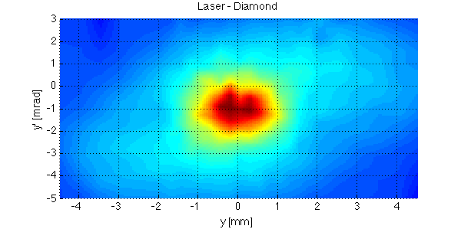
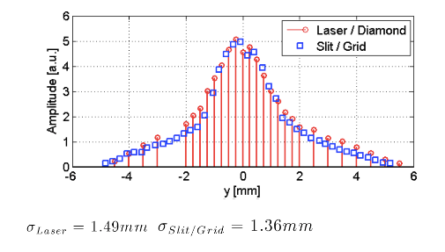
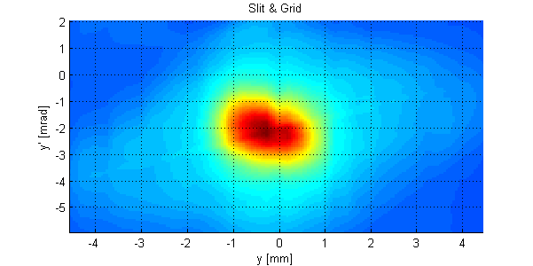
3 MeV Results - Comparison with Slit & Grid
Beam Profile
Phasespace
Ref: F. Roncarolo et al., Transverse profile and emittance measurements with a laser stripping system during the CERN LINAC4 commissioning at 3 and 12 MeV, Proc. LINAC14, Geneva, Switzerland

Slide 28
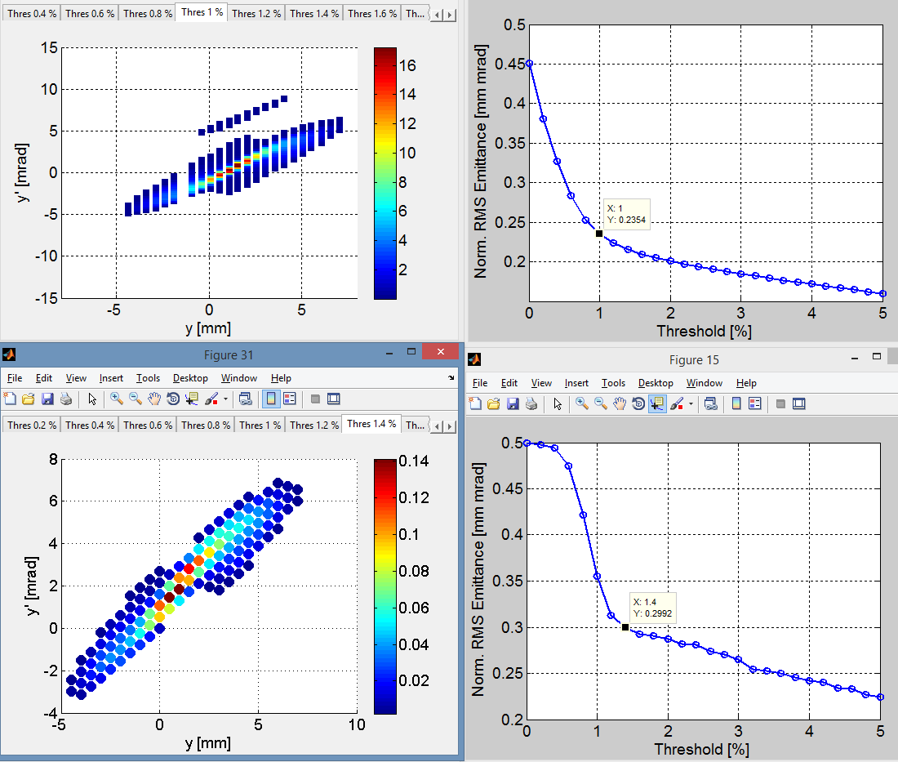
Emittance Value at 12 MeV
Slit & Grid
Emittance:
0.235 mm mrad
Laser Diamond
Emittance:
0.299 mm mrad

Slide 29
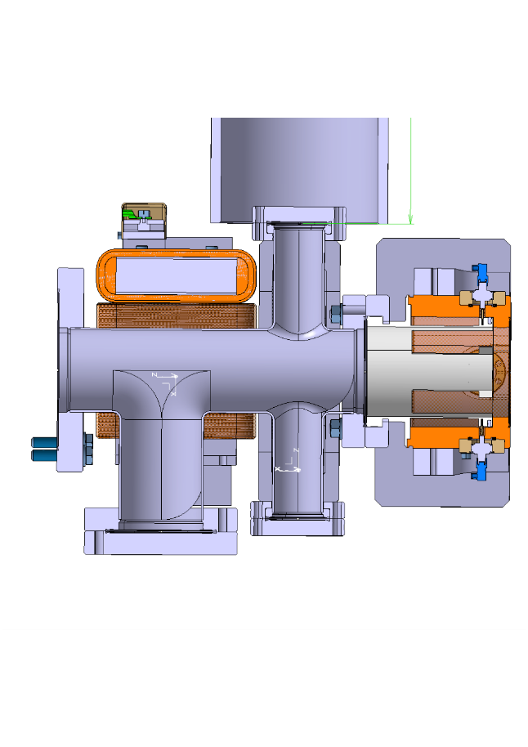
Concept Profile Meter
Laser
H⁻ beam
Electrons

Slide 30
Detector Possibilities for Electron Collector
Type | Faraday cup | Diamond detector | Silicon PIN Diode | Electron Multiplier
Sensitivity | 1 | 10^4 | 10^5 | >10^6
Rad. Hardness | +++ | ++ | + | +++
Time constant | High! | ps | 16ns | 2ns
Homogeneity | +++ | - | +++ | +++
Saturation | No limit | No limit | 2…3mA | 10mA
Vacuum | good | good | diffcult | good

Slide 31
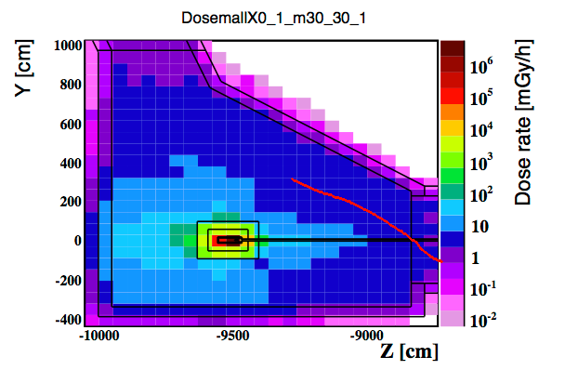
Radiation environment at LINAC4 160 MeV area
Dose over lifetime of LINAC4 (red: path of fiber)
-> ca. 50Gy will be radiation load of fiber over whole lifetime

Slide 32
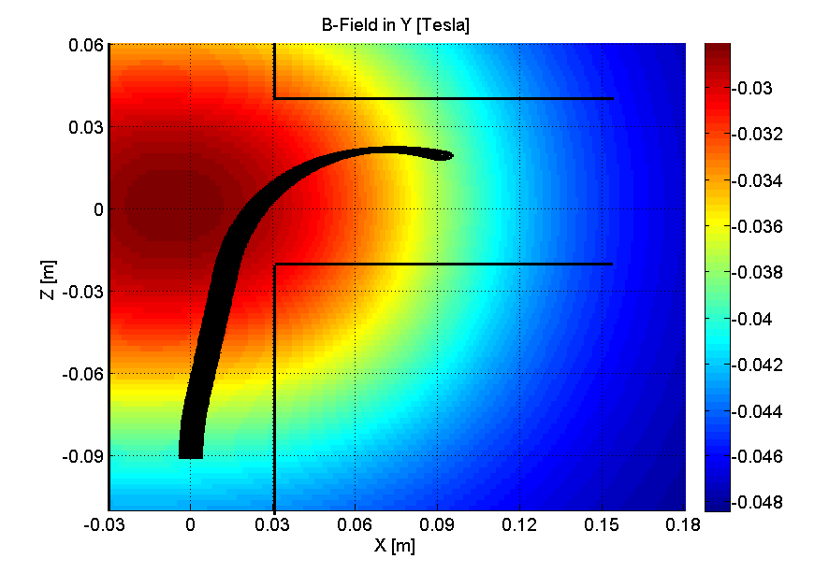
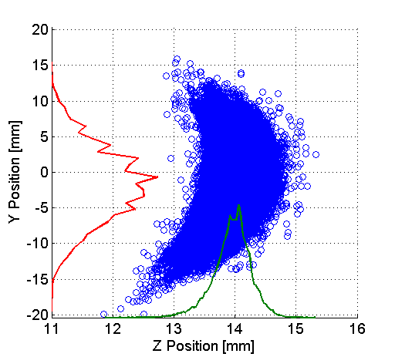
Simulation – Electron Collection

Slide 33
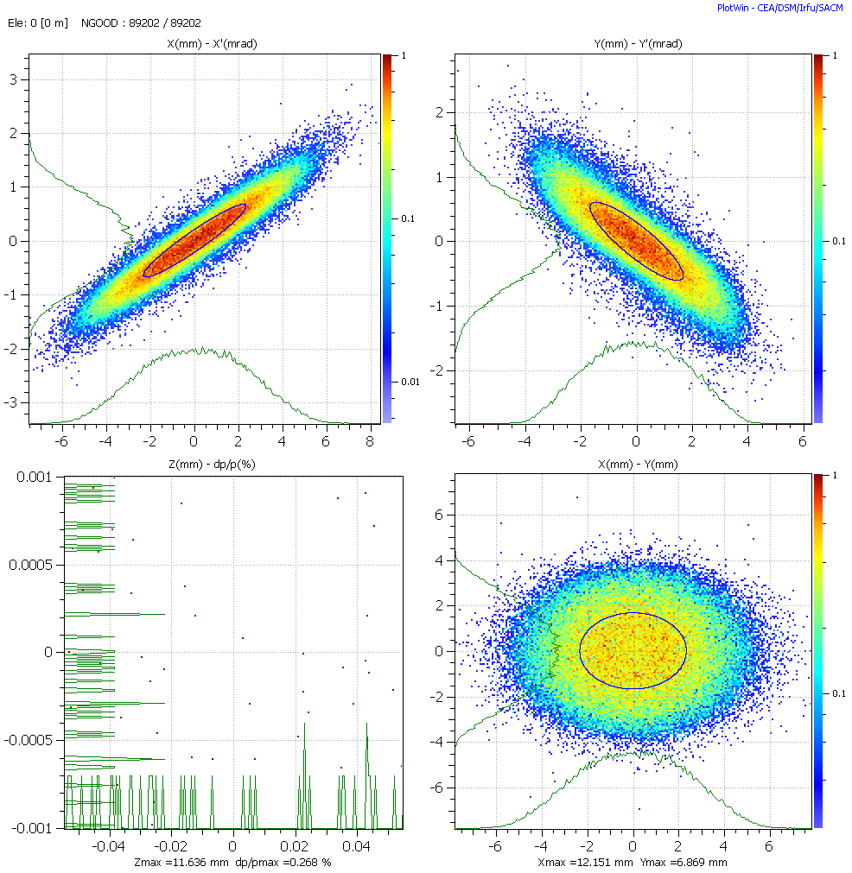
Beam at 160 MeV

