Slide 1



Beam Diagnostics at Free Electron Lasers
Laser Applications at Accelerators Conference 2015
25-27 March 2015
Son Caliu Hotel
Gero Kube
DESY / MDI
gero.kube@desy.de
Introduction
Beam Position (Intensity)
Transverse Profile Diagnostics
Longitudinal Profile Diagnostics
Timing and Synchronization

Slide 2


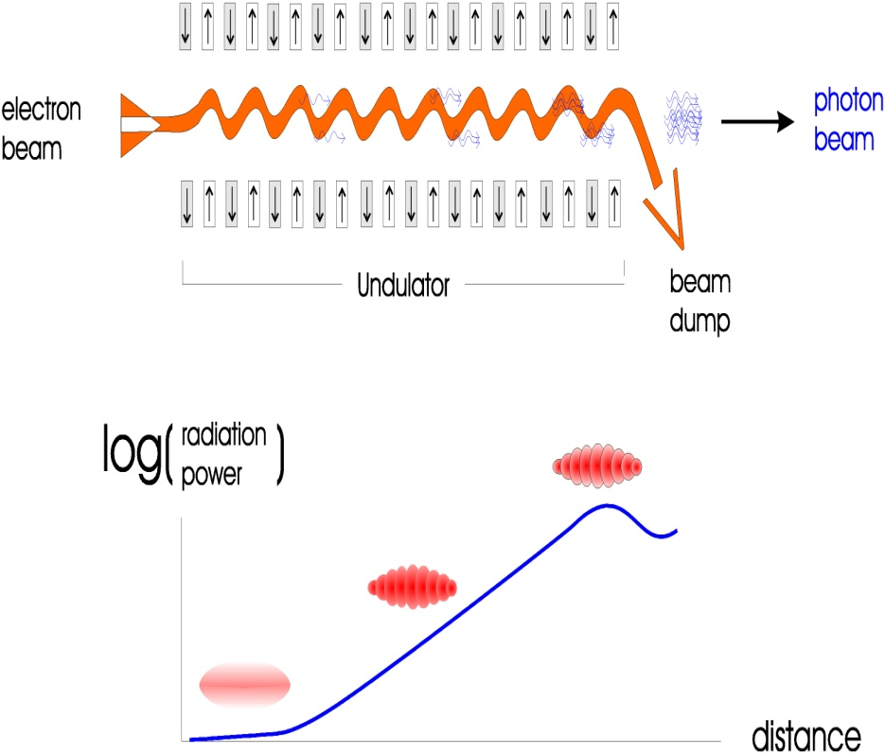
Free Electron Lasers (FELs)
linac (single pass) based 4th generation light sources
Linac based Self Amplification of Spontaneous Emission (SASE) FELs
(→ no matter for diagnostics which FEL type)
electron bunch modulated with
its own synchrotron radiation field
micro-bunching
more and more electrons radiate in
phase until saturation is reached
SASE FEL projects
European X-FEL @ DESY
LCLS @ SLAC
SACLA @ SPring8
Swiss FEL @ PSI
FLASH @ DESY
SPARC @ INFN-Frascati
…
Gero Kube, DESY / MDI
LA³NET Conference, Son Caliu Hotel (Spain), 27. March 2015

Slide 3
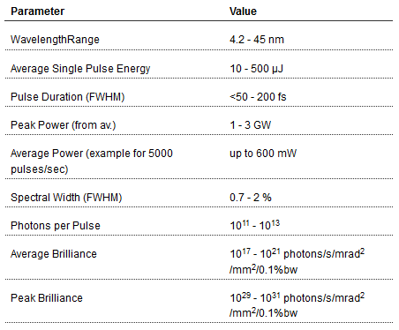
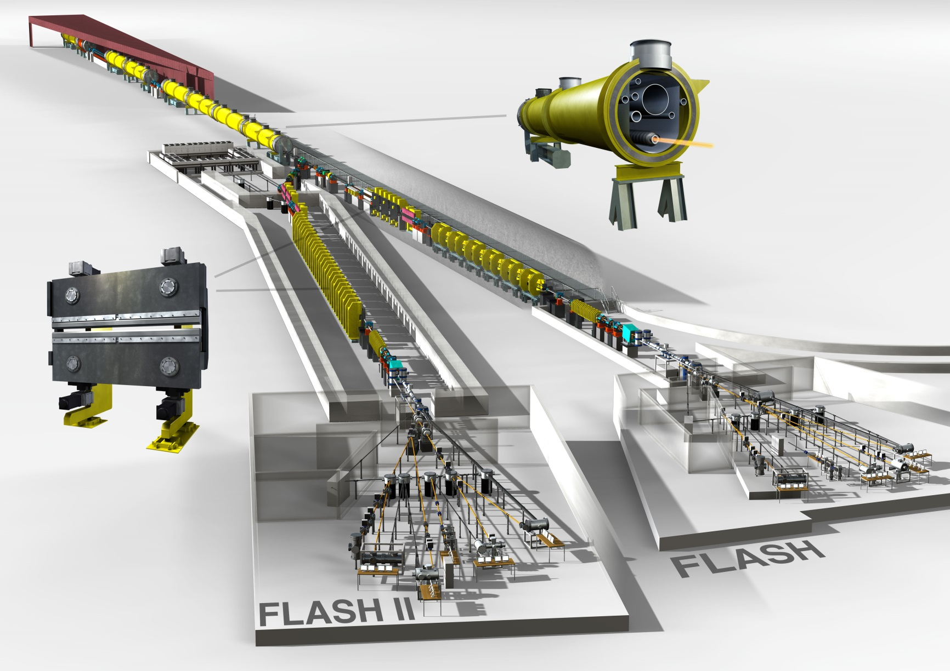
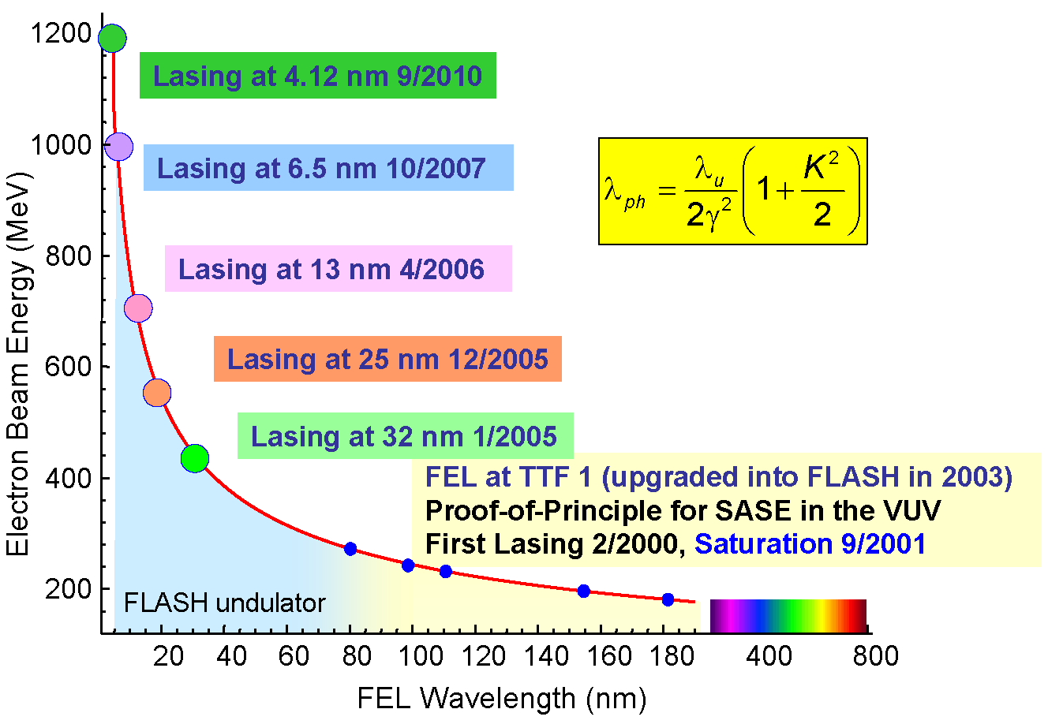
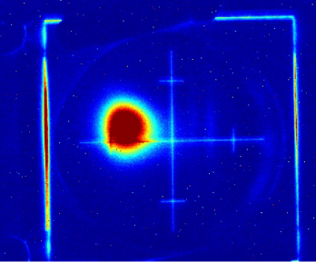
FLASH @ DESY
FLASH accelerator, FLASH I/II SASE FELs
FEL radiation parameters 2012
lasing @ FLASH:
first lasing FLASH II:
→ August 20, 2014
Gero Kube, DESY / MDI
LA³NET Conference, Son Caliu Hotel (Spain), 27. March 2015

Slide 4
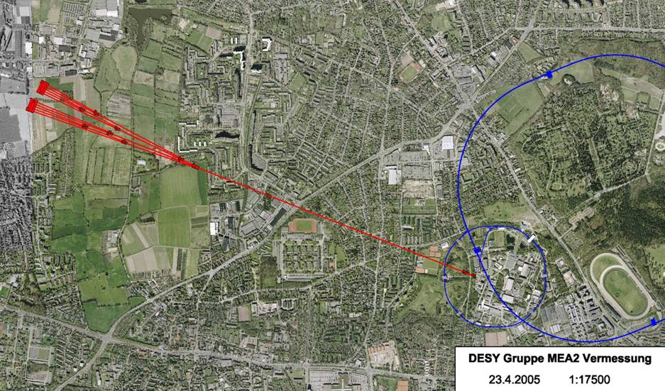
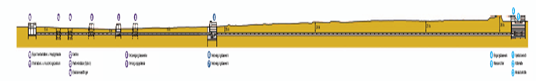
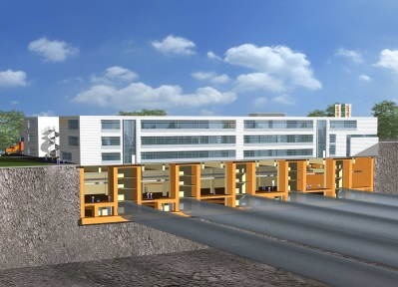
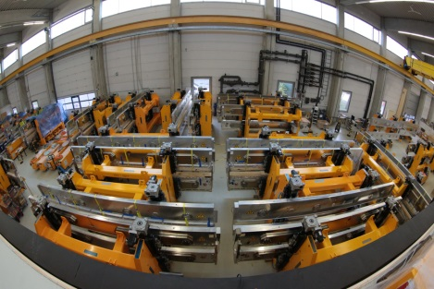
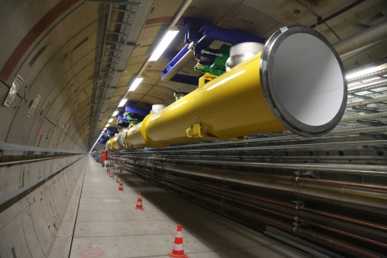
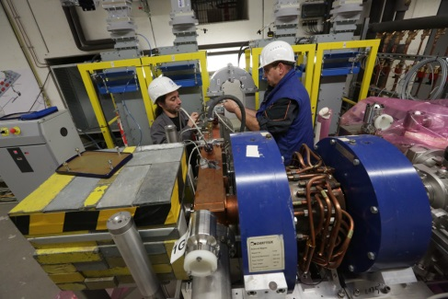
The European XFEL @ DESY
HERA
3.3 km
FLASH
PETRA III
DESY
Hamburg
City Centre (7 km)
Gero Kube, DESY / MDI
LA³NET Conference, Son Caliu Hotel (Spain), 27. March 2015

Slide 5
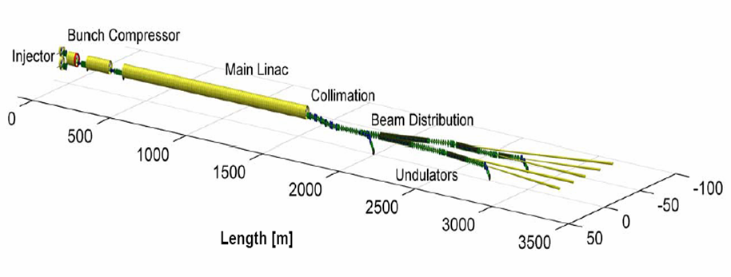

E-XFEL @ DESY
injector commissioning: mid 2015
linac commissioning: 2016
user operation: 2017
photo-injector RF electron gun
injector linac
two-stage bunch compression
collimation and beam distribution
undulator sections
photon beamlines
maximun energy: 17.5 GeV
normalized emittance: 1-2 mm mrad
typical rms beam sizes: 20-200 μm
bunch charge : 0.1-1 nCb
min. bunch spacing: 222 nsec
max. macro pulse length: 600 μsec
bunches within macro pulse: 1-2700
bunch pattern: arbitrary
RF repetition rate: < 30 Hz
λ_{min} 0.1 nm (12.4 keV)
Gero Kube, DESY / MDI
LA³NET Conference, Son Caliu Hotel (Spain), 27. March 2015

Slide 6
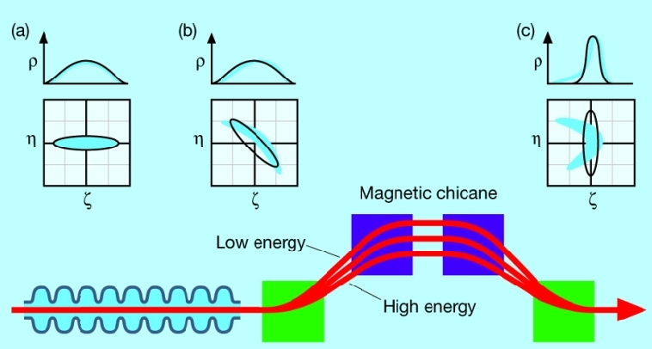
Beam Properties (1)
single or few bunches, typically with large separation
requires single bunch measurements
Ü
high current density
sufficient energy transfer from electron beam to radiation field
natural scale: number of electrons per wavelength
requires additional bunch compression in order to increase current density
Ü
extremely short bunch lengths O(10-100 fsec)
Ü
charge per bunch: pCb up to about nCb
new trend: short pulse operation, requires lower and lower charges…
signal to noise problems at low charge, even for kA peak currents
Gero Kube, DESY / MDI
LA³NET Conference, Son Caliu Hotel (Spain), 27. March 2015

Slide 7
Beam Properties (2)
high electron beam quality
energy spread
transverse emittance
(→ high energy helps)
for resonant energy exchange and good overlap with radiation field
high demands on 6-dimensional phase space
Ü
longitudinal phase space
short bunches require complicate longitudinal diagnostics
new methods required to verify pulse lengths of electron and laser bunch
transverse phase space
beam gets extremely small, often weird shape
emittance is no equilibrium property, many effects can spoil it
optics errors propagate through entire machine (linac is open loop system)
coherent effects due to short pulses and instabilities
Gero Kube, DESY / MDI
LA³NET Conference, Son Caliu Hotel (Spain), 27. March 2015

Slide 8
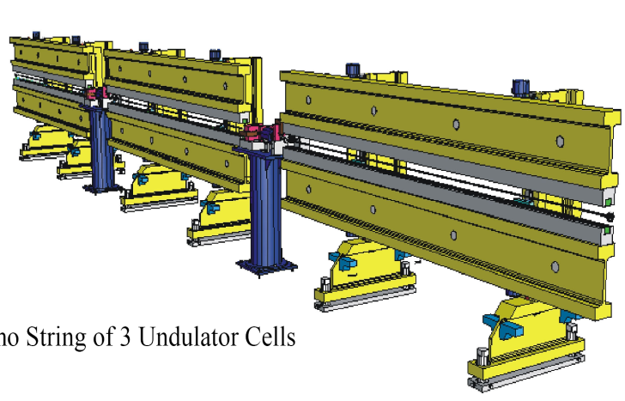
Beam Properties (3)
comment: transverse emittance
electrons slip back in phase with respect to photons by l_{r} each undulator period
FEL integrates over slippage length → slice emittance of importance
projected emittance
x´
x´
slice emittance
x
x
l_{r}
stability
energy stability → wavelength stability
arrival time stability → pump probe experiments
LLRF feedback
high level synchronisation
high resolution BPMs, orbit feedback
position stability
→ overlap between beam and radiation in undulators
example: XFEL @ DESY
length of undulator section: 100-150 m
BPM position resolution:
1 μm (single bunch), 100 nm (average over bunch train)
Gero Kube, DESY / MDI
LA³NET Conference, Son Caliu Hotel (Spain), 27. March 2015

Slide 9
Standard FEL Diagnostics @ FLASH
 |  | FLASH1 | FLASH2
Charge | Toroids | 12 | 5
 | Dark Current Monitor | 1
 | Faraday Cups | 3
 | BPMs | 6 | 33
Transverse Size | OTR-Screens | ~30
 | Scintillating-Screens | 1 | 7
 | Wire scanners (MDI) | 10
 | Wire scanners (Zeuthen) | 9
Transverse Position | Button-BPMs | 26 | 12
 | Stripline-BPMs | 33 | 4
 | Cold Cavity BPMs | 6
 | Cavity BPMs |  | 17
 | HOM-based monitors | 39
Beam Loss | BLMs | >70 | ~55
 | Cherenkov Fibers | 2 | 1
 | Beam Halo Monitors | 1x4 | 1x4
 | Ionization Chambers | 4 | 4
about ~ 400 monitors
and a lot of additional special diagnostics…
Gero Kube, DESY / MDI
LA³NET Conference, Son Caliu Hotel (Spain), 27. March 2015

Slide 10
Standard FEL Diagnostics @ E-XFEL
Monitor (Standard Diagnostics Only) | Number
BPMs (cold) | 120
BPMs (Striplines, Pickups) | 250
Undulator BPMs (Cavity, 1µm Resolution) | 140
Charge Monitors (Toroids, Faraday Cups) | 40
Beam Size: OTR, Wirescanners | 77
Dark Current | 10
Loss Monitors (PM Systems, Fibers) | 320
Phase | 15
Other | about 50
Total | about 1000
and a lot of additional special diagnostics…
Gero Kube, DESY / MDI
LA³NET Conference, Son Caliu Hotel (Spain), 27. March 2015

Slide 11
Beam Position Monitors
short version of E-XFEL BPM specification
 | Number | Beam Pipe | Length | Type | Single Bunch Resolution (RMS) | Train Averaged Resolution (RMS) | Optimum Resolution Range | Relaxed Resolution Range | x/y Crosstalk | Bunch to Bunch Crosstalk | Trans. Alignment Tolerance (RMS)
 |  | mm | mm |  | μm | µm | mm | mm | % | μm | μm
Standard BPM | 219 | 40.5 | 200/ 100 | Button | 50 | 10 | ± 3.0 | ± 10 | 1 | 10 | 200
Cold BPM | 102 | 78 | 170 | Button/ Re- entrant | 50 | 10 | ± 3.0 | ± 10 | 1 | 10 | 300
Cavity BPM Beam Transfer Line | 12 | 40.5 | 255 | Cavity | 10 | 1 | ± 1.0 | ± 2 | 1 | 1 | 200
Cavity BPM Undulator | 117 | 10 | 100 | Cavity | 1 | 0.1 | ± 0.5 | ± 2 | 1 | 0.1 | 50
IBFB | 4 | 40.5 | 255 | Cavity | 1 | 0.1 | ± 1.0 | ± 2 | 1 | 0.1 | 200
specified charge range: 0.1 – 1nC
different BPM types to meet different requirements
courtesy: D.Nölle (DESY)
Gero Kube, DESY / MDI
LA³NET Conference, Son Caliu Hotel (Spain), 27. March 2015

Slide 12
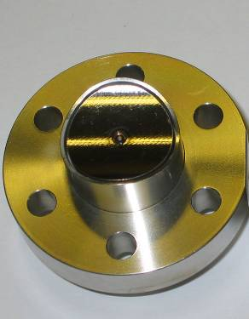
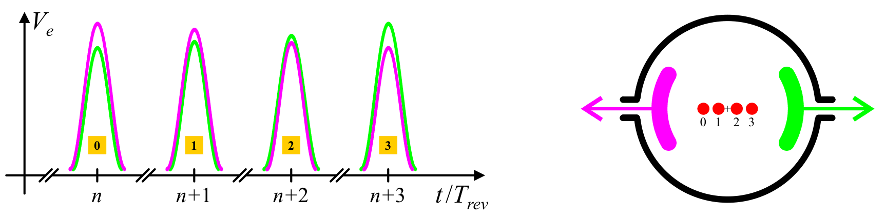
Beam Position Monitors
operation principle of (capacitive) button pickup
LHC button pickup
courtesy: R.Jones (CERN)
electric field induces image charge on pick-up
→ pick-up mounted isolated inside vacuum chamber
→ amount of induces charge depends on distance between beam and pick-up
y
processing example: Δ/Σ method
beam
x
x = K_{x}
P₁ – P₃
y = K_{y}
P₂ – P₄
P₁ + P₃
P₂ + P₄
beam position information
amplitude modulated on large (common mode) beam intensity signal
Courtesy: M. Gasior (CERN)
signal subtraction to obtain position information
→ difficult to do electronically without some of the intensity information leaking through
Gero Kube, DESY / MDI
LA³NET Conference, Son Caliu Hotel (Spain), 27. March 2015

Slide 13
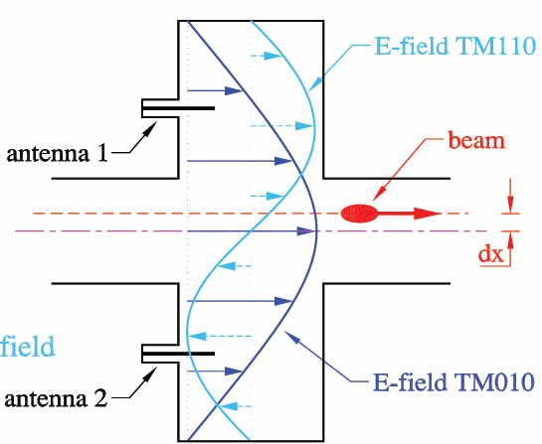
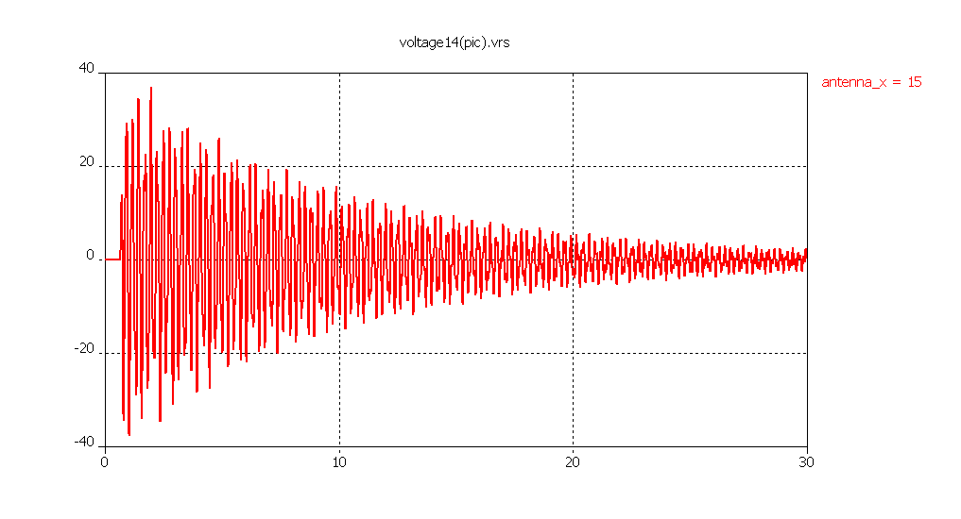
Cavity BPM
collect directly position information
bunch excites several resonating modes while passing a
pillbox-like cavity
→ short bunches deliver wide spectrum of frequencies
monopole mode TM₀₁₍₀₎: beam intensity
→ maximum at center
→ strong excitation
dipole mode TM₁₁₍₀₎: beam position
→ minimum at center
→ excitation by beam offset
→ slightly shifted in frequency wrt. monopole mode
antenna for outcoupling of dipole mode
antenna signal: time domain
amplitude: position information
→ only absolute value !
phase (wrt. monopole mode): sign information
→ simultaneous measurement required !
U / V
t / ns
Gero Kube, DESY / MDI
LA³NET Conference, Son Caliu Hotel (Spain), 27. March 2015

Slide 14
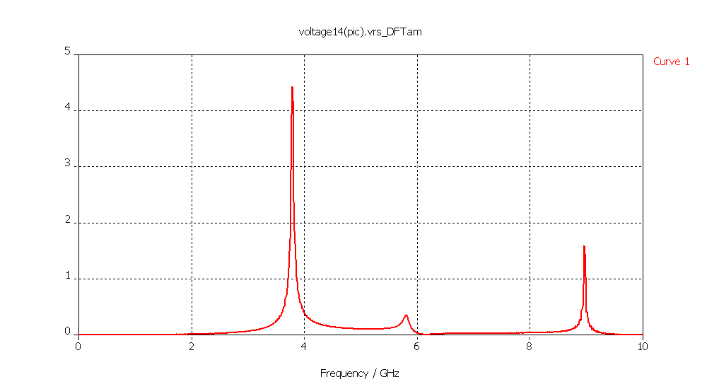
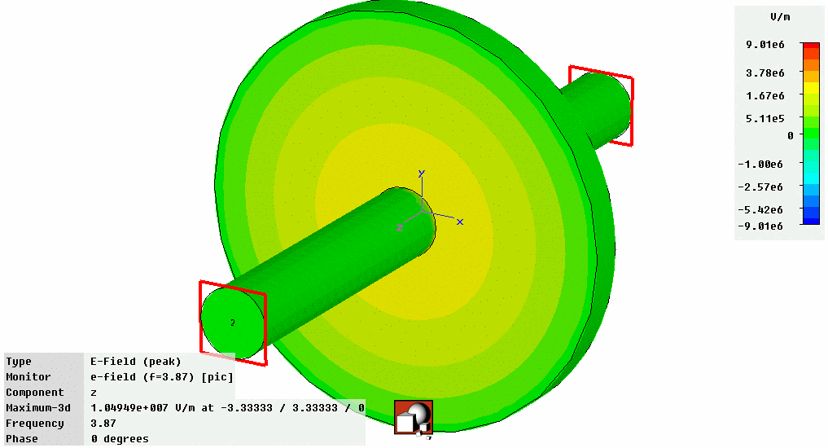
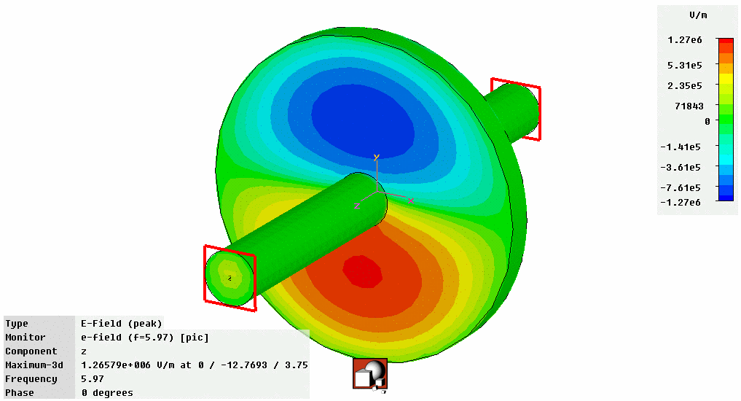
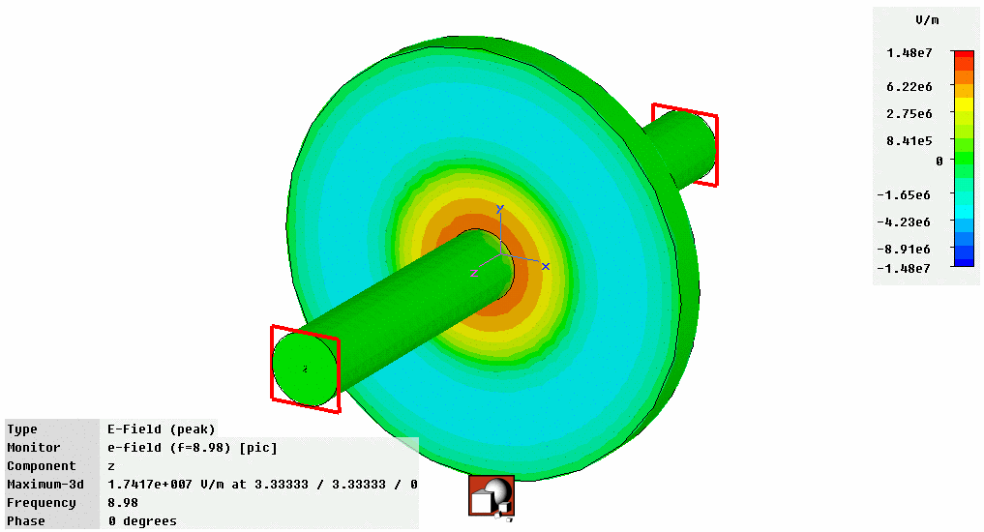
Cavity BPM
cavity frequency spectrum
U / V
TM₀₁
TM₀₂
TM₁₁
U~q
U~q∙|r|
U~q
f / GHz
q: beam charge, r: beam offset
problem: monopole mode (TM₀₁) leakage into dipole mode (TM₁₁)
→ suppression of monopole mode required
courtesy: D.Lipka (DESY)
Gero Kube, DESY / MDI
LA³NET Conference, Son Caliu Hotel (Spain), 27. March 2015

Slide 15
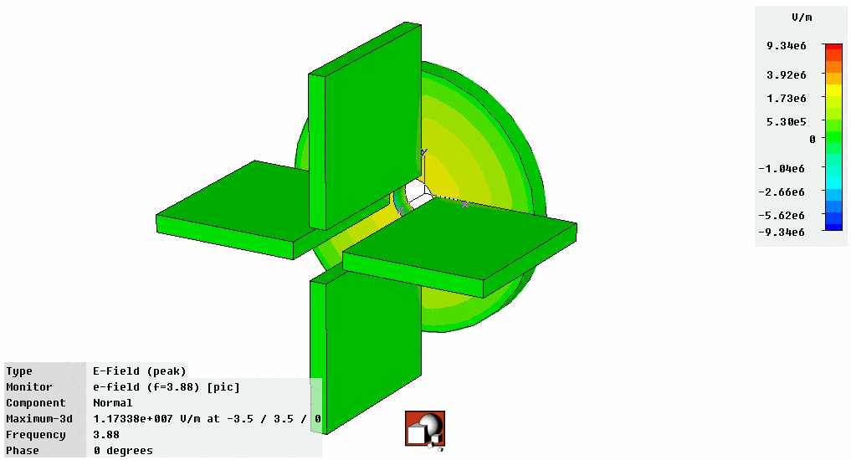
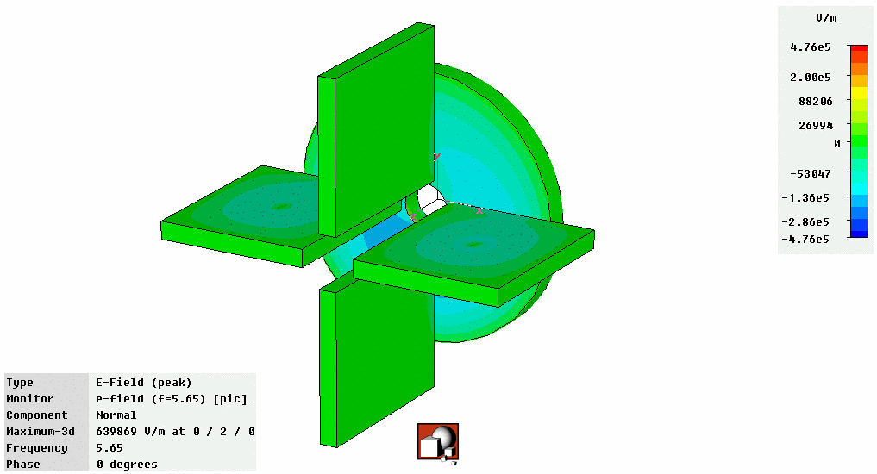
Cavity BPM
suppresion of monopole mode
dipole mode (TM₁₁) signal coupled out via waveguide
→ choose outcoupling at position of large TM₁₁ electric field amplitude
design waveguide with cutoff frequency above f₀₁ (monopole mode) resonance
influence of outcoupling waveguide
Monopole Mode
Dipole Mode
courtesy: D.Lipka (DESY)
narrow-band electronics for signal processing
→ B.Keil, Proc. DIPAC’09, Basel (Switzerland) 2009, TUOC01, p.275
→ D.Lipka, Proc. DIPAC’09, Basel (Switzerland) 2009, TUOC02, p.260
Gero Kube, DESY / MDI
LA³NET Conference, Son Caliu Hotel (Spain), 27. March 2015

Slide 16
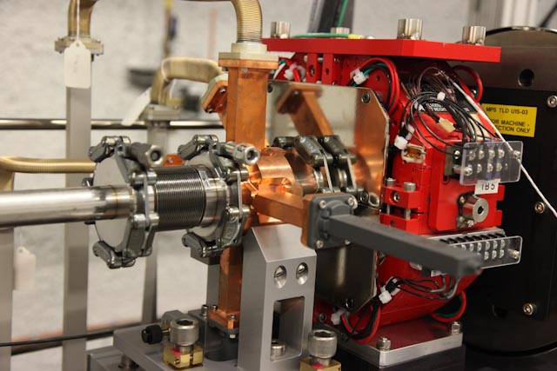
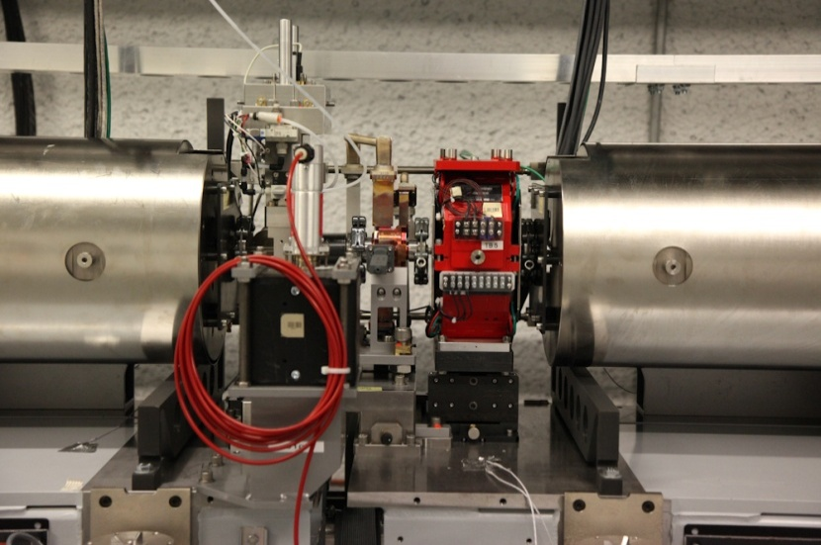
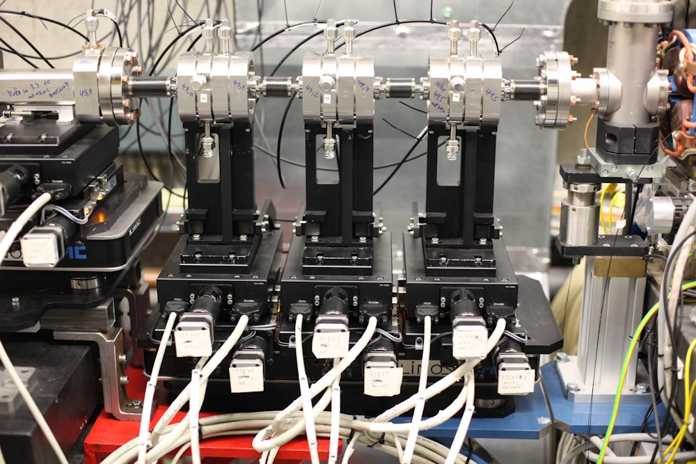
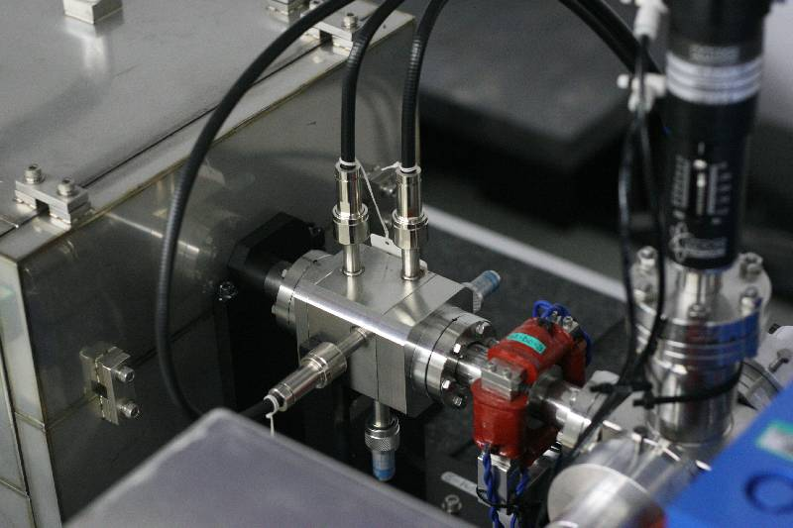
Cavity BPMs for SASE Machines
Cavity BPM @ LCLS
courtesy: D.Nölle (DESY)
Undulator intersection @ LCLS
Low Q Cavity BPM @ SCSS
E-XFEL Cavity BPM Test @ FLASH
Gero Kube, DESY / MDI
LA³NET Conference, Son Caliu Hotel (Spain), 27. March 2015

Slide 17
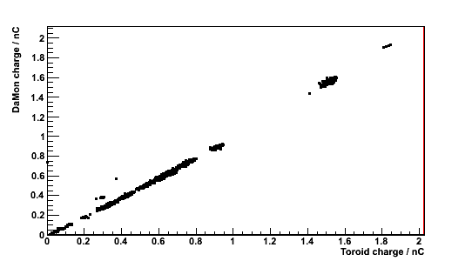
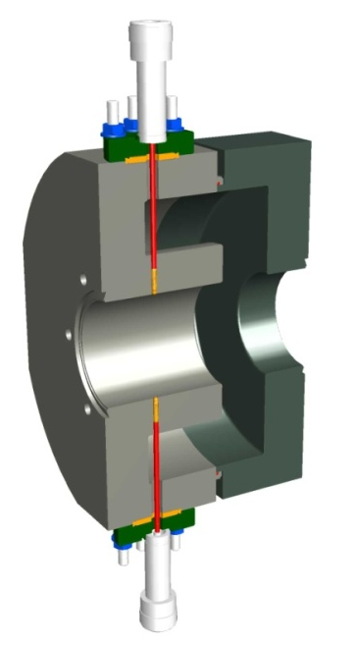
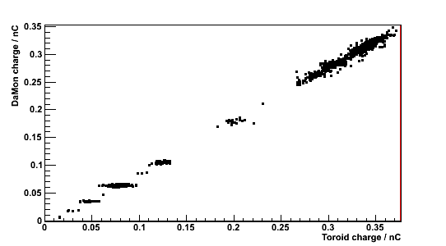
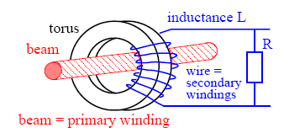
Cavity Monitor for Bunch Current
E-XFEL design
parameters:
→ f_{res} = 1.3 GHz, Q_{L} = 198.4
→ 40.5 mm diameter tube, 9 cm length
Cavity vs. Toroid
achieved sensitivity:
→ S = 11.83 V/nCb
Toroid principle
μ_{r}
N
P. Forck, “Lecture Notes on Beam Instrumentation and Diagnostics”, JUAS 2011
D.Lipka et al., Proc. DIPAC 2011,
Hamburg (Germany) 2011, WEOC03
Gero Kube, DESY / MDI
LA³NET Conference, Son Caliu Hotel (Spain), 27. March 2015

Slide 18


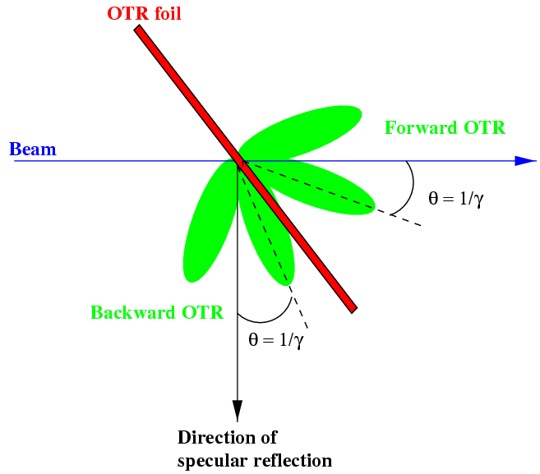
Transverse Profile / Emittance
working horse: Transition Radiation
electromagnetic radiation emitted when a charged
particle crosses boundary between two media with
different optical properties
visible part: Optical Transition Radiation (OTR)
beam diagnostics: backward OTR
typical setup: image beam profile with optical system
radiation generation
→ virtual photon reflection at boundary
(perfect conductivity)
→ reflected and incident
field are the same
advantage: fast single shot measurement
linear response (neglect coherence !)
disadvantage: high charge densities may destroy radiator → limitation on bunch number
Gero Kube, DESY / MDI
LA³NET Conference, Son Caliu Hotel (Spain), 27. March 2015

Slide 19
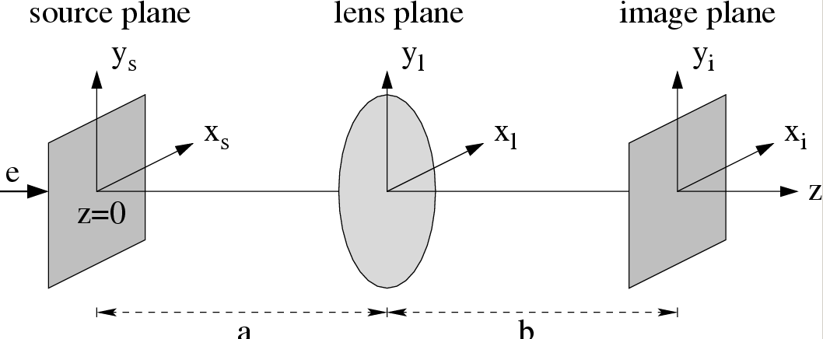
OTR Monitor Resolution
calculation of point spread function in image plane
G. Kube, TESLA-FEL Report 2008-01
parameters of calculation
R_{i0}
E = 1 GeV
λ = 500 nm
f = 250 mm
a = b = 500 mm (1:1 imaging)
lens-Ø = 50.8 mm
OTR resolution
resolution definition according to classical optics:
first minimum of PSF (→ diameter of Airy disk)
M: magnification
θ_{m}: lens acceptance angle
Gero Kube, DESY / MDI
LA³NET Conference, Son Caliu Hotel (Spain), 27. March 2015

Slide 20
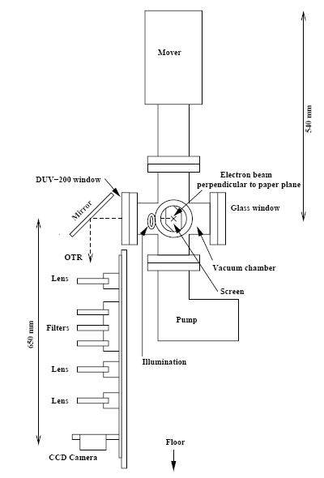
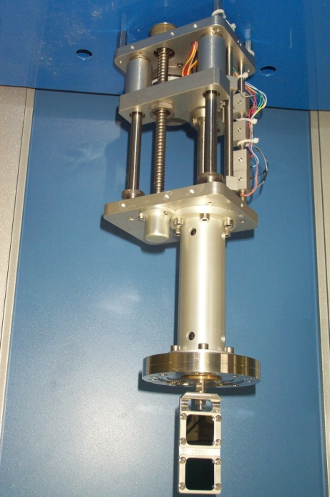
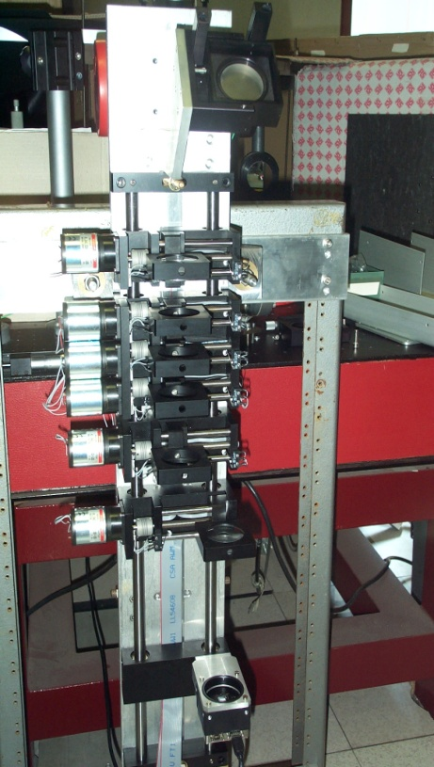
OTR Monitors at FLASH
Mover
K. Honkavaara et al., Proc. PAC 2003, p.2476
2 Screens
Calibration Marks
Mirror
3 Filters
optical system
magnification f / mm a / mm b / mm
1 250 500 500
0.382 200 724 276
0.25 160 800 200
3 Lenses
Camera
Gero Kube, DESY / MDI
LA³NET Conference, Son Caliu Hotel (Spain), 27. March 2015

Slide 21
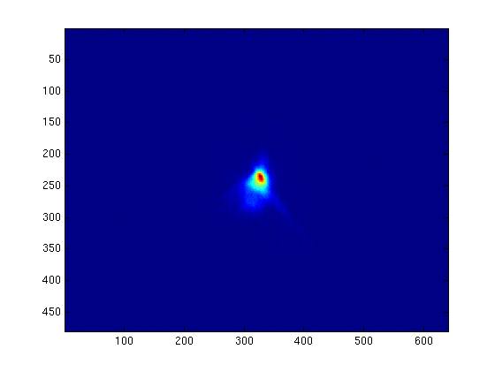
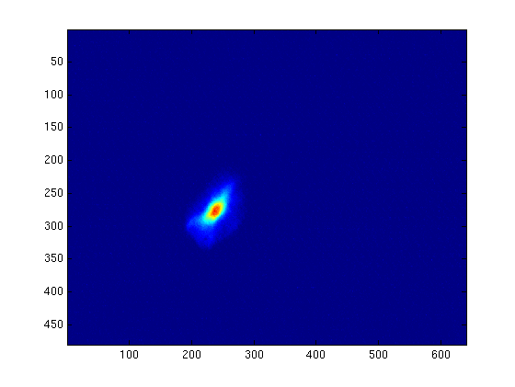
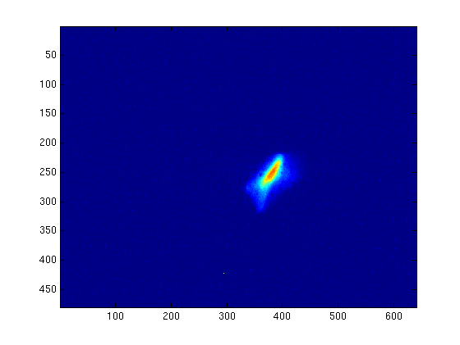
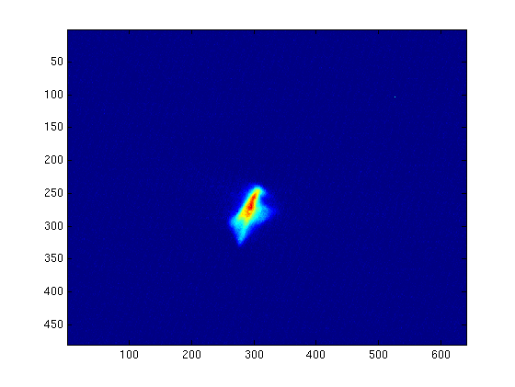
Example of Beam Images (matched)
4DBC2
6DBC2
1 bunch, 1 nC, Solenoid 277 A, ACC1 on-crest
6.4 mm
8DBC2
10DBC2
4.8 mm
courtesy: K. Honkavaara (DESY)
Gero Kube, DESY / MDI
LA³NET Conference, Son Caliu Hotel (Spain), 27. March 2015

Slide 22
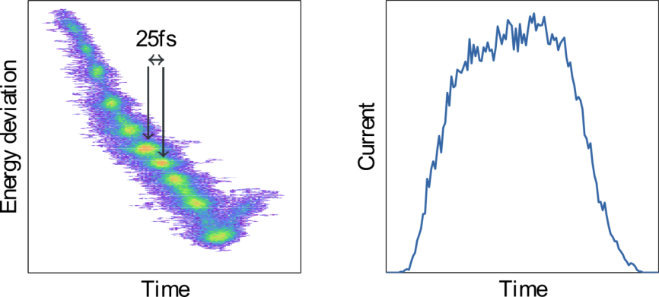
COTR and possible Mitigation
unexpected Coherent OTR observation during LCLS commissioning
R. Akre et al., Phys. Rev. ST Accel. Beams 11 (2008) 030703 H. Loos et al., Proc. FEL 2008, Gyeongju, Korea, p.485.
strong shot-to-shot fluctuations
doughnut structure
change of spectral contents
courtesy:
H. Loos (SLAC)
measured spot is no beam image!
interpretation of coherent formation in terms of “Microbunching Instability”
E.L. Saldin et al., NIM A483 (2002) 516
Z. Huang and K. Kim, Phys. Rev. ST Accel. Beams 5 (2002) 074401
G. Stupakov, Proc. IPAC 2014, Dresden, Germany (2014), p.2789.
alternative schemes for transverse profile diagnostics
long term perspective: TR imaging at smaller λ
additional advantage of better resolution
proof of principle experiment @ λ = 19.6 nm:
L.G. Sukhikh, G. Kube, S. Bajt et al., Phys. Rev. ST Accel. Beams 17 (2014) 112805
short term perspective: scintillating screen monitors
Gero Kube, DESY / MDI
LA³NET Conference, Son Caliu Hotel (Spain), 27. March 2015

Slide 23
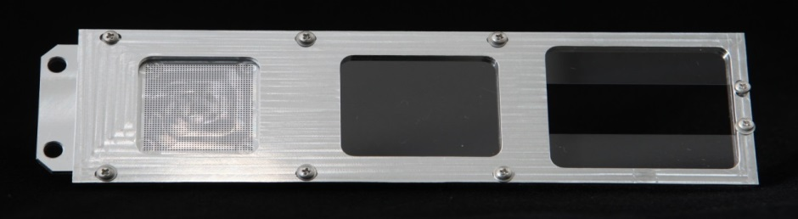
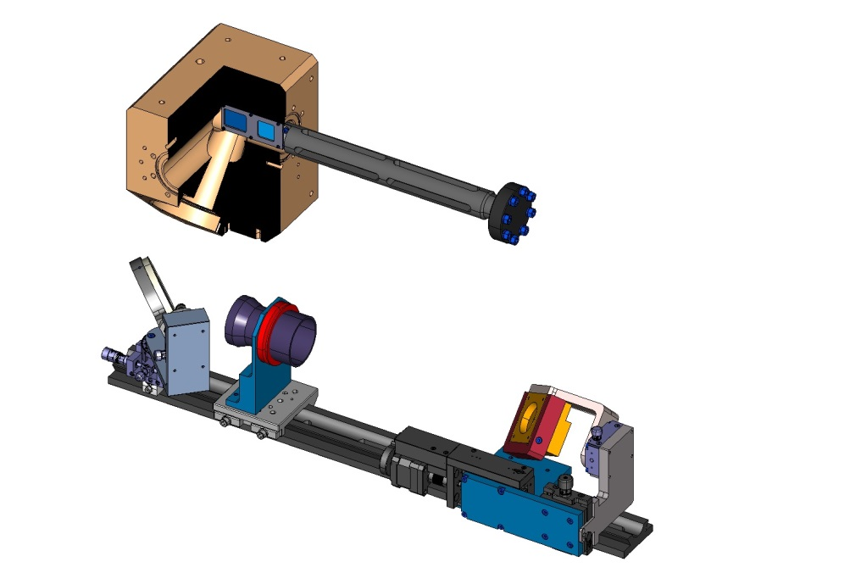
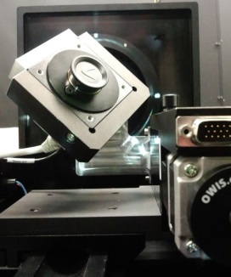
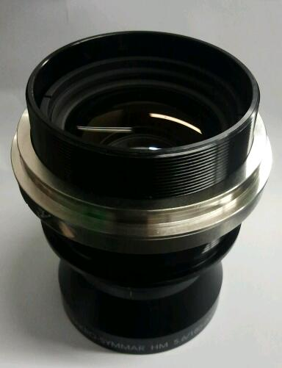
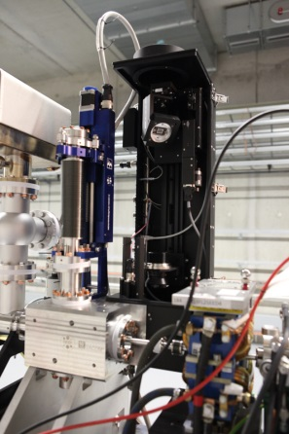

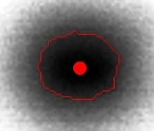
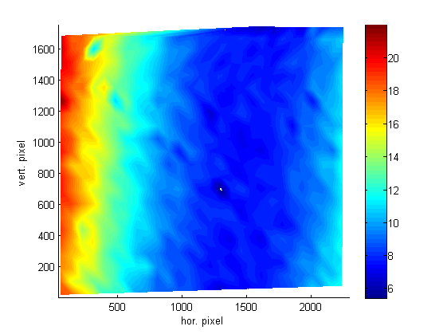
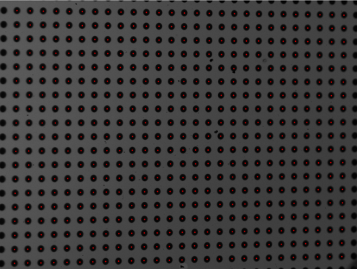
Screen Station for E-XFEL
monitor setup
dot grid target(spot Ø .50mm)
BEAM
f = 180mm for 1:1
200µm thick LYSO screen (on-axis)
f = 120mm for 1:2
2 half 200µm thick LYSO screens (off-axis)
Optical Axis
FLASH II installation
Optics Axis
optical resolution
BEAM
Scheimpflug observation geometry
10.5 μm average resolution
(dot → optical „step“ function)
Gero Kube, DESY / MDI
LA³NET Conference, Son Caliu Hotel (Spain), 27. March 2015

Slide 24
Longitudinal Profile Diagnostics
Coherent Radiation Diagnostics (CRD)
long bunch (λ<σ_{z})
standard method for radiation based bunch length diagnostics
O. Grimm, Proc. PAC 2007, Albuquerque, USA, p.2653
short bunch (λ>σ_{z})
electro-optical (EO) techniques
σ_{t} ≈ 100 fsec
principle idea:
statement about bunch profile via longitudinal extension of particle bunch Coulomb field
→ good approximation for ultra-relativistic beam energies (1/γ opening angle)
task:
detection of transient Coulomb field → electro-optical detection in THz region
- imprint influence of Coulomb field onto electro-optical crystal
- convert action in crystal into detectable signal
opt. intensity variation → laser + polarizer + analyzer
following 2 talks by Andrii Borysenko and Mateusz Tyrk
σ_{t} ≈ 30 fsec
Transverse Deflecting Structure (TDS)
intra-beam streak camera
→ potential for sub-fsec resolution
→ access to slice parameters
Gero Kube, DESY / MDI
LA³NET Conference, Son Caliu Hotel (Spain), 27. March 2015

Slide 25




RF Cavity Manipulation
Transverse Deflecting Structures (TDS)
iris loaded RF waveguide structure
designed to provide hybrid deflecting modes (HEM_{1,1})
→ linear combination of TM_{1,1} and TE_{1,1} dipole modes, resulting in transverse force that act on
synchronously moving relativistic particle beam
used for beam separators and RF deflectors
traveling wave RF deflector ”LOLA-type”
→ SLAC design
standing wave RF deflector
→ SPARC-INFN design
Input coupler
E-field configuration
2π/3 phase shift per cell
2856 MHz (S-band)
courtesy D. Alesini (INFN-LNF)
“LOLA”: G.A. Loew, R.R. Larsen, O.A. Altenmueller
G. A. Loew et al., SLAC Technical Report SLAC-PUB-135 (1965)
D . Alesini et al., NIM A568 (2006) 488
L. Ficcadenti, Proc. PAC‘07, Albuquerque, (2007), p.3994
Gero Kube, DESY / MDI
LA³NET Conference, Son Caliu Hotel (Spain), 27. March 2015

Slide 26

TDS Working Principle
TDS as intra-beam streak camera
transverse density distribution
electron beam
CCD camera
vertical
screen
horizontal
courtesy C. Behrens (DESY)
Gero Kube, DESY / MDI
LA³NET Conference, Son Caliu Hotel (Spain), 27. March 2015

Slide 27

TDS Working Principle
TDS as intra-beam streak camera
transverse density distribution
electron beam
CCD camera
vertical
screen
vertical
horizontal
longitudinal
courtesy C. Behrens (DESY)
Gero Kube, DESY / MDI
LA³NET Conference, Son Caliu Hotel (Spain), 27. March 2015

Slide 28

TDS Working Principle
TDS as intra-beam streak camera
transverse density distribution
electron beam
CCD camera
vertical
screen
vertical
horizontal
longitudinal
courtesy C. Behrens (DESY)
Gero Kube, DESY / MDI
LA³NET Conference, Son Caliu Hotel (Spain), 27. March 2015

Slide 29

TDS Working Principle
TDS as intra-beam streak camera
transverse density distribution
electron beam
CCD camera
vertical
screen
vertical
horizontal
longitudinal
courtesy C. Behrens (DESY)
Gero Kube, DESY / MDI
LA³NET Conference, Son Caliu Hotel (Spain), 27. March 2015

Slide 30


TDS Measurements
effect of TDS on observation screen
current profiles with (left) and without (right) magnetic compression
courtesy C. Behrens (DESY)
Gero Kube, DESY / MDI
LA³NET Conference, Son Caliu Hotel (Spain), 27. March 2015

Slide 31

TDS Properties
resolution limit
deflected spot size σ_{defl} equals un-deflected beam size σ_{beam} : σ_{ζ} → σ_{ζ,res} = c ∙ σ_{t,res}
example:
XFEL design parameters for TDS behind first BC
f_{RF} = 3 GHz V₀ = 18 MV (P = 45 MW)
β_{tds} = 20 m ε = 1 nm.rad @ 500 MeV
→ σ_{t,res} = 10.5 fsec / sinΔΦ
good resolution:
→ Ψ = 0 zero-crossing for bunch centroid
→ β_{tds} as large as possible for most effective kick
→ ΔΦ 90/270° ideal for phase advance
→ V₀ high deflecting voltage (high RF power)
→ f_{RF} high RF frequency
X-band TDS @ LCLS: f_{RF} = 11.424 GHz → σ_{t,res} = 1 – 4 fsec (rms)
C. Behrens et al., Nature Communications 5:3762 (2014), DOI:10.1038/ncomms4762
TDS for slice profile (emittance) diagnostics
camera at view screen (OTR) delivers 2D information
→ vertical beam size: bunch length information
→ horizontal beam size: transverse profile information
streaked image
→ transv. profile as function of long. position (slice) ζ
→ access to slice emittance
Gero Kube, DESY / MDI
LA³NET Conference, Son Caliu Hotel (Spain), 27. March 2015

Slide 32




TDS @ LCLS, FLASH, SPARC, …
low energy TW RF deflector @ LCLS
TW RF deflector @ FLASH
X-band TDS @ LCLS
SW RF deflector @ SPARC
Gero Kube, DESY / MDI
LA³NET Conference, Son Caliu Hotel (Spain), 27. March 2015

Slide 33
Beam Synchronous Timing (BST)
BST tasks
T. Korhonen , Proc. ICALEPCS’99 , Trieste, Italy (1999) p.167
generate and remotely distribute phase reference
trigger fast sub-systems
trigger slow systems
interface to the control system
two levels of timing
fast timing → level of individual bunches
slow timing → level of revolution clock (circ. accelerator) or bunch (train) repetition rate (linac)
synchronization
local task → implemented at different clients of timing system
BST building blocks (expected timing jitter)
reference oscillator → phase reference for all sub-systems (≈ ps to fs)
master time-base (event system) → trigger, bunch clock, injection/extraction, experiment triggers (≈ ns to ps)
distribution system (coaxial vs. fiber optics) → phase reference (down to fs ), trigger (100ps to <10ps)
interface to the control system
courtesy M. Ferianis (Sincrotrone Trieste)
Gero Kube, DESY / MDI
LA³NET Conference, Son Caliu Hotel (Spain), 27. March 2015

Slide 34

fs-Synchronization System @ FLASH
distribution of synchronization reference
courtesy M. Felber (DESY)
star topology
optical reference pulse train
mode-locked Erbium Doped Fiber Laser
repetition rate 216.7 MHz
→ 6th subharmonic of accelerator RF
point-to-point stability over several km:
short term: < 1 fsec
long term: < 3.5 fsec
→ rms values, measured out-of-loop with
independent detector
applications:
Bunch Arrival Time Monitor (BAM)
→ beam based arrival time feedback
→ user driven (pump-probe)
laser synchronisation
→ e.g. pump-probe, seed, injector,…
RF reference stabilization or generation
→ LLRF stability
Gero Kube, DESY / MDI
LA³NET Conference, Son Caliu Hotel (Spain), 27. March 2015

Slide 35



Fiber Link Stabilization
interferometric method
courtesy M. Felber (DESY)
based on balanced optical cross-correlation
→ fast actuator: piezo stretcher
→ coarse actuator: motorized delay
C. Sydlo et. al. Femtosecond timing distribution for the European XFEL, FEL 2014, August 25-29, 2014
Schulz, S. et al., Nat. Commun. 6:5938 doi: 10.1038/ncomms6938 (2015).
Gero Kube, DESY / MDI
LA³NET Conference, Son Caliu Hotel (Spain), 27. March 2015

Slide 36

Synchronization System @ FLASH
S. Schulz et al., “Femtosecond all-optical synchronization of an X-ray free-electron laser” Nat. Commun. 6:5938 doi: 10.1038/ncomms6938 (2015).
Gero Kube, DESY / MDI
LA³NET Conference, Son Caliu Hotel (Spain), 27. March 2015

Slide 37


Beam-based Arriv. Time Stabilization
Bunch Arrival Time Monitor (BAM)
F. Loehl et al., Phys. Rev. Lett. 104, 144801 (2010)
uncorrelated jitter
over 2000 shots:
8.4 fs (rms)
electro-optical arrival time measurement:
→ < 10 fsec precision (> 300 pCb)
arrival time stability:
12 fsec (rms)
BAMs
FLASH:
Feedback
Feedback
fast feedback to LLRF station before bunch compressor (2 μsec latency, settling within 7 μsec)
→ arrival time stabilization to < 20 fsec precision
courtesy M.K. Czwalinna, S. Pfeiffer (DESY)
Gero Kube, DESY / MDI
LA³NET Conference, Son Caliu Hotel (Spain), 27. March 2015

Slide 38




Laser Synchronization
e.g. Ti:Sa pump-probe laser
balanced optical cross correlation
courtesy S. Schulz (DESY)
balanced detection scheme
elimination of amplitude changes by
subtraction of both detector signals
twofold sum frequency generation in BBO
pure timing sensitive response
conventional RF lock:
35 fs rms
optical lock:
6 fs rms
Gero Kube, DESY / MDI
LA³NET Conference, Son Caliu Hotel (Spain), 27. March 2015

Slide 39




Laser RF Phase Detector
for RF synchronization or laser-to-RF lock
courtesy E. Janas (DESY)
2.44 fsec integrated jitter
measured out of loop
(10 Hz to 1 MHz)
3.3 fsec peak-peak drift
over 24 hours
T. Lamb et. al. “Femtosecond stable laser-to-RF phase detection for optical synchronization systems”, IBIC 2013
Gero Kube, DESY / MDI
LA³NET Conference, Son Caliu Hotel (Spain), 27. March 2015

Slide 40
Summary
overview of diagnostic systems at modern 4th generation light sources
machine parameters and the requirements are challenging
monitor design offers the combination of various fields
lasers in beam diagnostics play important role
fancy monitor concepts
physics → radiation physics, interaction with matter, el.magn. theory, laser technology,…
electrical engineering → analog/digital signals, communication technology, control theory,…
mechanical engineering → material science,…
optical engineering → classical optics, lens design, wave optics, electro-optics,…
IT technology → computer science,…
laser wire scanners, EO techniques, timing and synchronization issues,…
many thanks ….
for your attention
to my DESY colleagues M. Felber, D. Lipka, D.Nölle, K.Wittenburg for their help in the preparation
and many stimulating discussions
special thanks to C. Welsch, R. Ashworth for organizing the LA³NET conference and their invitation
Gero Kube, DESY / MDI
LA³NET Conference, Son Caliu Hotel (Spain), 27. March 2015

