Slide 2
Proposal for ground motion in Point 5
Mechanical Measurements Laboratory
M. Guinchard – P. Grosclaude

Slide 3
Goal of the measurements
    Measure spatial correlation of ground motion (<100 Hz) with geophones between left/right of the cavern
    Measure spatial correlation of ground motion (<100 Hz) with geophones along the triplet positions

Slide 4
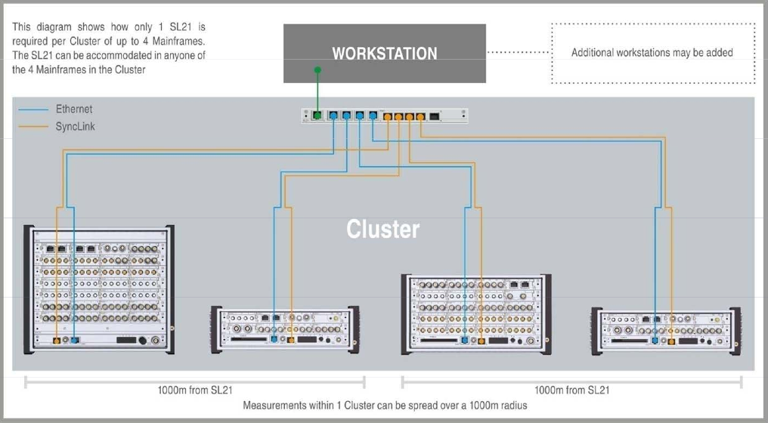
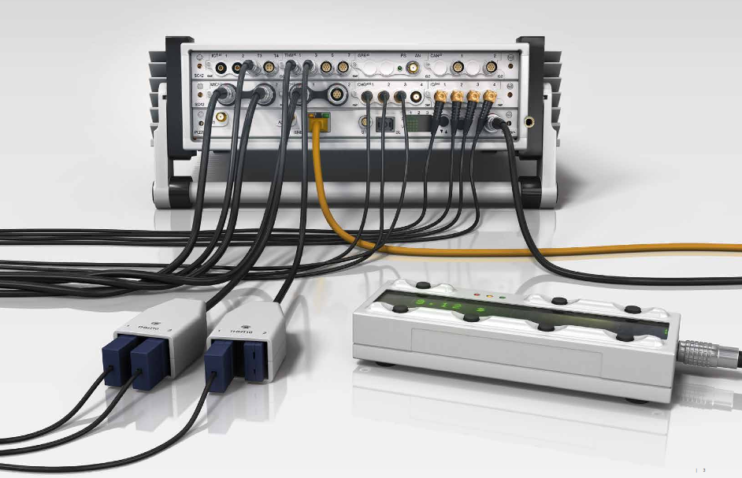
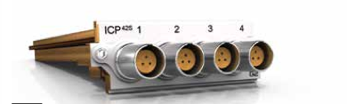
Technique of measurements
    Synchronous ground motion measurements up to 1 km done by optical fibre connection
    Phase shift below 0.1° on the bandwidth between two spectrum analyser
ICP42S G2 features:
• 24-bit resolution, 204.8 kSa/s sampling rate per channel, 90 kHz bandwidth
• <0.1° @ 10 kHz phase accuracy between channels of the same or any other Modules

Slide 5
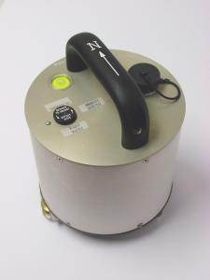
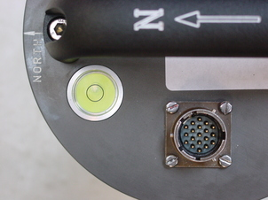
Technique of measurements
    Six geophones :
      CMG-T60-0004 from Guralp Systems
      Three directions measurements V, NS and EW
      Sensitivity of about 2000 [V/(m/s)]
      Frequency range between 30 [s] and 100 [Hz].

Slide 6
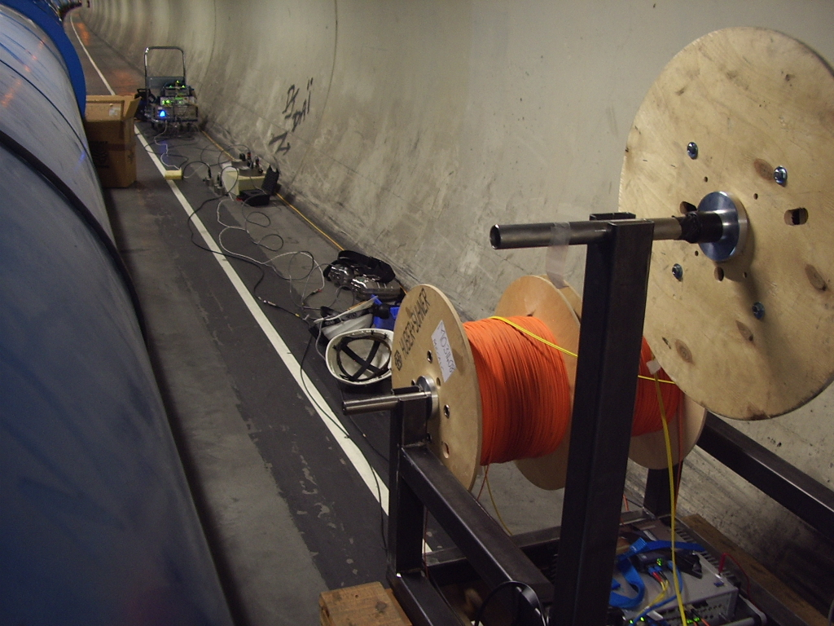
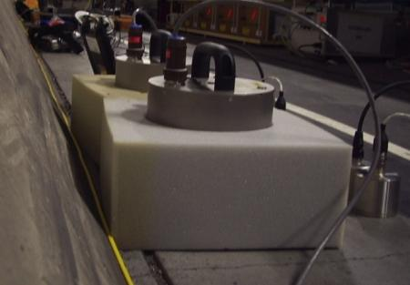
Technique of measurements
    Installation in the tunnel (from previous measurements)
2 Spectrum Analyzers
3 x 1 km of optical fiber
Geophones

Slide 7
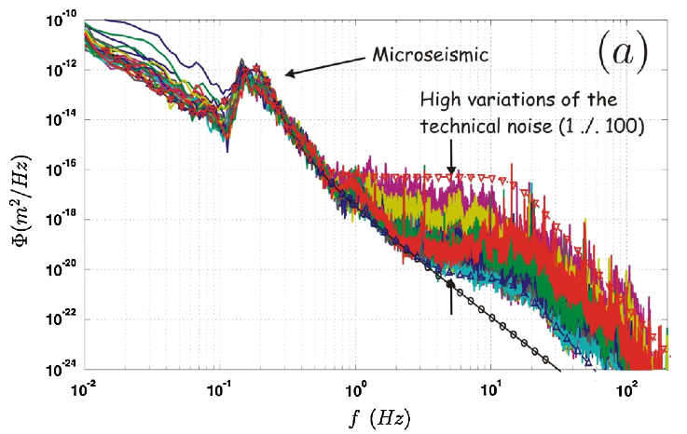
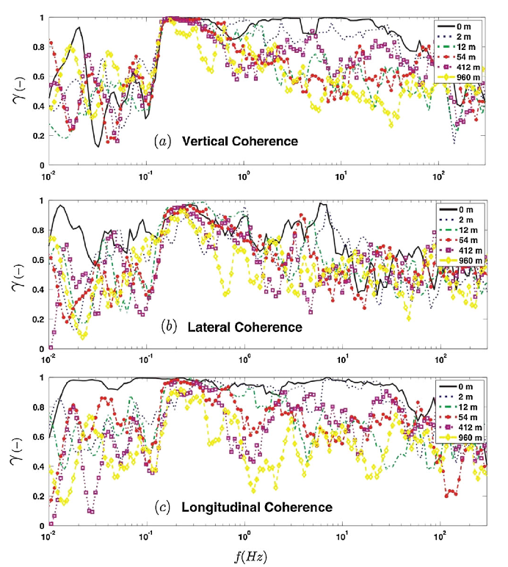
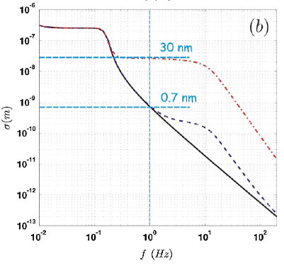
Typical measurements in LHC
PHYSICAL REVIEW SPECIAL TOPICS - ACCELERATORS AND BEAMS 13, 072801 (2010)
Seismic response of linear accelerators
C. Collette, K. Artoos, M. Guinchard, and C. Hauviller

Slide 8
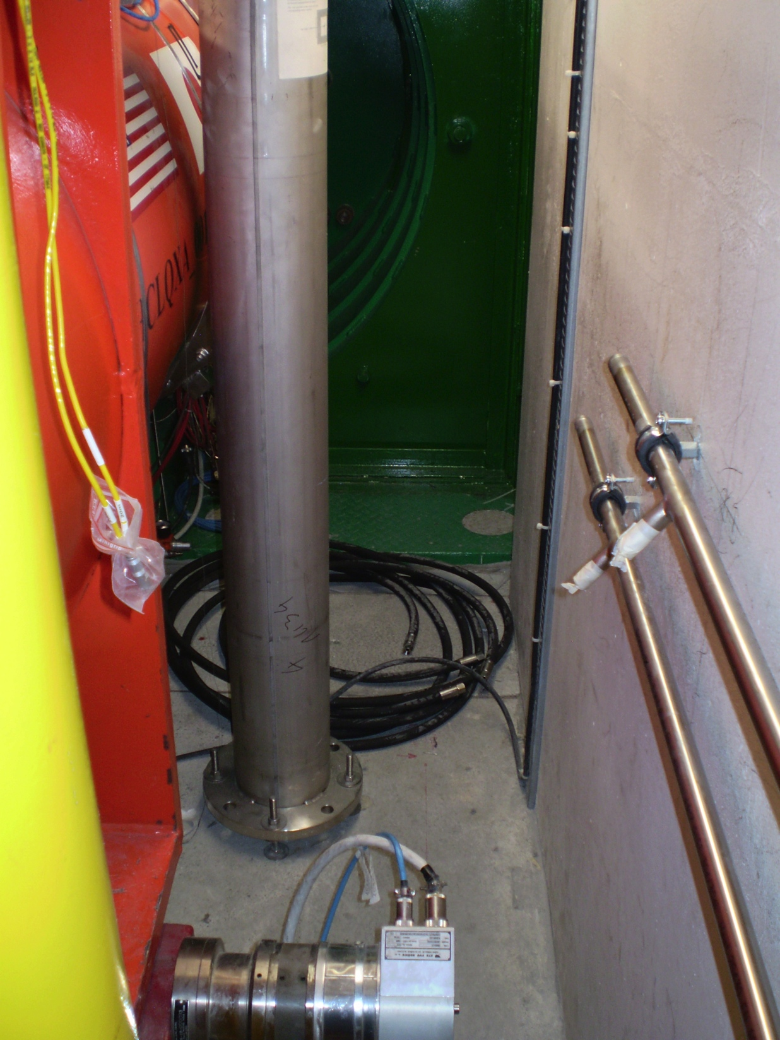
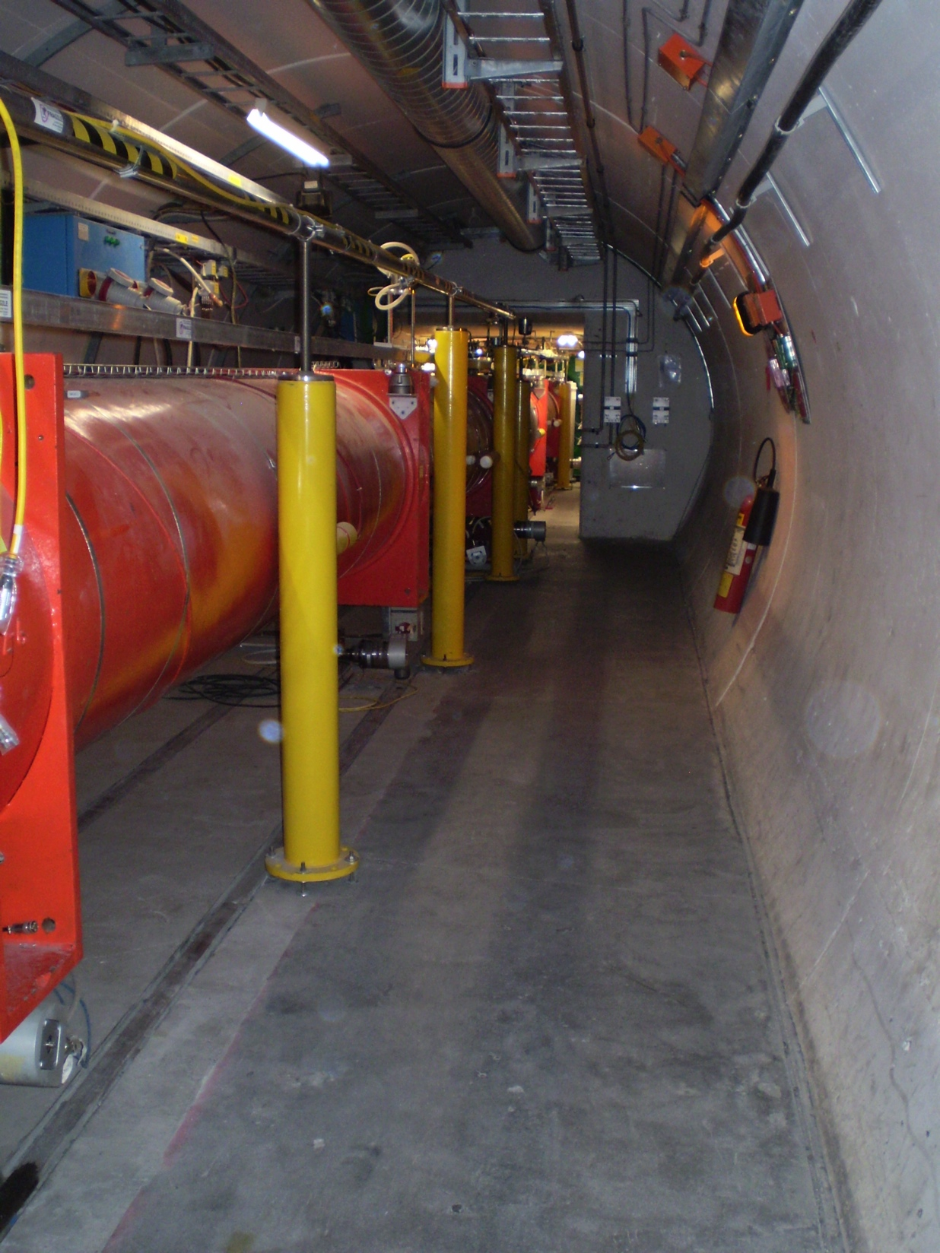
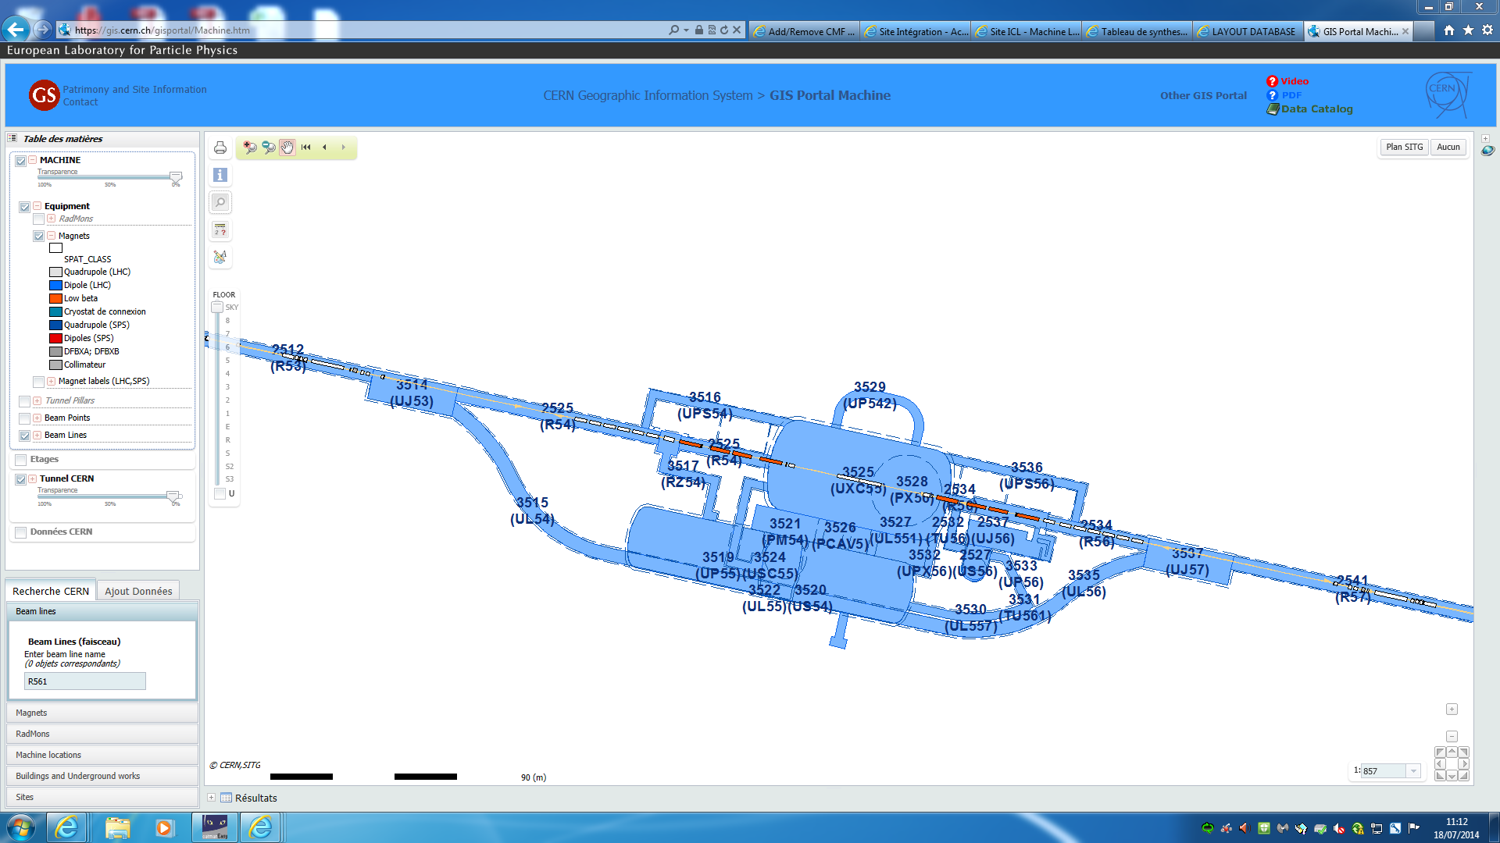
Sensors positions at point 5
    Measure spatial correlation of ground motion (<100 Hz) with geophones between left/right of the cavern
Geophone_54_1
Geophone_54_0
Geophone_54_2

Slide 9
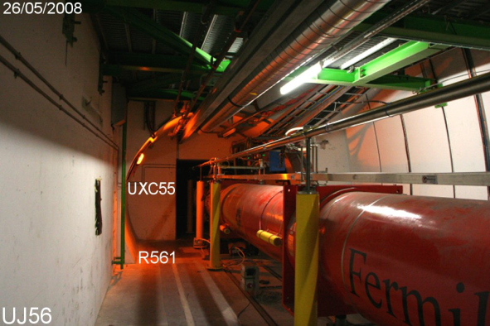
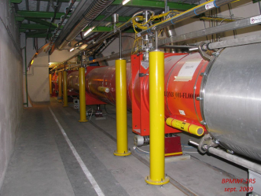
Sensors positions at point 5
    Measure spatial correlation of ground motion (<100 Hz) with geophones between left/right of the cavern
Geophone_56_0
Geophone_56_1
Geophone_56_2

Slide 10
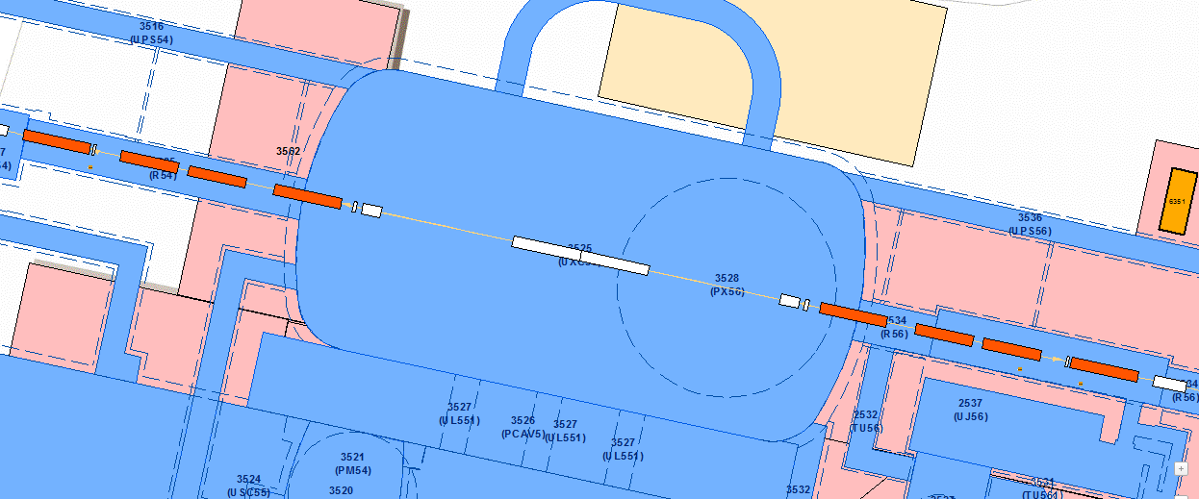
Sensors positions at point 5
    Measure spatial correlation of ground motion (<100 Hz) with geophones between left/right of the cavern
Sensors around Q2 should be placed at the same distance of the magnet foot both sides !

Slide 11
Sensors positions at point 5
    Measure spatial correlation of ground motion (<100 Hz) with geophones along the triplet positions
Set 1 of measurements
Set 2 of measurements
Geophone_54_1 (Reference point)

Slide 12
Comments
  Geophones at position 0 can be installed before cryogenic filling of the triplets;
  Final positions of the sensors will be adjusted on site depending of the quality of the slab and the position of services;
  Measurement time :
    ½ day to install sensors (left and right of CMS) ;
    One night of measurements
    ½ day to move sensors in 4-5 sector
    One night of measurements
    ½ day to remove equipment
  Measurement cost :
    Measurements between left/right of CMS : 10 460 CHF
    Coherence measurement between Q1 and Q3 : 18 000 CHF

