Slide 1
Proposal for ground motion and vibration measurements in Point 1 and 5
Miriam Fitterer
Acknowledgments: G. Arduini, K. Artoos, O. Brüning, R. De Maria, W. Herr, W. Höfle, B. Holzer, M. Giovannozzi, M. Guinchard, S. Redaelli, F. Schmidt, D. Schulte, F. Zimmermann

Slide 2
Summary Slides

Slide 3
based on discussion with many experts …
G. Arduini, K. Artoos, O. Brüning, R. De Maria, W. Herr, W. Höfle, B. Holzer, M. Giovannozzi, M. Guinchard, S. Redaelli, F. Schmidt, D. Schulte, F. Zimmermann

Slide 4
Theoretical Background (beam dynamics)
  Literature: [5] SSCL-Preprint-188 and [6] NIM A 391, p. 73-76, 1996 (more complete list on p. 6)
  => emittance growth assuming white noise and no correlation between IT quadrupoles (p. 7-9)
  Emittance growth estimates HL-LHC: (p. 8-12)
  1% emittance growth/hour, g=0.1, β₁=180 m, X_{noise,BPM}=0.05 μm (1-2 μm for LHC) , ε_{n}=2.5 μm
      d_{rms} = 0.022 nm (ws approx. [5]) and d_{rms} = 0.08 nm (ss case [6])
      => similar values as for CLIC!!!!
      => estimates probably too pessimistic as tight tolerances are also obtained for nominal LHC:
      d_{rms} = 0.15 nm (ws approx. [5]) for ε_{n}=3.75 μm, 7 TeV, β*=0.55 m
      => main contribution from IT in IP1/5

Slide 5
Proposed measurements – about 2 day campaign
  Individual measurements:
    measure spatial correlation of ground motion (<100 Hz) with geophones in Point 1 and 5 (between left/right of cavern, IT quadrupoles and along one quadrupole)
    measure transfer function from the ground to the cryostat and (evtl.) eigenmodes of the cryostat by measuring at different points at least for one magnet, optimally for several
ATLAS/CMS cavern
Q3
Q2
Q1
Q1
Q2
Q3
…
…
reference point
[8] C. Collette, K. Artoos, M. Guinchard, and C. Hauviller, “Seismic response of linear accelerators”, Phys. Rev. STAB 13, 2010

Slide 6
Proposed measurements – about 2 day campaign
  objectives and individual measurements:
    measure in particular movement of IP side of Q1 (larger than for Q2/Q3) due to shielding cone reaching into the cavern (only possible in Point 5?), correlation of movement between shielding cone and Q1
    are measurements of the high frequency part of the spectrum possible on a spare magnet
    (for details contact H. Prin)?
ATLAS/CMS
cavern
Q1

Slide 7
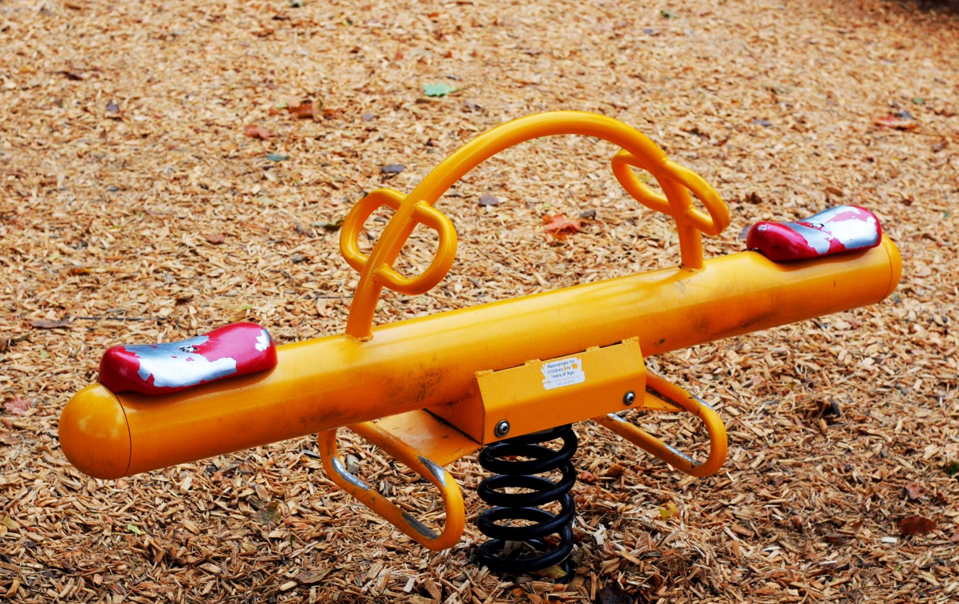
Proposed measurements – about 2 day campaign
  general comments on the measurements:
  measurements before “first beam”, but when sector is cooled down and all equipment in the area operational, but magnets are not powered (when powered measurements can be only done remotely and powering only changes spectrum in >100 Hz range)
  about 2 nights of access needed to perform one measurement campaign
  no other works in the nearby area!
  to keep in mind for the future …
  new IT magnets should be measured before installation
  resonance frequencies of the beam f_{n}=f_{rev}*(k*Q-n) should not coincide with resonant frequencies of the magnet/cryostat -> should be included in the design
  weight should be rather equally distributed on the
  feet of the magnet (banana shape should be avoided, otherwise
  same behaviour like a seesaw)
  install accelerometers on new IT permanently?

Slide 8
Detailed Slides

Slide 9
Ground motion and vibration measurements in Point 1 and 5
Miriam Fitterer
Acknowledgments: G. Arduini, K. Artoos, O. Brüning, R. De Maria, W. Herr, W. Höfle, B. Holzer, M. Giovannozzi, M. Guinchard, S. Redaelli, F. Schmidt, D. Schulte, F. Zimmermann

Slide 10
Outline
Spectrum of ground motion/vibrations (HERA)
Theoretical background
Estimates for HL-LHC
Measurement devices
Measurements in Point1/5:
    What to keep in mind …
    Proposal for measurements
Summary

Slide 11
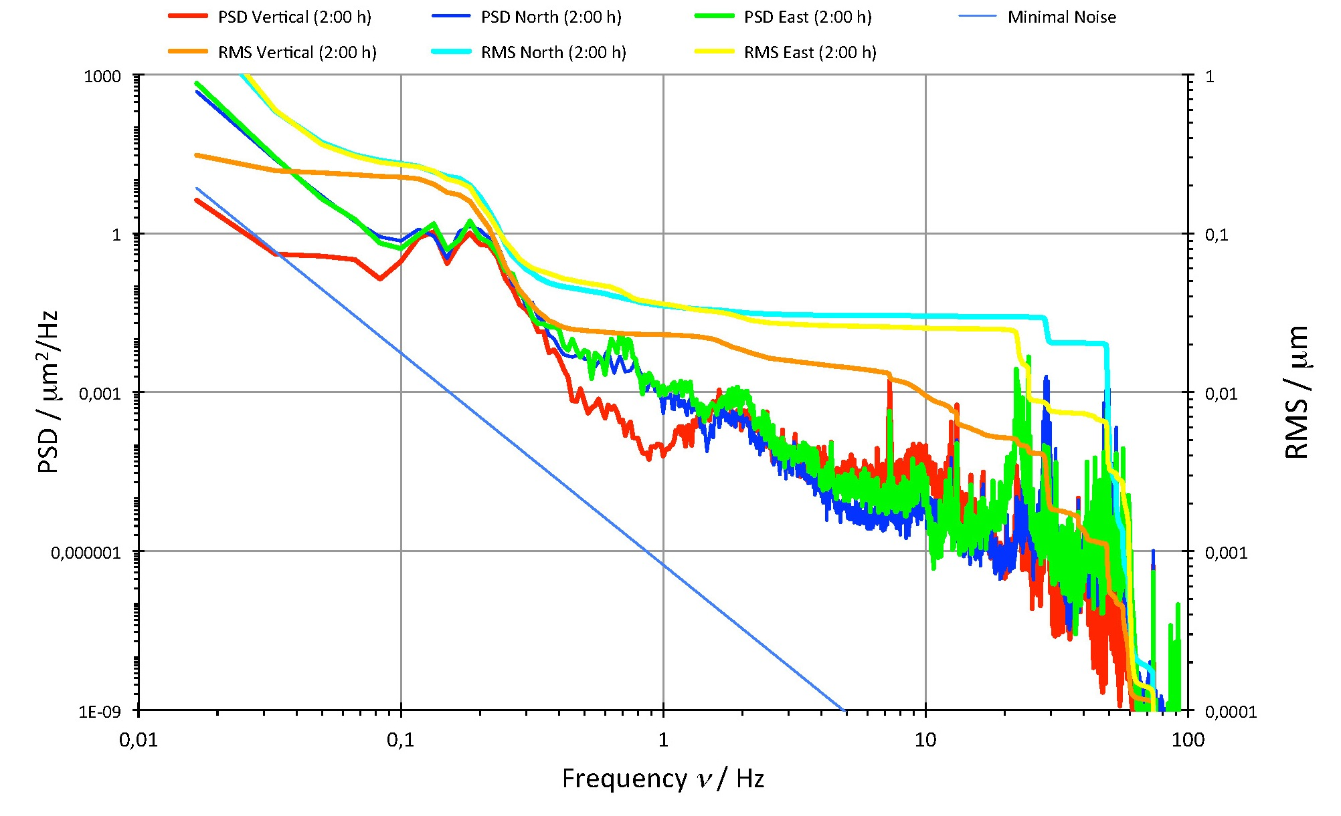
Typical Spectrum (here HERA)
Wilhelm Bialowons (DESY), Konstruktionsbesprechung, 02.10.2013
Ocean Waves
Incoherent
Ambient Noise
Floor Motion
and Resonances
Coherent
“White” Background Noise
strong decay with increasing frequency like f ^{-2.5}

Slide 12
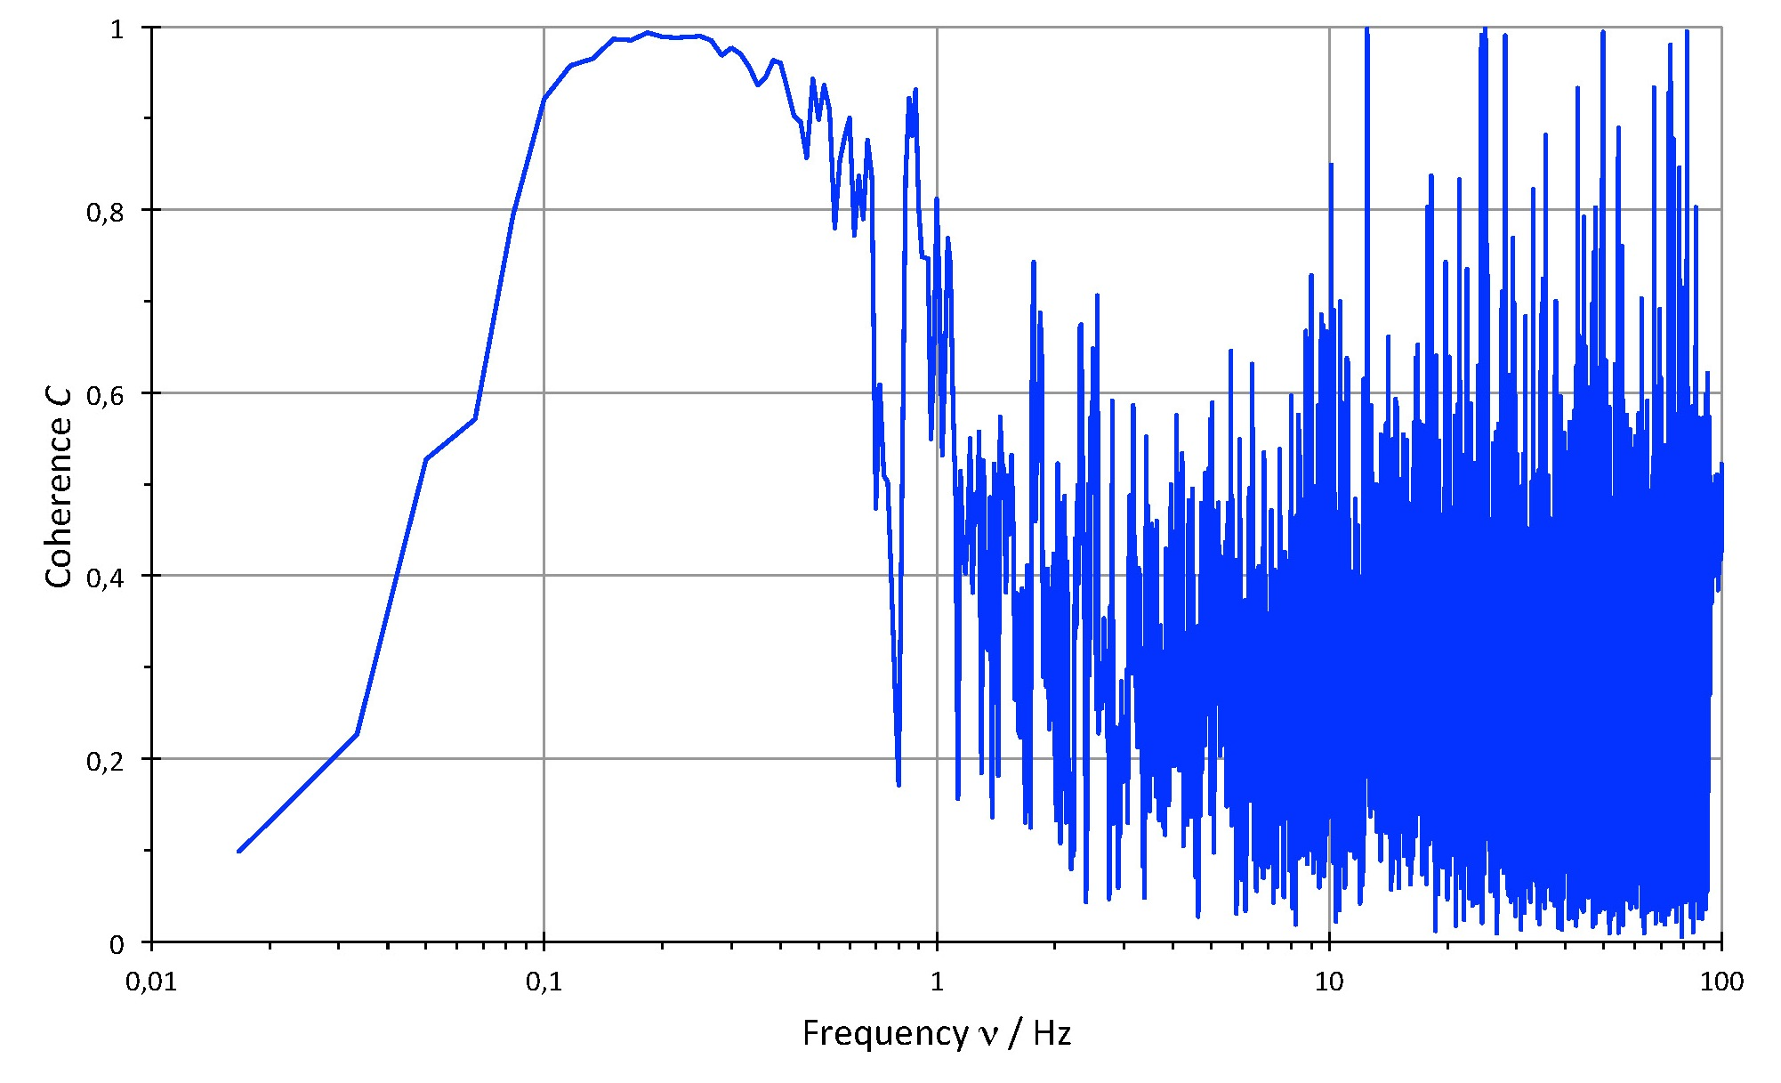
Crosscorrelation K und Coherence C
Wilhelm Bialowons (DESY), Konstruktionsbesprechung, 02.10.2013
Vertikale Kohärenz zwischen HERA WL350 und 745
(3. Juli 2013 2:00 h).
correlation only for low frequenciesc

Slide 13
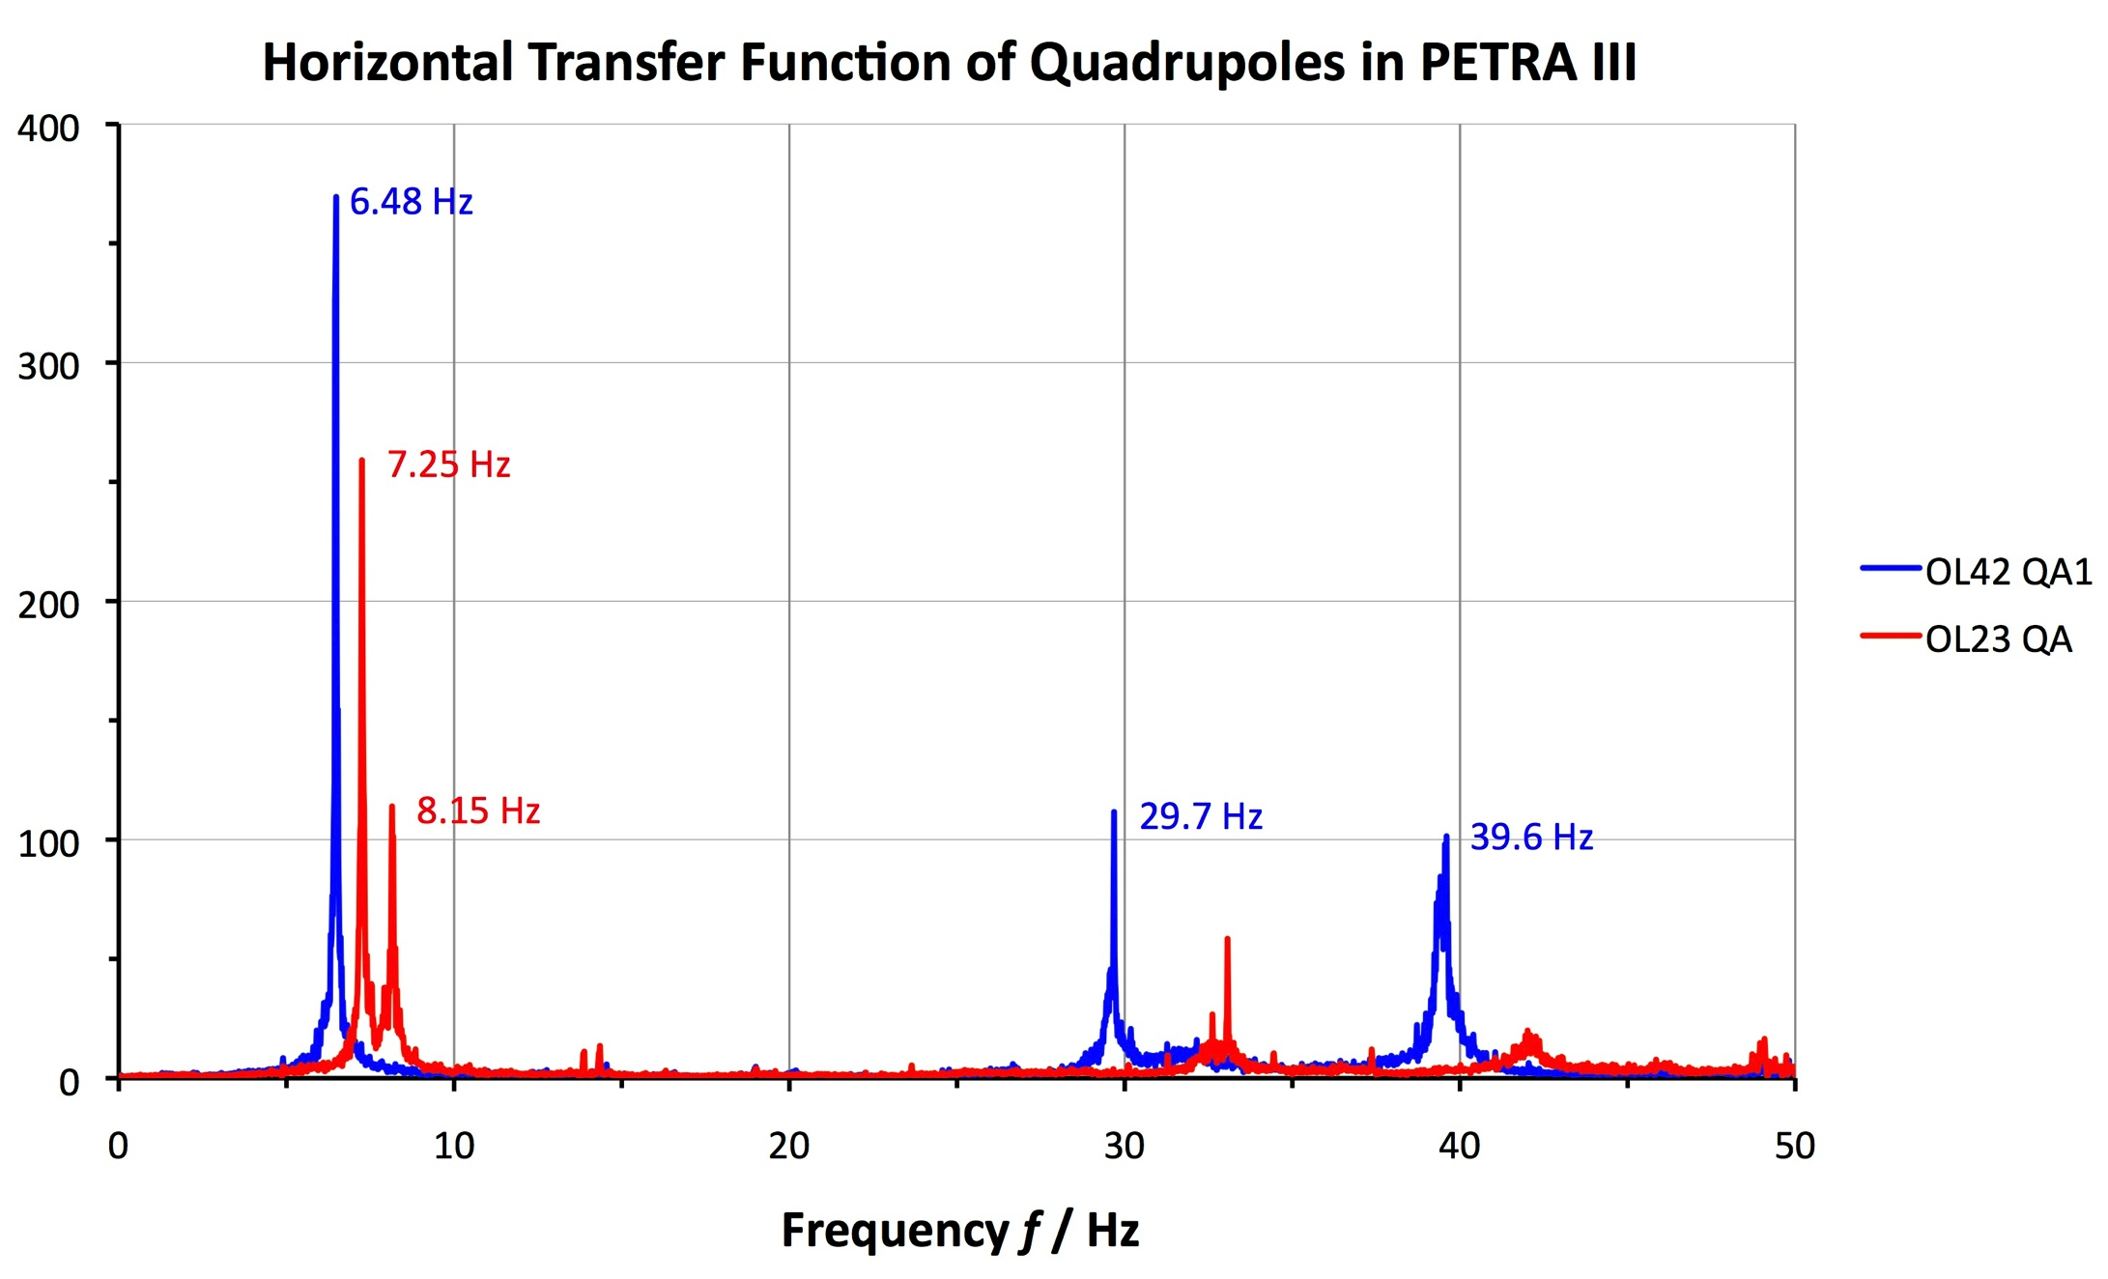
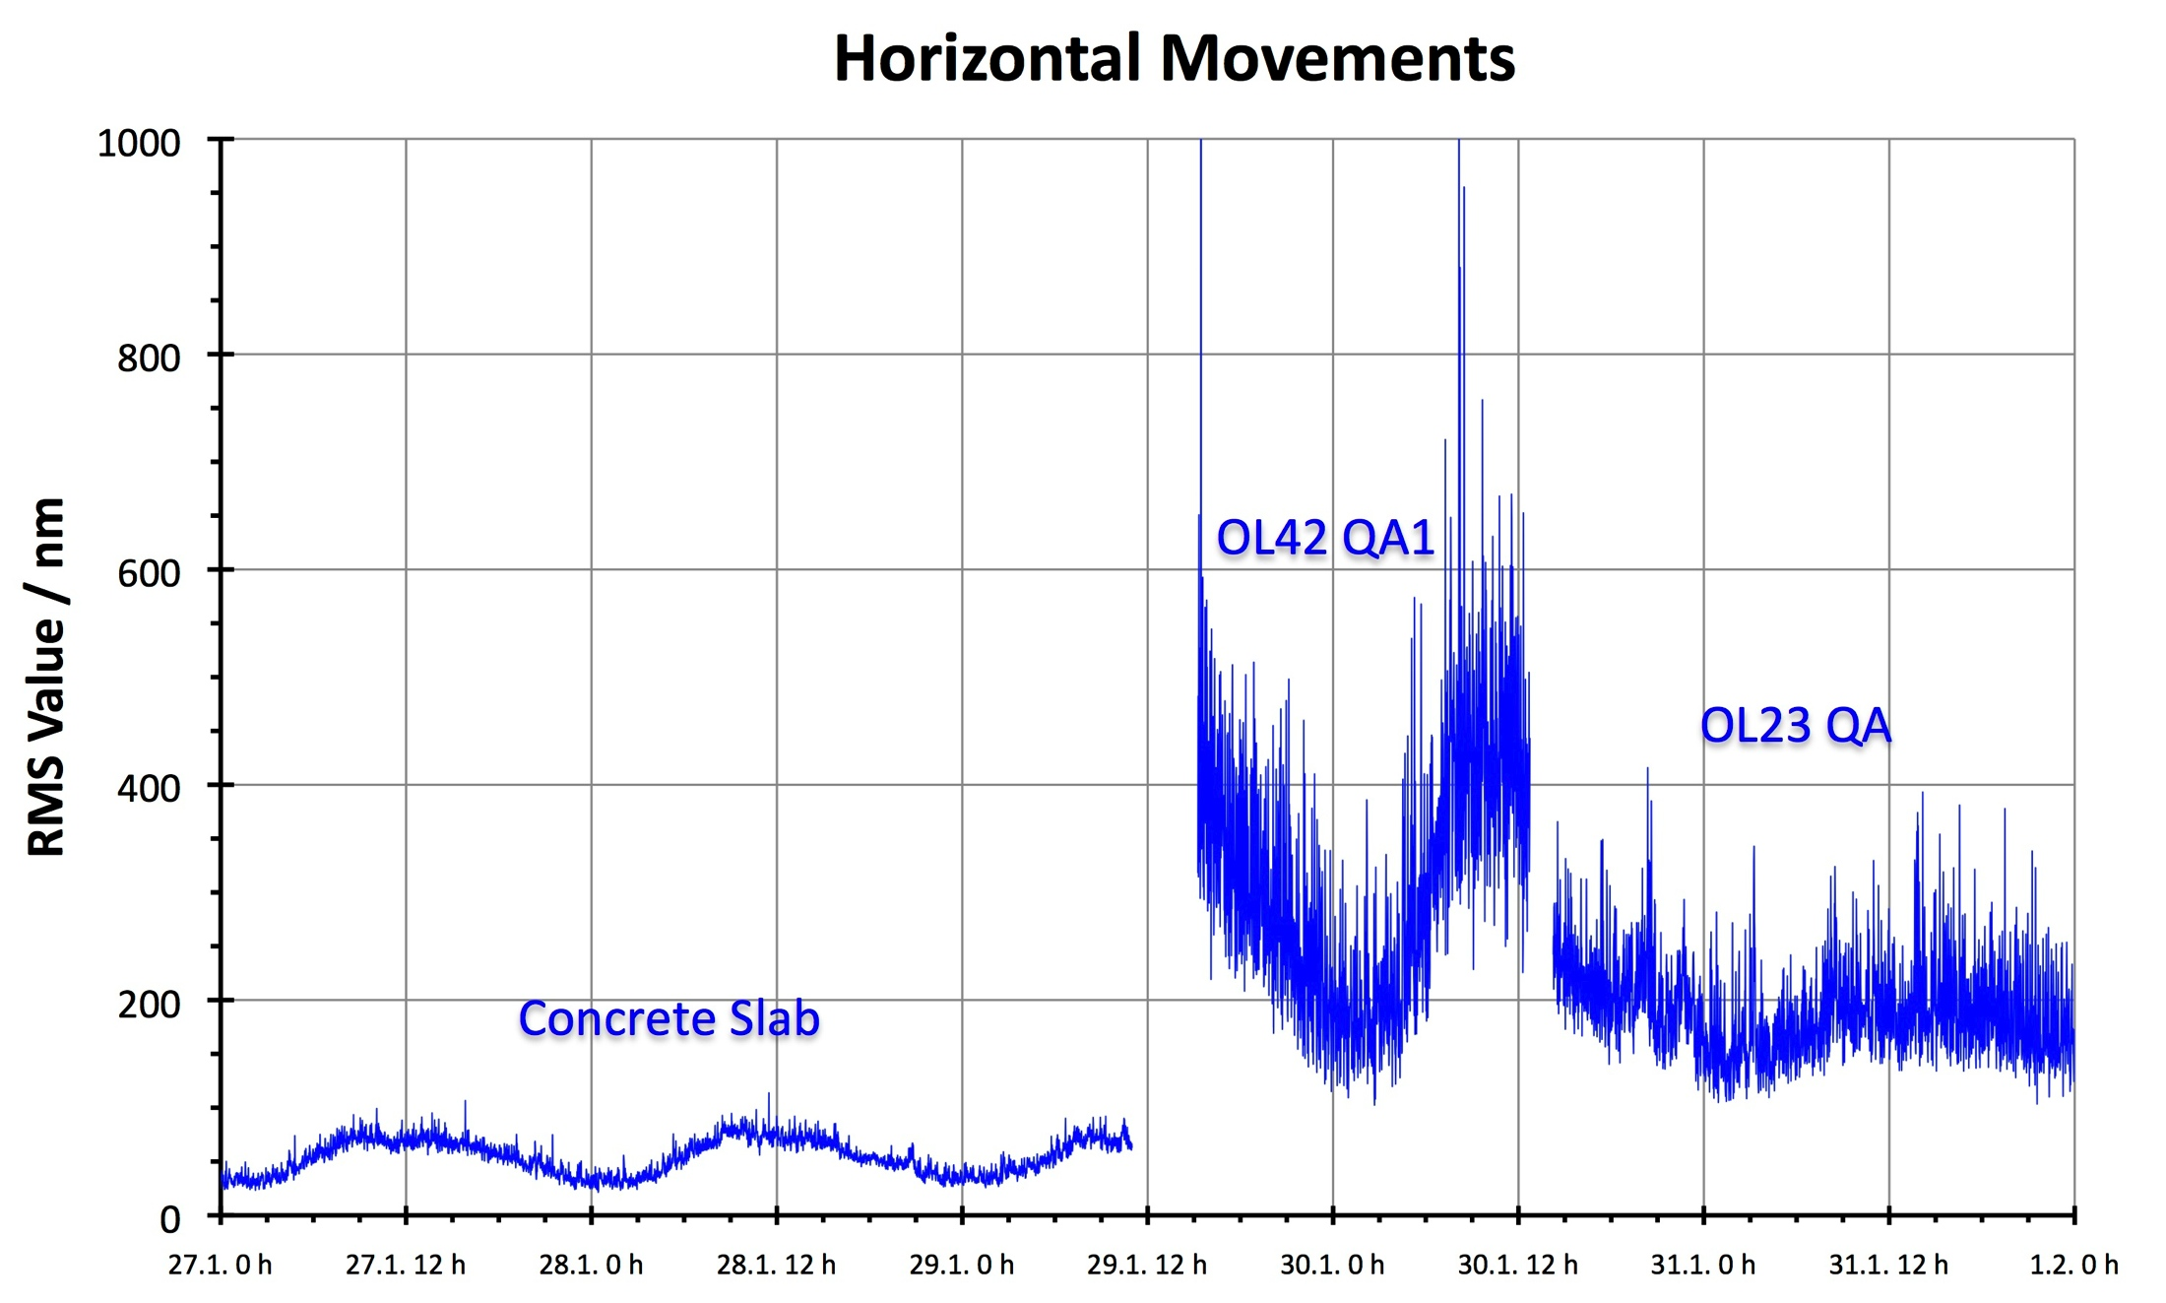
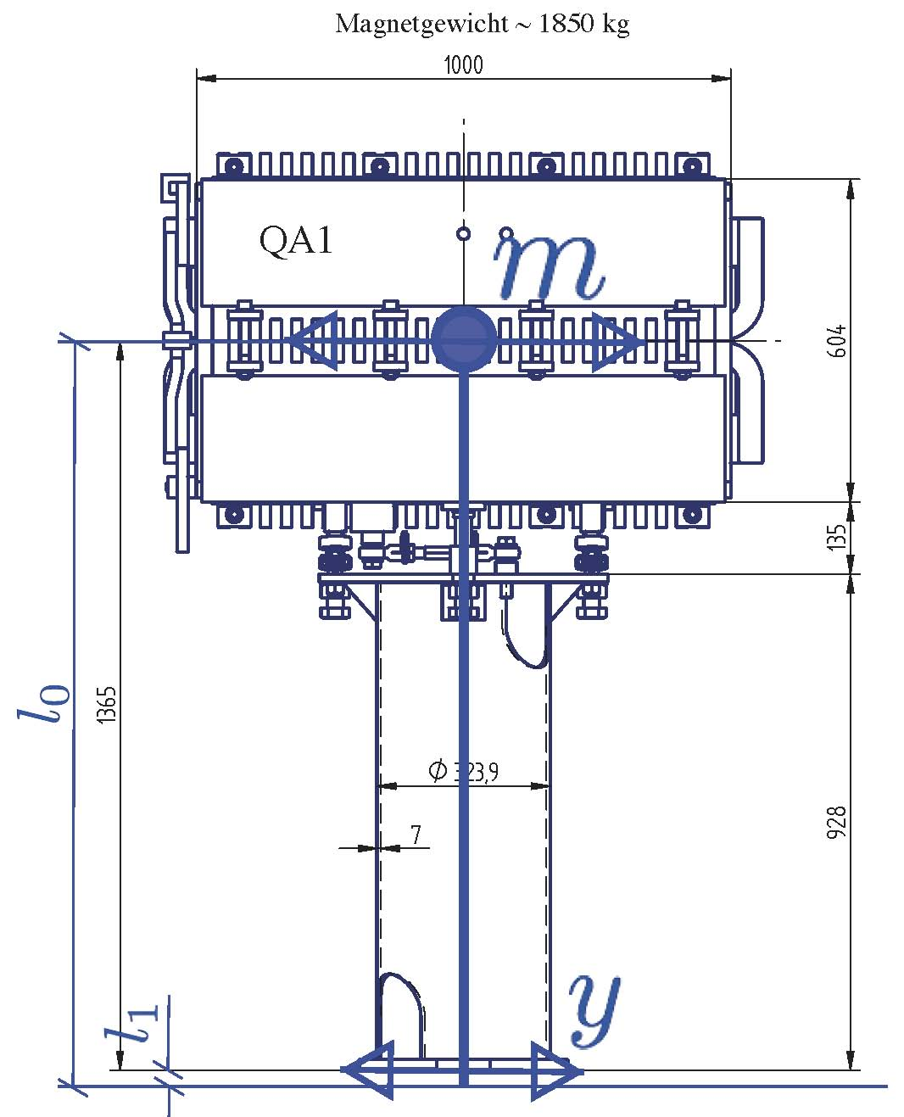
Amplification of Ground Motion
Wilhelm Bialowons (DESY), Konstruktionsbesprechung, 02.10.2013
possible amplification by structure

Slide 14
Theoretical Background - Literature
  Ground motion LEP/LHC: in general not much available (measurements in view of a linear collider study and in ATLAS/CMS experimental hall)
  [1] L. Vos, “Ground motion in LEP and LHC”, CERN-LHC-NOTE-299
  [2] M.P. Zorzano, T. Sen, “Emittance Growth for the LHC Beams Due to Head-On Beam-Beam Interaction and Ground Motion”, FERMILAB-TM-2106
  [3] V.E. Balakin, W. Coosemans et al., “Measurments of Seismic Vibrations in the CERN TT2A Tunnel for Linear Collider Studies”, CLIC-Note 191
  Ground motion HERA:
  all publications can be found at http://vibration.desy.de/documents/papers/
  Detailed studies for SSC (theoretical background):
  low frequency (f < f_{rev}ν):
    [4] K.Y. Ng, “Emittance Growth due to a Small Low-frequency Perturbations”, FERMILAB-FN-575
  high frequency (f ≥ f_{rev}ν):
    [5] V. Lebedev, V. Parkhomchuk, V. Shiltsev, G. Stupakov, “Emittance Growth due to Noise and its Suppression with the Feedback System in Large Hadron Colliders”, SSCL-Preprint-188
    [6] Y.I. Alexahin, “On the emittance growth due to noise in hadron colliders and methods of its suppresion”, NIM A 391, p. 73-76, 1996
  Ground motion CLIC: http://clic-stability.web.cern.ch/clic-stability/Ground_motion.htm

Slide 15
Theoretical Background (beam dynamics) -1
  Closed orbit distortion due to random dipole kicks:
  for HL-LHC kl similar to nominal LHC, but β about x4 larger
  Resonance effects for:
  for (HL-)LHC: e.g. k=1 and Q-n=ν_{x/y}=0.31/0.32) => f_{n}=f_{rev}ν_{x/y} = 3.46/3.60 kHz
  “ “ Q-n=ν_{x/y}±1=±1.31/1.32 => f_{n}= 14.7/14.8 kHz
  non-resonant frequencies:
  usually only low frequencies (<100 Hz) are relevant as the power spectral density decreases with ～f^{-2.5} [1]
  two main effects:
    luminosity loss due to orbit deviation at the IP (usually only relevant for linear collider with nm beam size compared to μm for the HL-LHC)
    emittance growth due to filamentation [4]

Slide 16
Theoretical Background (beam dynamics) -2
  weak-strong approximation [5]:
  assume: same spectrum for all quadrupoles, no correlation between displacements, white noise:
with feedback with gain factor g
without feedback
spectrum (quadrupole misalignment)
ν=tune (e.g. 64.32), β₀=β at quadrupole

Slide 17
Theoretical Background (beam dynamics) - 3
  strong-strong case for white noise [6]:
s₀(=0.645) accounts for that only a small fraction of the energy received from the kick is imparted into the continuum eigenmodes)

Slide 18
Estimates for HL-LHC (white noise) - 1
  nom. LHC (coll. optics, 7 TeV, β*=0.55 m):
HL-LHC (β*=0.15/0.15 m):
  => main contribution from IT in IP1/5
  Estimates for HL-LHC: assume 1% emittance growth per hour, ε_{n}=2.5 μm
  without feedback (weak strong approximation [5]):
  d_{rms} = 0.02 nm
  with feedback:
  tune spread only due to head-on bb:
  feedback parameters: β₁ = β_{BPM} = 180 m, X_{noise} = 0.05 μm (1-2 μm achieved in LHC), g=0.1
      d_{rms} = 0.022 nm (ws approx. [5]) and d_{rms} = 0.080 nm (ss case [6])
      => similar values as for CLIC!!!!
      nom. LHC (ε_{n}=3.75 μm, 7 TeV, β*=0.55 m, ξ=1.1x10⁻², same fb parameters) by factor 3-6 better
      d_{rms} = 0.15 nm (ws approx. [5]) and d_{rms} = 0.24 nm (ss case [6])
      => estimates probably too pessimistic???
Notes:
here corrected with 3.0e-2 bb tune shift

Slide 19
To keep in mind for measurements …
  following discussion with M. Guinchard …
  Measurement devices available:
    4 geophones (more precise than accelerometers) - 0.02 - 100 Hz (only on the ground)
    4 seismic accelerometers - 0.1 - 300 Hz
    approx. 20 (high frequency) – accelerometers – 2 Hz – 12 kHz
    microphones – up to 48 kHz
  initial idea for measurements:
  measure during (at least part of) run II the full spectrum (0.01 Hz – 20 kHz) and spatial correlation
  but …
    not possible to leave equipment installed, but set up time is ～1h, ～20 min per measurement point
    frequency spectrum (of cold mass):
        high frequency (kHz range) depends mainly on
        magnet/cryostat design
        possible external sources: Helium and gas flow in
        the cold mass, water flow in the pipes
        -> movement of cold mass inside cryostat difficult/impossible? to measure, but could be modeled
10 Hz

Slide 20
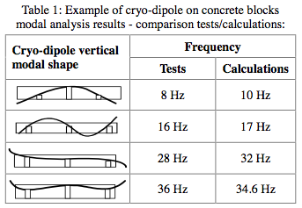
To keep in mind for measurements …
  but (continued) …
    frequency spectrum (of cold mass):
        low frequency range (10 Hz – 100 Hz) is a superposition of ground motion and excitation of the cryostat and the cold mass
        => as cryostat (～30 t, “stiff” metal) and cold mass (～3 t, “flexible”) have different mass and stiffness the frequency spectrum of the cold mass can differ considerably from the one of the cryostat
[7]
[7] K. Artoos et al., “Mechanical Dynamic Analysis of
the LHC Arc Cryo-magnets”, PAC2003

Slide 21
Proposed measurements – about 2 day campaign
  Individual measurements:
    measure spatial correlation of ground motion (<100 Hz) with geophones in Point 1 and 5 (between left/right of cavern, IT quadrupoles and along one quadrupole)
    measure transfer function from the ground to the cryostat and (evtl.) eigenmodes of the cryostat by measuring at different points at least for one magnet, optimally for several
ATLAS/CMS cavern
Q3
Q2
Q1
Q1
Q2
Q3
…
…
reference point
[8] C. Collette, K. Artoos, M. Guinchard, and C. Hauviller, “Seismic response of linear accelerators”, Phys. Rev. STAB 13, 2010

Slide 22
Proposed measurements – about 2 day campaign
  objectives and individual measurements:
    measure in particular movement of IP side of Q1 (larger than for Q2/Q3) due to shielding cone reaching into the cavern (only possible in Point 5?), correlation of movement between shielding cone and Q1
    are measurements of the high frequency part of the spectrum possible on a spare magnet
    (for details contact H. Prin)?
ATLAS/CMS
cavern
Q1

Slide 23
Proposed measurements – about 2 day campaign
  general comments on the measurements:
  measurements before “first beam”, but when sector is cooled down and all equipment in the area operational, but magnets are not powered (when powered measurements can be only done remotely and powering only changes spectrum in >100 Hz range)
  about 2 nights of access needed to perform one measurement campaign
  no other works in the nearby area!
  to keep in mind for the future …
  new IT magnets should be measured before installation
  resonance frequencies of the beam f_{n}=f_{rev}*(k*Q-n) should not coincide with resonant frequencies of the magnet/cryostat -> should be included in the design
  weight should be rather equally distributed on the
  feet of the magnet (banana shape should be avoided, otherwise
  same behaviour like a seesaw)
  install accelerometers on new IT permanently?

Slide 24
BACKUP SLIDES

Slide 25
Estimates for HL-LHC (white noise) – 3.3e-3 bb
  nom. LHC (coll. optics, 7 TeV, β*=0.55 m):
HL-LHC (β*=0.15/0.15 m):
  => main contribution from IT in IP1/5
  Estimates for HL-LHC: assume 1% emittance growth per hour, ε_{n}=2.5 μm
  without feedback (weak strong approximation [5]):
  d_{rms} = 0.02 nm
  with feedback (3x10⁻³ bb parameter):
  tune spread only due to head-on bb:
  feedback parameters: β₁ = β_{BPM} = 180 m, X_{noise} = 0.1 μm (1-2 μm achieved in LHC)
      d_{rms} = 0.27 nm (ws approx. [5]) and d_{rms} = 0.32 nm (ss case [6])
      => similar values as for CLIC!!!!
      but: nom. LHC (ε_{n}=3.75 μm, 7 TeV, β*=0.55 m, ξ=3x10⁻³, same fb parameters) similar
      d_{rms} = 0.52 nm (ws approx. [5]) and d_{rms} = 0.60 nm (ss case [6])
      => estimates probably too pessimistic???

