Slide 1
Update of the HL-LHC machine lay-out IR1 IR5 and upcoming issues
Presented by P. Fessia
Work by all WPs, particularly from WP2, WP3, WP6, WP 10, WP12, WP3

Slide 2
Summary
Status of foreseen modifications
New work to be done for next release
Approval process

Slide 3
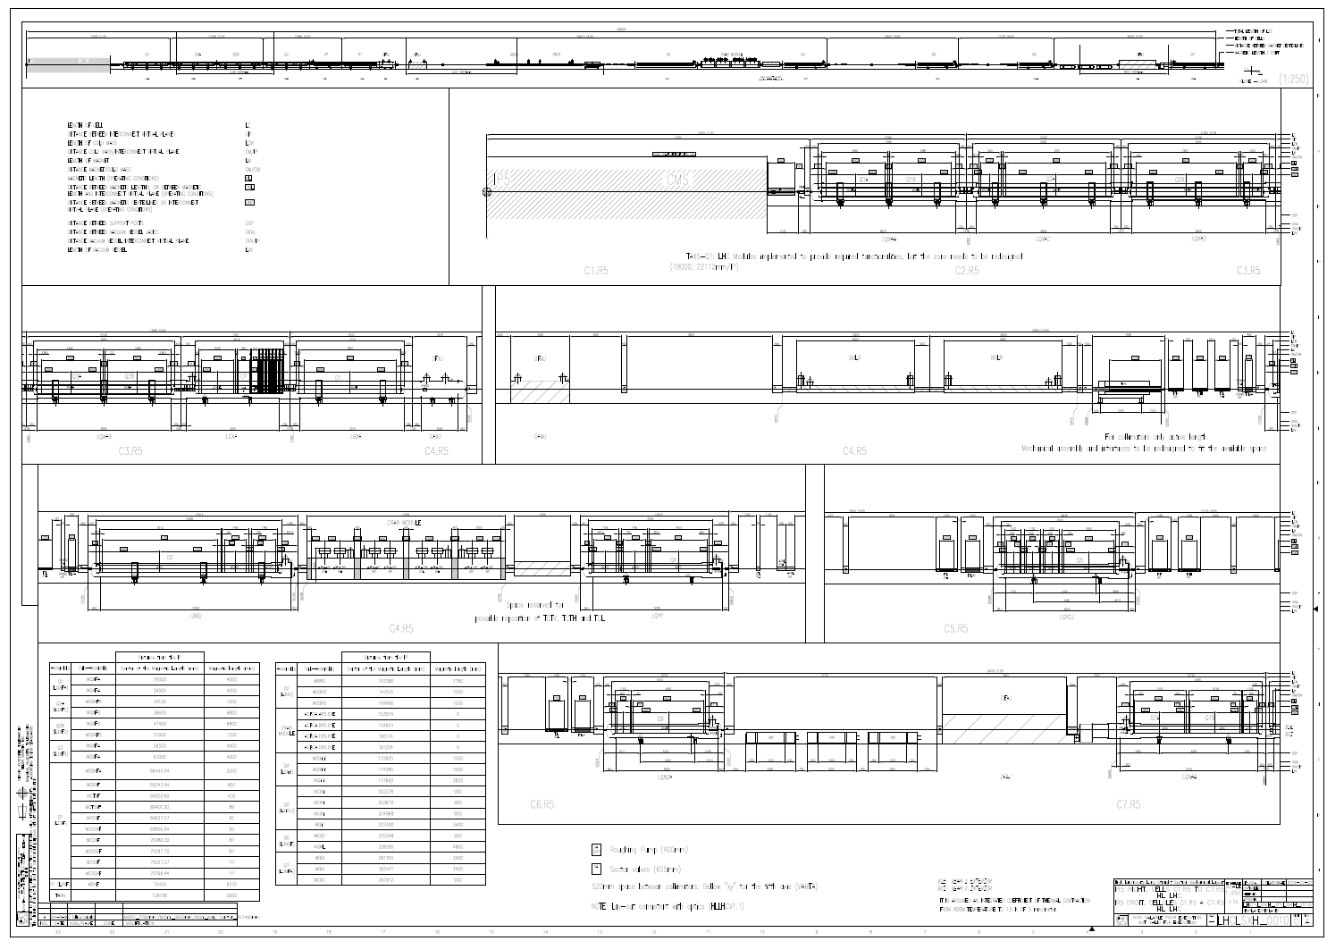
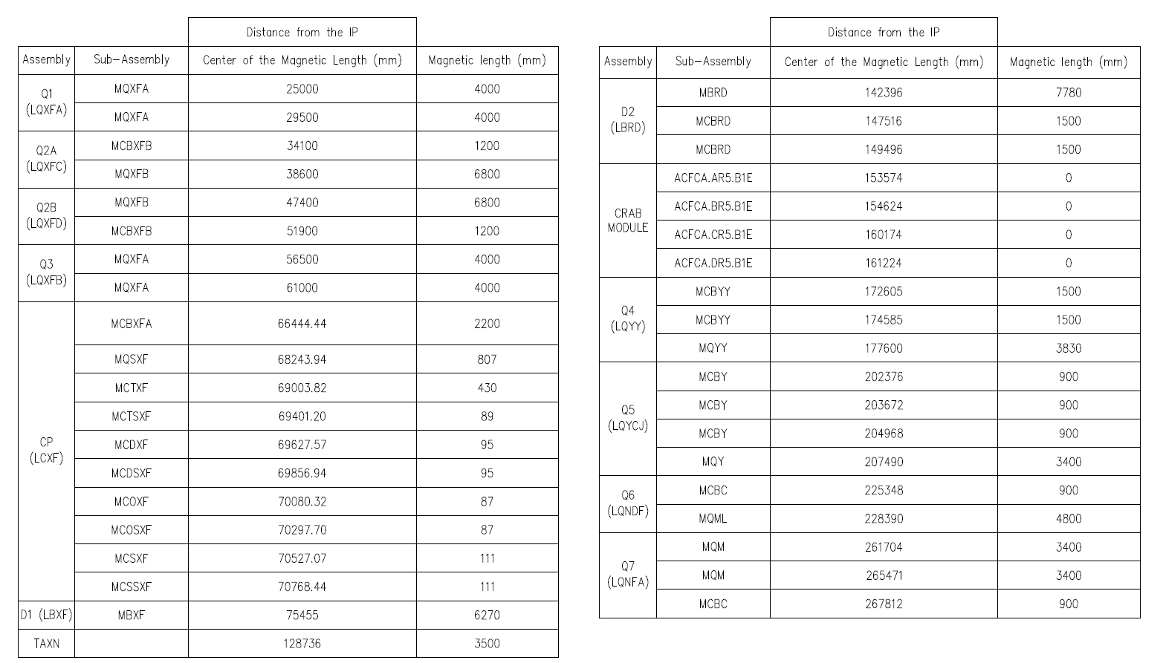

Slide 4
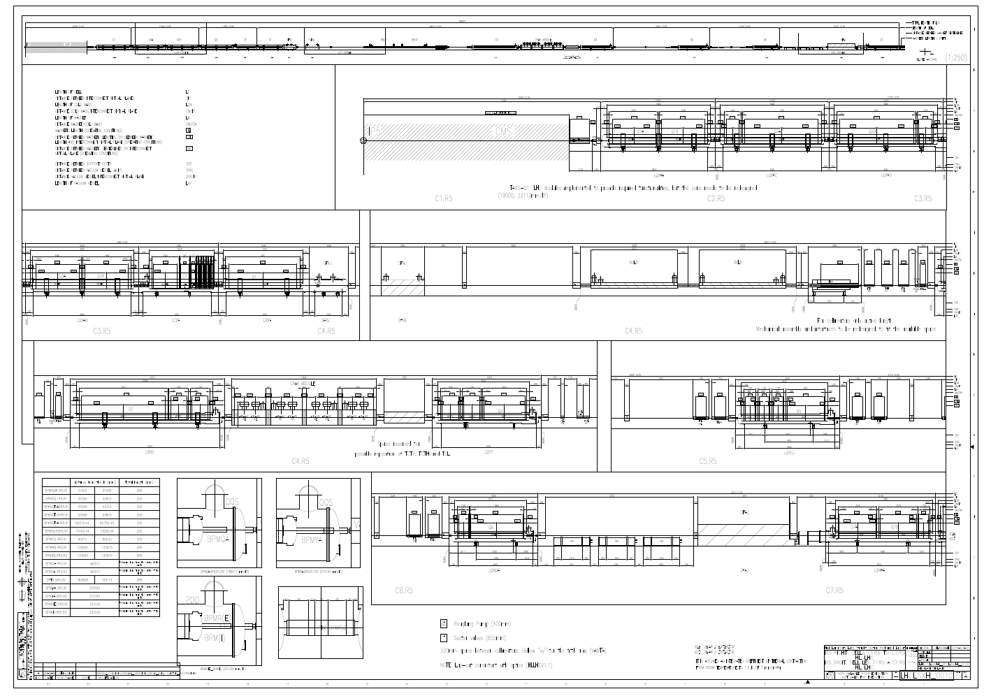
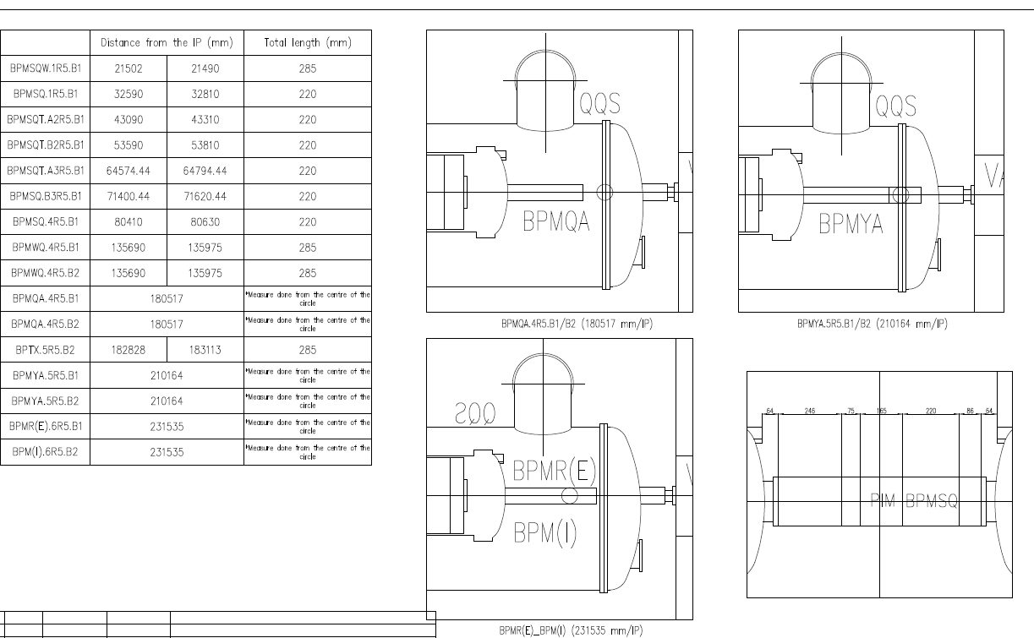

Slide 5
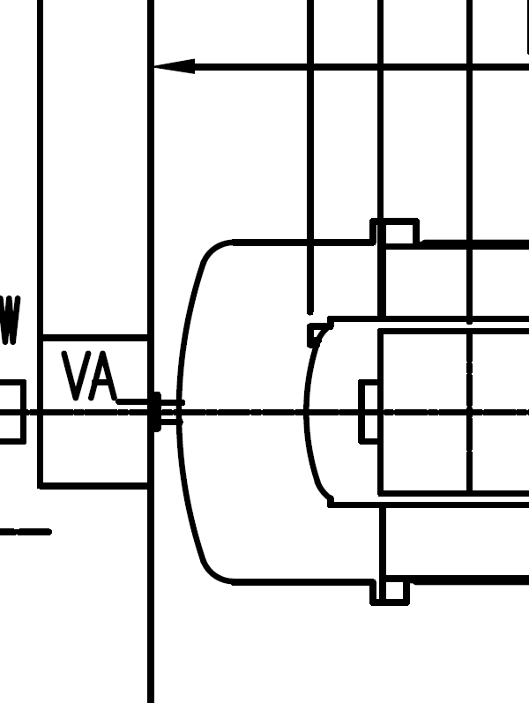
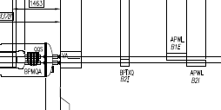
List of items when we started the work
Topic | status
MCBY MCBC: discrepancies in magnetic length and applicable drawings/ source of information | Values used by optics have been introduced in the database lay-out after the measurement of the series production. Agreed to revert to the design value. The last are on the drawings. ACTION: Conf. management to change database then optics will change file
Shuffling among points to reduce work load for Q4 and Q6 modifications (new Q5 and Q6) and Q4 assembly (corrector position vs quadrupole) | Proposal as in the lay-out, no changes. Seem feasible (1st check of correction scheme and needs to change MQY polarity done). Further discussion ongoing
Q1 longitudinal configuration with enough length for warm to cold transition/bellow/capillaries exit | The Distance between the warm flange of the Q1 cryostat and the reference plane of the Q1 CM is now compliant with technical requirements. Issue the Q1 to TAS area see below
BPM: revision of space allocation and type position by position | Done, all names updated, introduced graphical representation of the BPM mechanical lengths. Issue: BPM mechanical length see below
Q1-D1 interconnects revision of longitudinal space allocation taking into account capillaries BPM and bellow design | Study triggered see below open issues
DFM: selection of most probable installation slot | Done
magnet mechanical length for D2 and Q4: discrepancies between Conceptual spec and lay-out | CS to be changed according to plans, but iteration necessary when design of object more advanced
Pick up for crabs | Introduced

Slide 6
Uncompleted and new issues
Q1 to TAS distance is today even shorter then the LHC one. Necessary detailed mechanical study. Task agreed to be carried out by the WP12, but starting now
Preliminary discussion on Q5 IR6 done, and also 1st lay-out draft by H. Prin. When clearer make official drawings
TCLMA need between TAXN and Q4. New computations lead to think that it can be eliminated but whole analysis process not completed
Point 4
  Cleaning of the reservation space completed but not yet approved: configuration management is preparing official document to be submitted to LMC and HL-PLC for approval
  Re-population to be started, according to available resource in integration team

Slide 7
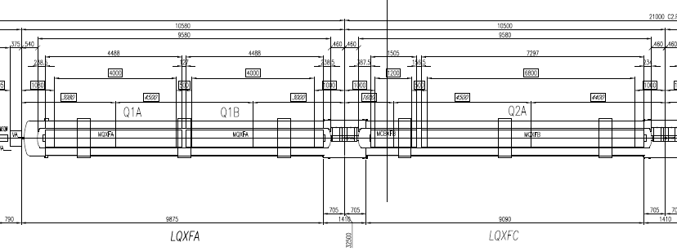
Main issue
Several concurrent issues for the lay-out Q1 to D1. Proposal: collect inputs from various stakeholders in order to prepare a coherent mechanical proposal to be provided to WP2 as starting point for new iteration. Issues
  Distance TAS-Q1 probably too short
  Distance between mechanical ends of the MQXF(A/B) magnets and end cover reference plane probably not enough to allocate all needed equipment-> possible increase of length of the units. IMPORTANT TO DECIDE HOW THE BUS BAR WILL BE ROUTED.
  Interconnection 1st study (“capillaries diameters ” now avaialble) lead to conclude that we are too short
Possible need to allocate more space to the correctors in D2, Q4. Under discussion

Slide 8
BPM minimum functional length 220 mm.
Mechanical length will be larger
Especially because of i/o of capillaries
205 mm
To be added distance capillary exit to welding flange
CM
CM
64 mm
165-170 mm
64 mm
CM to
Welding flare
Bellow CM/beam screen
Capillary I/O
PIM
BPM
Capillary I/O
CM to
Welding flare
Min total=883 mm, but still lot of mechanical studies to be performed
Transition W shielding in BPM to magnet beam screen to be defined
Today we have 810 mm
No radiation consideration in the analysis.
Hp: V line interconnect set the interconnect global length
160 mm
To be added distance capillary exit to welding flange

Slide 9
Approval process
The modified lay-out will be put in approval in the incoming days together with the HL-LHC excel file of the optics 1.1

