Slide 1
Minority Carriers: A Revolution for Low Background TPC Work
Dan Snowden-Ifft
7th Symposium on Large TPCs for Low Energy Rare Event Detection
December 16, 2014

Slide 2









Directional Recoil Identification From Tracks (DRIFT)
Sheffield University
Neil Spooner – PI
Matt Robinson
Dan Walker
Stephen Sadler
Sam Tefler
Andrew Scarff
Anthony Ezeribe
Frederic Mouton
Trevor Gamble
University of New Mexico
Dinesh Loomba - PI
Michael Gold – PI
John Matthews - PI
Eric Lee
Eric Miller
Nguyen Phan
Randy Lafler
Colorado State University
John Harton – PI
Jeff Brack
Dave Warner
Alexei Dorofeev
Fred Shuckman II
Occidental College
Dan Snowden-Ifft - PI
Jean-Luc Gauvreau
Chuck Oravec
Alex Lumnah
Chongmo Tang
University of Hawaii
Sven Vahsen – PI
Tom Thorped
Boulby Mine
Sean Paling – PI
Emma Meehan
Louise Yeoman
Wellesley College
James Battat – PI
The University of Edinburgh
Alex Murphy – PI

Slide 3
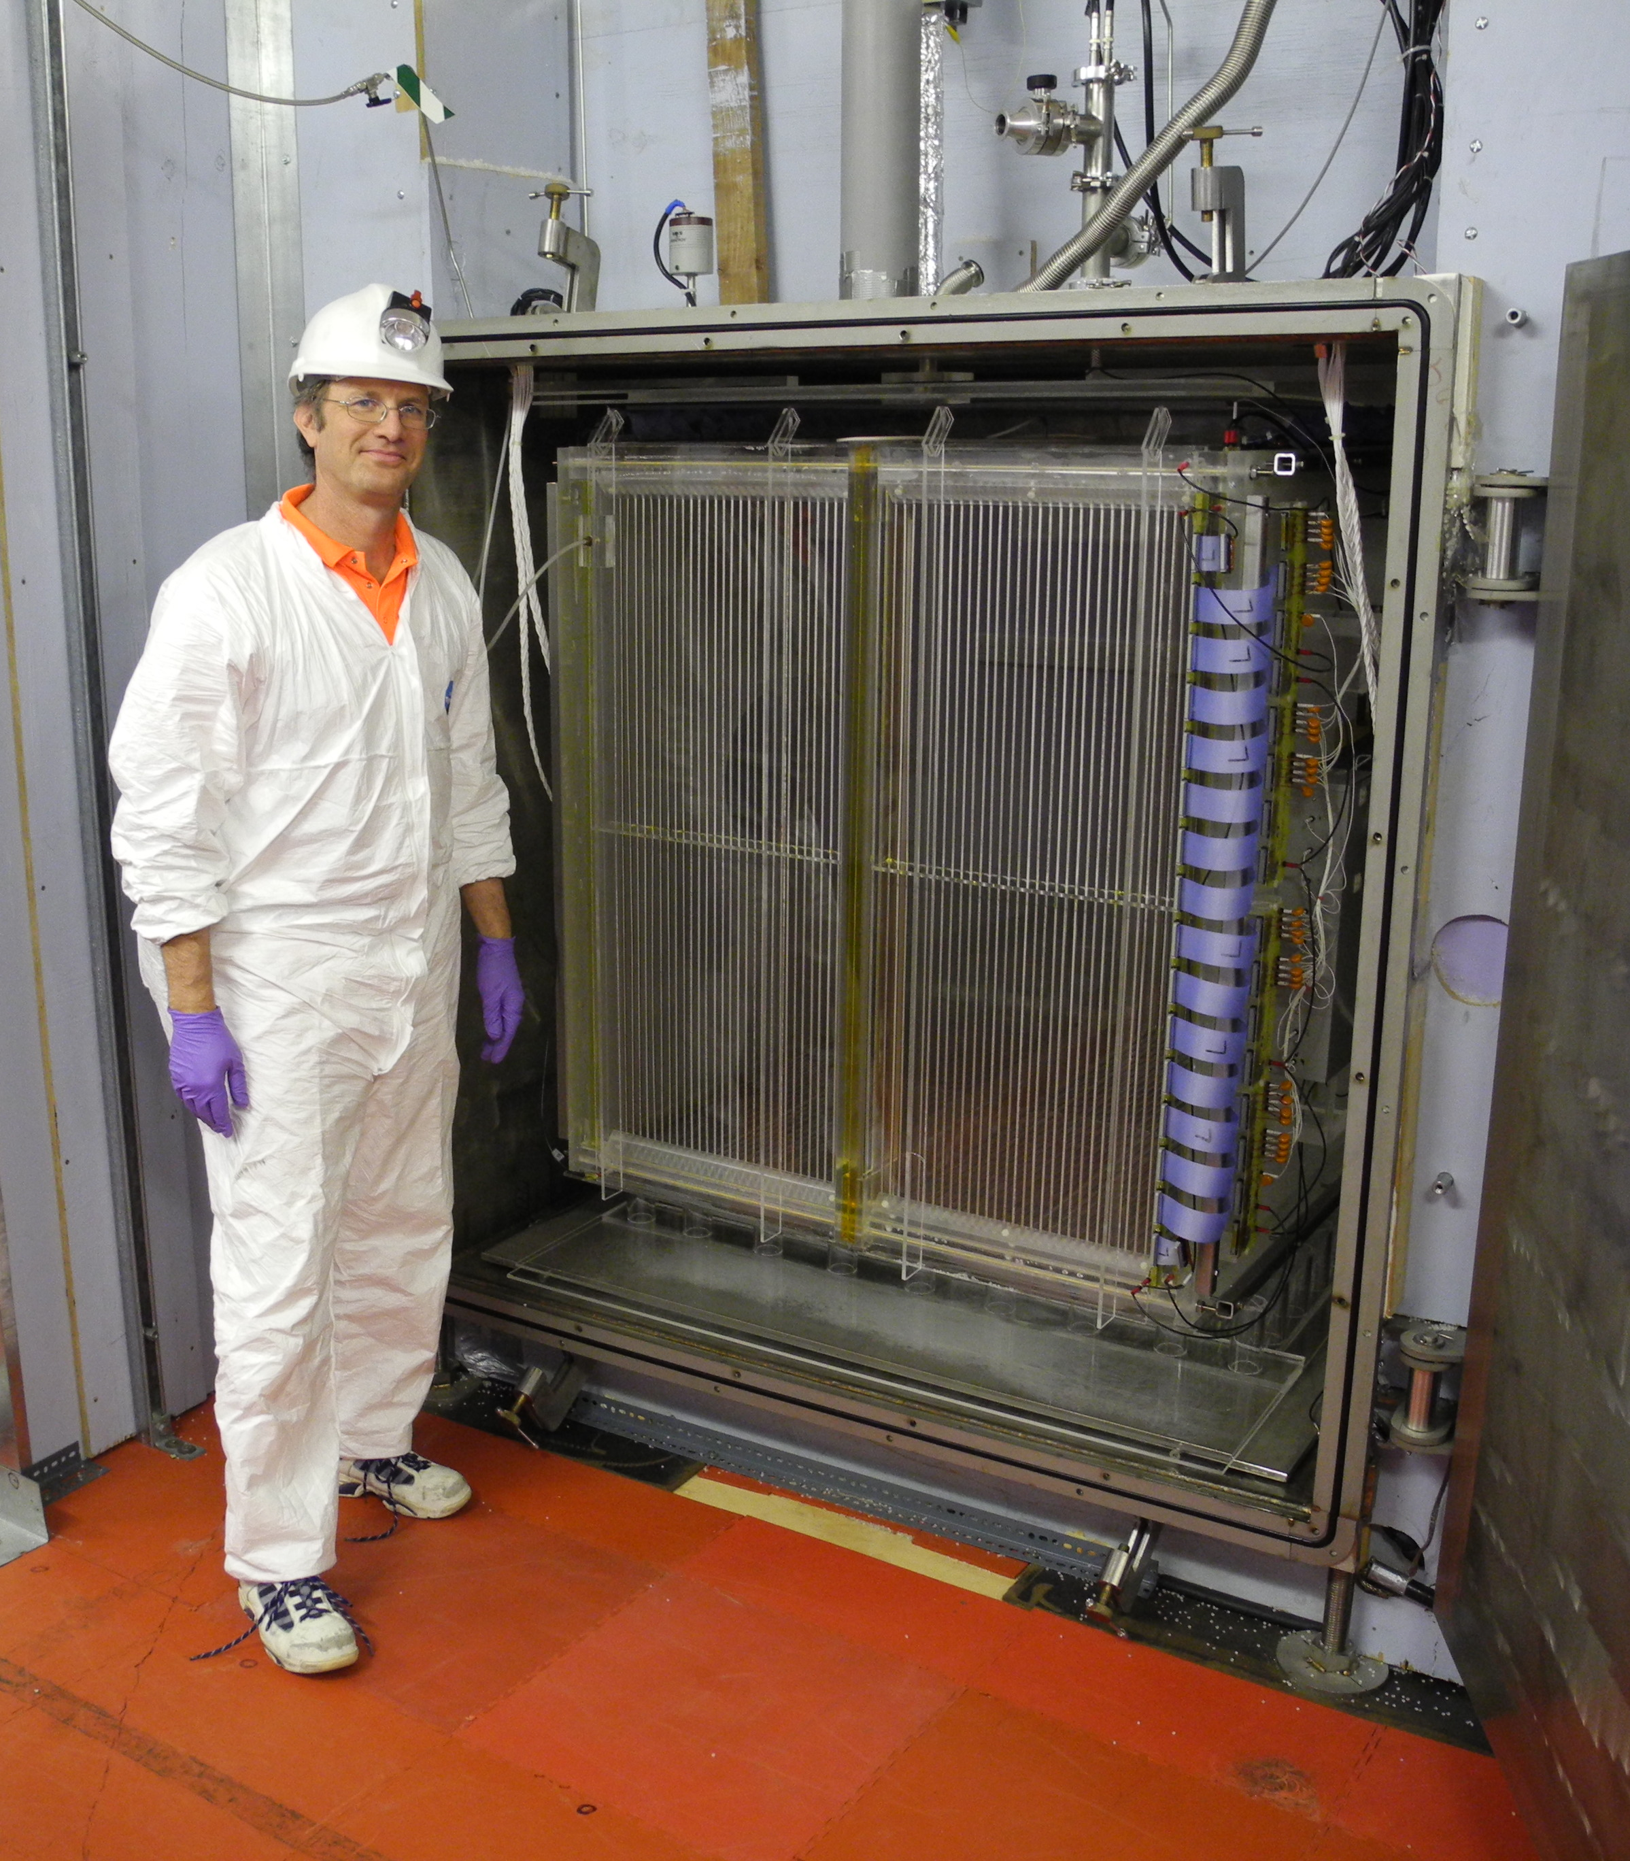
Introduction to DRIFT
Directional Recoil Identification From Tracks (DRIFT) is a directional dark matter detector (PRD, 61 (2000) 1, NIMA, 600 (2009) 417, AstroPle, 31 (2009) 261)
DRIFT has been operating in Boulby since 2001
DRIFT-I -> DRIFT-II (a-e)
DRIFT-IId volume = 0.8 m³, ~40 Torr gas
MWPC readouts (NIMA, 555 (2005) 173)
Negative CS₂ anion drift to limit diffusion (PRD, 61 (2000) 1)
Phenomenal Compton background rejection (AstroPle, 28 (2007) 409)
Many gas mixtures possible
DRIFT-IId used a 30-10 Torr of CS₂-CF₄ to optimize for spin-dependent limits, 139 g target mass. (AstroPle, 35(2007) 397)
Relatively cheap, clean, stable and scalable technology.

Slide 4
DRIFT-IId Data
47.4 days of live time recorded
A background of 130 events per day found
AstroPle, 35, (2012) 397.

Slide 5
Radon Progeny Recoils
α
-
-
α
-
-
-
-
-
-
-
20 μm
²¹⁸Po⁺
²²²Rn
²¹⁸Po
²¹⁴Pb⁺
Range = 12 μm
………………………………………………………………………...
…………………………………………………………………………
………………………………………………………………………..
²¹⁸Po
-
0 V
-32.5 kV
0 V
²¹⁴Pb⁺
AstroPle, 28, (2007) 409.

Slide 6
DRIFT-IId Data
Diffusion of the RPRs from the central cathode increases their width
So used width as a crude discrimination parameter
Black = Background
Red = Neutron recoils
AstroPle, 35, (2012) 397.

Slide 7
DRIFT-IId Data
Select an signal window
For 100 GeV WIMPs the signal window gives only 8% efficiency for events passing the cuts
AstroPle, 35, (2012) 397.

Slide 8
DRIFT-IId Spin-Dependent WIMP Limits
AstroPle, 35, (2012) 397.

Slide 9
Mobility and Diffusion Experiment
Vacuum Vessel
20 μm SS
anode wires
2 mm spacing
Al photo-cathode
200 μm pinhole
Quartz
(UV transmitting) lens
Grid wire
planes
Xe
Flashlamp
CS⁻
e⁻
e⁻
CS⁻
e⁻
CS⁻
Quartz
window
15 cm
Amptek Amplifiers
Computer
1 MHz
Digitizers
5 anode
readouts

Slide 10
Lateral Diffusion Measurements

Slide 11
Diffusion Theory

Slide 12
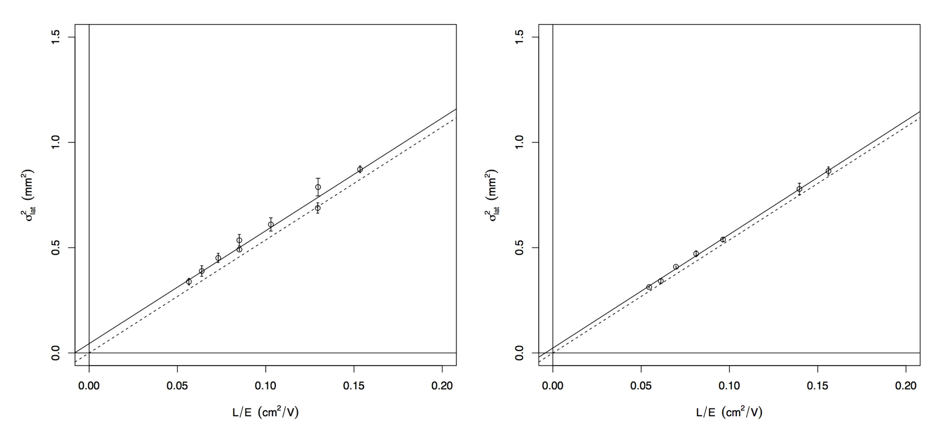
Lateral Diffusion Results
40 Torr CS₂
30-10 Torr CS₂+CF₄
Rev. Sci. Inst., 84, (2013) 1.

Slide 13
Longitudinal Diffusion Measurements
E = 239 V/cm
E = 118 V/cm
t = 0 => flashlamp pulse
Rev. Sci. Inst., 84, (2013) 1.

Slide 14
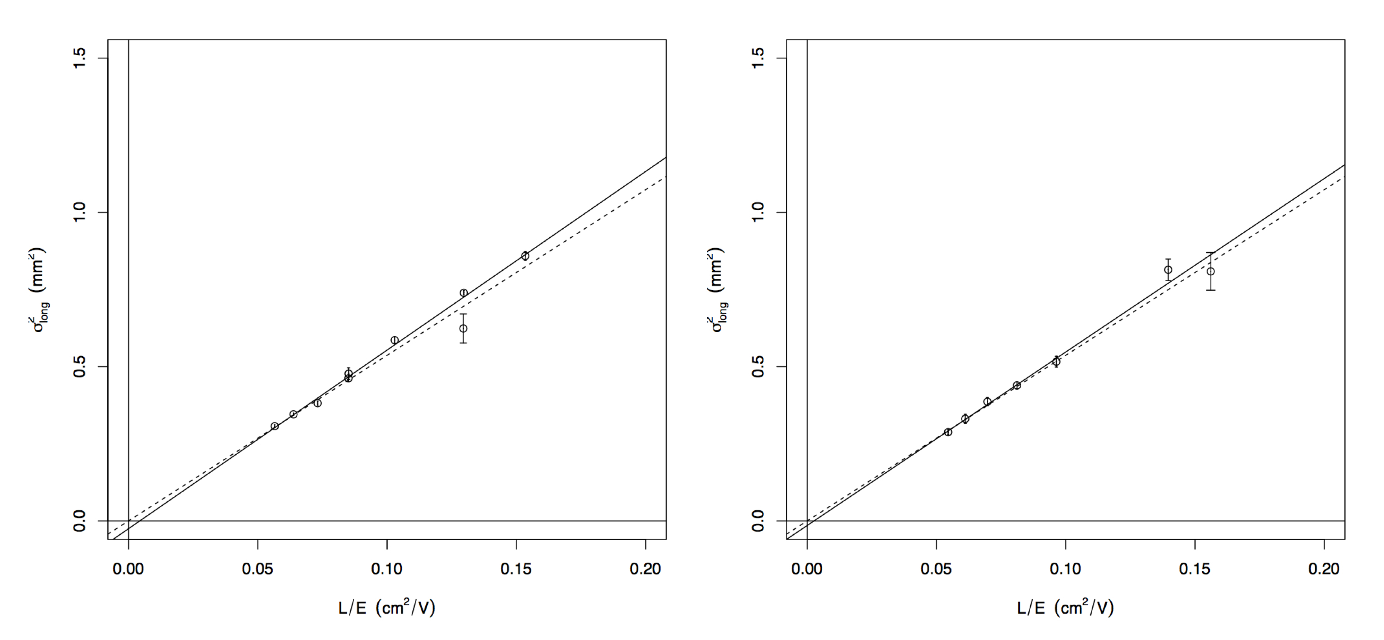
Longitudinal Diffusion Results
40 Torr CS₂
30-10 Torr CS₂+CF₄
Rev. Sci. Inst., 84, (2013) 1.

Slide 15
As discussed here in 2012
Separate peaks in the data indicate that other carriers, minority carriers, are generated at the site of the ionization and carry their charge with different velocity to the readout plane.
An interesting puzzle but of little impact to negative ion drift detectors because of their tiny size.
BUT…
Minority Carriers
!

Slide 16
Discovery of Minority Carriers in Mixtures of CS₂ and O₂
Rev. Sci. Inst., 85, (2014) 1.

Slide 17
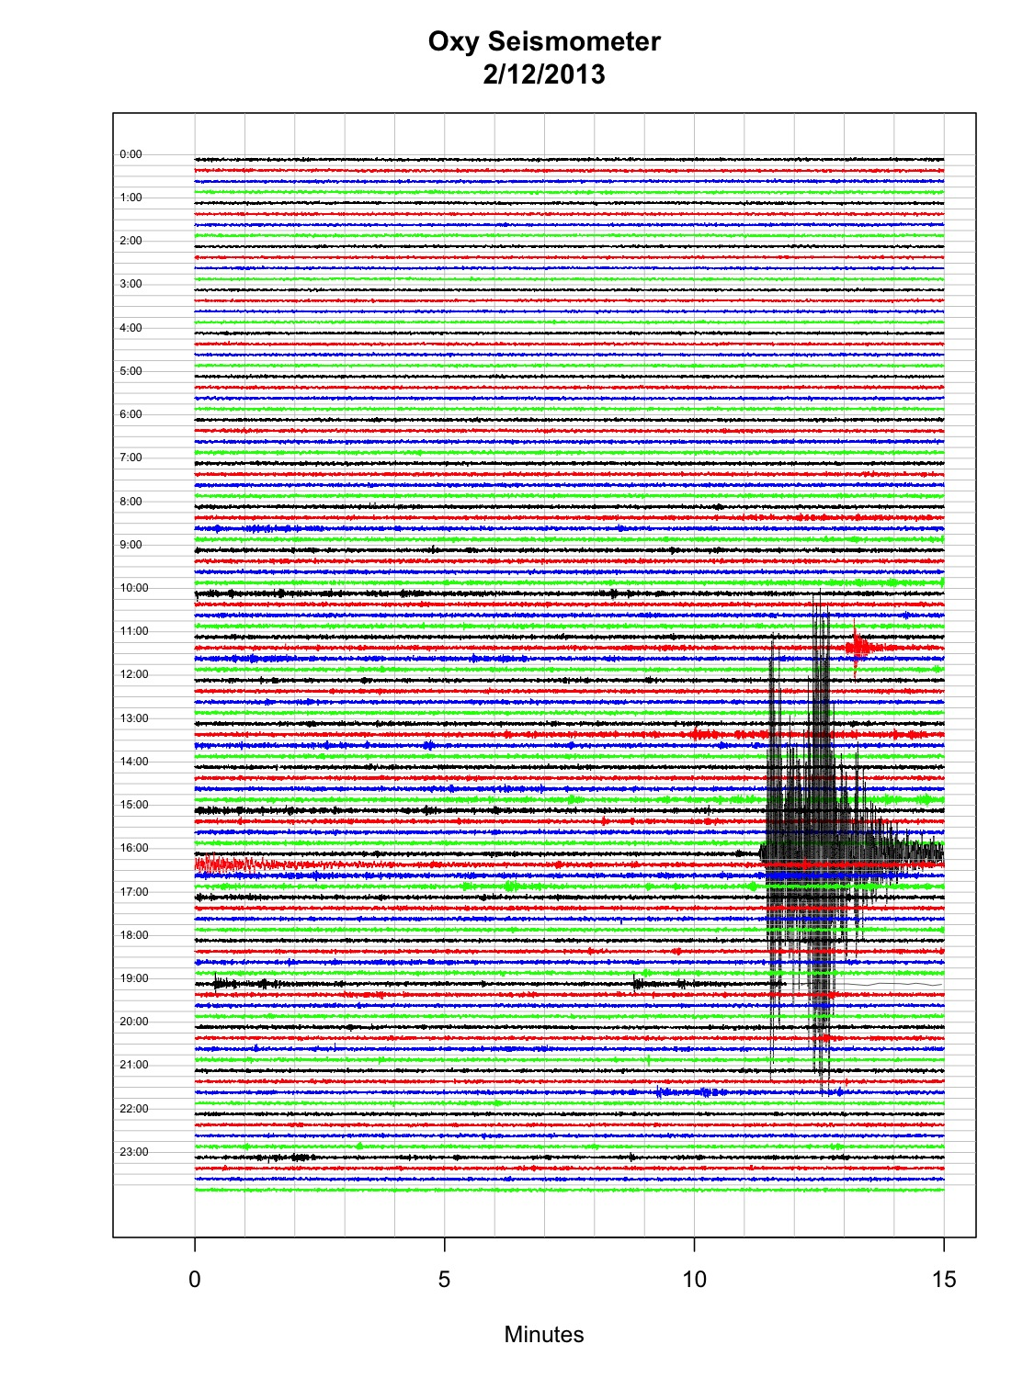
Earthquake Fiducialization

Slide 18
Discovery of Minority Carriers in Mixtures of CS₂ and O₂
Rev. Sci. Inst., 85, (2014) 1.

Slide 19
Fall 2013 DRIFT-IId Results with 30-10-1 Torr CS₂-CF₄-O₂
50 keVr F

Slide 20
DRIFT-IId Results with 30-10-1 Torr CS₂-CF₄-O₂
ArXiv 1410:7821

Slide 21
Fall 2014 DRIFT-IId Results with 30-10-1 Torr CS₂-CF₄-O₂
Preliminary

Slide 22
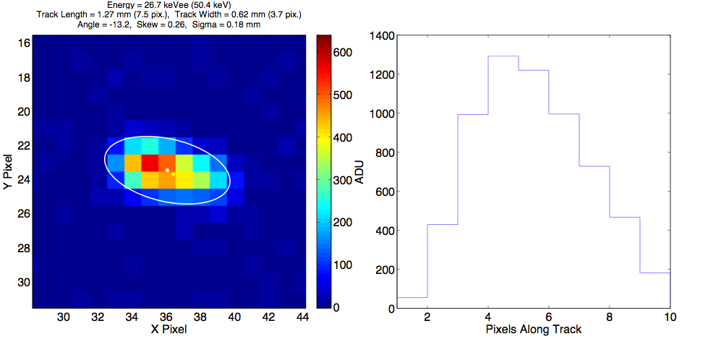
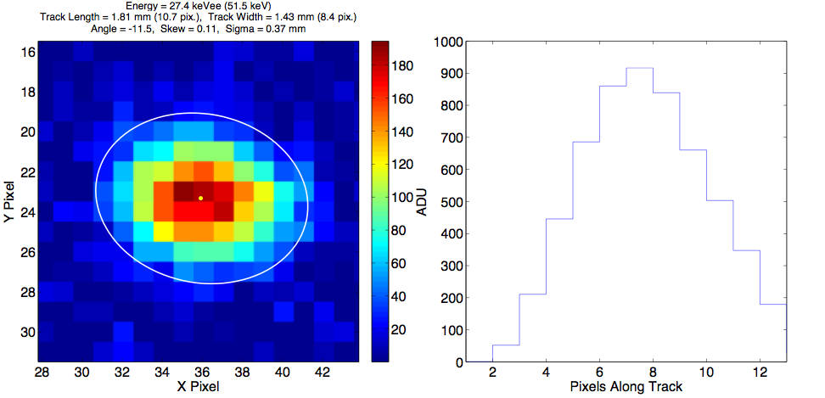
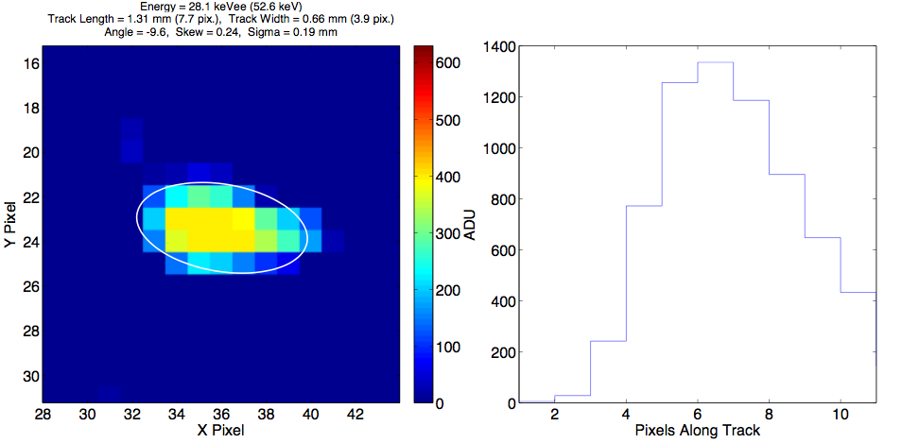
Deconvolution of Tracks
Knowledge of the drift distance allows us to precisely calculate the diffusion (the PSF) of the ionization.
Therefore we should be able to, like astronomers, deconvolve the observed track to get better knowledge of the actual track.
Here is a theoretical (20 cm drift) simulation.
Actual
Diffused
Deconvolved
Figure 7 – Simulation results for deconvolution of a 49.4 keVr F recoil track in 100 Torr CF₄. Left: the original, un-diffused image; Middle: the image with the same S/N, diffusion (σ~0.4mm) and pixelization as seen by Phan’s R&D detector; and Right: deconvolution result of the middle image. The deconvolved image correctly reconstructs the energy to within 5%, the track direction to 3.6 degrees and the head-tail asymmetry to within 8%. In the middle ‘detector’ image the asymmetry is almost washed out.

Slide 23
Deconvolution of Tracks
Here is some real data taken with a GEM-Optical readout TPC
Preliminary

Slide 24
Conclusion
The addition of O₂ to mixtures containing CS₂ produces abundant minority carriers.
The minority carriers allow us to accurately measure the drift distance of segments of ionization.
Fiducialization has revolutionized DRIFT’s background rejection capabilities because our only known backgrounds come from the central cathode.
New limits have been set and data for better limits are being taken now.
Knowledge of the diffusion should allow DRIFT to deconvolve tracks to obtain better directional information.
Vive la Révolution!

Slide 25
Thanks

Slide 26
Extra Slides

Slide 27
Alpha + O₂
Rev. Sci. Inst., 85, (2014) 1.

Slide 28
Triggerless Fiducialization
Rev. Sci. Inst., 85, (2014) 1.

Slide 29
The problem
The 6 MeV Po-218 alpha can hide in central cathode wires.
α
20 μm
Range = 12 μm
²¹⁸Po
-
²¹⁴Pb⁺

Slide 30
Thin film
Give the alphas few places to hide in an aluminized Mylar thin film.
μm scale
α
-
-
-
-
-
Range = 37 μm
-
²¹⁸Po
-
²¹⁴Pb⁺

Slide 31
Thin Film
Of course some alphas will find a way to hide
α

Slide 32
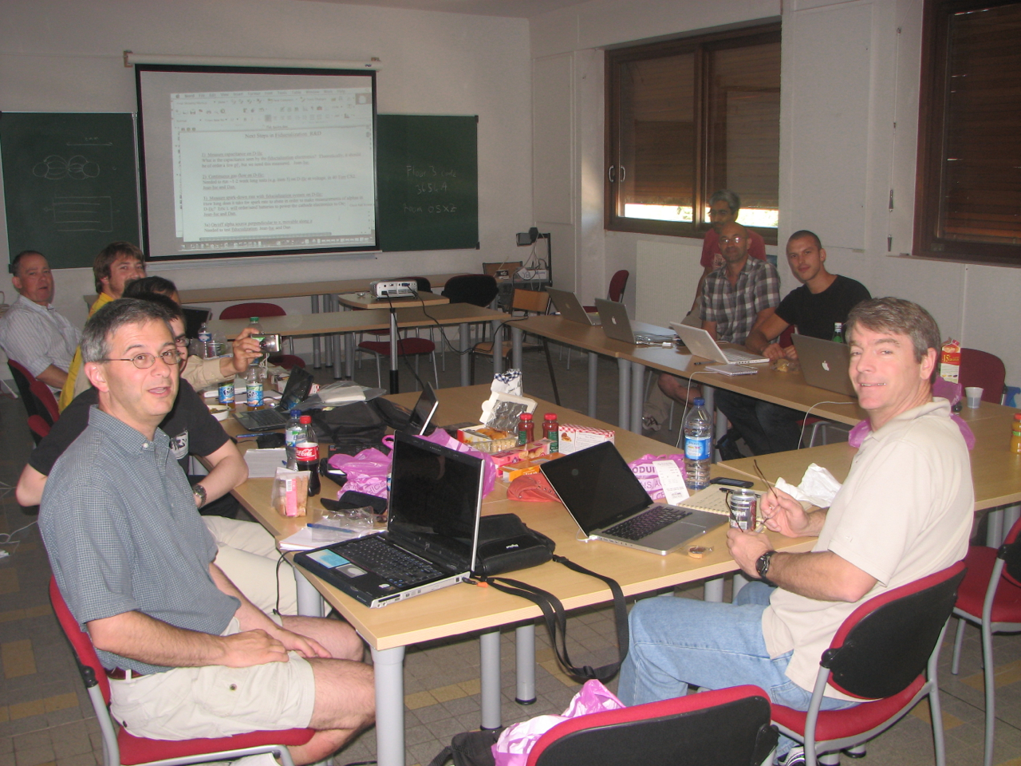
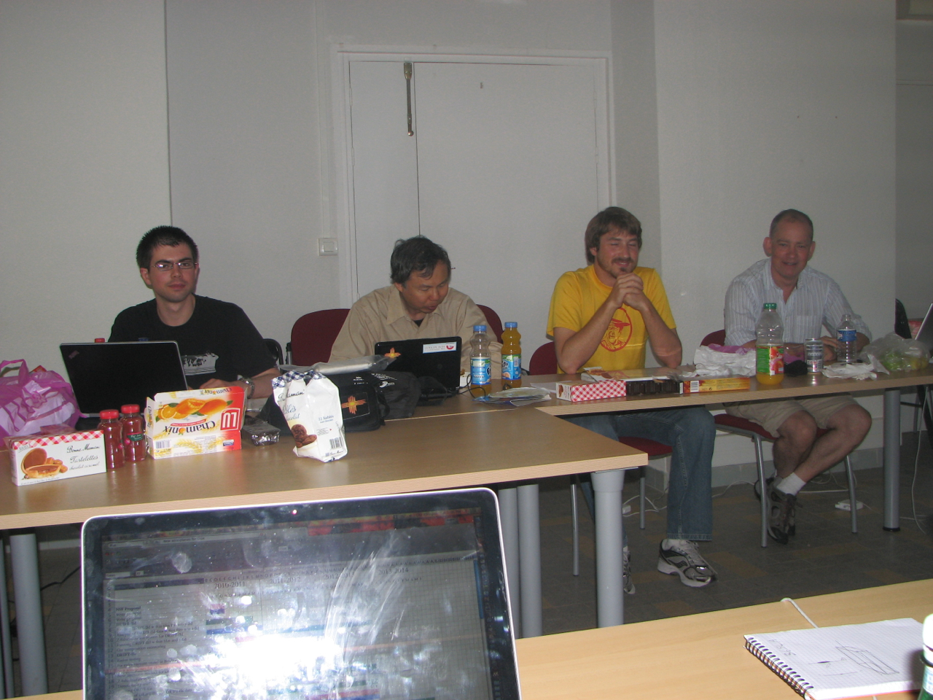
Thin Film
Give the alphas even less places to hide in a texturized aluminized Mylar thin film.
α
-
-
-
-
²¹⁸Po
-
²¹⁴Pb⁺
20 μm or less

Slide 33
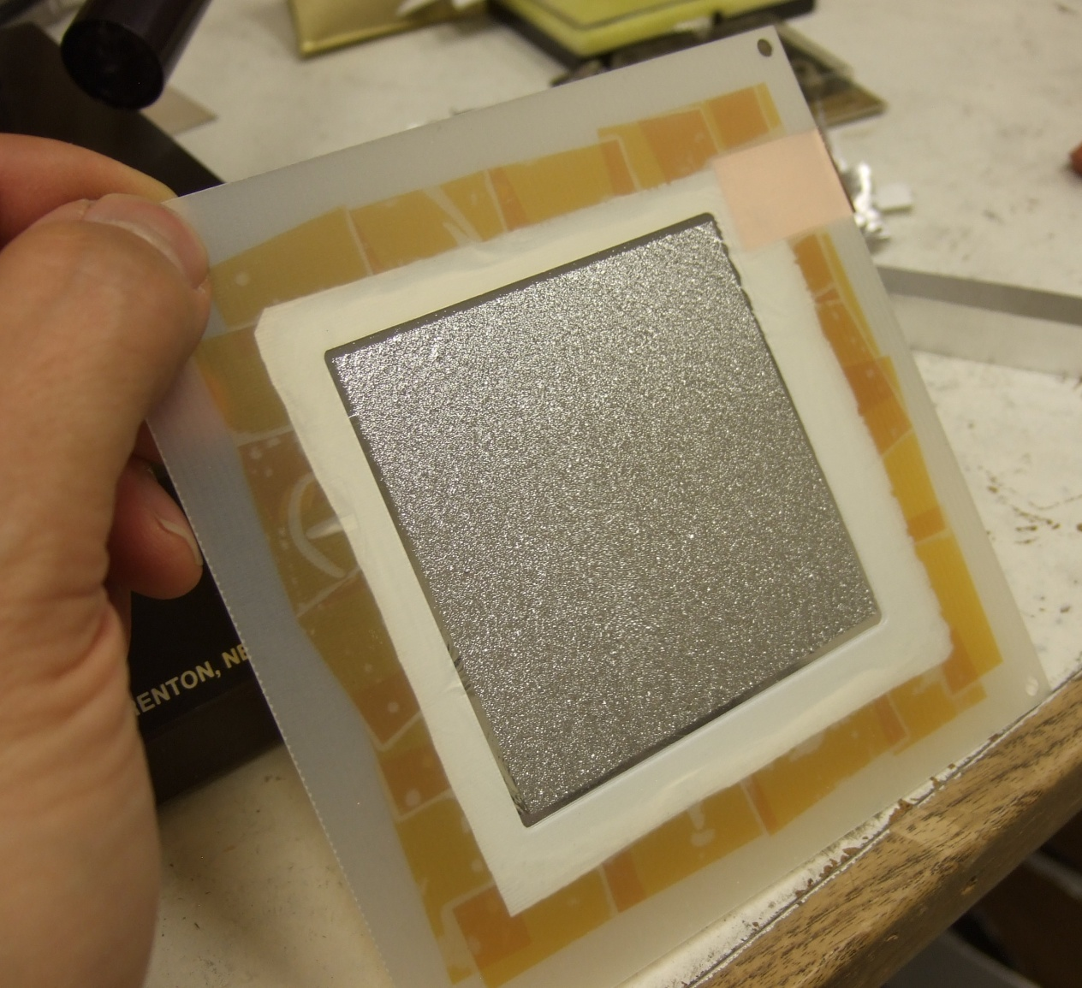
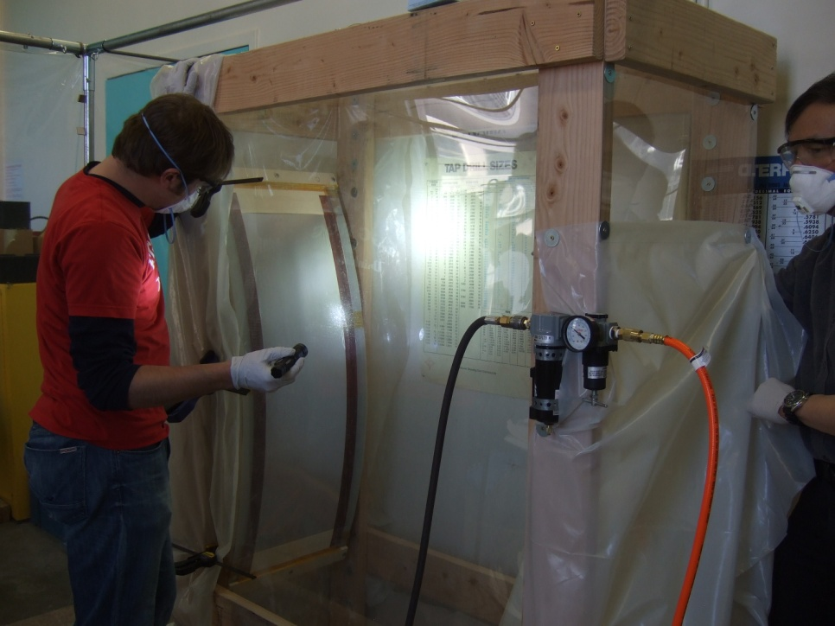
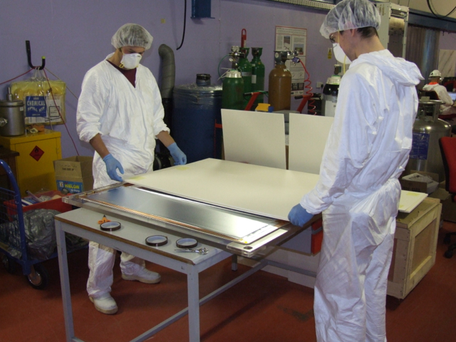
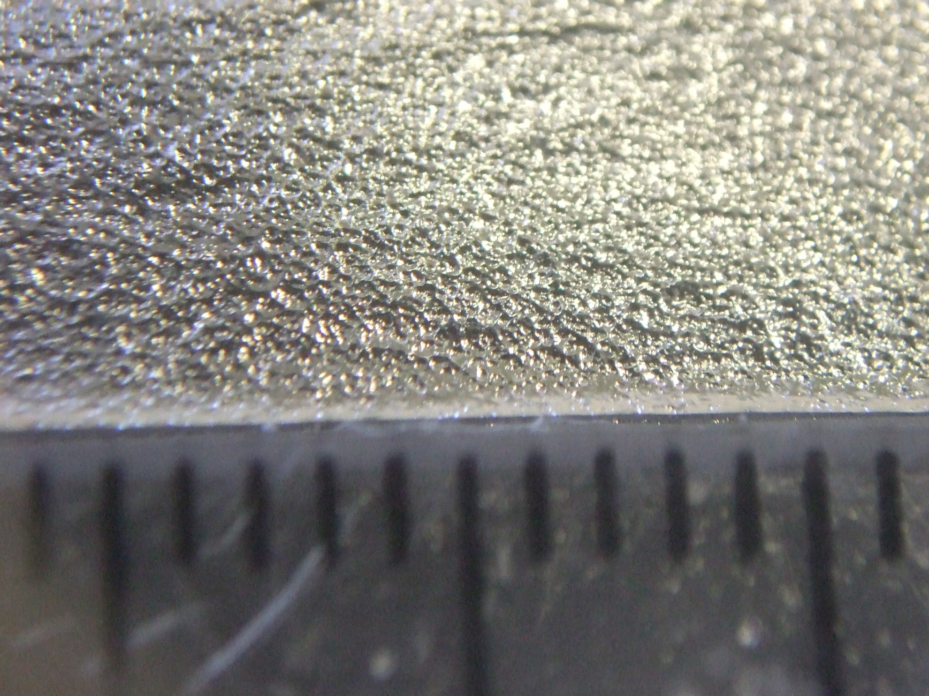
Texturized thin film
Miraculously the guys at UNM have managed to create a texturized 0.9 micron thin film.
This has been deployed on DRIFT-IId in Boulby.
Preliminary results indicate a drop from 130 events per day down to ~1 event per day.
Further improvements are expected with the deployment of DRIFT-IIe this spring.

