Slide 1







FCC week 2015
23-27 March 2015
Marriott Georgetown Hotel
Superconducting RF: Novel Cavity Concepts & Cryomodules
Fundamental Power Coupler (FPC)
Eric Montesinos, CERN-RF
(inputs from all world wide FPC experts, great thanks to all of them !)

Slide 2
FCC FPC requirements
Requirements for the FCC FPC to date
Less than 1 GHz (baseline 400 MHz)
100 MW CW SW
300 FPC - 350 kW to 1500 FPC - 80 kW

Slide 3
 | Coupler | Frequency [MHz] | Average Power [kW] | Peak power [kW] | # in operation or in construction
Coaxial disk | SNS | 805 | 78 | 2000 | 93
 | JPARK | 972 | 30 | 2200 | 23
 | SPS | 200 | 550 | 800 | 16
 | KEKB | 509 | 300 | 1420 | 8
 | IHEP | 500 | 150 | 270 | 2
 | CEA-HIPPI-ESS | 704 | 120 | 1200 | 120
 | SPL | 704 | 100 | 1000 | 4
 | Crab Cavities | 400 | 100 | 1000 | 4
WG | SPS | 801 | 120 | 120 | 8
 | Cornell | 500 | 350 | 350 | 4
 | LBNL | 700 | 800 | 800 | 2
 | Linac4 | 352 | 100 | 1000 | 30
Cylindrical | LEP († 1989-2000) | 352 | 550 | 565 | 252
 | LHC | 400 | 550 | 575 | 16
 | SPS († 1976-2000) | 200 | 375 | 500 | 16
 | New ESRF | 352 | 300 | 300 | 4
 | New APS | 352 | 100 | 100 | 1
 | New SOLEIL | 352 | 200 | 300 | 4
Two windows | TTF III XFEL | 1300 | 4.5 | 1100 | 600
 | APT | 700 | 1000 | 1000 | 2
 | Cornell ERL | 1300 | 75 | 75 | 2

Slide 4
 | Coupler | Frequency [MHz] | Average Power [kW] | Peak power [kW] | # in operation or in construction
Coaxial disk | SNS | 805 | 78 | 2000 | 93
 | JPARK | 972 | 30 | 2200 | 23
 | SPS | 200 | 550 | 800 | 16
 | KEKB | 509 | 300 | 1420 | 8
 | IHEP | 500 | 150 | 270 | 2
 | CEA-HIPPI-ESS | 704 | 120 | 1200 | 120
 | SPL | 704 | 100 | 1000 | 4
 | Crab Cavities | 400 | 100 | 1000 | 4
WG | SPS | 801 | 120 | 120 | 8
 | Cornell | 500 | 350 | 350 | 4
 | LBNL | 700 | 800 | 800 | 2
 | Linac4 | 352 | 100 | 1000 | 30
Cylindrical | LEP († 1989-2000) | 352 | 550 | 565 | 252
 | LHC | 400 | 550 | 575 | 16
 | SPS († 1976-2000) | 200 | 375 | 500 | 16
 | New ESRF | 352 | 300 | 300 | 4
 | New APS | 352 | 100 | 100 | 1
 | New SOLEIL | 352 | 200 | 300 | 4
Two windows | TTF III | 1300 | 4.5 | 1100 | 600
 | APT | 700 | 1000 | 1000 | 2
 | Cornell ERL | 1300 | 75 | 75 | 2

Slide 5
 | Coupler | Frequency [MHz] | Average Power [kW] | Peak power [kW] | # in operation or in construction
Coaxial disk | SNS | 805 | 78 | 2000 | 93
 | JPARK | 972 | 30 | 2200 | 23
 | SPS | 200 | 550 | 800 | 16
 | KEKB | 509 | 300 | 1420 | 8
 | IHEP | 500 | 150 | 270 | 2
 | CEA-HIPPI-ESS | 704 | 120 | 1200 | 120
 | SPL | 704 | 100 | 1000 | 4
 | Crab Cavities | 400 | 100 | 1000 | 4
WG | SPS | 801 | 120 | 120 | 8
 | Cornell | 500 | 350 | 350 | 4
 | LBNL | 700 | 800 | 800 | 2
 | Linac4 | 352 | 100 | 1000 | 30
Cylindrical | LEP († 1989-2000) | 352 | 550 | 565 | 252
 | LHC | 400 | 550 | 575 | 16
 | SPS († 1976-2000) | 200 | 375 | 500 | 16
 | New ESRF | 352 | 300 | 300 | 4
 | New APS | 352 | 100 | 100 | 1
 | New SOLEIL | 352 | 200 | 300 | 4
Two windows | TTF III | 1300 | 4.5 | 1100 | 600
 | APT | 700 | 1000 | 1000 | 2
 | Cornell ERL | 1300 | 75 | 75 | 2

Slide 6
 | Coupler | Frequency [MHz] | Average Power [kW] | Peak power [kW] | # in operation or in construction
Coaxial disk | SNS | 805 | 78 | 2000 | 93
 | JPARK | 972 | 30 | 2200 | 23
 | SPS | 200 | 550 | 800 | 16
 | KEKB | 509 | 300 | 1420 | 8
 | IHEP | 500 | 150 | 270 | 2
 | CEA-HIPPI-ESS | 704 | 120 | 1200 | 120
 | SPL | 704 | 100 | 1000 | 4
 | Crab Cavities | 400 | 100 | 1000 | 4
WG | SPS | 801 | 120 | 120 | 8
 | Cornell | 500 | 350 | 350 | 4
 | LBNL | 700 | 800 | 800 | 2
 | Linac4 | 352 | 100 | 1000 | 30
Cylindrical | LEP († 1989-2000) | 352 | 550 | 565 | 252
 | LHC | 400 | 550 | 575 | 16
 | SPS († 1976-2000) | 200 | 375 | 500 | 16
 | New ESRF | 352 | 300 | 300 | 4
 | New APS | 352 | 100 | 100 | 1
 | New SOLEIL | 352 | 200 | 300 | 4
Two windows | TTF III | 1300 | 4.5 | 1100 | 600
 | APT | 700 | 1000 | 1000 | 2
 | Cornell ERL | 1300 | 75 | 75 | 2

Slide 7
FCC FPC schedule
1995
2000
2005
2010
2015
LHC FPC programme
R&D + prototype
6 years
16 Series
4 years
12 Spares
7 years

Slide 8
FCC FPC schedule
1995
2000
2005
2010
2015
LHC FPC programme
R&D + prototype
6 years
16 Series
4 years
12 Spares
7 years
2015
2020
2025
2030
2035
FCC FPC programme
R&D + prototype
6 years
Series (hundreds)
5 years
FPC Ready for clean room
Michael Benedikt, 23 March 2015
Design
Proto
Construction

Slide 9
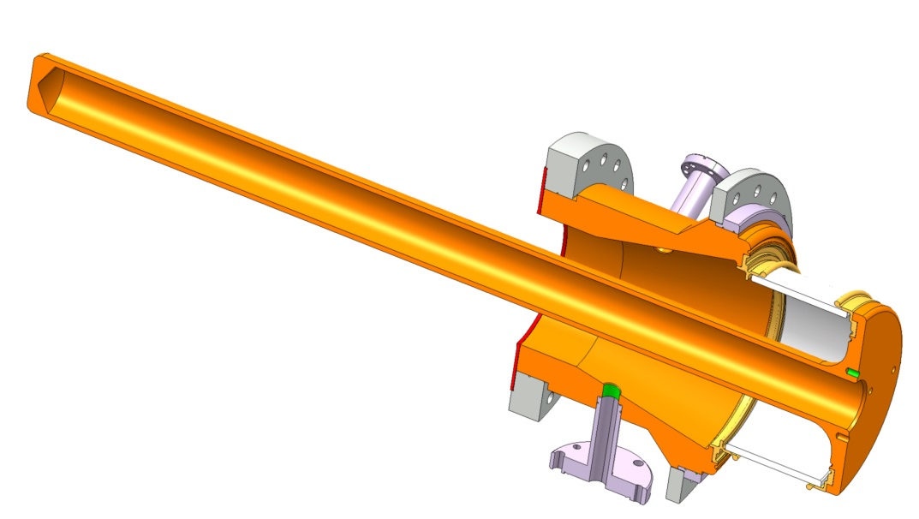
FPC
FPC is a specific RF transmission line
  Air side
  Vacuum side
  In between, there is a RF window
It has several additional features
  Coupling Element
  Double walled Tube
  DC Polarisation
  Variable coupling
  …
  = Optional

Slide 10
FPC
FPC is a specific RF transmission line
  Air side
  Vacuum side
  In between, there is a RF window
It has several additional features
  Coupling Element
  Double walled Tube
  DC Polarisation
  Variable coupling
  …
  = Optional
Goal of this talk
To list R&D topics that we should address for FCC FPC to be ready with a correct cost and in due time
Goal of this talk
To list R&D topics that we should address for FCC FPC to be ready with a correct cost and in due time

Slide 11
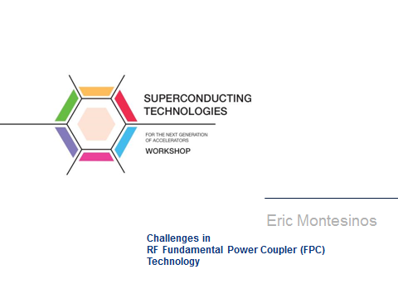
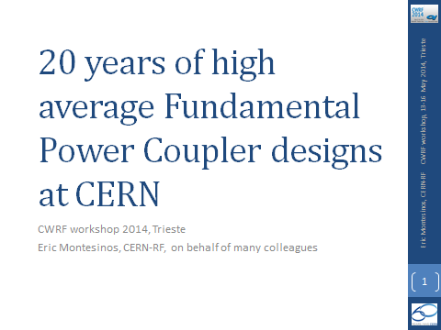
FCC FPC
Complementary to this talk
2012
https://indico.cern.ch/event/196164/
http://indico.cern.ch/event/196164/contribution/45/material/slides/7.pptx
https://indico.cern.ch/event/276274/
https://indico.cern.ch/event/276274/session/5/contribution/35

Slide 12
FPC Window (1/2)
The window is the key item of the FPC
The whole accelerator reliability will depend on its design
Fail safe design
Largely depends on the cryomodule design and cryomdodule integration
  Disk, Coaxial disk, Cylindrical, could be any other shapes
Maximum Power
  With less than 1 GHz, TW & SW all phases limits are probably (frequency dependant) 1 MW peak for few ms, 500 kW CW
  Lower power is only slightly easier and slightly less expensive

Slide 13
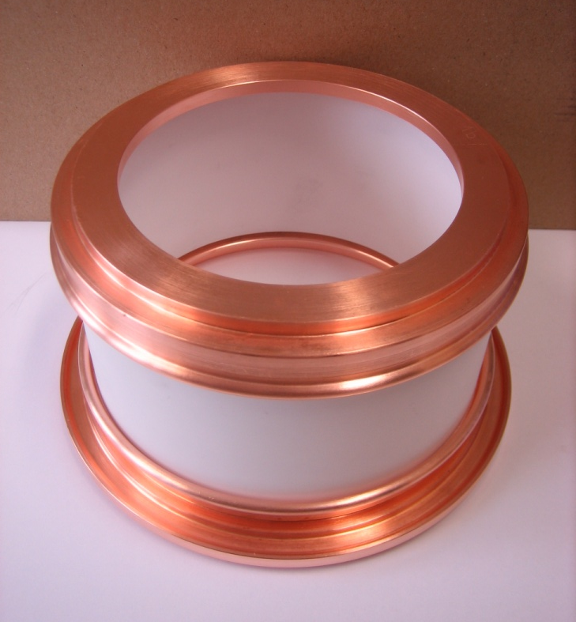
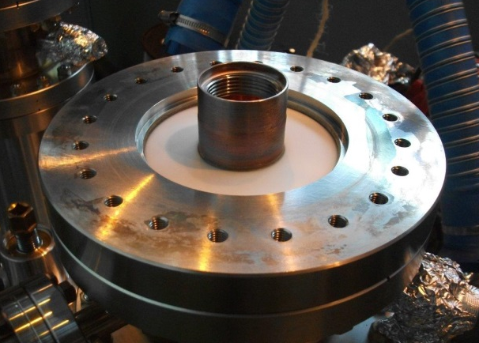
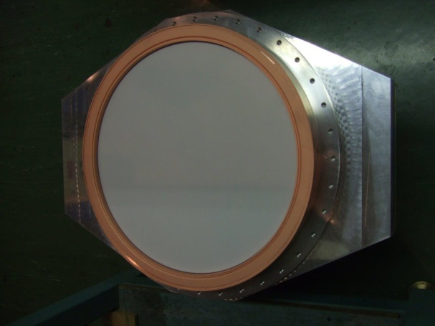
LHC cylindrical
400 MHz
500 kW
CW
TW + SW
ESRF-SOLEIL-APS
352 MHz
SPL
704 MHz
SPL coaxial disk
704 MHz
1000 kW
2 ms – 50 Hz
TW + SW
Crab Cavities
400 MHz
Linac 4 disk
352 MHz
1000 kW
1ms – 2Hz
TW + SW

Slide 14
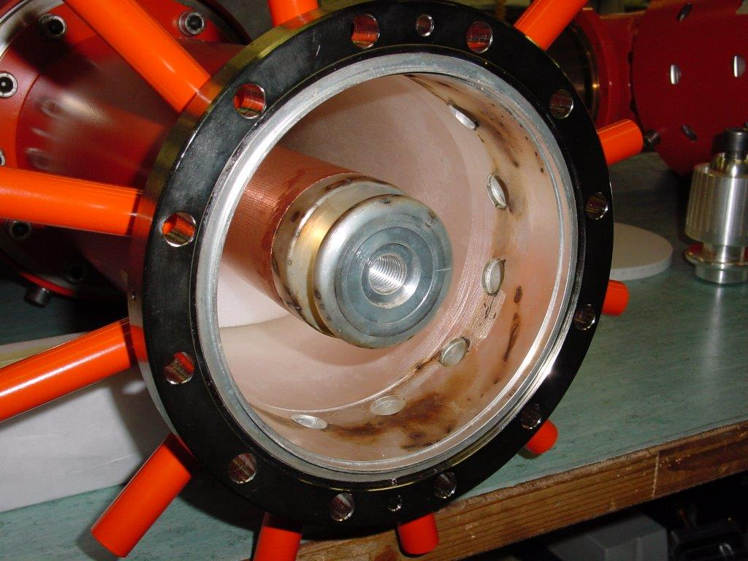
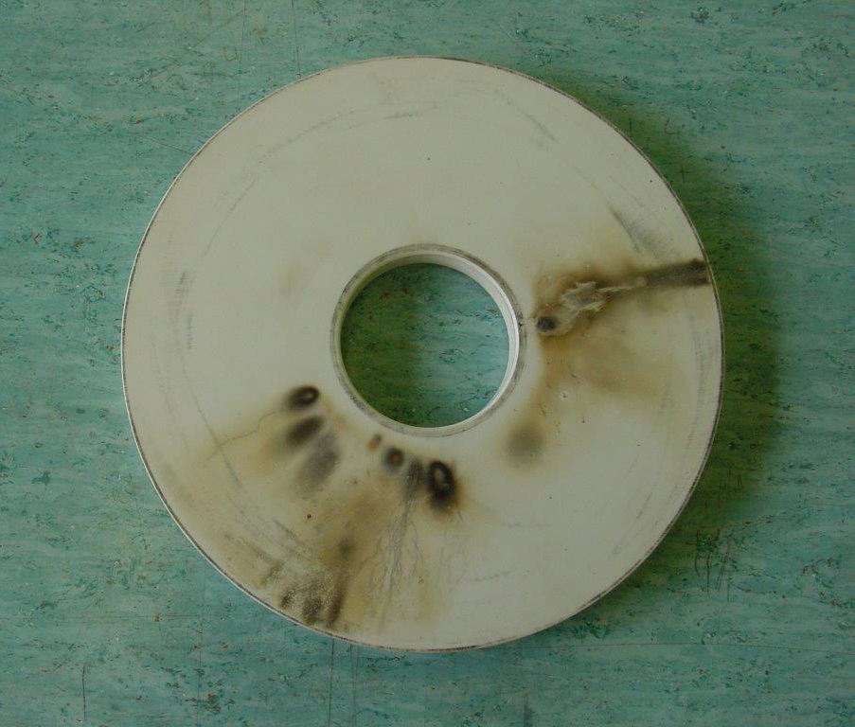
1998 SPS couplers during design phase
Operating at 200 MHz
800 kW TW ok
Arcing at almost 500 kW SW due to sharp edges at the air exhausts

Slide 15
FPC Window (2/2)
Materials
  Al2O3 + (TiOx or TINx) sputtering on vacuum side against multipacting
  Other ceramic without treatment having intrinsically better SEY against multipacting
  Could be other materials
Brazing, welding
  Copper (+ EBW provides RF continuity without RF contacts), Titanium, Kovar©, Stainless steel, …

Slide 16
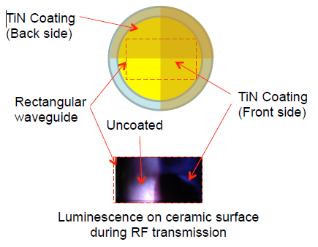
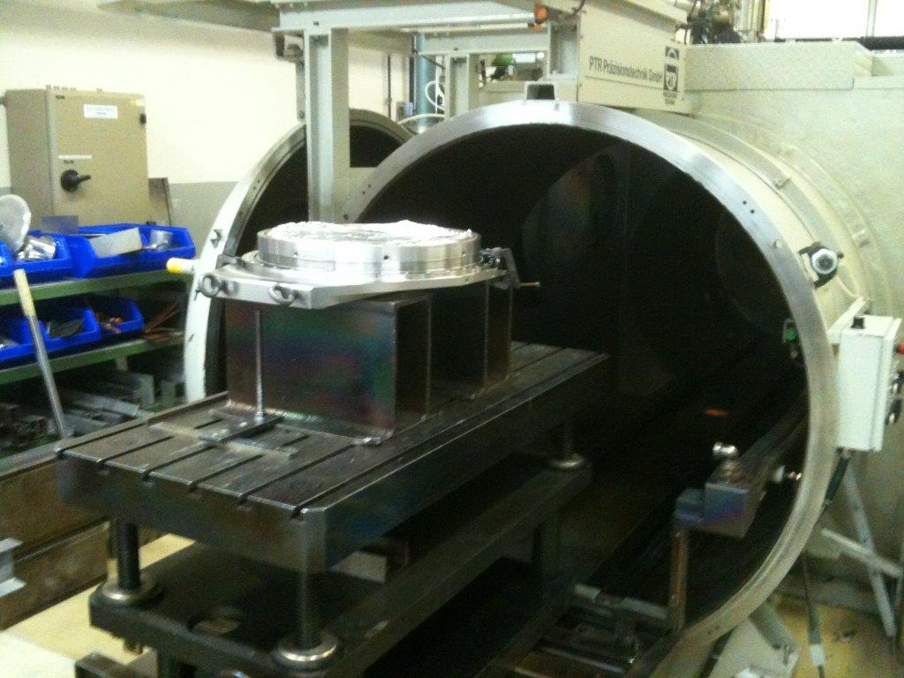
Large devices EBW at CERN
Linac4 window
600 mm x 400 mm x 60 mm
Copper/Copper
New Kyocera alumina
Test at KEK
(K. Iwamoto, KYOCERA Corporation)
(S. Michizono, A. Yamamoto, High Energy Accelerator Research Organization)

Slide 17
Variable Q_{ext}
Major additional difficulty due to Q_{ext} excursion
Main cost driver
  Everything is more complicated: design, drawings, construction, test, integration, operation, maintenance,… everything !
  Can drive cost from 1 (fixed coupling) to minimum 2 (variable coupling), and even more !
Efficiency
  S₁₁ & S₂₁ variations inducing loss of efficiency
  Better match to beam providing gain of efficiency

Slide 18
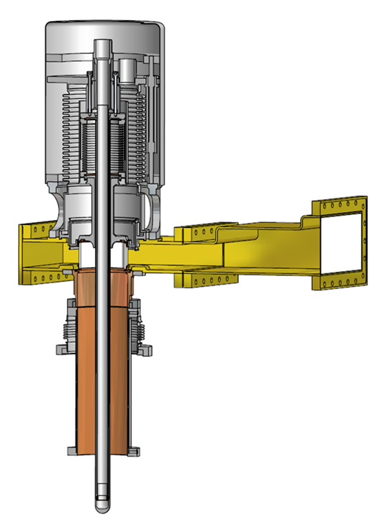
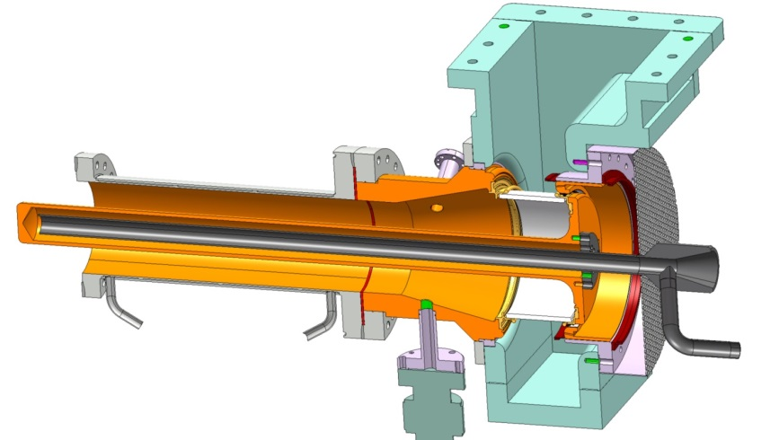
Fixed vs Variable
Same RF window
CERN LHC
2005
Variable coupling
CERN SPL
2013
Fixed coupling

Slide 19


CERN LHC
2005
Variable coupling
CERN SPL
2013
Fixed coupling
Fixed vs Variable
Same RF window
LHC Variable |  | SPL Fixed
185 | Drawings | 45
160 | Main items | 40
350 | All devices | 150
$$$ | Cost | $

Slide 20
Double walled Tube (DT)
DT makes the transition from cold to warm
  From FPC point of view DT is a simple thin copper tube
  Skin depth effect vs frequency
DT could be a support for the cavity
DT copper coating has always been a difficulty
  Cost & schedule

Slide 21
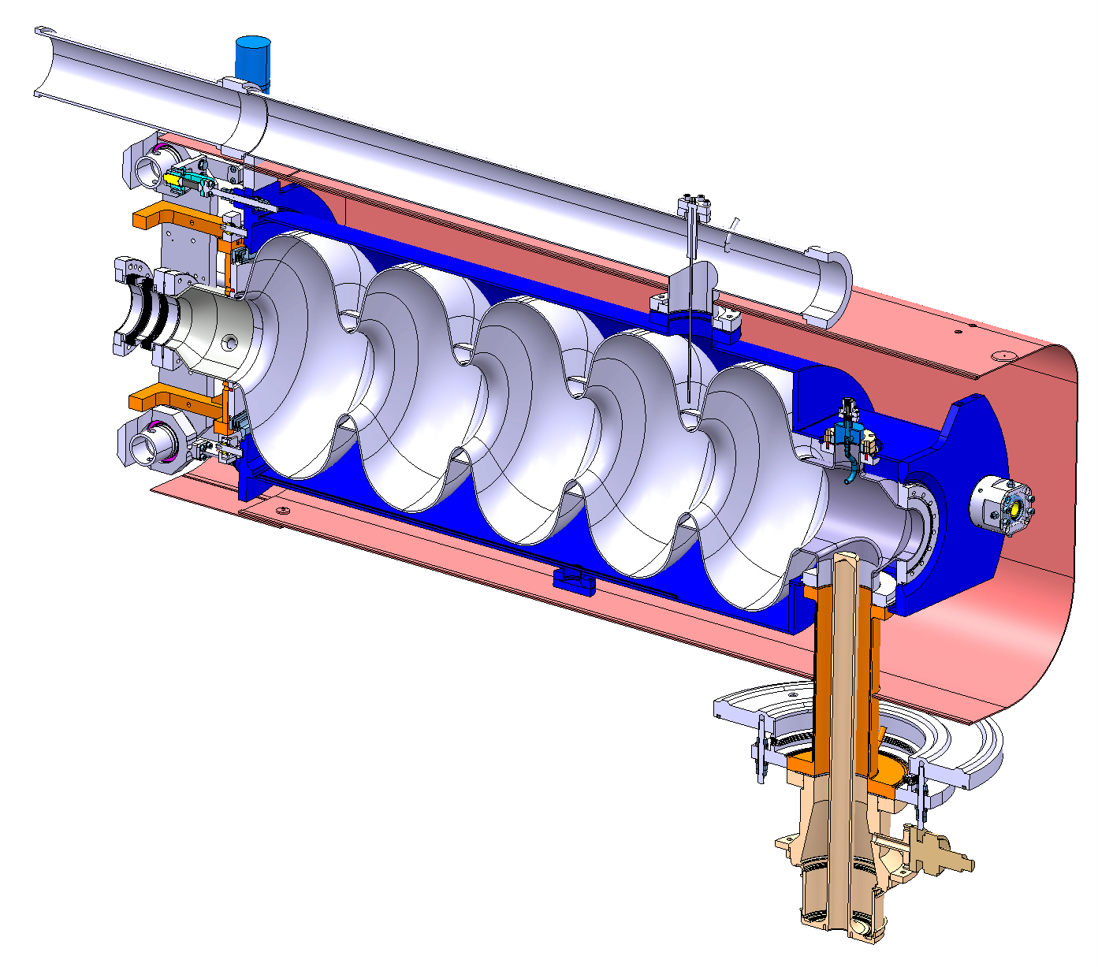
SPL DT as a support for the cavity

Slide 22
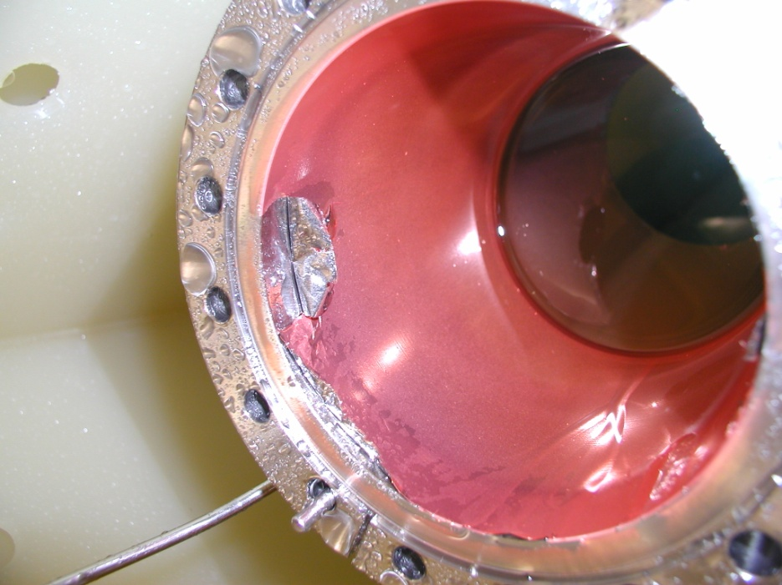
SPL Double walled Tube, copper coating peeling

Slide 23
Cooling
Air cooled only (specific rule at CERN)
for any part in direct view to beam vacuum in case of failure
  Brazing
  Electron Beam Welding
  Freezing of coolant problem
Side effect requirements
  Not a single water hammer effect allowed to the ceramic
  Clean air system as high E-field area
  Individual local pump or local blower close to the FPC
  Thermal losses added into the accelerator
  (could be up to hundreds of kW losses in the tunnel)

Slide 24
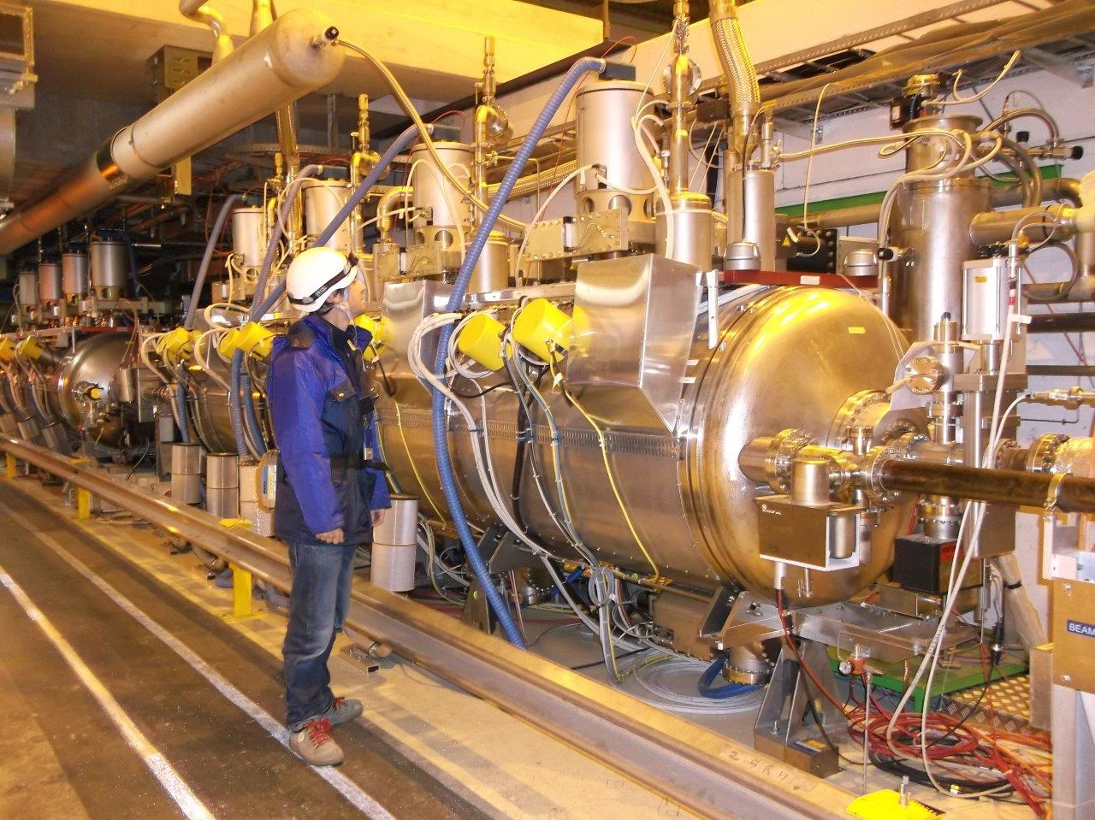
LHC cryomodule with individual 1 kW blower per coupler

Slide 25
Cleanliness
Key topic (specially large series production)
High gradient & clean room
  Clean room class vs gradient
  Specific cleaning tools and processes, to be though for large series production
  Trained specialists
  Cost of infrastructure can deeply impact the FPC costs
  Schedule impacted by the size and availability of the infrastructure
Handling and storage of sensitive items
  No degradation of clean & sensitive items
  Duration of storage

Slide 26
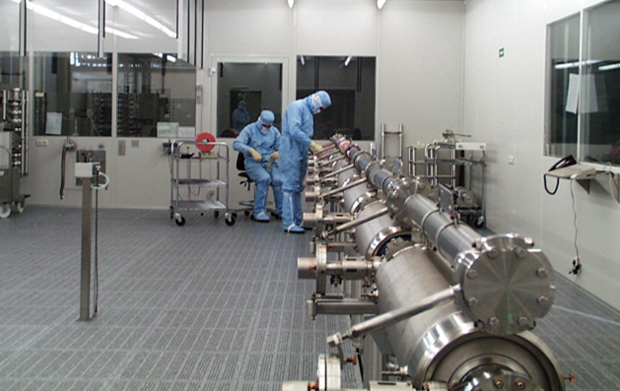
DESY clean room

Slide 27
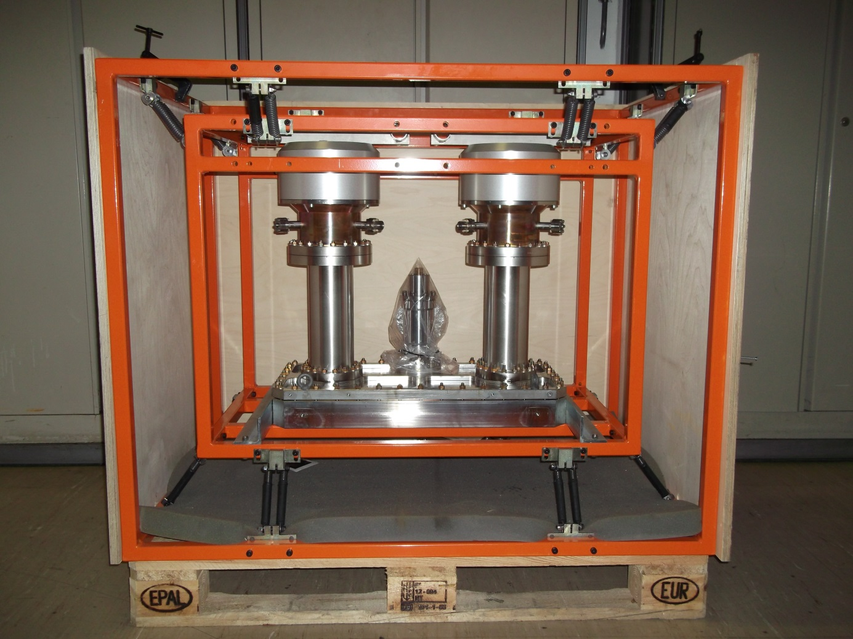
SPL special transport frame

Slide 28
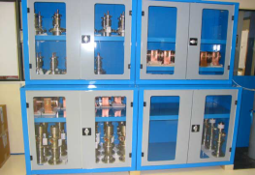
DESY coupler, metalic storage cabinet

Slide 29
FPC test benches (1/2)
Often neglected even if a so important topic
Minimum 2 test benches during R&D phase
  Including design and construction of the test box
  Designed for both TW and SW all phases
Define required diagnostics
  Quite a lot for the R&D phase
  Minimize the ones needed for machine operation
Prepare and define quick & safe RF conditioning processes for large series
  Bake out
  Pulsed mode - power ramping – outgassing limits

Slide 30
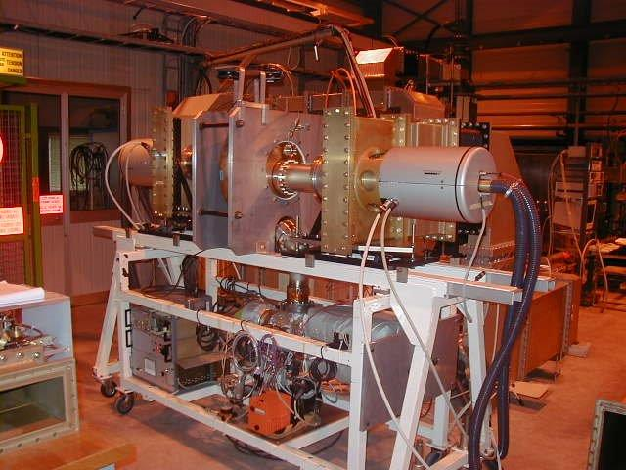
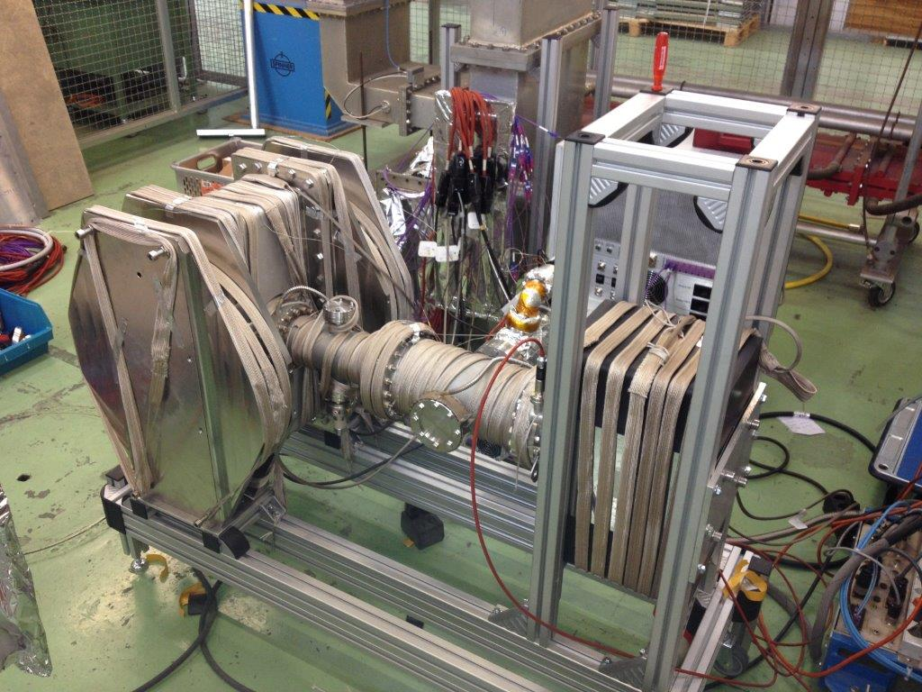
LHC test cavity
Linac4 test bench under baking

Slide 31
FPC test benches (2/2)
One destructive programme to check limits
  Maximum Power
  Maximum vacuum pressure
  Cooling system
  Materials
Minimum number of test benches during production phase depends on
  Total quantity of couplers to be produced
  Production schedule
  Cost of test benches (promising resonant rings R&D)

Slide 32
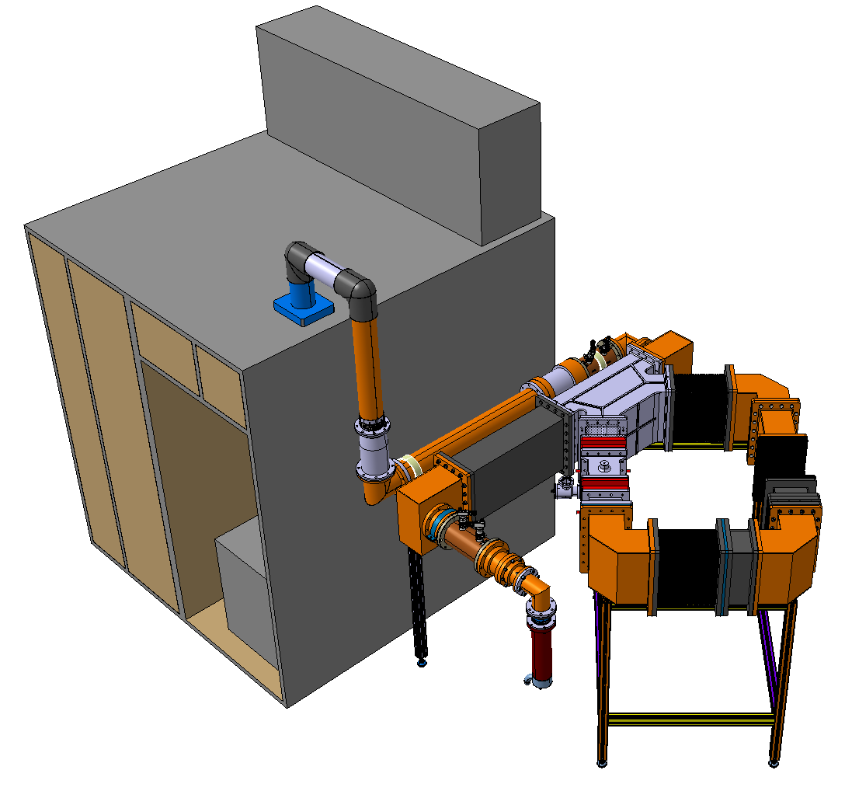
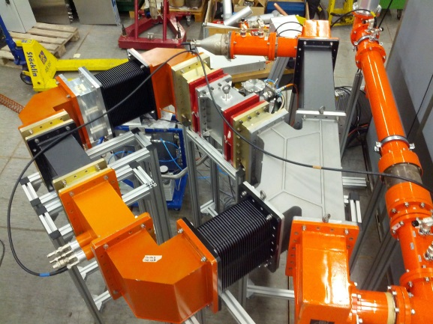
800 MHz resonant ring
to test SPS RF windows
up to 600 kW with a 60 kW IOT

Slide 33
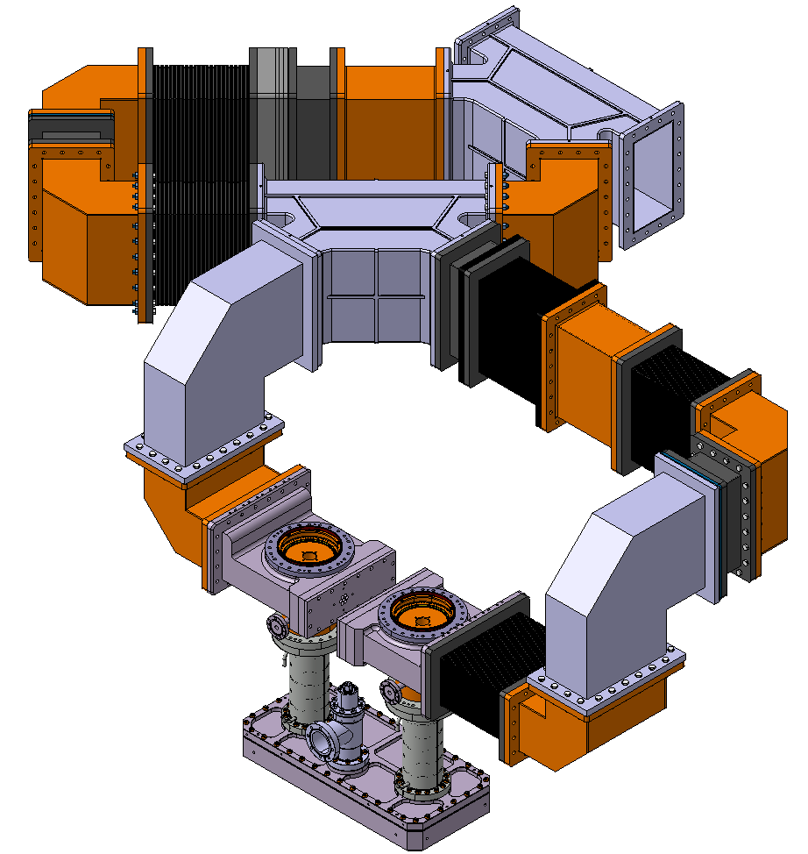
Latest idea
704 MHz double resonant ring
to test SPL FPC
up to 8000 kW with a 80 kW IOT

Slide 34
FCC Challenges
How to produce at low cost AND with high quality ?
Launch several R&D programmes
  FPC will deeply impact cryomodule design
  FPC design will deeply be impacted by cryomodule design (can cost a lot !)
All listed topics to be studied in detail to minimize cost and schedule impact, always taking into account large series production phase

Slide 35
World Wide Programme
Quite a lot of R&D to be addressed
(not all listed today, the list is too long…)
Setting up a World Wide community sharing R&D and results
  CERN, KEK, DESY, CEA, SLAC, ORNL, BNL, …
  First meeting at CERN in June 2015 to list all ideas to be addressed
  Yearly specific dedicated FPC workshop/meeting between experts
  Definition and distribution of ‘individual tasks’ and global sharing of results

Slide 36

WWFPCTS Ready to go !
World Wide Fundamental Power Coupler Task Force ™

